Slide 1
Data Analysis Procedure
COSPAR PRBEM / GSICS Swx Sub-group joint meeting
2025-07-01
Ce document est la propriété de l'ONERA. Il ne peut être communiqué à des tiers et/ou reproduit sans l'autorisation préalable écrite de l'ONERA, et son contenu ne peut être divulgué.
This document and the information contained herein is proprietary information of ONERA and shall not be disclosed or reproduced without the prior authorization of ONERA.

Slide 2
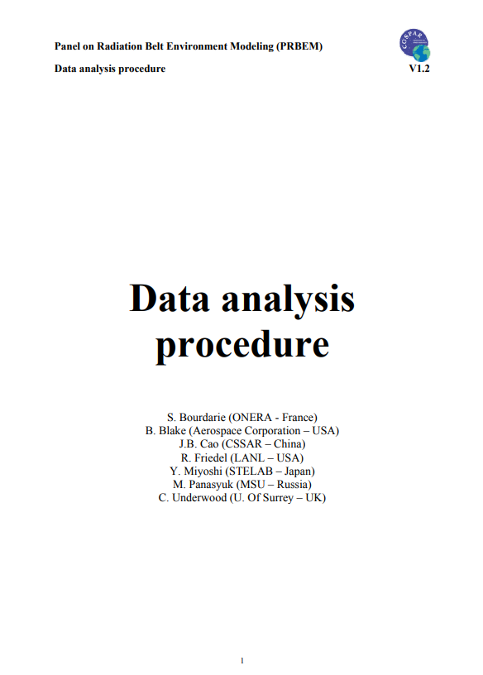
Data Analysis Procedure history
Current Data Analysis Procedure was written approx. 20 years ago
https://prbem.github.io/documents/Standard_Data_Analysis.pdf
The goal of this document was to provide guidelines for radiation monitor data processing:
  Data sanitization (contamination, saturation, background etc.)
  Inter-calibration
Philosophy: using these guidelines is supposed to be always safe, but they might not always be applicable

Slide 3
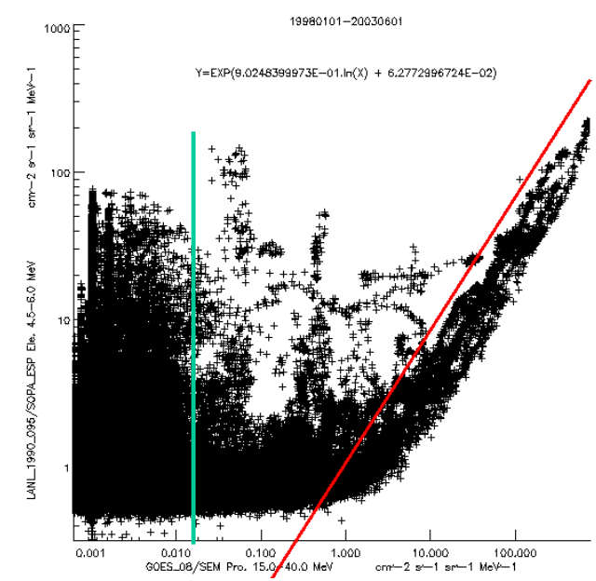
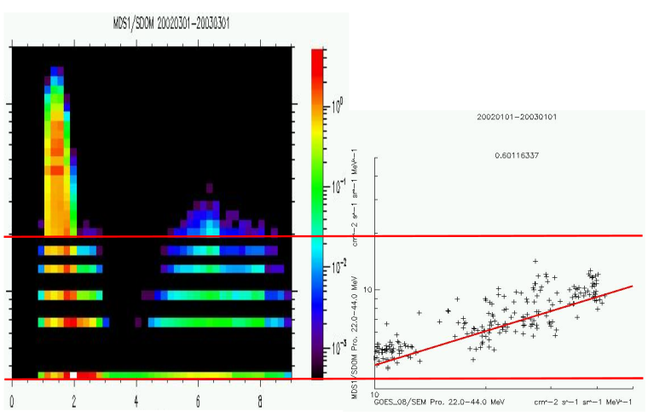
Data sanitization
The first step in the procedure is data sanitization:
  Cross-contamination
  Saturations
  Background levels (thermal noise, GCRs)
  Discretization noise
  Spacecraft charging bias
  Spikes, etc.
Do we need to update these recommendations?
  Are the detectors significantly different now compared to 20 years ago?
  Are some of these problems not relevant anymore? Did some new problems appear?
The procedure does not deal with the inversion from counts to fluxes: should it?

Slide 4
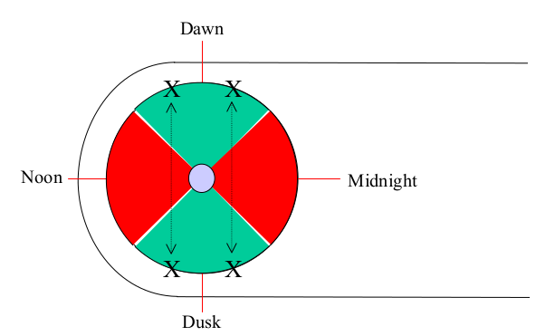
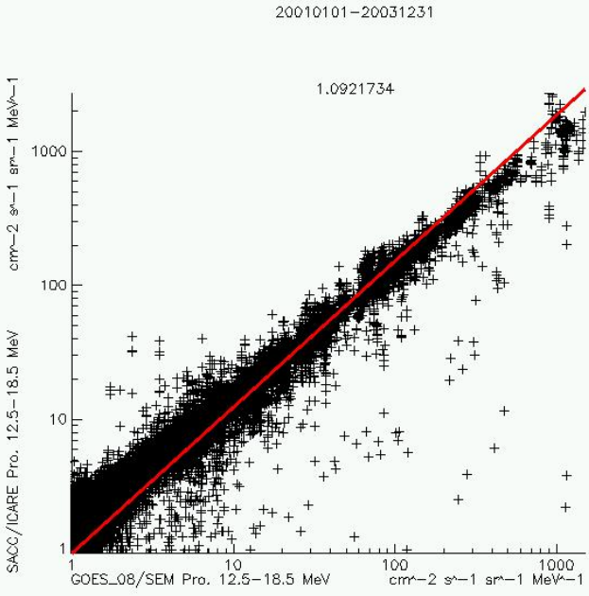
Inter-calibration overview
The procedure defines two types of inter-calibrations:
  Conjunction-based: find a set of “valid” spacecraft conjunctions, compare spectra to find the adjustment factor (with some filtering)
  SEP-based: for energetic protons (>5MeV at L*>7, or >10MeV at GEO), using the correlations obtained during SEP events
No procedure was identified for energies <50keV
The document does mention “long-time average comparisons” for GEO-GEO inter-calibration, but does not provide details on the procedure

Slide 5
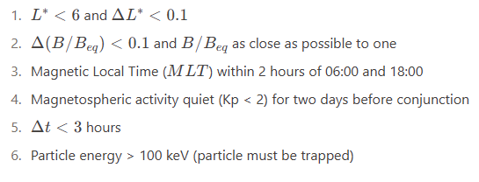
Conjunctions criteria
Following the design philosophy of the Data Analysis Procedure, the conjunctions criteria are quite strict: if one finds conjunctions using these criteria, they should be safe to use for inter-calibration
To minimize mapping uncertainties, the procedure uses the Olson-Pfitzer Quiet-time magnetic field model, and force conjunctions during quiet times
Should these constraints be revised?
Would another magnetic field model be more appropriate?
How to ensure that laxer criteria will not induce a bias during the cross-calibration?

Slide 6
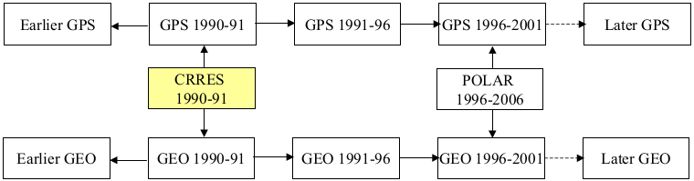
Gold standard datasets
Gold standards defined in the procedure:
  Electrons : CRRES/MEA between 300keV and 1.6MeV
  Protons: GOES-08/SEM between 10MeV and 100MeV
Has anyone kept track of all the calibrations performed from these spacecraft to today’s ?
Should newer datasets be considered as better gold standards?

Slide 7
Organisation notes
Objectives: present an updated document draft during the COSPAR Scientific Assembly 2026 (Florence, Italy) [Is this deadline realistic?]
Editing: I suggest hosting an editable copy of the document in the PRBEM Github space, so that anyone can see the document state and submit modifications [Is this something people are comfortable with? Would you prefer a MS Word document exchanged by e-mail? Or hosted on a different platform?]
Future discussions: telecons? e-mails? Github?

