Slide 1

LIME: Lunar Irradiance Model of ESA Pieter De Vis​ (NPL), Stefan Adriaensen (VITO), Africa Baretto (UVa), Agnieska Bialek (NPL), Marc Bouvet (ESA), Javier Gatón (UVa), Ramiro Gonzalez (UVa), Carlos Toledano (UVa) 13/11/2025 - GSICS Lunar Calibration Subgroup meeting

Slide 2
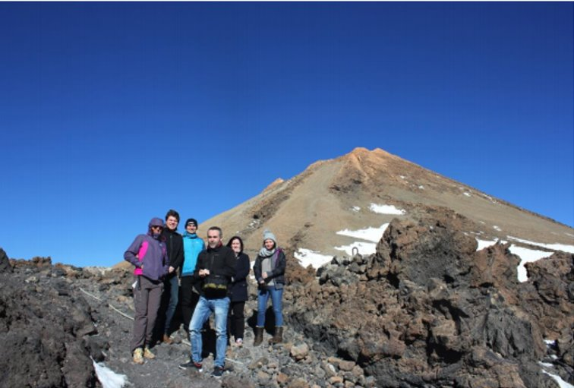
LIME: Lunar Irradiance Model of ESA
Derived using SI-traceable CIMEL measurements at Teide Peak and Izaña Observatory in Tenerife
Characterization and calibration at NPL and University of Valladolid
LIME model (ROLO-based) fitted at CIMEL wavelengths
Spectral interpolation using lunar ASD measurements
Uncertainty computation based on Monte Carlo simulations accounting for calibration, modelling and measurement uncertainties
LIME-TBX allows to simulate lunar observation and perform comparisons

Slide 3
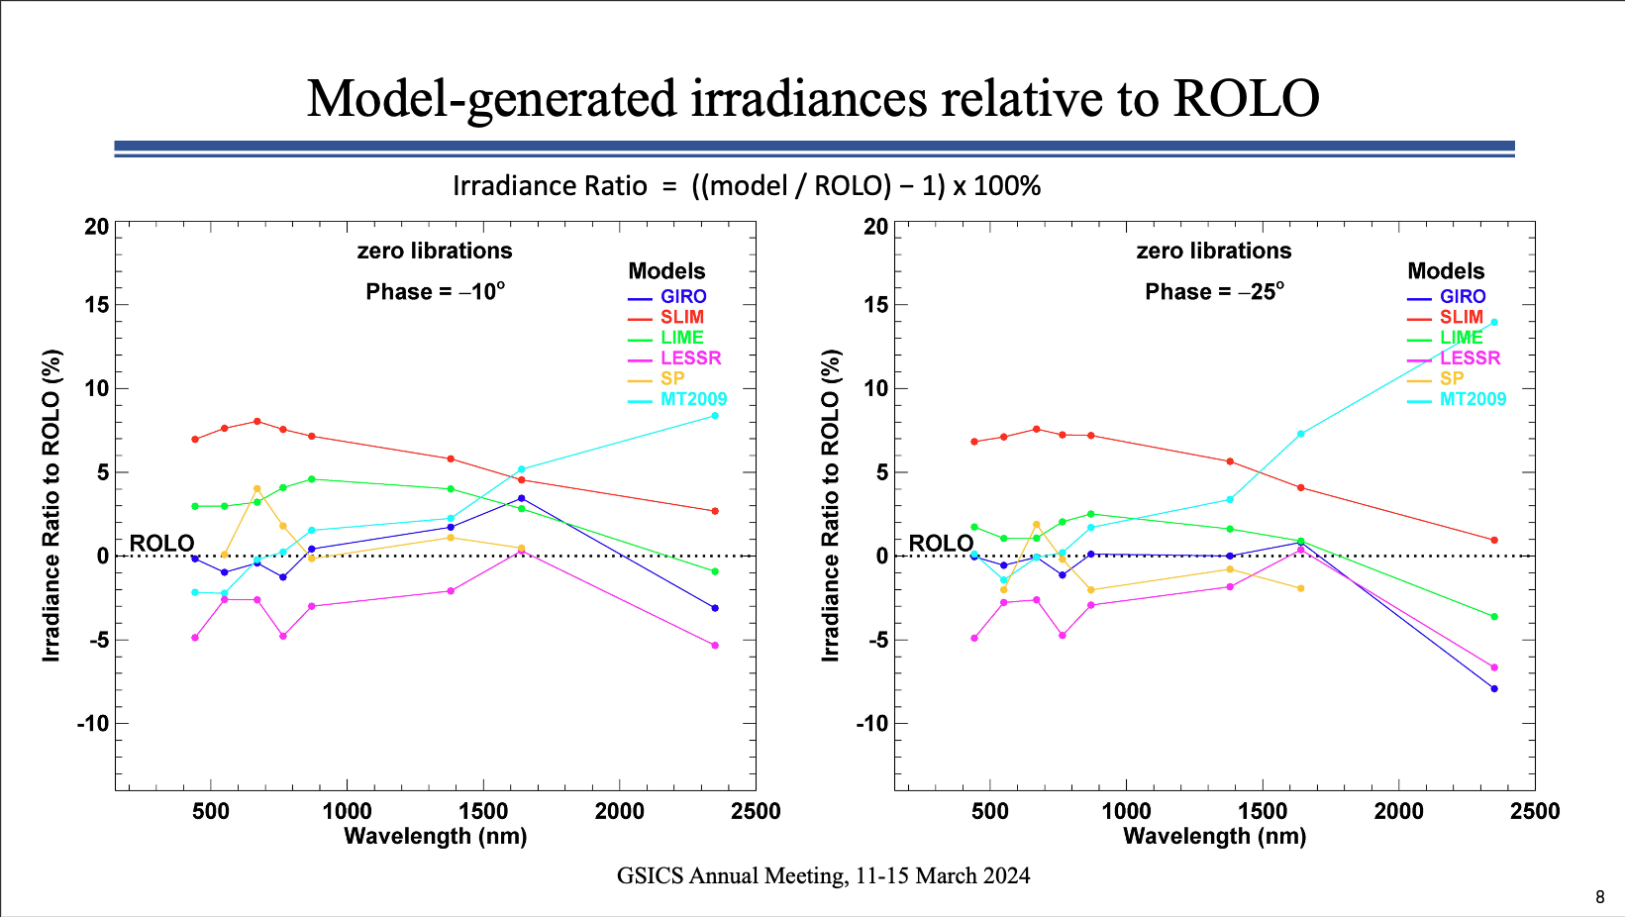
GSICS comparison of lunar models (T. Stone)
Just one example of the comparisons performed by T. Stone and lunar modellers in the frame of GSICS

Slide 4
Timeline
CIMEL measurements
ASD measurements
Toledano et al. (2024)
Polarisation added
After SI-traceable calibration at NPL, the CIMEL instrument is deployed in Tenerife, and starts taking lunar measurements.
During 2022, three field campaigns were undertaken to take hyperspectral measurements with an ASD spectrometer. These are used for spectral interpolation of the LIME model
Paper describing the LIME model is published. CIMEL data from 2018-2022 is used. Includes description of measurements, calibration, model fitting, uncertainties and comparisons.
DOLP and AOLP model added to LIME-TBX, based on measurements taken with different polarization filters.
2018 - 2019
Dec 2023
June 2024
Oct 2025
March 2018
2022
Mar 2024
Mar 2025
ROLO model fitted
LIME-TBX v1 released
LIME website
LIME-TBX v1.4 released
An adapted version of the ROLO lunar model is fitted to the CIMEL data. Uncertainties are propagated through the fitting process.
V1.0.0 of the LIME-TBX is released. The LIME toolbox allows to simulate output of the model and compare these to actual lunar observations.
The LIME website is online.
https://lime.uva.es/
Access LIME-TBX installers, documentation, forum, …
The latest version of the LIME-TBX is released, including updated coefficients, spectral interpolation and DOLP/AOLP model
LIME Sep 2017 – Dec 2019
LIME 2 Oct 2021 – Feb 2024
LIME 2 CCN Mar 2024 – Oct 2025
Maintenance contract for CIMEL measurements and coefficients 2019 – 2027

Slide 5
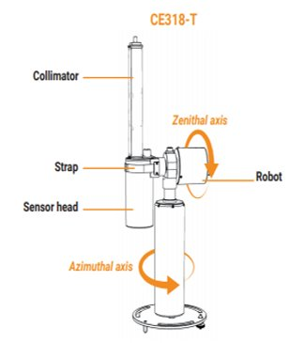
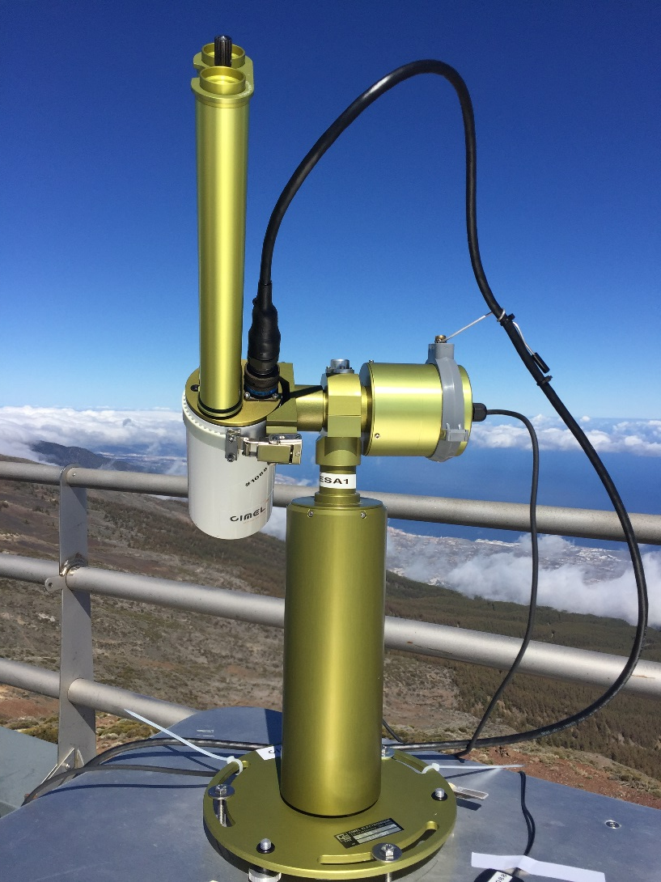
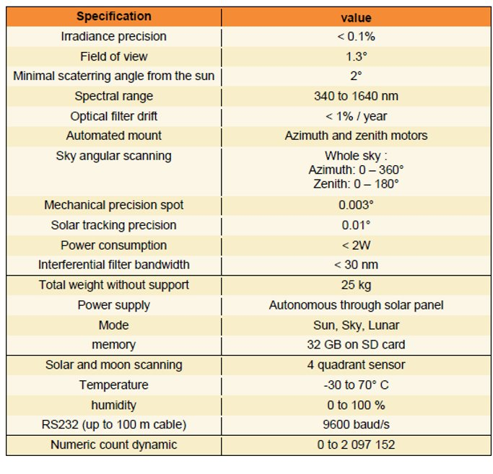
The LIME measurements
CIMEL 318-TP9

Slide 6
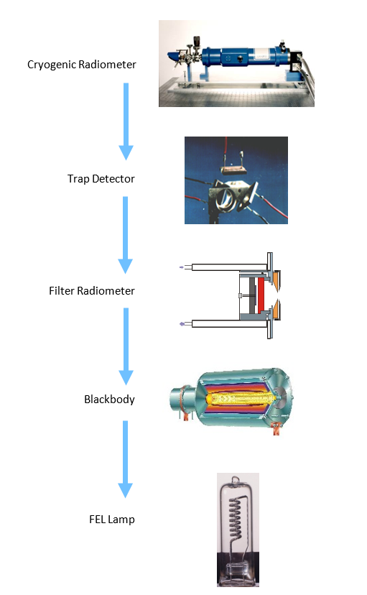
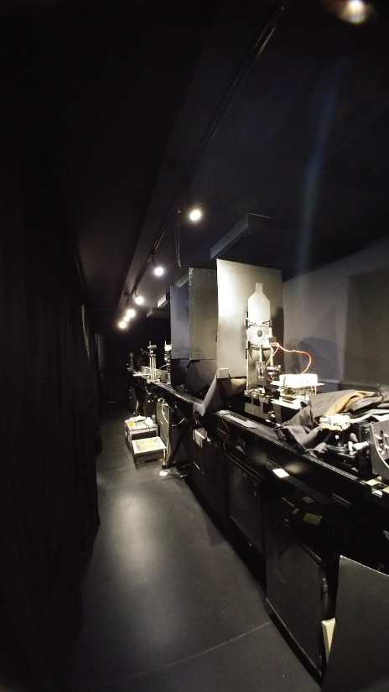
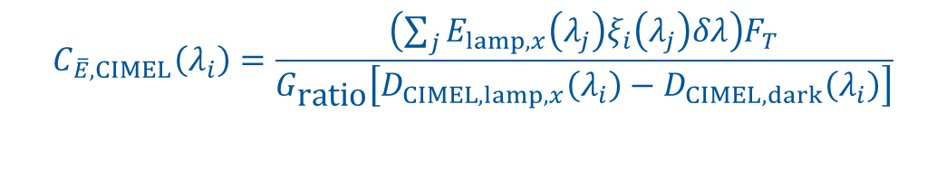
Irradiance Responsivity
Spectral Channel | Calibration Coefficient (MOON gain) | Standard uncertainty
440 nm Si | 5.759 × 10⁻¹⁰ | 0.97%
500 nm Si | 4.481 × 10⁻¹⁰ | 0.96%
675 nm Si | 3.205 × 10⁻¹⁰ | 0.92%
870 nm Si | 2.547 × 10⁻¹⁰ | 0.91%
937 nm Si | 2.431 × 10⁻¹⁰ | 0.97%
1020 nm Si | 2.735 × 10⁻¹⁰ | 1.05%
1020 nm InGaAs | 2.119 × 10⁻¹⁰ | 1.01%
1640 nm InGaAs | 4.893 × 10⁻¹¹ | 1.06%
$$C_{\overline{E},CIMEL}\left(λ_{i}\right)=\frac{\left(\sum_{j}{E_{lamp,x}\left(λ_{j}\right)ξ_{i}\left(λ_{j}\right)δλ}\right)F_{T}}{G_{\text{ratio}}\left[D_{CIMEL,lamp,x}\left(λ_{i}\right)−D_{CIMEL,dark}\left(λ_{i}\right)\right]}$$

Slide 7
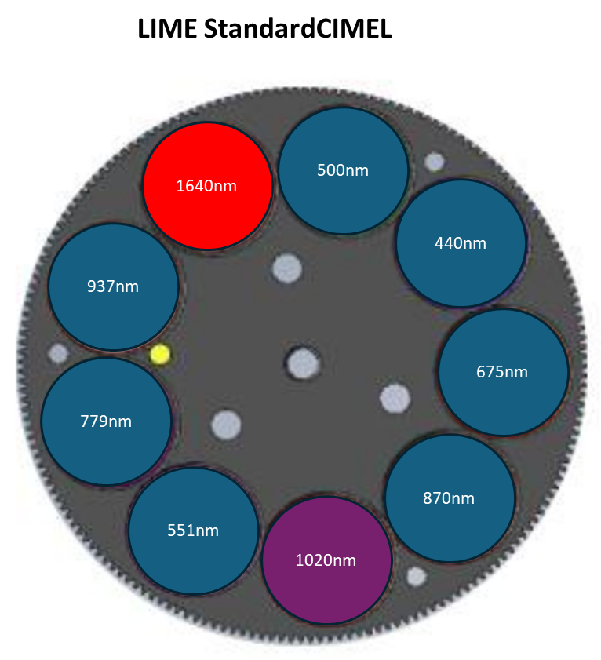
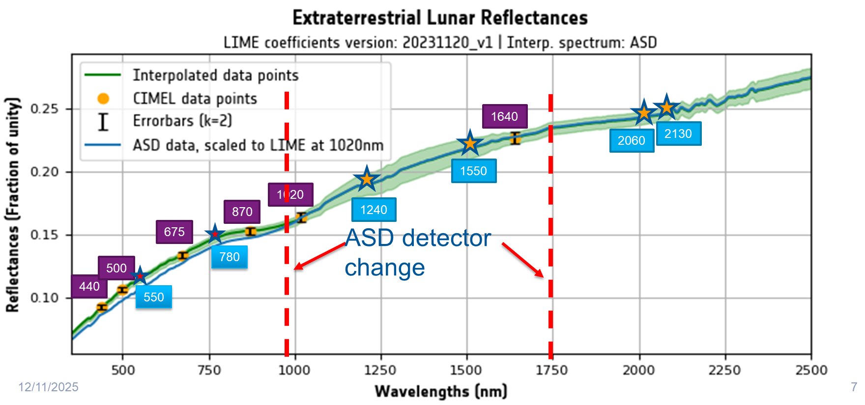
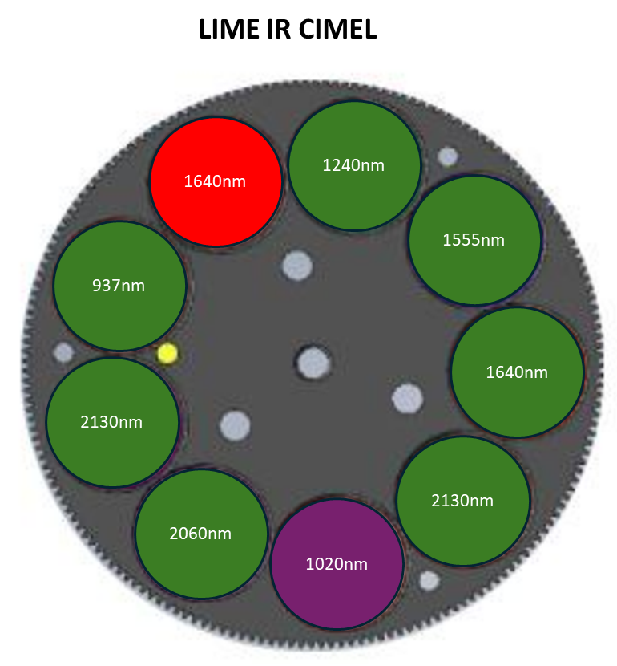
New CIMEL channels used in LIME
New LIME channels: 1240, 1550, 2060, 2130 nm
Insufficient data so far to provide model coefficients.

Slide 8
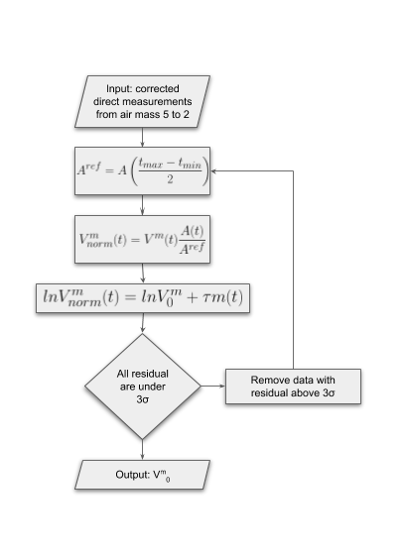
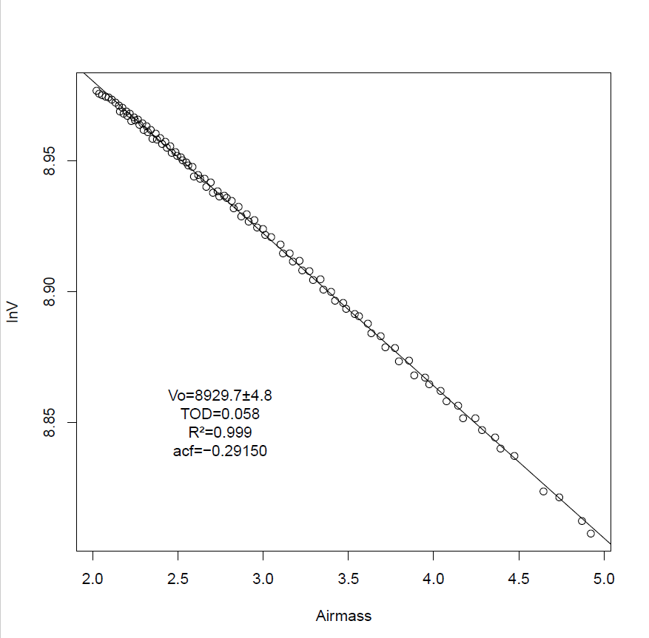
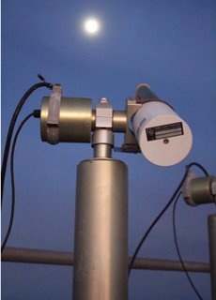
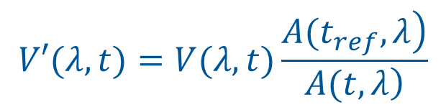

Lunar disc irradiance measurements
$$ln(V^{s}\left(λ,t\right)) = ln(V_{0}^{s}\left(λ\right)) − m\left(θ\right)τ_{λ}$$
$$V′(λ,t)=V(λ,t)\frac{\left.A(t_{ref},λ\right)}{\left.A(t,λ\right)}$$

Slide 9
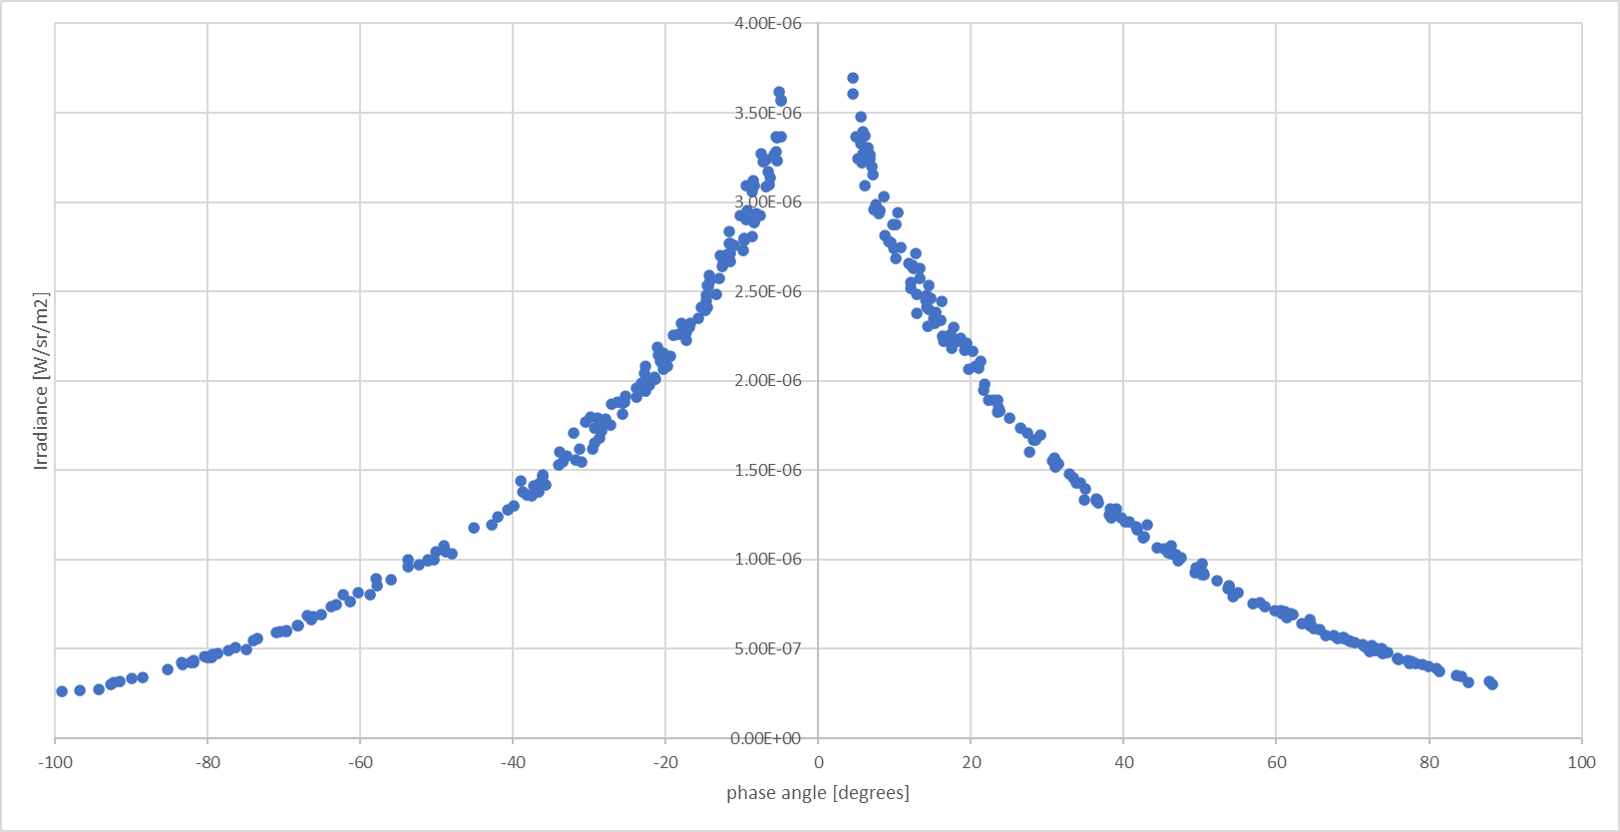
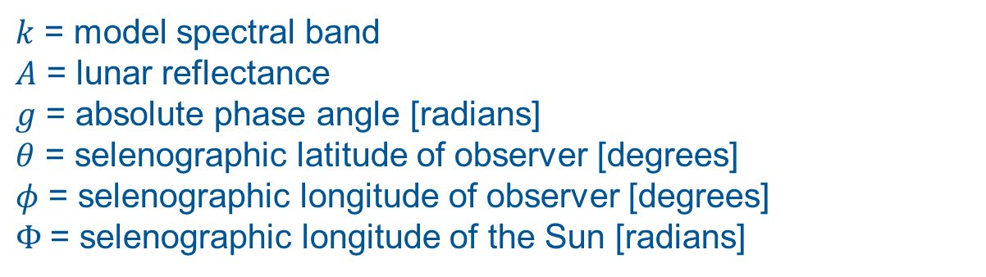
Lunar Irradiance Model
$$\ln\left(A_{k}\right)=\sum_{i=0}^{3}{a_{ik}g^{i}}+\sum_{i=1}^{3}{b_{ik}Φ^{2i−1}}+c_{1}θ+c_{2}φ+c_{3}Φθ+c_{4}Φφ+d_{1k}e^{−\frac{g}{p_{1}}}+d_{2k}e^{−\frac{g}{p_{2}}}+d_{3k}\cos\left(\frac{g−p_{3}}{p_{4}}\right)$$
$k$ = model spectral band
$A$ = lunar reflectance
$g$ = absolute phase angle [radians]
$θ$ = selenographic latitude of observer [degrees]
$φ$ = selenographic longitude of observer [degrees]
$Φ$= selenographic longitude of the Sun [radians]
Based on Kieffer and Stone (2005)​
Lunar irradiance measurements at 440 nm based on more than 3+ years of measurements

Slide 10


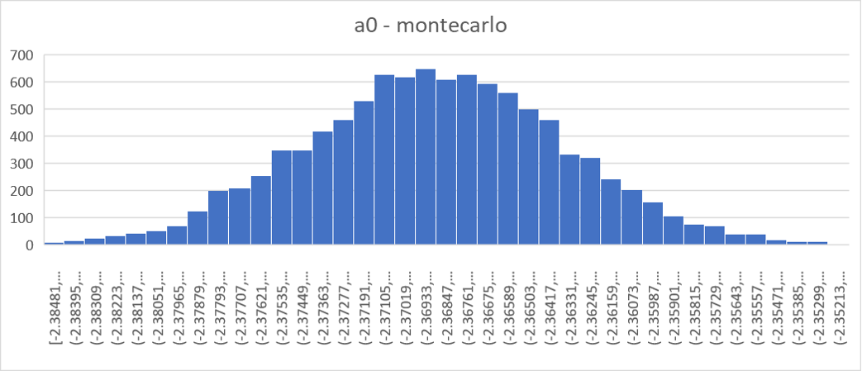
Uncertainty Analysis
Monte Carlo approach is used to propagate uncertainties, taking into account error-correlations
CoMet toolkit used for uncertainty propagation using 1000 MC iterations
Includes random measurement uncertainties, systematic instrument uncertainties, regression uncertainties & interpolation uncertainties
 | Langley points | Nights | Spectral
Calibration | C | C | PC
Instrument Noise | I | I | I
Temperature | C | I | C
Aerosol variability | PC | I | C
C = correlated; I = independent; PC = Partially correlated

Slide 11
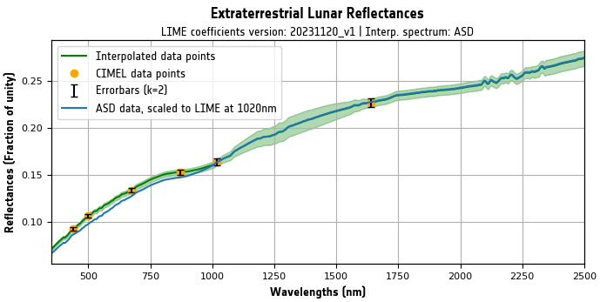
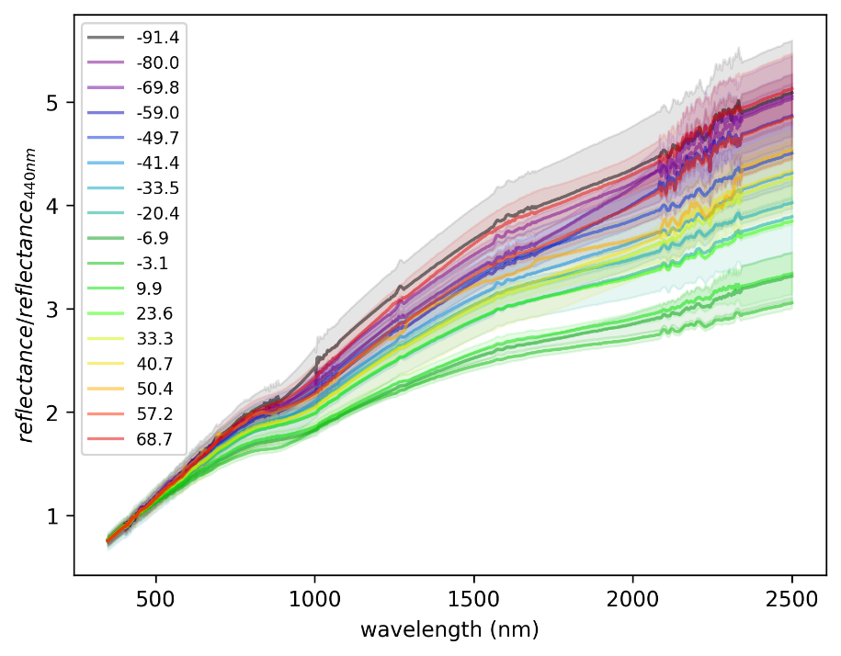
LIME-TBX Spectral interpolation
Aim is to extend LIME from the CIMEL wavelengths to 350-2500 nm
ASD measurements or Apollo spectrum can be used for spectral interpolation in LIME-TBX
ASD measurements reveal variation of spectral slope with phase angle
Reference dataset is rescaled to go through the LIME model reflectances at CIMEL wavelengths using CoMet toolkit
Combines relative accuracy of ASD with absolute accuracy of CIMEL

Slide 12
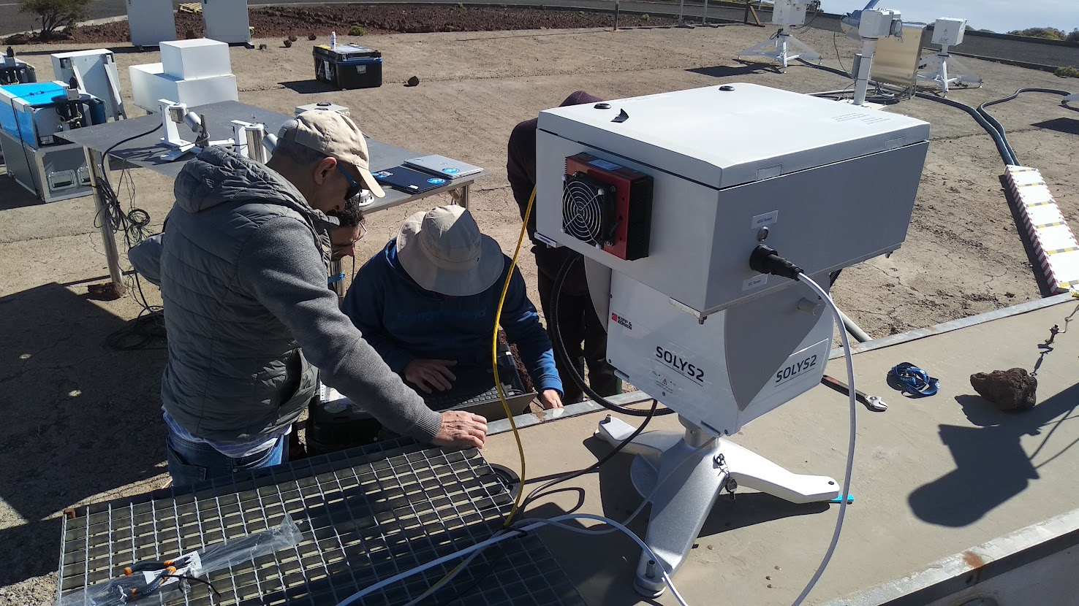
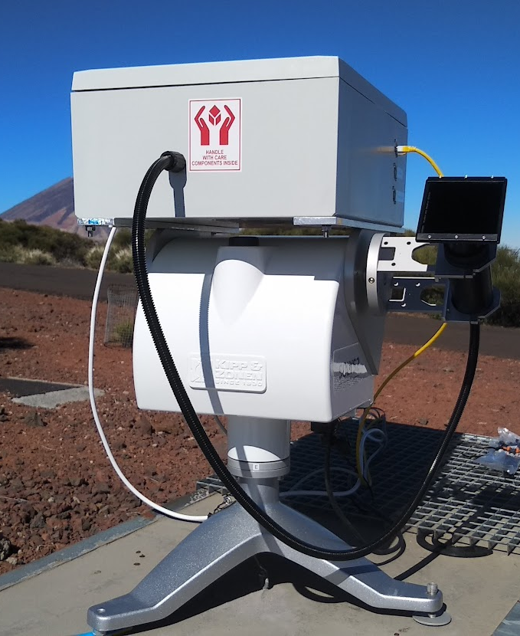
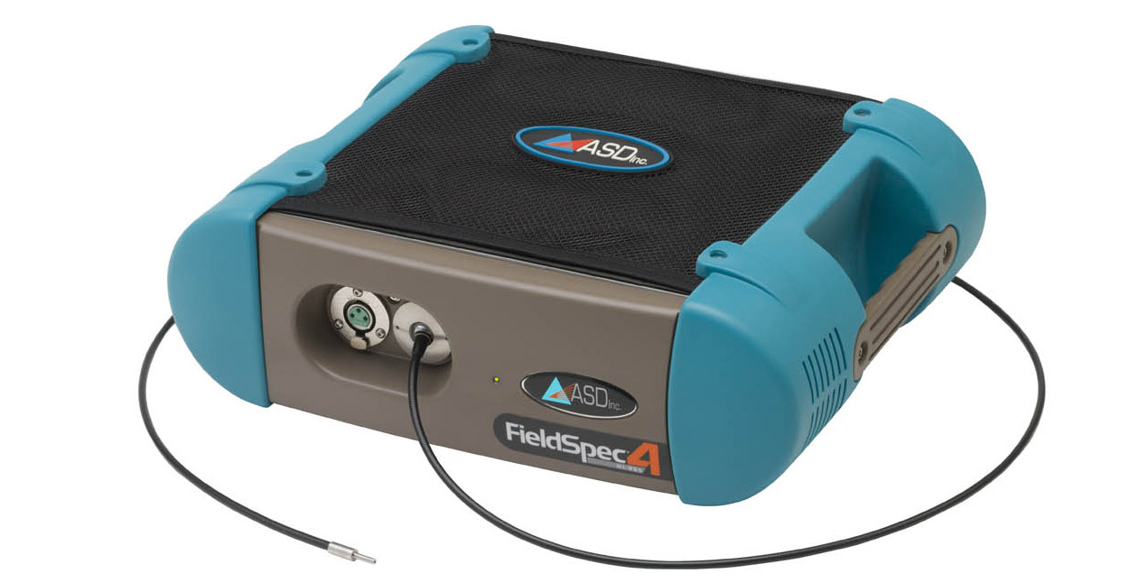
Lunar hyperspectral reflectance measurements
Thermally controlled ASD spectrometer
Foreoptics with optical fiber.
Improved foreoptics were developed as part of LIME 2 CCN
Neutral density filter to measure solar irradiance
Sun/moon tracker

Slide 13
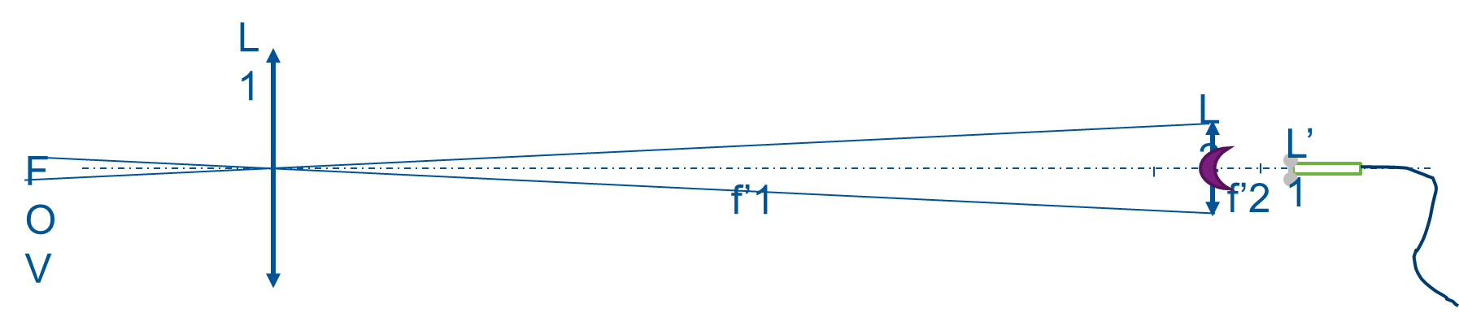
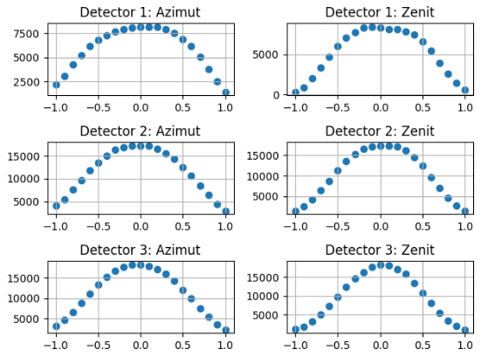
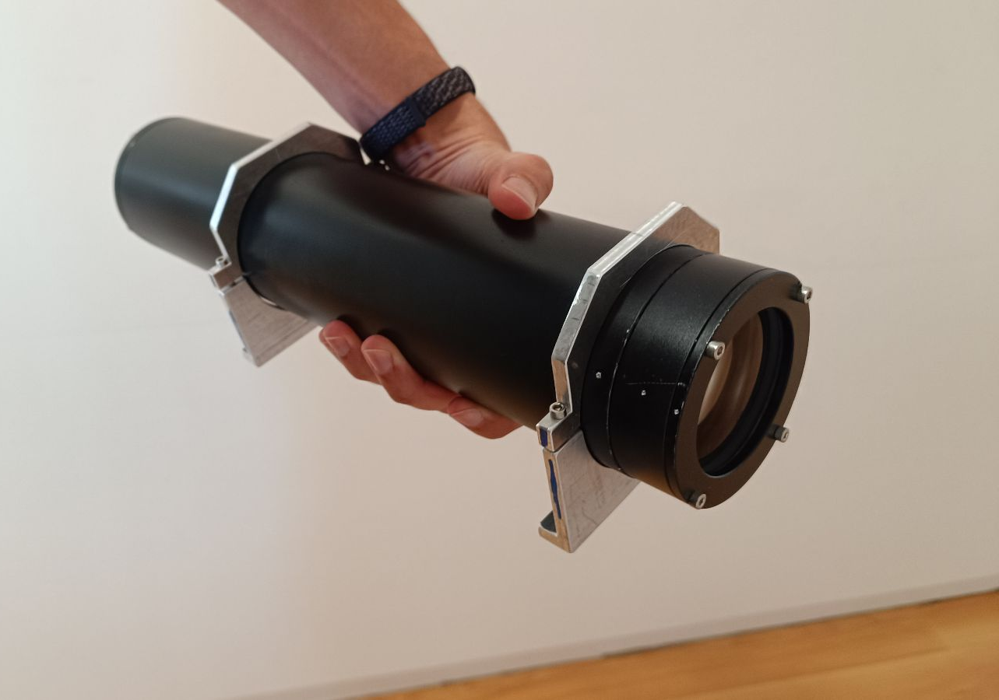
New foreoptics ASD
Köhler illumination
Acromat doublet
Aperture

Slide 14
Preparing ASD spectral interpolation dataset
ASD measurements were taken over 4 months in 2022 and 2 months in 2025
Measurements in absorption features are too noisy and are omitted
Replace masked data with rescaled Apollo spectrum using comet_maths
Data divided in bins of 10° spanning -95° to 95°
Linearly interpolated with phase angle to phase angles required within the LIME-TBX
Stored as NetCDF file for use within LIME-TBX

Slide 15
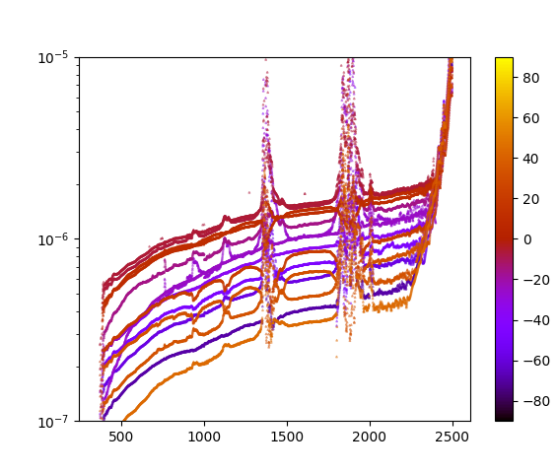
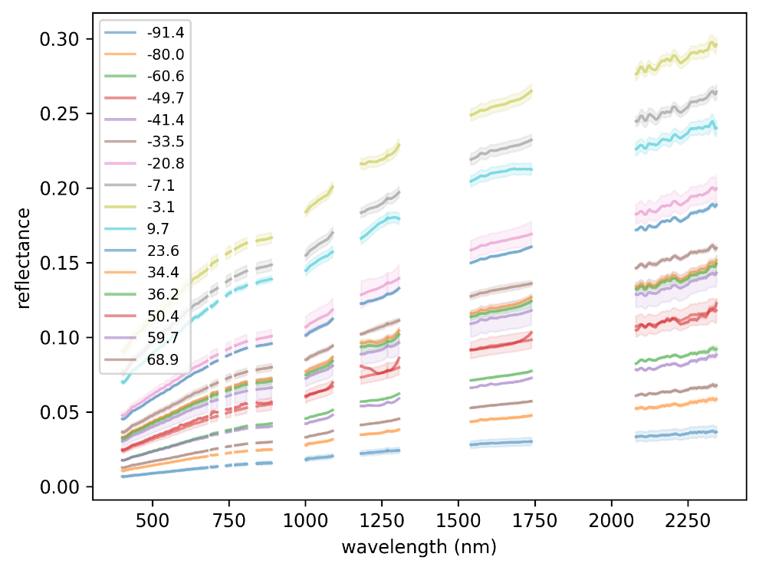
Preparing ASD spectral interpolation dataset
ASD measurements were taken over 4 months in 2022 and 2 months in 2025
Measurements in absorption features are too noisy and are omitted
Replace masked data with rescaled Apollo spectrum using comet_maths
Data divided in bins of 10° spanning -95° to 95°
Linearly interpolated with phase angle to phase angles required within the LIME-TBX
Stored as NetCDF file for use within LIME-TBX

Slide 16
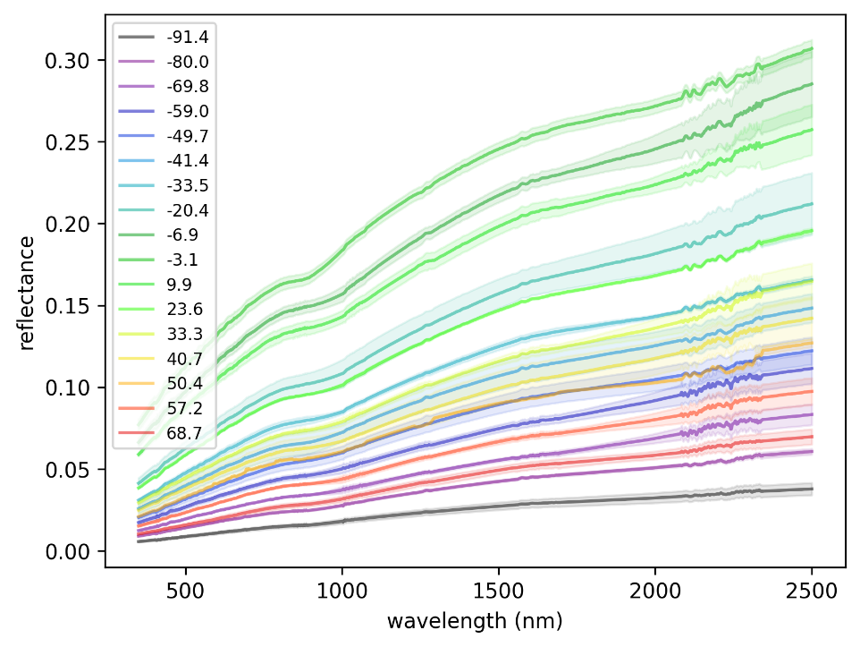
Preparing ASD spectral interpolation dataset
ASD measurements were taken over 4 months in 2022 and 2 months in 2025
Measurements in absorption features are too noisy and are omitted
Replace masked data with rescaled Apollo spectrum using comet_maths
Data divided in bins of 10° spanning -95° to 95°
Linearly interpolated with phase angle to phase angles required within the LIME-TBX
Stored as NetCDF file for use within LIME-TBX

Slide 17
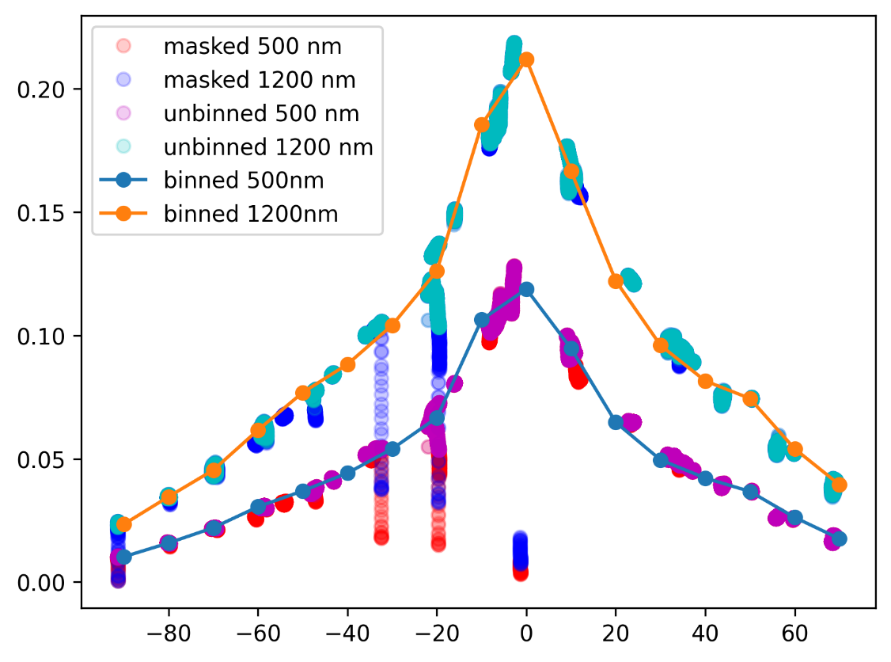
Preparing ASD spectral interpolation dataset
ASD measurements were taken over 4 months in 2022 and 2 months in 2025
Measurements in absorption features are too noisy and are omitted
Replace masked data with rescaled Apollo spectrum using comet_maths
Data divided in bins of 10° spanning -95° to 95°
Linearly interpolated with phase angle to phase angles required within the LIME-TBX
Stored as NetCDF file for use within LIME-TBX

Slide 18
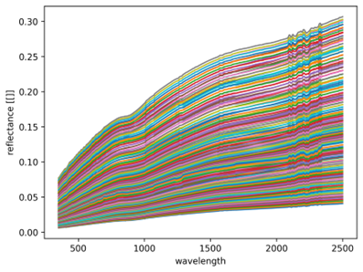
Preparing ASD spectral interpolation dataset
ASD measurements were taken over 4 months in 2022 and 2 months in 2025
Measurements in absorption features are too noisy and are omitted
Replace masked data with rescaled Apollo spectrum using comet_maths
Data divided in bins of 10° spanning -95° to 95°
Linearly interpolated with phase angle to phase angles required within the LIME-TBX
Stored as NetCDF file for use within LIME-TBX

Slide 19
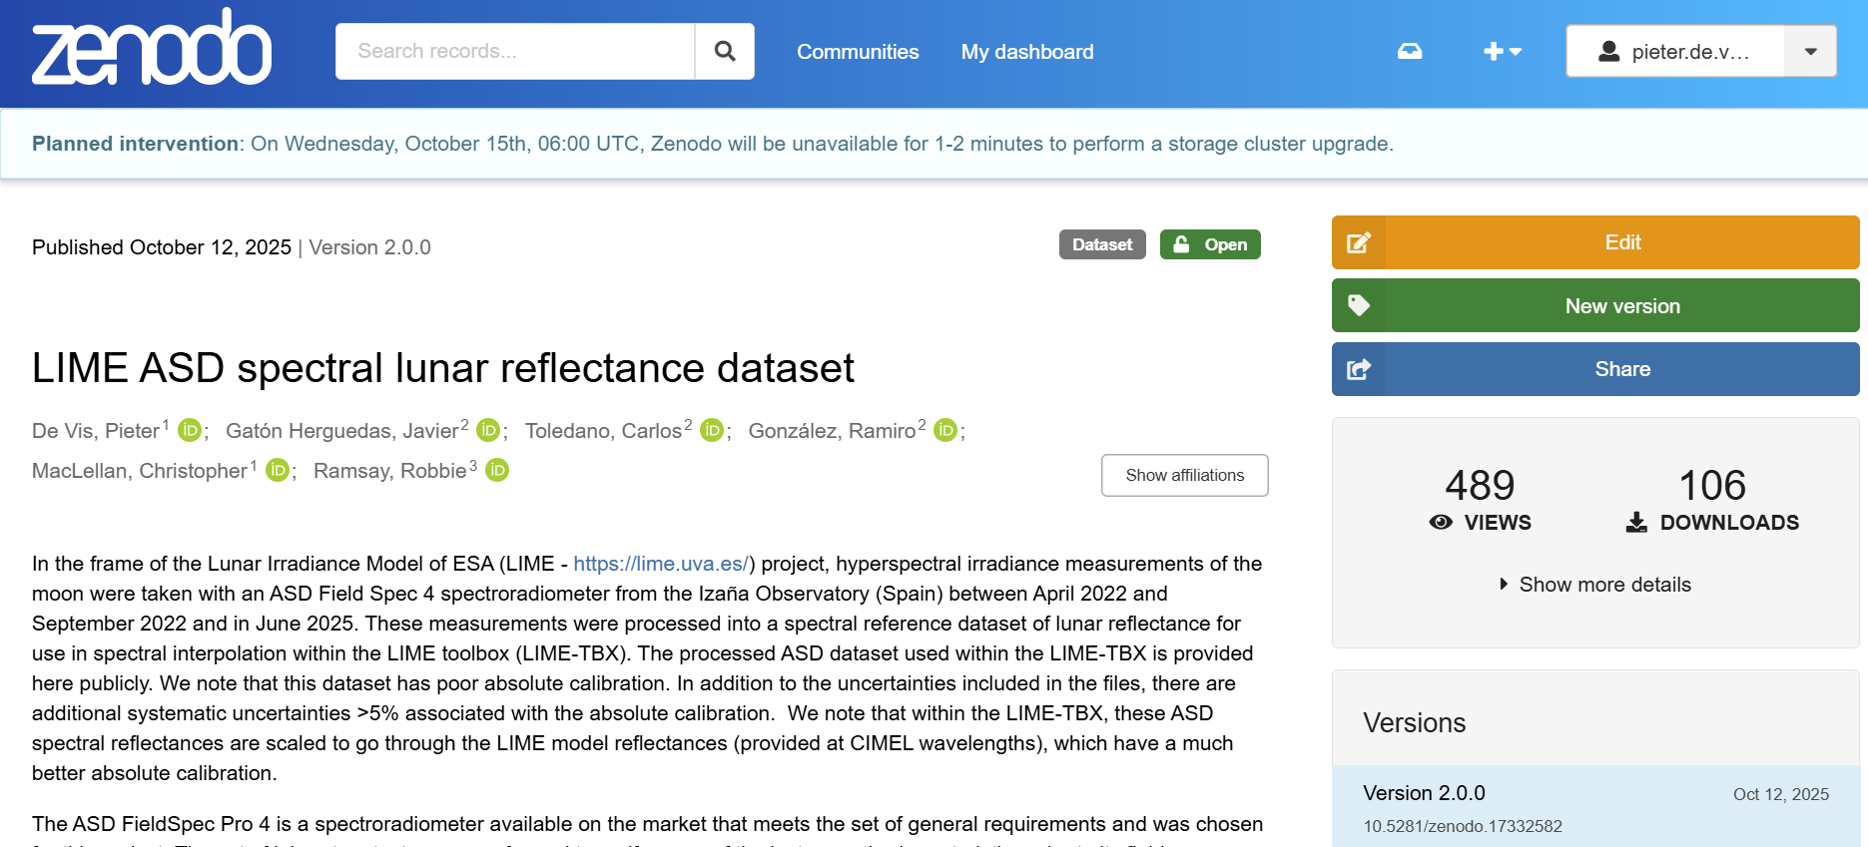
Preparing ASD spectral interpolation dataset
ASD measurements were taken over 4 months in 2022 and 2 months in 2025
Measurements in absorption features are too noisy and are omitted
Replace masked data with rescaled Apollo spectrum using comet_maths
Data divided in bins of 10° spanning -95° to 95°
Linearly interpolated with phase angle to phase angles required within the LIME-TBX
Stored as NetCDF file for use within LIME-TBX
Dataset available on Zenodo
https://doi.org/10.5281/zenodo.10534235

Slide 20
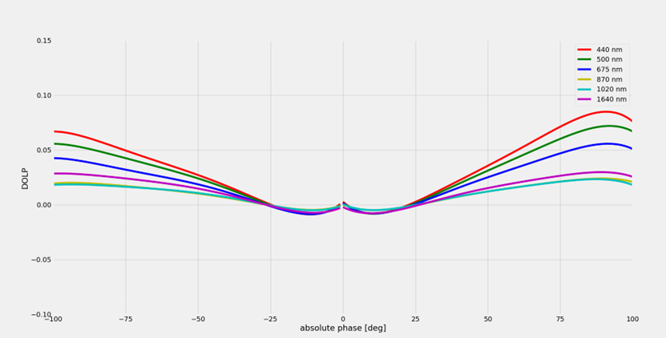
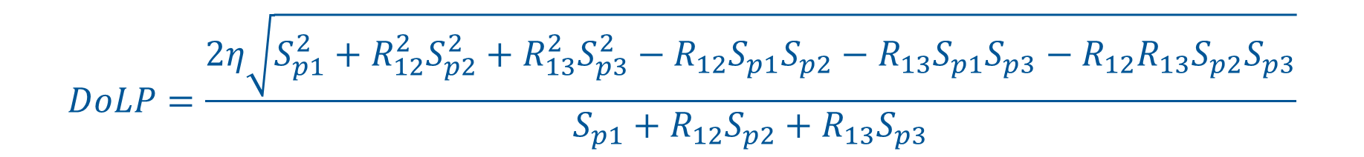
Degree of Linear Polarisation measurements
$$DoLP=\frac{2η\sqrt{S_{p1}^{2}+R_{12}^{2}S_{p2}^{2}+R_{13}^{2}S_{p3}^{2}−R_{12}S_{p1}S_{p2}−R_{13}S_{p1}S_{p3}−R_{12}R_{13}S_{p2}S_{p3}}}{S_{p1}+R_{12}S_{p2}+R_{13}S_{p3}}$$
Coyne et al, 1969
LIME DOLP

Slide 21
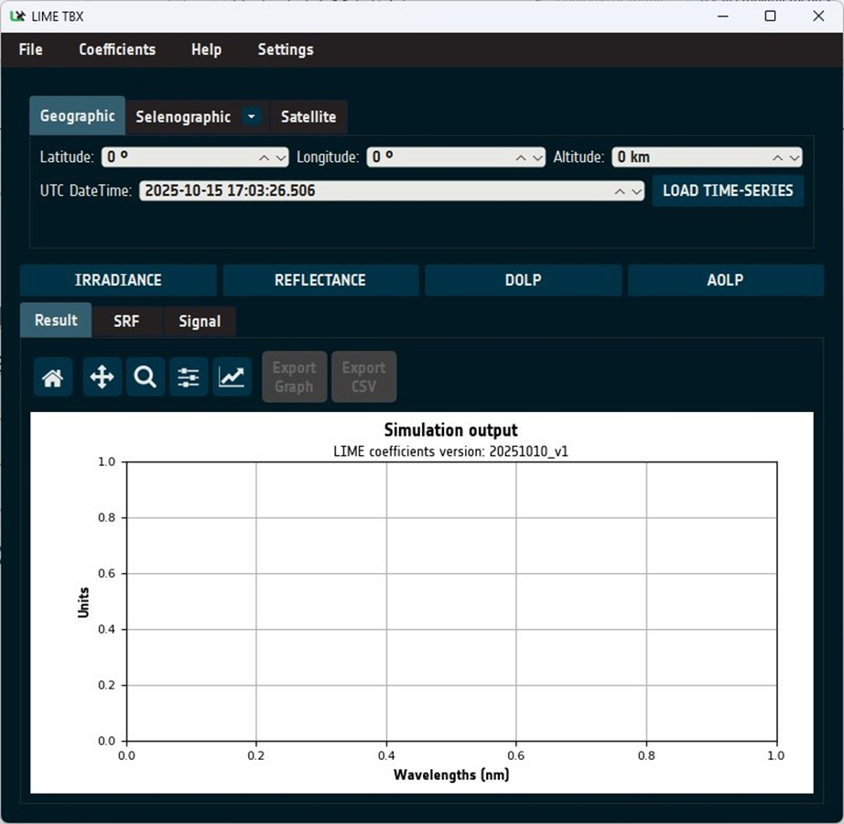
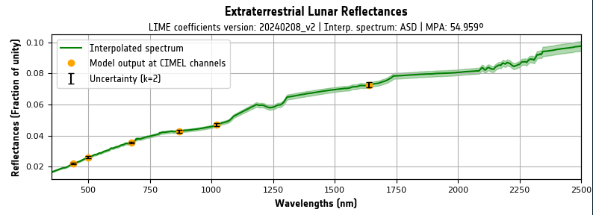
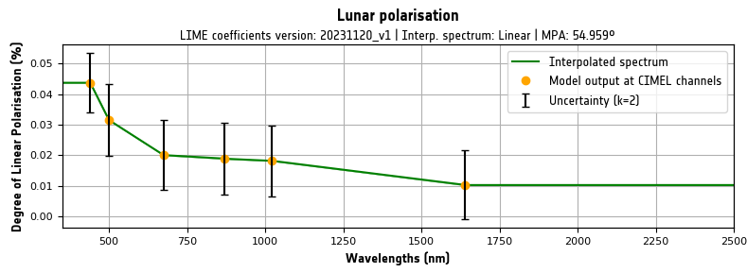
LIME toolbox: lunar irradiance / DoLP simulations
Simulates:
Irradiance
Band-integrated Irradiance (Signal)
Reflectance
Degree of linear polarisation
Angle of linear polarisation

Slide 22

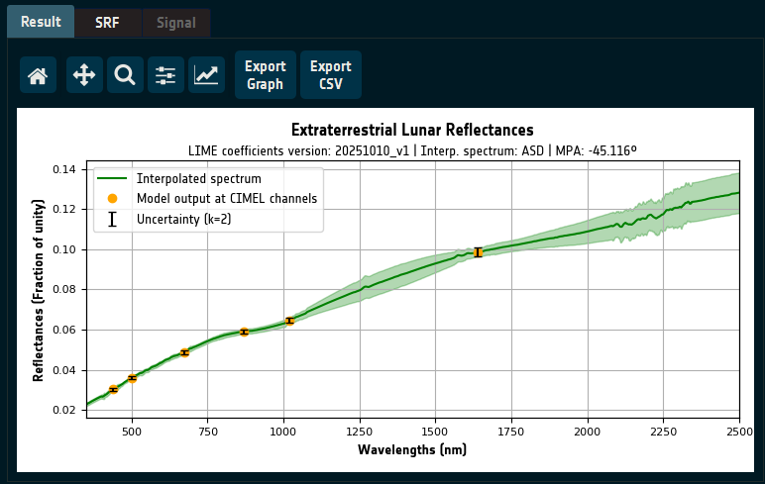
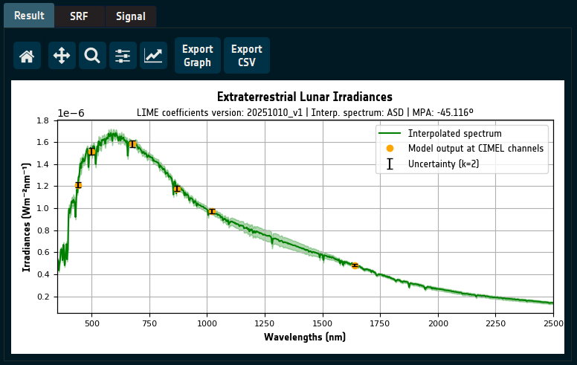
Reflectance & Irradiance Simulation

Slide 23
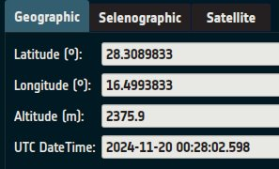
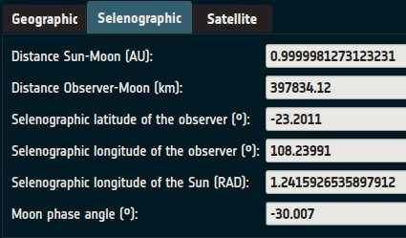
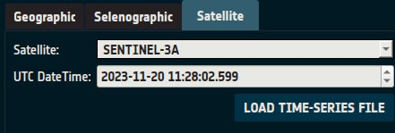
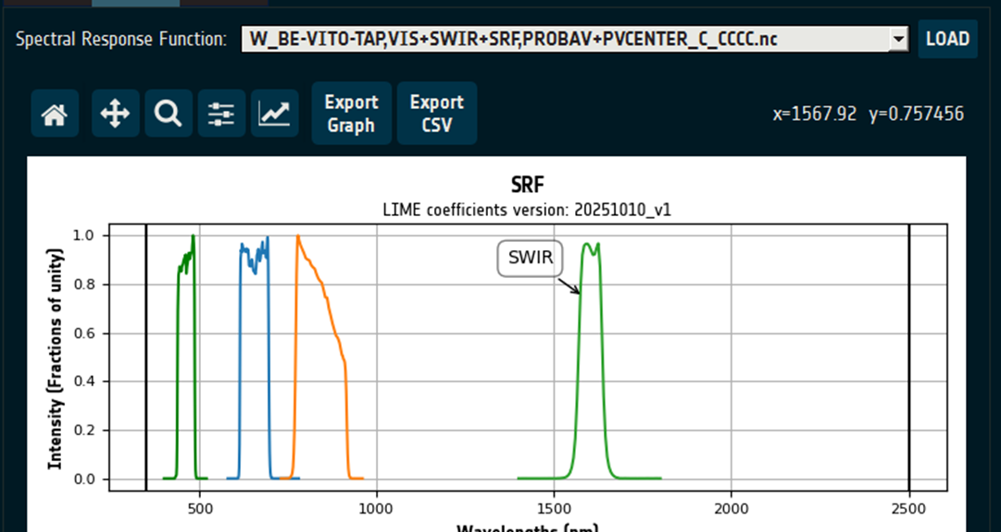
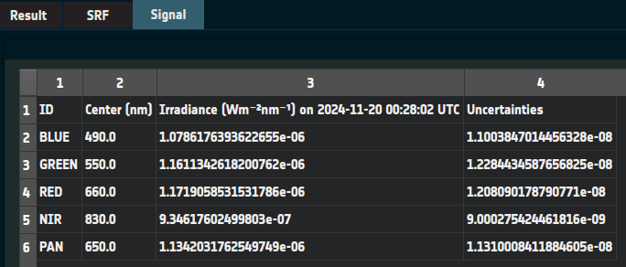
LIME toolbox: lunar irradiance / DoLP simulations
Input:
Geographic coordinates & datetime/s
Selenographic coordinates
Satellite name & datetime/s
User may add satellites if they have .tle or .osf files.
Optional: SRF file in GLOD format

Slide 24
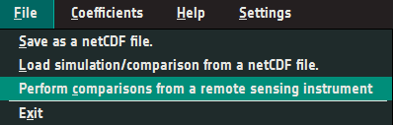
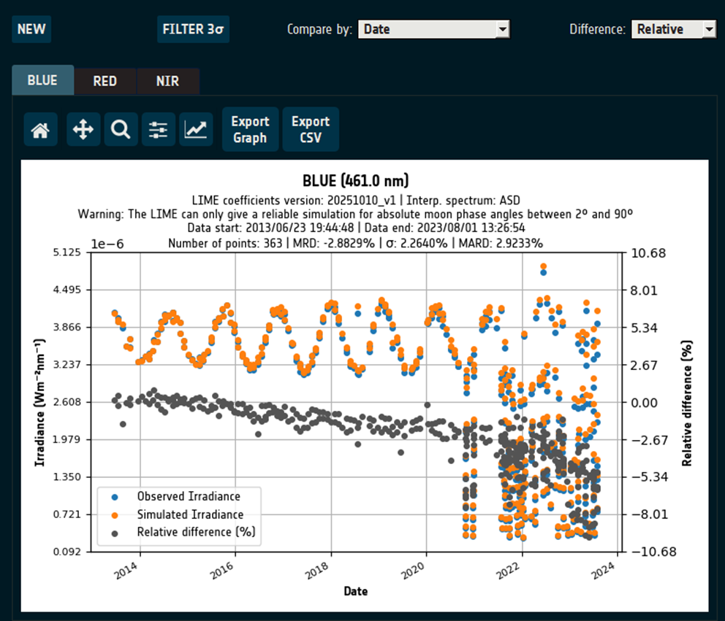
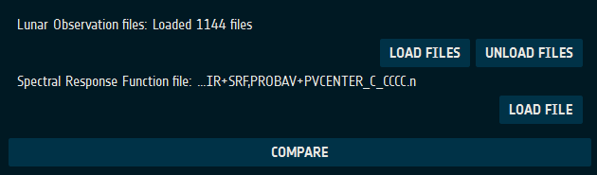
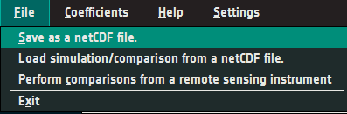
LIME toolbox: simulation vs. observation comparisons

Slide 25
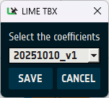
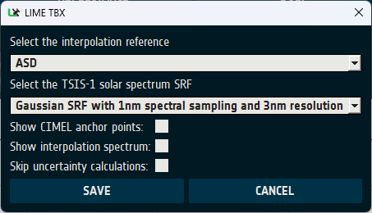

Coefficients & Settings
Select & Download updated LIME coefficients
Modify interpolation options

Slide 26

Command-Line Interface (CLI)

Slide 27

CIMEL

Slide 28

CIMEL

Slide 29

PROBA-V

Slide 30

PLEIADES

Slide 31

S3B-OLCI

Slide 32

AIR-LUSI (2019)

Slide 33

AIR-LUSI (2022)

Slide 34







LIME website: lime.uva.es
Downloads
LIME
Toolbox
Lunar
Datasets
Project
Documents

Slide 35
Conclusions
LIME modelling now based on 7+ years of continuous lunar measurements
Further measurements secured until 2027
Hyperspectral ASD measurements provide info on spectral shape, and are anchored to LIME model at CIMEL wavelengths
LIME-TBX allows to simulate output of the model and compare these to actual lunar observations.
Comparisons carried out and documented against various sensors
Continuous efforts to keep improving measurement quality and modelling
The measurements, the LIME toolbox and the associated documentation are available on LIME website and ESA Cal/Val portal

Slide 36
Thank you!
pieter.de.vis@npl.co.uk
https://lime.uva.es/
http://calvalportal.ceos.org/lime

