Slide 1
Second Lunar Model Inter-Comparison Exercise
T. Stone (USGS), S. Wagner (EUMETSAT)
GSICS web meeting 13.11.2025

Slide 2
Overview of the previous inter-comparison exercise
Conducted in 2023; results presented at LCWS4 − December 2023 at EUMETSAT
Comparisons of model-generated lunar irradiances computed for a fixed set of inputs, specified as a grid of observation geometries, and 8 spectral bands
  Lunar Observation Angle Set (LOAS): signed phase angle, sub-solar longitude, sub-solar latitude, sub-observer longitude, sub-observer latitude
Participation by 7 models: ROLO (USGS), GIRO (GSICS-EUMETSAT), LIME (ESA), SLIM (H. Kieffer), LESSR (EUMETSAT), CLIMES (Miller-Turner), SP (AIST)
Results showed significant differences between the models

Slide 3
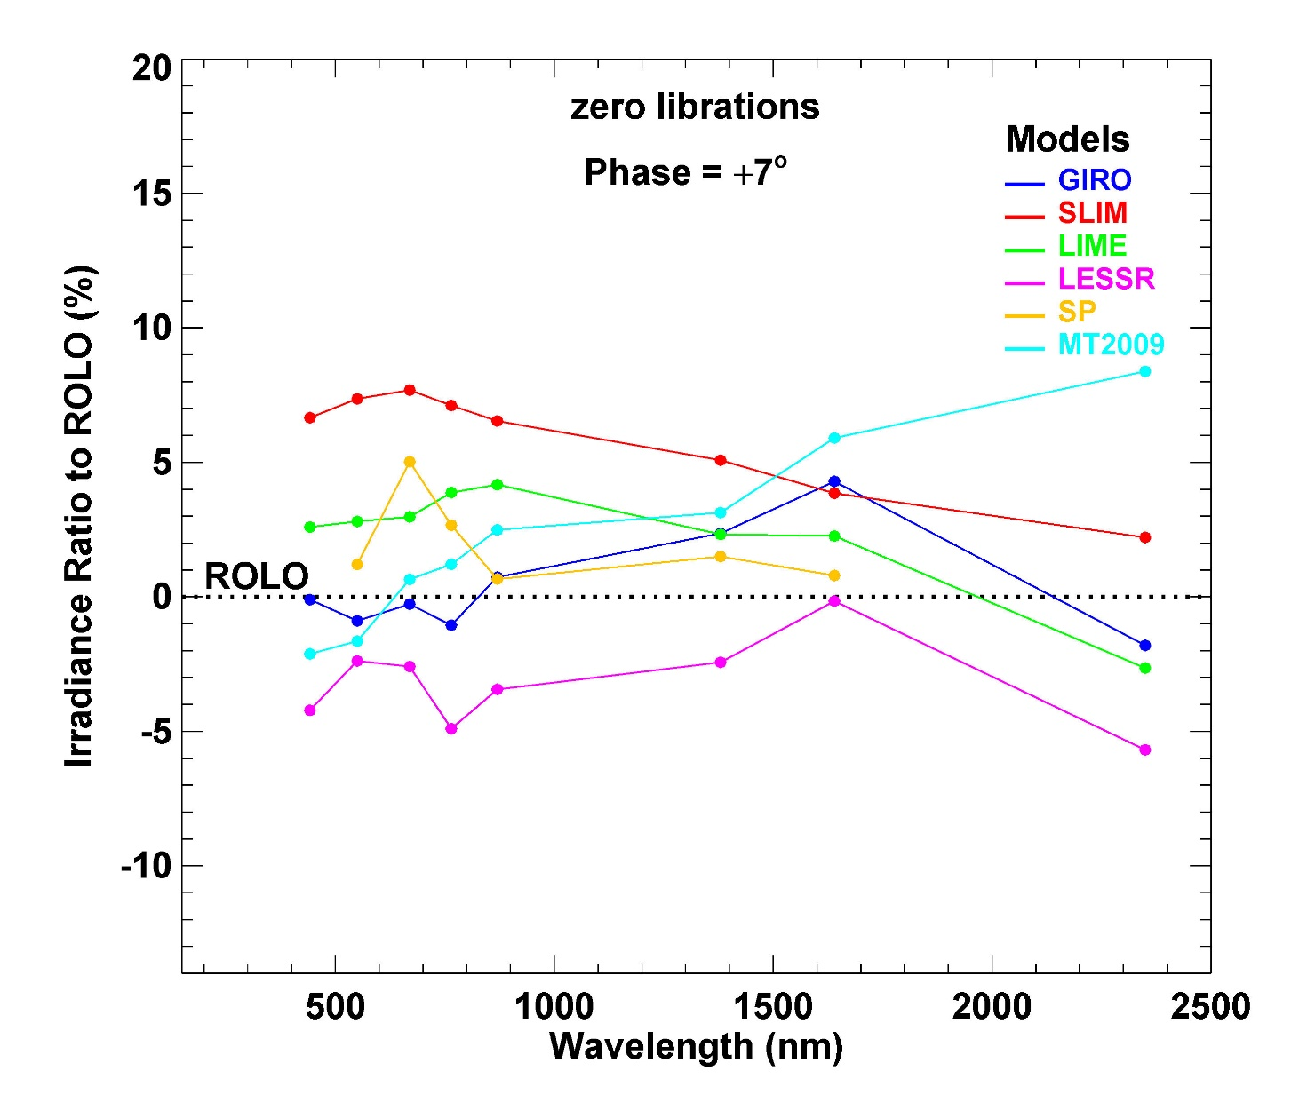
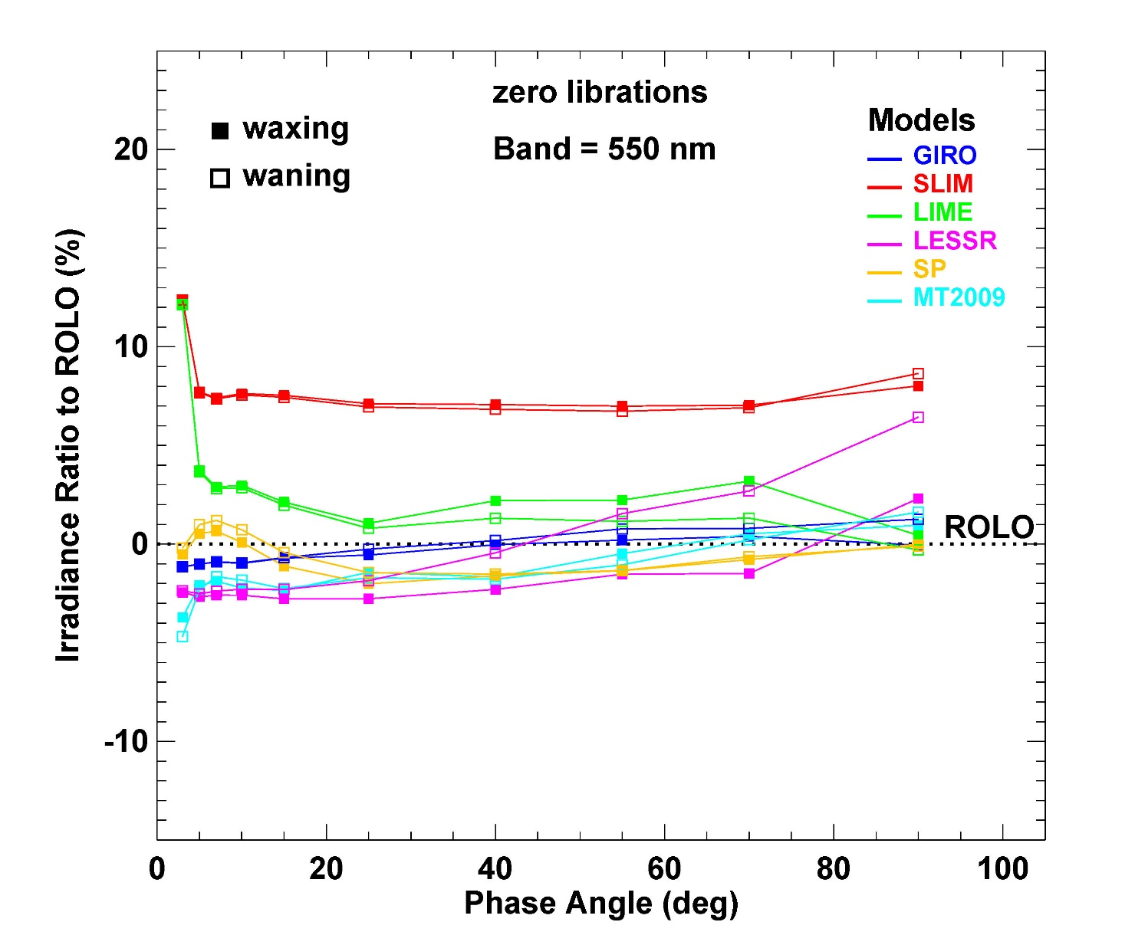
Overview of the previous inter-comparison exercise
Example plots: comparisons relative to ROLO

Slide 4
Motivation for the second inter-comparison exercise
Updates to the models: LIME, LESSR, SLIMM, GIRO*, Miller-Turner
Development of LSICS
  capability to interchange models within the LSICS framework
  models currently implemented: SLIMM, LESSR, GIRO
Desire to expand the spectral coverage of the exercise
* revised to align with current ROLO model

Slide 5
Vision for operating the second inter-comparison exercise
Use LSICS to run all the participating models !
Reduce or eliminate variability in processing the common inputs (geometry, SRFs)
Utilise the interchangeable model capability of LSICS
  operate the different models to generate lunar disk reflectance spectra only
All other processing will be handled identically within the LSICS framework
  the observation geometry test grid will be pre-defined for the DR module as an input intermediate file
  the DR module output reflectance spectra will be passed to the SI module for convolution with the test SRFs and a specified solar spectrum
Requires participating model developers to build a compatible interface to the DR module
  relatively simple and straightforward

Slide 6
Model interface to LSICS
Sub-class of the DR module
  can be a command-line executable, designed to be called from the DR module super-class (python)
  input arguments are the LOAS for each point of the test grid
    ordered arrays of angle values, in specified units
  output is a spectrum for each grid point, as ordered pairs of wavelength and reflectance
    on a model-specific wavelength grid
  any ancillary data needed by the model can be imported from external files; free-form formats
An example that runs GIRO (2013 version) has been built
  compiled from original C sources, with a new main driver program to implement command-line operation
The LIME team has expressed interest in implementing LIME in LSICS
  team members are participating in LSICS development discussions
Open call for other model developers to participate !
  lunar reflectance models in the reflected solar wavelength range (UV-Vis-SWIR)

Slide 7
Presenting results from the exercise
The challenge: to visualise the comparisons over multi-dimensioned independent variables:
phase angles, librations, spectral bands, models
Plotting tool being developed as part of LSICS
under construction — results from the model comparison exercise will be used for development

Slide 8
Thank you!
Questions are welcome.

