Slide 1
LSICS status
Sébastien Wagner
Remote Sensing Scientist – Radiometric Calibration
GSICS VNIR web meeting / 13.11.2025

Slide 2
The LSICS project
LSICS = activity within the GSICS Lunar Calibration subgroup
Development group, roles and responsabilities:
Project leader / coordinator : T. Stone (USGS)
Main developers : NOAA (Biskash Basnet) till December 2024 / EUMETSAT (Seb Wagner with support from Vincent Debaecker) since January 2025
Support: JMA (Masaya Takahashi), NOAA (Fangfang Yu, Fred Wu – till December 2024), Celestial Reasoning (Hugh Kieffer), Earth Space Solutions (Matthijs Krijger)
Coordination and meetings:
Regular meetings (every 2 or 3 weeks)
Minutes are available
Infrastructure
Gitlab repository with main and development branch hosted by EUMETSAT
“Main” to host the official version to be used
“Development” branch for enhancements / new functionalities development and testing
Project still in restricted access (version v1.0.0 in preparation)
Confluence page made available by EUMETSAT but currently not used by the group ➔ option still available if need arises

Slide 3
Development status
Main functionalities for LSICS have been implemented
SLIMM model
Modular approach to integrate additional models
Standard input / output formats
Functionality to feed LSICS with GIRO input files ➔ integrated converter
SRF files following the GSICS SRF format (GIRO compatible)

Slide 4
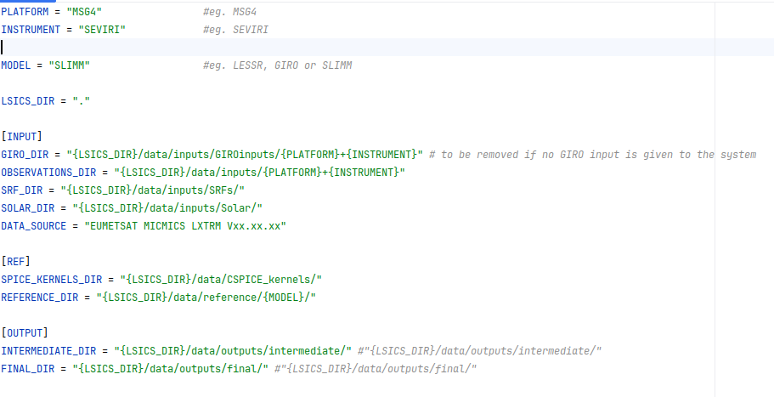
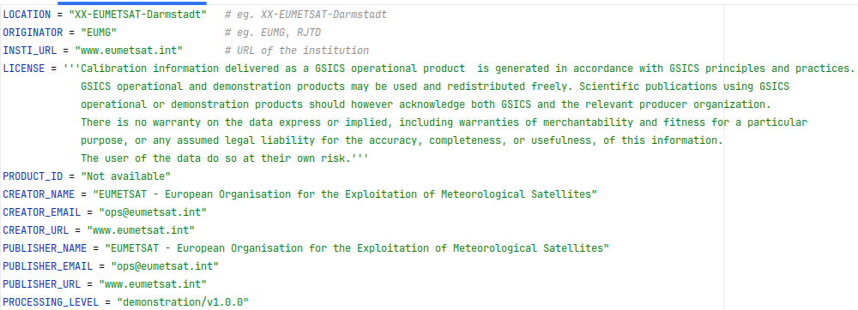
How does LSICS work?
Input
Dynamic configuration file
Static configuration file
Observations (GIRO/LSICS)
Ingest GIRO input
Operation: concatenate the GIRO records in one LSICS file
Global attributes as required by LSICS
History
Variables as required by LSICS
GIRO_INPUT defined
Yes
No
LSICS input
Ingest and Geometry Calculation Module
Operation: compute Lunar Observation Angle Set (LOAS)
• Phase angle (signed)
• Sub-solar longitude and latitude
• Sub-observer longitude and latitude
Model Definitions
• Operating wavelength set
• Basis function coefficients
Lunar Disk Reflectance Module
Operation: compute lunar disk equivalent reflectance spectra
• set up basis functions
• reconstruct disk reflectance model
• compute model on operating wavelenghts
DER output
LOAS output

Slide 5
How does LSICS work?
Input
Dynamic configuration file
Static configuration file
Observations (GIRO/LSICS)
Ingest GIRO input
Operation: concatenate the GIRO records in one LSICS file
Global attributes as required by LSICS
History
Variables as required by LSICS
Final Outputs
• Lunar spectral irradiances for input observations in sensor spectral bands
GIRO_INPUT defined
Yes
Spectral Irradiance Module
Operation: produce model irradiances in sensor bands
• Convolve disk reflectance, solar irradiance and SRF
• Apply distance corrections
No
LSICS input
Ingest and Geometry Calculation Module
Operation: compute Lunar Observation Angle Set (LOAS)
• Phase angle (signed)
• Sub-solar longitude and latitude
• Sub-observer longitude and latitude
Model Definitions
• Operating wavelength set
• Basis function coefficients
Reference Spectra
Lunar reflectance
Solar Irradiance
SRF file
SRF for each processed band
Lunar Disk Reflectance Module
Operation: compute lunar disk equivalent reflectance spectra
• set up basis functions
• reconstruct disk reflectance model
• compute model on operating wavelenghts
DER output
DER output
LOAS output

Slide 6
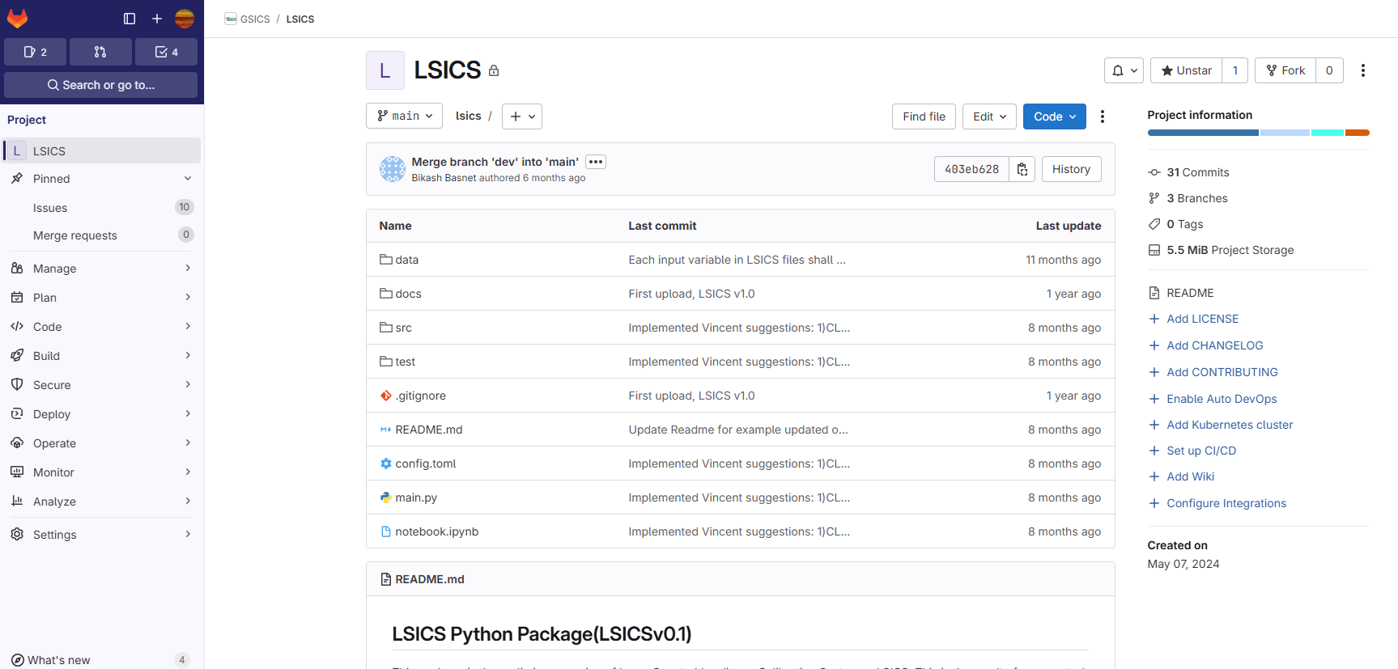
LSICS Gitlab

Slide 7
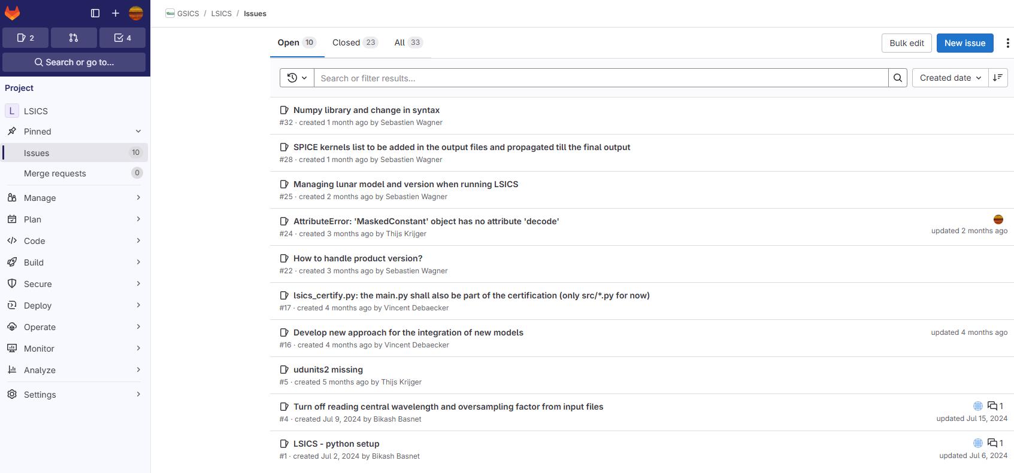
LSICS Gitlab

Slide 8
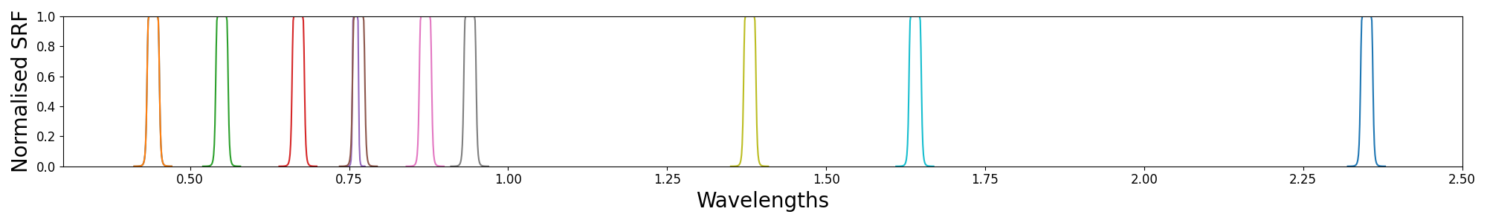
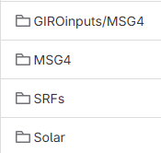
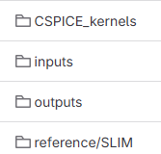
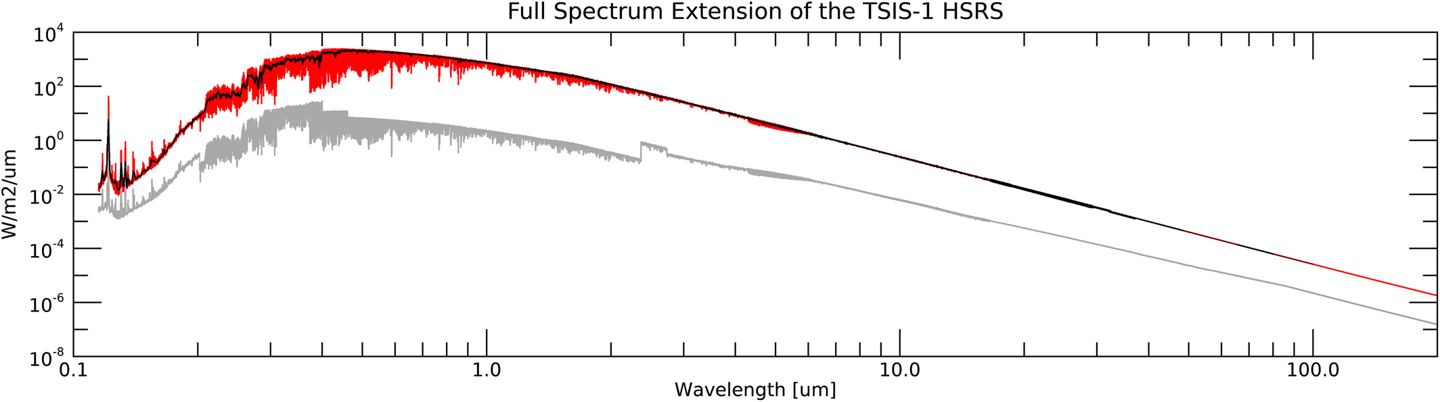

LSICS structure
$LSICS/
config.toml
static_config.toml
main.py
data/
src/
Source: LASP, Coddington 2023

Slide 9
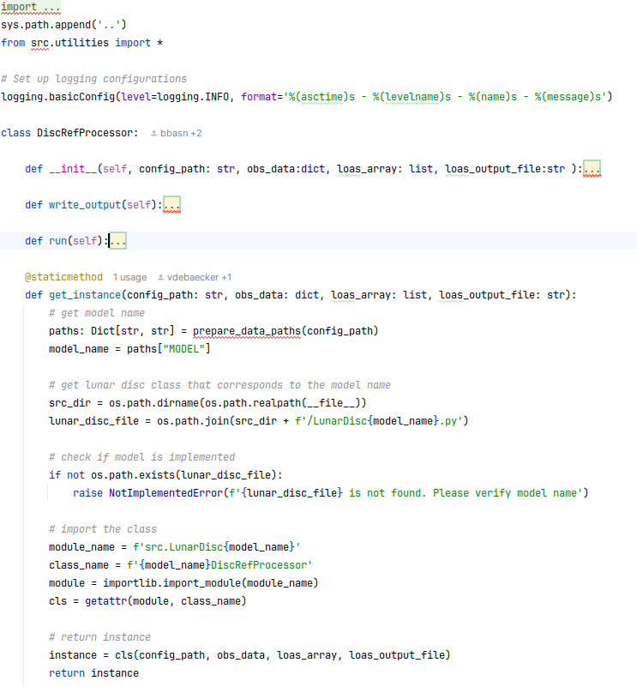
Some words on interfacing lunar reflectance models
Definition of a main class for the models

Slide 10
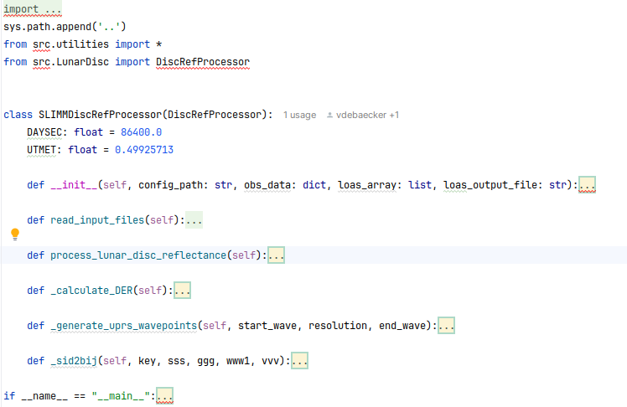
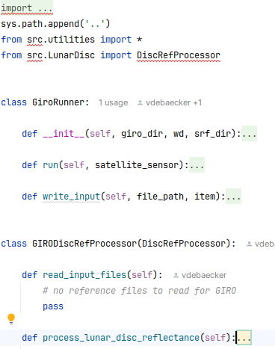
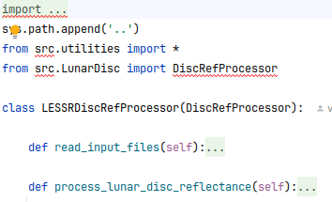
Some words on interfacing lunar reflectance models
Definition of subclasses inheriting from the main model class
SLIMM
GIRO
Function to read the LUTs / model parameters
Model computation
LESSR

Slide 11
Distribution and usage
Public access to the official release (“main” branch) for users
Creative Commons license
CC BY–ND — attribution required, no code derivatives allowed
avoids having a formal usage agreement
Digital markers and public signature key
to ensure that output products have been generated by the official agreed version of LSICS
implemented using JSON tokens

Slide 12
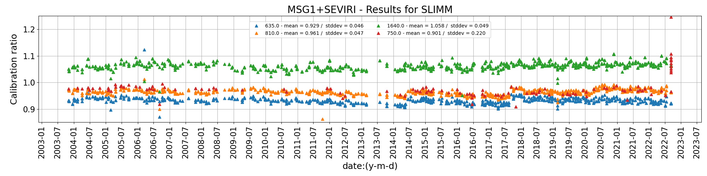
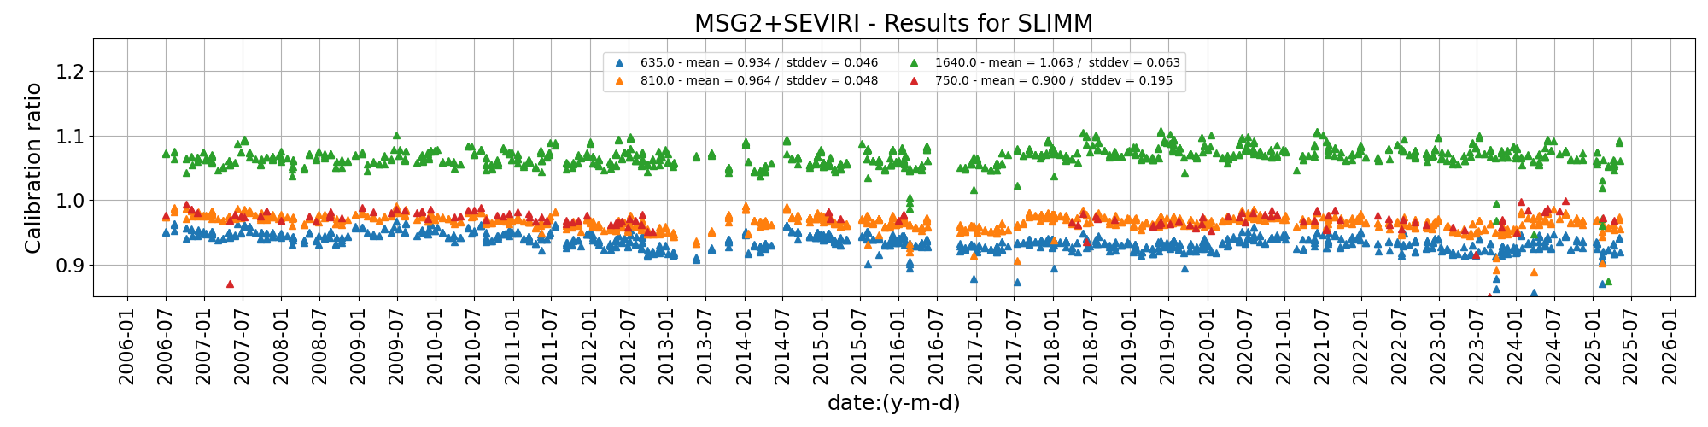
Some tests and results - MSG/SEVIRI

Slide 13
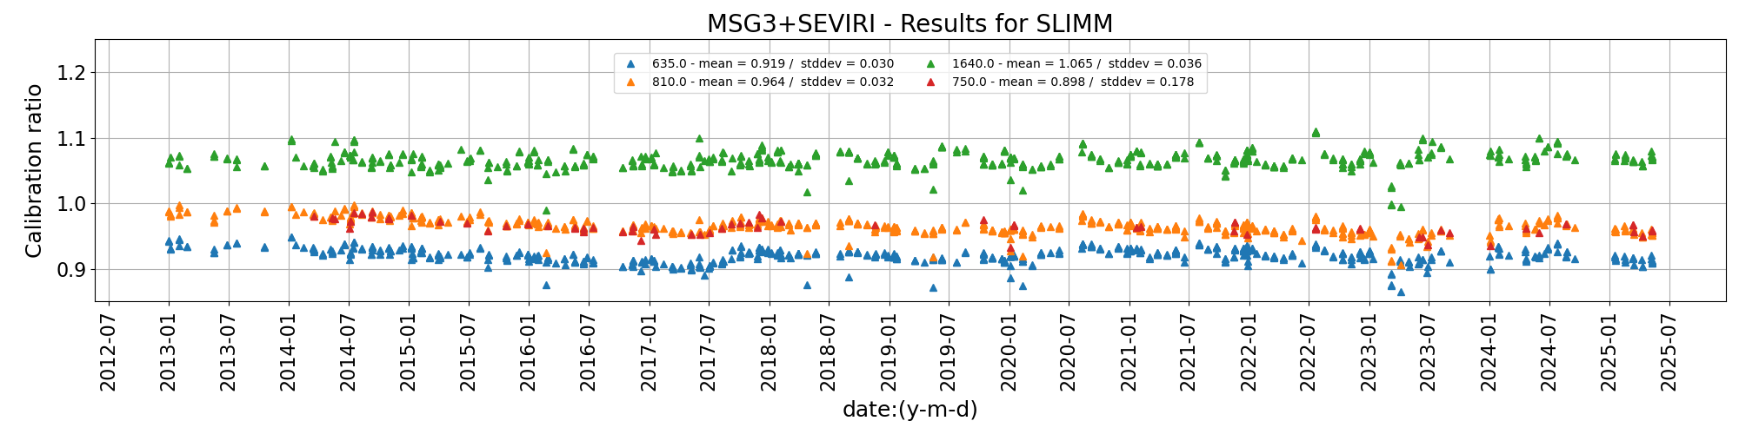
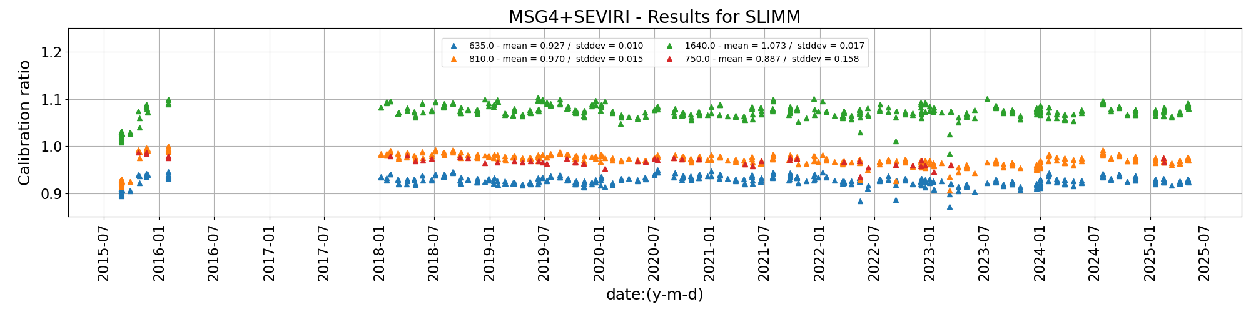
Some tests and results - MSG/SEVIRI

Slide 14
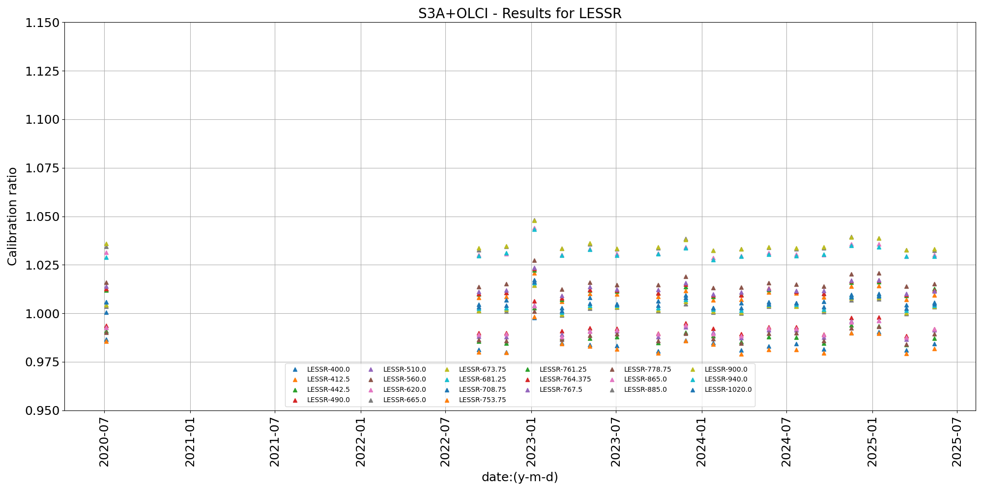
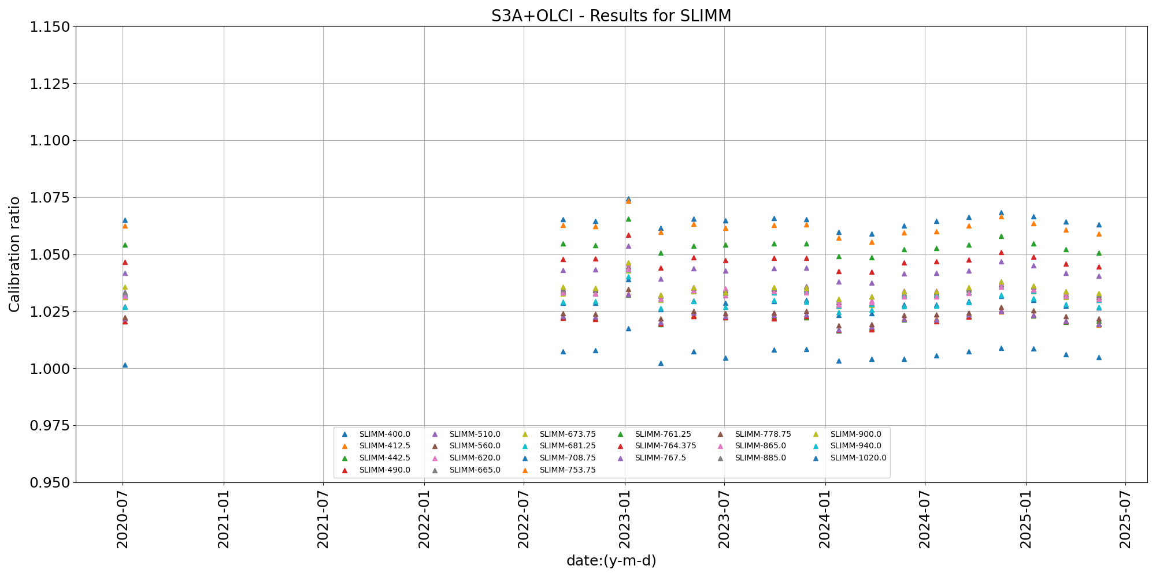
Switching lunar model / Inter-operability

Slide 15
Future work
Complement the system with a series of functionalities that were identified while developing (e.g. adding WGS84 to J2000 + ITRF93, consolidating the data and the run traceability, etc.)
Complete work on the definition of a benchmark + testing
Validation against the original lunar model implemented in the DR module
New enhancements implemented in LSICS (such the process for checking the versions in the runs by users)
Formal documentation
Functional requirements, code structure, file and data formats (I/O, SRF and internal/intermediate files), module interfaces (Interface Control Document)
Lunar model functional description
Documenting the system validation
Development of a toolbox to display the LSICS intermediate + final output, and extract relevant information such the run history (➔ traceability)
Release of version 1.0

Slide 16
Thank you!
Questions are welcome.

