Slide 1
Preparation of the 5th CGMS/GSICS-CEOS/WGCV Lunar Calibration Workshop
S. Wagner (EUMETSAT), T. Stone (USGS)
GSICS web meeting 13.11.2025

Slide 2
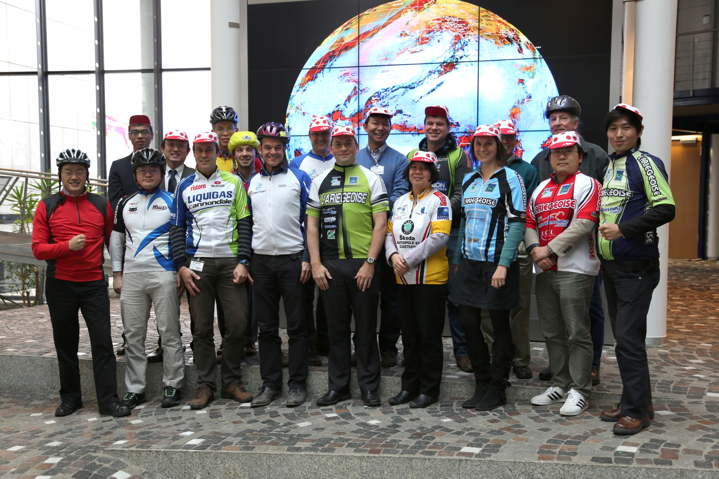
Previous workshops
2014 : EUMETSAT HQ Darmstadt – Germany (4 days)
Organisers: EUMETSAT / USGS / CNES / NASA
Focus:
Practical workshop around the GIRO model (GSICS Implementation of the ROLO model), developed by EUMETSAT
Definition of an input data format to process lunar observations from any instrument observing the moon with the GIRO
Data analysis and preparation of the observed lunar irradiance (recommendations)
Endorsement of the GIRO as GSICS common reference for lunar calibration
Participants: around 30 (including online)

Slide 3
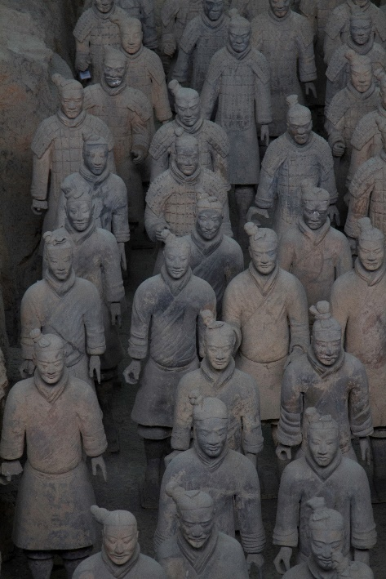
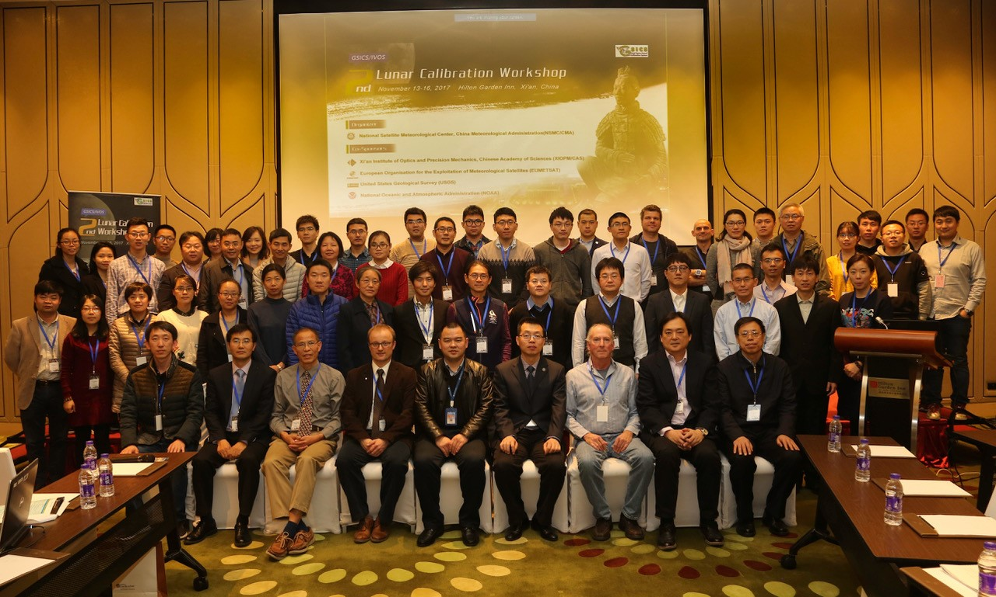

Previous workshops
2017 : Xi’an - China (4 days)
Organisers: CMA / XIOPM / CAS / EUMETSAT / USGS / NOAA
Focus:
Reference measurements (CMA + CAS in particular) + data from GOME-2 and SCIAMACHY
Lunar model development (ROLO, GIRO, new models) + lunar image processing
Inter-calibration and inter-band calibration
Alternative usage of the lunar measurements (MTF method comparison exercise).
Participants: between 60 and 70

Slide 4
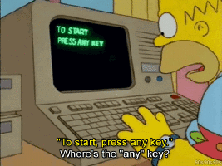
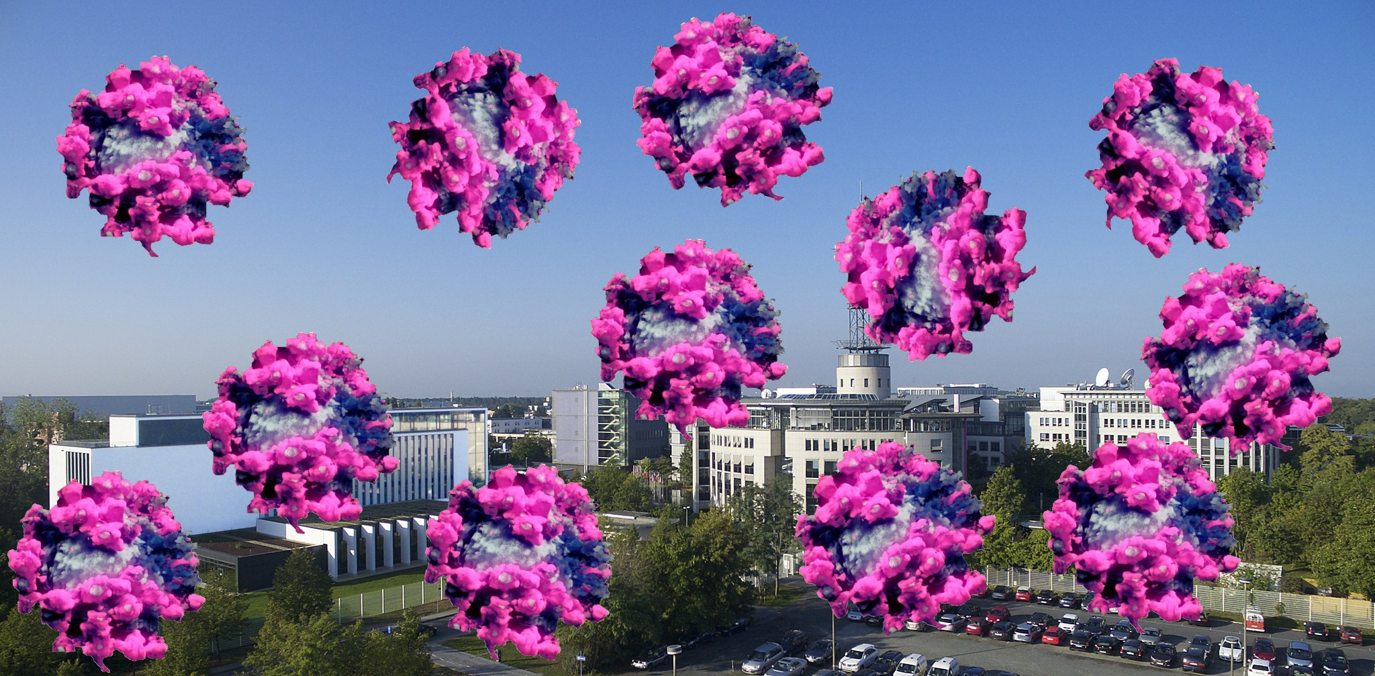
Previous workshops
2020 : online due to COVID restrictions (4 half-days)
Organisers: EUMETSAT / USGS
Focus:
Lunar model development (SP model, SLIMM, LIME,LESSR)
Lunar measurements and SI-traceability (Air-LUSI, ARCSTONE, Mauna Loa-LUSI)
Instrument monitoring using lunar observations
Usage of the Moon for microwave and thermal infrared instruments
Alternative usage of the lunar measurements (co-registration and MTF assessment postlaunch).
Discussions touched upon:
How to best integrate the observed lunar irradiance
Terminology
Solar irradiance
Lunar models and polarization
Participants: between 70 and 80

Slide 5
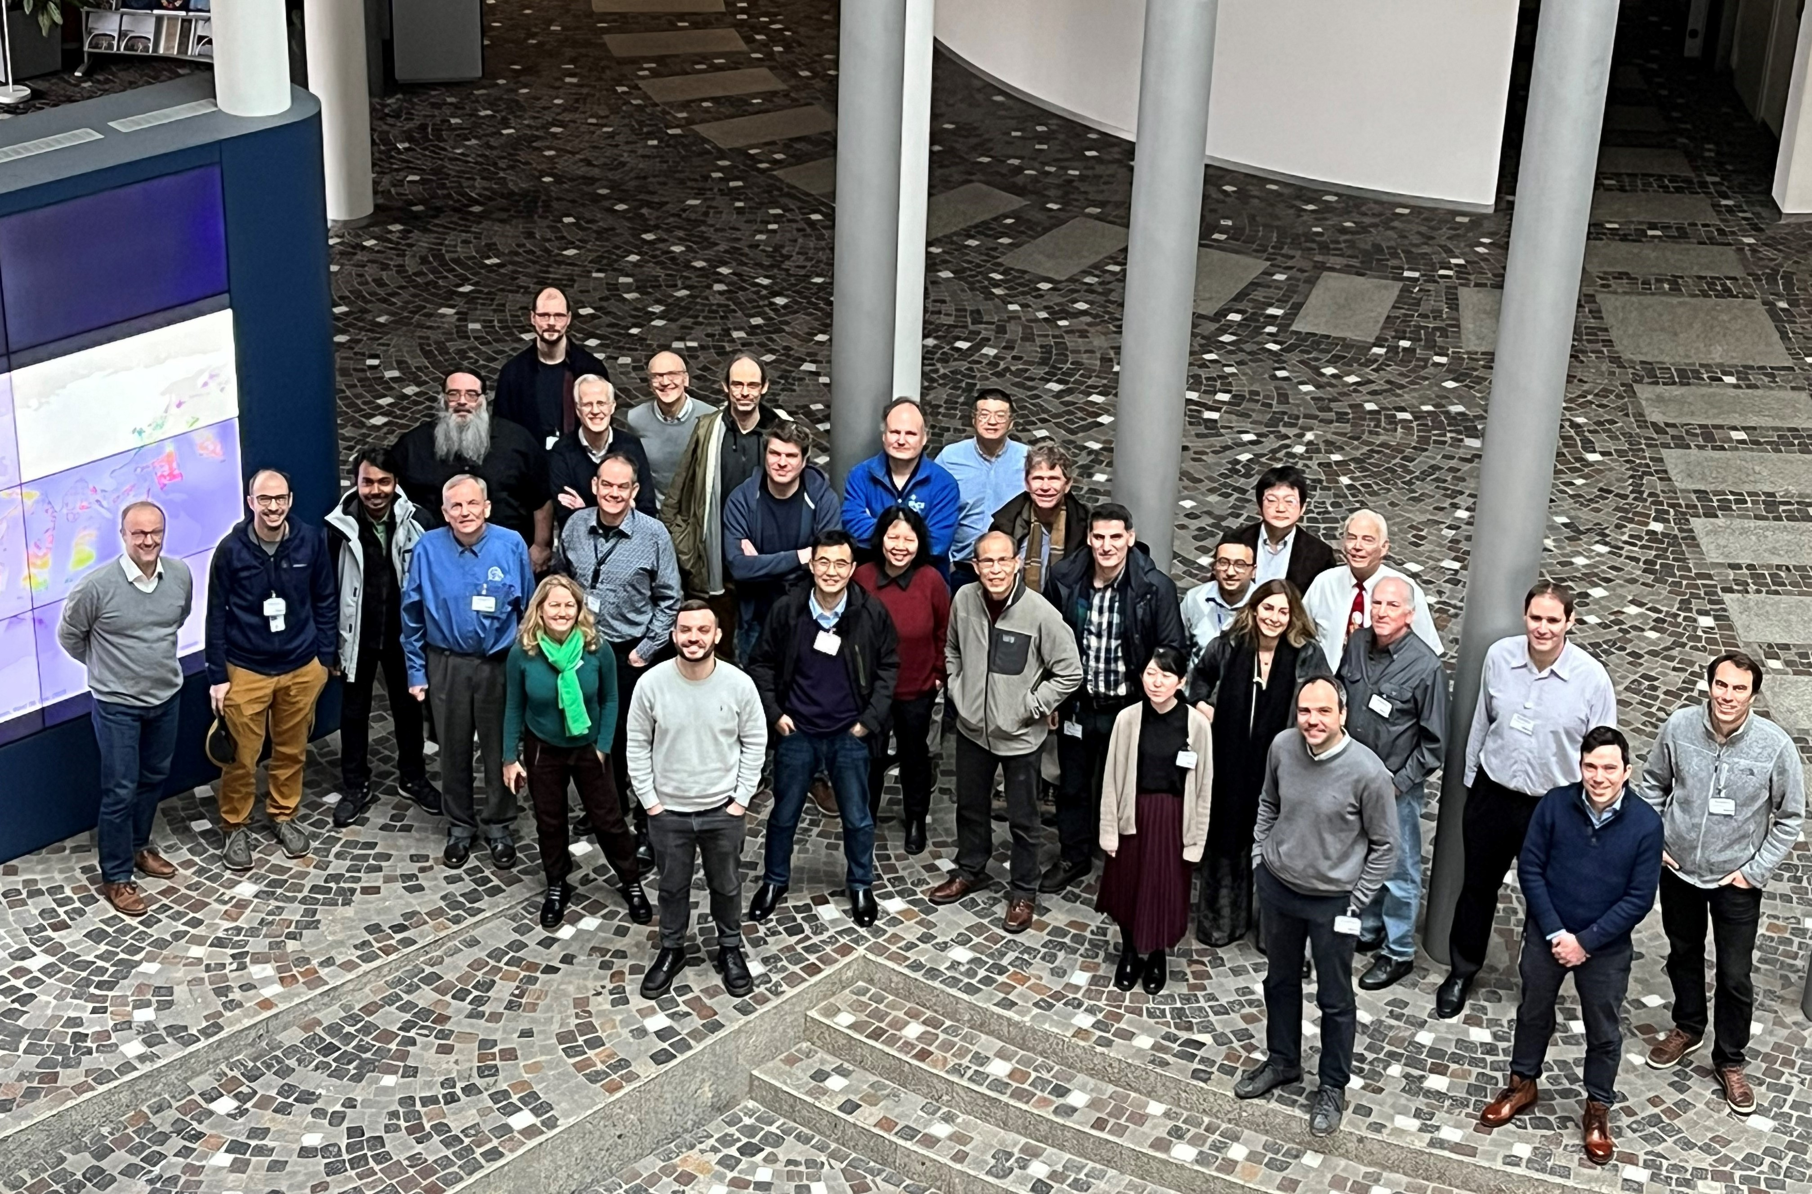
Previous workshops
2023 : Darmstadt – Germany (5 days)
Organisers: EUMETSAT / USGS
Focus:
Reference lunar measurements (Air-LUSI, Mauna Loa-LUSI, CMA+CAS, ESA LIME, ARCSTONE)
Lunar model development (SLIMM, LIME,LESSR, LSICS)
LSICS as a successor of the GIRO
Lunar model inter-comparison exercise (ROLO, CLIMES, SP, GIRO, SLIMM, LIME, LESSR)
Instrument monitoring using lunar observations
Lunar observations in microwave and thermal infrared
Alternative applications of the lunar measurements
In addition, discussions touched upon:
Best practices for lunar calibrations
Creation of a GSICS Lunar Sub-Group
Revise the GLOD approach for data sharing
Participants: around 70 (1/2 online)

Slide 6
5th CGMS/GSICS-CEOS/WGCV Lunar Calibration Workshop
Organisers: EUMETSAT
Duration: 5 days
Tentative date = 23-27 November 2026
Topics to cover (similar to previous editions):
Measurements and Moon Observations
Lunar Calibration Systems and Model Development
Instrument Monitoring using Lunar Calibration
Thermal infrared and Microwave
Alternative Applications of Lunar Observations

Slide 7
Topics…
Measurements and Moon Observations:
Measurements to serve a reference measurements for reflectance model inference
Review of existing datasets / discussion on data sharing
Uncertainty assessment and SI traceability
Lunar Calibration Systems and Model Development
Status on the existing models (known + new models)
LSICS
What is needed to improve the absolute accuracy?
Results on the 2nd model inter-comparison ➔ assume preparation well before the LCWS
Instrument Monitoring using Lunar Calibration
Teams to present updates, with detailed explanation on how they estimates the observed lunar irradiance
Inter-calibration / inter-bands
Sensors temporal stability assessment + absolute calibration
Thermal infrared and Microwave
Status of the model development
How to use lunar observations for radiometric assessment?
Alternative Applications of Lunar Observations
Co-registration
MTF
Ghosts / straylight

Slide 8
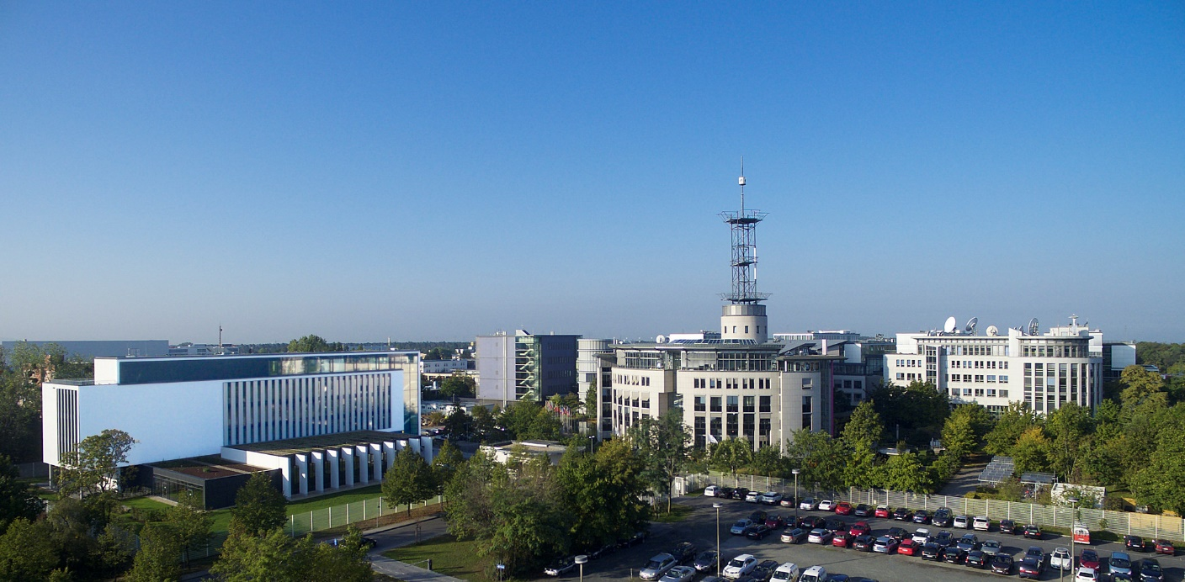
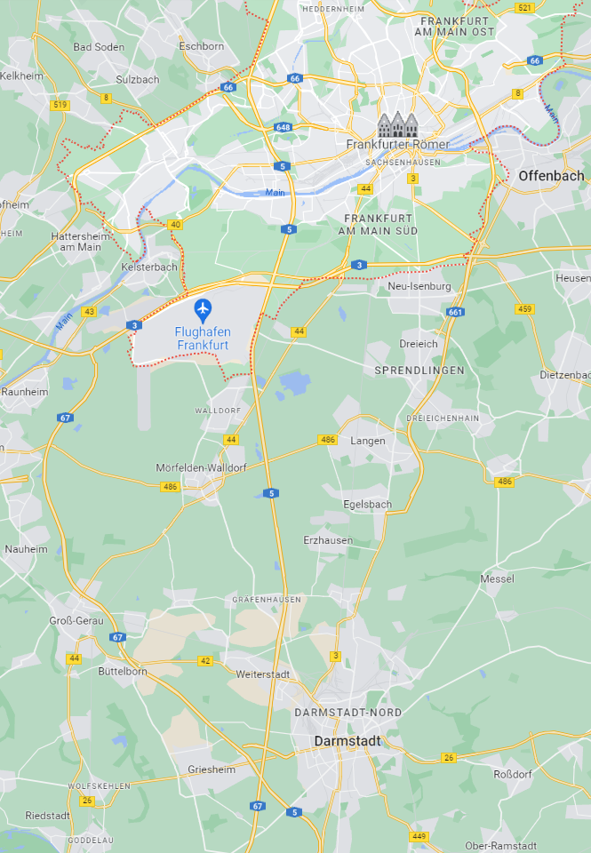
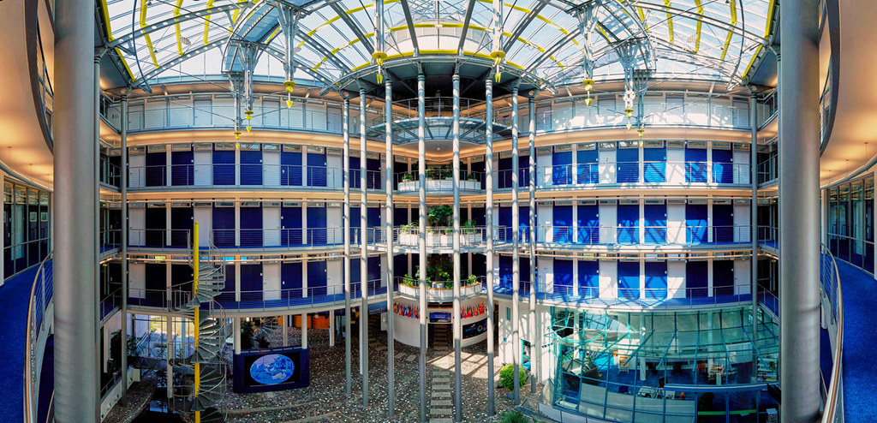
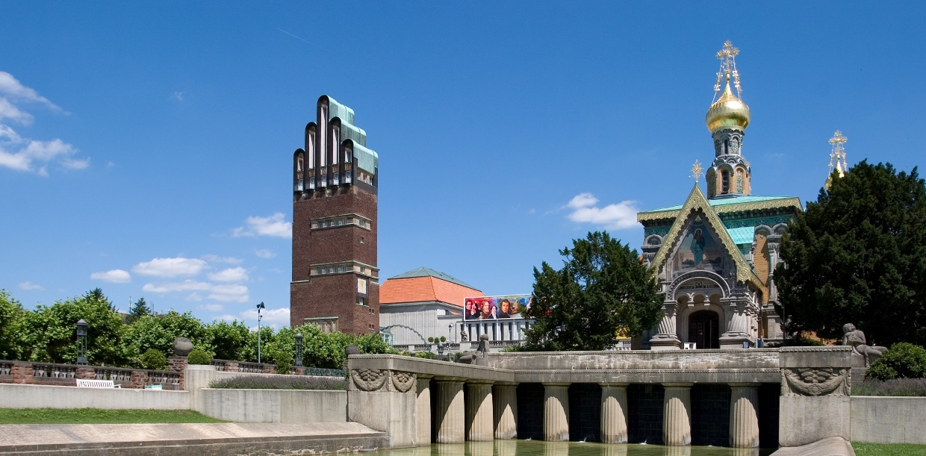
Venue
EUMETSAT headquarters, Darmstadt, Germany
https://www.darmstadt-tourismus.de/en/index.html
From darmstadt.de

Slide 9
5th CGMS/GSICS-CEOS/WGCV Lunar Calibration Workshop
Workshop format:
Similar to GSICS meeting: mix mini-conference / workshop type with discussions
A few boards for posters (depending on the agenda)
Outcome: list of recommendation / actions / decisions
Possibility to have remote participation (Teams)
Event preparation:
Web site will be prepared for registration (as in 2023)
Will include list of recommended accommodation
Invitation letters to prepare visa applications will be provided on request
No registration fees

Slide 10
Before the lunar calibration workshop…
Identify specific activities of particular interest for the community (to follow up on work presented in 2023 for instance…)
Release of LSICS version 1 ➔ participants could potentially prepare input data, process them with LSICS and present their results (including comparisons with other models / methods)
2nd Lunar models inter-comparison (led by T. Stone - USGS) ➔ exercise to be run before the LCWS; results to be presented at the workshop
Couple of dedicated web-meetings (using maybe GSICS monthly slots) to keep the Lunar Calibration Community informed on the progresses of those two activities + organisation of the workshop
Review of the recommendations / actions / decisions from the last LCWS

Slide 11
Thank you!
Questions are welcome.

