Slide 1
GSICS space weather subgroup meeting
Dec. 10, 2025

Slide 2
Today’s Agenda
GRWG SWx Sub-group Membership
Outcome of WMO Cg-Ext (2025)
Brief Report on GSICS SWx SG – COSPAR/PRBEM joint web meeting
Work plan of GSICS SWx sub-group
GSICS Website
GSICS Annual Meeting (Mar. 23-27, 2026) @ Ottawa
Action Items
Next sub-group meeting
AOB

Slide 3
GRWG SWx Sub-group Membership
Followings are the members of GRWG SWx Sub-group.
CMA Cong Huang
CU Brian Kress, Juan Rodriguez, Athanasios Boudouridis, Janet Machol
ESA Piers Jiggens, Hugh Evans, Juha-Pekka Luntama, Melanie Heil
EUMETSAT Andrew Monham
KMA Eunjeong Cha, Daehyeon Oh
NICT Tsutomu Nagatsuma (Chair)
NOAA Christian Naylor, Jim Spann, Dimitrios Vassiliadis
SPARC Ingmar Sandberg
WMO Jesse Andres
ISRO?

Slide 4
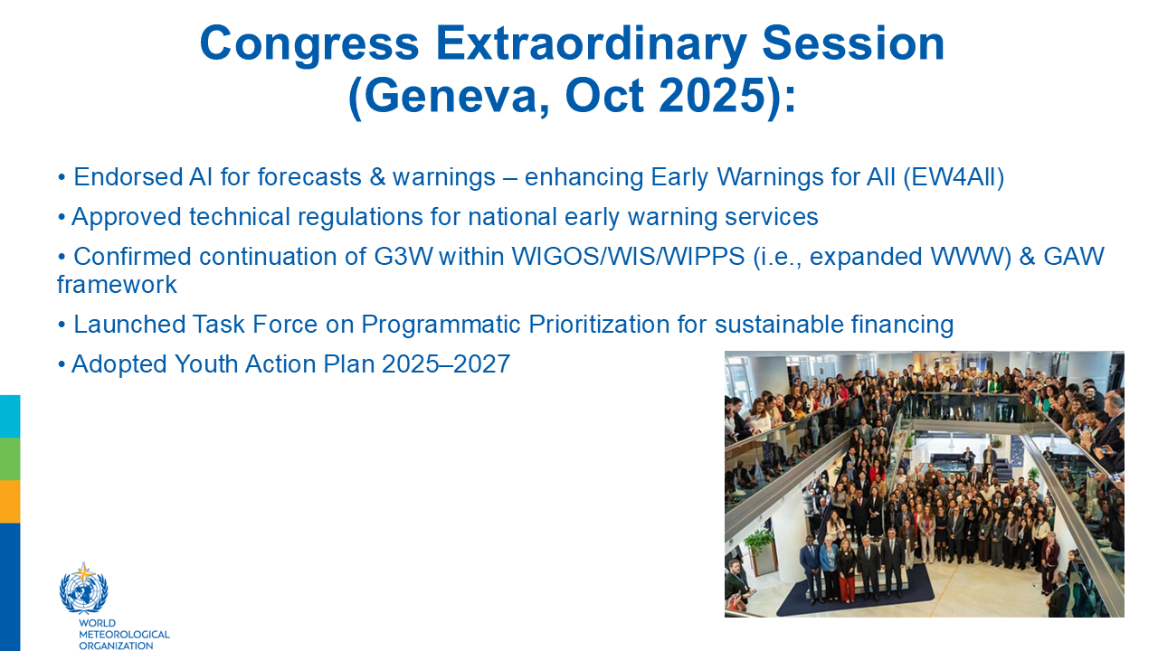
Outcome of WMO Cg-Ext (2025)

Slide 5
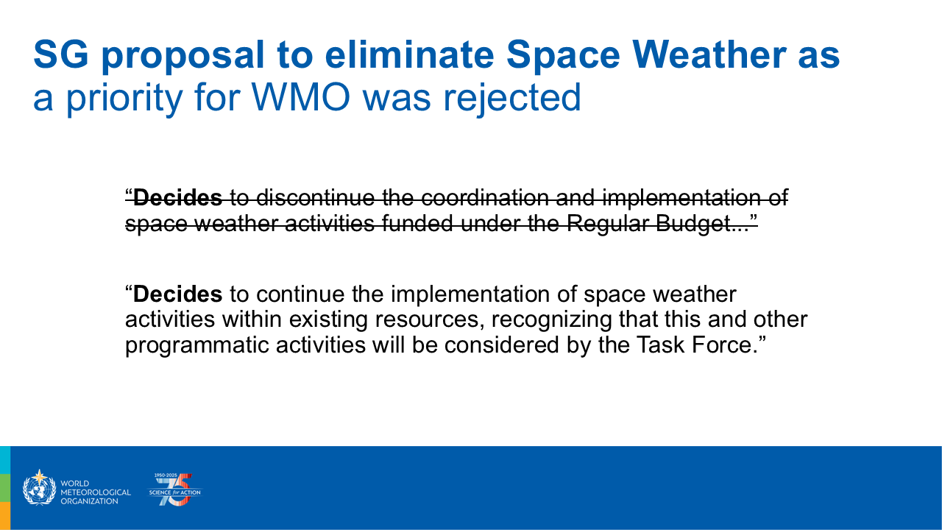
Outcome of WMO Cg-Ext (2025)

Slide 6
Work Plan of GSICS GRWG SWx Sub-group
Objective:
To provide coherent and consistent exchange of the data provided by radiation monitoring assets of the GSICS members.
Requirements:
Consistency of data level definitions.
Cross-calibration of datasets.
Standardisation and Specification of data, its meta data and necessary ancillary data.
Consistent data exchange service interfaces.
Tasks:
Map data level definitions of GSICS members
The definition of data set processing levels varies from instrument to instrument. To ensure consistency for data intercomparisons, it is necessary to provide a mapping between the different levels used by the members.

Slide 7
Work Plan of GSICS GRWG SWx Sub-group
Define procedure for dataset cross-calibration
A procedure for the cross-calibration of radiation instrument data is required. Existing procedures, such as the COSPAR/PRBEM procedure (https://prbem.github.io/documents/Standard_Data_Analysis.pdf) will be analysed. The unique aspects of the GSICS data sets on Geostationary orbits, i.e. a lack of conjunctions between spacecraft must be addressed in the process.
Identification of Ancillary Data
The datasets to be exchanged are generally time series data from in-situ radiation instrumentation, typically providing flux spectra for a set of energetic particles, e.g. protons and electrons. To effectively cross-calibrate the data additional ancillary information is required. This can include:
Geographic location
Magnetospheric location (B, L, L*, MLT, pitch angle), which introduces questions about consistency in the calculation method and geomagnetic field models.
Instrument response functions
Instrument calibration reports
Note: the COSPAR/PRBEM collaboration has developed a series of documents specifying the minimum level of ancillary data and meta-data required for a typical radiation belt data analysis, https://prbem.github.io/docs/.

Slide 8
Work Plan of GSICS GRWG SWx Sub-group
Define Data Exchange services
To effectively share data assets between the GSICS members, a coordinated approach for dissemination is necessary. Ideally, this includes the consistent implementation of services based upon the same interfaces to both to search and deliver data, but also provision of the ancillary data in a coherent and standardized manner.
Issues to be addressed include:
Latency in (near) real time dataset updates
Archival access to data
Local mirroring of data
Standardised provision of ancillary data
Documentation of changes in service (data outages, scheduled maintenance, recalibration/configuration of instruments, etc.)
Technology API (HAPI servers, CDF data file directories, etc.)

Slide 9
Assigning persons to lead individual tasks of work plan
To proceed our tasks based on the proposed work plan, following lead will be assigned. It is highly recommended that each lead will give some progress report and setting action items at the subgroup meeting.
Map data level definitions of GSICS members
Tsutomu Nagatsuma (NICT) and TBD
Status: Ask members to review data level definition and which level should be exchanged.
Define procedure for dataset cross-calibration
Lead: Ingmar Sandberg(SPARC) and Juan Rodriguez(CU)
Status: Reported by Juan Rodriguez (CU)
Identification of Ancillary Data
Lead: Jesse Andries(WMO) and Hugh Evans (ESA)
Status:
Define Data Exchange services
Lead: TBD (from ESA and NOAA)

Slide 10
Proposal of Data Level Mapping PDS4 Processing Levels for SWx Data Sets (Draft)
Level | Definition | CMA | ESA | JAXA | KMA | NOAA | NICT | WMO
Telemetry | An encoded byte system used to transfer data from one or more instruments to temporary storage where the raw instrument data will be extracted. |  |  |  |  | L0
Raw | Original data from an instrument. If compression, reformatting, packetization, or other translation has been applied to facilitate data transmission or storage, those processes will be reversed so that the archived data are in a PDS approved archive format. | L0 | L0 |  | L0 | L0b |  | L0
Partially processed | Data that have been processed beyond the raw level, but which have not yet reached calibrated status. |  | L1a | L1 |  | L1a |  | L1
Calibrated | Data converted to physical units, which makes values independent of the instrument. | L1 | L1b L2? | L2 | L1 | L1b L2(averages) | (L1) | L2
Derived | Results that have been distilled from one or more calibrated data products (for example, maps, gravity or magnetic fields, or ring particle size distributions). Supplementary data, such as calibration tables or tables of viewing geometry, used to interpret observational data should also be classified as ‘derived’ data if not easily matched to one of the other categories. | L2 | L2 L3 | L3 L4 | L2 | L2(moments) L3 |  | L3 L4
Feedback from NOAA

Slide 11
Proposal of Data Level Mapping (cont’d)
Please review proposed data level mapping (previous page).
Concept of Cross-Calibration for Particle Observation Instruments
When developing products or applications using numbers of in-situ observation data, it is necessary to use data corrected with cross-calibration information.
In-situ particle observations do not have an absolute reference.
Continuity and quality control of observation data obtained by each organization should be respected.
Based on the above,, “Calibrated (WMO-L2)” data with ancillary data should be exchanged for cross-calibration.
If sufficient calibration cannot be performed using internal heritage or resources, it is also possible to process data based on cross-calibrated data from “recommended instruments” and publish the resulting “Calibrated” data.

Slide 12
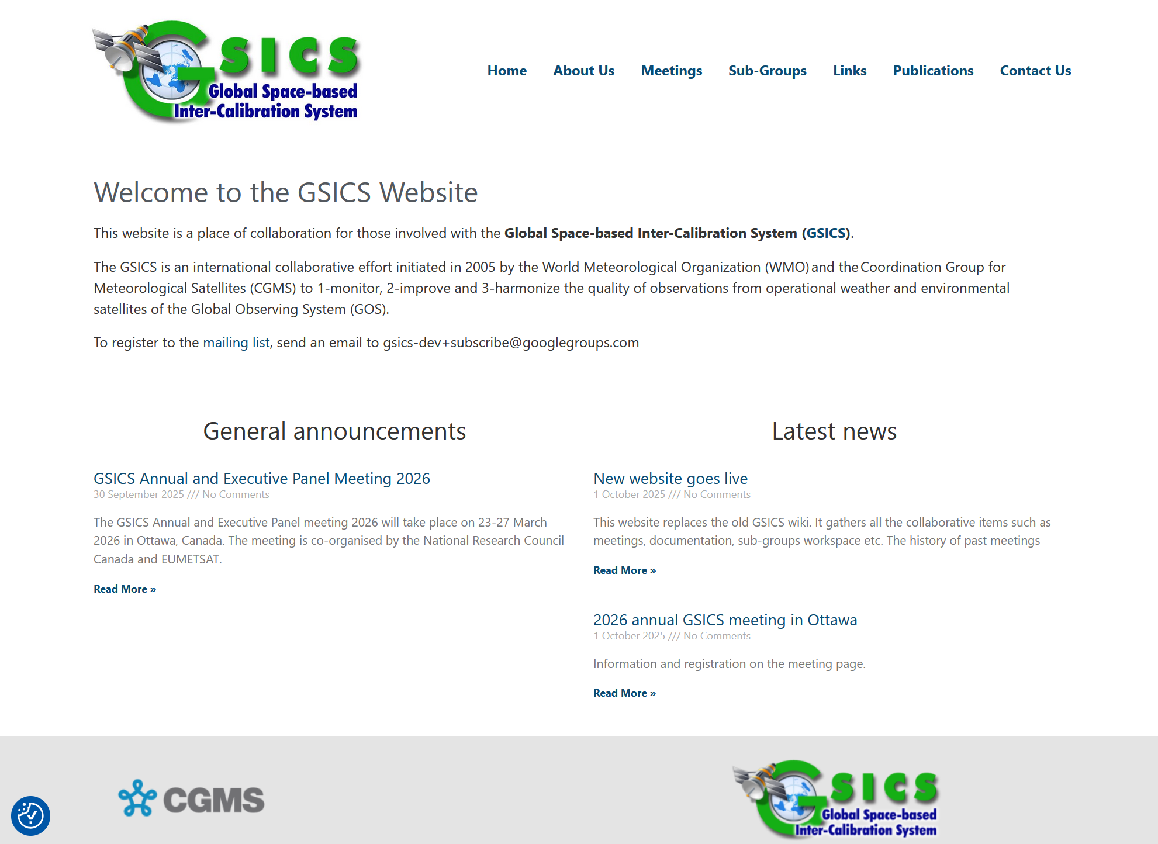
GSICS New Website (https://gsicsweb.eumetsat.int/)
Since GSICS Wiki page operated by UMD was broken, new GSICS Website have started since last October.

Slide 13

GSICS Annual Meeting (Mar. 23-27, 2026@Ottawa)
Please consider to join the meeting.
Detailed information will be announced soon.

Slide 14
Action Items (1/2)
To proceed the tasks in the work plan document, the following leads (different parts, different people) needs to be assigned.
Map data level definitions of GSICS members (1 person)
Define Data Exchange services (2 persons)
If you have interested in updating “Data Analysis Procedure Document”, please give your availability to https://doonera.onera.fr/studs.php?poll=doMbtv7CDP7txNRq
Please review proposed data level mapping (previous page), and review which level of data should be exchanged for cross-calibration.
Proposing application produced from multiple satellite data → I propose to forward this action item to TG on the improving Data Access in CGMS/SWCG (proposed to close from GSICS GRWG).
Open
Open

Slide 15
Action Items (2/2)
Ask for your cooperation with the action items related to the revision of the COSPAR/PRBEM Data Analysis Procedure document
New

Slide 16
Next Meeting proposal
Next meeting: Jan. 27 (Thu.), 2026 12:00UTC-

Slide 17
AOB?

