Slide 1
Addressing Angular and Spectral Differences through a Spectral-Information–Driven Approach within the GSICS Direct Inter-calibration Framework
Wan Wu¹, Rajendra Bhatt¹, Xu Liu¹, Qiguang Yang^{1,2}, Yolanda Shea¹, Adam Thurston^{1,3} , Aron Bartle^{1,3}, Luke Morrill¹,
Benjamin Scarino¹, and David Doelling¹
NASA Langley Research Center, Hampton, VA, USA
ADNET, Bethesda, MD, USA
Mechdyne, Inc. Marshalltown, IA, USA.

Slide 2
Introduction
Intercalibration between multiple sensors requires methodologies to achieve consistency between measurements in spatial-temporal, spectral, and angular dimensions.
  SNO, Ray-Matching
  Spectral Band Adjustment
Implementing angular correction allows for more relaxed angle-based collocation criteria, thereby enhancing the number of usable intercalibration samples and improving intercalibration accuracy in applications where residual angular mismatch is still significant.
The angular correction methodology has been developed and validated for Hyperspectral-broadband (multispectral) and multispectral-multispectral inter-calibration studies.

Slide 3
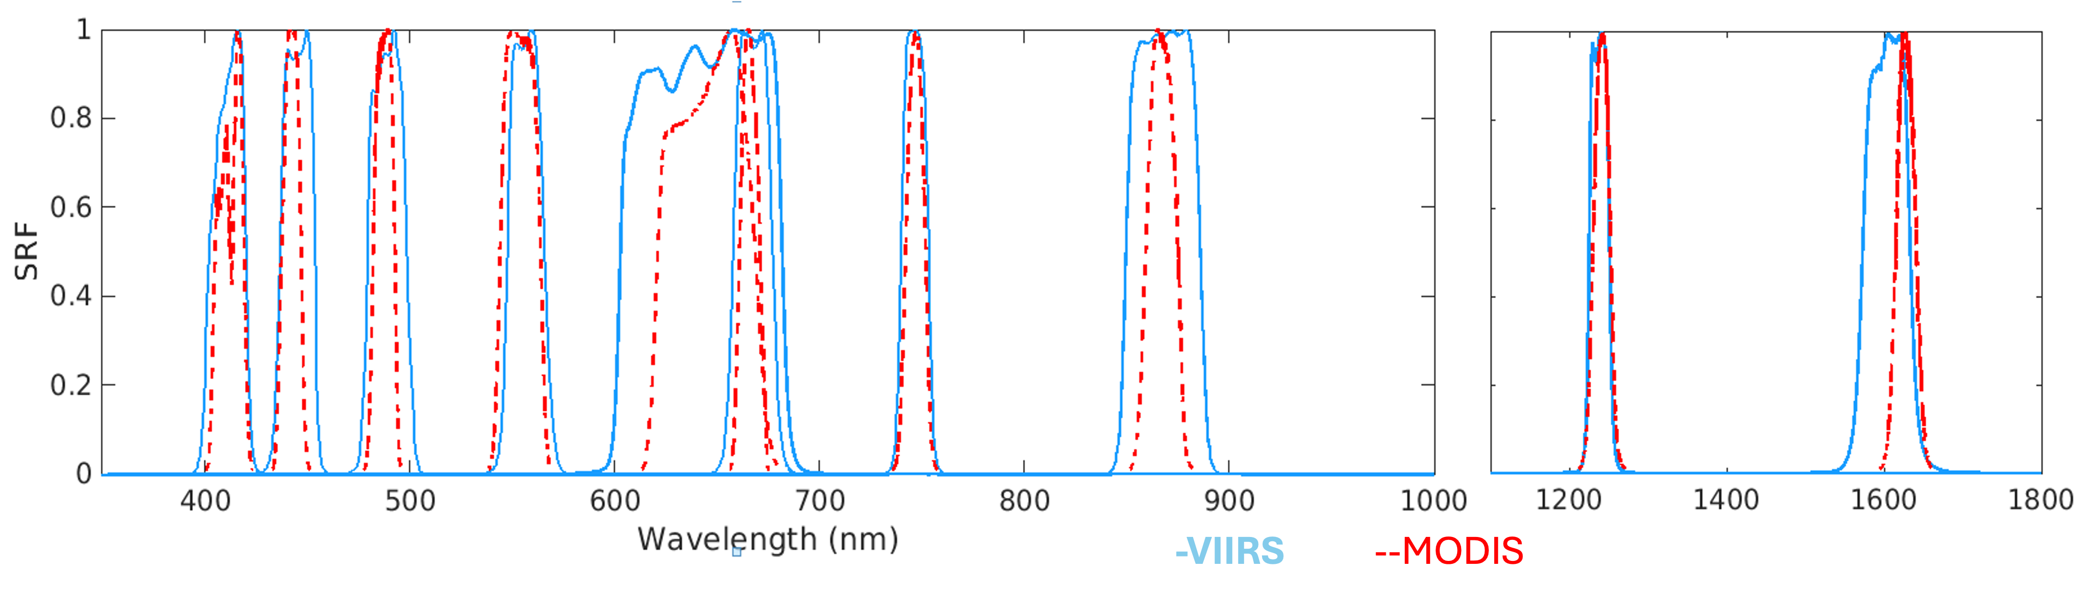
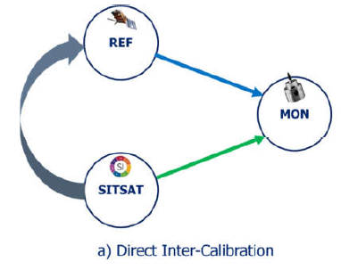
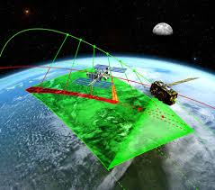
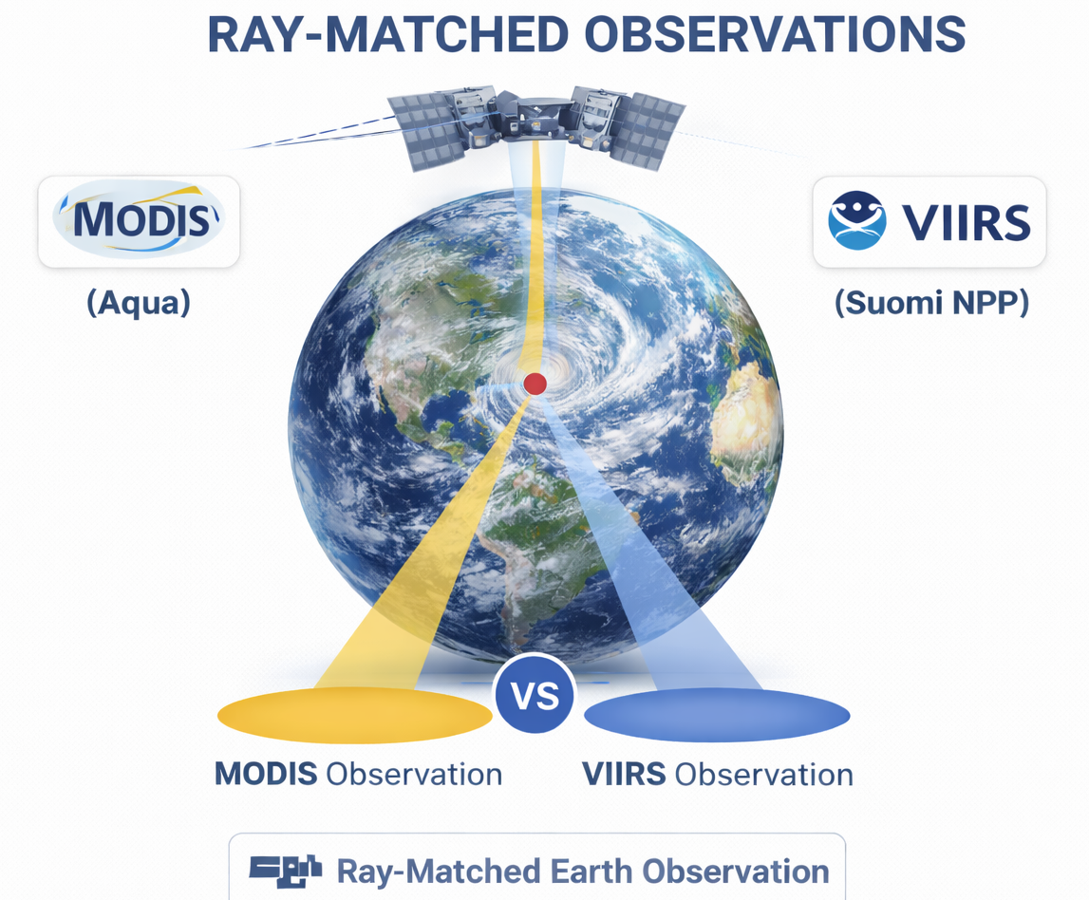
GSICS Direct Inter-calibration Strategy
From Hewison, Tim J., et al. 2020. "Extending the Global Space-Based Inter-Calibration System (GSICS) to Tie Satellite Radiances to an Absolute Scale" Remote Sensing 12, no. 11: 1782. https://doi.org/10.3390/rs12111782
• SITSAT = SI traceable SATellite referenced hyper-spectral sensor (CLARREO or TRUTHS)
• REF = is a well calibrated on orbit sensor that serves as the inter-calibration reference
• MON = is the monitored sensor that requires calibration

Slide 4
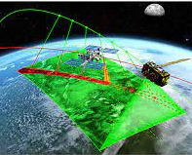
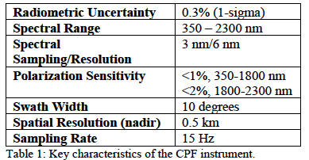
The Climate Absolute Radiance and Refractivity Observatory (CLARREO) Pathfinder Mission
The CPF mission will demonstrate the ability to provide a high accurate, SI-traceable reference on orbit to inter-calibrate other orbiting instruments.
A high accuracy reflected solar instrument will be sent to the ISS and take measurements starting in 2023.
The inter-calibration for the SW channel of CERES and RS bands of VIIRS will be first demonstrated.
Algorithms have been developed to facilitate CPF-VIIRS and CPF-CERES inter-calibration data analysis.
Y. Shea et al., "Clarreo Pathfinder: Mission Overview and Current Status," IGARSS 2020 - 2020 IEEE International Geoscience and Remote Sensing Symposium, 2020, pp. 3286-3289, doi: 10.1109/IGARSS39084.
2020.9323176.

Slide 5
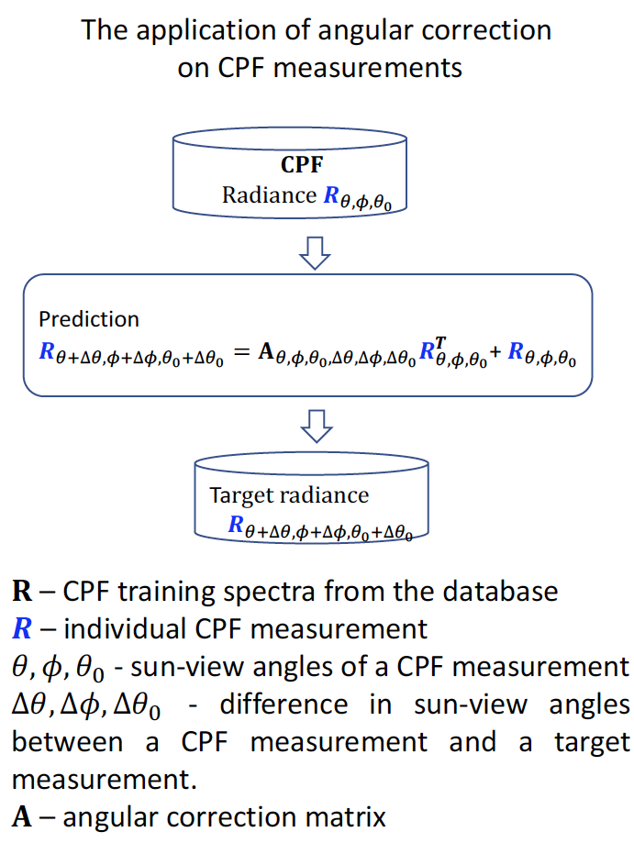
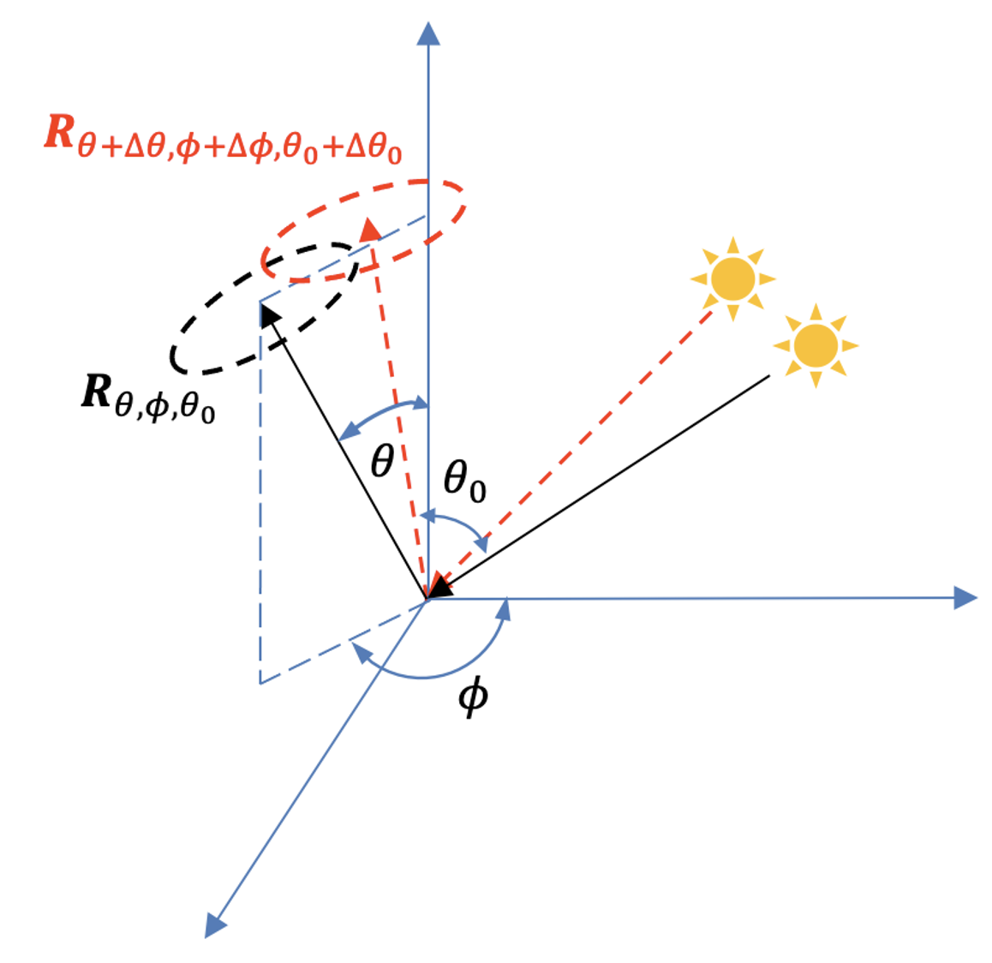
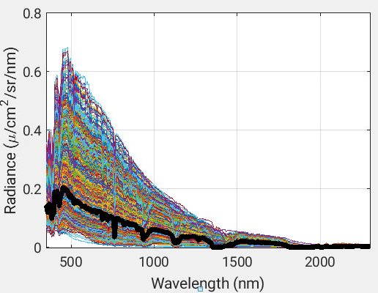
CPF Based Angular Correction Application
The method leverages the spectral correlations among the reflected solar radiances from the same surface target at two adjacent angles.
Spectral information can also be used for scene identification, providing constraint for the training of the angular correction relationship.

Slide 6
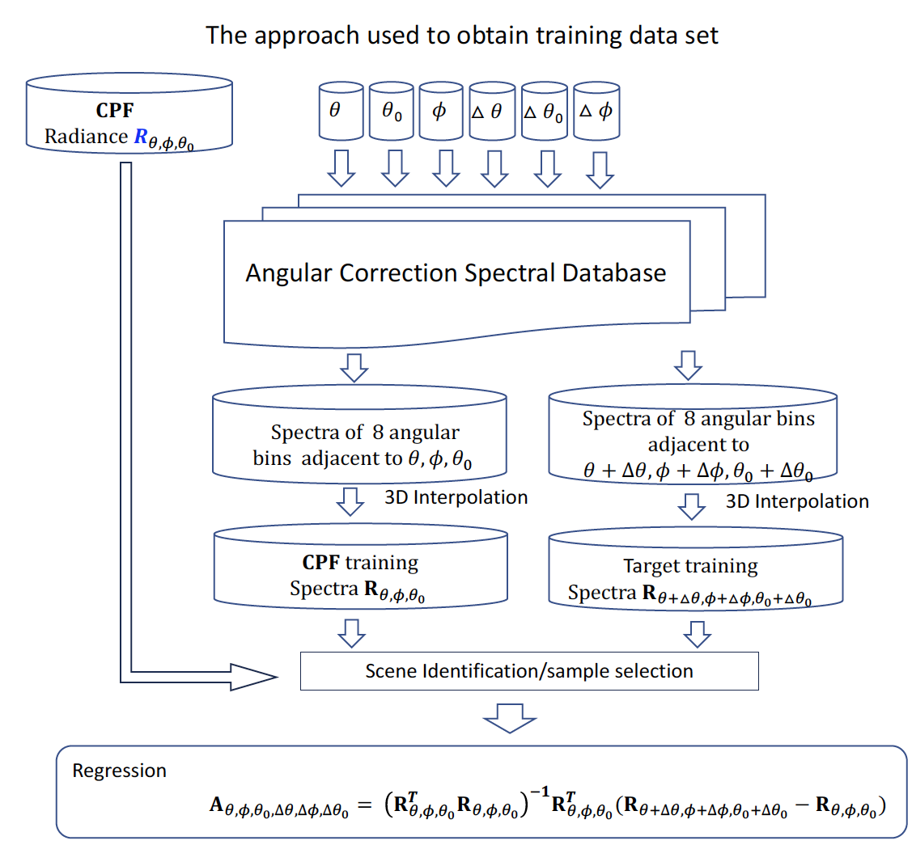
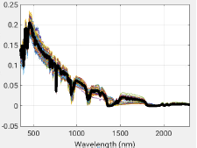
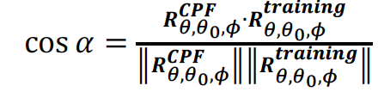
Training Scheme for Individual Inter-calibration samples

Slide 7

Example Angular Correction Study
Use spectral information to address the scene dependent relationship
Systematic angular mismatch error can be effectively reduced; The error residue after angular correction becomes more random-like noise.
$θ$=46.1º, $ϕ$=135.0 º,$θ$₀=40.0 º$,∆θ$=2.9 º, $∆ϕ$=5.0 º
Bias
Stdev.
Before AC
After AC

Slide 8
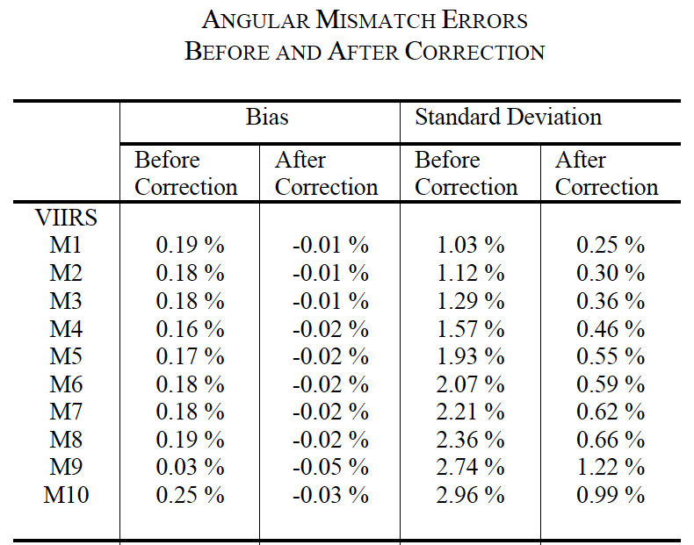
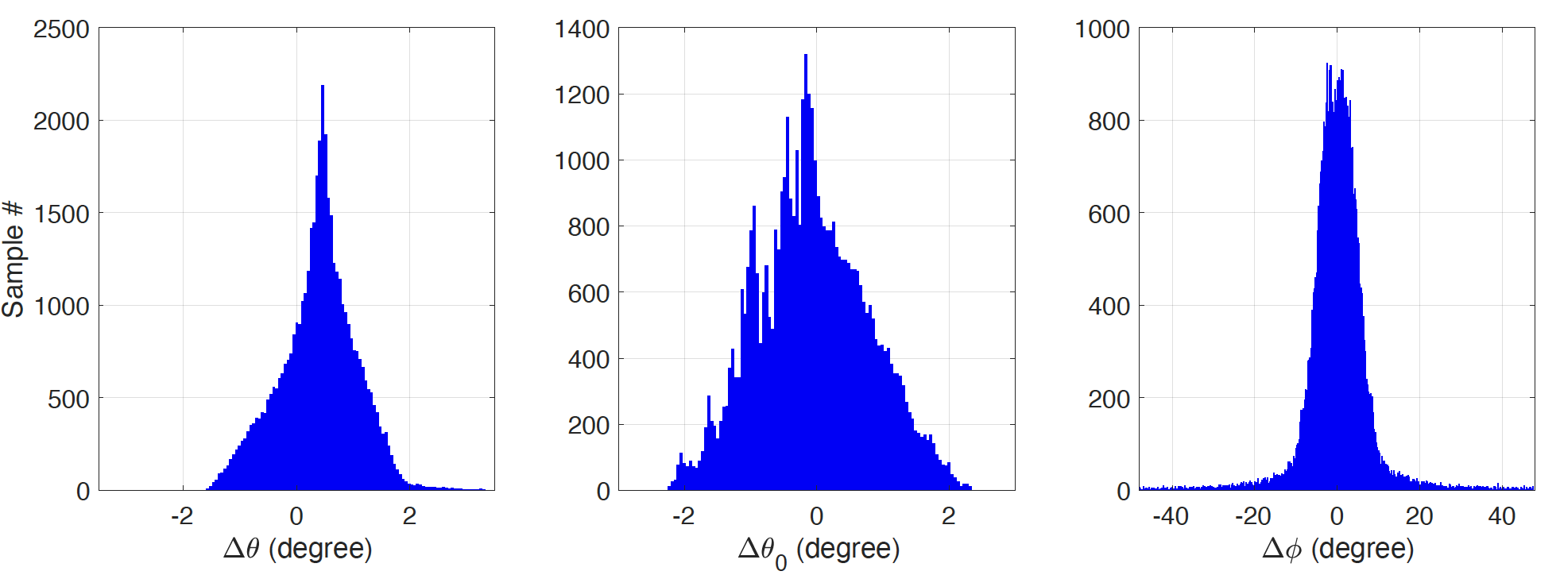
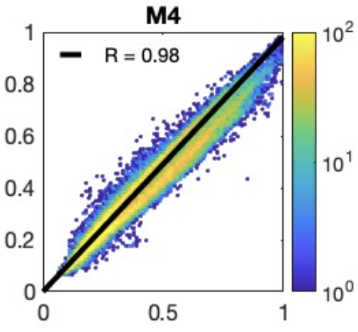
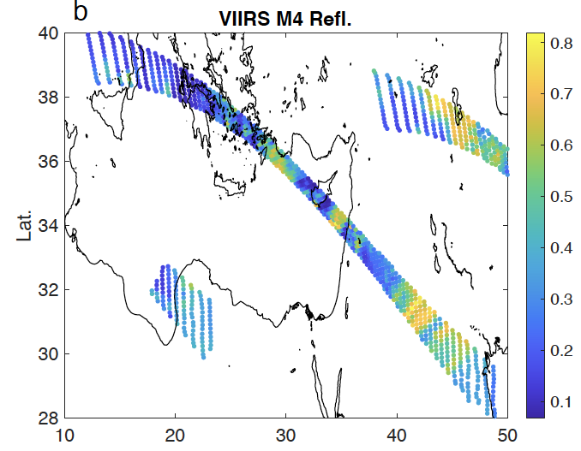
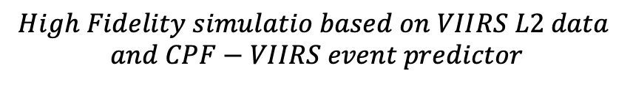

CPF-VIIRS Angular Correction based on the High-Fidelity Simulation Study
$∆θ$₀=-0.006 º$,∆θ$=0.38 º, $∆ϕ$=-0.21 º
$$High Fidelity simulatio based on VIIRS L2 data$$
$$and CPF−VIIRS event predictor$$

Slide 9
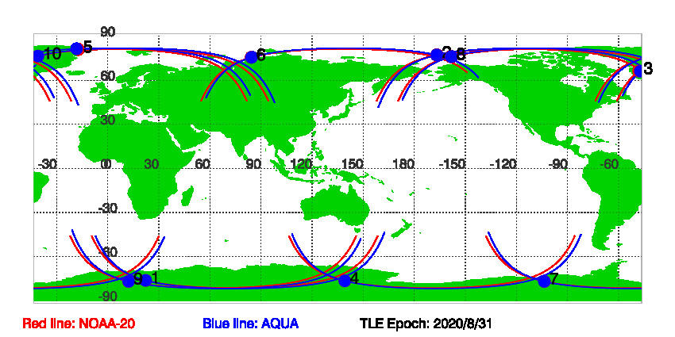
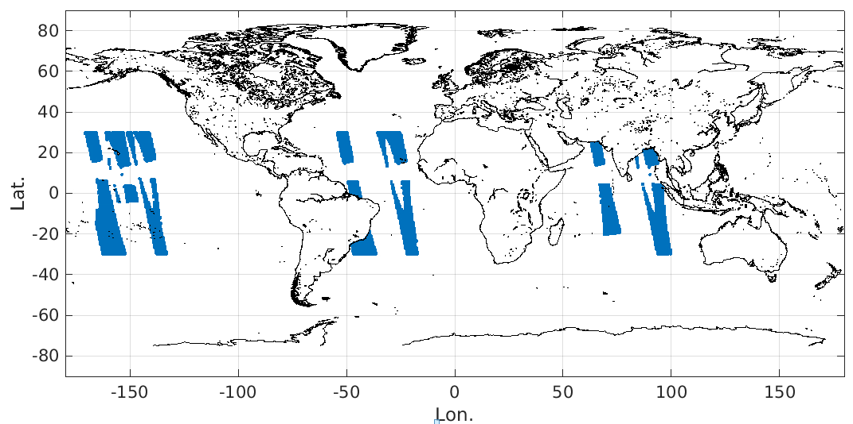
Extension for MODIS-VIIRS Inter-Cal Applications
Inter-calibration between MODIS and VIIRS measurements requires the use of collocated observations.
Using SNO observations means limited application scope since these SNOs mainly locate in the high-latitude region
Using non-SNO data requires the angular correction for sun-view geometry difference between MODIS and VIIRS measurements.
NOAA-20 and AQUA collocation events
SNOs only 10 collocated samples
(09/01/2020-09/12/2020)
NOAA-20 and AQUA collocation events
sun-view mismatch < 5 º over ocean only (09/01/2020-09/12/2020)
Courtesy of GSICS web-based SNO prediction tool

Slide 10
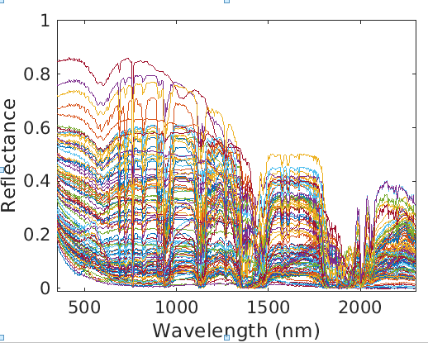
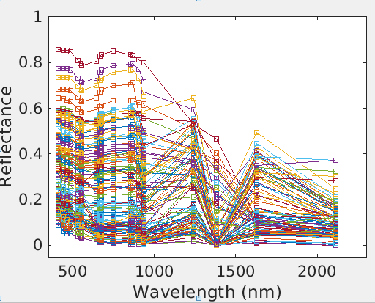
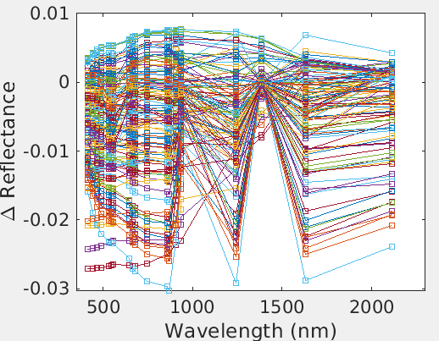
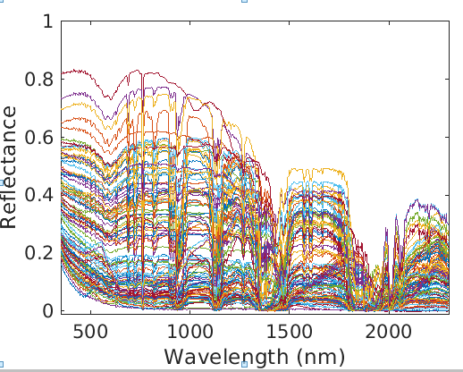
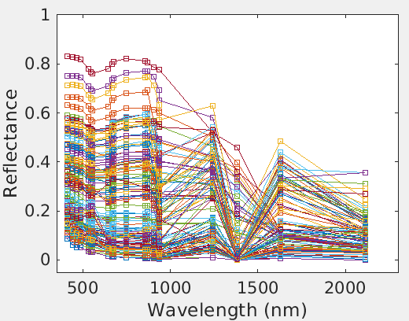




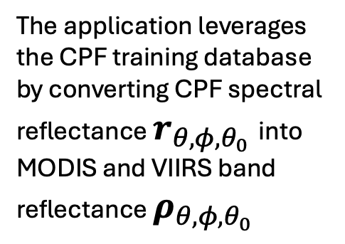

Explore the Spectral Correlation Relationship to Address the Angular Difference between MODIS and VIIRS
$ρ_{θ+∆θ, φ+∆φ,θ_{0}+∆θ_{0} }={A_{θ, φ,θ_{0},∆θ,∆φ,∆θ_{0}}∙ρ}_{θ, φ,θ_{0}}$ + $ρ_{θ, φ,θ_{0}}$
The application leverages the CPF training database by converting CPF spectral reflectance $r_{θ, φ,θ_{0}}$into MODIS and VIIRS band reflectance $ρ_{θ, φ,θ_{0}}$
$Δρ$ = $ρ_{θ+∆θ, φ+∆φ,θ_{0}+∆θ_{0} }−ρ_{θ, φ,θ_{0}}$
$$r_{θ, φ,θ_{0}}$$
$ρ_{θ, φ,θ_{0}}$
There are 20 MODIS measurement bands and 15 VIIRS bands within the CPF spectral range. MODIS and VIIRS keep a significant portion of the spectral information.
$$r_{θ+∆θ, φ+∆φ,θ_{0}+∆θ_{0} }$$
$$ρ_{θ+∆θ, φ+∆φ,θ_{0}+∆θ_{0} }$$

Slide 11
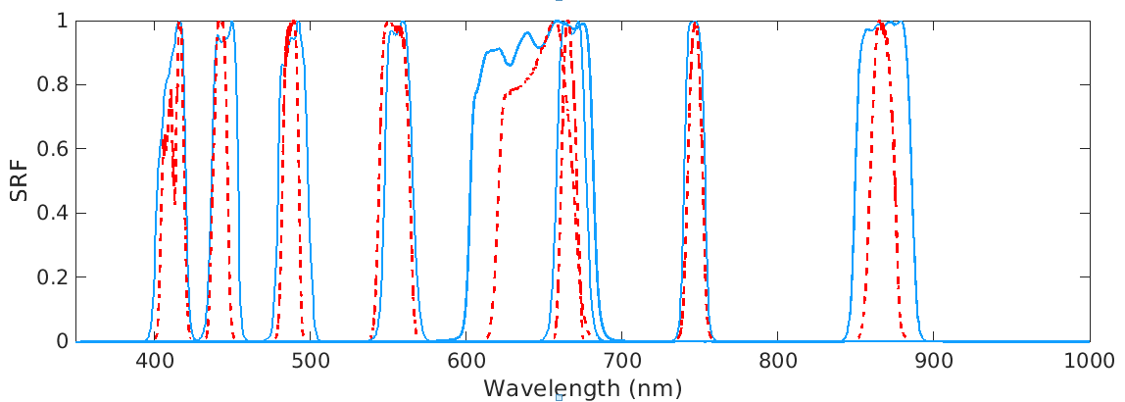
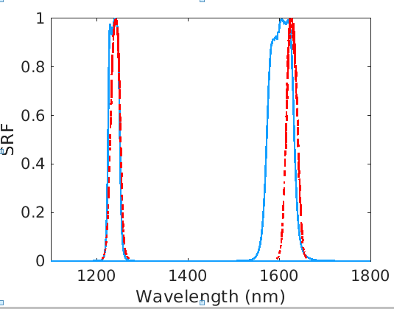
Account for both angular mismatch and instrument response difference
A significant part of the difference between collocated MODIS and VIIRS observations stems from variations in their spectral response functions (SRFs).
The angular correction algorithm need to capture the angular mismatch signal while accounting for SRF-related differences.
-VIIRS --MODIS

Slide 12
Angular Mismatch MODIS -VIIRS for All-sky Tropical Ocean Ray-Matching Cases

Slide 13
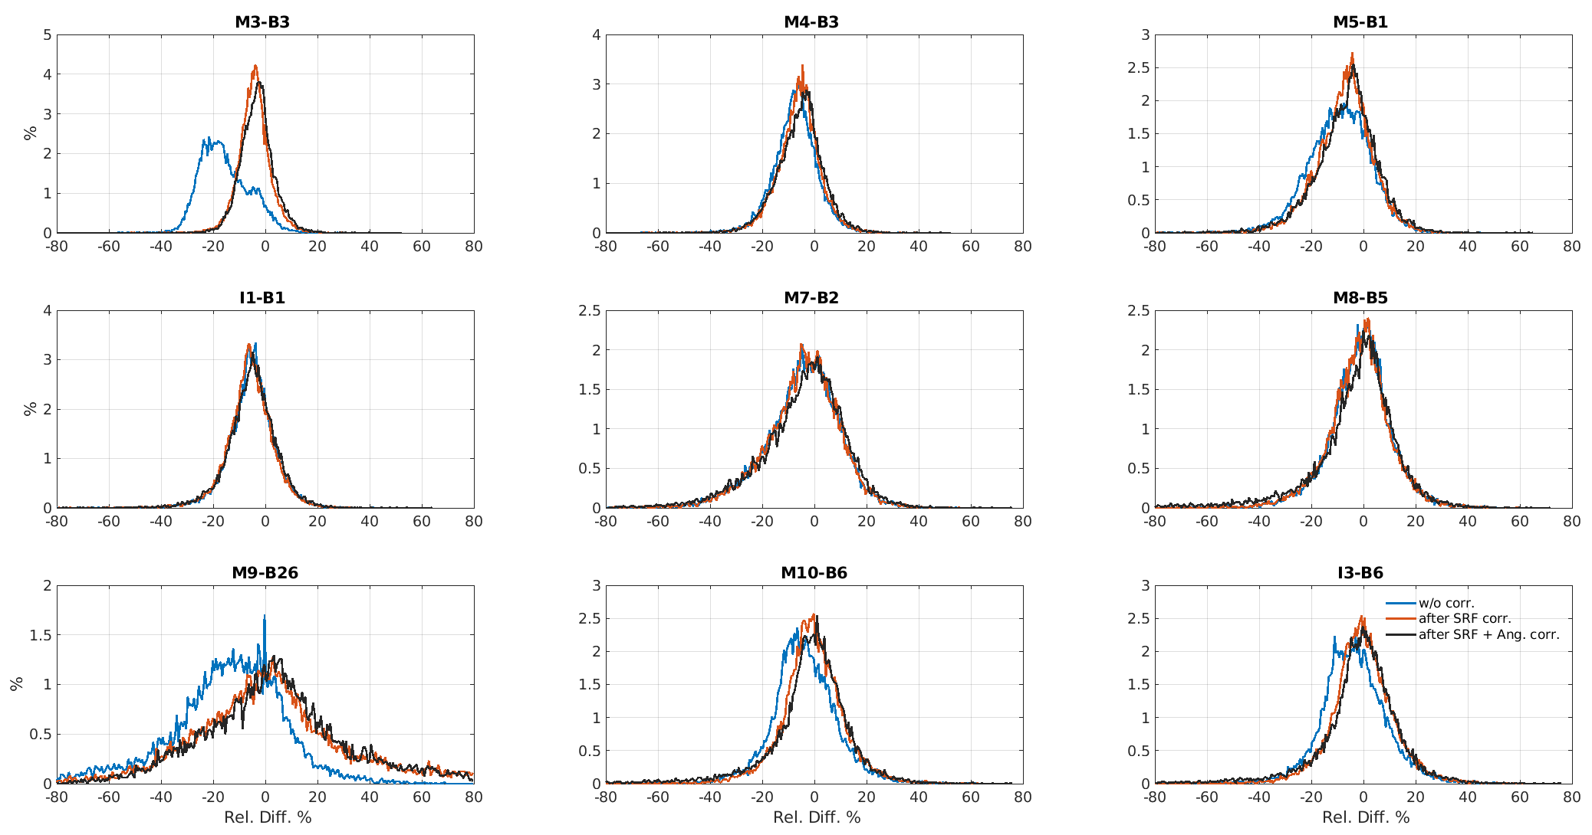
Resolve Angular Difference in addition to the Instrument Response Difference
Case study ( VIIRS-MODIS intercalibration events over tropical ocean April 2024)

Slide 14
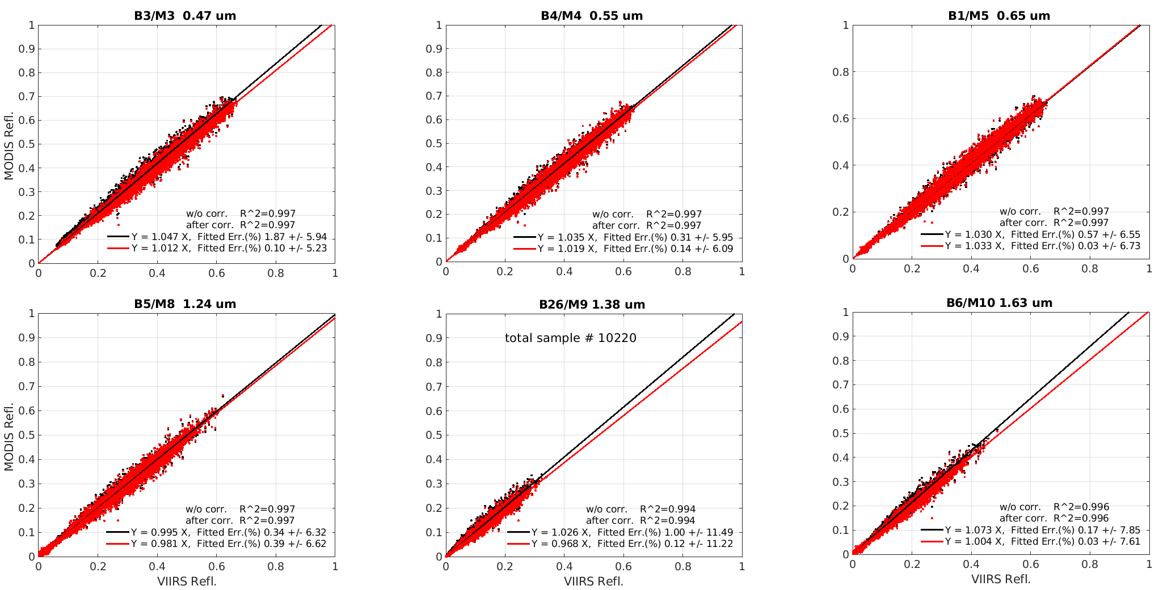
Linear Regression between the VIIRS Reflectance and the Ray-Matched MODIS Reflectance

Slide 15
Resolve Angular difference in addition to the Instrument Response Difference
Case study ( VIIRS-MODIS intercalibration events over tropical ocean April 2024)
 | Before Correction |  | After Correction for SRF diff. (SIAM) |  | After Correction for SRF and angular diff. (SIAM) |  | After Correction for SRF (SBAF)
 | k₀ | Δk | k₀ | Δk | k₀ | Δk | k₀ | Δk
B3/M3 (0.47 μm) | 1.047 | 4.38% | 1.024 | 0.36% | 1.012 | 0.24% | 1.027 | 0.97%
B4/M4 (0.55 μm) | 1.035 | 0.55% | 1.031 | 0.31% | 1.019 | 0.26% | 1.032 | 0.36%
B1/M5 (0.65 μm) | 1.030 | 0.85% | 1.047 | 0.19% | 1.033 | 0.05% | 1.053 | 0.56%
B1/I1 (0.65 μm) | 1.063 | 0.13% | 1.059 | 0.33% | 1.046 | 0.20% | 1.064 | 0.36%
B2/M7 (0.86 μm) | 1.001 | 1.02% | 1.000 | 1.05% | 0.984 | 0.92% | 1.009 | 1 .20%
B5/M8 (1.24 μm) | 0.995 | 0.48% | 0.999 | 0.45% | 0.981 | 0.56% | 0.979 | 0.61%
B26/M9 (1.38 μm) | 1.026 | 0.88% | 0.988 | 0.24% | 0.967 | 0.11% | 0.989 | 0.47%
B6/M10 (1.63 μm) | 1.073 | 0.24% | 1.027 | -0.24% | 1.004 | 0.04% | 1.014 | 1.34%
B6/I3 (1.63 μm) | 1.086 | -0.18% | 1.038 | -0.67% | 1.014 | -0.39% | 1.024 | 0.95%
k₀ - slope from the linear least squares regression with a forced zero intercept;
Δk = (k₀ -k)/k*100% - relative difference between the slopes obtained from the linear least square regression with and without a non-zero intercept.

Slide 16
Summary
The core part of the inter-calibration algorithms developed for the CPF mission is based on the utilization of the spectral correlation relationship to accurately predict the target measurements that can be mismatched in spectral and angular domain.
The methodology and the reference data base developed for the CPF mission can be extended for other inter-calibration applications, providing a effective mean to relax the collocation criterion and therefore greatly increase the scope of the usable measurement samples .
The application on MODIS-VIIRS inter-calibration has been demonstrated. The capability of using the is method to effectively resolve the small angular mismatch difference from the instrument response difference has been validated.

Slide 17
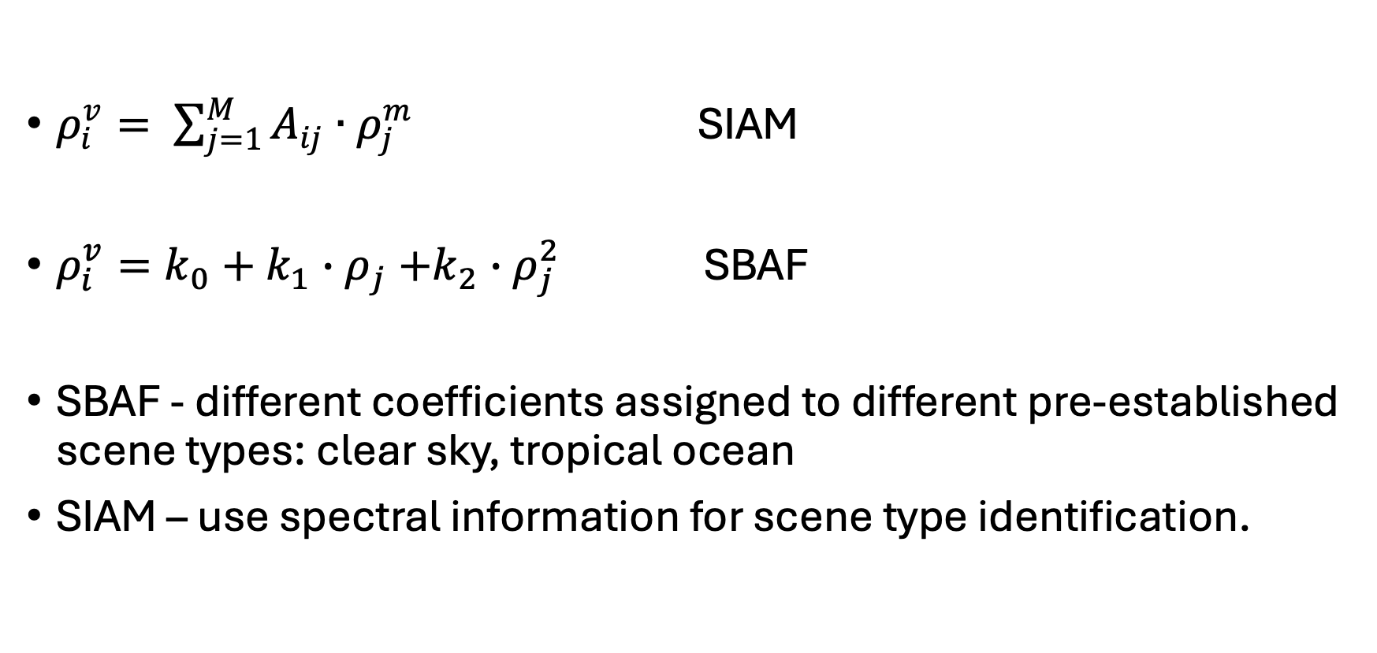
Difference between SBAF and SIAM approach
$ρ_{i}^{v}= \sum_{j=1}^{M}{A_{ij}∙ρ_{j}^{m}}$ SIAM
$ρ_{i}^{v}=k_{0}+k_{1}{∙ρ}_{j}+k_{2}∙ρ_{j}^{2}$ SBAF
SBAF - different coefficients assigned to different pre-established scene types: clear sky, tropical ocean
SIAM – use spectral information for scene type identification.

Slide 18
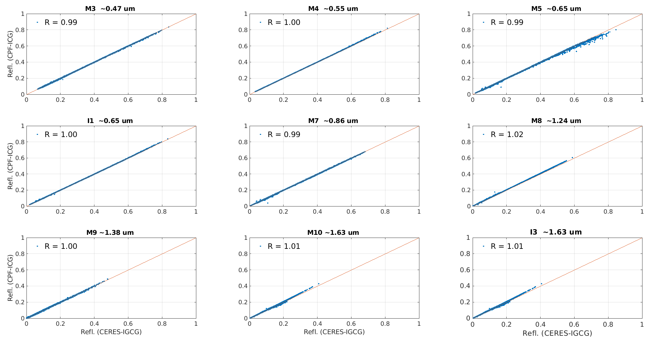
SBAF vs SIAM in correction for SRF difference between MODIS and VIIRS

