Slide 1
Libya-4 and DCC stability monitoring demonstration
GSICS VIS/NIR web meeting, Jan 8, 2026
David Doelling, Conor Haney, Prathana Khakurel, Arun Gopalan, Rajendra Bhatt

Slide 2
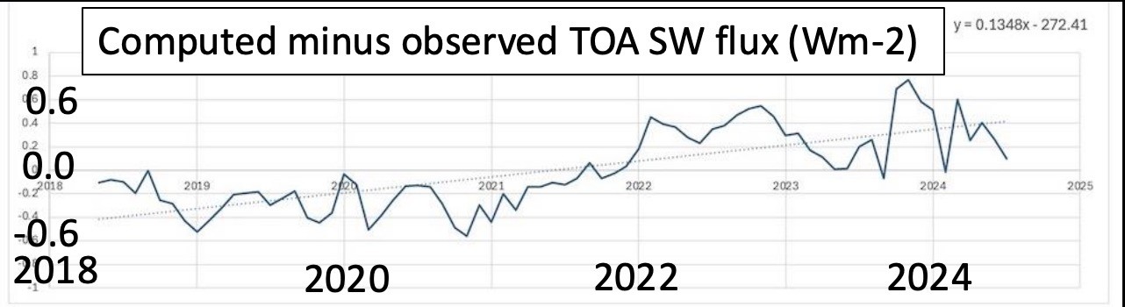
Introduction
The NASA CERES project provides TOA shortwave (SW) broadband fluxes for the climate modeling community
We monitor the stability of the CERES instrument calibration using radiative transfer (RT) SW fluxes based on cloud properties, atmosphere profile, aerosols, etc
We noticed there was a difference between the CERES and RT monthly global mean fluxes in the NOAA-20 record
The Cloud properties are based on NOAA20 VIIRS retrievals, where cloud optical depth is directly correlated with the 0.65µm channel calibration and stability in the RT fluxes
Use the Libya-4 and Deep Convective Cloud (DCC) methodology to monitor the 0.65µm MODIS and VIIRS stability

Slide 3
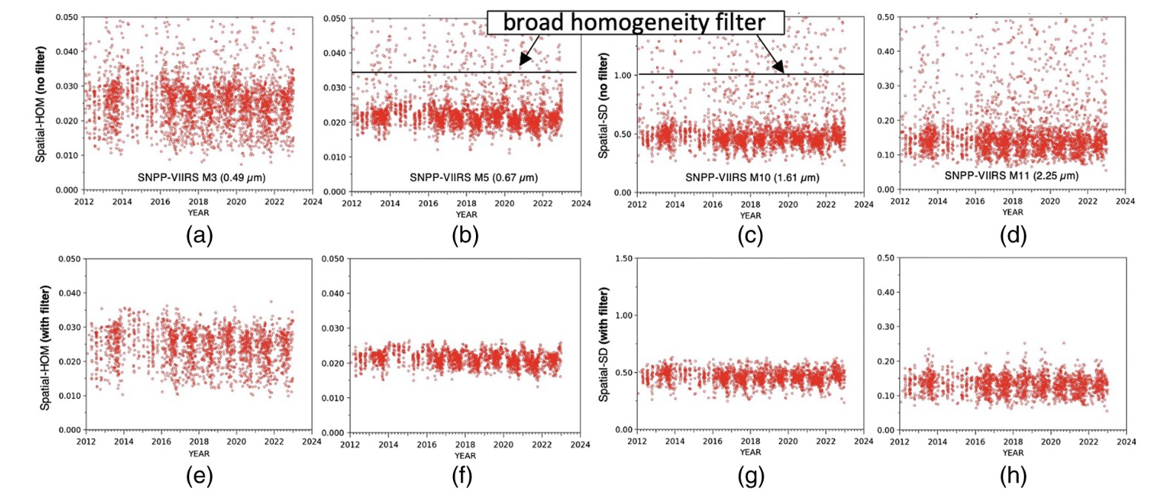
Libya-4 clear-sky filtering using spatial homogeneity
Libya-4 (ROI) centered at 28.6°N latitude and 23.4°E longitude for 1° by 1° region (100²km)
0.49µm
0.65 µm
1.61 µm
2.25µm
NPP-VIIRS daily obs over Libya-4
0.65µm Hom factor < 0.035
1.61µm Hom < 1 rad
11µm Hom < 2K
Hom factor = sigma/mean
Hom=sigma
2-sigma outlier filters using 0.5µm and 1.6µm

Slide 4
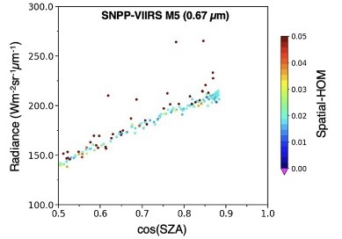
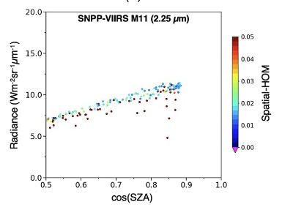
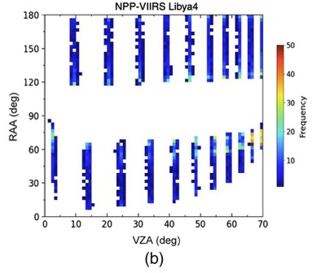
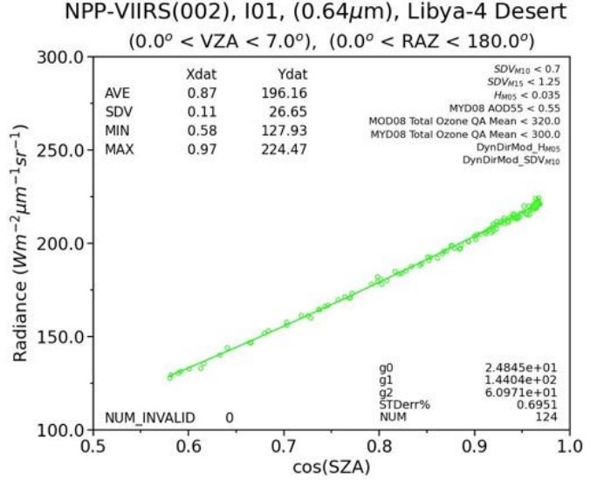
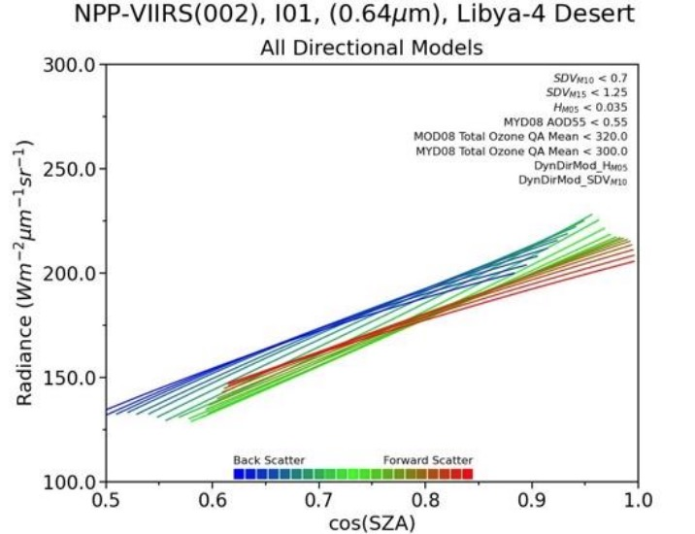
Directional Models to describe each repeat cycle day
Note clear-sky filtering removed the outliers

Slide 5
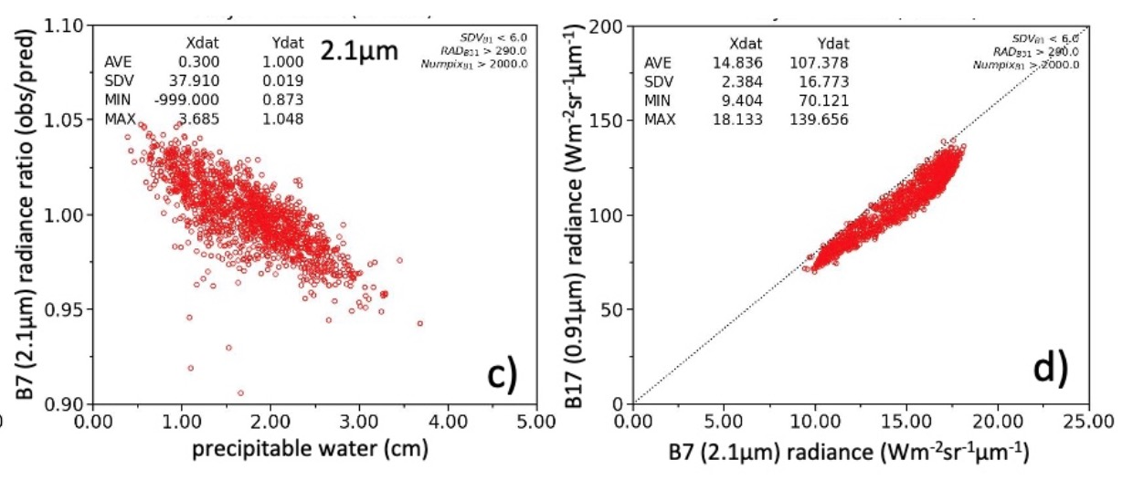
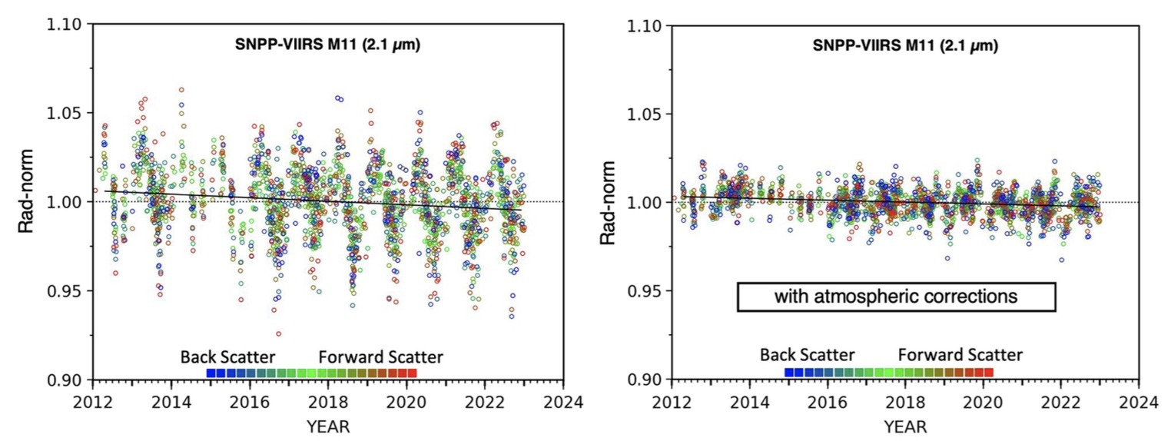

Add PW, Ozone, AOD to Directional Models
PW water based on the MODIS 0.91µm is used to retrieve PW
Note how well correlated the MODIS 2.1µm and 0.91µm radiances over Libya-4
PW water is linearly correlated with the relative radiance difference of the MODIS 2.1µm
For NPP-VIIRS 2.2µm channel

Slide 6
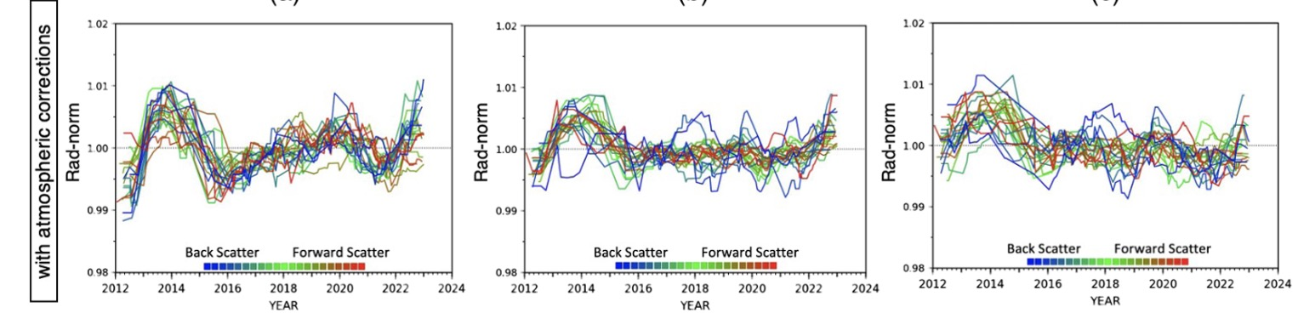

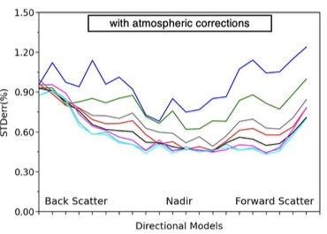
NPP-VIIRS stability by repeat cycle day
Apply a 365 running-day mean to the daily normalized radiances
Note the stability consistency between each of the 16-days
0.55µm
1.24µm
2.2µm
• Note how the 0.65µm, and 1.61 have the lowest timeline standard error
• The 0.49 µm and 0.55 µm have the highest standard errors
• Perfect atmospheric correction would bring all channels to the level of the 1.61µm channel
• Could improve the variability by excluding certain repeat cycle days

Slide 7

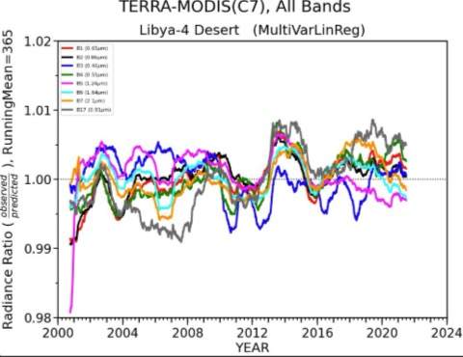
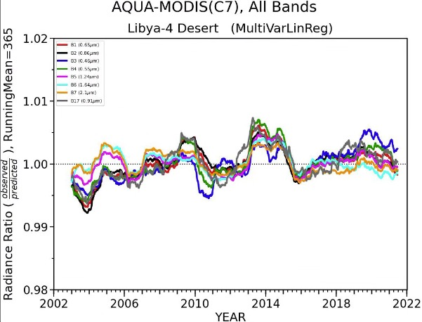
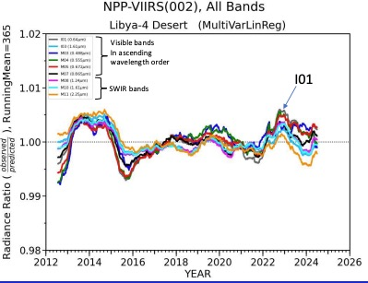
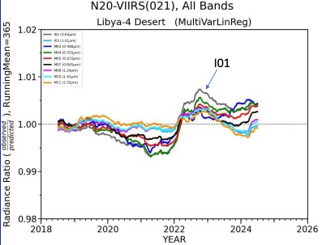
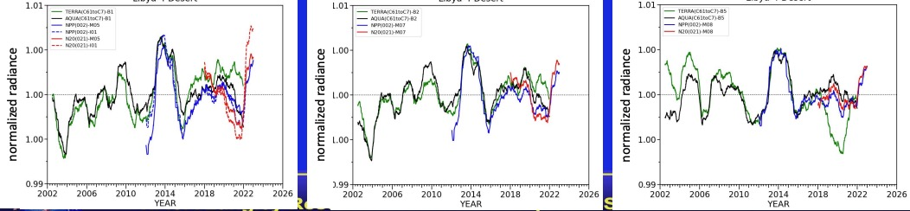
Libya-4 stability with MODIS and VIIRS
0.65
0.86
1.64
Terra
Aqua
NPP
N20

Slide 8
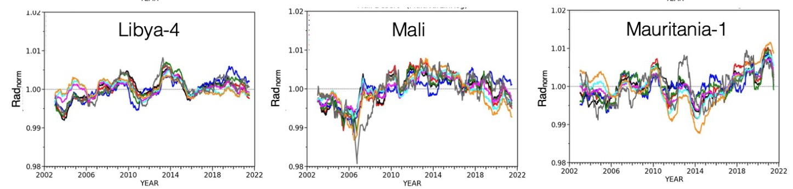
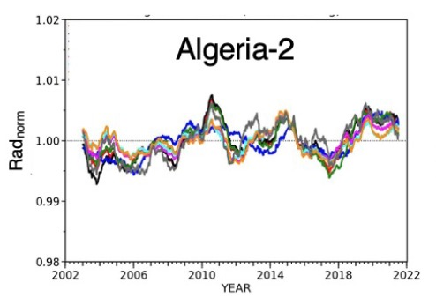
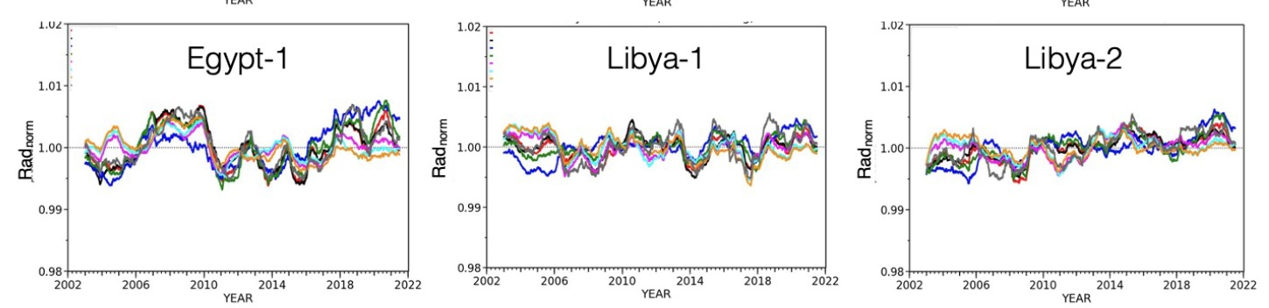
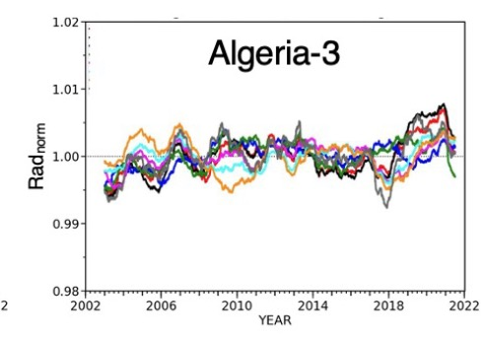
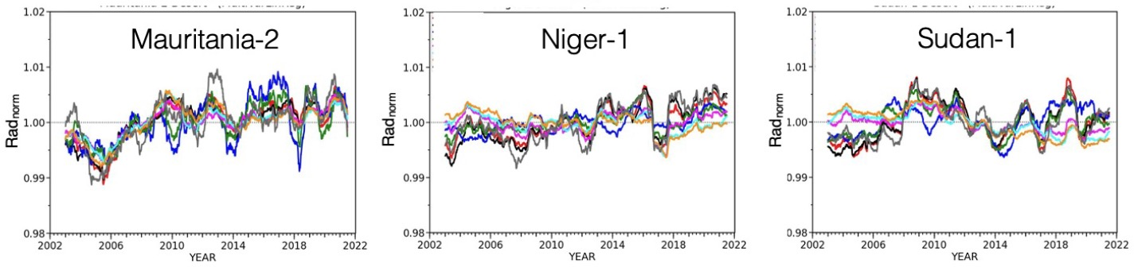
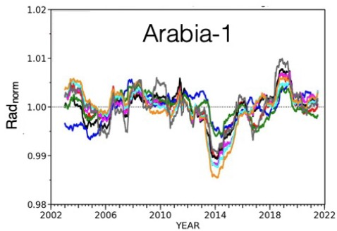
Stability over Saharan and Arabian deserts
±2%

Slide 9
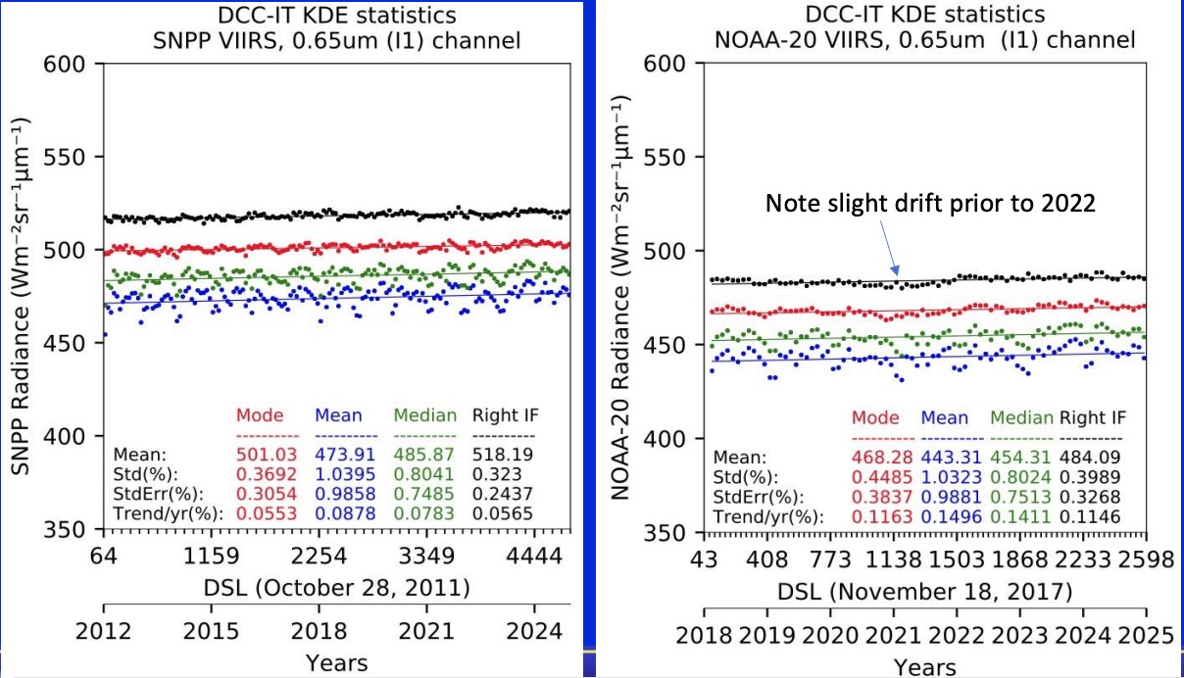
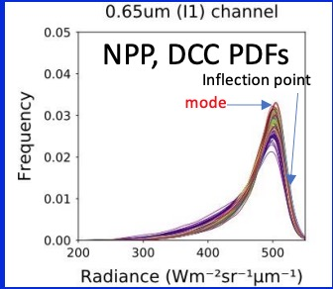
NPP and N20 VIIRS-I01 DCC PDF statistics

Slide 10
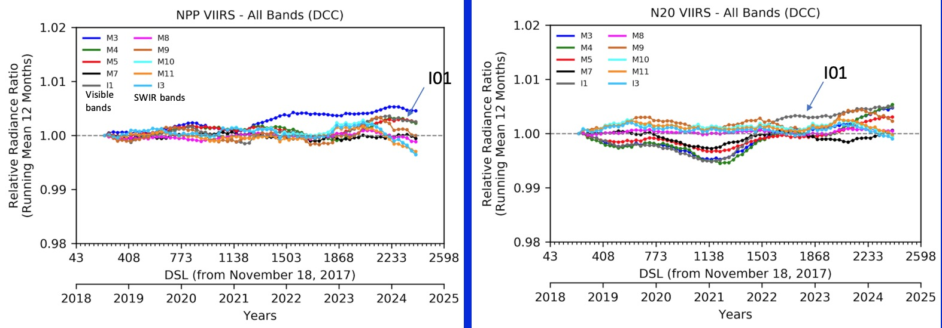
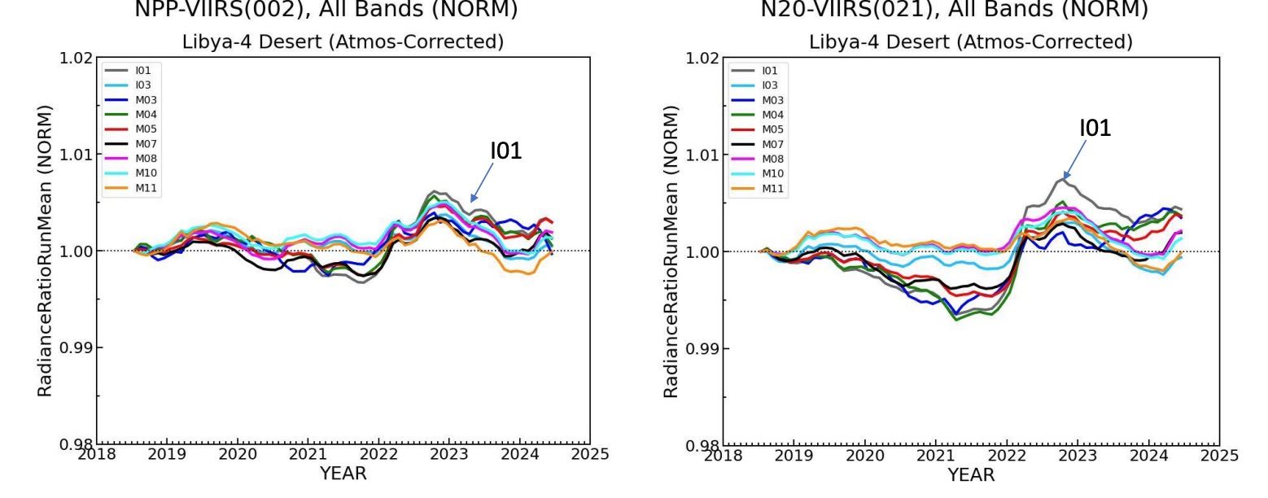
NPP and N20 VIIRS DCC and Libya-4 stability
NPP-VIIRS
N20-VIIRS
DCC stability
Libya-4 stability

Slide 11
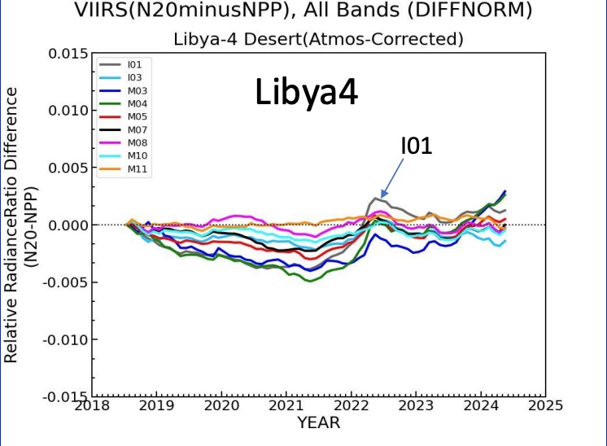
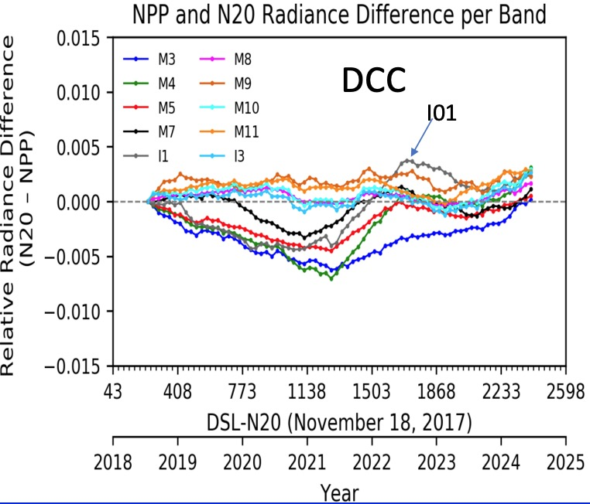
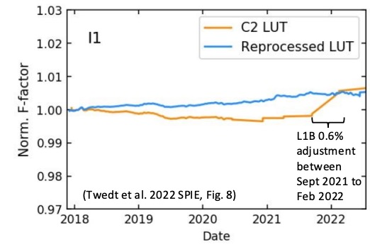
N20 minus NPP VIIRS relative radiance difference
• NASA VIIRS calibration group noticed a downward trend in the lunar radiance for I01, M3, M4, M5 calibration.
• A LUT adjustment was made to follow the lunar data resulting in a 0.6% increase between Sept 2021 and Feb 2022.
• The NASA N20 VIIRS was reprocessed as C2.1
By subtracting the N20 from NPP the impact of the invariant target can be mitigated
Note the similarity between the Libya-4 and DCC N20 minus NPP VIIRS relative radiance differences

Slide 12
Conclusion
The Libya-4 MODIS and VIIRS stability assessment was improved by
Use all clear-sky days in the 16-day repeat cycle
Clear-sky filtering based on spatial homogeneity factors of the 0.65µm 1.6µm and 11µm channels which are least impacted by the atmosphere
Model each day by cosine SZA, PW, ozone, and AOD
Perform a running 365 day mean
All days in the repeat cycle show the same temporal variability
All VIS/NIR/SWIR channels show nearly same temporal variability
Both MODIS and VIIRS channels show the same temporal variability
The DCC MODIS and VIIRS stability assessment was improved using the PDF inflection point for visible bands
The N20 and NPP DCC and Libya-4 2018-2024 stability is within ±0.5%
Due to the excellent L1b calibration from the NASA VIIRS calibration group
By subtracting N20 from NPP relative stability a small trend was detected in the N20-VIIRS I01 channel
The subtraction facilitated mitigating the natural variability of the target

