Slide 1
GSICS Data Working Group 24/02/2026
GDWG teleconf
Paolo Castracane (Starion for ESA)

Slide 2
ToC
Topics:
GSICS Annual Meeting. GDWG Breakout Session Agenda.
Roadmap to GSICS Products Dashboard
AOB

Slide 3
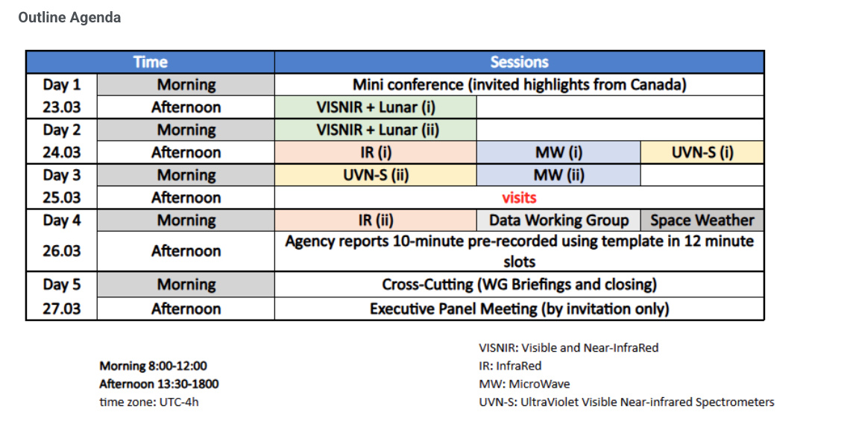
GSICS Annual Meeting Agenda

Slide 4
GDWG Breakout Session Proposed Agenda
Day 4: 26-Mar-26 Data Working Group
Session Chair:
Time | Topic | Presenter
08:00 | Welcome remarks from GDWG Chair | Paolo Castracane (in person)
08:20 | WMO report | Heikki Pohjola (in person)
08:40 | KMA GDWG Report | Hanbyul Lee (remotely - recorded file)
09:00 | JMA GDWG Report | Masaya Takahashi (in person)
09:20 | CMA GDWG Report | Lin Tian (TBC)
09:40 | IMD GDWG Report | Ashim Mitra (TBC)
10:00 | NOAA GDWG Report | Banghua Yan or Ninghai Sun NOAA (TBC)
10:20 | EUMETSAT GDWG Report | Simon Elliott (TBC)
10:40 | ESA GDWG Report | Paolo Castracane
11:00 | Topic Discussion | All

Slide 5
Roadmap to GSICS Product Dashboard
Draft document proposed: Roadmap_to_GSICS_Products_Dashboard_V0.0
Objectives of the document:
Transition GSICS from a correction-centric model to an assessment-, monitoring-, and harmonization-oriented framework.
Provide bias, stability, uncertainty, and traceability information with clear harmonization guidance.
Use GSICS reference instruments as continuous performance benchmarks for monitoring and anomaly detection.
Deliver products through interoperable, user-friendly services (Dashboards, APIs, toolkits) building on existing tools.
Support automated generation of the Status of the System (SoS) Report.
Ensure full alignment with GSICS governance and procedures

Slide 6
Roadmap to GSICS Product Dashboard
The GSICS Dashboard would provide the following core functionalities:
Integrated Performance Monitoring
Centralized visualization of inter-calibration results, bias time series, stability indicators, and trends.
Support for GEO–LEO and LEO–LEO comparisons using GSICS Reference Instruments as benchmarks.
Assessment and Diagnostics
Access to bias, uncertainty, and traceability information derived from existing GSICS products.
Interactive filtering by instrument, mission, channel, time period, and reference.
Status of the System (SoS) Support
Aggregation of key monitoring indicators to support the generation of GSICS and CGMS Status of the System reports.
Consistent views of system-level radiometric performance across missions.
Data and Product Access
Direct links to GSICS Correction Products, monitoring outputs, and reference documentation hosted on existing catalogues and servers.
Export of figures and summaries for reporting purposes.
Service-Oriented Access
Progressive integration of APIs to support automated access and downstream use by operators and partners.

Slide 7
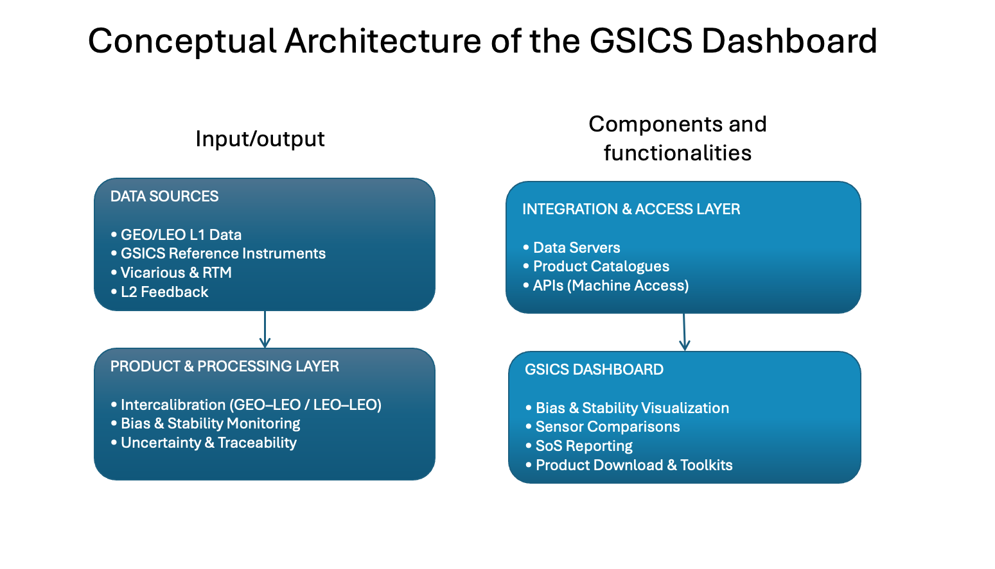
Roadmap to GSICS Product Dashboard

Slide 8
Roadmap to GSICS Product Dashboard
Please provide your ideas/inputs
Please edit the shared document directly
The Goal is to consolidate the document for the
GSICS Annual Meeting

Slide 9
AOB
@Banghua proposal to establish a centralised reference database of atmospheric profiles for official GSICS RTMs – input to document.
@Manik : ARTS (The Atmospheric Radiative Transfer Simulator) by University of Hamburg. A single model could simulate MW, IR and VIS TOA radiance/refelctance and many GSICS members were involved in its development. It has a python interface so easy to install.
https://atmtools.github.io/arts-docs-2.6/features.html
@Masaya status of ToR, discussion

