Slide 1
Improving the Deep Convective Cloud (DCC) BRDF Model Using AI/ML for VIIRS Reflective Solar Bands
Wenhui Wang
CISESS/ESSIC, University of Maryland – College Park
NOAA STAR VIIRS SDR Team
The GSICS VIS/NIR Monthly Web Meeting
February 12, 2026
Originally presented at The 106th AMS Annual Meeting (January 27, 2026 Houston, TX)

Slide 2
Outline
Background
VIIRS Data Used
Data used for training and validation
Characteristics of VIIRS Deep Convective Cloud (DCC) observations
Methodology
AI/ML PyTorch Multilayer Perceptron (MLP)-based method
Angular Bin-based method
Method for Validation
DCC BRDF Models and Validation Results
Shortwave infrared (SWIR) bands
Visible and near infrared (VisNIR) bands
Summary

Slide 3
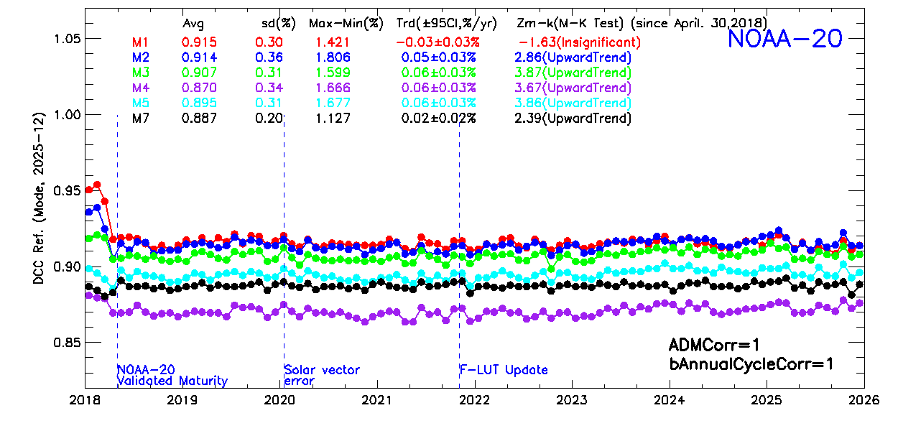
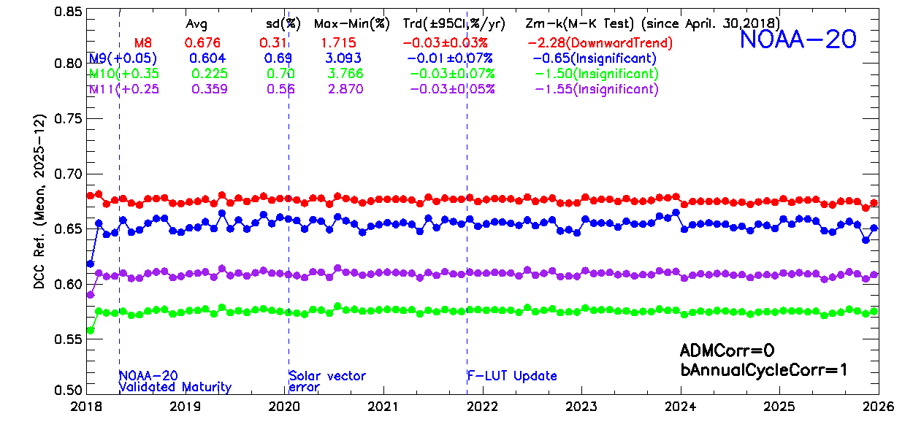
Background
The DCC technique has been widely used for the on-orbit calibration stability monitoring of satellite radiometers in the solar reflective spectrum.
Statistics-based, using large # of DCC observations over the tropics.
The DCC methods for NOAA VIIRS solar band calibration performance monitoring.
VisNIRs: Hu2004 Angular Distribution Model (ADM) + residual annual cycle for Bidirectional Reflectance Distribution Function (BRDF) correction; uncertainties of trends are small.
SWIRs: annual cycle correction only; uncertainties of trends are ~2 times as large as that of VisNIRs. Hu2004 ADM does not work.
Larger amount of data is processed daily, requiring considerable computing resources.
The purpose of this study is to investigate the feasibility of using AI/ML-based technique to improve the DCC method for VIIRS, especially for SWIR bands.
VisNIR
95%CI: 0.02-0.03%/year
SWIR
95%CI: 0.03-0.07%/year

Slide 4
VIIRS Data Used
NOAA operational NOAA-20 VIIRS M-Band RSB (M1-M11) DCC observations were used for BRDF model training/development.
On-orbit degradations very small based on existing studies: lunar, PICS, and DCC.
The small degradations have been well accounted for by the on-orbit calibration updates
Trends less than 0.06%/year.
2022-2024 (3 years), with complete DCC pixels extracted at all VZAs (0-70°), were used for model training/development.
VIIRS DCC Data for validation purposes:
NOAA-20: 2018-2021 and 2025
NOAA-21: 2023-2025

Slide 5
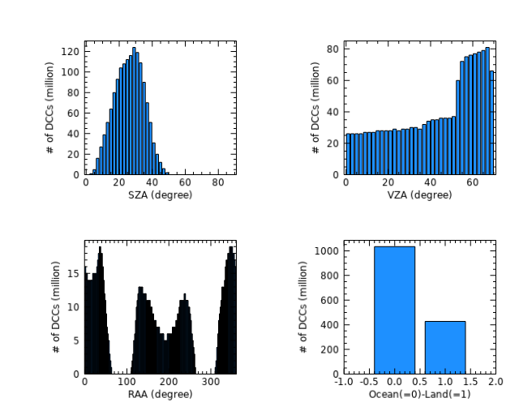
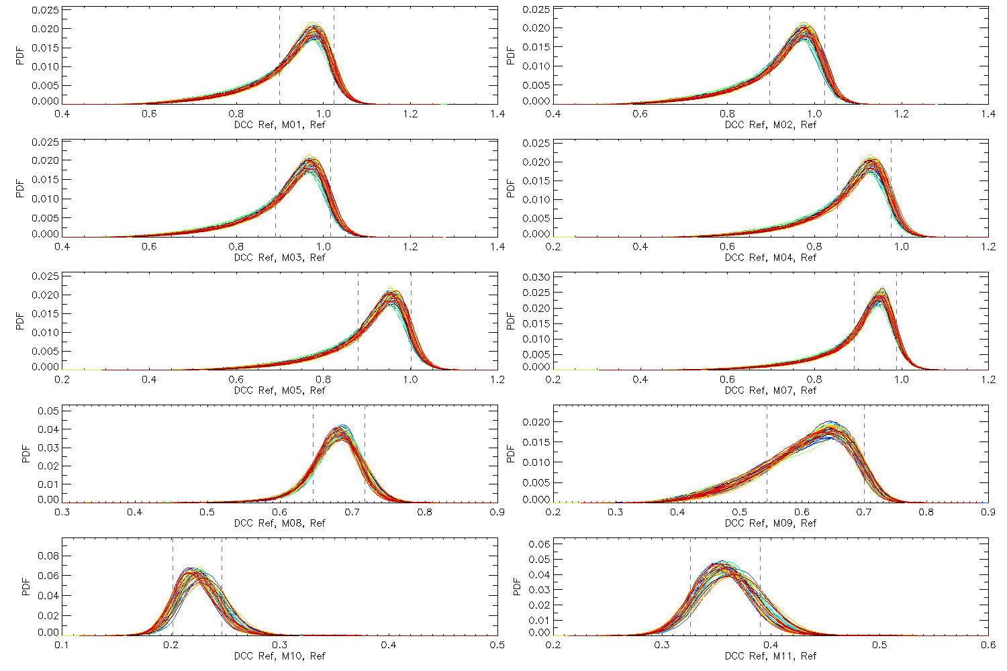
Characteristics of VIIRS DCC Observations
Potential challenges of using VIIRS data to model DCC BRDF effects
Not uniformly distributed at different solar/view geometries, with large solar zenith angle (SZA) and relative azimuth angle (RAA) gaps due to VIIRS’s orbital configuration.
DCCs exhibit a range instead of a constant reflectance at a given solar/view geometry, and usually negative skewed.
False DCC detections exist due to the use of simple 205 K M15 BT threshold.
NOAA-20 (2022-2024)

Slide 6
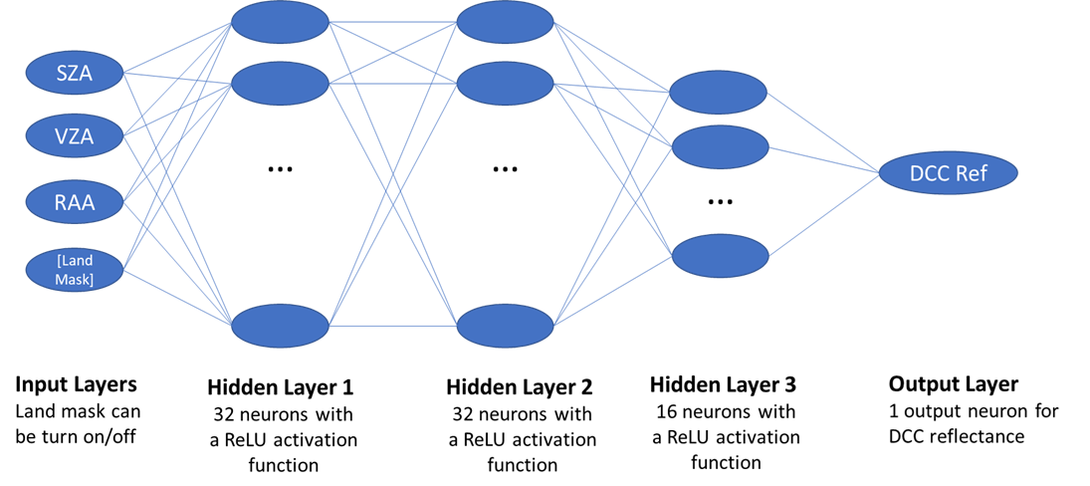
Methodology (2-1)
The AI/ML-based Method
PyTorch Multilayer Perceptron (MLP) artificial neural network was used.
Different subsets of data were experimented to train the BRDF models:
Train one model for each band using all training data, fitting month by month continuously due to RAM constrains.
Train one model for each band using every n^{th} DCC pixels
Train monthly (12) models for each band
Use data at all view zenith angles (VZA) versus VZA ≤ 35° only
w/wo the Land Mask Layer
Different configuration of hidden layers and number of neurons were also explored.
Computing resources used:
~20 CPUs
~20 GB of RAM.
Required 2-3 hours/band/subset
LandMask

Slide 7
Methodology (2-2)
Angular Bin-based Method
Similar to Bhatt et al., 2017.
Different subsets of data were also experimented to develop Angular Bin-based DCC BRDF models, similar to the AI/ML-based method.
Angular Bin – based BRDF models were compared to the AI/ML-based models.
Validation Method
Monthly DCC statistics (mode or mean) are usually used for calibration stability monitoring → dividing data (e.g., 80-90% for training and 10-20% for validation) does not work well.
The uncertainty of long-term trend and computational costs will be used as the criteria for validation.
Successful models are expected to reduce the uncertainty of DCC trends and/or speed up data processing.

Slide 8
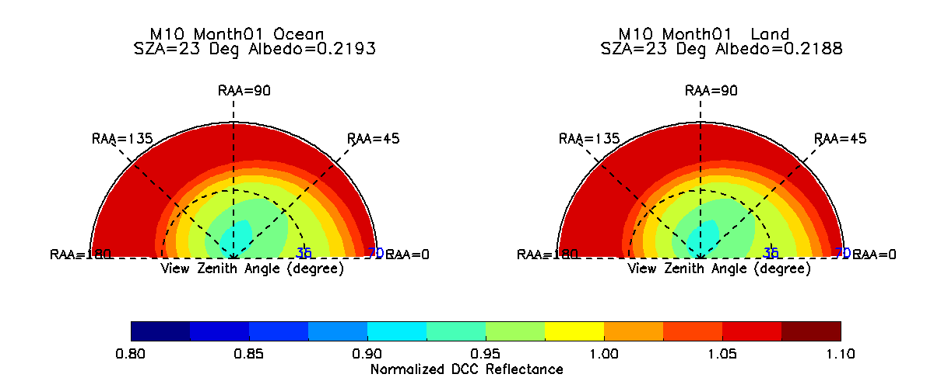
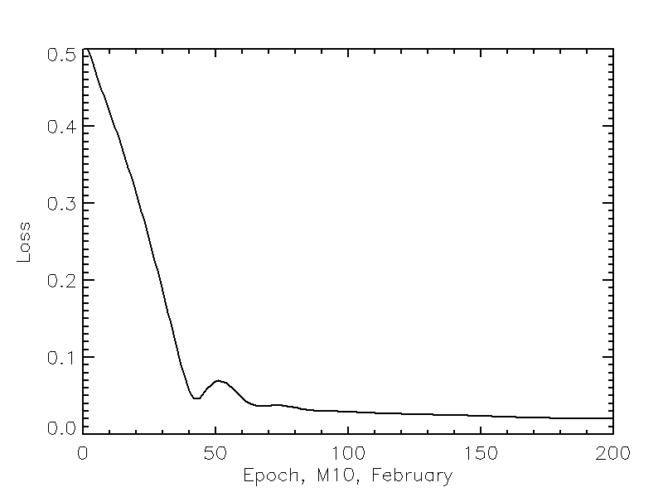
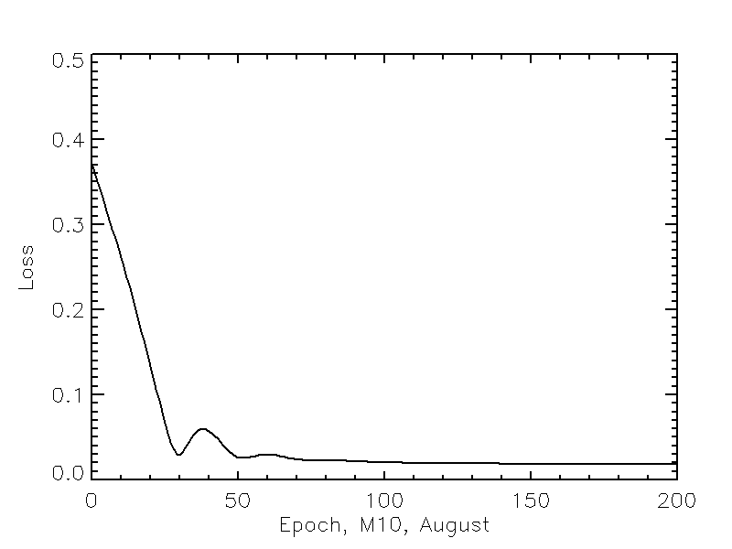
Examples of AI/ML-based DCC BRDF Models (M10, Monthly Land/Ocean, VZA<=35°)
Loss
(February)
Loss
(August)
Ocean
Land
Reflectance differences between land and ocean DCCs are ~5% for SWIRs.
Only results at VIIRS solar/view geometries for VIIRS calibration monitoring will be used for BRDF effect correction.

Slide 9
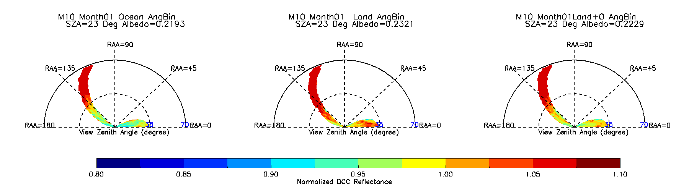
Examples of Angular Bin–based DCC BRDF Models (M10, Monthly, Ocean, Land, Ocean+Land)
The magnitudes and spatial patterns of the AI/ML and Angular Bin – based DCC BRDF models are similar at VIIRS solar/view geometries.
Ocean
Land
Ocean+Land

Slide 10
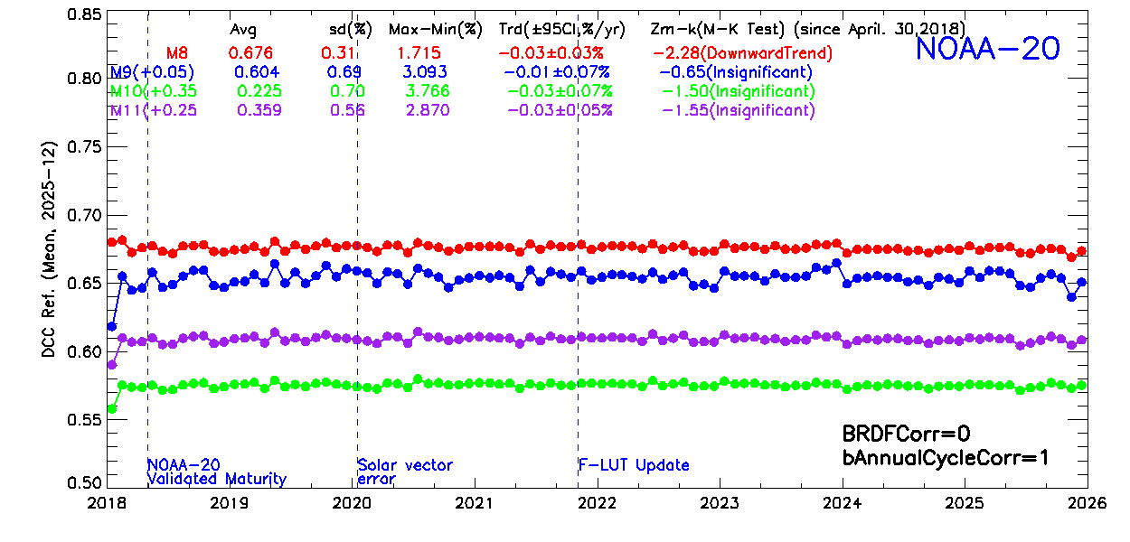
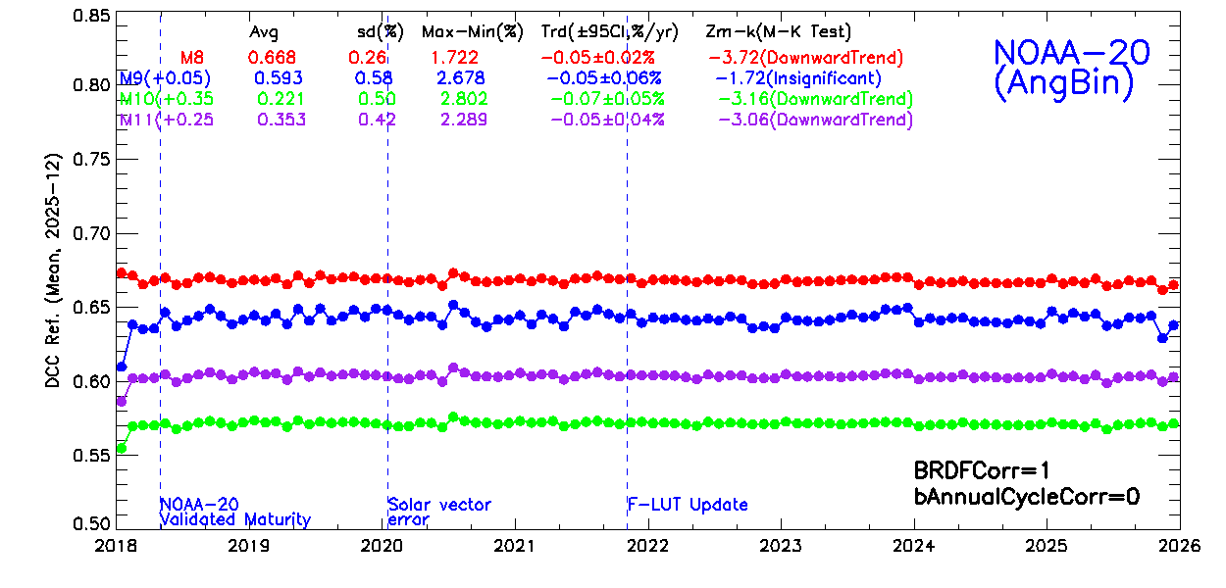
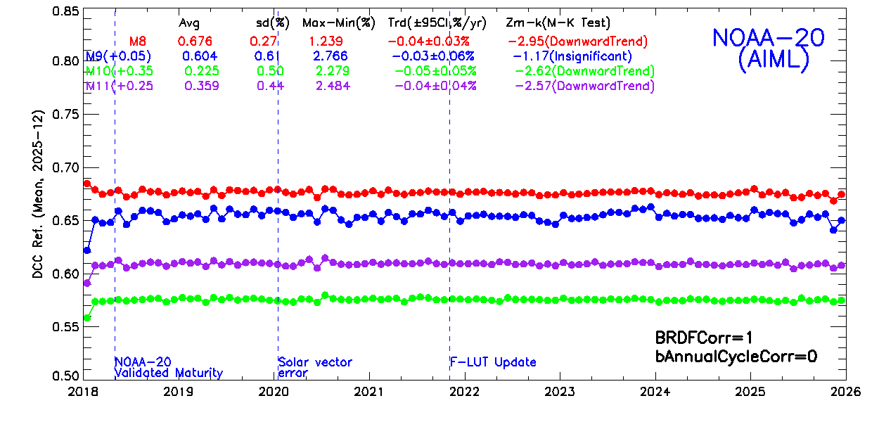
Validation Results: NOAA-20 SWIRs
Monthly land ocean AI/ML DCC BRDF models perform the best.
Effectively reduce the uncertainty of SWIR DCC trends, with 95%CI reduced and |Zm-k| increased.
Outperform annual cycle correction.
The performances of AI/ML and Angular Bin methods are close to each other.
The impacts of additional annual cycle correction are very small.
AI/ML-based BRDF correction runs faster than the Angular Bin-based correction (~1 time faster).
Empirical-based Annual Cycle Correction
(baseline)
Angular Bin-based Method
AI/ML-based Method

Slide 11
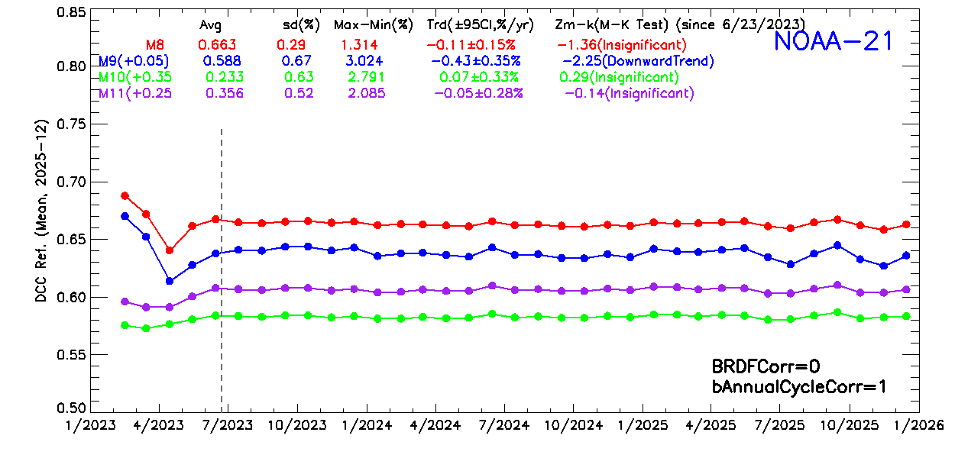
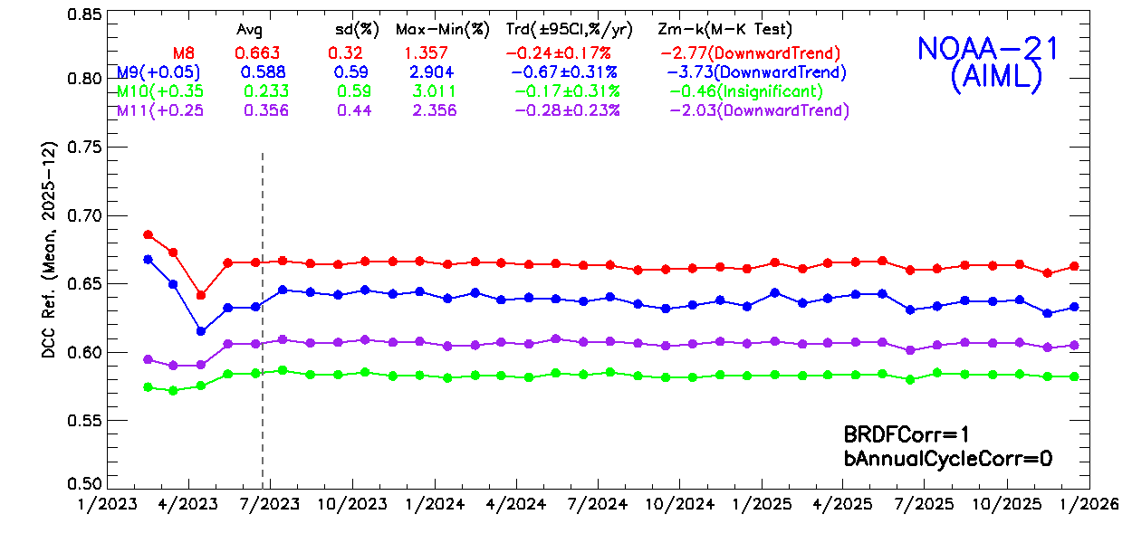
Validation Results:NOAA-21 SWIRs
Monthly land ocean AI/ML DCC BRDF models trained using NOAA-20 DCC data were applied to NOAA-21 SWIRs.
Preliminary results suggest the models also work well for NOAA-21.
The uncertainties of trends were generally reduced compared to the empirical annual cycle correction.
Empirical Annual Cycle Correction (baseline)
AI/ML-based Method

Slide 12
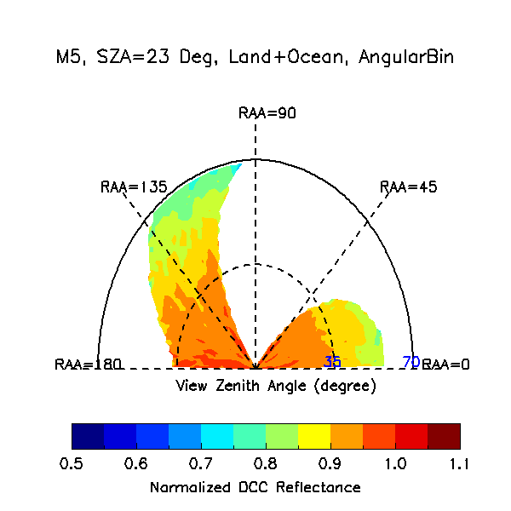
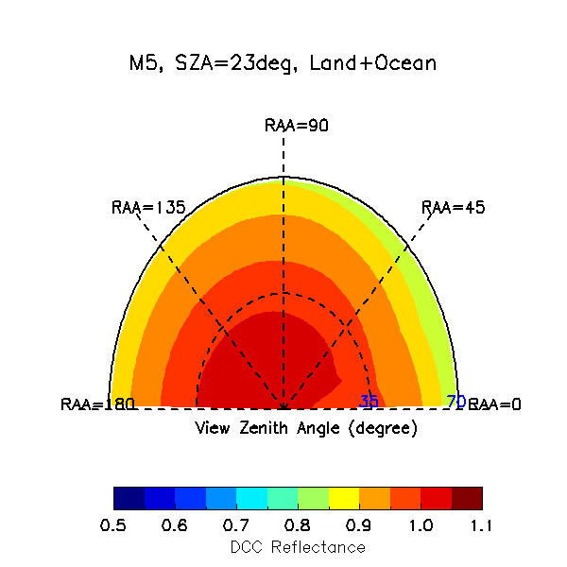
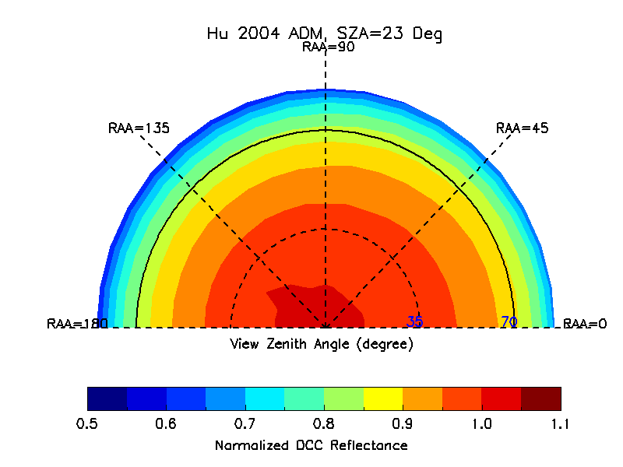
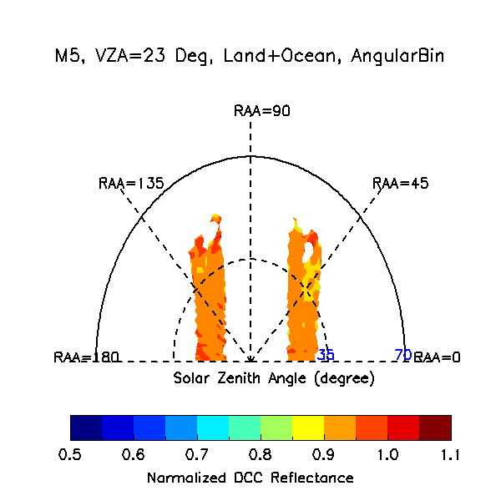
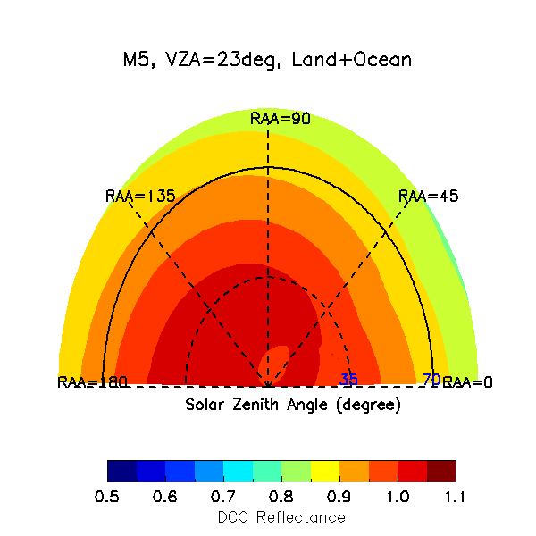
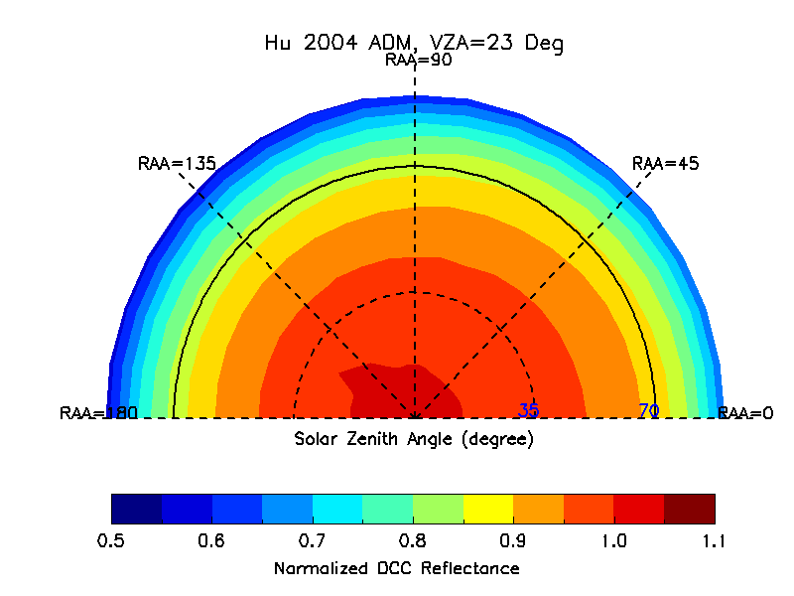
Comparison of VisNIR DCC BRDF Models
Hu2004 ADM
Angular Bin (M5)
AI/ML (M5)

Slide 13
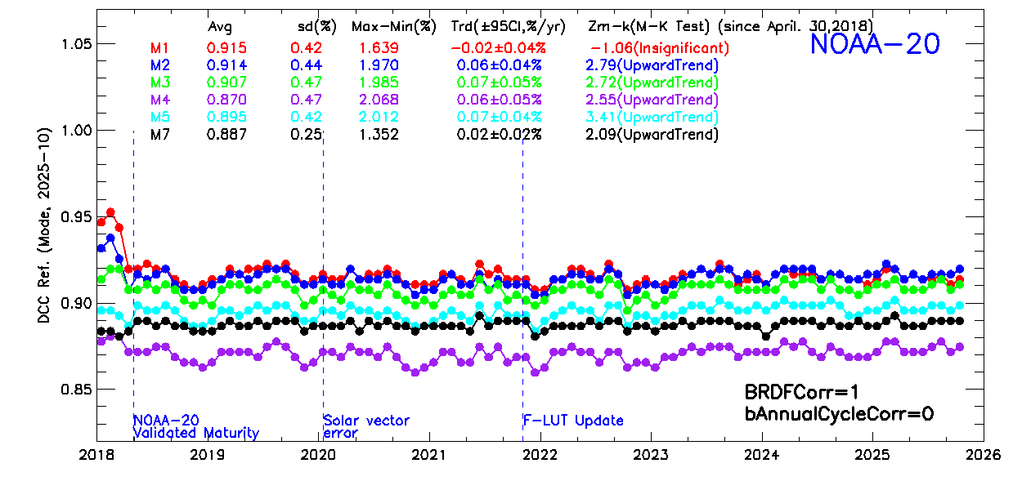
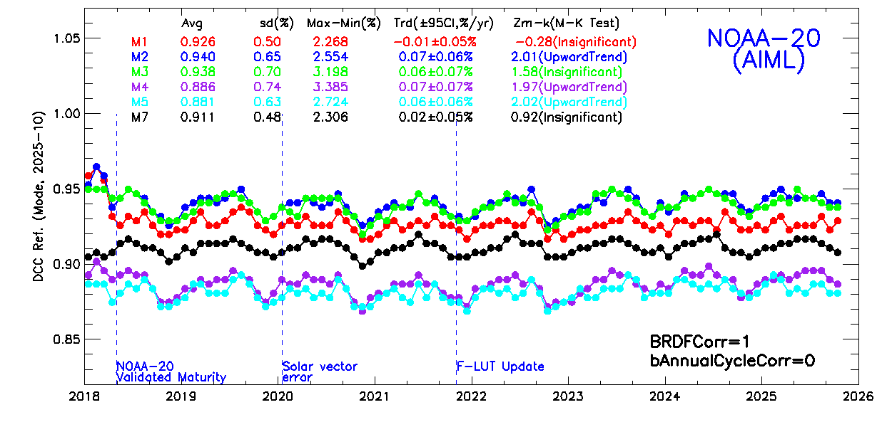
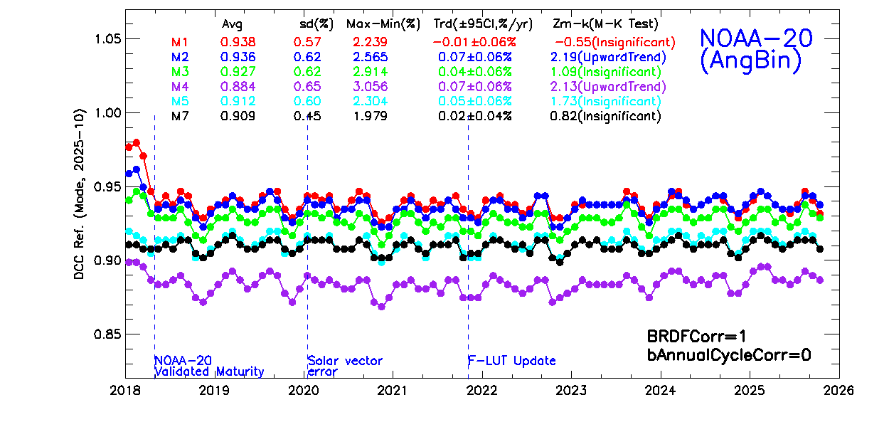
Validation Results: NOAA-20 VisNIRs
The Hu2004 ADM still performs the best.
The performance of AI/ML and Angular Bin-based BRDF models are similar.
Both can reduce the uncertainty of VisNIR DCC trends.
But less effective than the Hu2004 ADM.
May be caused by the gaps and non-uniform distribution of VIIRS DCCs, limitations of the MLP neural network framework.
Separate ocean & land does not help much.
Will be further investigated.
Hu2004 ADM (baseline)

Slide 14
Summary
This study investigated the feasibility of using AI/ML PyTorch MLP neural network to develop DCC BRDF models for improving the DCC method for VIIRS.
VIIRS SWIRs: monthly land ocean AI/ML-based models perform well.
Uncertainty of trends comparable to the Angular Bin models, both outperforming the annual cycle corr.
AI/ML-based BRDF models are smoother and run faster for BRDF correction.
The models developed using NOAA-20 data can also be applied to NOAA-21 SWIRs.
VIIRS VisNIRs: the Hu2004 ADM still performs the best.
The AI/ML and Angular Bin based BRDF models can reduce the annual cycles, but less effective.
Potential causes: gaps and non-uniform/skewed distribution of VIIRS DCCs, limitations of the MLP neural network framework, catastrophic forgetting, …
Future Works
Explore more AI/ML techniques that can better handle the VIIRS DCC data (with gaps and non-uniformly sampled).
Explore more input parameters (such as M15 BT, geolocation, …)
Further improve the quality control of train data.

Slide 15
Acknowledgement and Disclaimer
The author would like to thank Dr. Changyong Cao of NOAA/NESDIS/STAR for the inspiring and insightful guidance and discussions.
The scientific results and conclusions, as well as any views or opinions expressed herein, are those of the author(s) and do not necessarily reflect those of NOAA or the Department of Commerce.

Slide 16
Backups

Slide 17
The Hu2004 DCC BRDF Model (Hu et al. 2004)
Developed using TRMM (Tropical Rainfall Measuring Mission) CERES data
Low-inclination, non-sun-synchronous circular orbit, able to observe diurnal cycle.
Spatial coverage: tropical zone
Using CERES shortwave broad spectral band (0.3 – 5 µm) observations.
DCCs are brighter toward solar/view zeniths.
Performs well for VIIRS VisNIRs, used for operational trending.
Not effective in the VIIRS SWIR spectrum.
Used for comparison purpose.

Slide 18
Background
VIIRS DCC Identification Criteria
Latitude: ±25°
TB11 (M15, center wavelength 10.7 m) ≤ 205 K
sd(TB11) of the subject pixel and its eight adjacent pixels 1 K
sd(ref) of the subject pixel and its eight adjacent pixels 3%
View zenith angle (VZA) ≤ 35°
Major Characteristics of VIIRS DCCs
There are abundant of DCCs over the tropics, ~400 million pixels each year.
The mode of daily/monthly DCC reflectance is more stable for VisNIRs.
The mean of daily/monthly DCC reflectance is more stable for SWIRs
VisNIRs: highly reflective (mode: ~0.9 or higher), mainly a function of cloud optical depth (COD).
SWIRs: band-dependent (mean: 0.2-0.7), varying with COD and cloud effective radius.
DCCs migrate over time; land DCCs are brighter than those over oceans.

