Slide 1
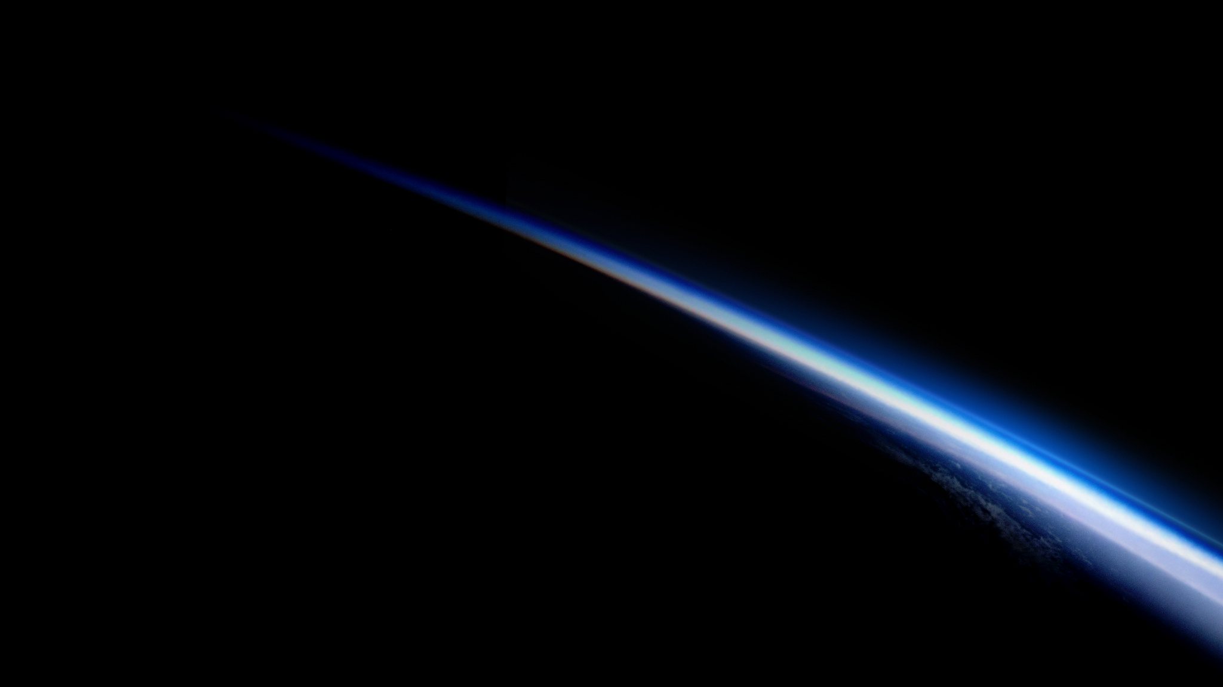
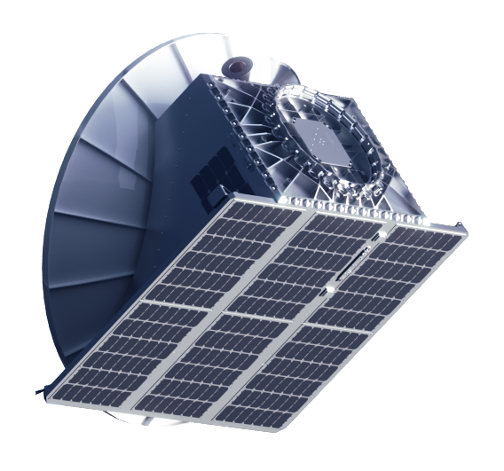
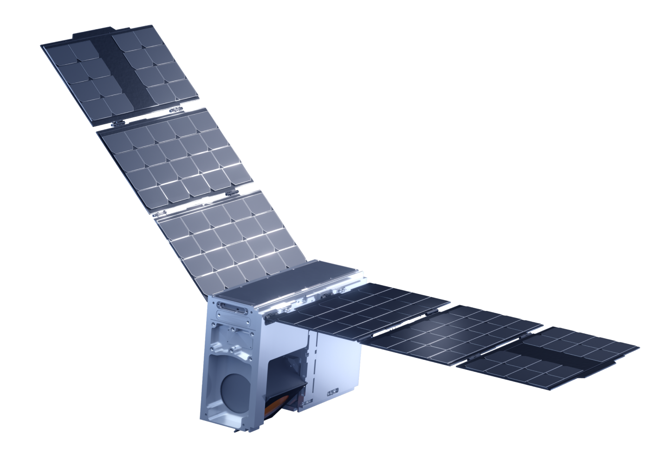










TOMORROW.IO AT A GLANCE
R. Honeyager, S. J. Munchak; GSICS 2026 Annual Meeting
2016
Founded
in Boston
150+
Employees
Worldwide
11
Microwave Sounders Launched
2
Ka-band Radars Launched
TRUSTED BY

Slide 2
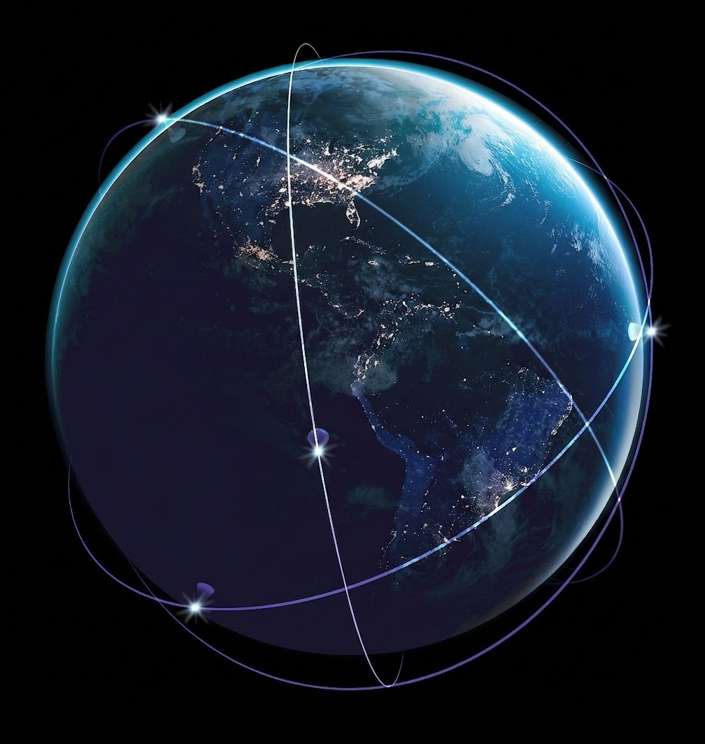
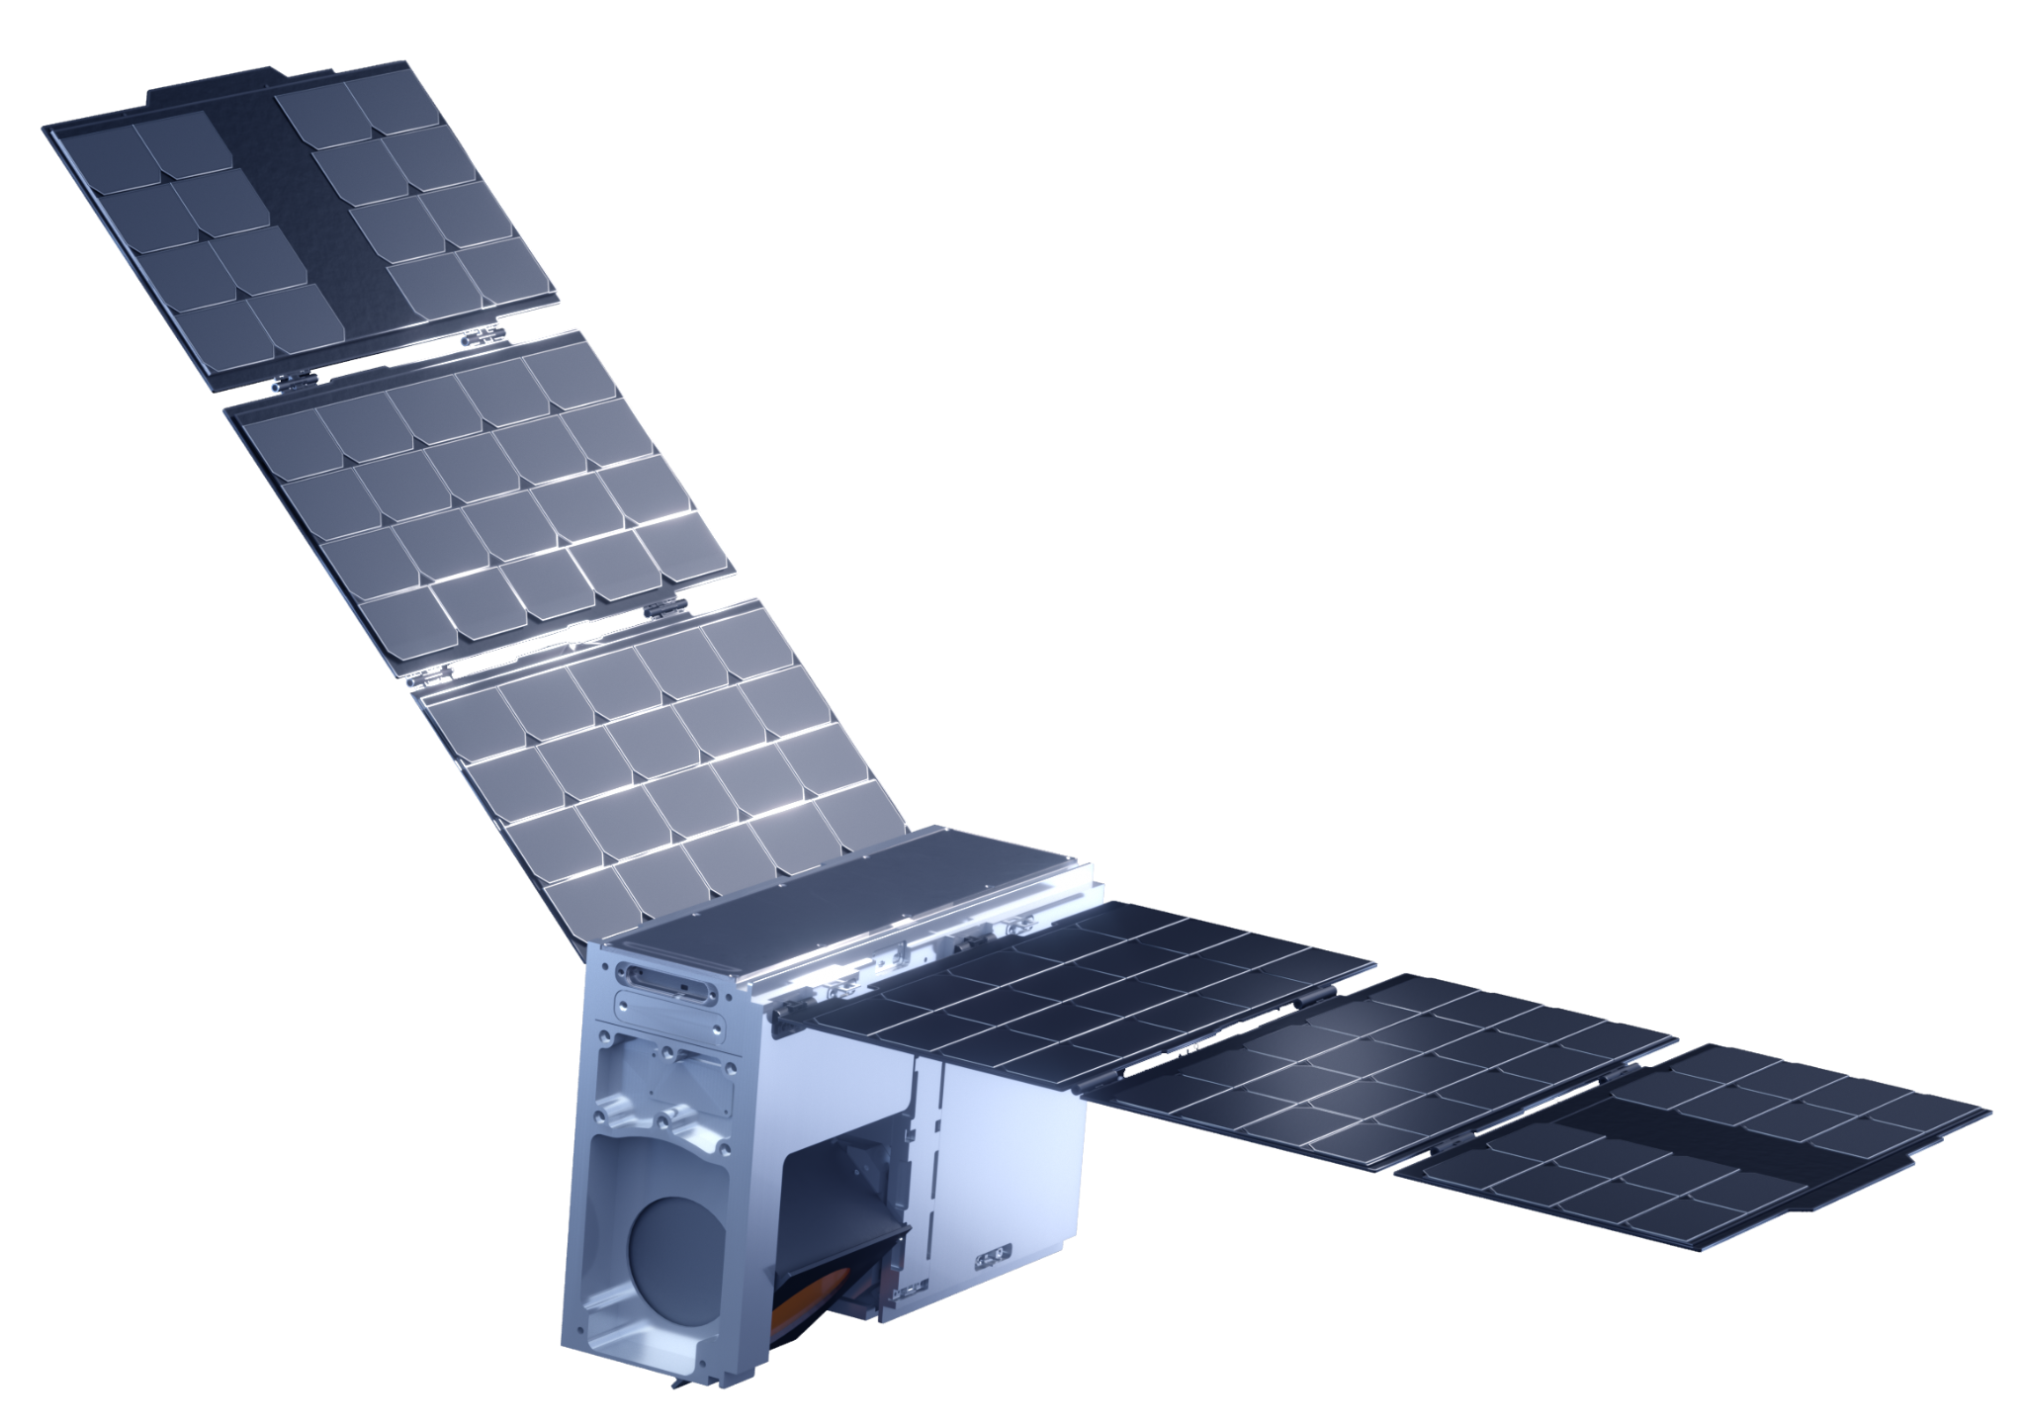
Tomorrow.io’s First-Generation Constellation
Goal: Hybrid constellation of satellites in Low Earth Orbit
18+ Microwave Sounders (11 currently on orbit)
2 Precipitation Radars (2 launched; 1 currently on orbit)
Fully Deployed Constellation Capabilities:
Full Global Coverage
<1 hour average revisit rate
Vastly improved coverage of near real-time precipitation estimates and 3D atmospheric profiles
Regular collection of valuable data for precipitation nowcasts, rapid-refresh forecast models, tropical cyclone warnings, and flood alerts
Outlook:
Full Operational Capability (FOC) Microwave Sounder constellation achieved in January 2026. Continuing to launch for margin, end of life replenishment and upgrades.
Enhanced Precipitation Radars are in development with target deployment in 2029

Slide 3
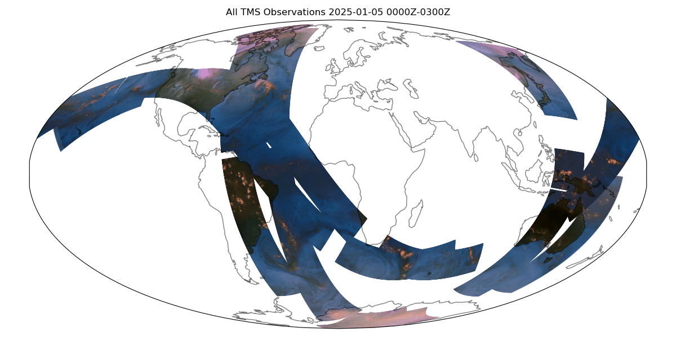
Where we were early last year…

Slide 4
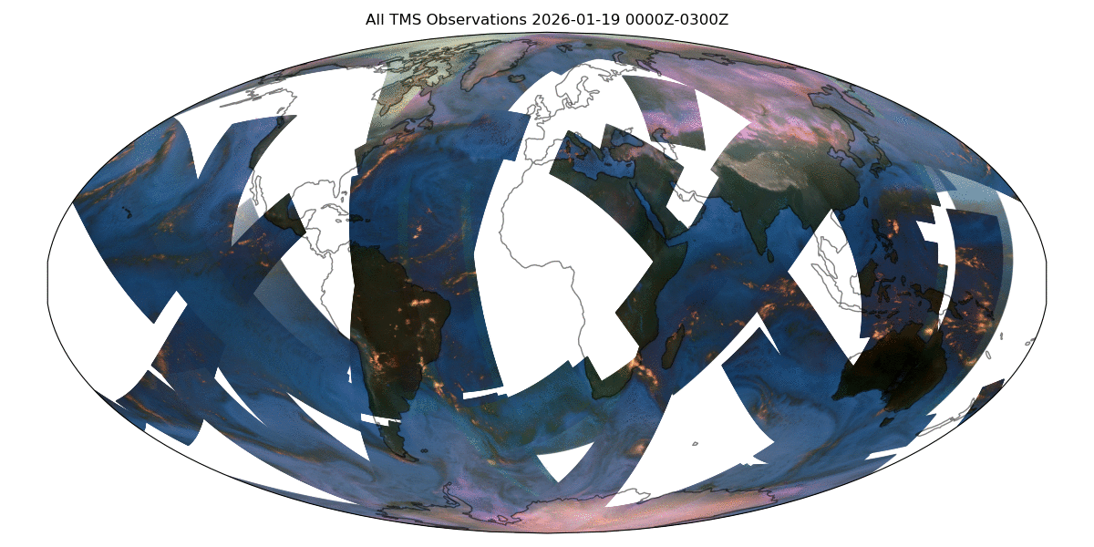
… to where we are now

Slide 5
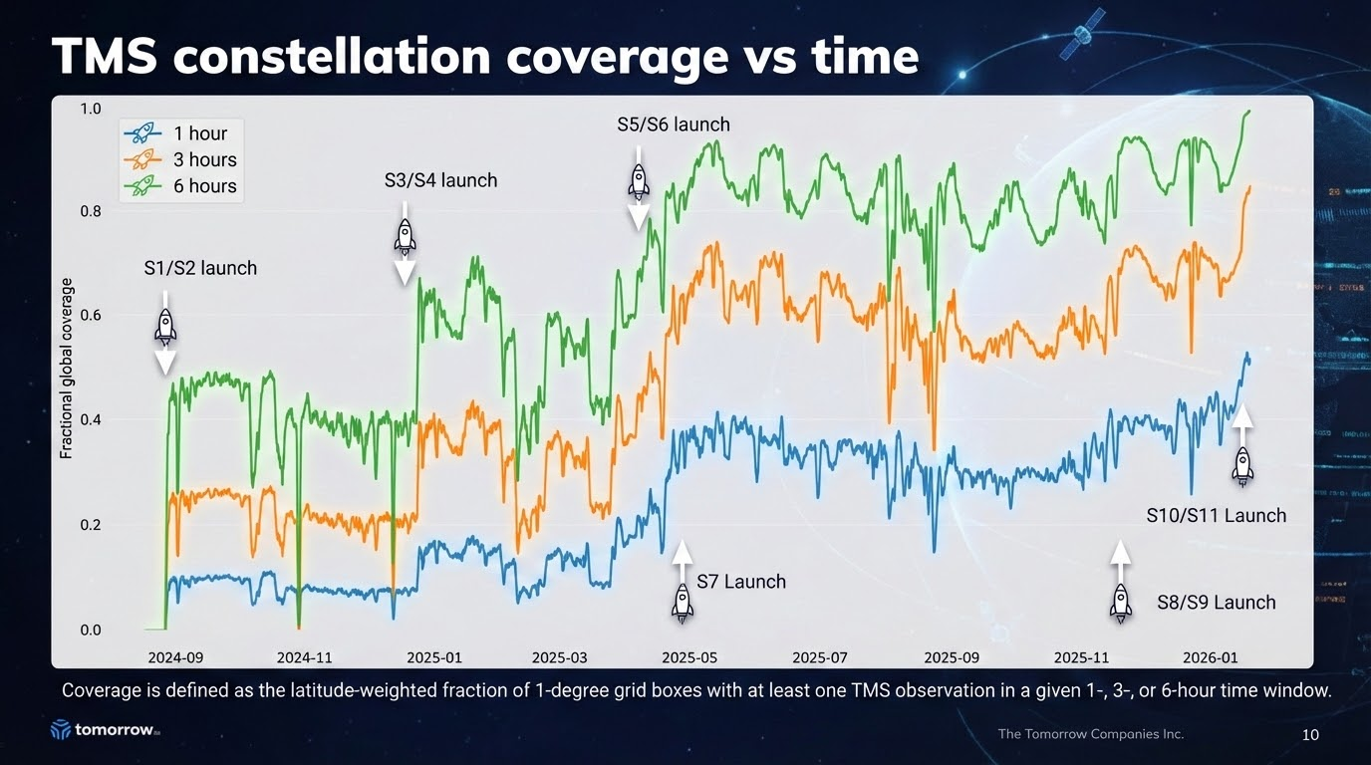

Slide 6
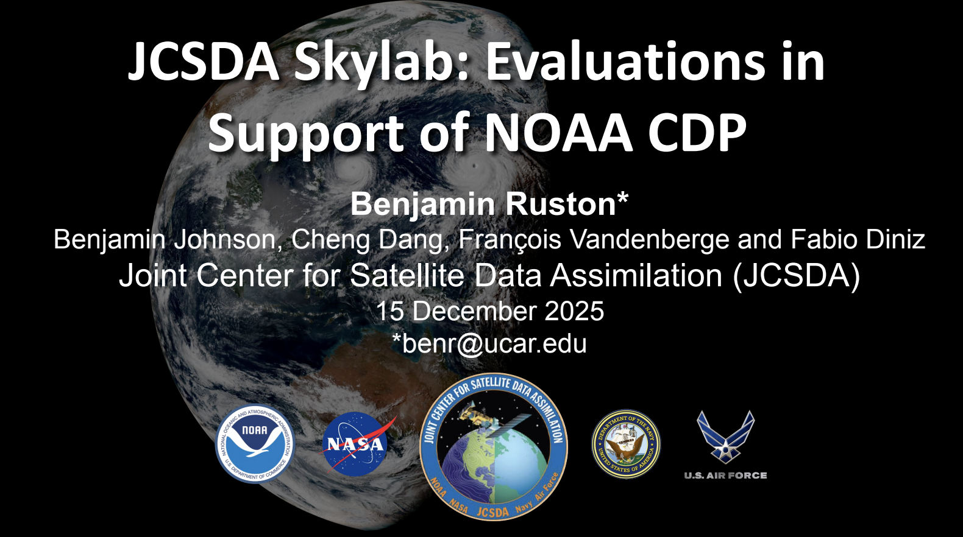
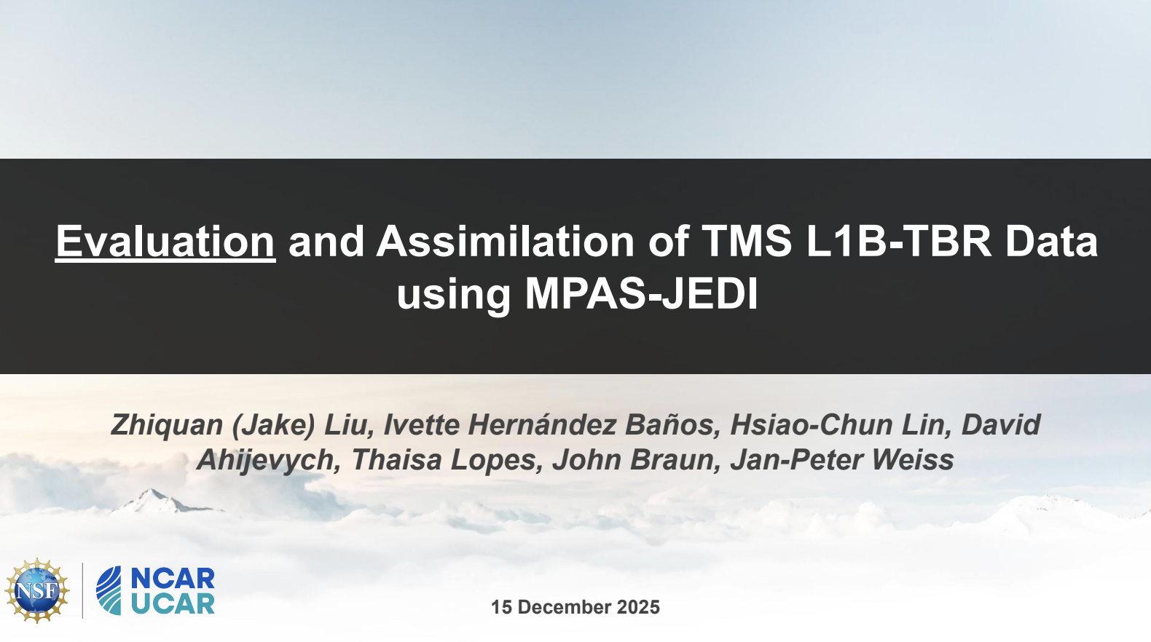
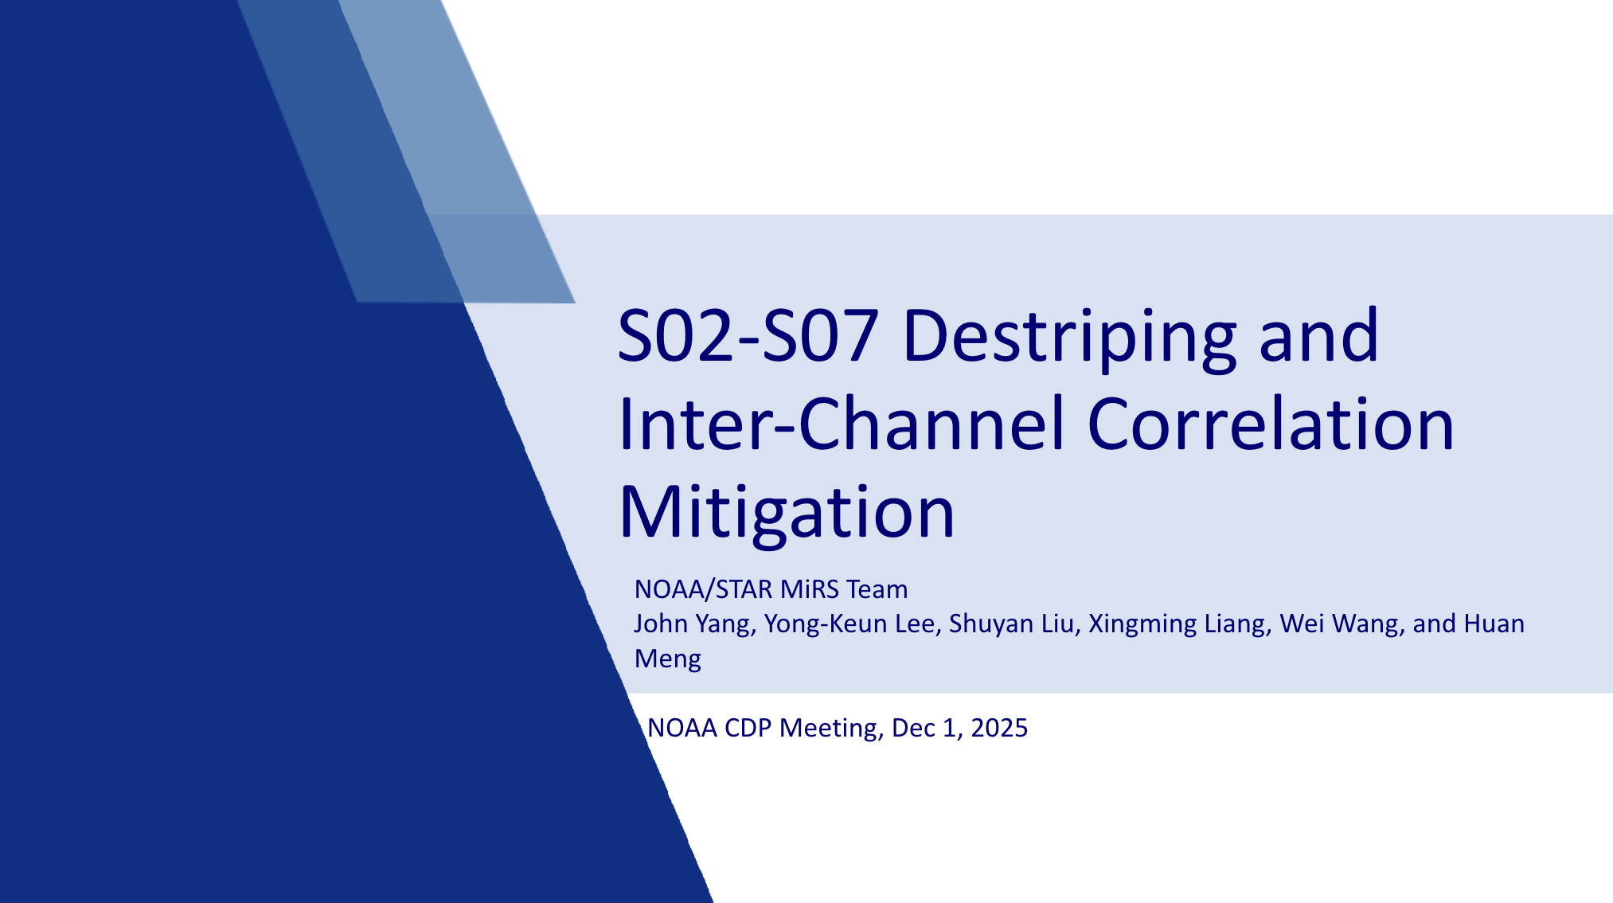
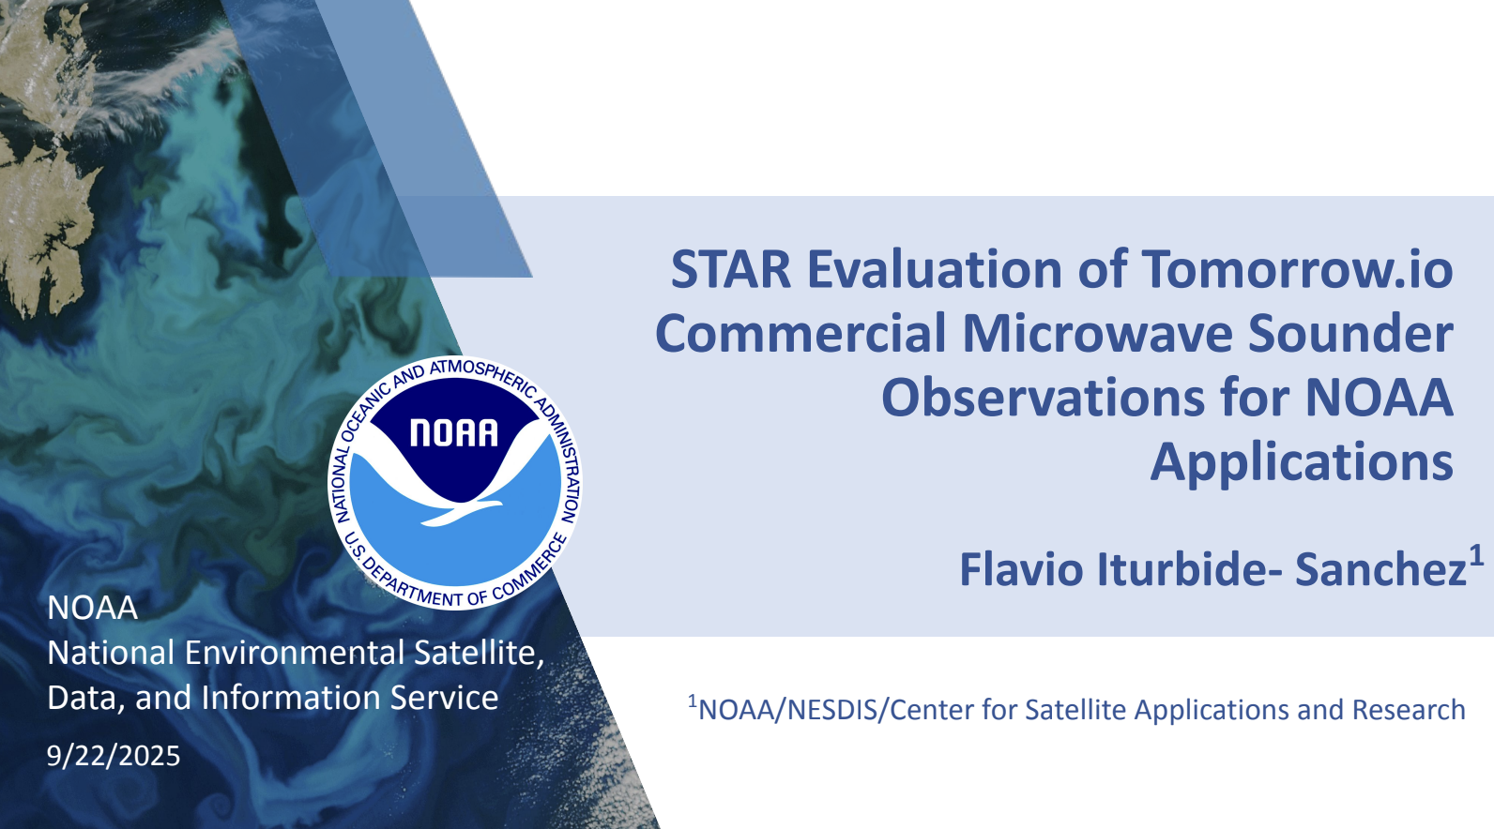
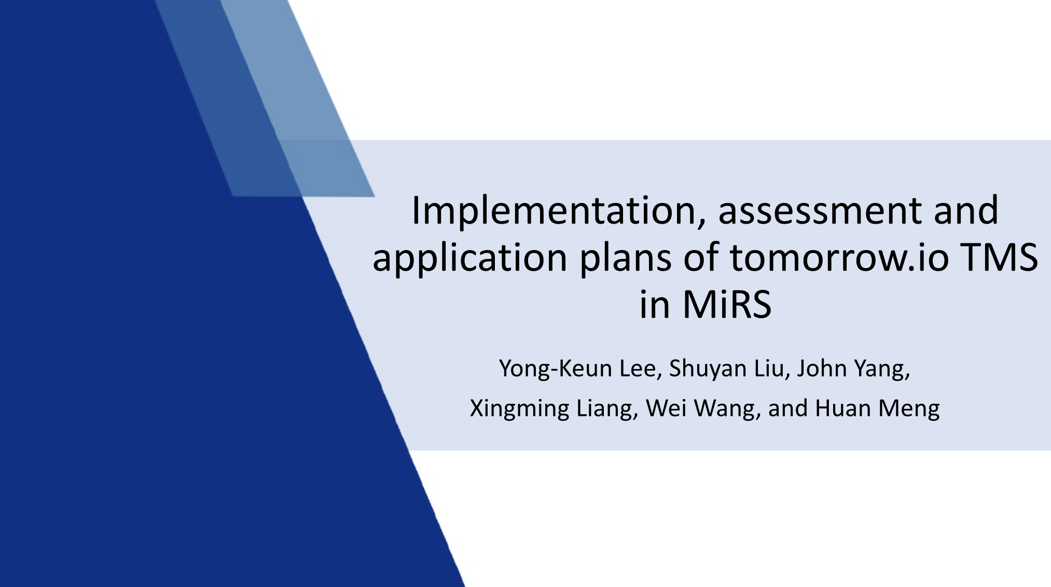
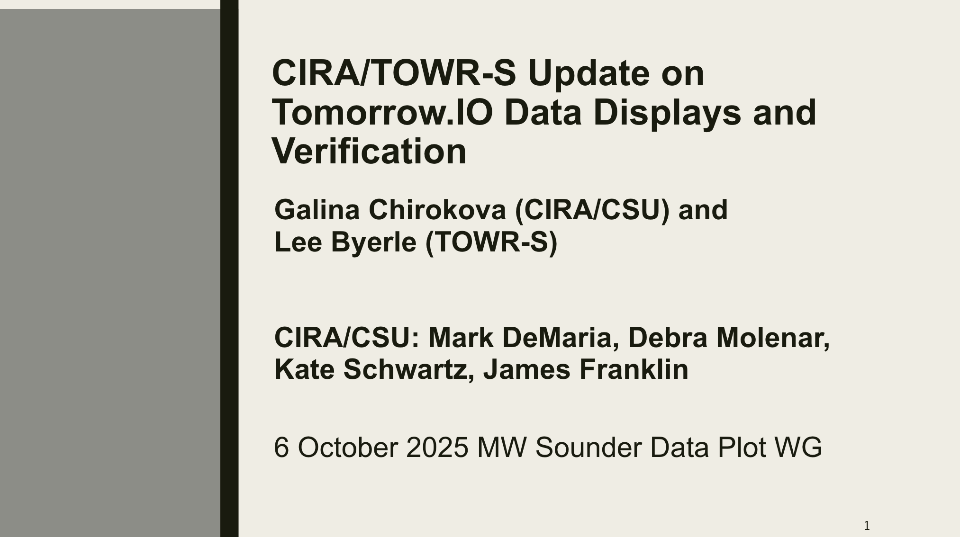
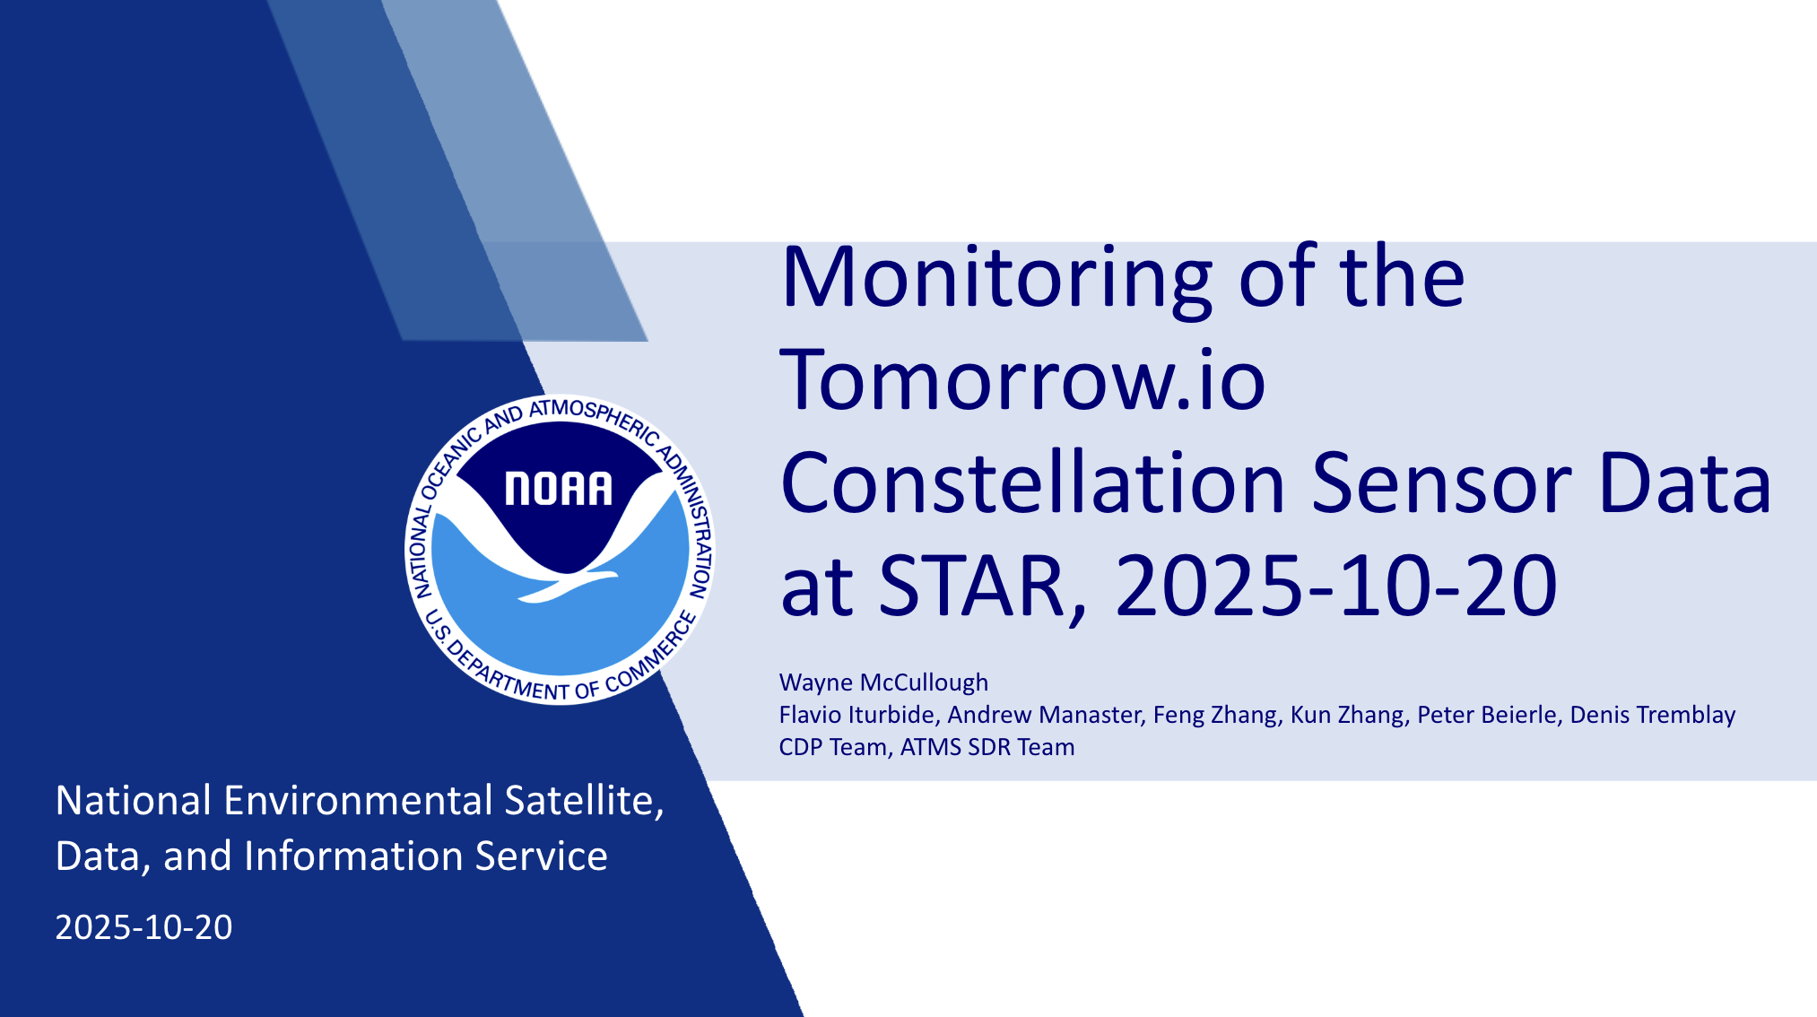
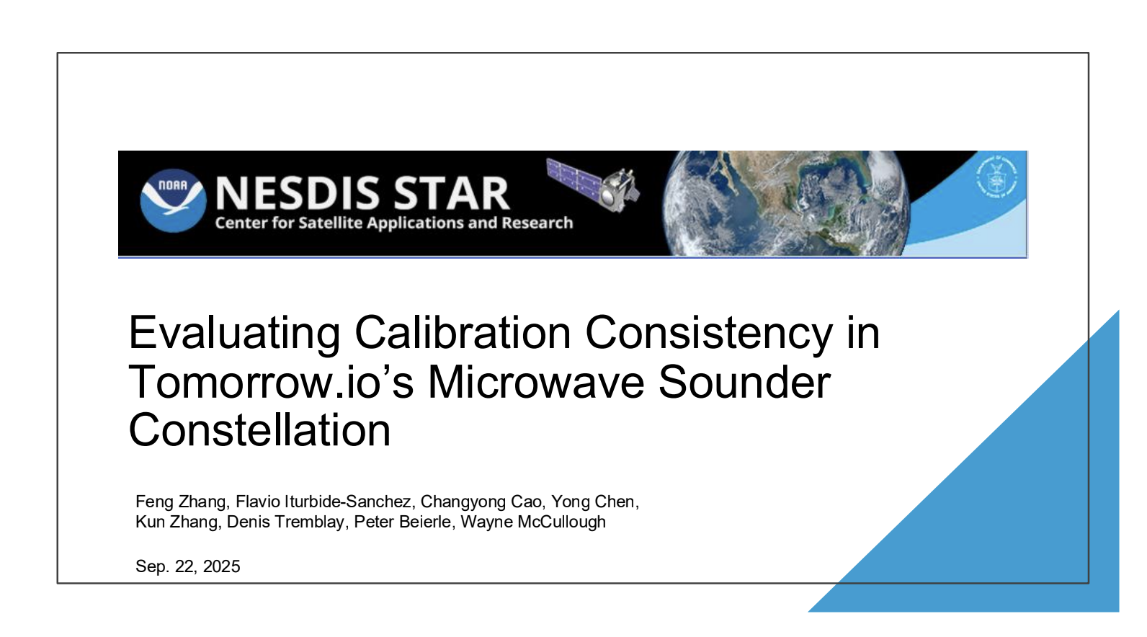
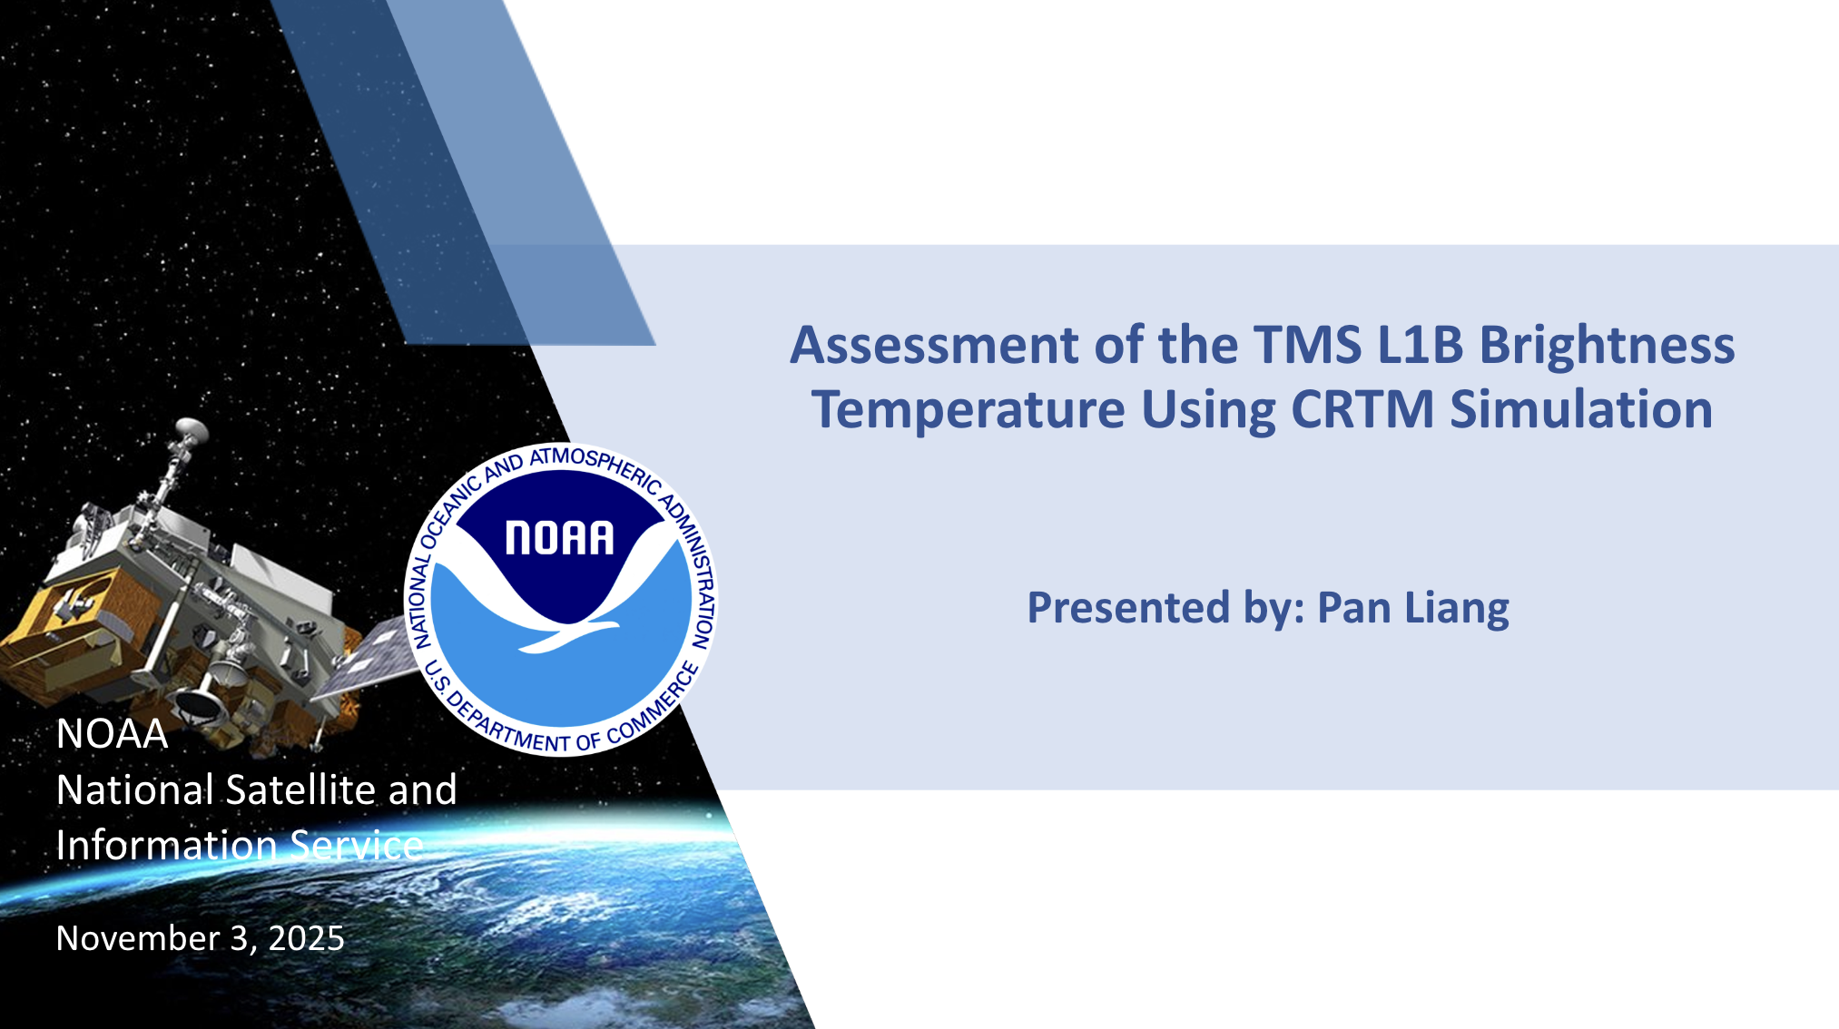
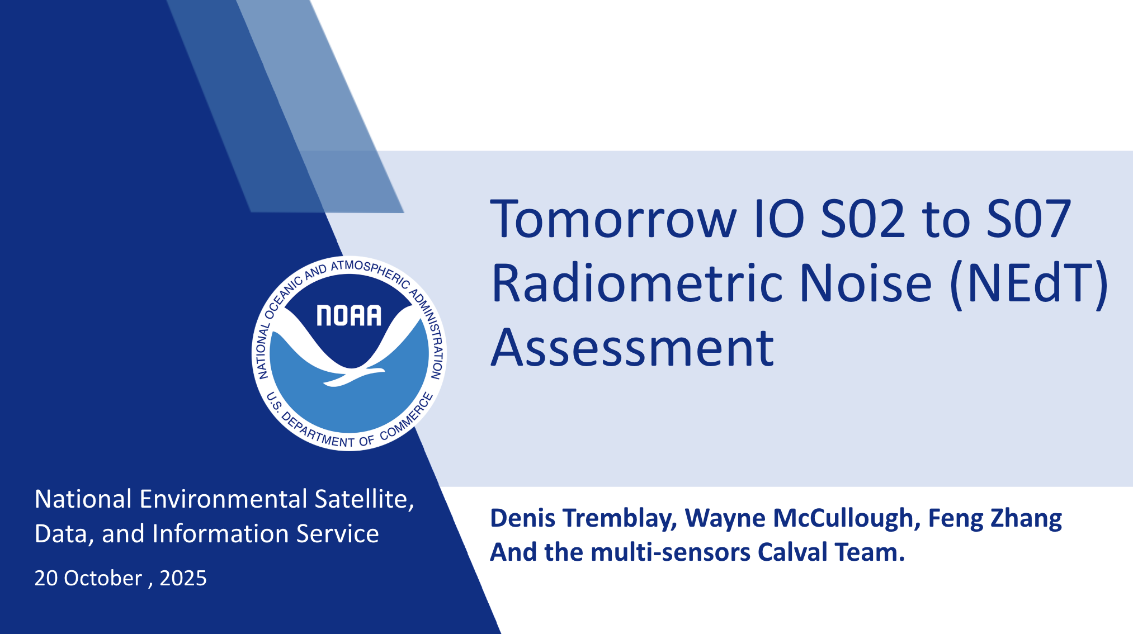
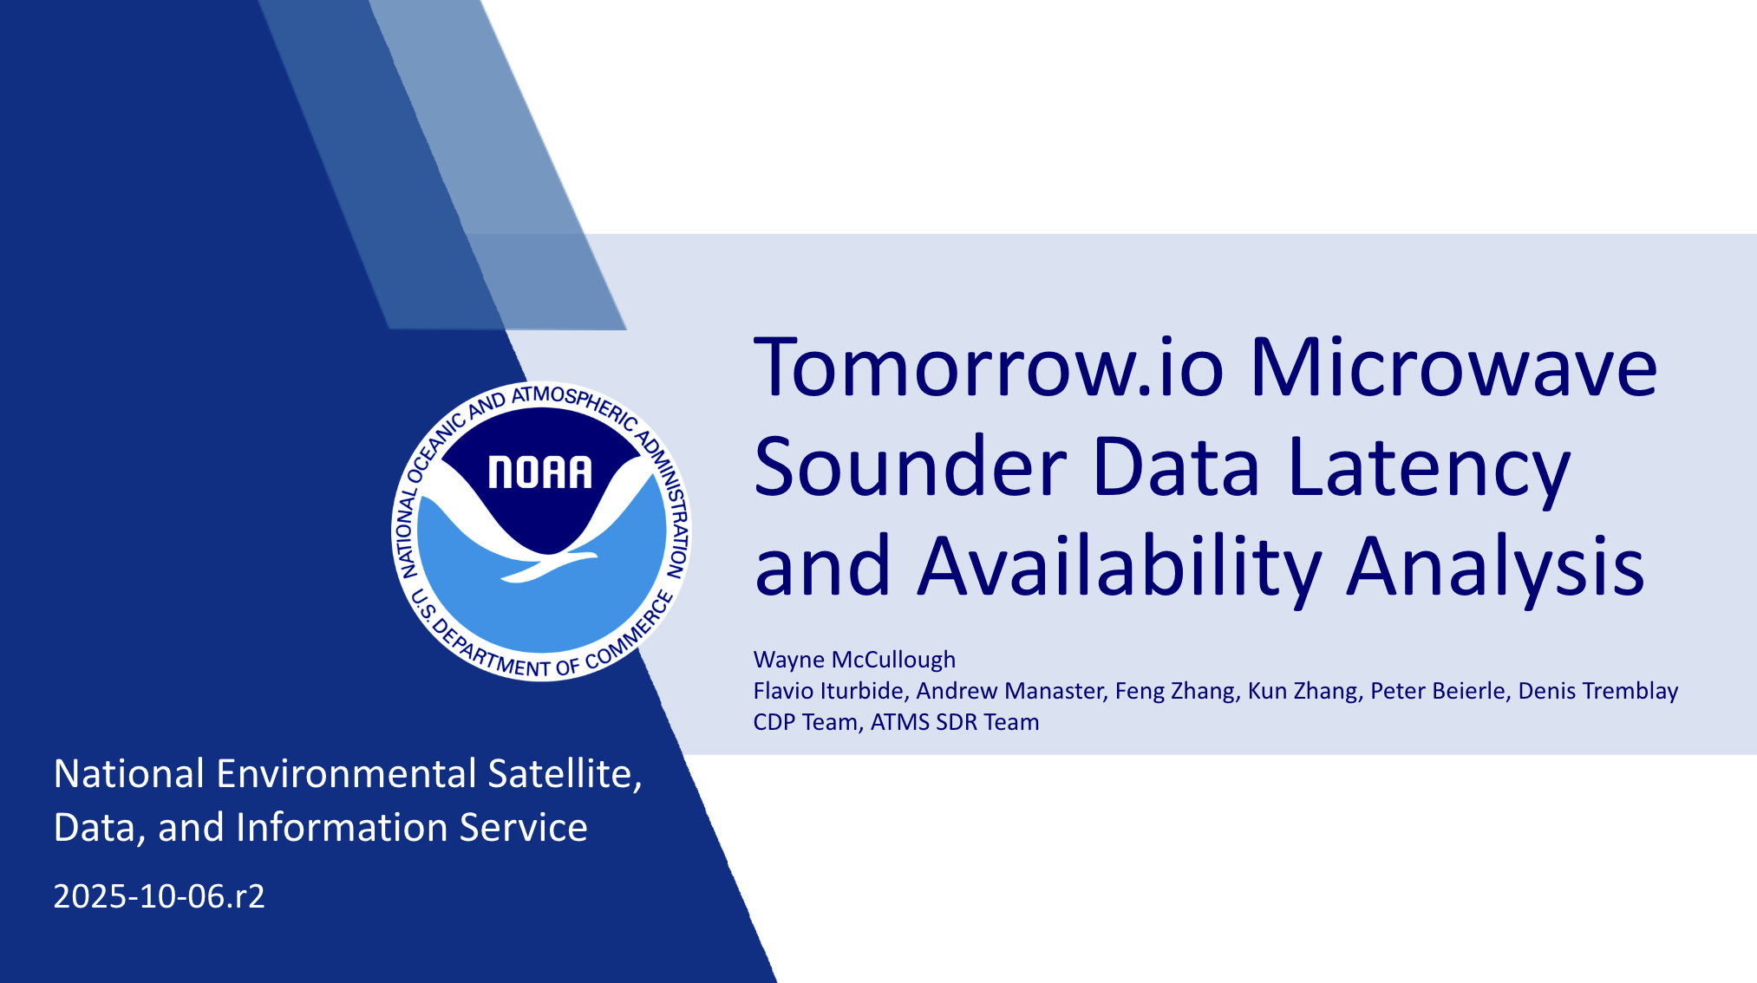
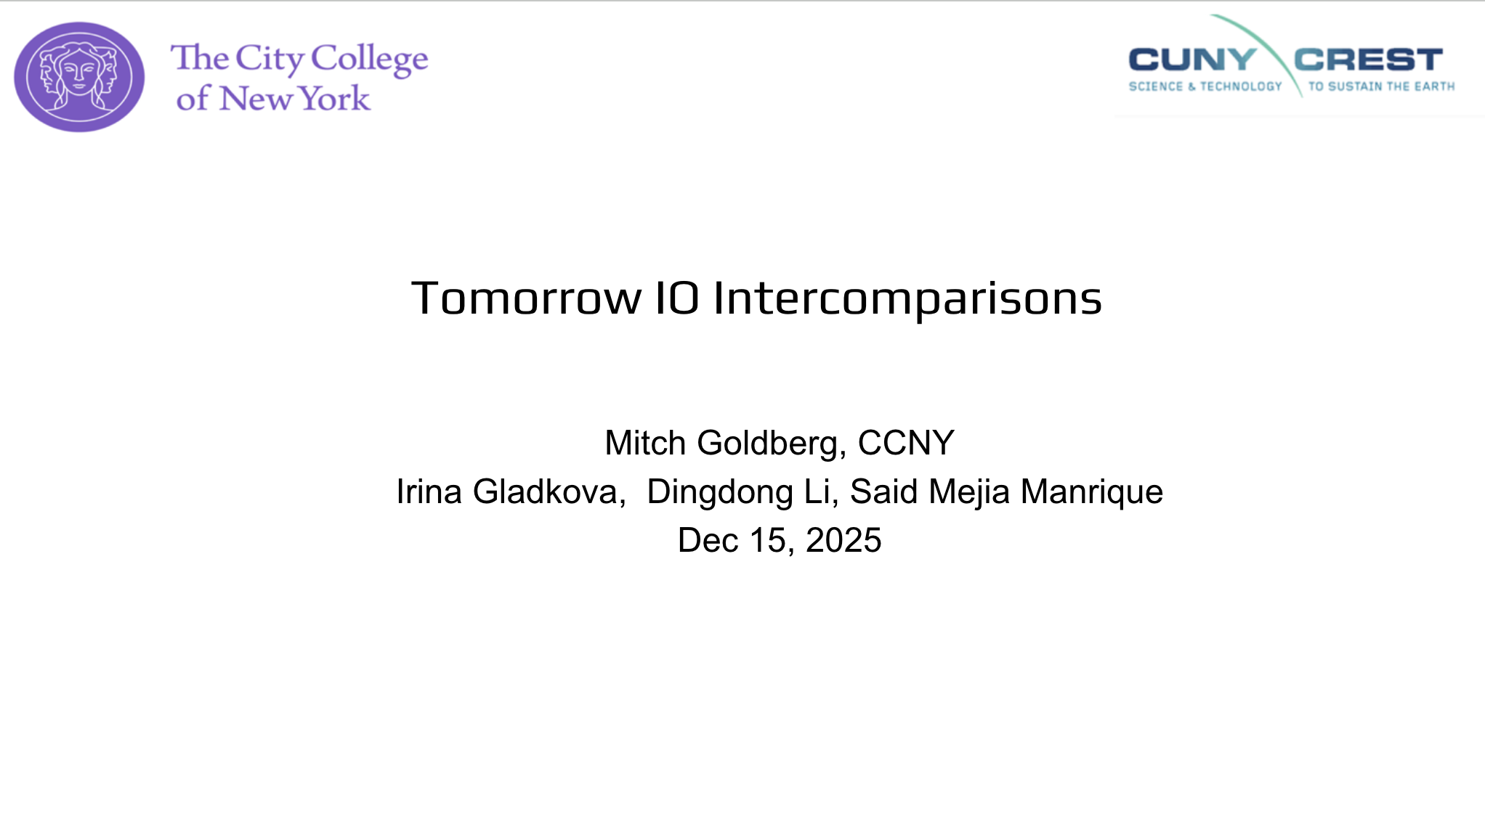
NOAA Commercial Pilot Cal/Val Assessments are Ongoing
NOAA-specific talk this Wednesday at 10:30; at AMS over twenty presentations discussed TMS evaluations

Slide 7
Recent Publications on TMS
S. J. Munchak, E. Nelson, E. Watson, S. Williams, M. DiLiberto, R. V. Leslie, R. Keenan, and W. Blackwell (2026): On-orbit calibration of the Tomorrow.io Microwave Sounders, Journal of Atmospheric and Oceanic Technology, preprint. doi: 10.22541/essoar.175250254.43121152/v1.
J. Guerrette, R. Honeyager, S. J. Munchak, and X. Tian (2026): All-sky assimilation impacts of the Tomorrow.io Microwave Sounder constellation on global weather forecasts, Quarterly Journal of the Royal Meteorological Society, e70106. doi: 10.1002/qj.70106.
F. Cannon et al. (2026): Deep learning for multi-satellite precipitation retrievals: impact of Tomorrow.io’s Microwave Sounders, J. Hydromet., e250007. doi: 10.1175/JHM-D-25-0007.1.
We have many white papers & calibration reports; we want to engage with GSICS to see how we can share these and how we can collaborate with the community.

Slide 8

THANK YOU

