Slide 1
Executive Panel Chair Address
(Agenda item 1c)
Dr. Bojan R. Bojkov
(EUMETSAT)

Slide 2

Welcome to Ottawa!
Special thanks to our local hosts from NRC, Mr. Thomas Puestow and Ms. Nour Oudni!
A big thank you to Global Affairs Canada, Mr. Majid Dellah, for facilitating the visa process!

Slide 3
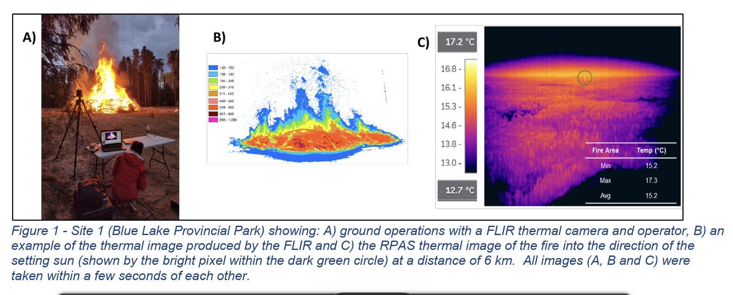
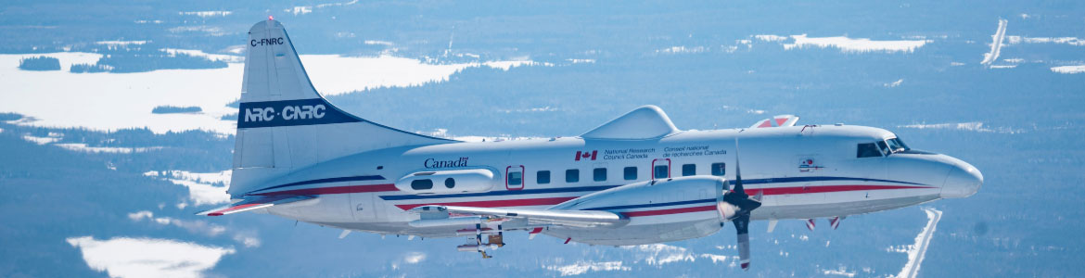
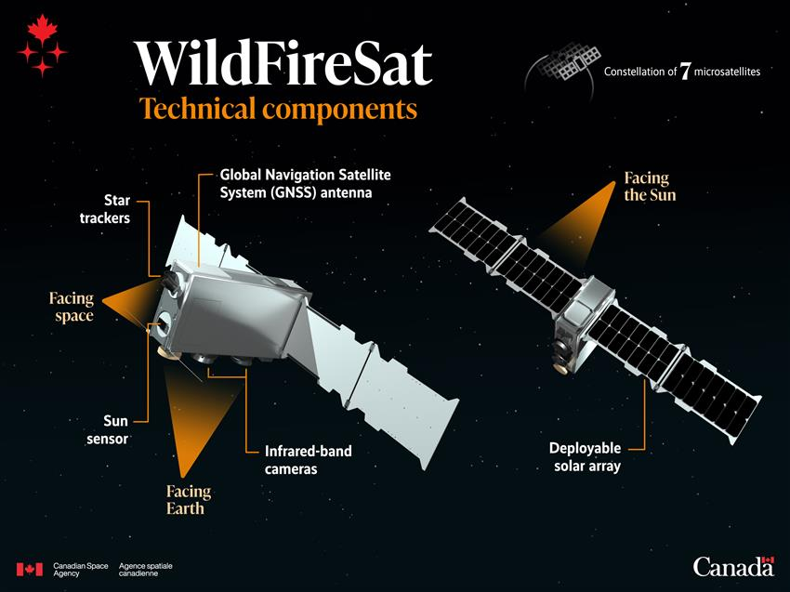
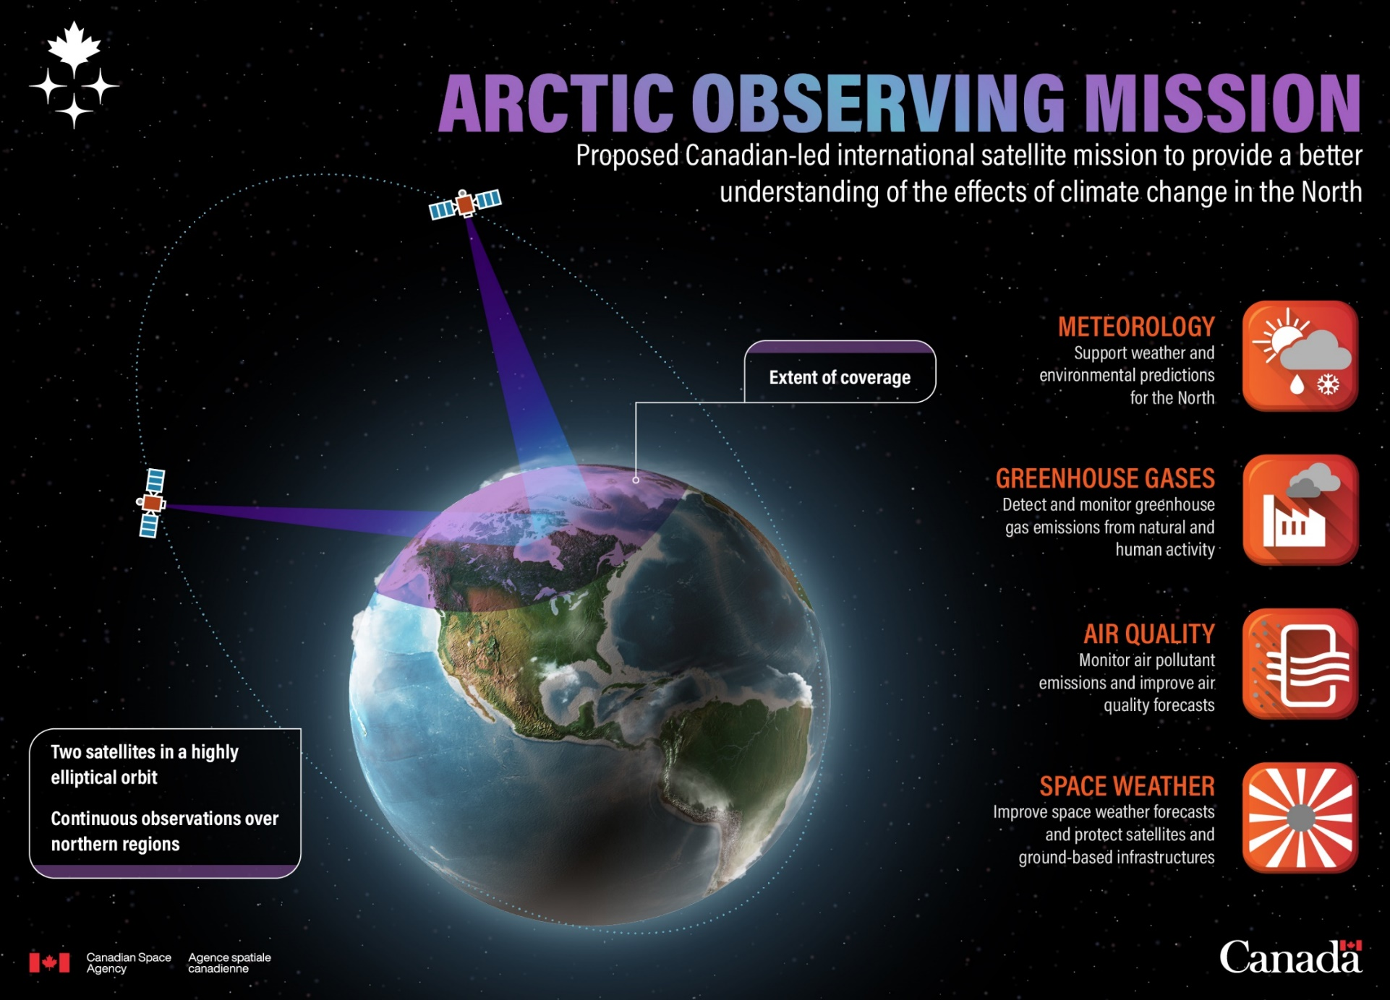
Canadian interests in GSICS…
NRC activities:
  Aerospace Research Centre and Mer Bleu Vicarious Calibration
  Ocean, Coastal and River Engineering use of EO data
Canadian Earth Observation missions:
  NRCan WildFireSat: a constellation of 7 fire monitoring microsatellites
  ECCC’s Arctic Observing Mission (AOM)
Learning from GSICS activities

Slide 4
Welcome commercial EO activities to GSICS
Increasing commercial EO and PPP, also in the field of meteorology and environmental monitoring across the globe
WMO and the GSICS EP have reached out to numerous companies over the last 6 months
We welcome commercial participants this week (and their invited presentations this morning)
Looking forward to close cooperation with commercial entities on the development and implementation of GSICS intercalibration best practices

Slide 5
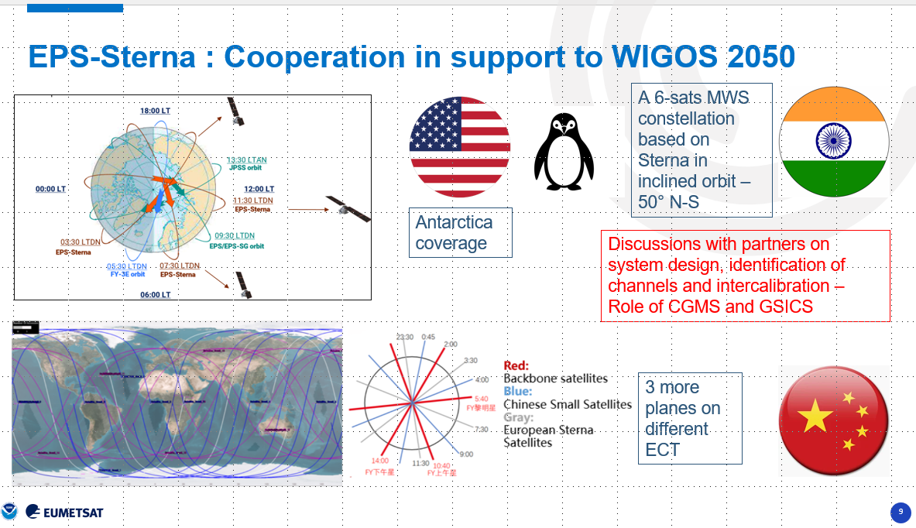
Intercalibration in the frame of CGMS: microwave sounders

Slide 6

I wish you a good and a very productive week!

