Slide 1
GSICS Annual Meeting 2026
Adoption of Agenda
Mounir Lekouara (EUMETSAT)

Slide 2
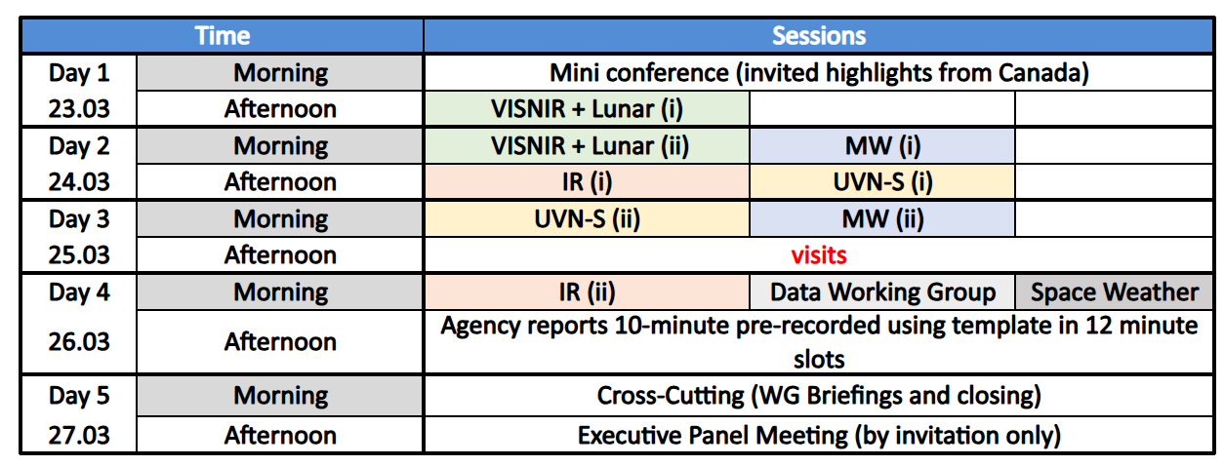
High Level Agenda (140 talks)
See online detailed agenda for start/end time of sessions (not all the same!)

Slide 3
Information
See the Meeting page on https://gsicsweb.eumetsat.int/ for
  Agenda (under “Collaborative Excel Agenda”), including session rooms
  Teams Links
  Collaborative Minutes
  Sharepoint Folders with the presentations
    filename convention: itemReference_name_shortTitle (e.g. 1a_Davies_WelcomeAndOpeningRemarks)
    If you cannot access, try clearing cookies or incognito mode
    USB sticks will be available in each session

Slide 4
Please address in each session’s discussion
The sub-group needs for the website evolutions
  See https://gsicsweb.eumetsat.int/
  will be summarized in the cross-cutting (item 10j)
The sub-group needs and contribution for the GSICS Dashboard
  See mockup on https://gsicsweb.eumetsat.int/gsics-plotter/
  Discussion on the GDWG session (item 7j) for the implementation and data exchange interface.
  Will be summarized in the cross-cutting (item 10l)
What to report/discuss in the cross-cutting reports
Have a fruitful meeting !

