Slide 1



GSICS 2026 Logistics
March 23, 2026

Slide 2
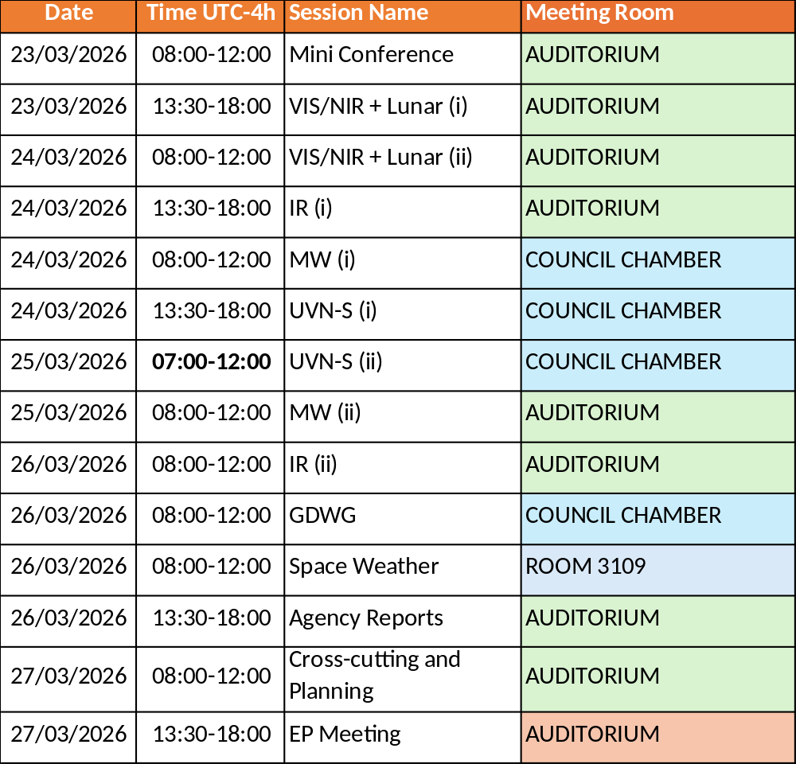
Building Logistics
    No fire drills planned
    Always wear your badge when inside the building
    Food will be served in the cafeteria downstairs during breaks
Notes:
These are the major lines of enquiry/research related to the Resilient Shores strategic pillar
Significant amount of coastal/riverine infrastructure (e.g. dams, port infrastructures, coastal defenses) in Canada has been designed for extreme environmental conditions without taking into account climate change; OCRE examines approaches to make existing infrastructure more climate resilient
Climate change impacts patterns of extreme events, OCRE provides predictive tools for decision makers that take into account climate change impacts on surges and waves
Temporary flood barriers/building retrofits are an emerging industry in Canada, OCRE is the only facility in Canada capable of testing temporary flood protection technologies according to existing international standards
In addition to their utility in climate change adaptation, nature-based solutions can provide a multiple co-benefits; this includes hybrid solutions, comprising conventional infrastructure paired with nature-based approaches; nature-based approached seek to harness the resilience inherent in natural systems, such as wetlands

Slide 3
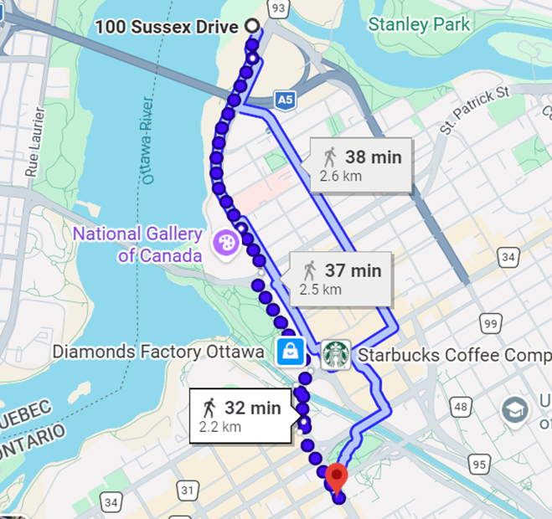
Icebreaker
    Monday, March 23
    Beckta, 150 Elgin Street
    Start at 18:45
    Bus leaves NRC at 18:30
Notes:
These are the major lines of enquiry/research related to the Resilient Shores strategic pillar
Significant amount of coastal/riverine infrastructure (e.g. dams, port infrastructures, coastal defenses) in Canada has been designed for extreme environmental conditions without taking into account climate change; OCRE examines approaches to make existing infrastructure more climate resilient
Climate change impacts patterns of extreme events, OCRE provides predictive tools for decision makers that take into account climate change impacts on surges and waves
Temporary flood barriers/building retrofits are an emerging industry in Canada, OCRE is the only facility in Canada capable of testing temporary flood protection technologies according to existing international standards
In addition to their utility in climate change adaptation, nature-based solutions can provide a multiple co-benefits; this includes hybrid solutions, comprising conventional infrastructure paired with nature-based approaches; nature-based approached seek to harness the resilience inherent in natural systems, such as wetlands

Slide 4
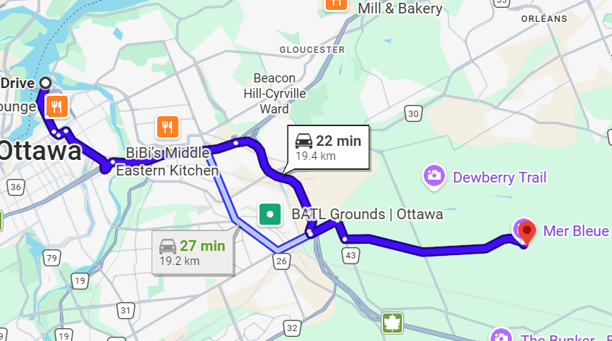
Mer Bleue
    Wednesday, March 25
    Bus leaves NRC at 13:15
    Bus leaves Mer Bleue at 17:00
    Snow/wet conditions
Notes:
These are the major lines of enquiry/research related to the Resilient Shores strategic pillar
Significant amount of coastal/riverine infrastructure (e.g. dams, port infrastructures, coastal defenses) in Canada has been designed for extreme environmental conditions without taking into account climate change; OCRE examines approaches to make existing infrastructure more climate resilient
Climate change impacts patterns of extreme events, OCRE provides predictive tools for decision makers that take into account climate change impacts on surges and waves
Temporary flood barriers/building retrofits are an emerging industry in Canada, OCRE is the only facility in Canada capable of testing temporary flood protection technologies according to existing international standards
In addition to their utility in climate change adaptation, nature-based solutions can provide a multiple co-benefits; this includes hybrid solutions, comprising conventional infrastructure paired with nature-based approaches; nature-based approached seek to harness the resilience inherent in natural systems, such as wetlands

