Slide 1


`
An Overview of The Arctic Observing Mission (AOM)
Ray Nassar¹, Alec Casey¹, John Evans², Dan-Tam Nguyen², Matt Arkett¹, Chris Sioris¹, Chris McLinden¹, Joseph Mendonca¹, Josep Aparicio¹, Shen-En Qian², Isabelle Jean², Mary-Anne Fobert³, Alexander Trishchenko³
1) Environment and Climate Change Canada (ECCC)
2) Canadian Space Agency (CSA)
3) Natural Resources Canada (NRCan)
GSICS Annual Meeting
Mini-Conference: Highlights from Canada
March 23, 2026

Slide 2
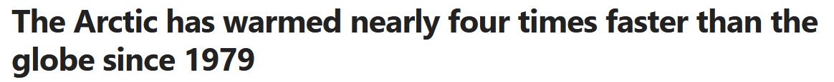
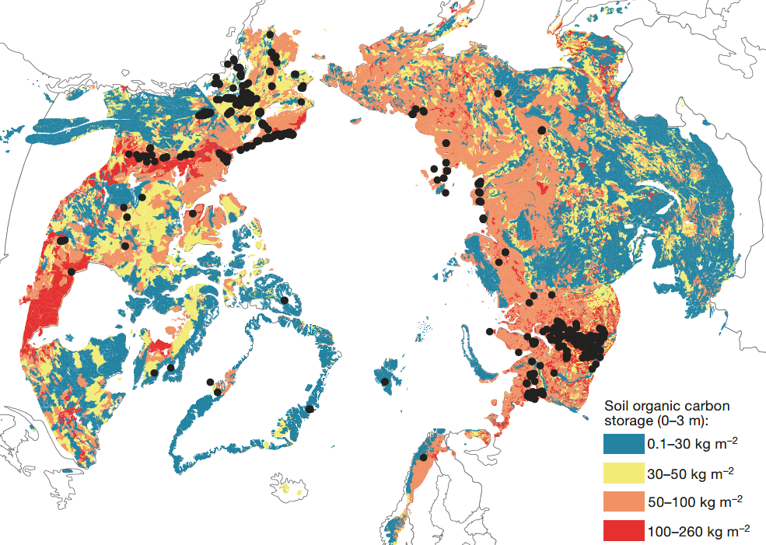
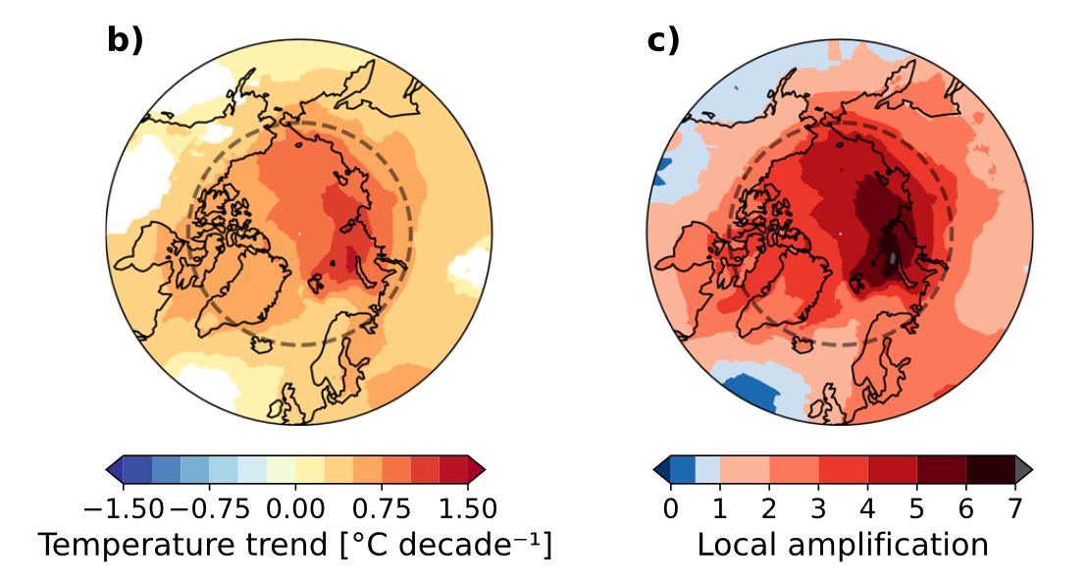
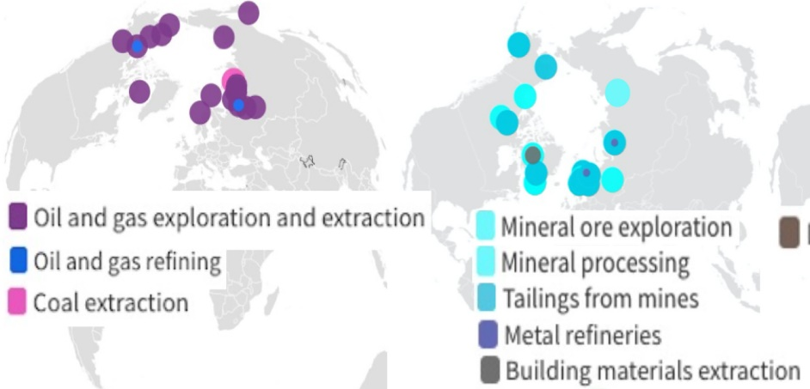
The Changing Arctic
Weather & Climate
Resource Extraction
Climate Feedbacks
Permafrost Carbon
Hanaček et al. 2022, Ecological Economics
Rantanen et al. 2022, Comm. Earth & Env.
Schuur et al. 2015, Nature
Arctic temperatures have increased 3-4 times global average and this trend is expected to continue
Changes occurring in multiple Arctic systems (land, atmosphere, ocean, cryosphere) are linked to climate and other anthropogenic drivers
New, enhanced observations are needed over the Northern high latitudes to improve weather prediction, situational awareness and environmental science and monitoring for societal benefit

Slide 3
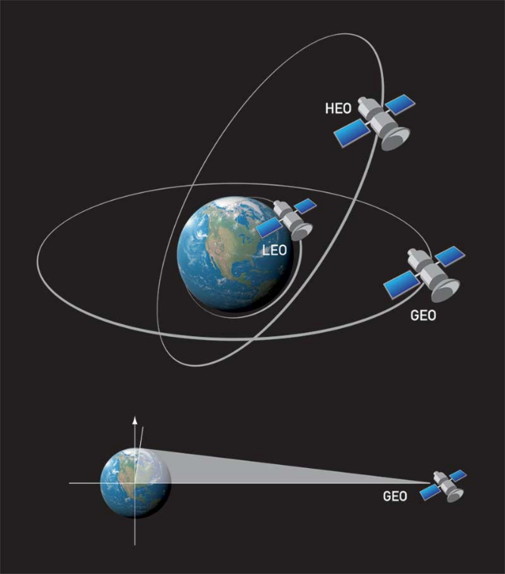
Satellite Orbits
Low Earth Orbit (LEO) satellites give global coverage but with low temporal revisit rates
Geostationary Orbit (GEO) gives rapid revisit, but satellite coverage is limited to ~60ºS-60ºN due to viewing geometry from equatorial orbit
A Highly Elliptical Orbit (HEO) can address the spatial/temporal gap over one circumpolar region, here the North

Slide 4
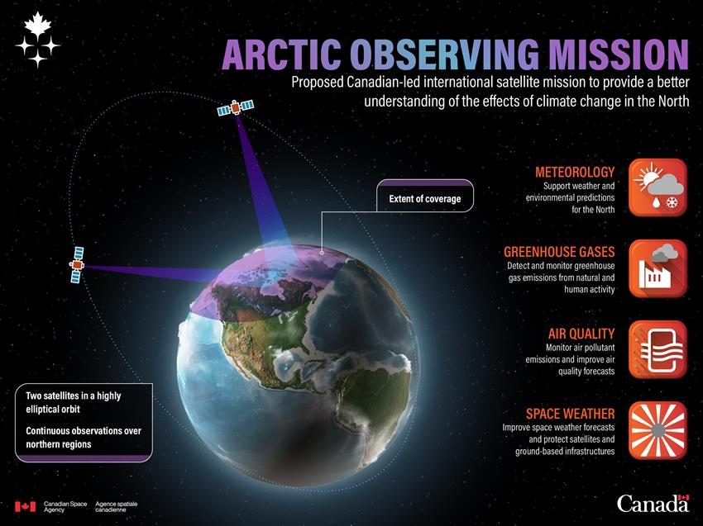
AOM
Proposed Canadian-led international satellite mission to provide improved environmental monitoring and situational awareness in the Arctic region
Observations north of ~40°N

Slide 5
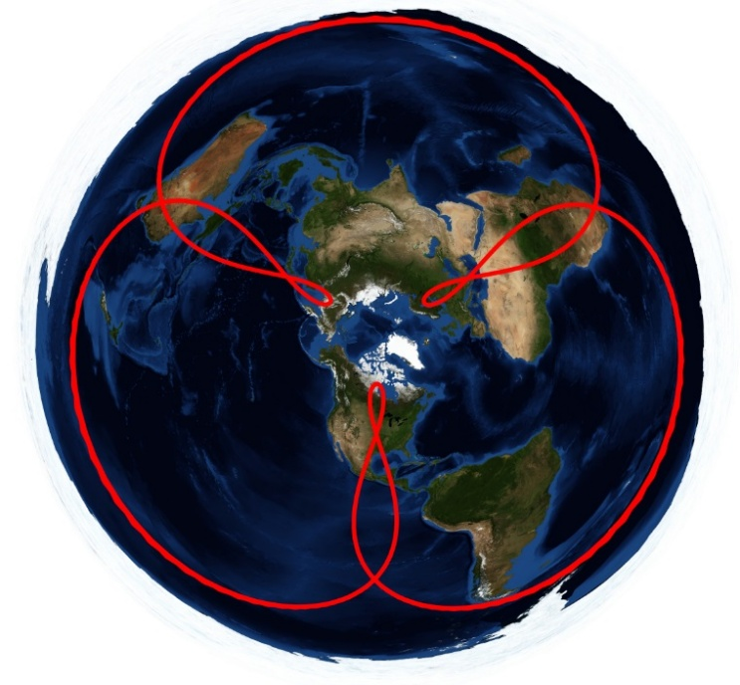
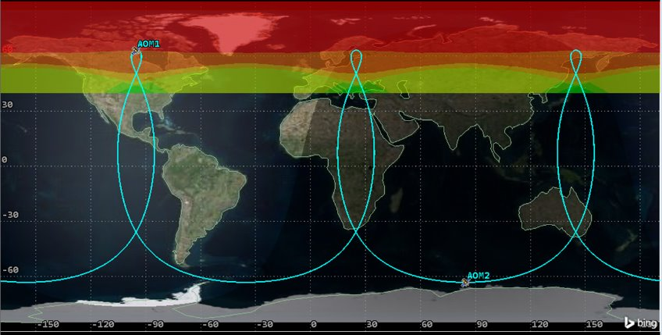
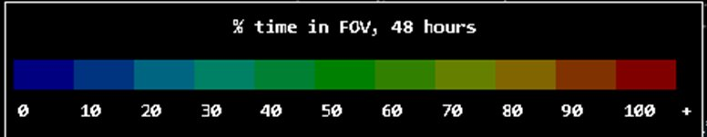
AOM Orbit
Many science and technical implementation factors considered & weighed in orbit selection process.
Three-Apogee (TAP) orbit selected to optimize apogee height (SNR and spatial resolution performance) while meeting geographic coverage requirements (for continuous meteorological observations down to at least 65°N).
Ground stations in both North America and Europe are required to enable continuous access to the AOM spacecraft throughout their operational period (apogee±1/3 orbital period).
Three Apogee (TAP)
Orbit
Eccentricity | Apogee Height | Inclination | Period
0.50 | 41,885 km | 63.435° | 16 hours

Slide 6
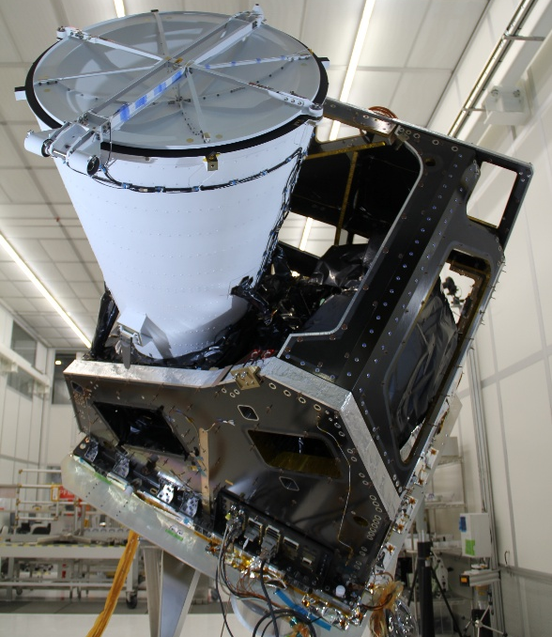
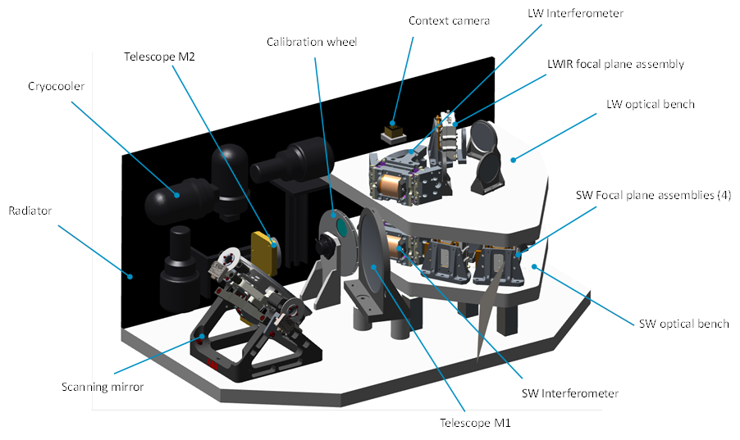
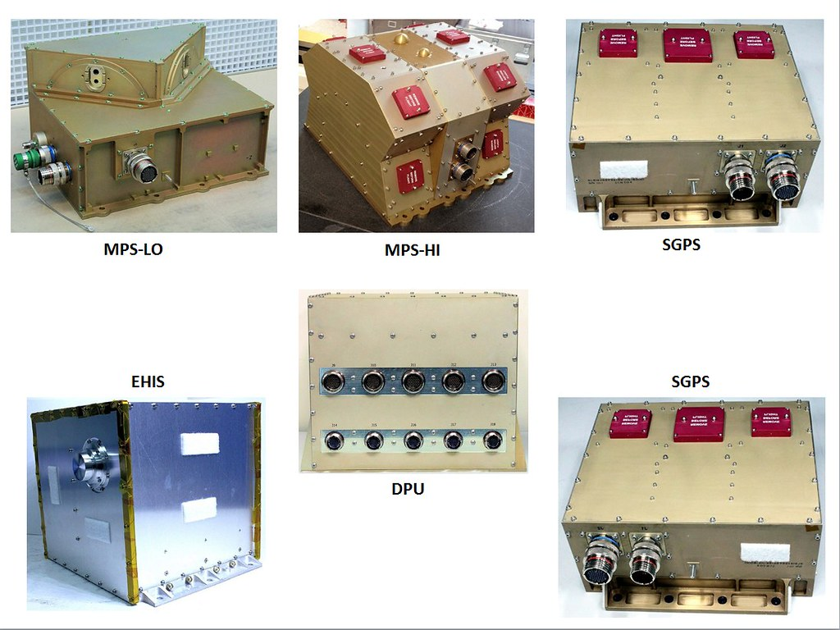
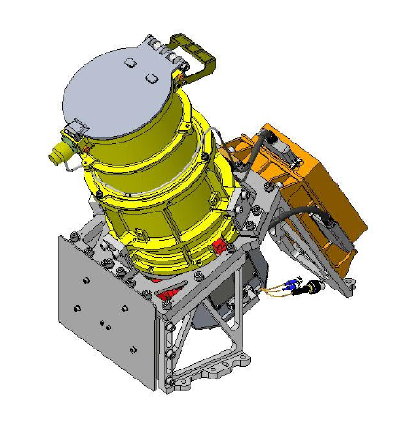



Proposed AOM Payloads and Partnerships
Meteorological Imager
Infrared Sounder
Imaging Fourier Transform Spectrometer (IFTS)
6 hyperspectral bands:
NIR and 3 SWIR for retrieval of CO₂, CH₄, CO and solar induced fluorescence (SIF)
MWIR and LWIR for enhanced vertical information (temperature, water vapour, ozone, 3D winds) and other trace gas profiles for meteorology, air quality and climate.
Multi-spectral VIS-IR Imager (16+ bands - e.g. FCI, GXI, Canadian MSI)
Space Weather Payload
Varying levels of potential partnership are under discussion
Auroral Imager, Particle Detectors, Magnetometer

Slide 7
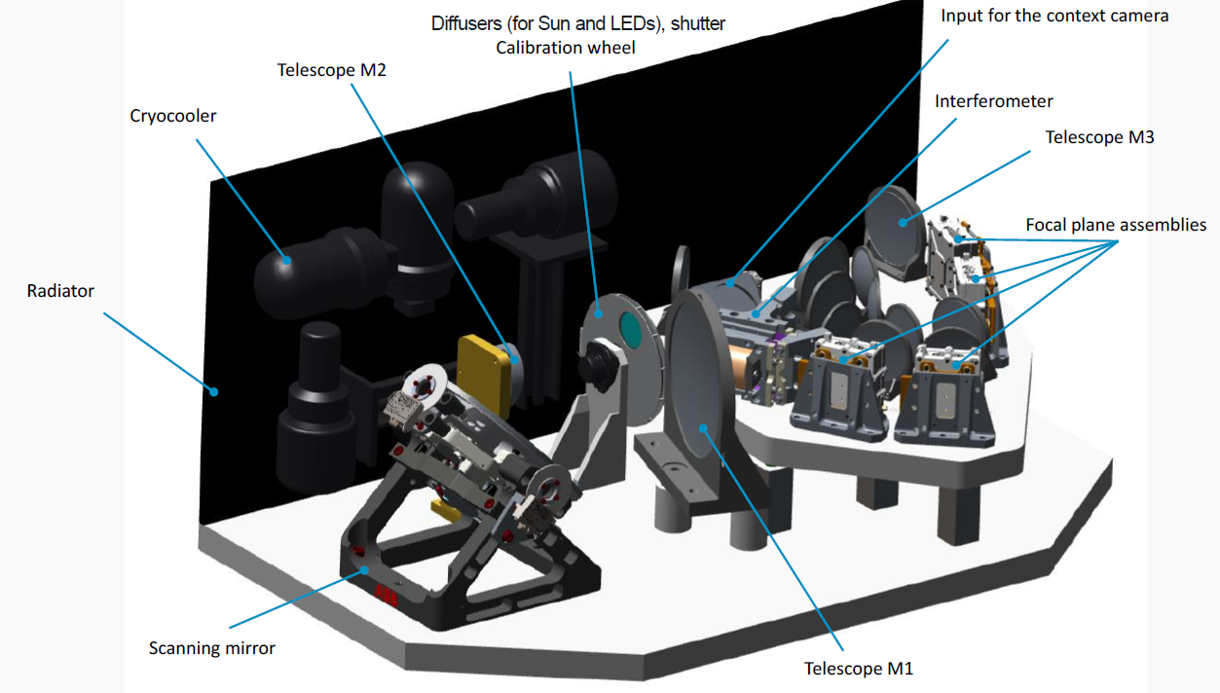
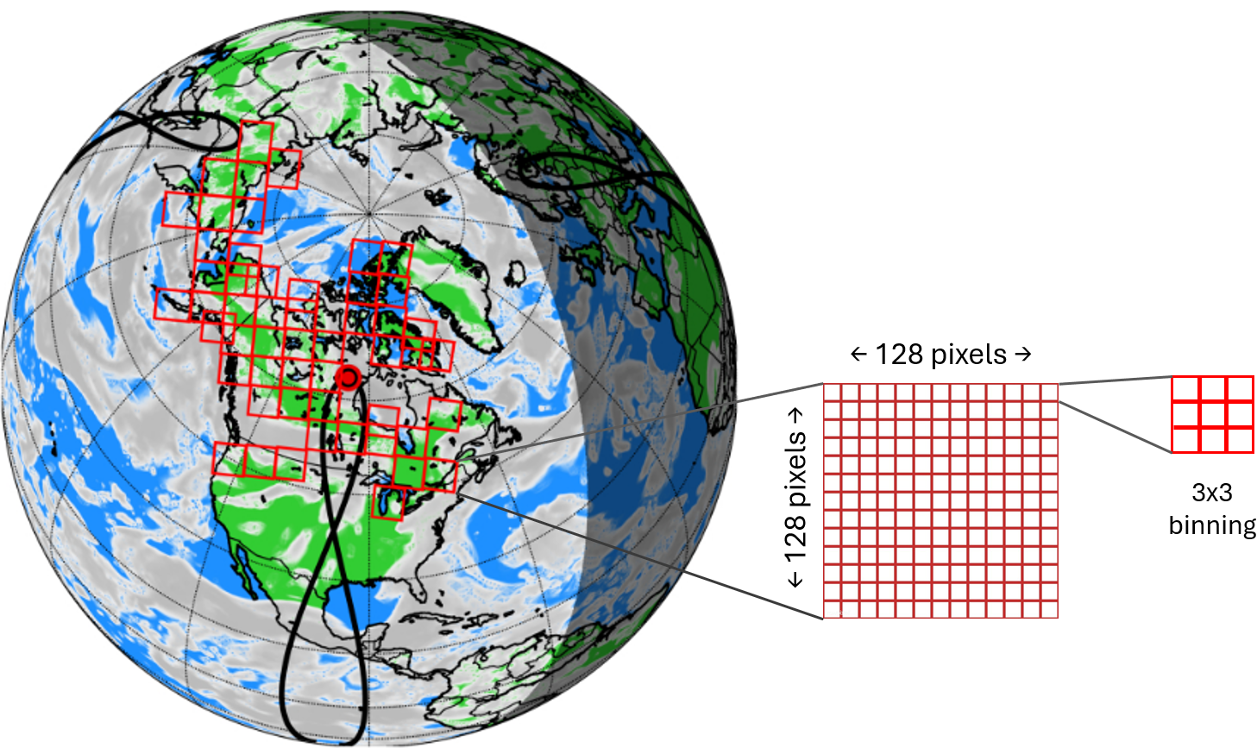
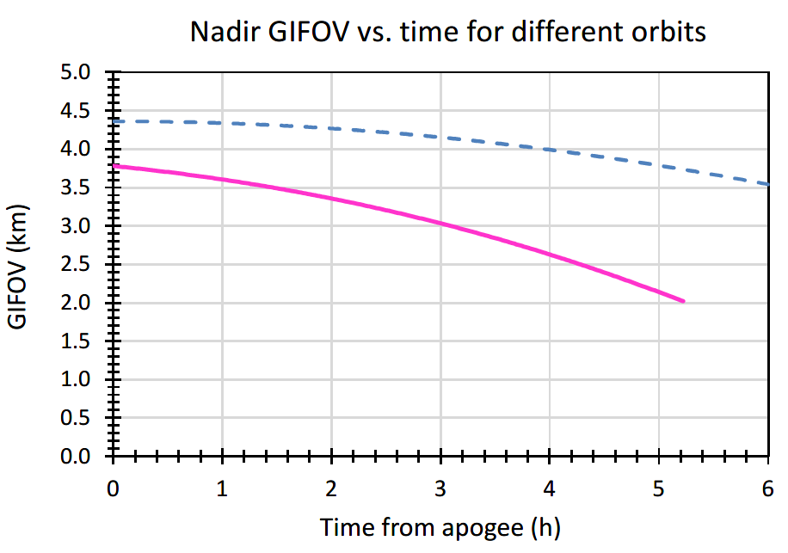

Imaging Fourier Transform Spectrometer (IFTS)
If observing mainly clear sky areas using a cloud mask from the Met imager, the IFTS can obtain hourly column-averaged CO₂, CH₄ and CO observations and solar induced fluorescence (SIF) observations over cloud-free land north of 40°N during daylight. CO₂ and CH₄ will be assimilated in a model to obtain surface fluxes.
Using 2D focal plane arrays (FPAs), IFTS will record interferograms in a 128x128 (binned) pixel field-of-view (FOV) every 60 seconds.
Tundra
Level 0 Interferograms, later transformed to spectra
Pixel size (km)
TAP
 | Binned Pixel | Unbinned Pixel
At 40,000 km | 3.6 km | 1.2 km
TAP orbit average | ~ 3.0 km | ~ 1.0 km
Due to changing satellite altitude, pixel size varies during orbit.
*Only binned pixels meet threshold precision & accuracy
Each binned pixel is made up of 9 ‘unbinned’ pixels, which can potentially be available for applications that favour spatial resolution over precision (if pointing stability goal can be achieved).
Level 3
Hourly 3D CO₂ and CH₄ fields (1°x1°)
Level 4
Monthly CO₂ and CH₄ surface fluxes (1°x1°)
54 FOVs observed per hour (due to repointing time).
Level 1
Level 2
Baseline spectral sampling interval 0.30 cm⁻¹
Band | Wavelength (μm) | Wavenumber (cm⁻¹) | SNR Goal & Threshold | Expected SNR
1) O₂ A | 0.758 – 0.772 | 12953–13192 | 54 / 18 | 20
2) CO₂ – 1 | 1.598 – 1.618 | 6180–6258 | 119 / 40 | 91
3) CO₂ – 2 | 2.042 – 2.079 | 4810–4897 | 116 / 40 | 99
4) CH₄, CO | 2.301 – 2.380 | 4195–4345 | 140 / 50 | 87
Expected precision (1σ) for binned pixel
XCO₂ | ~2 ppm (~0.5%)
XCH₄ | ~18 ppb (~1.0%)
XCO | ~ 5 %
SIF | ~1.5 Wm⁻² sr⁻¹ μm⁻¹
IFTS+
Possible addition of longwave and mid-wave infrared bands (LWIR, MWIR) would also enable measurements of N₂O along with vertical profiles of CO₂, CH₄ and CO during day/night, summer/winter and over land/water.

Slide 8
IFTS+ HEO IR Sounder
Imaging Fourier Transform Spectrometer (IFTS)
Band | Wavelength (μm) | Wavenumber (cm⁻¹)
1) O₂ A | 0.758 – 0.772 | 12,953 – 13.192
2) CO₂ – 1 | 1.598 – 1.618 | 6180 – 6258
3) CO₂ – 2 | 2.042 – 2.079 | 4810 – 4897
4) CH₄ & CO | 2.301 – 2.380 | 4195 - 4345
5) LWIR | ~7.1 - 14.7 (goal) | ~680 - 1400 (goal)
6) MWIR | ~4.44 - 6.25 (goal) | ~1600 - 2250 (goal)
IFTS+ adds 2 new spectral bands (LWIR & MWIR) for vertical info on temperature, water vapour and 3D winds for meteorology, along with retrieval of trace gas profiles (O₃, NH₃, N₂O, CO, CO₂, CH₄...).
Alternate scan patterns to intelligent pointing are now being studied at ECCC to optimize coverage for meteorological applications.
“Resizing” IFTS: e.g. 0.625 cm⁻¹ spectral sampling to match IRS, GIIRS, GXS and Himawari Sounder; 160x160 pixels to improve instantaneous coverage and revisit, optical design changes to improve SNR / reduce dwell time.
5-band dual-interferometer IFTS
Baseline 20 cm aperture. Dual interferometer design adds ~50 kg, no added volume compared with 4-band IFTS. Each beamsplitter is optimized for its spectral region so SNR for NIR-SWIR is maintained. Interferometers can operate at different spectral sampling/resolution. Spacious 2nd level has room for 5th and 6th band (MWIR+ LWIR) delivering the most benefits.

Slide 9
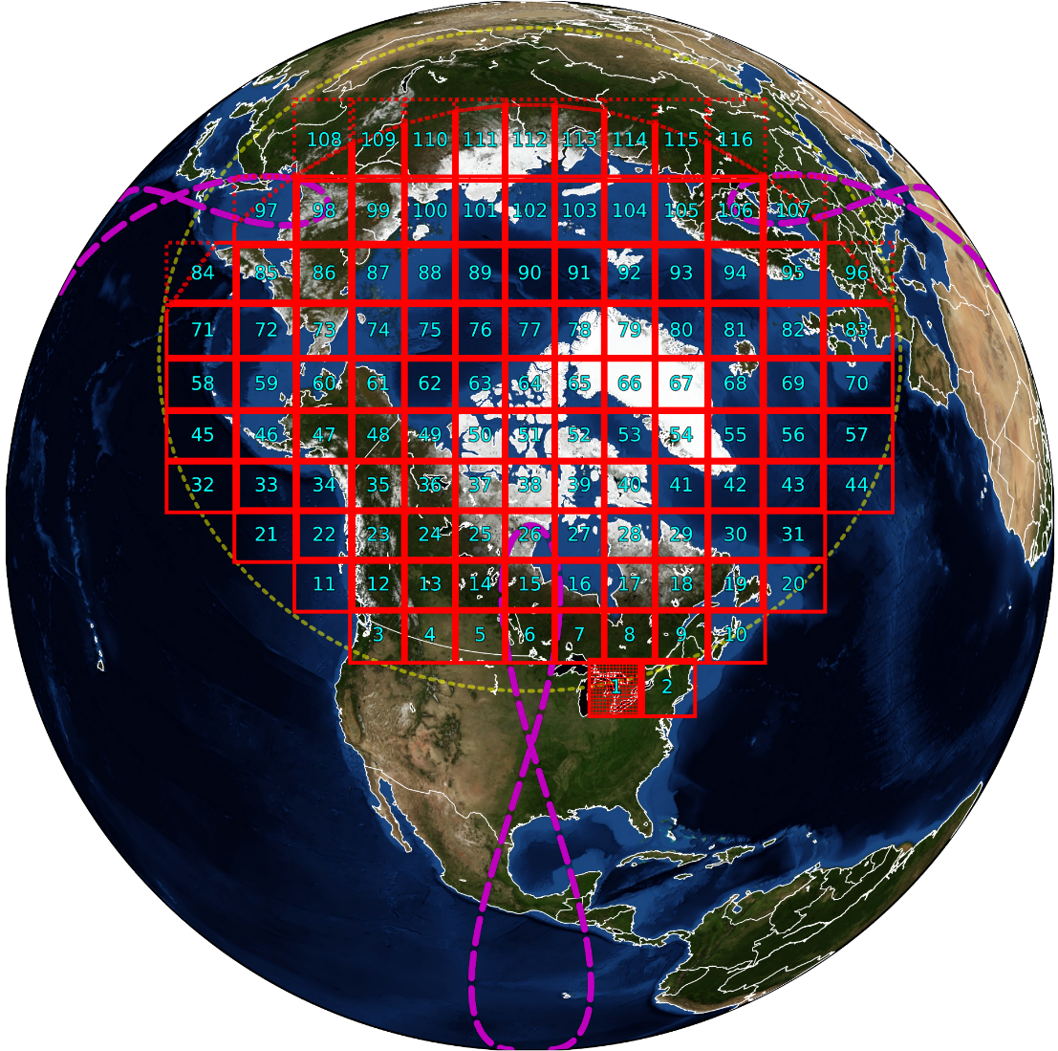
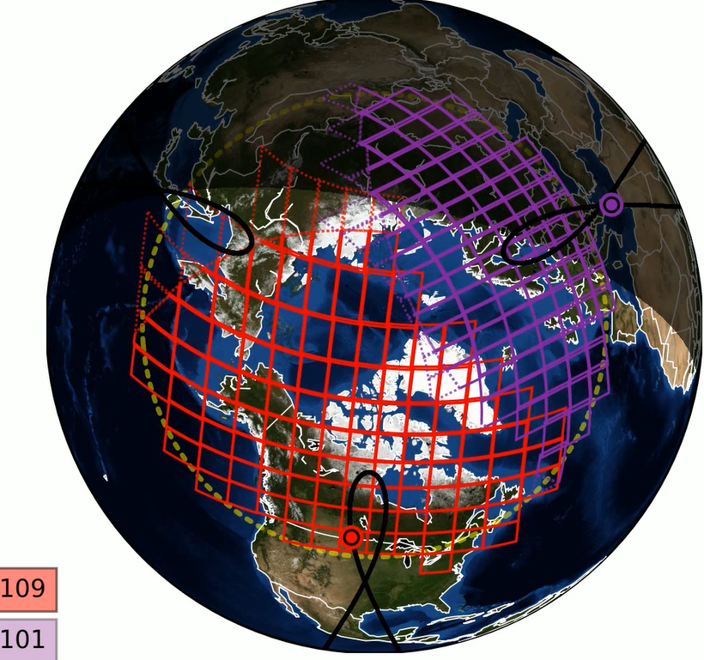
Studies on IR Sounder Scanning, Coverage and Revisit
One satellite at apogee
Two satellite viewing
From apogee ~116 Fields of View (160x160) are needed for circumpolar coverage north of 45°N and the rest of Canada, with view zenith angles ≤60°.
About one third of the time, dual satellite viewing is possible, giving ~105 FOVs/satellite, improving the revisit rate.
IFTS design changes to reduce dwell time from 60 s to ~20-23 s would enable ≤ 40 min. revisit

Slide 10

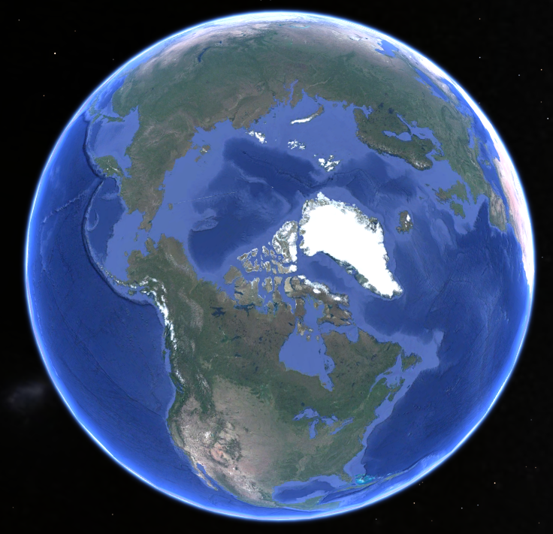
VIS-IR Imager
Each AOM satellite will carry a meteorological imager with 16 or more image channels.
FCI Instrument:
Channel | Colloquial Name | Applications | Central λ (µm) | λ width (µm) | Resolution (km)*
VIS 0.4 | Blue | clouds, aerosol, surface | 0.444 | 0.06 | 1.0
VIS 0.5 | Green | clouds, aerosol, vegetation | 0.510 | 0.04 | 1.0
VIS 0.6 | Red | clouds & fog, snow/ice, winds | 0.640 | 0.05 | 1.0
VIS 0.8 | Veggie | vegetation, winds | 0.865 | 0.05 | 1.0
VIS 0.9 | Low-Level WV | water vapour (WV) | 0.914 | 0.02 | 1.0
NIR 1.3 | Cirrus | Cirrus detection | 1.38 | 0.03 | 1.0
NIR 1.6 | Snow/Ice | cloud phase, snow/ice | 1.61 | 0.05 | 1.0
NIR 2.2 | Particle Size | particle size, cloud phase, smoke | 2.25 | 0.05 | 1.0
IR 3.8 | Fire | fires, microphysics, winds | 3.80 | 0.40 | 2.0
WV 6.3 | Upper-Level WV | WV, winds, rainfall | 6.30 | 1.00 | 2.0
WV 7.3 | Lower-level WV | WV, winds | 7.35 | 0.50 | 2.0
IR 8.7 | Cloud-Top Phase | cloud phase, TPW | 8.70 | 0.40 | 2.0
IR 9.7 | Ozone | turbulence, total O₃ | 9.66 | 0.30 | 2.0
IR 10.5 | Clean IR | SST, clouds temp | 10.50 | 0.70 | 2.0
IR 12.3 | Dirty IR | TPW, dust, ash | 12.30 | 0.50 | 2.0
IR 13.3 | CO2 | air temp, cloud height | 13.30 | 0.60 | 2.0
Near real-time Level 1 imagery can be used directly by meteorologists to improve short-range forecasts and can be assimilated in numerical weather prediction (NWP) systems.
A wide range of Level 2 data products can also be retrieved including: aerosol, cloud, wind, rain, snow, surface albedo, skin temperature, fire hotspot, and sea/lake ice parameters.
View from the TAP Orbit’s North American Apogee:
The hyperspectral LWIR and MWIR band of the IR Sounder also provide observations of significant meteorological value, specifically temperature and humidity data with much more vertical information than from a VIS-IR imager, and possibly 3D winds. Assimilation of LWIR and MWIR radiances and 3D winds in NWP are expected to substantially improve forecast skill in northern regions.
*Resolutions are for FCI in GEO, but AOM resolution will vary throughout its elliptical orbit. AOM resolution will be ~17% coarser near apogee of the proposed TAP orbit, but will be finer than above when AOM is acquiring imagery at altitudes lower than GEO (35,786 km; AOM will be at GEO altitude at ±3.3 h from apogee).

Slide 11
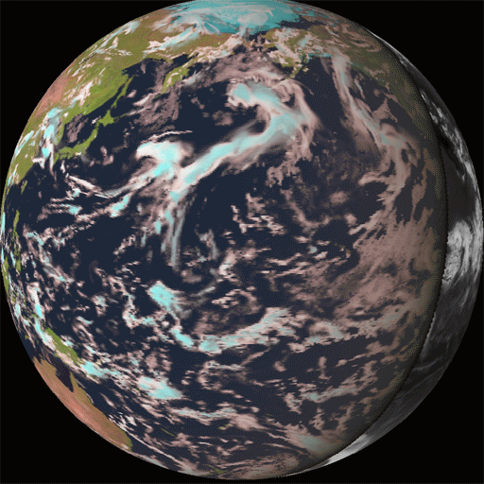
Key Meteorological Benefits
Transformative data sets for nowcasting operations:
Increased temporal (≤ 15 mins) and spatial resolution (~1 to 2 km at nadir) over the pan-Arctic domain
Reduction of parallax effects at mid to high latitudes
Significant gains will be made in the IR channels (e.g. cloud top temperature)
Enhanced observations of:
  Wildland fires and smoke ▪ Tracking of high Arctic systems
  Blowing snow/blizzards ▪ More details and tracking of polar lows
  Thunderstorm activity ▪ Continuous ice motion (in cloud free areas)
  Sea spray and better observations for marine regions
Support METAREAs, VAAC, Aviation & Defence services etc.
Address capability gaps
Substantial contributions to NWP skill anticipated
Improved coverage of atmospheric motion vectors, particularly from 50-70 N (between dense GEO and LEO coverage)
Continuous radiance observations at pan-Arctic scale
LWIR and MWIR bands on GHG instrument will complement coverage of planned GEO IR sounders, with possibility for 3D wind products if sufficiently short revisit time can be achieved
Earth view from TAP orbit
TOA modeled radiative fluxes (24-h @ 15 min) at 30 km spatial resolution.
Daytime images Nighttime images
Red – 1.6 μm Greyscale - 11 μm
Green – 0.85 μm
Blue – 0.63 μm

Slide 12
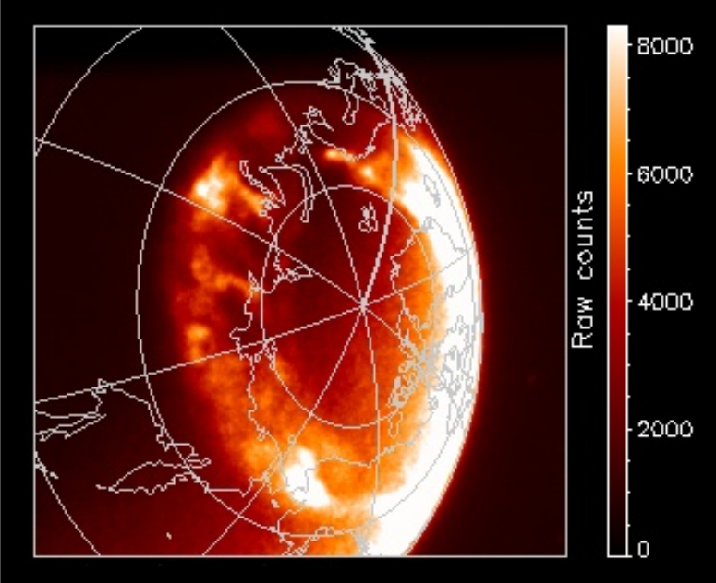
Space Weather Instrument Suite
HEO provides a unique vantage point for both in situ and remote sensing of space weather.
Space weather is outside of ECCC’s mandate, but of interest to OGDs: especially NRCan and DND.
AOM space weather instrument suite is less mature than other payloads, but could consist of:
  an Auroral Imager observing in the far-UV
  a magnetometer on a 1-2 m boom
  an energetic particle (electron, proton, ion) detector
  plasma analyzers
e.g. Auroral imaging from the past NASA Image mission

Slide 13
AOM Timeline
2022-2025: Pre-formulation Studies – Phase 0
2025-2026: Working to secure funding for mission development and implementation as well as support from international partners.
Letters of Support from: EUMETSAT, FMI, NordMet Council, CEOS, WMO, …
If successful:
2028-2033: Phases A-C (Definition and Design)
2033-2038: Phase D (Build, integrate, launch, commissioning)
2038-2048: Phase E (Operations)
Notes:
Select Phase 0 deliverables:
GHG instrument sub-orbital demonstration stratospheric balloon flight: August 2022
NOAA-funded meteorological imager adaptation study with L3Harris: Completed December 2022
Socio-economic benefits study (EuroConsult): Completed June 2023
GHG observing strategy (intelligent pointing) manuscript: Published October 2023
AOM CO₂/NO₂ science study (Univ. of Toronto): Completed March 2024
AOM Mission Design Contract (MDA, ABB, Airbus): Completed March 2025
GHG instrument Focal Plane Array (FPA) study: Started Fall 2023, ongoing
Various other science/application studies (AOM OSSE, orbit studies, etc): in progress

Slide 14






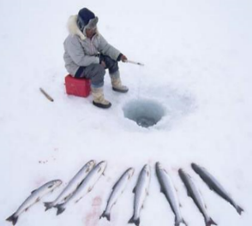
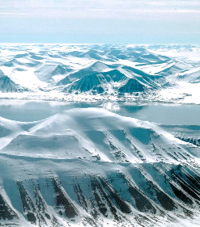
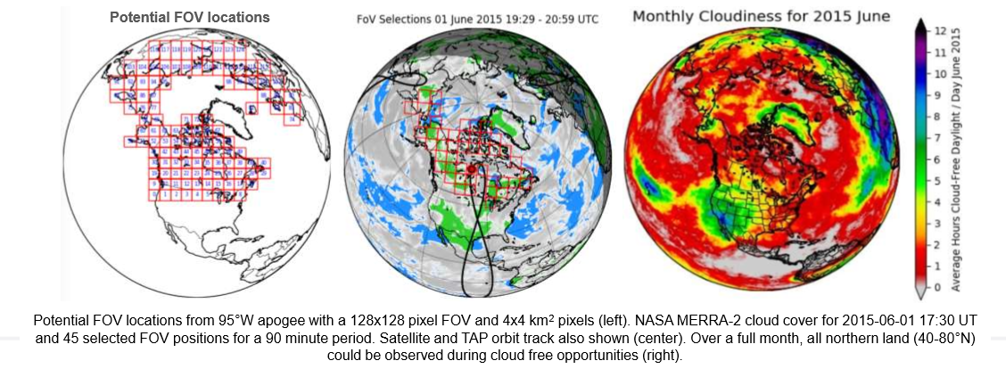
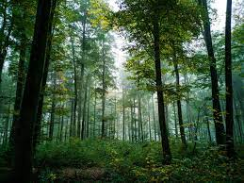
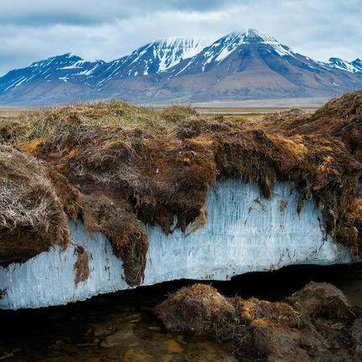
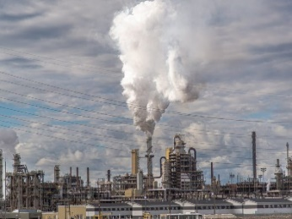

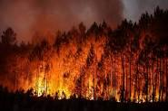
Anticipated Benefits
Obtaining high density and high frequency observations of weather, climate, air quality and space weather over northern latitudes would benefit Arctic and northern communities in many profound ways, including:
Improved
Weather
Forecasting
Infrastructure
& Transport
Networks
Hazard
Identification
& Response
Climate Change Adaptation
& Resilience
Reducing GHG
Emissions
Arctic
Environmental Stewardship

Slide 15


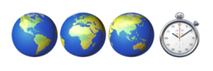
International Perspectives
AOM could contribute to many international priorities including:
AOM could provide complementarity with many international missions:
  Extend the GEO ring to high northern latitudes (MTG/M4G, GeoXO, etc)
  Contribute to the CEOS Atmospheric Composition Virtual Constellation (AC-VC)
International partnership remains essential for AOM’s business case and to ensure overall mission success
Global Greenhouse Gas Watch (G3W)
Notes:
Also note:
- WMO Vision for WIGOS in 2040
- Complementarity with other Canadian missions (RADARSAT+, WildFireSat, HAWC on AOS, TSMM)

Slide 16
Summary
AOM is a high-priority initiative that Canada continues to advance​ with input from key international partners
AOM responds to ECCC, Government of Canada, and international priorities in the domains of meteorology, climate, air quality and space weather
AOM would deliver new observational capacity across these domains at unprecedented frequency over Canada and other Northern regions (above ~40° N)
Attending GSICS to learn more about this group and prepare for future participation.
Notes:
Improve operations and service delivery in areas of weather, climate, air quality, and space weather
Collect authoritative data on greenhouse gases over northern latitudes to inform decision-making and support policies around climate change adaptation, mitigation and resilience
Improve the quality of life for Arctic and Northern communities
Enhance Canada’s contributions to Arctic monitoring and the international pool of satellite data

Slide 17



Slide 18
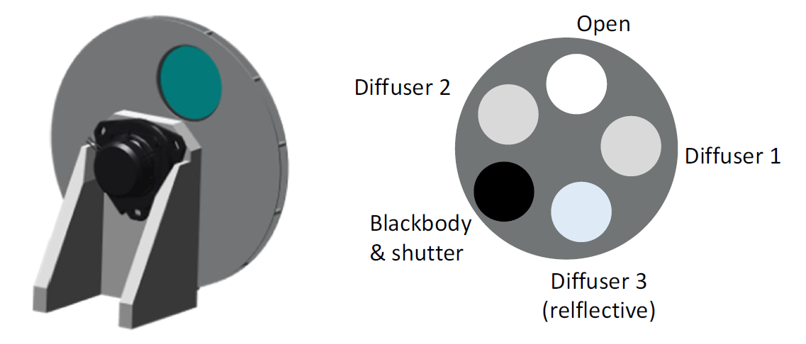
AOM IFTS Calibration Sub-system
Open: For observations or for Lunar calibration
Diffuser 1: Primary solar diffuser for Solar calibration
Diffuser 2: Secondary solar diffuser for Solar calibration and tracking degradation of Diffuser 1
Diffuser 3 (reflective): would work with onboard LED calibration sources
Blackbody & shutter: For calibration of LWIR/MWIR bands, acts as a shutter for other bands

Slide 19
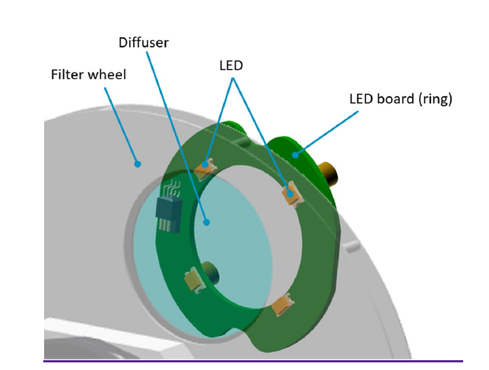
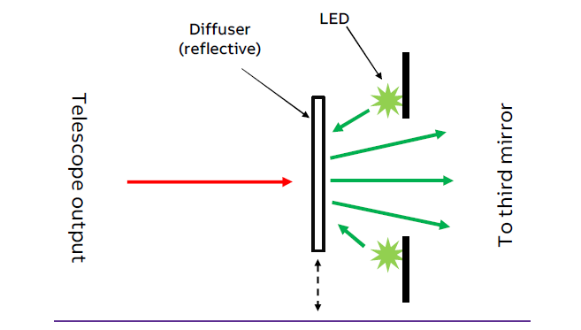
IFTS Onboard Calibration Light Source
At least 4 LEDs needed for 4 NIR-SWIR bands, but some redundancy would better enable detection of degradation to onboard sources.
Potential topic for technology development prior to Phase B

Slide 20

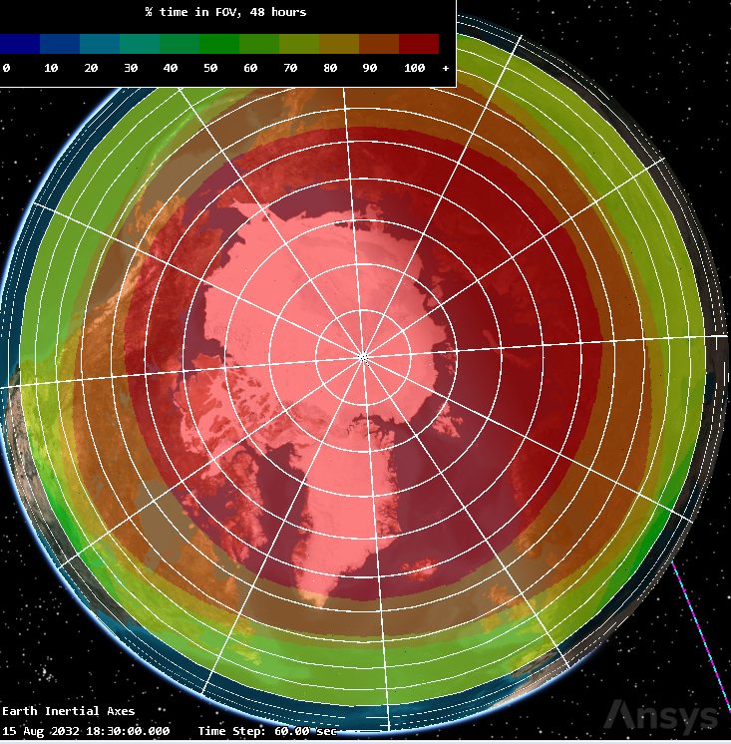
VIS-IR Imager: Coverage
AOM Mission requirements stipulate that the VIS-IR imager provide full disc imagery every 15 minutes or less, with continuous coverage above 65N and a goal for regional/mesoscale scan capability
Figures illustrate the % of time in a 48-hour ground track repeat period that a given location can be imaged by the VIS-IR Imager with acceptable viewing geometry (View Zenith Angle < 70°)

