Slide 1



NRC Aerospace Validation Activities and Support Infrastructure
George Leblanc
Team Lead: Remote Sensing Imagery Group (RSIG)
Drone Flight and Autonomy Laboratory (DFAL)
National Research Council Canada

Slide 2
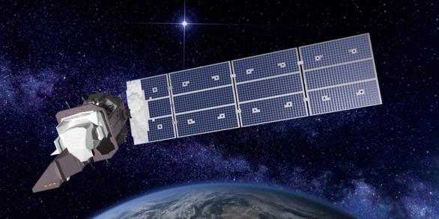
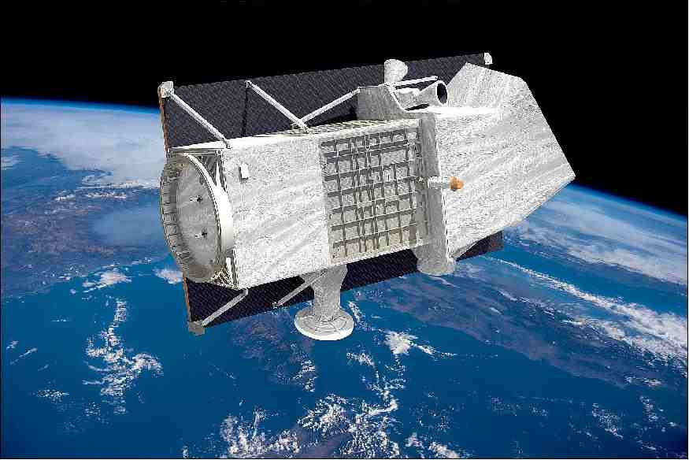
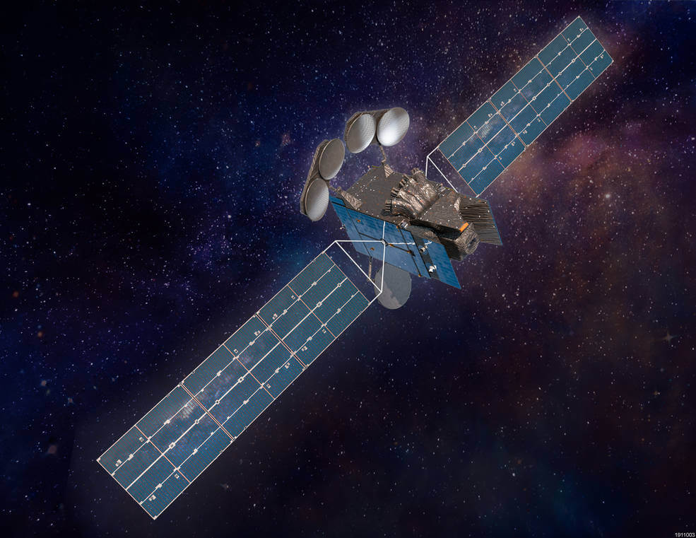
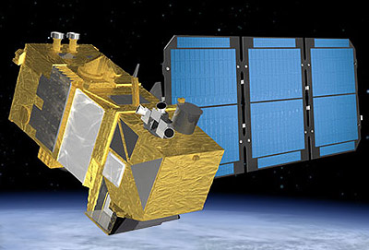
NRC AERO
Overview of Our Approach to EO Validaiton
Examples of Activities
Future

Slide 3
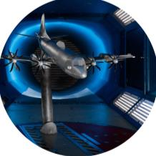
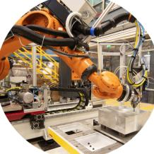
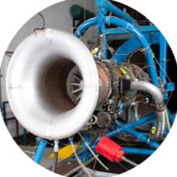
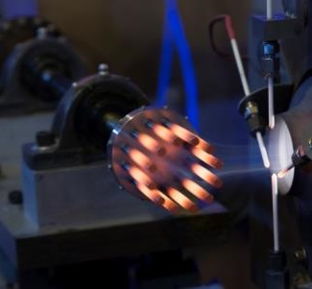
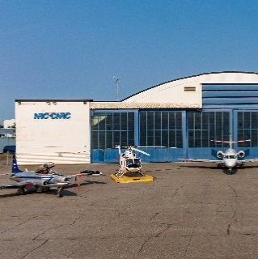
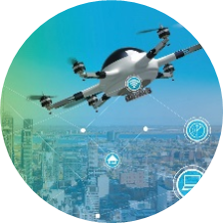
NRC Aerospace | Laboratories
Aerodynamics Laboratory
Aerospace Manufacturing Technology Centre
Propulsion and Power Laboratory
Structures and
Materials Performance Laboratory
Flight Research Laboratory
Drone & Flight Autonomy Laboratory
Subsonic to supersonic wind tunnel testing and aerodynamic evaluation of vehicles and propulsion systems across multiple scales
Additive manufacturing for repairing and sustaining CAF, and durable coatings for defence and dual‑use applications
Propulsion systems and engine testing
Flight testing, Intelligence, surveillance & reconnaissance, Simulation and Training, Human Health and Performance, and Environmental Assessments
Drone & counter-drone technology development, flight experiments, and flight autonomy
Structural health monitoring, fleet sustainment, and life extension

Slide 4
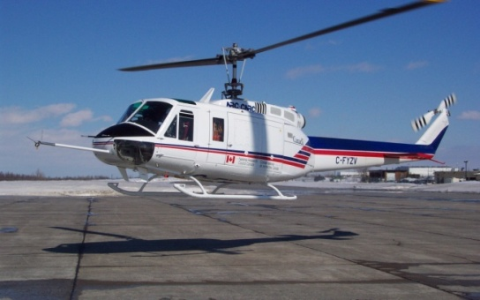
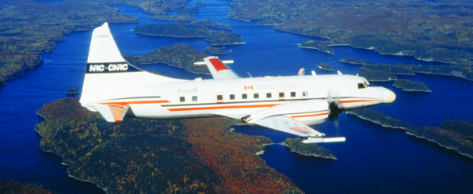
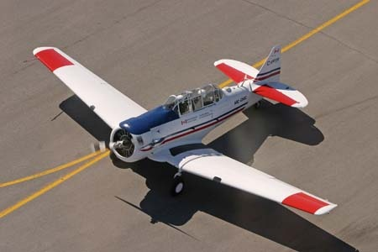
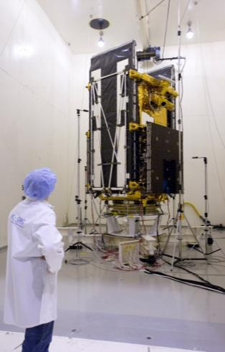
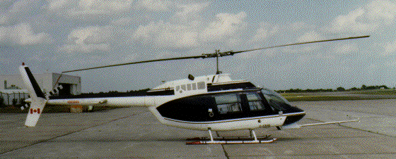
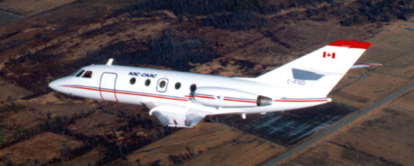
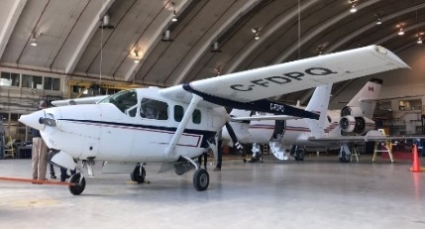
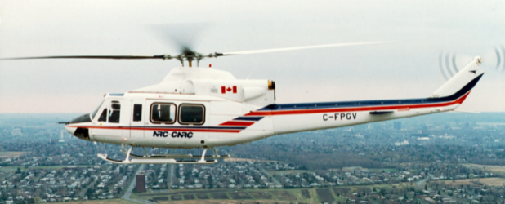
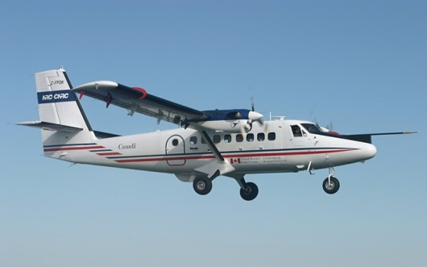
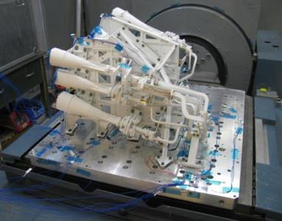
The Flight Research Laboratory
Bell 205: Airborne Simulator
Convair 580: Airborne Research
Harvard: Training/Aerobatics and
Alternative Fuels
Bell 206: Remote Sensing & Training
Falcon 20: Microgravity & Biofuels
C337: Hybrid Electric propulsion
acoustic
Bell 412: Flight Control Testbed
Twin-Otter: Biospheric & Remote Sensing
vibration

Slide 5
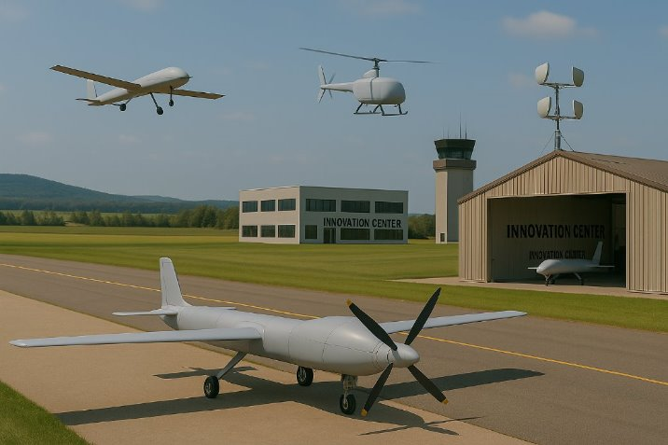
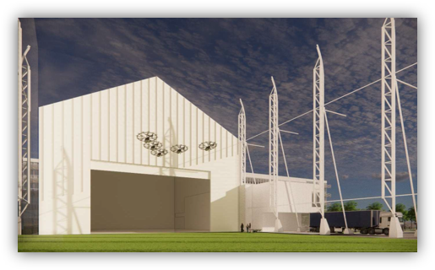
Drone and Flight Autonomy Lab (DFAL)
Centre for Drone Innovation (CDI)
Drone and counter drone R&D capability (0-25kg)
    Focusing on small drones / countering.
    Swarming, drone interception, flight arenas, drone prototyping & controlled environments.
RPAS and RPAS traffic Management R&D capability (~25-600kg)
    Focusing on medium RPAS R&D, BVLOS capabilities, UTM.
    Sandbox and flight experiments capabilities, fleet of RPAS, Ground Control stations.
Centre for Autonomous Flight Systems (CAFS)
Rotary and Fixed Wing autonomy / teaming R&D
capability
    Focusing on optionally crewed and large
    uncrewed (surrogate) aircraft.
    Group I, II and III RPAS
    Research, Fixed-wing autonomy, systems integration,
    and teaming technologies, Air Launched Effects.
    Simulators, telemetry room, aircraft
    integration space.
    Deployable experimentation support
    capability.
    Advanced ISR capabilities
A full complement of drone and surrogate platforms, sensors and people providing instrumented access for airborne needs

Slide 6
EO Validation Process

Slide 7
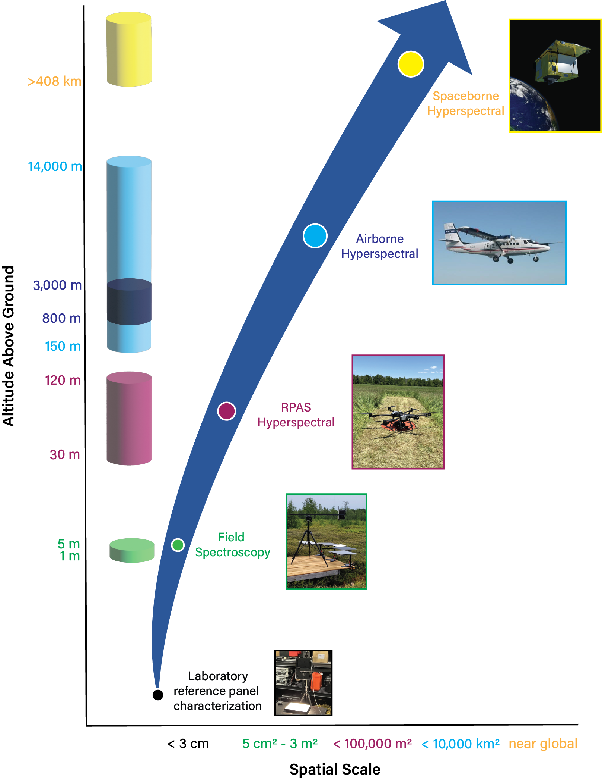
Validation via a bottom-up approach
Measurements that are traceability, uncertainty budget, well-developed protocols, etc.
Use of RPAS at the ground level.
Sensor: spectral uniformity and stability, calibration, good SNR, etc.
Platform: safety, stability, reliability, quality.
Best practices for low error measurements & new methodologies.
Uncertainty baseline
Development of IEEE Hyperspectral data standards

Slide 8

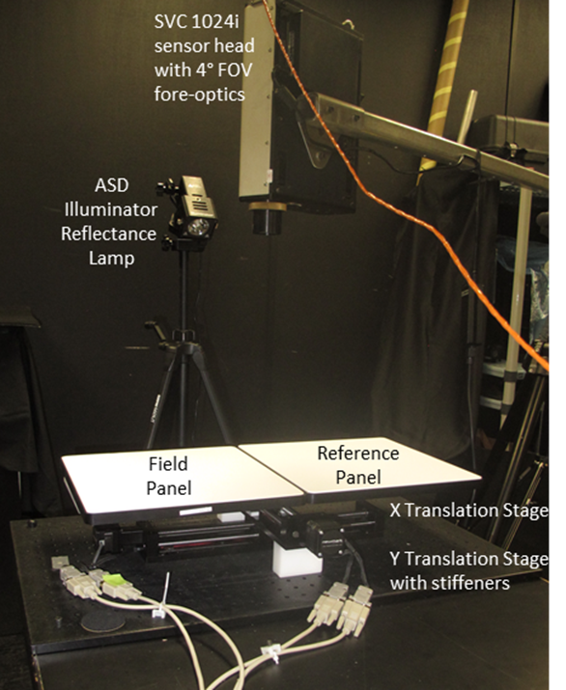
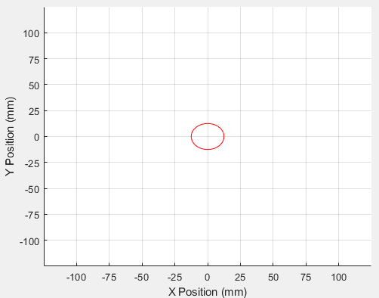
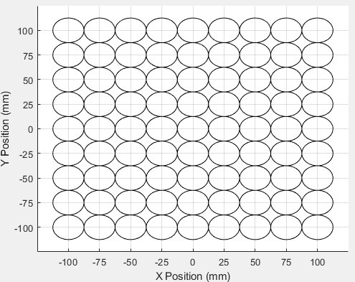
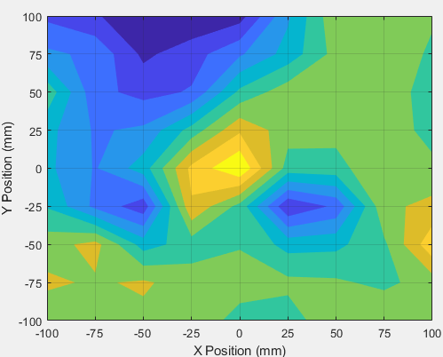
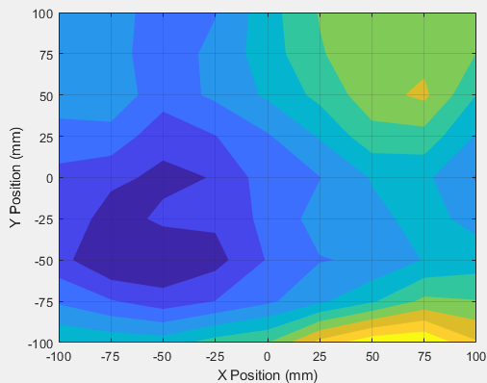
Laboratory – Uniformity Measurements
Reference Scan
Target Scan
NRC40% - 0.5 m Permaflect – 700 nm
NRC05% - 0.5 m Permaflect – 700 nm
Original - 25 mm sampling
Max = 100.02%
Min = 92.97%
Mean = 96.59%
SD = 1.534%
Max = 102.91%
Min = 99.05%
Mean = 100.54%
SD = 0.82%
Still not a calibration even in the lab

Slide 9
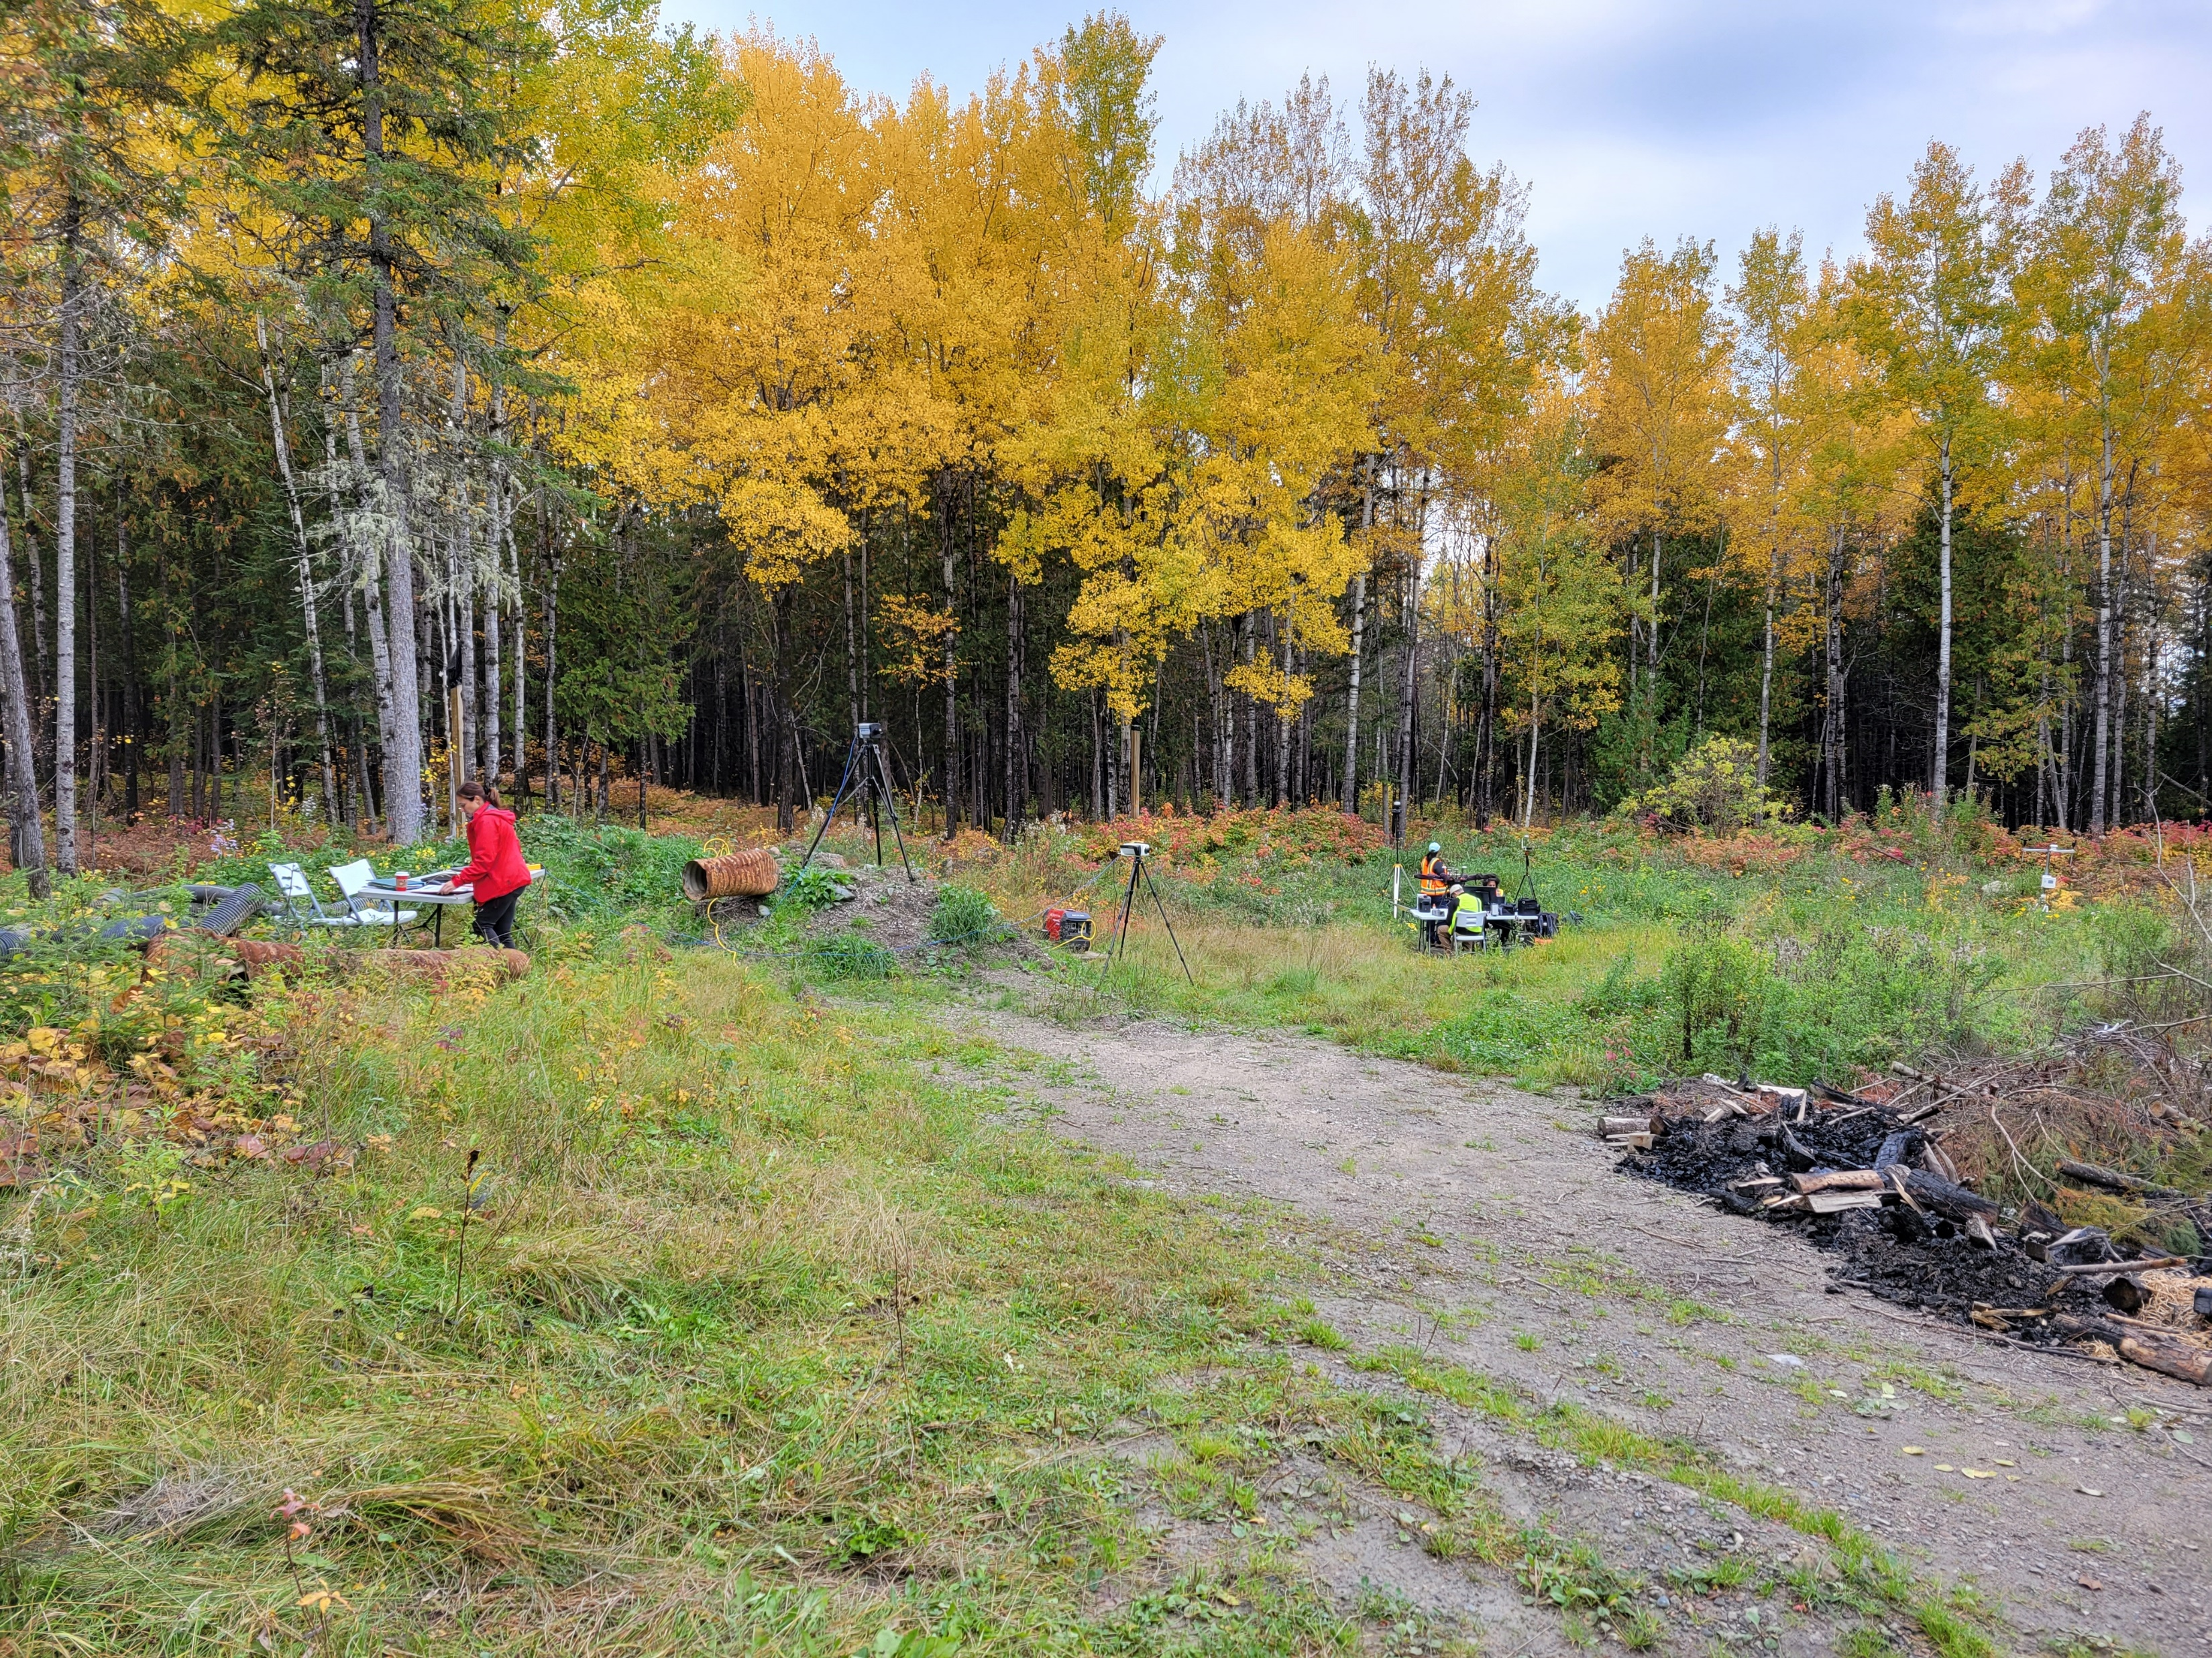
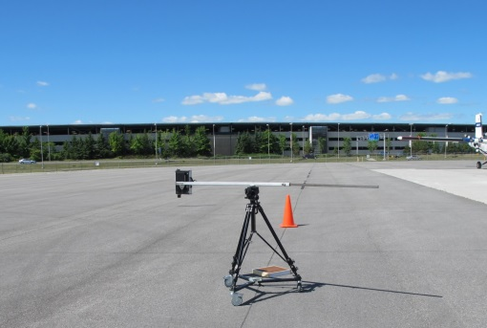
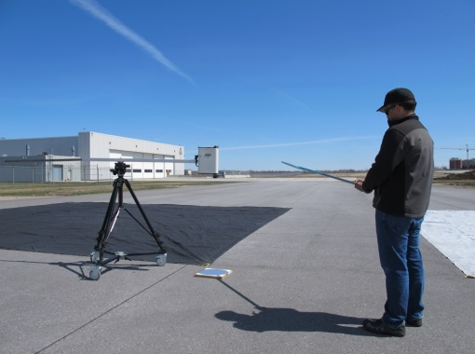
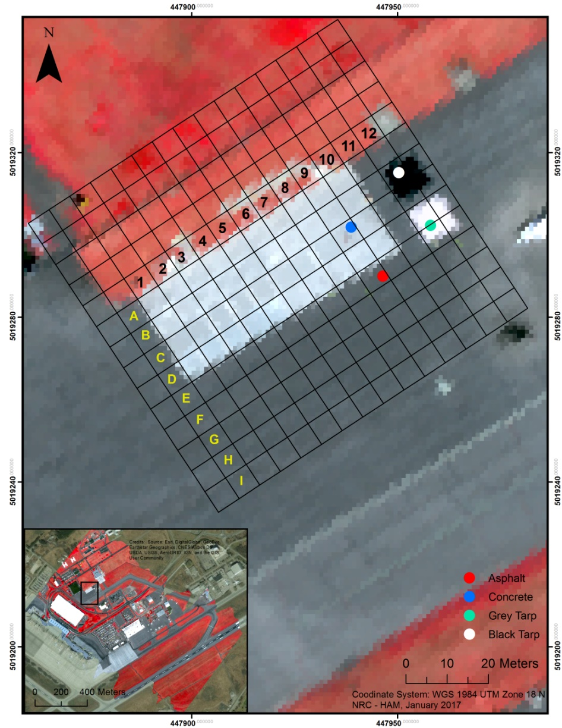
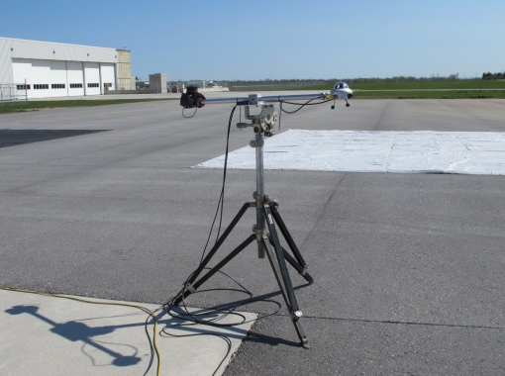
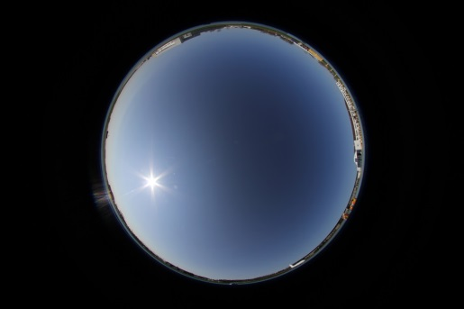
Validation Site Selection

Slide 10
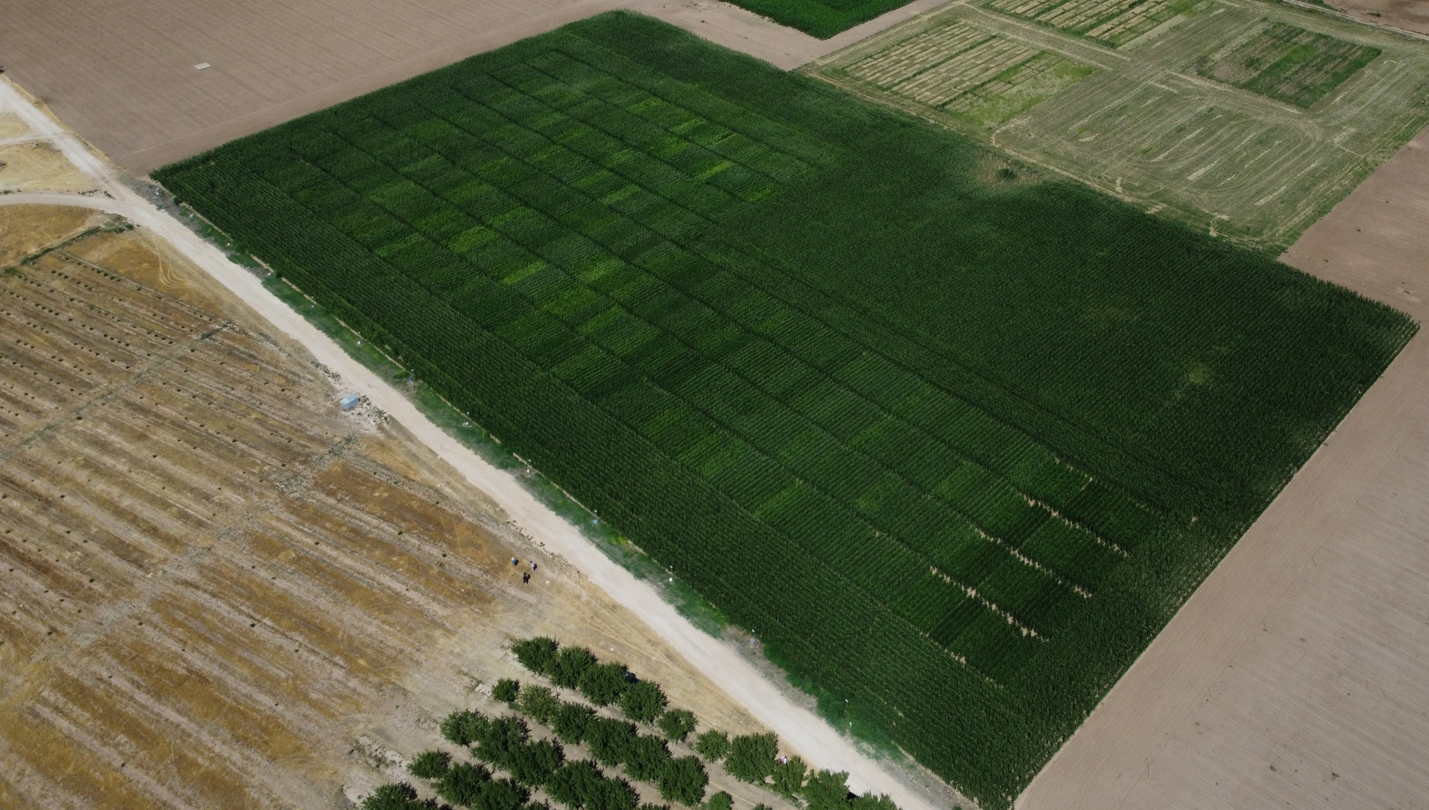
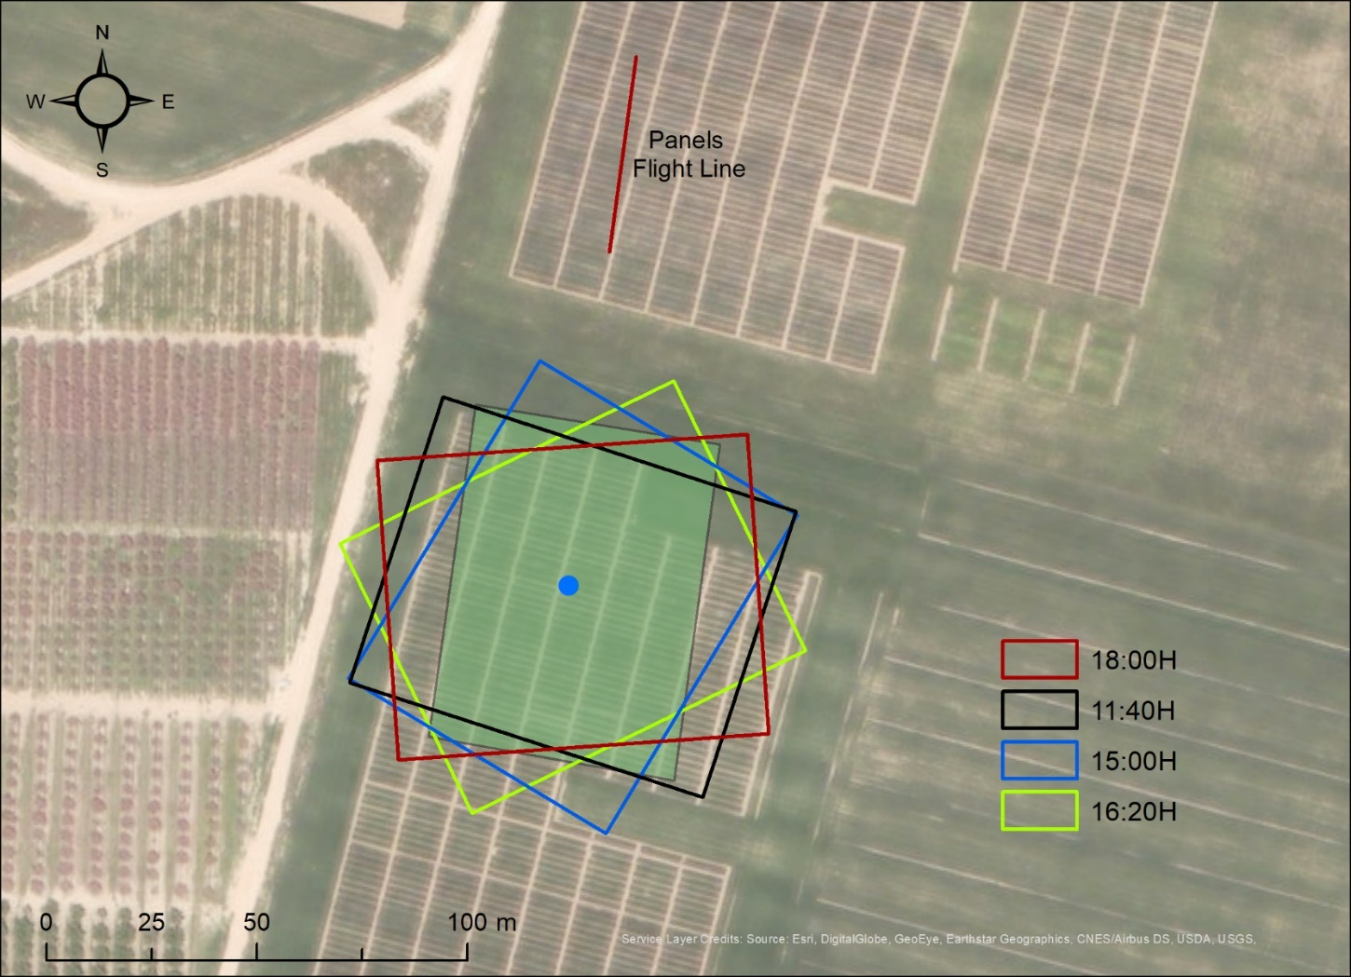
Flight Planning
Flight Heading as a function of solar azimuth
(Symmetrical BRDF)
Flight | Date | Start Time (UTC) | SZA (°) | SAA (°) | VZA(°) Cal/Val Targets | Alt (m AGL) | Heading (°)
19A | 2022-07-19 | 9:11:18 | 43.2 | 101.3 | 1.75 - 4.25 | 77.3 | 187.4
20A | 2022-07-20 | 9:13:23 | 42.9 | 101.9 | < 2.3 | 75.0 | 192.7
20B | 2022-07-20 | 10:46:36 | 26.3 | 128.0 | < 2.0 | 73.5 | 187.0
20C | 2022-07-20 | 16:38:22 | 58.7 | 272.2 | < 1.3 | 118.6 | 191.5
21A | 2022-07-21 | 9:29:25 | 40.0 | 105.4 | < 2.2 | 114.7 | 198.8
21B | 2022-07-21 | 13:25:03 | 24.0 | 224.1 | < 1.9 | 116.7 | 189.7
21C | 2022-07-21 | 14:35:56 | 35.5 | 248.8 | < 1.7 | 117.3 | 188.1
Each flight included an initial line of the cal/val targets and 3 parallel overlapping lines of the corn crop.

Slide 11
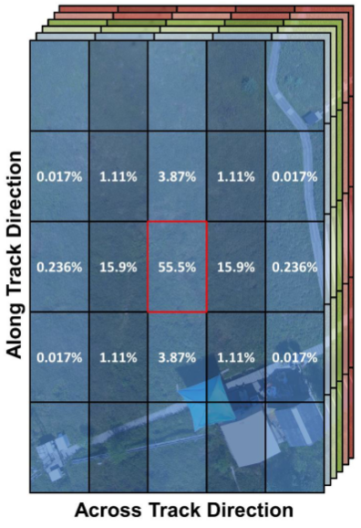
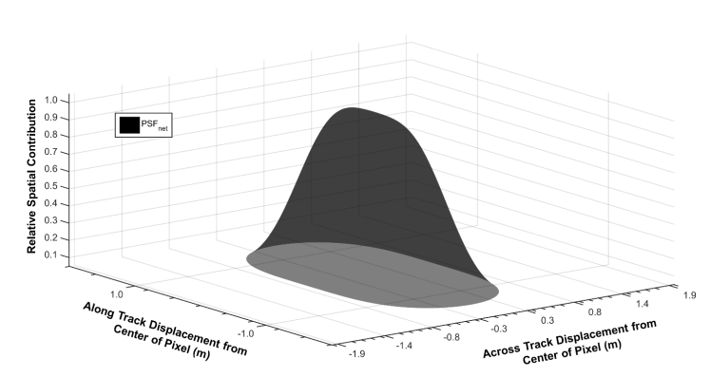
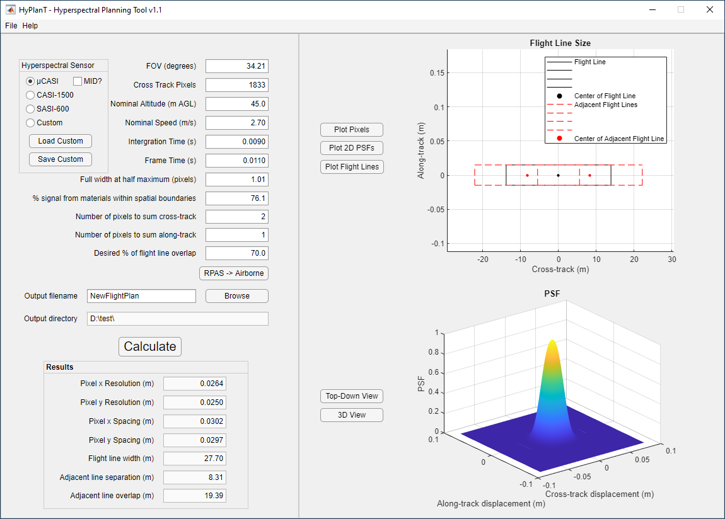
Sensor Considerations: Point Spread Function
PSF directly affects the energy/pixel of the target.
Requires detailed flight planning

Slide 12
Examples of Cal/Val Activities

Slide 13
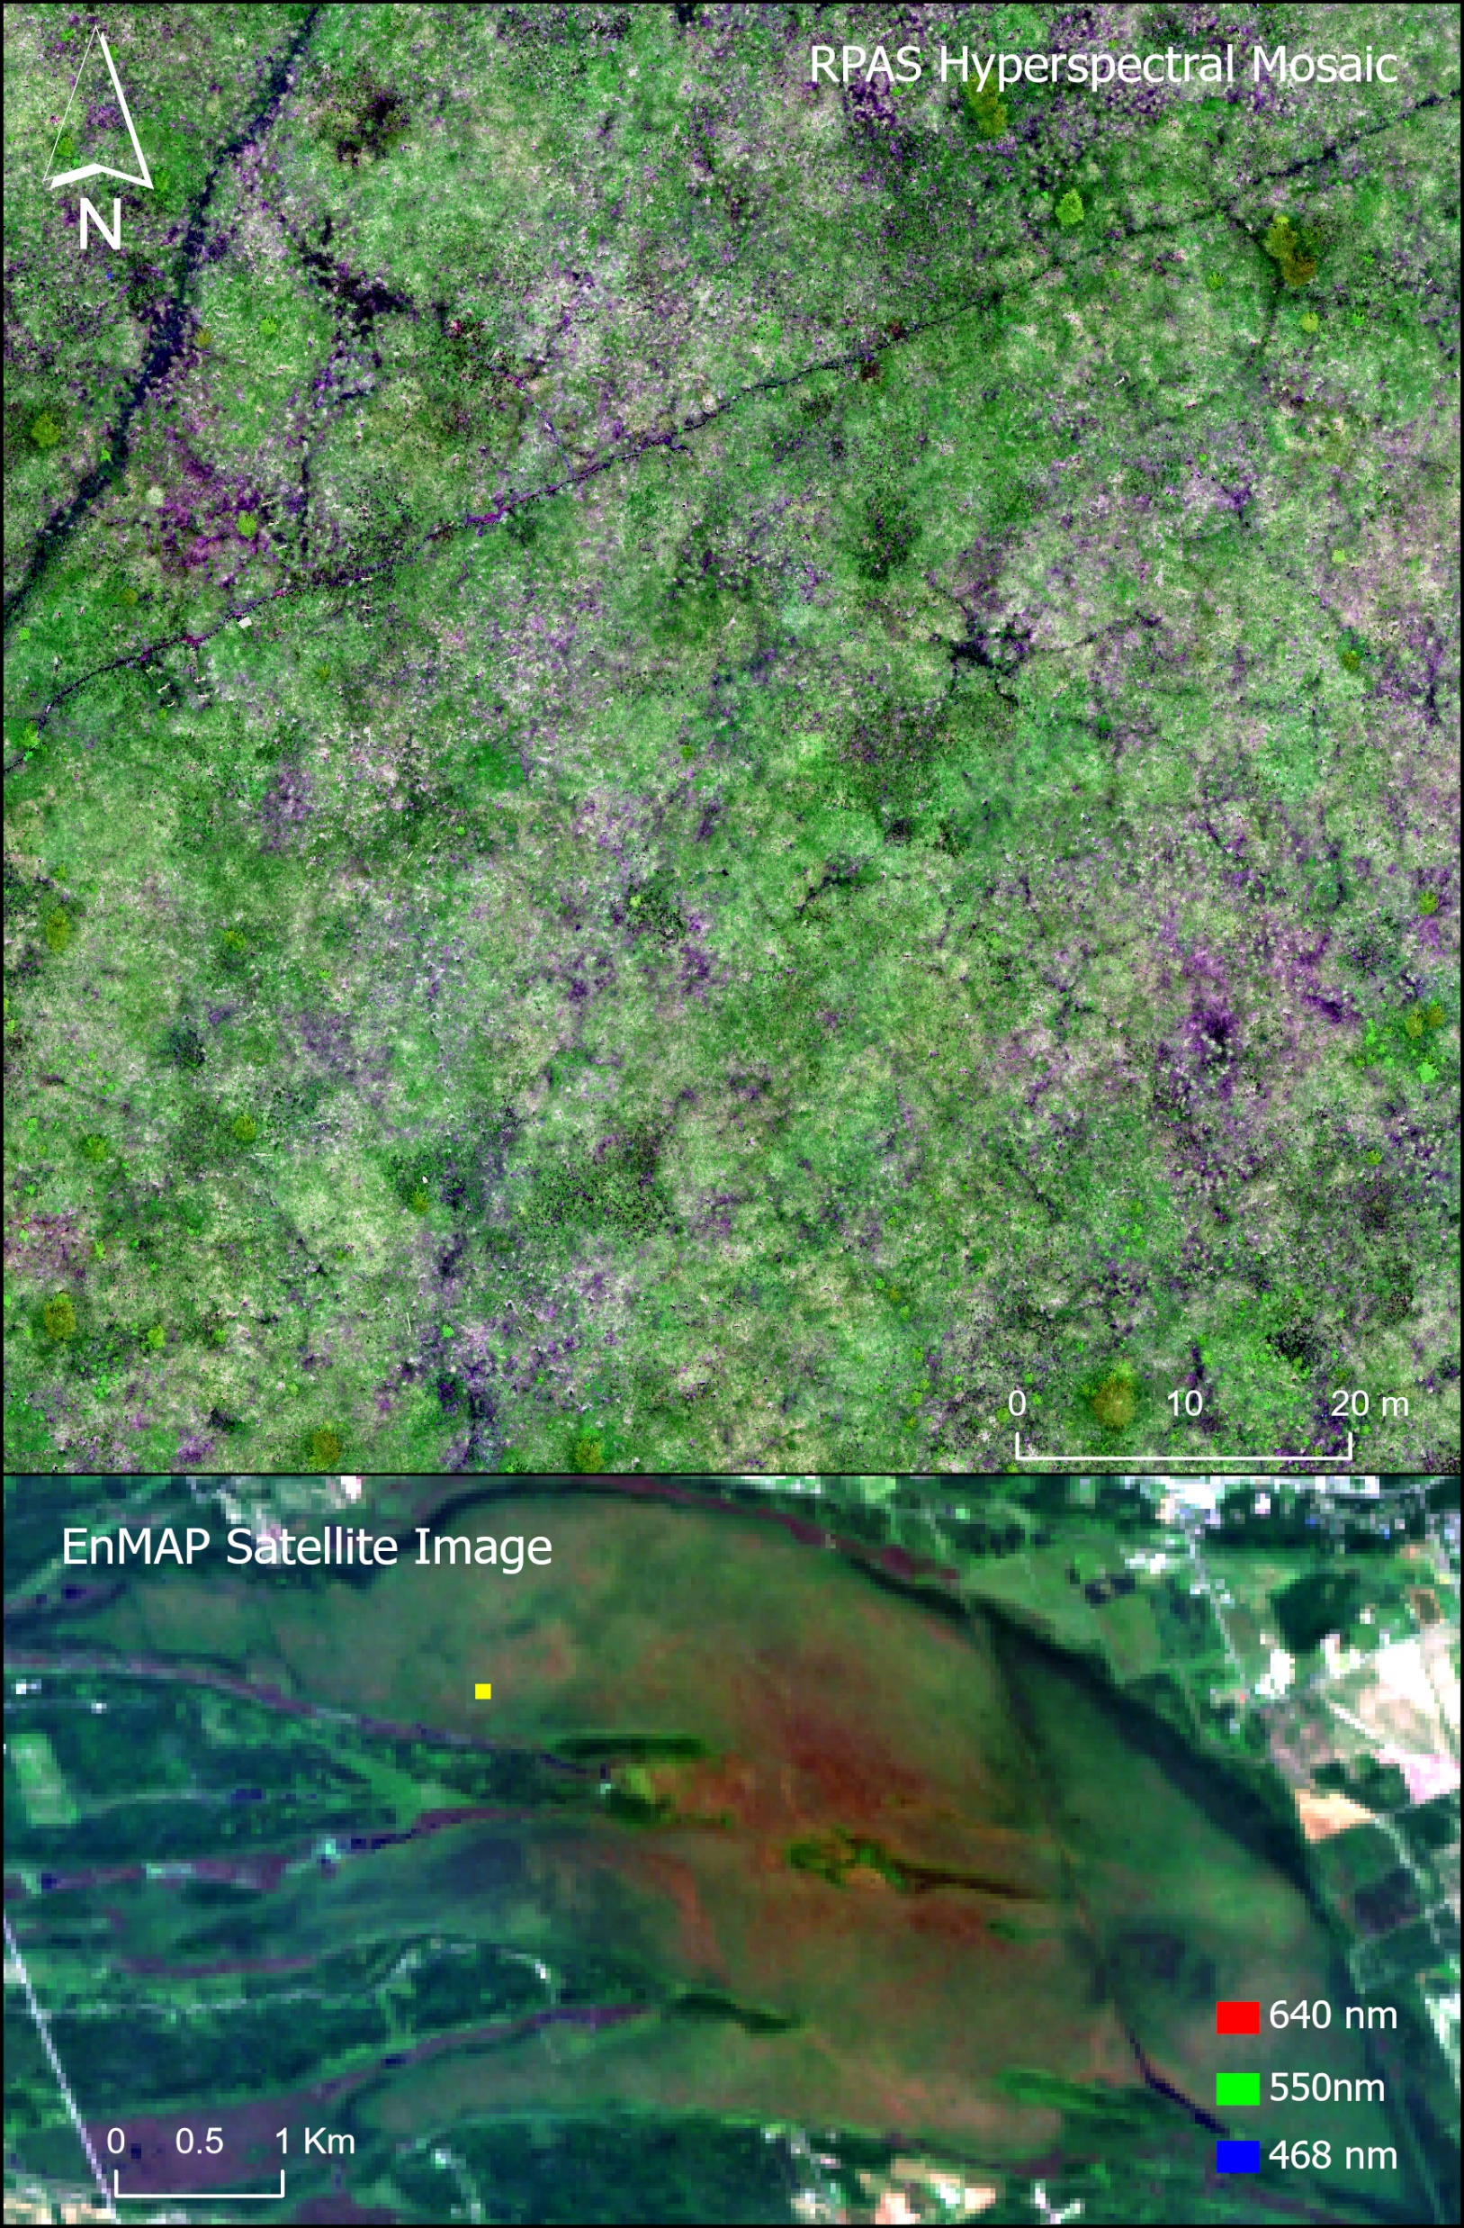
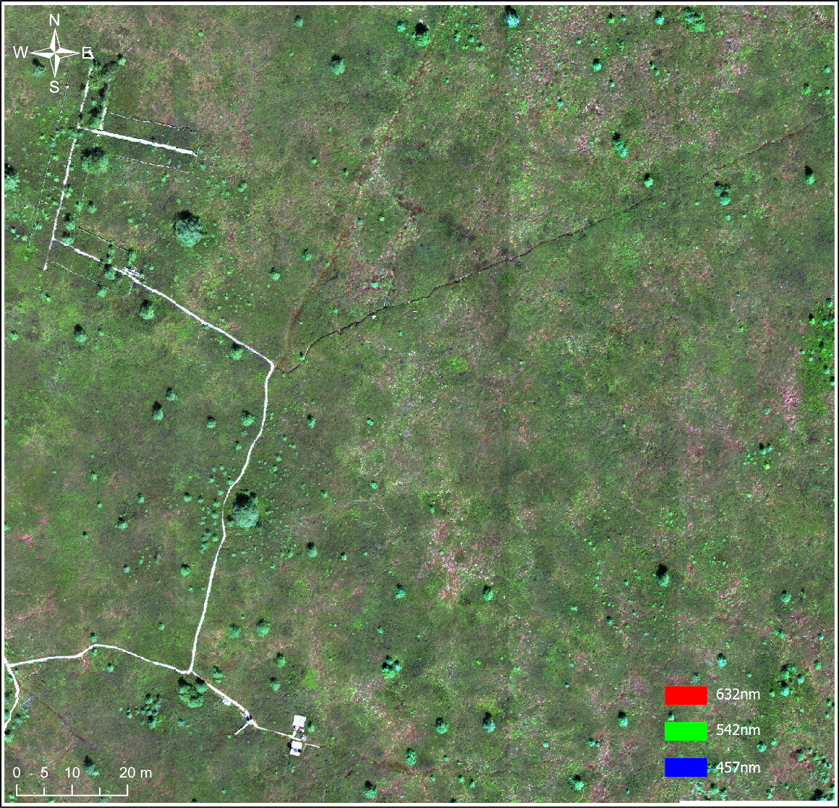
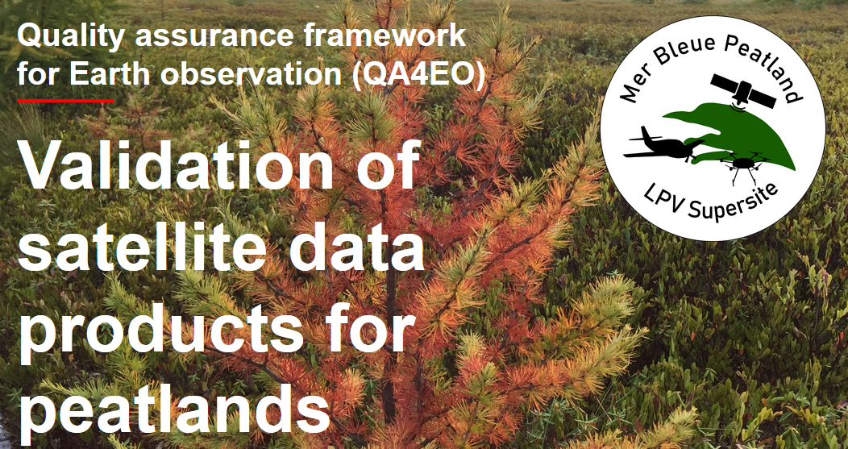
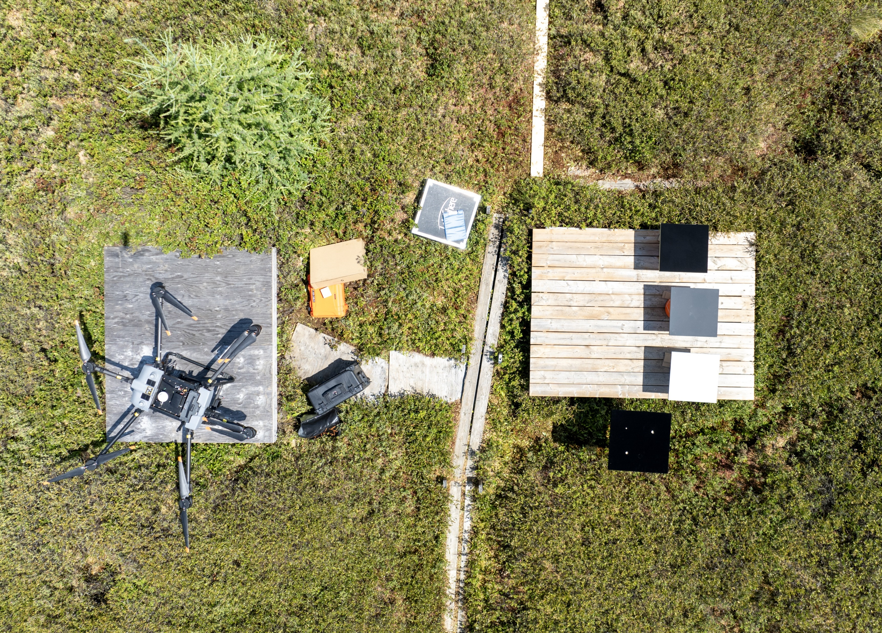
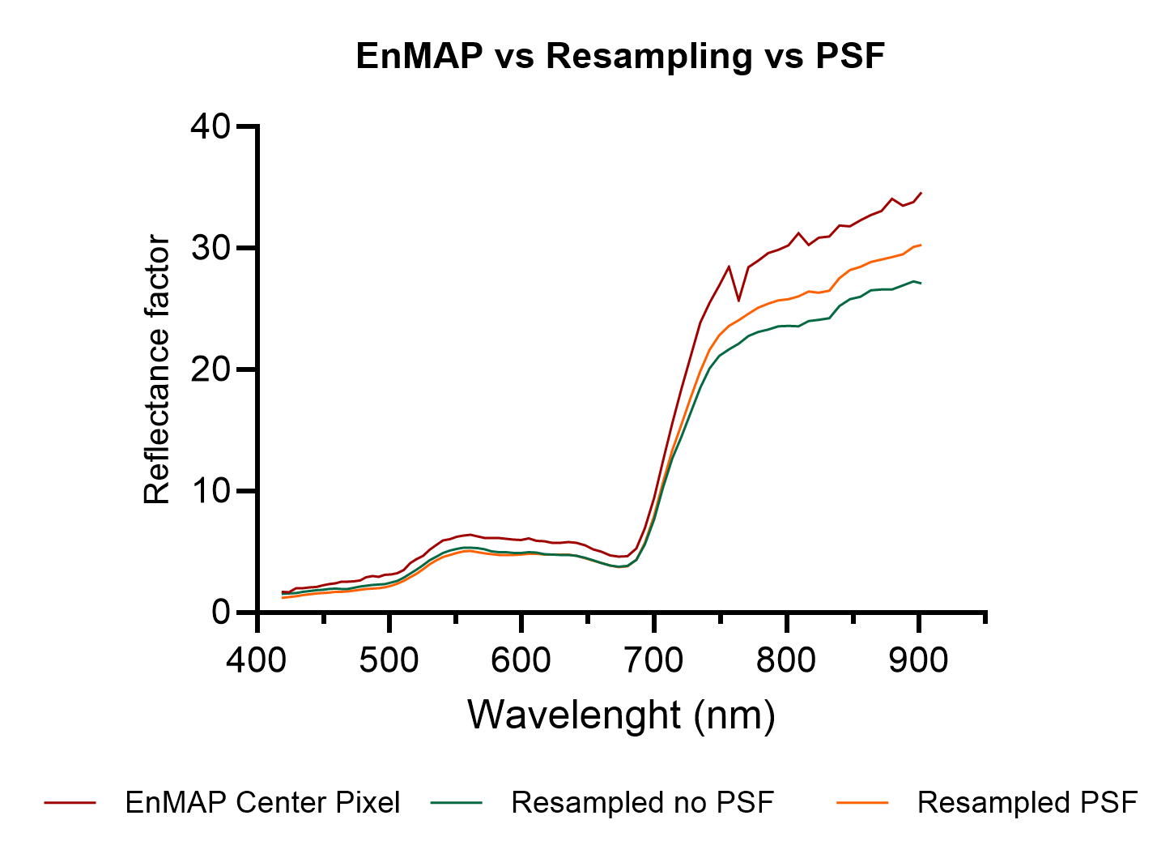





Slide 14
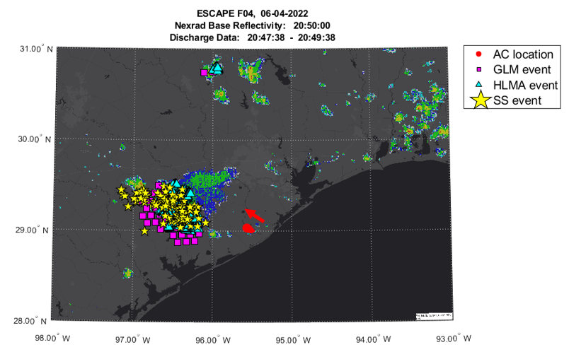
Lightning study (ESCAPE,TX, USA 2022) 2 min segment :
NEXRAD, GLM(GOES16), HLMA(ground), StormScope(aircraft) overlayed

Slide 15
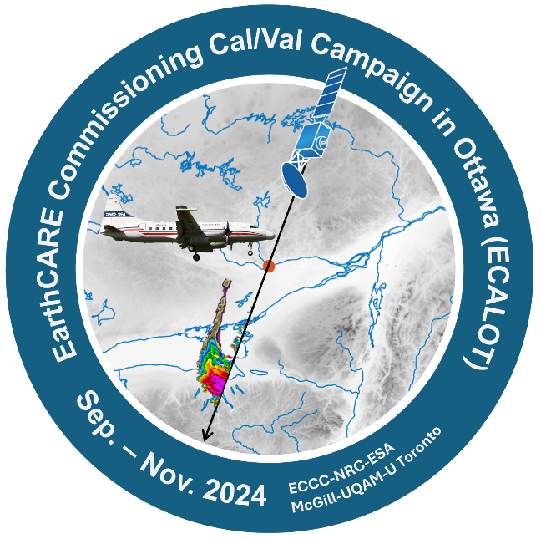


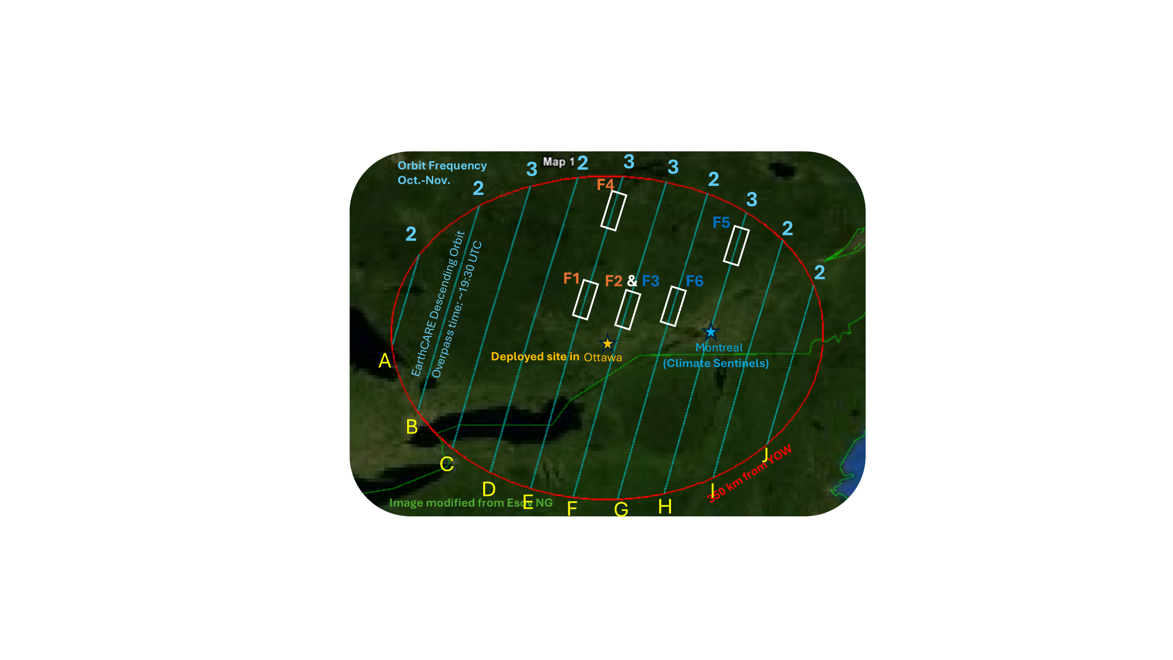
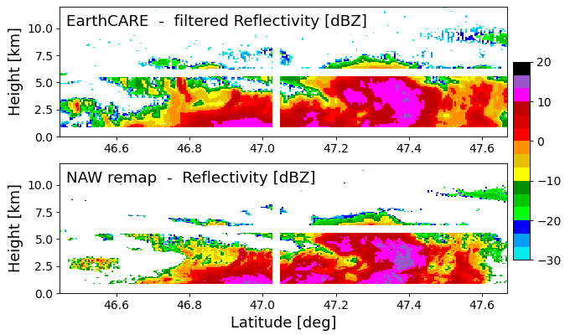
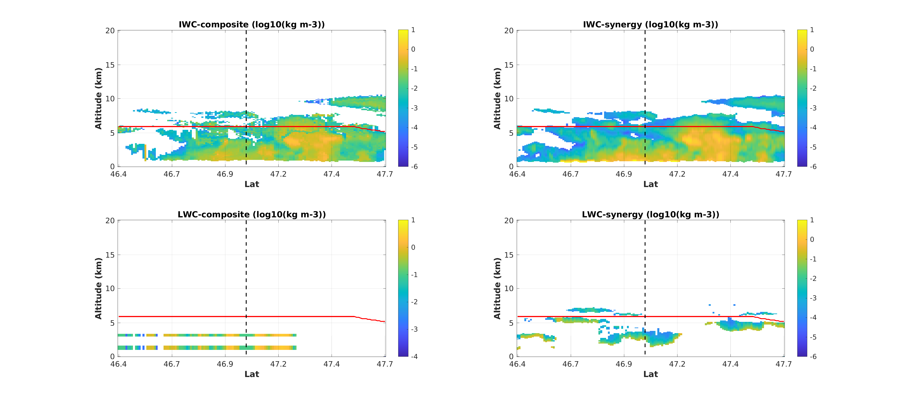
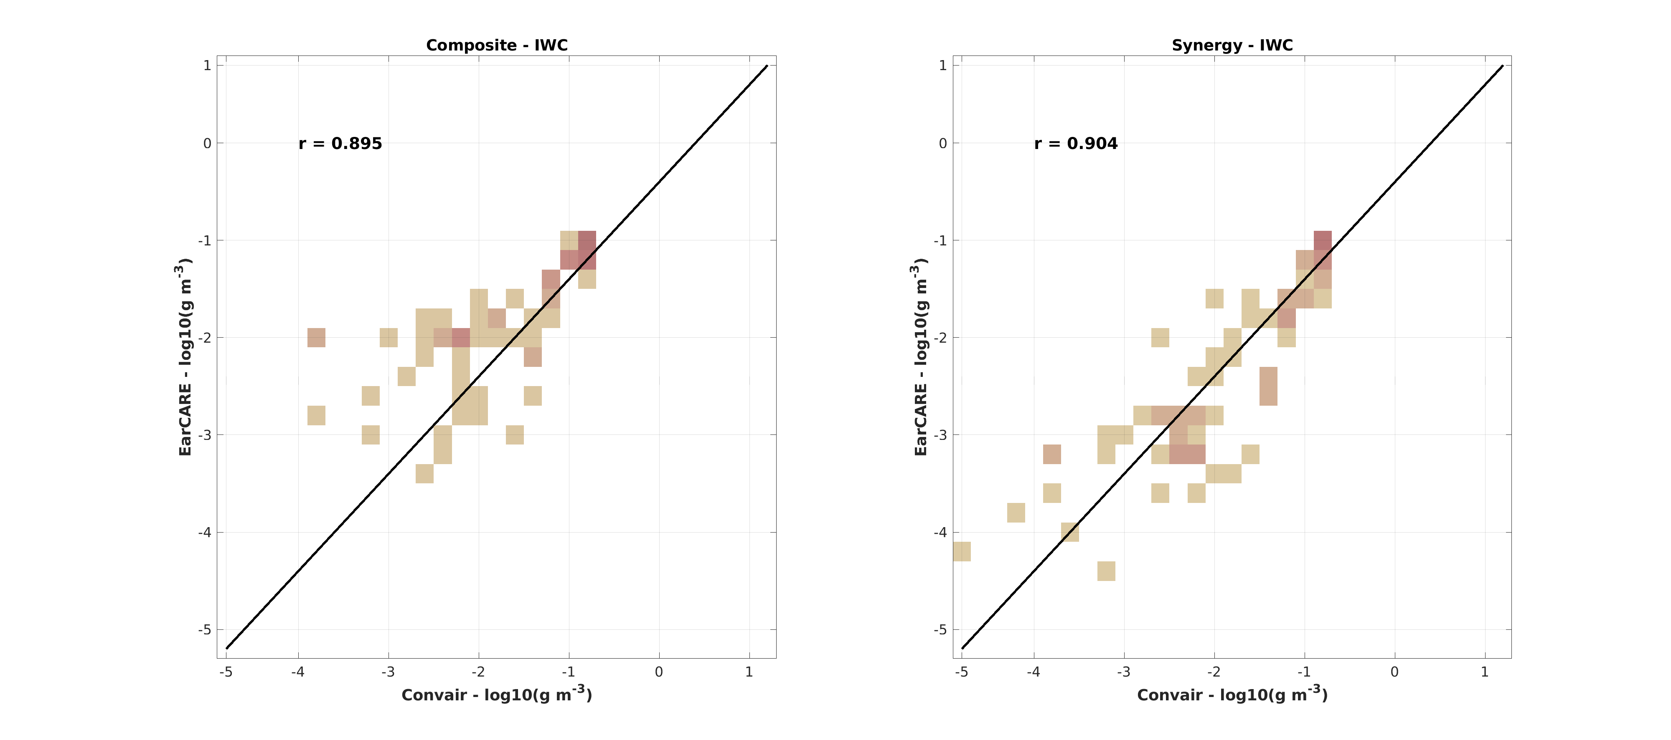



EarthCARE Commissioning Cal/Val Campaign in Ottawa (ECALOT)
Zhipeng Qu (ECCC lead), Cuong Nguyen (NRC PM), Paloma Borque, Keyvan Ranjbar, Kenny Bala, Natalia Bliankinshtein, Leonid Nichman, Mengistu Wolde
Flights
Level 1 - CPR reflectivity
Level 2 - ice water content
Flight 5 Nov. 22nd
Flight 5 Nov. 22nd
Composite (ACM-COM)
Synergy (ACM-CAP)
& F7
Aircraft path
Surface sites
A-ICE (AC) vs. in situ
ACM-CAP vs. in situ
7 Flights (Oct. 2024 – Mar. 2025)
Longest flight operation window among all EarthCARE cal/val campaigns (6 months!)
One of the key campaigns covers all levels of EarthCARE validation (L1, L2a/b) with both airborne & surface components
Data used for satellite algorithm dev. & NWP model validation
r² = 0.967
Large validation points (>10 k)
Good correlation
CPR offset: -5 dBZ
C-NOM Baseline: BA
ACM-COM (A-ICE)
ACM-CAP
In situ (OAP composite)
Convair-580 flight crew of Flight 6 (snowy & windy!)

Slide 16
NRC – EUMETSAT
AEROSPACE
Wildfire Fire Radiative Power (FRP):
1) Validation of underlying assumptions
2) Considerations of the space-based data product chain
3) Variable Biomes (Topical to Boreal to Arctic Peatland)
4) Personnel exchanges to commence Fall/winter 2026/27
Hyperspectral Microwave work
Wildfire suppression effectiveness – pre/post fire analysis and in-situ active fire data collection for validation

Slide 17
Future

Slide 18


Drones

Slide 19




Medium-Long range Aircraft Platform for Environmental Research (MAPLE)
Goal: Develop a medium-long range research aircraft platform for atmospheric and earth observations: A National World-Class and Versatile Facility Enabling Interdisciplinary Research
  Advance Science Infrastructure
  World-class Facility with a global reach
  Versatile Research Platform: Interdisciplinary
  National Facility
Focus: National Facility for Earth System Sciences: – Tied to GOC/NRC Climate Agenda / Strategic Plan
  Earth System Sciences: Arctic; Air quality; Wildfire; Aerosol, Cloud and Precipitation; Satellite Earth Observation; Climate; Sustainable and Green Aviation; Extreme weather Severe weather & icing; Earth Sciences
  Is being developed through extensive expert inputs
  Aim to develop a consortium based governance structure as a national facility
In-service operational timeframe 2029/30

Slide 20

AD ASTRA (Bombardier Global 6500)
Endurance = 14 hrs
Range = ~12,000 km
Max. Ceiling = 15.5 km
Speed:
Max = ~1100 km/hr (0.9 Mach)
Cruise = ~ 1050 km/hr (0.85 Mach)
Max. Payload = ~ 2700 kg
Primarily a defense-related platform
In-service operational timeframe 2028/29

Slide 21
Thank You
George Leblanc
Team Lead: Remote Sensing Imagery Group (RSIG)
Drone Flight and Autonomy Laboratory (DFAL)
National Research Council Canada

