Slide 1





Panels or Mirrors? Evaluating Calibration Targets with RPAS Hyperspectral Imagery
Margaret Kalacska, J. Pablo Arroyo-Mora, Oliver Lucanus, George Leblanc
Dr. Margaret Kalacska
Applied Remote Sensing Laboratory
Department of Geography
McGill University

Slide 2
How do reflectance panels and SPARC mirrors perform under real-world illumination in RPAS hyperspectral calibration?
Notes:
Mention objective and expand to Labsphere report findings…

Slide 3

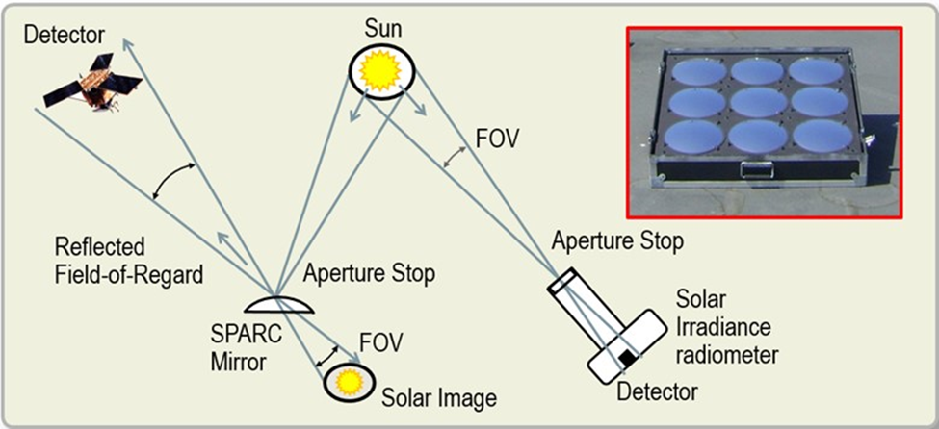
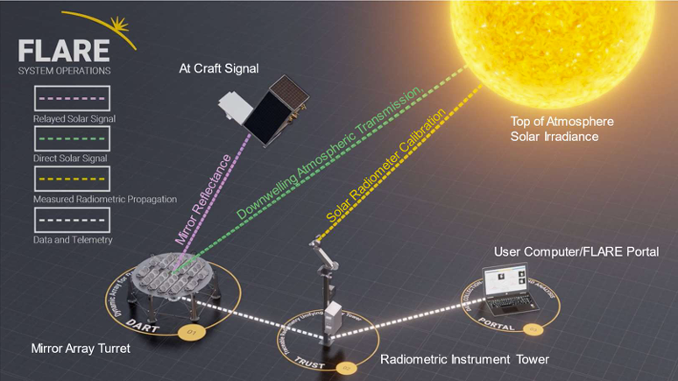
SPecular Array Radiometric Calibration (SPARC) Overview
Convex mirrors used to relay an image of the solar disk to an Earth Observation Sensor.
Used to produce radiometric and spatial calibration and characterization targets for MSI and HSI imaging systems mounted on satellites, aircraft, and RPAS.
With simultaneous measurements of the downwelling direct and diffuse solar irradiance, the SPARC point targets are suitable to derive (or validate) calibration coefficients for absolute at-aperture spectral radiance.
Multiple radiance levels across the sensor’s dynamic range can be deployed in a single scene allowing for radiometric calibration using a Mirror-based-Empirical Line Method (MELM).
.
Field Line-of-sight Automated Radiance Exposure (FLARE)
Durrell et al. 2019
Holt et al. 2021

Slide 4
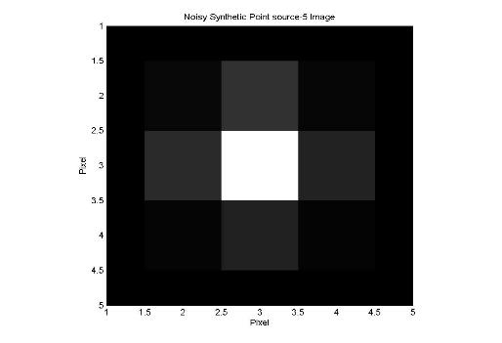
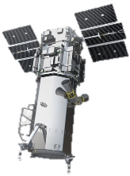
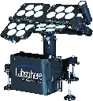
Small Target vs. Large Target Radiometry (Theoretical)
Image of target
All these atmospheric paths contribute to top-of-atmosphere spectrum
Diffuse Sky Irradiance
Sky Path Radiance
Diffuse Sky Irradiance
Adjacency Effect
5x5 Pixel
Direct Solar Irradiance
Direct Solar Irradiance
Multiple Scattering
Target
Target
Surround
Surround
Lambertian Large Target Radiometry
Small Target Radiometry
Soffer et al. 2023

Slide 5
SPARC Benefits
Can be used to augment more traditional pseudo-Lambertian reflectance techniques.
Mirror reflectance can be measured to a high degree of accuracy (low uncertainty).
By contrast, BRDF of diffuse reflectance targets can vary potentially unpredictably, particularly for large Solar Zenith Angles (SZA) or off-nadir observations.

Slide 6
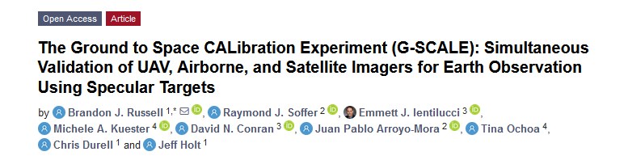
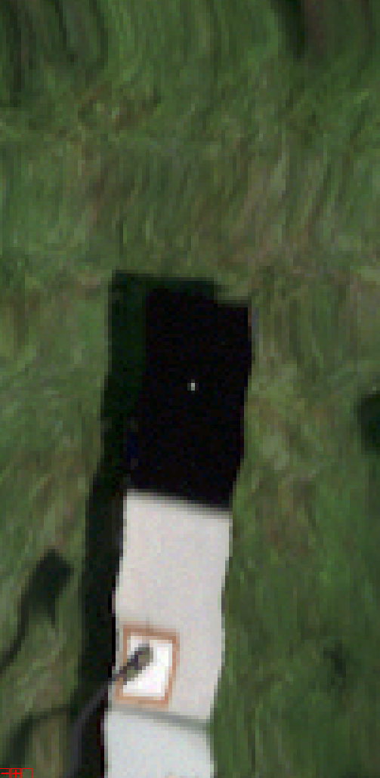
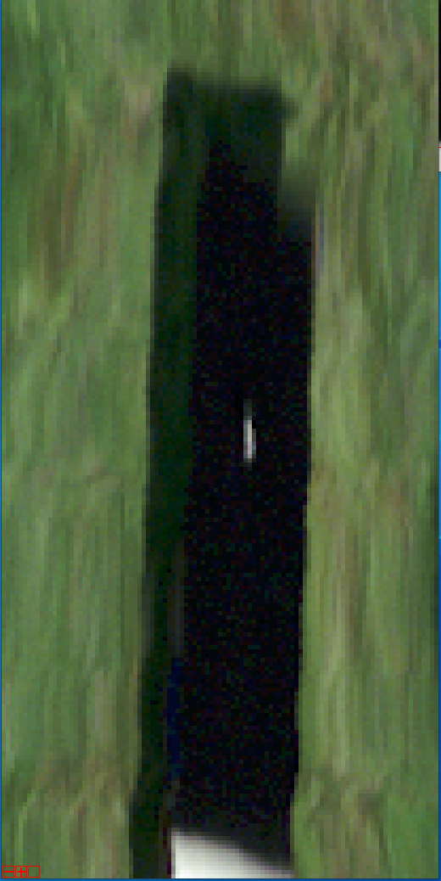
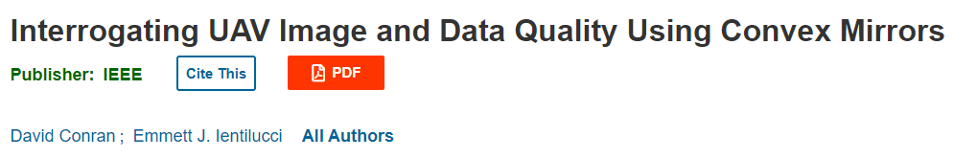
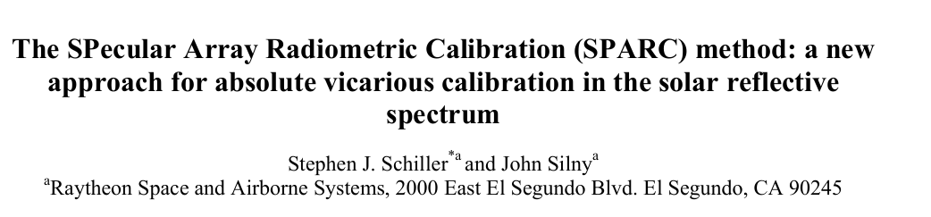
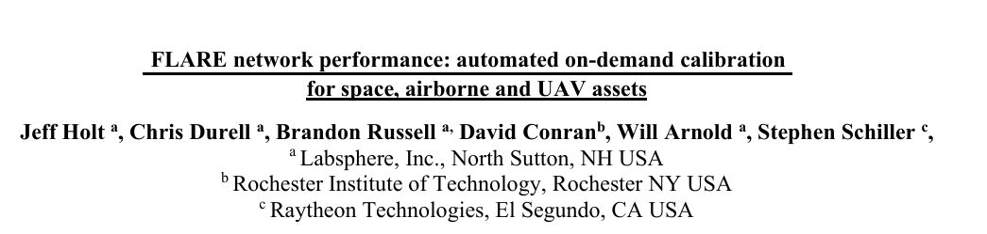

SPARC Methodology – RPAS based HSI
Deployed for HSI and MSI airborne and satellite assets in the VNIR-SWIR nm range.
The impact of the flight and sensor parameters in the actual SPARC results are still unknown, therefore its evaluation for RPAS HSI is needed.
The integration of drone uncertainties are poorly demonstrated in the current HSI literature.
Mirror B31
Ground Speed 6 m/s
Mirror B31
Ground Speed: 1m/s

Slide 7


Slide 8
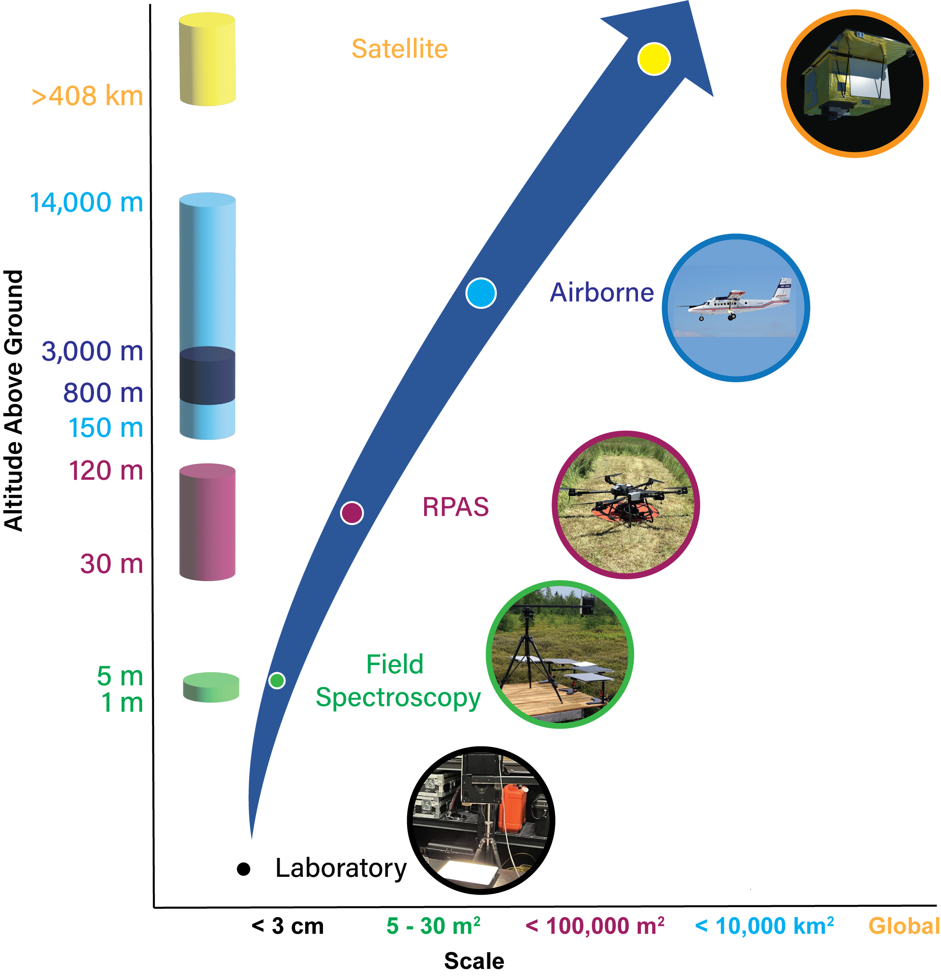

Validating Satellite Products from the Ground Up
Arroyo-Mora et al. 2023. Drones
Notes:
Upscaling is not averaging — it’s understanding what changes with scale. Each step away from the ground introduces new sources of uncertainty. If we want to trust global products, we have to understand what happens between centimeters and kilometers.

Slide 9
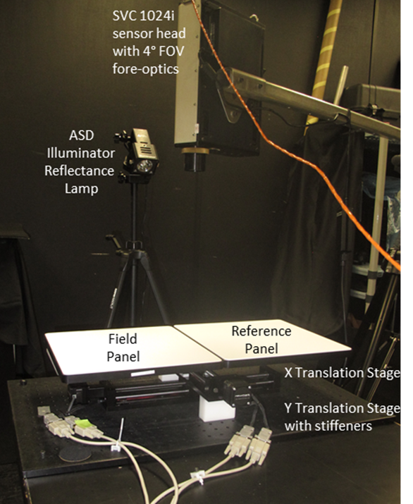
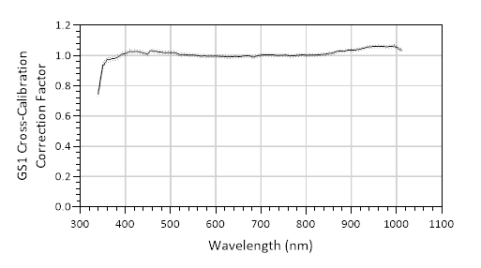
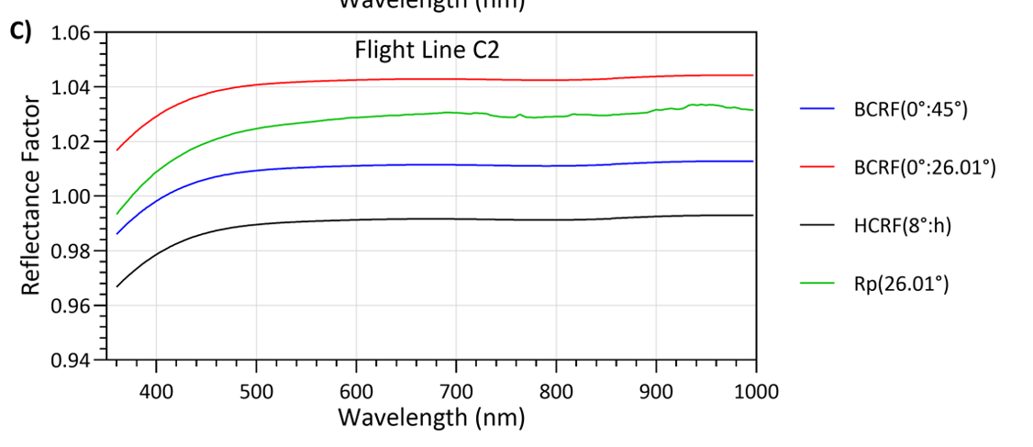
Lab Baseline
Characterization of NRC SVC HR1024i with Labsphere’s GS1 (NIST traceable uniform light source) integrating sphere.
  GS1 has ≤ 1.1% expanded uncertainty (2σ)
Mirror characterization (curvature and diameter) and spectral reflectance measurement (Labsphere)
Uniformity measurements (9 x 9 grid): SPB(1%), Permaflect (5%, 40%)
Panel R(0°:45°) cross calibration
  BCRF(0°:45°) of the panels were cross-calibrated against a laboratory reflectance reference panel of known BCRF(0°:45°)

Slide 10
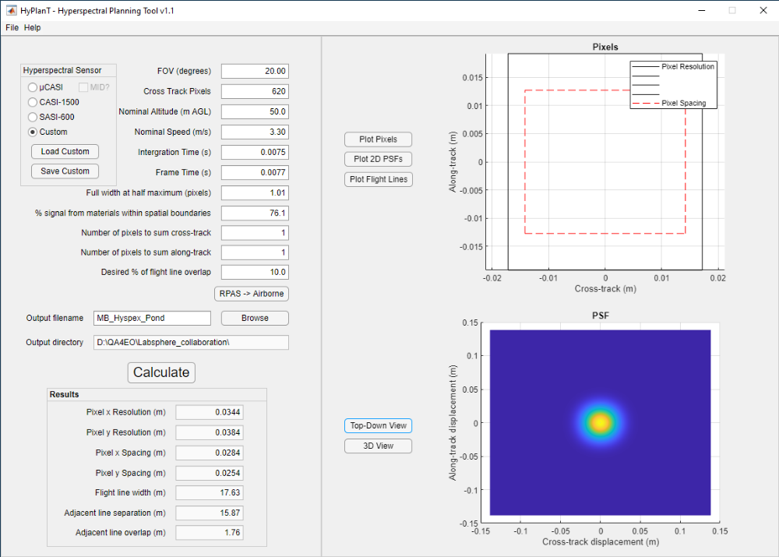
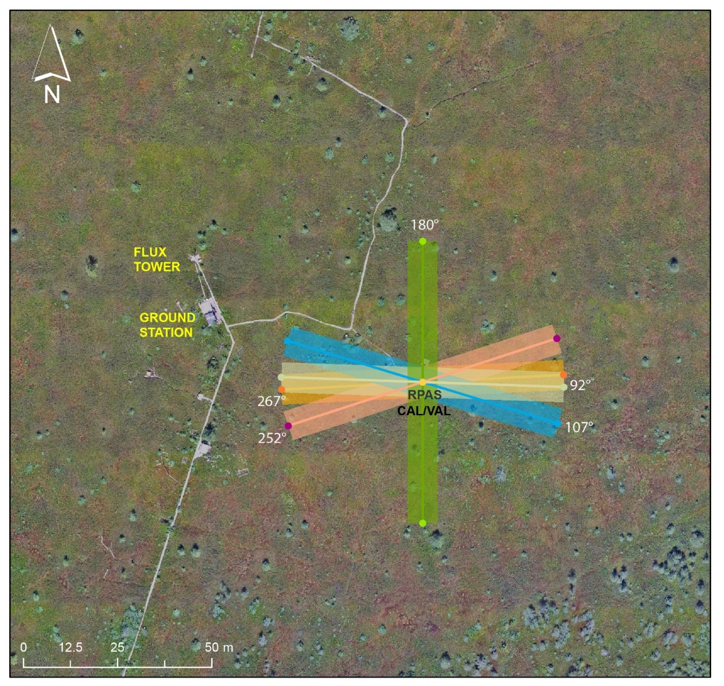
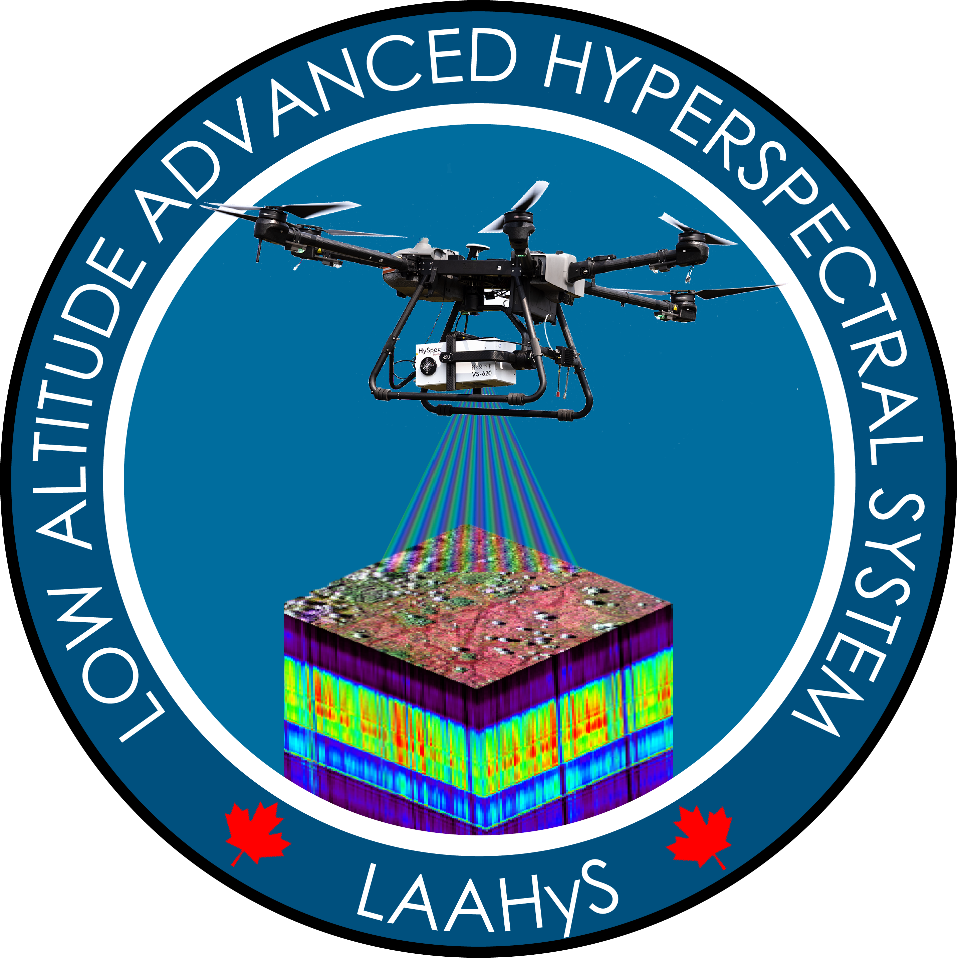
Methods: Flight Planning
Flight | Time (UTC -4) | SZA | Sky Conditions
A | 8:51 ± 0:03 | 57.6 ± 0.4 | Clear
B | 10:07 ± 0:02 | 44.6 ± 0.3 | Clear
C | 12:28 ± 0:03 | 25.9 ± 0.2 | Clear solar disk w clouds
D | 15:51 ± 0:03 | 41.3 ± 0.3 | Clear solar disk w clouds
E | 17:19 ± 0:03 | 56.2 ± 0.3 | Cloud obscuration of solar disk

Slide 11
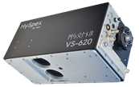
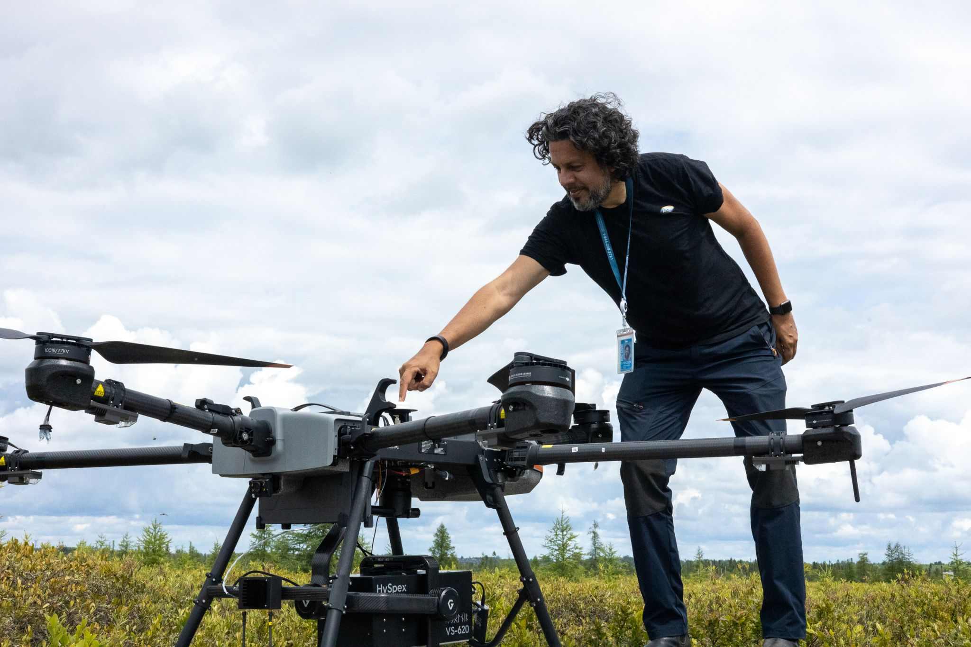
RPAS Hyperspectral System
Low Altitude Advanced Hyperspectral System (LAAHyS) for EO Cal/Val
 | V-1240 | S-620
Spectral range | 400 – 1000 nm | 970 – 2500 nm
Combined spectral range | 400 – 2500 nm
Spatial pixels | 1240 | 620
Combined spatial pixels | 620
Spectral channels and sampling interval | 200 bands @ 3.0 nm | 300 bands @ 5.1 nm
Combined spectral channels | 490
FOV | 20° | 20°
Bit resolution | 12 bits | 16 bits
Detector type | Silicone CCD | Mercury Cadmium Telluride (MCT) FPA
Smile and keystone | < 10% per pixel per band
Radiometric calibration traceability | To a Physikalisch-Technische Bundesanstalt (PTB) standard
Power consumption* | 50 W
Dimensions (l-w-h) | 374 – 202 – 178 mm
Weight* | < 6.7 kg including standard battery
Flight/Sensor parameters: 50 m AGL – 3.3 m/s – IT 6.8 ms –FT 7.7 ms
Arroyo-Mora et al. 2023. Drones.

Slide 12
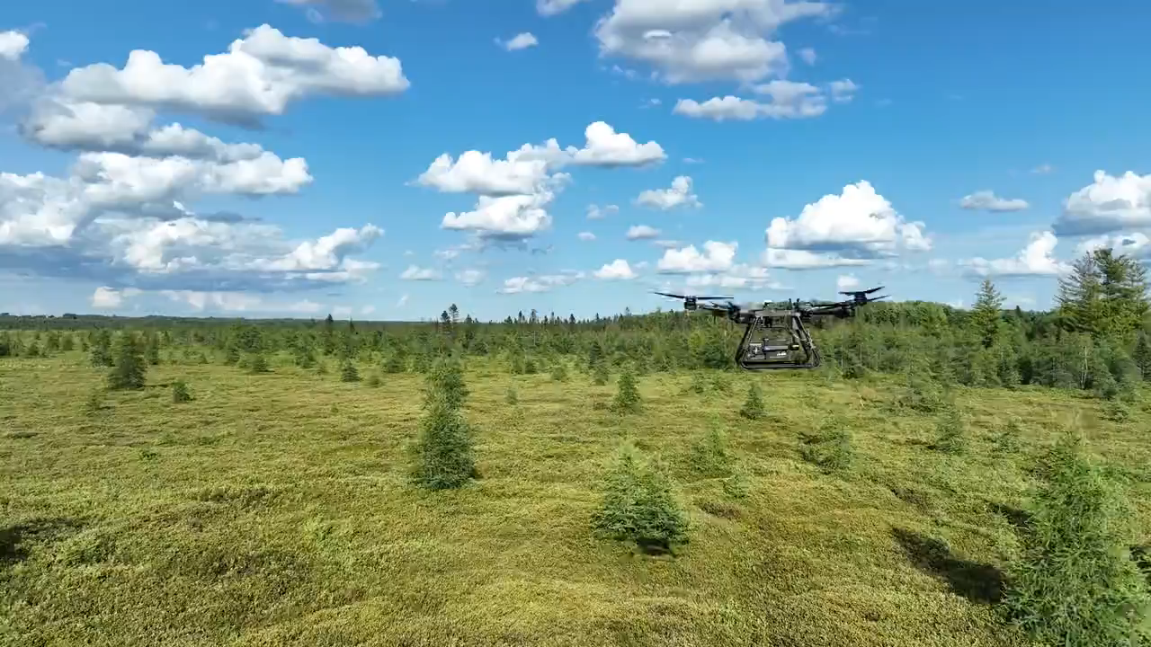

Slide 13
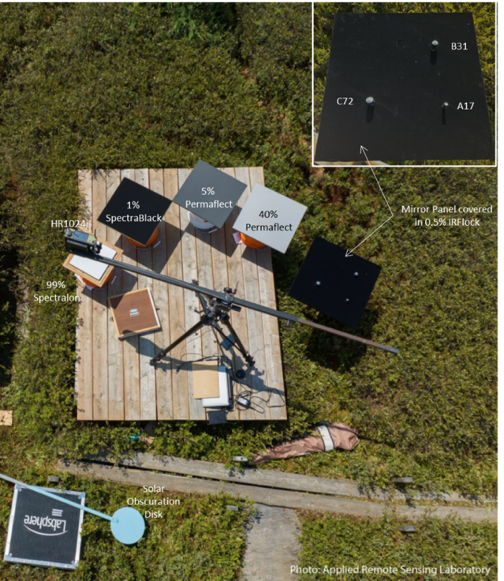
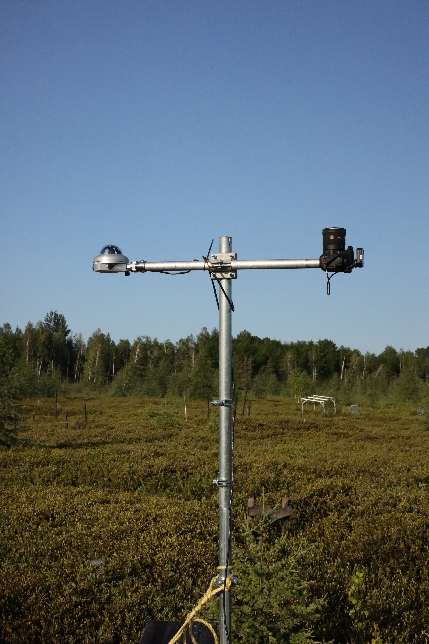
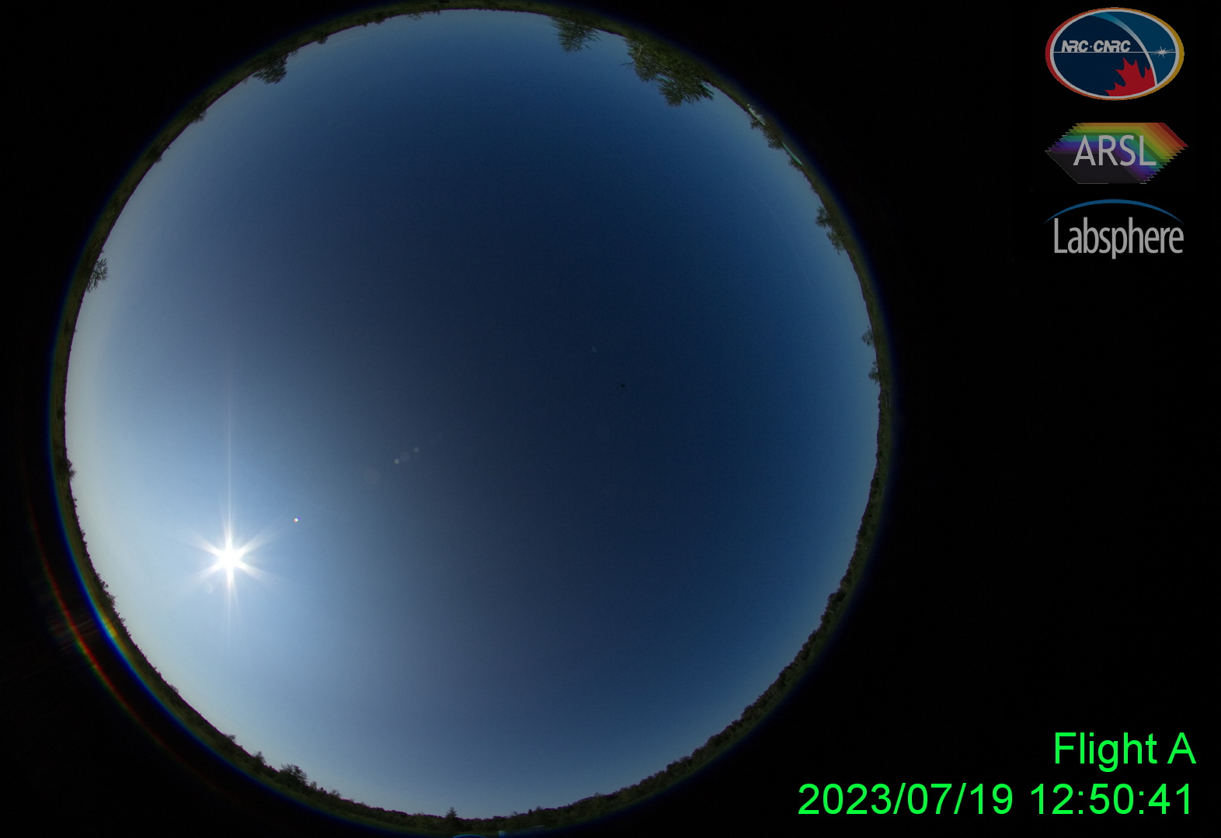
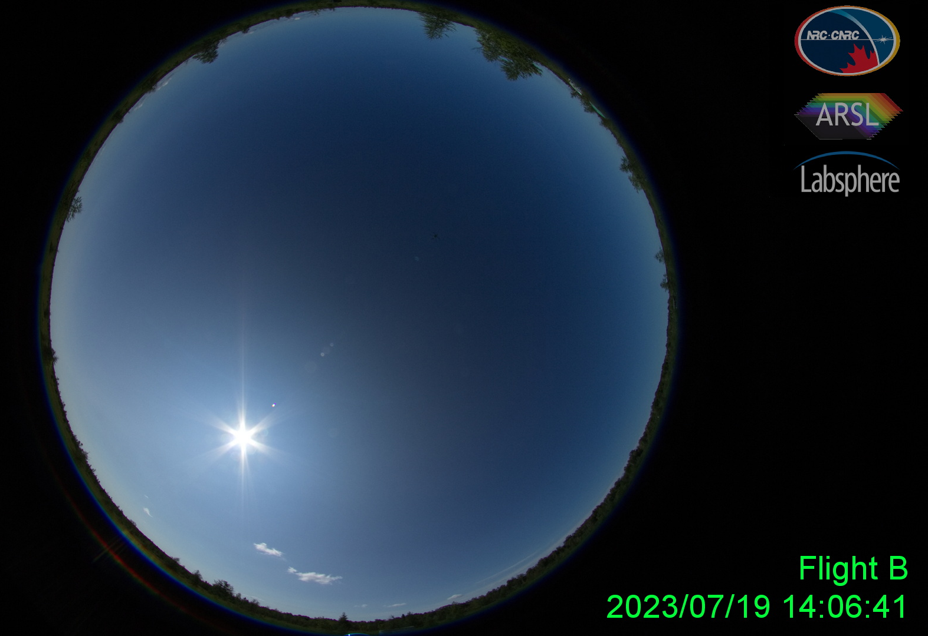
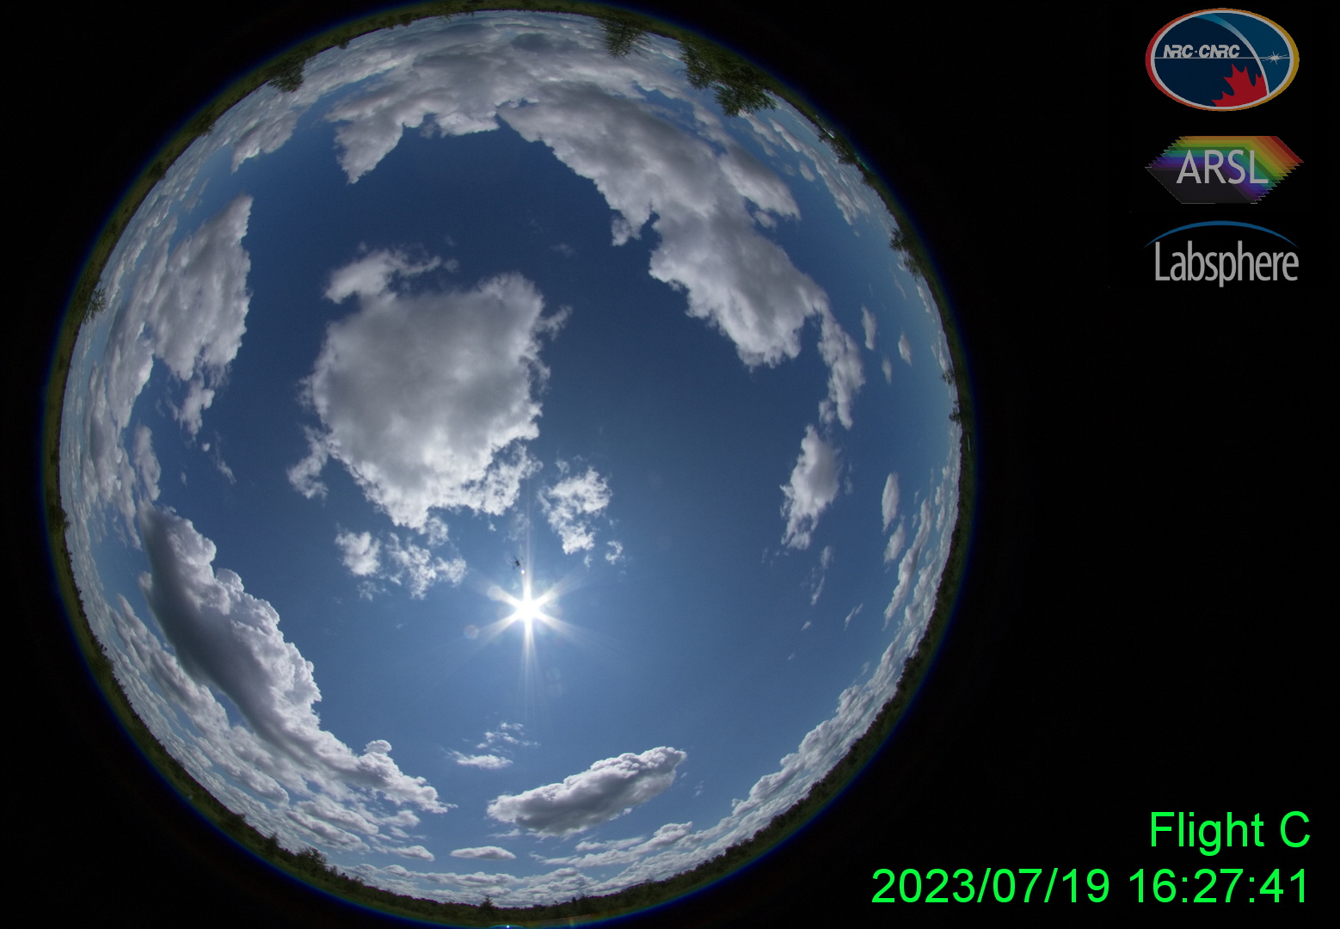
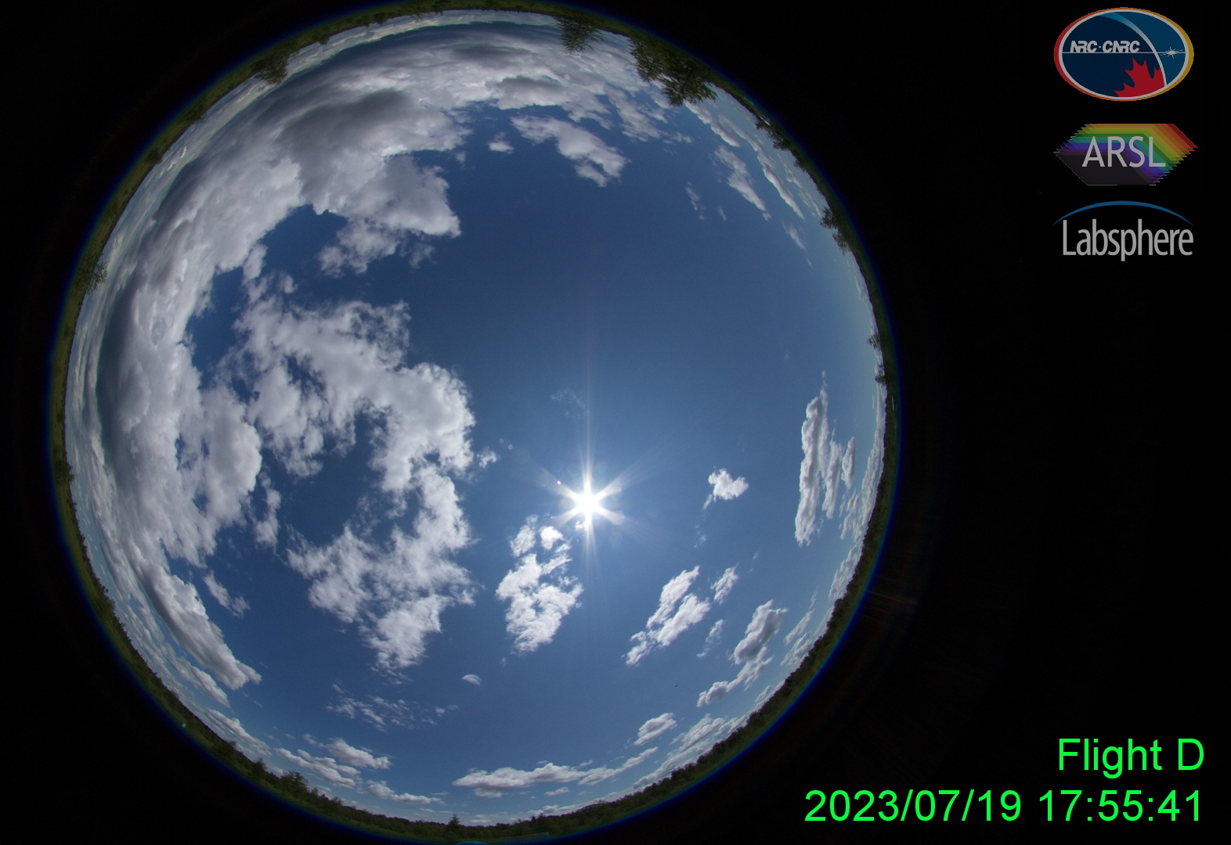
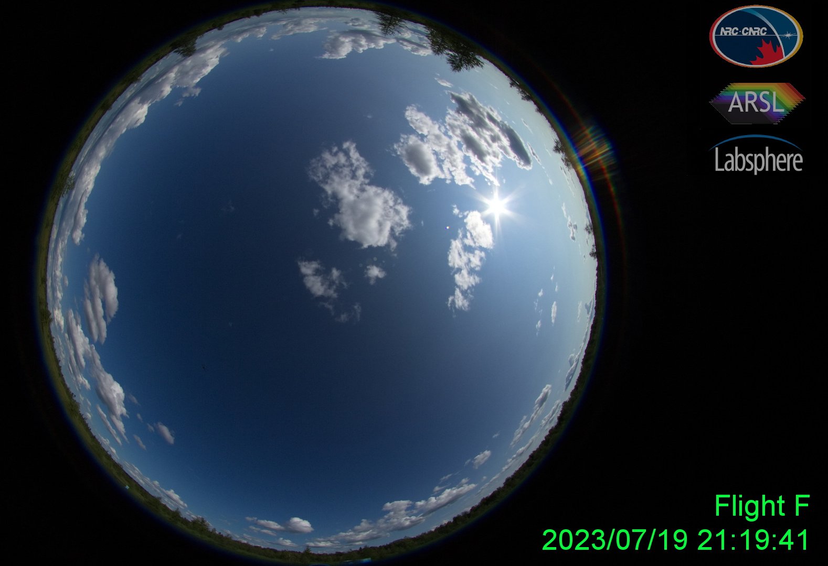
Field Measurements
Mirror | Radius of Curvature (mm) | Diameter (mm) | Field of Regard (°) | Lambertian Equivalent Reflectance
C72 | 25.03 | 25.64 | 121 | 72
B31 | 15.50 | 24.96 | 215 | 31
A17 | 12.09 | 11.98 | 118 | 17
Four flight lines per period (low vs high gain)
During HSI acquisition: downwelling irradiance monitoring HR1024i observations of Spectralon 99% panel of known HCRF. Automated scans every 6 seconds.
After HSI acquisition: PSM measurements of 4 panels and mirror background material, and diffuse illumination measurements.

Slide 14
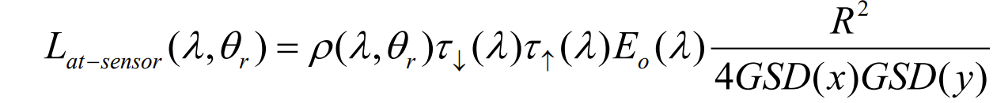
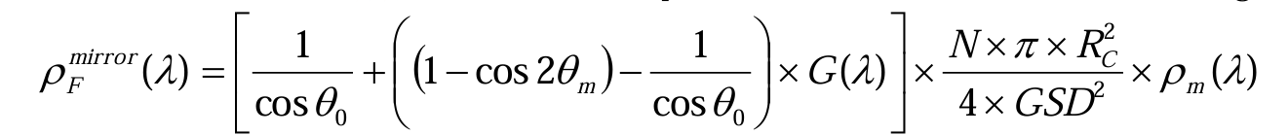
Data Processing and Analysis
From SPARC theory:
Due to lack of reliable irradiance data:
Or:

Slide 15
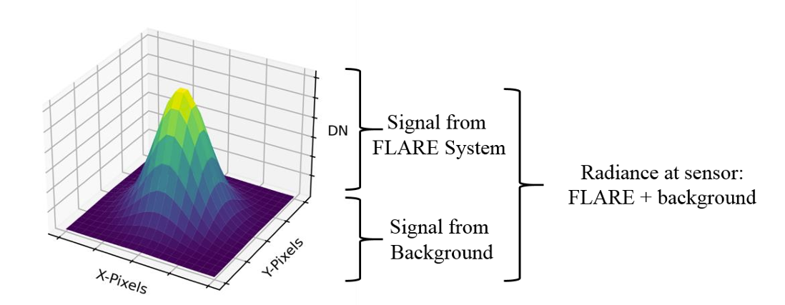
Data Processing and Analysis
Effective panel reflectance is a combination of the panel Biconical Reflectance Factor (BCRF_{P}) for the SZA at which the panel is illuminated, and its Hemispherical Reflectance Factor (HCRF_{P}) weighted by the direct to global irradiance ratio and the diffuse to global reflectance ratio respectively:
Ensquared energy:
Texeira Pinto et al. 2022

Slide 16
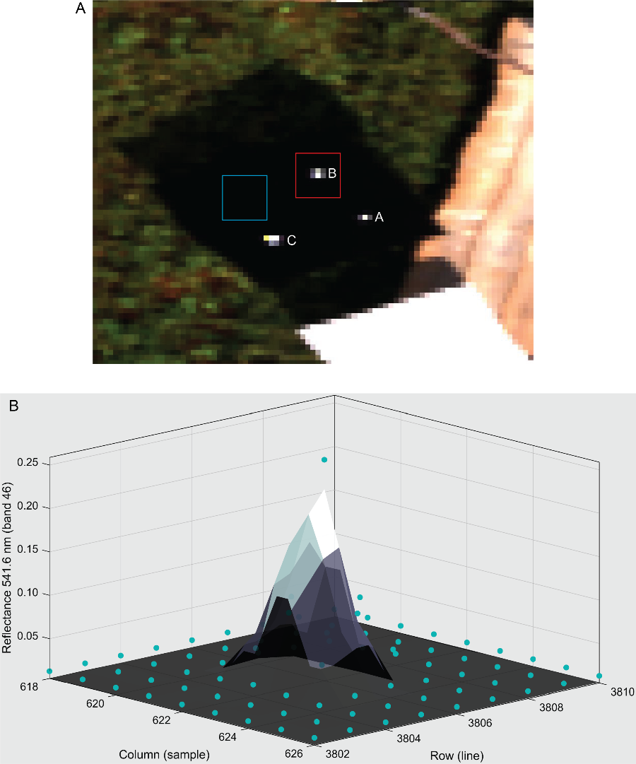
Ensquared energy

Slide 17
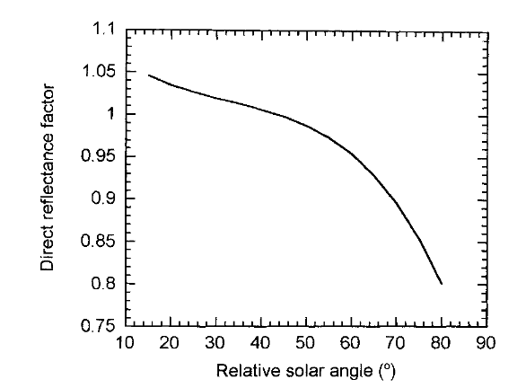
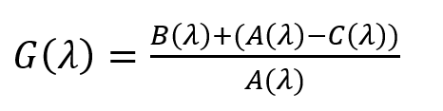
Panel Reflectance
Rollin et al. 2000
The nBCRF scaling factor is a dimensionless correction that adjusts a panel’s measured Biconical Reflectance Factor (BCRF) from a reference illumination geometry to the SZA, accounting for its non-Lambertian reflectance behaviour

Slide 18
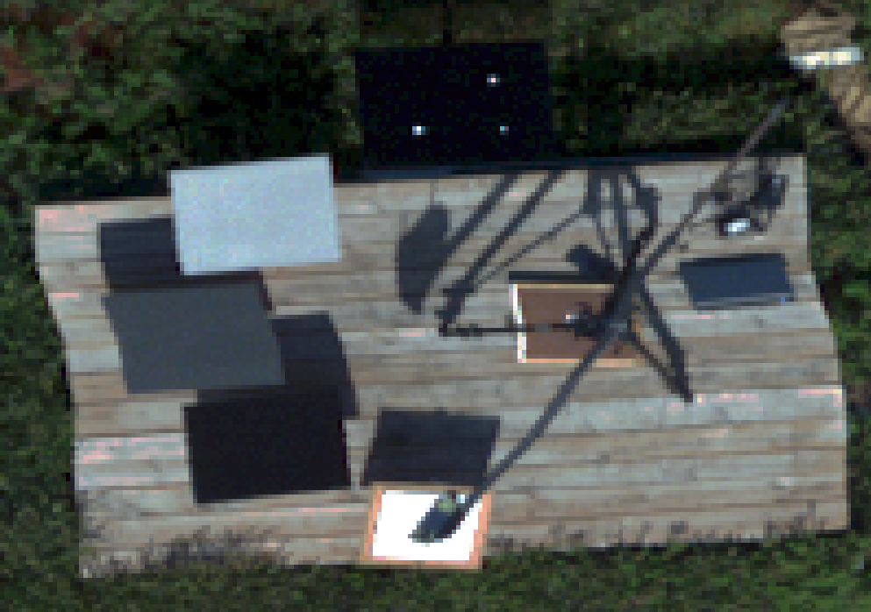

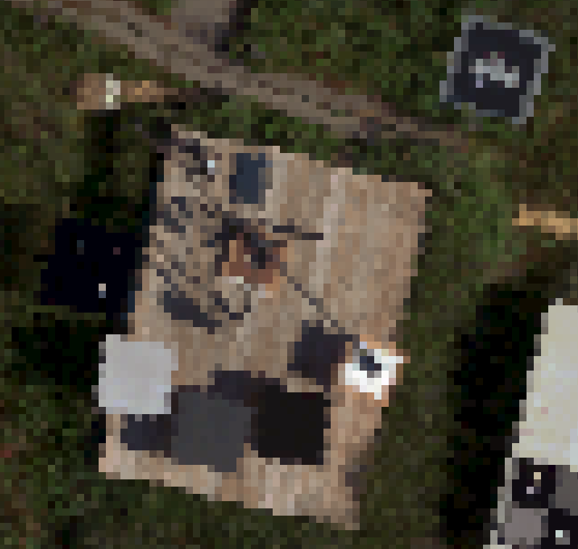
RESULTS
Resampled Pixel Size
Horizontal: 5 cm
Vertical: 5 cm
V1240 Imagery
Raw Geometry – no summation
IRFlock
<1%
B31
C72
A17
Permaflect
40%
MJOLNIR VS-620 RAW GEOMETRY
Permaflect
5%
SpectraBlack
1%
SVC
HR1024i
Spectralon 99%
Reflectance Reference Panel
Downwelling Irradiance Monitor

Slide 19

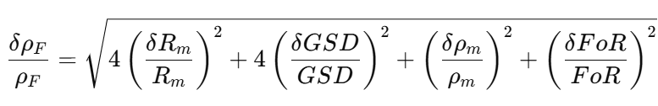
Data Processing and Analysis
Mirror characteristic uncertainties
  Field of Regard
  Radius of Curvature
  Specular reflectance
Uncertainty of predicted mirror LER
Russell et al. 2023
Mirror A
RoC: 4.6%
GSD: 89.7%
Rho: 5.7%
FoR: 0.03%

Slide 20
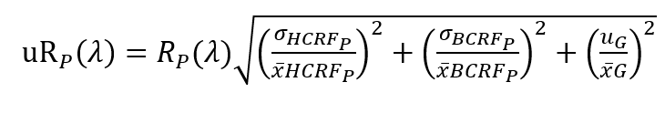
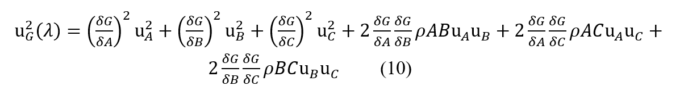
Reference panel uncertainty

Slide 21
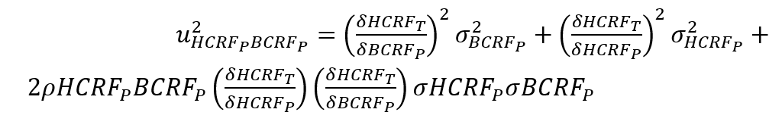
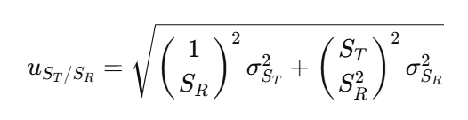
Field panel uncertainty

Slide 22
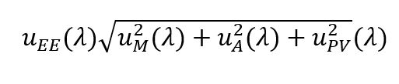
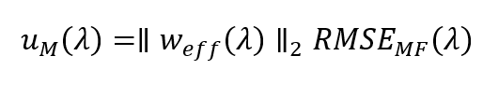


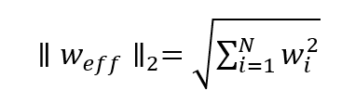
Ensquared Energy Uncertainty

Slide 23
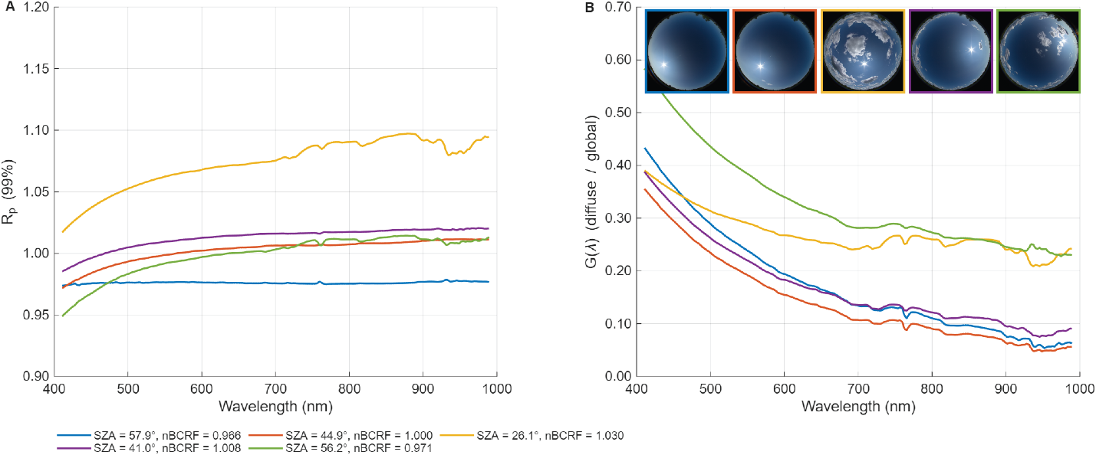
Reference panel reflectance

Slide 24
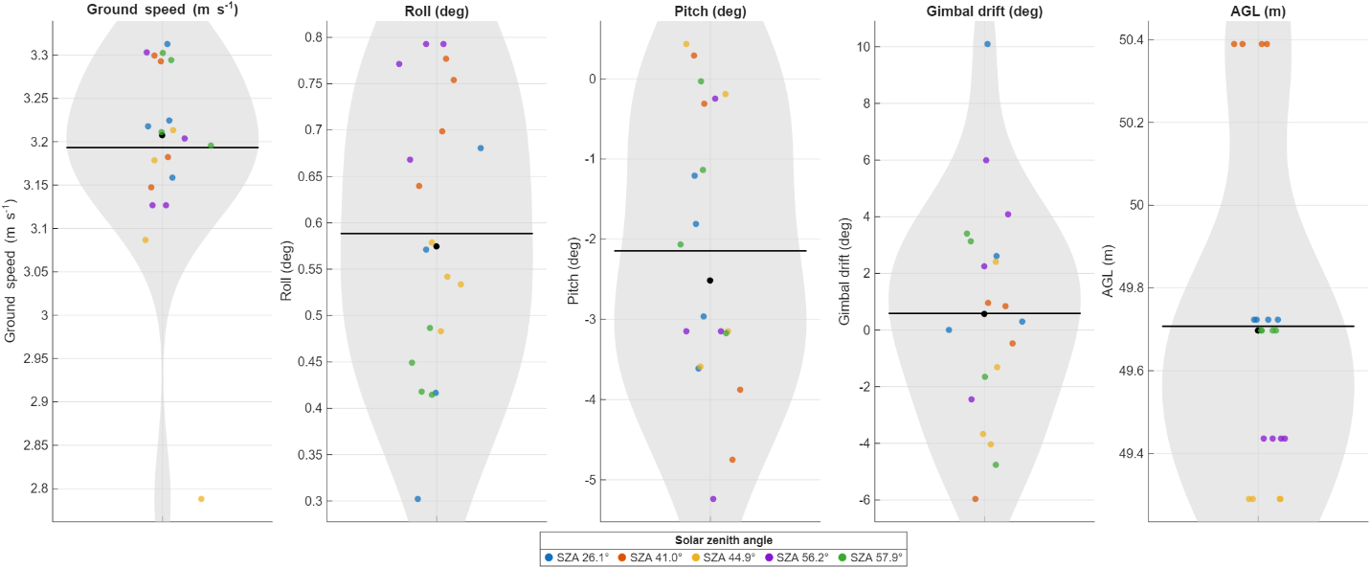
RPAS Attitude

Slide 25
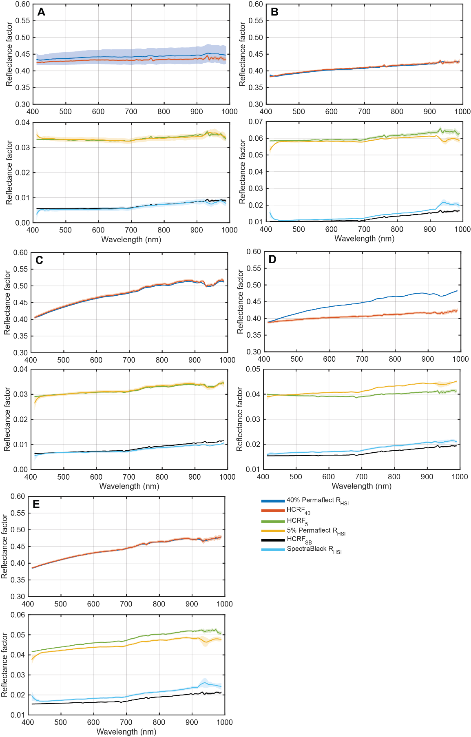

$$R_{HSI} vs {HCRF}_{p}$$
SZA=57.6º
SZA=44.6º
SZA=25.9º

Slide 26
Mirror selection (VNIR)
Mirror C, the brightest target with the highest LER saturated the detector in several spectral bands
Mirror B was unsaturated, however, its larger diameter and wider FoR produced a strong dependence of Moffat fit RMSE on both sensor geometry and illumination
  larger optical footprint integrates geometric, illumination and atmospheric variability, reducing generalizability across flight conditions
Only Mirror A met both radiometric (no saturation) and geometric (pixel-compatible) constraints for reliable analysis

Slide 27
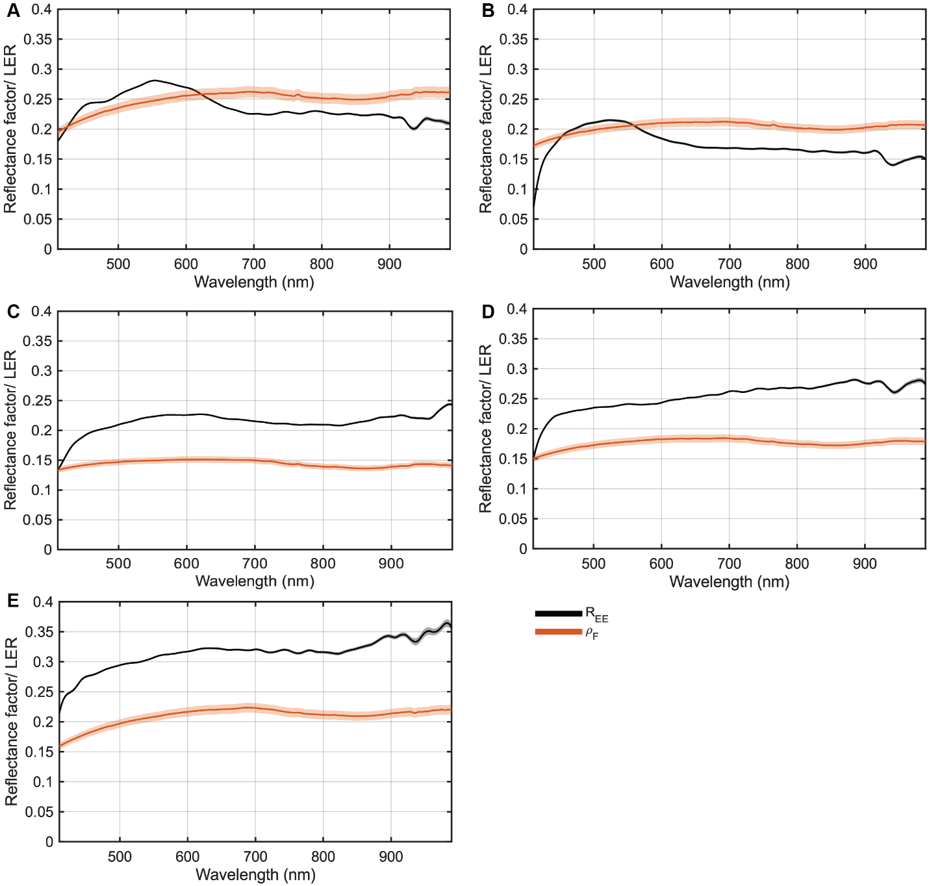

$$R_{EE }vs ρ_{F}$$
SZA=57.6º
SZA=44.6º
SZA=25.9º

Slide 28
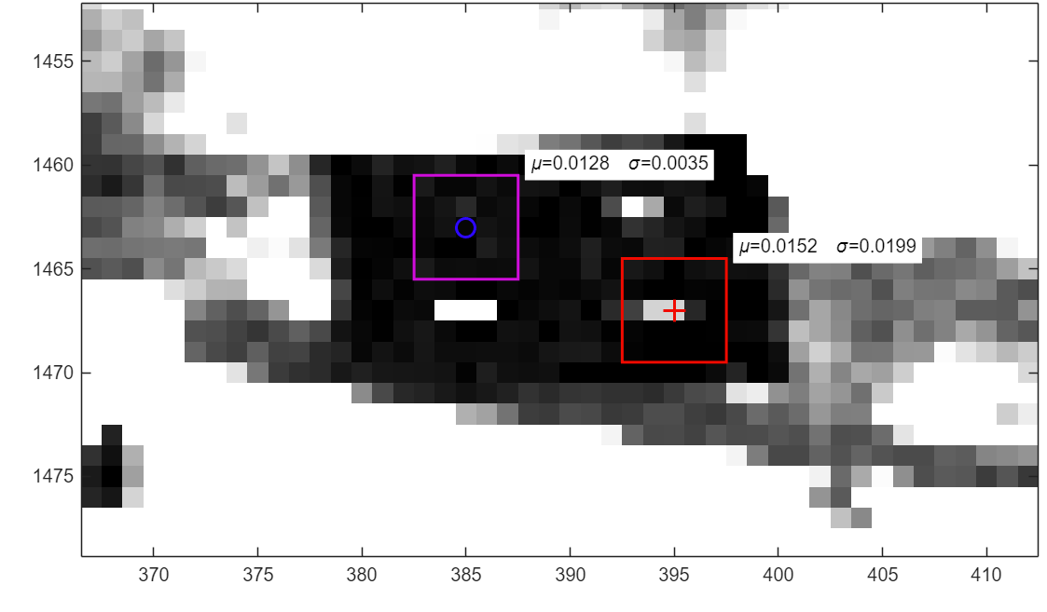
Problem SWIR pixel size

Slide 29
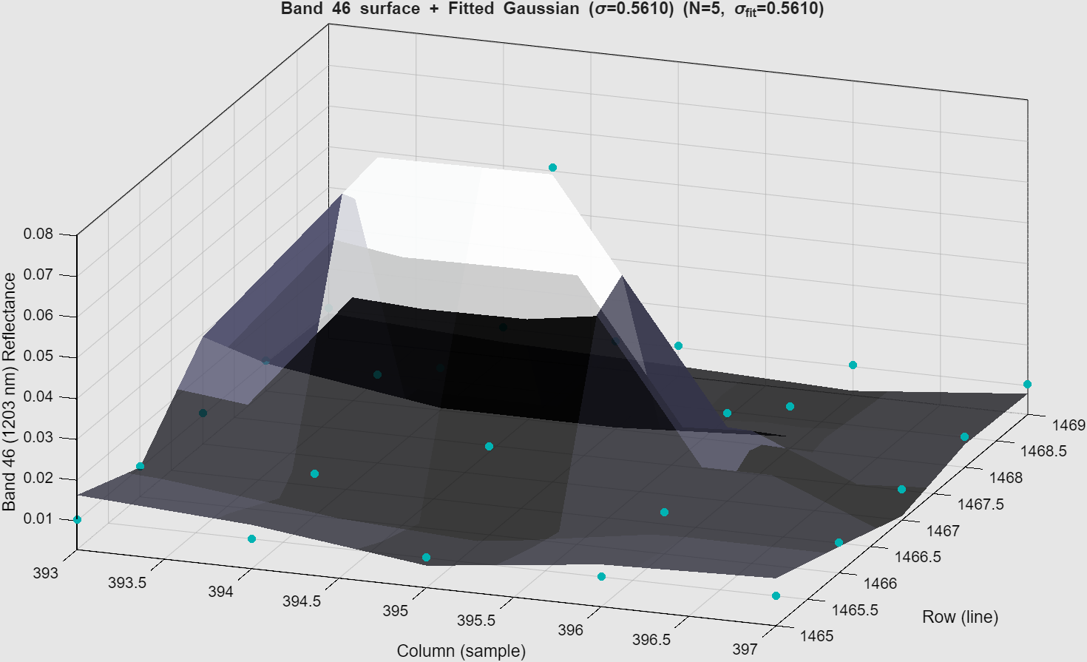
Problem SWIR pixel size

Slide 30
Key takeaway
Calibration performance at RPAS scale is controlled by illumination stability
We demonstrated:
Diffuse panels remain robust across solar geometry and cloud conditions
SPARC mirrors are highly sensitive to illumination variability
Mirror-derived reflectance agrees well in clear skies (~5%) but errors increase with clouds in vicinity (~15%)

Slide 31
Why this matters….
Illumination (diffuse vs direct) is the dominant source
of uncertainty
RPAS conditions amplify sensitivity (small targets, motion,
sampling)

Slide 32
Robust hyperspectral Cal/Val at RPAS scale requires methods that are stable under real-world illumination variability

Slide 33

Questions?
Notes:
This work is really about making RPAS a reliable bridge between field measurements and satellite validation, and ensuring those measurements remain robust under real-world conditions.
what we see is that at RPAS scale, calibration performance is really controlled by illumination stability.
Diffuse panels remain robust, while SPARC mirrors are much more sensitive to real-world conditions.
I look forward to the discussion and welcome your questions

