Slide 1


Optical Power and Radiation Thermometry
Metrology
Andrew Todd
Sara Hosseini, Rachel Santos, Nifia Garg, Pinrui Shen, Channprit Kaur, Jim Shaffer

Slide 2
Outline
  Introduction to NRC Metrology
  Primary Optical Power
  Non-contact thermometry
  Research Activities

Slide 3
NRC Metrology
As the National Metrology Institute of Canada:
    We realize and disseminate the units in the International System of Units (the SI);
    Perform research into methods and devices that improve the quality and accuracy of measurements;
    Engage with global NMIs through the BIPM and its consultative committees;
    Perform comparisons against other NMIs to ensure equivalence of measurements as part of Canada’s commitment to the Treaty of the Metre;
    Provide scientifically sound advice to government, industry and for the development of documentary standards.
Notes:
Note that the WMO is part of the CIPM MRA and participates in CCT & CCPR CCs
The CCT has a WG on Climate

Slide 4








NRC Metrology: Teams
Aerosol and Gas Metrology
Biotoxin Metrology
Dimensional Metrology
Electrical Power Measurement
Electrical Standards
Frequency and Time
Inorganic Chemical Metrology
Mass and Related Quantities
Medical and Industrial Dosimetry
Nanometrology
Organic Chemical Metrology
Photometry & Spectrophotometry
Radiation, Environment and Security
Thermometry & Radiometry

Slide 5
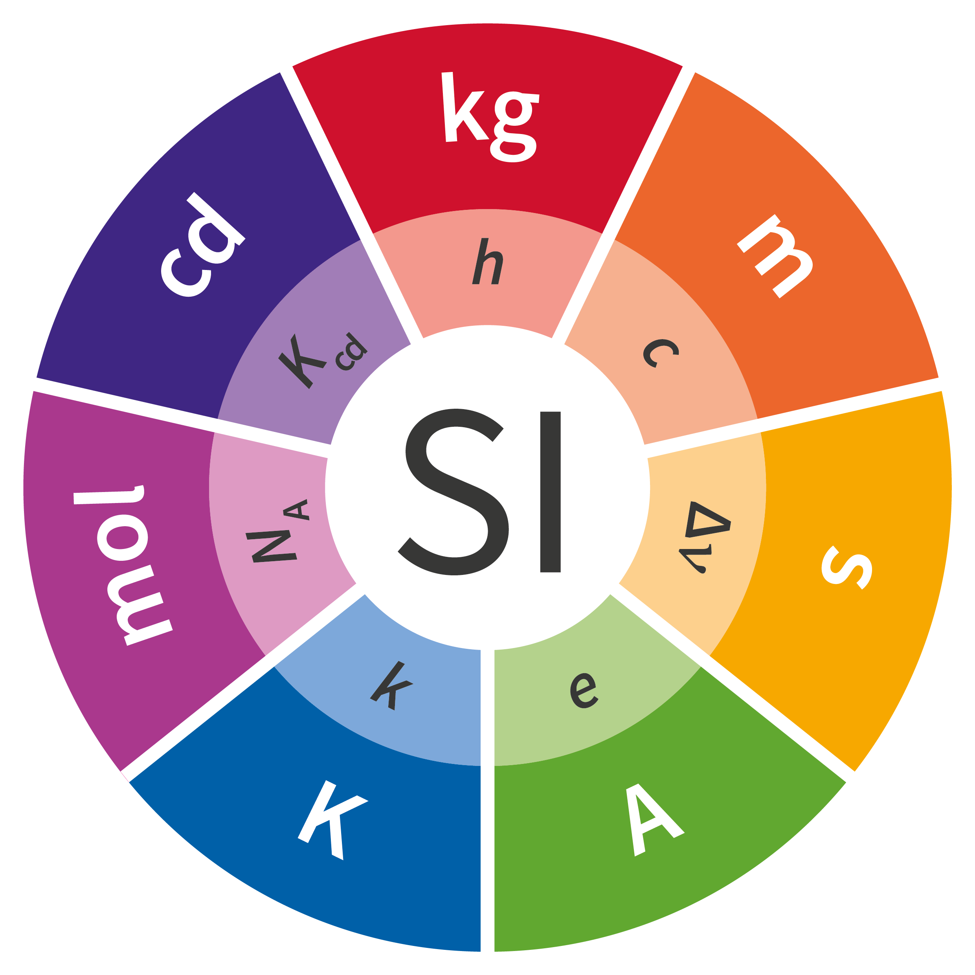
Outline
  Introduction to NRC Metrology
  Primary Optical Power
  Non-contact thermometry
  Research Activities
How do we obtain a primary measurement of optical power?
i.e., can we relate a measurement of optical power to constants in the SI (k, h, e, c, etc.)
Notes:
In general, we want to relate our measurements back to some invariant property of nature, such as physical constants. The redefinition of the SI in 2019 formalized this by defining the base SI units in terms of fundamental constants.

Slide 6
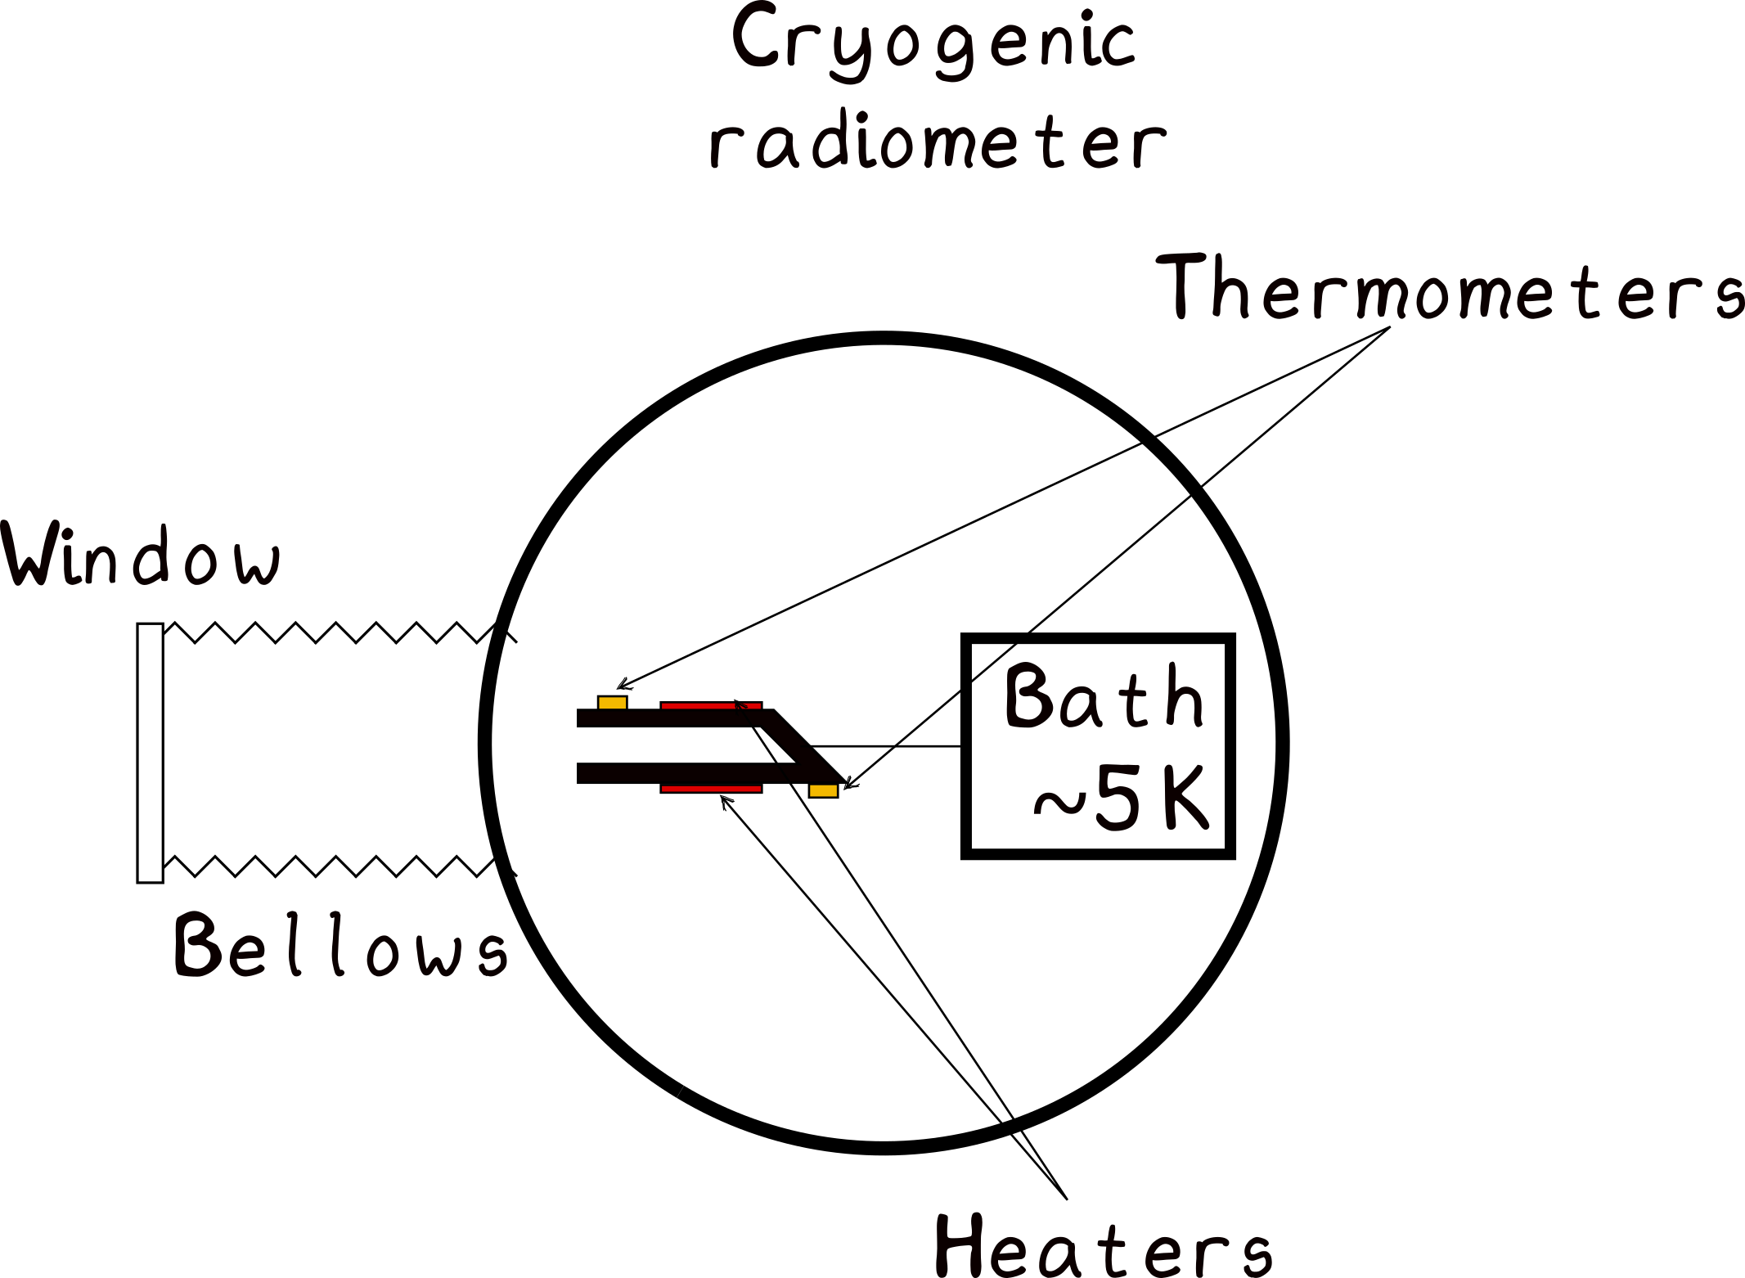
SI-traceable primary optical power: electrical substitution radiometry

Slide 7
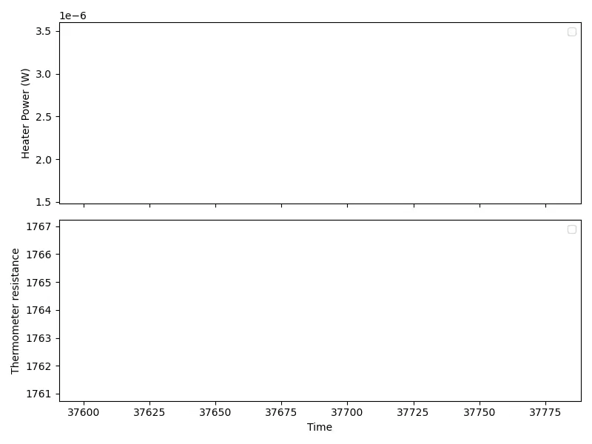
SI-traceable primary optical power

Slide 8
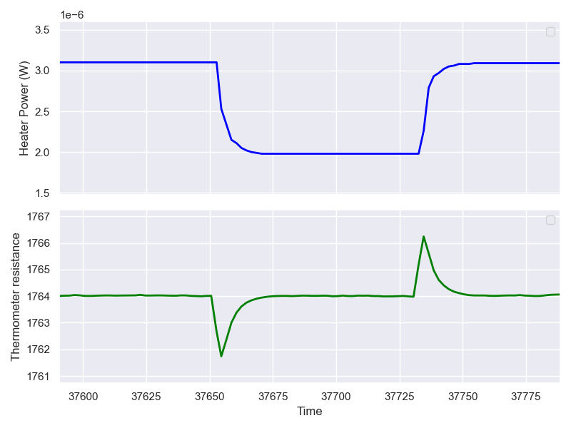
SI-traceable primary optical power

Slide 9
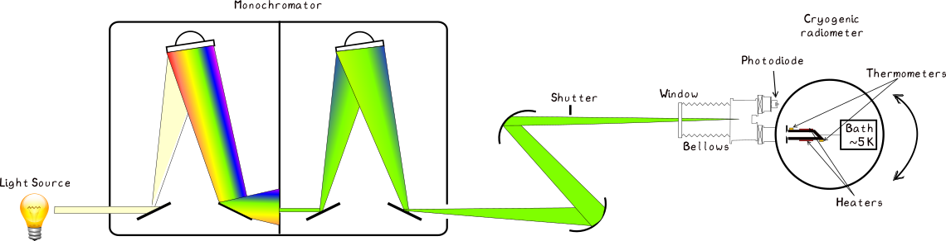
SI-traceable primary optical power: electrical substitution radiometry

Slide 10
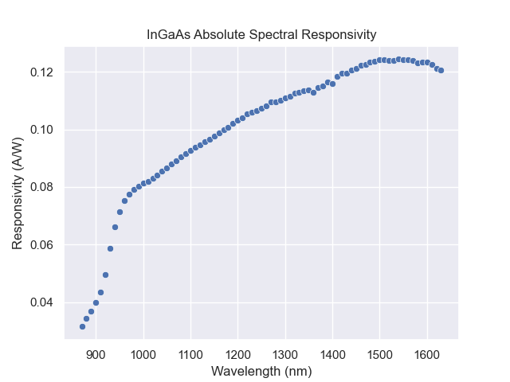

Slide 11
SI-traceable primary optical power: electrical substitution radiometry
  Why cryogenic?
    Equivalence: heater wires are superconducting;
    Sensitivity: lower heat capacity of absorber;
    Bath: weak link to cold bath enable temperature control of cavity
  Traceability?
    Power: current measurements to Quantum Hall via a resistor;
    Voltage: to the NRC Josephson via 8.5-digit voltmeter
    Wavelength: monochromator calibrated against know spectral lines
  What for?
    Services: disseminate optical power via photodiodes;
    Internal services: enables other radiometric and photometric services;
    Research: supports high temp. thermometry, single photon radiometry.

Slide 12
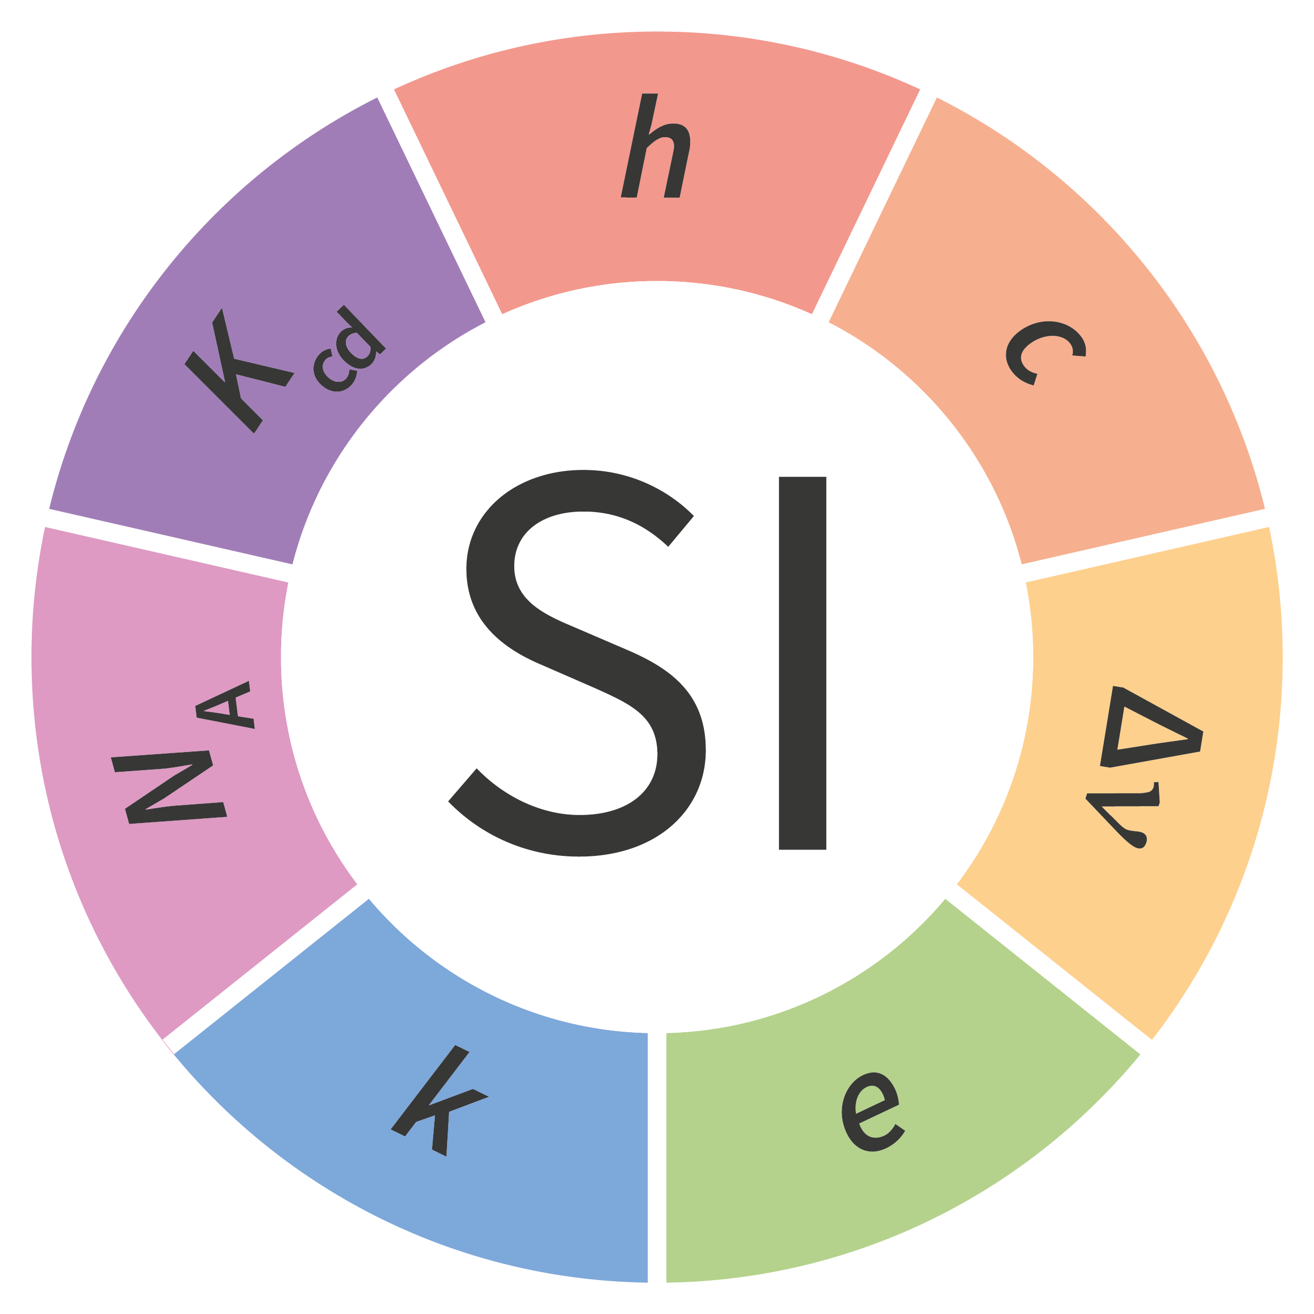
Outline
  Introduction to NRC Metrology
  Primary Optical Power
  Non-contact thermometry
  Research Activities
Traceability for temperature measurement using non-contact, i.e optical radiation thermometers

Slide 13
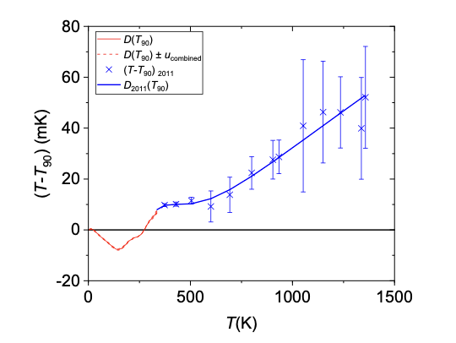
A note about temperature measurement: scale vs thermodynamic
    Most temperature measurements are made with SI traceability to the International Temperature Scale of 1990 (ITS-90);
    Temperature scales emphasize consistency over truth;
    Best estimate of thermodynamic temperature as of 1989;
Notes:
- No thermometers measure temperature…

Slide 14
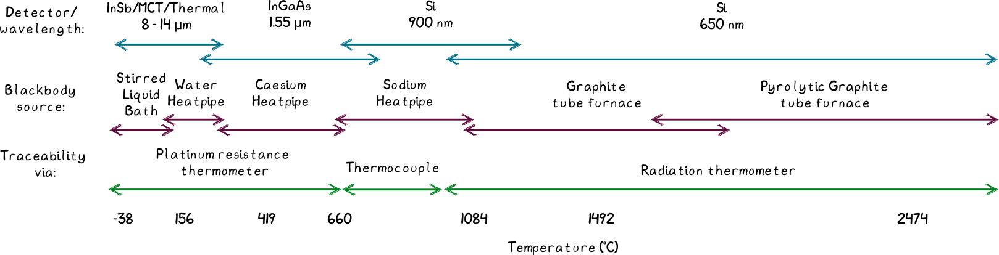
Non-contact thermometry
    For non-contact thermometry, we cover the range between -40 °C to > 3000 °C
    Different ranges require different traceability paths and different instruments

Slide 15
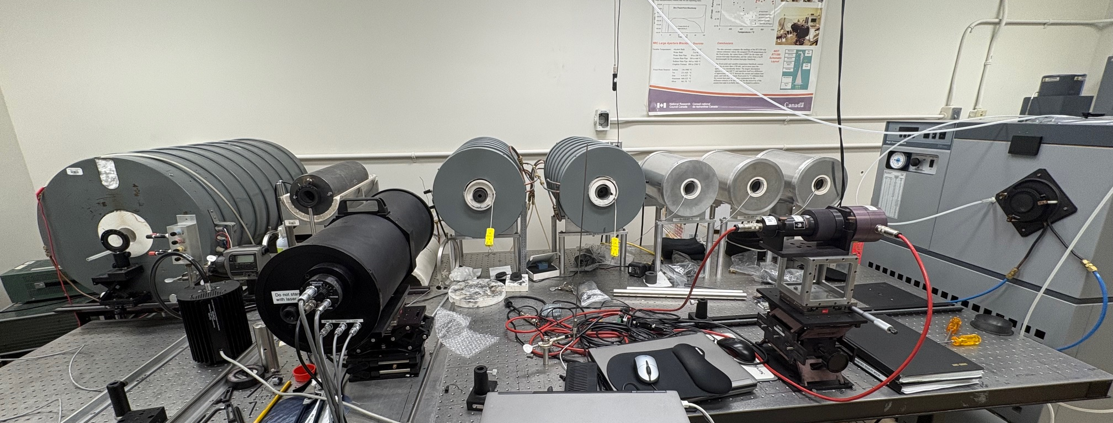
Non-contact thermometry: below 968 °C
Notes:
- No thermometers measure temperature…

Slide 16
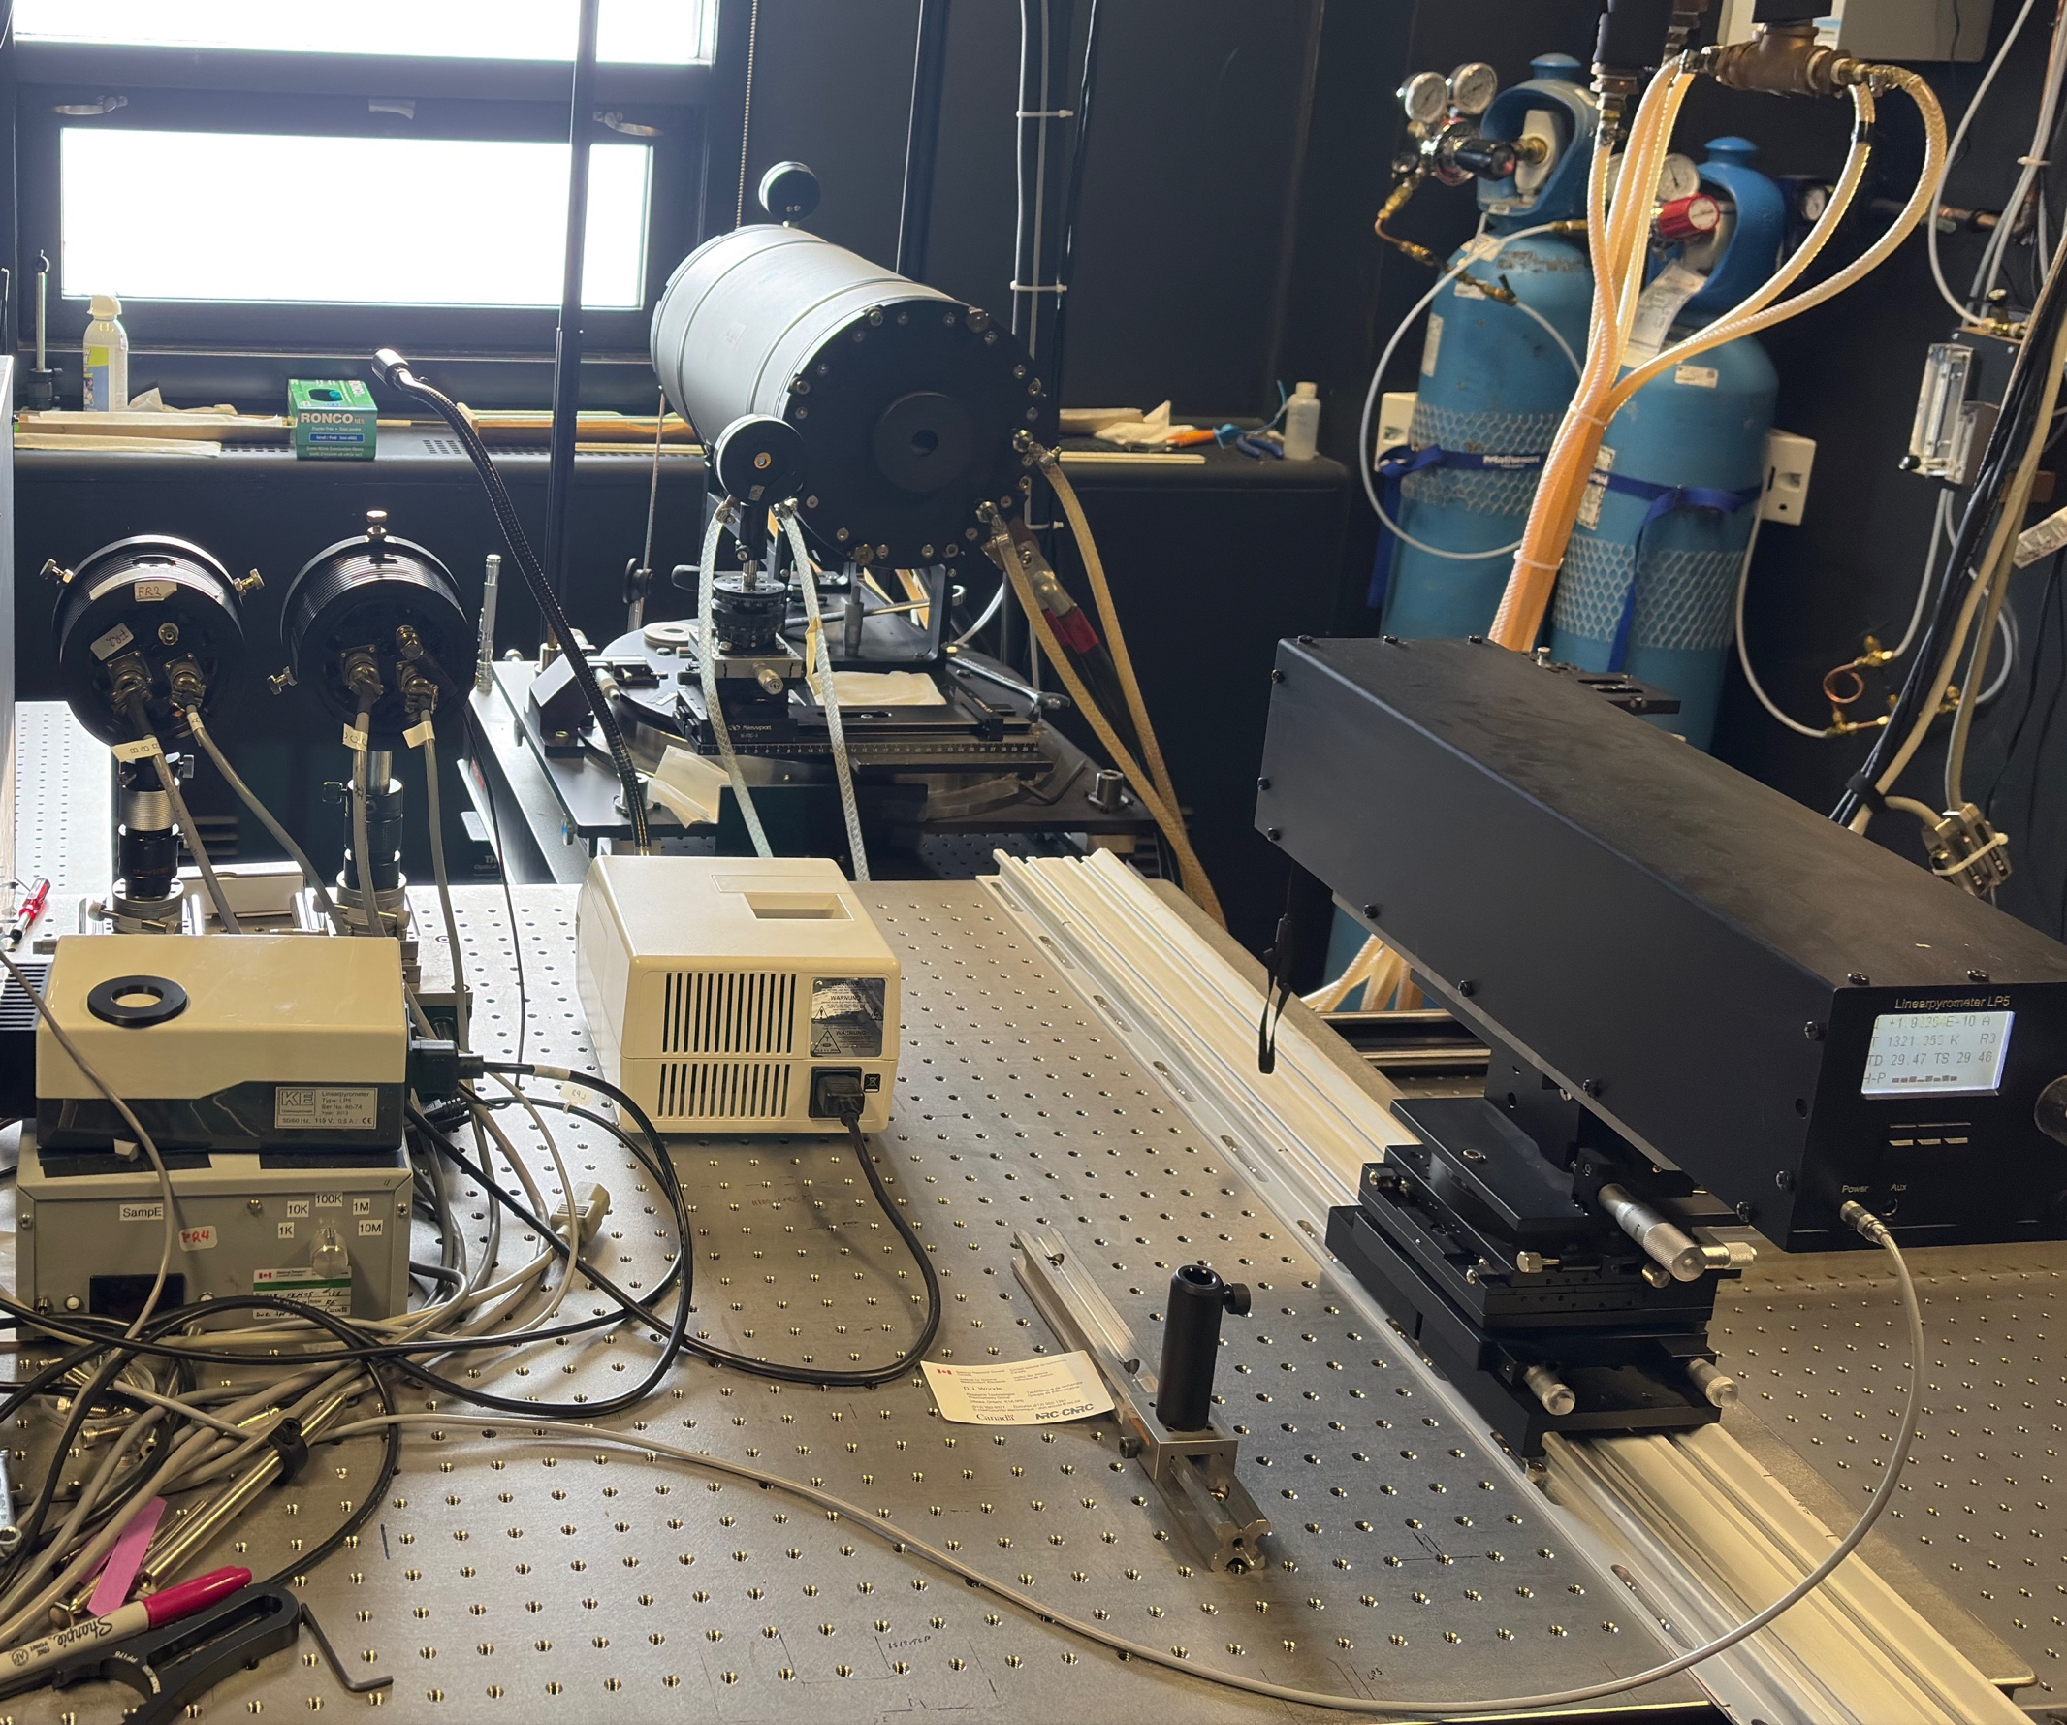
Non-contact thermometry: above 968 °C
Notes:
- No thermometers measure temperature…

Slide 17
Outline
  Introduction to NRC Metrology
  Primary Optical Power
  Non-contact thermometry
  Research Activities
One example: Radiometry with Rydberg atoms

Slide 18
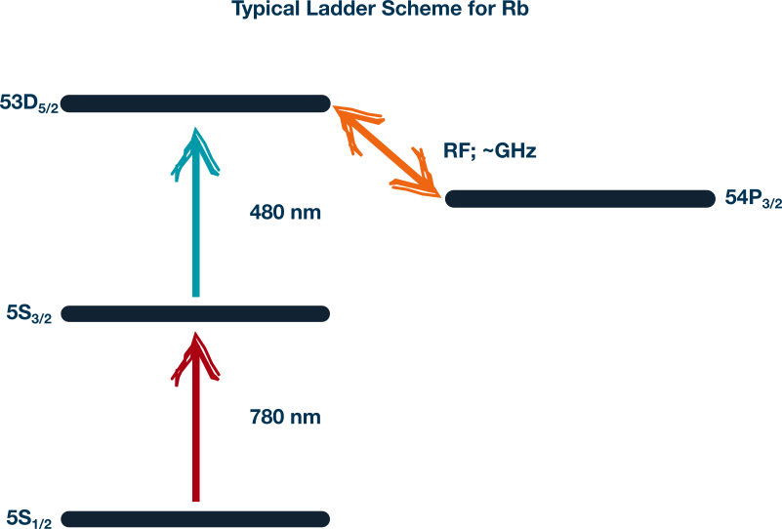

Rydberg atom radiometry
Basis
  atoms in a highly excited state, i.e. one electron occupying a high quantum number;
  highly sensitive to electromagnetic radiation, but also to blackbody radiation;
  usually optically dressed and read-out;
  Frequently used for RF sensing.

Slide 19
Why an atom-based radiometer?
Primary: Utilizes atomic standards, providing absolute measurements without need for recalibration.
Broadband: Capable of sensing electric fields across a wide frequency range (MHz, GHz and THz range).
Small size: Size is independent of wavelength.

Slide 20
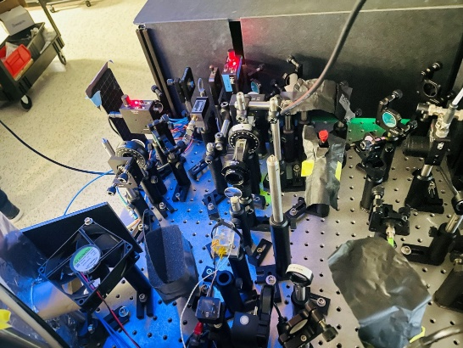
New Rydberg radiometry scheme: NRC and QVIL
Rydberg atoms are prepared using two lasers and an RF field;
They resonantly absorb photons, leading to measurable absorption of the probe laser;
Exposure to an external EM field modifies this absorption, producing electromagnetically induced transparency (EIT);
Blackbody photons alter the decay rate of the atoms, further changing the probe laser absorption;
The change in absorption is recorded using a photodetector.

Slide 21
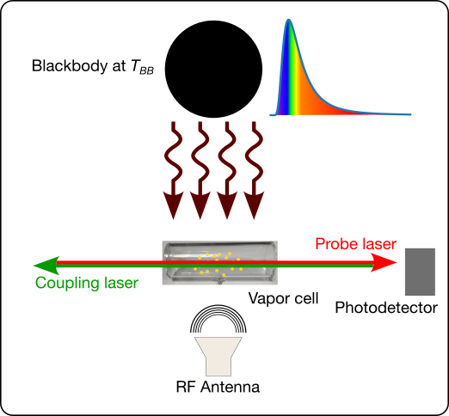

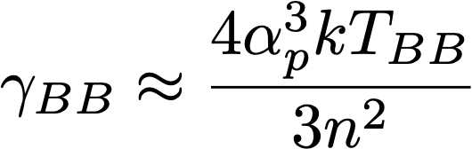
Recent results: NRC and QVIL
Caesium gas as sensing medium;
Two lasers (509 nm and 852 nm) and RF field (133.3 GHz) to prepare Rydberg atoms;
A blackbody (BB) source with temperature up to 773.15 K.
The Impact of Thermal Fields on Rydberg Atom Radio Frequency Sensors. arXiv preprint arXiv:2508.17506.
Notes:
The effect we are measuring is the change in decay rate of the excited atoms.
𝛾 is the decay rate
𝛼p is the polarizability of the atom

Slide 22
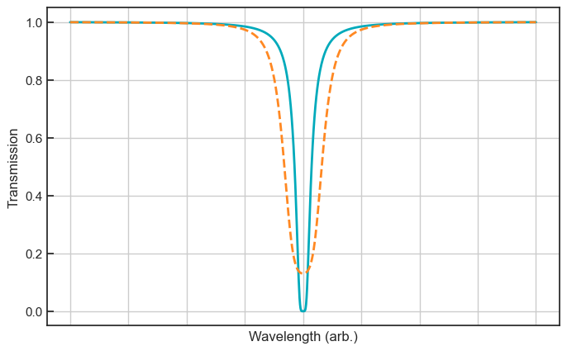
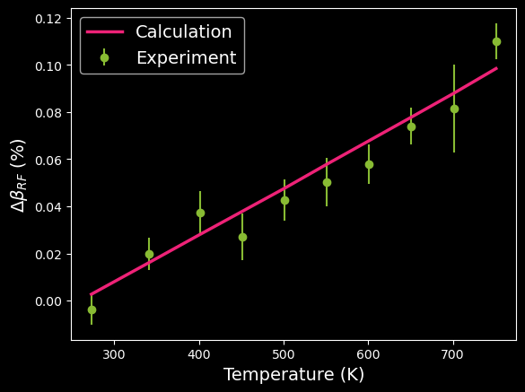
Recent results: NRC and QVIL
Probe laser is locked to the transmission peak;
Blackbody radiation begins to split the peak and the transmission changes
The Impact of Thermal Fields on Rydberg Atom Radio Frequency Sensors. arXiv preprint arXiv:2508.17506.
Notes:
We saw direct heating of the cell which causes classical changes in the transmission through the cell

Slide 23
Atom-based radiometer: applications?
    Early on, but the Rydberg work is meant to be application focused;
    We want to engage with the radiometric sensing community to understand pain-points, gaps etc. to see if devices such as an atom-based radiometric sensor can help;
    If you have areas where a new type of sensor may benefit your measurements, we’d be happy to talk about it.

Slide 24
Thanks
Andrew Todd, NRC Metrology
andrew.todd@nrc-cnrc.gc.ca

