Slide 1



Ocean, Coastal and River Engineering (OCRE)
March 23, 2026

Slide 2
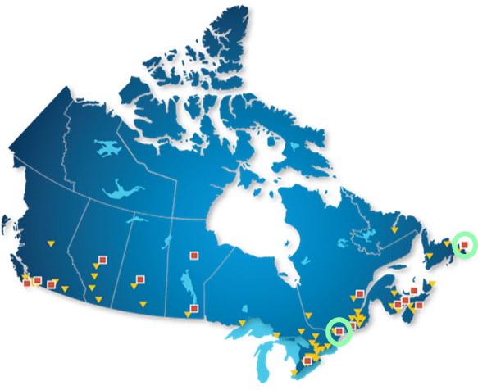
OCRE Vision and Mission
Our Vision
  Resilient Shores. Zero-Impact Ships. Safe and Secure Canada.
Our Mission
  Focusing on harsh environments and extreme conditions, we work with our partners to enhance Canada’s prosperity by innovating and building knowledge to protect people, infrastructure and the environment.
Notes:
The map shows NRC RCs (red squares) and IRAP offices (yellow triangles) across Canada
OCRE is based in two locations, St. John’s and Ottawa
St. John’s facilities are located on the MUN campus (RC co-location with university campuses is often the case as it facilitates access to students and collaborative research)

Slide 3
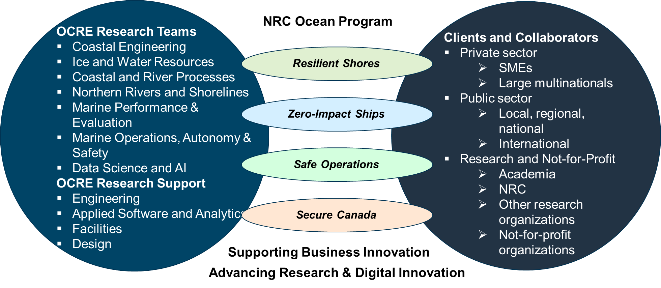
OCRE at a Glance
Notes:
OCRE is part of the NRC Engineering Division; accordingly, OCRE is primarily engaged in applied research (other RCs are focusing on much more emerging fields, such as quantum/nano)
This means OCRE solves problems for its clients
The vast majority of projects executed at OCRE involve clients and/or collaborators
Left circle: research at OCRE is carried out by its research teams and research support teams
Right circle: OCRE works with clients and collaborators from industry, government and academia, nationally and internationally
Center: OCRE strategic pillars (informed by needs of OCRE stakeholders): all activities carried out at OCRE must have strong link with at least one strategic pillar’ cross-cutting activities: Ocean program (sunsetting 2027), supporting business innovation, advancing innovation

Slide 4
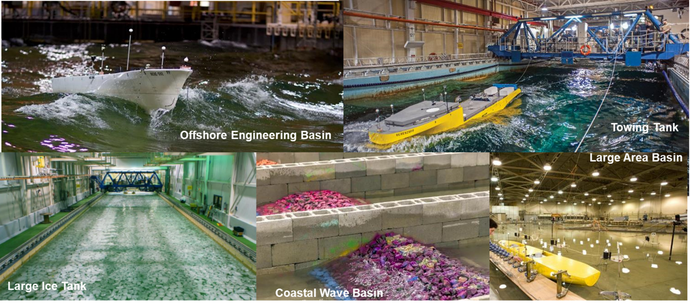
OCRE Facilities
Notes:
Physical experimentation is a key element of OCRE’s research; corresponding facilities comprising different wave basins and flumes are located in Ottawa and St. John’s
Focus in Ottawa is on coastal and river engineering (flooding, erosion, infrastructures): this often entails the building of model-scale environments, including elements such as bathymetry, infrastructures that require in-basin construction
Focus in St. John’s is on deep-water/offshore environments (shipping, offshore operations, vessel performance); St. John’s includes one of the world’s largest ice tanks
In addition to physical experimentation/modelling, OCRE researchers use numerical modelling (hydrodynamic modelling, computational fluid dynamics, hydraulic/hydrological modelling, machine learning/data-driven modelling); often, physical modelling provides the necessary high-quality observations required for the calibration and validation of numerical models
OCRE researchers also engage in field work (e.g. measurements of environmental parameters for coastal modelling, full-scale ship trials)

Slide 5
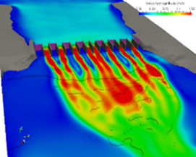
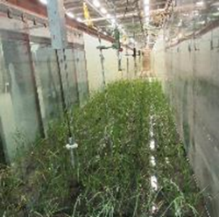
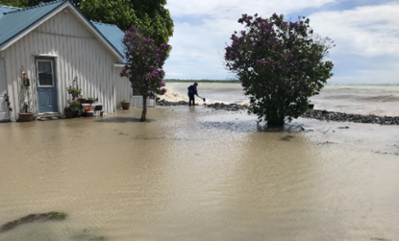
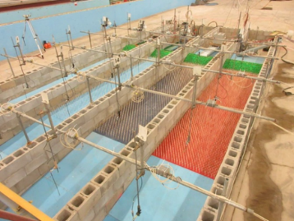
Resilient Shores
    Adapting coastal infrastructure for greater climate resilience
    Climate change impacts on storm surge and waves
    Evaluation of new technologies – emergency flood barriers
    Nature-based solutions for coastal & Riverine resilience
    Developing best practices to address hazards related to river ice
Notes:
These are the major lines of enquiry/research related to the Resilient Shores strategic pillar
Significant amount of coastal/riverine infrastructure (e.g. dams, port infrastructures, coastal defenses) in Canada has been designed for extreme environmental conditions without taking into account climate change; OCRE examines approaches to make existing infrastructure more climate resilient
Climate change impacts patterns of extreme events, OCRE provides predictive tools for decision makers that take into account climate change impacts on surges and waves
Temporary flood barriers/building retrofits are an emerging industry in Canada, OCRE is the only facility in Canada capable of testing temporary flood protection technologies according to existing international standards
In addition to their utility in climate change adaptation, nature-based solutions can provide a multiple co-benefits; this includes hybrid solutions, comprising conventional infrastructure paired with nature-based approaches; nature-based approached seek to harness the resilience inherent in natural systems, such as wetlands

Slide 6
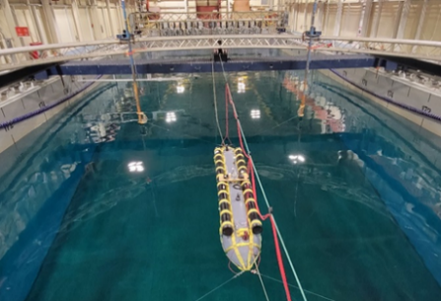
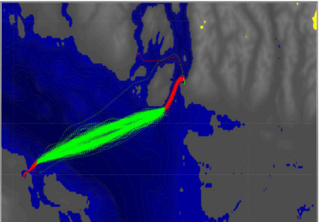
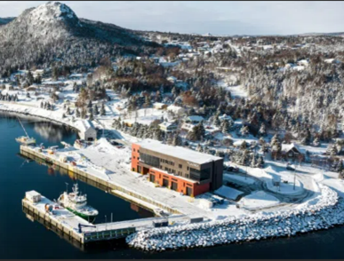
Zero-Impact Ships
    Baselining vessel performance
    Operational data analytics in support of greening government fleets
    Characterization of operational best-practices using machine-learning
    Navigation and route optimization in ice
    Evaluation hull form designs and green technologies
    Collaboration with living labs/test sites across Canada
Notes:
Baselining vessel performance – OCRE establishes detailed reference measurements of ship efficiency, including speed, fuel consumption, and propulsion system behaviour under different operating conditions. This baseline allows researchers to detect performance changes over time due to factors like hull fouling, mechanical wear, or environmental influences.
Operational data analytics in support of greening government fleets – OCRE collects and analyzes large sets of operational data from government vessels to pinpoint inefficiencies.
Characterization of operational best-practices using machine-learning – OCRE applies machine learning techniques to operational datasets to uncover patterns that lead to optimal vessel performance.
Navigation and route optimization in ice – OCRE combines satellite imagery, ice charts, and historical ice movement data to develop navigation tools that help ships plan safe and fuel-efficient routes through ice-covered waters. This includes exploring algorithm-based route optimization and predictive ice modelling for improved safety and efficiency.
Evaluation of hull form designs and green technologies – OCRE uses computational fluid dynamics simulations and scale-model testing to compare how different hull shapes and coatings perform in various conditions, including ice. This can include assessing the integration of green propulsion technologies such as hybrid-electric systems and LNG engines, measuring their long-term environmental benefits and operational efficiency.

Slide 7
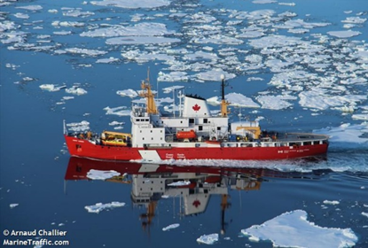
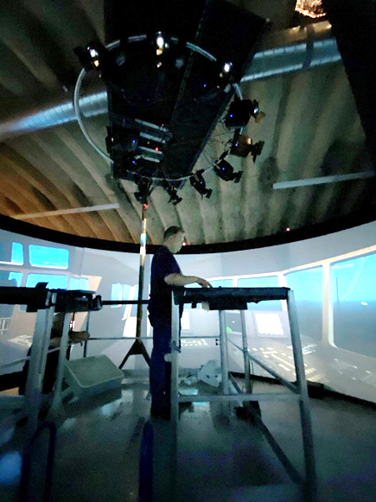
Safe Operations
    Performance evaluation of ships and equipment in ice and harsh environments
    Evaluation of marine incidents to provide insights towards prevention and recovery
    Development and evaluation of marine autonomous technologies
    Evaluation and mitigation of ship underwater-radiated noise
    Digital twinning and simulation
Notes:
Performance evaluation of ships and equipment in ice and harsh environments – OCRE conducts controlled tests and field trials to measure how ships and marine equipment perform in extreme cold, heavy ice, and rough seas. This includes assessing propulsion efficiency, hull integrity, and onboard systems reliability under real-world and simulated environmental stresses.
Evaluation of marine incidents to provide insights towards prevention and recovery – OCRE analyzes data from past marine accidents, mechanical failures, and operational disruptions to identify root causes. By applying forensic engineering and systems analysis, they develop recommendations to improve safety procedures, vessel design, and emergency response strategies.
Development and evaluation of marine autonomous technologies – OCRE designs, tests, and validates autonomous vessel systems, including navigation, obstacle detection, and operational decision-making algorithms. Field and lab trials assess the reliability, safety, and efficiency of these technologies in varied marine conditions, including ice-covered waters.
Evaluation and mitigation of ship underwater-radiated noise – OCRE measures and characterizes the acoustic footprint of vessels, focusing on noise emitted underwater from propulsion systems and machinery. They study the impact on marine life and develop engineering solutions such as quiet propeller designs, vibration isolation, and alternative propulsion systems to reduce noise levels.
Digital twinning and simulation – OCRE creates high-fidelity digital replicas of vessels and marine systems to simulate performance, predict maintenance needs, and test modifications virtually. This allows researchers to evaluate scenarios like extreme weather navigation, equipment failures, and energy optimization

Slide 8
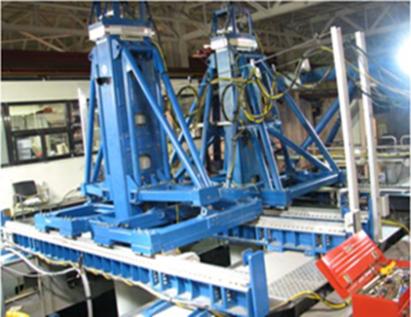
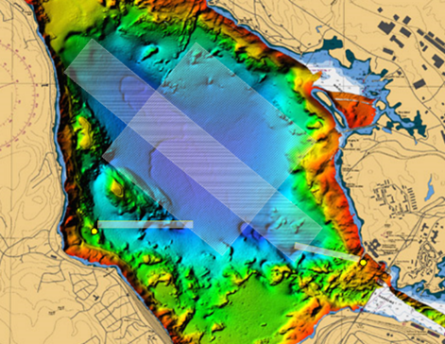
Secure Canada
    Research support for the Royal Canadian Navy
    Hydrodynamics research
    Ship-ice interaction
    Digital twinning and simulation
    Numerical modelling, physical modelling, field trials
    Dual-use applications
Notes:
Much of the work conducted under Secure Canada is related to performance and safety of surface and underwater vessels
Confidentiality/secret restrictions apply

Slide 9
Recent Project Examples

Slide 10
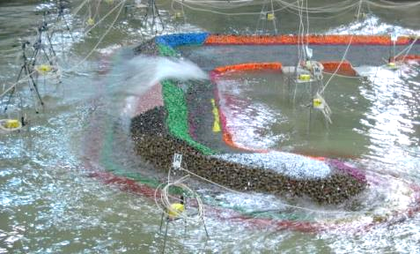
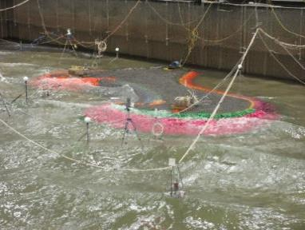
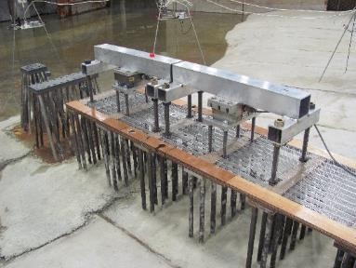
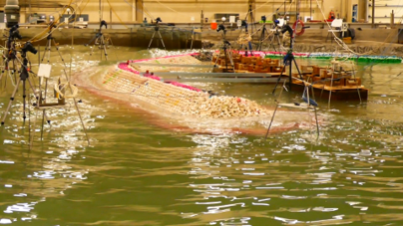
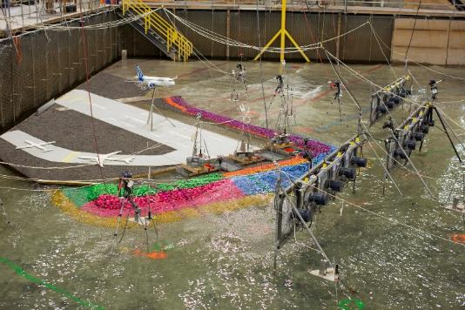
Testing and Optimization of Coastal and Port Structures

Slide 11
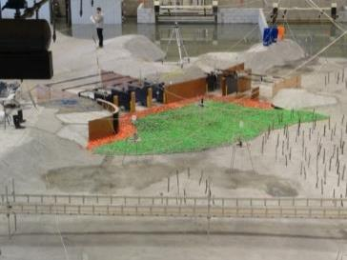
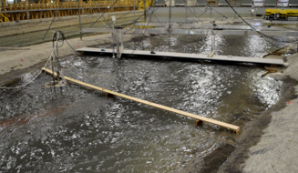
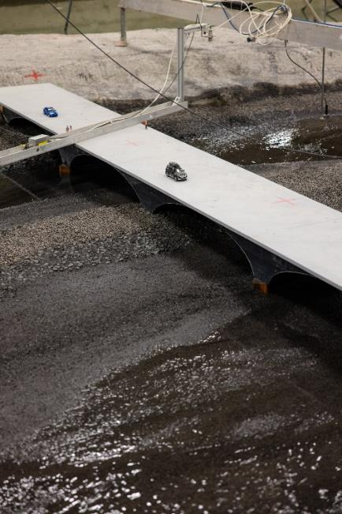
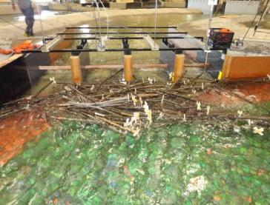
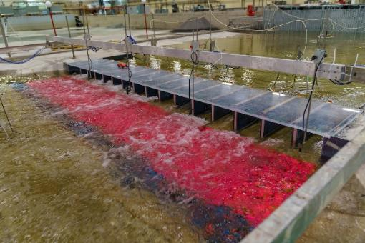
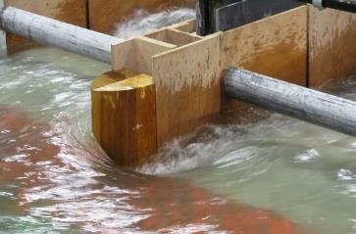
Hydraulic Infrastructure
Notes:
Middle Photo:
The 2013 flood event caused a number of morphologic changes in the Bow River, including the development of new gravel bars which is the elevated sediment caused by sediment transport, near Calgary’s downtown core in the vicinity of the Tenth Street Bridge. The formation of gravel bars in dense urban settings can restrict flow and impact the capacity to convey floodwater. One solution would be dredging, however, that would have a negative impact on the riparian habitat. So we did the physical modelling in our lab to evaluate gravel bar management strategies that will mitigate flood and erosion risks while preserving or enhancing aquatic habitat.
We also used the results for the development and calibration of the numerical models that address the sediment transport.
Right Photos
Large (1:16 scale) physical model was constructed in NRC-OCRE’s Large Area Basin (the model was so big it is hard to get a good photo of its extents but you can see the researcher in the photo in the top left)
********
Model Objectives were to,
Investigate and validate the hydraulic performance
Sediment behavior and scour potential
Understand the interaction with woody debris and the structures
Develop rating curves for the gate operations on the sluiceway and diversion strucutres
And the key objective was to develop design optimizations for improved life-cycle costs of the project
You can see the model layout schematic in the 50m by 30m LAB
The large flood flows were supplied at the top of model, flooded the upstream flood channel and then flowed over the concrete representation of the model river and floodplain, the flood flows then split to flow thorugh the model diversion strcutre at the top of the schematic and the main river sluiceway at the bottom of the schematic
The physical model showed that the nature-based approach to managing the sediment within the Bow River provided a stable solution that met the City of Calgary's requirements. Specifically, showed that the City could reuse/reshape the gravel sediment deposited by the 2013 flood within the river instead of removing it from the river system (which is the typical engineered solution). Removing sediment from the system can result in downstream scour issues and general loss of aquatic habitat.

Slide 12
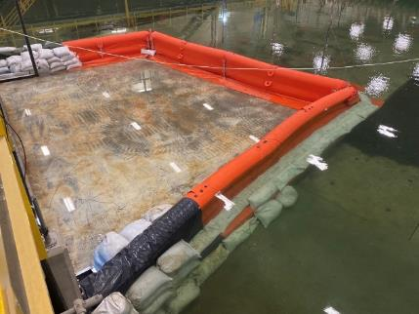
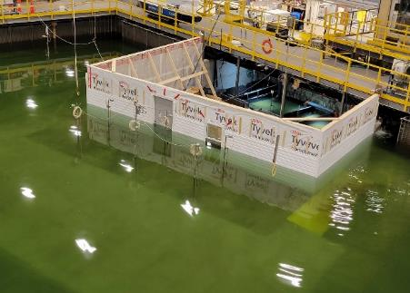
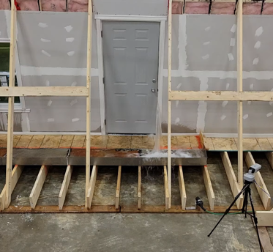
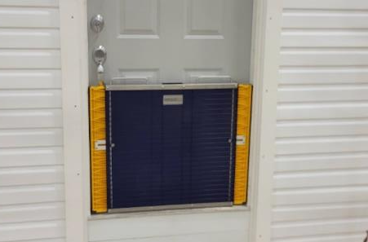
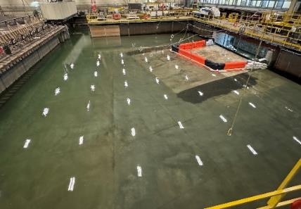
Flood Barriers

Slide 13
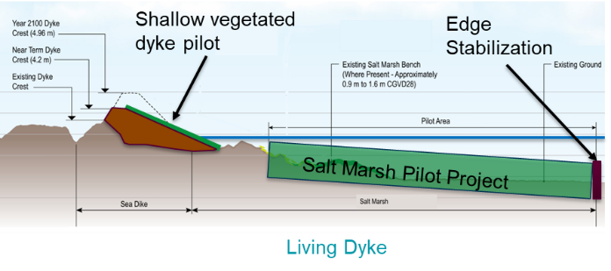
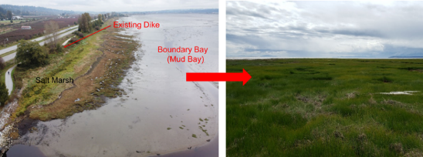
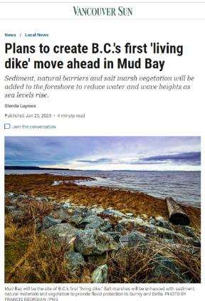
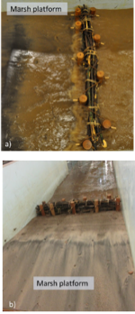
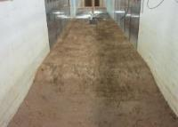
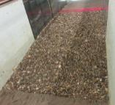
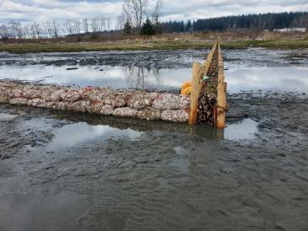
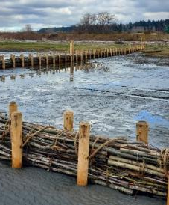
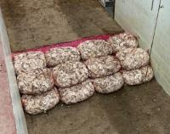
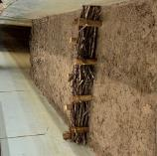
Nature-Based Infrastructure for Coastal Resilience
BC’s First Living Dyke pilot, Mud Bay
Notes:
Title: Field Trials on a Living Dyke in British Columbia: Wave Attenuation of Edge Treatment Features
Goals:
Mitigate coastal flooding
Restore estuarine habitat
Test restoration techniques:
Planting methods
Marsh elevations
Sediment composition
Temporary Nature-Based Edge Treatments
Objectives:
Measure nearshore wave characteristics
16 pressure sensors, Oct.-Jan.
Wave transmission coefficient
Monitoring conditions of treatments
Eight-month period
Conclusion:
All four edge treatments can attenuate waves for site conditions
Brushwood dam, gravel berm, oyster bag berm
Feasible, with design changes.
Sand berm
Sediment replenishment may be needed
Nature-based edge treatments can be effective on semi-sheltered salt marsh restoration projects in BC

Slide 14
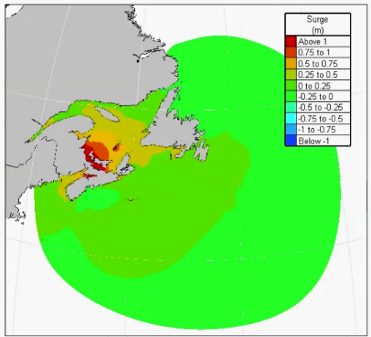
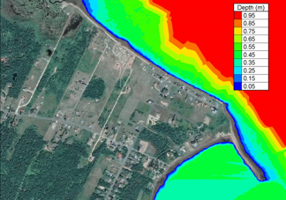
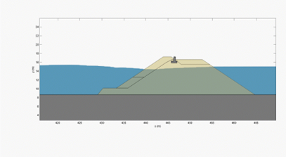
Numerical Modelling at Different Scales
Regional
Intermediate / Local
High Fidelity - CFD
Characterize tide- and wind-driven hydrodynamics, waves, sediment transport and morphology change
Impacts on regional hydrodynamics
Overland flow and inundation
Storm-driven erosion
Wave run-up, overtopping and interactions with shoreline / vegetation
Focus on understanding key processes, e.g.:
Fluid-structure interactions
Debris interactions with structure
Wave run-up, overtopping
Scouring

Slide 15
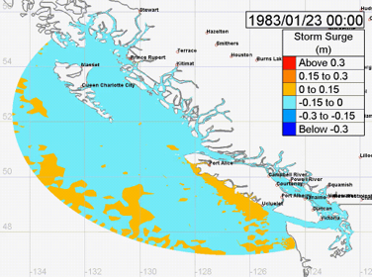
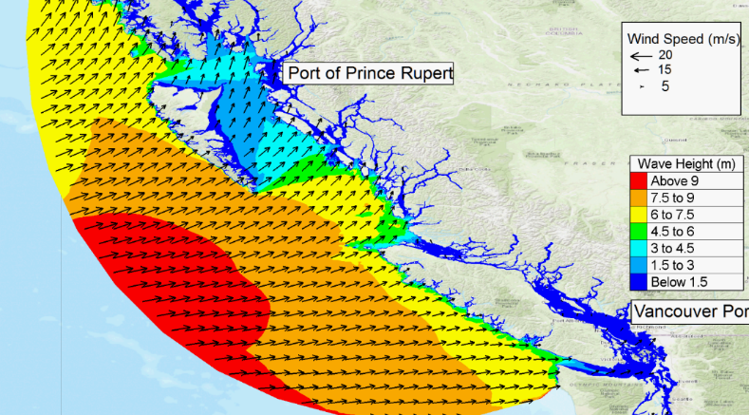
Climate Change Impacts on Waves & Storm Surges
Notes:
Objective is to predict and assess the impacts of climate change on coastal storm surges and extreme waves
Support climate risk assessments and adaptation planning for infrastructures (ports, airports) on the coast
Enables risk assessments for assets (example shown here is BC coasts in Canada)
Involves:
Wind and wave hindcast
Statistical (extreme value) analysis (Identify wind and wave conditions for future climate scenarios)
Numerical simulations to predict future wave conditions
Nearshore wave transformation modelling
Wave run-up and overtopping analysis
Data visualization using communication tools

Slide 16
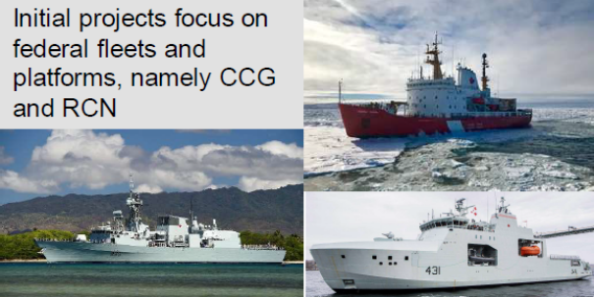
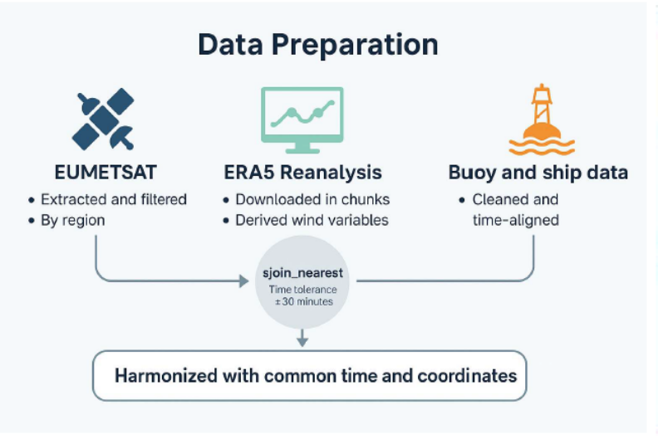
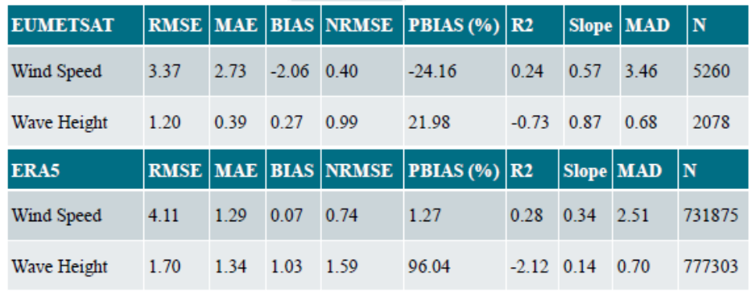
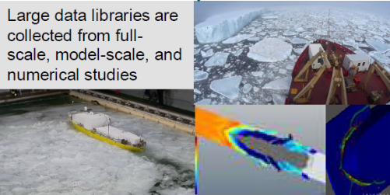
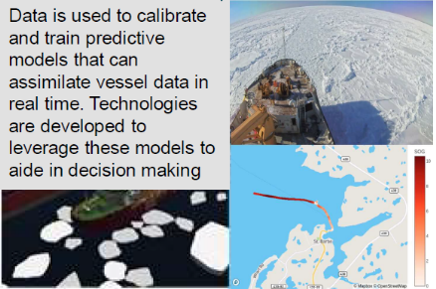

COMPARE
    Comprehensive Oceanic and Meteorological Product Analysis for Reanalysis and Evaluation (COMPARE)
Notes:
Performance evaluation of ships and equipment in ice and harsh environments – OCRE conducts controlled tests and field trials to measure how ships and marine equipment perform in extreme cold, heavy ice, and rough seas. This includes assessing propulsion efficiency, hull integrity, and onboard systems reliability under real-world and simulated environmental stresses.
Evaluation of marine incidents to provide insights towards prevention and recovery – OCRE analyzes data from past marine accidents, mechanical failures, and operational disruptions to identify root causes. By applying forensic engineering and systems analysis, they develop recommendations to improve safety procedures, vessel design, and emergency response strategies.
Development and evaluation of marine autonomous technologies – OCRE designs, tests, and validates autonomous vessel systems, including navigation, obstacle detection, and operational decision-making algorithms. Field and lab trials assess the reliability, safety, and efficiency of these technologies in varied marine conditions, including ice-covered waters.
Evaluation and mitigation of ship underwater-radiated noise – OCRE measures and characterizes the acoustic footprint of vessels, focusing on noise emitted underwater from propulsion systems and machinery. They study the impact on marine life and develop engineering solutions such as quiet propeller designs, vibration isolation, and alternative propulsion systems to reduce noise levels.
Digital twinning and simulation – OCRE creates high-fidelity digital replicas of vessels and marine systems to simulate performance, predict maintenance needs, and test modifications virtually. This allows researchers to evaluate scenarios like extreme weather navigation, equipment failures, and energy optimization

Slide 17




Wave Altimetry from Large-Scale Remote Sensing for Uncertain Simulations (WALRUS)
Notes:
Performance evaluation of ships and equipment in ice and harsh environments – OCRE conducts controlled tests and field trials to measure how ships and marine equipment perform in extreme cold, heavy ice, and rough seas. This includes assessing propulsion efficiency, hull integrity, and onboard systems reliability under real-world and simulated environmental stresses.
Evaluation of marine incidents to provide insights towards prevention and recovery – OCRE analyzes data from past marine accidents, mechanical failures, and operational disruptions to identify root causes. By applying forensic engineering and systems analysis, they develop recommendations to improve safety procedures, vessel design, and emergency response strategies.
Development and evaluation of marine autonomous technologies – OCRE designs, tests, and validates autonomous vessel systems, including navigation, obstacle detection, and operational decision-making algorithms. Field and lab trials assess the reliability, safety, and efficiency of these technologies in varied marine conditions, including ice-covered waters.
Evaluation and mitigation of ship underwater-radiated noise – OCRE measures and characterizes the acoustic footprint of vessels, focusing on noise emitted underwater from propulsion systems and machinery. They study the impact on marine life and develop engineering solutions such as quiet propeller designs, vibration isolation, and alternative propulsion systems to reduce noise levels.
Digital twinning and simulation – OCRE creates high-fidelity digital replicas of vessels and marine systems to simulate performance, predict maintenance needs, and test modifications virtually. This allows researchers to evaluate scenarios like extreme weather navigation, equipment failures, and energy optimization

Slide 18


Winter Road Characterisation
Notes:
Performance evaluation of ships and equipment in ice and harsh environments – OCRE conducts controlled tests and field trials to measure how ships and marine equipment perform in extreme cold, heavy ice, and rough seas. This includes assessing propulsion efficiency, hull integrity, and onboard systems reliability under real-world and simulated environmental stresses.
Evaluation of marine incidents to provide insights towards prevention and recovery – OCRE analyzes data from past marine accidents, mechanical failures, and operational disruptions to identify root causes. By applying forensic engineering and systems analysis, they develop recommendations to improve safety procedures, vessel design, and emergency response strategies.
Development and evaluation of marine autonomous technologies – OCRE designs, tests, and validates autonomous vessel systems, including navigation, obstacle detection, and operational decision-making algorithms. Field and lab trials assess the reliability, safety, and efficiency of these technologies in varied marine conditions, including ice-covered waters.
Evaluation and mitigation of ship underwater-radiated noise – OCRE measures and characterizes the acoustic footprint of vessels, focusing on noise emitted underwater from propulsion systems and machinery. They study the impact on marine life and develop engineering solutions such as quiet propeller designs, vibration isolation, and alternative propulsion systems to reduce noise levels.
Digital twinning and simulation – OCRE creates high-fidelity digital replicas of vessels and marine systems to simulate performance, predict maintenance needs, and test modifications virtually. This allows researchers to evaluate scenarios like extreme weather navigation, equipment failures, and energy optimization

Slide 19
Thank You
Thomas Puestow (thomas.puestow@nrc-cnrc.gc.ca)

