Slide 1
The GEMS2-Amethyst mission and radiometer developments at Weather Stream
Richard Delf, PhD
Chief Product Officer, Weather Stream

Slide 2
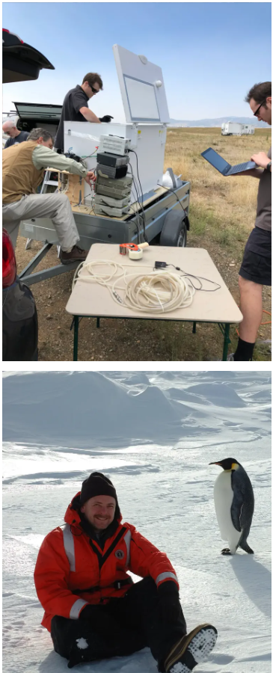
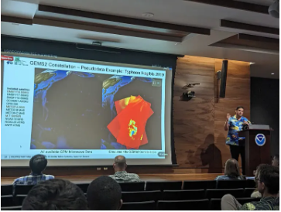
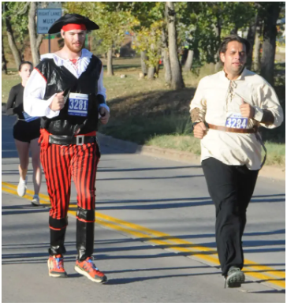
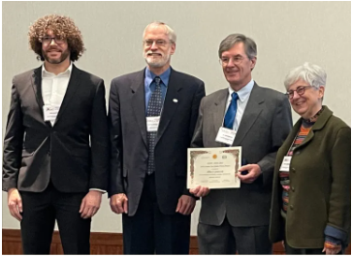
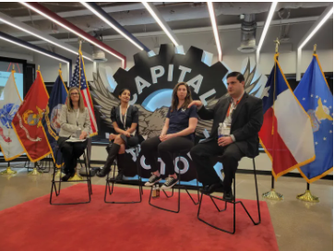
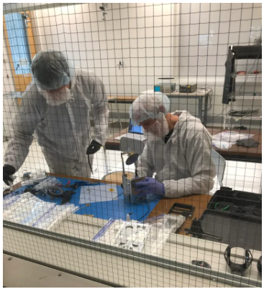
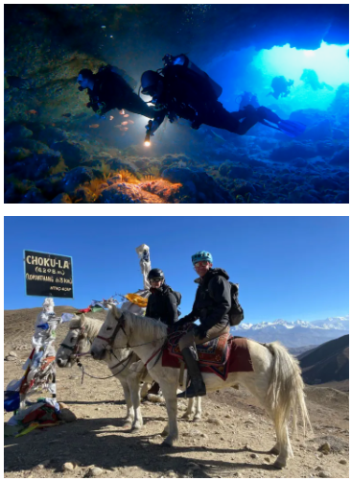
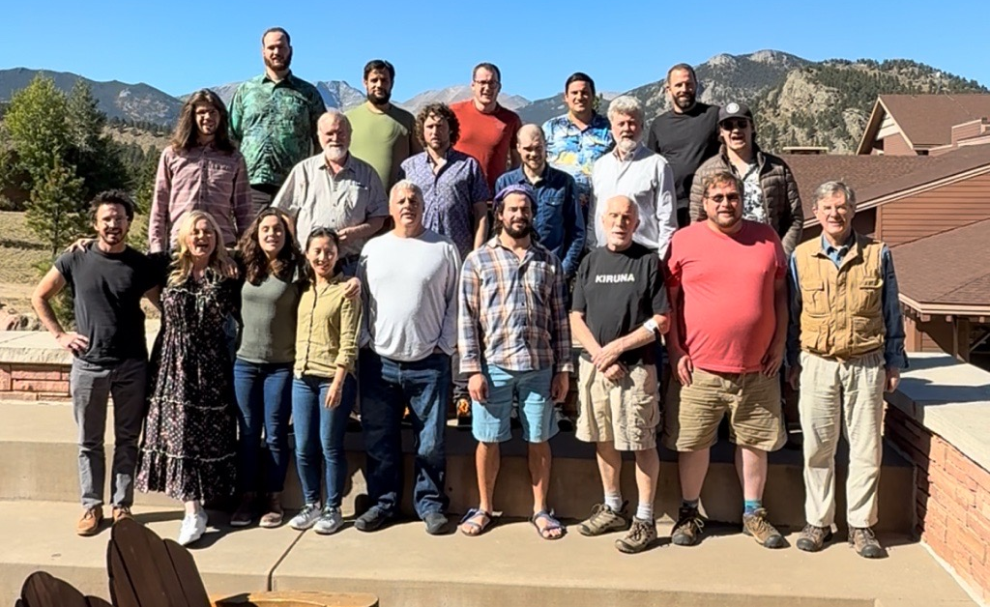
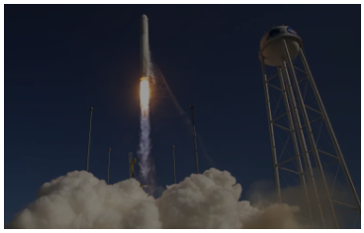
History and Culture
Weather Stream’s company mission is to stream real-time weather intelligence to the global community
Weather Stream’s company science objective is to achieve Nyquist spatiotemporal sampling with passive microwave instruments
Team and Culture:
• World’s first commercial passive microwave mission
• Founded 2015 based on CU Boulder Research
• 30 Employees, 13 PhDs, 15 engineers
• Civil servants trapped in a startup
• Relationship and partnership driven
• Outdoor enthusiasts
• Community oriented, volunteers
• Driven to solve tough problems
• “Every Photon is Sacred”
• A global weather data supply chain partner
Bootstrapped to space!

Slide 3
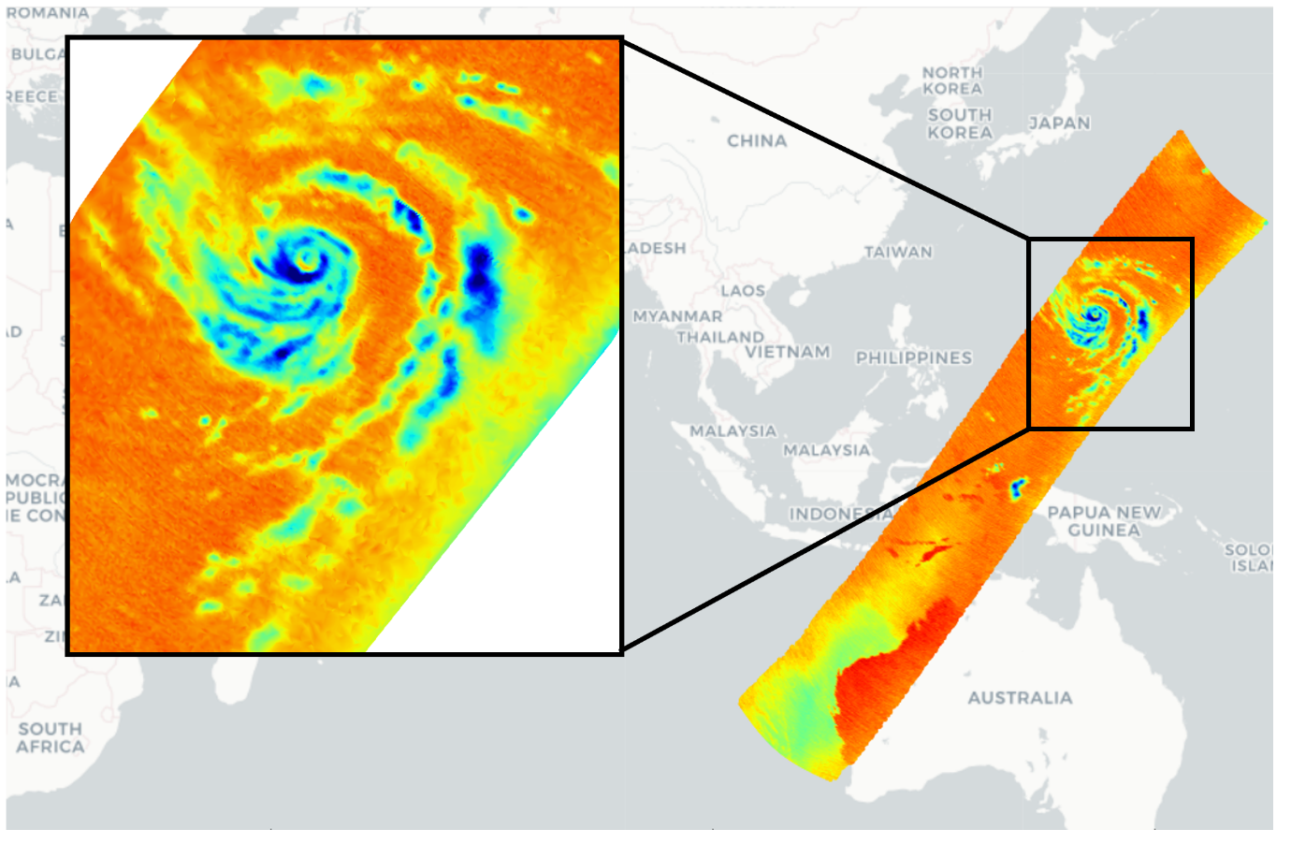
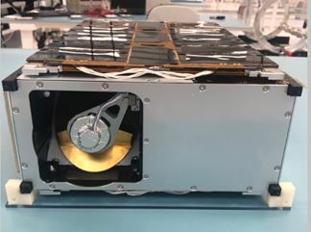

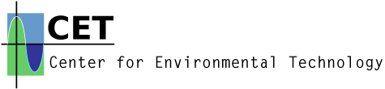
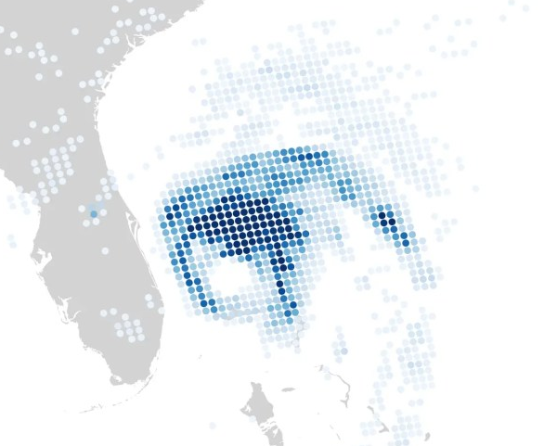
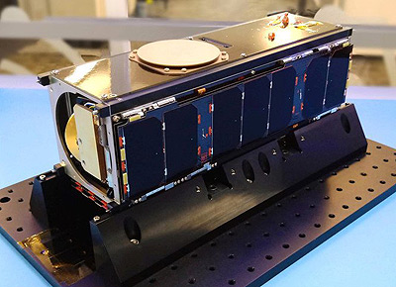
Where we’ve come from
IOD-1 GEMS1 mission launches – on orbit for 2 years
2019-2021
GEMS2 first article completed
2023
OMS Founded to deploy GEMS mission
2015
GEMS2A launch
GEMS3, GEMS-PEARL focused development
2025+
2018
IOD-1 GEMS1 instrument developed and integrated to 3U CubeSat
2022
GEMS2 development begins with US Air Force CWDP
Focus on Development of ML-based derived products
2024
GEMS-PEARL, GEMS-CZ, GEMS-CUBIC development started
Preparations for GEMS2 launch
Constellation Sustainment and Technology Insertions
© Weather Stream. All rights reserved. Confidential. Do not share without permission.

Slide 4
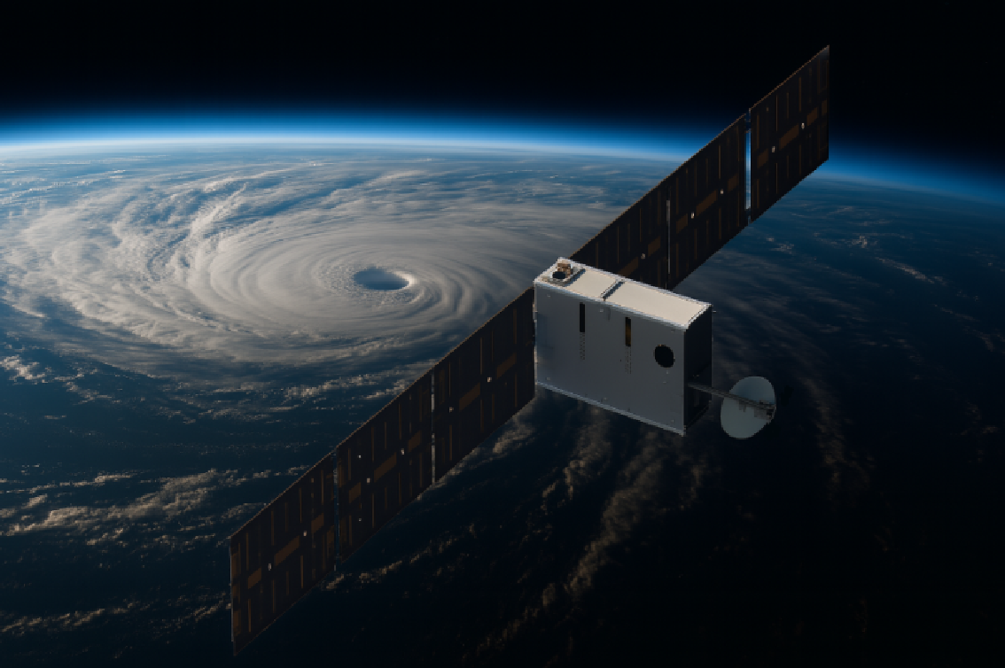
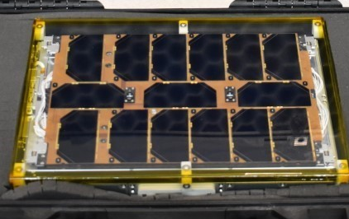
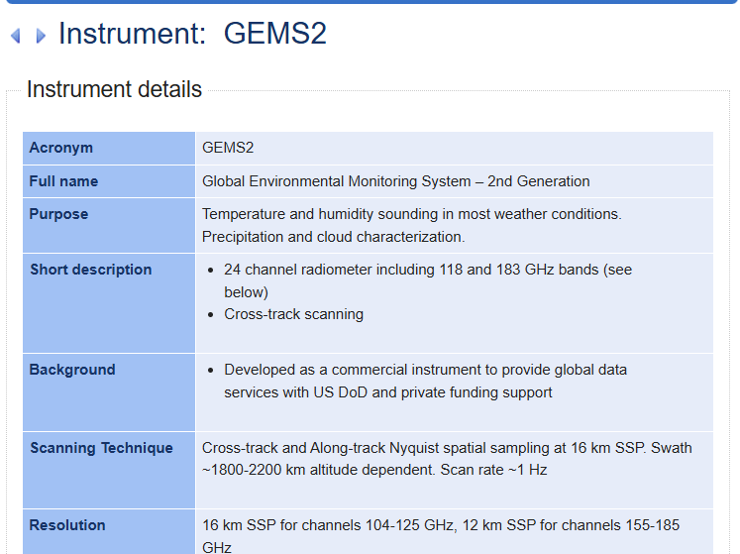
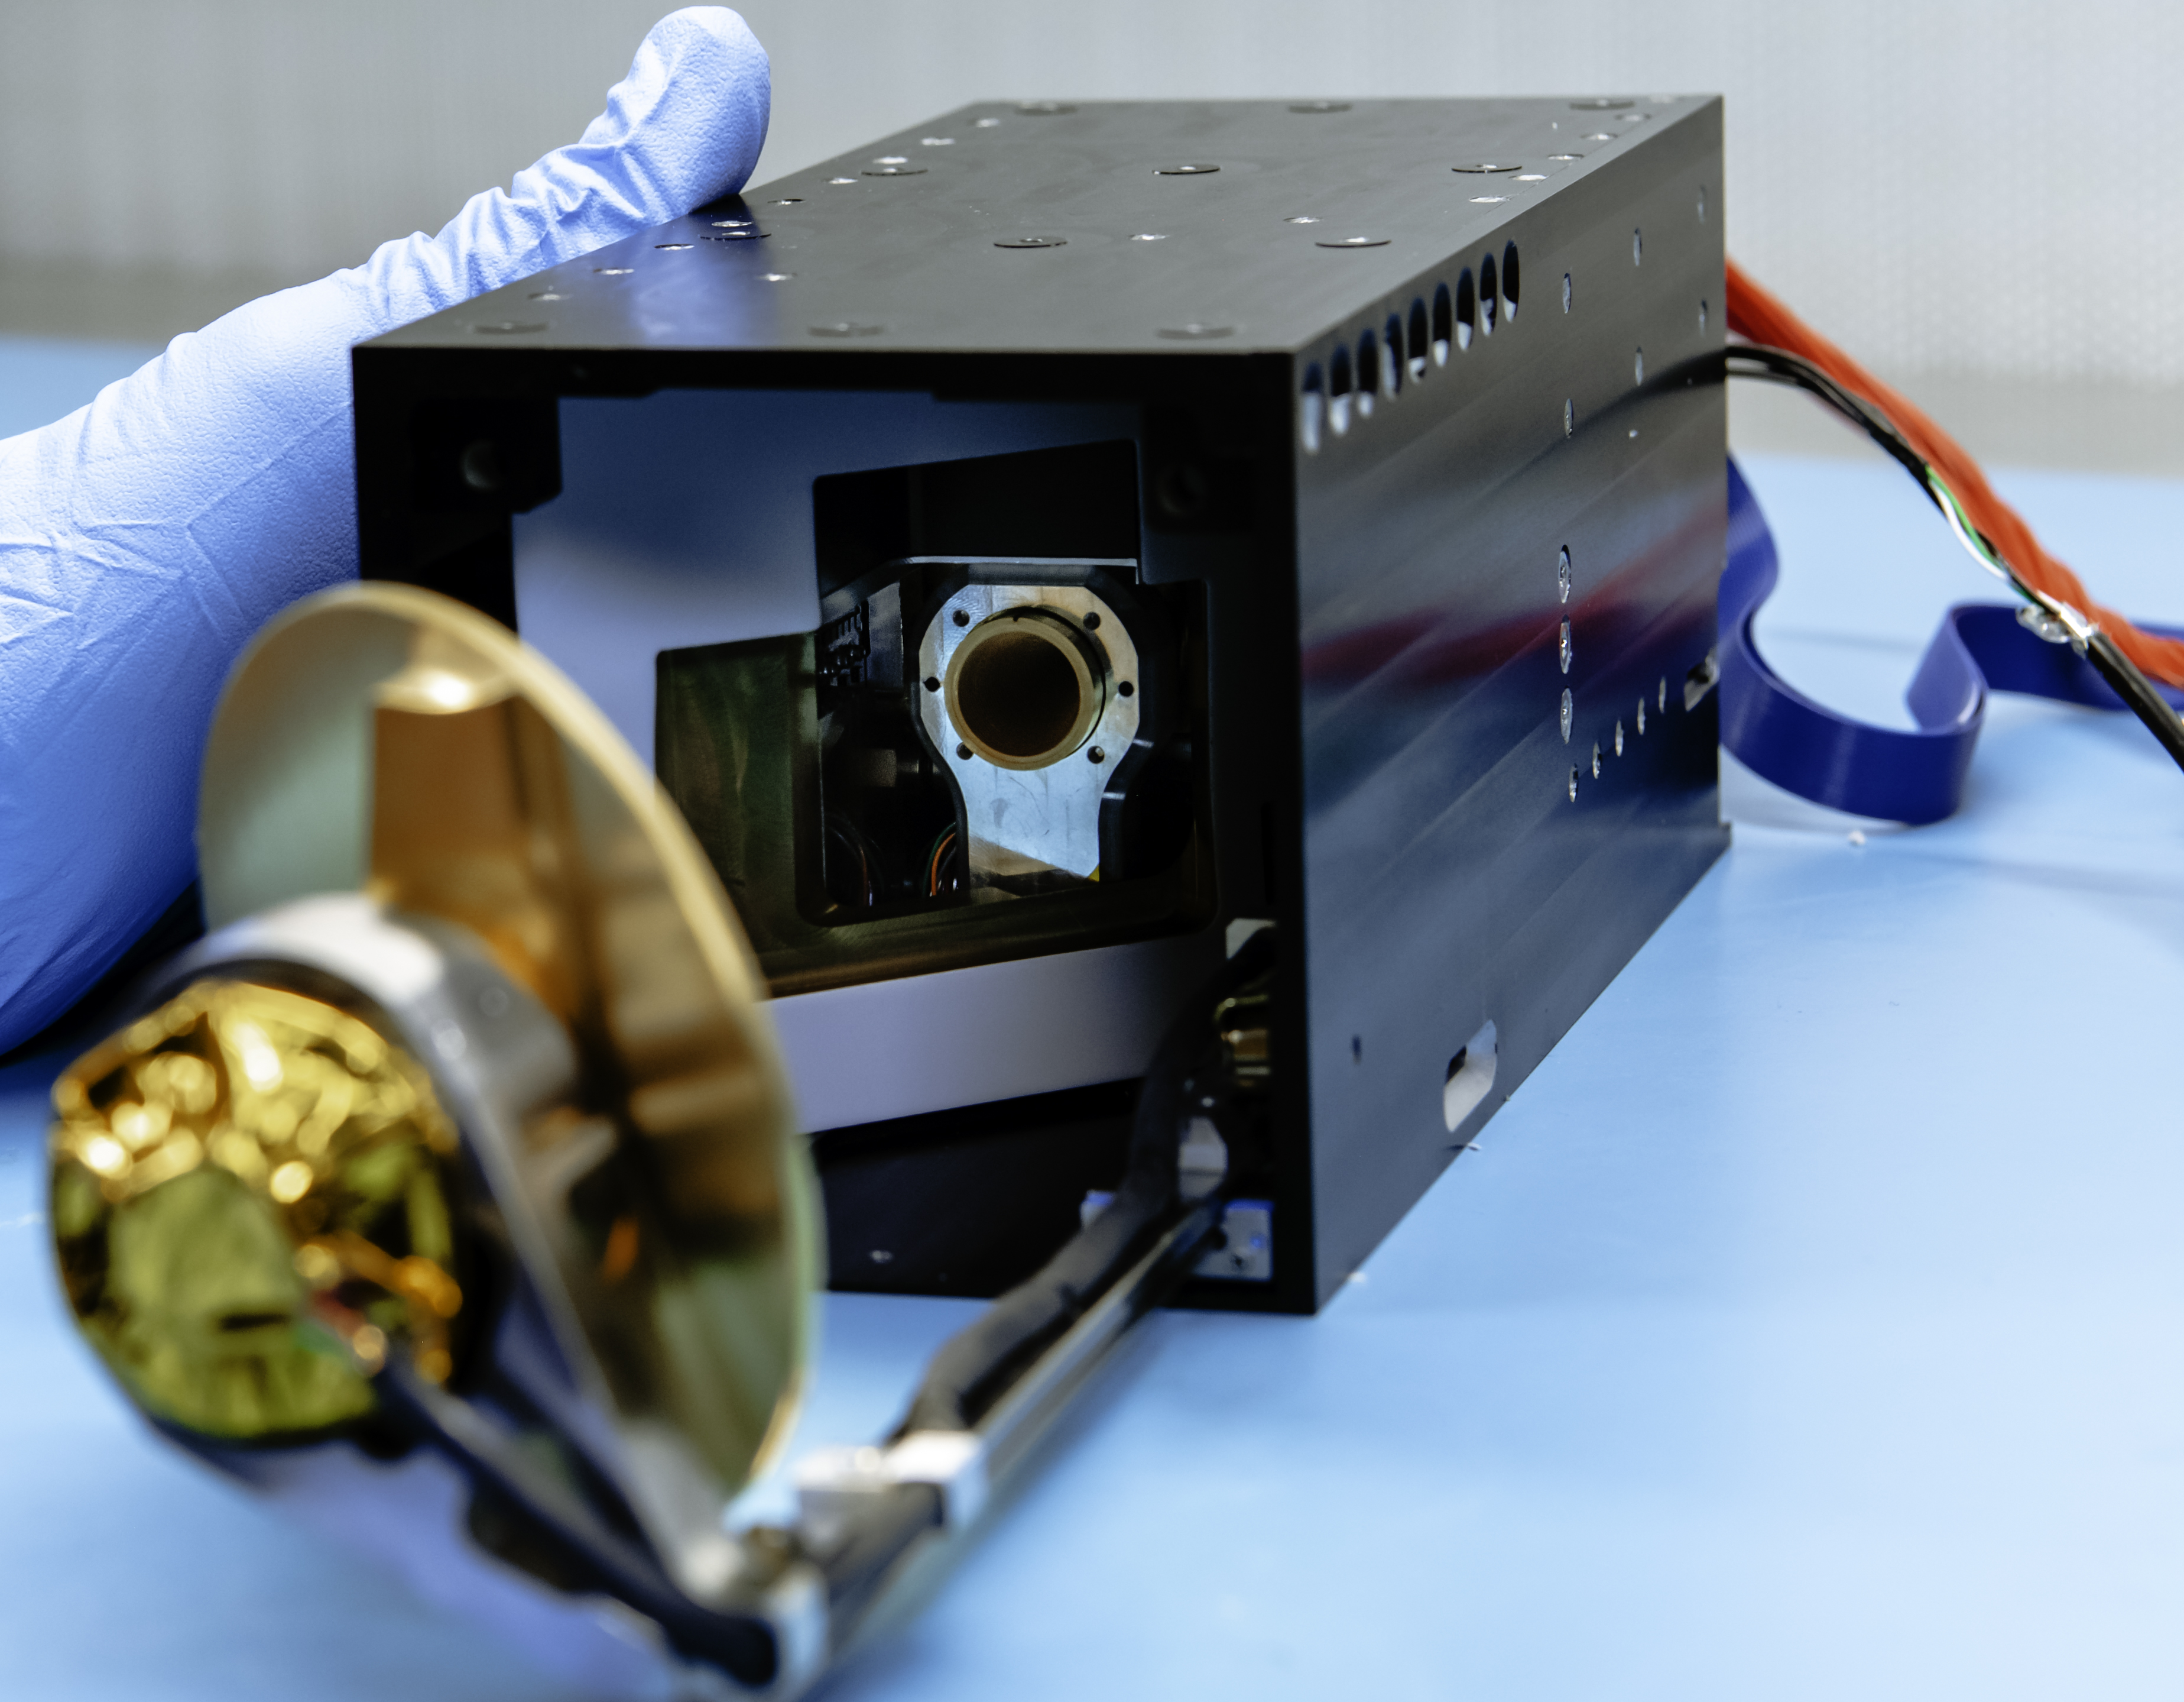

GEMS2-Amethyst mission
Our 2nd generation payload providing improved atmospheric all-sky sounding.
Payload: 104-125 and 155-190 GHz microwave radiometer.
Spacecraft: 6U CubeSat built by GOMSpace.
Ground segment: KSAT ~95-% <1 hour latency
Launch: Transporter-16 to 590 km SSO.
Design life: up to 3 years, dependent on final altitude and solar conditions.
WMO Entry: https://space.oscar.wmo.int/satellites/view/gems2_amethyst
© Weather Stream. All rights reserved. Confidential. Do not share without permission.

Slide 5
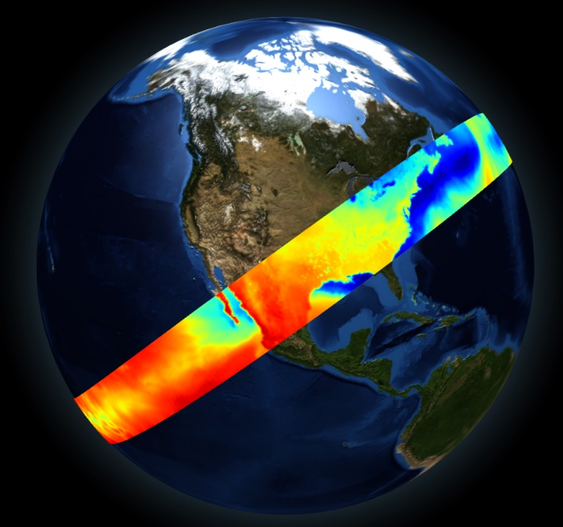
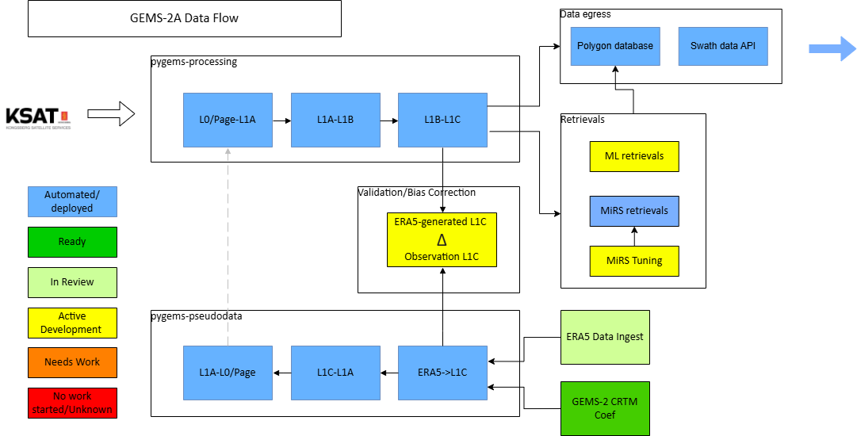
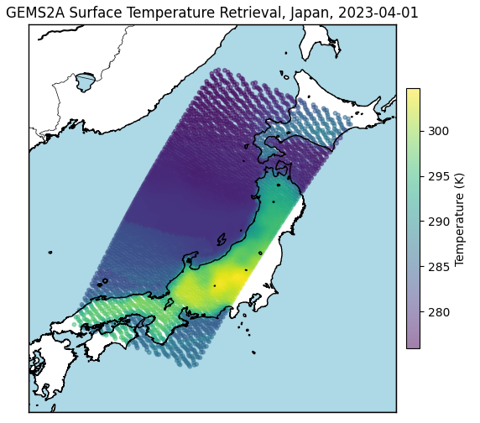

GEMS2A mission ground segment overview
Ground segment architecture deployed and in late-stage testing
L1b data will be available free for evaluation; open to collaboration and feedback!
CRTM and RTTOV coefficients available.
Validation of O-B ERA5 + CRTM and radiosonde + ARTS.
Retrievals using MiRS and ML-based approaches.
© Weather Stream. All rights reserved. Confidential. Do not share without permission.

Slide 6
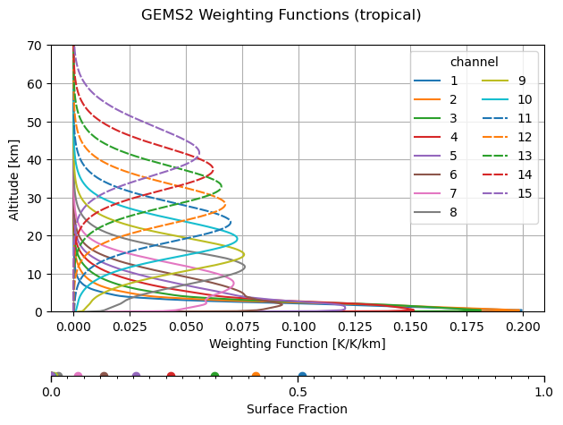
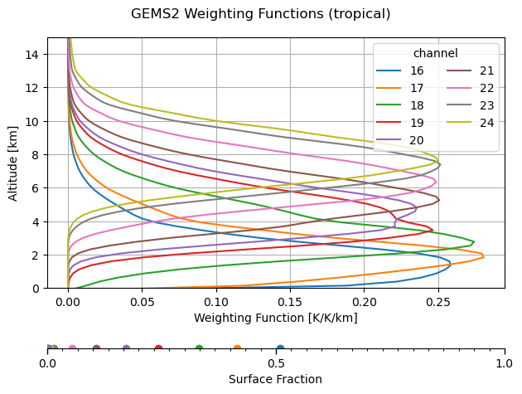
Radiometer performance: 118/183 GHz band SRFs
Modeling using ARTS with measured passband responses, clear sky over ocean with a typical Tropical atmosphere profile
© Weather Stream. All rights reserved. Confidential. Do not share without permission.
6

Slide 7
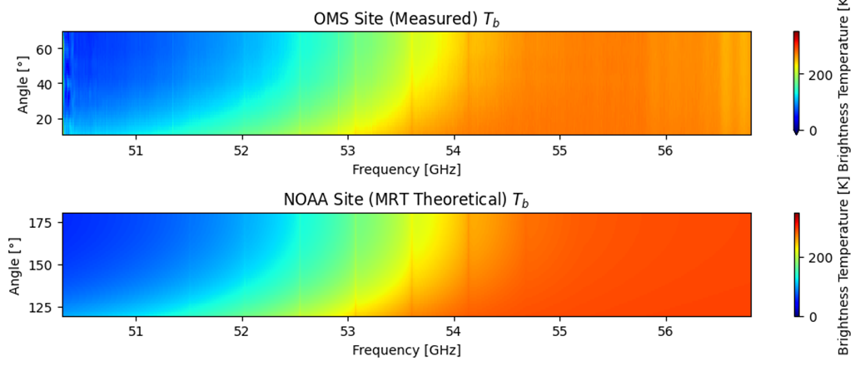
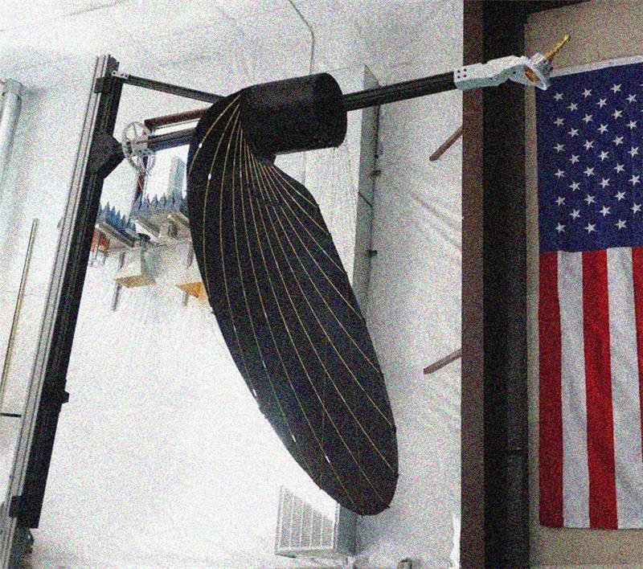
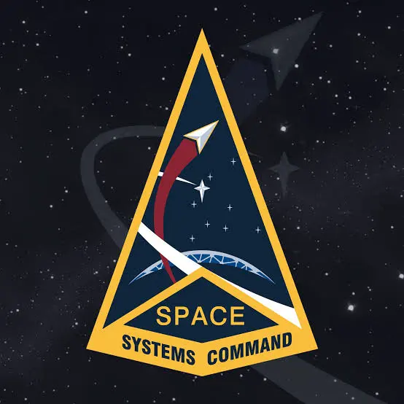




Radiometer developments
GEMS-CZ/3
Hyperspectral radiometer backend developed under NASA SMBA Phase A
8k channels @ 1 MHz resolution
On-ground prototype demonstrated in upward-looking configuration.
Targeting development towards integration on GEMS-3.
GEMS-PEARL
Prototype a family of modular, exchangeable sensors that can in aggregate produce microwave imagery based Environmental Data Record (EDR) products.
Deployable reflector enabling large antenna aperture on a small satellite bus
Target EDRs: Ocean Surface Vector Winds (OSVW), Tropical Cyclone Imagery (TCI), Temperature soundings (T), and Humidity soundings (q).
The GEMS-PEARL family of sensors should be compatible with a distributed, low cost, resilient, multi-satellite architecture.
© Weather Stream. All rights reserved. Confidential. Do not share without permission.
7

Slide 8
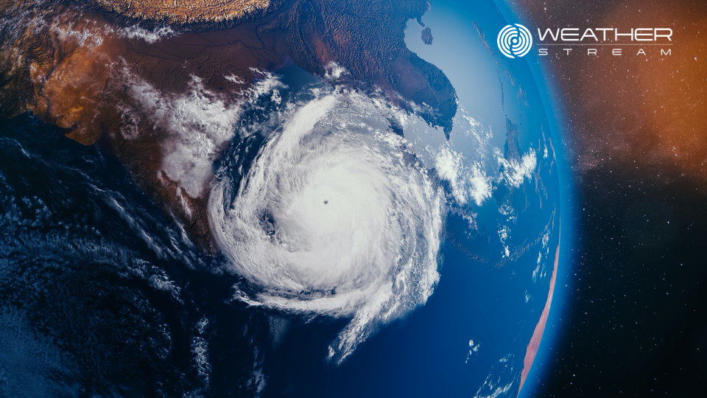

Thank you!
Richard Delf, PhD
rdelf@weatherstream.com

