Slide 1

Investigation into Improving AHI Radiometric Performance Monitoring by Ray-matching Inter-calibration
TOMA Tsuguyoshi and TAKAHASHI Masaya
Meteorological Satellite Center of Japan Meteorological Agency

Slide 2
Outline
Introduction
Specifications of Ray-matching
Himawari-9/AHI radiometric trends (monthly stats)
Current issues
Investigations
  Introduction of line-of-sight (LOS) vector
  Impact of spatial resolution
Summary and future plans

Slide 3
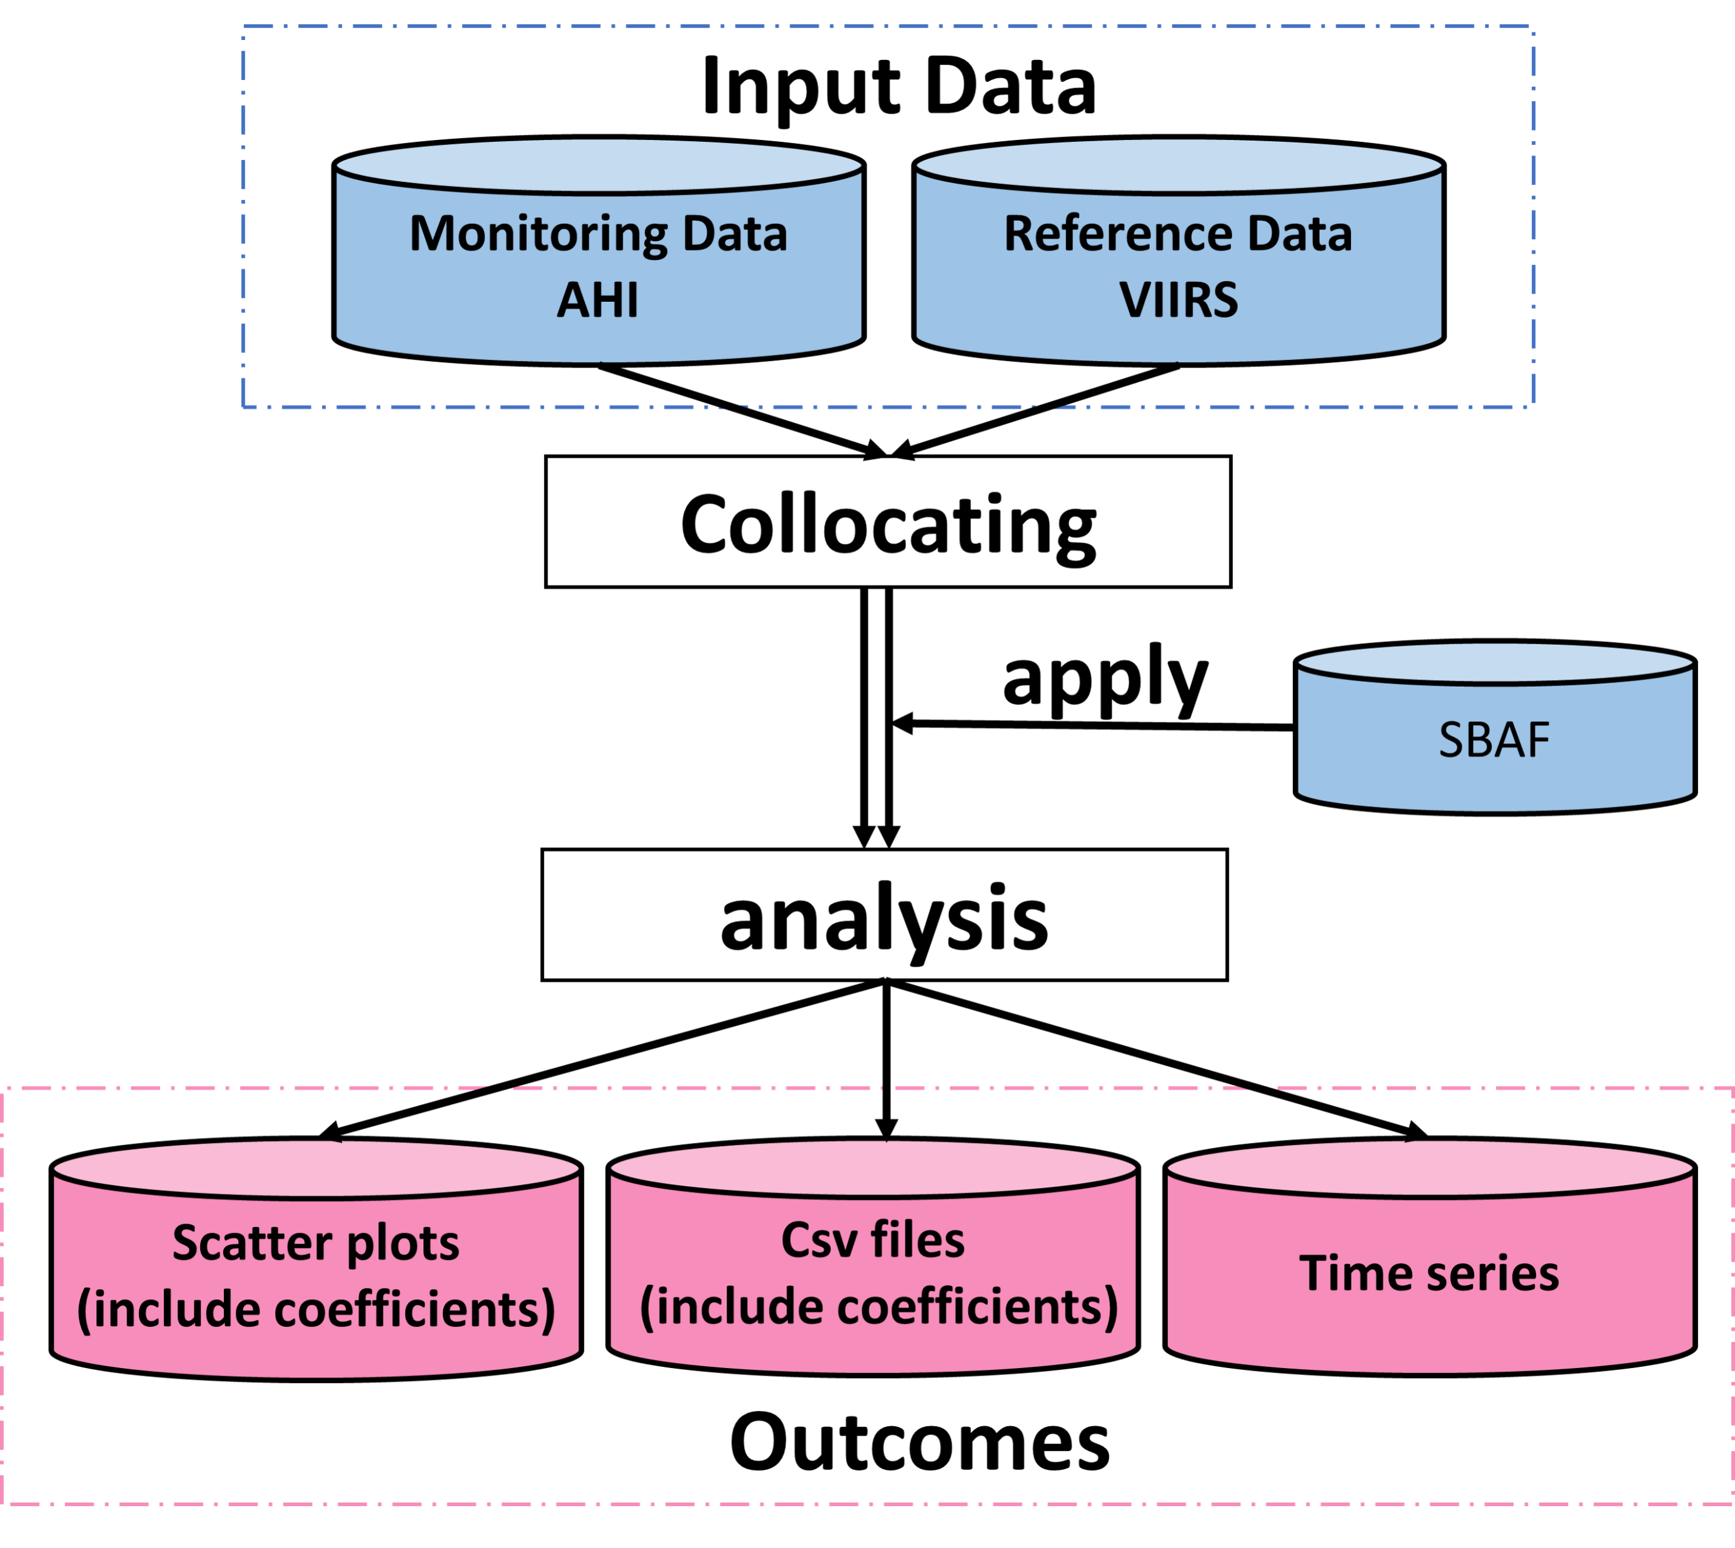
Introduction
Ray-matching is an inter-calibration method that compares GEO instrument-based observation with a sensor on a Low Earth Orbit (LEO) satellite as a reference.
JMA implements validation of Himawari-8/-9 VIS/NIR data based on the Ray-matching method with VIIRS as a reference adding to vicarious calibration.
We are working on improving the Ray-matching method toward the future Himawari-10 mission.
Ray-matching process

Slide 4
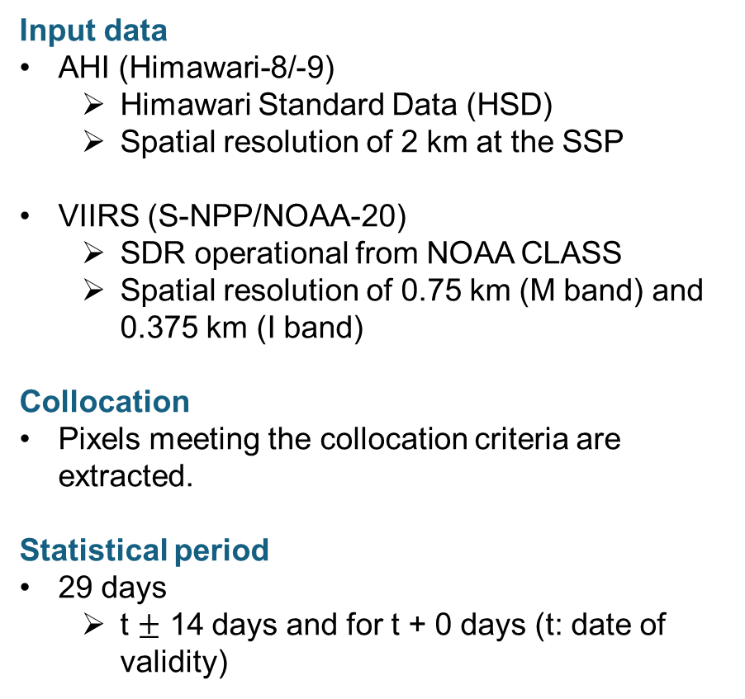
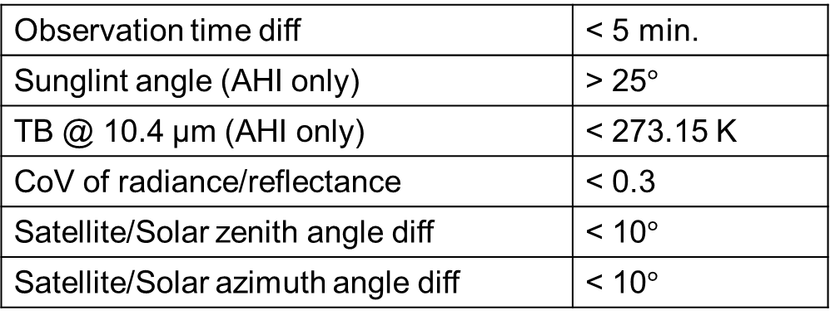
Specifications of ray-matching
Input data
AHI (Himawari-8/-9)
  Himawari Standard Data (HSD)
  Spatial resolution of 2 km at the SSP
VIIRS (S-NPP/NOAA-20)
  SDR operational from NOAA CLASS
  Spatial resolution of 0.75 km (M band) and 0.375 km (I band)
Collocation
Pixels meeting the collocation criteria are extracted.
Statistical period
29 days
  t $±$ 14 days and for t + 0 days (t: date of validity)
Spectral band adjustment factors (SBAF)
“All-sky tropical ocean” of NASA SBAF tool (B01-B05)
Relative transfer simulation (B06)
Selected VIIRS bands corresponding to AHI bands
Himawari-8/9 AHI | B01 0.47 μm | B02 0.51 μm | B03 0.64 μm | B04 0.86 μm | B05 1.6 μm | B06 2.3 μm
S-NPP/NOAA-20 VIIRS | M3 0.49 μm |  | I1 0.64 μm | M7 0.87 μm | M10 1.6 μm | M11 2.3 μm
Collocation criteria
Observation time diff | < 5 min.
Sunglint angle (AHI only) | > 25$°$
TB @ 10.4 μm (AHI only) | < 273.15 K
CoV of radiance/reflectance | < 0.3
Satellite/Solar zenith angle diff | < 10$°$
Satellite/Solar azimuth angle diff | < 10$°$

Slide 5
Himawari-9/AHI radiometric trends (monthly stats)
Differences between reference sensors are generally in good agreement with earlier studies (e.g., Doelling et al., 2021, Uprety et al., 2020, Wu 2021).
Ray-matching results are more stable than vicarious calibration, but temporal variation exists.
Ray-matching w/ S-NPP/VIIRS
Ray-matching w/ NOAA-20/VIIRS
Vicarious calibration using Aqua/MODIS C6
B01 (0.47 μm)
B02 (0.51 μm)
B03 (0.64 μm)
AHI / Reference
B04 (0.86 μm)
B05 (1.6 μm)
B06 (2.3 μm)
AHI / Reference

Slide 6
Current issues
Our implementation of the Ray-matching method has the following issues for further improvement. As a background, we need to obtain reliable and stable results in a short period toward the in-orbit test of Himawari-10.
Collocation conditions
  Unused low radiance (dark) scenes due to inconsistent AHI/VIIRS ratio with bright scenes
  Spatial resolution and observation angle difference
How to calculate the results
  Best method with regard to linear regression, statistical period, and target elements (radiance or reflectance)
SBAF
  Difference of linear fitting, force fitting, and quadratic fitting
  Scene dependence
Here we will introduce two studies about collocation conditions (A) .

Slide 7
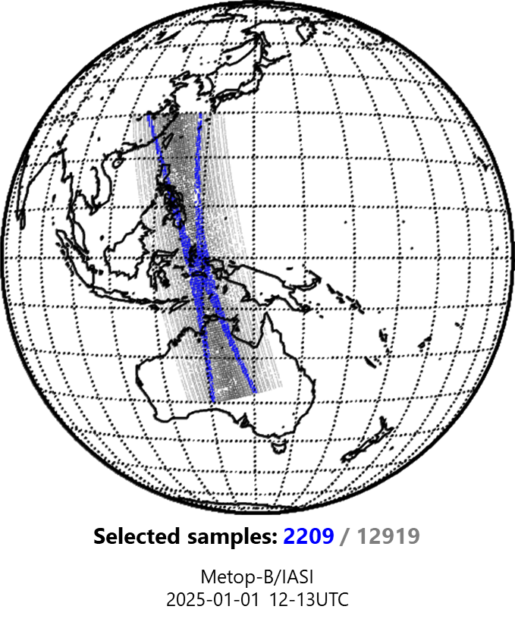
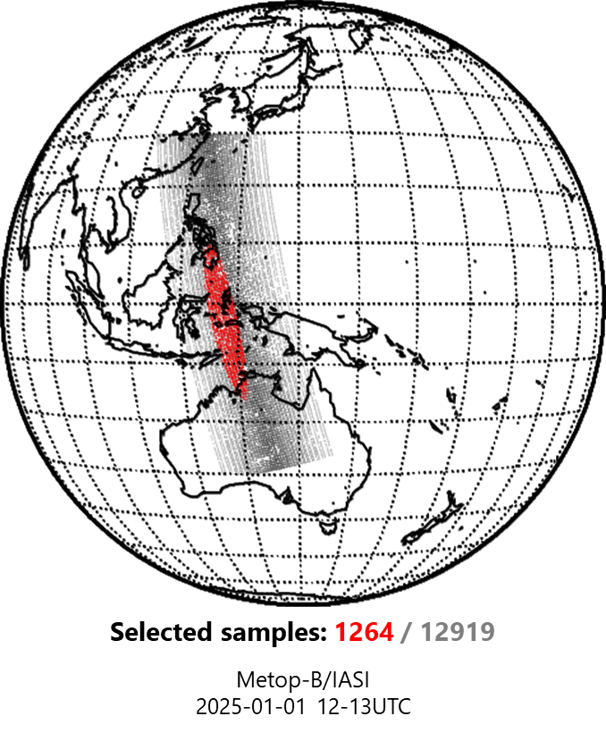
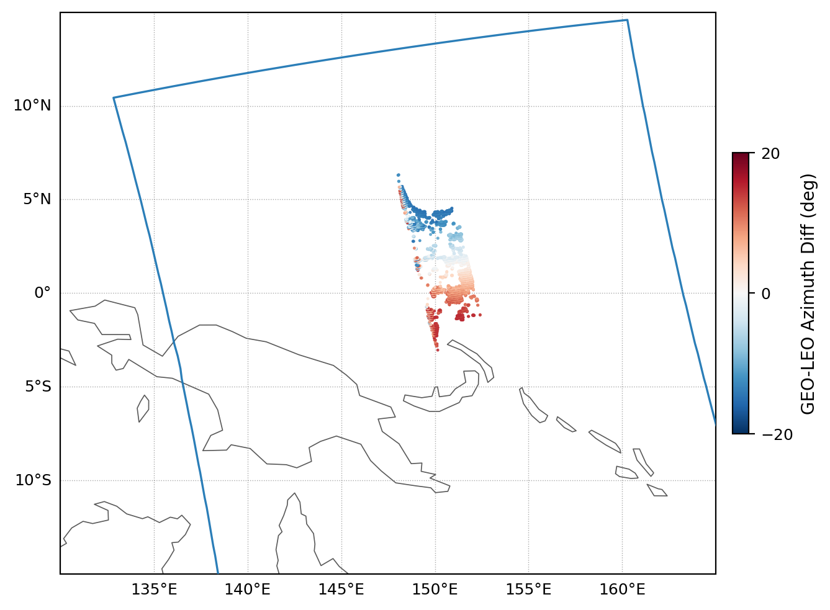
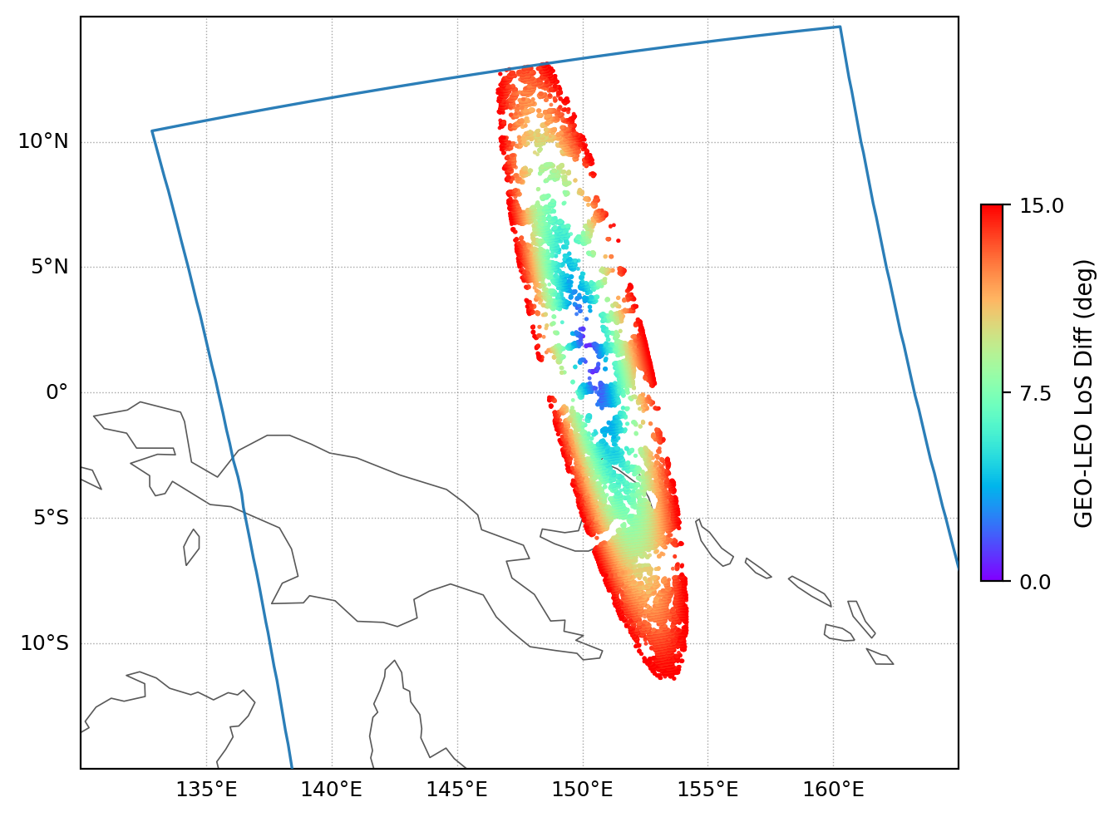
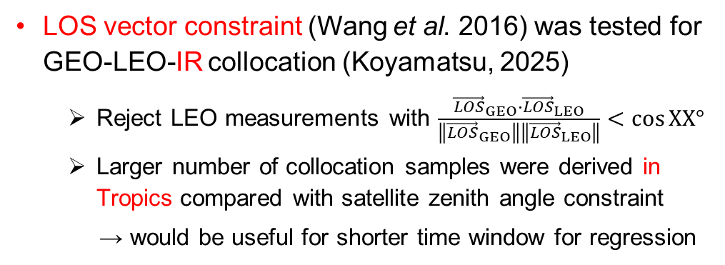
Use of line-of-sight (LOS) vector
AHI-8 vs. IASI-B collocation
Satellite zenith angle constraint
LOS vector constraint
LOS vector constraint (Wang et al. 2016) was tested for GEO-LEO-IR collocation (Koyamatsu, 2025)
  Reject LEO measurements with $\frac{{\vec{LOS}}_{GEO}∙{\vec{LOS}}_{LEO}}{\left\|{\vec{LOS}}_{GEO}\right\|\left\|{\vec{LOS}}_{LEO}\right\|}<\cos{XX°}$
  Larger number of collocation samples were derived in Tropics compared with satellite zenith angle constraint
  → would be useful for shorter time window for regression
Koyamatsu (2025) @ GSICS Annual Meeting
The same approach was applied to VNIR Ray-matching to see the impact of LOS vector constraint on inter-calibration slope
Sat/Solar zenith/azimuth angle constraint (operational)
LOS Vector constraint
< 15 deg
  15890
  samples
  87786
  samples
Right: collocation between Himawari-9/AHI B01 (0.47 μm) and NOAA-20/VIIRS M3 (0.49 μm) for 2025-12-28
← Boundary of VIIRS granule

Slide 8
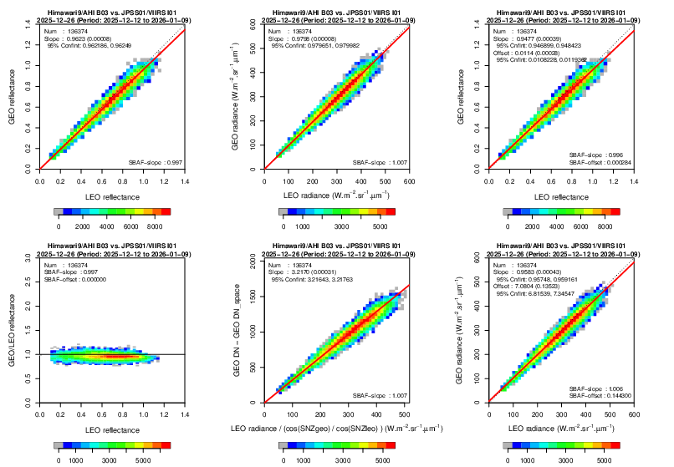
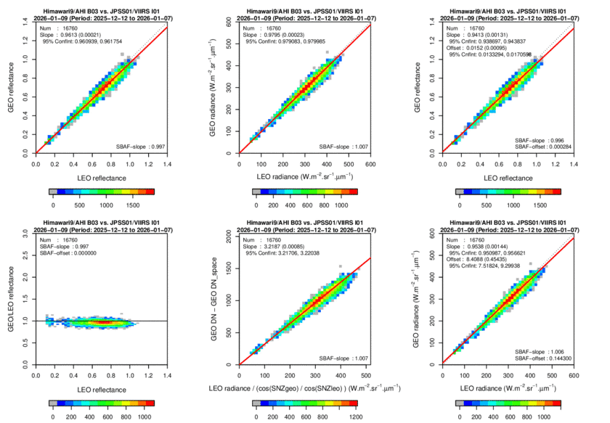
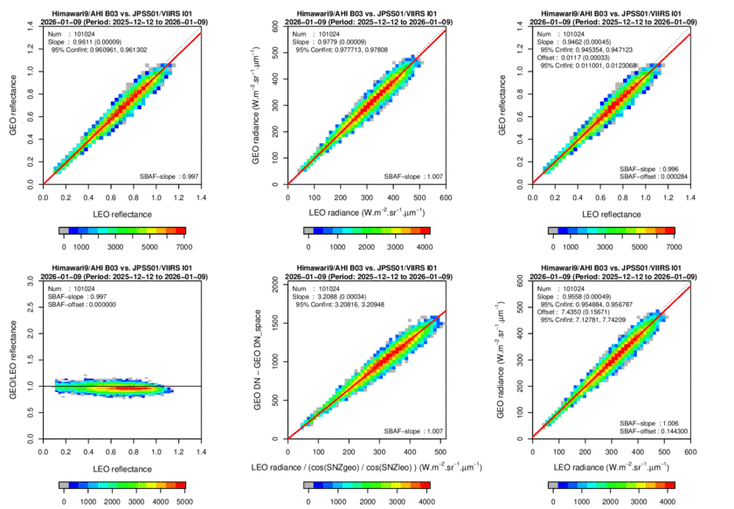
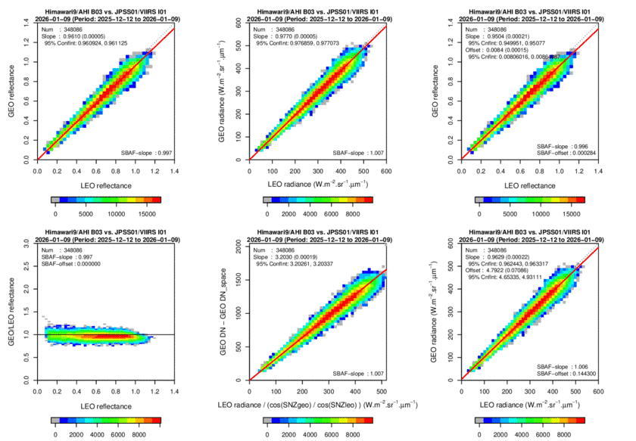
Preliminary result
Himawari-9/AHI B03 (0.64 μm) vs. NOAA-20/VIIRS I1 (0.64 μm)
29-d force fitting (2025-12-12/2026-01-09)
Sat/Solar Zenith/Azimuth Angle Check (operational)
< 10 deg
Difference of inter-calibration slopes between LOS vector and zenith/azimuth angle screenings is ~0.1%
Soft LOS vector angle threshold would be helpful for quick assessment (e.g., period of in-orbit test)
LOS Vector Diff < 2 deg
 | # of samples | Inter-cal slope
Operational < 10 deg | 136374 | 0.9623
LOS ang. < 2 deg | 16760 | 0.9613
LOS ang. < 5 deg | 101024 | 0.9611
LOS ang. < 10 deg | 340808 | 0.9610
LOS Vector Diff < 5 deg
LOS Vector Diff < 10 deg

Slide 9
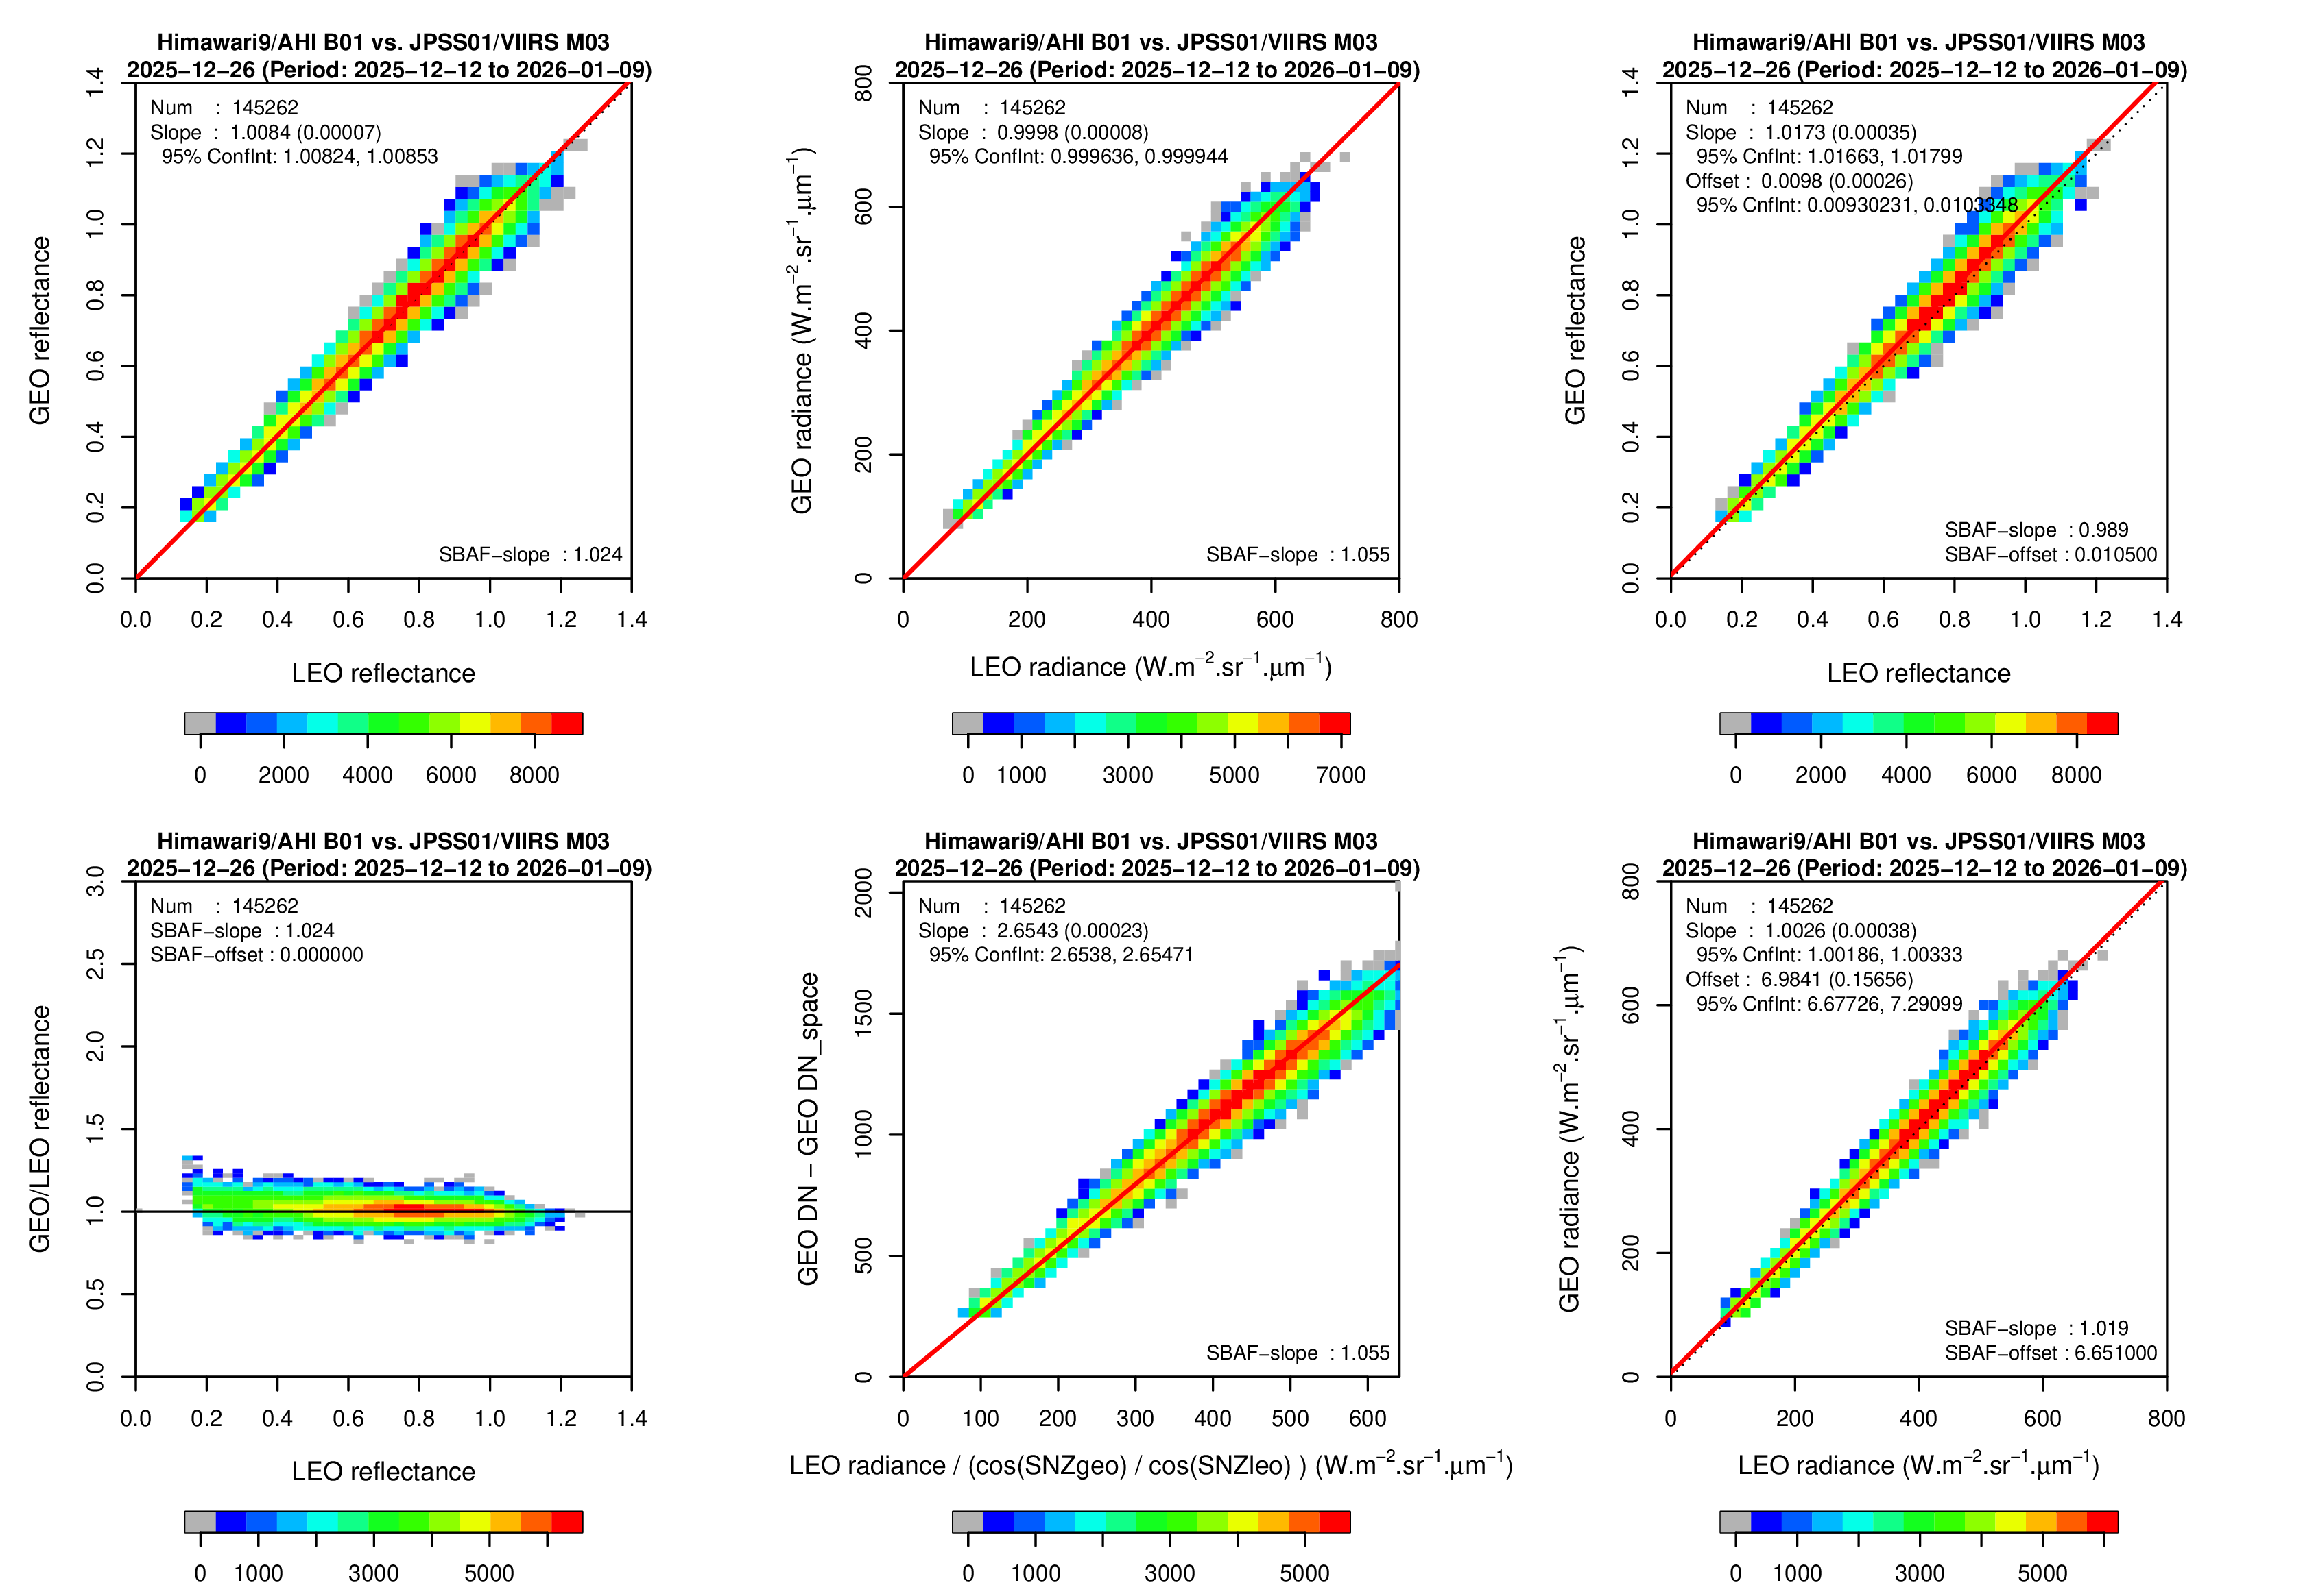
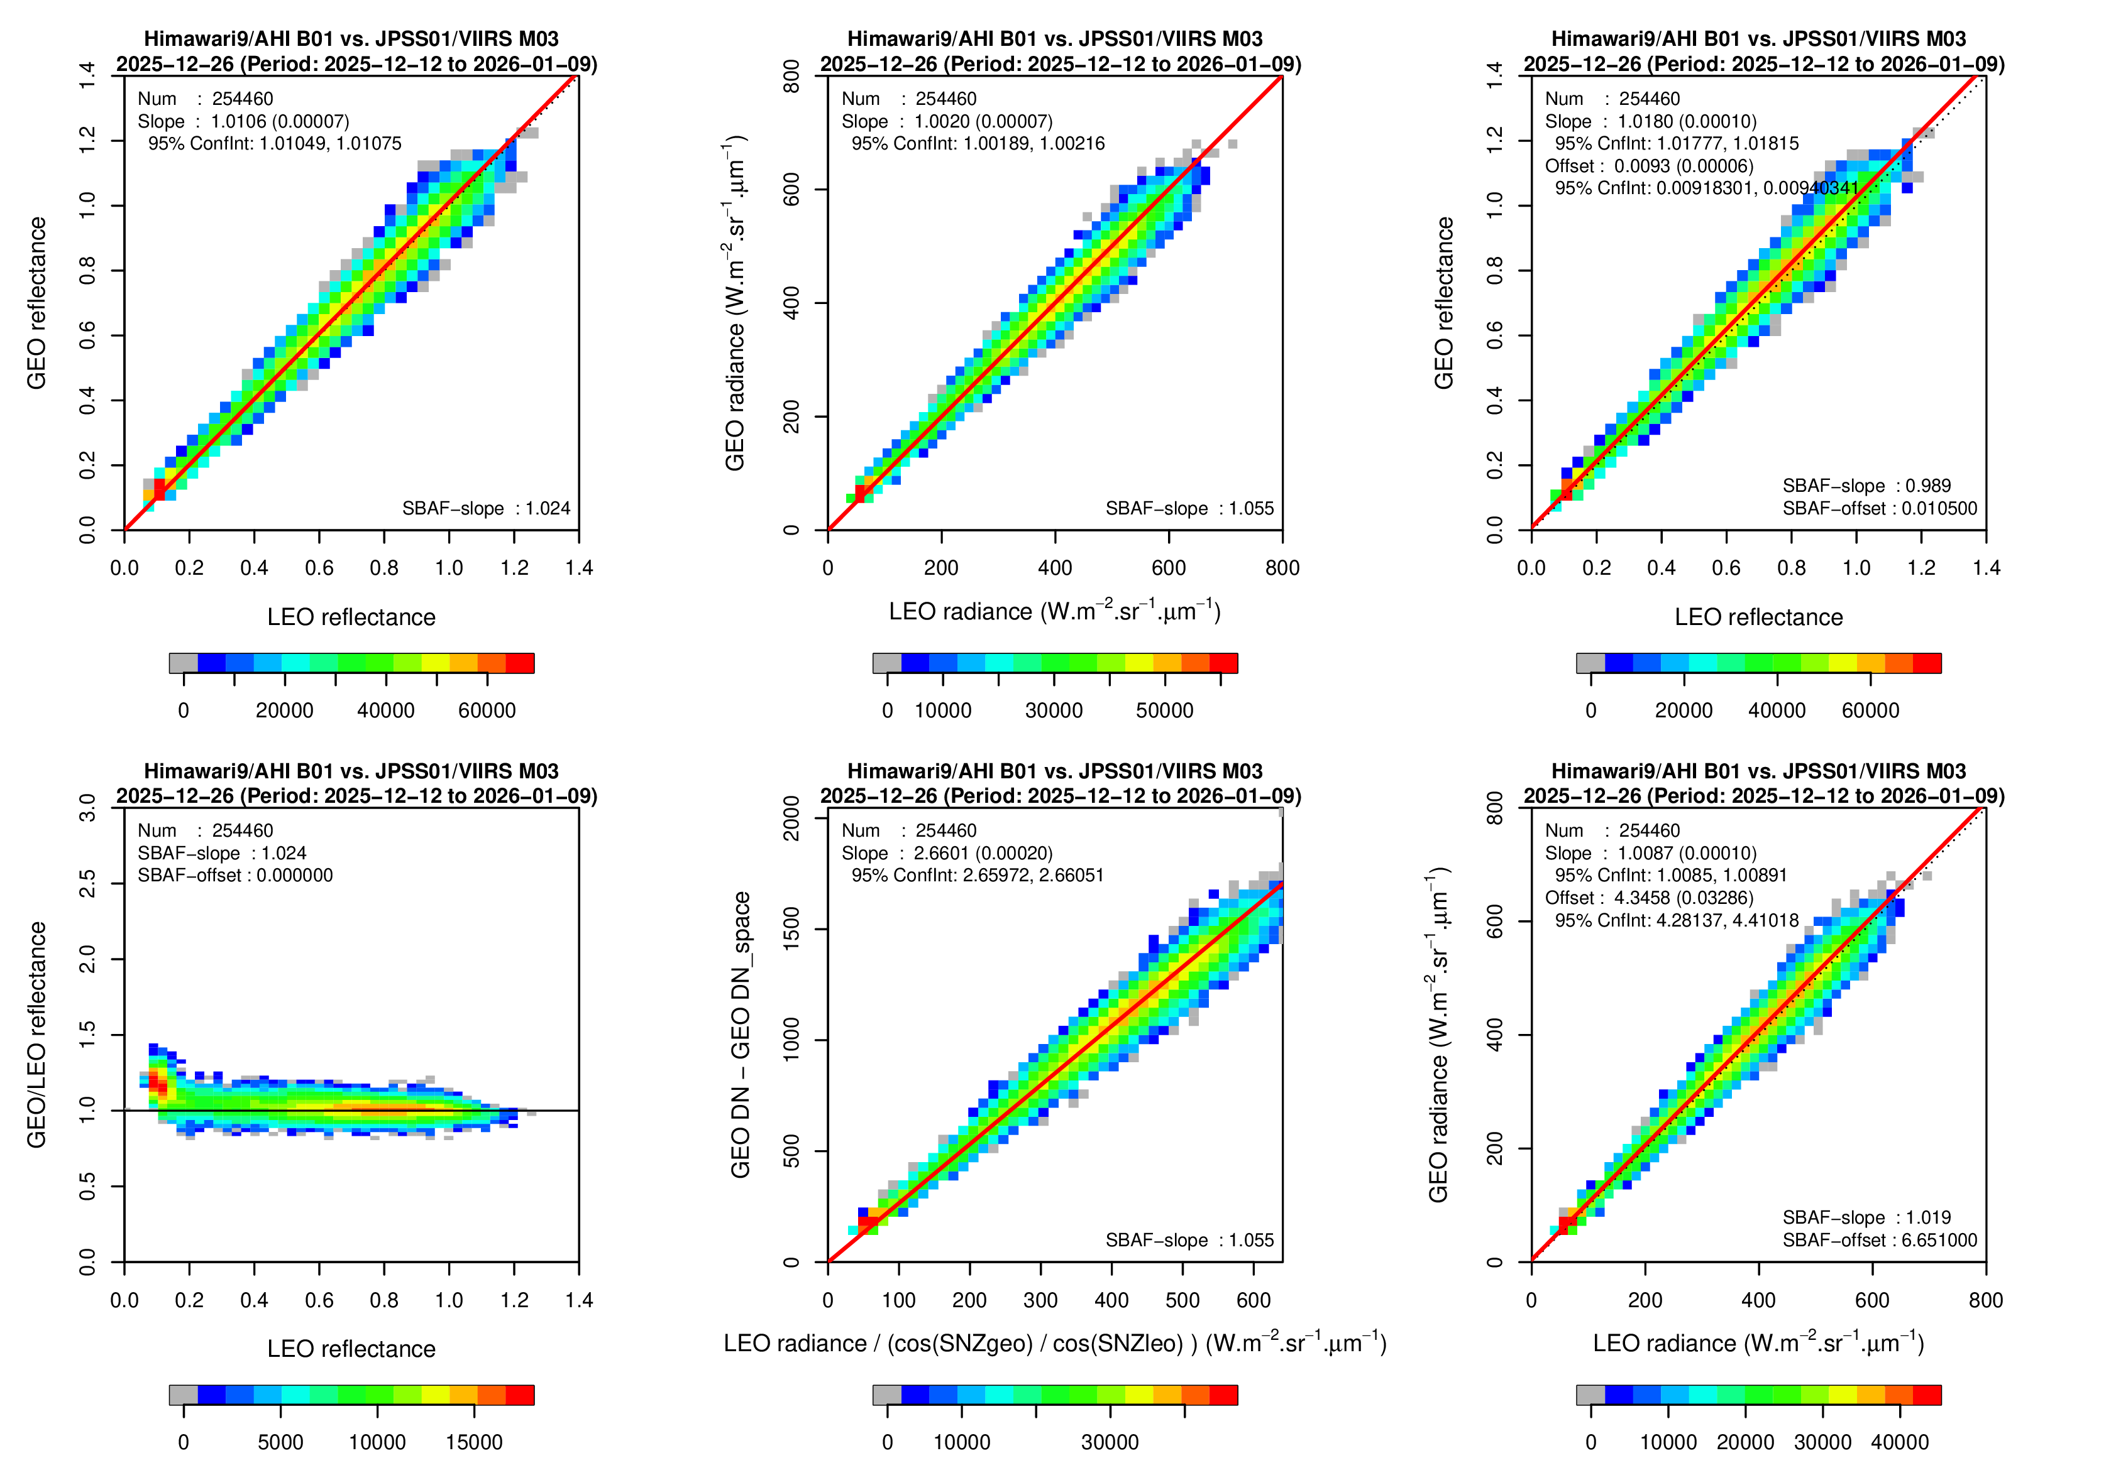
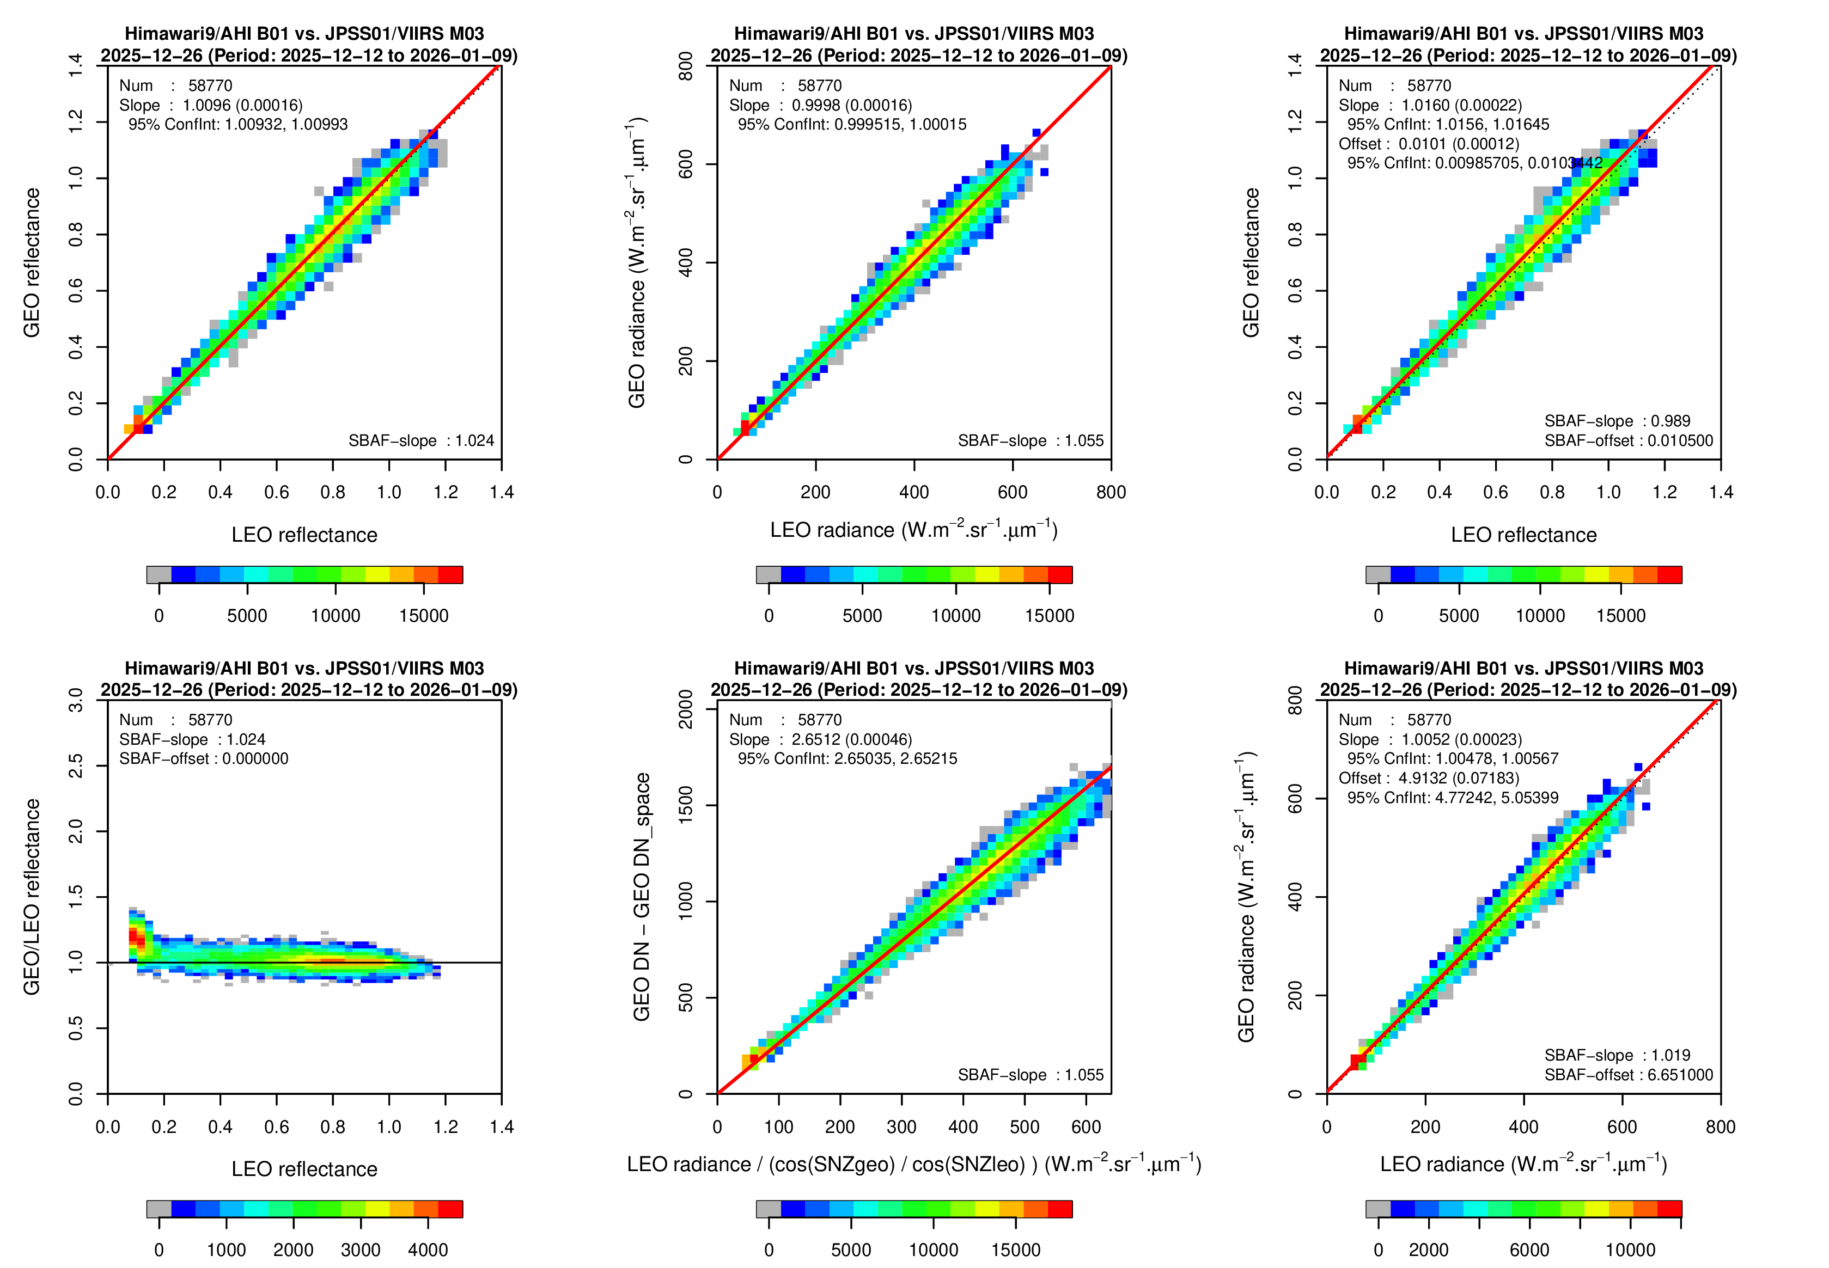
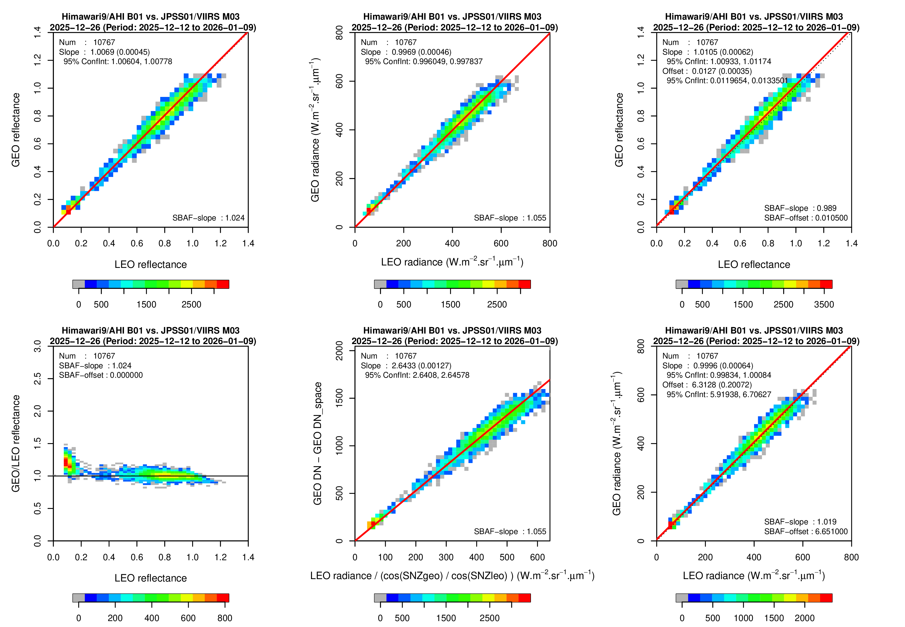
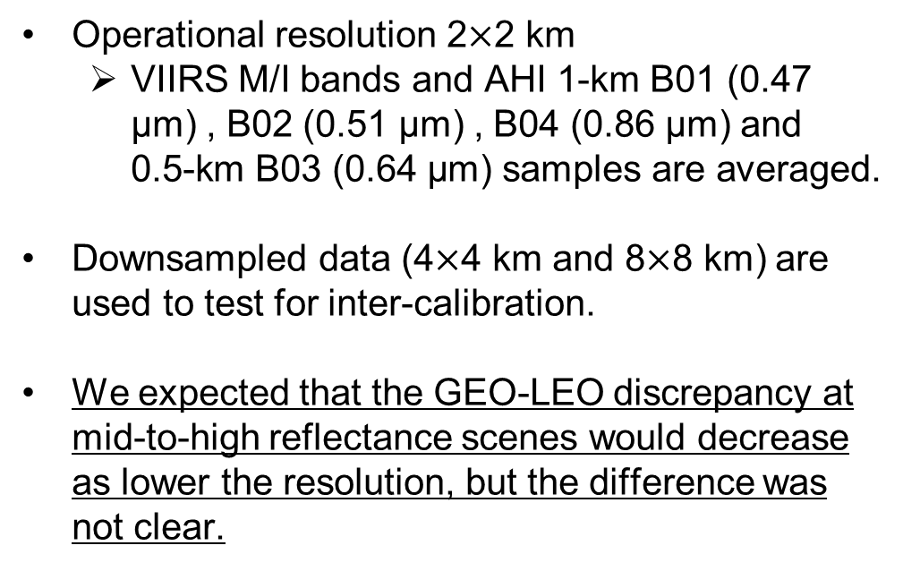
Impact of spatial resolution
Himawari-9/AHI B01 (0.47 μm) vs. NOAA-20/VIIRS I1 (0.49 μm)
29-d force fitting (2025-12-12/2026-01-09)
Operational resolution 2$×$2 km
  VIIRS M/I bands and AHI 1-km B01 (0.47 μm) , B02 (0.51 μm) , B04 (0.86 μm) and 0.5-km B03 (0.64 μm) samples are averaged.
Downsampled data (4$×$4 km and 8$×$8 km) are used to test for inter-calibration.
We expected that the GEO-LEO discrepancy at mid-to-high reflectance scenes would decrease as lower the resolution, but the difference was not clear.
A) Operational
B) Operational ＋ dark scene
C) Same as B), but
4 x 4 km downsampled data
D) Same as B), but
8 x 8 km downsampled data
Further investigations with lower spatial resolution is necessary to clarify the impact.

Slide 10
Summary and future plans
At JMA, Ray-matching is one of the inter-calibration methods for VNIR bands, and we are working on improving it along with lunar calibration toward Himawari-10 missions.
Among its issues, we investigated line-of-sight vector and spatial resolution. Further investigations will be conducted.
    LOS vector constraint resulted in large number of collocated samples, which would be useful for quick assessment in commissioning phase.
    The impact of lower resolution (4/8 km) was not clear than 2km.
Other issues such as regression method and SBAF would also be investigated in the future.

Slide 11
References
https://www.data.jma.go.jp/mscweb/data/monitoring/gsics/vis/raymatch/techinfo_raymatch.html
AISHENG Wu. Assessment of MODIS and VIIRS Calibration Consistency for RSB Using Vicarious Approaches. MODIS/VIIRS Calibration Workshop (Virtual), February 25-26, 2021.
UPRETY, Sirish; CAO, Changyong; SHAO, Xi. Radiometric consistency between GOES-16 ABI and VIIRS on Suomi NPP and NOAA-20. Journal of Applied Remote Sensing, 2020, 14.3: 032407-032407.
DOELLING, D.; CAO, C.; XIONG, Jack. GSICS recommends NOAA-20 VIIRS as reflective solar band (RSB) calibration reference. GSICS Q, 2021, 14: 2-4.
WANG, Likun, et al. Fast and accurate collocation of the visible infrared imaging radiometer suite measurements with cross-track infrared sounder. Remote Sensing, 2016, 8.1: 76.

Slide 12
Thanks for your attention!

Slide 13
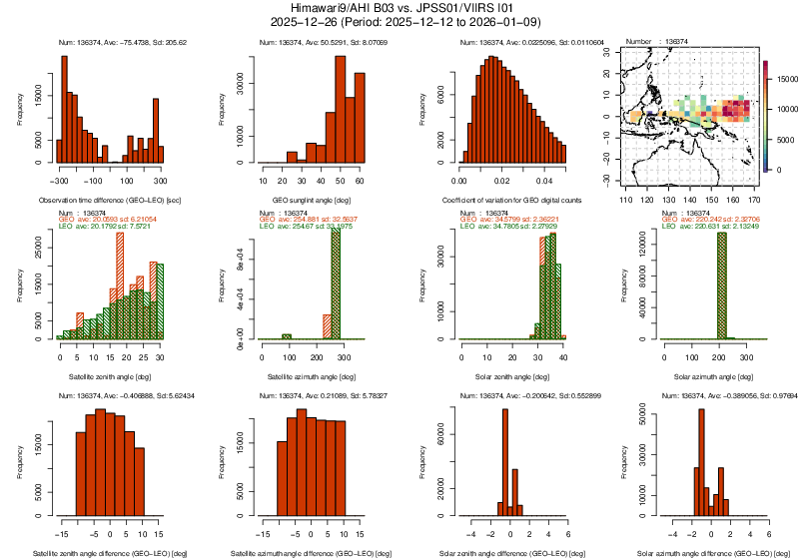
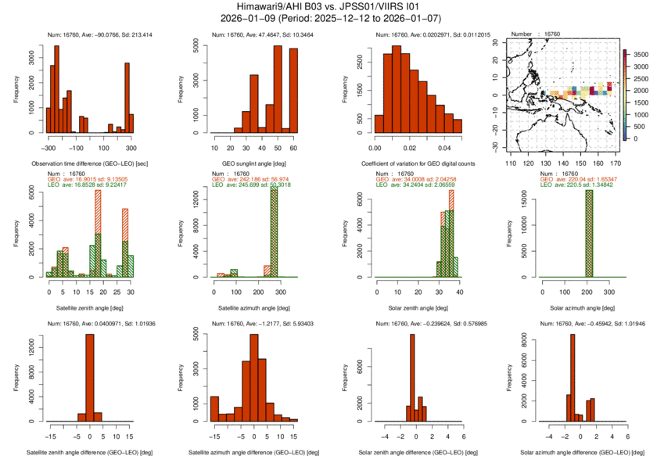
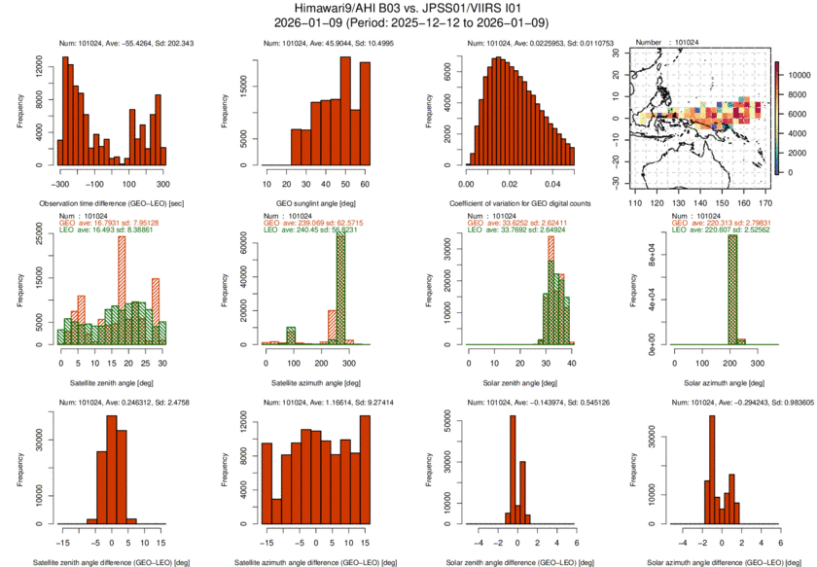
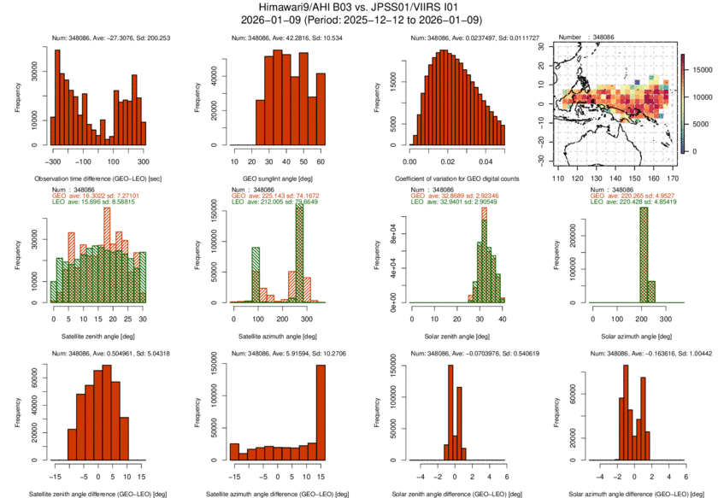
Satellite Zenith Angle Diff Satellite Azimuth Angle Diff Solar Zenith Angle Diff Solar Azimuth Angle Diff
Sat/Solar Zenith/Azimuth Angle Check
LOS Vector Diff < 2 [deg]
LOS Vector Diff < 5 [deg]
LOS Vector Diff < 10 [deg]

Slide 14
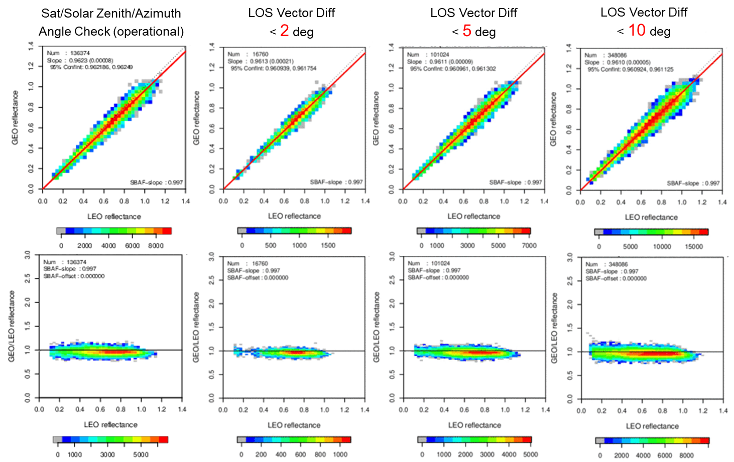
Preliminary result
Himawari-9/AHI B03 (0.64 μm) vs. NOAA-20/VIIRS I1 (0.64 μm)
29-d force fitting (2025-12-12/2026-01-09)
Sat/Solar Zenith/Azimuth Angle Check (operational)
< 10 deg
Difference of inter-calibration slopes between LOS vector and zenith/azimuth angle screenings is ~0.1%
Soft LOS vector angle threshold would be helpful for quick assessment (e.g., period of in-orbit test)
LOS Vector Diff
< 2 deg
LOS Vector Diff
< 5 deg
LOS Vector Diff
< 10 deg
 | # of samples | Inter-cal slope
Operational < 10 deg | 136374 | 0.9623
LOS ang. < 2 deg | 16760 | 0.9613
LOS ang. < 5 deg | 101024 | 0.9611
LOS ang. < 10 deg | 340808 | 0.9610

Slide 15
Impact of spatial resolution
Himawari-9/AHI B01 (0.47 μm) vs. NOAA-20/VIIRS I1 (0.49 μm)
29-d force fitting (2025-12-12/2026-01-09)
C) Same as B), but
4 x 4 km downsampled data
D) Same as B), but
8 x 8 km downsampled data
A) Operational
B) Operational ＋ dark scene

