Slide 1

Trusted in Space. Essential on Earth.
Ray-Matching for Calibration Monitoring of MTG-I1 FCI VNIR Channels:
An Initial Assessment
Vincent Debaecker (Telespazio France),
Ali Mousivand, Sebastien Wagner, Mounir Lekouara
(EUMETSAT)
23–27 March 2026
GSICS Annual Meeting, Ottawa

Slide 2
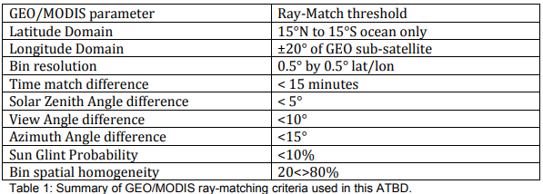
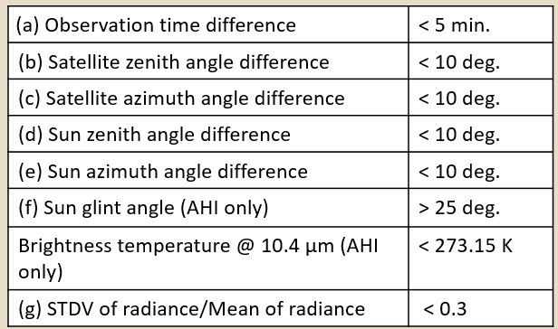
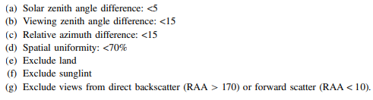
Already a long experience behind in GSICS
GSICS ATBD - GSICS_ATBD_RayMatch_NASA_2011_09.pdf
Improvements to the Geostationary Visible Imager Ray-Matching Calibration Algorithm for CERES Edition 4 (Doelling, 2016)
Daily monitoring algorithms to detect geostationary imager visible radiance anomalies (Doelling, 2022)
Radiometric consistency between GOES-16 ABI and VIIRS on Suomi NPP and NOAA-20 (SPIE 2020) (Uprety, 2020)
JMA Presentaton (GSICS 2024)
(but reviewed in 2025)

Slide 3
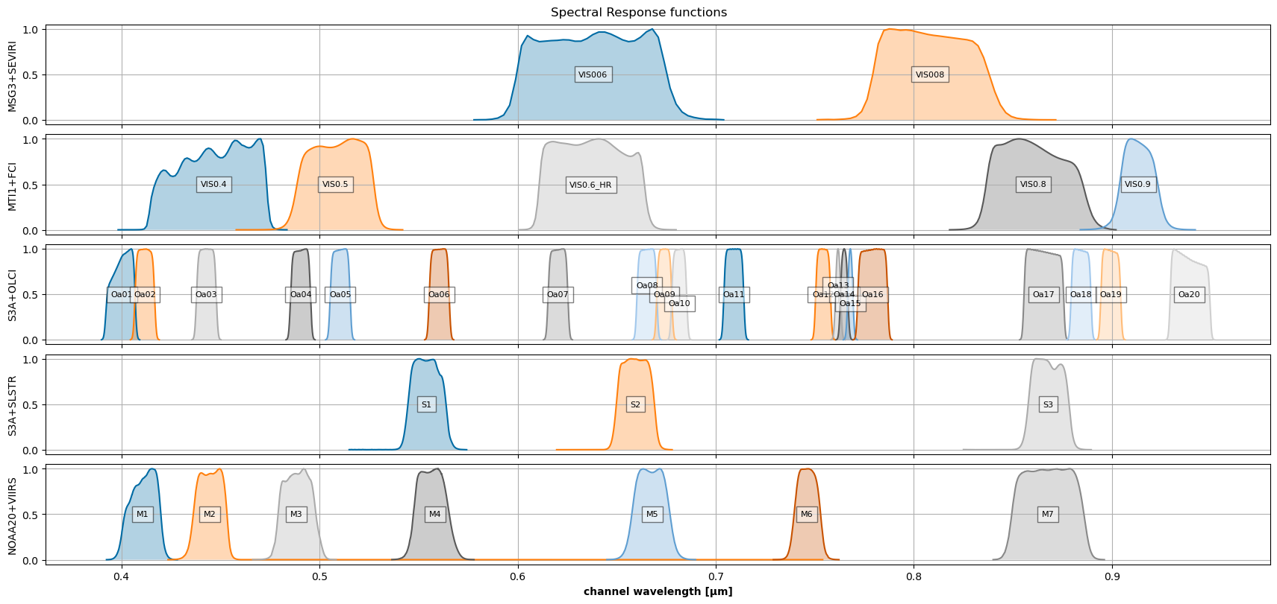
Evaluation of FCI VIS-NIR as monitored sensor
FCI
OLCI
SLSTR
VIIRS
Notes:
The focus is on FCI

Slide 4
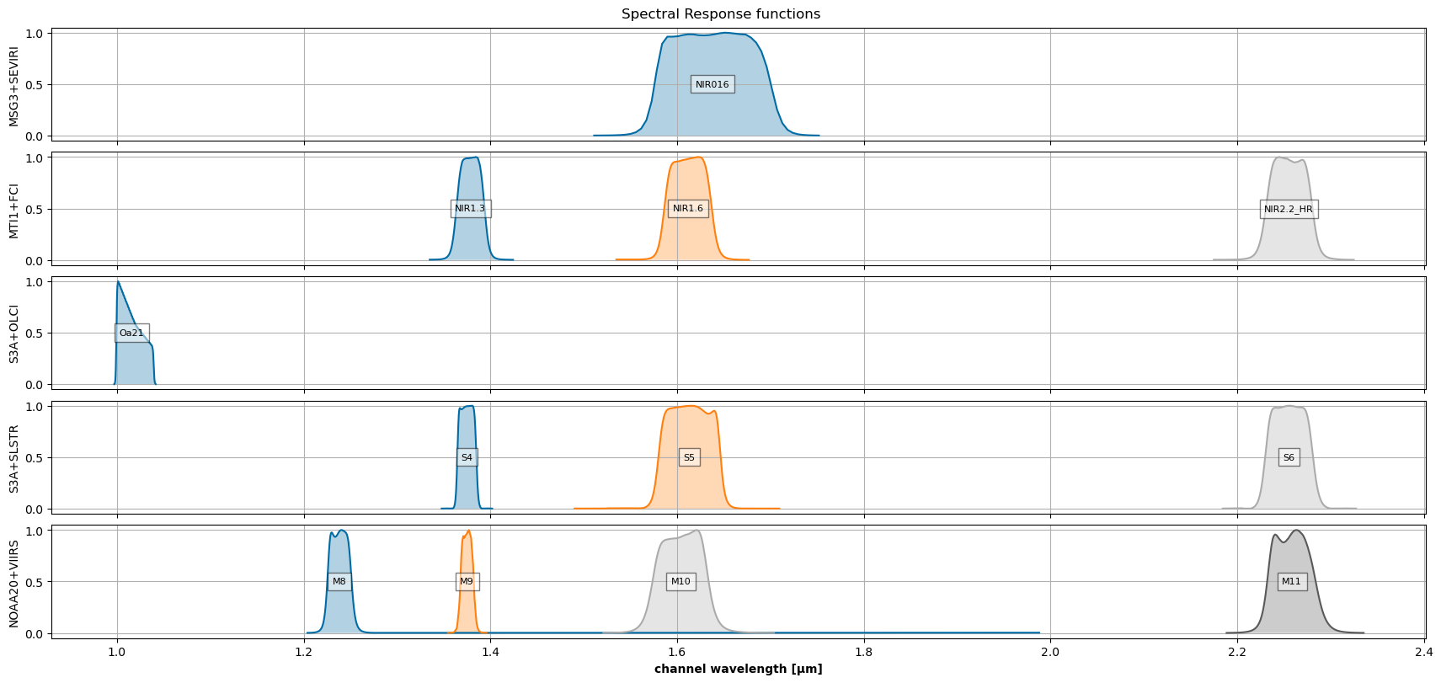
Evaluation of FCI SWIR as monitored sensor
FCI
OLCI
SLSTR
VIIRS

Slide 5
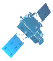
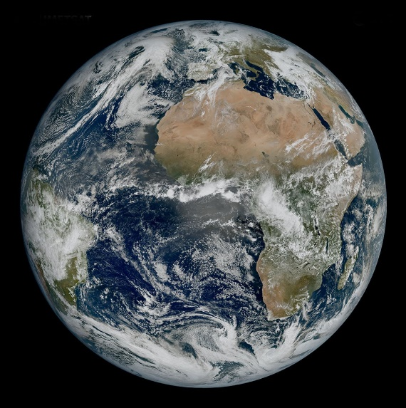
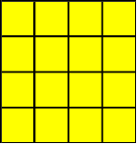
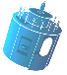
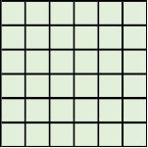
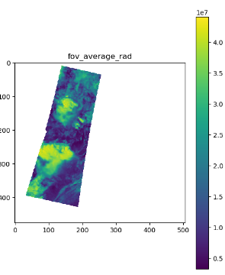
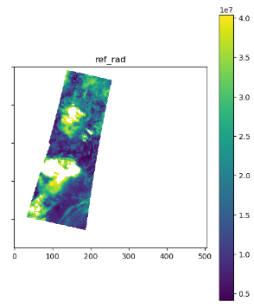
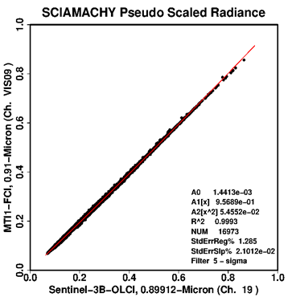
Implementation
Step 1: COLLOCATION
Pre-collocation
ROI -15/15° longitude -10/10° latitude
Time difference: |dt|< 300s
Collocate in Space, Time, Angle
  Pre-downsampling of ref image (e.g.. FCI vs OLCI: to 900m)
  Re-grid mon and ref images to 8x8 km
  Pixels’ max time difference |dt| < 300s
  Maximum VZA < 30° (GEO)
  Calculate Mean & Variance
  Tag land/sea/day/night for analysis
Account for Spectral differences
  Apply Spectral Band Adjustment Factors
Filter
  Apply Sun-Glint mask
  Step 2: ANALYSIS
Combine
  Collocations within 30 or 60 days windows
  With additional filters on angles and time difference
Compare
  Weighted regression of radiances or reflectance
  Evaluate uncertainties
(µ, σ)
|
(µ, σ)
Spectral Band Adjustment Factors
FCI VIS0.6 OLCI Oa07
Notes:
Applied to GEO-LEO this time
FCI: full disk every 10 minutes
OLCI: 3min granule (covers approx. 6° lat). Pass over -10/10° latitude is equivalent to 10 minutes (4 granules)

Slide 6
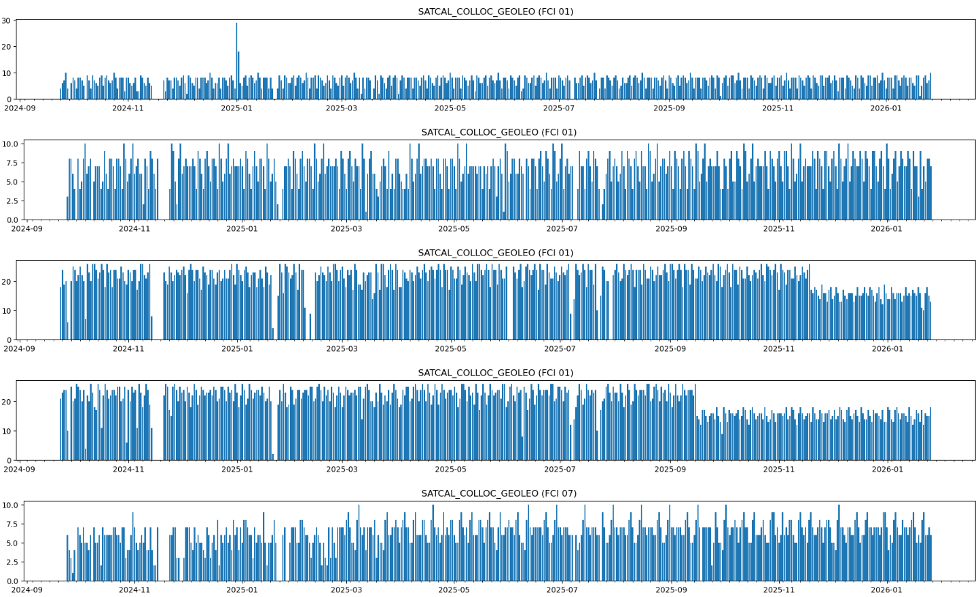
FCI – collocations datasets
FCI/OLCI-Sentinel3A
FCI/OLCI-Sentinel3B
FCI/SLSTR-Sentinel3A
FCI/SLSTR-Sentinel3B
FCI/VIIRS-Noaa21
Notes:
Sliding time window.
Typically 30/60 days.
Time sample: every day

Slide 7
Filtering optimization
Example of filters
Tuning
  The set of filters that performs the fine selection of collocations
    Time difference and geometry difference (viewing angles)
    Temporal window size
    Spatial homogeneity criteria
  Other parameters
    Spatial resolution
    SBAF
  The regression
    Using weights
    In radiance or in reflectance
Assessment
  Visual inspections:
    scatter plots
    distribution of the collocations in the temporal window
    the spatial distribution
    Temporal stability (time series)
  Comparisons
    with other reference sensors
    with other methods (such as desert calibration)
 | v06d
Diff time (s) | 300
Diff VZA (°) | 10
Diff VAA (°) | 10
Max VZA (°) | 25
GAM (°, °) | (2.5, 25)
Water only | yes
Sunglint mask | yes
Std as weights | yes
Temporal window (days) | 30
SBAF order | 1
Spatial resolution (km) | 8

Slide 8
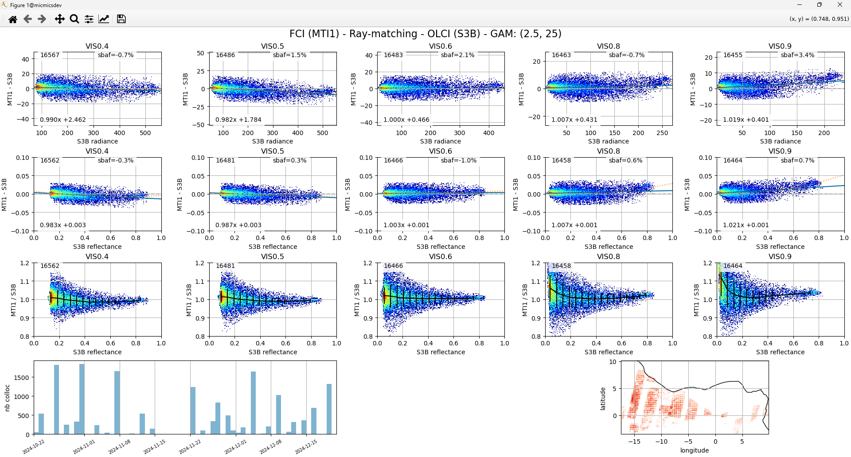
FCI/OLCI – Visual inspection - Scatterplots & other outputs
Radiance
(as a diff)
Reflectance
(as a diff)
Reflectance
(as a ratio)
timeline
geolocation
Notes:
Detect the presence of outliers
Verify the dispersion is limited
Check the distribution is linear
Check the temporal and geographical distrbution

Slide 9
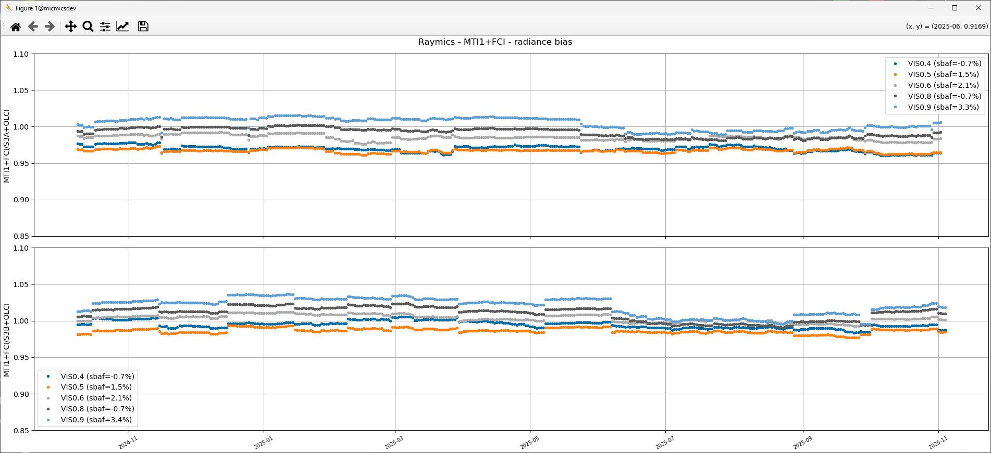
Visual inspection – temporal stability

Slide 10
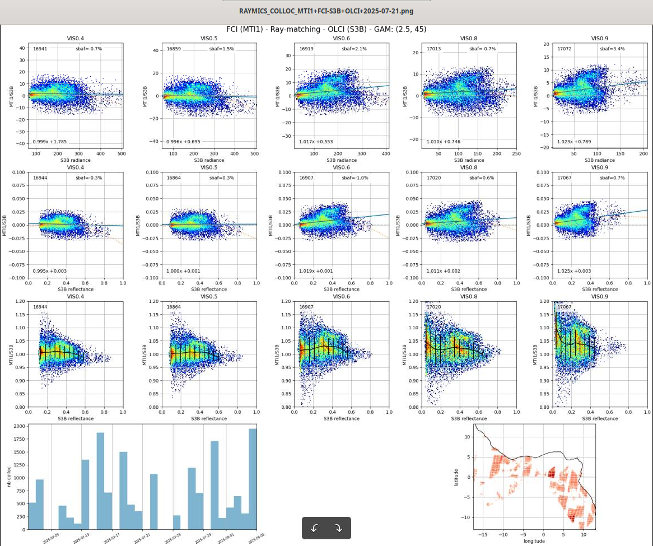
Visual inspection - example of outliers
FCI / OLCI-B
30 days window
Summer

Slide 11
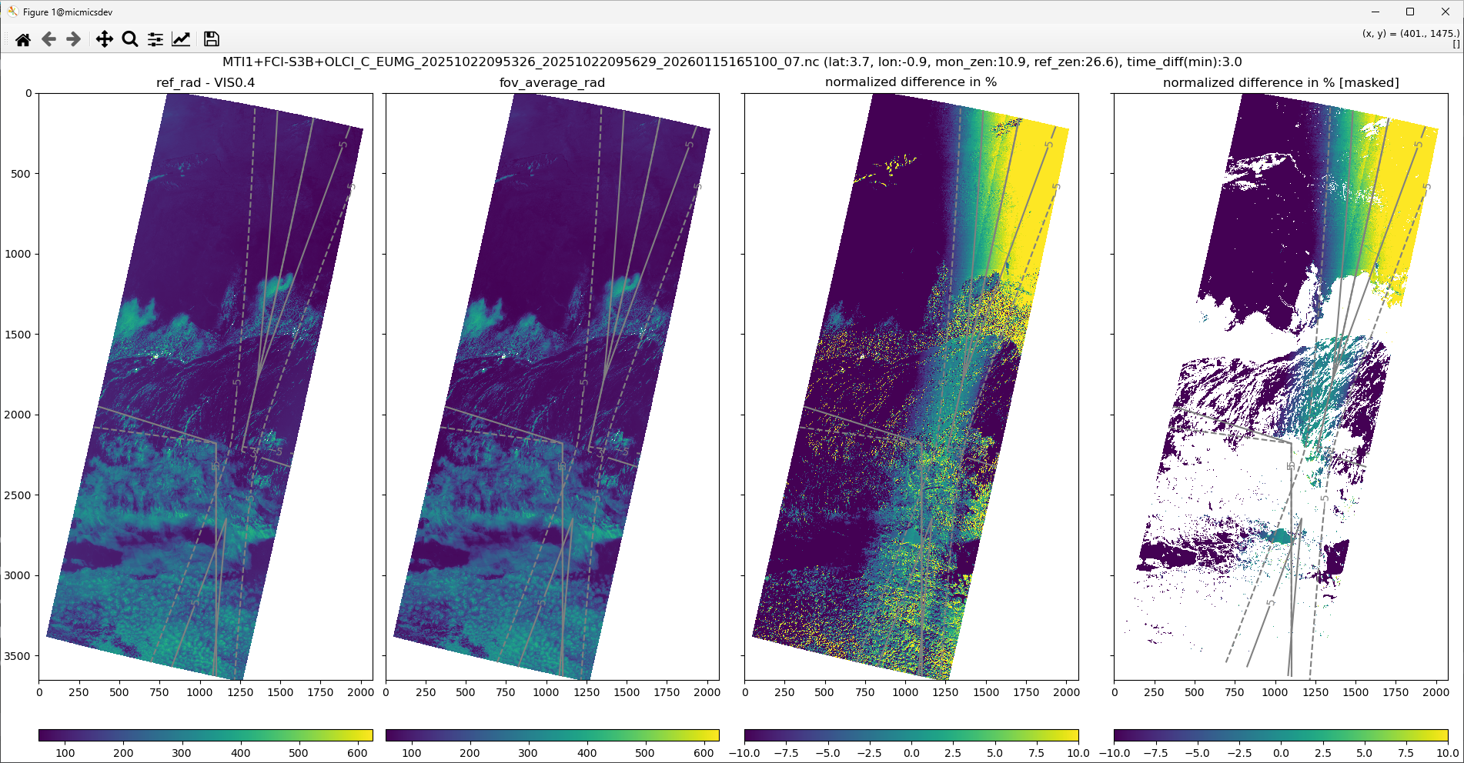
Visual inspection - image to image - case 1
Slow variations:
Seems to be mainly driven by viewing angle difference
Amplitude of errors increased on land (upper part)
Mitigation: limiting difference of viewing angles + land mask
High variations:
Seems to be mainly driven by parallax effect and time difference on cloudy pixels
Mitigation: downsampling, spatial homogeneity test

Slide 12
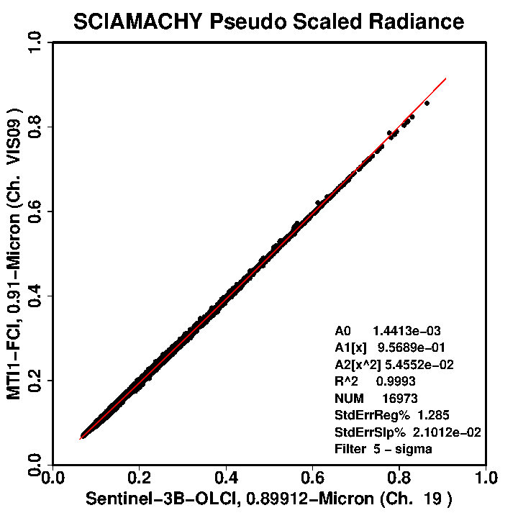
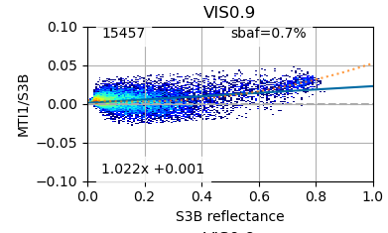
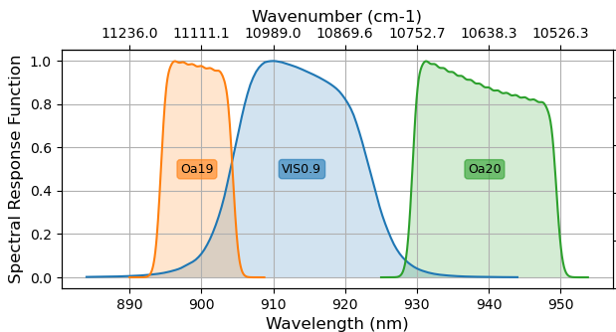
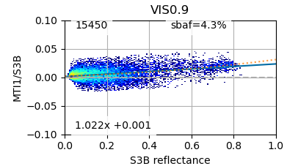
Spectral Band Adjustment Factors (SBAF)
Source:
NASA-LaRC with SCIAMACHY V7.01
Earth spectra:
all-sky-tropical
Units:
Pseudo radiance
Pseudo scale radiance
Regression:
Linear
2d polynomial
Limitation:
SCIAMACHY data limited to continuous spectral range of Channels 1-6, or 0.24 - 1.75 µm
Linear
2d polynomial

Slide 13
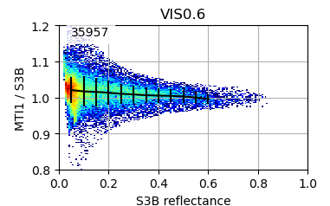
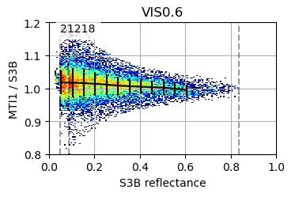
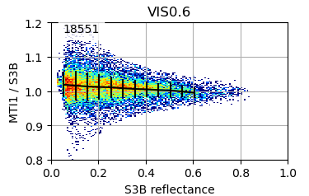
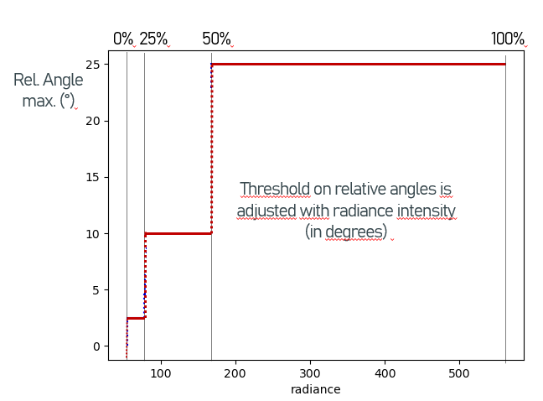
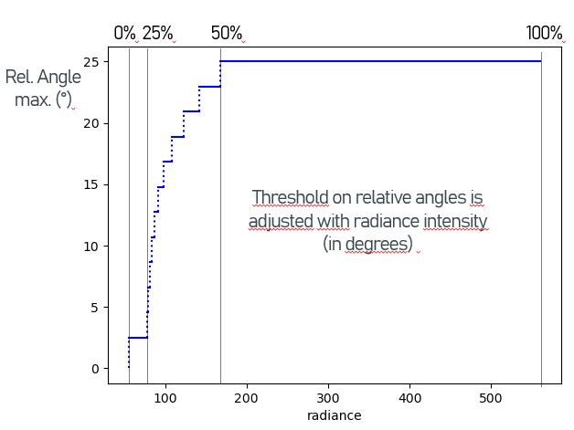
Graduated Angle Matching (GAM)
GAM: Graduated Angle Matching (D. Dwoeling, 2016)
GAM(2.5°, 10°, 25°)
GAM(2.5°, 25°)
most restrictive for anisotropic clear-sky ocean radiances
least restrictive for isotropic bright cloud radiances
tends to optimize the distribution of the collocation over the dynamic range
Notes:
D. DOELLING (2026): Using a graduated angle matching method (GAM), which is most restrictive for anisotropic clear-sky ocean radiances and least restrictive for
isotropic bright cloud radiances, reduces the bidirectional bias while preserving the dynamic range.

Slide 14
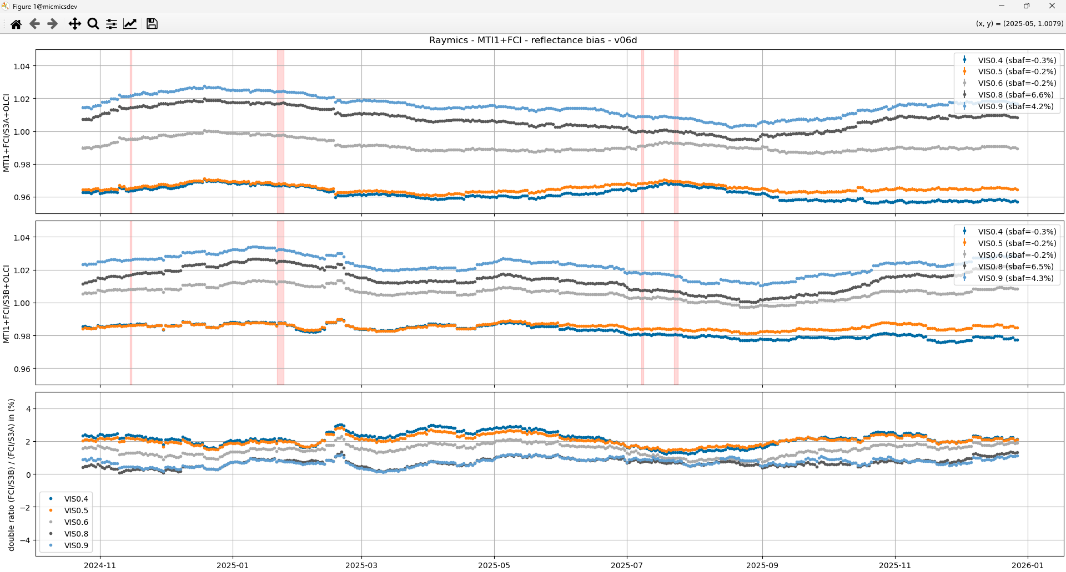
Example of time series: OLCI-A / OLCI-B
FCI / OLCI-A
FCI / OLCI-B
Double diff
(in %)
2%
2%

Slide 15
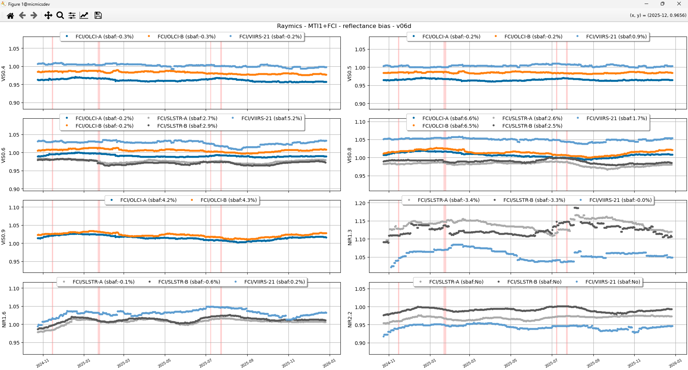
Comparing all references

Slide 16
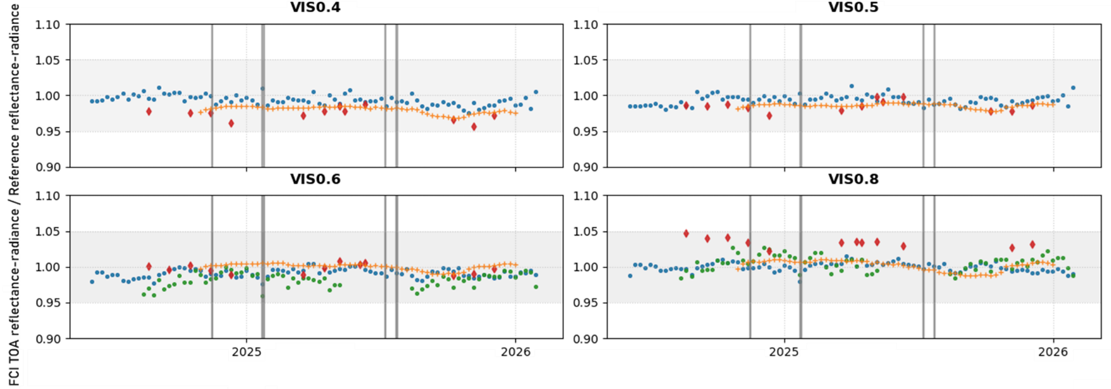
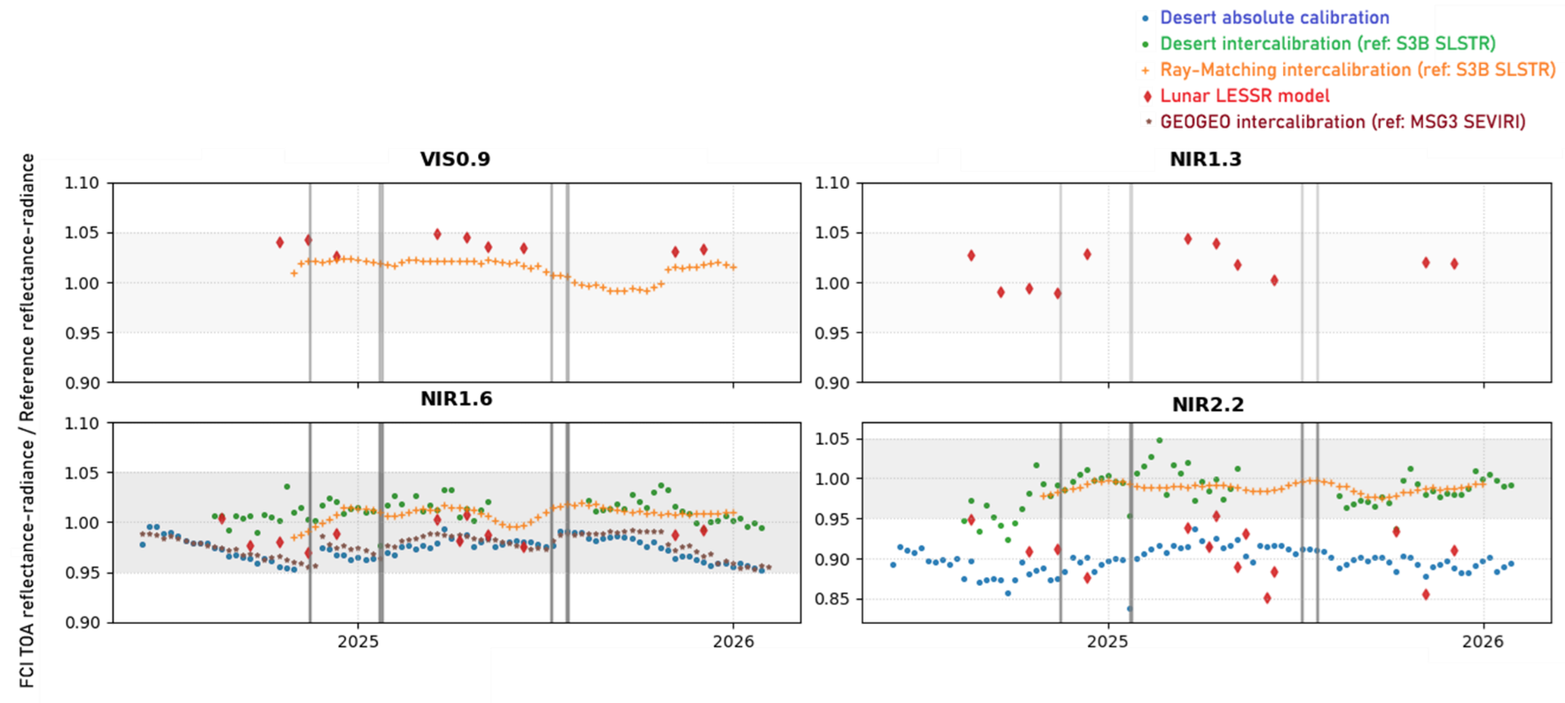

Comparison with other methods

Slide 17
Conclusion and way forward
A very good method
  Not constraint to a small extent of the dynamic range
  Great spectral coverage of FCI channels, with several possible reference sensors
  Results are promising, already consistent with other methods
Challenges:
  Limited areas due the GEO-LEO configuration and sunglint
  Strong filtering on angles is required but means less collocations
  Temporal window can be extended to include more collocations, but monitoring of rapid changes becomes difficult (e.g. FCI 1.6)
  Lower spatial resolution helps to mitigate geometrical errors, but reduces the number of collocations
  Difference between results in radiance and results in reflectance (SBAF influence? Solar Spectrum?)
Way forward
  Based now on this implementation:
    Continue to improve tuning (e.g. 2d order of SBAF, spatial resolution, spatial homogeneity, sunglint…)
    Improve collocations by adding more information (on reference, L1 masks, thermal)
  Improve method assessment by computing dedicated metrics
    Such as errors on the regressions and the temporal stability
  Test with other sensors (e.g. SEVIRI, with longer datasets) and integrate new ones as reference (e.g. VIIRS-NOAA20)
  Continue to report and interact within GSICS working group
Notes:
A difficult trade-off:
Limited area due to strong angle constraints and GEO (bow tie) – less collocations
Robustness: quickly degraded when an outlier comes in - partly due to the low number of collocations
Outliers difficult to exclude by current filters - using strong values, but means less collocations
Sensibility to the distribution of collocations along the dynamic range – partly mitigated with GAM method, 2d order SBAF
Difference between results in radiance and results in reflectance
Difficult to reduce the temporal window, even better to increase it to 60 days – but monitoring of quick changes (FCI NIR1.6) not anymore possible
Way forward:
2d order of SBAF seems promising - but needs more validation
Continue testing downsampling
Spatial homogeneity test to be investigated
Add more metadata to each collocation:
For reference sensor: solar angles, spatial standard deviation (spatial homogeneity)
But also, when in L1 product, cloud masks, sunglint mask, thermal band…
Systematic exclusion of FCI/VIIIRS Collocations to be ingestigated
Move from the “try and see” approach to a finer approach, based on dedicated metrics, such as regression errors and temporal stability error, and an automated process

Slide 18
Thank you!
Questions are welcome.

Slide 19
…
BACKUP Slides

Slide 20
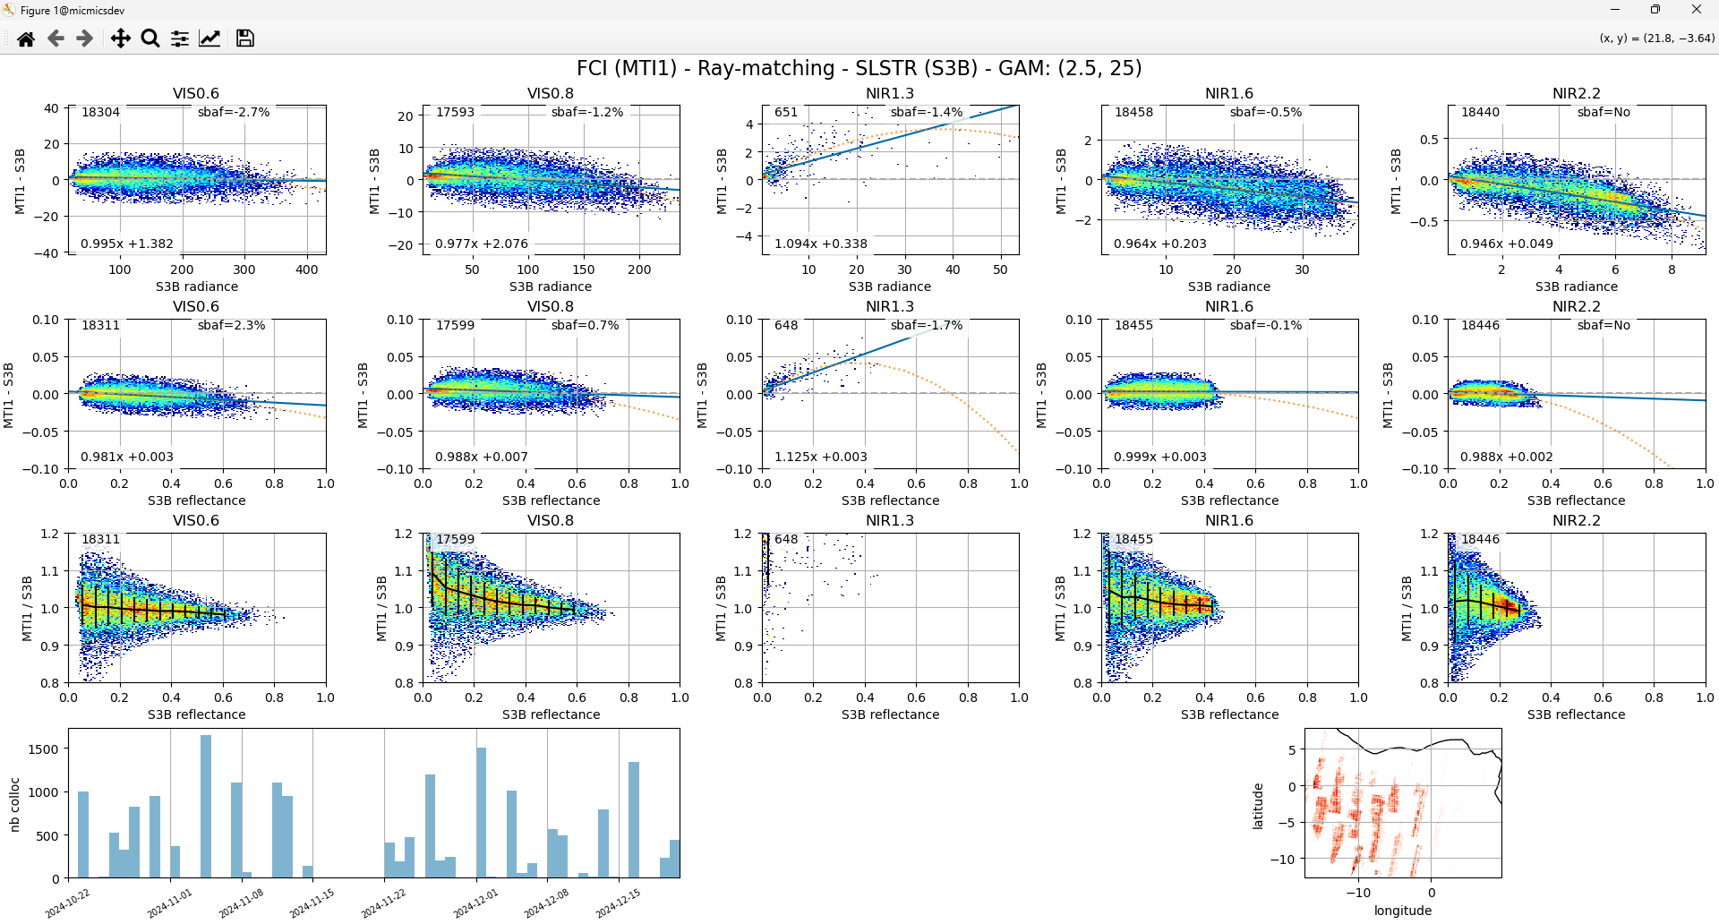
Testing other references : SLSTR (Sentinel-3)
Notes:
NIR1.3 SLSTR:
- images for this band is always contaminated by a certain number of invalid pixels (no data).
the no data pixels tend to be propagated when reprojecting and downsampling the data.
at end, the number of remaining valid pixel is low
NIR2.2:
- Shows non-linearity / but not SBAF for this band

Slide 21
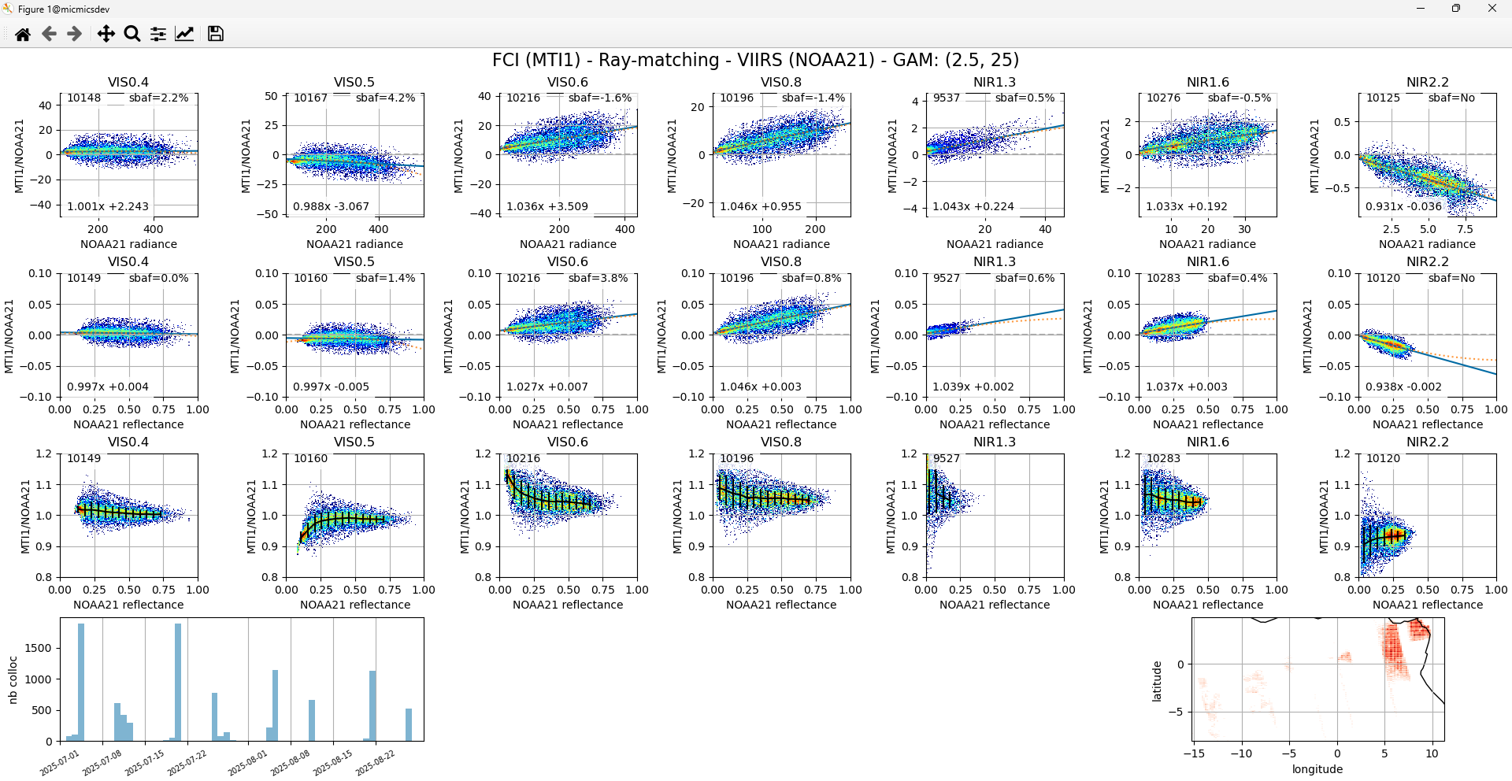
Testing other references : VIIRS (NOAA-21)

Slide 22
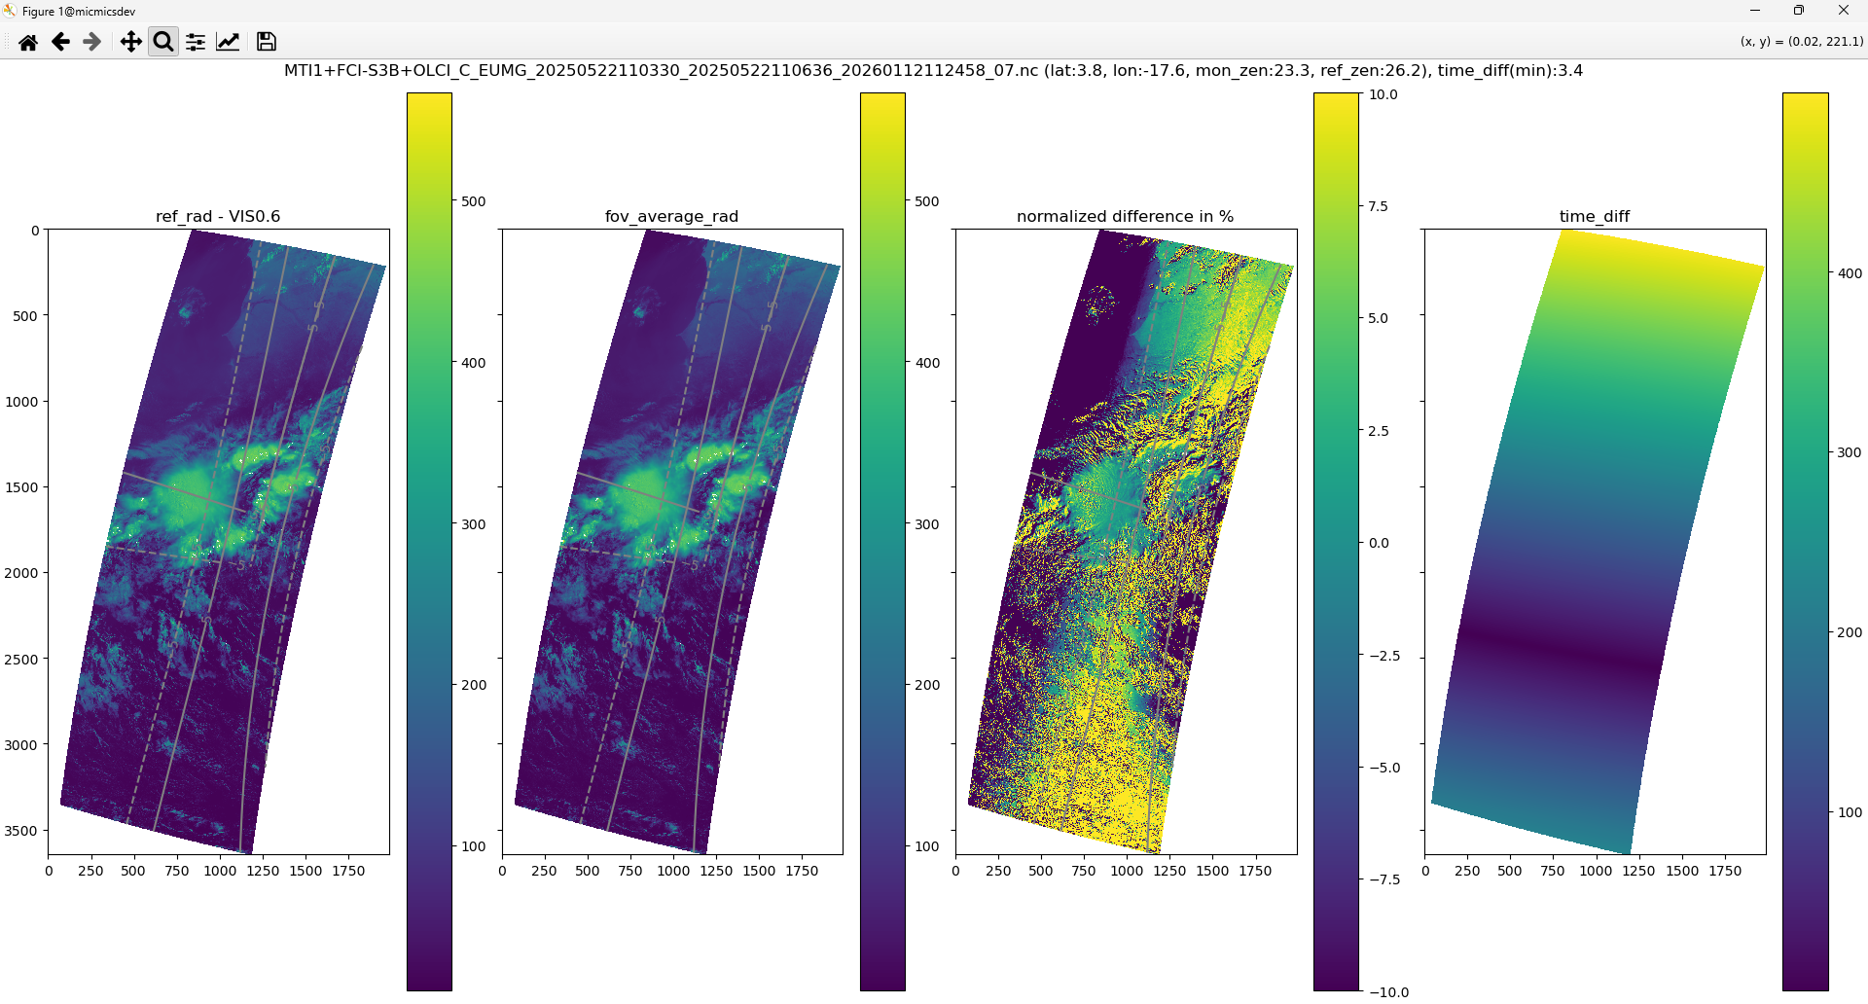
Visual inspection – image to image - case 2

Slide 23
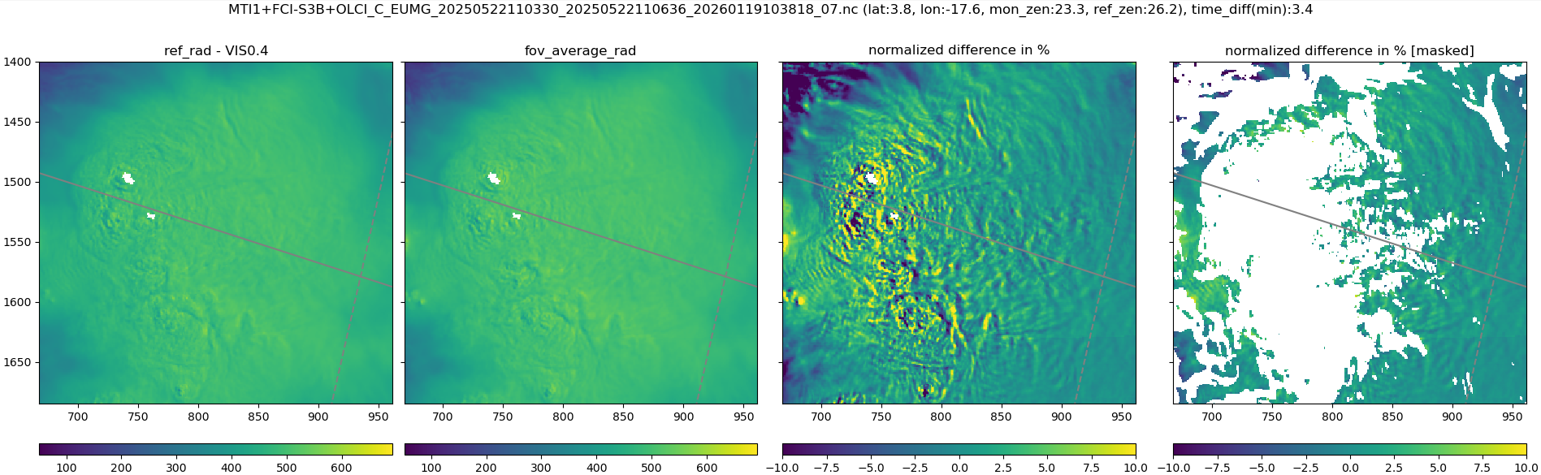
Visual inspection – image to image - zoom on DCC

Slide 24
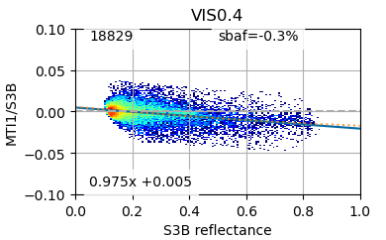
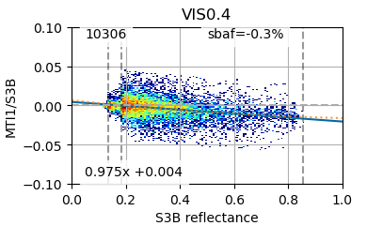
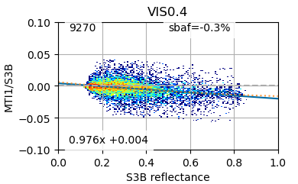
Graduated Angle Matching (GAM)
GAM: Graduated Angle Matching (D. Dwoeling, 2016)
GAM(2.5°, 10°, 25°)
GAM(2.5°, 25°)
most restrictive for anisotropic clear-sky ocean radiances
least restrictive for isotropic bright cloud radiances
tends to optimize the distribution of the collocation over the dynamic range
Notes:
D. DOELLING (2026): Using a graduated angle matching method (GAM), which is most restrictive for anisotropic clear-sky ocean radiances and least restrictive for
isotropic bright cloud radiances, reduces the bidirectional bias while preserving the dynamic range.

Slide 25
Different versions
 | V01a/b | V02 | V03a | V03b | V03c | V03d | V03e | V04 | V05 | V03f | V06d | V06e
Spatial res. (km) | 8 | 8 | 8 | 8 | 8 | 8 | 8 | 8 | 8 | 8 | 16 | 16
Diff time (s) | 600 | 100 | 100 | 100 | 100 | 100 | 100 | 100 | 100 | 100 | 300 | 300
Diff VZA (°) | 10 | 10 | 10 | 10 | 10 | 10 | 10 | 10 | 10 | 10 | 10 | 10
Diff VAA (°) | 10 | 10 | 45 | 25 | 25 | 25 | 35 | 25 | 25 | 25 | 25 | 25
Max VZA (°) | - | 25 | 20 | 20 | 20 | 20 | 20 | 20 | 20 | 20 Max VAA: 180 | 20 | 20
GAM (°, °) | (2.5, 10) | (2.5, 10) | (2.5, 45) | (2.5, 25) | (2.5, 25) | (2.5, 25) | (2.5, 35) | (2.5, 25) | (2.5, 25) | (2.5, 25) | (2.5, 25) | (2.5, 25)
Water only | a: no b: yes | yes | yes | yes | yes | yes | yes | no | yes | yes | yes | yes
Sunglint mask | yes | yes | yes | yes | yes | yes | yes | yes | yes | yes | yes | yes
Std as weights | yes | yes | no | no | no | yes | no | no | no | no | no | no
Temporal window (days) | 30 | 30 | 30 | 30 | 60 | 60 | 60 | 60 | 60 | 60 | 60 | 60
SBAF order | 1 | 1 | 1 | 1 | 1 | 1 | 1 | 1 | 2 | 1 | 2 | 1
Typical number of collocations

Slide 26
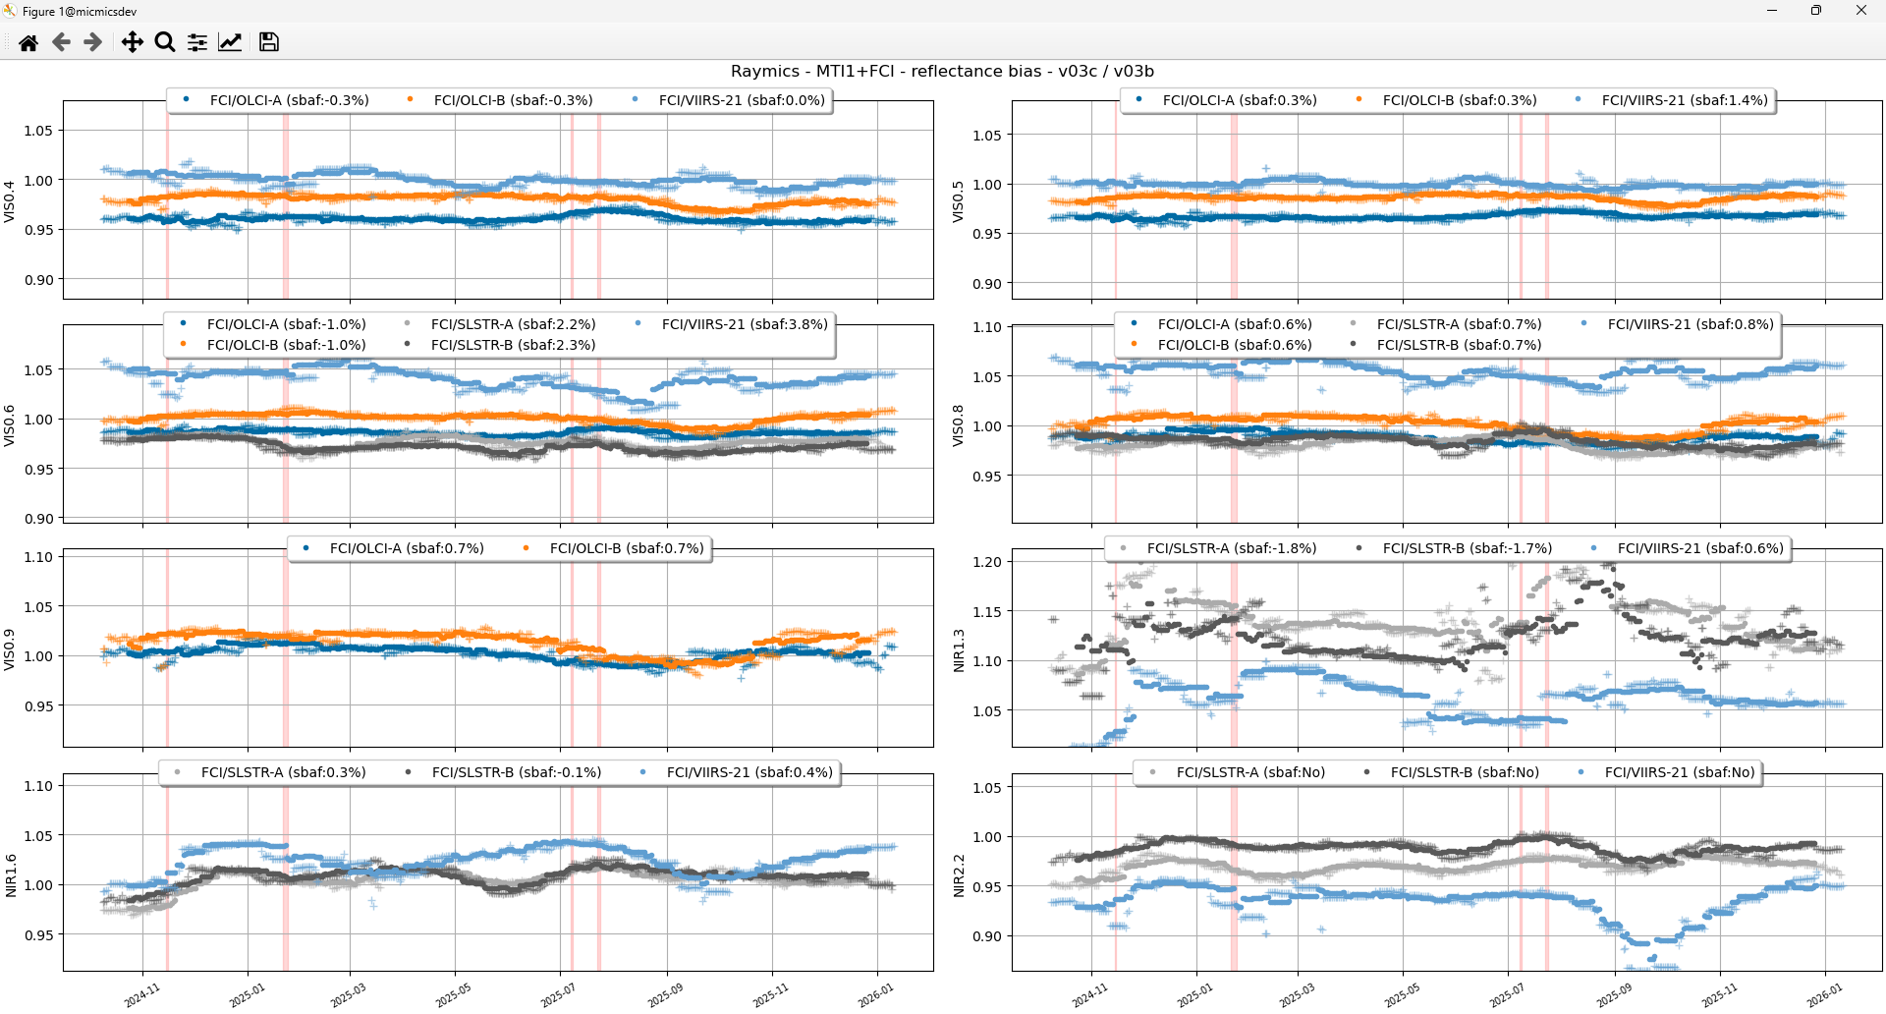
Temporal window – 60days vs 30days

Slide 27
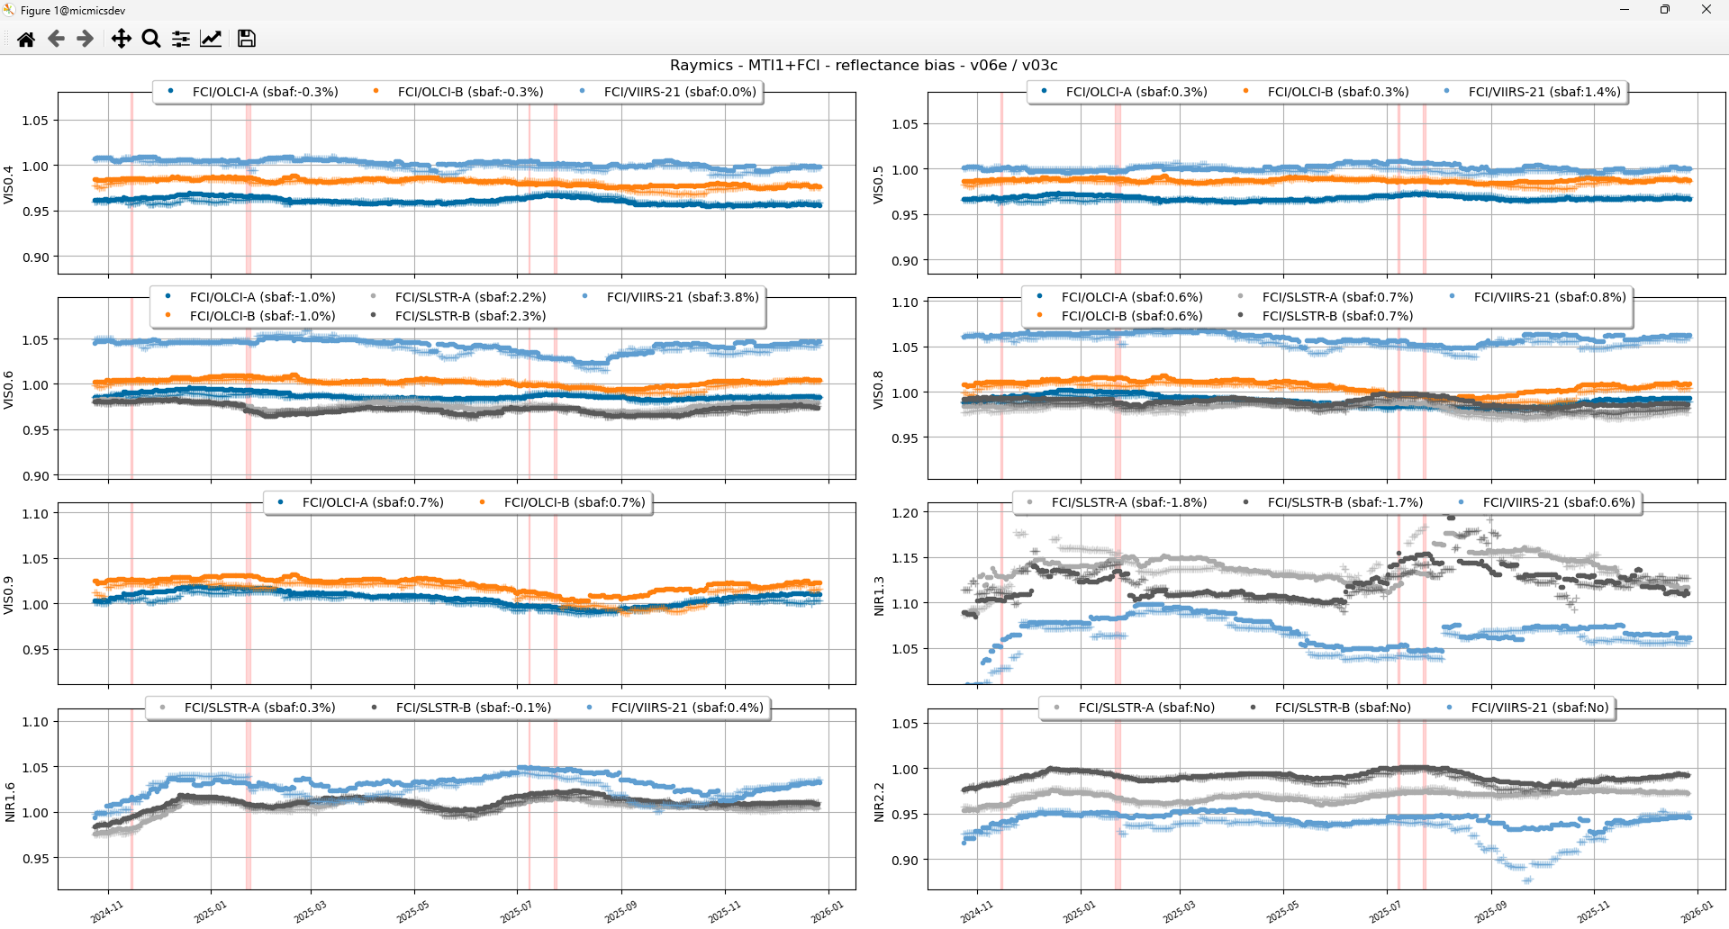
Spatial bin size – 8km vs 16km

Slide 28
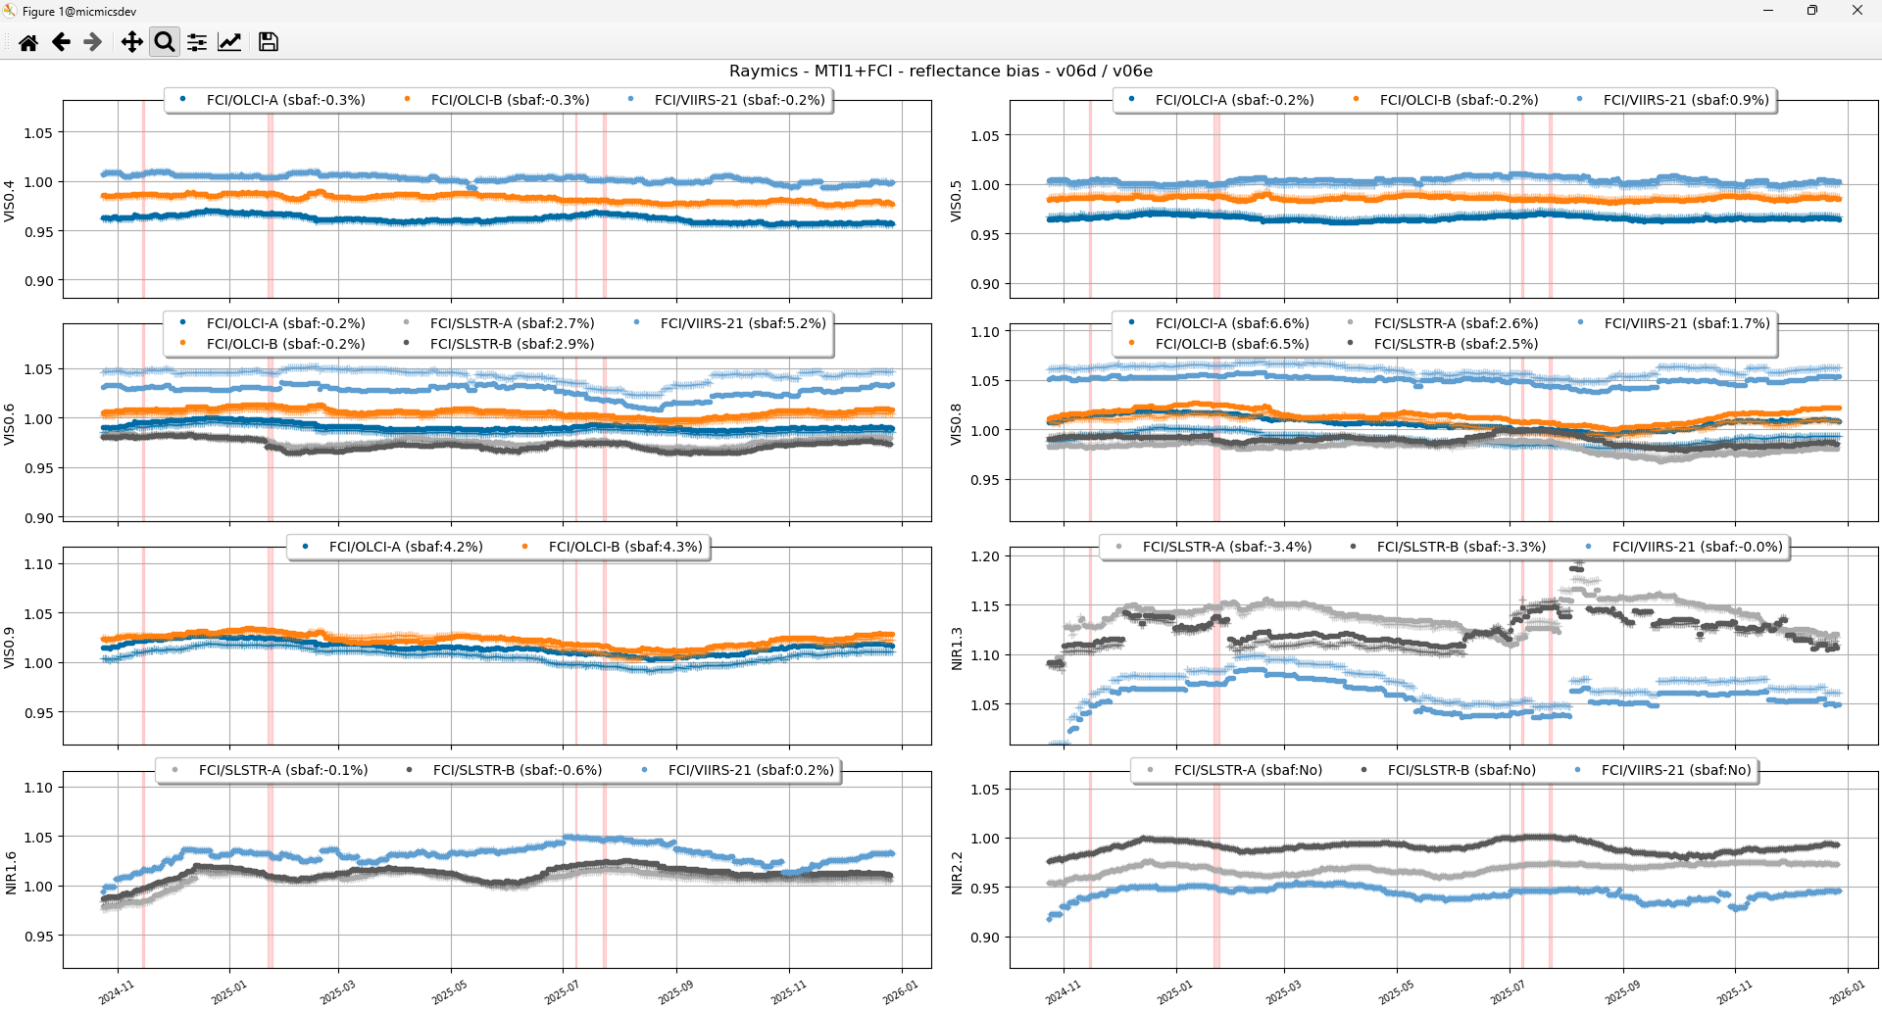
SBAF 2 order vs. 1st order // 16 km

Slide 29
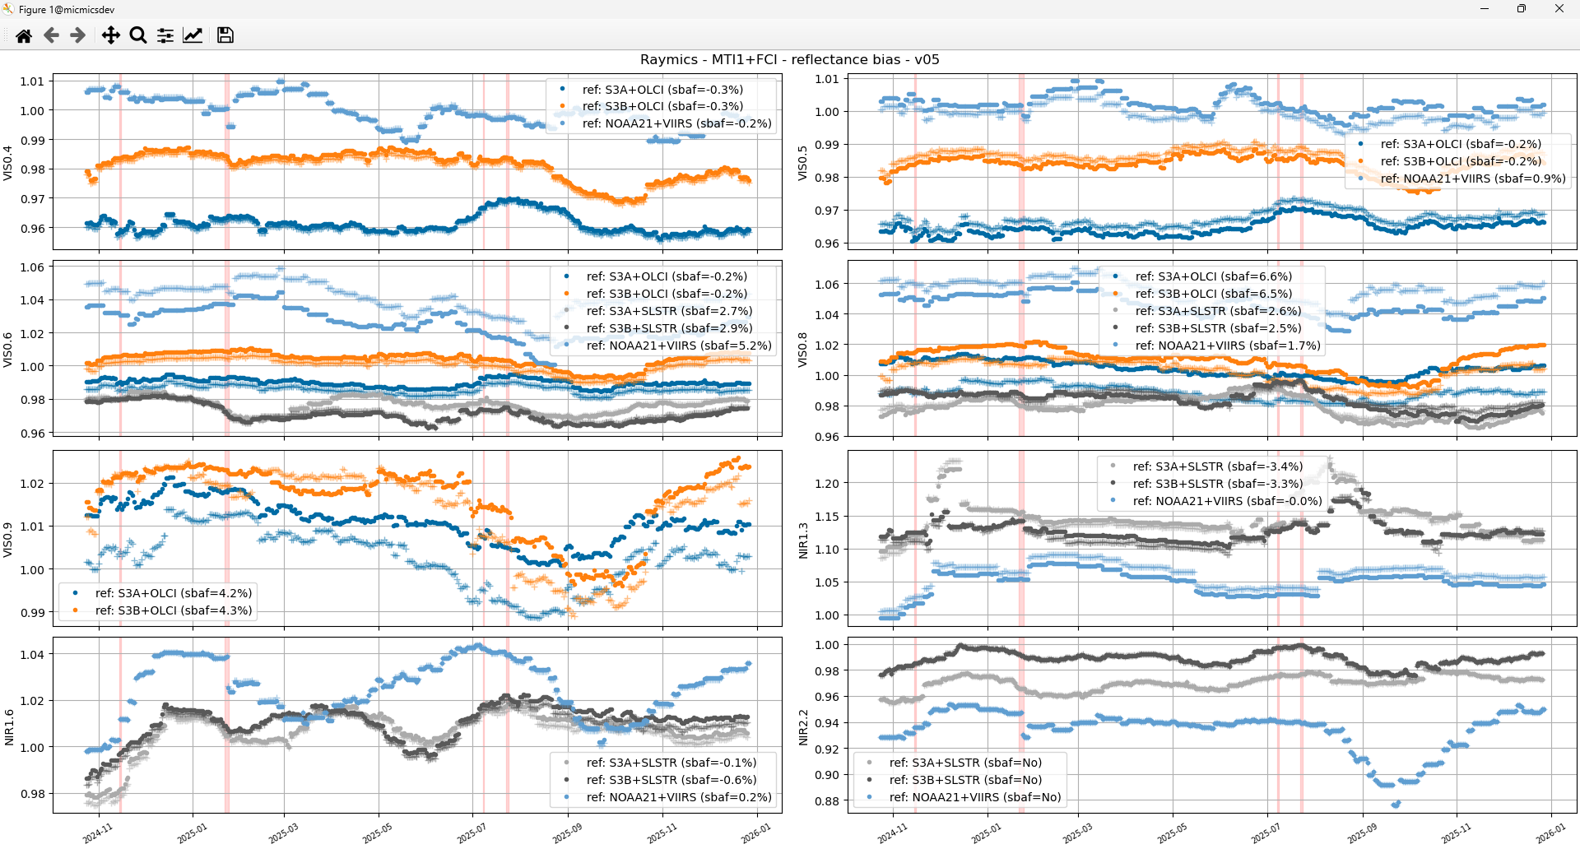
SBAF 2 order vs. 1st order // 8 km

Slide 30
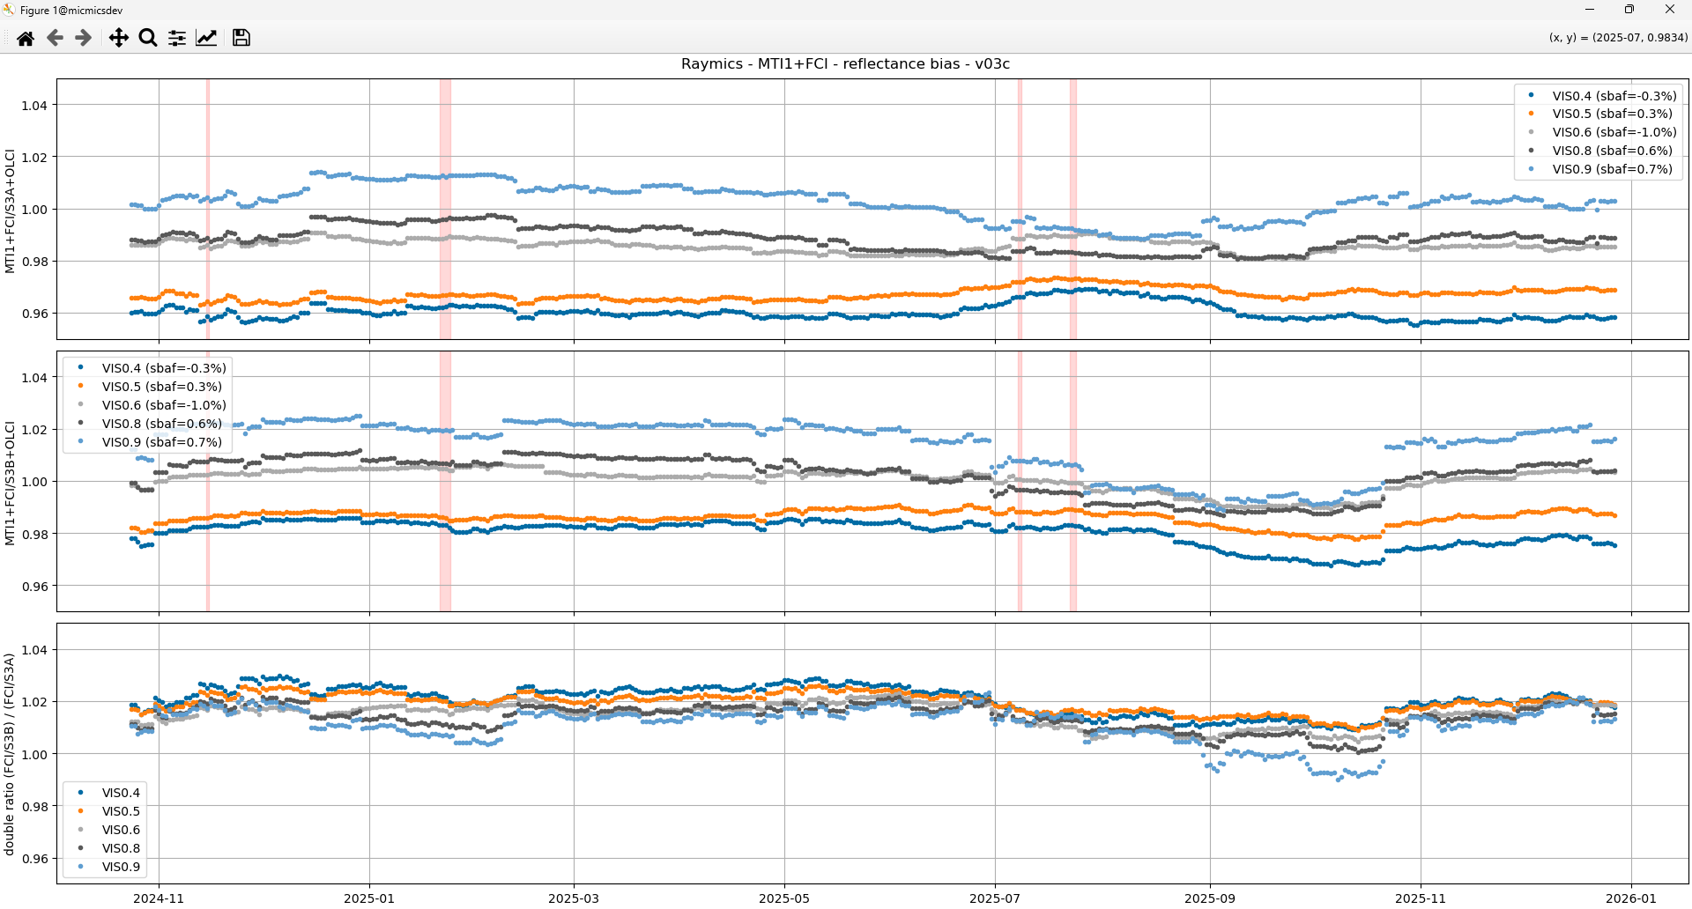
Double difference OLCI-A / OLCI-B

Slide 31
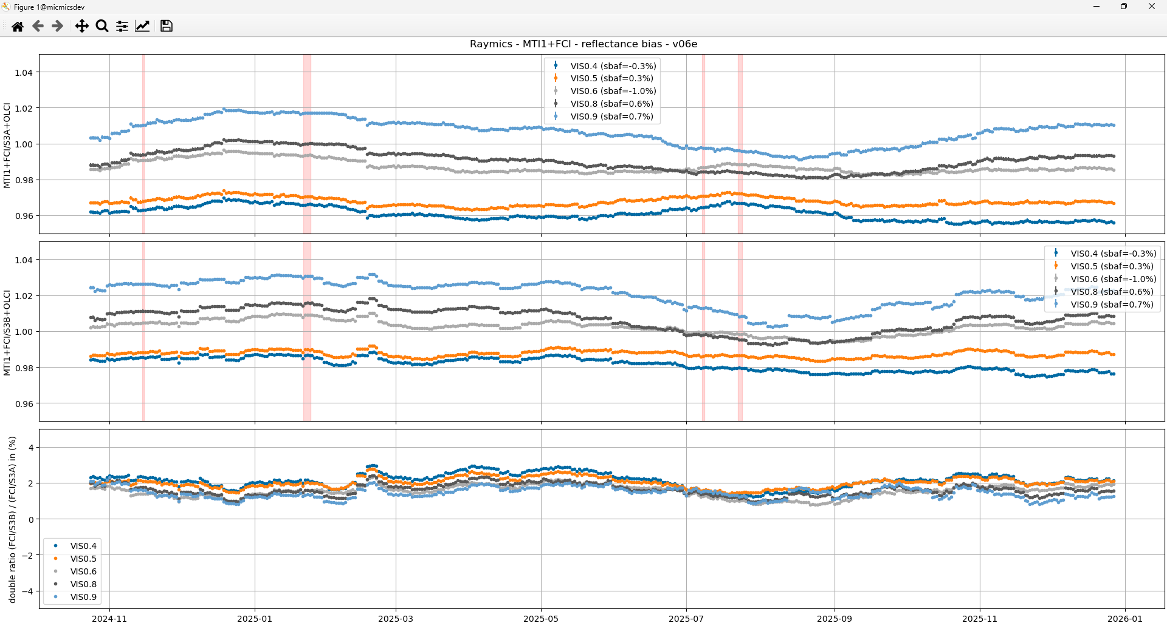
Double difference OLCI-A / OLCI-B

Slide 32
Double difference OLCI-A / OLCI-B

