Slide 1
Desert Calibration and Intercalibration: State-of-the-Art Methods and Challenges.
Ali Mousivand
EUMETSAT
GSICS Annual Meeting, March 23-27 2026, Ottawa

Slide 2
Agenda
Desert Calibration: State-of-the-Art
Best Practices & Recommendations
Challenges and Limitations

Slide 3
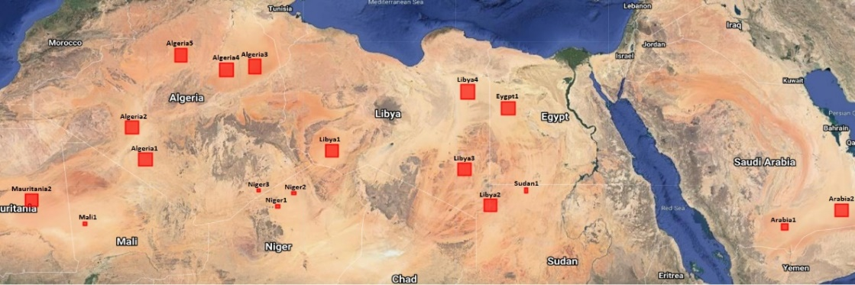
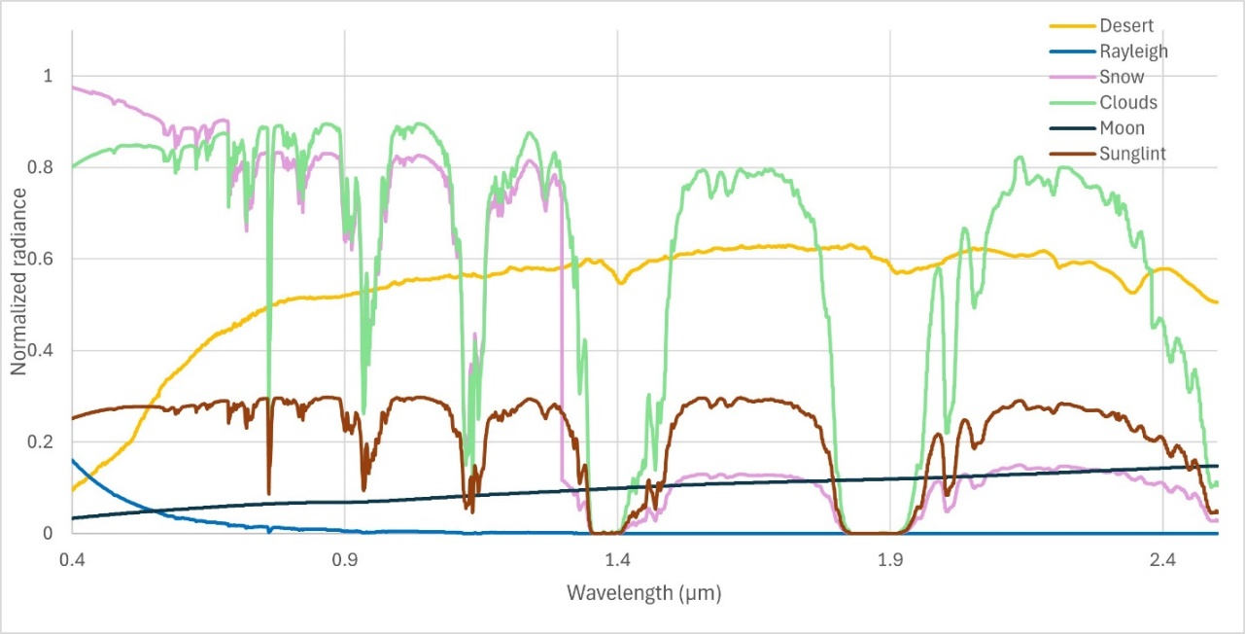
Desert Sites for Radiometric Calibration
Desert sites are excellent calibration sources for reflective solar channels due to:
  Radiometric Temporal Stability (Pseudo-Invariant Calibration Sites- PICS)
  Relative Spatial Uniformity
  Availability across multiple instruments
Desert sites support:
  Absolute radiometric calibration
  Cross-calibration / intercalibration between sensors
  Long-term temporal stability monitoring
Key advantages:
  Applicable across the solar reflective spectrum (VIS,NIR,SWIR),
  except in strong atmospheric absorption regions
  Variety of reference instruments for intercalibration
  Availability of variety of sites distributed globally
  Allows use of the full instrument field of view (FOV)
  Covers parts of dynamic range, often not covered with other
  vicarious methods
Typical TOA normalized radiances for various calibration targets

Slide 4
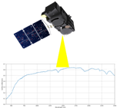
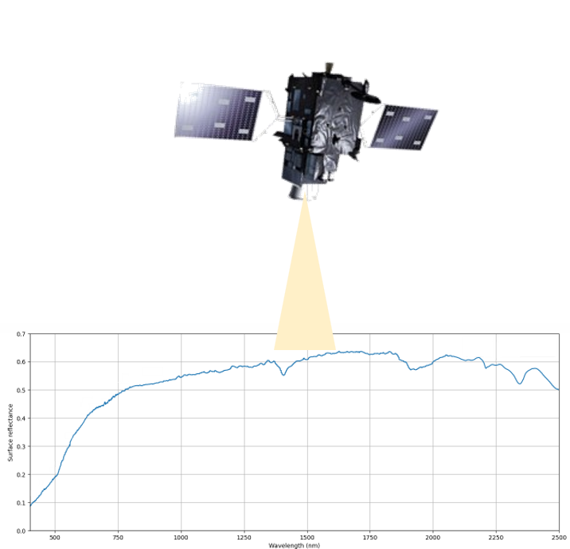

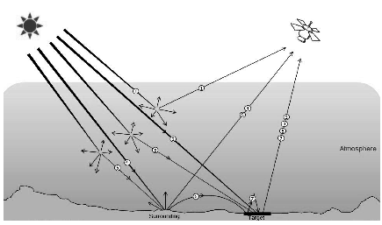
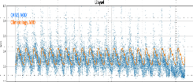
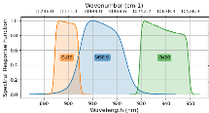



Desert calibration and intercalibration
Uses desert PICS to transfer the calibration from a reference instrument/model (RTM) to the monitored instrument.
Desert Absolute Calibration
Desert Intercalibration
Reference TOA
reflectance
Measured
reflectance
Surface BRDF parameters
Find collocations
Radiative transfer model
Atmospheric parameters
High resolution spectrum
Atmospheric correction
Instrument characteristics
Surface
reflectance
Calibration coefficients
Measured
reflectance
Simulated
reflectance
Atmospheric parameters
Instrument characteristics
Simulated
reflectance
Absolute calibration coefficients
Radiative transfer model

Slide 5
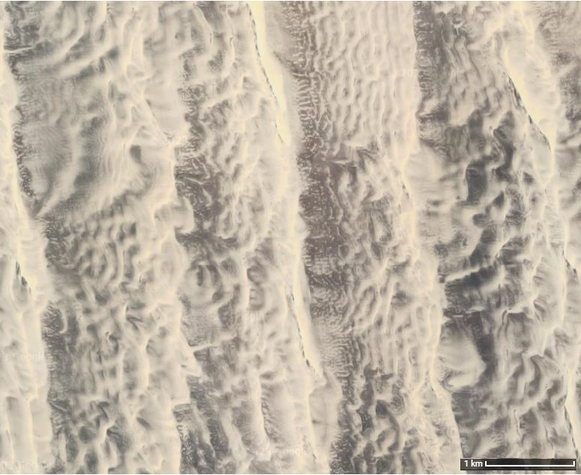
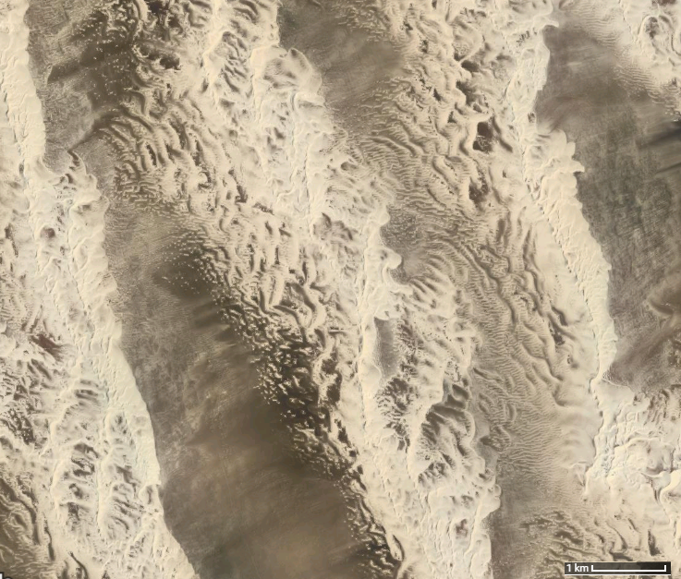
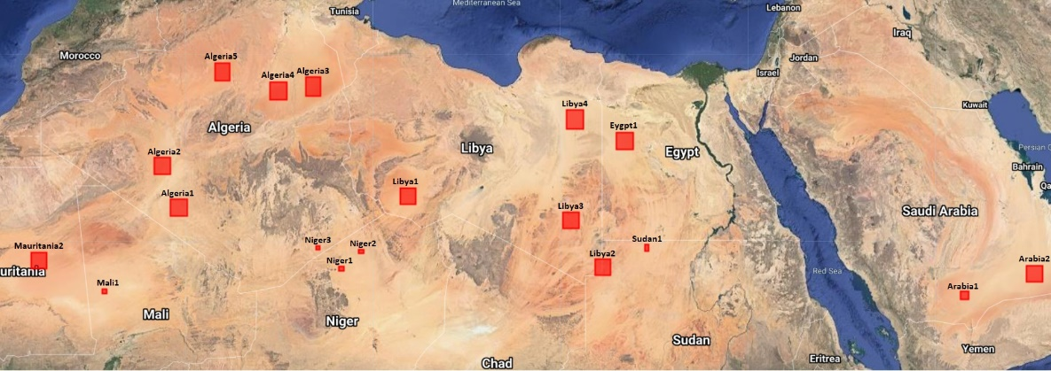

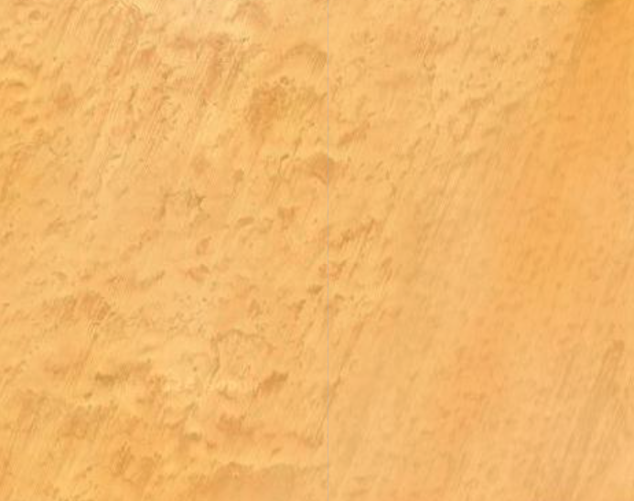
MICMICS Desert Absolute Calibration
TOA reflectance simulation
  RTM: a customised version of the polarized 6SV2.1, DISORT, Monte-Carlo;
  Surface: 4-parameter BRDF RPV model using spectrally resolved BRDF parameters;
  Atmosphere:
    Customized Desert Aerosol model over the Sahara and Arabian Peninsula;
    US standard atmosphere, scaled with H2O and O3 column;
    O3, WV, surface pressure from ECMWF, and AOT550 from CAMS;
Evaluate & Monitor bias:
  Estimate the absolute calibrations by comparing simulated radiance against actual measurements
The uncertainty in the desert model is understood to be about 2%-3%

Slide 6
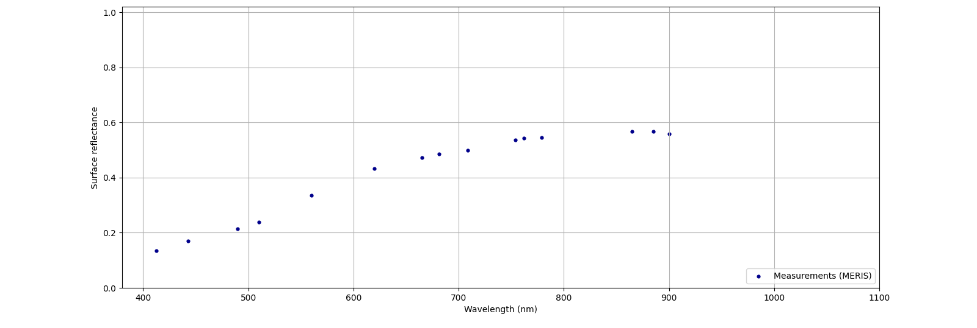
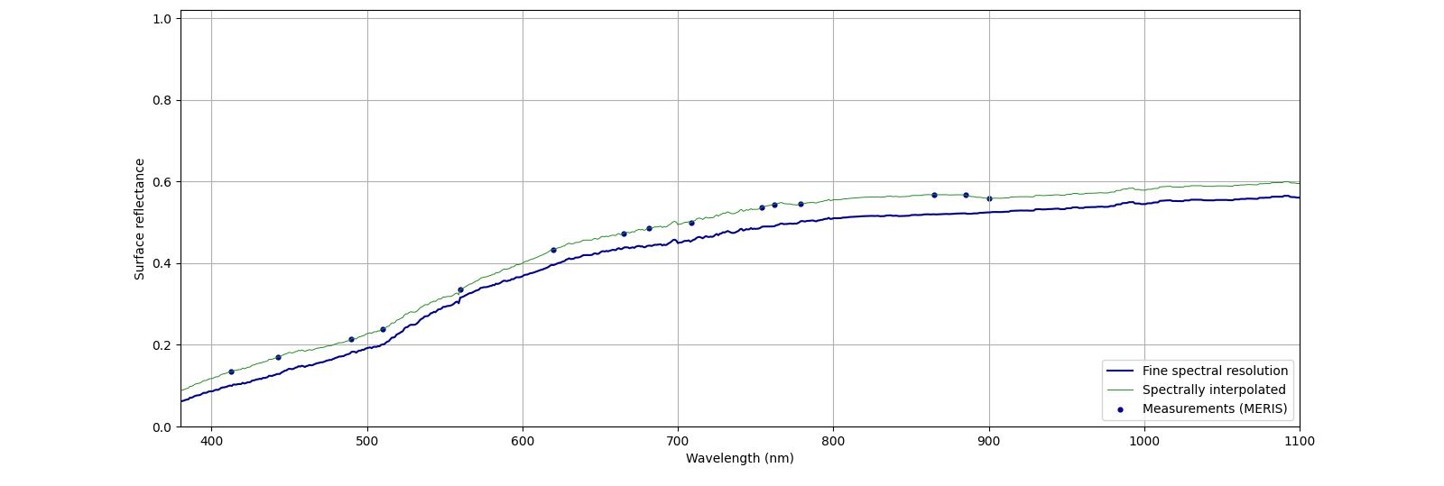
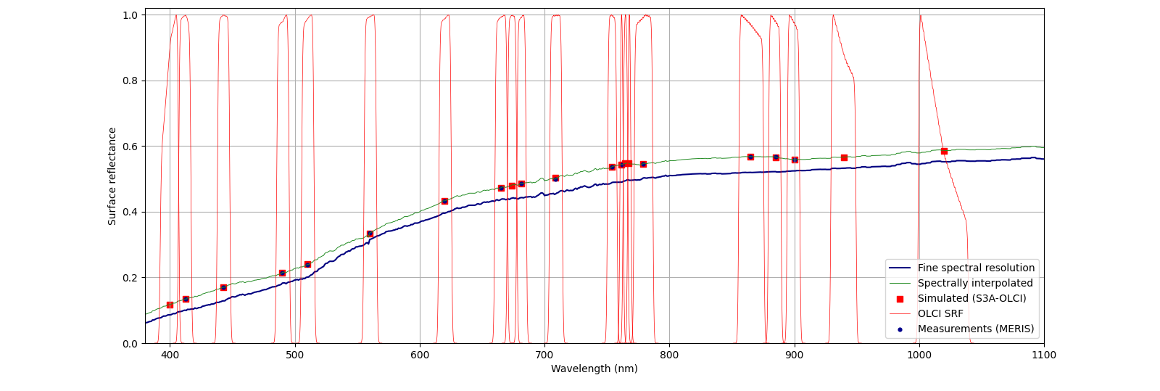
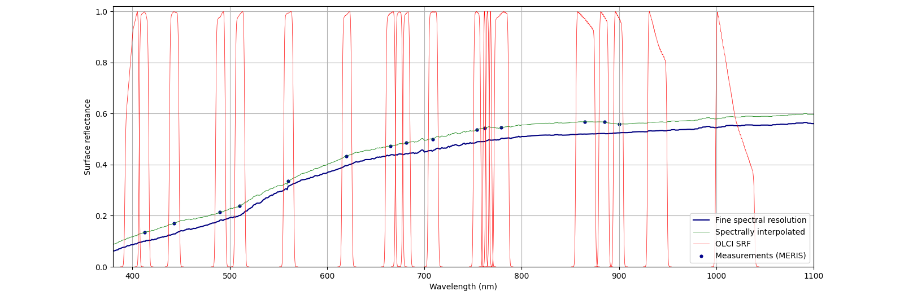
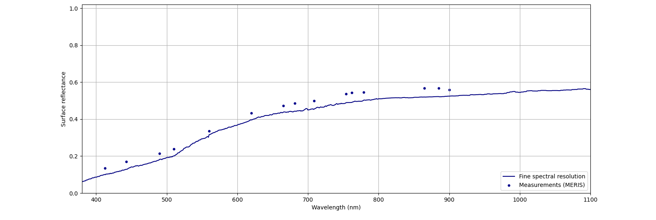
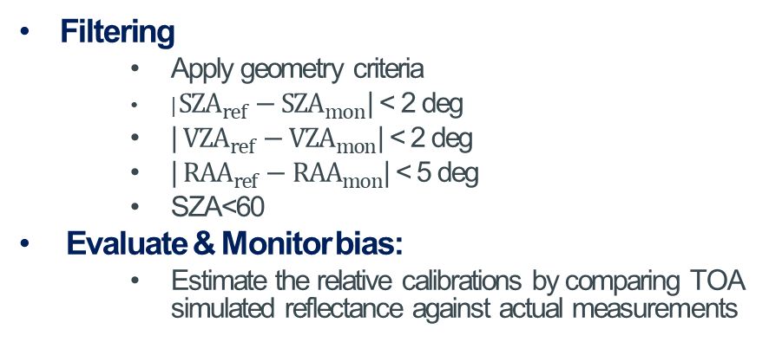
MICMICS DESert Inter-Calibration System (DESICS)
BOA reflectance retrieval
  Atmospheric correction: Customised version of the polarized 6SV2.1,
  Atmosphere:
    Customized Desert Aerosol model over the Sahara and Arabian Peninsula;
    US standard atmosphere, scaled with H2O and O3 column;
    O3, WV, surface pressure from ECMWF, and AOT550 from CAMS;
TOA reflectance simulation
  RTM: customised version of the polarized 6SV2.1
  Surface: simulated spectral surface reflectance for monitored instrument
  Atmosphere: same as those of BOA reflectance retrieval
Filtering
  Apply geometry criteria
  | ${SZA}_{ref}−{SZA}_{mon}$| < 2 deg
  | ${VZA}_{ref}−{VZA}_{mon}$| < 2 deg
  | ${RAA}_{ref}−{RAA}_{mon}$| < 5 deg
  SZA<60
Evaluate & Monitor bias:
  Estimate the relative calibrations by comparing TOA simulated reflectance against actual measurements

Slide 7
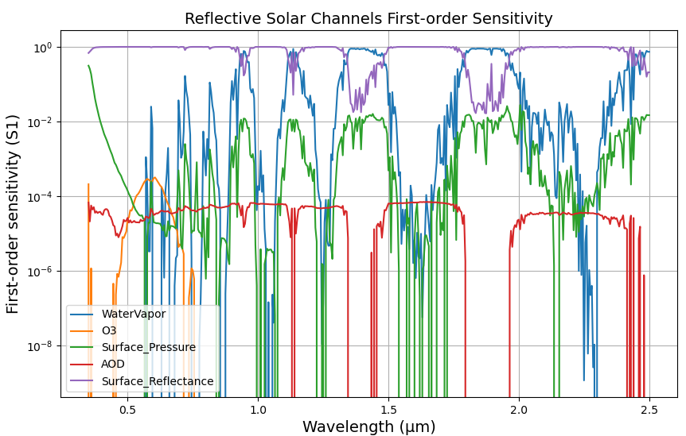
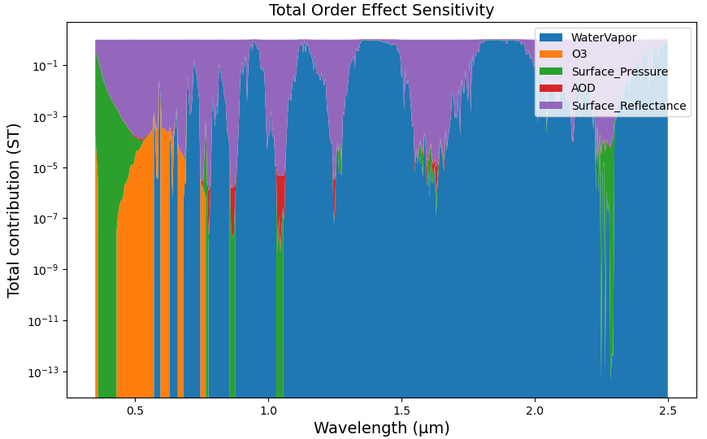
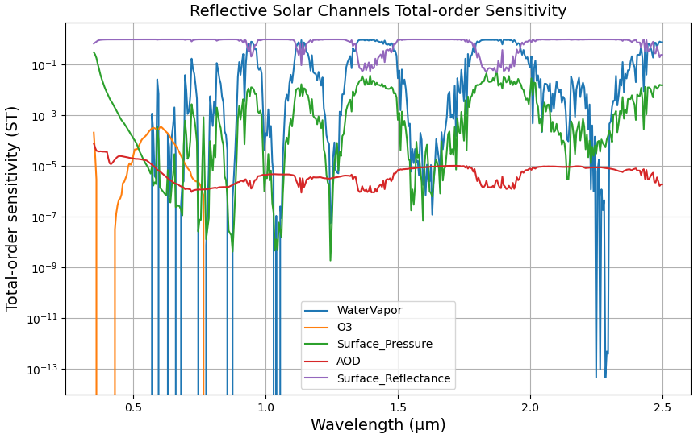
Key Factors Influencing Calibration Coefficient Accuracy
Under favorable desert conditions, most Radiative Transfer Models achieve high accuracy in TOA simulations.
The primary uncertainty contributors are:
  Surface modelling
  Atmospheric modelling
Sensitivity analysis indicates that:
  Surface reflectance dominates the model behavior (~99%) for non-absorption channels.
  Atmospheric parameters contribute negligibly (≈1% combined) under clear sky conditions.
Error propagation:
  A 1% perturbation in surface reflectance leads to an approximately proportional (~1%) change in model output (near-linear response under these conditions)
Implication:
  Improving BRDF characterisation is the most effective way to improve absolute calibration accuracy

Slide 8
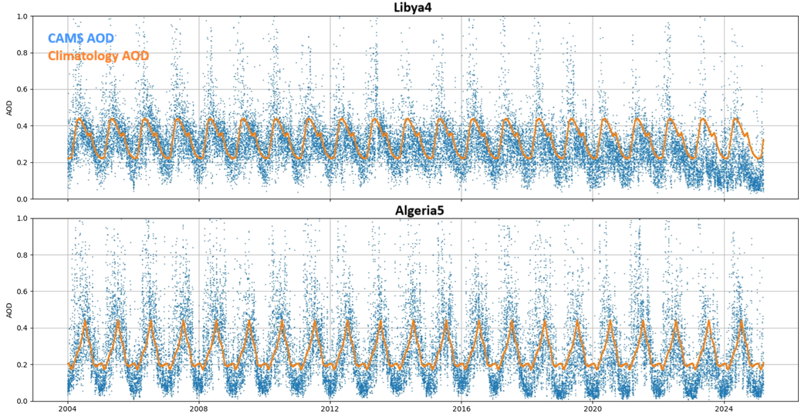
Atmospheric modelling over desert targets
Key atmosphere variables: Total Column Water Vapour (WV) ; Total Column Ozone (O₃) ; Aerosol Optical Depth (AOD) and Surface Pressure (P) , aerosol type and model
Data sources:
  ECMWF: Forecast, Analysis or Reanalysis datasets
  AOD: CAMS or similar products
Alternative approach:
  Climatology or long-term averages can be used, significant variations must be avoided
Uncertainty considerations:
  Typically ~5–20%
  Limited impact under clear-sky conditions (per sensitivity analysis)

Slide 9
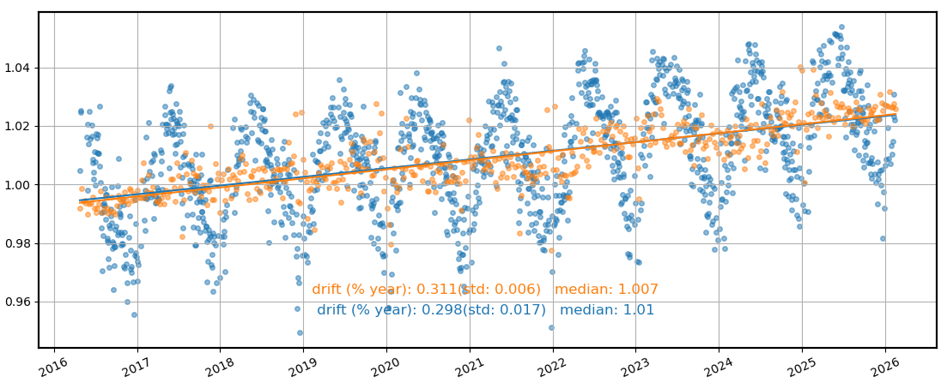
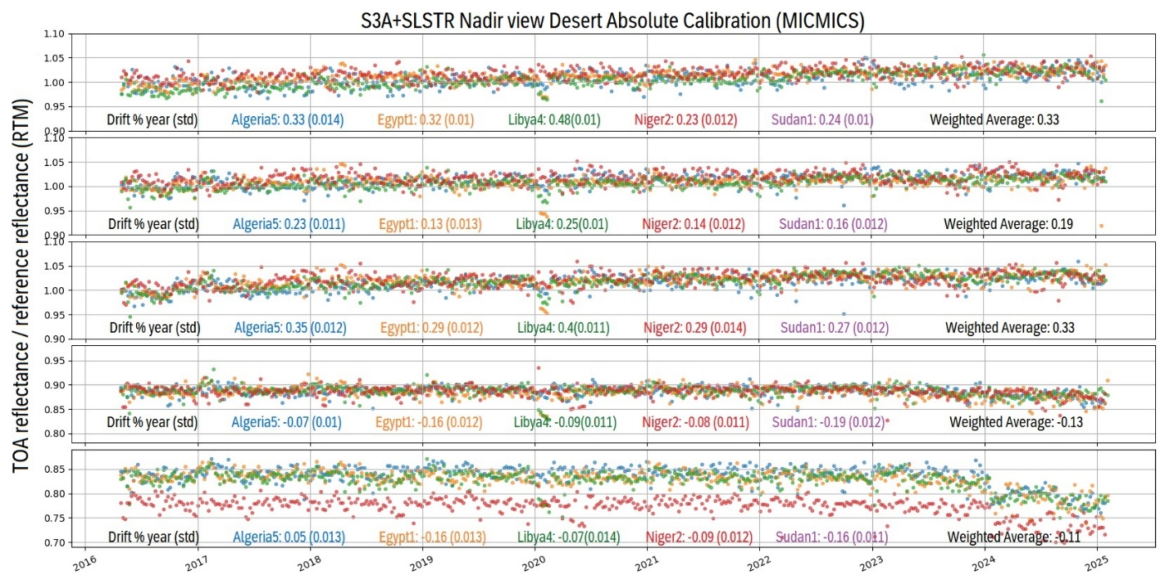
Seasonality and Results Aggregation
Seasonality effects:
  Strong seasonality is often observed over desert targets
  Can be effectively removed using statistical approaches
  No significant impact on drift monitoring after correction
Variability across targets:
  Results differ between sites due to:
    Surface stability
    Surface reflectance properties
    Atmospheric conditions
Target selection:
  Combining multiple targets provides more representative results
  A limited number of well-chosen sites is sufficient
Important consideration:
  Previously identified calibration sites are not necessarily optimal
  Site selection should be re-evaluated based on stability and performance

Slide 10
Challenges and Limitations
Surface BRDF modelling:
  Largest source of uncertainty
  Difficult to accurately characterise and model
  Limited ground truth for validation
Target monitoring limitations:
  Desert sites not revisited frequently, human activities can hinder applicability
  Significant variability can occur across different targets
Lack of standardised methodology:
  No widely accepted ATBD (Algorithm Theoretical Basis Document)
  No GSICS-endorsed approach or unified documentation
  Practices remain inconsistent across studies
Other challenges:
  Atmospheric correction remains complex, even under clear-sky conditions
  Need for high spectral resolution to accurately perform spectral interpolation in desert intercalibration

Slide 11
Thank you!
Questions are welcome.

Slide 12
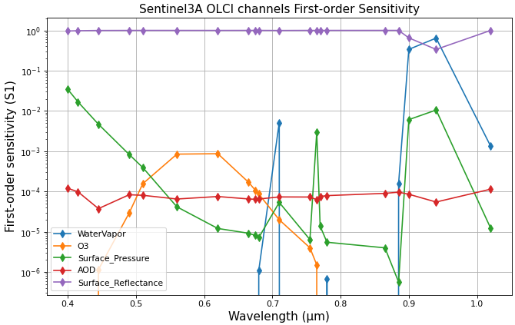
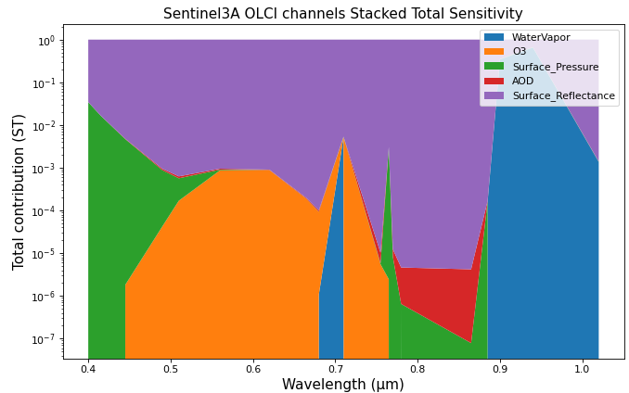
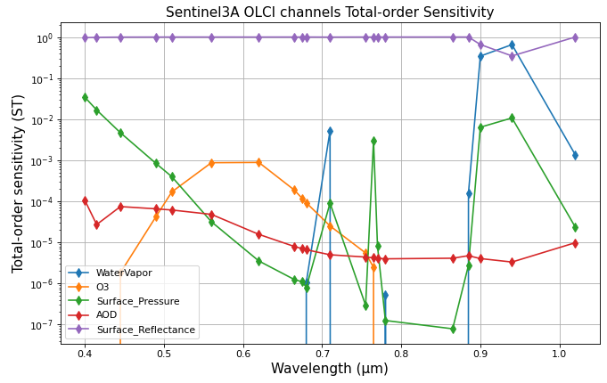
Key Factors Influencing Calibration Coefficient Accuracy
Under favorable desert conditions, most Radiative Transfer Models achieve high accuracy in TOA simulations.
The primary uncertainty contributors are:
  Surface modelling
  Atmospheric modelling
Sensitivity analysis indicates that:
  Surface reflectance dominates the model behavior (~99%) for non-absorption channels.
  Atmospheric parameters contribute negligibly (≈1% combined) under clear sky conditions.
Error propagation:
  A 1% perturbation in surface reflectance leads to an approximately proportional (~1%) change in model output (near-linear response under these conditions)
Implication:
  Improving BRDF characterisation is the most effective way to improve absolute calibration accuracy

