Slide 1
Assessment of GOES-19 ABI Solar Calibration Variations Using GSICS Methods
Fangfang Yu¹, Xiangqian Wu², Hui Xu¹, Bikash Basnet¹, and Haifeng Qian¹
1: ERT, Greenbelt, MD
2: NOAA/NESDIS/STAR, College Park, MD
Declaimer: The scientific results and conclusions, as well as any views or opinions expressed herein, are those of the authors and do not necessarily reflect those of NOAA or the Department of Commerce

Slide 2
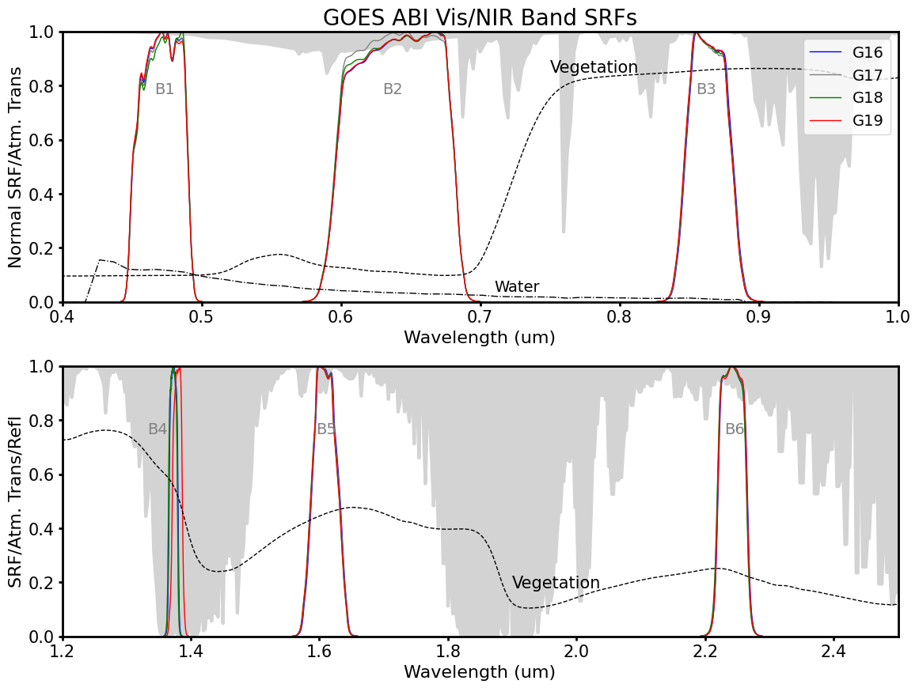
GOES-19 Advanced Baseline Imager (ABI)
ABI VNIR Spectral response functions (G16/17/18/19)
GOES-19 (G19) is NOAA’s fourth and final GOES-R series of geostationary weather satellites
  Launched: 25 June 2024
  Became GOES-East (75.2ºW) on 7 April 2025, replacing GOES-16
ABI radiometric calibration
  Solar diffuser (SD) for the six Visible and Near-Infrared (VNIR) bands
  Blackbody for the ten Infrared (IR) bands
Spectral attributes and spectral response functions (SRFs) are consistent with previous three ABI instruments
  Small SRF shift in G19 B04
Spectral attributes for ABI VNIR Bands (central Wavelength, detector materials and spatial resolution)
Band No. | Central Wavelength (µm) | Detectors | Pixel Spacing at Nadir (km)
B01 | 0.47 | Silicon | 1
B02 | 0.64 | Silicon | 0.5
B03 | 0.86 | Silicon | 1
B04 | 1.38 | HgCdTe | 2
B05 | 1.61 | HgCdTe | 1
B06 | 2.25 | HgCdTe | 2
Notes:
Similar radiometric calibration behavior is expected across the ABI instruments

Slide 3
GOES-19 Semiannual Yaw-flip Maneuvers
GOES-19 carries a new instrument, the Compact Coronagraph (CCOR-1)
To support the CCOR-1 operation, GOES-19 performs semi-annual yaw flips around the vernal and autumnal equinoxes.
  Inverted orientation: boreal summer
  Upright orientation: boreal winter
G19 Event | Date | Note
First Solar Calibration | 8/29/2024
B02 K-LUT Update | 01/13/2025
1st Yaw flip | 03/18/2025 | at 89.5ºW, before drifting to GOES-East position
Became operational GOES-East (75.2ºW) | 04/07/2025 | GOES-16 was nearby at 75.5W until its decommissioning on 04/07/2025
2nd Yaw-flip | 9/22/2025
3rd Yaw-flip | 3/19/2026

Slide 4
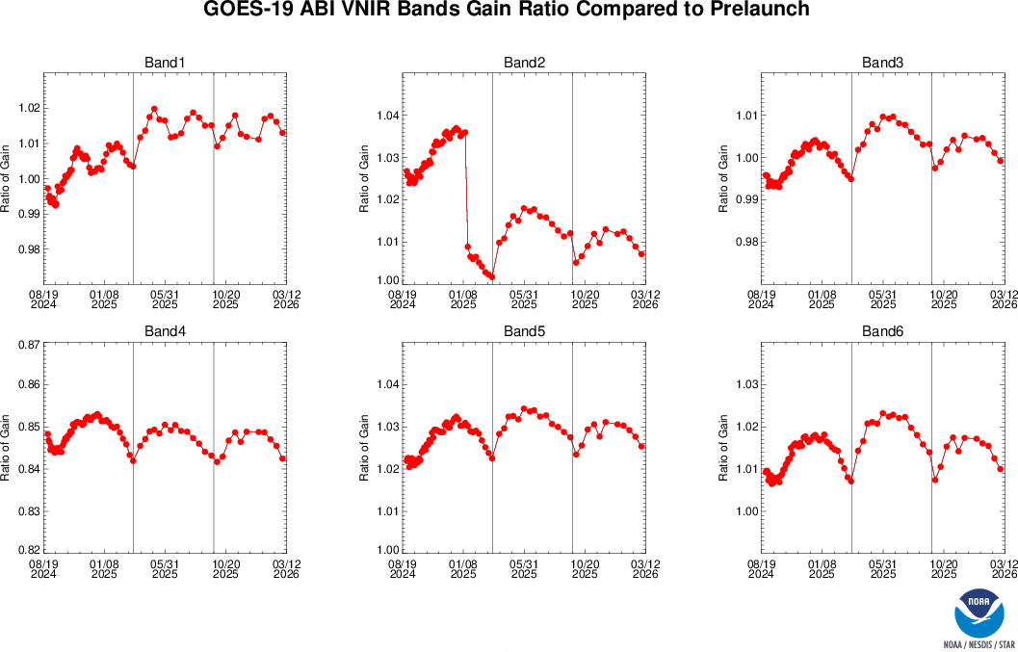

G19 ABI Solar Calibration Gain Variations
B02 gain change on 13 January 2025
  Sudden B02 gain drop due to solar calibration look-up-table (K-LUT) update
  Similar K-LUT adjustments were previously applied to B02 in the other ABIs
Unexpected gain behaviors in solar calibration
  Quasi-periodic gain variations over long-term trending across all six bands
  Variation amplitude depends on s/c orientation (upright vs inverted)
Variation magnitude is generally larger than observed for G16 and G18
  G19: 1-2%
  G16/G18: generally <1%
Upright Inverted Upright
Upright Inverted Upright
Upright Inverted Upright
K-LUT adjustment
yaw-flip
yaw-flip
yaw-flip
$$Ratio ofGain=\frac{On−orbit gain}{prelaunch gain}$$

Slide 5
GSICS Methods Used to Evaluate GOES-19 ABI Solar Calibration
Overall VNIR calibration accuracy
  GEO-LEO Ray-matching (ABI vs. VIIRS)
Impact of B02 K-LUT update
  GEO-LEO Ray-matching
Impact of gain change at yaw-flip
  G16 vs. G19 GEO-GEO inter-comparison
Impacts of seasonal calibration variations
  GSICS Lunar Spectral Irradiance Calibration System (LSICS/SLIMM)

Slide 6
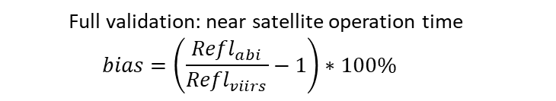
Overall Absolute Calibration Accuracy (ABI vs. VIIRS)
NOAA-20 VIIRS used as the primary reference, following GSICS VNIR subgroup recommendation
GOES-19 ABI VNIR accuracy is generally within 5%, except for B05
  Comparable to those on GOES-16/17/18.
  Note: G16 B02 values shown here are before the later K-LUT adjustment that reduced the bias
  Full validation: near satellite operation time
  $$bias=\left(\frac{{Refl}_{abi}}{{Refl}_{viirs}}−1\right)∗100\%$$

Slide 7
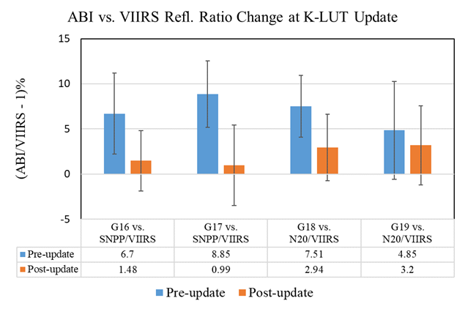
Validation of the B02 K-LUT Update
Band 2 (0.64 µm) is the highest-resolution ABI band (0.5 km) and is critical for many products, including vegetation, cloud, and aerosol retrievals.
After the launch of GOES-16, B02 radiances were found to be systematically high using multiple independent methods, including inter-calibration with VIIRS.
  G16 B02 was 7-9% brighter than SNPP/VIIRS
NOAA revised the solar diffuser BRDF correction Look-Up-Table (K-LUT) based on the pre-launch integrating sphere measurements for B02 all four ABI sensors
  G19 B02 update reduced radiance by ~1.65%
The update reduced B02 radiances and improved consistency with VIIRS reference measurements.

Slide 8
Unexpected Gain Behaviors
Assess the impact of gain variations on calibrated radiance before pursuing root-cause investigation
Do these gain variations affect calibrated radiances?
  Sudden large changes across yaw-flips
  Quasi-seasonal gain variations
Upright Inverted Upright
Upright Inverted Upright
Upright Inverted Upright
yaw-flip
yaw-flip
yaw-flip
Last solar calibration before 1st yaw flip: 03/17/2025
First solar calibration following yaw flip: 04/02/2025 at 23:00z

Slide 9
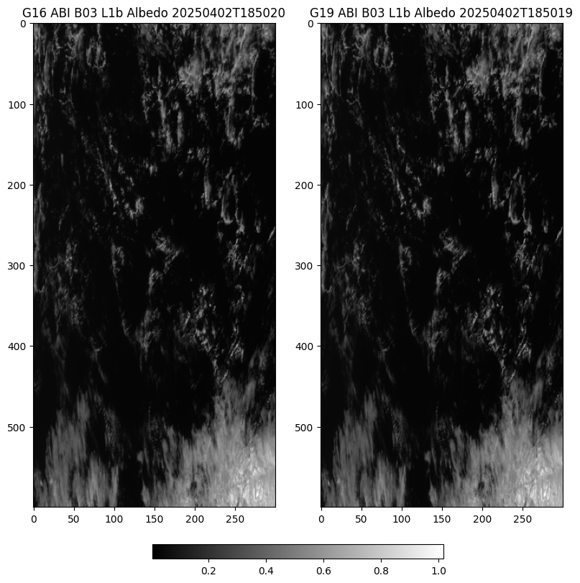
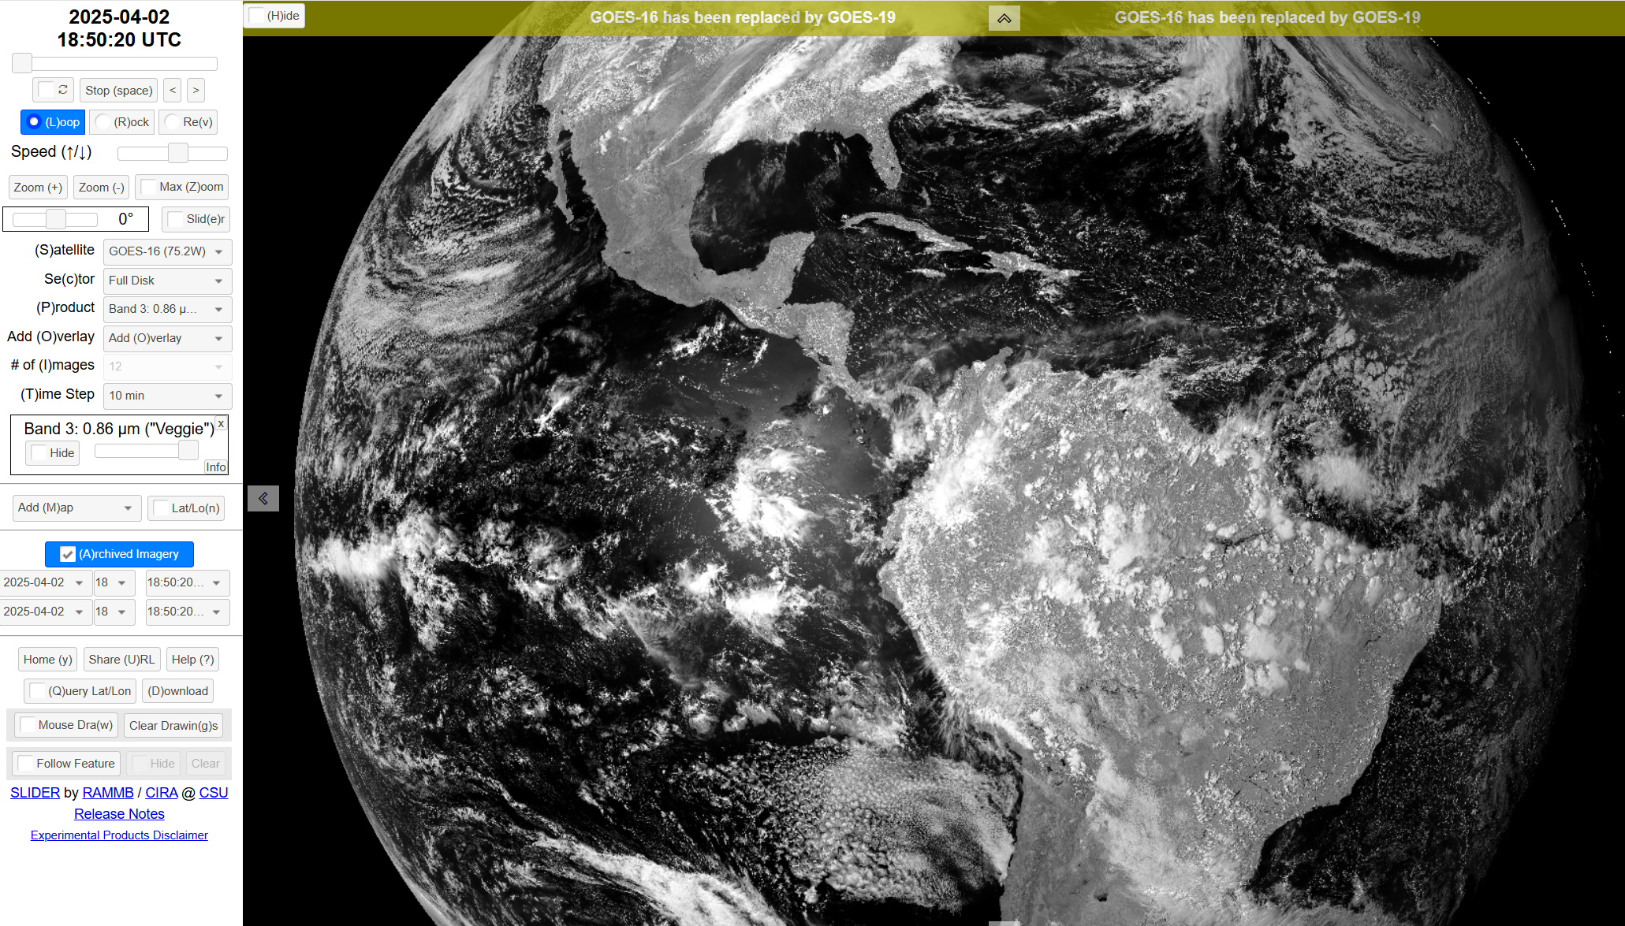
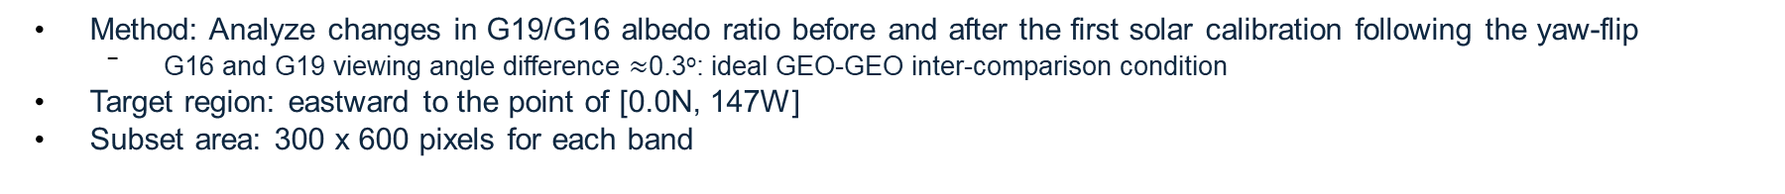
GEO-GEO: Impact of Yaw-flip on Radiances
Example ABI B03 images from G16 and G19 used for the GEO-GEO comparison
G16 and G19 Target Area/Size
Courtesy of SLIDER by RAMMB/CIRS@CSU
Method: Analyze changes in G19/G16 albedo ratio before and after the first solar calibration following the yaw-flip
  G16 and G19 viewing angle difference $≈$0.3º: ideal GEO-GEO inter-comparison condition
Target region: eastward to the point of [0.0N, 147W]
Subset area: 300 x 600 pixels for each band

Slide 10
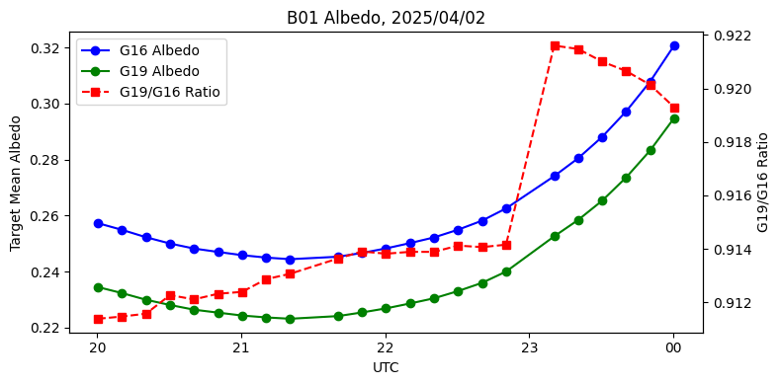
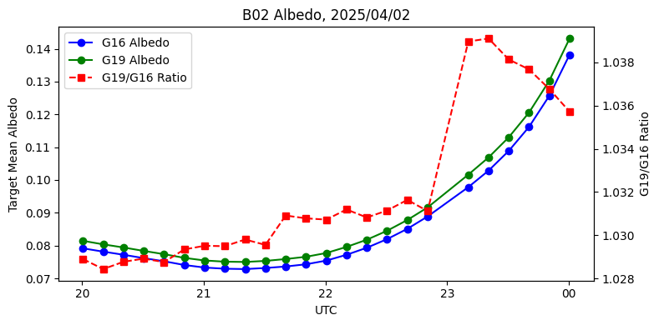
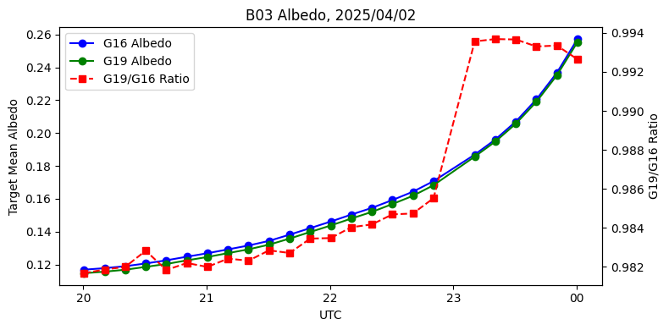
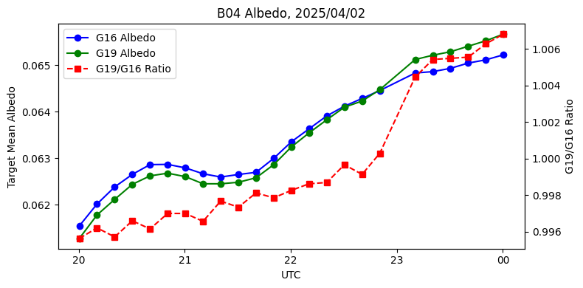
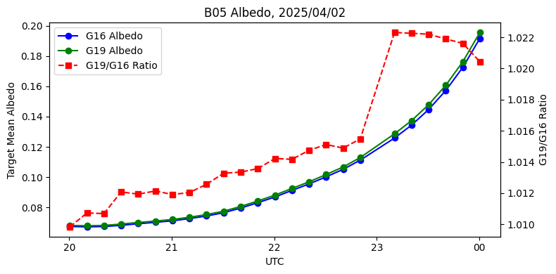
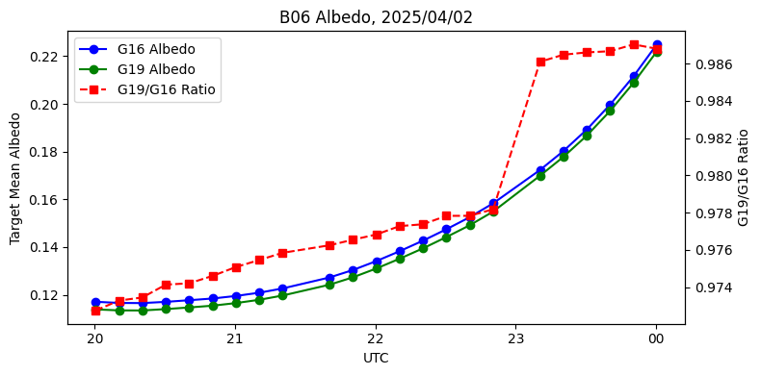
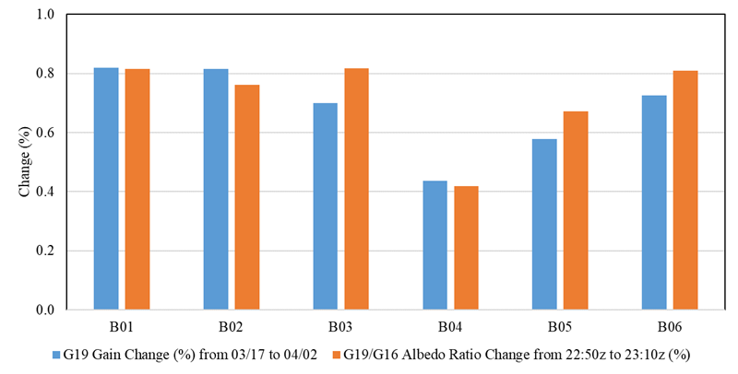
G19 vs. G16: Impact of Yaw-flip on Radiances
Time-series of G16 albedo, G19 albedo, and G19/G16 albedo ratio (referring to the second y-axis) on 04/02/2025.
Comparison between gain and radiance changes
Changes (%) | B01 | B02 | B03 | B04 | B05 | B06
Albedo ratio (G19/G16) from 22:50z to 23:10z on 04/02 | 0.81 | 0.76 | 0.82 | 0.42 | 0.67 | 0.81
G19 gain ratio change from 03/17 to 04/02 | 0.82 | 0.82 | 0.70 | 0.44 | 0.58 | 0.72
All VNIR bands show radiance changes consistent with their corresponding gain variations
The observed changes confirm that the gain variations propagate into calibrated radiance

Slide 11
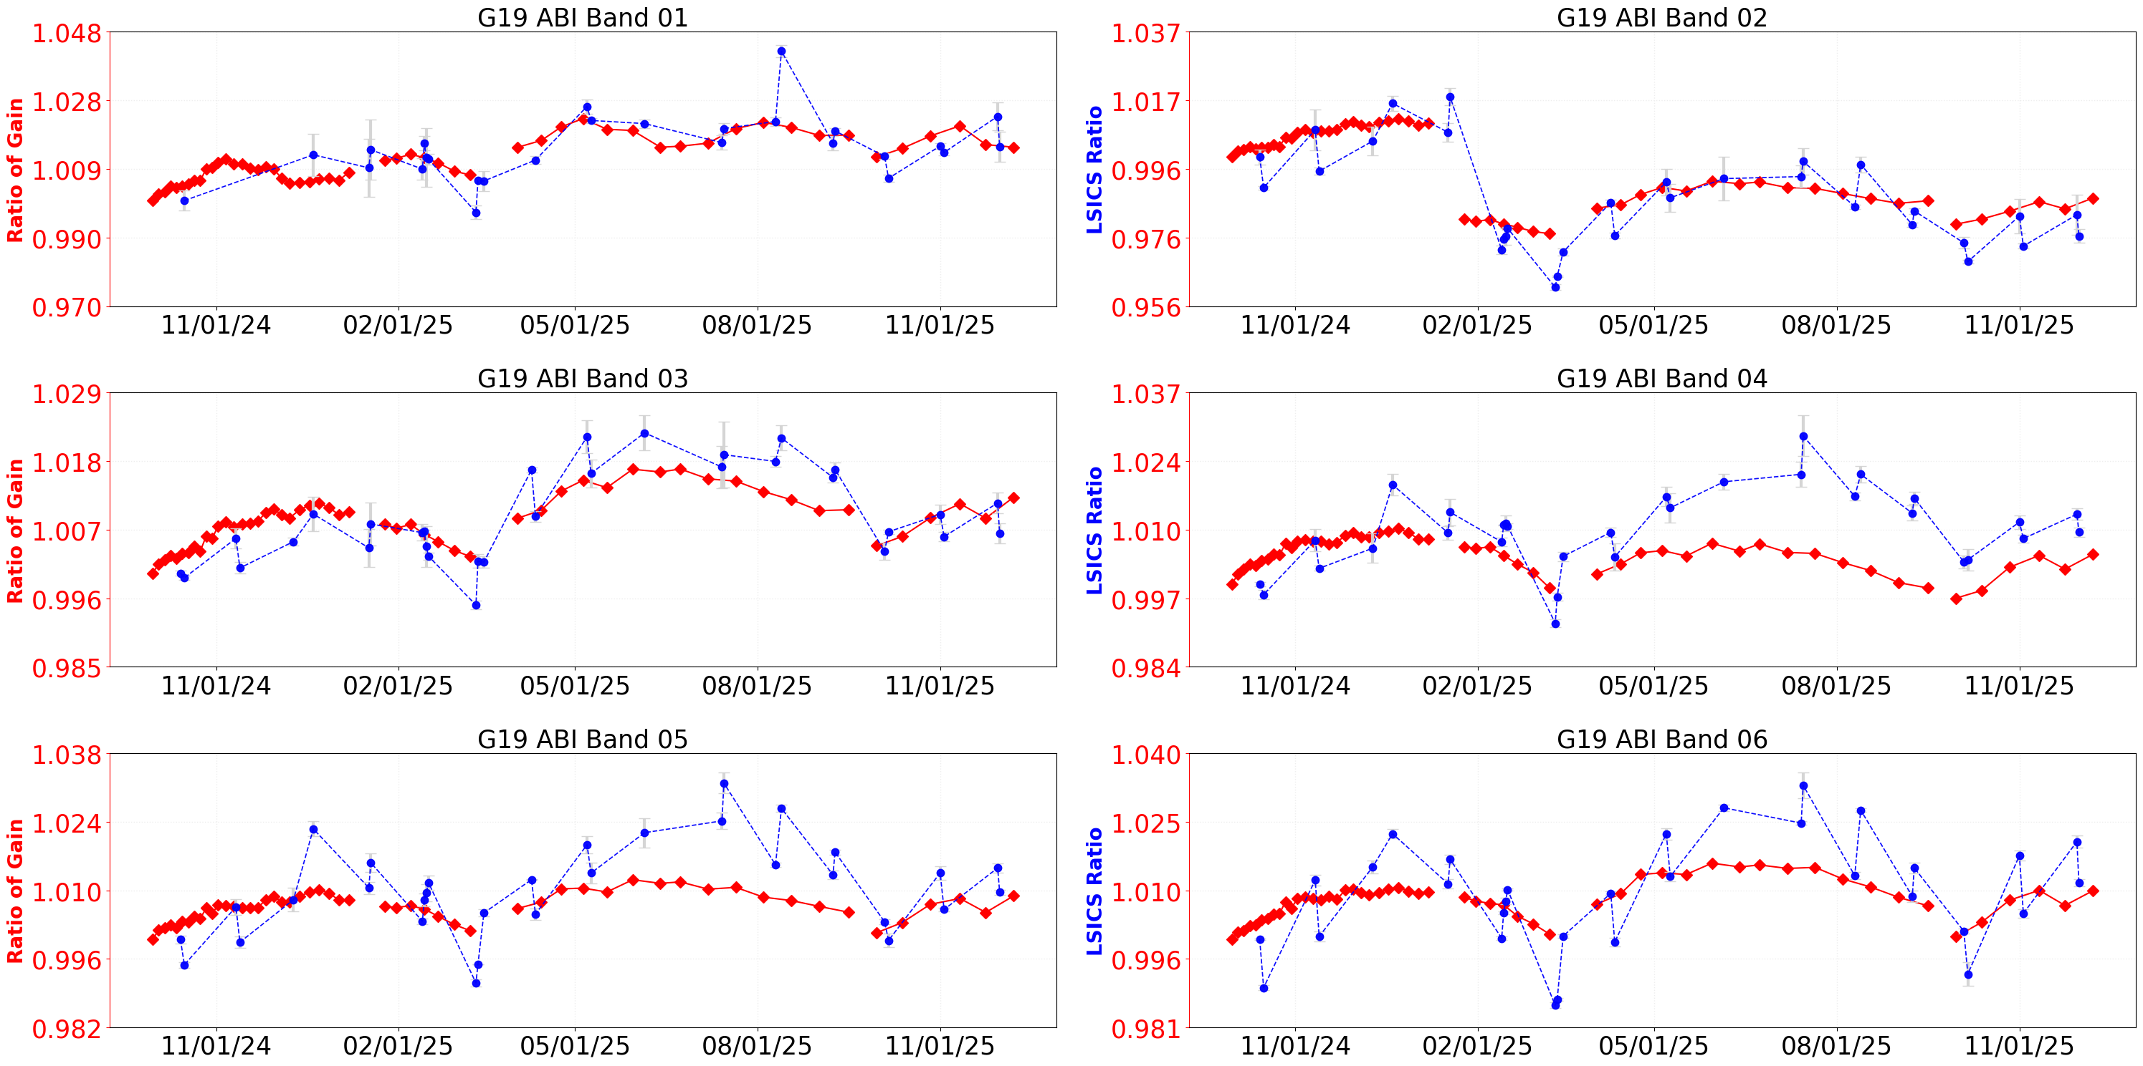


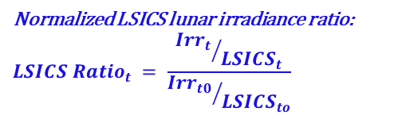
LSICS Lunar Cal: Impact of Seasonal Gain Variations on Radiances
$$Normalized solar calibration gain:$$
$${Ratio of Gain}_{t}=\frac{{Solar Cal. Gain}_{t}}{{ Solar Cal. Gain}_{2024−09−30}}$$
Normalized LSICS lunar irradiance ratio:
$${LSICS Ratio}_{t} = \frac{{{Irr}_{t}}/{{LSICS}_{t}}}{{{Irr}_{t0}}/{{LSICS}_{to}}}$$
$${Irr}_{t}:ABI meausred lunar irradiance at time t$$
$${LSICS}_{t}:LSICS simulated irradiance at time t$$
Strong correlation is observed between normalized gains and the LSICS/SLIMM lunar irradiance ratio across the six VNIR bands
  Slightly larger lunar irradiance ratios during the inverted s/c orientation,
  Impact of B02 K-LUT update was also evident.
Lunar calibration confirms that seasonal gain variations and yaw-flip transitions propagate into observed radiances

Slide 12
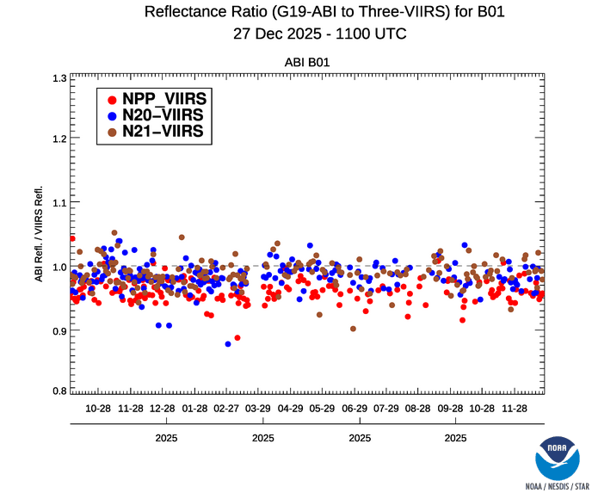
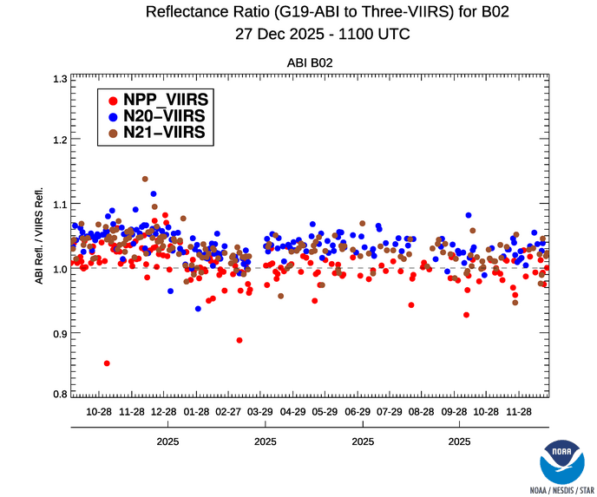
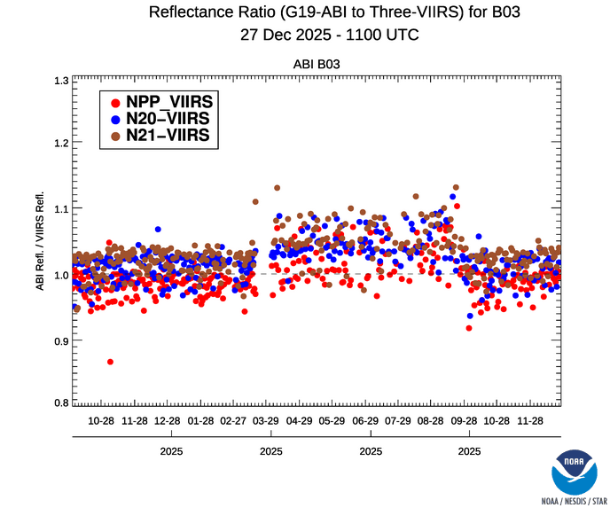
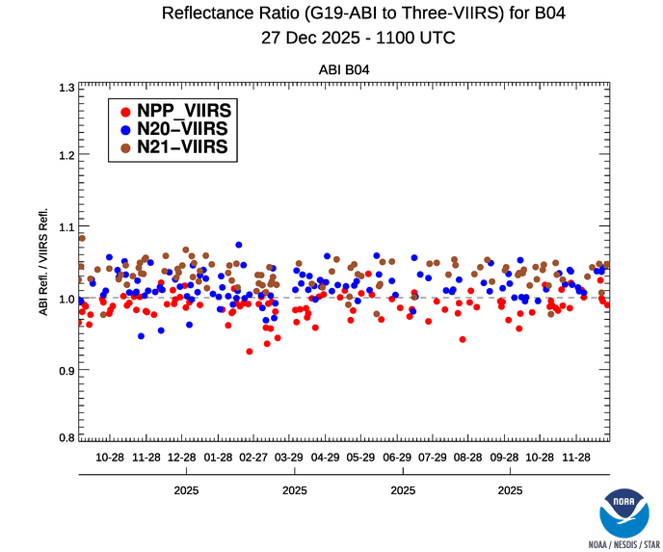
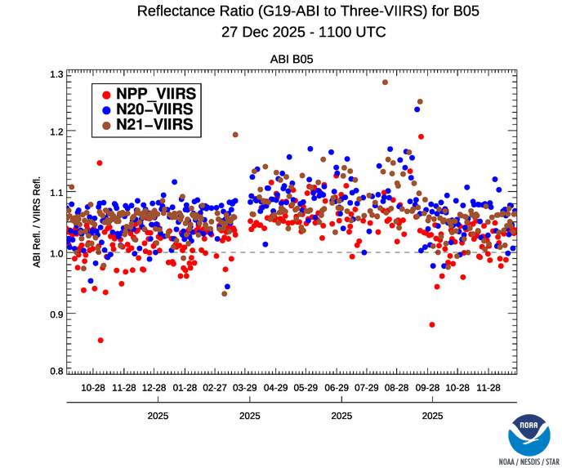
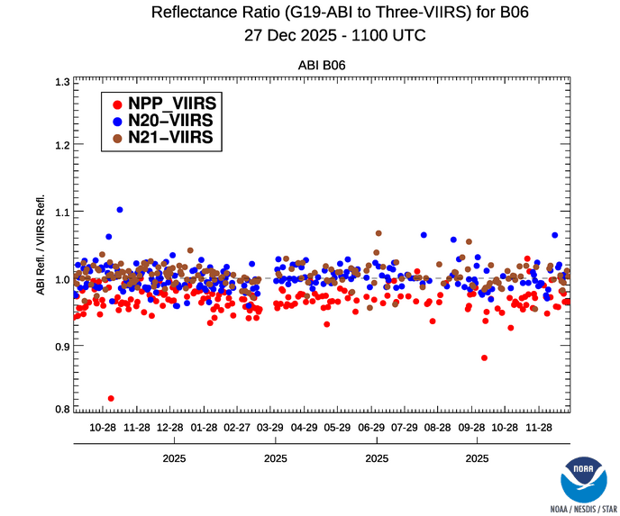
Time-series of G19 ABI vs. VIIRS Inter-Calibration
Yaw-flip
Increased scatter in the ABI vs. VIIRS reflectance ratio is observed for Bands 3 and 5 when the spacecraft enters the inverted configuration
  Mean and scattering of calibration bias are generally stable within the upright or inverted s/c position
The cause of this behavior is currently under investigation and is unlikely related to instrument radiometric performance.

Slide 13
Summary
GEO-LEO intercalibration with VIIRS shows that overall G19 VNIR calibration accuracy remains within 5% relative to NOAA-20 VIIRS, except for B05
  Comparable to previous ABI sensors
  G19 B05 is brighter by ~7%
The GEO-GEO and LSICS analyses indicate that the gain variations propagate into calibrated radiance
  Radiance changes generally consistent with or reflect the magnitude of the gain variations
Further investigation of the underlying causes of the gain variations and the increased GEO-LEO scatter during s/c inverted period is ongoing

Slide 14
Acknowledgement
We acknowledge NOAA OSPO for GOES ABI operational calibration support and GOES-R PRO for their efficient coordination and support.

