Slide 1
ABI Solar Diffuser Reflectance Error and Mitigation
Xiangqian Wuª, Haifeng Qian^{b}, Fangfang Yu^{b}, Jon Fulbright^{c}, and Dan Goldberg^{d}
ª: NOAA/NESDIS/STAR ^{b}: ERT ^{c}: KBR, Inc ^{d}: NOAA/NESDIS/OSPO
Declaimer: The scientific results and conclusions, as well as any views or opinions expressed herein, are those of the authors and do not necessarily reflect those of NOAA or the Department of Commerce.

Slide 2
Introduction
Calibration is the process of quantifying instrument response to known signals*.
Advanced Baseline Imager (ABI), together with the Advanced Himawari Imager (AHI) and the Advanced Meteorological Imager (AMI), are the first instruments on a geostationary platform with onboard calibration for their solar channels.
Periodically, a Solar Diffuser (SD) reflects sunlight to the ABI for calibration.
This is the “known signal” if we also know the SD reflectance.
*: From CEOS WGCV, with modifications

Slide 3
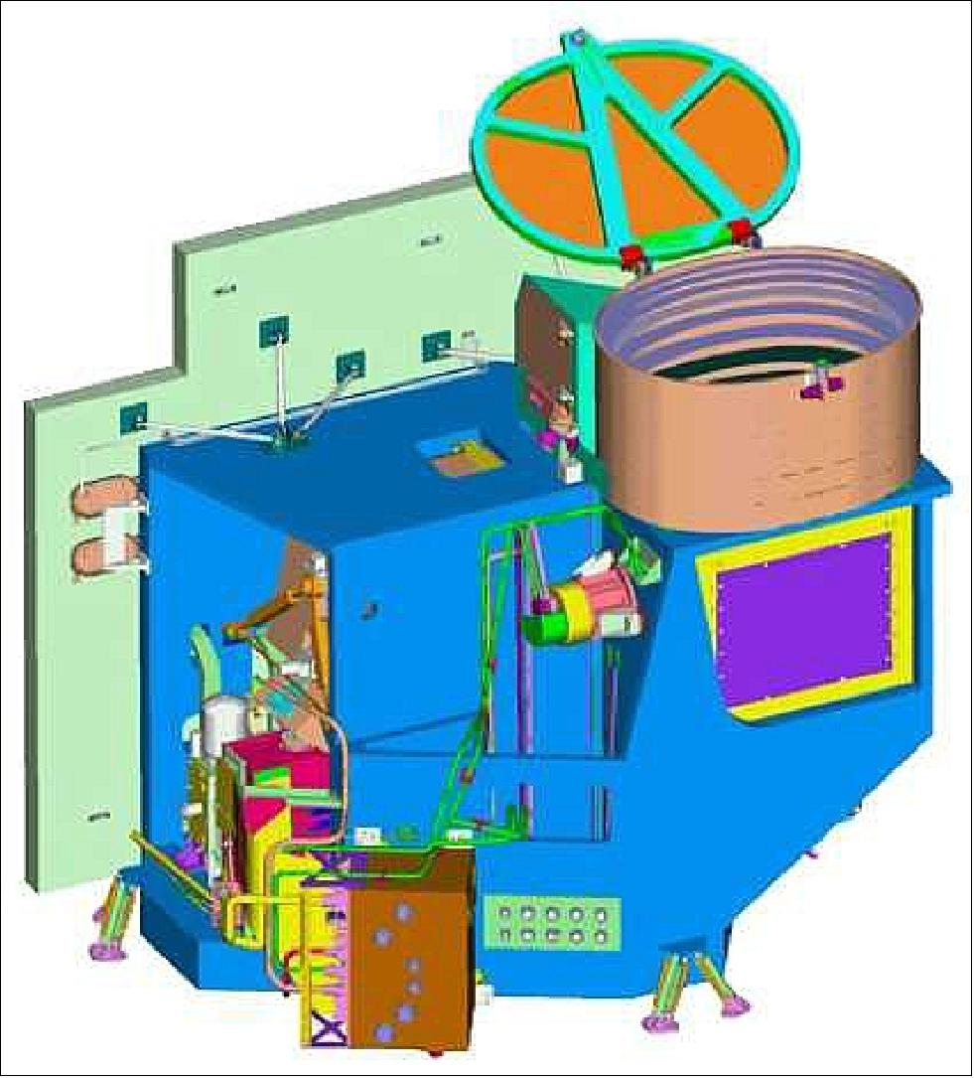
Plan
On geostationary platform, sunlight comes from a wide range of Angle Of Incident (AOI).
SD reflectance for each of these AOIs were characterized pre-launch to facilitate onboard calibration.
Unfortunately, the results were less than satisfactory.
  Pre-launch characterization?
  Alignment?
  And/Or?
GOES-R Data Book

Slide 4
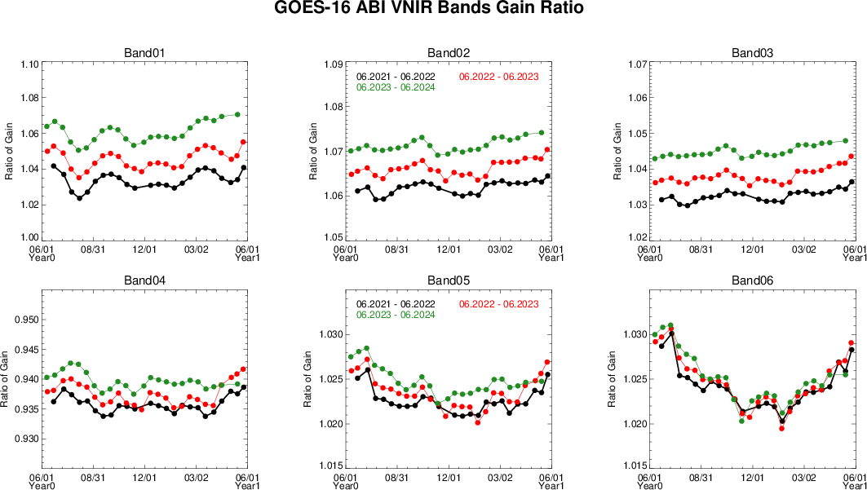
Problem
Seasonal variation of gain, due to SD reflectance, can be larger than degradation

Slide 5
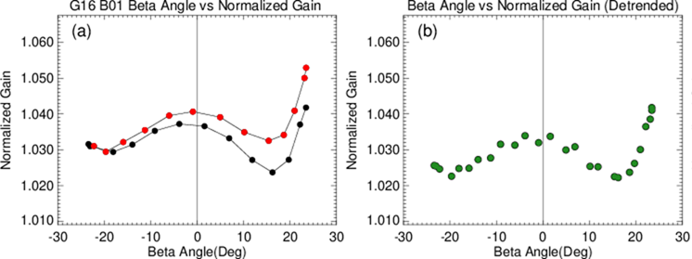
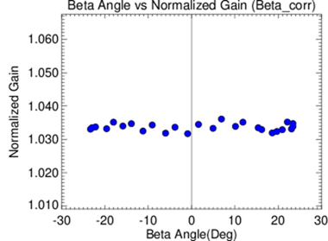
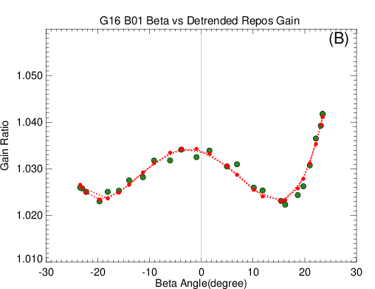
Mitigation – Channel 1
Normalized gain, summer solstice to winter solstice and back to summer solstice.
Corrected for instrument degradation.
Fitted to a 4th order polynomial.
Residual after the beta angle correction.
(d)
(c)
Presented at the 2023 Annual Meeting

Slide 6
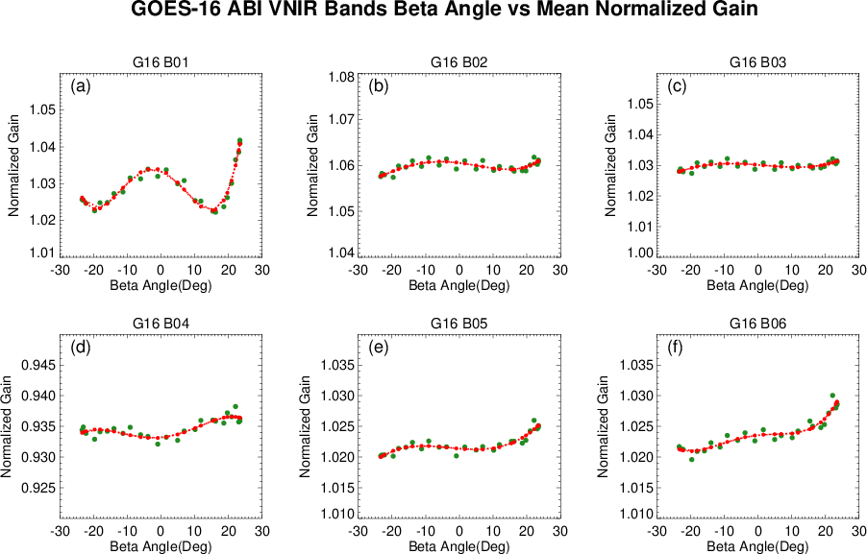
Mitigation – All Channels
Presented at the 2023 Annual Meeting

Slide 7
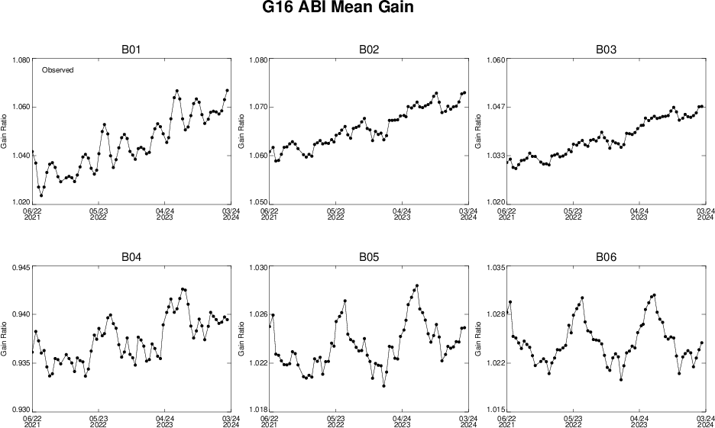
Implementation – Observed Gains
Input Data

Slide 8
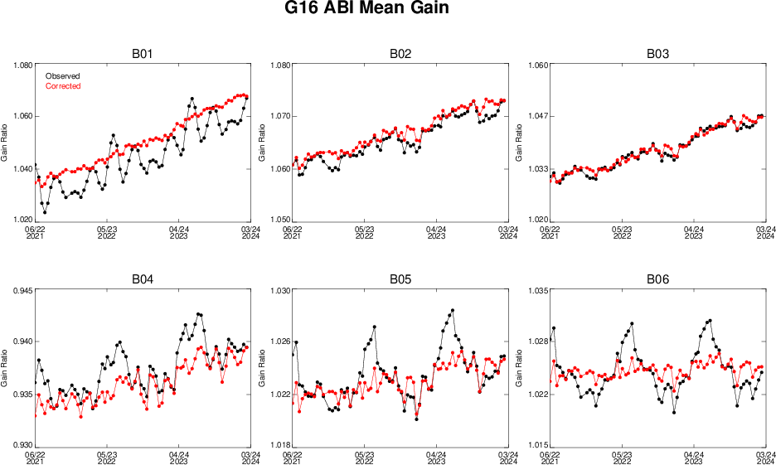
Implementation – Corrected Gains
Corrected for Systematic Errors

Slide 9
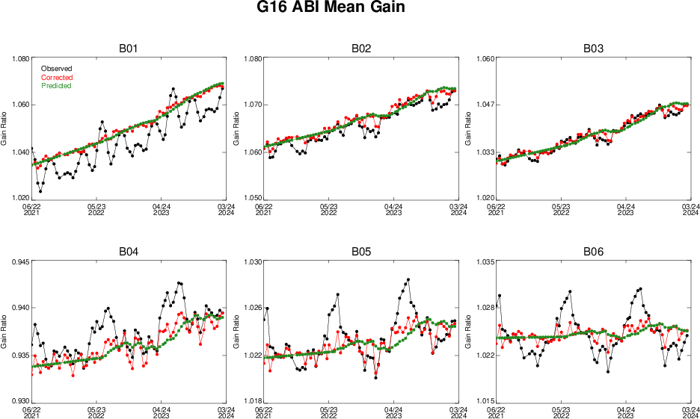
Implementation – Smoothed Gains
Smoothed for Random Errors

Slide 10
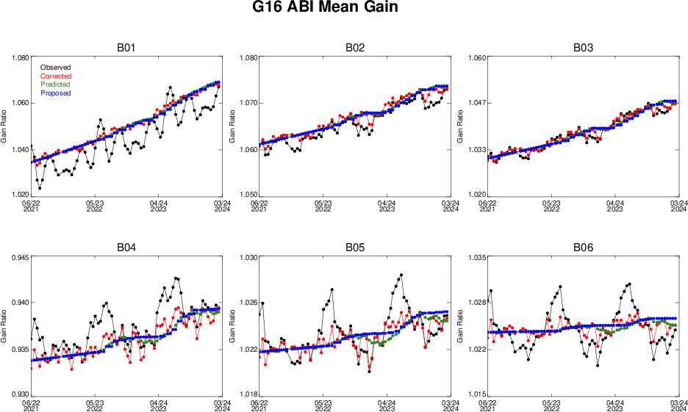
Implementation – Operational Gains
Selected for Operation

Slide 11
Concept of Operation (CONOPS)
Bi-Weekly Calibration
Automatically Generated Gains
Bi-Weekly Solar Gain Update
Switch ON
Switch OFF
CWG
Generated Gains
As Needed
Solar Gain Update
Insertion
Was: Must and only use the automatically generated gains. Default.
Is: Use the optimized gain as needed, which requires:
  Capability to insert externally generated gains – developed for GOES-17 ABI.
  Switch to choose CONOPS – implemented.

Slide 12
Operation
E1
E5
SCT Event
Provide Approved Gains
Legend
CWG
E2
E6
Send Data
DE GovStore
Test Gains on ITE/DE
OSPO MOD
DOST
E3
E7
CWG Ingest and Processing
E4-1
Validate Gains
PRO
Write OCCR
Program Science
E4
E8
Key Users
Update Gain Decision
Update Gain Decision
E9
E10
Publish?
False
Publish to DF
Update CEL
X

Slide 13
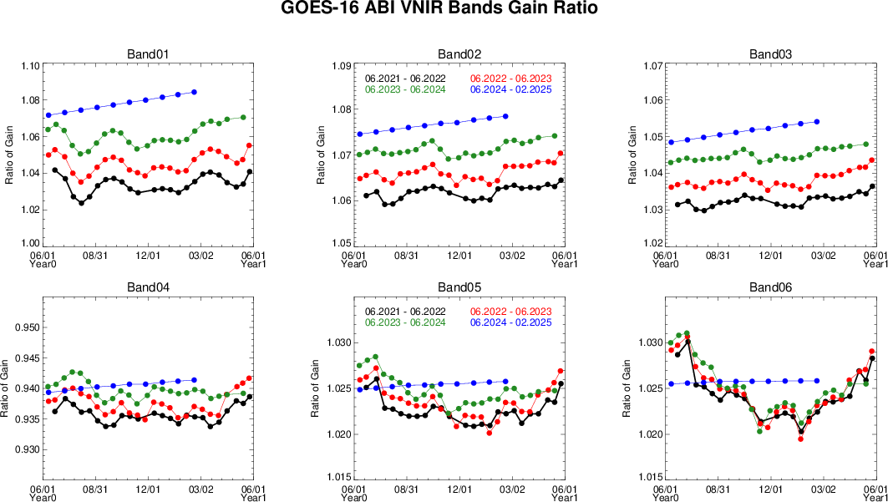
Validation

Slide 14
Summary
Onboard calibration for ABI solar channels was unsatisfactory.
The unrealistic seasonal variation of the gains could be caused by error in solar diffuser (SD) reflectance, alignment, or else.
An empirical correction for the SD reflectance was developed for all solar channels.
The correction was implemented with additional consideration of ABI operation.
The new CONOPS was implemented for GOES-16 in April 2024, and is being implemented for GOES-18.

