Slide 1
Radiometric Calibration Performance of the VNIR Channels of EUMETSAT Optical Missions.
Ali Mousivand¹, Seb Wagner¹, Vincent Debaecker², Romain Degoul², Mounir Lekouara¹
¹EUMETSAT
²Telespazio France
GSICS Annual Meeting, March 23-27 2026, Ottawa

Slide 2
Agenda
GEO missions
MTG-I1 FCI
MSG2-4 SEVIRI
LEO missions
Sentinel-3A&B OLCI
Sentinel-3A&B SLSTR
EPS MetopB&C AVHRR
Conclusions

Slide 3
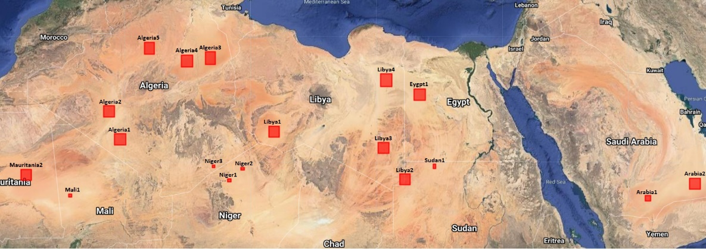
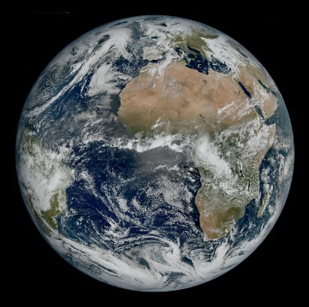


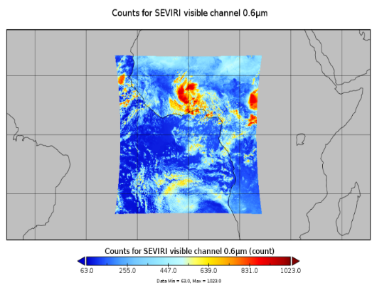
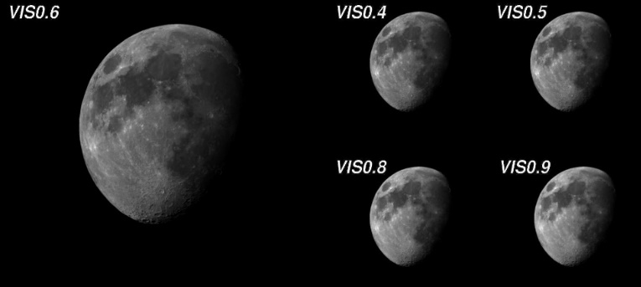
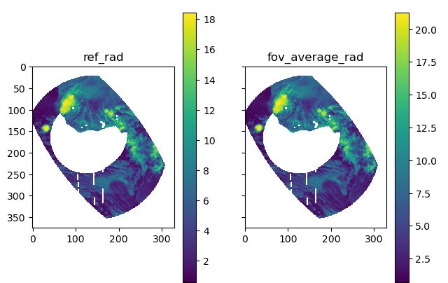
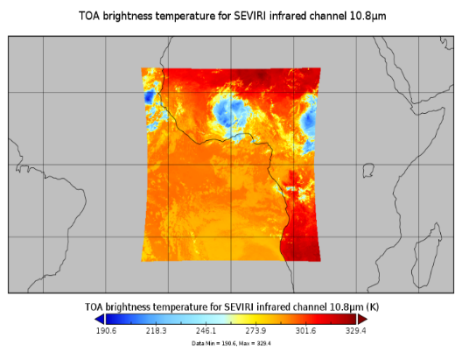
MICMCIS VIS-NIR channels Calibration Monitoring
MICMICS employs multiple Calibration and Intercalibration modules to monitor and validate the absolute calibration and stability of the reflective solar channels over time, including:
  Desert vicarious calibration;
  Desert intercalibration;
  Lunar calibration;
  DCC intercalibration;
  Ray-Matching intercalibration;
  GEO-GEO intercalibration.
There is no single method that satisfies all Level 1 requirements.
The applicability of individual calibration and intercalibration module varies between channels.
SEVIRI VIS0.6 FCI VIS0.6
MICMICS Calibration and intercalibration workflows for reflective solar channels radiometric performance

Slide 4
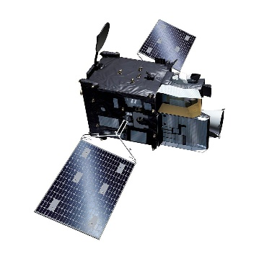
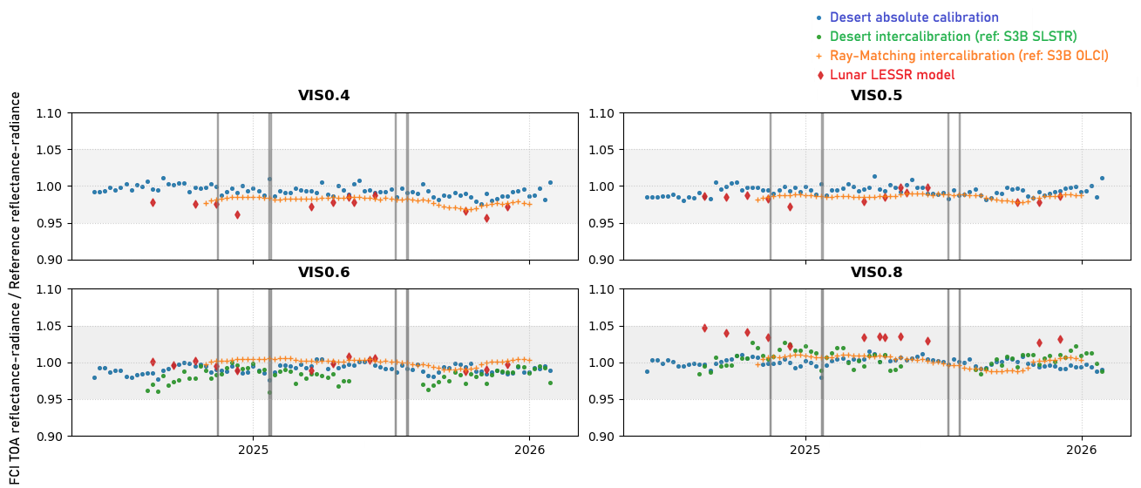
FCI VIS-NIR channels Calibration Monitoring
The VIS0.4, VIS0.5, VIS0.6, and VIS0.8 channels remain stable, showing minimal to no degradation and meeting user requirements for absolute calibration accuracy (5% for VIS channels), typical observed biases below 2%;
Consistent performance is observed across multiple MICMICS modules.
The horizontal grey box indicates the absolute radiometric requirement, while vertical lines mark decontamination or similar events.

Slide 5
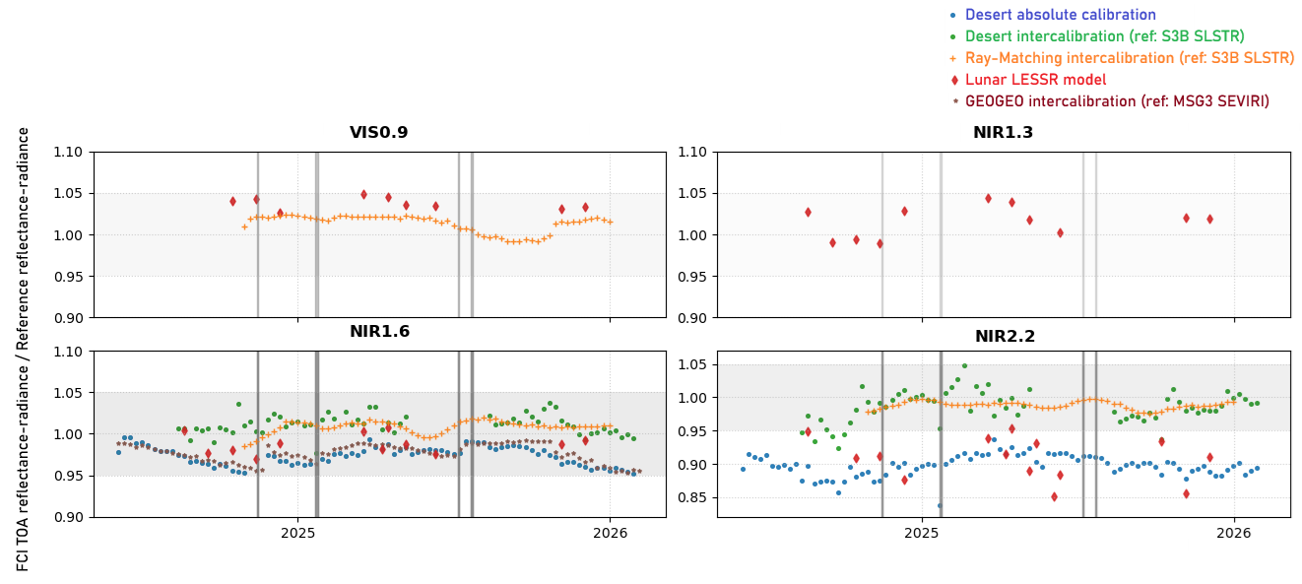
FCI VIS-NIR channels Calibration Monitoring
VIS0.9: Appears relatively stable, and further analyses are being performed to assess its calibration performance;
NIR1.3: Due to strong absorption, this channel can only be monitored using a limited set of modules. Lunar calibration suggests that the channel meets requirements, though with a bias that requires further investigation;
NIR Lunar results will be revisited after developing an accurate Earth stray light correction for Lunar acquisitions.
The horizontal grey box indicates the absolute radiometric requirement, while vertical lines mark decontamination or similar events.

Slide 6
FCI VIS-NIR channels Calibration Monitoring
NIR1.6: Vicarious calibration and intercalibration indicate that there is an issue with the channel, which appears to be influenced by decontamination events. Ongoing investigations aim to characterise the issue and determine appropriate corrective actions;
NIR2.2: The channel shows stable performance and is not impacted by decontamination, but differences between calibration approaches suggest a potential bias that needs to be quantified and further investigated.
The horizontal grey box indicates the absolute radiometric requirement, while vertical lines mark decontamination or similar events.

Slide 7
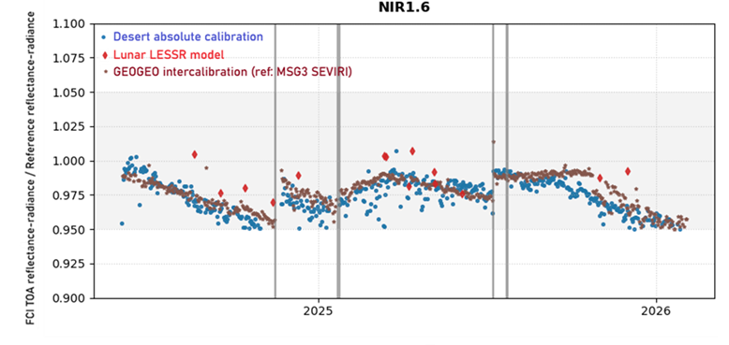
Stability behaviour of the NIR 1.6 µm channel
Investigations on instrument side
As part of the root cause analysis the cryostat design was reviewed, and sources of unexpected outgassing were tried to identify e.g. paints, adhesives, seals, and O‑rings;
Also, additional samples were subjected to dedicated testing campaigns. However, to date, no root cause has been identified that could explain the observed stability characteristics of the NIR1.6 channel;
The most recent decontamination campaign may provide additional insight into the detailed behaviour and recovery characteristics associated with decontamination events.

Slide 8
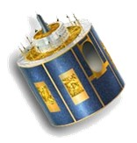
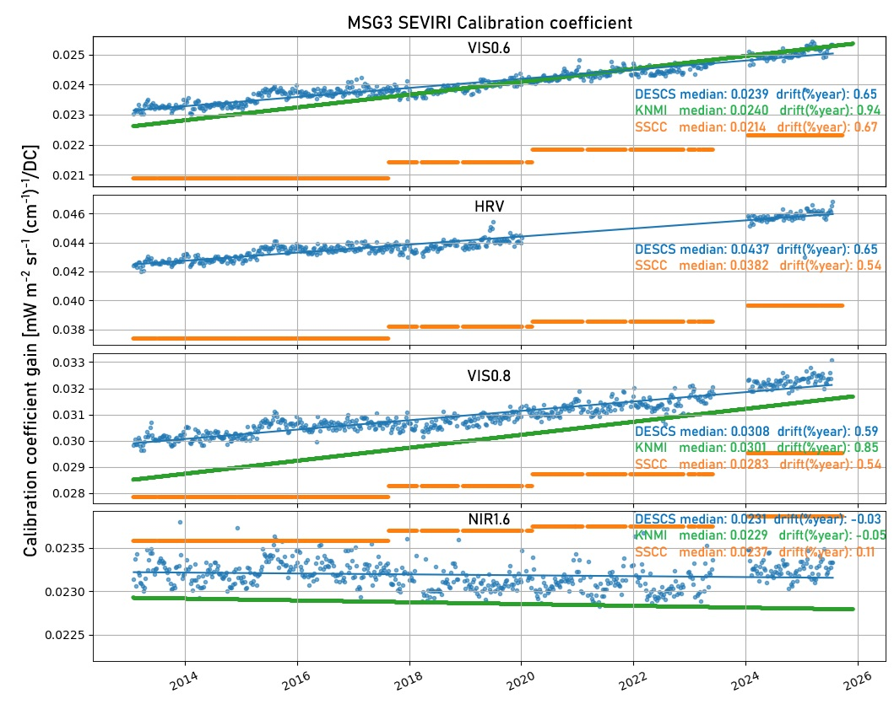
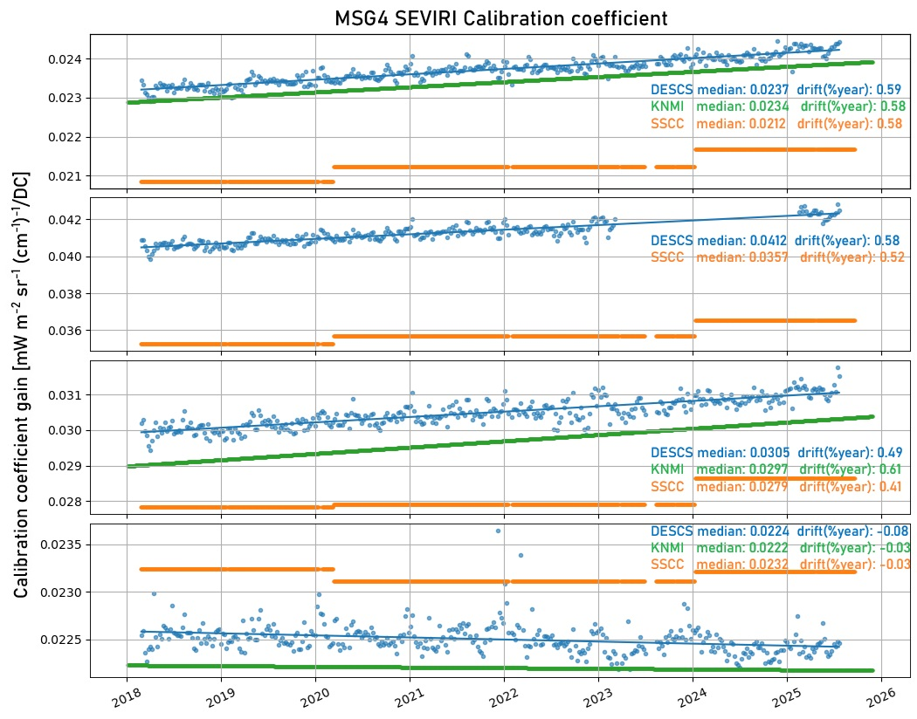
MSG2, MSG3 and MSG4 SEVIRI
SEVIRI channels across all MSG satellites exhibit behaviour consistent with past observations.
Calibration updates:
  Recent SEVIRI calibration updates have been implemented.
  These updates are expected to introduce observable discontinuities (“jumps”) in the data (see table). https://user.eumetsat.int/news-events/news/seviri-calibration-changes
 | Meteosat-9 | Meteosat-10 | Meteosat-11
VIS0.6 | 10% | 12% | 12%
VIS0.8 | 7% | 9% | 8%
HRV | 14% | 16% | 14%
NIR1.6 | -4% | -3% | -3%

Slide 9
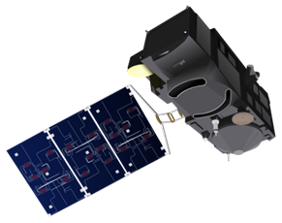
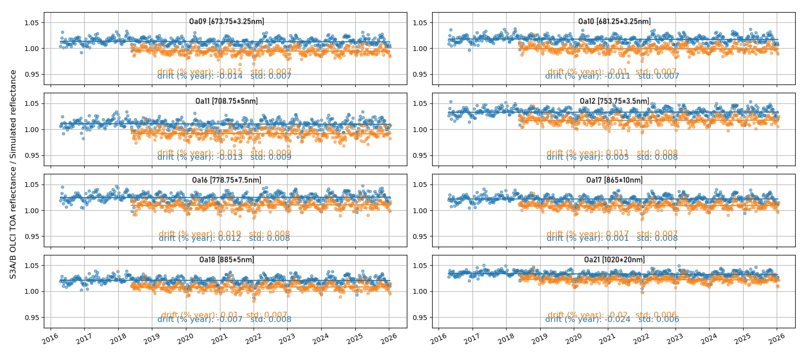
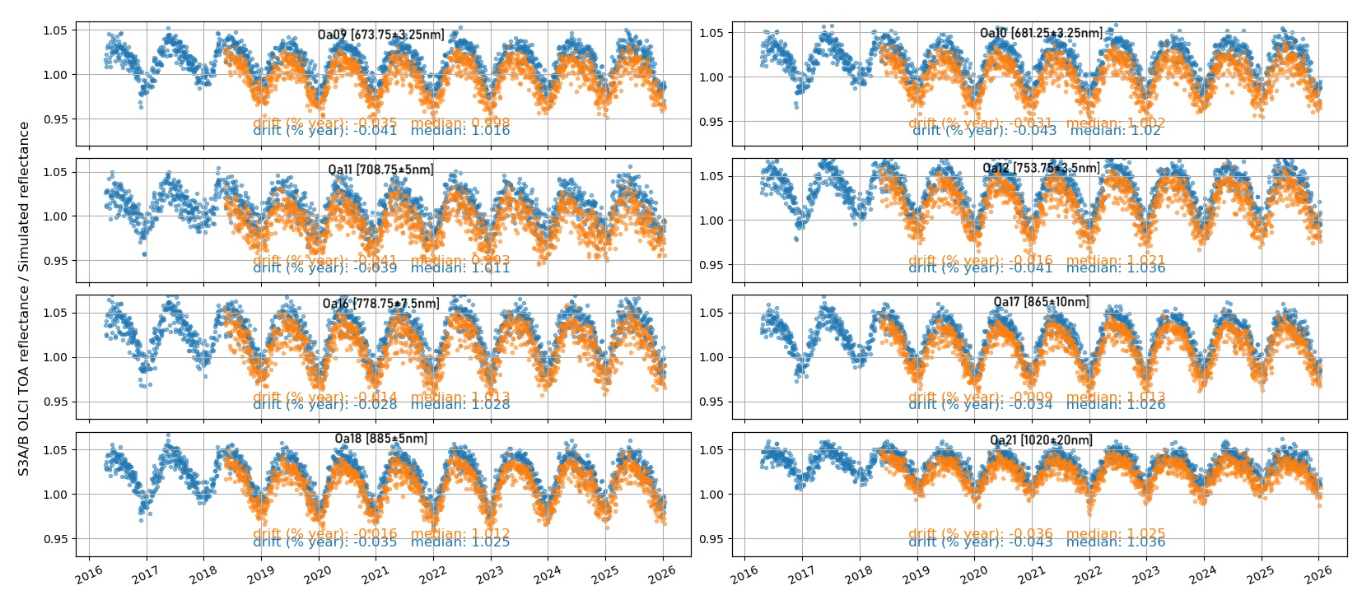
Sentinel-3A & B OLCI
Strong, channel-dependent seasonality is observed over PICS.
Very good long-term stability, with marginal to no observable drift.

Slide 10
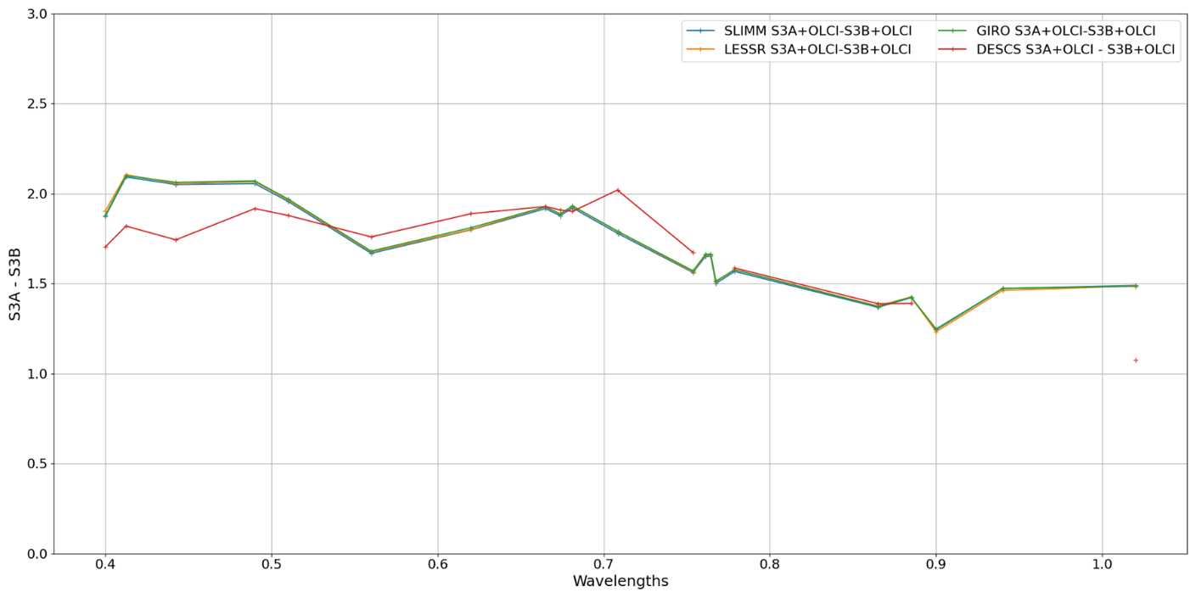
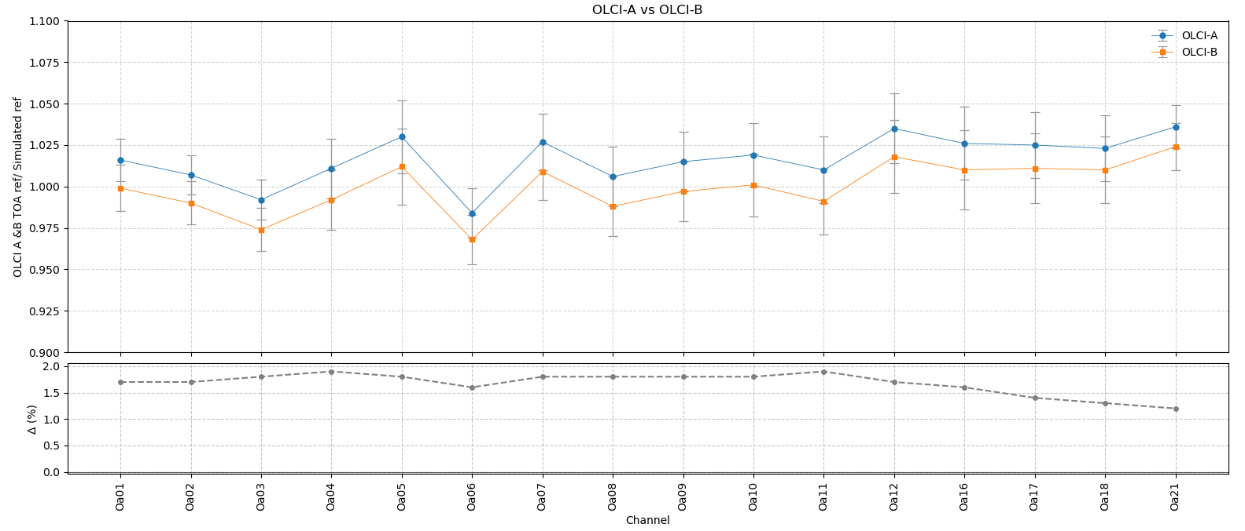
OLCI A vs OLCI B
The known bias between Sentinel-3A OLCI and Sentinel-3B OLCI is confirmed.
Results are consistent across multiple calibration and inter-calibration methods.
Absolute calibration reveals relatively large biases in some channels, partially attributed to surface BRDF modelling, however, the inherent uncertainty of all vicarious calibration methods (about ±2–3%) must be acknowledged when interpreting these results.

Slide 11
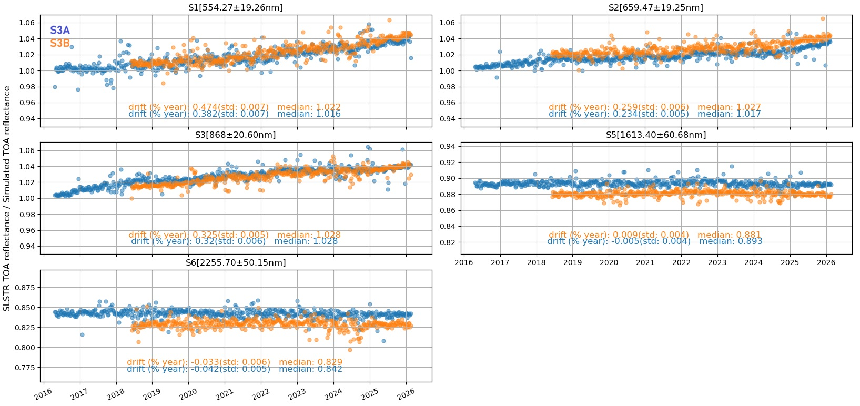
Sentinel-3 VIS-SWIR channels (Nadir View)
The plots represent the MICMICS desert calibration time series for the SLSTR nadir view after statistically removing seasonality, with statistics computed over the full time series

Slide 12
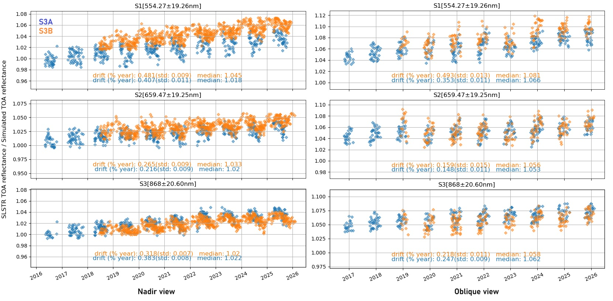
VIS channels stability-Desert Intercalibration (ref: S3B OLCI)
The plots show the MICMICS desert intercalibration time series (reference: S3B OLCI) for the SLSTR nadir and oblique views, with statistics computed over the full time series

Slide 13
VIS-SWIR channels conclusion
Drift observed in VIS-SWIR channels are consistent with previously derived. The VIS-SWIR corrections agreed end of 2025 to be deployed.
Drift estimates are similar for Nadir and Oblique views, but absolute calibration differs by up to a few percent.
SLSTR on Sentinel-3A and Sentinel-3B agree well, with differences around 1%.
Overall good consistency between MICMICS desert calibration and desert intercalibration results.
Preliminary Lunar and Ray-matching analyses (not shown) confirm these findings.
 | View | S1 | S2 | S3 | S5 | S6
S3A-SLSTR | Nadir | 0.39 | 0.22 | 0.35 | -0.01 | -0.04
S3A-SLSTR | Oblique | 0.35 | 0.18 | 0.30 | -0.01 | -0.06
S3B-SLSTR | Nadir | 0.48 | 0.26 | 0.32 | 0.01 | -0.03
S3B-SLSTR | Oblique | 0.46 | 0.20 | 0.29 | -0.02 | -0.06
 | View | S1 | S2 | S3 | S5 | S6
S3A-SLSTR | Nadir | 1.02 | 1.02 | 1.03 | 0.89 | 0.84
S3A-SLSTR | Oblique | 1.05 | 1.05 | 1.05 | 0.94 | 0.88
S3B-SLSTR | Nadir | 1.03 | 1.03 | 1.03 | 0.88 | 0.83
S3B-SLSTR | Oblique | 1.06 | 1.06 | 1.05 | 0.93 | 0.87
These statistics were computed over the full time series up to February 2026.

Slide 14
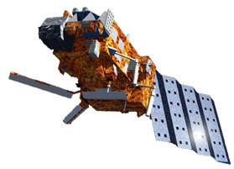
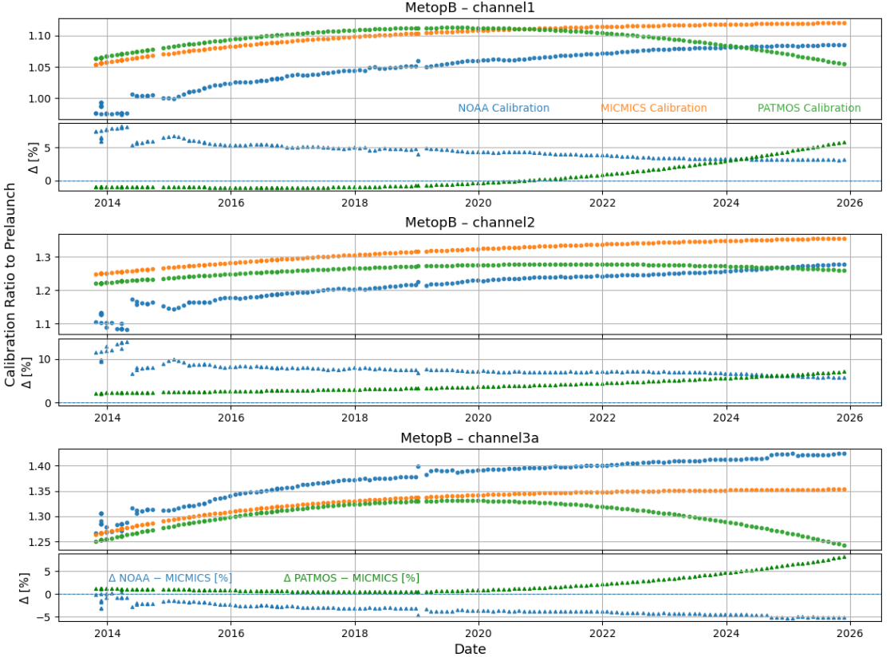
MetopB AVHRR solar reflectance channels
MICMICS-derived coefficients will replace AVHRR VNIR channels calibration on MetopB and MetopC, planned for April 23.
The update will enhance the calibration coefficients using MICMICS validated calibration and inter-calibration modules, with a channel-specific adjustment (“jump”) of a few percent expected
The ratio of current gains to pre-launch gains is compared among MICMICS, NOAA, and PATMOS-x (NOAA Climate Data Record, CDR) for MetopB
NOAA calibration results show noticeable channel-dependent differences relative to MICMICS:
  Channel 1: approximately −3%
  Channel 2: approximately −6%
  Channel 3A: approximately +4%
PATMOS-x calibrations show close agreement with MICMICS up to 2023 (the last year included in the latest release), but diverge thereafter due to the use of a quadratic fit to model the degradation

Slide 15
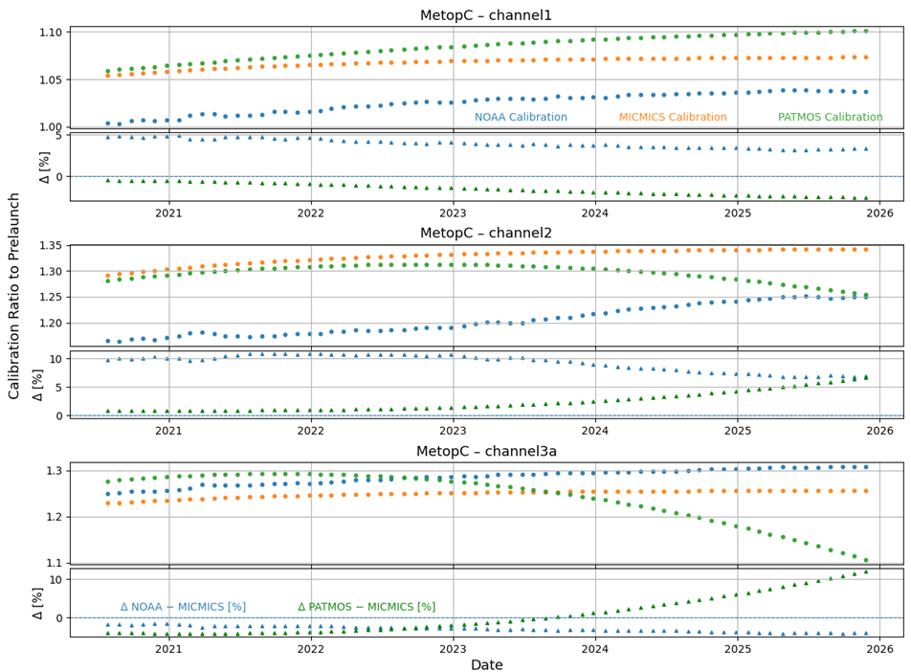
MetopC AVHRR solar reflectance channels
The ratio of current gains to pre-launch gains is compared among MICMICS, NOAA, and PATMOS-x for MetopC
NOAA calibration results show noticeable channel-dependent differences relative to MICMICS:
  Channel 1: approximately −3%
  Channel 2: approximately −7%
  Channel 3A: approximately +3.5%
PATMOS-x calibrations show close agreement with MICMICS up to 2023 (the last year included in the latest release), but diverge thereafter due to the use of a quadratic fit to model the degradation

Slide 16
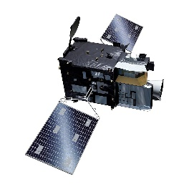
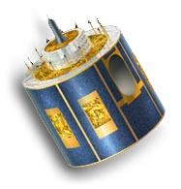
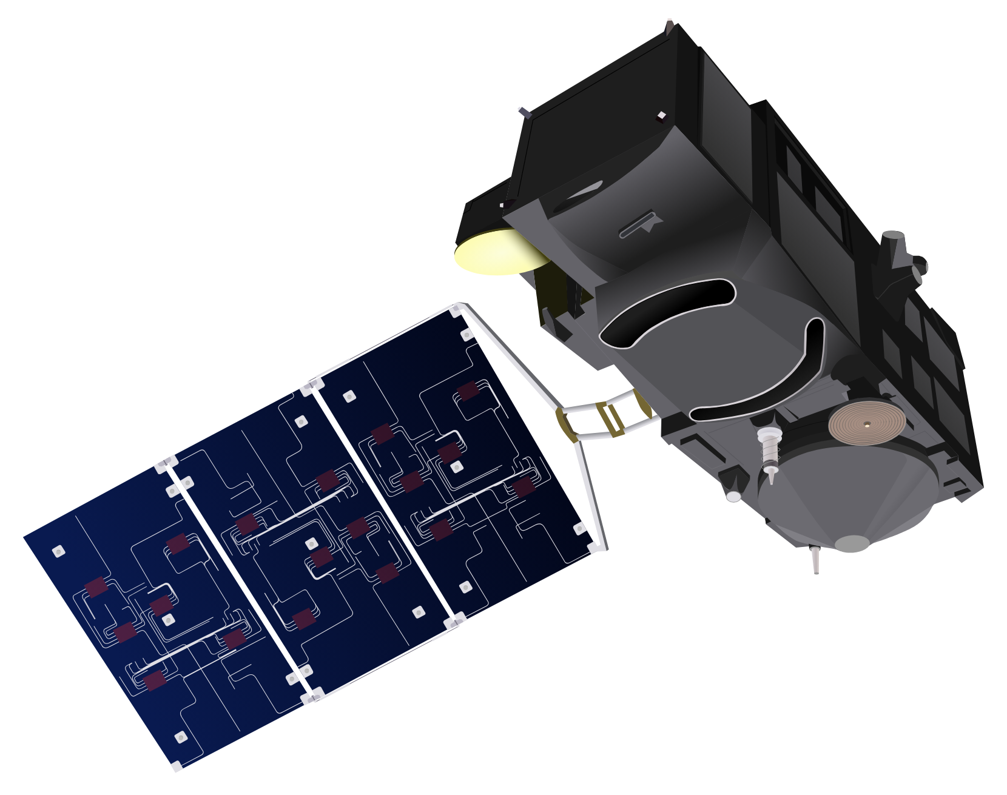

Conclusions
MTG-I1 FCI
VIS0.4–VIS0.8 channels remain stable with negligible degradation. VIS0.9 and NIR1.3 also appear stable.
NIR2.2 is relatively stable; however, potential biases are currently under investigation.
The behaviour of NIR1.6 indicates a channel anomaly, with the root cause still under investigation.
All channels except NIR2.2 currently meet radiometric requirements; NIR2.2 requires further analysis.
MSG-2/3/4 SEVIRI
Recent calibration updates (March 2026) have been implemented.
These updates are expected to introduce observable discontinuities (“jumps”) in the data.
Sentinel-3
OLCI:
  Channels demonstrate strong long-term stability, with little to no observable drift.
  Cameras show good temporal stability and strong inter-band consistency.
  The known bias between OLCI-A and OLCI-B is confirmed.
SLSTR:
  Observed drift in VIS–SWIR channels is consistent with previously derived estimates (similar for both nadir and oblique views).
  VIS–SWIR corrections, agreed upon at the end of 2025, are ready for deployment.
  Measurements from Sentinel-3A and Sentinel-3B show good agreement, with differences of around 1%.
Metop-B & Metop-C AVHRR
MICMICS-derived coefficients will replace the VNIR calibration for AVHRR channels on Metop-B and Metop-C.
Deployment is planned for April 23.
A channel-specific adjustment (“jump”) of a few percent is expected.

Slide 17
Thank you!
Questions are welcome.

