Slide 1
DCC inflection point statistic and SWIR band empirical BRDFs
David Doelling, Conor Haney, Prathana Khakurel, Rajendra Bhatt, Arun Gopalan
The GSICS Annual and Executive Panel meeting, VIS/NIR session
National Research Council Canada, Ottawa, Canada, 23-27 March 2026
Doelling et al. 2025, Regional Characterization of Deep Convective Clouds for Enhanced Imager Stability Monitoring and Methodology Validation. Remote Sens. 2025, 17, 3258. https://doi.org/10.3390/rs17183258

Slide 2

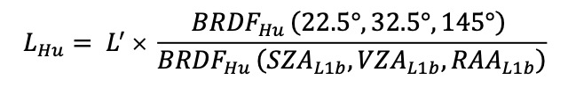
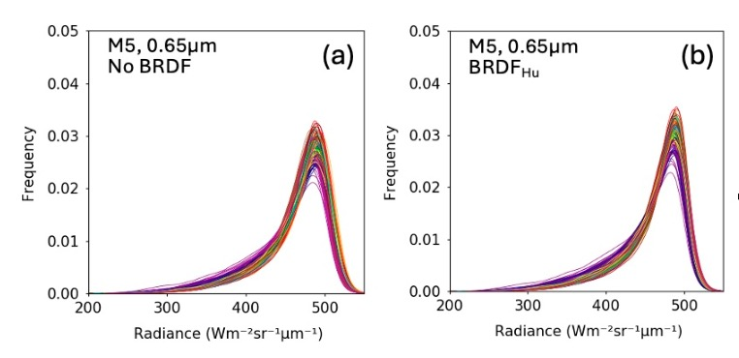
The VIS/NIR band DCC calibration stability approach
The DCC methodology relies on identifying DCC pixels based on the following criteria:
  BT_{11µm} < 205 K
  Hom_{0.65µm} < 0.03
  Hom_{11µm} < 1.0 K
  where Hom = spatial homogeneity of 3x3 pixels
Apply the Hu BRDF model
Aggregate the pixel radiances into a monthly PDF
Plot the monthly PDF modes to track the stability
NPP-VIIRS C2 monthly PDFs, color coded by month

Slide 3
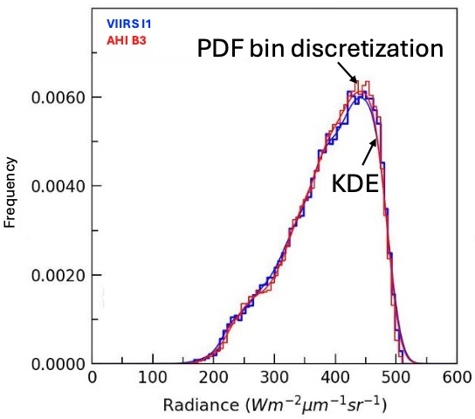
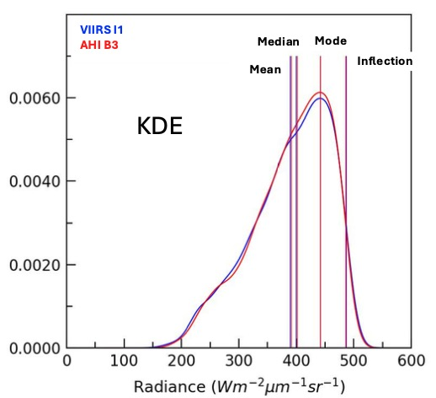
Kernel Density Estimation (KDE)
Right Inflection Point
• To overcome the histrogram discretization impact, Use a Kernel Density Estimation (KDE) function
• The KDE uses a dampening factor or smoothing bandwidth parameter dependent on the sampling frequency and assumed distribution.
• Use the Gaussian function from the SciPy Python module (SciPy 1.6.1, Python 3.7.0)
• Bandwidth parameter is based on Scott’s Rule
• Lamquin et al., 2020 paper used the KDE and right inflection point to overcome sparse sampling
• The PDF inflection point is where the radiance
curvature changes sign, i.e., where the 2nd order derivative sign changes.

Slide 4
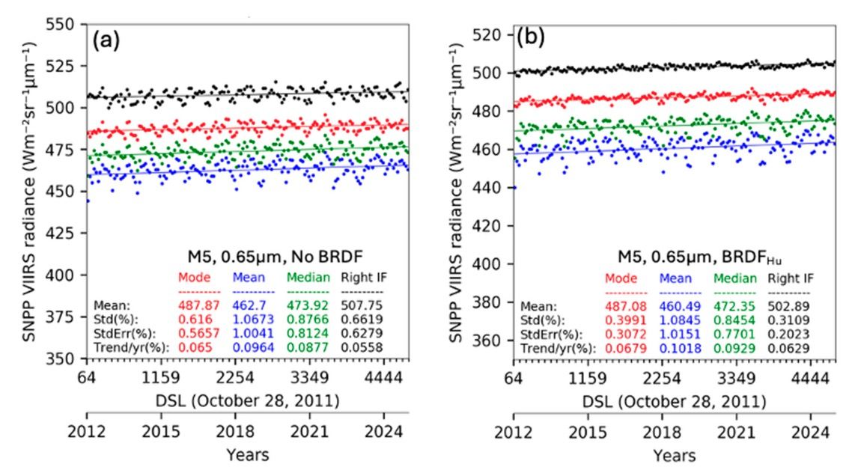
Comparison of PDF statistics applying Hu BRDF
No BRDF
Hu BRDF
KDE applied to both cases
• The PDF_{mode} and PDF_{RightInflection} provides the greatest reduction of the trend standard error using the Hu BRDF
• The Hu BRDF is best suited for the brightest DCC

Slide 5
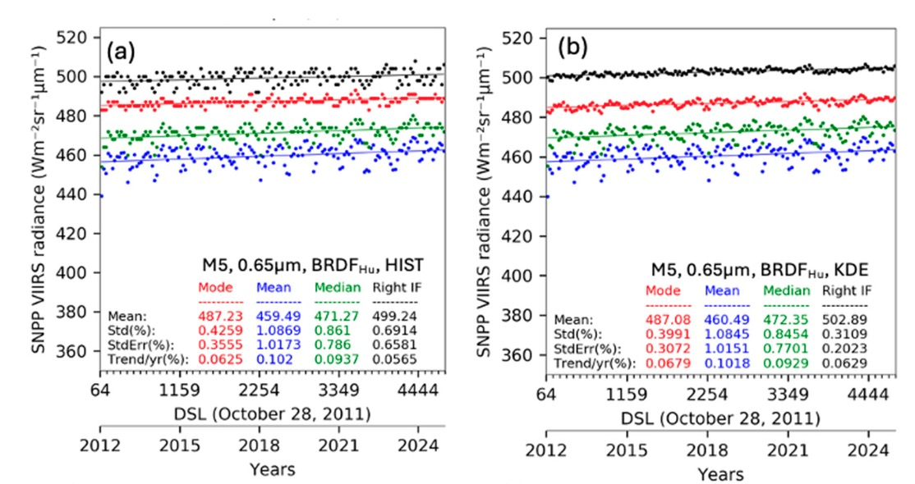
Comparison of PDF statistics using KDE
Without KDE
Hu BRDF applied to both cases
With KDE
Greatest reduction of the standard error by applying the KDE is for the PDF_{RightInflection}
Obviously, no change for the PDF_{mean} and PDF_{median}

Slide 6
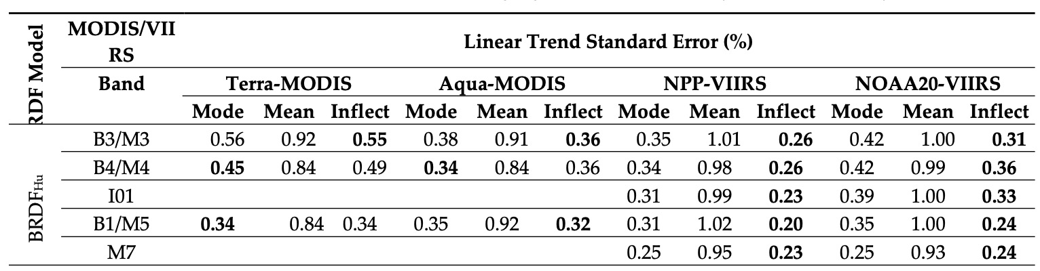
MODIS and VIIRS stability VIS/NIR comparison
MODIS based on C6.1, C7 is much better
Monthly tropical domain
• Using the PDF_{RightInflection} point reduces the trend standard error by an additional 30% from the PDF_{mode}
• For NPP-VIIRS well calibrated imager an VIS/NIR band trend uncertainty <0.3% can be achieved
• The improved methodology could only be validated by using a well-calibrated imager

Slide 7
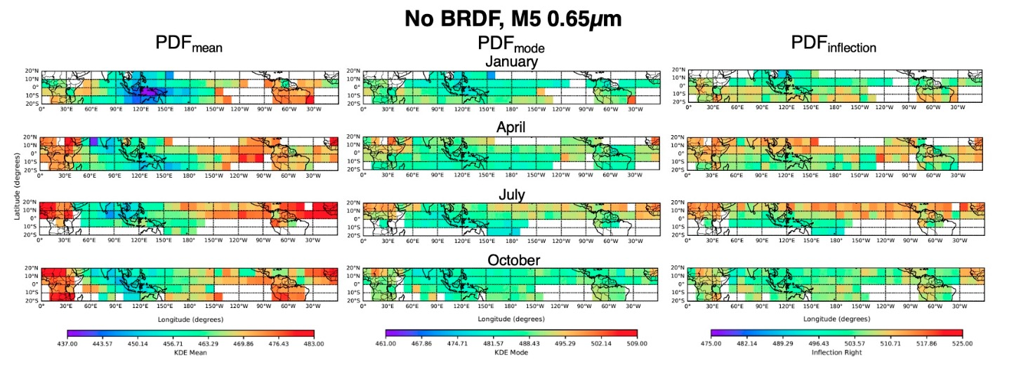
10° Regional comparison of PDF statistics, no BRDF
• The 2012 to 2024 NPP-VIIRS DCC-IT M5 0.65 µm mean radiance using utilizing 3-month sampling
• The colorbar in each case represent a 10% range
Note the PDF_{mode} is the best statistic

Slide 8
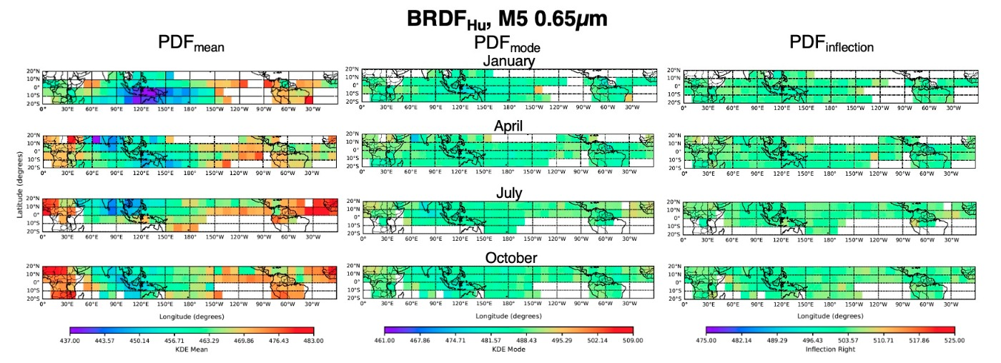
10° Regional comparison of PDF statistics, with Hu BRDF
• Note the PDF_{mode} and PDF_{RightInflection} provides the most uniform regional mean radiance
• The Hu BRDF improves the regional consistency for all PDF statistics

Slide 9

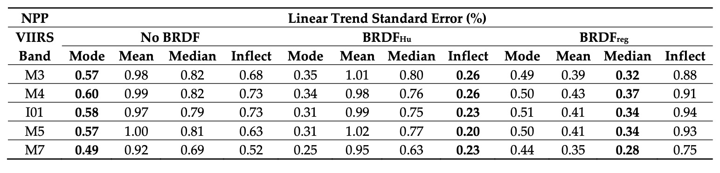
Regional BRDF comparison with Hu BRDF
• The impact of using the Hu BRDF model is minimal for the PDF_{mean} and PDF_{median} statistics
• Empirical BRDF models are best used to reduce the noise for the PDF_{mean} and do not benefit from PDF statistics
• The 10° regional empirical BRDF model reduces the PDF_{mean} and PDF_{median} by 60%

Slide 10
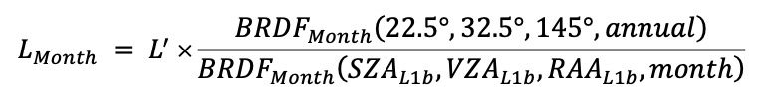
The SWIR band DCC calibration stability approach
The DCC methodology relies on identifying DCC pixels based on the following criteria:
  BT_{11µm} < 205 K
  Hom_{0.65µm} < 0.03
  Hom_{11µm} < 1.0 K
  where Hom = spatial homogeneity of 3x3 pixels
Apply the band specific empirical BRDF
  Using the most stable part of the record, or fromanalogous imagers in the same local time orbit
Aggregate the pixel radiances into a monthly mean or median
Plot the monthly mean or median to track the stability
Use the first 5-year or most stable part of the imager record to develop the empirical BRDF

Slide 11
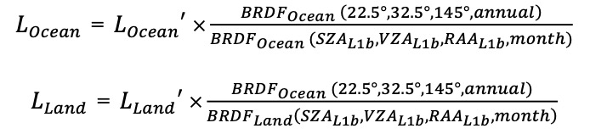

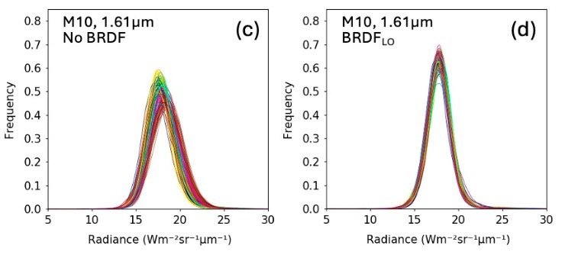
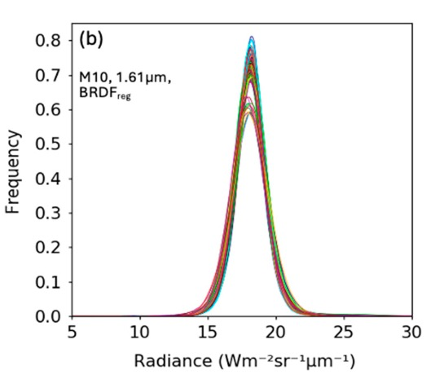
PDF comparison of empirical BRDF models
NPP-VIIRS C2 monthly PDFs, color coded by month
No BRDF
Ocean and Land BRDF
10° regional BRDF

Slide 12
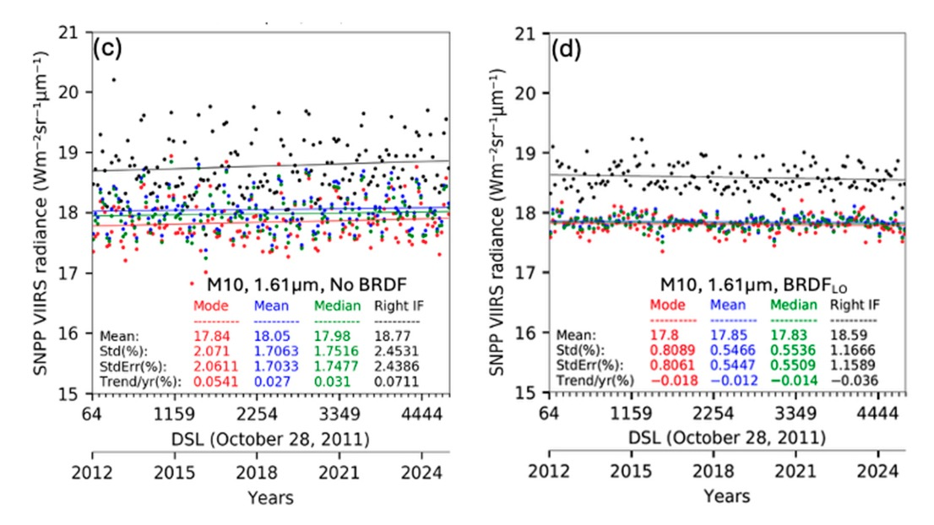
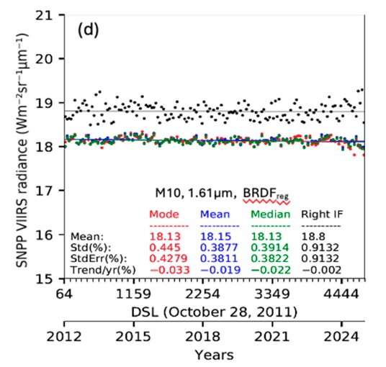
PDF statistic comparison of empirical BRDF models
No BRDF
Ocean and Land BRDF
10° regional BRDF
• The empirical models are designed for either the PDF_{mean} or PDF_{mode} statistics
• The land/ocean BRDF model reduces the PDF_{mean} standard error by ~70% and the regional BRDF another 30%

Slide 13
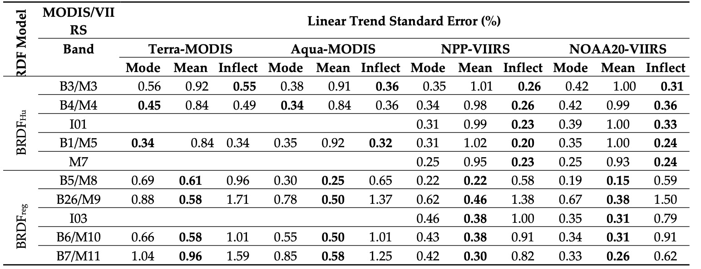
MODIS and VIIRS stability RSB comparison
• For VIIRS well calibrated imagers a SWIR band uncertainty <0.5% can be achieved
• Across MODIS and VIIRS an VIS/NIR uncertainty <0.5% and SWIR uncertainty <1.0%
• MODIS C7 should see improvements along the values of VIIRS

Slide 14
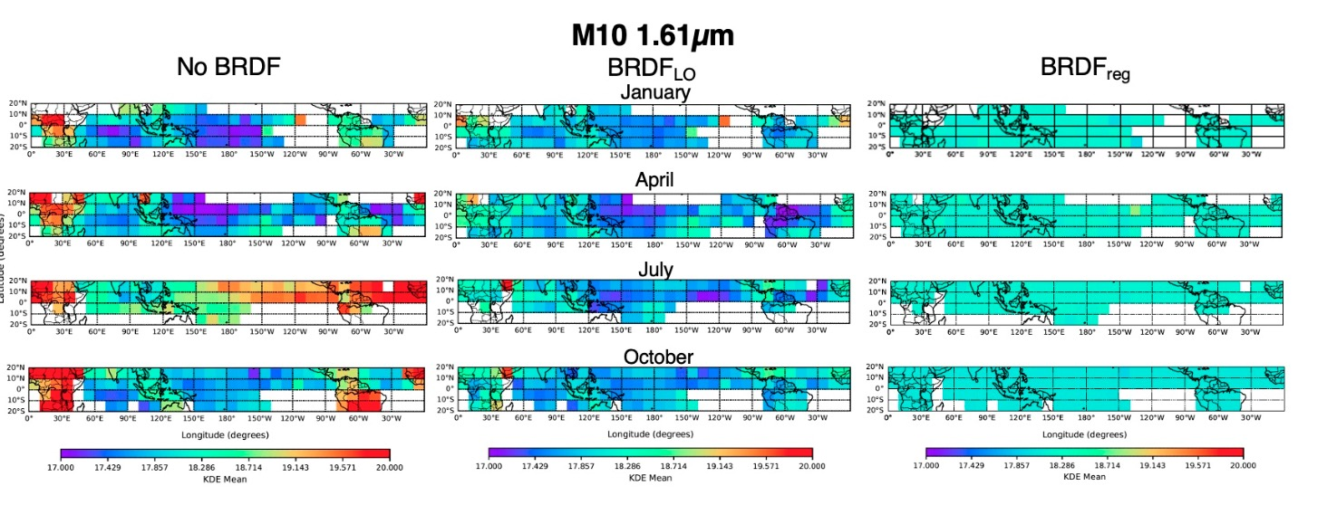
10° Regional comparison of SWIR band BRDFs
• The 2012 to 2024 NPP-VIIRS DCC-IT M10 1.61 µm mean radiance using utilizing 3-month sampling
• The colorbar in each case represent a 10% range
Note the regional BRDF provides the most uniform regional mean radiance

Slide 15
The VIS/NIR and SWIR band DCC calibration stability approaches updated
Identifying DCC pixels based on the following criteria:
  BT_{11µm} < 205 K
  Hom_{0.65µm} < 0.03
  Hom_{11µm} < 1.0 K
  where Hom = spatial homogeneity of 3x3 pixels
Apply the Hu BRDF model
Aggregate the pixel radiances into a monthly PDF using KDE
Plot the monthly PDF Right Inflection point to track the stability
30% temporal standard error reduction (HIST_{mode})
DCC pixels based on the following criteria:
  BT_{11µm} < 205 K
  Hom_{0.65µm} < 0.03
  Hom_{11µm} < 1.0 K
  where Hom = spatial homogeneity of 3x3 pixels
Apply the band specific empirical 10° regional/monthly BRDF
Aggregate the pixel radiances into a monthly mean or median
Plot the monthly mean or median to track the stability
30% temporal standard error reduction (Land/Ocean BRDF)

Slide 16
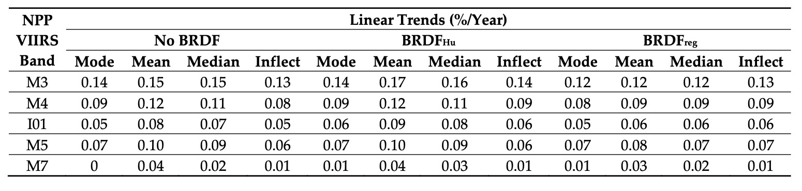
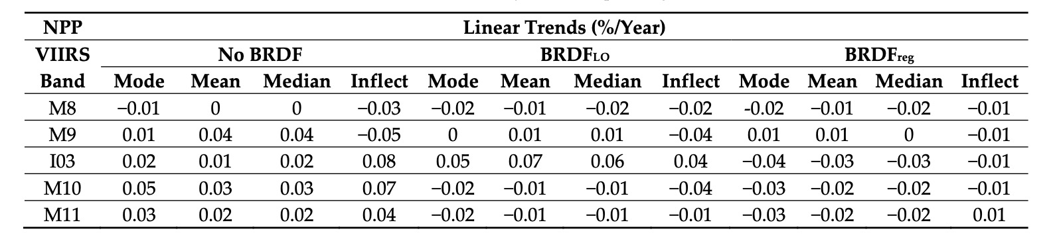
How do the differing approaches impact the resulting trend
• The trends are mostly within 0.05%/year across all the PDF statistics and BRDF models, except for the 1.61µm band

Slide 17
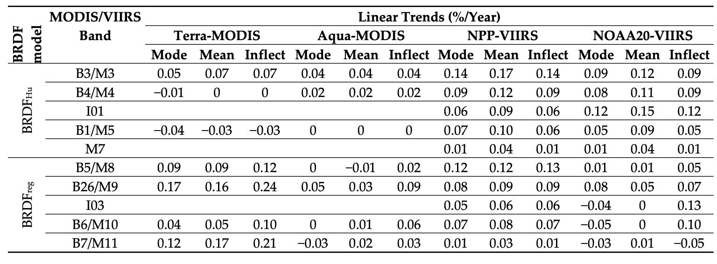
How do the differing PDF approaches impact the resulting trend
• The PDF statistic and BRDF approaches do not significantly change the resulting MODIS and VIIRS trends
• However, trend uncertainty is reduced with the PDF statistic and BRDF approaches

Slide 18
Conclusions
The GSICS DCC VIS/NIR calibration approach can now achieve trend uncertainties within 0.3%
  This is accomplished by using the Hu BRDF and the KDE inflection point
The GSICS DCC SWIR calibration approach can now achieve trend uncertainties within 0.5%
  This is accomplished by using band specific empirical 10° regional/monthly BRDFs
The various DCC calibration approaches do not significantly impact the imager statbility trend values but reduce the trend uncertainty
  Except for the 1.6µm band where the DCC response is very small and dependent on DCC microphysics such as particle size

