Slide 1


Improving the Deep Convective Cloud (DCC) Method for VIIRS using AI/ML based BRDF Models
Wenhui Wang
CISESS/ESSIC, University of Maryland – College Park
NOAA STAR VIIRS SDR Team
The GSICS Annual Meeting
March 23-27, 2026

Slide 2
Outline
Background
VIIRS Data Used
  Data used for training and validation
  Characteristics of VIIRS Deep Convective Cloud (DCC) observations
Methodology
  AI/ML PyTorch Multilayer Perceptron (MLP)-based method
  Angular Bin-based method
  Method for Validation
DCC BRDF Models and Validation Results
  Shortwave infrared (SWIR) bands
  Visible and near infrared (VisNIR) bands
Summary

Slide 3
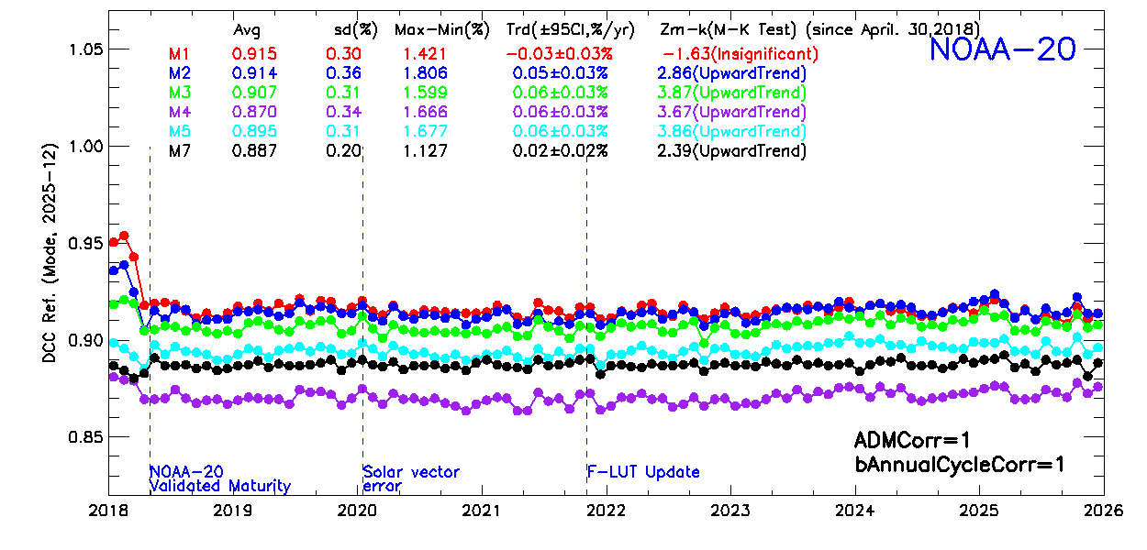
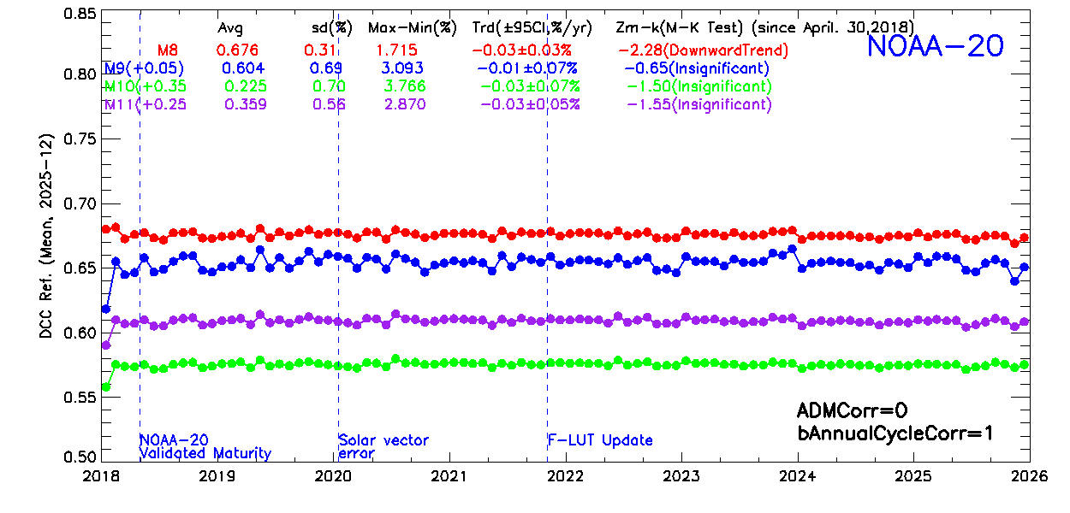
Background
The DCC technique has been widely used for the on-orbit calibration stability monitoring of satellite radiometers in the solar reflective spectrum.
  Statistics-based, using large # of DCC observations over the tropics.
The DCC methods for NOAA VIIRS solar band calibration performance monitoring.
  VisNIRs: Hu2004 Angular Distribution Model (ADM) + residual annual cycle for Bidirectional Reflectance Distribution Function (BRDF) correction.
  SWIRs: annual cycle correction only; uncertainties of trends are ~2 times as large as that of VisNIRs.
  Larger amount of data is processed daily, requiring considerable computing resources.
The purpose of this study is to investigate the feasibility of using AI/ML-based technique to improve the DCC method for VIIRS, especially for SWIR bands.
VisNIR
95%CI: 0.02-0.03%/year
SWIR
95%CI: 0.03-0.07%/year

Slide 4
Background
VIIRS DCC Identification Criteria
  Latitude: ±25°
  TB11 (M15, 10.7 μm) ≤ 205 K
  σ(TB11) of the subject pixel and its eight adjacent pixels 1 K
  σ(ref) of the subject pixel and its eight adjacent pixels 3%
  View zenith angle (VZA) ≤ 35°
Major Characteristics of VIIRS DCCs
  There are abundant of DCCs over the tropics, ~400 million pixels each year.
  The mode of daily/monthly DCC reflectance is more stable for VisNIRs.
  The mean of daily/monthly DCC reflectance is more stable for SWIRs
  VisNIRs: highly reflective (mode: ~0.9 or higher), mainly a function of cloud optical depth (COD).
  SWIRs: band-dependent (mean: 0.2-0.7), varying with COD and cloud effective radius.
  DCCs migrate over time; land DCCs are brighter than those over oceans.

Slide 5
VIIRS Data Used
NOAA operational NOAA-20 VIIRS M-Band RSB (M1-M11) DCC observations were used for BRDF model training/development.
  GSICS on-orbit solar band reference.
  Degradations very small based on existing studies: lunar, PICS, and DCC.
  The small degradations have been well accounted for by the on-orbit calibration updates
  Trends less than 0.06%/year.
  2022-2024 (3 years), with complete DCC pixels extracted at all VZAs (0-70°), were used for model training/development.
VIIRS DCC Data for validation purposes:
  NOAA-20: 2018-2021 and 2025
  NOAA-21: 2023-2025

Slide 6
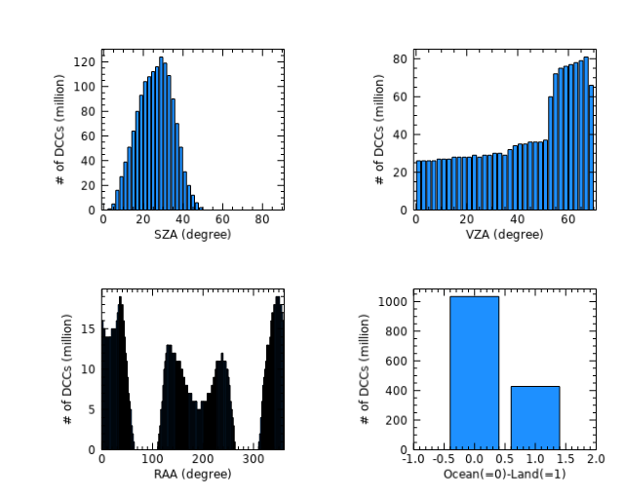
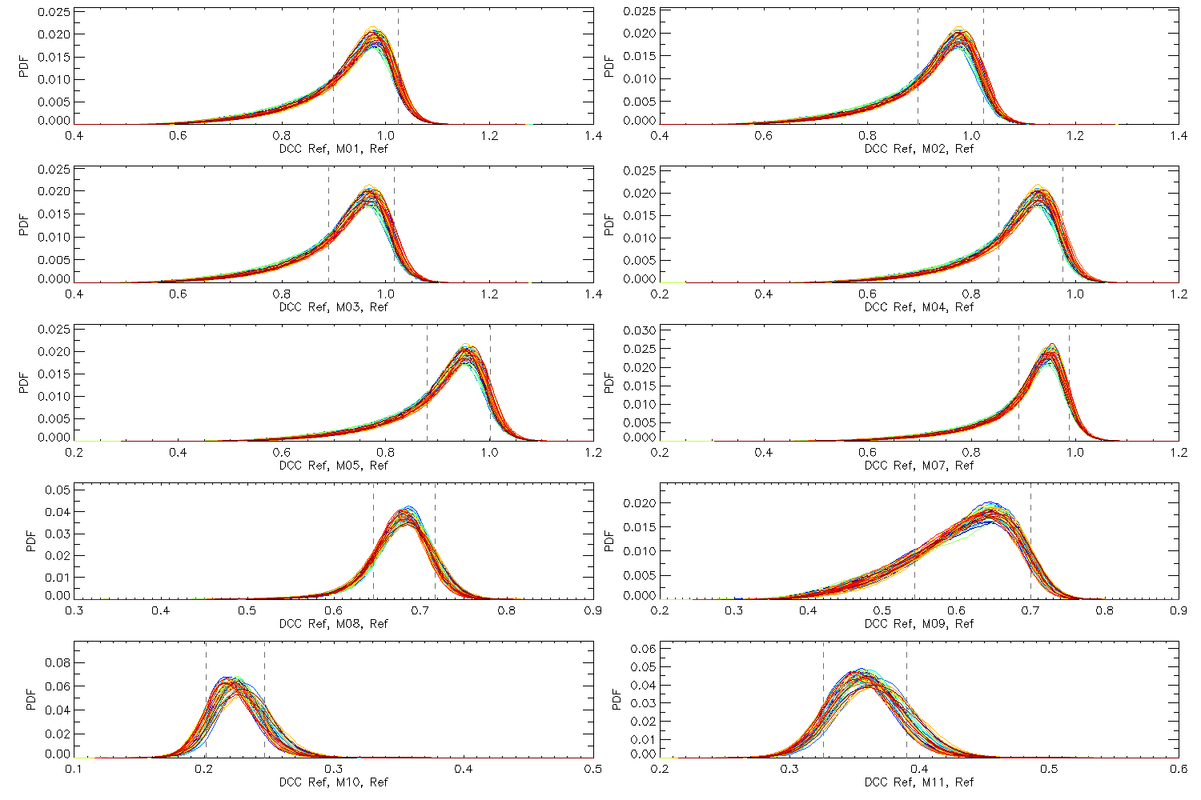
Characteristics of VIIRS DCC Observations
Potential challenges of using VIIRS data to model DCC BRDF effects
  Not uniformly distributed at different solar/view geometries, with large solar zenith angle (SZA) and relative azimuth angle (RAA) gaps due to VIIRS’s orbital configuration.
  DCCs exhibit a range instead of a constant reflectance at a given solar/view geometry, and usually negative skewed.
  False DCC detections exist due to the use of simple 205 K M15 BT threshold.
NOAA-20 (2022-2024)

Slide 7
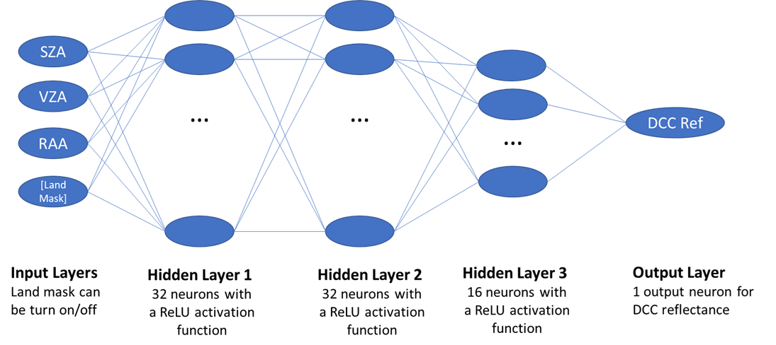
Methodology (2-1)
The Multilayer Perceptron (MLP) - based AI/ML Method
  PyTorch MLP artificial neural network frame was used.
  Different subsets of data were experimented to train the BRDF models:
      Train one model for each band using all training data, fitting month by month continuously due to RAM constrains.
      Train one model for each band using every n^{th} DCC pixels
      Train monthly (12) models for each band
      Use data at all view zenith angles (VZA) versus VZA ≤ 35° only
      w/wo the Land Mask Layer
  Different configuration of hidden layers and number of neurons were also explored.
Computing resources used:
  ~20 CPUs
  ~20 GB of RAM.
Required 2-3 hours/band/subset
LandMask

Slide 8
Methodology (2-2)
Angular Bin-based Method
  Similar to Bhatt et al., 2017.
  Different subsets of data were also experimented to develop Angular Bin-based DCC BRDF models, similar to the AI/ML-based method.
  Angular Bin – based BRDF models were compared to the AI/ML-based models.
  Validation Method
    Monthly DCC statistics (mode or mean) are usually used for calibration stability monitoring → dividing data (e.g., 80-90% for training and 10-20% for validation) does not work well.
    The uncertainty of long-term trend and computational costs will be used as the criteria for validation.
      Successful models are expected to reduce the uncertainty of DCC trends and/or speed up data processing.

Slide 9
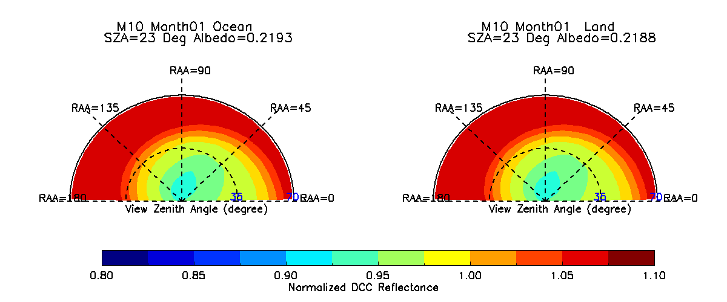
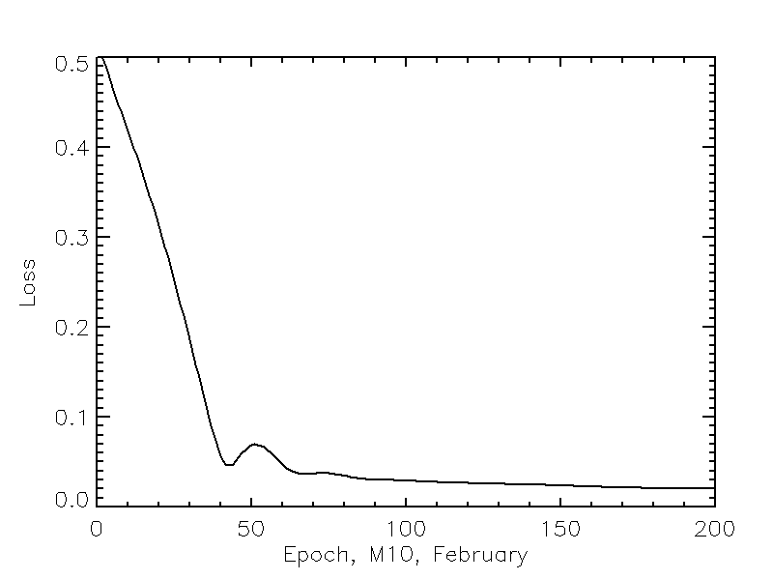
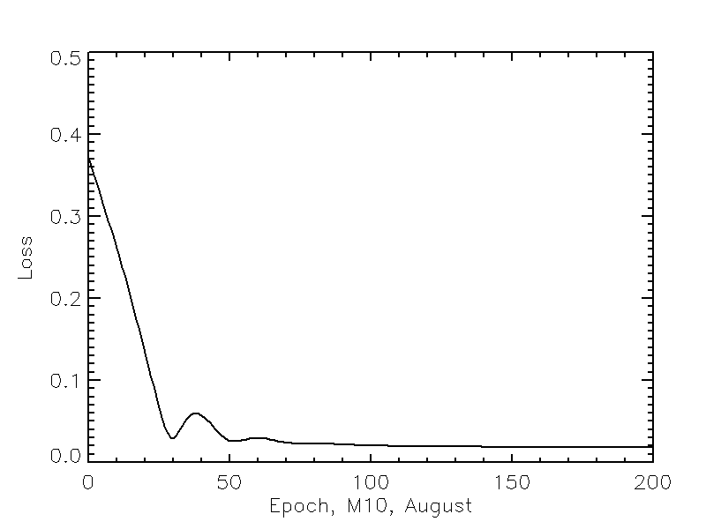
Examples of MLP-based DCC BRDF Models
(M10, Monthly Land/Ocean, VZA<=35°)
Loss
(February)
Loss
(August)
Ocean
Land
Reflectance differences between land and ocean DCCs are ~5% for SWIRs.
Only results at VIIRS solar/view geometries for VIIRS calibration monitoring will be used for BRDF effect correction.

Slide 10
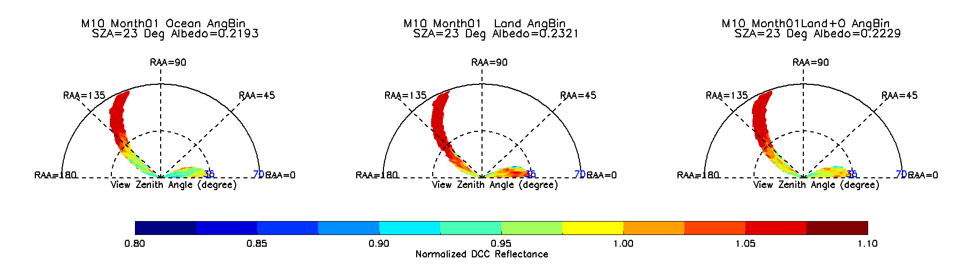
Examples of Angular Bin–based DCC BRDF Models
(M10, Monthly, Ocean, Land, Ocean+Land)
The magnitudes and spatial patterns of the MLP and Angular Bin – based DCC BRDF models are similar at VIIRS solar/view geometries.
Ocean
Land
Ocean+Land

Slide 11
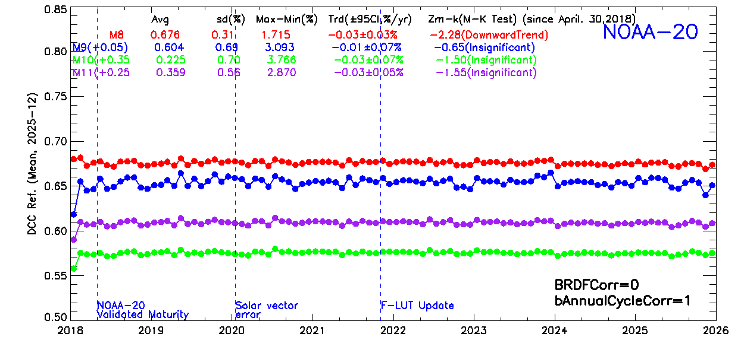
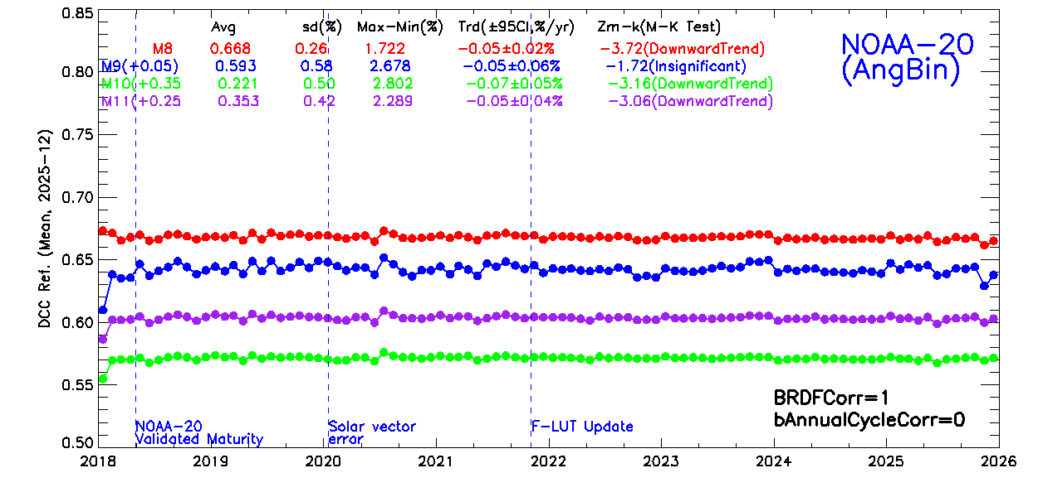
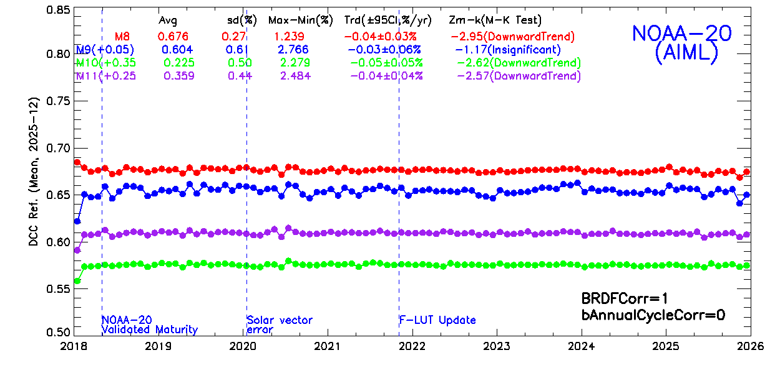
Validation Results: NOAA-20 SWIRs
Monthly land ocean MLP-based AI/ML DCC BRDF models perform the best.
  Effectively reduce the uncertainty of SWIR DCC trends, with 95%CI reduced and |Zm-k| increased.
  Outperform annual cycle correction.
  The performances of MLP and Angular Bin methods are close to each other.
  AI/ML-based BRDF correction runs faster than the Angular Bin-based correction (~1 time faster).
Empirical-based Annual Cycle Correction
(baseline)
Angular Bin-based Method
AI/ML-based Method

Slide 12
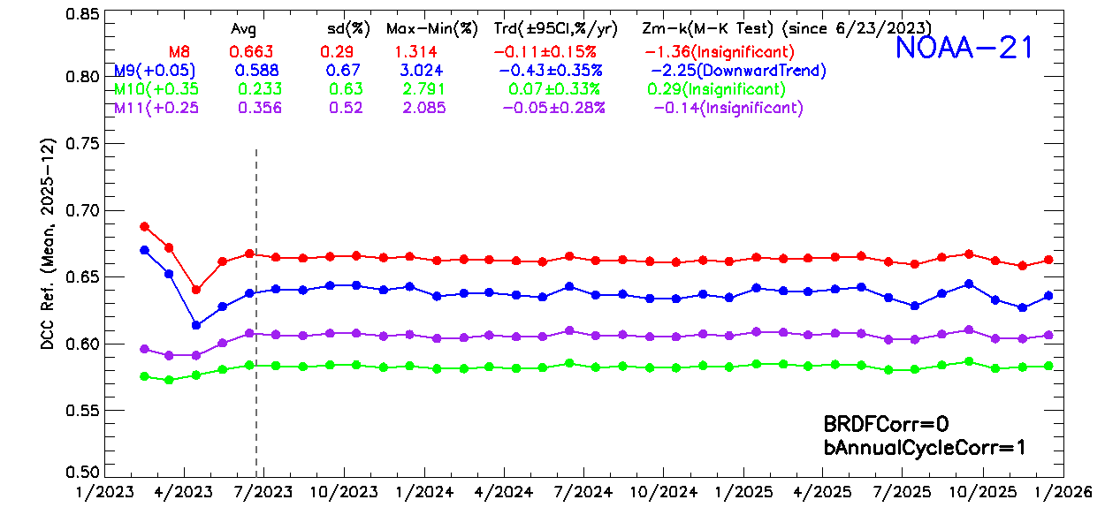
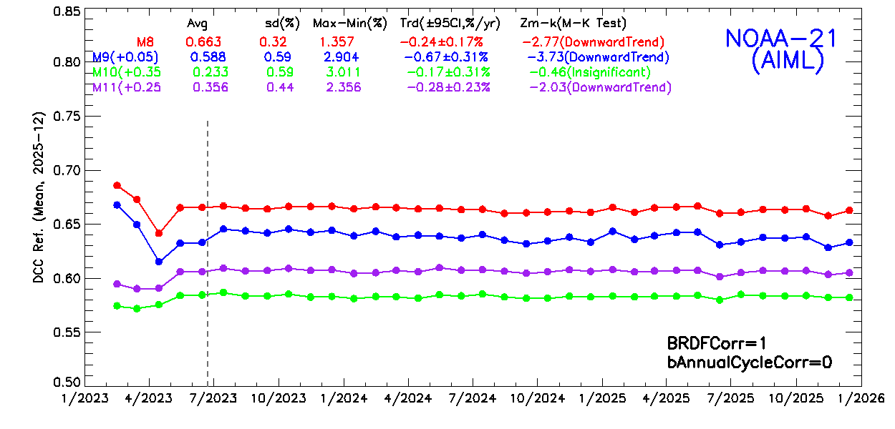
Validation Results: NOAA-21 SWIRs
Monthly land ocean MLP-based DCC BRDF models trained using NOAA-20 DCC data were applied to NOAA-21 SWIRs.
Preliminary results suggest the models also work well for NOAA-21.
  The uncertainties of trends were generally reduced compared to the empirical annual cycle correction.
Empirical Annual Cycle Correction (baseline)
MLP-based Method

Slide 13
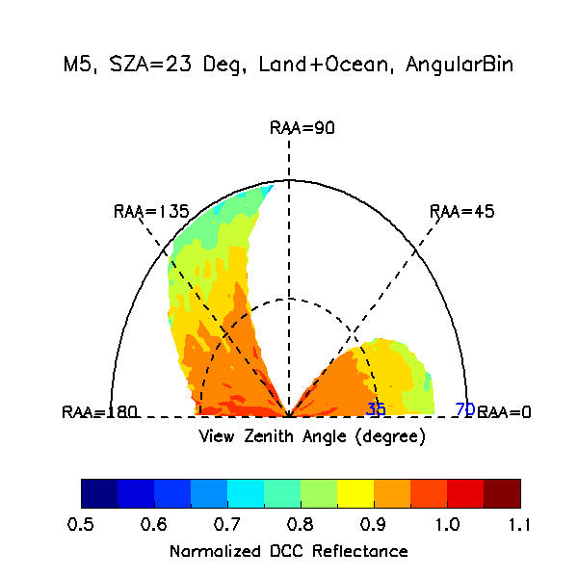
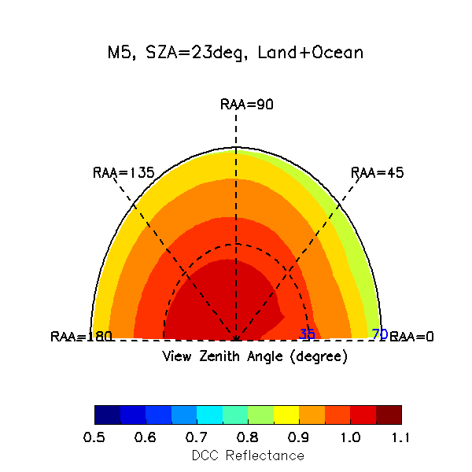
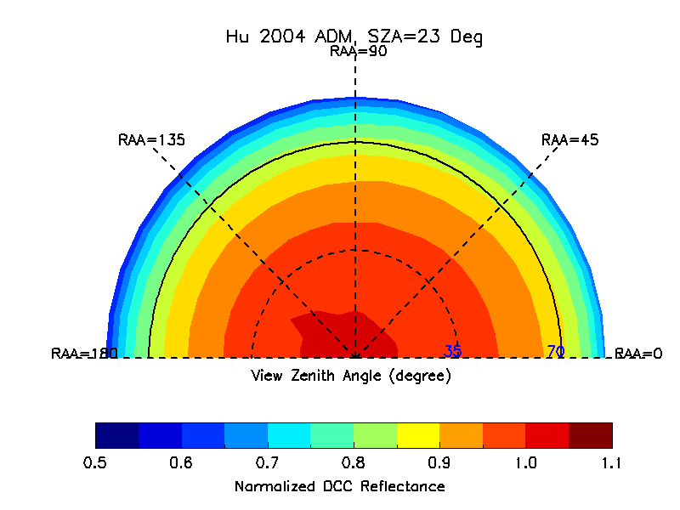
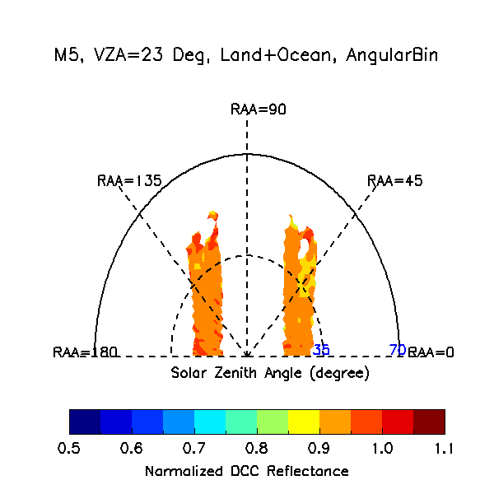
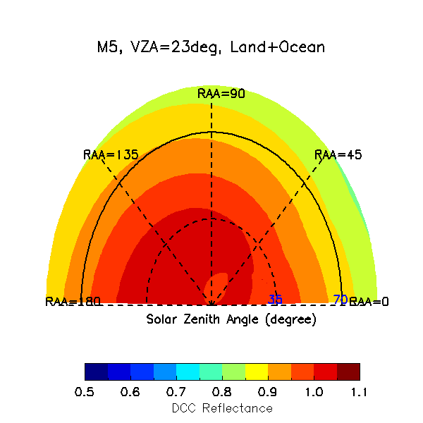
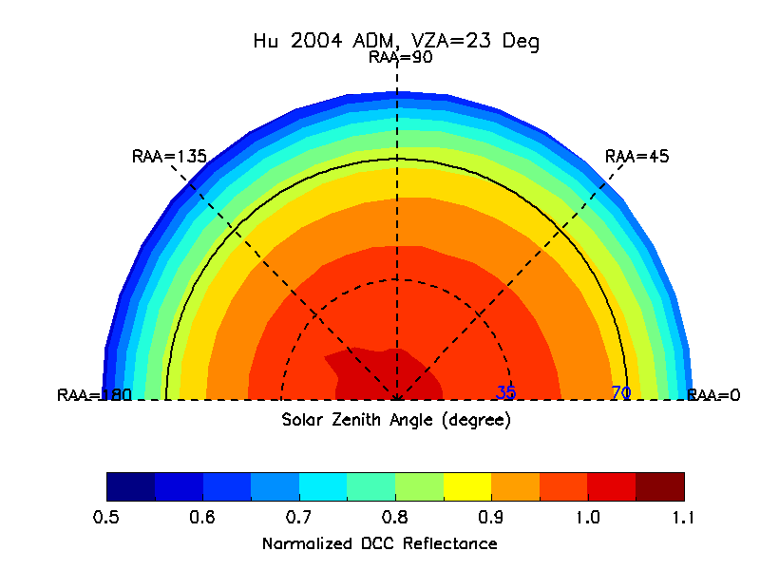
Comparison of VisNIR DCC BRDF Models
Hu2004 ADM
Angular Bin (M5)
MLP (M5)

Slide 14
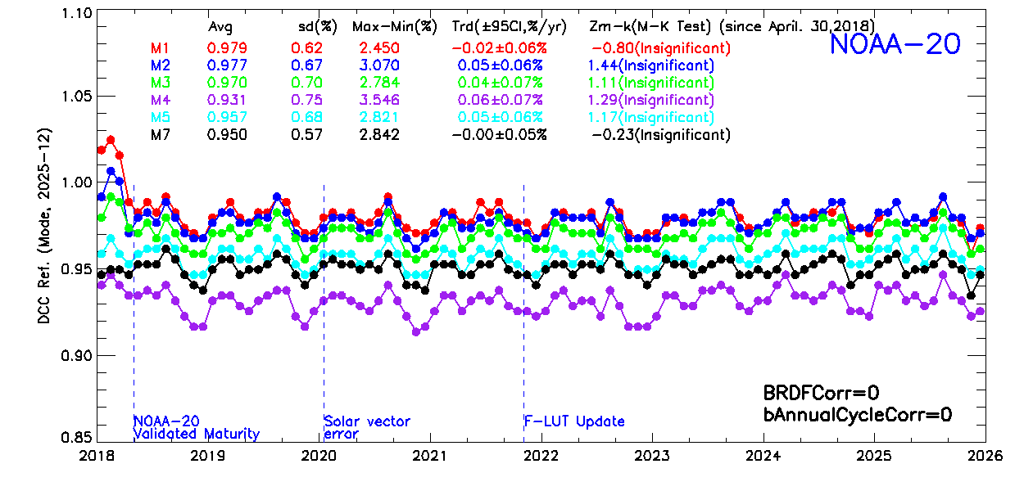
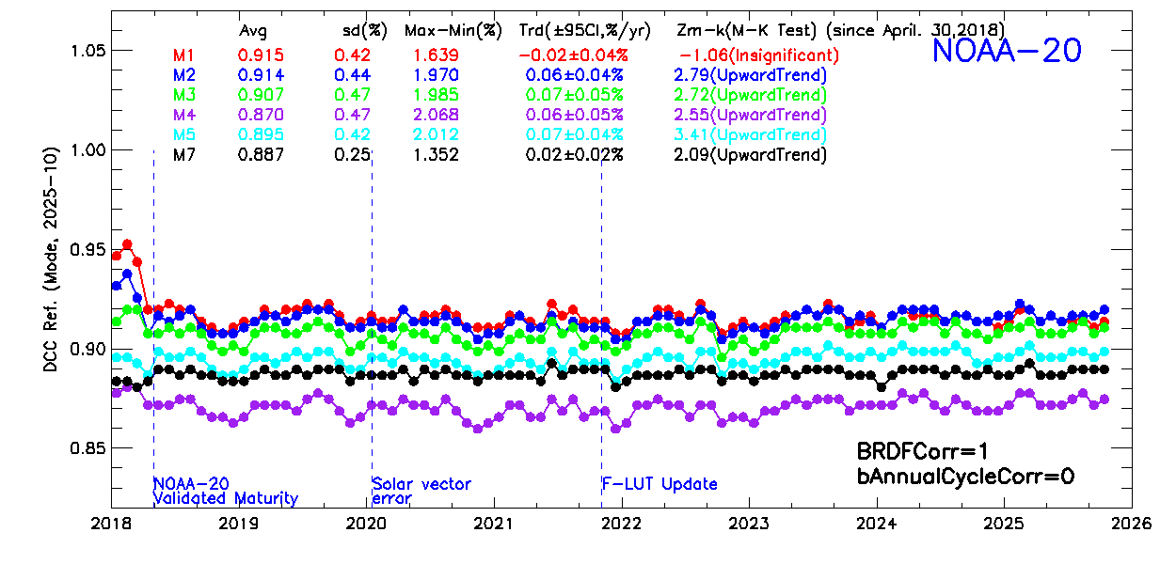
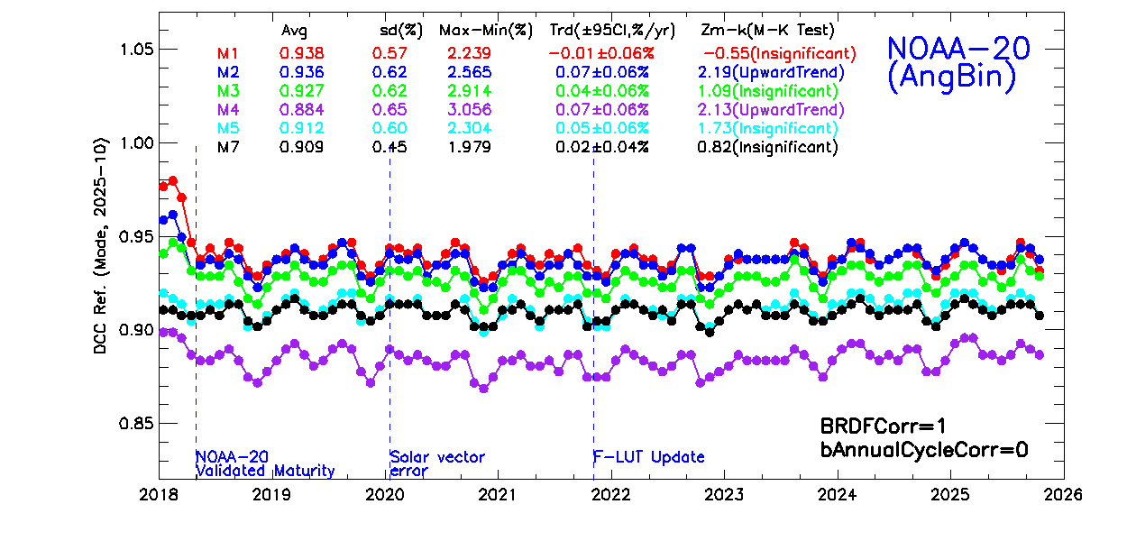
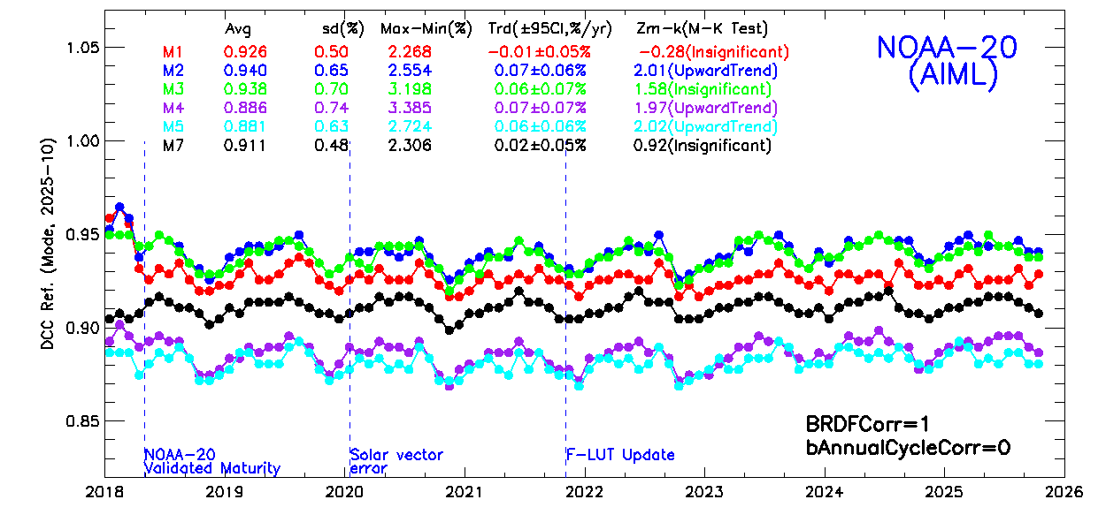
Validation Results: NOAA-20 VisNIRs
The Hu2004 ADM performs the best.
The performance of MLP and Angular Bin-based BRDF models are similar.
  Less effective than the Hu2004 ADM.
  Separate ocean & land does not help much.
Hu2004 ADM (baseline)
No BRDF Corr.
MLP
  Will be further investigated.

Slide 15
Summary
This study investigated the feasibility of using AI/ML PyTorch MLP neural network to develop DCC BRDF models for improving the DCC method for VIIRS.
VIIRS SWIRs: monthly land ocean MLP-based models perform well.
  Uncertainty of trends comparable to the Angular Bin models, both outperforming the annual cycle corr.
  AI/ML-based BRDF models are smoother and run faster for BRDF correction.
  The models developed using NOAA-20 data can also be applied to NOAA-21 SWIRs.
VIIRS VisNIRs: the Hu2004 ADM still performs the best.
  The MLP and Angular Bin based BRDF models can reduce the annual cycles, but less effective.
  Potential causes: gaps and non-uniform/skewed distribution of VIIRS DCCs, overfitting, catastrophic forgetting, …
Future Works
  Explore more AI/ML techniques, such as lightGBM, that can better handle the VIIRS DCC data (with gaps and non-uniformly sampled).
  Explore more input parameters (such as M15 BT, geolocation, …)
  Further improve the quality control of train data.

Slide 16
Acknowledgement and Disclaimer
The author would like to thank Dr. Changyong Cao of NOAA/NESDIS/STAR for the inspiring and insightful guidance and discussions.
The scientific results and conclusions, as well as any views or opinions expressed herein, are those of the author(s) and do not necessarily reflect those of NOAA or the Department of Commerce.

Slide 17
Backups

Slide 18
The Hu2004 DCC BRDF Model (Hu et al. 2004)
Developed using TRMM (Tropical Rainfall Measuring Mission) CERES data
  Low-inclination, non-sun-synchronous circular orbit, able to observe diurnal cycle.
  Spatial coverage: tropical zone
  Using CERES shortwave broad spectral band (0.3 – 5 µm) observations.
  DCCs are brighter toward solar/view zeniths.
Performs well for VIIRS VisNIRs, used for operational trending.
Not effective in the VIIRS SWIR spectrum.
Used for comparison purpose.

