Slide 1
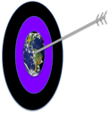

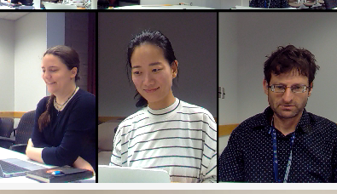
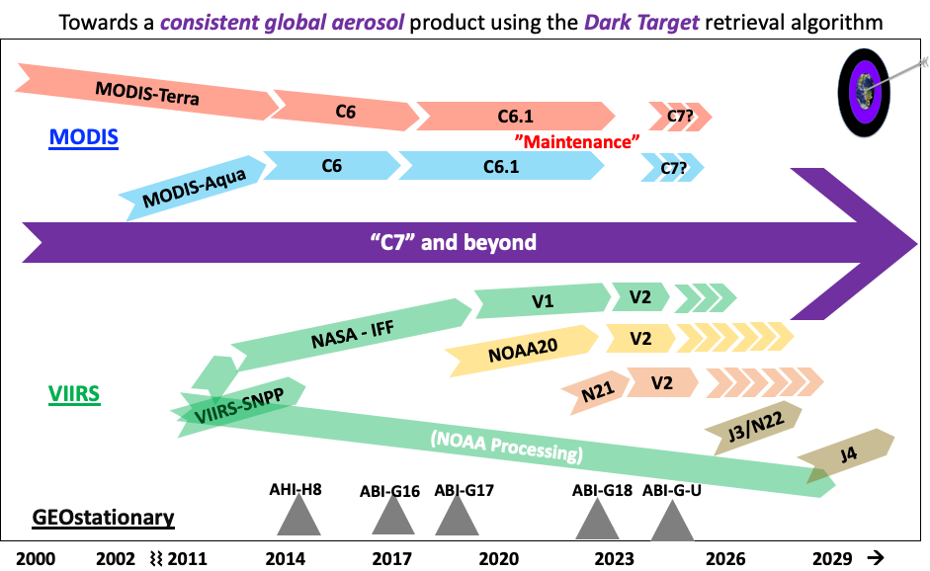
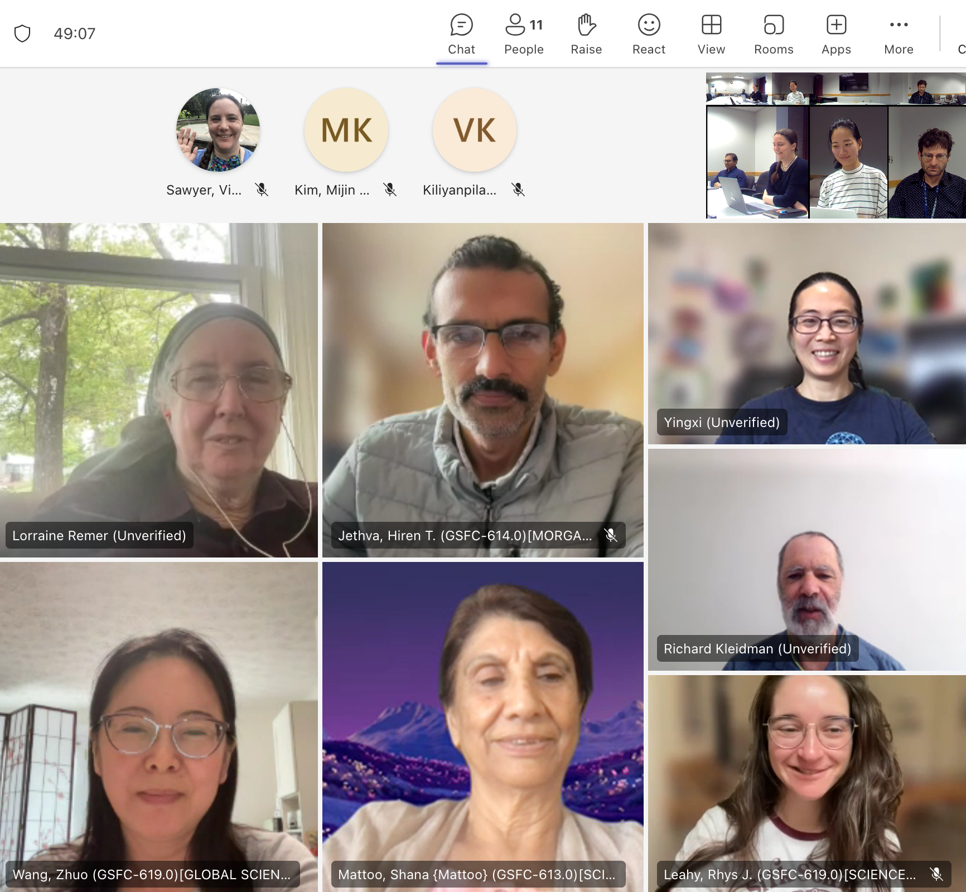
Towards (Aerosol) Retrieval Consistency and Continuity across 2 MODIS + 3 VIIRS
2026
Robert C. Levy. (NASA Goddard Space Flight Center)
Virginia Sawyer (STC/GSFC)
Mijin Kim (Morgan State/GSFC)
Yingxi Shi (UMBC/GSFC)
Acknowledgements:
MODAPS team at GSFC (MODIS processing)
A-SIPS team at U. Wisconsin (VIIRS processing)
https://darktarget.gsfc.nasa.gov

Slide 2
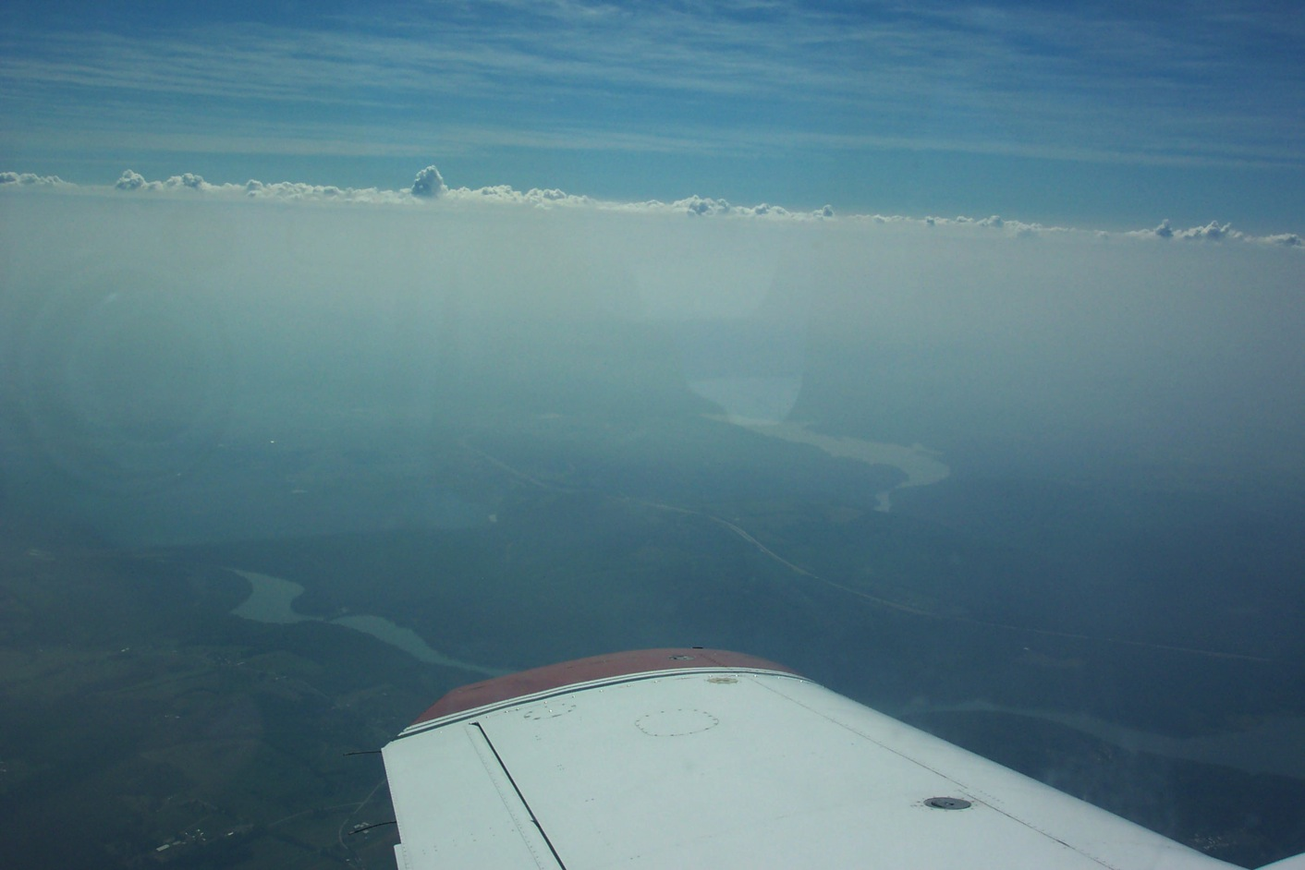
Why do we care about aerosols?
They affect visibility
They affect human health and morbidity
They enable clouds and precipitation
They have roles in Earth’s chemistry (carbon, sulfate, etc)
They have roles in biology (e.g. transport nutrients)
They directly and indirectly impact the radiative budget
They are both natural and manmade
They are inhomogeneous in space and time
Their distributions are changing
The science of aerosols is truly “interdisciplinary”
We need datasets that characterize climatology, trends and variability

Slide 3
Why do we care about aerosols? (Bonus)
They affect visibility
They affect human health and morbidity
They enable clouds and precipitation
They have roles in Earth’s chemistry (carbon, sulfate, etc)
They have roles in biology (e.g. transport nutrients)
They directly and indirectly impact the radiative budget
They are both natural and manmade
They are inhomogeneous in space and time
Their distributions are changing
The science of aerosols is truly “interdisciplinary”
We need datasets that characterize climatology, trends and variability
Their “retrieval” helps fine-tune VIS/NIR imager calibration!!!

Slide 4
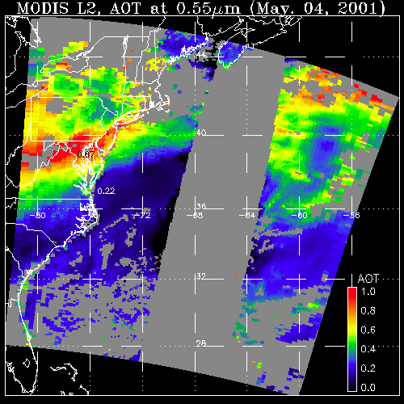
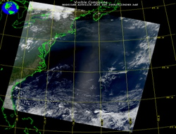

Dark Target (DT) Aerosol retrieval Algorithm
What a sensor observes
Attributed to aerosol (AOD)
May 4, 2001; 13:25 UTC
Level 1 “reflectance”
May 4, 2001; 13:25 UTC
Level 2 “product”
Established by Kaufman, Tanré, Remer, et al (1997)
Modified by Remer, Levy, Gupta, Sawyer, Shi et al (2005, 2010, 2013, 2015, 2020, etc.)
DT
LAND
OCEAN
GLINT
AOD
1.0
0.0
Requires: Observations of spectral reflectance in 7 selected bands between ”blue” and “SWIR” wavelengths (other bands help with cloud/surface masking and filtering)
Retrieves: AOD at 0.55 μm, spectral AOD (AE), cloud-cleared reflectances, diagnostics, Quality Assurance and Confidence
Notes:
Note that now there are many more algorithms for MODIS, including Deep Blue (retrieves over bright surfaces using a 0.412 micron channel that land surface is much darker), Also MAIAC, which uses multi-day observations to separate quickly changing aerosols from slowly changing land surfaces

Slide 5
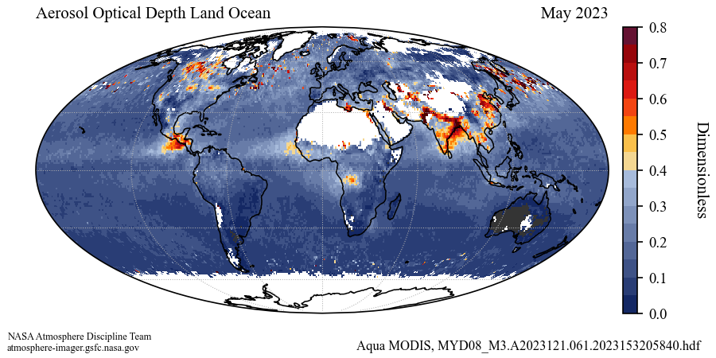
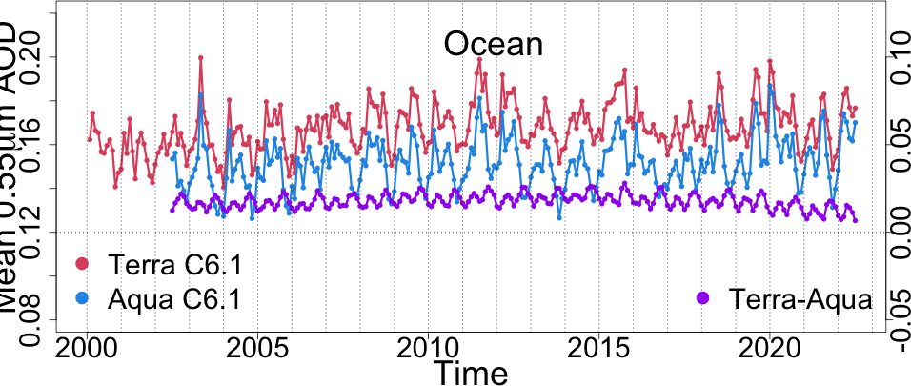

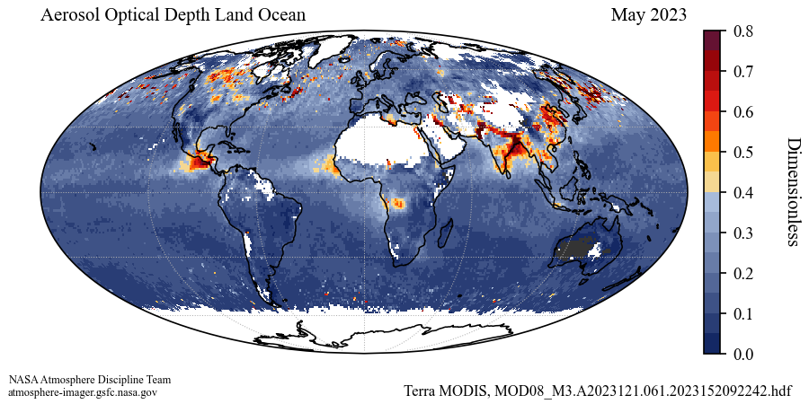
20+ years of MODIS: Terra vs Aqua time series (with C6.1)
AOD: May 2023
Aqua
Terra
With same Collection 6.1 algorithm, no visual difference between Terra and Aqua globes
Time series indicates Terra offset high compared to Aqua by about 0.015 (10-15%).
Yet, both within expected uncertainties
Small calibration adjustments of 2% or less might help, but requires doing all wavelength bands and maybe also time-dependence

Slide 6

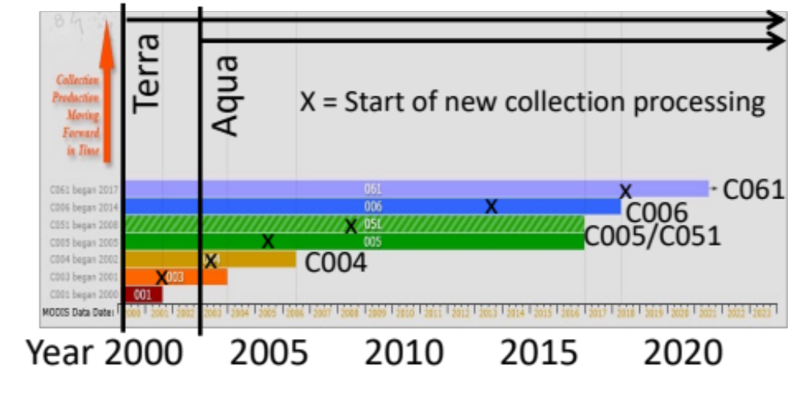
MODIS Collections
https://atmosphere-imager.gsfc.nasa.gov/collections/overview
C001: Initial algorithms at Terra launch
C003: Provisional for both Terra and Aqua
C004: First significant “validation” (2003)
C005: First real “science” (2005)
C051: Some calibration and bug fix (2008)
C006: Major upgrades to science (2013)
C061: updates to the L1B. (2017)
C007: L1B, Science, formats!: MID 2026!
2000 2003 2006 2009 2012 2015 2018 2021
Towards “Collection 7” (C007)
  Level 2: Modernize to NetCDF Climate and Forecast file format and metadata conventions
  Updated L1B calibration/geolocation. Possibly include a polarization correction
  Level 3: TBD, but will look much as does now (e.g. 1° x 1° grids at daily, 8 day and monthly).
  Science updates: 1) Ocean nonspherical dust, 2) improved cloud mask, 3) heavy aerosol coverage.
“legacy” as MODIS missions (both Terra and Aqua) will end sometime soon)
  How does orbital drifting (since 2022) impact long term record (e.g., sampling of clouds, high latitudes, sun angles, etc.) ?

Slide 7
Global Climate Observing System (GCOS)
requirements for Aerosol Optical Depth (AOD) climate data record (CDR):
Target metric | Target
Horizontal Resolution | 5-10 km, globally
Accuracy | MAX(0.03 or 10%)
Stability / bias | <0.01 / decade
Time Length | 30+ years
Temporal Resolution | 4 h
  }
MODIS data record
  }
  }
EXTEND with VIIRS
EXPAND with GEO and other platforms
Focus on VIIRS today

Slide 8


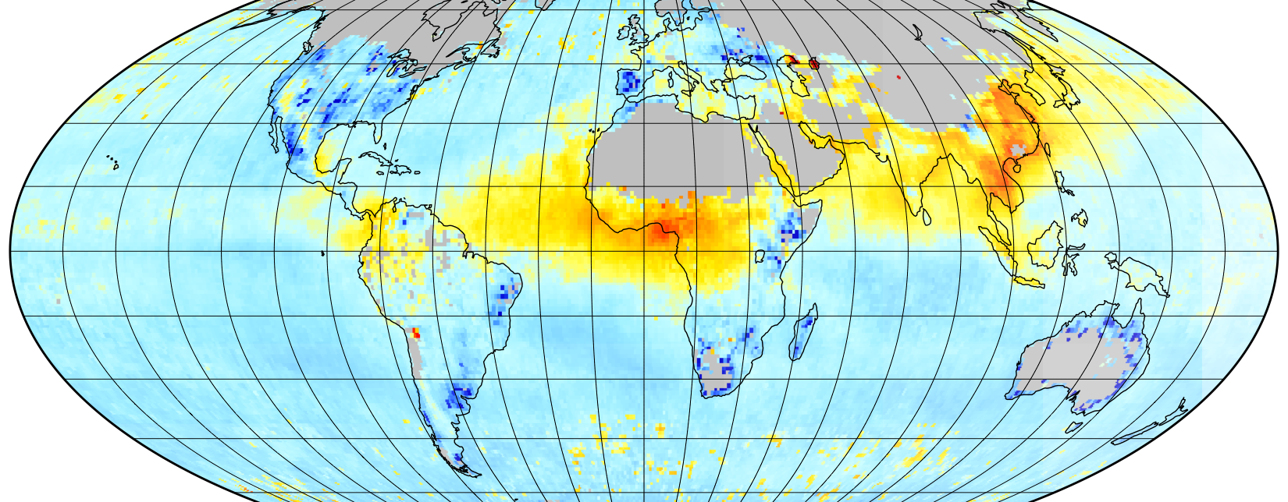
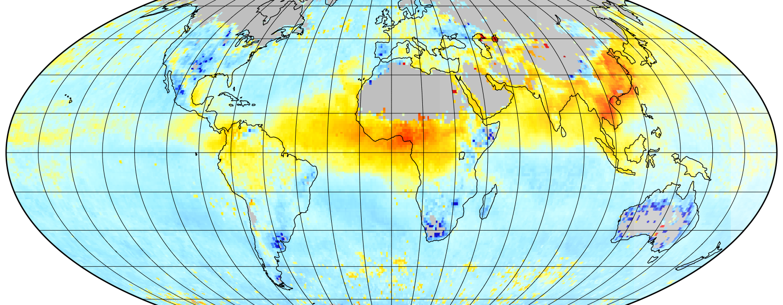


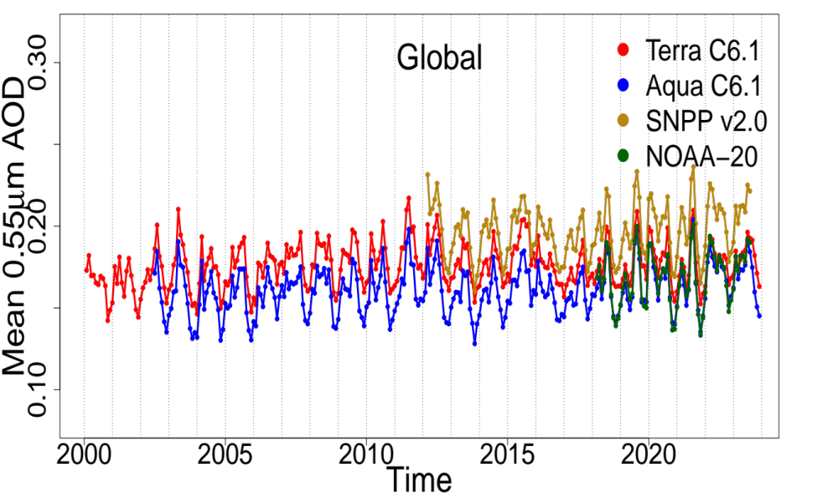
Extend record with VIIRS (Visible-Near Infrared Radiometer Suite)
MODIS on Aqua (c. 2002)
VIIRS on Suomi-NPP (c. 2011)
2000 ← MODIS → 2026
March 2015
2011 ← VIIRS → 2030+
With MODIS ending before 30 years, we need continuity provided by similar instrument = VIIRS. Ported DT algorithm from MODIS to VIIRS
Suomi-NPP, NOAA20 and NOAA21 are in orbit. VIIRS V2.0 products agree with MODIS C6.1 to ±0.02 in AOD units.
Additional VIIRS sensors to launch NOAA’s JPSS3/4 into at least the late 2030s, thus satisfying the multi-decadal needs of GCOS.
Sawyer et al., 2025 (VIIRS V2.0)

Slide 9
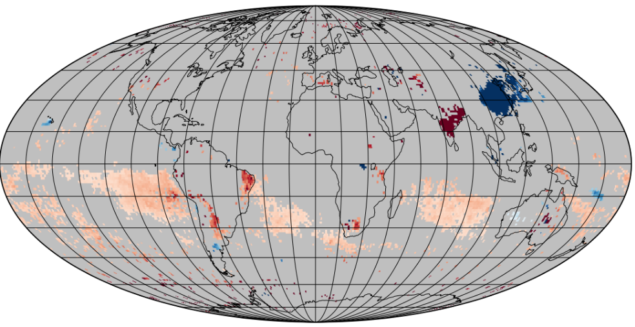
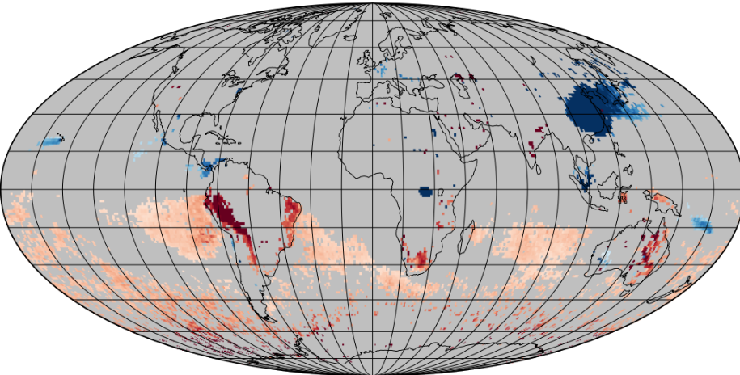
Consistency of Dark Target AOD 11-Year Trends (SNPP vs Aqua):
MODIS-Aqua
VIIRS-SNPP
2012-2023
Slope of the linear regression where p ≤ 0.01.
Some places, the 10-year trends may be different than 20-year trends (of MODIS).
Overall, SNPP sees the same world as Terra / Aqua (except for southern midlatitude ocean?)
Sawyer et al., 2025 (VIIRS V2.0)

Slide 10
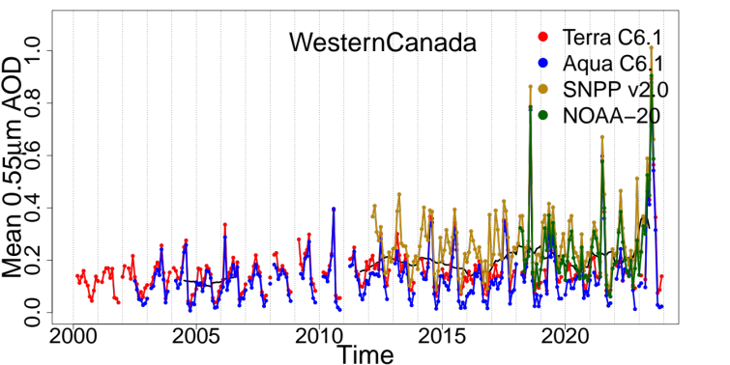
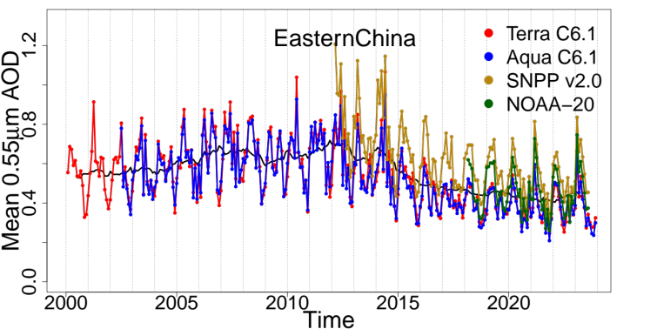
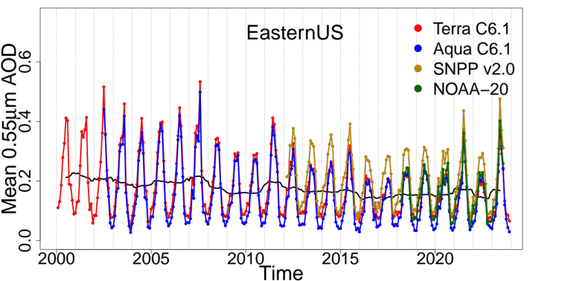
Regional trends (picking some 10° x 10° boxes)
Wildfires in western Canada drive variability. Autumn/winter flat.
Reductions seen in Eastern U.S. due to policy regarding emissions. But no trend during SNPP lifetime. Spike in 2021 due to fires
Coherent interannual change in eastern China, strong decrease during SNPP period.
Sawyer et al., 2025 (VIIRS V2.0)

Slide 11
MODIS C6.1 vs VIIRS 2.0
Overall tendencies are consistent.
All AODs within ± 0.02-is to MODIS-Aqua but....
SNPP > Terra > Aqua > N20
And total range of ±0.05
0.22 vs 0.17 “not insignificant” for understanding climate
Can we do better?

Slide 12
MODIS C6.1 → C7 : VIIRS V2.0 → V2.1 → V2.2
Algorithm improvements common to both streams
High-resolution 3x3 red-band cloud masking over ocean (250 m for MODIS, 375 I-band for VIIRS)
Log-fit to lookup table when AOD < 0.2 (disallows negative AOD)
Detect (and retrieve) dust using non-spherical model over ocean
Update formulas for Surface Reflectance Parameterization (SRP) over land that estimates Blue, Red & SWIR2.½ bands via NDVI, Urban Percentage & Angles. Now same formulas for both.
Uses same “ancillary” GEOS-IT meteorological re-analyses.
Same ”Yori” (University of Wisconsin) aggregation for Level 3 product
Bug fixes as needed

Slide 13
MODIS C6.1 → C7 : VIIRS V2.0 → V2.1 → V2.2
Algorithm updates that are separate
MODIS C6.1 → C7 (MxD04_L2)
Products are in NetCDF4 (to match VIIRS)
DT-only SDS names, groups, and metadata are simplified (to match VIIRS)
Reads in “entire” granule for cloud and other masking (to match VIIRS)
New “call back” to retrieve heavy surface-level aerosol over eastern Asia
C7 L1B files include “solar eclipse flag”
Uses C7 Wisconsin Cloud mask (3 tests for clouds + other tests for Dust Detection
Deep Blue (DB) retrievals and DB/DT “merge” remain in same MxD04_L2 file
VIIRS V2.0 → V2.1 → V2.2 (AERDT_L2)
SDS names exactly match MODIS C7
Does not need a call-back to retrieve heavy surface-level aerosol over Asia
Uses updated Wisconsin Continuity Cloud Mask
Fixes QA-Filtering bugIntroduces X-calibration between V2.0 and V2.1.
Deep Blue (DB) retrievals remain in separate file (AERDB) and no DT/DB merge provided by the aerosol teams.

Slide 14
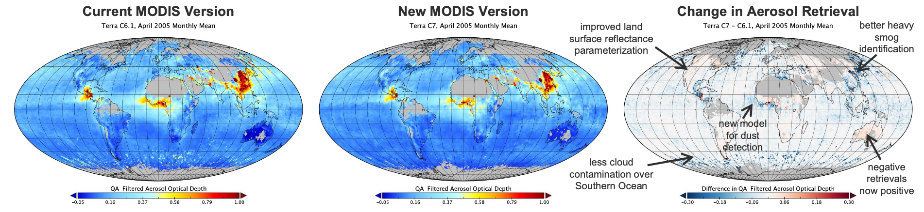
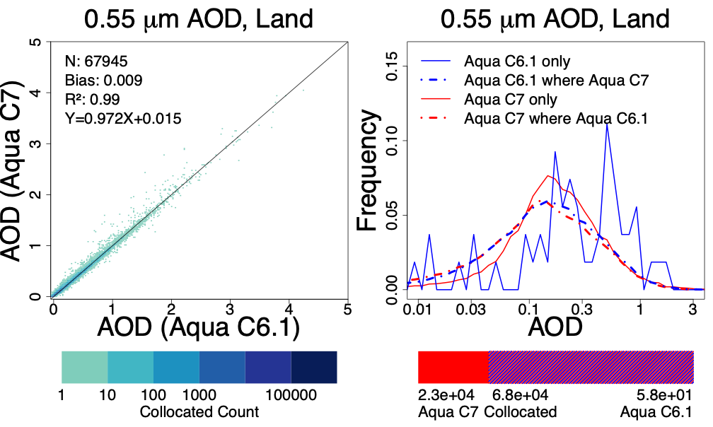
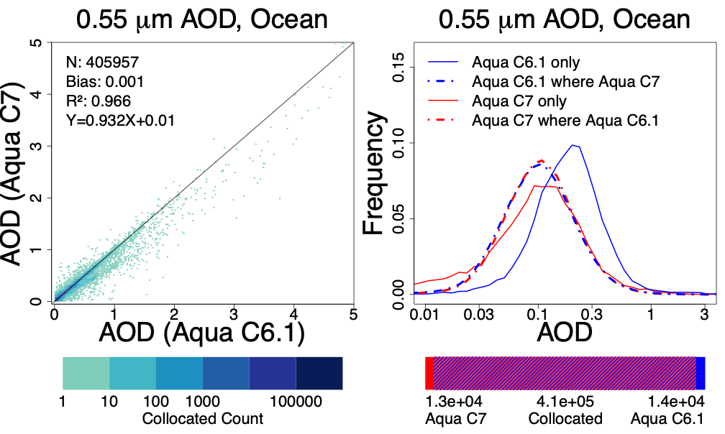
Overall “Algorithm Updates”
C6.1
MODIS: April 2005
C7
nearly unchanged distribution
High outliers reduced

Slide 15
X-calibration Coefficients in DT algorithm
(MODIS-Aqua → VIIRS). Not applied to MODIS
Band Pair [nm] |  |  |  | X-calibration Coefficient [1] Lyapustin et al. (2023), [2] Meyer et al. (2020), [3] Wang et al. (AGU 2024)
 |  |  |  | [1] | [2] | [1] | [2] | [3]
VIIRS |  | MODIS |  | AQUA/SNPP | AQUA/SNPP | AQUA/N20 | AQUA/N20 | AQUA/N21
M3 | 478 - 488 | B3 | 459 – 479 | 0.98 | - | 1.03 | - | 1.06
M4 | 545 - 565 | B4 | 545 – 565 | 0.98 | - | 1.04 | - | 1.08
M5 | 662 - 682 | B1 | 620 – 670 | 0.98 | 0.95 | 1.02 | 1.00 | 1.02
M7 | 846 - 885 | B2 | 841 – 876 | 0.97 | 0.97 | 1.01 | 1.01 | 1.02
M8 | 1230 - 1250 | B5 | 1230 – 1250 | - | 0.99 | - | 1.02 | 1.04
M10 | 1580 - 1640 | B6 | 1628 – 1652 | - | 0.98 | - | 1.02 | 1.07
M11 | 2225 - 2275 | B7 | 2105 – 2155 | - | 0.97 | - | 0.99 | 1.00
Courtesy Mijin Kim

Slide 16
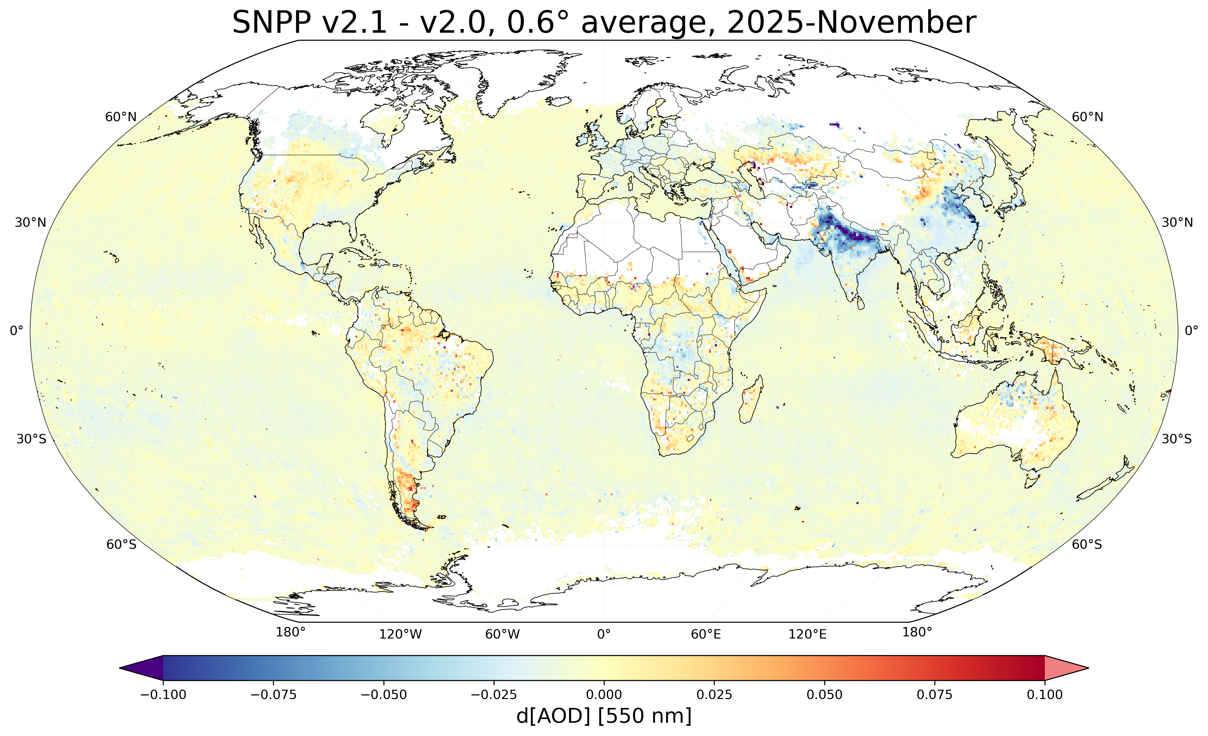
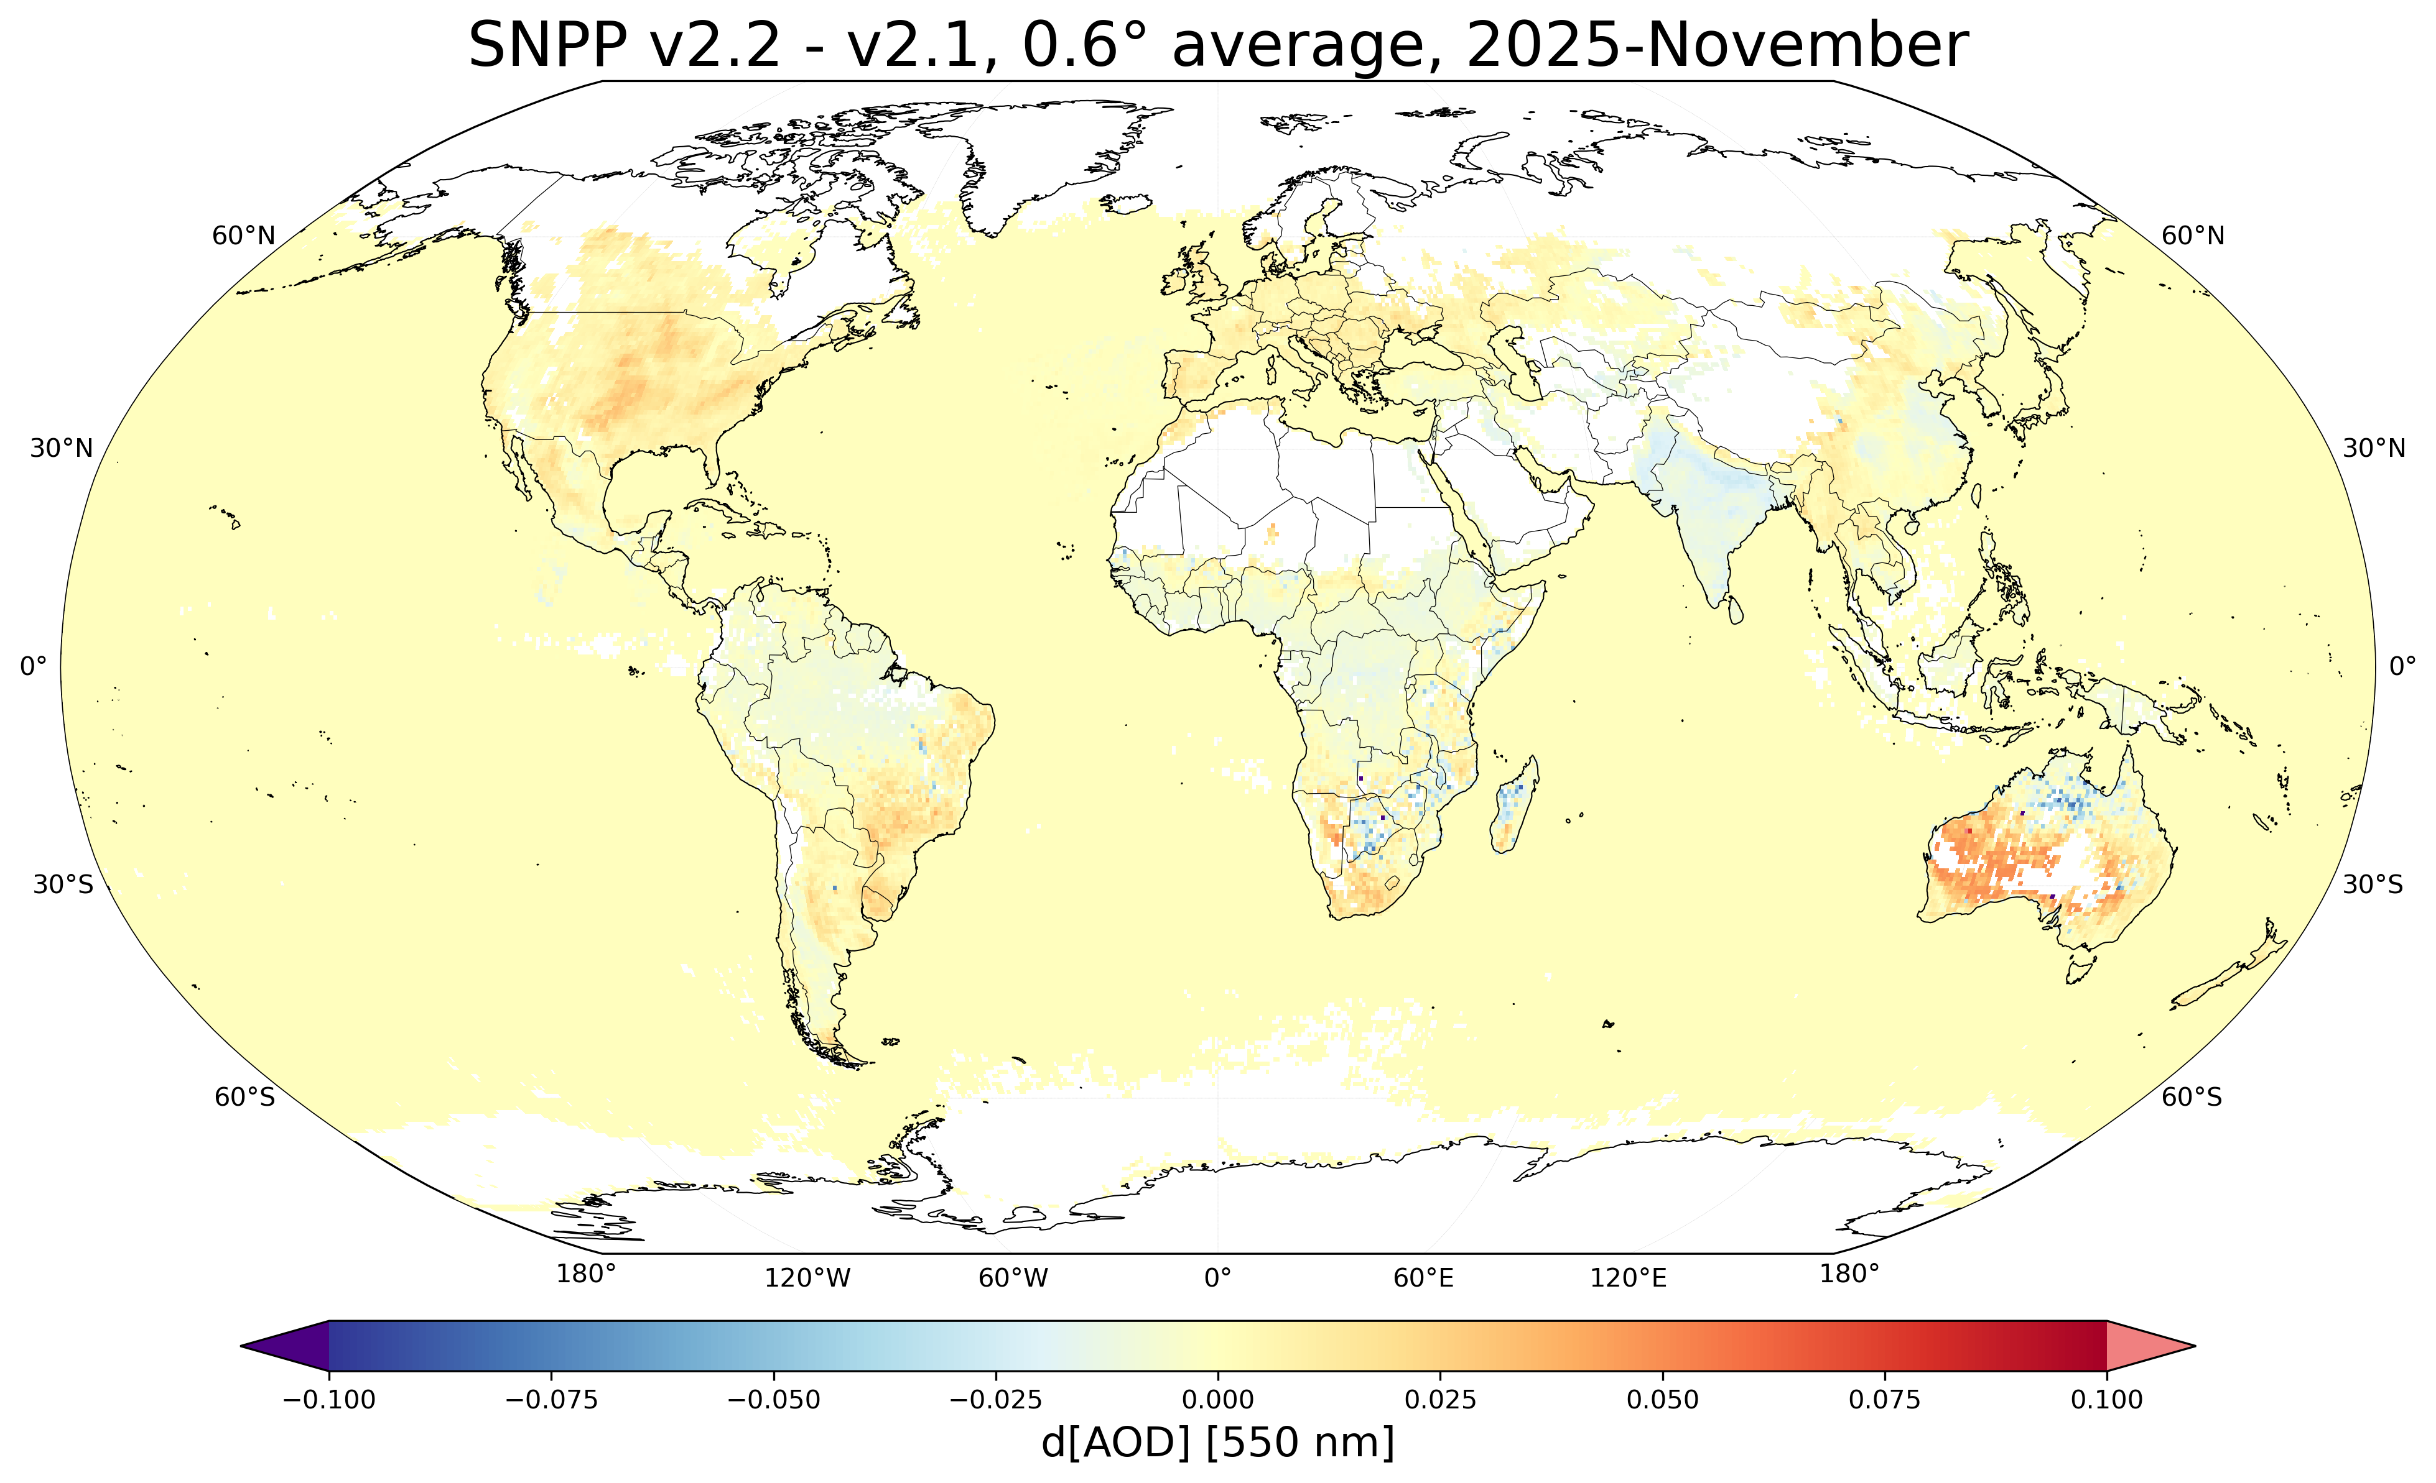
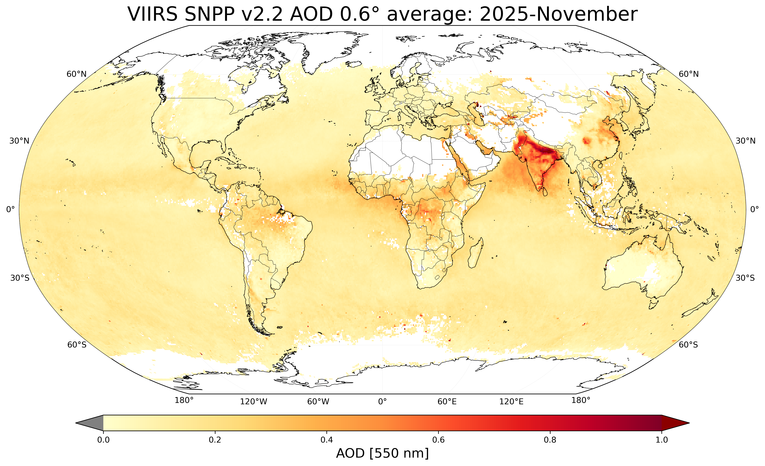
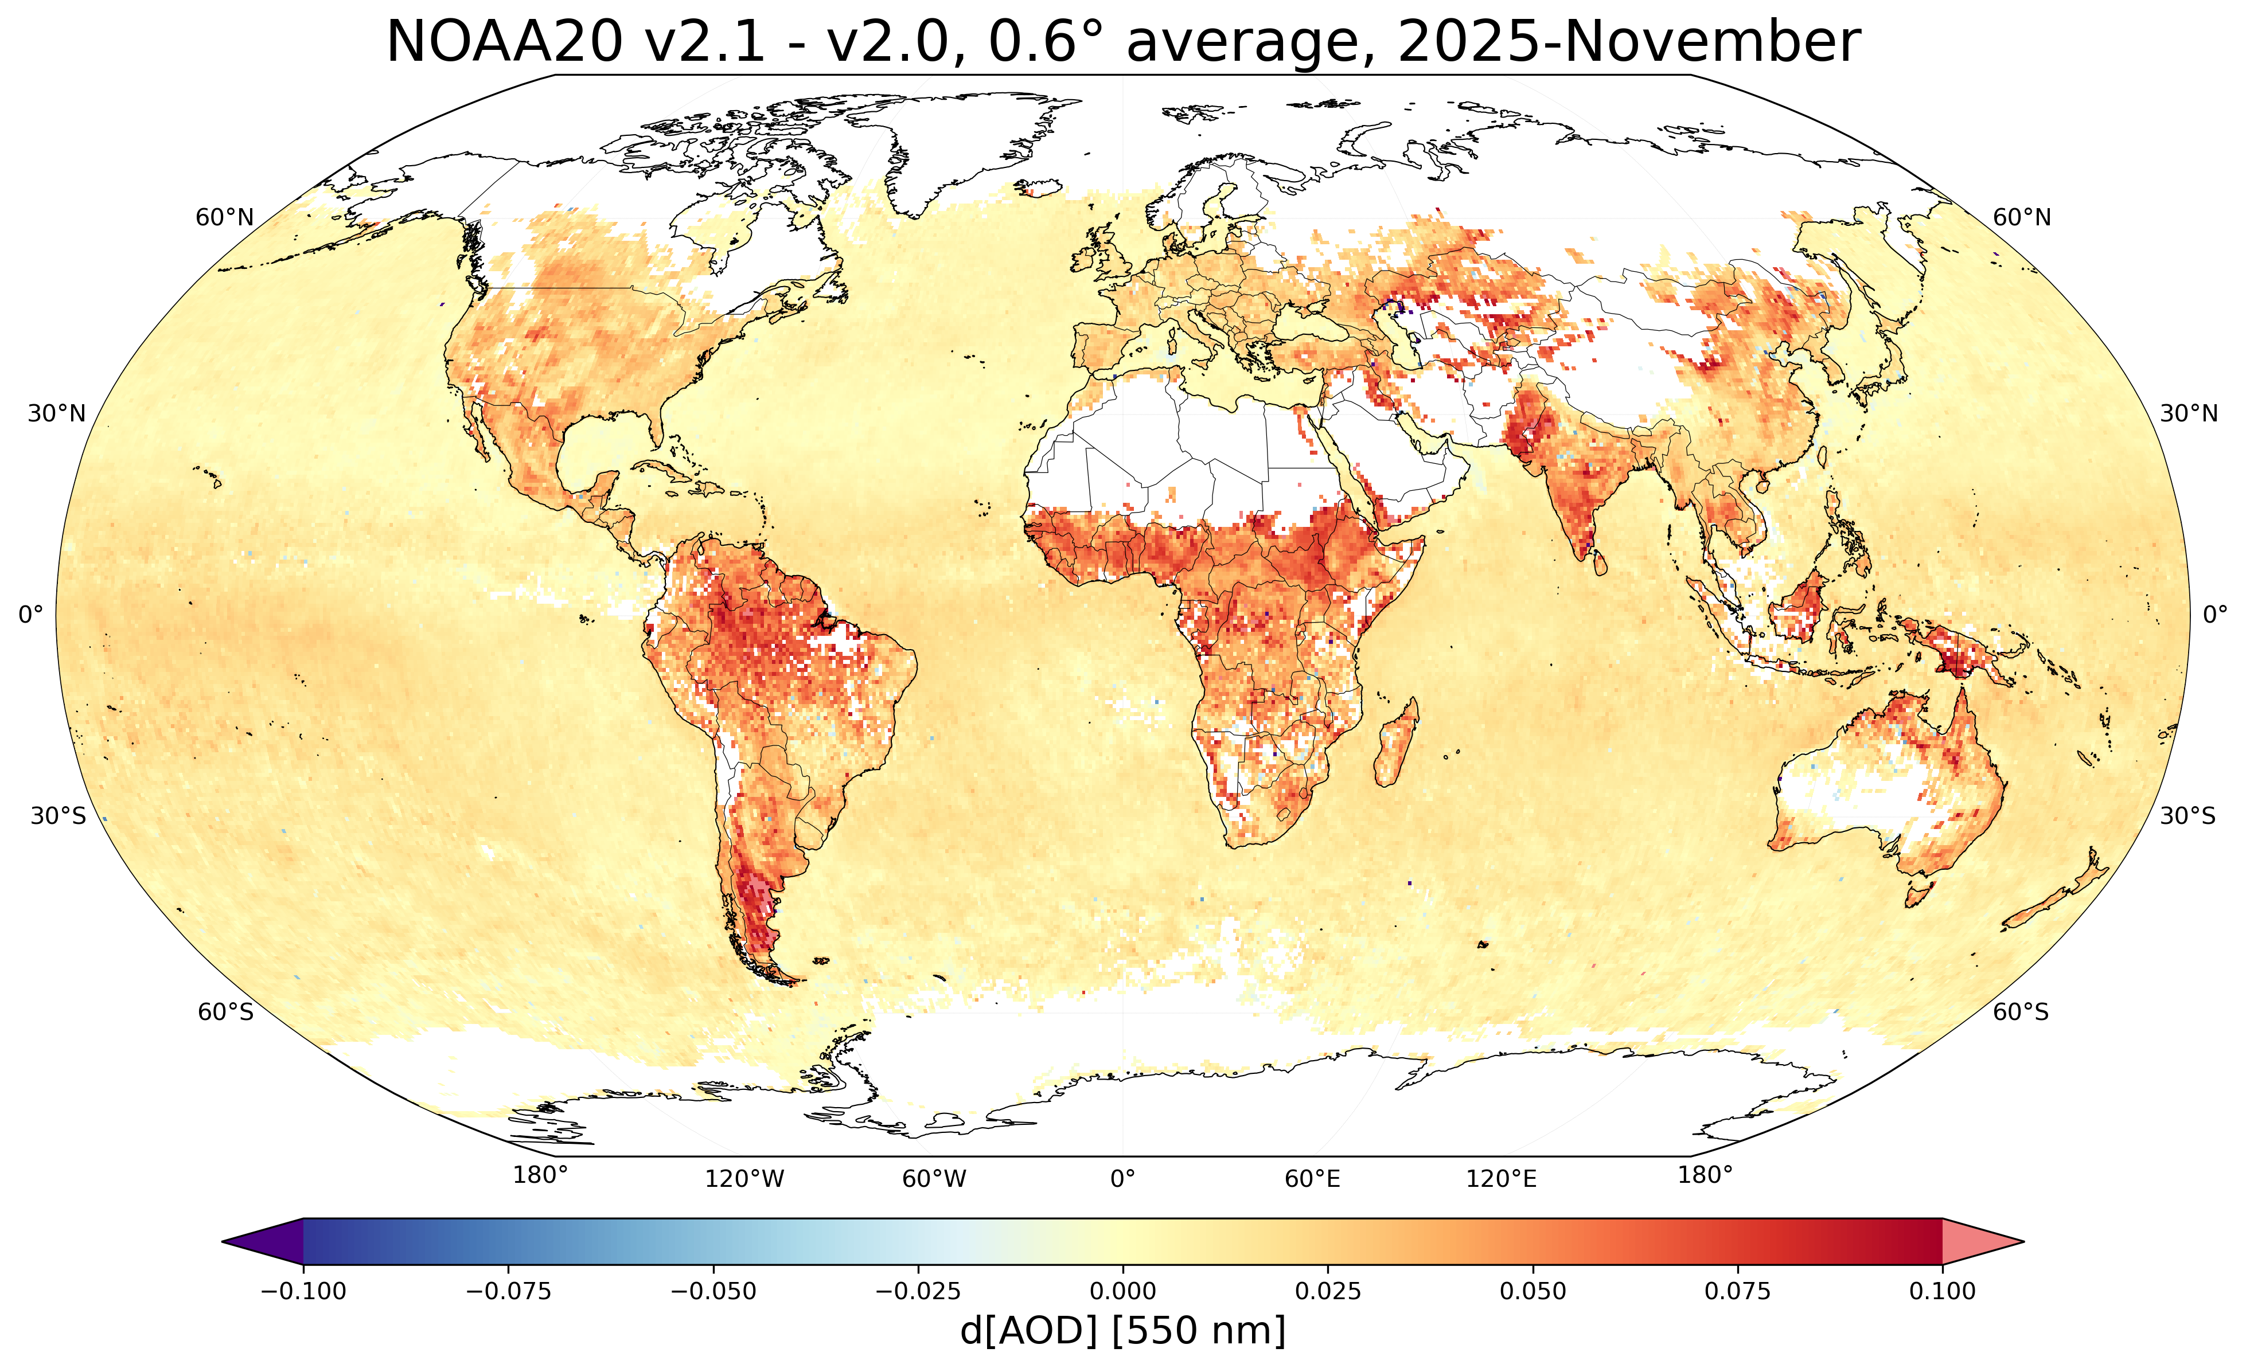
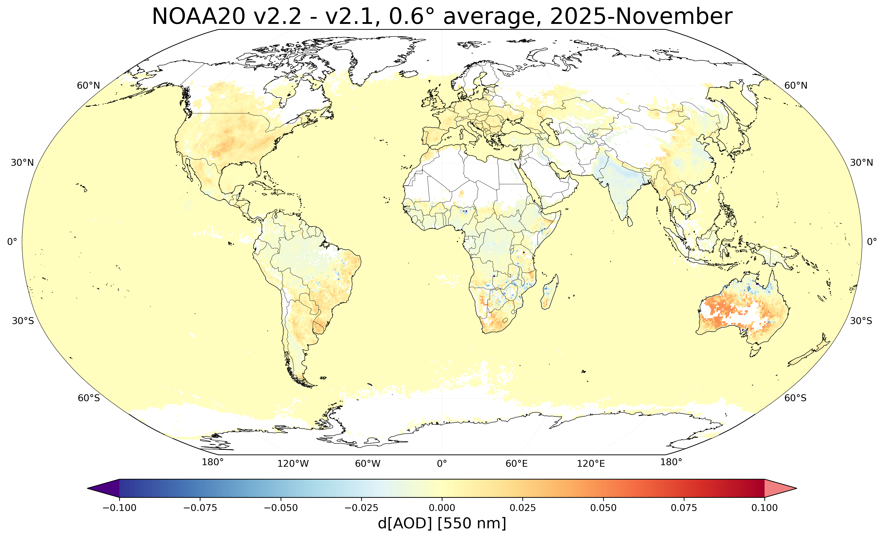


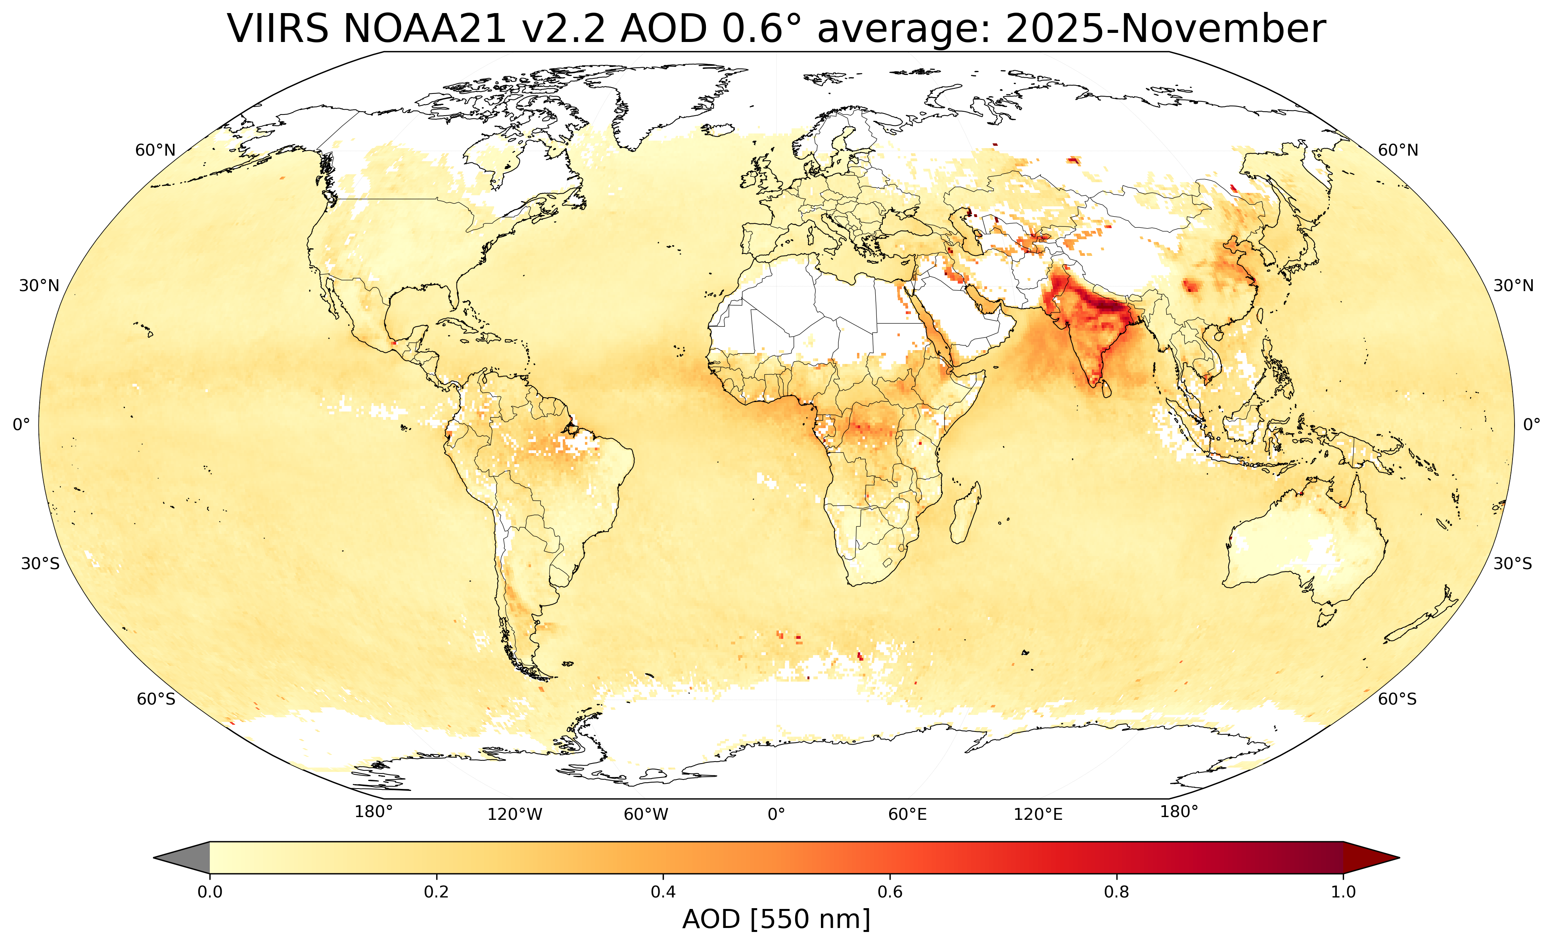
VIIRS DT AOD Changes : V2.2 vs V2.1 vs V2.0
V2.1 – V2.0
V2.2 – V2.1
V2.2
Key Changes in V2.1: X-cal, SRP over land
- Decreased SNPP over land
- Increased NOAA-20 everywhere
V2.2: Log-fit, Coastal retrieval
- Increased near-zero AOD over land
Courtesy Mijin Kim

Slide 17
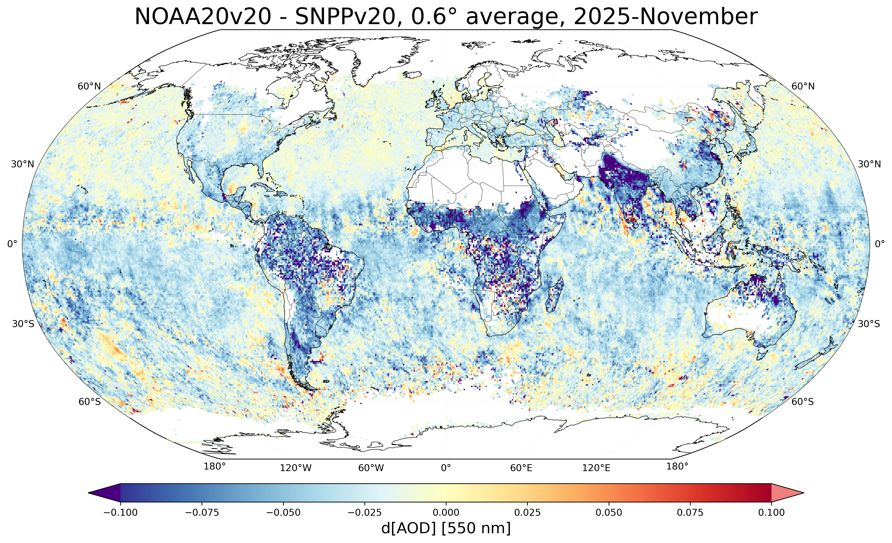
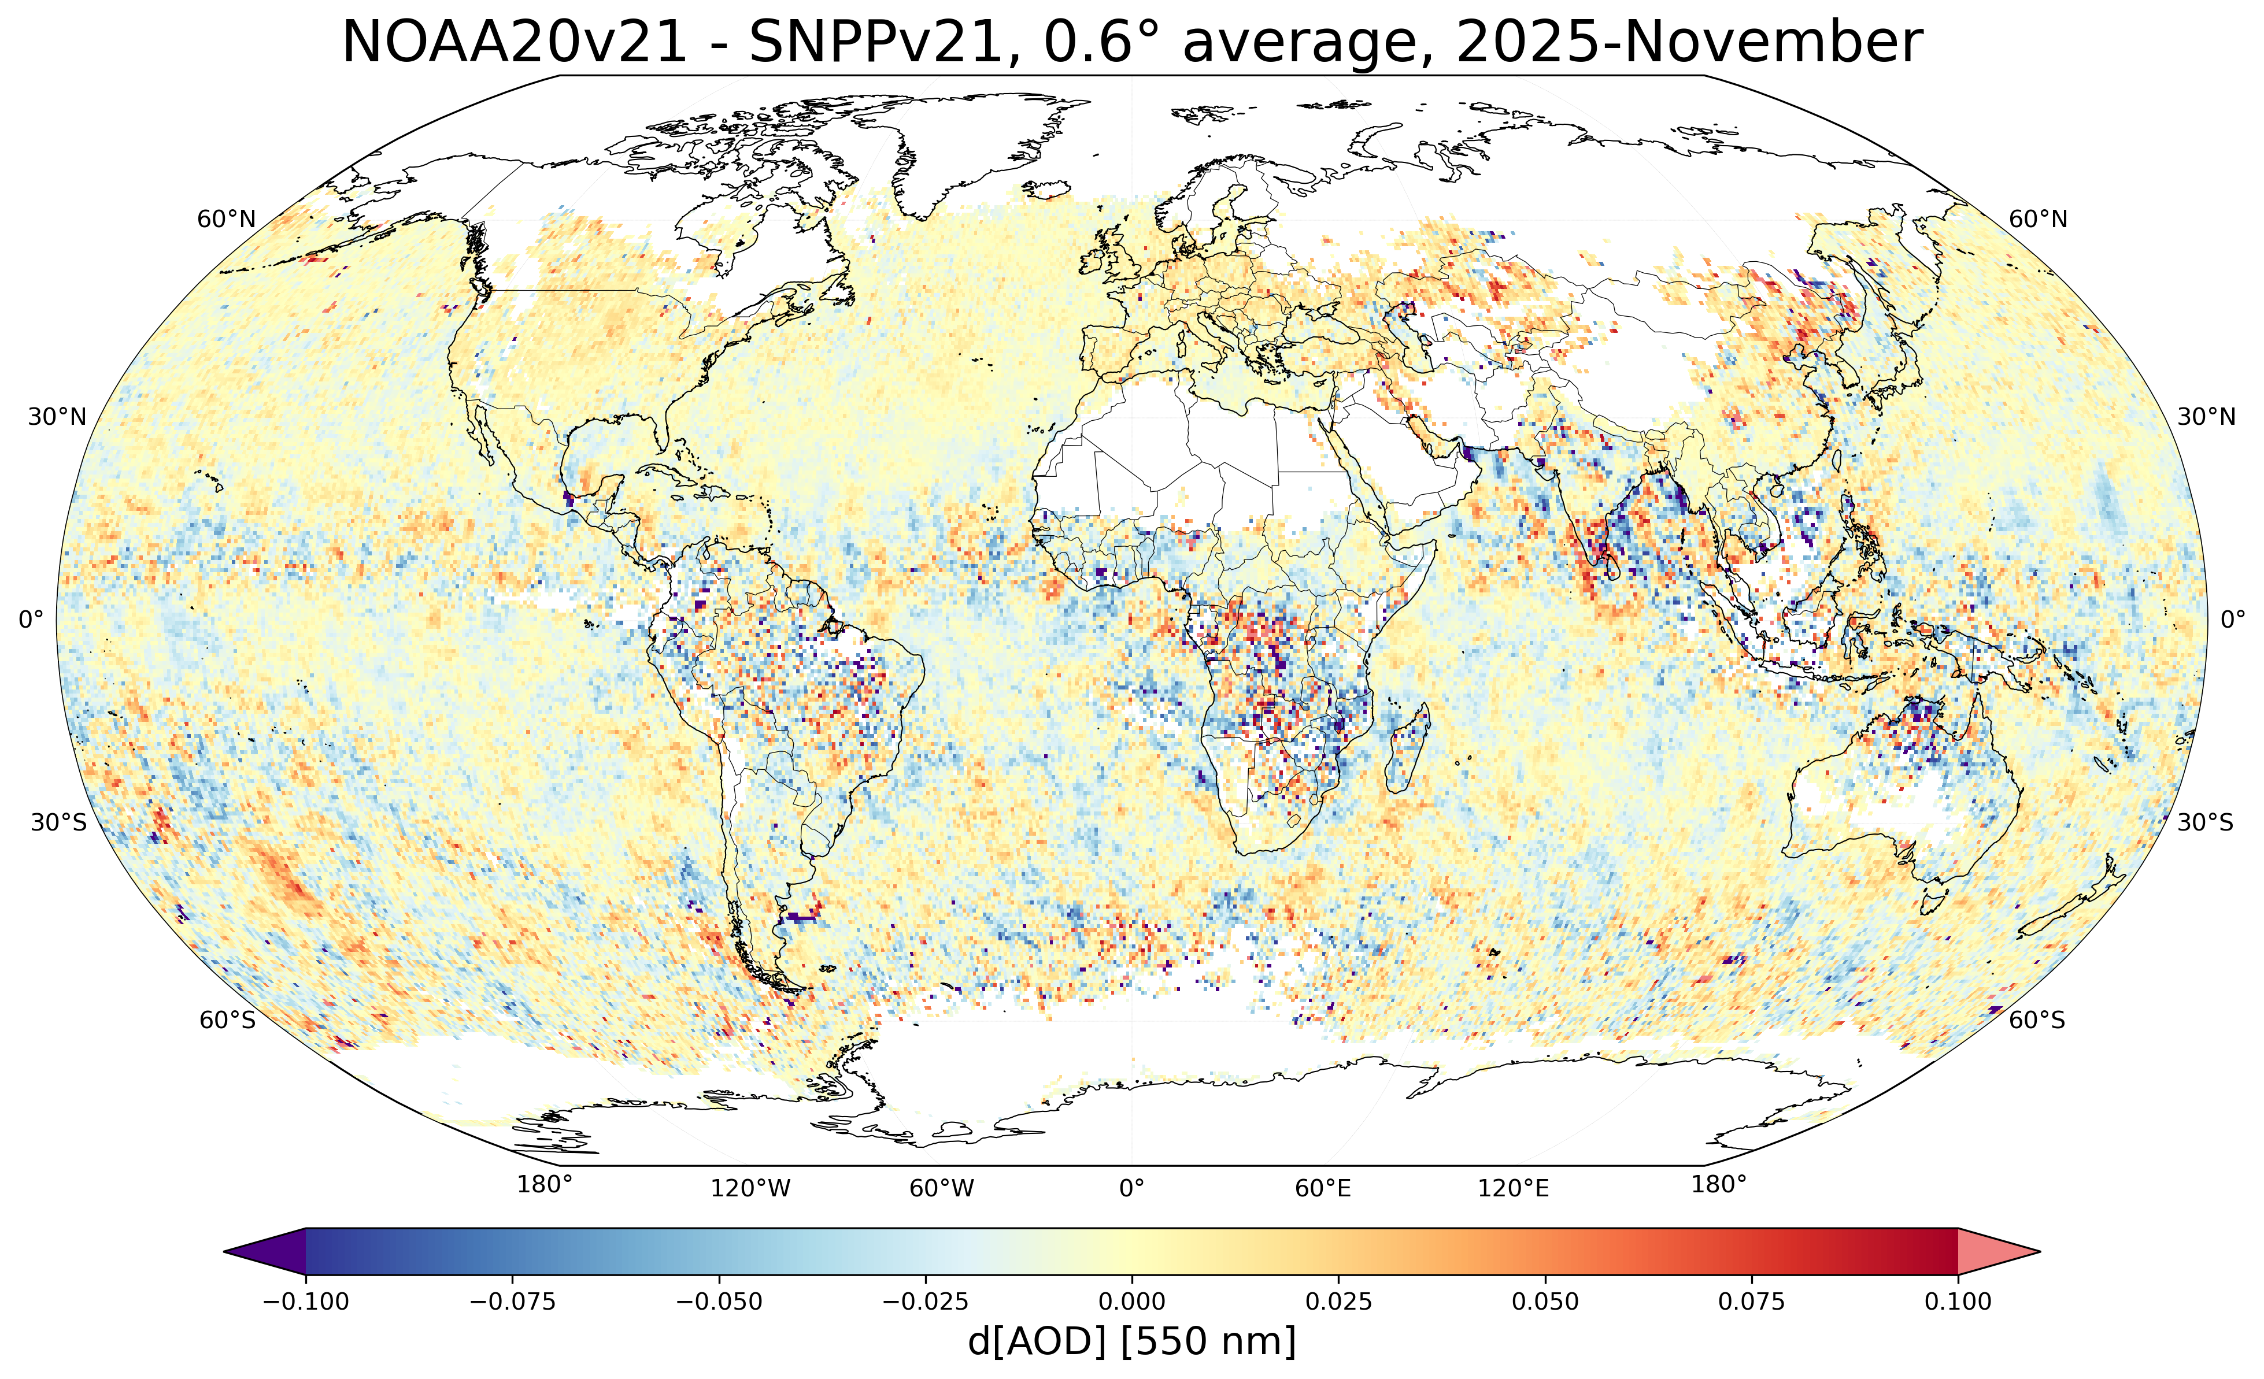
X-Cal applied reduces overall bias
V2.0 N20-SNPP (Before X-calibration)
V2.1 N20-SNPP (After X-calibration)
Overall offsets much closer to zero!
Differences are primarily due to cloud positions?
Courtesy Mijin Kim

Slide 18
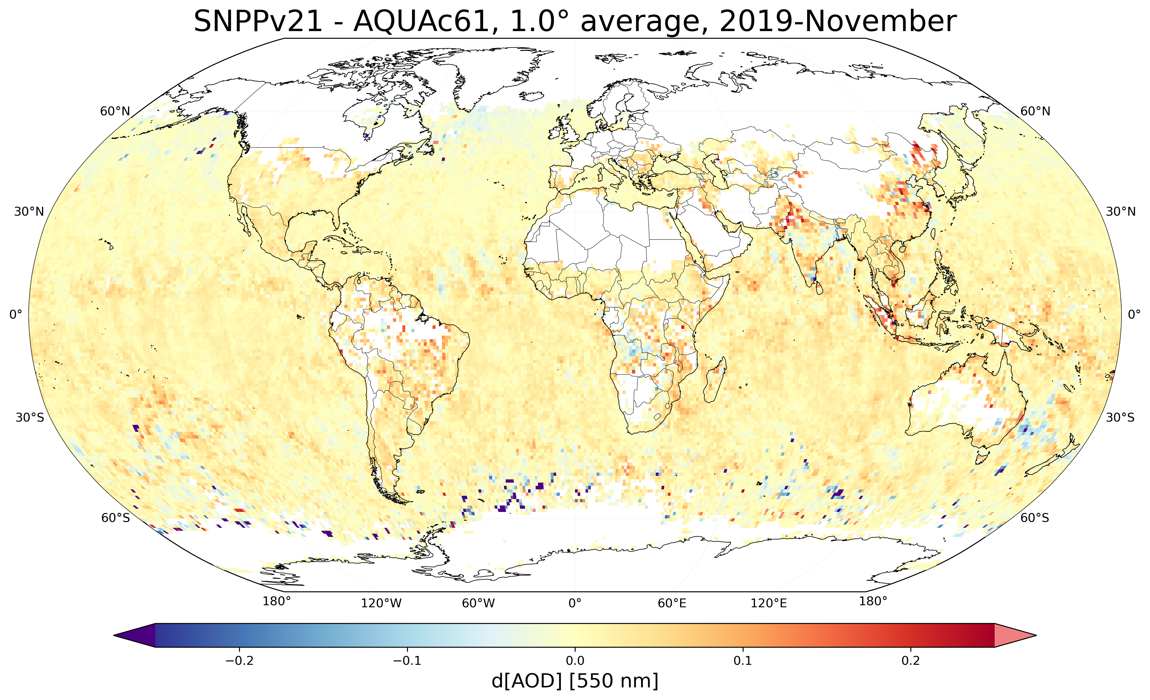
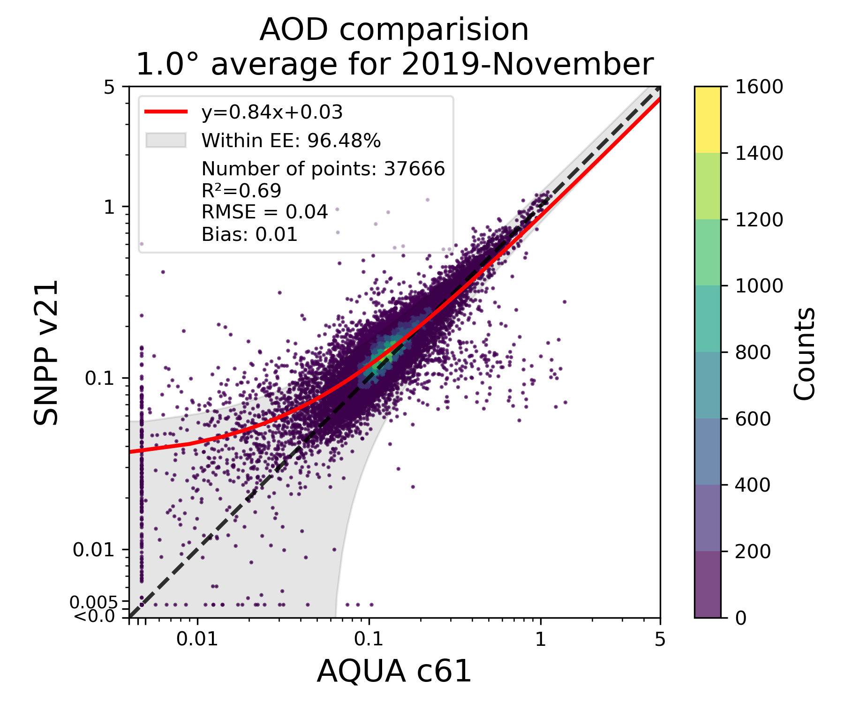
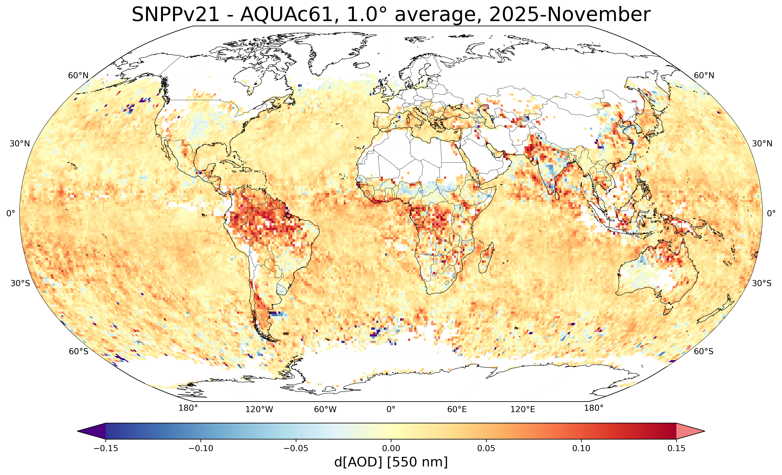
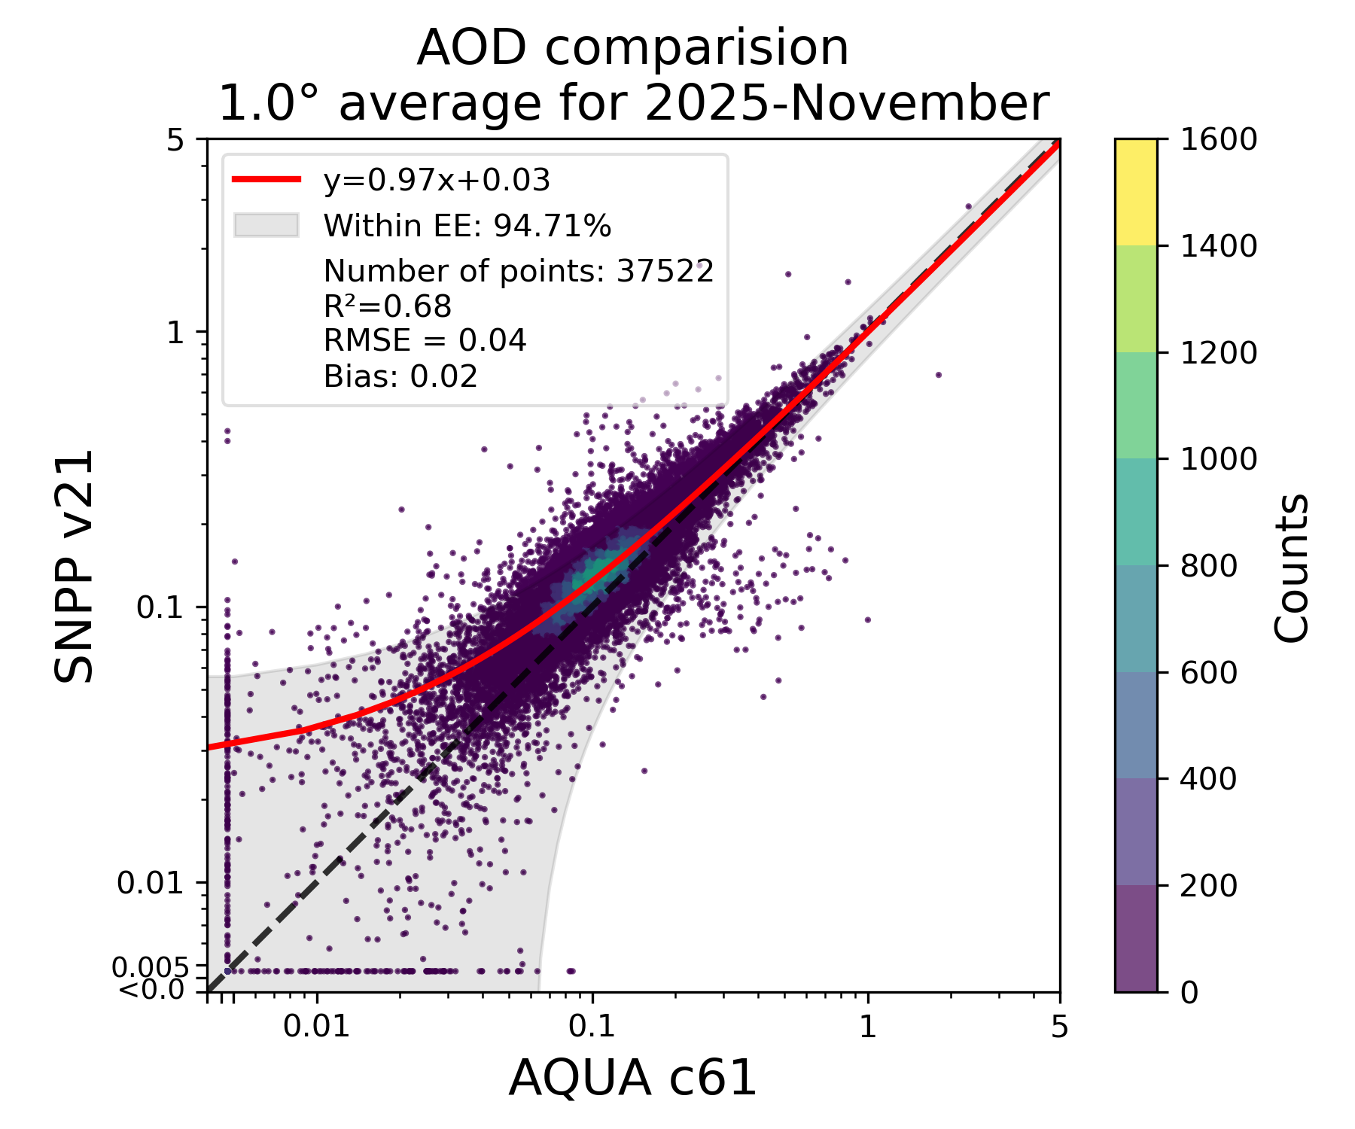
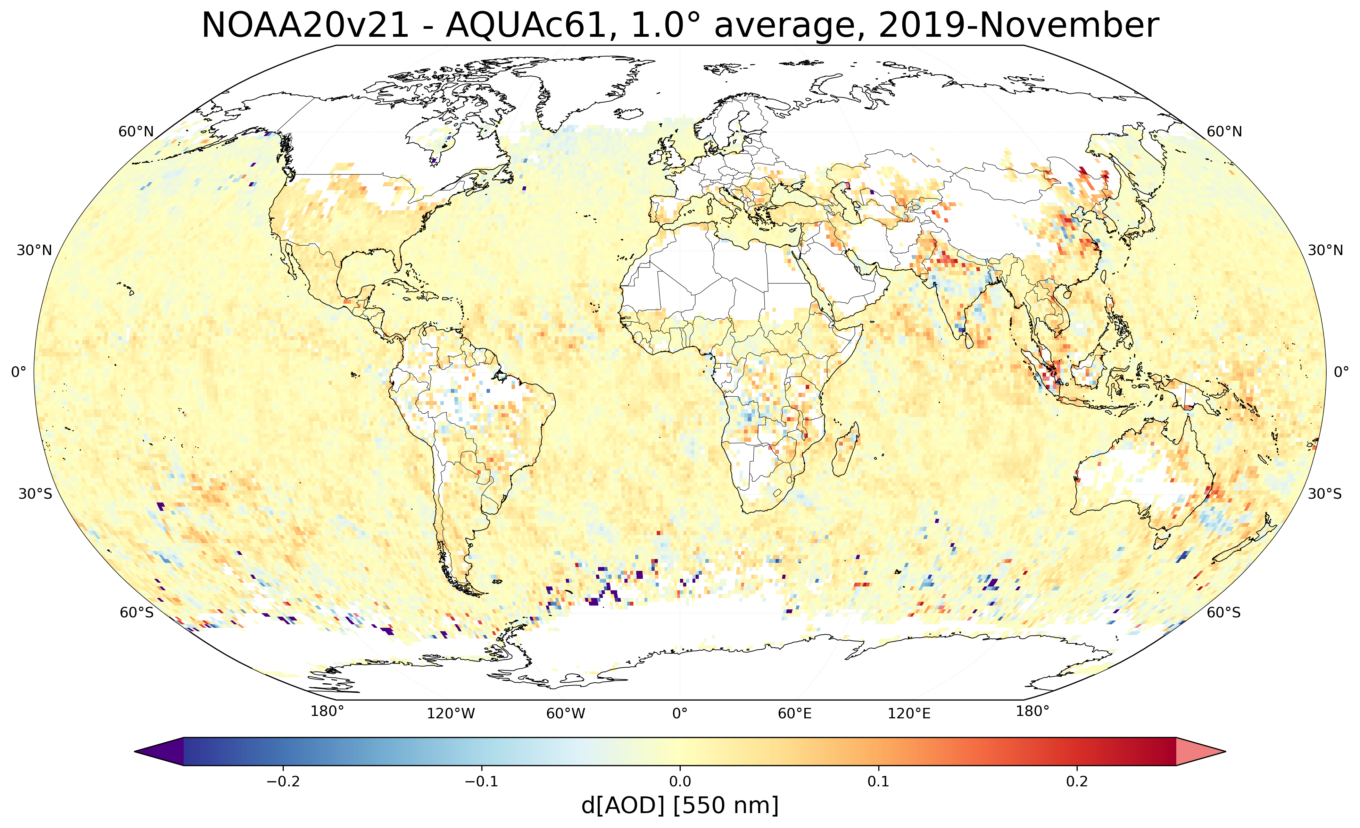

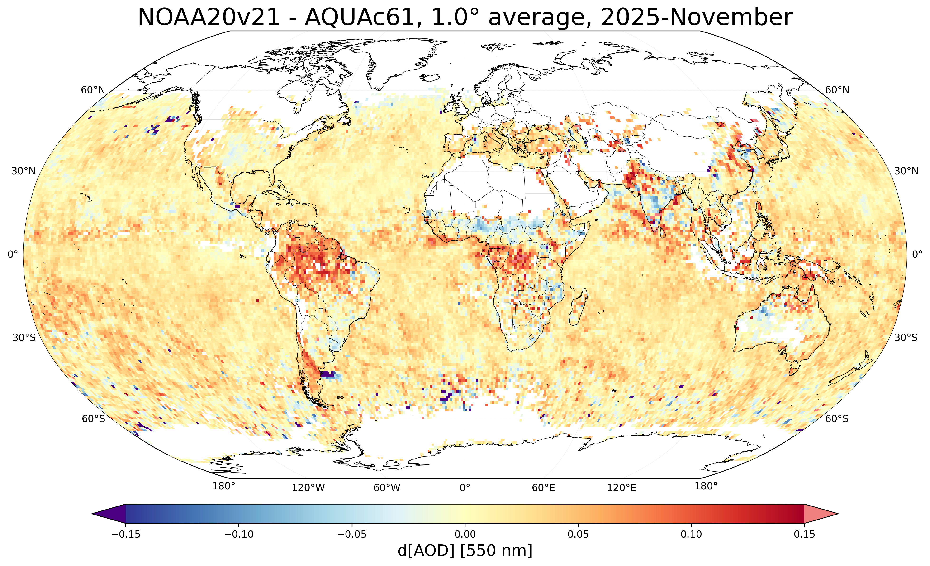
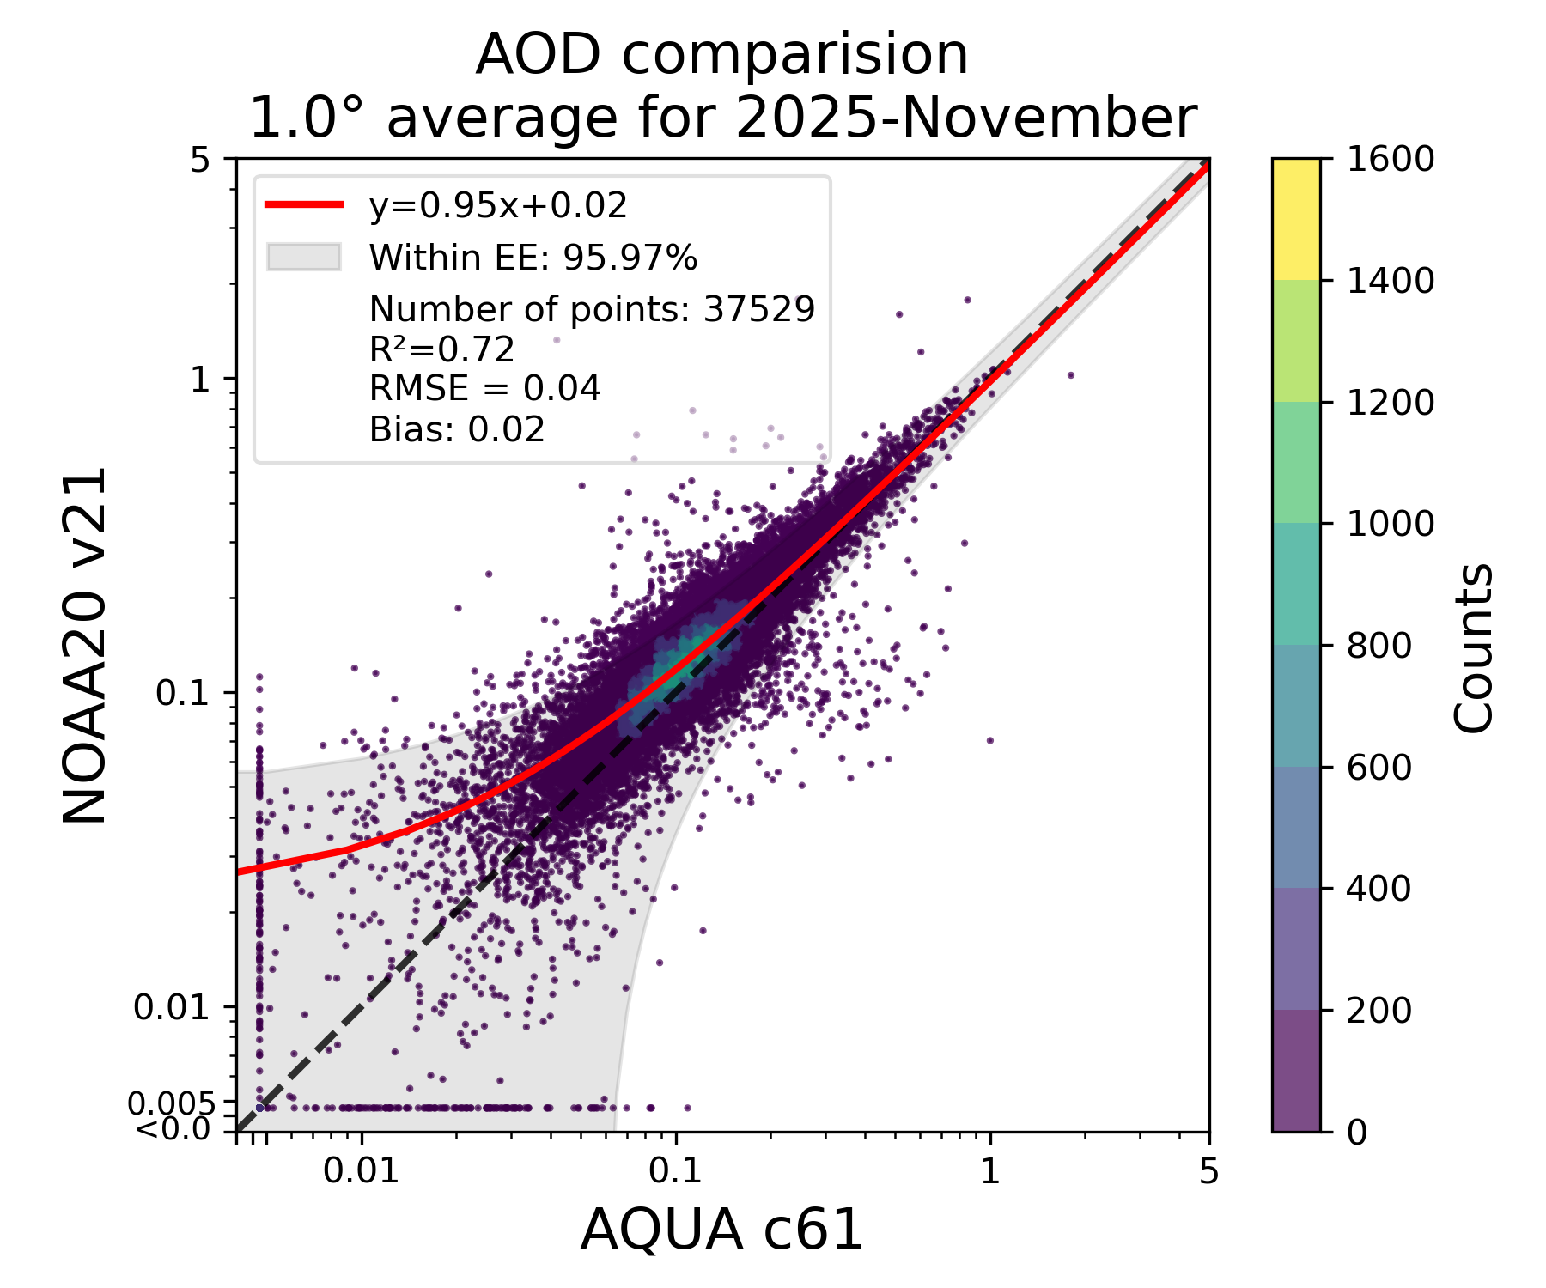
Changes in VIIRS vs. MODIS Aqua (C6.1) relationship before and after Terra drift
V2.1 vs Aqua C6.1: November 2019 (before Aqua drift)
V2.1 vs Aqua C6.1: November 2025 (1.5 hours apart!)
Land 0.026, Ocean 0.008
Land 0.029, Ocean 0.021
Land 0.018, Ocean 0.001
Land 0.023, Ocean 0.016
Courtesy Mijin Kim

Slide 19
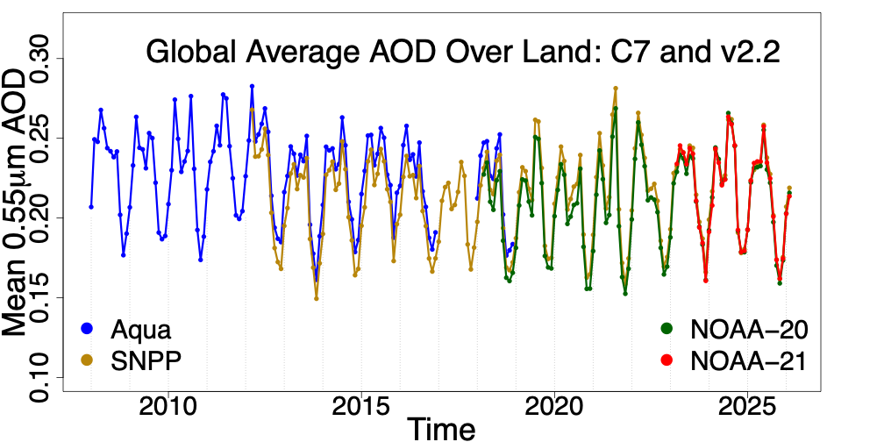
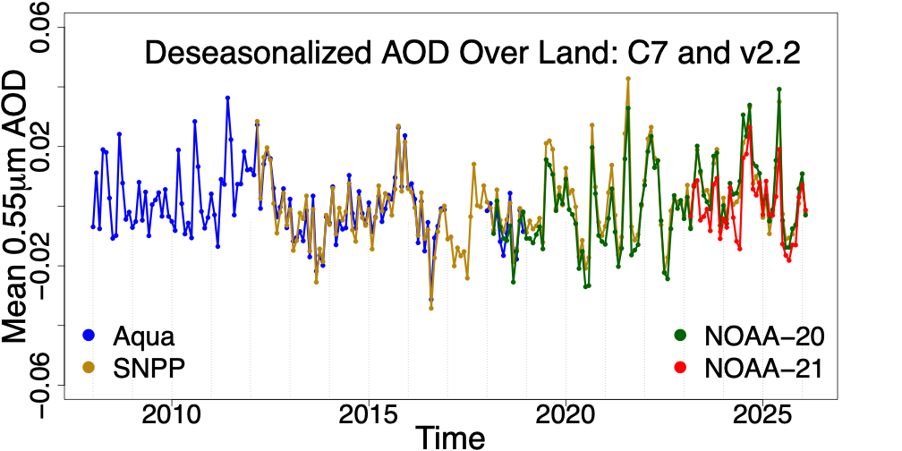
MODIS C7: ”Tier 1” (2008-2018) and three VIIRS V2.2
LAND

Slide 20
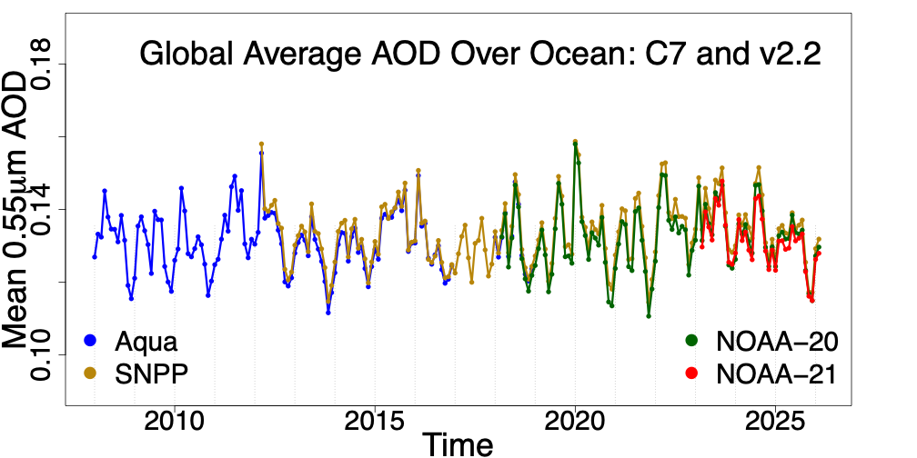
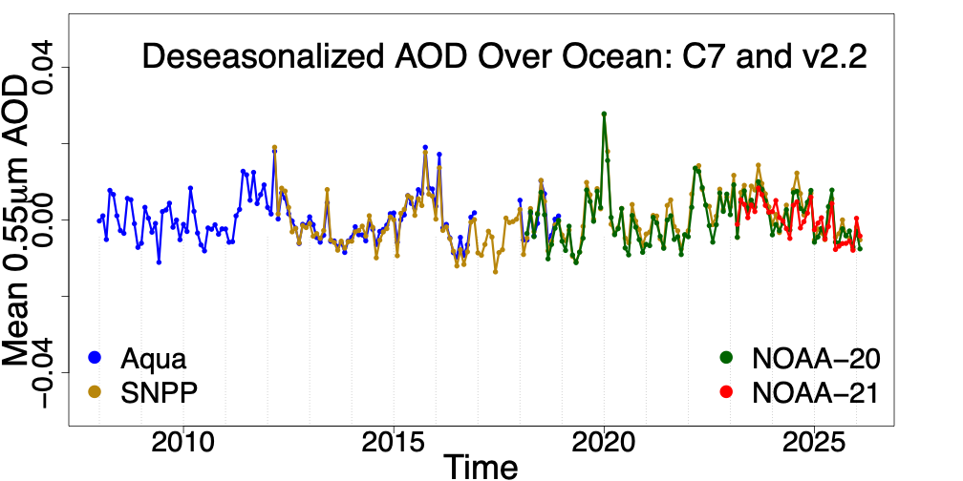
MODIS C7: ”Tier 1” (2008-2018) and three VIIRS V2.2
OCEAN

Slide 21
MODIS C7 vs VIIRS 2.2
Overall tendencies are even more consistent!
All AODs within ± 0.01-ish!
We are doing much better!!!
Note, no X-Cal applied to MODIS-Terra

Slide 22

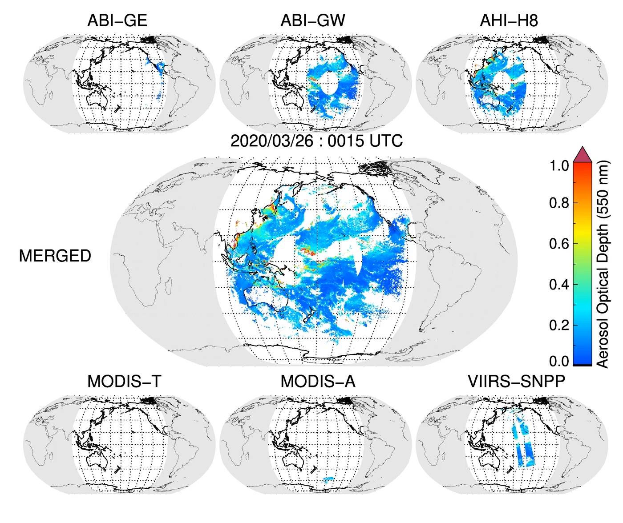

Dark Target (DT) Aerosol Retrieval Project
One algorithm + many sensors = All daylight globe
https://ladsweb.modaps.eosdis.nasa.gov/missions-and-measurements/applications/geoleo/
https://darktarget.gsfc.nasa.gov

