Slide 1
Long-Term Monitoring of AMI VIS/NIR Radiometric Performance and Initial Results from AMI-AHI Inter-Comparison
Hanbyul Lee

Slide 2
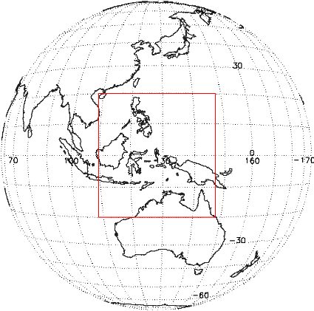
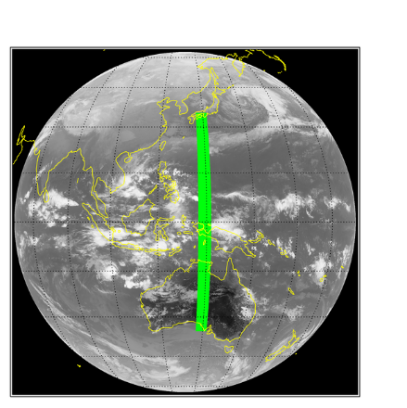
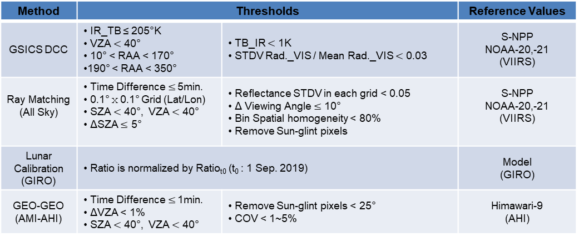
KMA’s Calibration
  GEO-LEO (AMI-VIIRS)
Monitoring GK2A AMI VIS/NIR Radiometric performance
  Ray Matching(Terra MODIS, S-NPP VIIRS, NOAA-20,21 VIIRS)
  GSICS DCC(S-NPP VIIRS, NOAA-20,21 VIIRS)
  Lunar calibration(GIRO)
  GEO-GEO (AMI-AHI)
Results period: Aug. 2019. ~ Dec. 2025.
Method | Thresholds |  | Reference Values
GSICS DCC | IR_TB ≤ 205°K VZA $<$ 40° 10° < RAA < 170° 190° < RAA < 350° | TB_IR $<$ 1K STDV Rad._VIS / Mean Rad._VIS $<$ 0.03 | S-NPP NOAA-20,-21 (VIIRS)
Ray Matching (All Sky) | Time Difference $≤$ 5min. 0.1°ⅹ0.1° Grid (Lat/Lon) SZA $<$ 40°, VZA $<$ 40° ΔSZA $≤$ 5° | Reflectance STDV in each grid < 0.05 Δ Viewing Angle $≤$ 10° Bin Spatial homogeneity < 80% Remove Sun-glint pixels | S-NPP NOAA-20,-21 (VIIRS)
Lunar Calibration (GIRO) | Ratio is normalized by Ratio_{t0} (t₀ : 1 Sep. 2019) |  | Model (GIRO)
GEO-GEO (AMI-AHI) | Time Difference $≤$ 1min. ΔVZA < 1% SZA $<$ 40°, VZA $<$ 40° | Remove Sun-glint pixels < 25° COV < 1~5% | Himawari-9 (AHI)
Lat. : ± 20°
Lon. : 108.2° ~ 148.2°
  GEO-GEO (AMI-AHI)
Lat. : ± 35°
Lon. : 132° ~ 137°

Slide 3
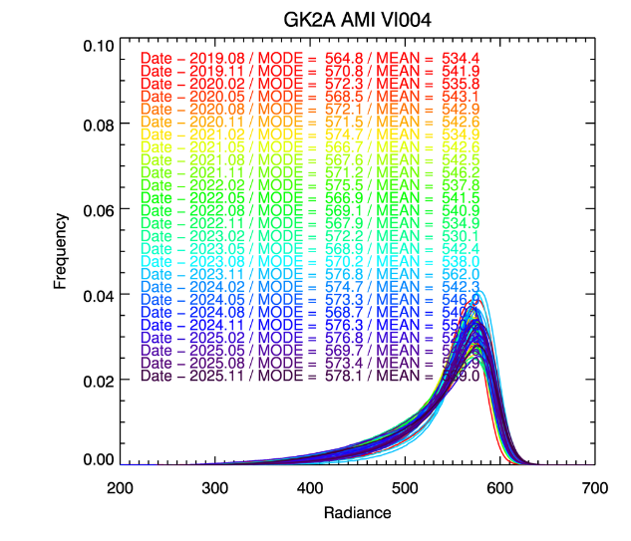
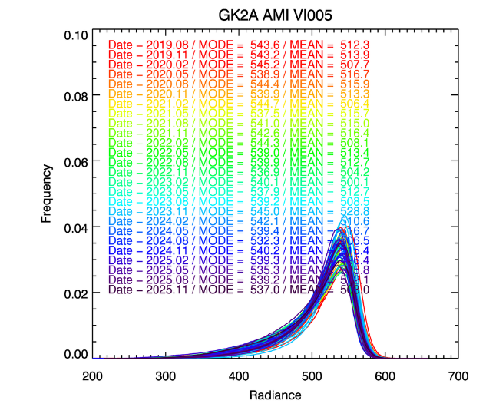
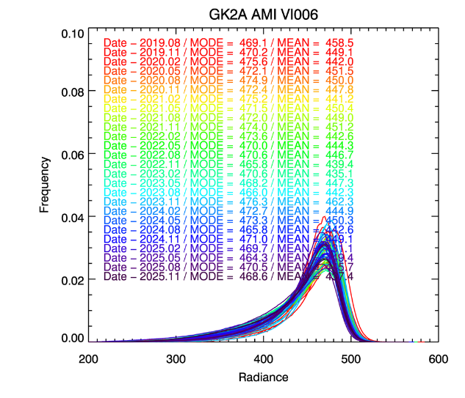
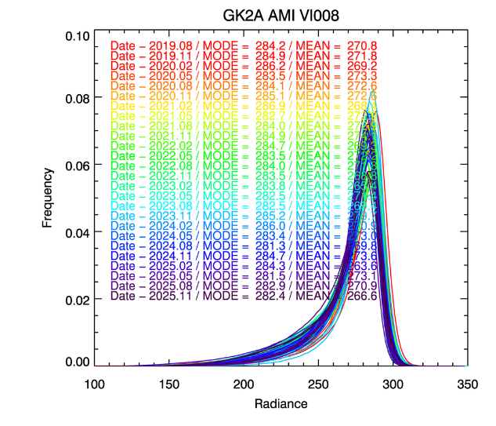
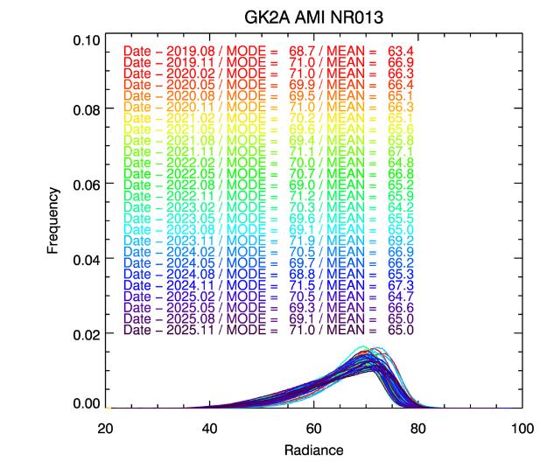
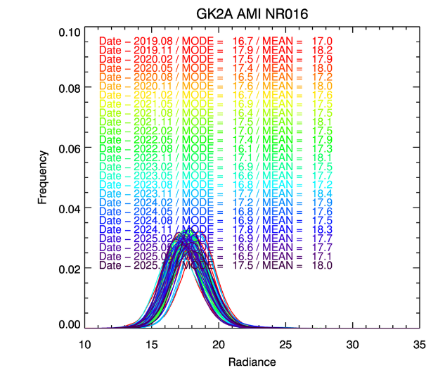
AMI Radiance, DCC Target
(Aug. 2019. ~ Dec. 2025.)

Slide 4
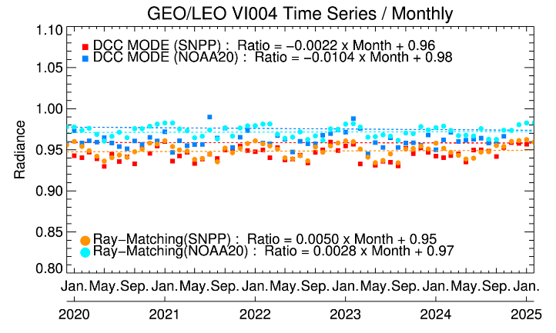
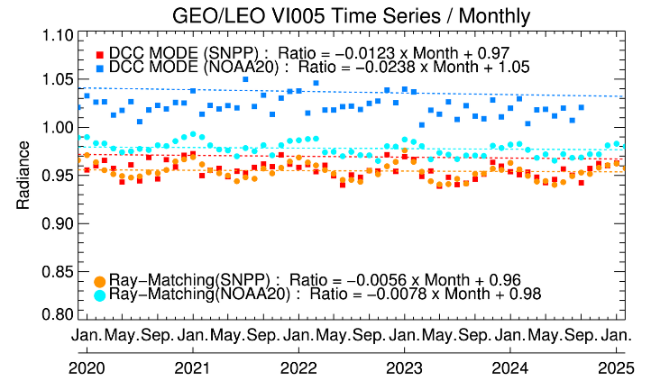
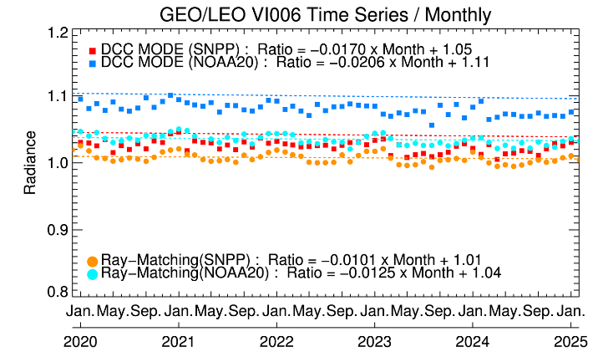
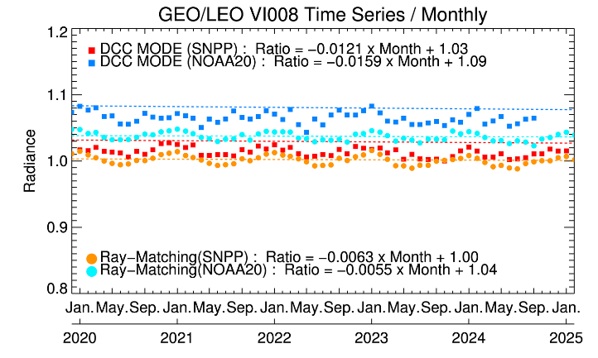
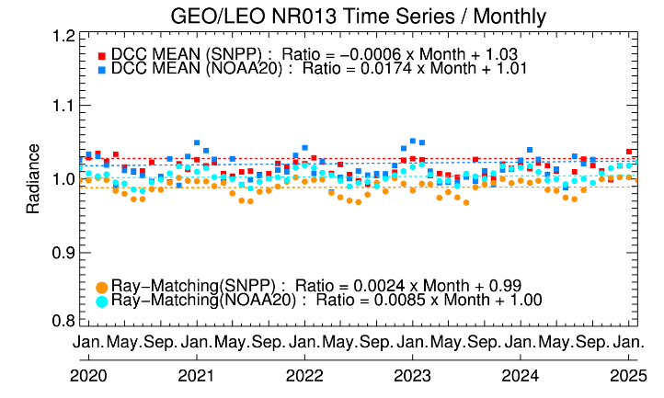
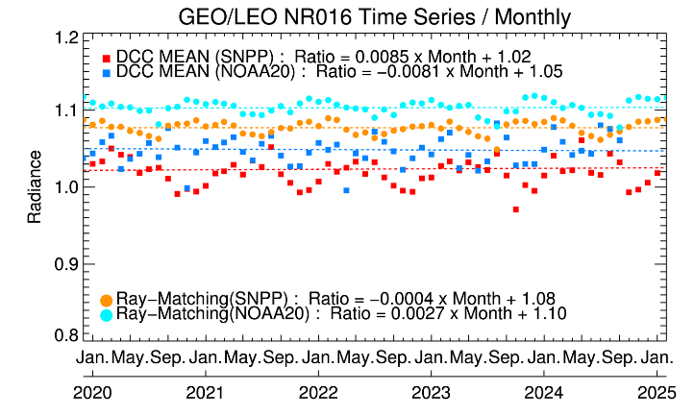
Timeseries of DCC with Ray-matching
AMI/VIIRS ratio of DCC radiance with AMI/VIIRS Ray-matching from Aug. 2019. to Dec. 2025.
  Ray-Matching: data selected for DCC Reflectance : < 0.8 (VI004~VI008), < 0.6(NIR013), < 0.1(NIR band)

Slide 5
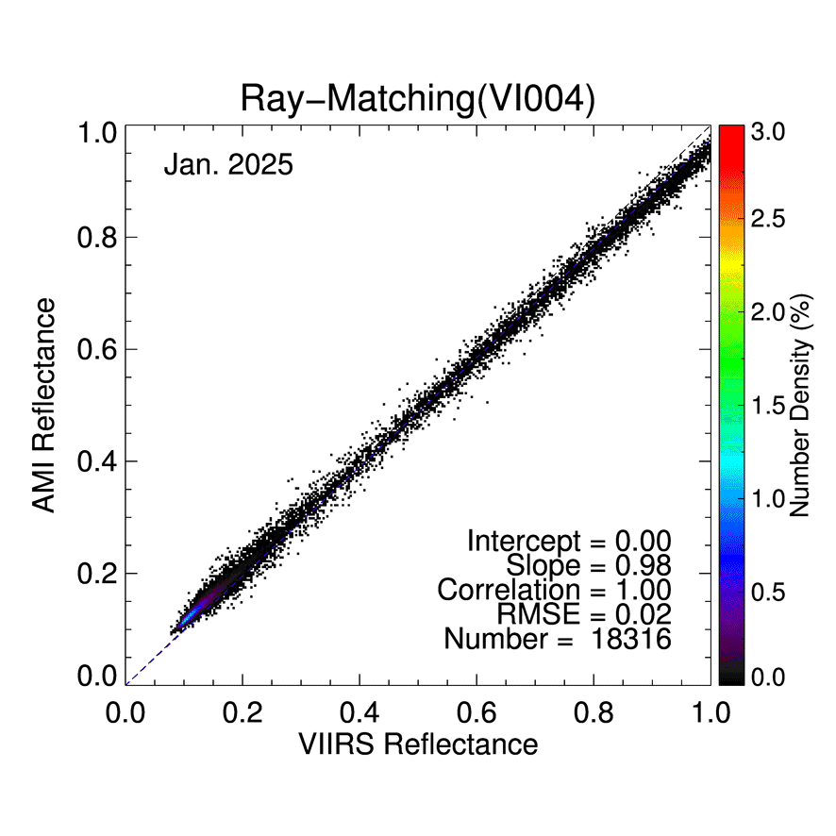
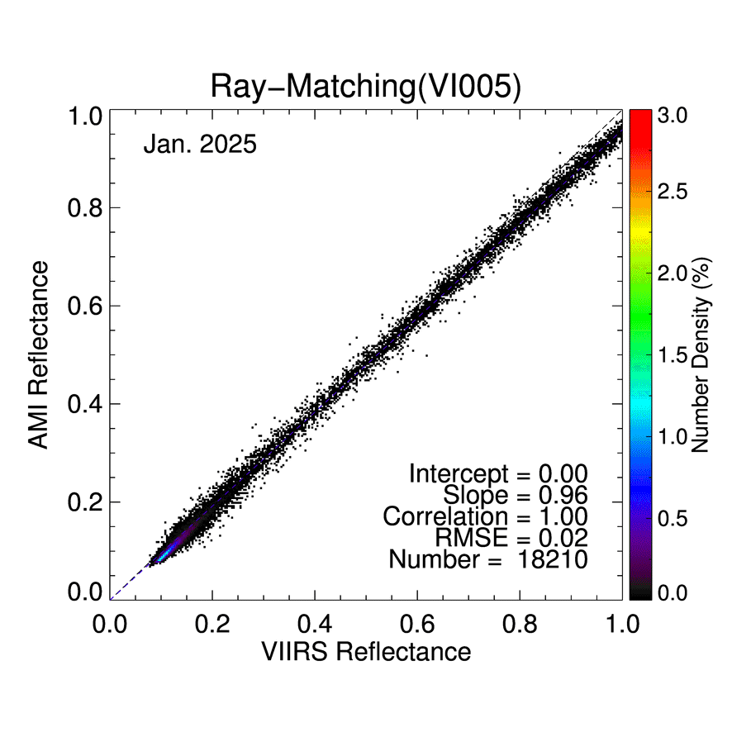
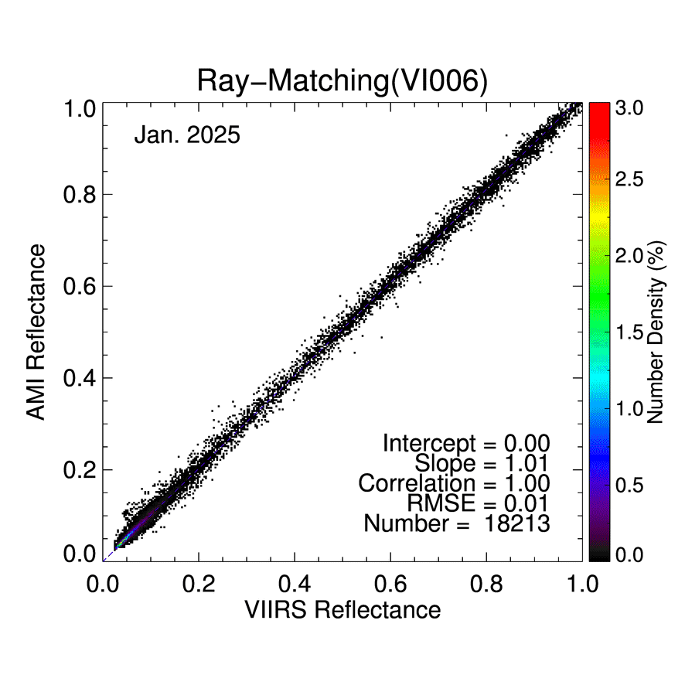
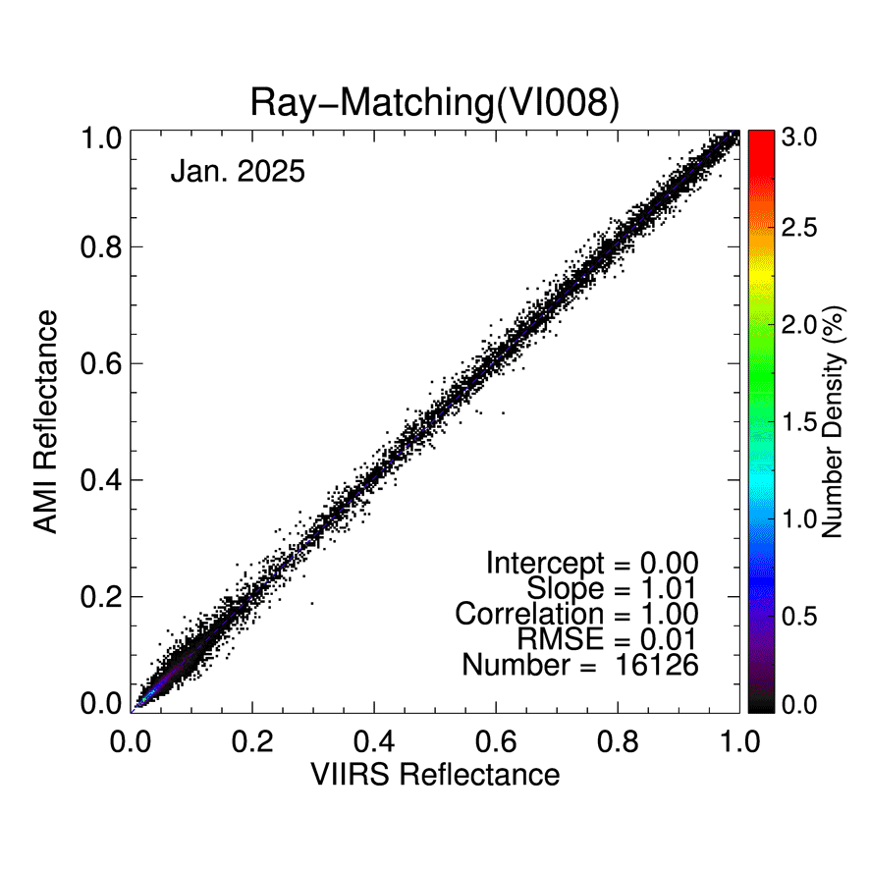
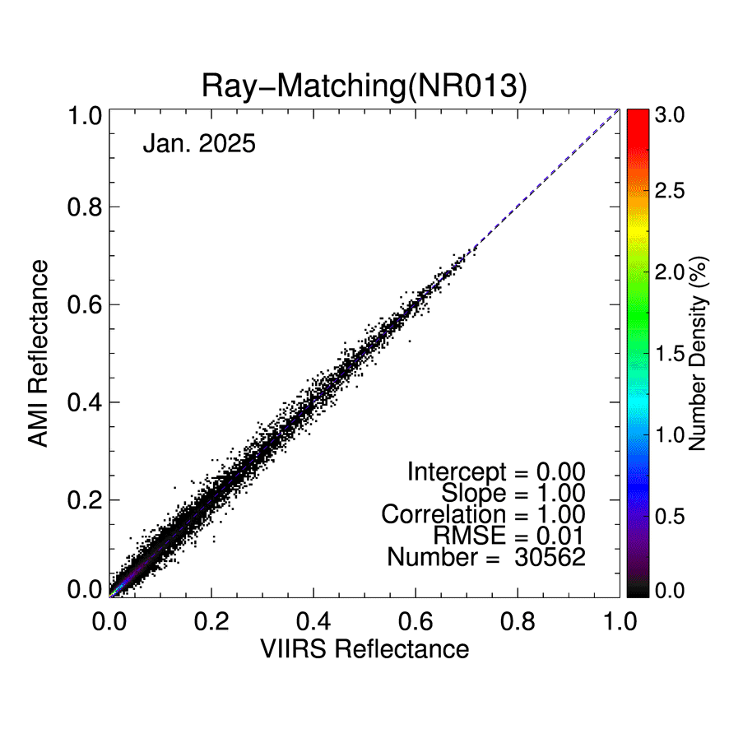
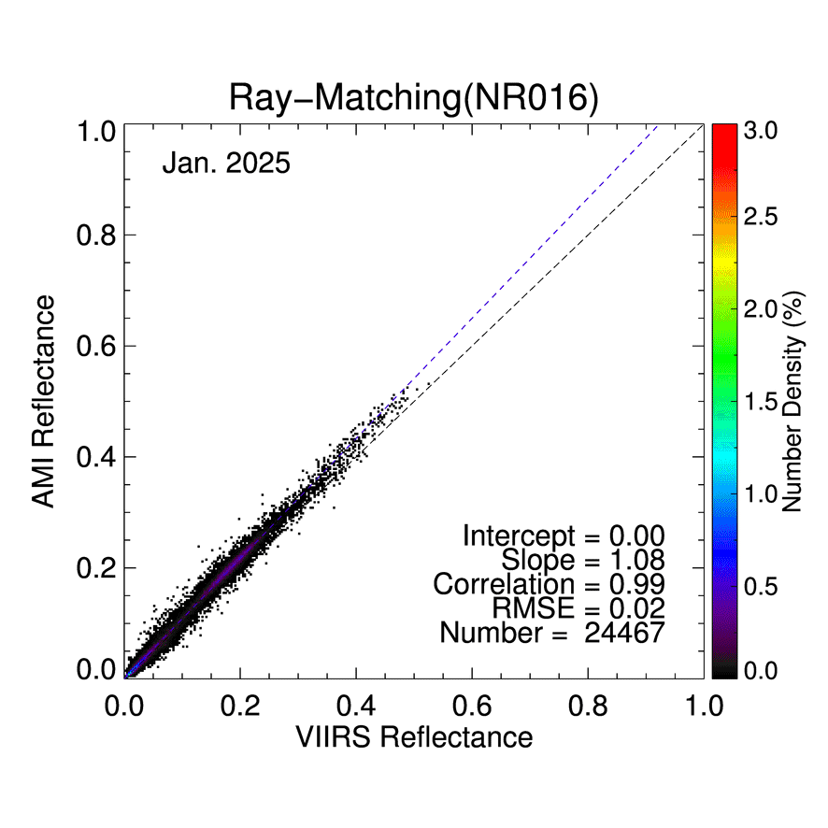
Monthly Scatter plot
AMI vs VIIRS (2025)

Slide 6
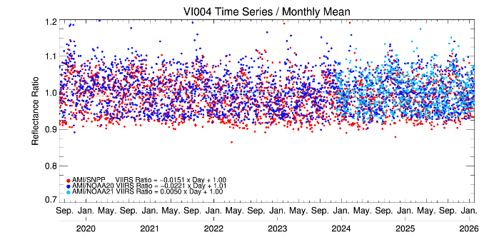
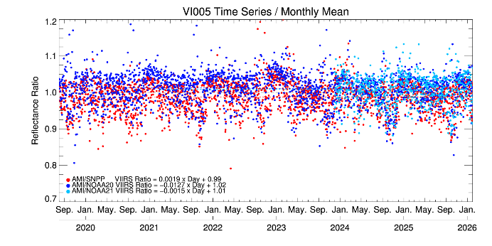
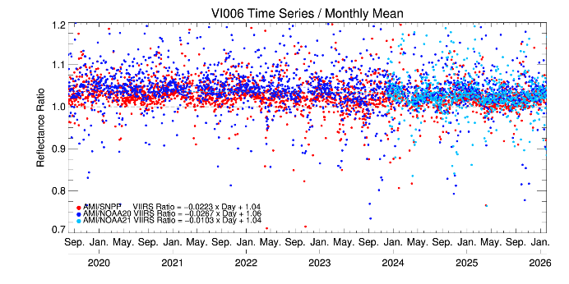
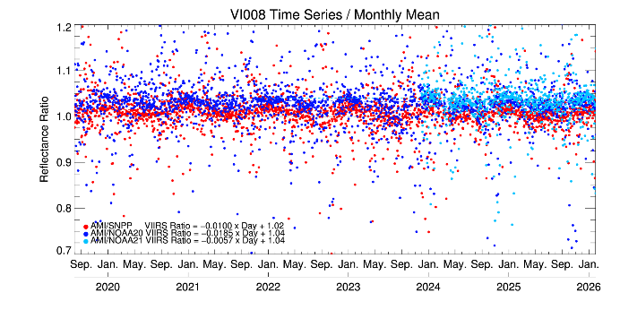
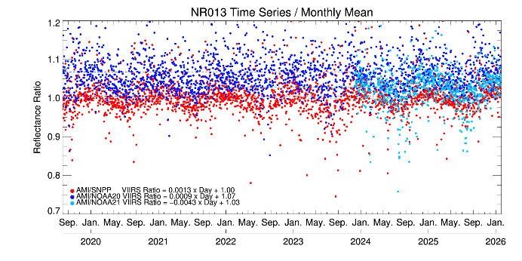
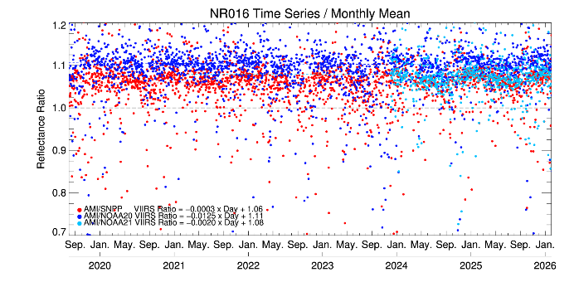
Daily Timeseries (AMI vs VIIRS)
AMI vs. VIIRS(SNPP, NOAA-20,-21)
(Aug. 2019. ~ Feb. 2026.(SNPP, NOAA-20), Sep. 2023. ~ Feb. 2026.(NOAA-21) )
Daily Mean Bias (Uncertainty)
 | VI004 | VI005 | VI006 | VI008 | NR013 | NR016
SNPP | -3.74 (±2.10) | -0.51 (±1.07) | 1.80 (±0.98) | 0.30 (±1.05) | -1.97 (±0.68) | 4.92 (±0.96)
NOAA-20 | -1.87(±1.76) | 1.63(±1.14) | 3.38(±1.02) | 2.06(±1.17) | 2.8(±0.63) | 8.49(±1.01)
NOAA-21 | -2.05(±1.74) | 1.64(±1.24) | 2.14(±1.00) | 2.57(±1.26) | 0.76(±0.75) | 6.2(±0.97)

Slide 7
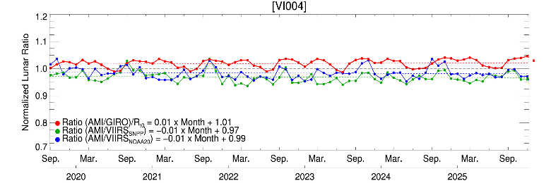
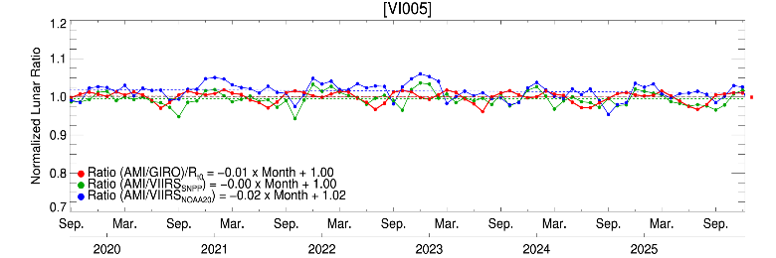
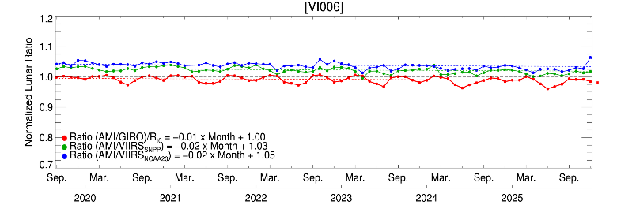
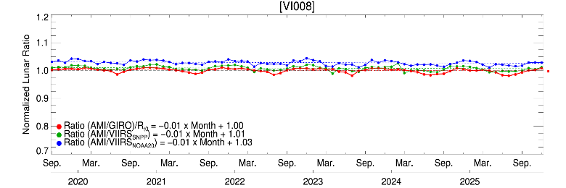
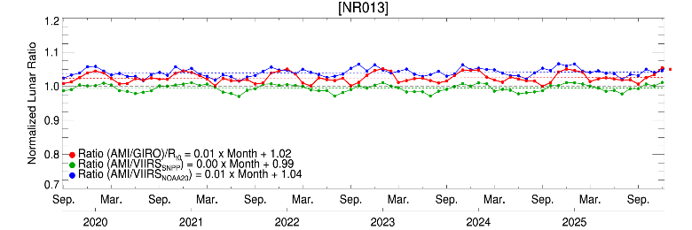
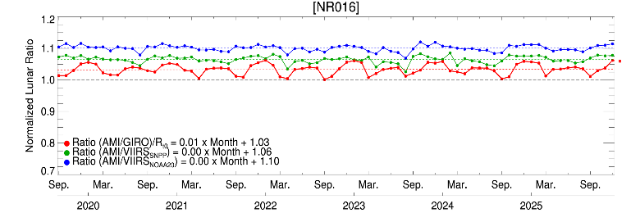
Monthly Lunar ratio(GIRO) with Ray-Matching
(Sep. 2019 ~ Jan. 2026)
Reference Satellite | Mean Bias (Uncertainty)
Channel | Lunar (GIRO) | S-NPP /VIIRS | NOAA-20 /VIIRS
VI004 | -1.8 (±0.79 ) | -1.87 (±1.76) | -2.05 (±1.74)
VI005 | -0.47 (±0.59) | 1.63 (±1.14) | 1.64 (±1.24)
VI006 | 0.53 (±0.21) | 3.38 (±1.02) | 2.14 (±1.00)
VI008 | 0.18 (±0.13) | 2.06 (±1.17) | 2.57 (±1.26)
NR013 | -2.08 (±0.19) | 2.8 (±0.63) | 0.76 (±0.75)
NR016 | -2.1 (±0.20) | 8.49 (±1.01) | 6.2 (±0.97)
Note : Sub-sampled lunar observations are shown, Ratio is normalized by Ratio_{t0} (t₀ : 1 Sep. 2019)

Slide 8
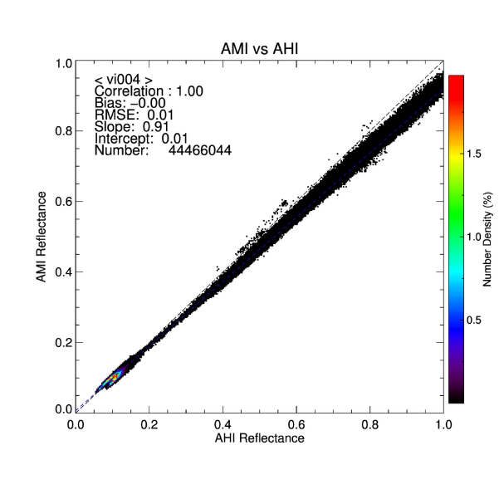
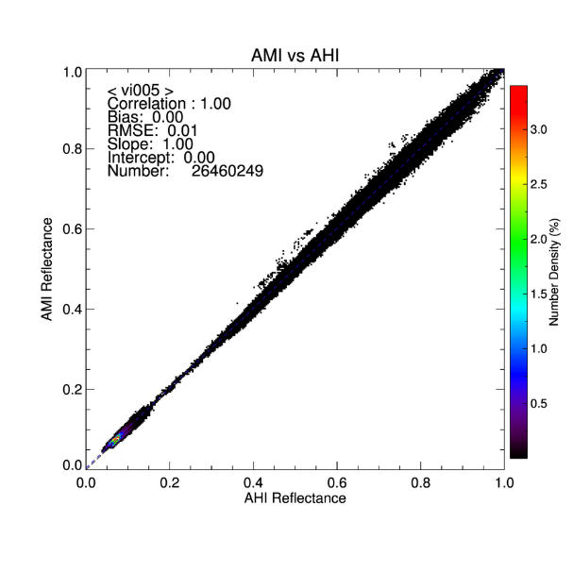
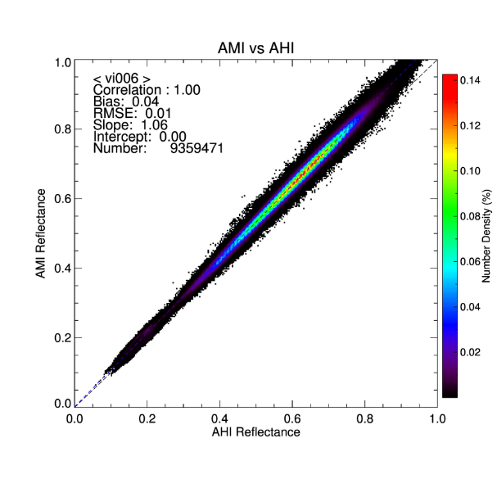
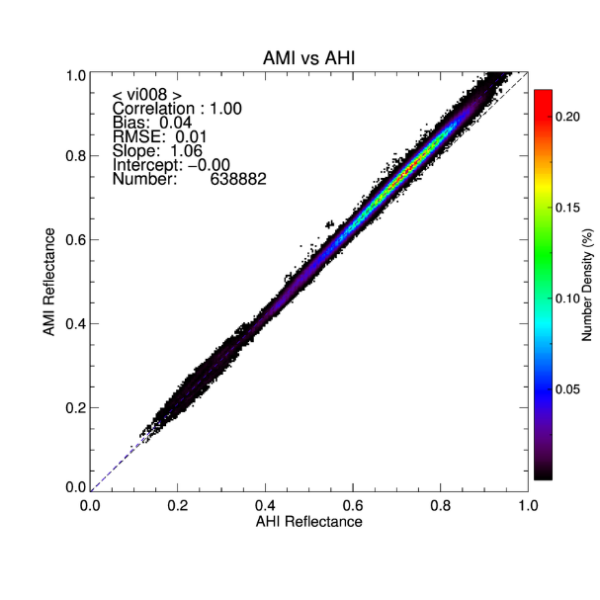
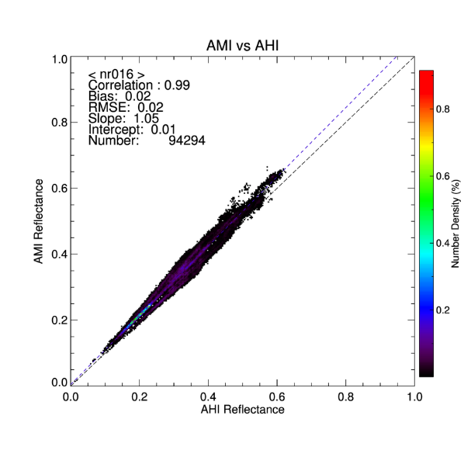
Scatter plot (2024)
Channel | Corr. | Slope | RMSE | Bias
VI004 | 1.00 | 0.91 | 0.01 | 0.0
VI005 | 1.00 | 1.00 | 0.01 | 0.0
VI006 | 1.00 | 1.06 | 0.01 | 0.4
VI008 | 1.00 | 1.06 | 0.01 | 0.4
NIR016 | 0.99 | 1.05 | 0.02 | 0.02

Slide 9
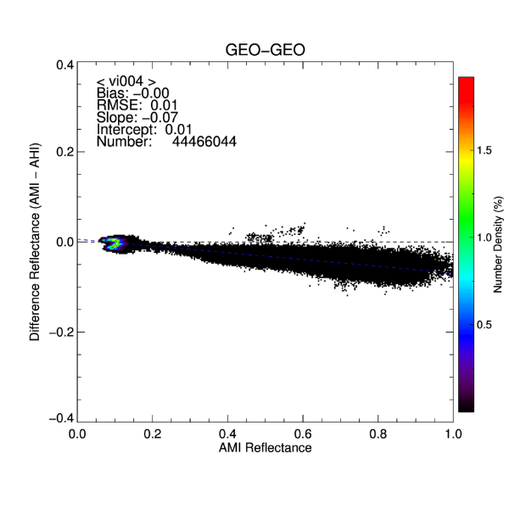
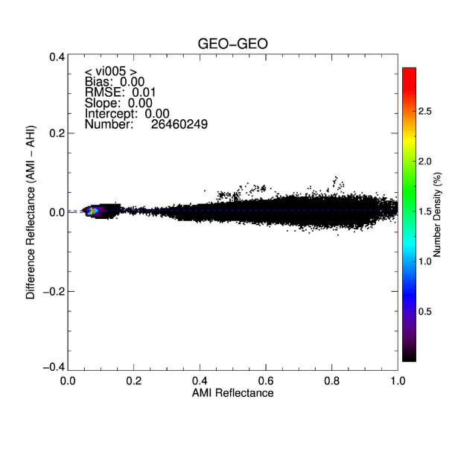
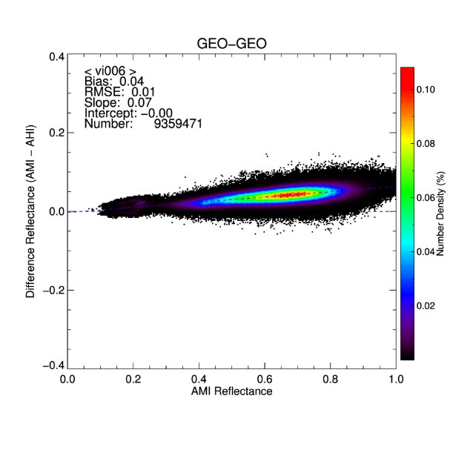
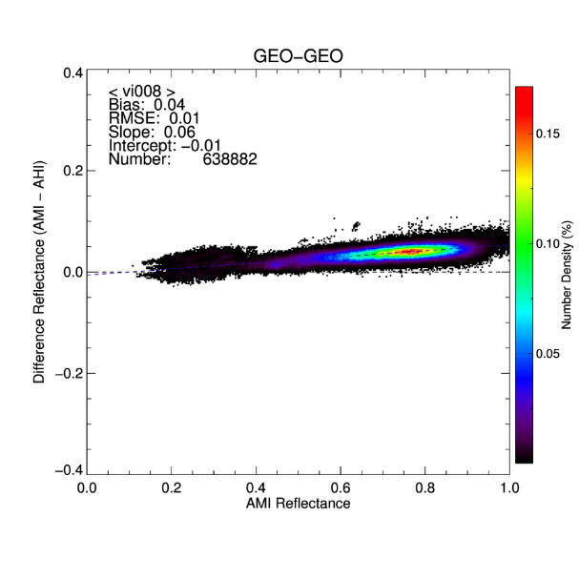
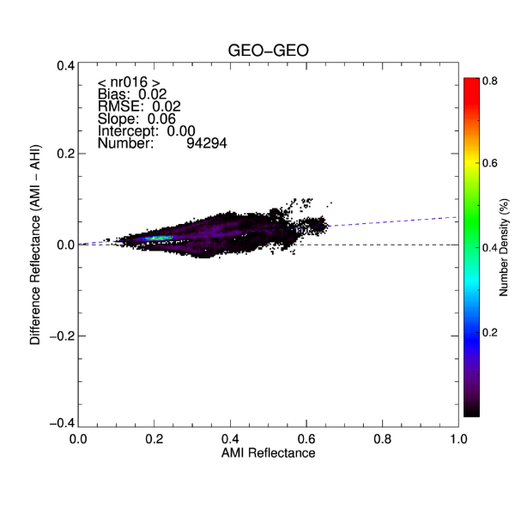
Scatter plot (2024)
AMI-AHI differences increase with AMI reflectance
Only VI004 channel shows a negative slope

Slide 10
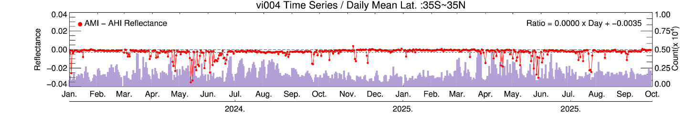
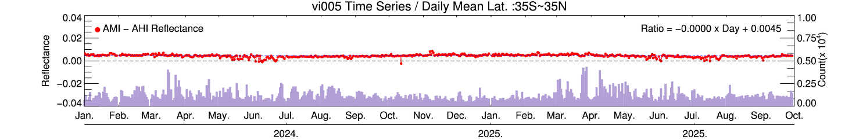
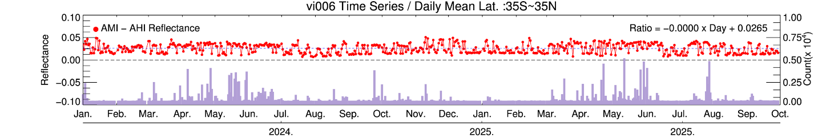
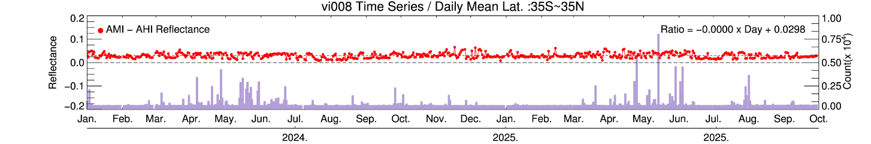
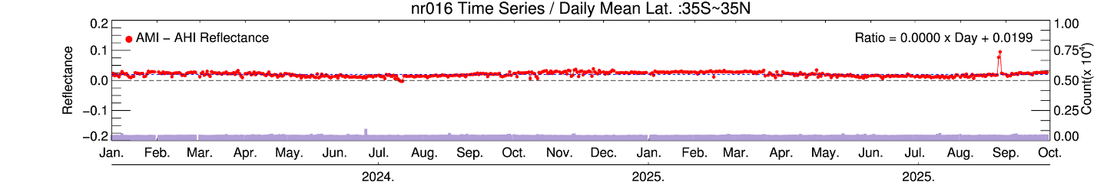
Daily Timeseries (AMI - AHI)
(2024.01 ~2025.10)
VI004: negative deviations during the summer season, likely related to parallax effects
Other channels: consistent variability patters
Overall, stable behavior between the AMI and AHI

Slide 11
Summary and Future Plan
GK2A AMI VIS/NIR Calibration
  AMI VIS/NIR radiometric performance has remained stable since launch
  Long-term Ray-Matching analysis with VIIRS shows <1% degradation, indicating consistent performance over time
  AMI–AHI comparison shows strong agreement between the two sensors
    Overall stable and consistent radiometric performance between AMI and AHI
Plan :
  Apply to the new GSICS lunar calibration framework (LSICS) and test its application to AMI
  Preparation for GK5(GKMI, Geo-KOMPSAT Meteorological Imager ) – planned launch in 2031

Slide 12
Thank you

