Slide 1
On-orbit radiometric assessment of
FY-3G/HAOC and intercalibration utilization for other sensors
Xiuqing(Scott) Hu, Junwei Wang
China Meteorological Administration (CMA)

Slide 2
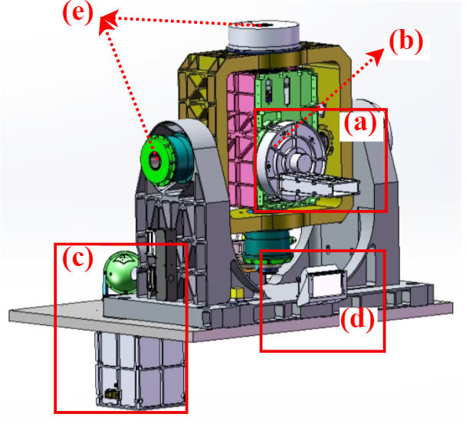
Overview of FY-3G/HAOC instrument
The High Accuracy On-board Calibrator (HAOC) is onboard the FY-3G satellite launched on April 16, 2023
HAOC is the first prototype for China’s Space-based Radiometric Benchmark (CSRB) initiative.
2-axis pointing system
Parameter | Index
Ground Sample Distance (GSD) | 250 m
Spectral Range | 400~1060 nm
Swath Width | 50 km
Quantization | 12 bit
Nadir Observation Range | ±30°
Pointing Accuracy | 5″
MTF @ Nyquist Frequency | ≥0.2
Radiometric Calibration Uncertainty | ≤2%
Radiometric Calibration Stability | 0.6%/year
Spectral Resolution | 3~4 nm
Spectral Calibration Uncertainty | ≤1 nm
Polarization Sensitivity | ≤1%
Imaging spectrometer
Attenuator assembly
Spectral calibration component
Base transmissive diffuser

Slide 3
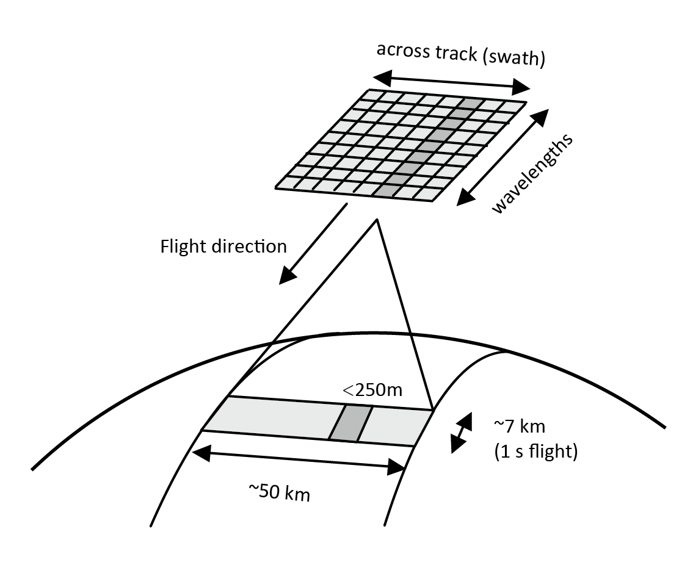
Overview of FY-3G/HAOC instrument
The Attenuator Assembly has three attenuators, one transmissive diffuser, and one through hole. The selection is made according to the observed target (Sun, Moon, Earth or BDTP).
HAOC is an Offner imaging spectrometer, forms a three-dimensional data cube through the satellite’s push-broom scanning motion.

Slide 4
Overview of FY-3G/HAOC instrument
HAOC supports multiple observation modes. By steering the 2-axis pointing system toward different targets and selecting different elements on the attenuation wheel, it performs various functions, including onboard calibration and intercalibration with other sensors.
When observing the Sun and the Moon (in the XOY plane), HAOC can always scan across the target in a direction perpendicular to the cross-track dimension, regardless of the azimuth angle.

Slide 5
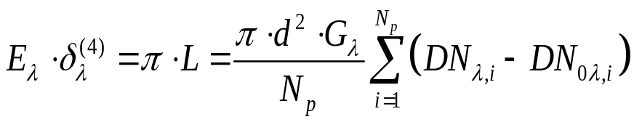
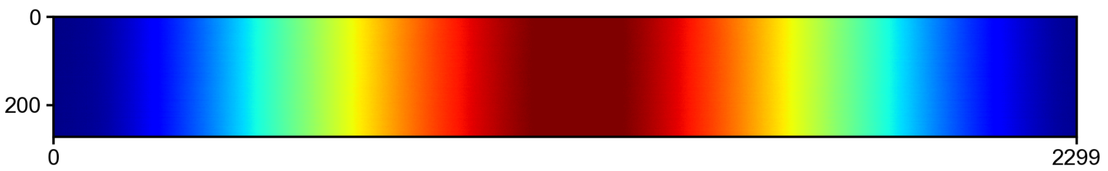
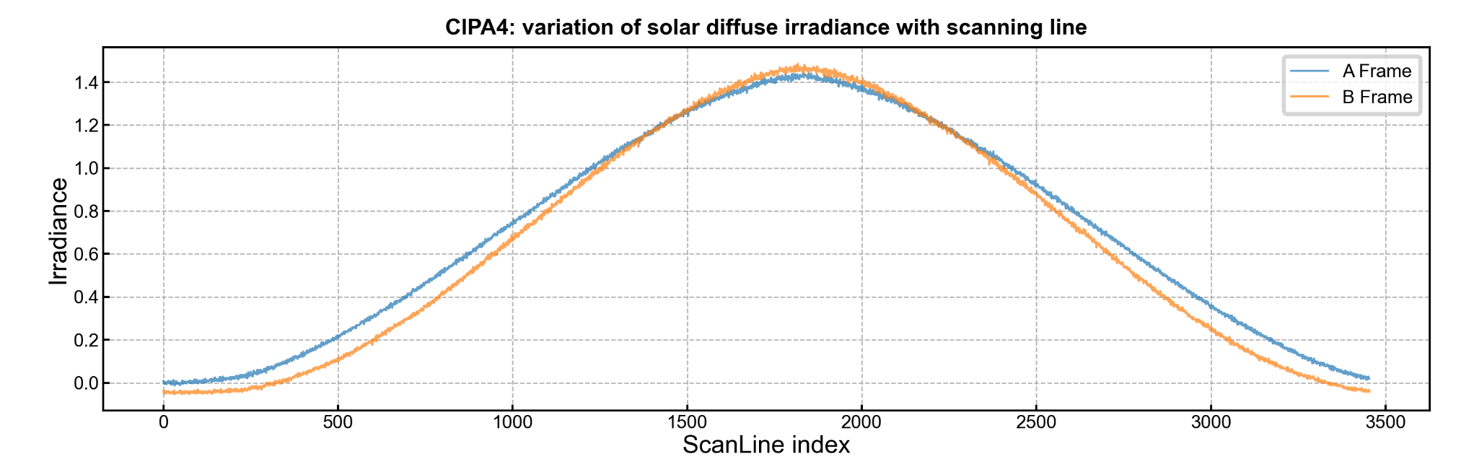
Solar calibration with transmissive diffuser
Switch the attenuation assembly to the diffuser and perform a pushbroom scan of the Sun to retrieve the solar spectral irradiance. When the Sun lies in the X–Y plane, it is at normal incidence and the received energy reaches its maximum.
when the Sun scans across the field of view, the signal increases from low to high and then decreases. The maximum occurs when the Sun lies in the X–Y plane; the solar irradiance is calculated using the data at this moment.
Eλ: solar irradiance
δ(λ): attenuation rate of transmissive diffuser，
Np: Pixels observed when the Sun lies in the X–Y plane.
DN0λ,i: dark current digital number
Gλ: radiometric gain of channel λ-th

Slide 6
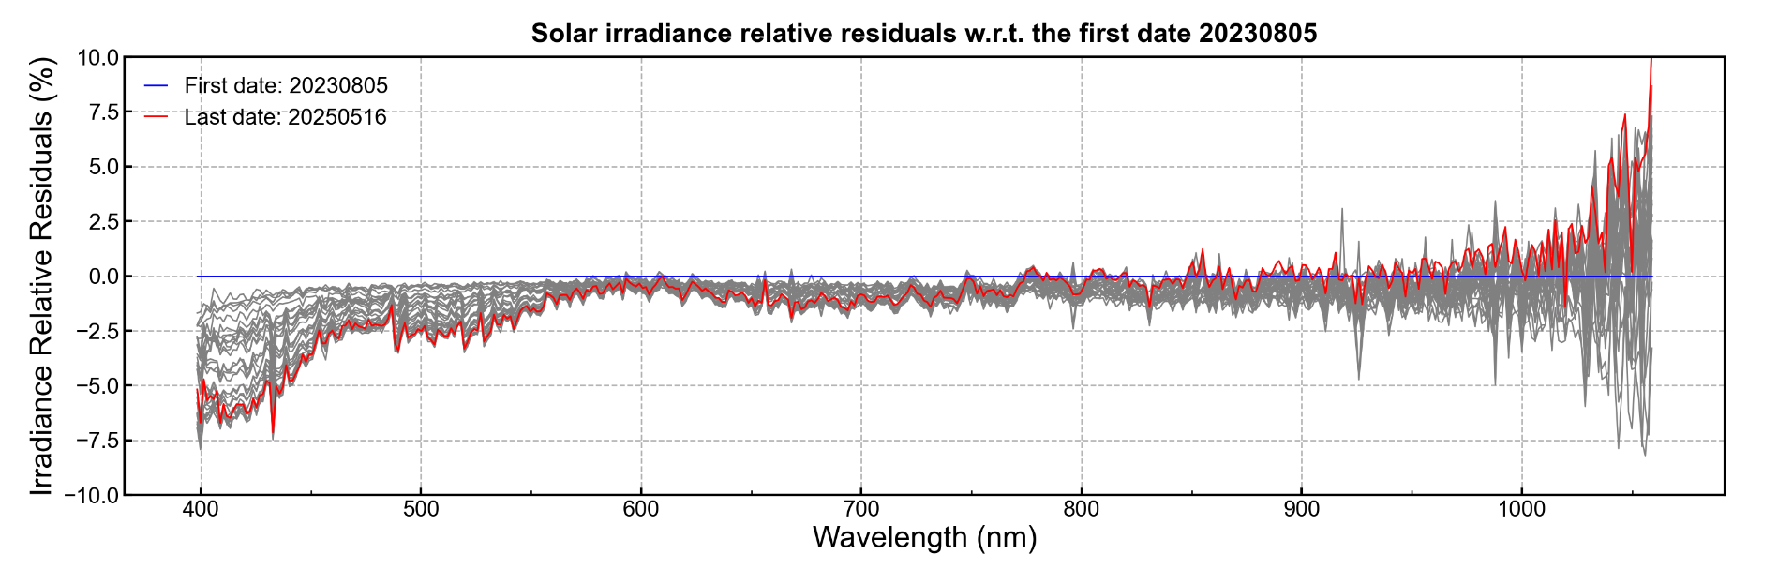
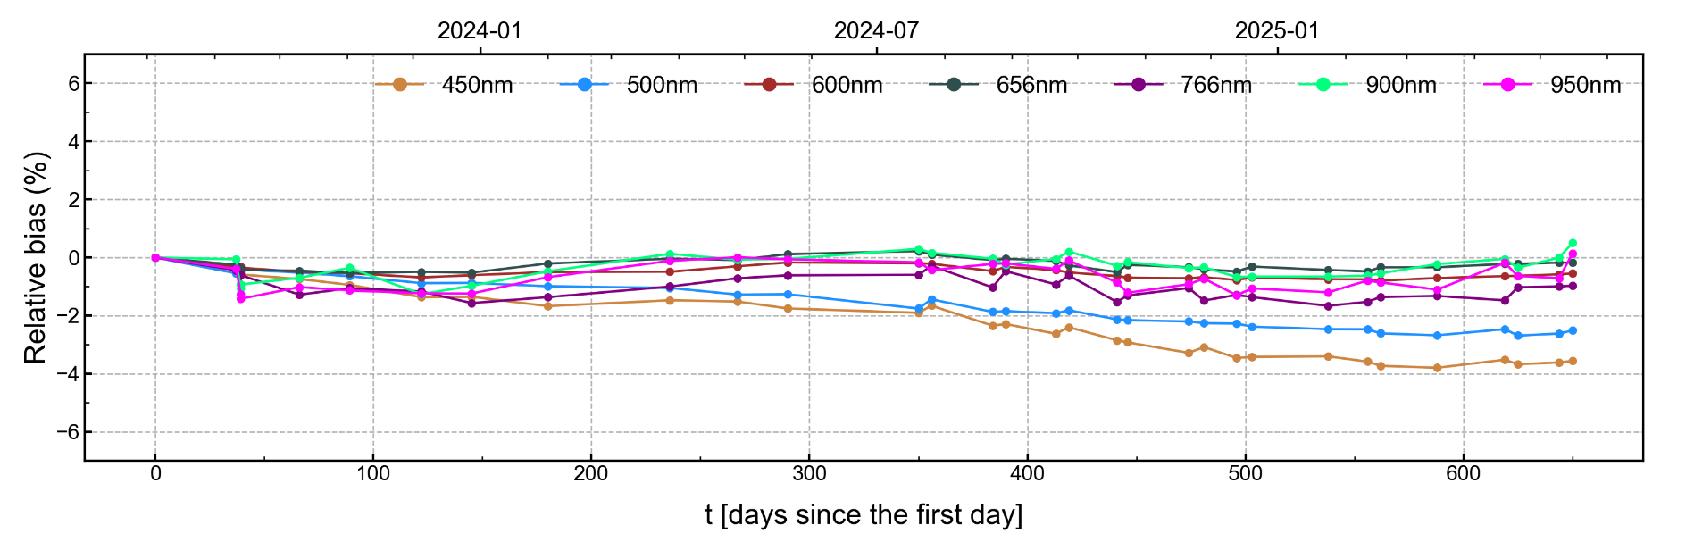
Long-term tracking of solar calibration results
Computed the relative variation of solar irradiance over nearly two years with respect to the first day.
In the 550–900 nm band, the overall variation is less than 2%. At shorter and longer regions, the degradation is more pronounced, and in regions with lower signal-to-noise ratio, the fluctuations are more significant.
Note that the observed variation includes both changes in the detector response and potential changes in transmittance.

Slide 7
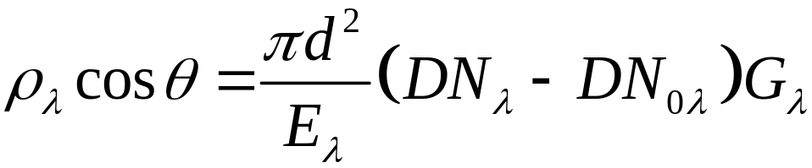
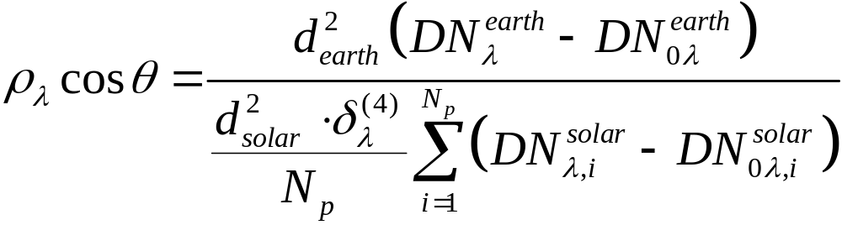
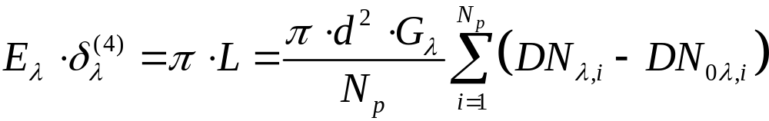
Calculation of TOA ρ for Earth observation.
Calculate the TOA ρ of Earth observation data using the solar spectral irradiance obtained with the transmissive diffuser instead of the attenuators, because the diffuser material is more stable than the attenuators.
Using the ratio method, variations in surface reflectance originate from changes in the transmittance of the diffusing plate and are unrelated to changes in the calibration coefficients.

Slide 8
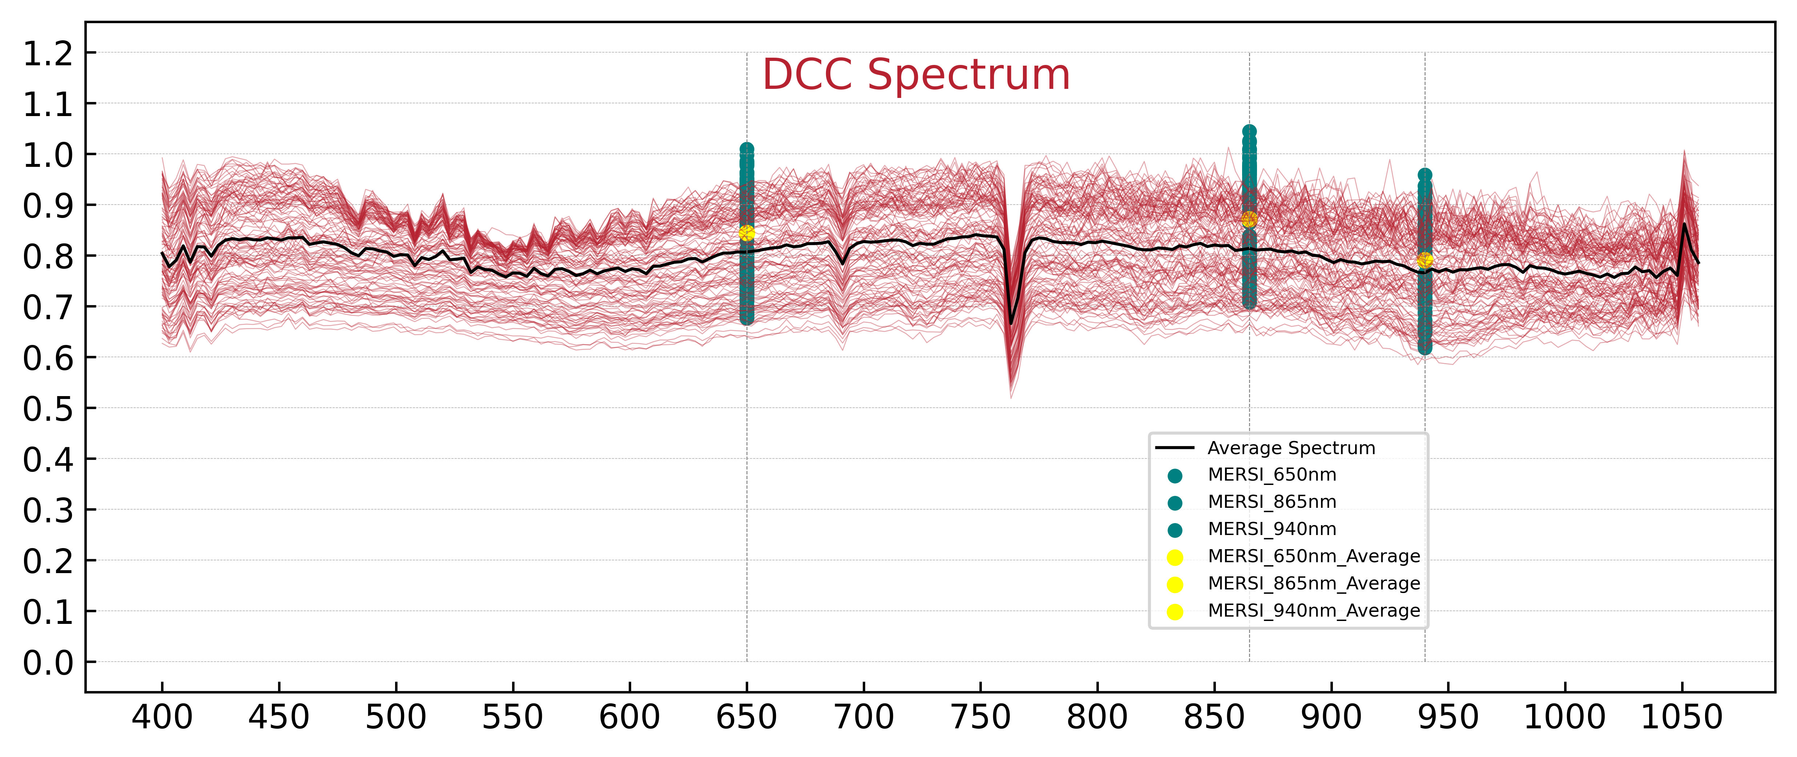
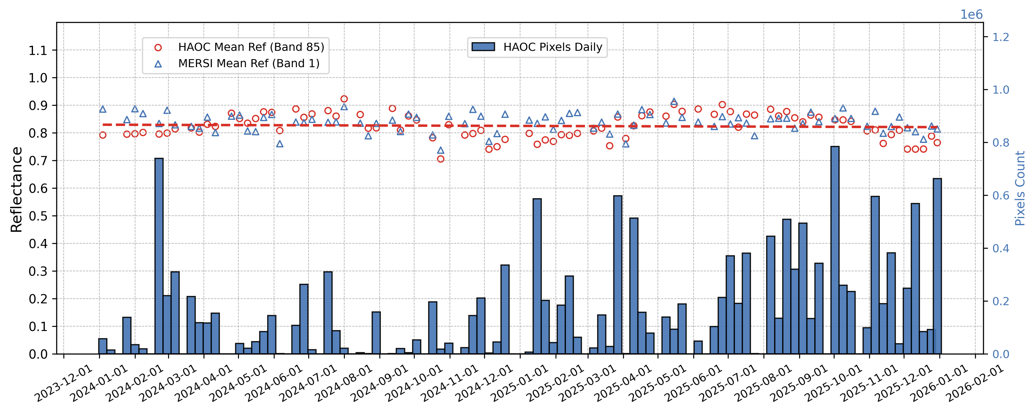
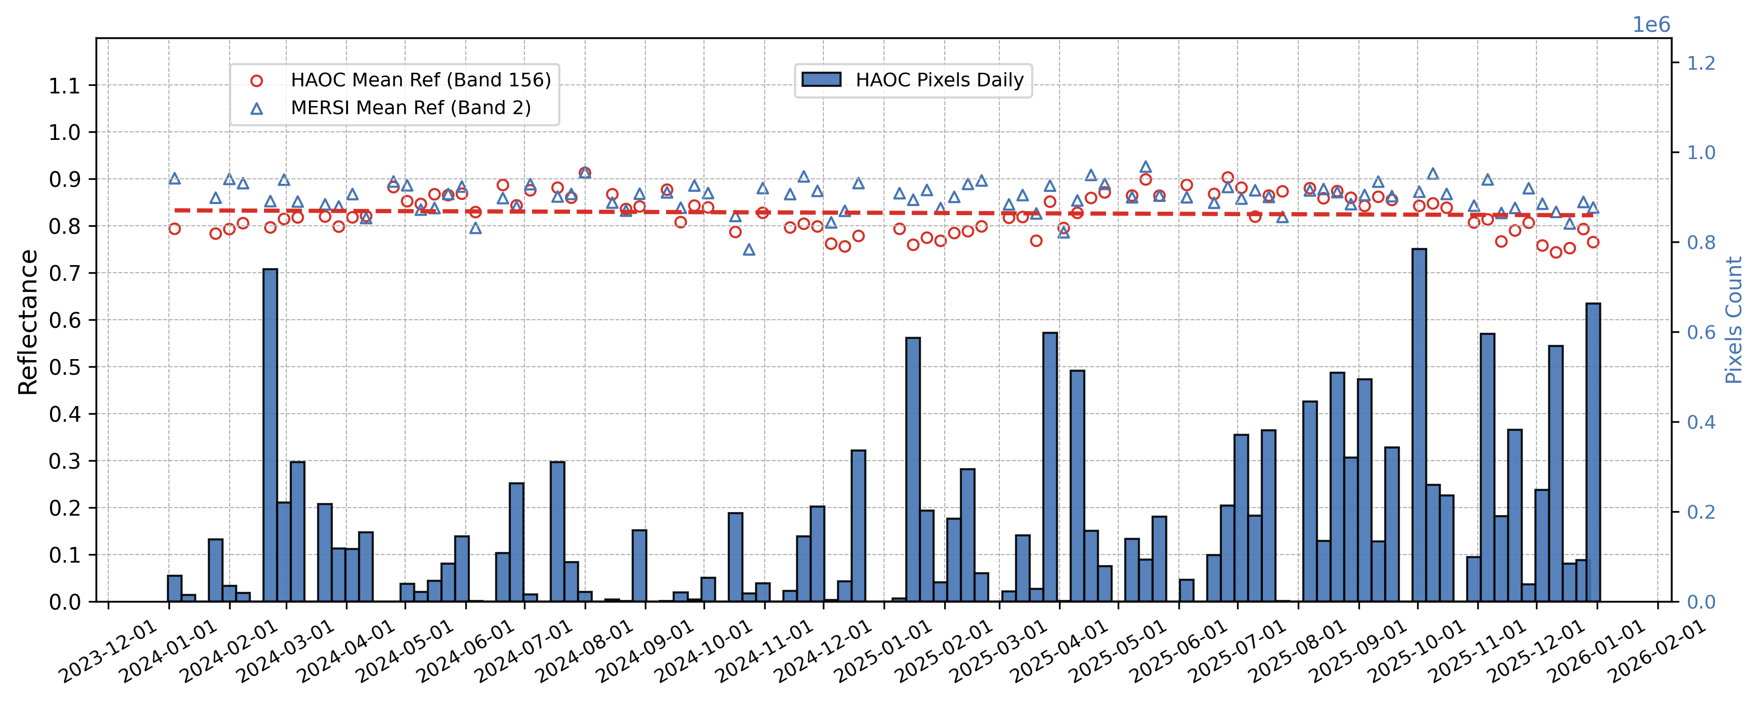

Stability of HAOC TOA ρ for Earth targets
The stability of HAOC’s TOA ρ for Earth targets can be verified through long-term tracking of stable targets. The trend appears relatively stable and consistent with MERSI results, although some seasonal fluctuations are observed for reasons that remain unknown.
20240126_1818
BT_{10.8}<205K
STD_{BT}<1k
STD_{REF}<1%
Lat<35
SZA,VZA <= 40
Distance_{HAOC-MERSI} < 100m
PIXELS_{HAOC} : 116
PIXELS_{MERSI} :110

Slide 9
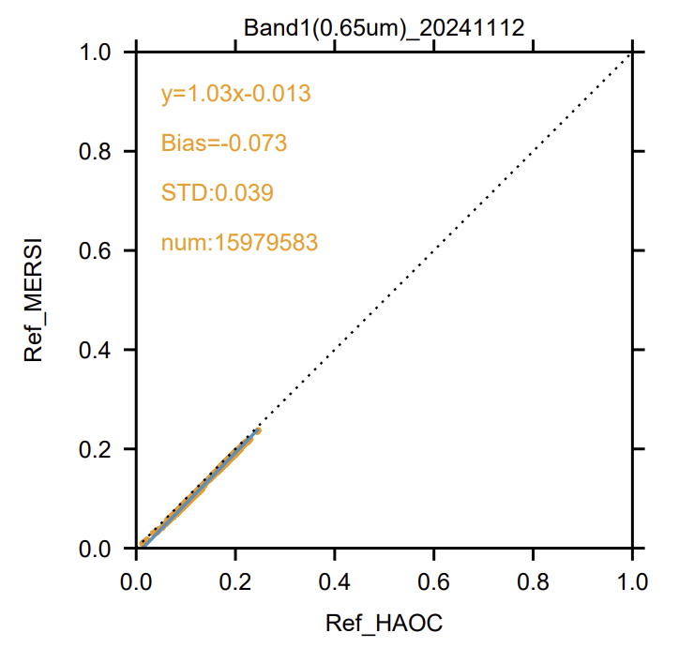
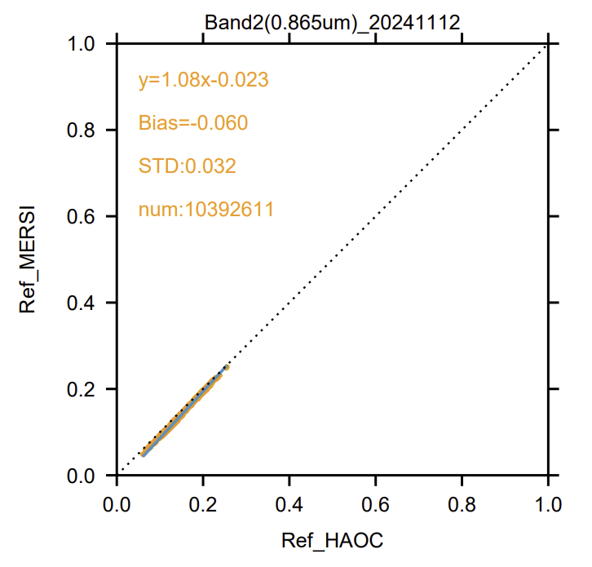
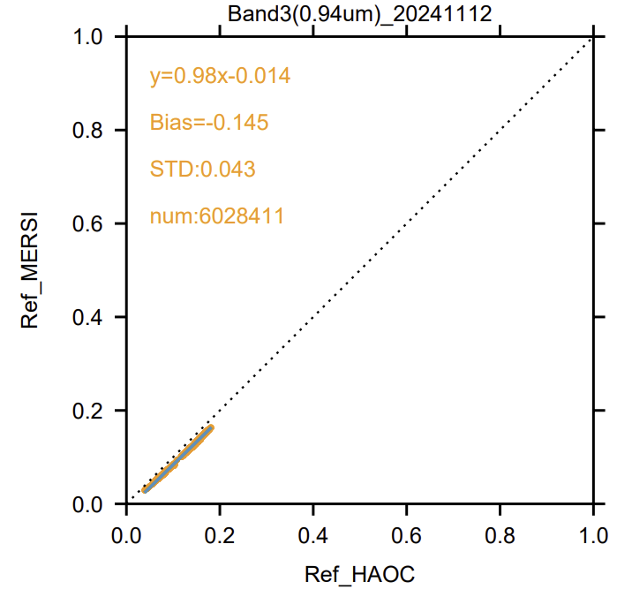
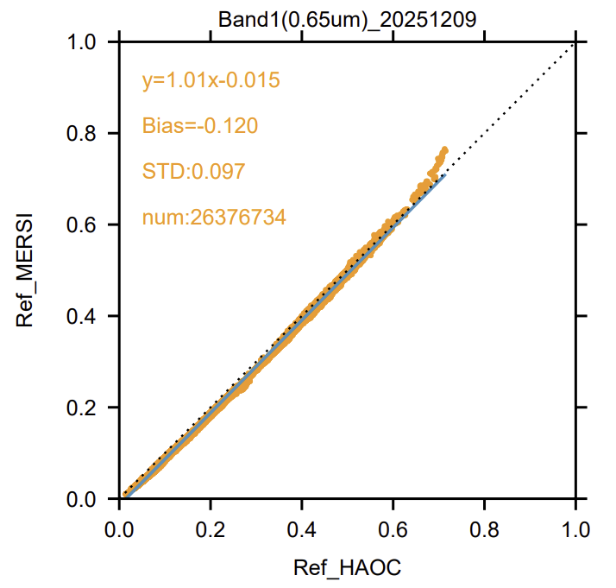
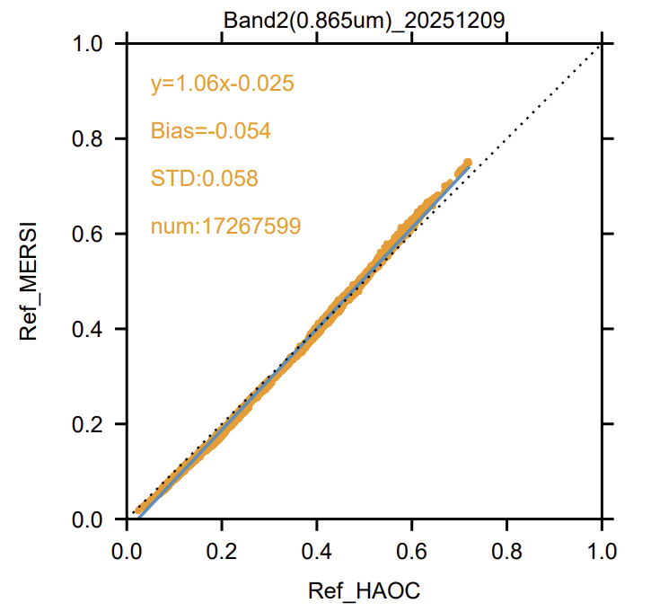
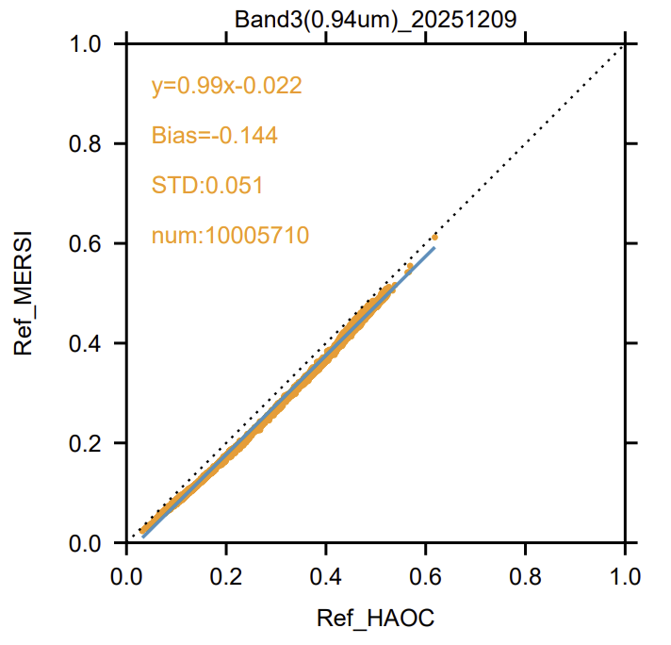
Intercalibration with MERSI-RM on the same platform
Two intercalibration results with the MERSI over a one-year interval show relatively small uncertainties,
a certain degree of nonlinearity is observable. The TOA ρ method described above for HAOC does not include any nonlinearity correction.

Slide 10
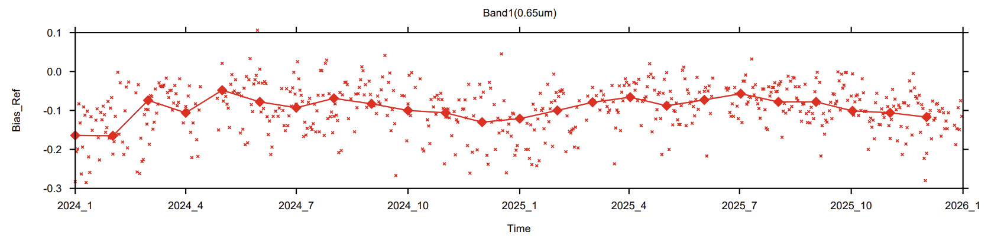
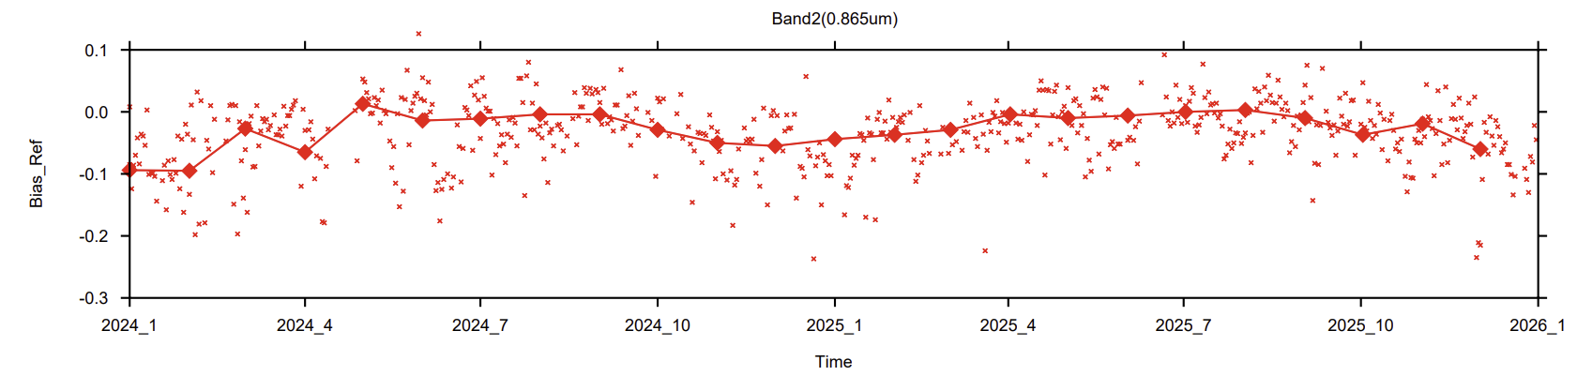
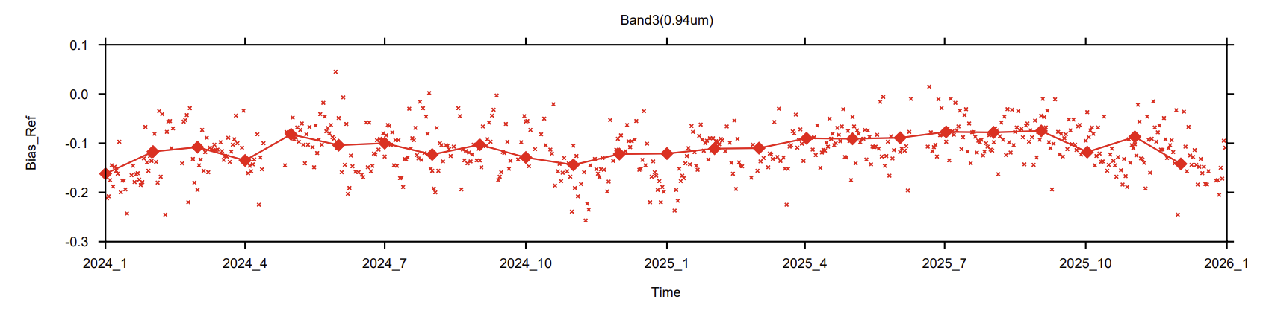
Longterm Intercalibration results with MERSI-RM
Long-term results for the 3 matched channels between HAOC and MERSI-RM show that the deviations are consistent and relatively stable over time, though some seasonal fluctuations are still noticeable.

Slide 11
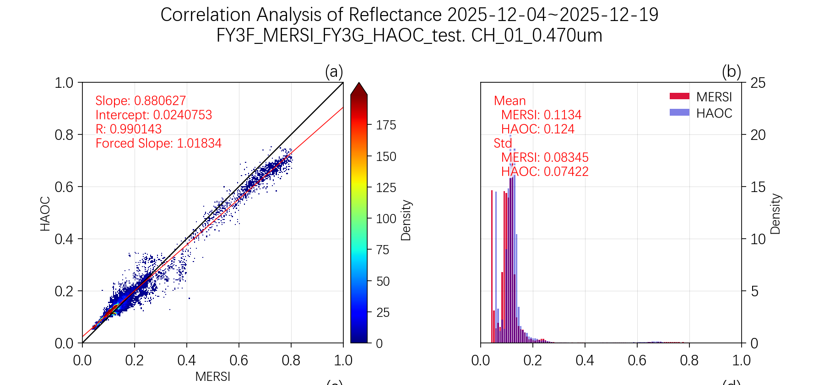
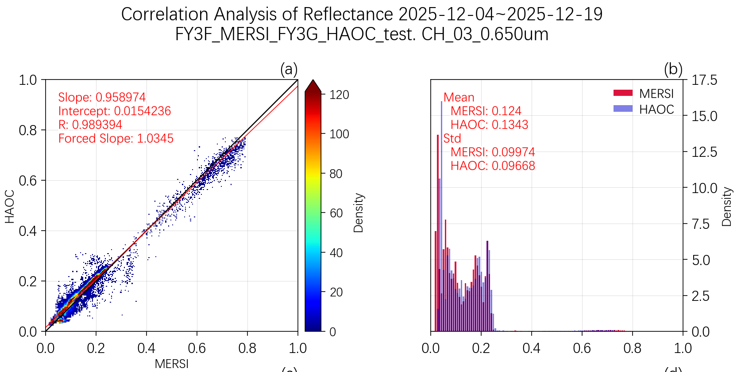
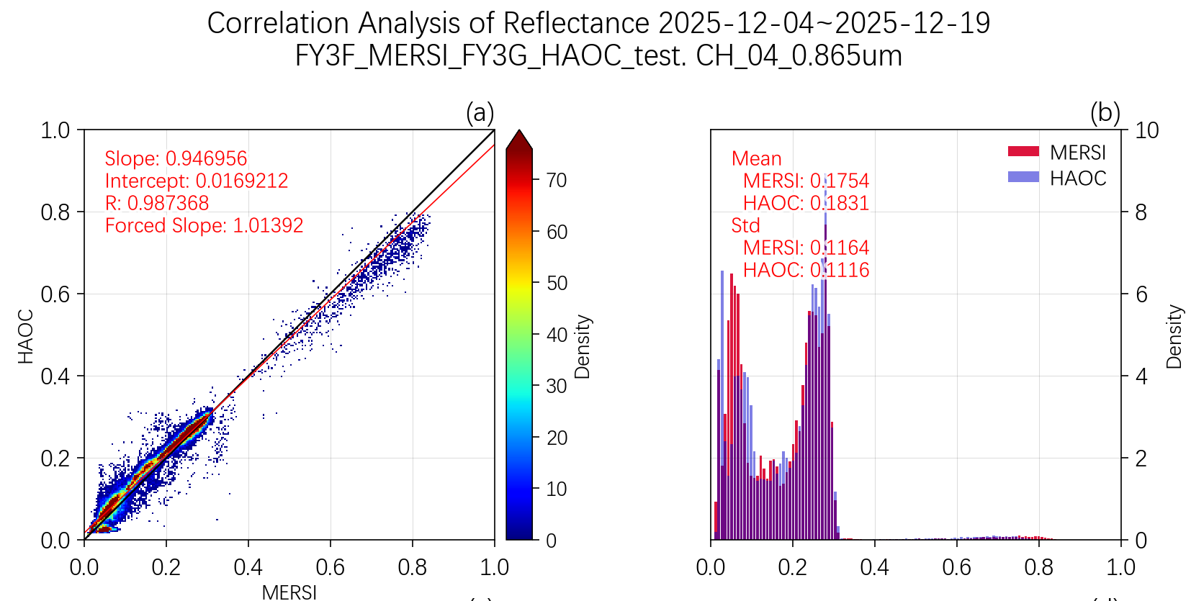
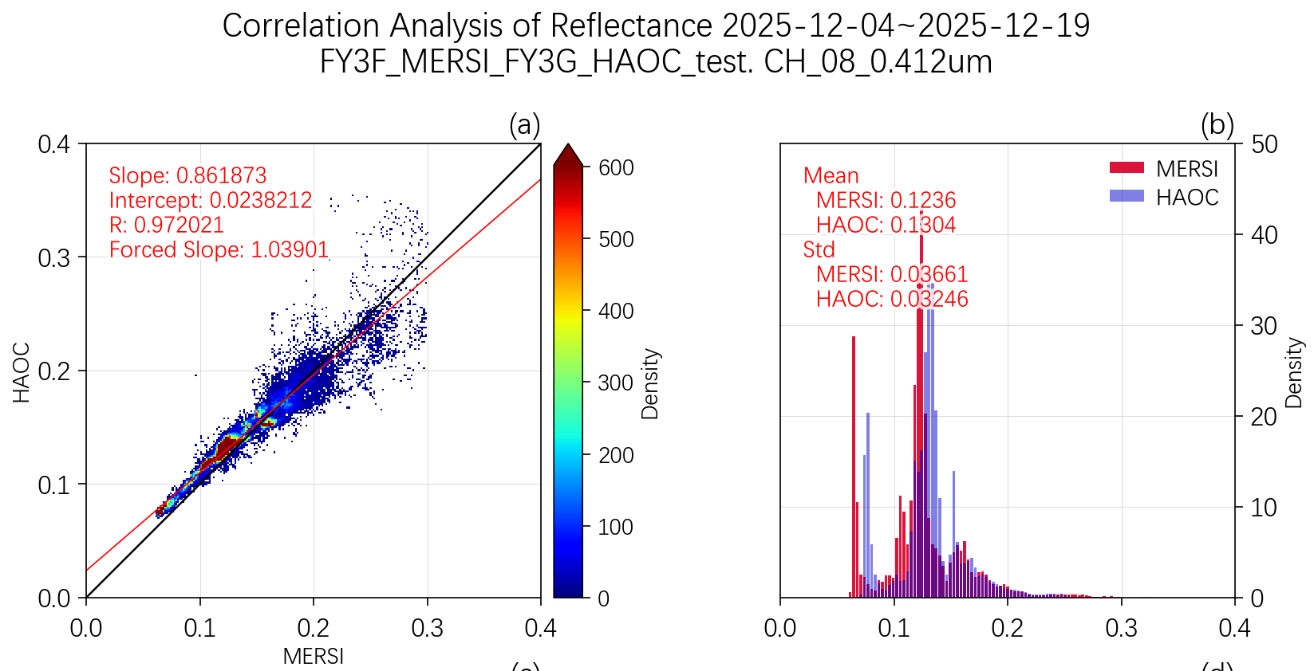
Intercalibration with MERSI-III on FY-3F
Compared with MERSI on the same platform, the results exhibit greater uncertainty, and a certain degree of nonlinearity is still visible across different channels.

Slide 12
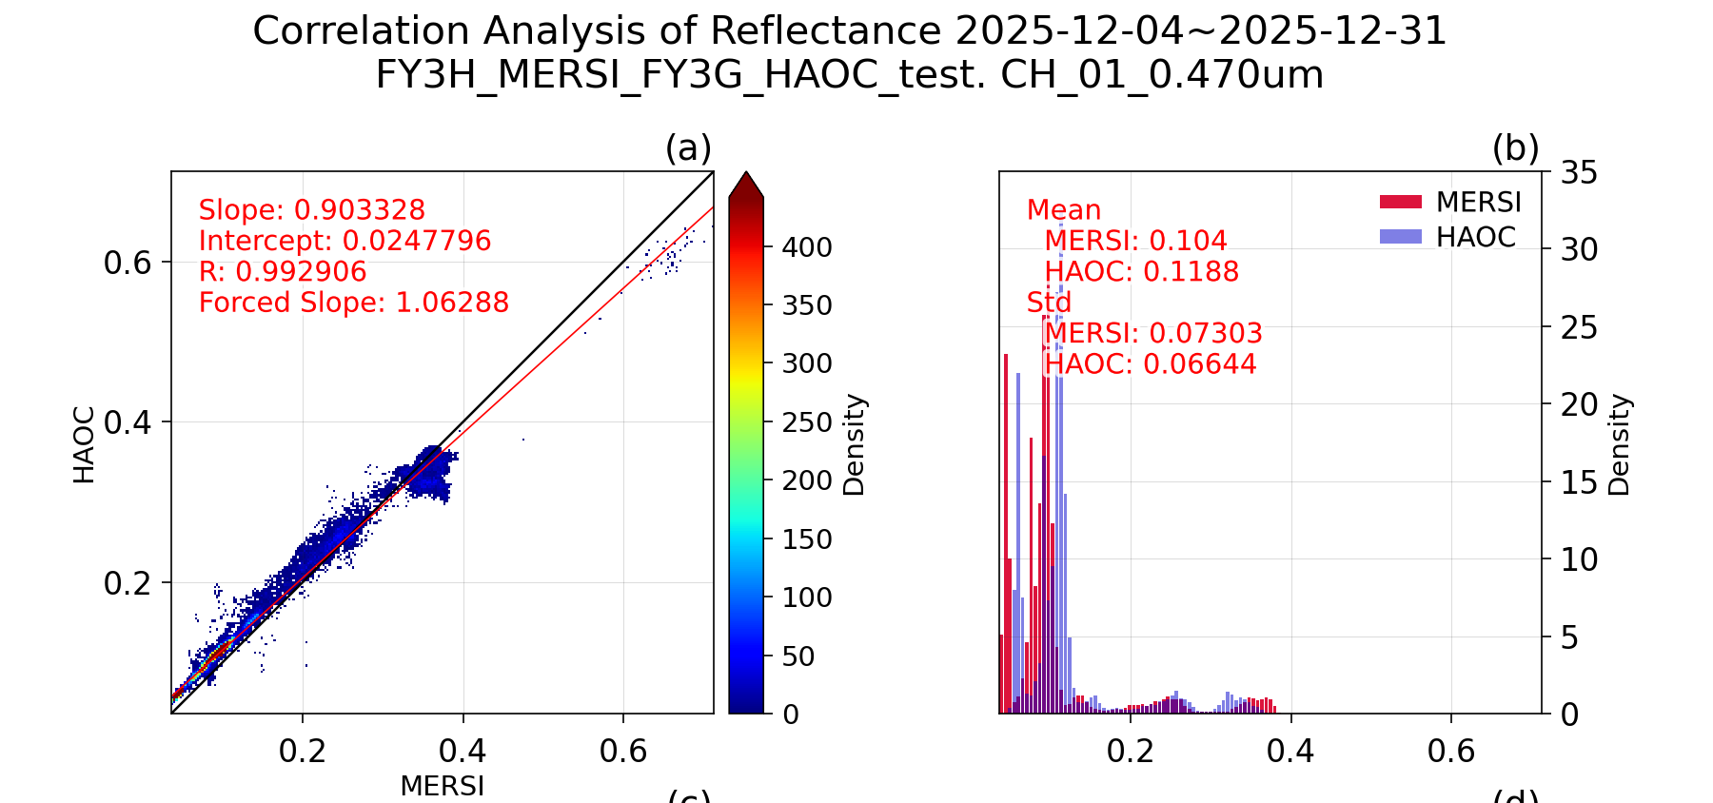
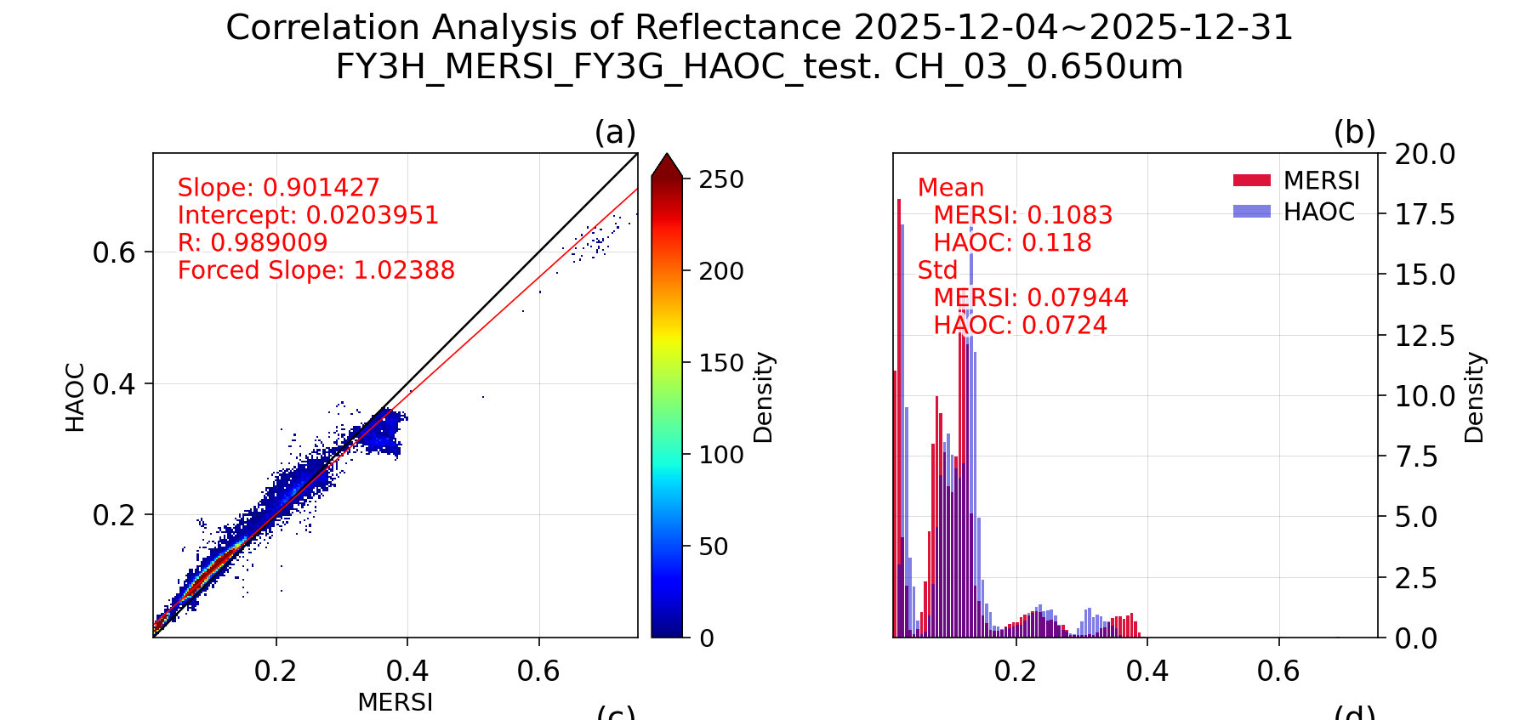
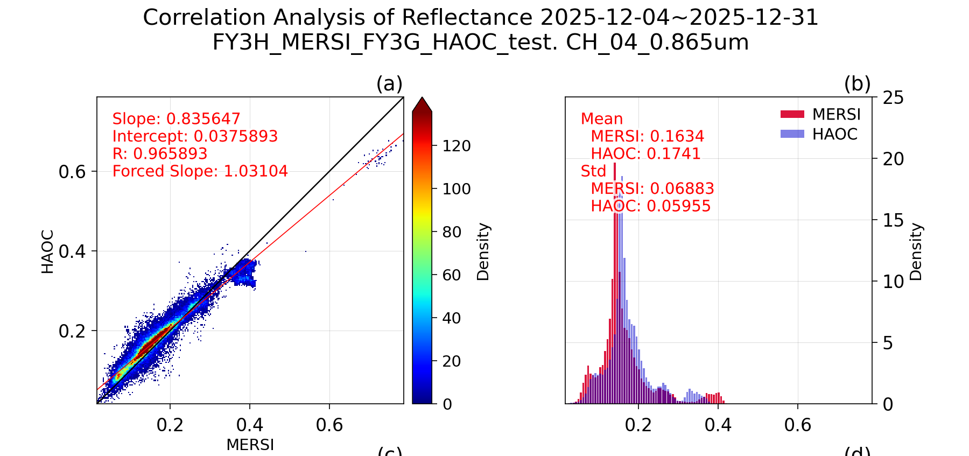
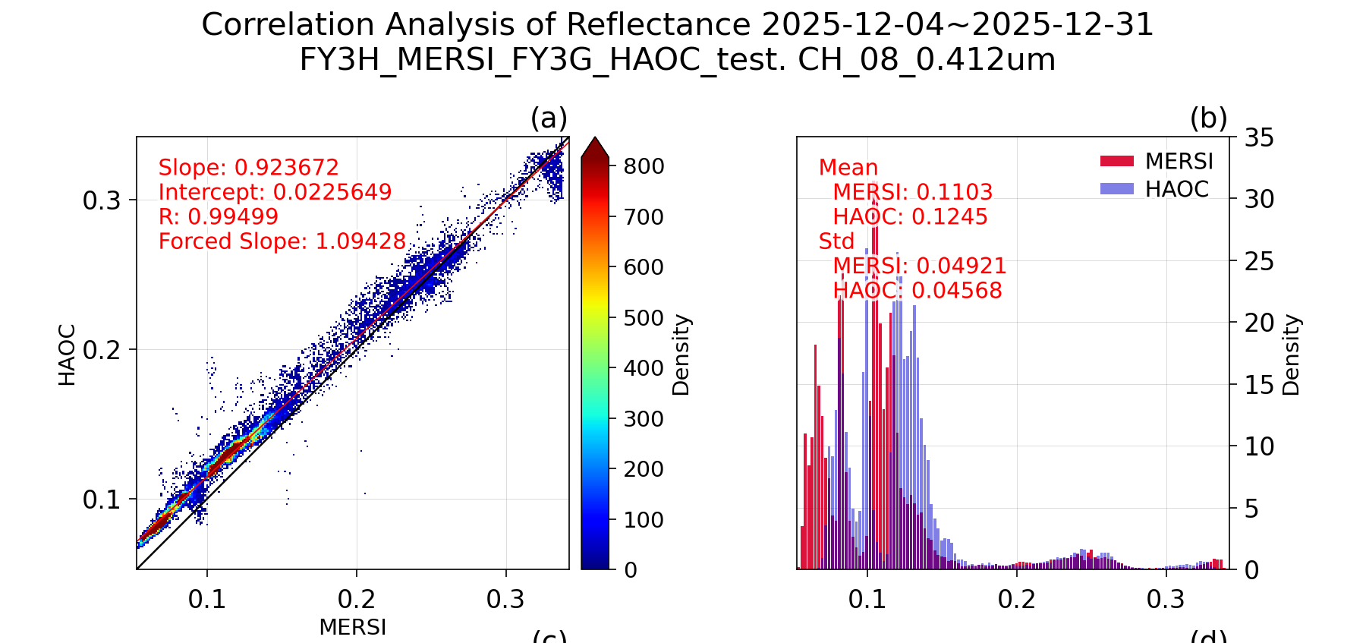
Intercalibration with MERSI-III on newly launched FY-3H
Compared with MERSI on the same platform, the results exhibit greater uncertainty, and a certain degree of nonlinearity is still visible across different channels.

Slide 13
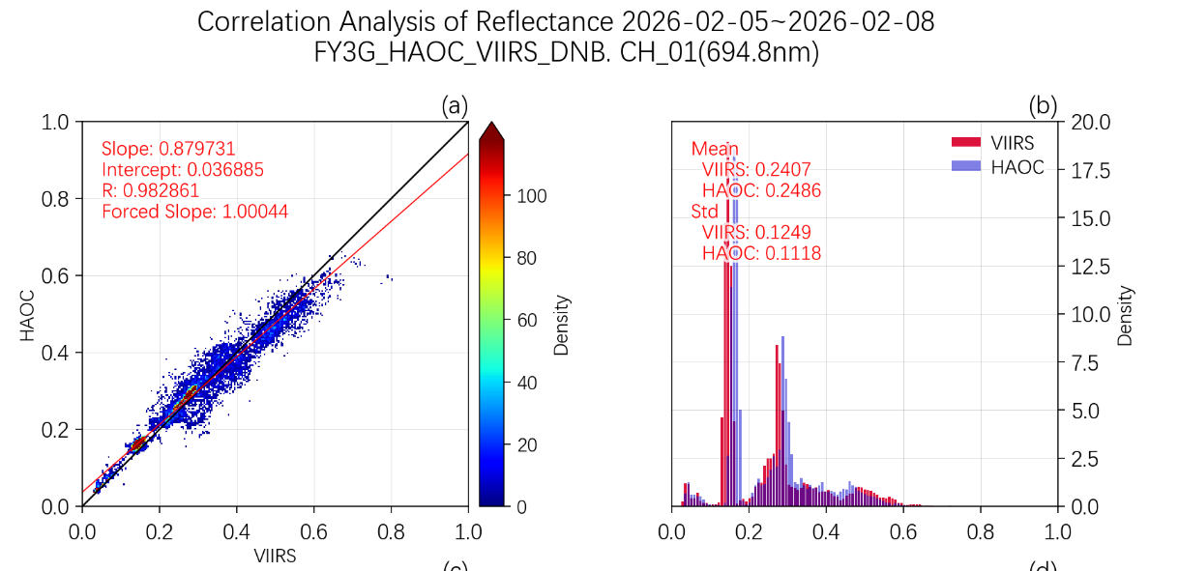
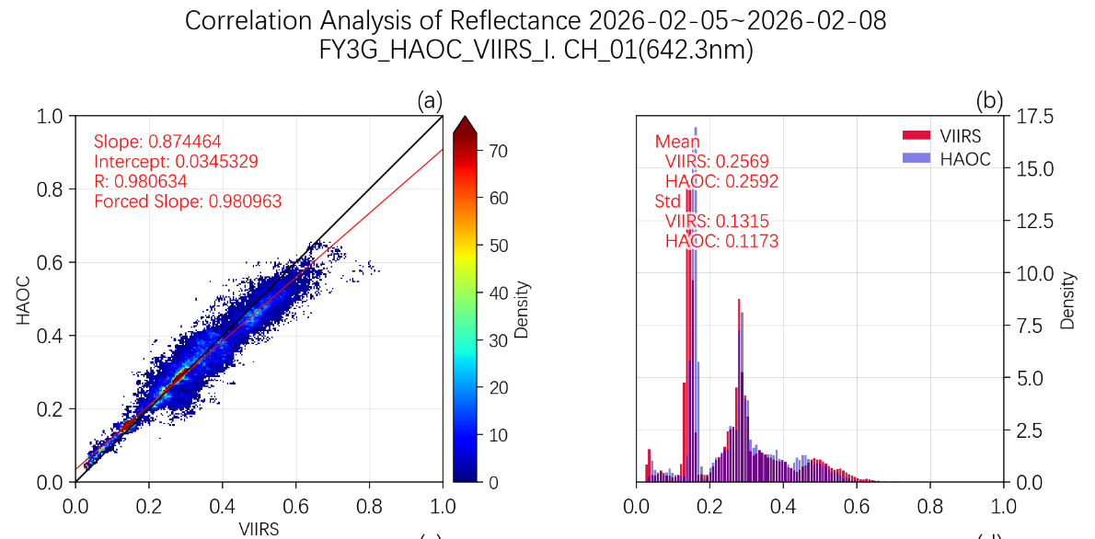
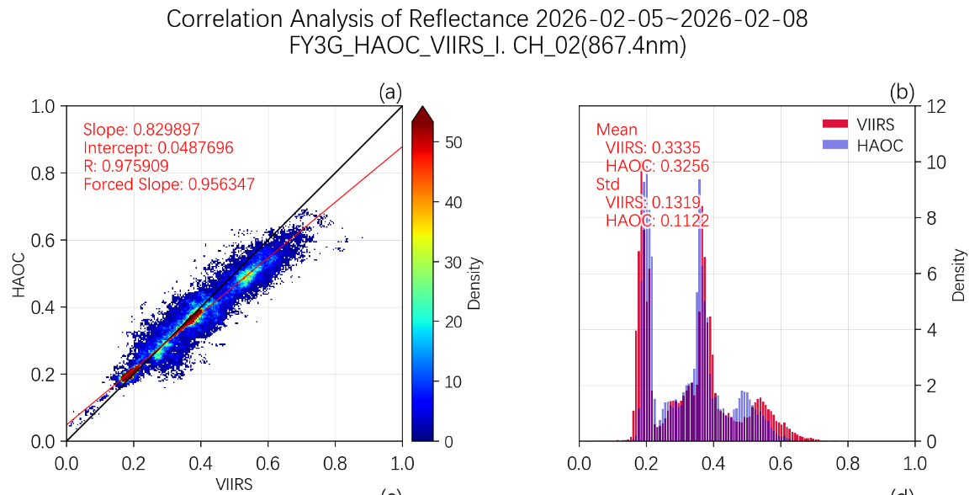
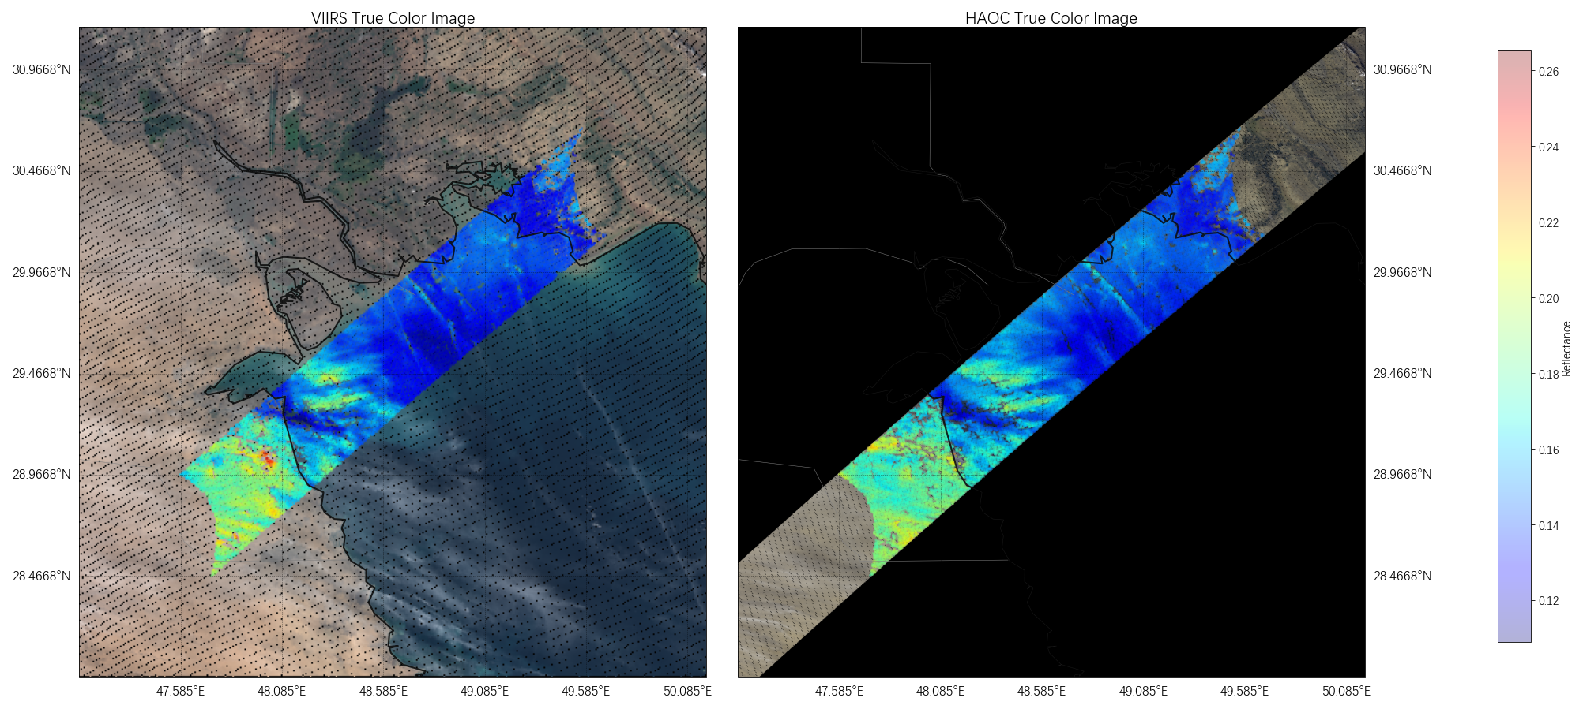
Intercalibration with NOAA-20 VIIRS DNB/I1/I2 bands
inter-comparison with the three channels of NOAA-20 VIIRS yields similar conclusions.

Slide 14
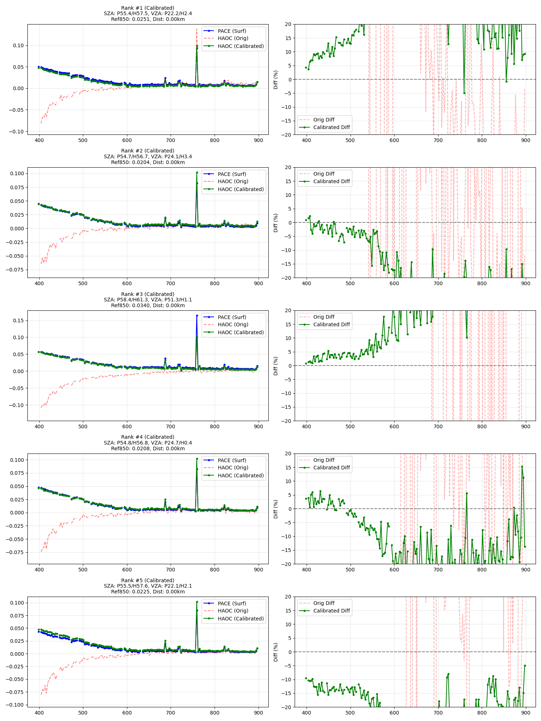
Intercalibration with PACE OCI
PACE (Plankton, Aerosol, Cloud, ocean Ecosystem) / OCI (Ocean Color Instrument)
Procedures:
6S Atmospheric Correction: Convert satellite-observed apparent reflectance (TOA reflectance) to surface reflectance.
Linear Regression Calibration: Calculate gain and offset coefficients based on paired data.
Dark Target Selection: Choose ocean or deep-water areas as calibration references.
Geometric Matching: Select synchronous observation points based on spatiotemporal consistency.
Since dark targets (ocean&water) were selected, the relative deviation is larger in the near-infrared channels, while the deviation in the visible channels is less than 5%.

Slide 15
Conclusions and Future Plans
Tracking using solar calibration and stable Earth targets indicates that HAOC data TOA ρ is generally stable. Future work can explore additional methods to verify the stability of on-board diffusers.
Inter-comparison with different instruments indicates some nonlinearity in HAOC, which will be addressed in the next step through nonlinearity correction.
HAOC data exhibit some seasonal variations; the underlying causes need to be investigated further.
Cross-matching criteria can be further refined to reduce uncertainties in intercalibration.

