Slide 1
Validation of MWHS-II Onboard FY-3H in the Post-Launch Phase
Yang Guo
Jieying He, Xinxin Xie, Songyan Gu, Naimeng Lu, Shengwei Zhang
CMA NSMC

Slide 2
Outline
Instrument: FY-3H MWHS-II
Calibration in the postlaunch phase
Summary

Slide 3
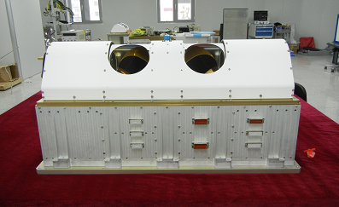
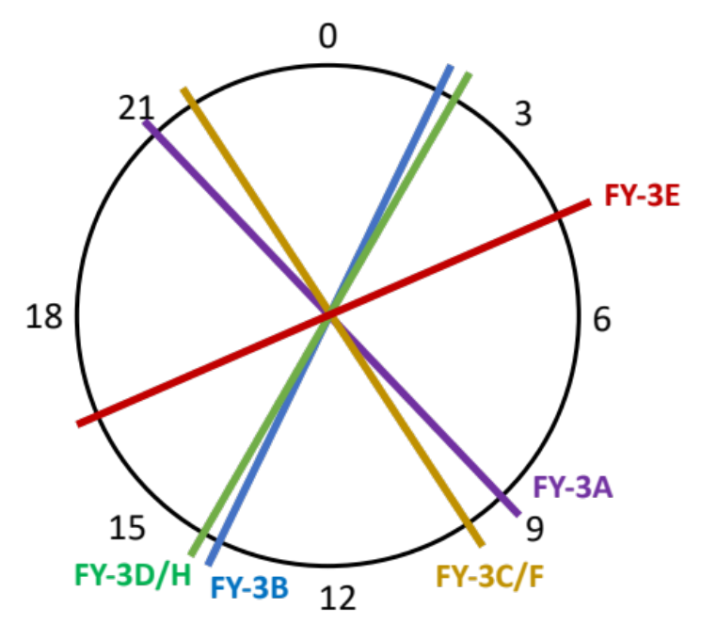
FY-3H MWHS-II
The instrument was powered-on on October 2, 2025
Equatorial crossing time is 14:00 in the ascending node
It will be a substitute for its predecessor FY-3D
FY-3 satellite constellation
Microwave humidity sounder (MWHS) onboard FY-3 satellites
Satellite | Microwave Humidity Sounder | Launch Time (yyyy-mm-dd) | Equatorial Crossing Time* | Current Status
FY-3A | MWHS-I | 2008-05-27 | 09:05 (D) | Not operational
FY-3B | MWHS-I | 2010-11-05 | 13:40 (A) | Not operational
FY-3C | MWHS-II | 2013-09-23 | 10:15 (D) | Not operational
FY-3D | MWHS-II | 2017-11-15 | 14:00 (A) | Operational
FY-3E | MWHS-II | 2021-07-05 | 05:30 (D) | Operational
FY-3F | MWHS-II | 2023-08-03 | 10:15 (D) | Operational
FY-3H | MWHS-II | 2025-09-27 | 14:00 (A) | In-orbit testing
*D and A are abbreviated from the equatorial crossing time in the descending and ascending nodes, respectively.
Equatorial crossing time of FY-3 satellite series.

Slide 4
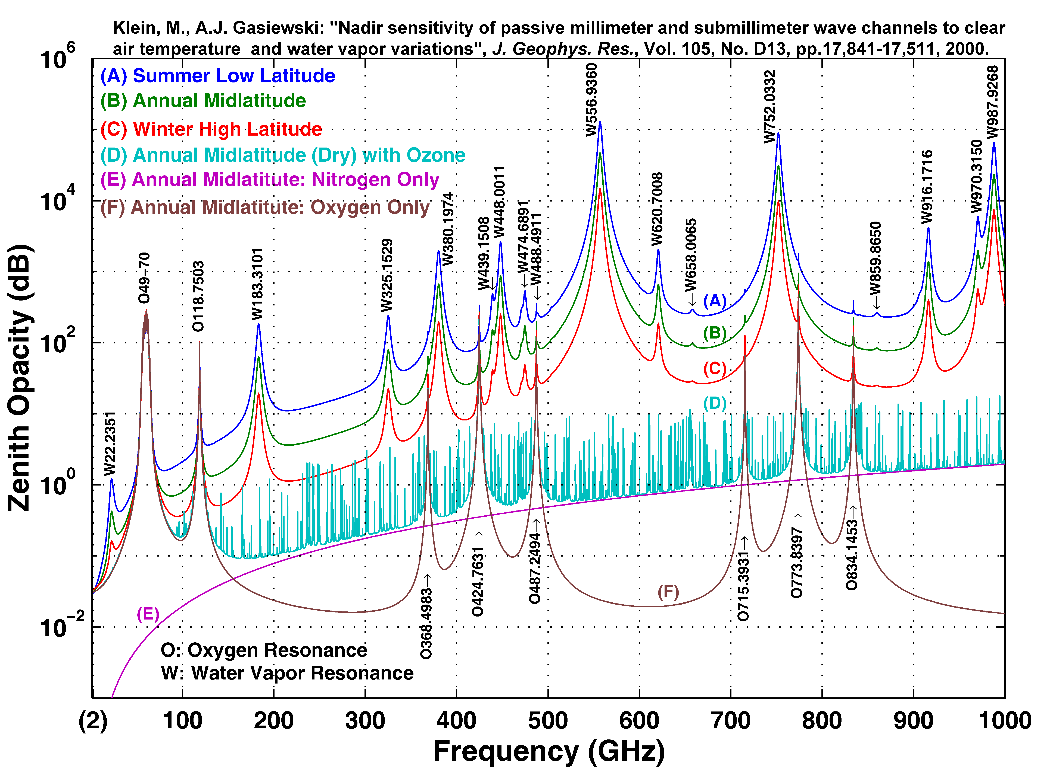
Channel
Channel central frequencies of MWHS
Channel frequency (GHz) | FY-3A/B MWHS-I | FY-3C/D MWHS-II | FY-3E/F/H MWHS-II
89 |  | √ | √
118.75±0.08 |  | √ | √
118.75±0.2 |  | √ | √
118.75±0.3 |  | √ | √
118.75±0.8 |  | √ | √
118.75±1.1 |  | √ | √
118.75±2.5 |  | √ | √
118.75±3.0 |  | √ | √
118.75±5.0 |  | √ | √
150 | √* | √
166 |  |  | √
183.31±1 | √ | √ | √
183.31±1.8 |  | √ | √
183.31±3 | √ | √ | √
183.31±4.5 |  | √ | √
183.31±7 | √ | √ | √
*MWHS-I onboard FY-3A/B has both quasi- vertical (QV) and horizontal (QH) polarization channels at 150 GHz.

Slide 5
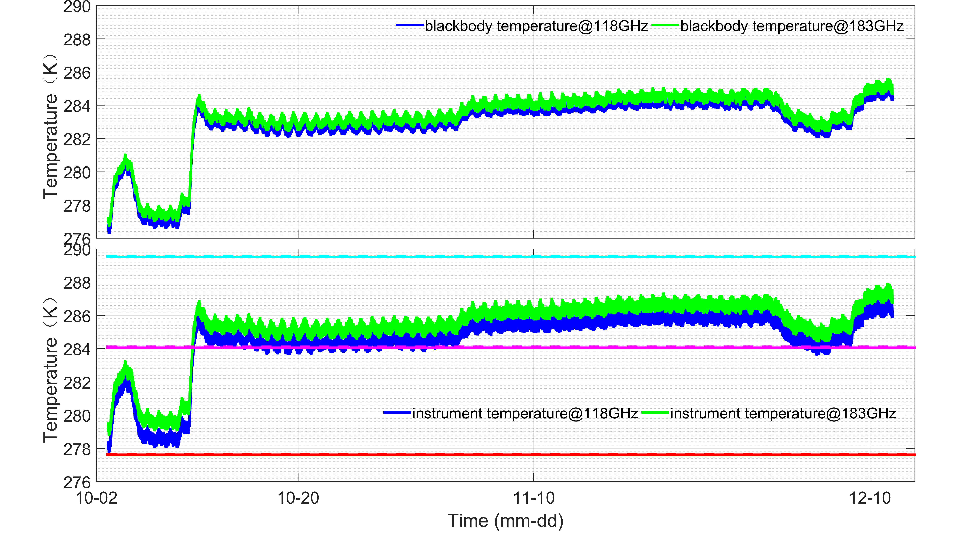
Temperature
The temperature of MWHS –II is susceptible to the environment.
118GHz
183GHz
289.57K
289.52K
284.11K
284.05K
277.67K
277.62K
To quantify the nonlinearity of the sensor, the ground thermal vacuum chamber (TVAC) tests are performed at the instrument temperatures of 5℃, 12℃, 18℃ and 25℃.

Slide 6
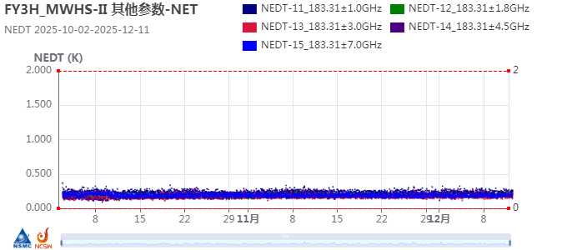
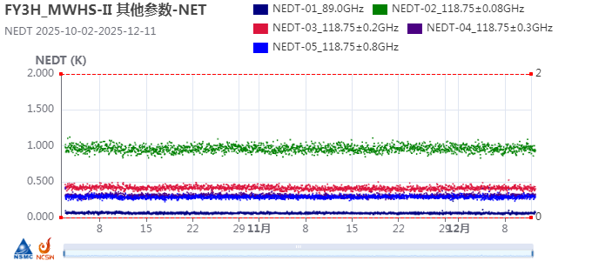
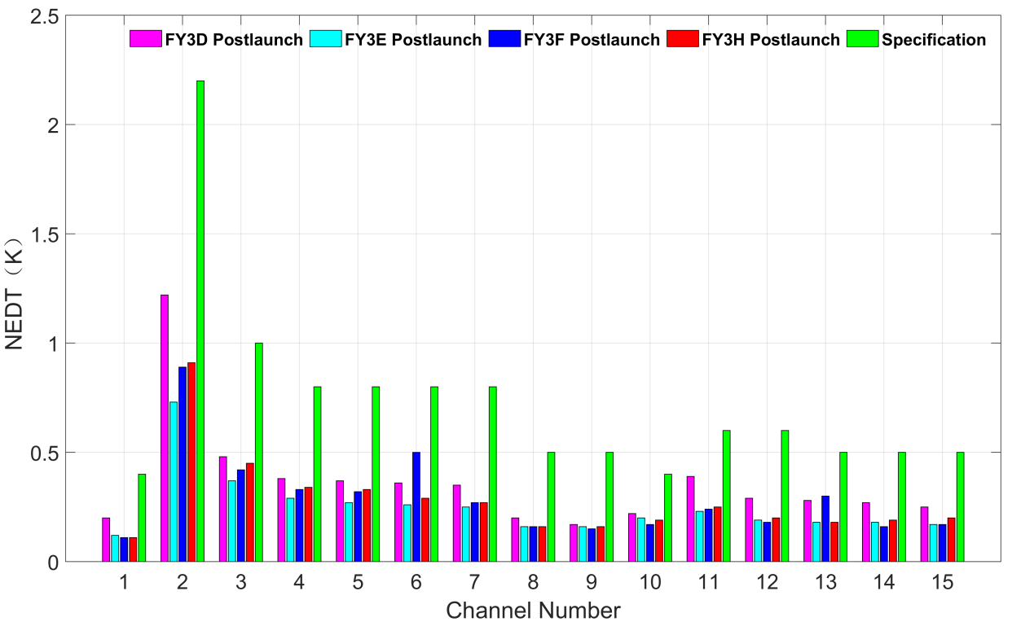
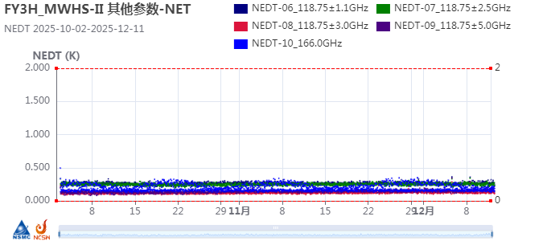
Noise Equivalent Delta Temperature
During the first 2 months, the radiometric sensitivity of MWHS-II remains very stable with negligible variations for all channels.

Slide 7

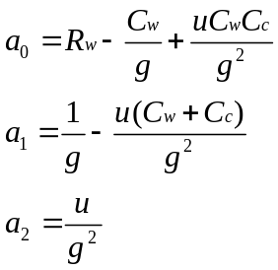
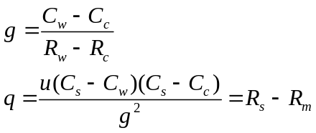
Calibration
180±2º
Hot Targets
Calibration flowchart
accelerate
270º
90º
287±2º
Cold Space
earth scene
306.65º
53.35º
0º(Nadir)
MWHS(II) Scan Cycle during which 98 earth views,
3 cold and 3 warm calibrations are made.
MWHS(II) antenna brightness temperature
is obtained through this equation.

Slide 8
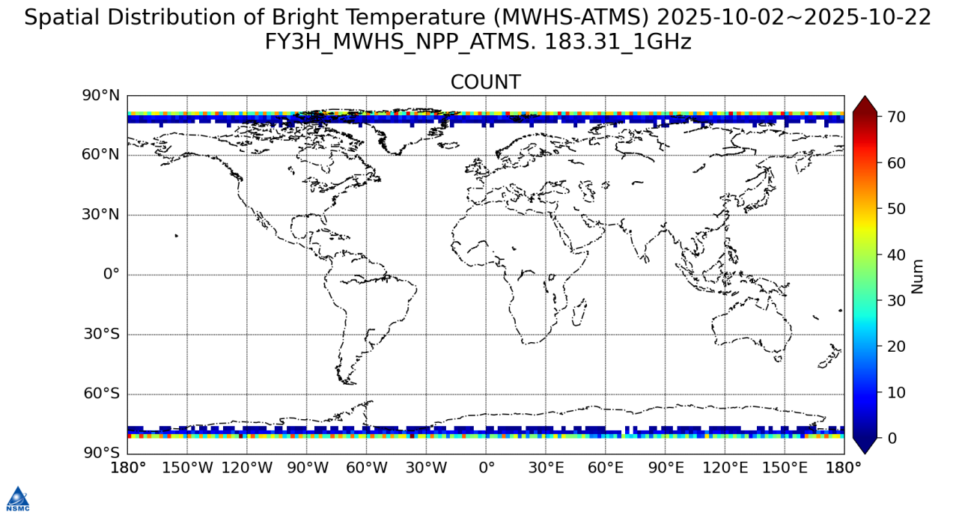
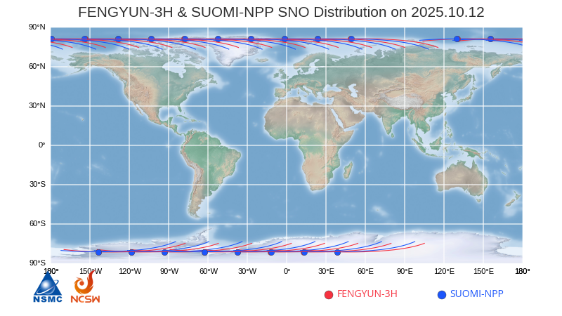
Validation
MWHS compared with ATMS
The SNO data with a time difference greater than 15 min and spatial distance greater than 3 km are rejected in the comparison. The data used in this study is within an earth-viewing-angle of ±5°
Compared Channel
Center Frequency （GHz） | MWHS-II (Channel Number) | ATMS (Channel Number)
183.31±1 | 11 | 22
183.31±1.8 | 12 | 21
183.31±3 | 13 | 20
183.31±4.5 | 14 | 19
183.31±7 | 15 | 18
Considering the satellite orbits, the SNO dataset is mainly distributed near the latitude of 70°N or 70°S.

Slide 9
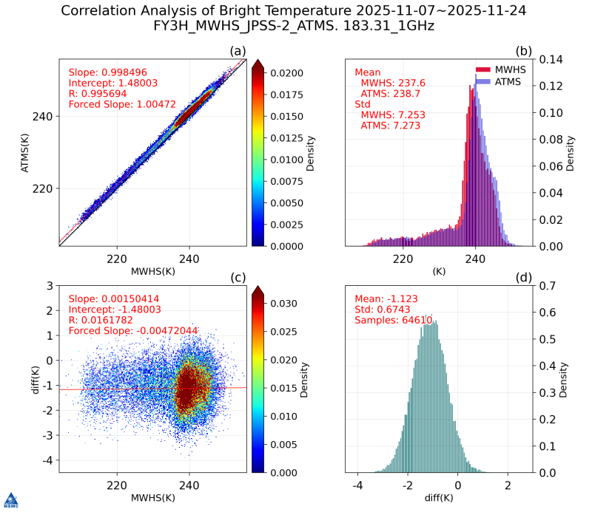
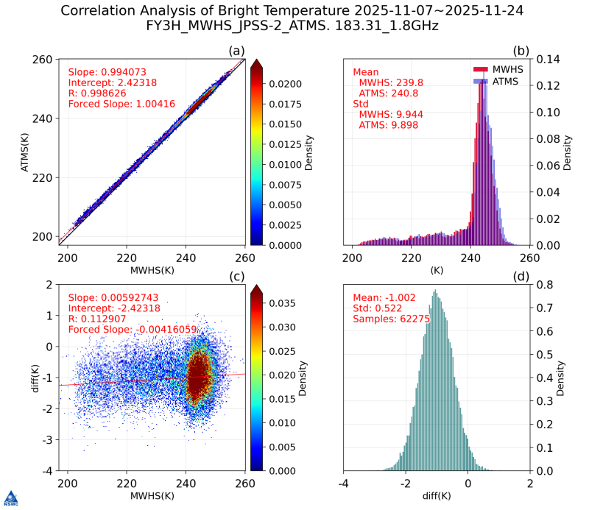
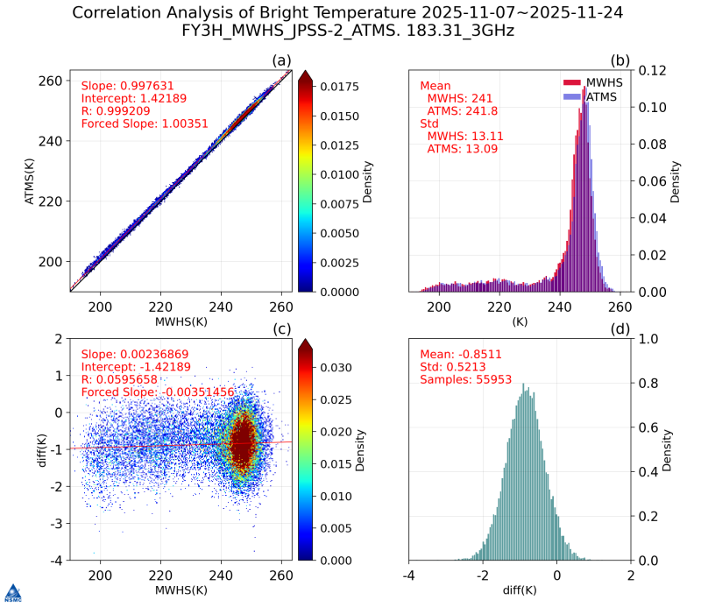
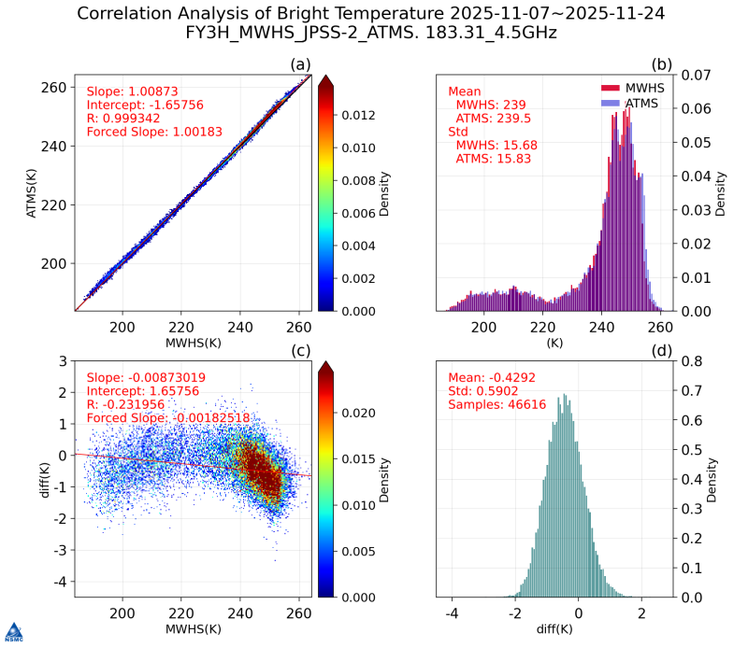
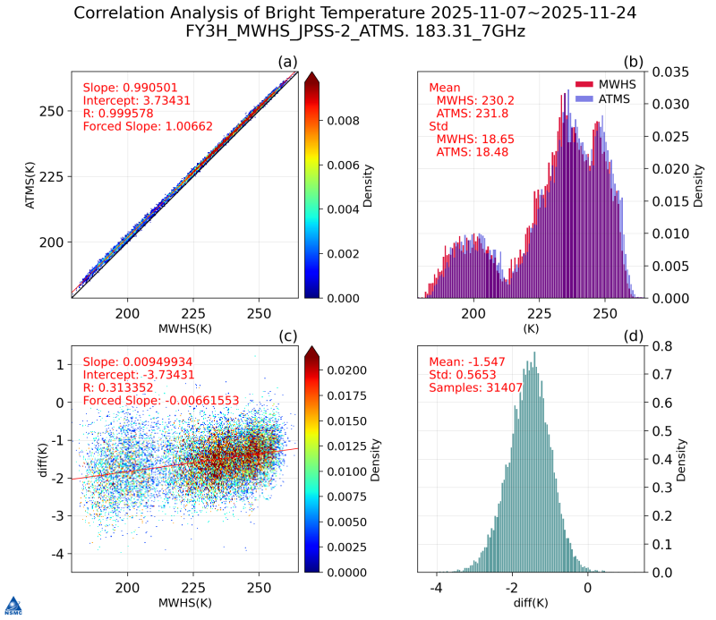
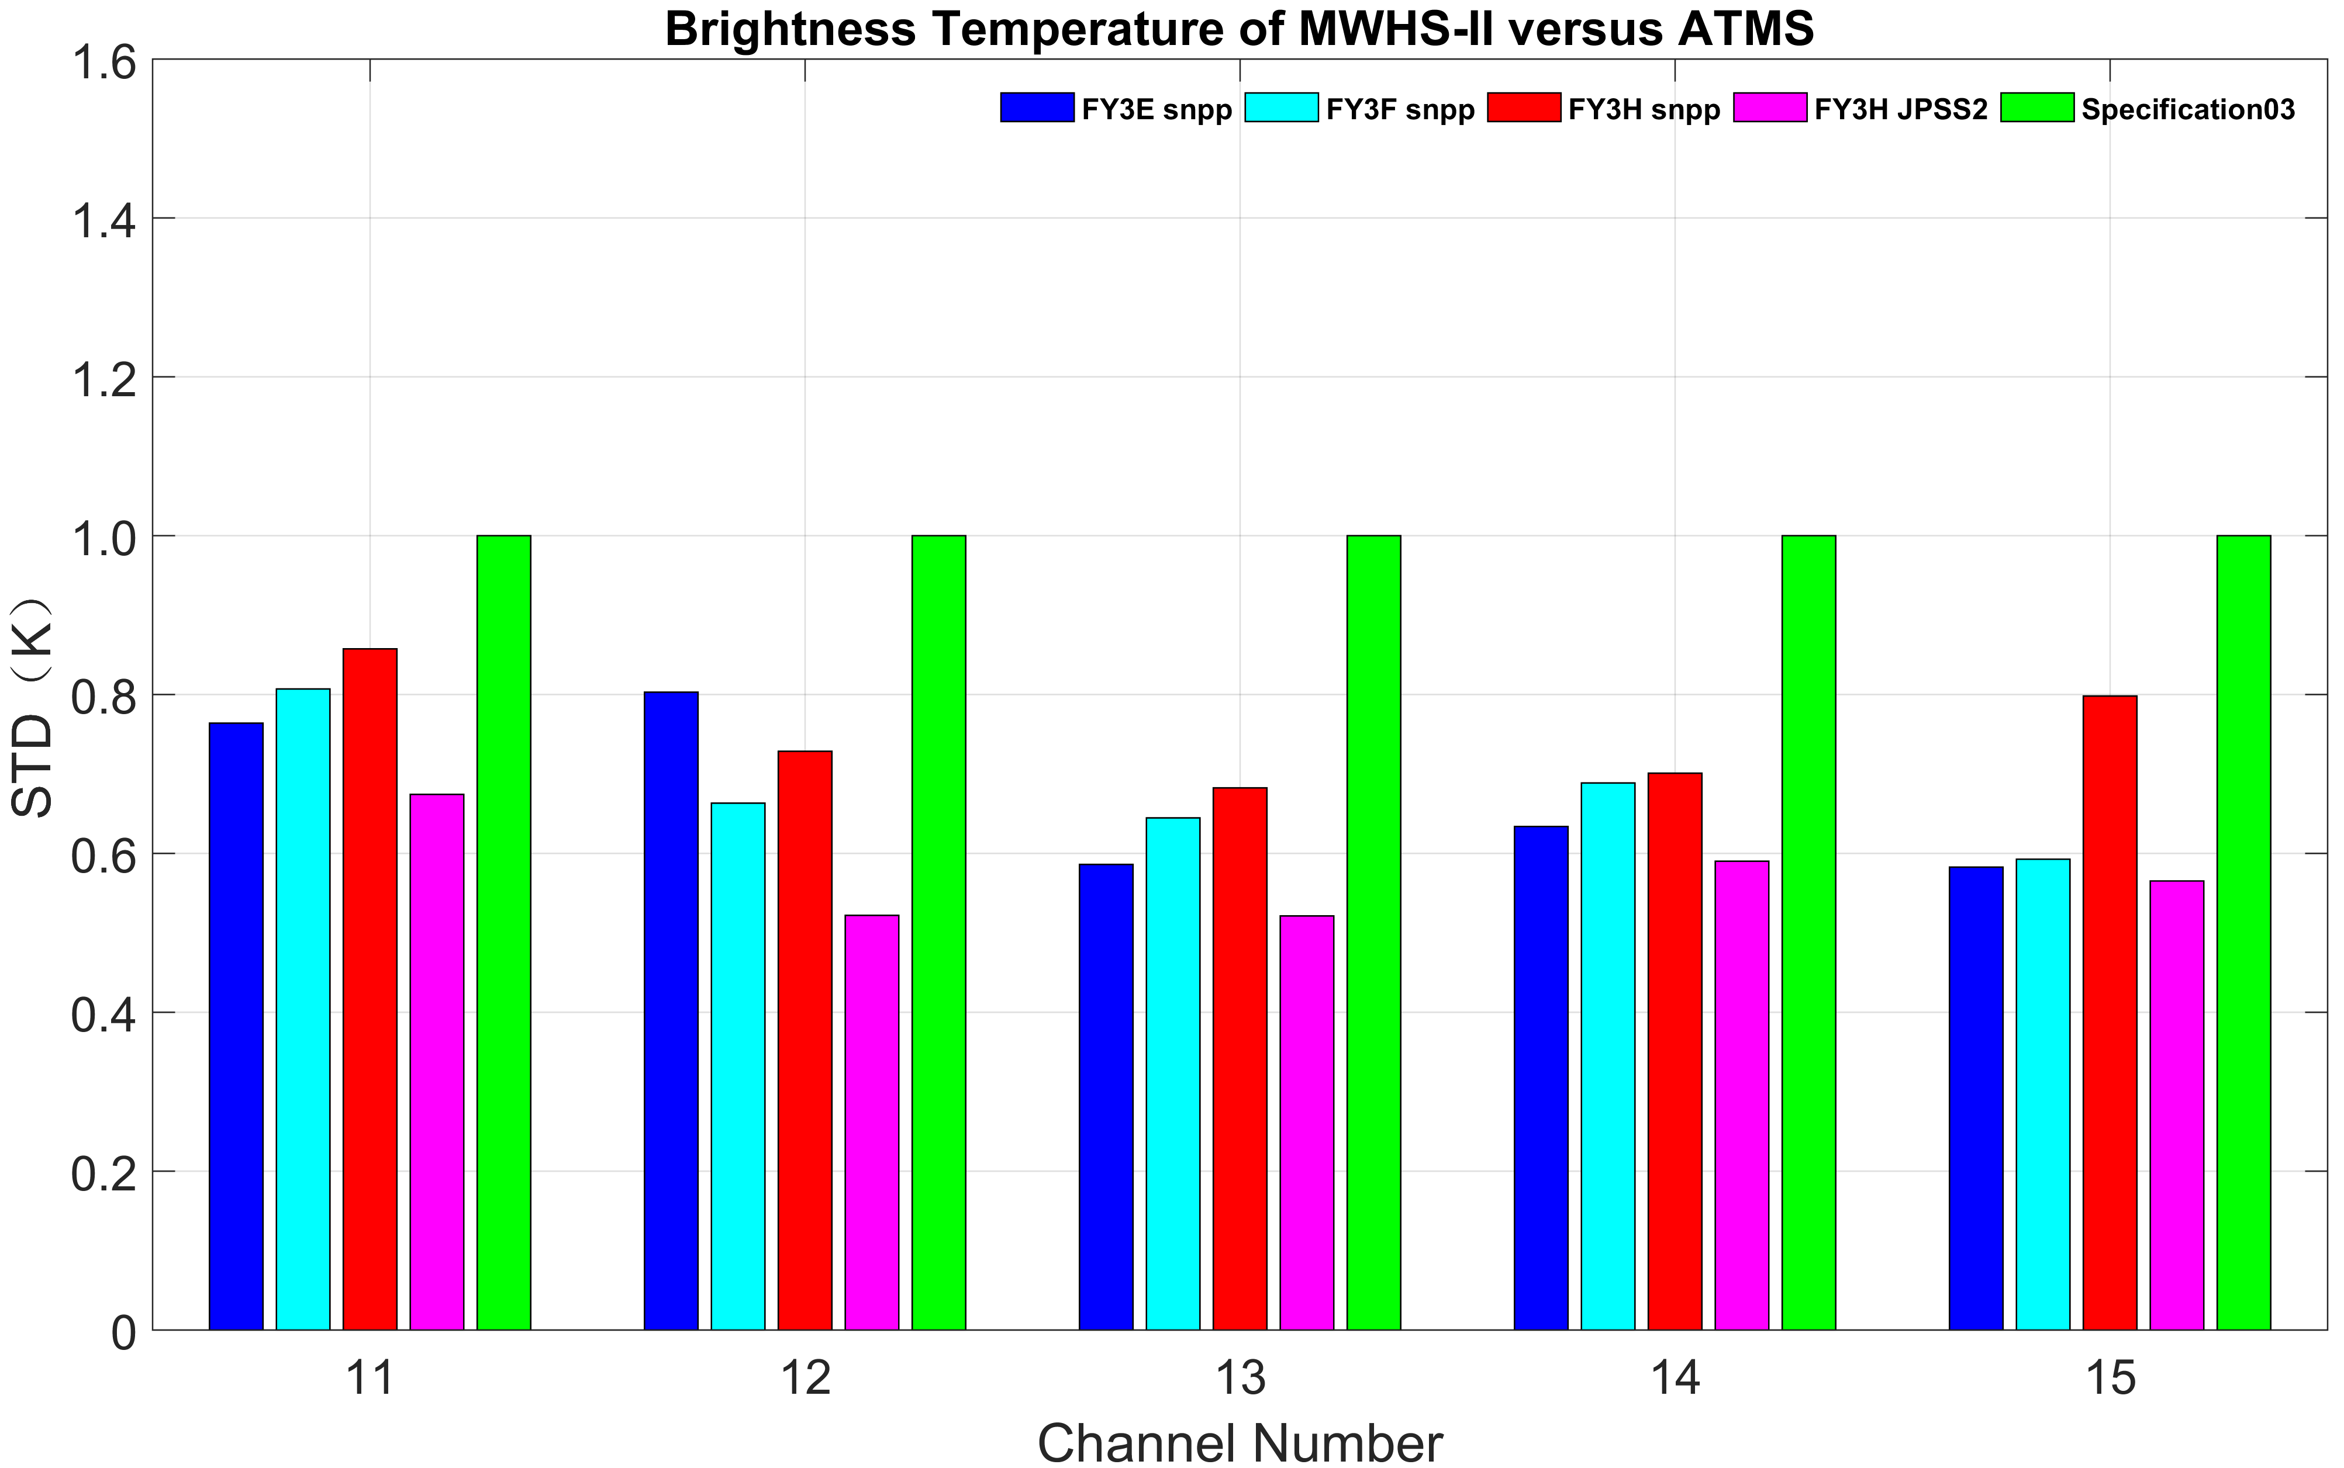
Results
183.31±1GHz
183.31±1.8GHz
183.31±3GHz
183.31±4.5GHz
183.31±7GHz
The standard deviation is below 0.8 K for all five channels.
E,F,H .VS. SNPP; H .VS. JPSS2
Specification

Slide 10
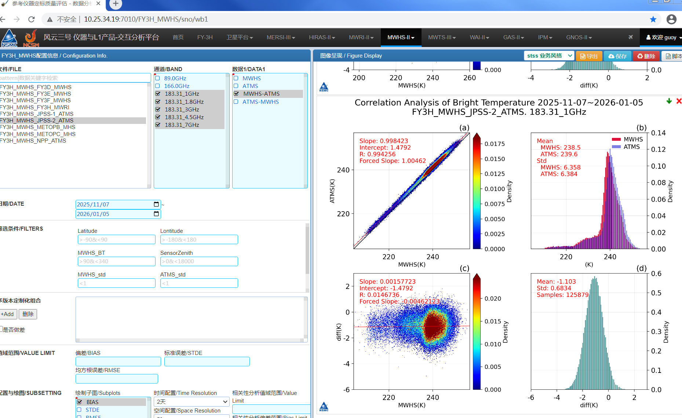
Monitoring Tools
Instrument
Time-series
Statistical analysis charts

Slide 11
Summary
The in-orbit radiometric sensitivity is very stable within specification.
The SNO bias of MWHS-II and ATMS is on the order of 0.8 K for the 183 GHz channels.
The performance of the heritage MWHS-II onboard FY-3H was improved, compared to FY-3D.
With the enhanced performance, MWHS-II will be beneficial to numerical weather prediction.

Slide 12
Thank you for your attention !
Email：guoyang@cma.gov.cn

