Slide 1
GSICS Data Working Group
GDWG
GSICS Dashboard
Paolo Castracane
Starion for ESA/ESRIN

Slide 2
Table of Contents
Topics:
Roadmap to GSICS Product Dashboard - motivations
GSICS Dashboard core functionalities
GSICS Dashboard Conceptual Architecture
GSICS Dashboard high-level requirements
GSICS Dashboard Key design principles
Porposed prototype
Discussion and outcomes

Slide 3
Roadmap to GSICS Product Dashboard
Draft document proposed: Roadmap_to_GSICS_Products_Dashboard_V0.0
Objectives of the document:
Transition GSICS from a correction-centric model to an assessment-, monitoring-, and harmonization-oriented framework.
Provide bias, stability, uncertainty, and traceability information with clear harmonization guidance.
Use GSICS reference instruments as continuous performance benchmarks for monitoring and anomaly detection.
Deliver products through interoperable, user-friendly services (Dashboards, APIs, toolkits) building on existing tools.
Support automated generation of the Status of the System (SoS) Report.
Ensure full alignment with GSICS governance and procedures

Slide 4
GSICS Dashboard - motivations
GSICS evolution toward continuous radiometric monitoring has increased the volume and diversity of outputs.
Existing GSICS products and tools are distributed across multiple platforms, limiting accessibility and usability.
Fragmentation reduces visibility, integration, and operational use by satellite operators and users.
A unified Dashboard is needed to consolidate and streamline access to products and services.
The Dashboard will integrate and harmonize existing capabilities, not (necessarily) replace them.
The approach will enhance usability while remaining consistent with GSICS governance and procedures.

Slide 5
GSICS Product Dashboard – Core functionalities
The GSICS Dashboard would provide the following core functionalities:
Integrated Performance Monitoring
Centralized visualization of inter-calibration results, bias time series, stability indicators, and trends.
Support for GEO–LEO and LEO–LEO comparisons using GSICS Reference Instruments as benchmarks.
Assessment and Diagnostics
Access to bias, uncertainty, and traceability information derived from existing GSICS products.
Interactive filtering by mission, instrument, channel, time period, and reference.
Status of the System (SoS) Support
Aggregation of key monitoring indicators to support the generation of GSICS and CGMS Status of the System reports.
Consistent views of system-level radiometric performance across missions.
Data and Product Access
Direct links to GSICS Correction Products, monitoring outputs, and reference documentation hosted on existing catalogues and servers.
Export of figures and summaries for reporting purposes.
Service-Oriented Access
Progressive integration of APIs to support automated access and downstream use by operators and partners.

Slide 6
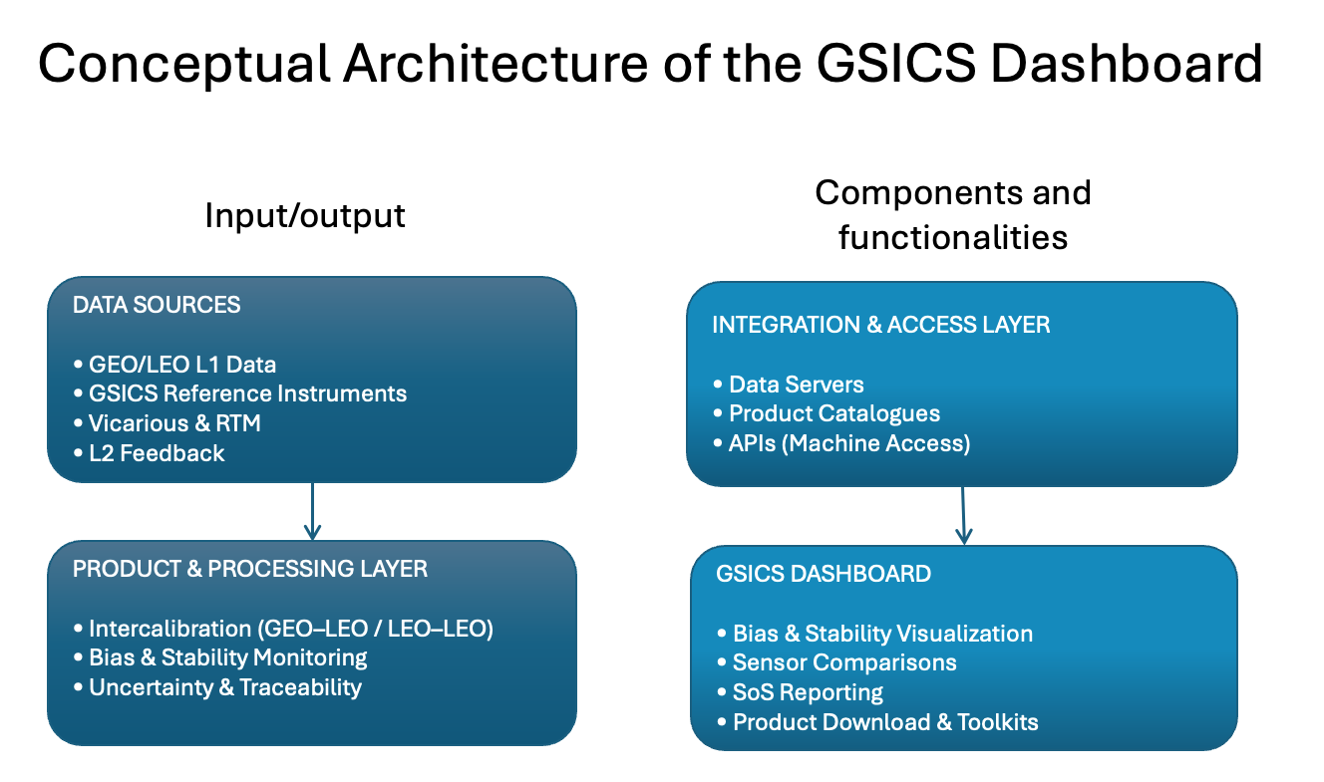
GSICS Product Dashboard

Slide 7
Dashboard: Key design Principles
The system shall:
Emphasize transparency over black-box correction delivery.
Support assessment and harmonization, not mandate calibration changes.
Remain modular and extensible.
Preserve agency ownership of calibration decisions.
Serve both operational and scientific communities.

Slide 8
Dashboard High-level requirements
Functional requirements
  Product Discovery and Access
  Visualization and Monitoring
  Status of the System Support
  API and Machine Access
  Interoperability
Non Functional Requirements
  Governance and Compliance
  Performance
  Reliability and Availability
  Usability

Slide 9
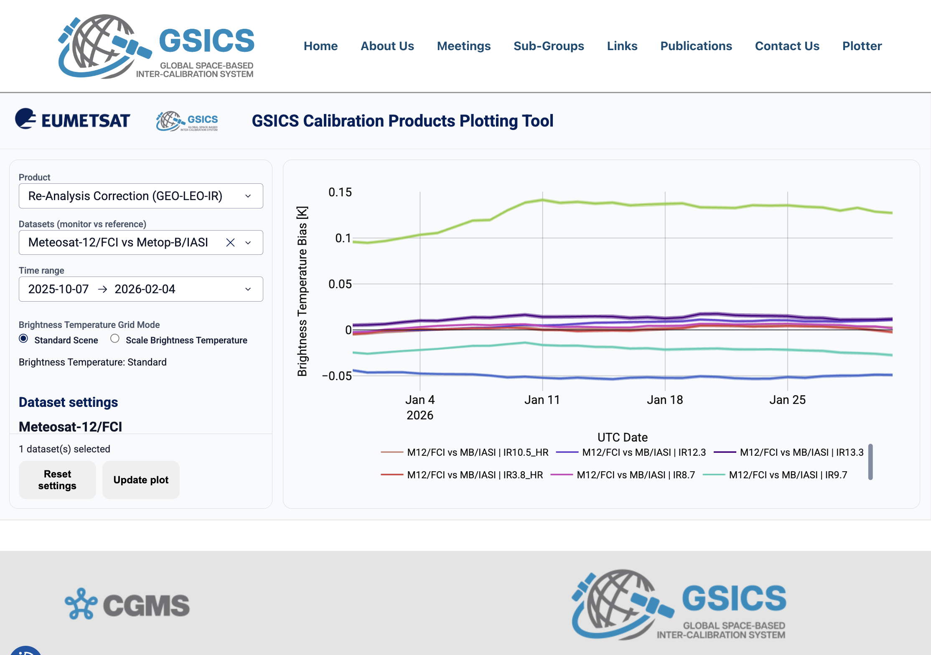
Product Dashboard Mockup (Mounir Lekoaura)
GSICS-centralized plottinng tool for GSICS products generated by agencies
Purpouse:
Mockup to support the definition of the requirements
Support the State of the Observing System reporting to CGMS
Increase visibility for GSICS achievements
Ongoing:
Discussion with the sub-groups to define the further products to be included

Slide 10
Main outcomes form discussion
The proposed dashboard is unanimously viewed as an excellent initiative that meets the requirements and is consistent with an initial prototype development phase.
The current prototype builds on the experiences of existing tool capabilities such as MATRICS, the GSICS Plotting Tool, and uses the EUMTESAT DS as source of data.
To establish a mechanism for uploading data from other agencies to the EUMETSAT DS (with particular attention to security policies).
Confirm that the uncertainty band associated with the data is consistent with that calculated with the current plotting tool.
Create a shared document with list of ideas for products that could be included in plotting tool.
to investigate possibility (from other agencies) to share GEO-LEO monitoring results for inclusion in the new dashboard
To be evaluate in a second phase:
Support for SoS reporting (Aggregation of key monitoring indicators)
Introduction of other sources (RTM, vicarious, L2 feedback etc)

