Slide 1


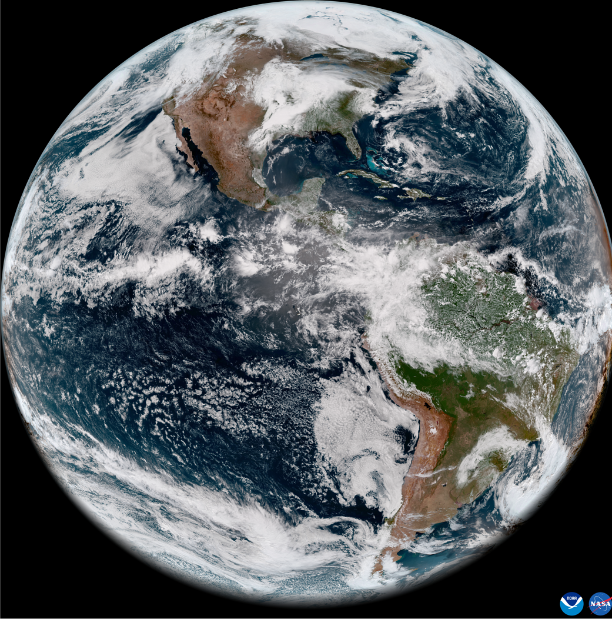
GSICS Coordination Centre (GCC)
Report for 2025-2026
Changyong Cao, Director GSICS Coordination Center
GSICS Annual and Executive Panel Meeting 2026
23-27 March 2026
Ottawa, Canada

Slide 2
Agenda
Introduction
GCC Activities and Accomplishments
  GSICS Product Status Update
  GSICS Quarterly Newsletter
  Support working groups
  Outreach
Guidance from Executive Panel

Slide 3
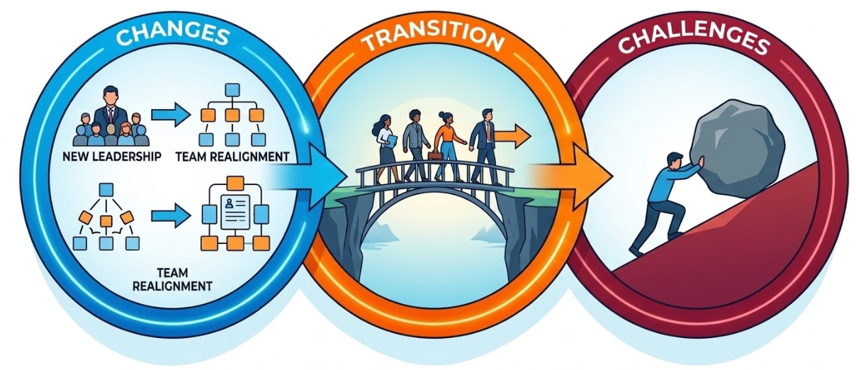
Roles & Responsibilities
Support GSICS products and services
Publish GSICS Quarterly newsletter
Support working groups
Support Executive Panel Priorities
Maintain GCC website
Transition and challenges

Slide 4
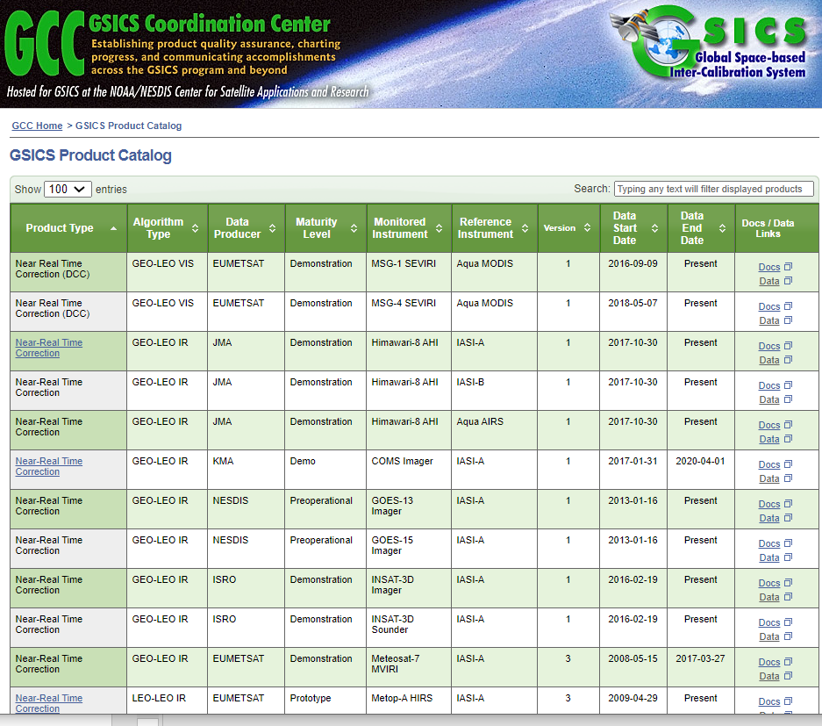
Product Catalog: Overview
GSICS currently maintains 91 inter-calibration products, which are disseminated via the EUMETSAT THREDDS server or can be accessed from https://www.star.nesdis.noaa.gov/smcd/GCC/ProductCatalog.php
The Product Status System continues monitoring and providing status of GSICS product generation.

Slide 5
Product Updates
Six new MSG#-IASI-C Products from EUMETSAT were added to the product catalog in 2025
A total of 91 (6 added in 2025) Products presently delivered via the GSICS Product Catalog
Operational 16 products (including 6 products delivered in 2025) [16 EUMETSAT]
Preoperational 16 products [10 NOAA. 6 EUMETSAT]
Demonstration 57 products [12 EUMETSAT, 17 NOAA, 16 JMA, 10 KMA, 2 ISRO]
Prototype 2 products [2 EUMETSAT]
The Six New Products:
MSG2-IASIC NRTC: https://gsics.eumetsat.int/thredds/catalog/msg2-seviri-metopc-iasi-oper-nrtc/catalog.html : Colab review file here
MSG3-IASIC NRTC: https://gsics.eumetsat.int/thredds/catalog/msg3-seviri-metopc-iasi-oper-nrtc/catalog.html : Colab review file here
MSG4-IASIC NRTC: https://gsics.eumetsat.int/thredds/catalog/msg4-seviri-metopc-iasi-oper-nrtc/catalog.html: Colab review file here
MSG2-IASIC RAC: https://gsics.eumetsat.int/thredds/catalog/msg2-seviri-metopc-iasi-oper-rac/catalog.html :Colab review file here
MSG3-IASIC RAC: https://gsics.eumetsat.int/thredds/catalog/msg3-seviri-metopc-iasi-oper-rac/catalog.html : Colab review file here
MSG4-IASIC RAC: https://gsics.eumetsat.int/thredds/catalog/msg4-seviri-metopc-iasi-oper-rac/catalog.html : Colab review file here
Reference:
July 3, 2025
Dear Bojan,
I am writing to inform you and the Executive Panel that the GCC has approved six new GSICS intercomparison products submitted by Eumesat for inclusion in the GSICS Product Catalog
https://www.star.nesdis.noaa.gov/smcd/GCC/ProductCatalog.php
They have been accepted at the pre-operational maturity level through the family of instruments exception for new products following confirmation of their format compliance and availability.
Best,
Larry Flynn, GCC Director

Slide 6
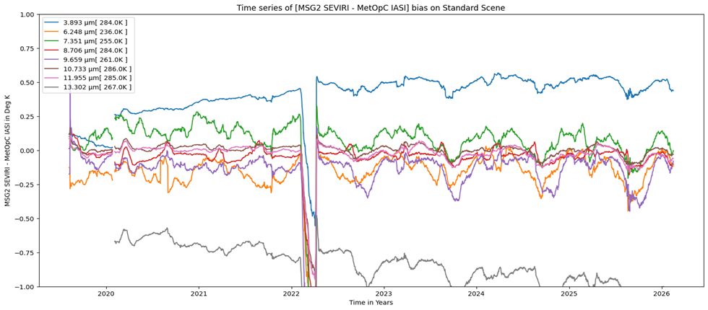

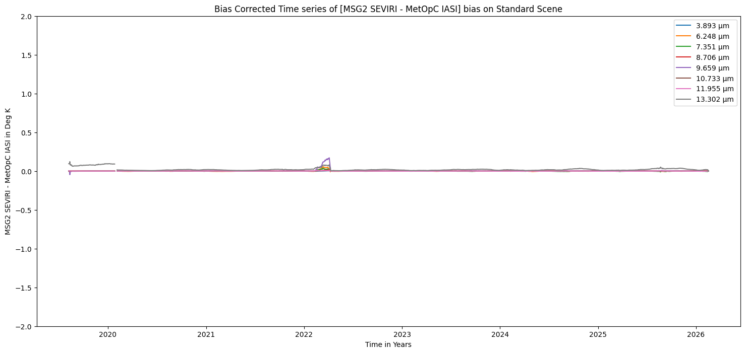
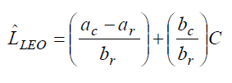
Product Status Monitoring
Example #1: MSG2 SEVIRI vs MetOp-C IASI Re-Analysis
Example of GSICS Correction Validation
Operational Radiance Calculation
Before correction
GSICS-Corrected Radiance
a_{r} and b_{r} from submitted inter-IASI calibration
After correction

Slide 7
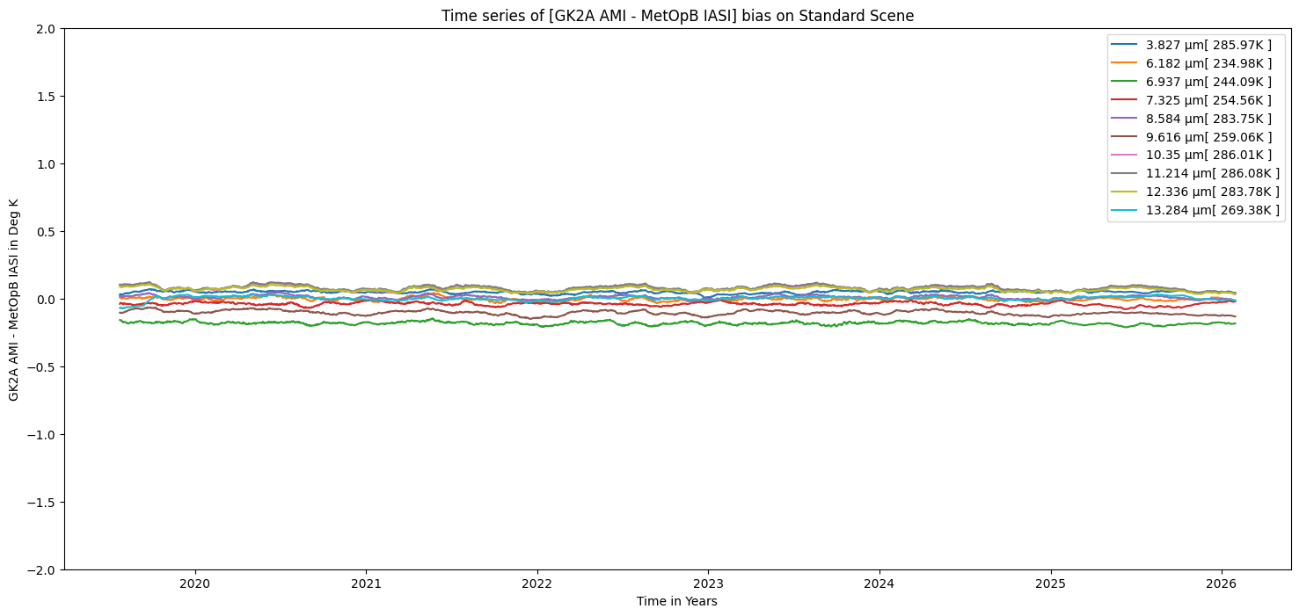
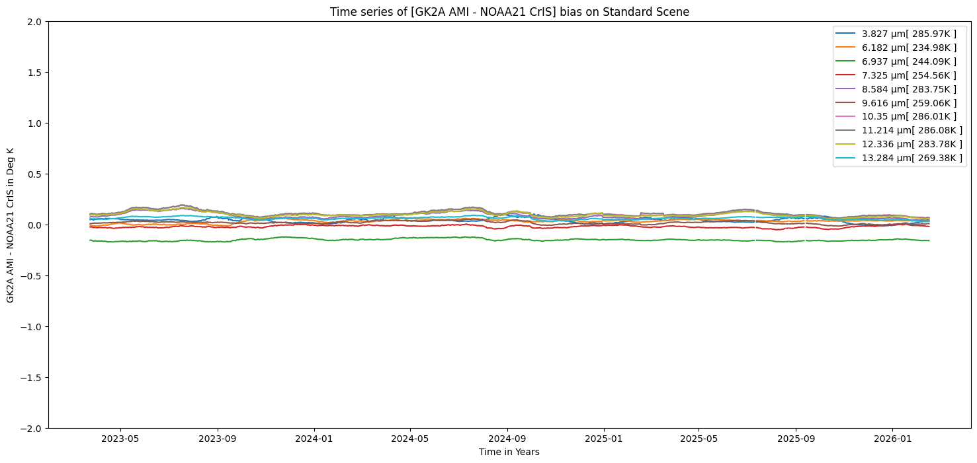
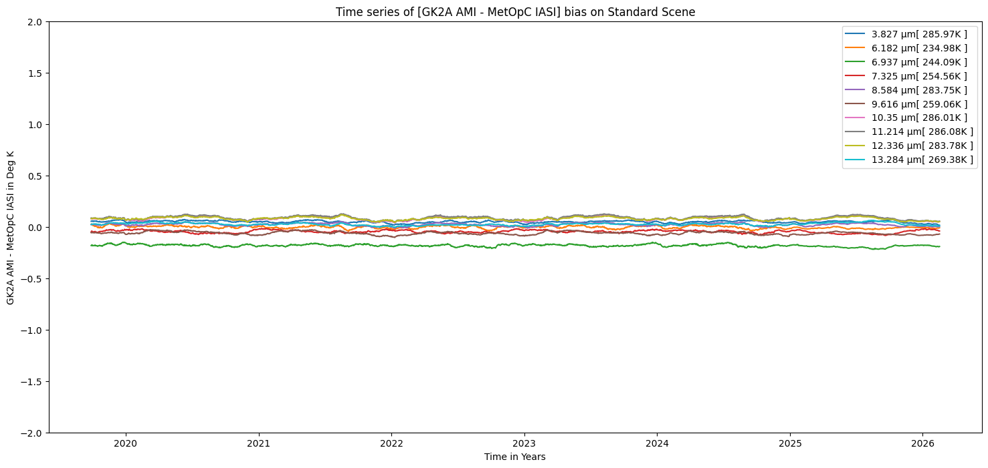
Product Status Monitoring
Example #2: GK-2A AMI vs IASI-B/C and NOAA-21 CrIS
GK-2A AMI vs. MetOp-B IASI
GK-2A AMI vs. NOAA-21 CrIS
GK-2A AMI vs. MetOp-C IASI
GSICS inter-calibration shows
The bias trends of GK-2A AMI against IASI-B, IASI-C, and CrIS indicate consistent calibration performance of GK-2A AMI and good agreement among the hyperspectral reference IR instruments.
Instrument calibration is stable and consistent

Slide 8
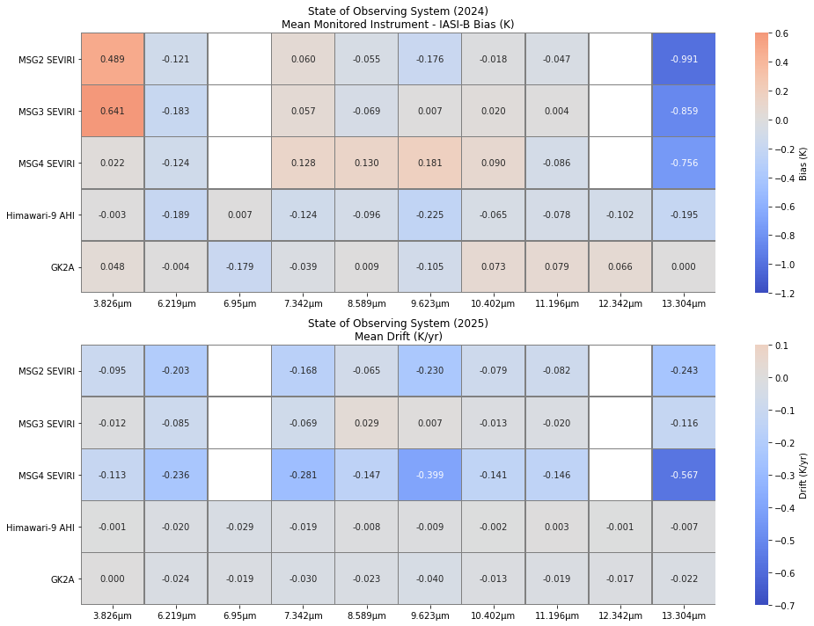
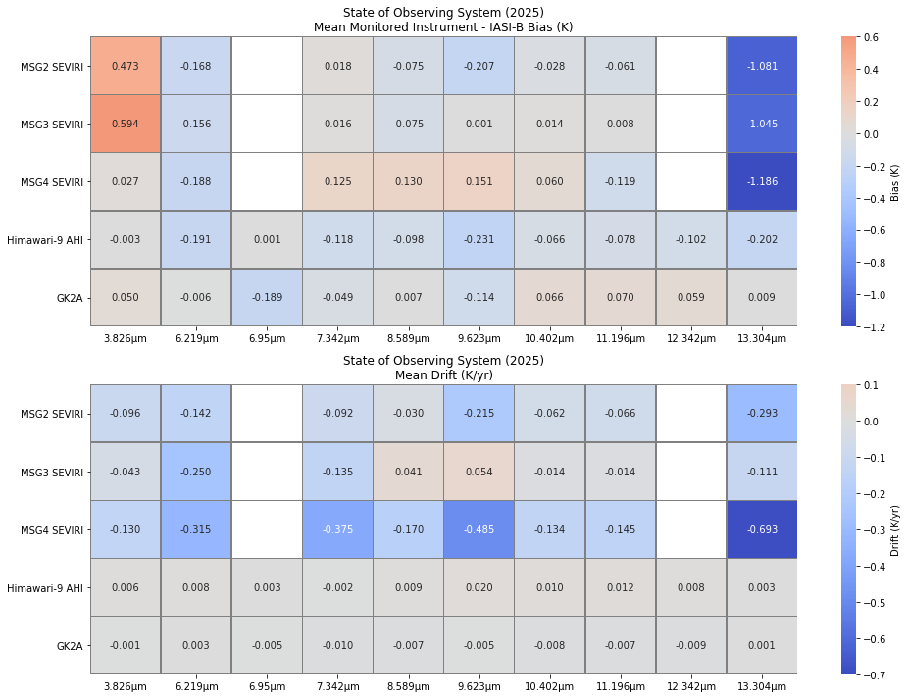
State of Observing System
(IASI-B as Reference)
2024
2025
Bias (k)
Drift (k/Year)
Inter-calibration Performance Chart for IR channels (IPC-IR) from 5 selected instruments shows:
  Calibration Biases have been consistent
  Calibration stability is maintained in 2025

Slide 9
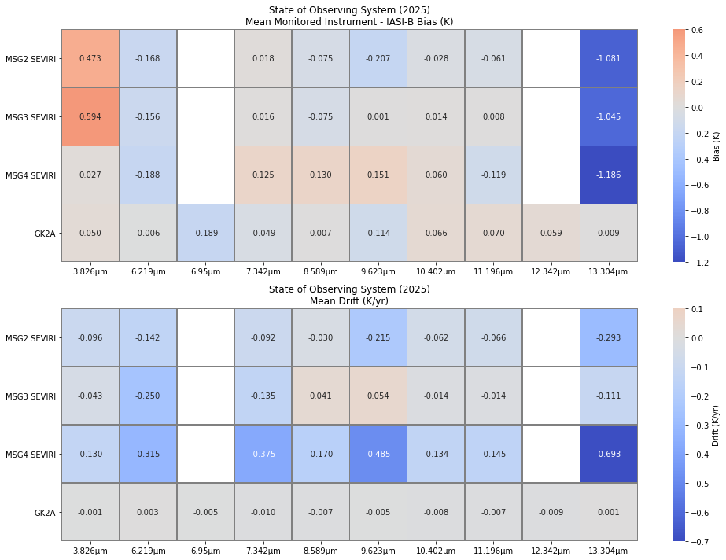
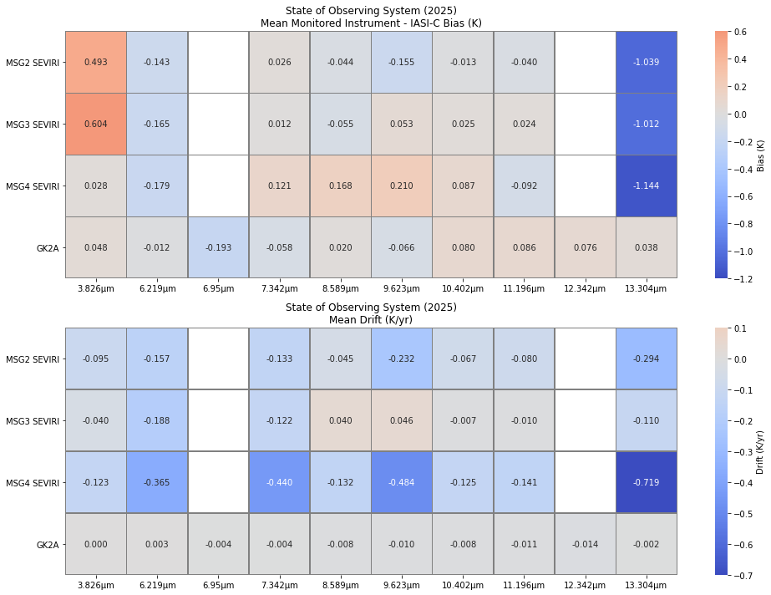
State of Observing System
(vs. IASI-B and IASI-C) in 2025
SEVERI and GK2A vs. IASI-B
SEVERI and GK2A vs. IASI-C
Bias (k)
Drift (k/Year)
IPC-IR using IASI-B vs. IASI-C as reference shows:
  Biases and stability have been consistent with both IASI-B and IASI-C as reference
  IASI-B and IASI-C performances are consistent

Slide 10
Use of AI-Tools to Maintain GSICS Product Catalog
Detection of Product Non-Current End Dates
Product Type | Algorithm Type | Data Producer | Maturity Level | Monitored Instrument | Reference Instrument | Data Start Date | Data End Date | Updated
Re-Analysis Correction (DCC) | GEO-LEO VIS | EUMETSAT | Demonstration | MSG-3 SEVIRI | Aqua MODIS | 3/19/2016 | Present | 11/12/2024
Re-Analysis Correction (DCC) | GEO-LEO VIS | EUMETSAT | Demonstration | MSG-4 SEVIRI | Aqua MODIS | 5/7/2018 | Present | 2024-11-12
Near-Real Time Correction | GEO-LEO IR | ISRO | Demonstration | INSAT-3D Imager | IASI-A | 2/19/2016 | Present | 2022-03-11
Near-Real Time Correction | GEO-LEO IR | ISRO | Demonstration | INSAT-3D Sounder | IASI-A | 2/19/2016 | Present | 2019-03-06
Detection of Broken Links (to be fixed)
# | URL | Status
1 | https://www.star.nesdis.noaa.gov/smcd/GCC/documents/documentation/gsics_docs/pub/Development/ReviewKMAProducts/ATBD_for_KMA_Inter-Calibration_of_COMS-IASI_v1.0.docx | 404
2 | https://www.star.nesdis.noaa.gov/smcd/GCC/documents/documentation/gsics_docs/pub/Development/ISROINSAT3DIASIACorrectionProduct/GSICS_ISRO_INSAT3D_IASI_ATBD_2014.pdf | 404
3 | http://www.eumetsat.int/website/home/Data/Products/Calibration/Intercalibration/index.html | 404
4 | https://www.star.nesdis.noaa.gov/smcd/GCC/images/productComparison/ | 403

Slide 11
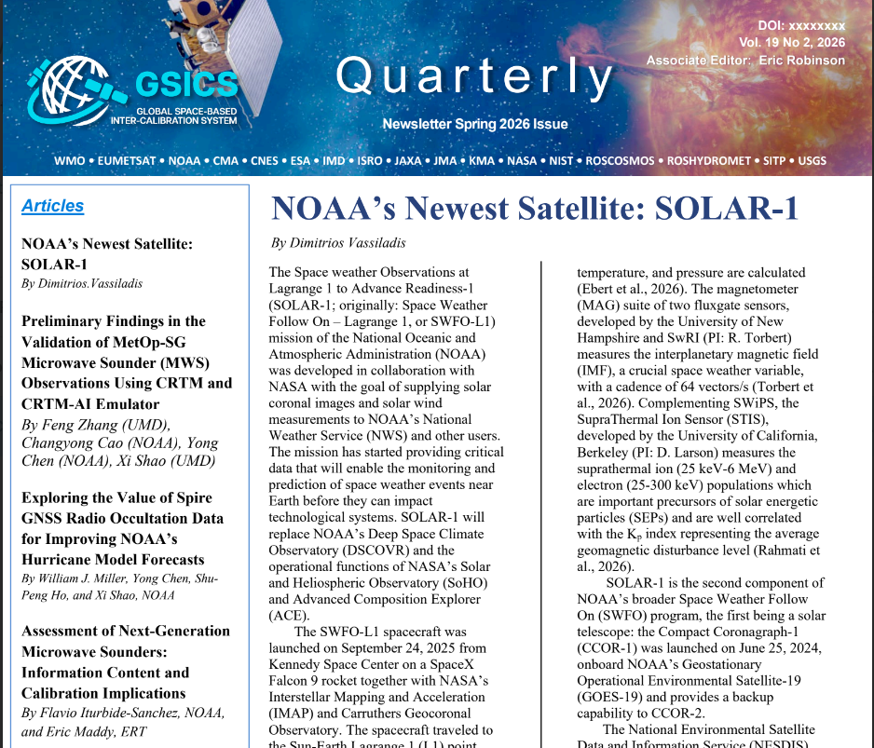
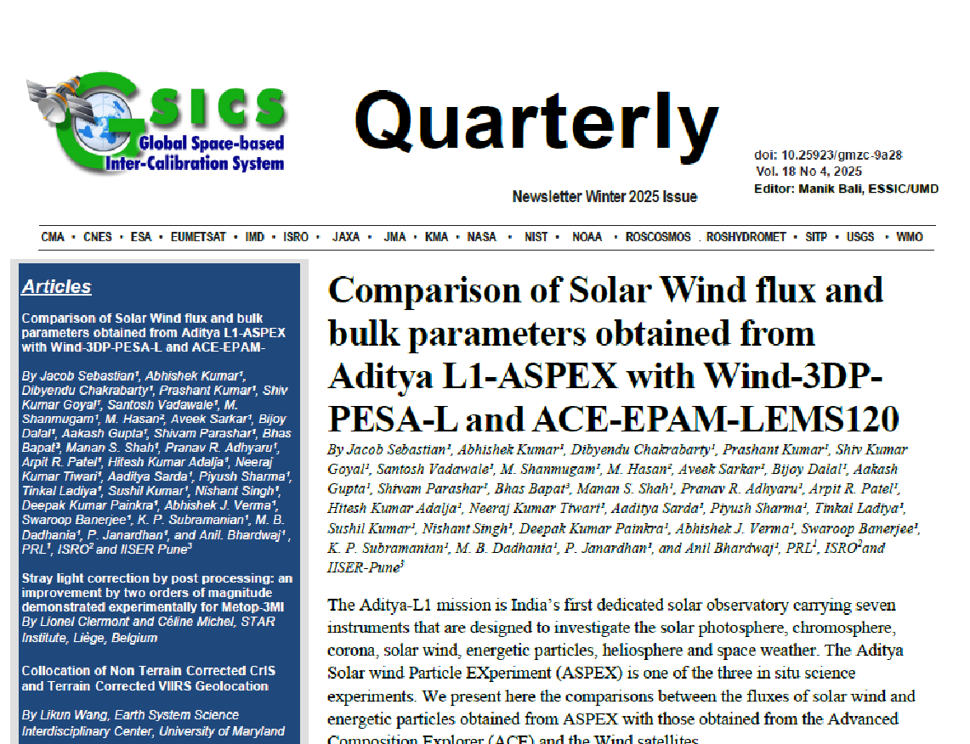
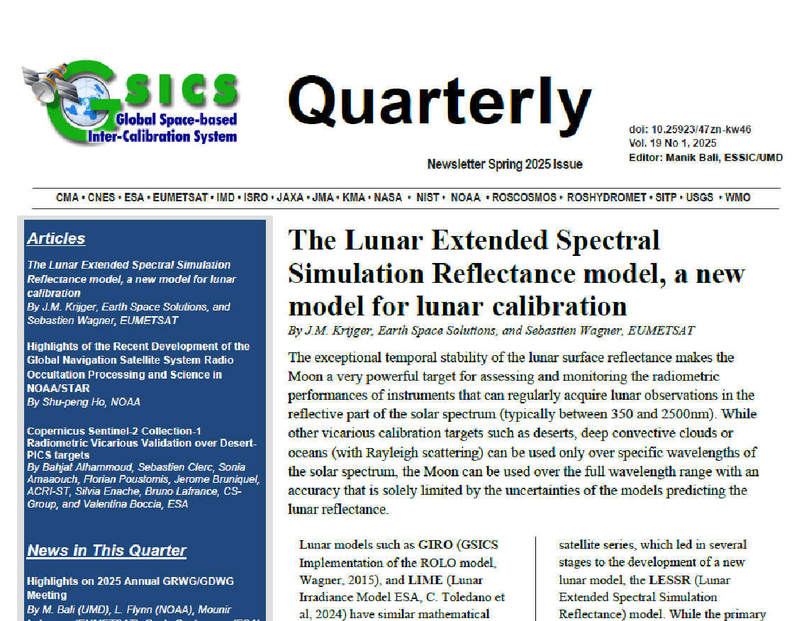
GCC Newsletter
GSICS Newsletter Editorial Board
Eric Robinson, Associate Editor
Lawrence E. Flynn, Reviewer
Lori K. Brown, Tech Support
Tim Hewison, European Correspondent
Yuan Li, Asian Correspondent
Fangfang Yu, US Correspondent.
Reviewers in the past year
Lawrence E. Flynn, NOAA
Tim Hewison, EUMETSAT
Sri Harshara Madhavan, SSAI/NASA
Cheng-Zi Zou, NOAA

Slide 12
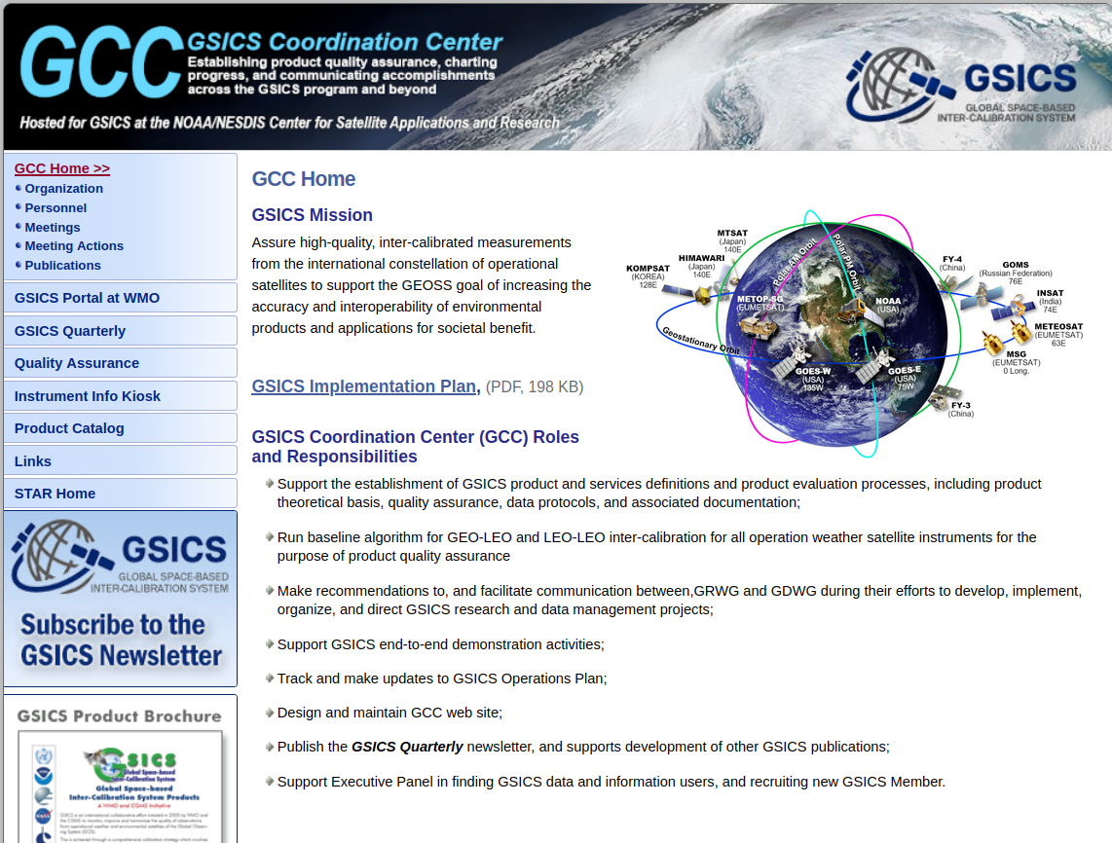
GCC Website
New banner with new logo
New Figure with satellites updated
Transitions
  GSICS Wiki (phased out due to security loophole)
  EUMETSAT:
    https://gsicsweb.eumetsat.int
  WMO Sharepoint for Meeting agendas

Slide 13
THANK YOU

