Slide 1
GSICS Data Working Group
GDWG
Breakout Session
Report
Paolo Castracane
Starion for ESA/ESRIN

Slide 2
Table of Contents
Topics:
GDWG overview
Breakout Session
Discussion and Outcome
Plan for next year

Slide 3
GDWG Overview
The GSICS Data Management Working Group (GDWG) is an advisory body of the GSICS Executive Panel (EP) for data management and exchange issues. It is composed of Data Management experts designated by GSICS member organizations.
Coordinate GSICS data management and advise the Executive Panel
Define and maintain standardized data, metadata, and product formats (FAIR-aligned)
Support GSICS systems, tools, and information services
Ensure quality, compliance, and long-term accessibility of GSICS deliverables
Guide usability and accessibility of GSICS web platforms
Collaborate with GPRCs and report on activities and recommendations

Slide 4
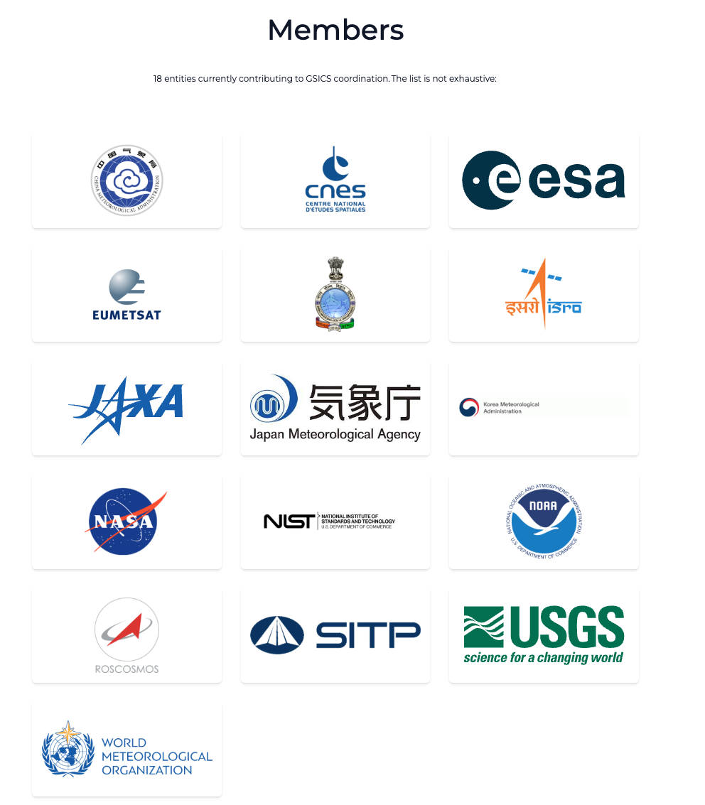
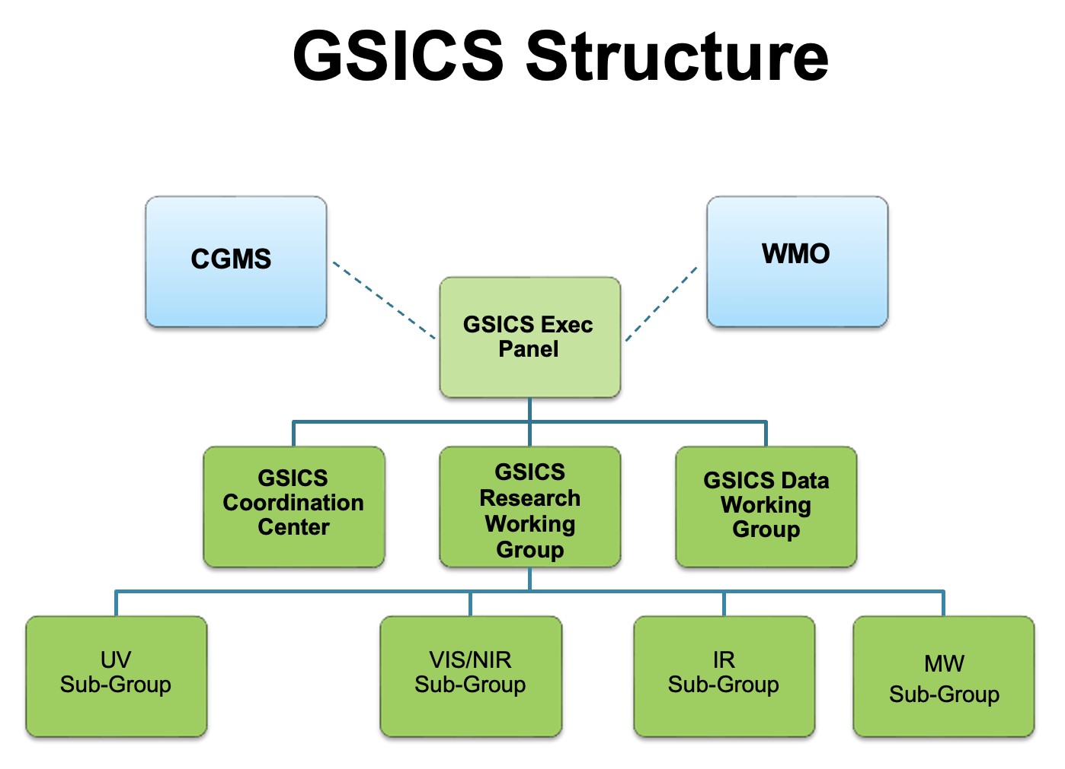
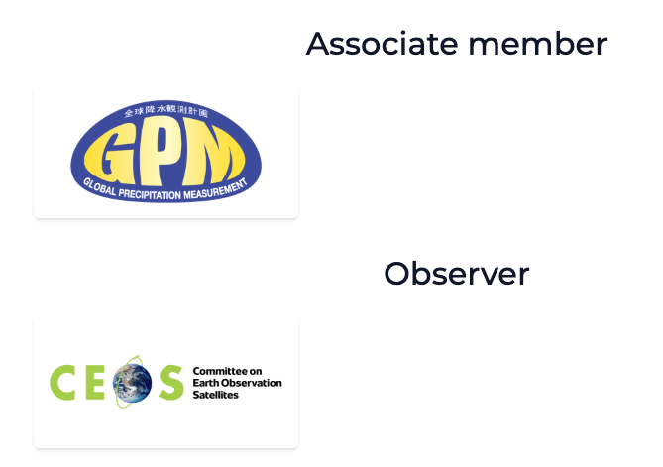
GDWG in the GSICS Framework
GDWG actively supports all aspects of GSICS activities
e.g . systems/metadata/products/web/GPPA
Detailed ToR here
Oversee and coordinate the data management activities of GSICS and advise the EP on questions related to GSICS data management including information delivery services

Slide 5
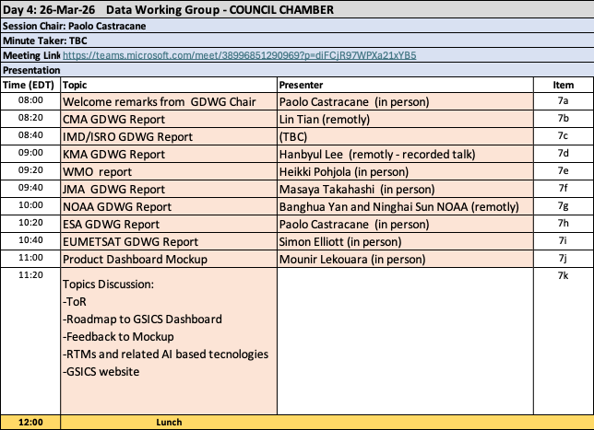
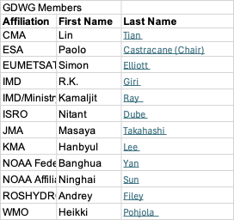
GDWG Membership and GDWG Breakout Session schedule
https://gsics.wmo.int/en/focal-points

Slide 6
Topics for discussion
Topics for discussion:
GSICS Terms of Reference: GSICS-RD004_tor-V3.docx
Document: Roadmap_to_GSICS_Products_Dashboard_V0.0
Feedback on Dashboard Mockup
GSICS Website
Vice-Chair request

Slide 7
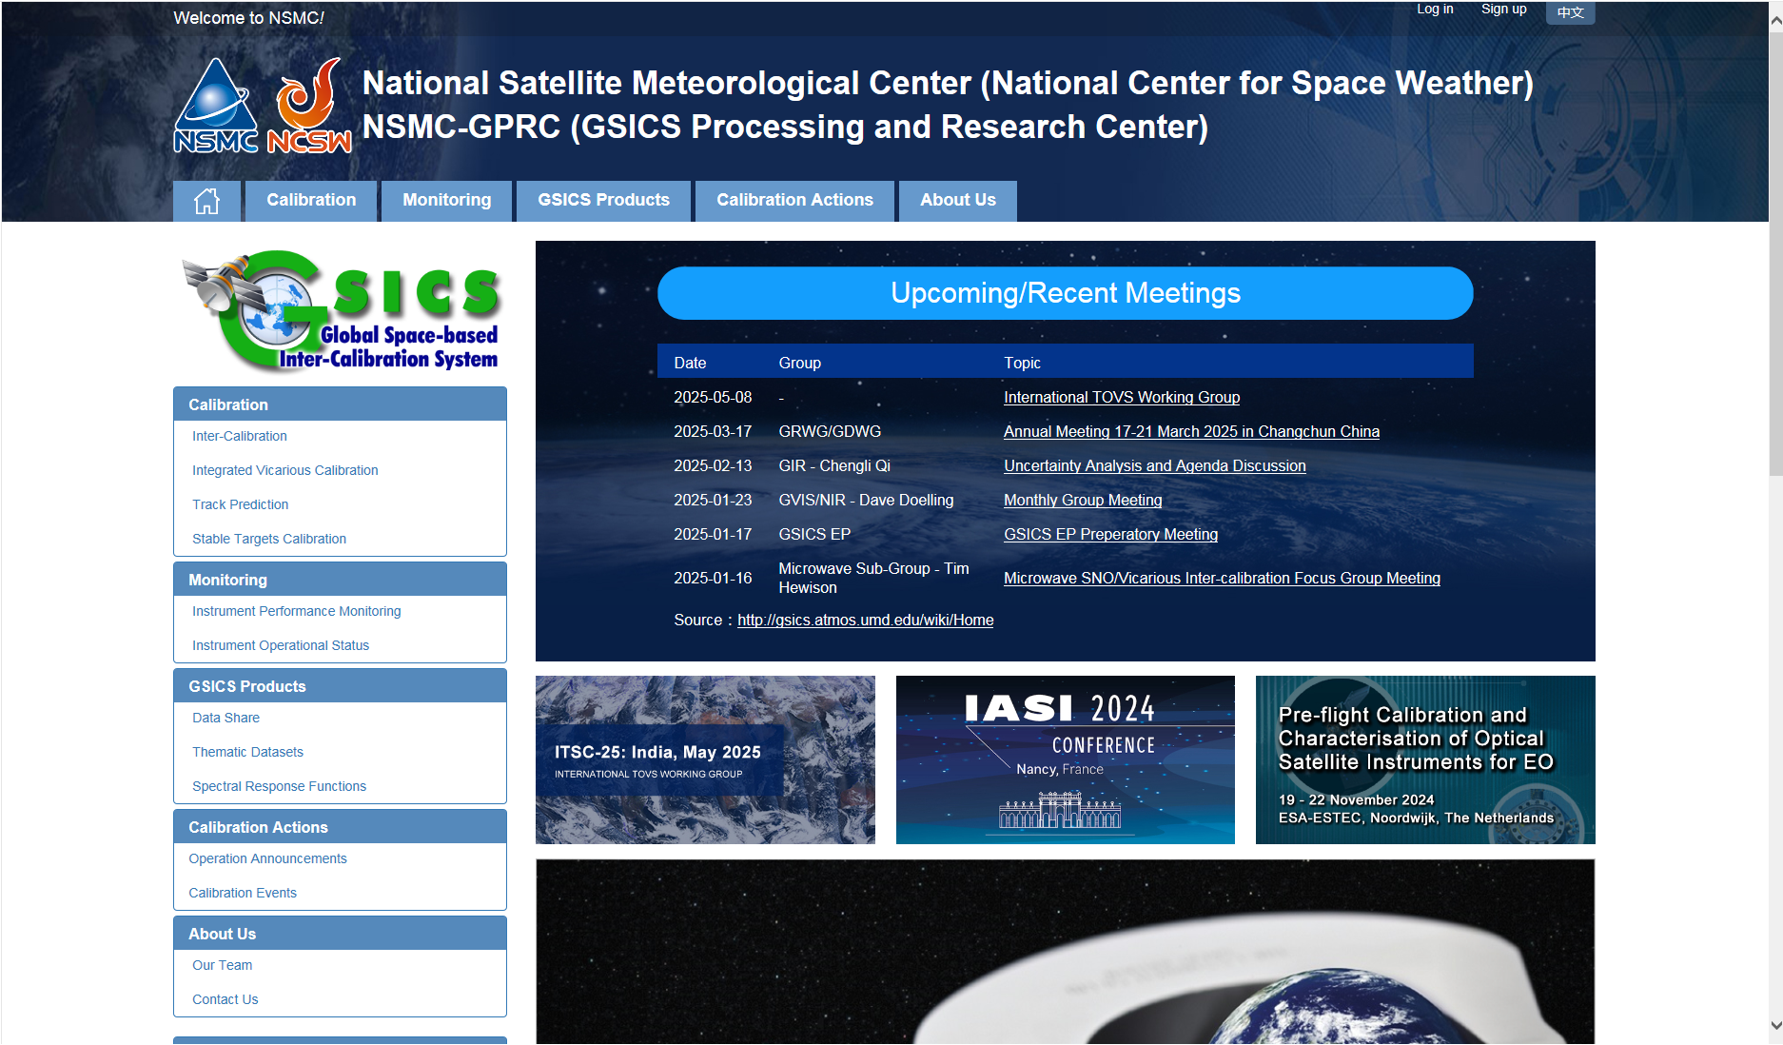
CMA GDWG Report (Lin Tian)
Agency’s support to GDWG Activites
Keep CMA GPRC Website Content updating:
  GPRC Information
  CMA GSICS product sharing (Thredds)
  FengYun Satellites Instrument Operation Status (Landing Pages）
CMA GDWG:
  Website construction and maintain
  New satellite data sharing
  NSMC-GPRC Website Upgrade
Recent launches and Instrument Updates (Landing pages for new FY-LEO / FY-GEO instruments)
Calibration Major Updates
FY-4B/C calibration with new FY-LEO under development
GSICS meeting information Updates
http://gsics.nsmc.org.cn/portal/en/fycv/monitoring.html

Slide 8
KMA GDWG Report (Hanbyul Lee)
KMA’s GSICS Correction
Current Status
Near-Real Time Correction (NRTC)
  GK2A / AMI / IR with reference to IASI(Metop-B/-C) and CrIS(S-NPP and NOAA-20/21) : Demo. phase
  COMS / MI / IR with reference to AIRS(Aqua), IASI(Metop-A/-B): Demo. phase
Re-analysis Correction (RAC)
  GK2A / AMI / IR with reference to IASI-B/-C and CrIS(S-NPP and NOAA-20/21) : Demo. phase
  COMS / MI / IR with reference to IASI-A : Demo. phase
NRTC and RAC Correction Data were previously distributed through the EUMETSAT GSICS Server from Jan. 15, 2018
Plans to align with the new GSICS Dashboard framework for future data sharing
The KMA GPRC provides AMI performance monitoring in the ACVs web portal
  ACVs includes time series and stability assessment of AMI
  User accessibility is supported
    CSV data download
    Figure/image download
Future plan
  KMA Align with GSICS Dashboard concept : ACVs already supports many elements
    Performance monitoring
    Assessment & Diagnostics
    Satellite system status
    Data and Product Access
  Provide GEO–GEO inter-comparison products (AMI–AHI) in the ACVs web portal

Slide 9
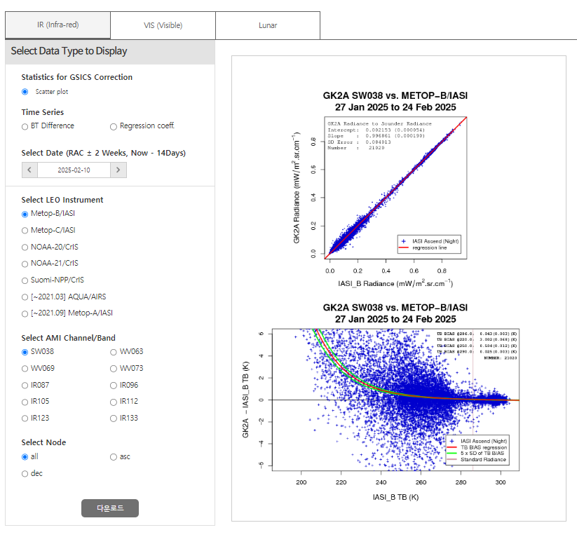
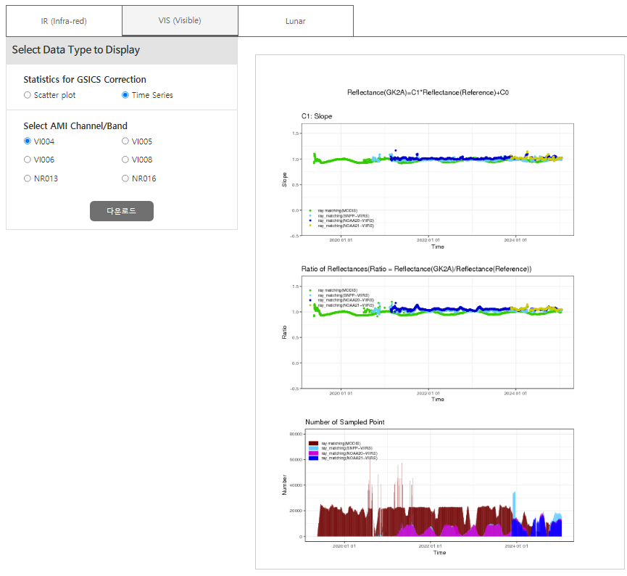
KMA GDWG Report (Hanbyul Lee)
Monitoring page(IR)
Monitoring page(VNIR)

Slide 10
WMO GDWG Report (Heikki Pohjola)
GSICS WMO Website https://gsics.wmo.int/
Discussion on websites
WMO SharePoint: WMO Community – Collaboration Hub https://wmoomm.sharepoint.com/sites/Collaboration/
GSICS mailing lists
Need for other mailing list

Slide 11
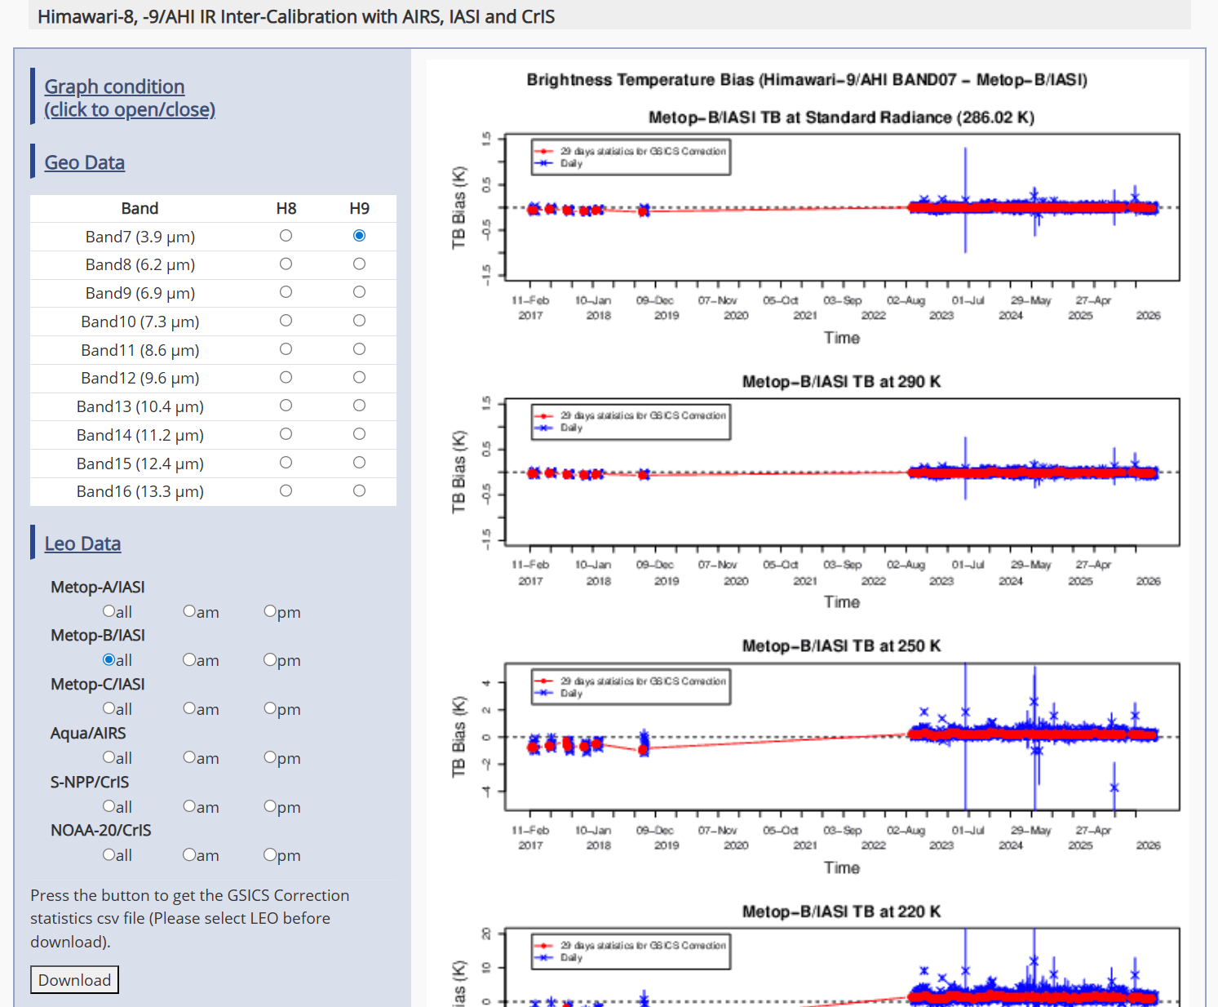
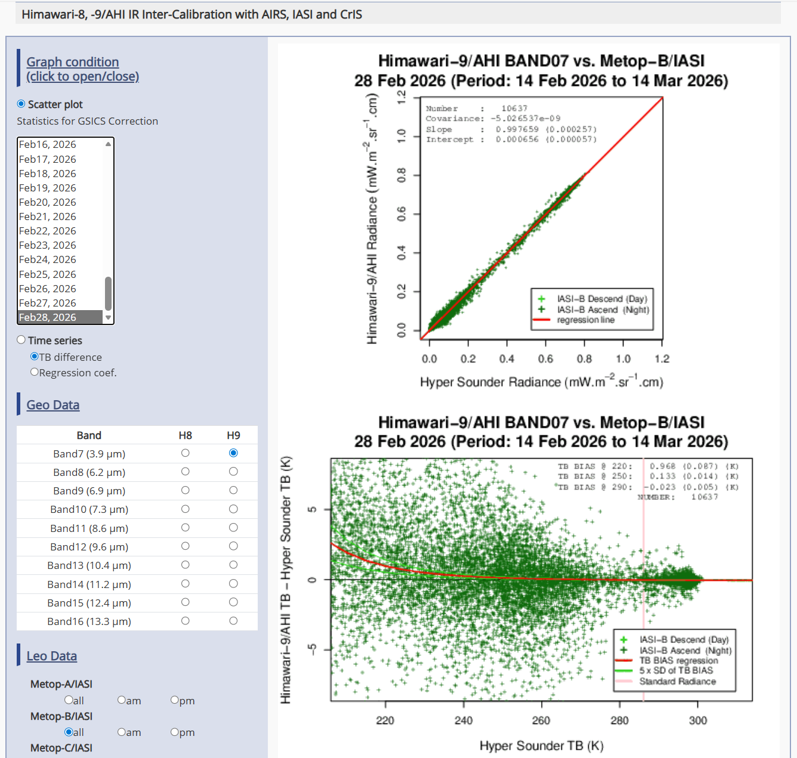
JMA GDWG Report (Masaya Takahashi)
JMA GSICS Monitoring Page for Himawari Imagers
2025-2026 JMA GDWG Activities
Static charts: time series and scatterplots
  Inter-calibration coefficients
  Monitored instrument’s biases against reference instruments (e.g., Himawari-9/AHI vs. Metop-B/IASI)
Users can inter-calibration results as csv files
  This may be related to “Dashboard” development
We started to develop new monitoring system for Himawari-10 mission (for internal use at this moment)
  GSICS member agencies’ systems like ICVS, MATRICS and MICMICS are very nice references
Lunar calibration
  Development of I/O data Convention for new lunar calibration framework (LSICS)
Maintaining JMA GPRC webpage
  Calibration landing page
    Instrument info (e.g., SRF)
    Event logging
  Himawari-8/-9 AHI monitoring pages
    VNIR Ray-matching
    VNIR Vicarious calibration
    GEO-LEO-IR
No open actions

Slide 12
Proposal for Future GDWG Session
To have a slot to review GSICS baselines relevant to GDWG activities would be important to play our roles written in the (new) GDWG Terms of Reference.
Websites
  Each agency’s (GPRC’s) website, including Landing Page as a part of Event Logging activity
  GSICS Developers website
  WMO website
GSICS Conventions
  File naming Convention
  netCDF Convention for GSICS Deliverables (products, data file like SRF, tools, documents, …)

Slide 13
NOAA GDWG Report (Ninghai Sun)
NOAA GDWG Actions and Status
NOAA STAR Activities Relevant to the GSICS Community
  Summary of NOAA Legacy Satellites Decommissioning
  NOAA vs. EUMETSAT Metop AMSU-A L1b Data Comparison
NOAA ICVS Inter-sensor Comparison Products to Support the GSICS Community
  Inter-Sensor Radiometric Calibration Bias Assessment (iSensor-RCBA) Monitoring Tool
  Key Showcases and Products
    ATMS Inter-sensor Bias through SNO and 32-Day Mean Methods
    ATMS Inter-sensor Bias through CRTM Simulation O-B Double Difference
    CrIS LEO-GEO/LEO-LEO Inter-sensor Bias through SNO
    CrIS Inter-sensor Bias through CRTM Simulation O-B and SNO Bias Double Difference
Path Forward
Acknowledgement

Slide 14
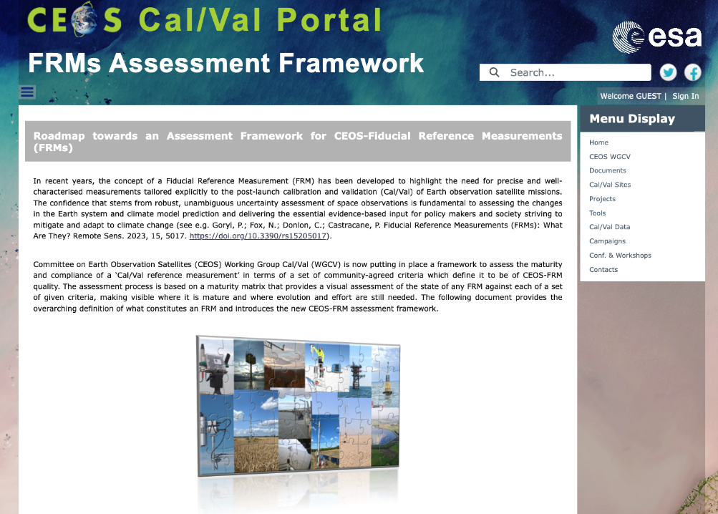
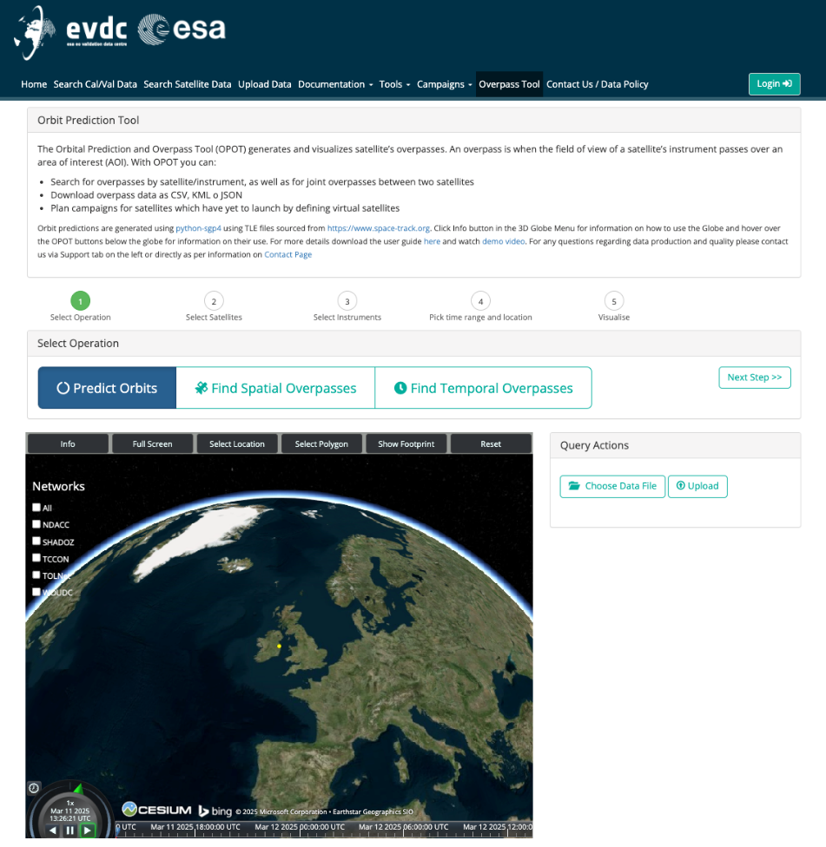
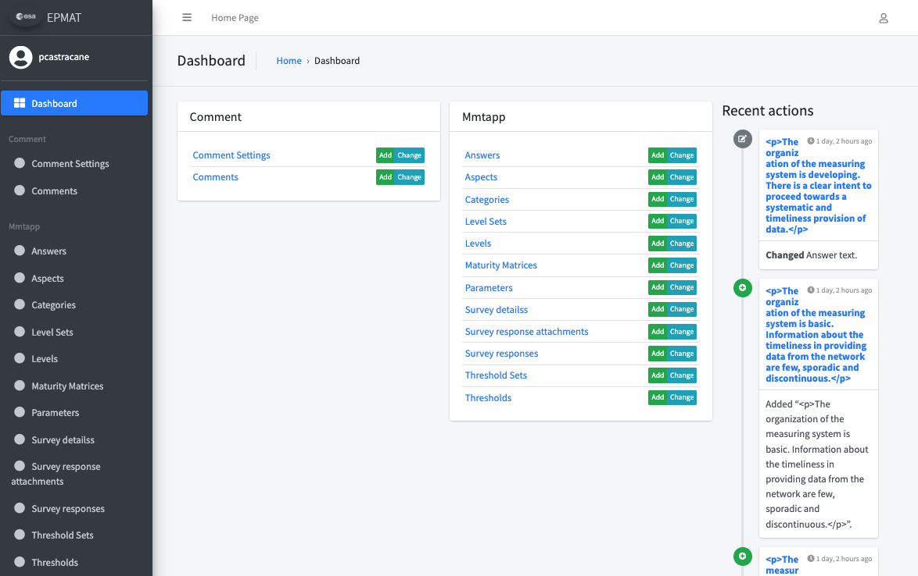
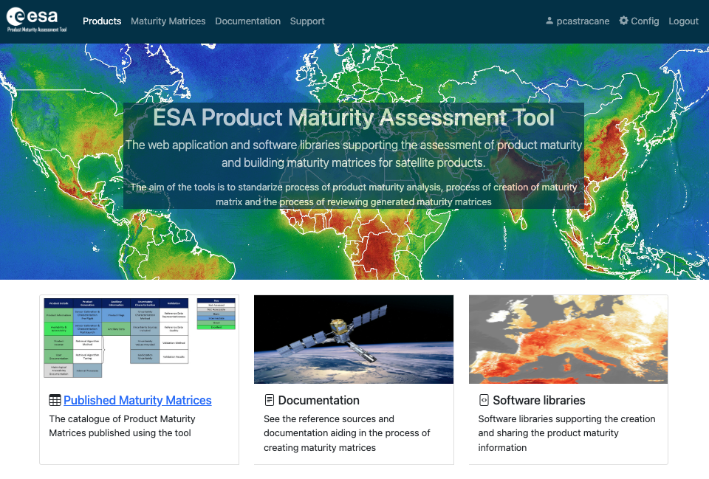
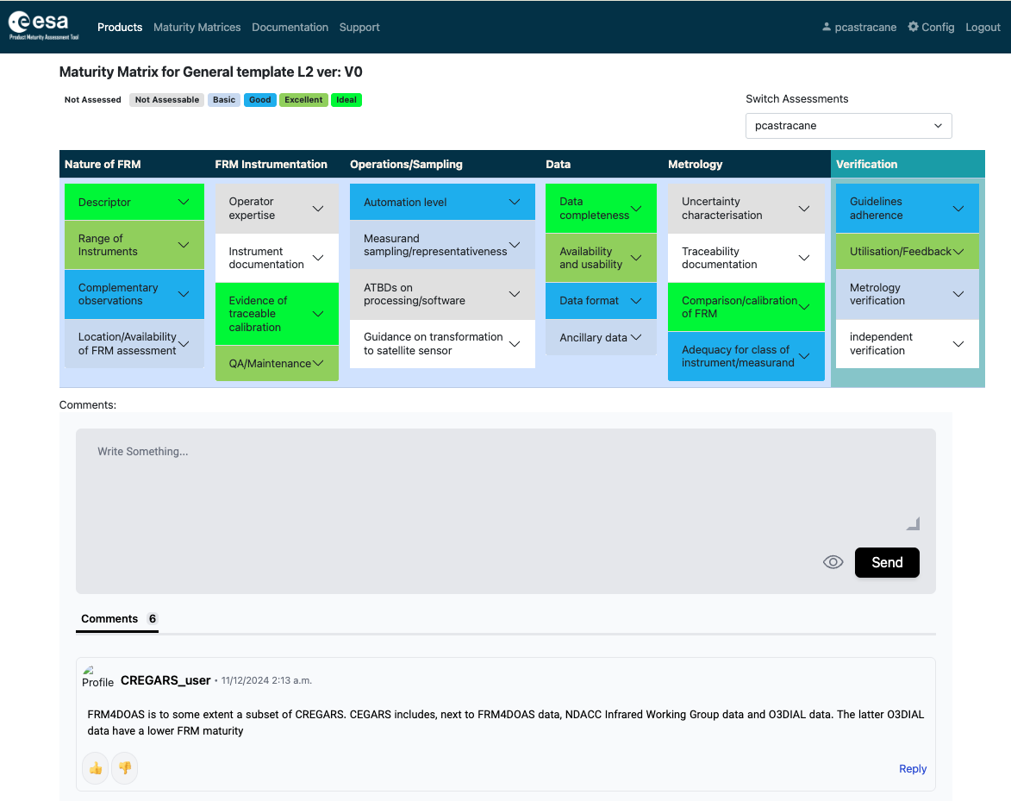
ESA GDWG Report (Paolo Castracane)
Status and updates of the main webportals supporting cal/val activities in different domains:
ESA Atmospheric Validation Data Centre (EVDC) (https://evdc.esa.int/)
  with focus on EarthCARE
Pilot-Mission Exploitation Platform (Pi-MEP) salinity (https://www.salinity-pimep.org/)
FRM4SM
FRMs Assessment Framework

Slide 15
EUMETSAT GDWG Report (Simon Elliot)
Discussion points …
Summary
Distribution of IASI data and need for GSICS-format: being used by CMA – please give feedback on details
To be confirmed: no users of GOME data via GISCS server
Deadline for GSICS server decommissioning - after period of parallel operations (2 months) for all services (including visualisation etc)
GSICS Plotting Tool - to be replaced by MATRICS (covered later in presentation under TOP 7j, “GSICS Calibration Products Plotting Tool”, – here also 2 months
Decommissioning of EUMETSAT GSICS products as discussed
  No new ones, old ones stored in UMARF
EUMETSAT GSICS Server to be turned off in H2 2026
2 months advance notice to be given
Data available via EUMETSAT Data Store
Plotting available using MATRICS
Support available from ops@eumetsat.int

Slide 16
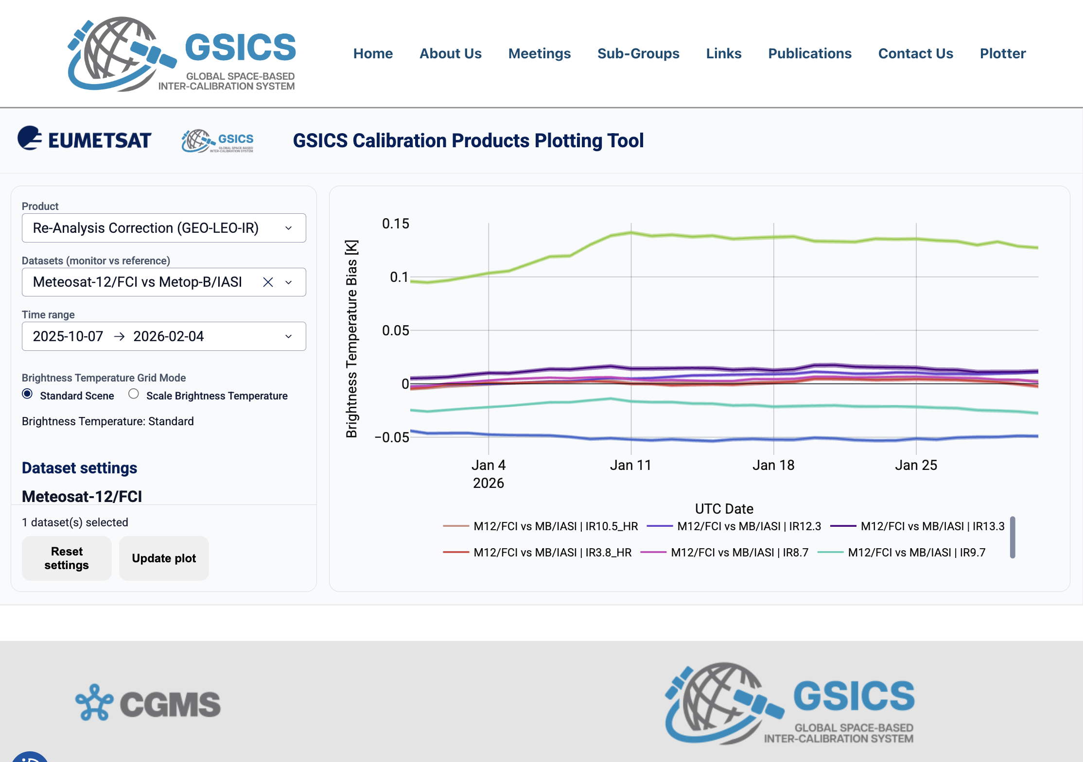
Product Dashboard Mockup (Mounir Lekoaura)
GSICS-centralized plottinng tool for GSICS products generated by agencies
Purpouse:
Mockup to support the definition of the requirements
Support the State of the Observing System reporting to CGMS
Increase visibility for GSICS achievements
Ongoing:
Discussion with the sub-groups to define the further products to be included

Slide 17
Main outcomes from discussion
Discussion on GSICS websites
GSICS development – use different url domain (no Eumetsat)
Use of collaborative environment for subgroups (e.g. slack)
Use of different level of access rights (user-password protected for admin, chairs, members)
Highlighted the topic to mantain Action Tracker and GSICS Product Catalogue currently in GCC website.
Security requirements
Discussion on ToR
An action to review internally the the Terms of Reference of GDWG is proposed
A Work Plan will be proposed by the Chair and discussed internally
GSICS server decommissioning
get a clear status from all the agencies (in particular from CMA and KMA)
GSICS Vice-Chair
Request for the nomination of a vice-chair of the GDWG and invites proposals – to be addressed by EP
GSICS Dashboard
See dedicated presentation

Slide 18
Plan for next year
ToR Finalize Internal discussion
Work Plan for next year
Support GSICS Dashboard evolution
Quarterly GDWG meetings to be organized during 2026
Following Actions (definition of actions is in progress)

