Slide 1
GRWG Report
Mounir Lekouara (EUMETSAT)

Slide 2
GRWG structure
GSICS Exec Panel
GSICS Coordination Centre
GSICS Research Working Group
Chair: Mounir Lekouara (EUM)
GSICS Data Working Group
Space Weather
Sub-Group
Chair: Tsutomu Nagatsuma (NICT)
UVN Spectrometer
Sub-Group
Chair: Lawrence Flynn (NOAA)
VIS/NIR
Sub-Group
Chair: David Doelling (NASA)
IR
Sub-Group
Chair: Chengli Qi (CMA)
MW Sub-Group
Co-chairs: Shengli Wu(CMA)
Flavio Iturbide (NOAA)
Lunar Calibration
Sub-Group
Chair: Tom Stone (USGS)

Slide 3
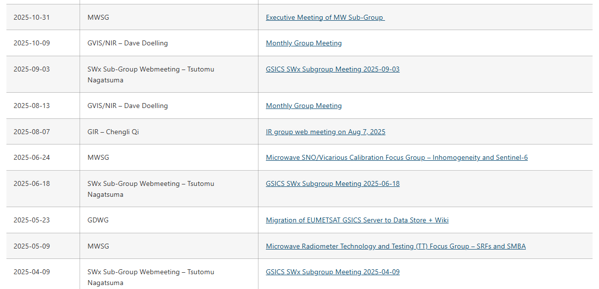
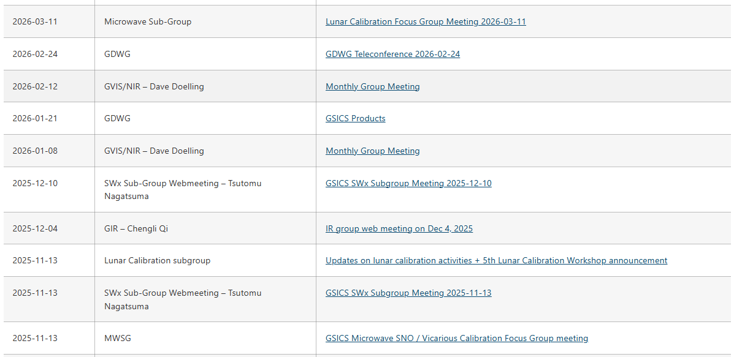
Web meetings
SWx : 5
MW : 5
IR : 2
VIS/NIR : 4
Lunar : 1

Slide 4
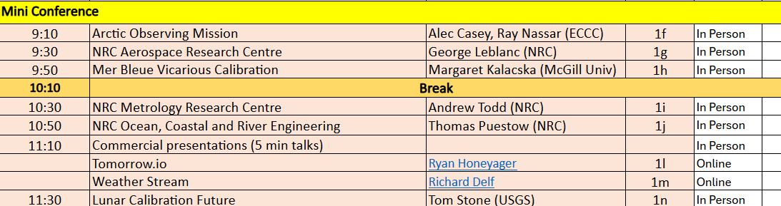
Miniconf

Slide 5
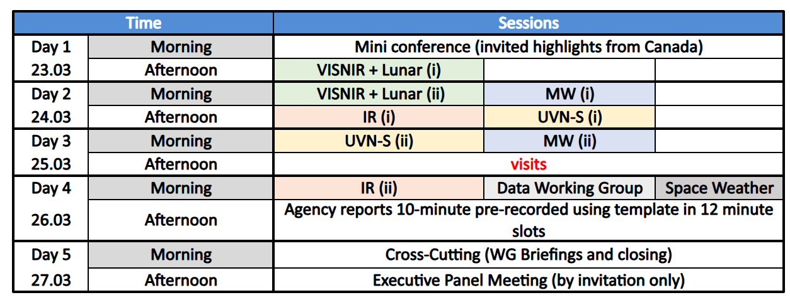
2026 annual meeting in Ottawa
140 items!

Slide 6
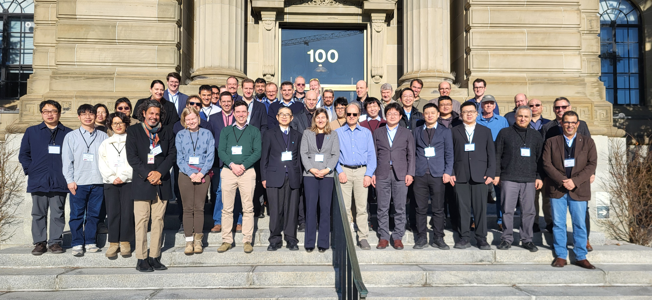
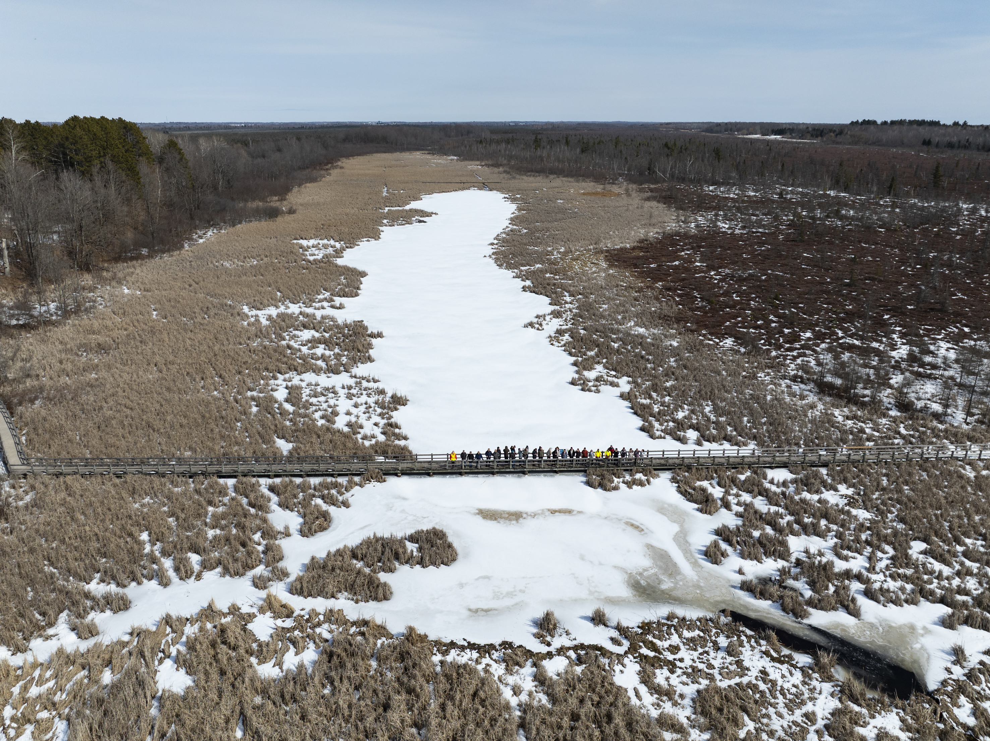
2026 annual meeting in Ottawa
Thank you to NRC, especially Thomas Puestow, Oudi Nour, Ali Khan and colleagues for setting up the meeting.

Slide 7
Need of international momentum
Pre-flight calibration WS:
  Took place in ESA in November 2024
  The report is not yet drafted
  Thematic groups to be put in place to issue good practices
Polarisation validation: time to kick off the cooperation !

Slide 8
GISCS is not (should not be?) a conference
VIS-NIR
  ATBDs need to be drafted to align the methodologies
    DCC : NASA
    Deserts : EUMETSAT
    Ray-matching : JMA
  SBAF tool funding at NASA is discontinued and this needs to become a GSICS common development to secure it.
Lunar
  LSICS : good example of cooperative work
  Exchange of data is esssential to progress (HAOC, Arctsone etc.)
  MW lunar modelling is picking momentum
IR
  Uncertainty estimation : needs commitment
UVNS
  Solar spectra to be shared and documented
  Inter-calibration methods to be developed

Slide 9
GISCS is not (should not be?) a conference
MW
  Pre-flight calibration target traceability
  Starting the coordination on the bias reporting
  Design intercalibration algorithms: more commitment needed
  Characterisation of the FOVs using coastline crossing and lunar observations
All sub-groups
  Website : sub-group spaces and collaborative tools to be put in place
  Dashboard : definition of the parameters to be added and interfaces
  NOAA ICVS : sub-groups to propose further reporting
  Uncertainty estimation methods : we need to get the momentum
  Documenting best practices : also momentum needed

Slide 10
Thank you

