Slide 1
GRWG IR Report
Chengli Qi
NSMC/CMA qicl@cma.gov.cn

Slide 2
Outline
IR Sub-Group Activities in 2025
Session agenda and Highlights
Actions response
Future Direction and Plans

Slide 3
Three Web Meetings in 2025
  The IR sub-group is active as usual. Three web meetings have been organized.
  2025/08/07: IASI-NG L1 Processing, Implementation of Retrieving CrIS FOV SRFs.
  2025/12/04: Crosstalk Correction of Geostationary High-speed Imager (GHI) onboard FY-4B satellite. Uncertainty Evaluation of AGRI-IASI Cross Calibration in Infrared Channels.
  2026/02/13: Hybrid PCA compression methodology for IASI, IASI-NG, and MTG-IRS, Compression and Reconstruction Experiments of HIRAS Data.
The topics includes L1 calibration algorithms improvements, Cross calibration uncertainly , and PCA compression techniques for Hyperspectral data .

Slide 4
Session agenda
Day 2: 24-Mar-26 IR Breakout Session (i) - AUDITORIUM
Session Chair: Chengli Qi (CMA)
Minute Taker: Likun Wang (UMD)
Meeting Link: | https://teams.microsoft.com/meet/3184732366424?p=5o6Jmo3cI47rzLI1cm
Presentations:
Time (EDT) | Topic | Presenter | Item
14:00 | Session Introduction | Chengli QI (CMA) | 5a | In person
14:10 | FY-3E/HIRAS and FY-4B/GIIRS radiometric and spectral performances analysis using IASI | Dorothee Coppens (EUMETSAT) | 5b | In person
14:40 | On orbit performance assessment of HIRAS-II onboard FY-3H satellite | Junwei Wang (CMA) | 5c | In person
15:00 | Radiometric Calibration Performance of the IR Channels of EUMETSAT Optical Missions | Ali Mousivand (EUMETSAT) | 5d | In person
15:20 | Break
15:30 | <15 mK/decade Radiometric Calibration Stability Demonstrated By Long Term CrIS/VIIRS Comparisons | Dave Tobin (SSEC) | 5e | In person
15:50 | Assessing FOV-to-FOV Differences in NOAA Sensors Using EUMETSAT Algorithms | Likun Wang (UMD) | 5f | In person
16:10 | FY-4C satellite overview and commissioin status | Chengli QI (CMA) | 5g | In person
16:30 | METimage preliminary radiometric validation for IR bands | Francesc Lucas Carbo (EUMETSAT) | 5h | In person
16:50 | Discussion |  | 5i
17:30 | Close
7 talks in first half-day session----- (PM 24 Mar)
IR channel calibration monitoring and gsics products : HIRAS & GIIRS, EUMETSAT optical missions(FCI, SEVIRI, METimage) , CrIS & VIIRS.
Improved CAL/VAL technology: CrIS FOV-to-FOV difference assessing.
Improved cross calibration method: collocation method, data filetering.

Slide 5
Session agenda
Day 4: 26-Mar-26 IR Breakout Session (ii) - AUDITORIUM
Session Chair: Likun Wang (UMD)
Minute Taker: Chengli Qi (CMA)
Meeting Link: | https://teams.microsoft.com/meet/3184732366424?p=5o6Jmo3cI47rzLI1cm
Presentations:
Time (EDT) | Topic | Presenter | Item
8:00 | Intercomparison of the GSICS Engine and MICMICS for IR GEO–LEO Intercalibration | Ali Mousivand (EUMETSAT) | 5j | In person
8:20 | An overview of the current TircalNet status | Steffen Dransfeld(ESA) | 5k | Virtual
8:40 | Lunar-Based Cross-Calibration of GF-4 Mid-Infrared Band: Establishing a Radiometric Link from FY-4B/AGRI | Wenkai Xu (PMO/CAS) | 5l | Virtual
9:00 | An Operational Monitoring System for HIRAS | Junwei Wang (CMA) | 5m | In person
9:20 | Break
9:40 | MTG/IRS commissioning status | Dorothee Coppens (EUMETSAT) | 5n | In person
10:00 | The Cross-track Infrared Sounder (CrIS) Hybrid Principal Component Analysis / Rapid Event Detection (PCA/RED) Product | Dave Tobin (SSEC) | 5o | In person
10:20 | A Study on the Use of Reconstructed Radiances from Infrared Sounders for Inter-Calibration | Shin koyamstsu (JMA) | 5p | In person
10:40 | Discussion |  | 5q
11:30 | Close
12:00 | Lunch
7 talks in second half-day session----- (AM 26 Mar)
Mission status:
MTG/IRS, FY-4C, TircalNet,
IR Lunar calibration: Lunar-based cross calibration of GF IR band using Lunar observation link from FY-4B/AGRI.
PCA data compression: CrIS Hybrid PCA, Reconstructed data using in inter-calibration.

Slide 6
Session agenda
Discussion 1: The sub-group needs for the website evolutions ( PM 24 Mar)
  https://gsicsweb.eumetsat.int/, be summarized in (item 10j)
  16:50-17:30
Discussion 2: Needs and contribution for the GSICS Dashboard​( AM 26 Mar)
  https://gsicsweb.eumetsat.int/gsics-plotter/​, be summarized in (item 10l)​
  Discussion 3: Web meeting plan of 2026
  10:40-11:30
Notes:
1）Meeting info and presentation files; 2) Actions and feedback or progress; 2) Publication, related to GSICS, model, method, validation, dataset distribution...

Slide 7
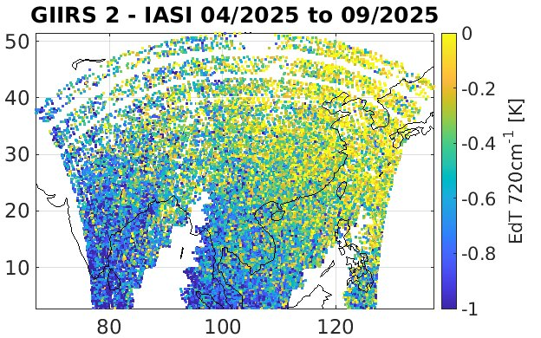
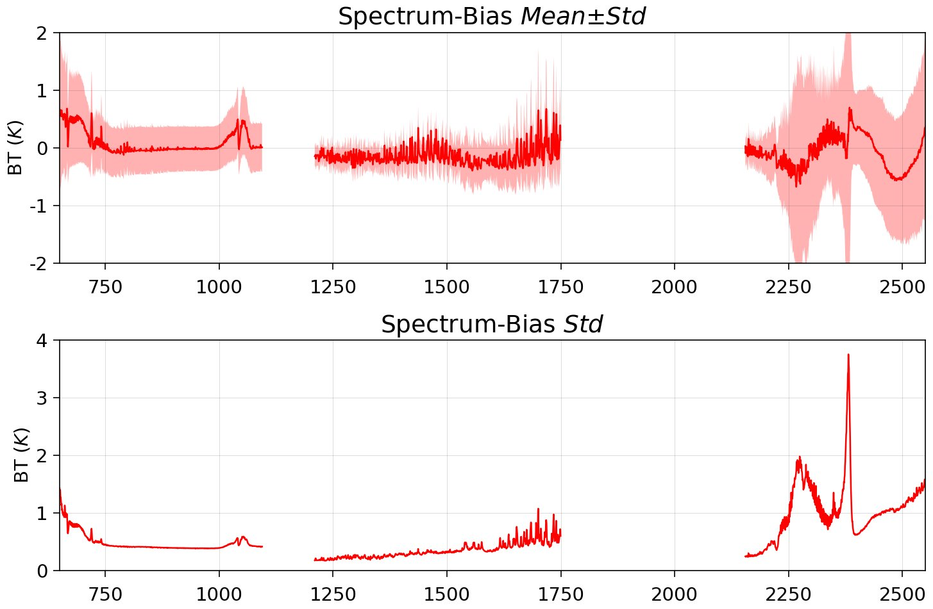
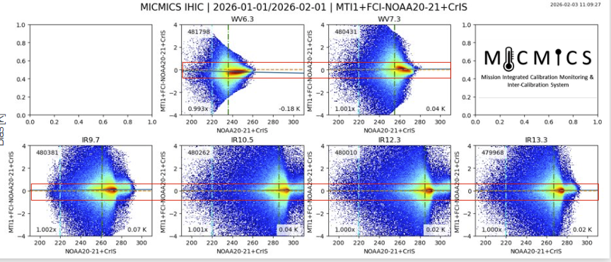
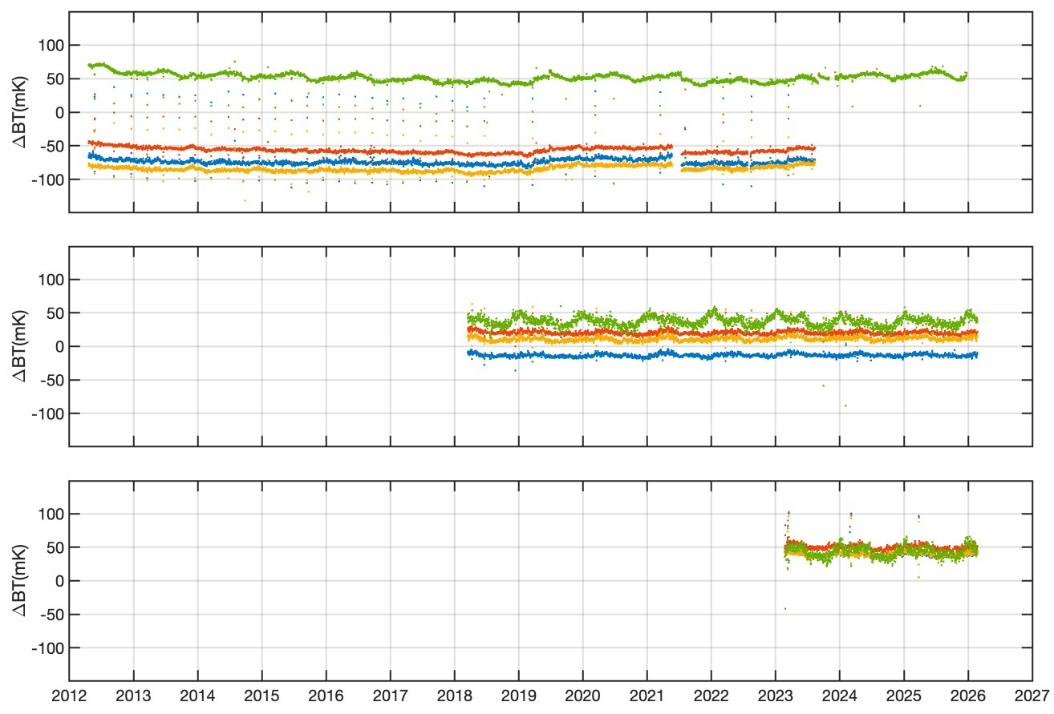
Session highlights
From Dorothee Coppens
IR channel calibration monitoring and gsics products : HIRAS & GIIRS, EUMETSAT optical missions(FCI, SEVIRI, METimage) , CrIS & VIIRS.
From Junwei Wang
From Dave Tobin
From Ali Mousivand

Slide 8
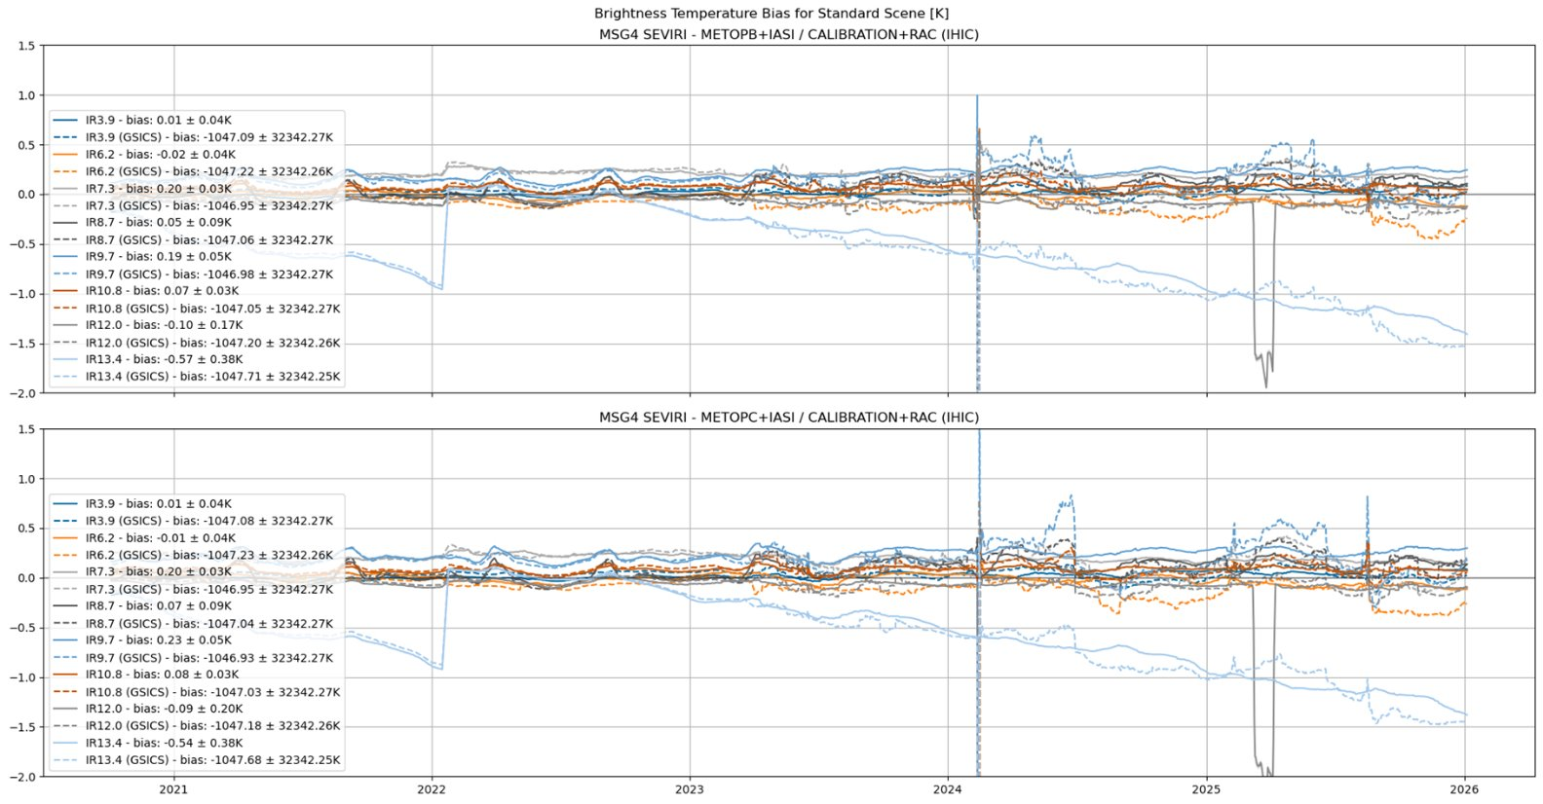
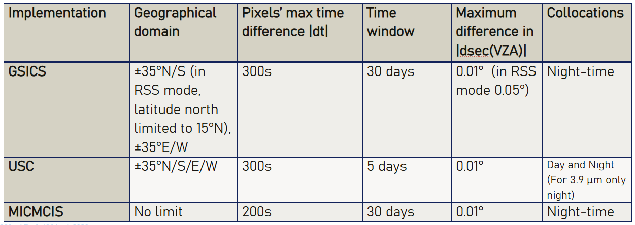
Session highlights
Improved cross calibration method: collocation method, data filetering.
From Ali Mousivand

Slide 9
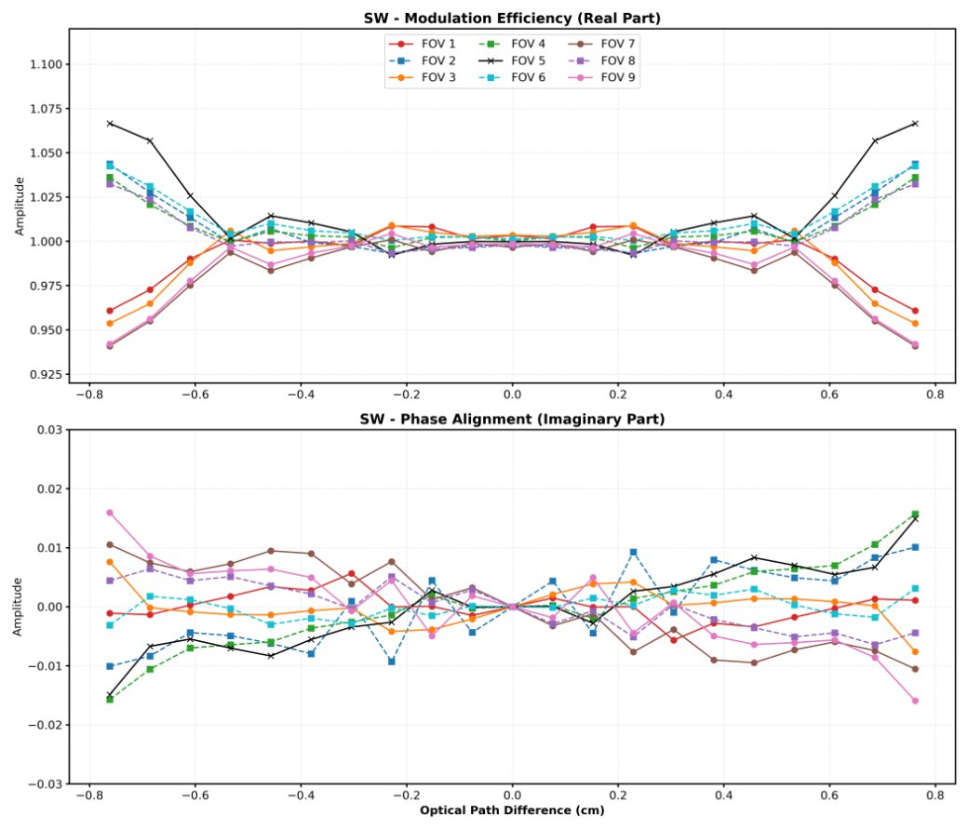
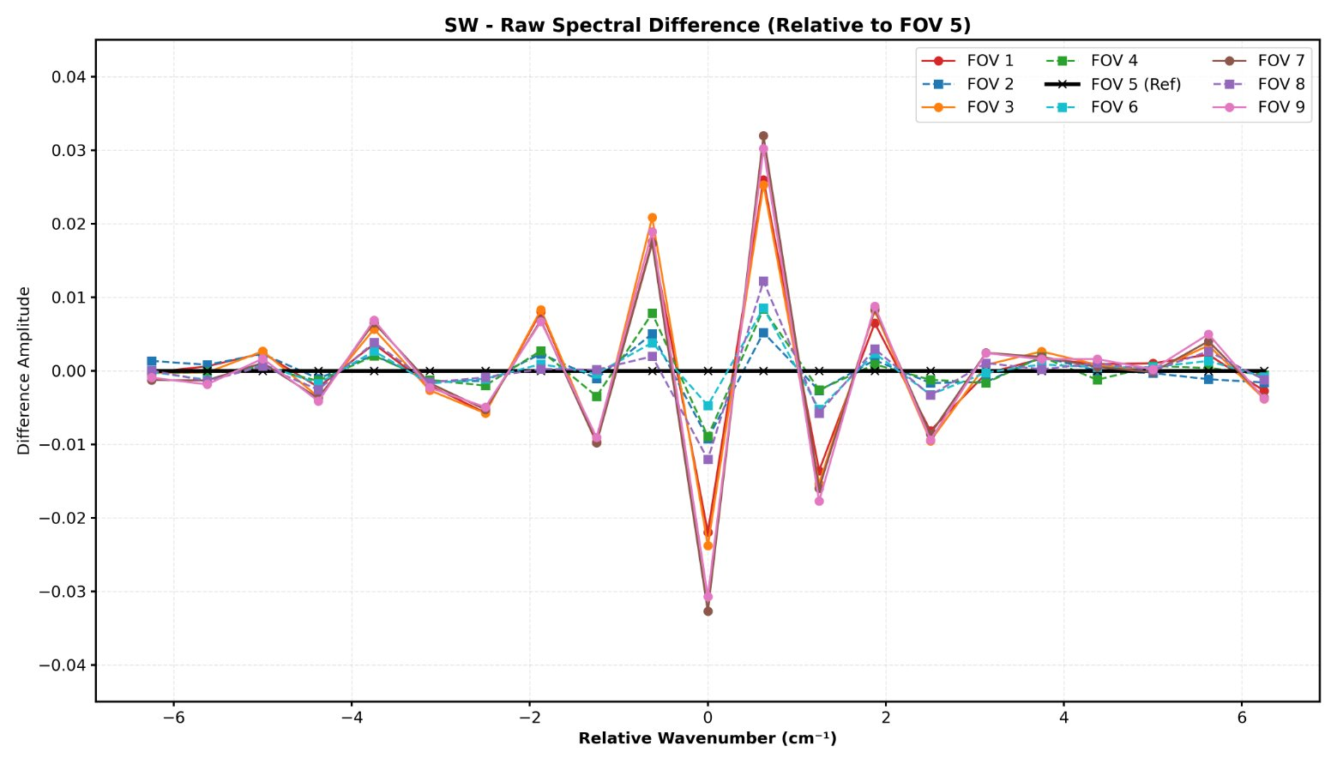
Session highlights
apply similar practices to CrIS SRFs using the same method retrieval of relative spectral response functions of IASI.
Improved CAL/VAL technology: CrIS FOV-to-FOV difference assessing.
From Likun Wang

Slide 10
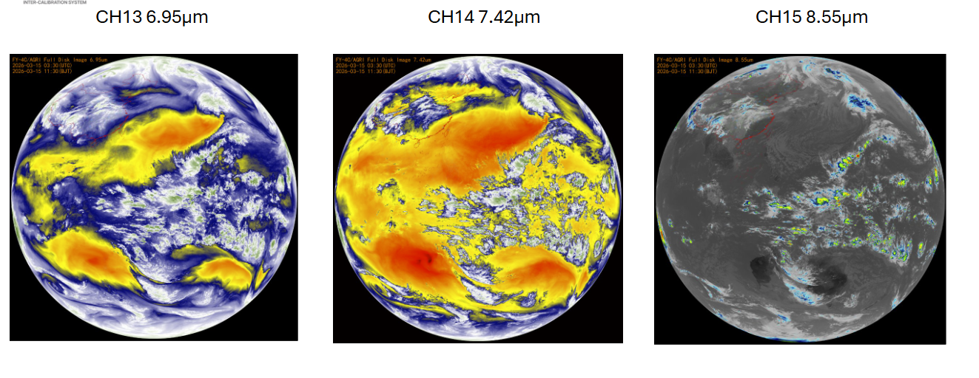
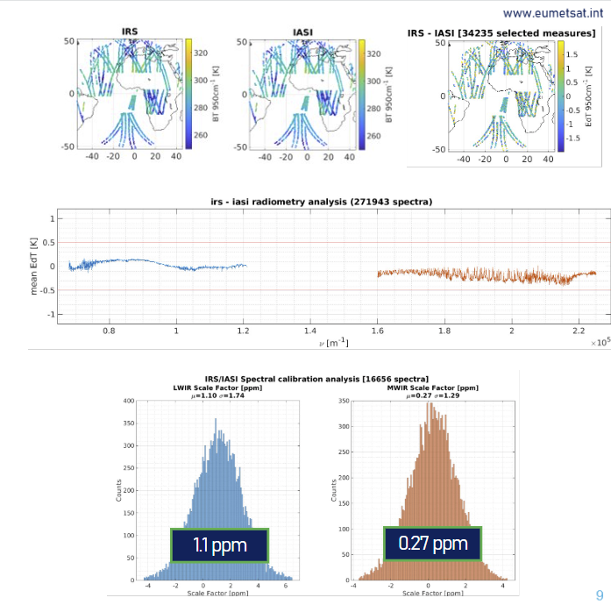
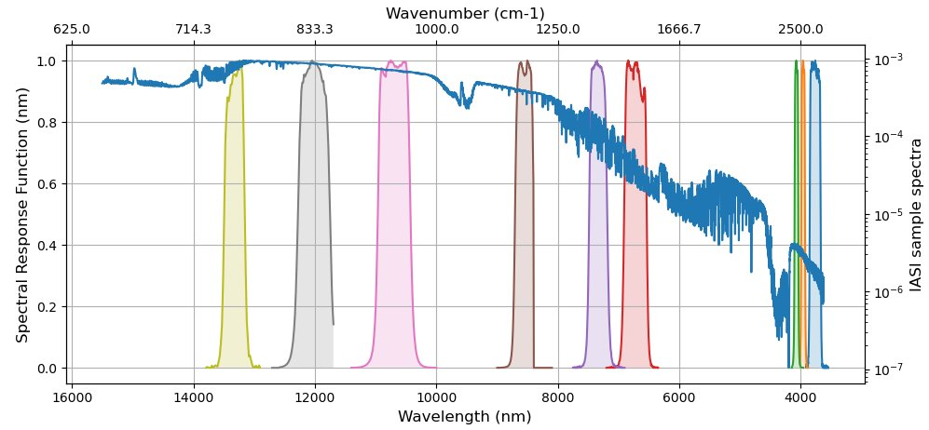
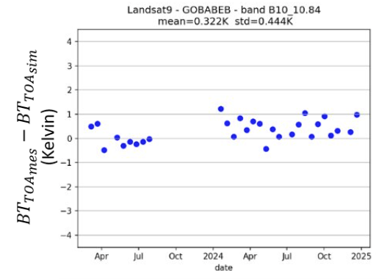
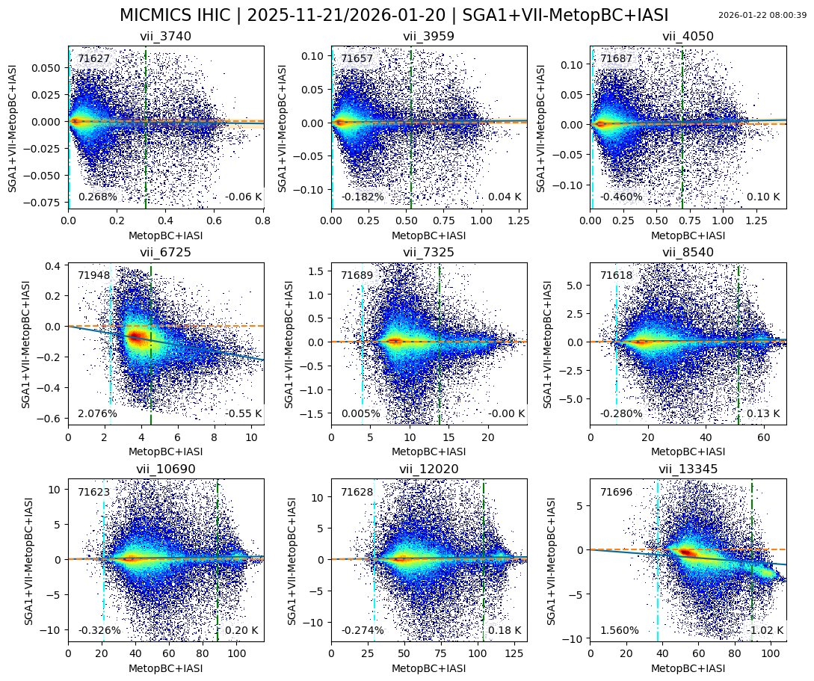
Session highlights
Mission status:
MTG/IRS, FY-4C, EPS-SG/MET image TIRCalNet,
From Chengli Qi
From Steffen Dransfeld
From Dorothee Coppens
From Francesc Lucas Carbo

Slide 11
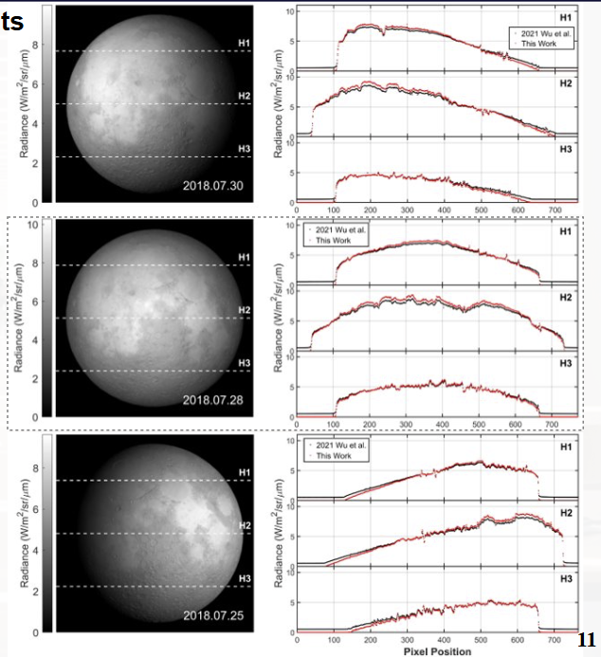
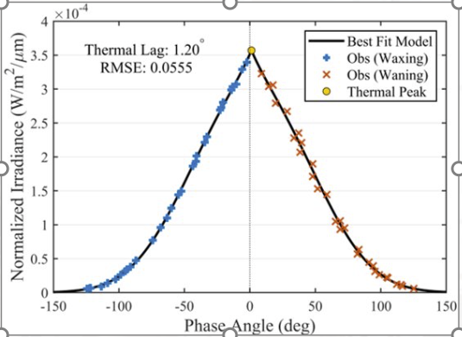
Session highlights
IR Lunar calibration: Lunar-based cross calibration of GF IR band using Lunar observation link from FY-4B/AGRI.
From Yunkai Xu

Slide 12
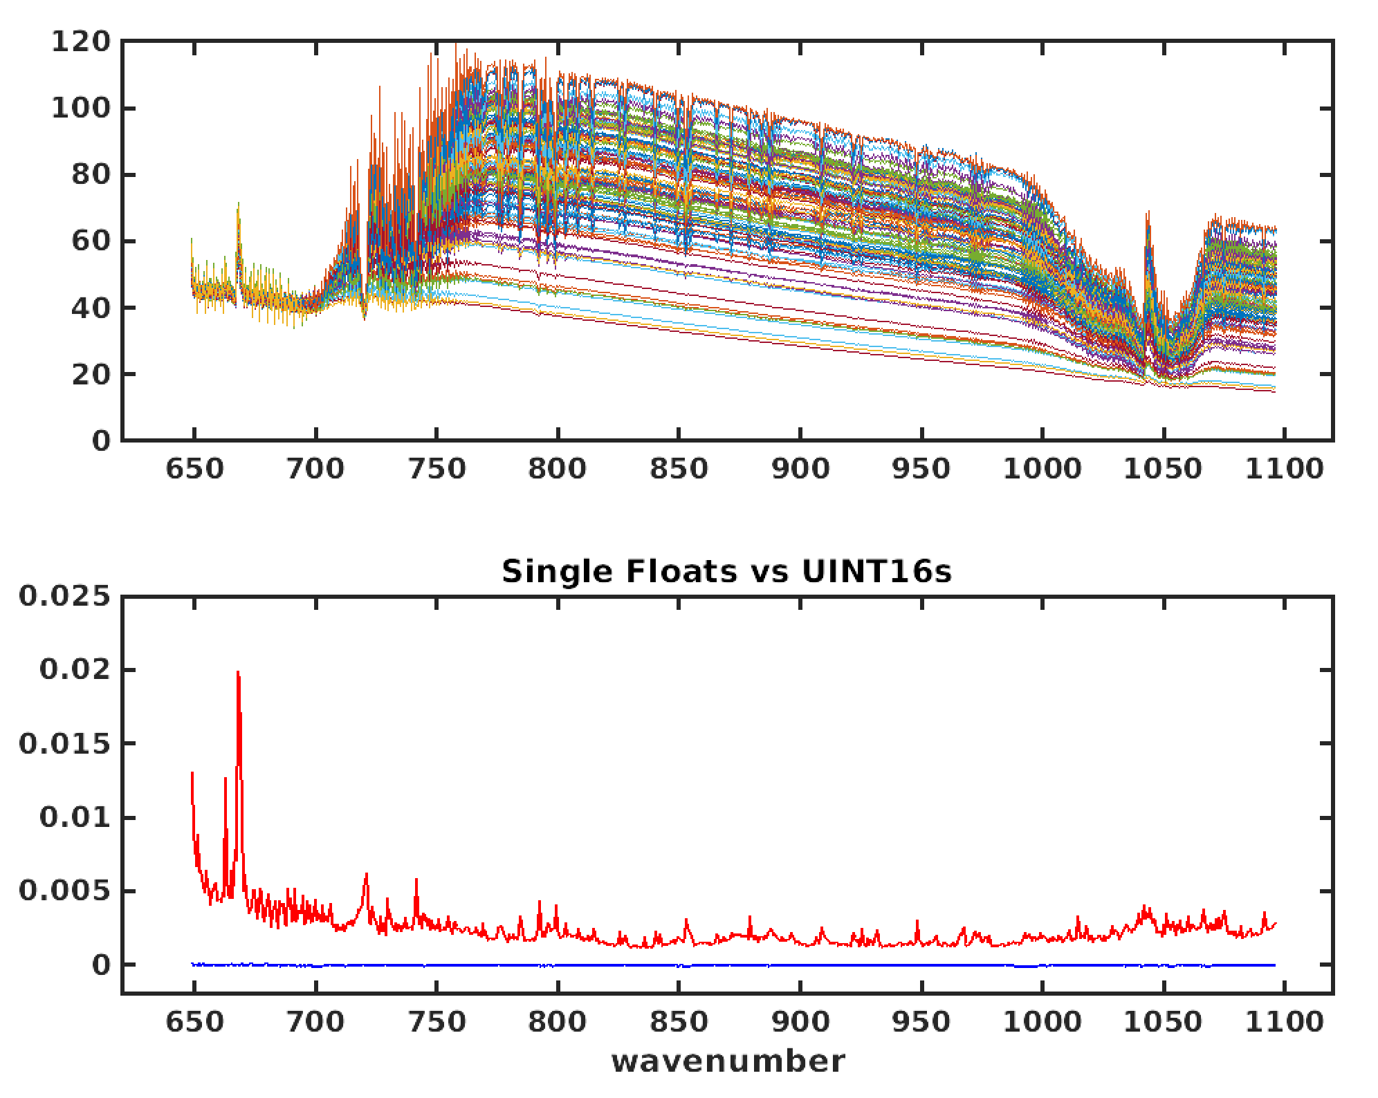
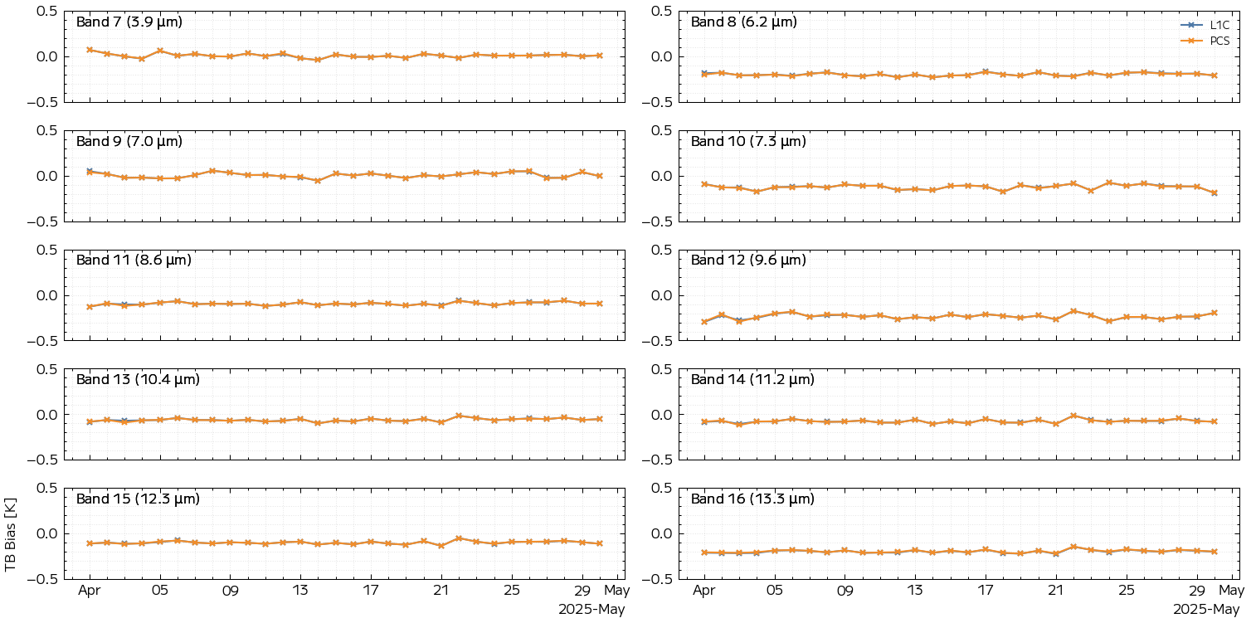
Session highlights
PCA data compression: CrIS Hybrid PCA, Reconstructed data using in inter-calibration.
BT bias using IASI L1C VS IASI PCS
mW/(m² sr. cm⁻¹)
mW/(m² sr. cm⁻¹)
From Dave Tobin
From Koyamatsu Shin

Slide 13
Action response
Action Id | Summary | Lead | Progress | Status
A.GIR.2025.5g.1 | Evaluate how many samples reduced after used LOS collocation method | Shin Koyamatsu (JMA) |  | Open
A.GIR.2025.5h.1 | Agency applied the SRF retrieval method for detecting and eliminating striping and FOV difference. EUMETSAT Share the SRF retrieval code ? | Agency Pierre Dussarat (EUMETSAT) | NOAA impleted CMA are impleting | Ongoing
A.GIR.2025.10d.1 | Generate a common dataset file format including inputs for Lunar model development and inter-comparison | EUMETSAT(IASI), CMA(HIRAS&GIIRS) |  | Open
A.GIR.2025.10d.2 | Generate Lunar information dataset files according to common dataset format to Lunar model as inputs | Likun Wang |  | Open
A.GIR.2025.10e.1 | Martin Burgdorf give a requirement of inputs for Lunar model development and inter-comparison | Martin Burgdorf |  | Open

Slide 14
Future Webmeeting Plans
Counterpart of VIS/NIR, Microwave and UV Sub-Groups
  For Detector uniformity correction method
  For Hyperspectral instruments, spectral CAL/VAL
Organize special topic web meetings on:
data compression, uncertainty models
recalibration, radiometric reference transfer
detector uniformity processing.
Review existing, or develop new inter-calibration
  Algorithms, procedures, corrections, collocation, spectral-gap filling etc.
  Using NWP+RTM, ground-based, near-space measurements, etc.
To define and promote calibration standards, tools and datasets, and best practices
  Including selection of inter-calibration reference
  Threshold values of time/spatial/spectral/angle difference.

Slide 15
Thanks!

Slide 16
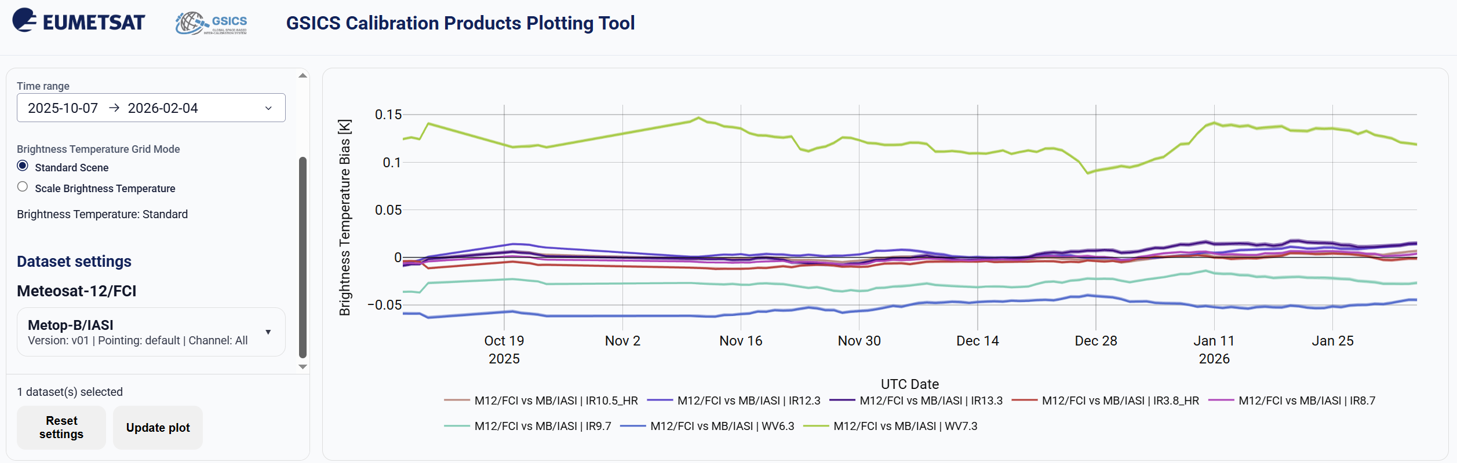
eg.
Notes:
1) not line, but dot line or star line, can look at the sample data. How much samples.

