Slide 1
VIS/NIR subgroup report
2025 annual meeting
March 27, 2026

Slide 2
GSICS VIS/NIR group overview
There is no SITSAT hyperspectral VIS/NIR/SWIR sensor to directly inter-calibrate coincident sensor channel radiances
Use multiple calibration strategies to transfer the calibration of the recommended calibration sensor reference
  Lunar, Ray-matching, DCC, deserts, Dome-C, Rayleigh scattering, sunglint, each target with a specific response range and scene types needed for retrieval
  Combine the various calibration coefficients based on the square of their uncertainties
Use scene and channel specific spectral band adjustment factors (SBAFs) to account for the spectral response difference when inter-calibrating two sensors
  This is accomplished by using apriori channel convolved hyper-spectral radiances over specific earth targets
  Is a challenge when atmospheric absorption and scattering significant
NOAA-20 VIIRS is the recommended on-orbit calibration reference
  Data is freely available and assessable
  The NOAA and NASA N20-VIIRS L1B reflectances are within 0.2% for most visible channel
  NOAA-21-VIIRS is performing optimally – considering for future reference instrument
TSIS-1 HSRS is the recommended solar spectra
  A high-resolution modeled spectra anchored to the well-calibrated TSIS instrument

Slide 3
VIS/NIR group previous year web meetings
We had 4 monthly web meetings
August 2025
  Costy Lukashin – ARCSTONE lunar calibration mission update
  Sebastien Wagner - LSICS update
  Ali Mousivand – MSG SEVIRI solar cal update
  Mounir Lekouara – update on EUMETSAT VISNIR GSICS products
October 2025
  Kevin Twedt – calibrating MODIS during the Terra and Aqua drift period
  Dave Doelling – Compared MODIS C7 and C6.1 calibration stability improvement
January 2026
  Wan Wu - described the CLARREO angular and spectral difference correction for inter-calibration
  Nils Madenach – EARTHCARE MSI imager intercalibration using RTM
  Dave Doelling = demonstrated Libya-4 and DCC stability monitoring
February 2026
  Wenhui Wang – Used Machine Learning to construct DCC BRDFs
  Alexei Lyapustin – described his MAIAC model to intercalibrate MODIS and VIIRS over Libya-4
  Ali Mousivand –AVHRR calibration update for Metop-B and Metop-C

Slide 4
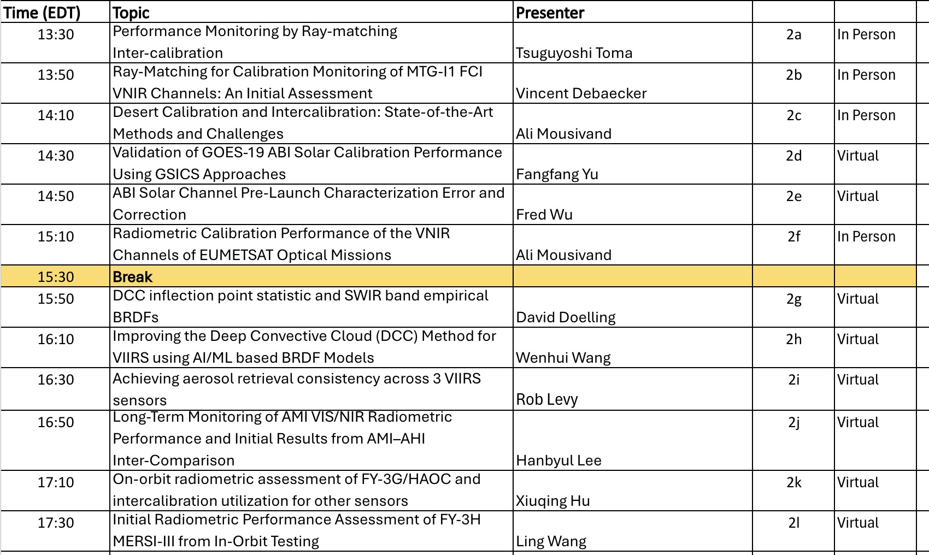
Presentations during annual meeting

Slide 5
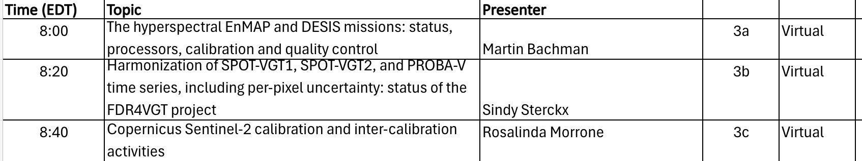
Presentations during annual meeting
Showed how calibration provides aerosol retrieval continuity
HOAC hyper-spectral looks promising
DESIS and ENMAP calibration assessment
Tandem overlap provides calibration continuity

Slide 6
GSICS product development and Dashboard
SWIR Band DCC ATBD is being written by Rajendra Bhatt (NASA)
VIS/NIR band DCC ATBD
  Start with EUMETSAT ATBD
  Write a DCC paper with contributions from participating agencies
April 2026 web meeting dedicated for ATBD development
The GSICS dashboard will display the target sensor relative or normalized radiances over record
  Multiple algorithm, such as lunar, DCC, ray-matching SNO), as well as reference sensors can be visualized simultaneously

Slide 7
Methodology Leads
The VISNIR group relies on multiple calibration methodologies
  The methodology lead will organize web meetings and discussions to determine best practices
DCC – NASA
  For visible Incorporate PDF (KDE) right inflection point monitorint
  For SWIR use channel specific empirical BRDFs
Ray-Matching – JMA – summer web meeting planned
  Many agency presentations utilizing ray-matching
  Time to start coming up with best practices and common GSICS algorthm
Desert – EUMETSAT
  involve CEOS group
  Begin exploring standardizing – surface wavelength BRDF, atmospheric correction
SBAF

Slide 8
SBAF tool status
The NASA SBAF tool designed to account for sensor band spectral band differences has been operational since 2016
  The funding for this effort was based on a NASA ROSES proposal to acquire the Hyperion, SCIAMACHY, and GOME-2 hyperspectral dataset as well as the computer resources
Ben Scarino wrote the code that has organized the hyperspectral radiances into a common format for selection of Earth scenes, spectral response functions, and regression functions
  He has left NASA and no new features or datasets can be incorporated into the tool
  Looking into exporting both the data and the code
How to maintain the tool into the future

Slide 9
Additional hyper-spectral datasets
ENMAP – limited record
DESIS – establish point of contact and review spectral calibration
HOAC – Action Item for CMA to provide hyperspectral data both lunar and PICS
Future CLARREO is being shipped for launch and awaiting launch
TRUTHS – defunded
Radiative Transfer Model hyper-spectral radiance datasets – CLARREO LUT that corrects for angular and spectral differences

