Slide 1
GSICS 2026 Lunar Subgroup Report and
Lunar Workshop Announcement
Tom Stone (USGS) and Seb Wagner (EUMETSAT)

Slide 2
Lunar Calibration Subgroup Activities
LSICS development (next slide)
  Lunar model development — in LSICS framework
Outline of medium-term (5−10 years) vision for lunar calibration
Acquiring new reference lunar irradiance measurements
  air-LUSI: high value for model development; final flight campaign Feb 2026
  ARCSTONE: launch June 2025; extended ops; level-1 processing slowdown
Sensor performance monitoring
  Developing sensor lunar measurement techniques
Documenting Best Practices

Slide 3
LSICS Development Efforts
Developing the framework
  standardised I/O formats
  module interfaces, supporting DER inter-changeability
  processing history propagation
  results visualisation (plotting tool)
Interfacing lunar models — including LIME, LESSR v2
Updating GIRO (v2.0)
  re-aligned with ROLO
  LSICS interface
Regular team meetings — every 2-3 weeks nominally

Slide 4
Interactions with the Community
One webmeeting since last GSICS Annual meeting
Coordinating with IR and MW subgroups
  Decision: keep lunar cal discussions within topical subgroups, to maintain peer awareness
Engaging with New Space

Slide 5
5th Joint GSICS / CEOS WGCV Lunar Calibration Workshop
S. Wagner (EUMETSAT), T. Stone (USGS)
A. Mousivand (EUMETSAT), M. Lekouara (EUMETSAT)
GSICS annual meeting – Ottawa, 23-27 March 2026

Slide 6
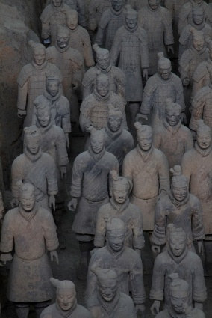
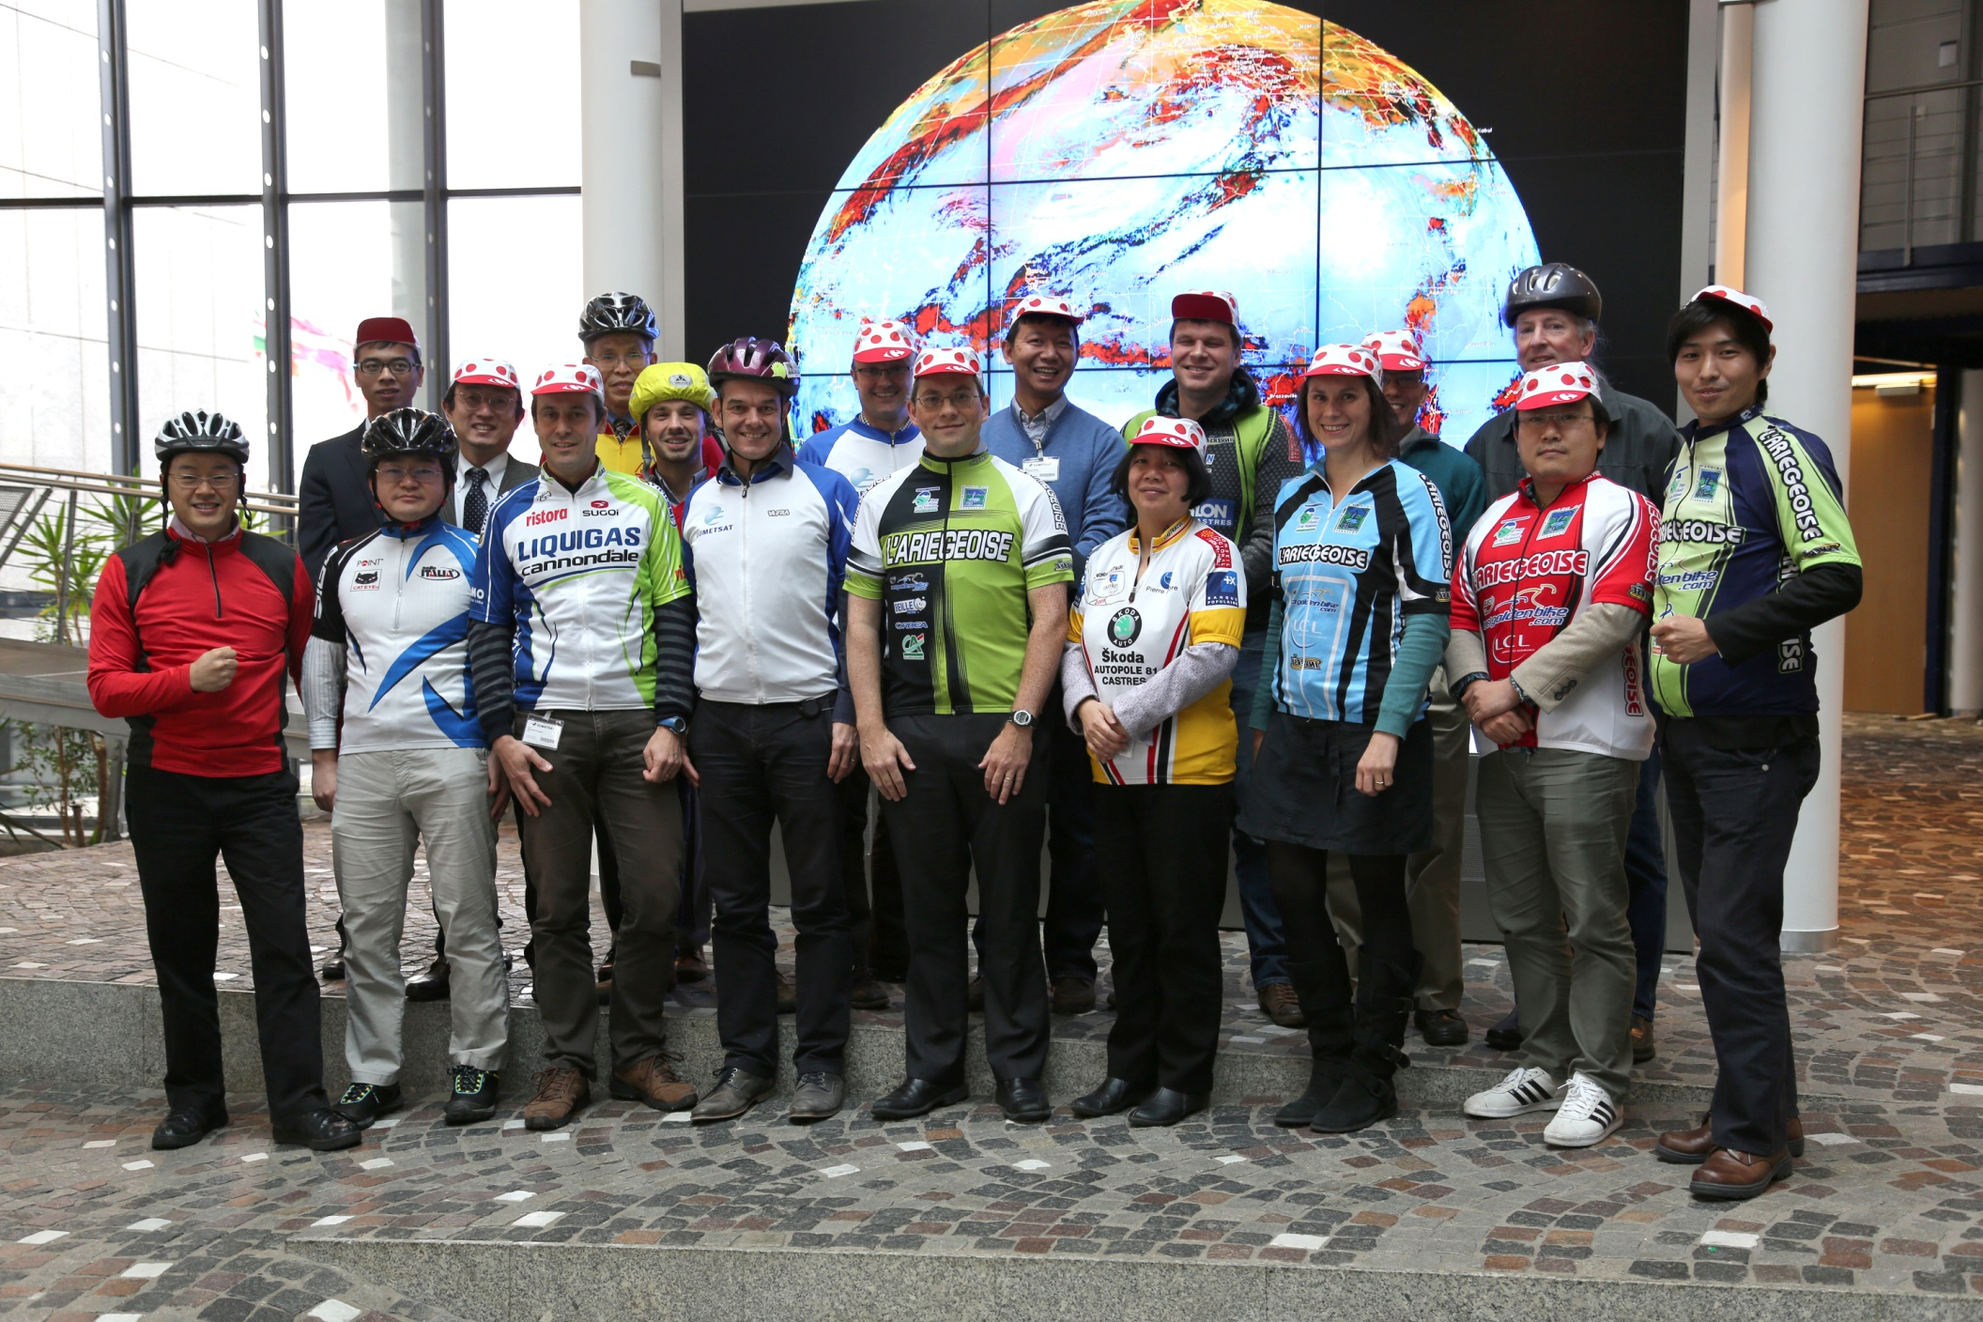

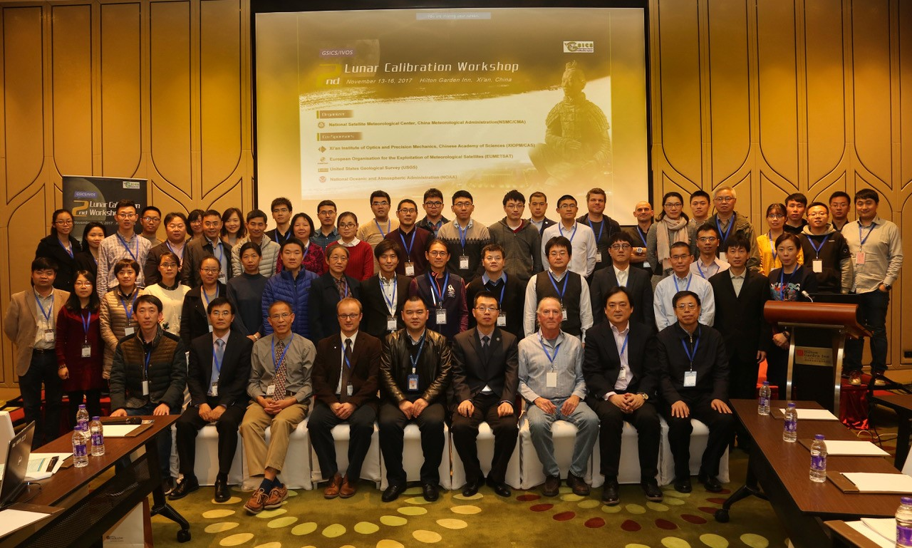
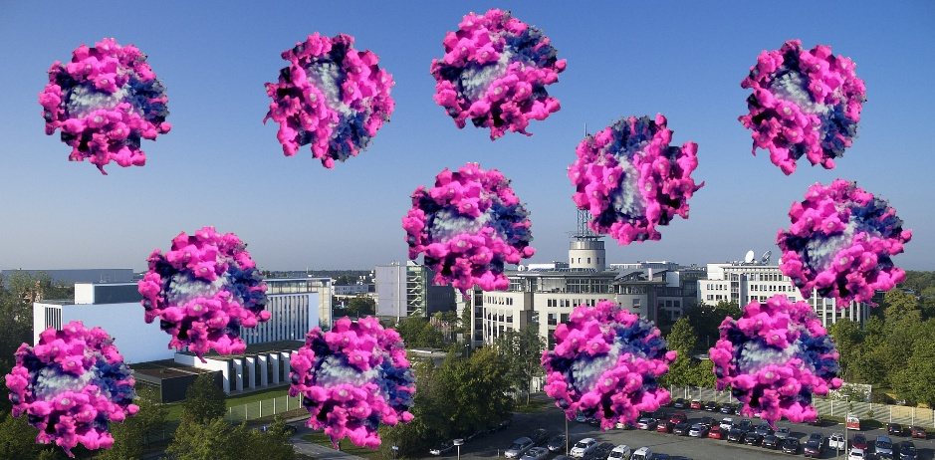
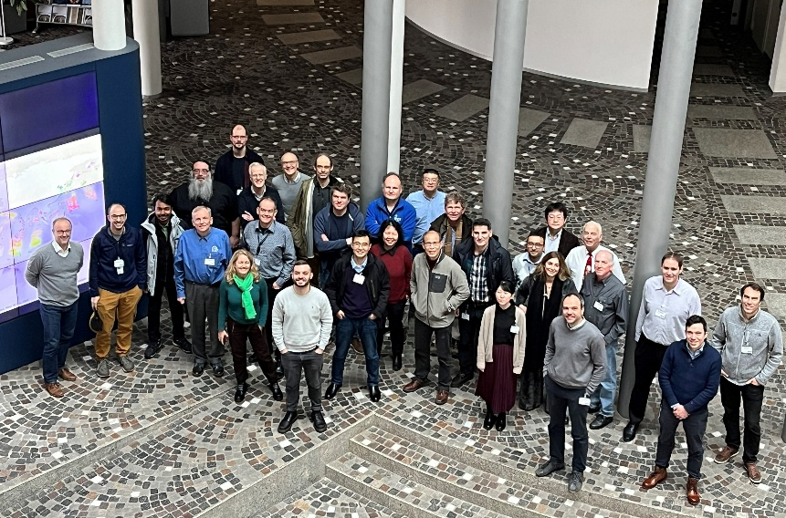
Previous workshops
2014
EUMETSAT, USGS, CNES, NASA
Darmstadt, Germany
2017
CMA, XIOPM, CAS, EUMETSAT, USGS, NOAA
Xi’an, China
2020
EUMETSAT, USGS
Online
2023
EUMETSAT, USGS
Darmstadt, Germany

Slide 7
5th GSICS / CEOS WGCV Lunar Calibration Workshop
Organisers: EUMETSAT, USGS
Duration: 5 days
Dates = 16-20 November 2026
Main topics (sessions) :
  Measurements and Moon Observations
  Lunar Calibration Systems and Model Development
  Instrument Monitoring using Lunar Calibration and Inter-Calibration
  Thermal Infrared and Microwave
  Alternative Applications of Lunar Observations

Slide 8
Topics
  Measurements and Moon Observations:
    Measurements to serve a reference measurements for reflectance model inference
    Review of existing datasets / discussion on data sharing
    Uncertainty assessment and SI traceability
  Lunar Calibration Systems and Model Development
    Status on the existing models (known + new models)
    LSICS
    What is needed to improve the absolute accuracy?
    Results on the 2nd model inter-comparison ➔ assume preparation well before the LCWS
  Instrument Monitoring using Lunar Calibration and Inter-Calibration
    Teams to present updates, with detailed explanation on how they estimates the observed lunar irradiance
    Inter-calibration / inter-bands
    Sensors temporal stability assessment + absolute calibration
  Thermal infrared and Microwave
    Status of the model development
    How to use lunar observations for radiometric assessment?
  Alternative Applications of Lunar Observations
    Co-registration
    MTF
    Ghosts / straylight

Slide 9
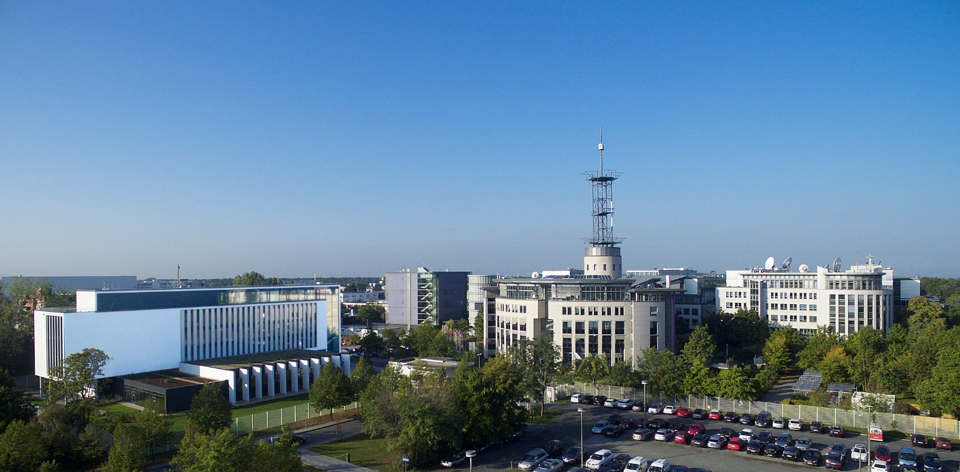
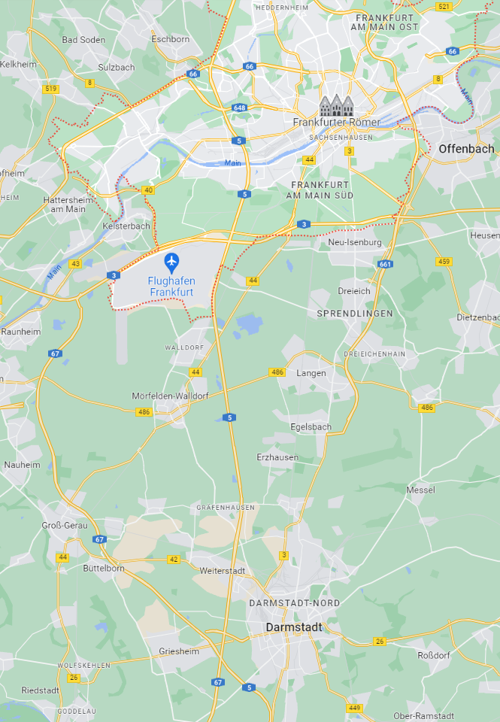
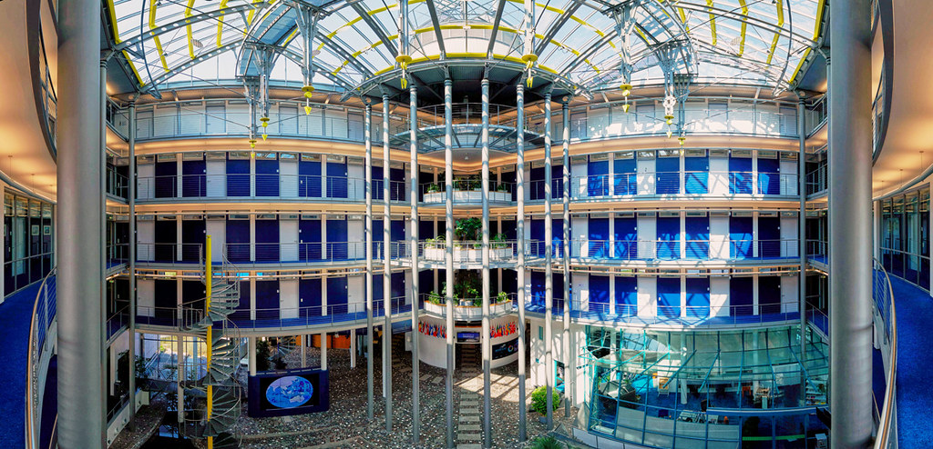
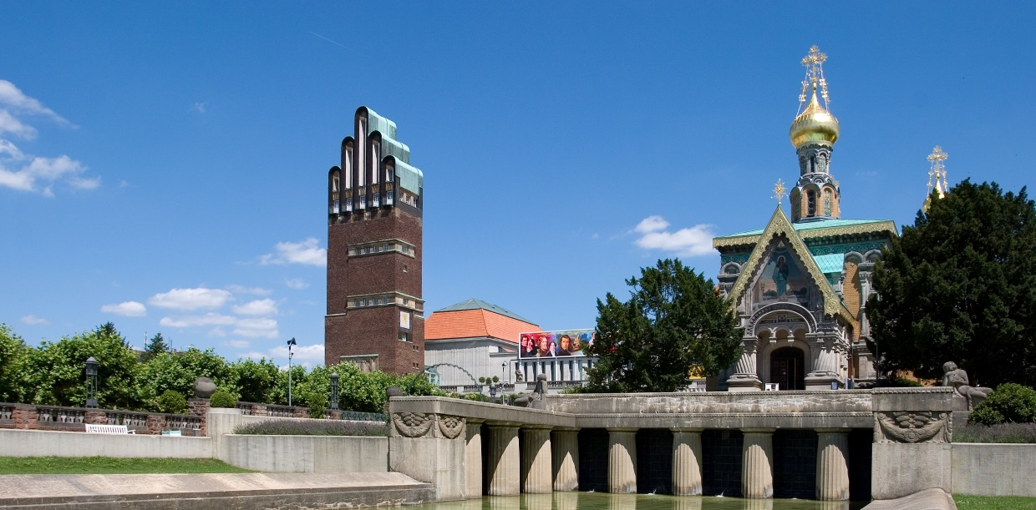
Venue
EUMETSAT headquarters, Darmstadt, Germany
https://www.darmstadt-tourismus.de/en/index.html
From darmstadt.de

Slide 10
5th GSICS / CEOS WGCV Lunar Calibration Workshop
Workshop format:
  Similar to GSICS meeting: mix mini-conference / workshop type with discussions
  A few boards for posters (depending on the agenda)
  Outcome: list of recommendation / actions / decisions
Possibility to have remote participation (Teams)
Event preparation:
  Web site for registration (as in 2023)
    Include a list of recommended accommodations
  Invitation letters to prepare visa applications will be provided on request
  No registration fees

Slide 11
Registration and communications
Registration to the event ➔ website
5th Joint GSICS / CEOS WGCV Lunar Calibration Workshop
Abstract submission (a few lines) to give context + allow agenda preparation
Deadline for registration = 15/10/2026
For general communication before the registration is closed ➔ Lunar Calibration Mailing List
➔ POC: sebastien.wagner@eumetsat.int
Once registration is closed ➔ Use of the list of registered attendees ( + contact: events@eumetsat.int)

Slide 12
Before the lunar calibration workshop…
Identify specific activities of particular interest for the community (to follow up on work presented in 2023 for instance…)
Release of LSICS version 1 ➔ participants could potentially prepare input data, process them with LSICS and present their results (including comparisons with other models / methods)
2nd Lunar models inter-comparison (led by T. Stone - USGS) ➔ exercise to be run before the LCWS; results to be presented at the workshop
Couple of dedicated web-meetings (using maybe GSICS monthly slots) to keep the Lunar Calibration Community informed on the progresses of those two activities + organisation of the workshop
Review of the recommendations / actions / decisions from the last LCWS

Slide 13
Thank you!
Questions are welcome.

