Slide 1
GRWG Space Weather Sub-group Report
Tsutomu Nagatsuma (NICT)
GSICS Annual Meeting 2026, March 27, 2026 09:45-10:00 EDT

Slide 2
GRWG SWx Sub-group Membership
Followings are the members of GRWG SWx Sub-group.
  CMA Cong Huang
  CU Brian Kress, Juan Rodriguez, Athanasios Boudouridis, Janet Machol
  ESA Piers Jiggens, Hugh Evans, Juha-Pekka Luntama, Melanie Heil
  EUMETSAT Andrew Monham
  KMA Eunjeong Cha, Daehyeon Oh
  NICT Tsutomu Nagatsuma (Chair)
  NOAA Christian Naylor, Jim Spann, Dimitrios Vassiliadis, Richard Ullman
  SPARC Ingmar Sandberg

Slide 3
Sub group meetings
We have had 7 subgroup meetings since last annual meeting.
2025/04/09
2025/06/18
2025/09/03
2025/12/10
2026/01/27
2026/02/24
2026/03/25

Slide 4
Work Plan of GSICS GRWG SWx Sub-group
Objective:
To provide coherent and consistent exchange of the data provided by radiation monitoring assets of the GSICS members.
Requirements:
Consistency of data level definitions.
Cross-calibration of datasets.
Standardisation and Specification of data, its meta data and necessary ancillary data.
Consistent data exchange service interfaces.
Tasks:
Map data level definitions of GSICS members (Lead: T Nagatsuma (NICT)
  The definition of data set processing levels varies from instrument to instrument. To ensure consistency for data intercomparisons, it is necessary to provide a mapping between the different levels used by the members.

Slide 5
Work Plan of GSICS GRWG SWx Sub-group
Define procedure for dataset cross-calibration (Lead: I Sandberg(SPARC) and J Rodriguez(CU))
A procedure for the cross-calibration of radiation instrument data is required. Existing procedures, such as the COSPAR/PRBEM procedure (https://prbem.github.io/documents/Standard_Data_Analysis.pdf) will be analysed. The unique aspects of the GSICS data sets on Geostationary orbits, i.e. a lack of conjunctions between spacecraft must be addressed in the process.
Identification of Ancillary Data (Lead: H. Evans (ESA))
The datasets to be exchanged are generally time series data from in-situ radiation instrumentation, typically providing flux spectra for a set of energetic particles, e.g. protons and electrons. To effectively cross-calibrate the data additional ancillary information is required. This can include:
  Geographic location
  Magnetospheric location (B, L, L*, MLT, pitch angle), which introduces questions about consistency in the calculation method and geomagnetic field models.
  Instrument response functions
  Instrument calibration reports
Note: the COSPAR/PRBEM collaboration has developed a series of documents specifying the minimum level of ancillary data and meta-data required for a typical radiation belt data analysis, https://prbem.github.io/docs/.

Slide 6
Work Plan of GSICS GRWG SWx Sub-group
Define Data Exchange services (M Heil (ESA) and R Ullman (NOAA))
To effectively share data assets between the GSICS members, a coordinated approach for dissemination is necessary. Ideally, this includes the consistent implementation of services based upon the same interfaces to both to search and deliver data, but also provision of the ancillary data in a coherent and standardized manner.
Issues to be addressed include:
  Latency in (near) real time dataset updates
  Archival access to data
  Local mirroring of data
  Standardised provision of ancillary data
  Documentation of changes in service (data outages, scheduled maintenance, recalibration/configuration of instruments, etc.)
  Technology API (HAPI servers, CDF data file directories, etc.)

Slide 7
Updating COSPAR/PRBEM Data Analysis Procedure
We have discussed with Antoine Brunet and Paul O’Brien about how to proceed this issue. They consider to prepare some progress on the report.
A. Brunet submitted following abstract to COSPAR/PRBEM.1.
  A.Brunet, T. Nagatsuma, I. Sandberg, Y. Miyoshi, J. Rogriguez, A. Boudouridis, B. Kress and H. Evans, “Update to the PRBEM Data Analysis Procudure”
I also submitted to an abstract about reporting GSICS SWx sub-group activity to COSPAR/PRBEM.1.
  T. Nagatsuma, J. Rodriguez, I. Sundberg, H. Evans, M Heil, and R Ullman, “GSICS Space Weather Subgroups for Cross-Calibration of Operational Space-Based Space Weather Instruments”
A. Brunet arranged the PRBEM DAP update meeting on Apr. 9.

Slide 8
Breakout session (Mar. 26, 2026) 5 presentations
Exploring Space Weather Monitoring Capabilities of ESA's Swarm and SMOS Missions(Lorenzo Trenchi, ESA)
The in-orbit Validation of IPM onboard FengYun-3H (Song Qian, CMA)
Comparison of KSEM observations during the space weather events in November 2025 and January 2026, cross-checked with measurements from GOES and Himawari satellites (Daehyeon Oh, KMA)
GOES-R MPS-LO: Investigating Plasma Observations at Geostationary Orbit (Trevor Leonard, CU)
The SOLAR-1 (SWFO-L1) Product Validation Review process (Dimitrios Vassiliadis, NOAA)

Slide 9
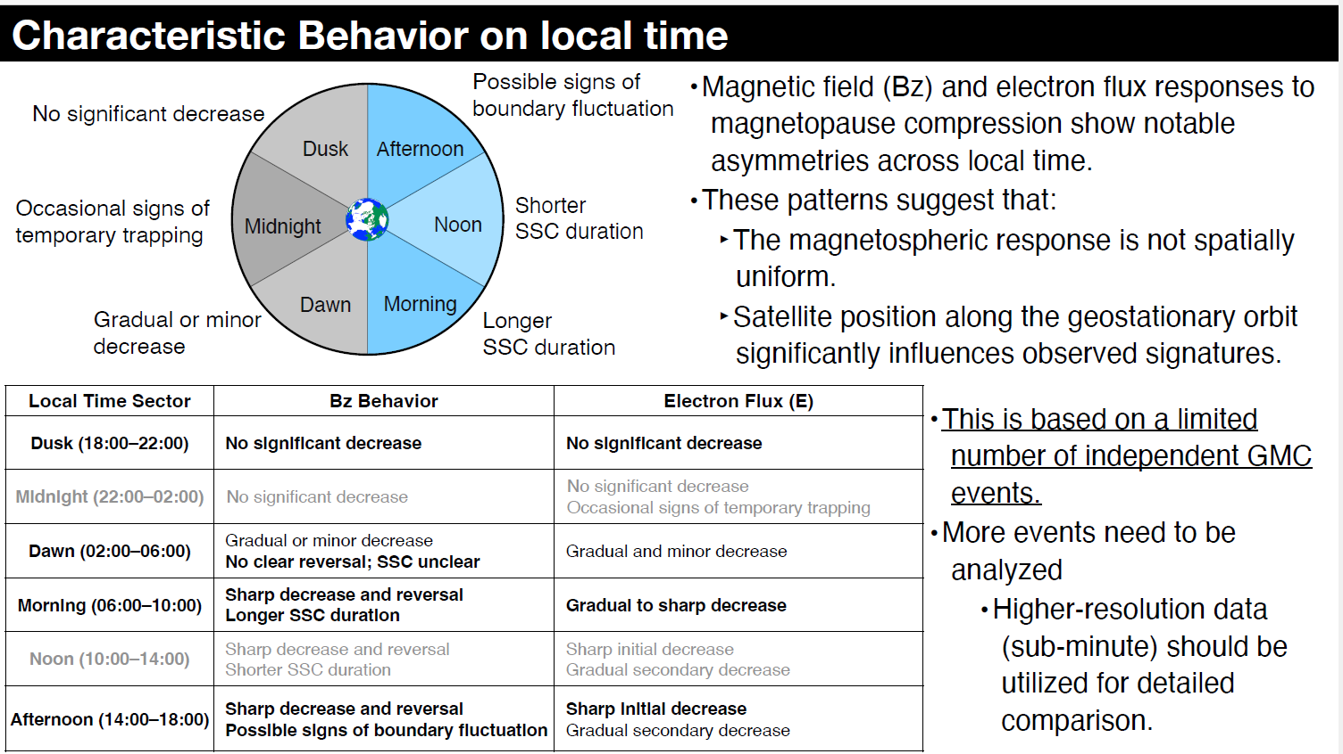
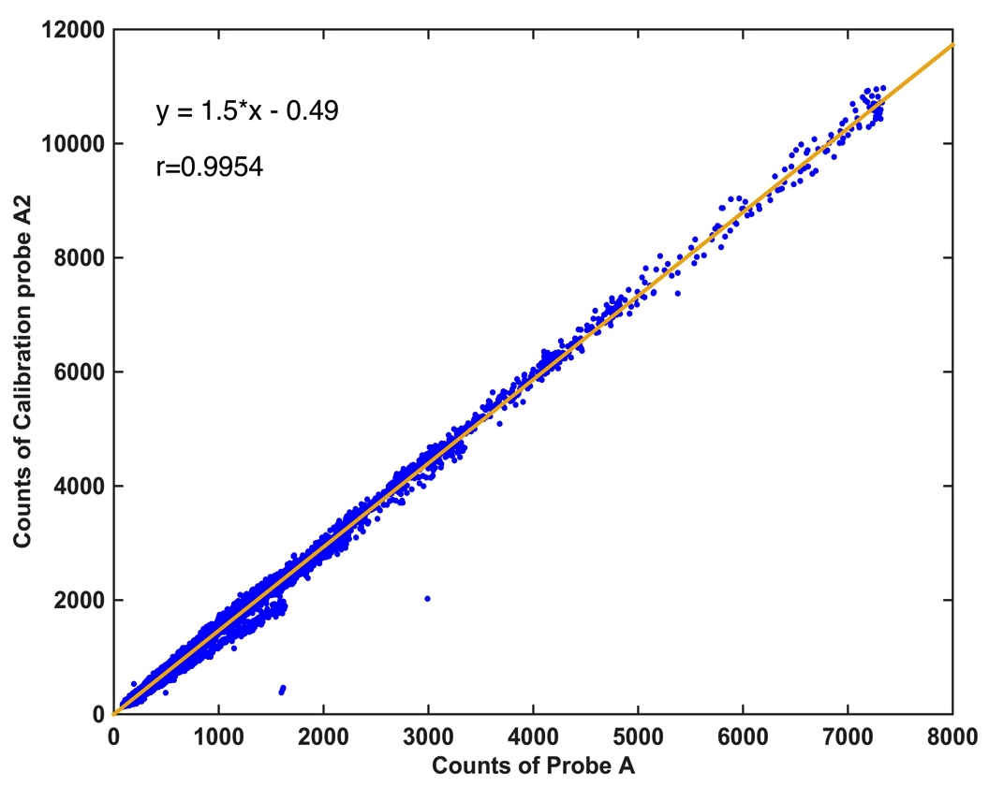
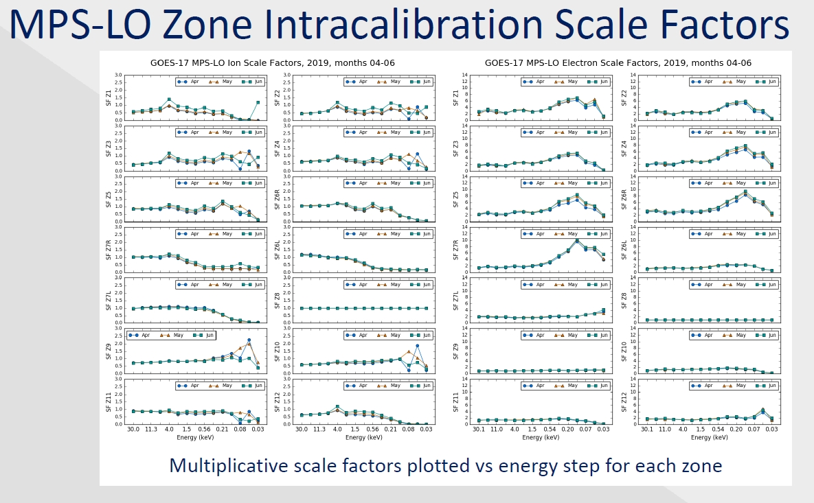
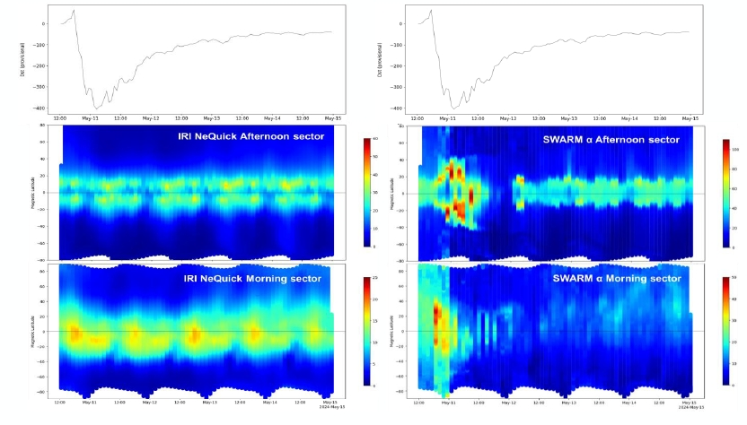
Highlights
On-orbit Calibration
[Dehyeon Oh]
[FY-3H IPM:Qian Song]
Model comparison
[Lorenzo Trenchi]
[Torevor Leonard]

Slide 10
Summary
The Space Weather Subgroup is working toward standardization of cross-calibration methods for high energy particle sensors and mutual data exchange and utilization through information exchange among members and collaboration with the space weather research community.

Slide 11
Thank You!

