Slide 1
Report on UVN-S Session and Plans for the Coming Year
L. Flynn (NOAA), R. Lindstrot (EUMETSAT) and Yuan Li (CMA)
27 March 2026

Slide 2
Disclaimer
"The contents of this presentation are those of the authors and do not necessarily reflect any position of the US Government or the National Oceanic and Atmospheric Administration."

Slide 3
UVN-S Session Agenda Part I
Session Chair: Larry Flynn (NOAA)
 | Minute Taker: Rasmus Lindstrot (Eumetsat)
Meeting Link: | https://teams.microsoft.com/meet/38996851290969?p=diFCjR97WPXa21xYB5
Presentations: | https://wmoomm.sharepoint.com/:f:/s/Collaboration/IgCfehG8zFDTS7dKgRKJp6WbAWMB1gxmyQeERSoi7PQgmI4?e=QHAObo
Time (EDT) | Topic | Presenter | Item |  | TZ
14:00 | Session introduction | Larry Flynn (NOAA) |  | Remote
14:10 | 8 years TROPOMI: Long-term instrument degradation: derivation, validation and lessons learned | Erwin Loots KNMI (R) | 6a | Remote
14:30 | GOME-2 in-orbit performance, including end-of-life activities | Rasmus Lindstrot Eumetsat (R) | 6b | Remote
14:50 | Sentinel-4 and Sentinel-5 status in the first year after launch | Rasmus Lindstrot Eumetsat (R) | 6c | Remote
15:10 | Calibration of the NOAA-20 OMPS instrument for NASA products | Bradford Fisher NASA/STC (R) | 6d | Remote
15:30 | BREAK | BREAK
15:40 | V8TOz as a transfer of radiometric calibration | Lawrence Flynn NOAA (R) | 6e | Remote
16:00 | Improving Mission-Long Quality Stability of SNPP OMPS NP SDR Data through Solar Activity and Optical Throughput Degradation Adjustments | Steven Buckner NOAA/ERT (R) | 6f | Remote
16:20 | Vicarious calibration at Railroad Valley for the operating MISR and upcoming MAIA missions | Graziela Keller Rodrigues NASA (R) | 6g | Remote
16:40 | The OCO-2/3 Radiometric Puzzle | Rob Rosenberg NASA (R) | 6h | Remote
17:00 | Discussion | All

Slide 4
UVN-S Session Agenda Part II
Session Chair: Rasmus Lindstrot (Eumetsat)
Minute Taker: Yuan Li (CMA)
Meeting Link: | https://teams.microsoft.com/meet/38996851290969?p=diFCjR97WPXa21xYB5
Presentation | https://wmoomm.sharepoint.com/:f:/s/Collaboration/IgCfehG8zFDTS7dKgRKJp6WbAWMB1gxmyQeERSoi7PQgmI4?e=QHAObo
Time (EDT) | Topic | Presenter | Item
7:00 | Calibration status of GOSAT and GOSAT-2 | Kei Shiomi JAXA (R) | 6i | Remote
7:20 | GEMS Status and Calibration Update | Changsuk Lee NIER (R) | 6j | Remote
7:40 | Research on the Non-Uniformity Correction Method for FY-3F OMS-N | Jinghua Mao NSSC/CAS (R) | 6k | Remote
8:00 | On-Orbit Performance Algorithm Optimization and Global Calibration Consistency Verification of the OMS-L Instrument | Yuan Li NSMC/CMA (R) | 6l | Remote
8:20 | On-orbit stripe correction and degradation monitoring and correction for the EMI instrument | Fuqi Si CAS/AIOFM (R) | 6m | Remote
8:40 | TEMPO Version 4 Level 1 Products | Heesung Chong SAO (R) | 6n | Remote
9:00 | Discussion | All

Slide 5
Planned Activities
GHG Missions quarterly meetings:
  OCO-TROPOMI-GOSAT Calibration Team meetings organized by JAXA,
  Next meeting: 12-13UTC, Friday, May 22, 2026
Potential UVN-S Topical Quarterly Meetings (5th Thursday of the month)
  Solar inter-comparisons and comparisons to TSIS-1 HSRS Version 2.
  Matchup Inter-comparisons for LEO/GEO, LEO/GEO/Lagrange-1, LEO/LEO (SNO)
    Geostationary – GEMS, TEMPO and Sentinel 4 UVN
    Do we have stable instruments to use as long-term transfer standards?
  Use of Targets and Statistical approaches for reflectivity channels
    Ice Radiances, Open Ocean, Land (PICS, etc.), Deep Convective Clouds
    Comparisons of surface reflectivity databases
  UV Ozone Profiler homogenization methods for Climate Data Records
  Discussion of Radiative Transfer Model strengths and weaknesses
    Can we make a recommendation?

Slide 6
Overview of presentations
14 talks with over 50 attendees covering most of the operational UV/Vis/NIR spectrometers.
Presentations will be linked to the agenda at
  https://wmoomm.sharepoint.com/:f:/s/Collaboration/IgCfehG8zFDTS7dKgRKJp6WbAWMB1gxmyQeERSoi7PQgmI4?e=QHAObo
Minutes are in revision but will be accessed through links at
  https://gsicsweb.eumetsat.int/meeting/2025/09/gsics-annual-and-executive-panel-meeting-23-27-march-2026-ottawa/

Slide 7
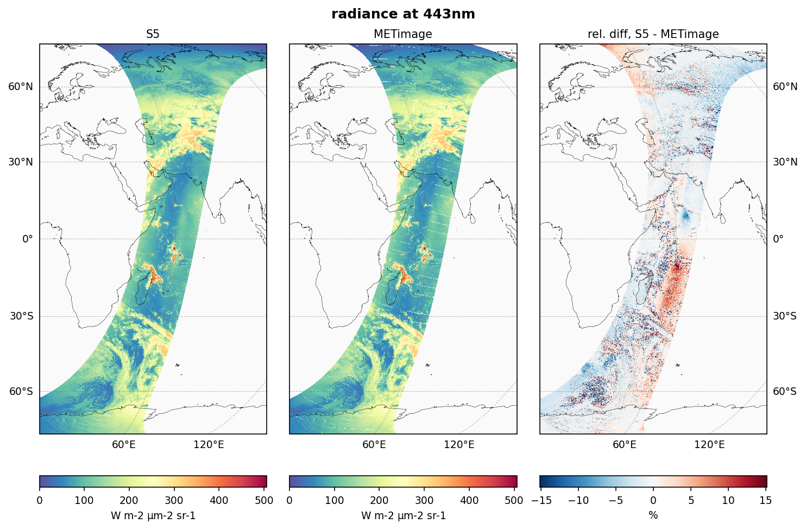
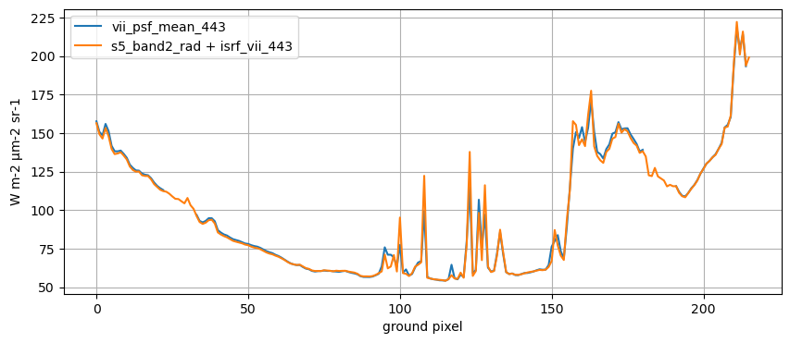
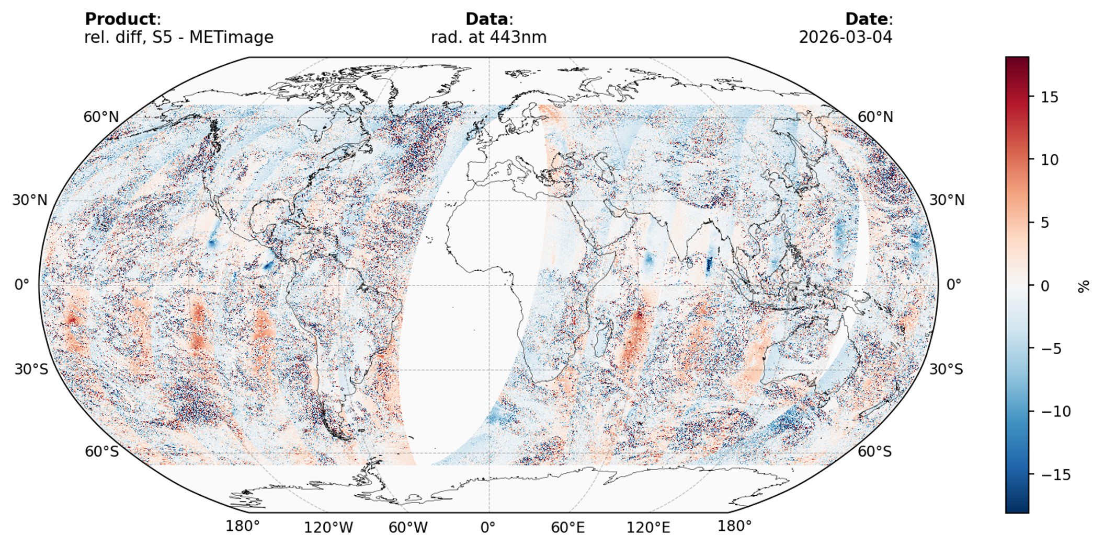
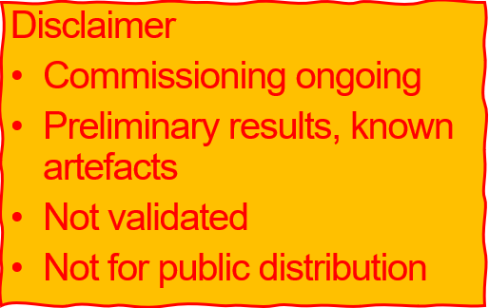
6c. Copernicus Sentinel-4 & -5 – status Rasmus Lindstrot
Sentinel-5/UVNS vs METimage radiances
* Both missions in commissioning!
* S5 and METimage radiances in close agreement over homogeneous surfaces.
* Larger deviations observed over cloudy scenes and in regions affected by sun glint.
* Some viewing angle dependent deviations found, flipping sign at the equator.
* Pattern persistently found in all orbits

Slide 8
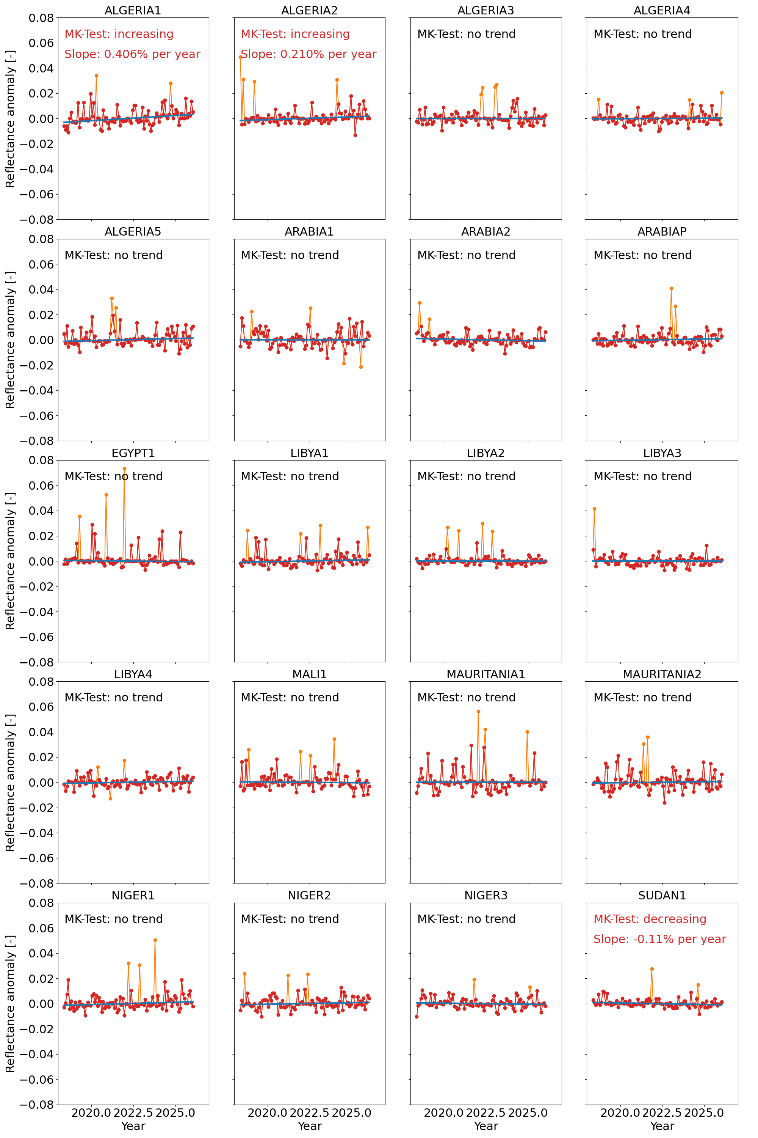
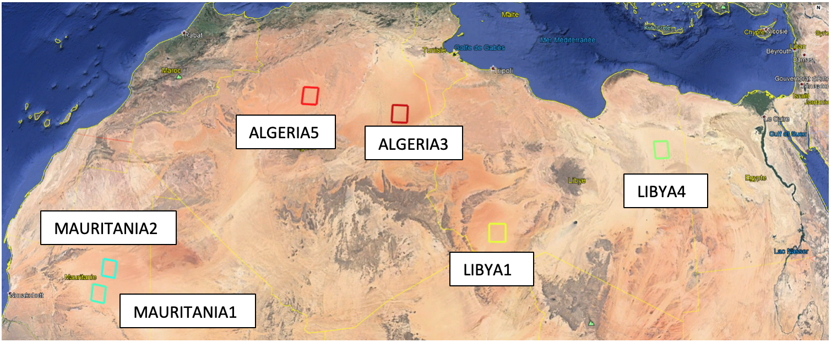
6a. 8 years TROPOMI long-term instrument degradation, Erwin Loots et al.
Validation (2/3): PICS
From: https://mpc-vdaf.tropomi.eu
Stability of reflectance (B3,4,6) has been obtained from near cloud-free, near nadir measurements over 20 Pseudo-Invariant Calibration Sites located in the Saharan Desert and the Arabian Peninsula from May 2018 through January 2026. For all bands, the long-term drift is statistically not significant for the bulk of the sites.

Slide 9
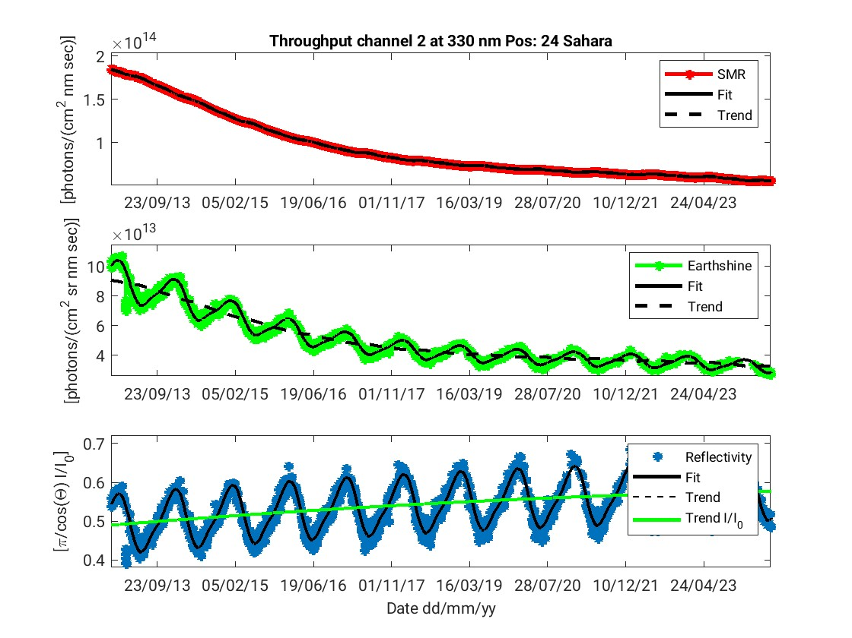

6b. GOME-2 in-orbit performance, Pieter Valks, et al.
GOME-2 L1B - Throughput 330 nm (Ch. 2) scan pos 24 (west)
SMR
Earthshine (Sahara)
Reflectivity (Sahara)

Slide 10
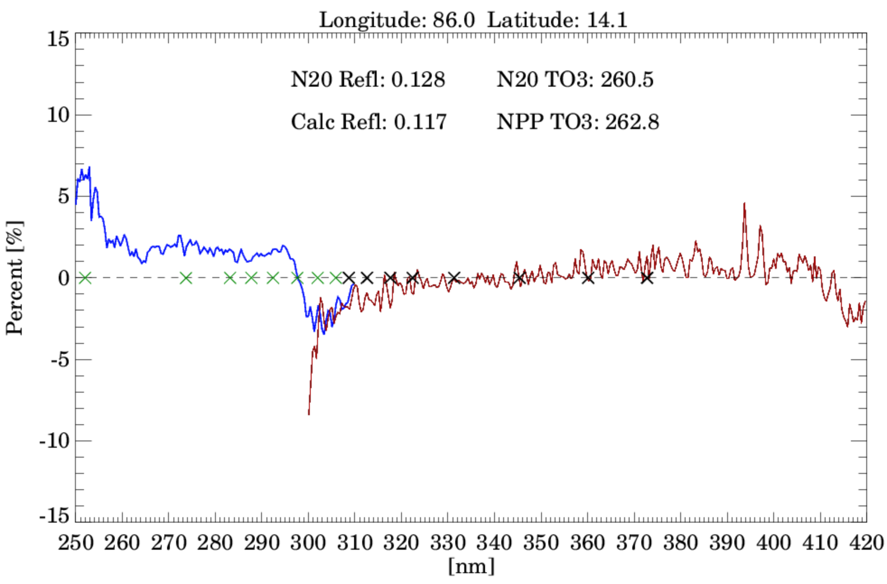
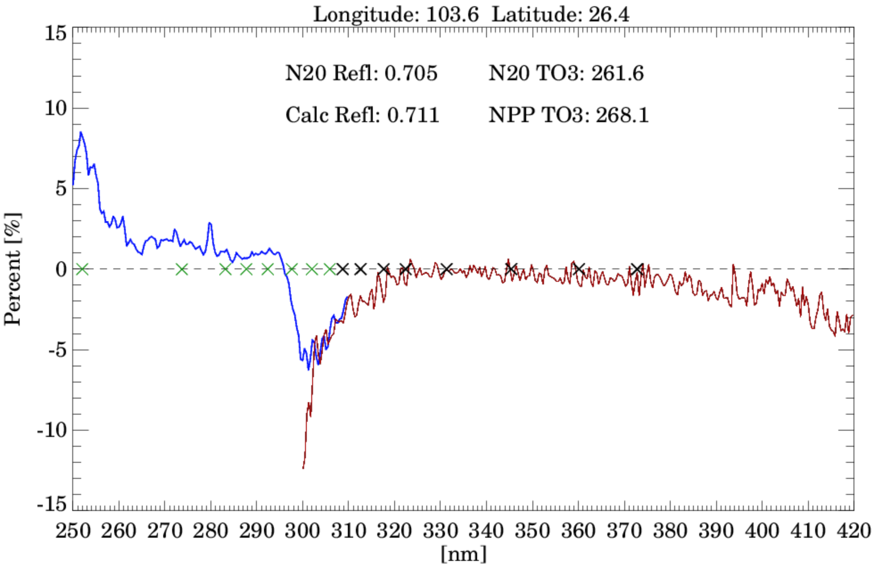
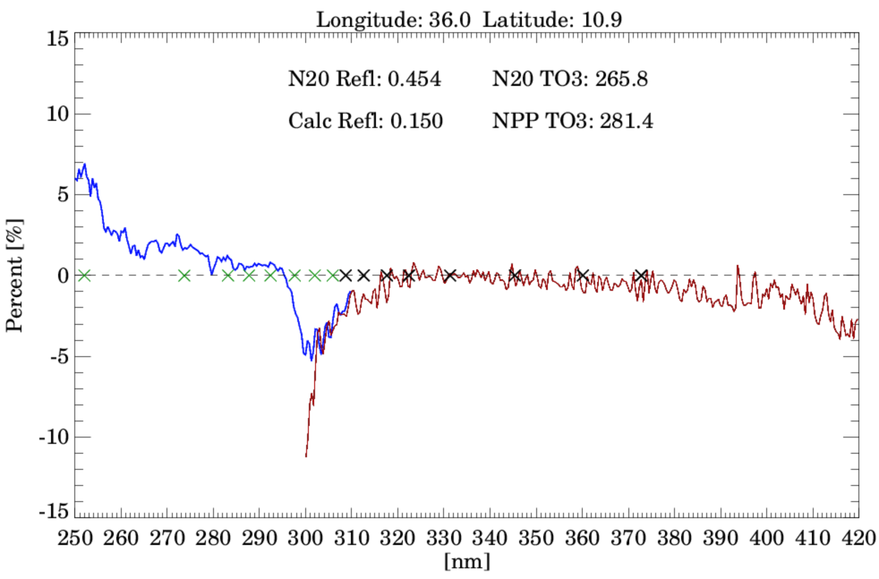
6d. Calibration of the NOAA-20 OMPS Instrument for NASA Products, Brad Fisher
RTM Assessment of OMPS NOAA-20 Performance
for Clear and Cloudy Conditions using OMPS-NPP Ozone
Clear Sky Case (REF < 0.15)
DC Case (ECF >=0.8)
PC Case (0.3 < ECF < 0.5)
N20 Residuals [% change]
N20 Residuals [% change]
N20 Residuals [% change]
Apply MLER Cloud Model
BCW wavelengths for L2 retrievals
X = NM
X = NP
BCW wavelengths for L2 retrievals
X = NM
X = NP
BCW wavelengths for L2 retrievals
X = NM
X = NP
NPP and N20 fly in parallel orbits at the same latitude separate by 12º longitude
A Radiative Transfer Model is used to assess performance based on OMPS-NPP Ozone profile and OMPS-N20 viewing conditions (geometry, surface, and cloud conditions)
For Clear and DC cases: The RTM is run and then the NOAA-20 reflectivity is recalculated before computing normalized radiances for Clear and Deep Convections (DC) cases.
For partly cloudy (PC) skies: Apply MLER cloud model and then run RTM twice for clear (REF = 0.15) and cloudy (REF = 0.8). Use the 331 residual to adjust the whole NP and NM wavelength spectrum

Slide 11
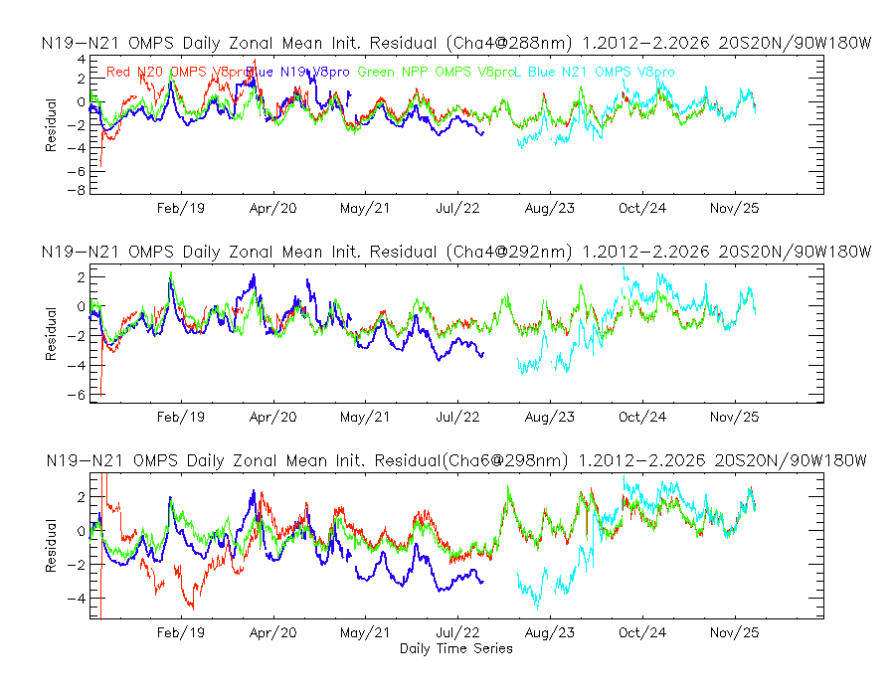
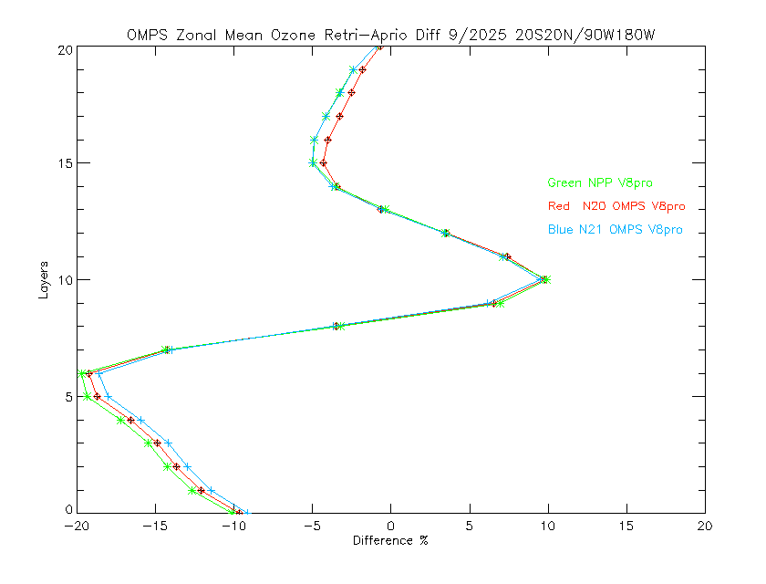
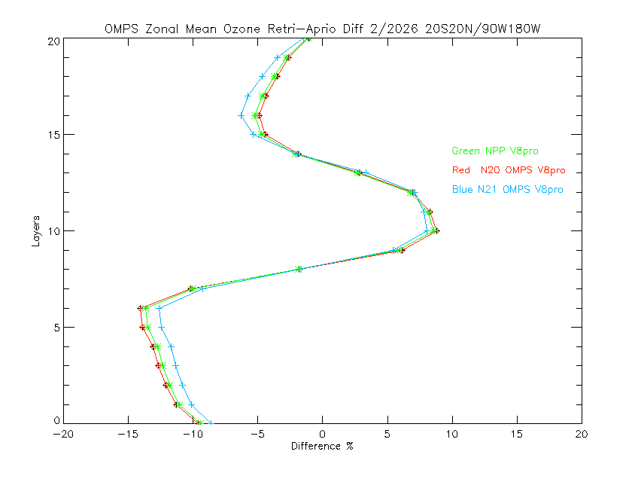
6e. Monitoring of Measurements for S-NPP, NOAA-20 & -21 OMPS and Metop-C GOME-2 for 2023 to 2025 by using V8TOZ and Global Statistics
Monthly Mean Difference for V8Pro
Retrieval versus A Priori for 9/2025 and 2/2026
Green NPP
Red N20
Blue N21
Retrieval Layers, #
5%
5%
Layer Difference, %

Slide 12
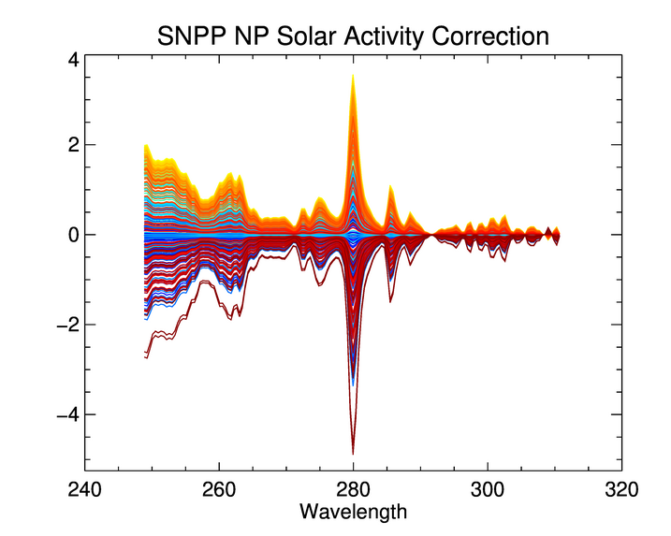
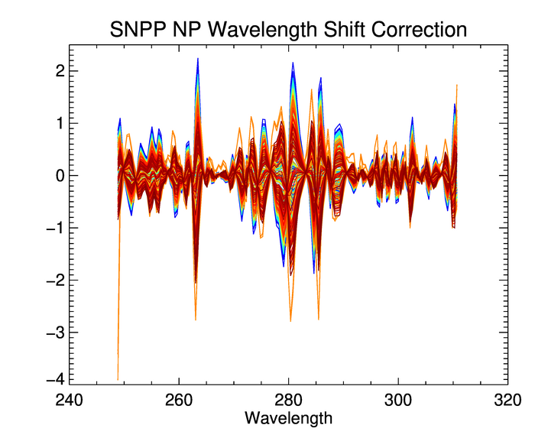
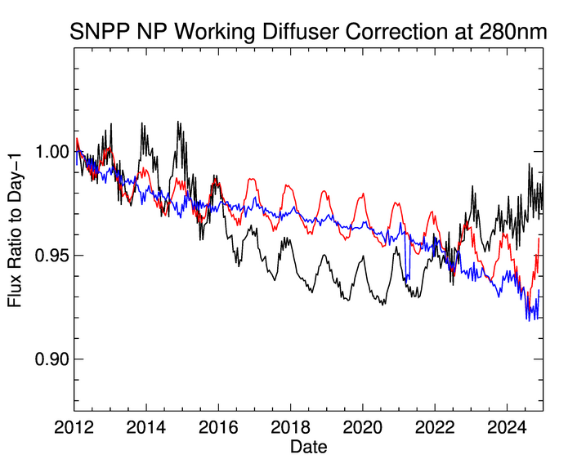
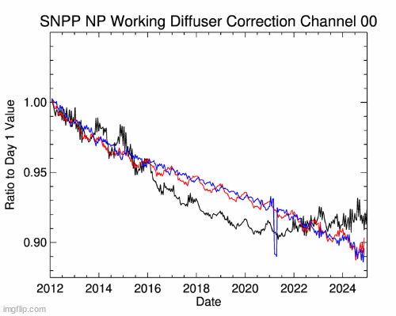
6f. Improving Mission-Long Quality Stability of SNPP OMPS NP SDR Data through Solar Activity and Optical Throughput Degradation Adjustments, Steven Buckner et al.
Applying Both Corrections to the Data
To determine the amount of correction that needs to be applied to each solar measurement, scale factors are multiplied by the percent change in Mg-II Index compared to the day-1 measurement
  For example, if the scale factor value is 0.5 and the change in Mg-II Index from day-1 is 4%, then the total impact from solar activity would be 2%
Wavelength shift adjustments are also made relative to day-1
  Shift adjustments are made to the data following adjustments for solar activity
Corrections have been calculated for the lifetime of each of the three NP sensors
Oldest Data → Most Recent Data
Oldest Data → Most Recent Data
(Animated for all Wavelength Channels)
Original
Solar Activity Corrected
SA and Shift Corrected
Original
Solar Activity Corrected
SA and Shift Corrected

Slide 13
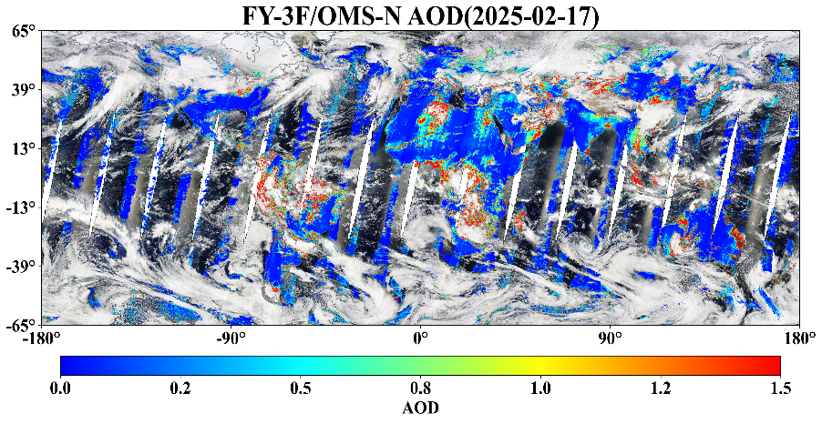
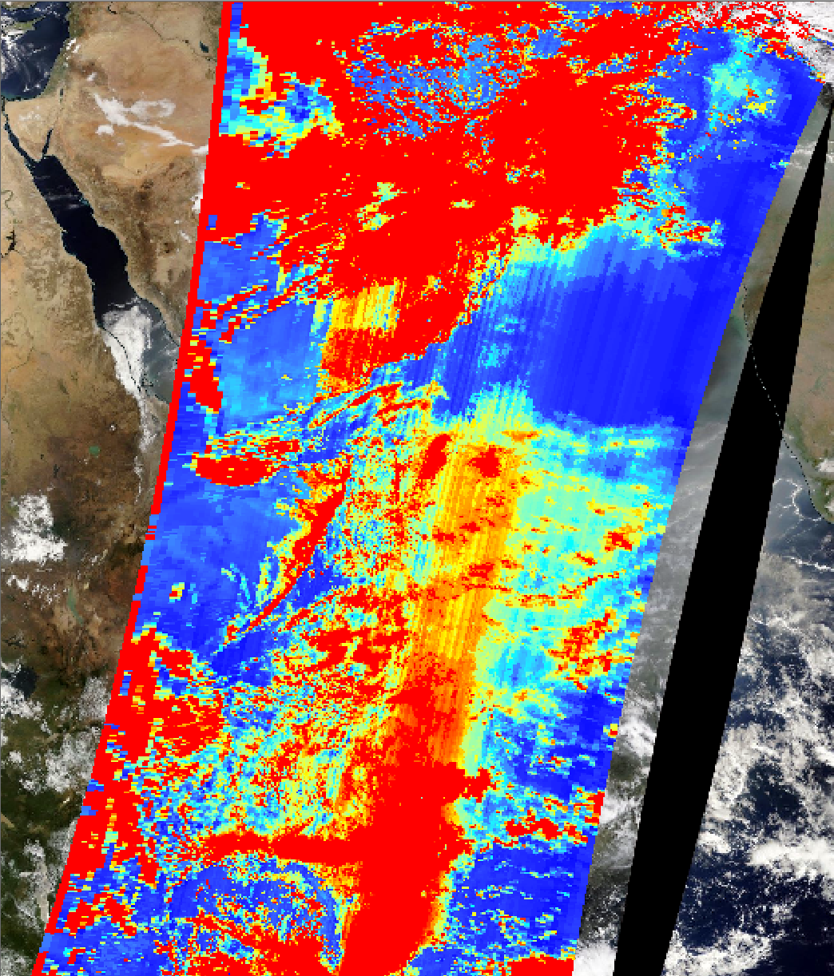
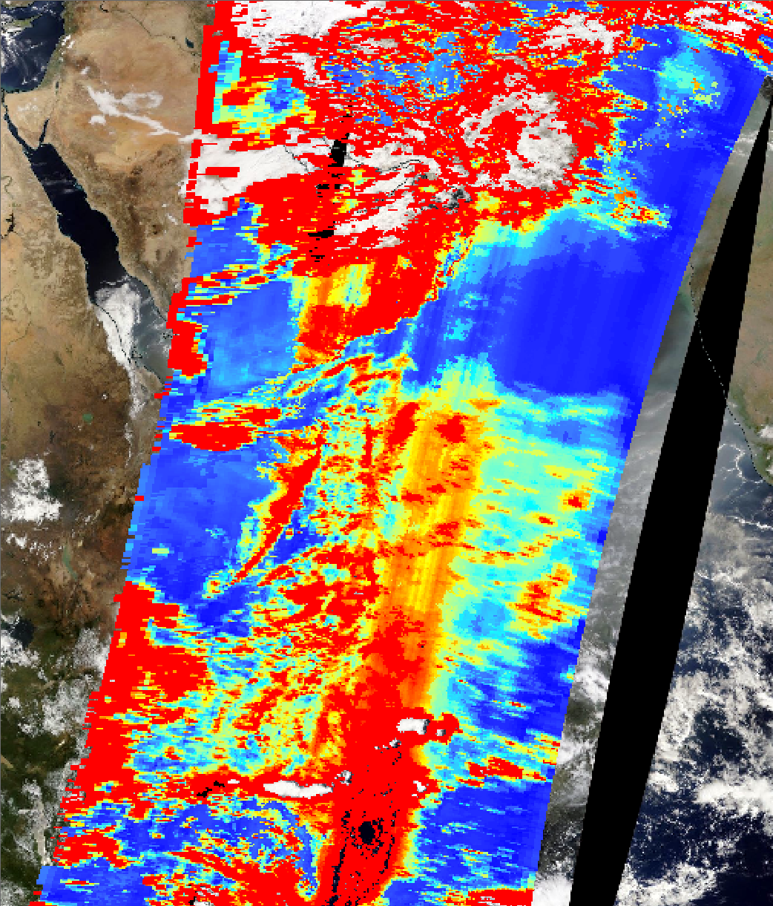
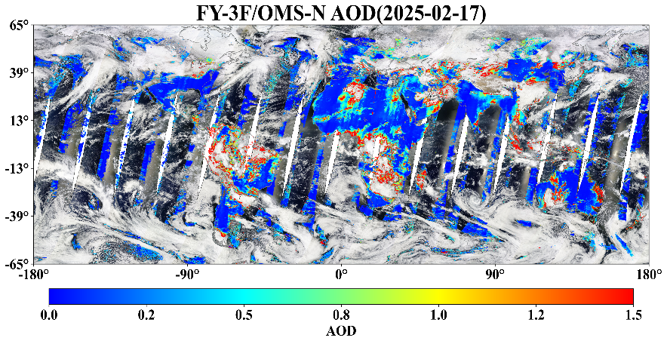
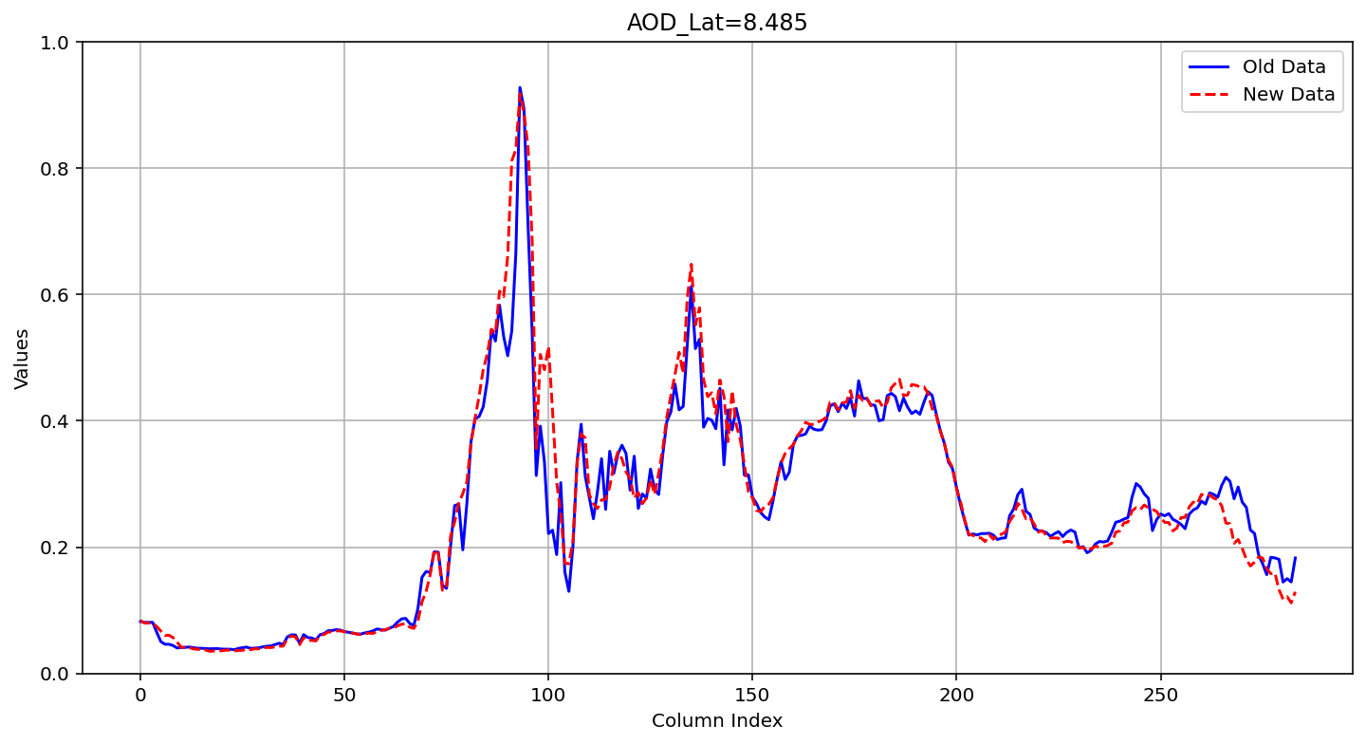
6k. Research on the Non-Uniformity Correction Method for FY-3F OMS-N, Mao Jinghua et al.
Level 2 Product Validation
Aerosol Optical Dep
Before Correction
After Correction
0.5
(a) Original L1
0
Fine striping artifacts are significantly improved
(b) L1 after PRNU correction
13

Slide 14
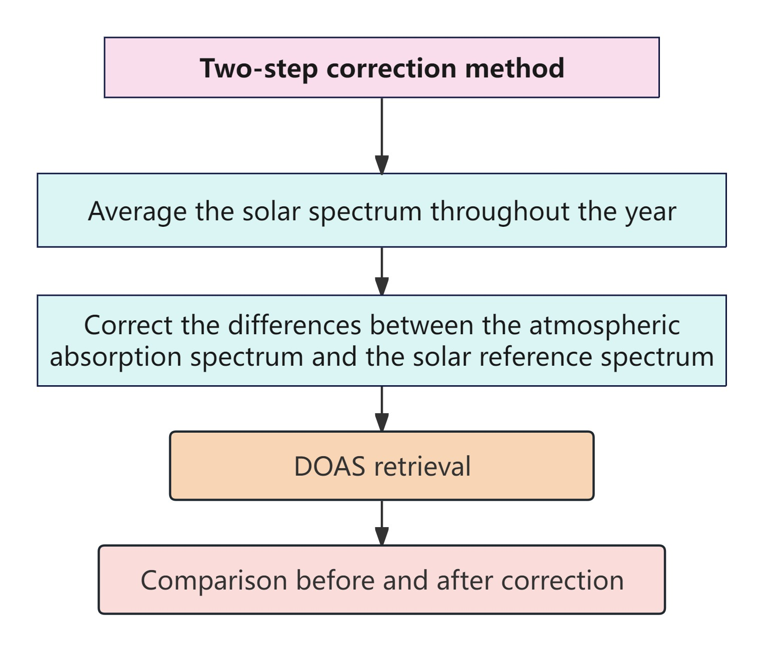
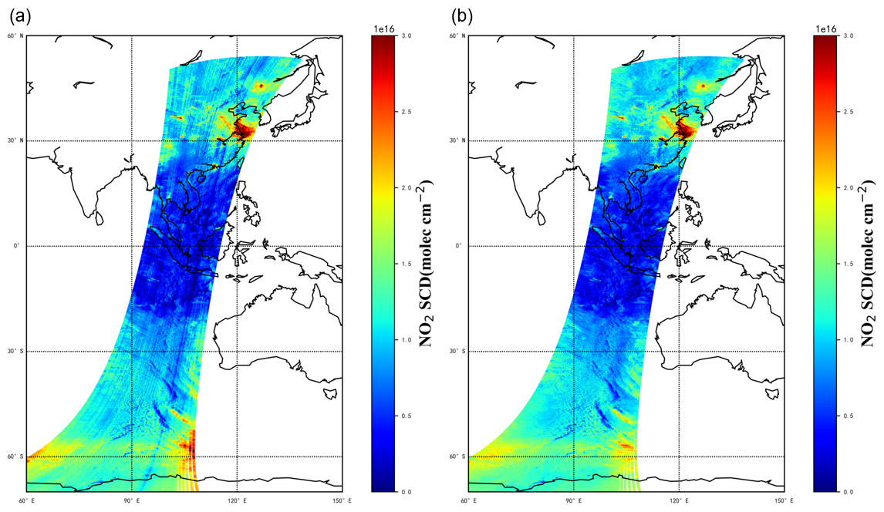
6m. EMI Stripe Error Correction Method and Results, Zhao Minjie et al.
Stripe Error Correction using Average Solar Spectra
NO₂ SCD retrieval results
Before stripe correction
After stripe correction
RMS± 6×10¹⁵ molec/cm²
RMS± 0.8×10¹⁵ molec/cm²

Slide 15
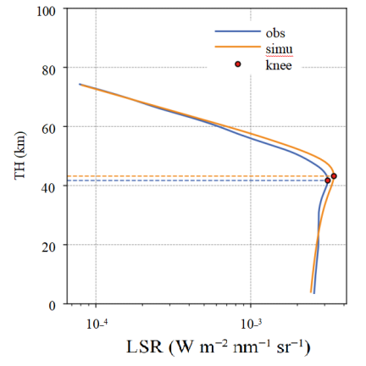
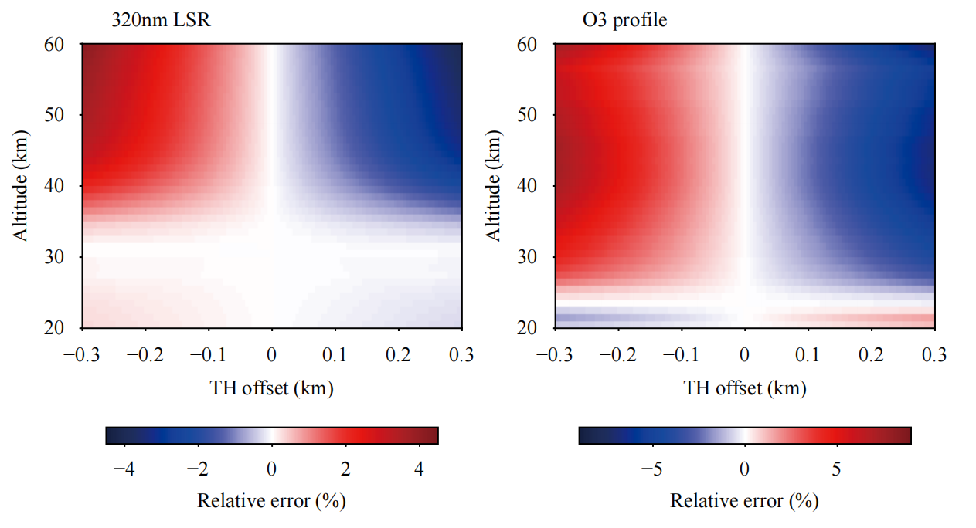
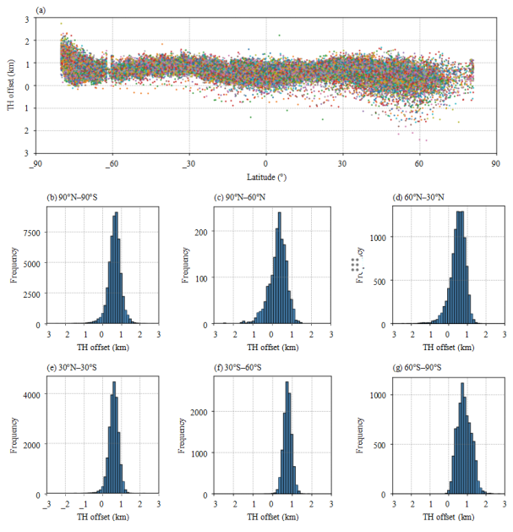
6l. On-Orbit Performance Algorithm Optimization and Global Calibration Consistency Verification of the OMS-L Instrument, Li Yuan et al.
Tangent Height Correction via Knee Point Method (Liu Song)
Aiming at the problem that OMS-L has no star tracker and cannot directly verify the tangent height, an on-orbit tangent height verification and correction algorithm (KB algorithm) based on the knee point of the 305 nm ultraviolet limb scattered radiance (LSR) profile is proposed. After correction by this algorithm, the correlation coefficient between the simulated radiance and the observed spectrum reaches 0.973, which verifies the reliability of the algorithm and provides key support for improving the OMS-L data quality and retrieving ozone products.
Comparison of the 305 nm LSR profile observed by OMS-L with the corresponding simulated profile
Sensitivity analysis shows that the theoretical accuracy of the algorithm is ±300 m, and its error impacts on the 320 nm radiance simulation and ozone profile retrieval are within ±4% and ±8%, respectively.
The results from November 2024 to March 2025 show that the overall tangent height deviation is within ±1 km.
Citation: Liu, S., Y. Li, N. Xu, et al., 2026: Validation and correction of in-orbit tangent height for the ozone monitoring suite-limb onboard . J. Meteor. Res., 40(2), 1-9, doi: https://doi.org/10.1007/s13351-026-5189-3

Slide 16
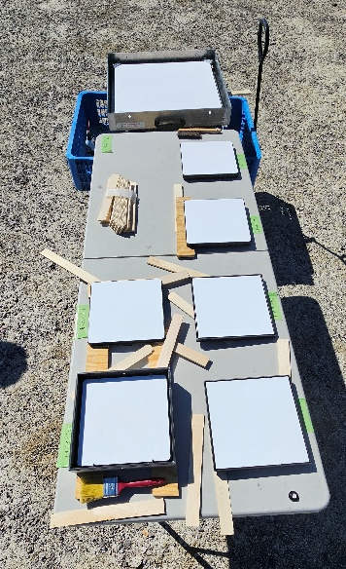
6g. JPL Vicarious Calibration at the Railroad Valley Playa, Graziela Keller et al.
The JPL Viccal Team’s measurements of the RRV Playa currently support calibration efforts by various missions: OCO-2, OCO-3, MISR, MAIA.
Our unique calibration approach, in which we take ASD measurements of a Spectralon Panel, provides surface reflectances that are independent of solar and atmospheric models.
Our measurements, framework, and existing software can be adapted for other missions.
We are currently extending our capabilities to include UV in-situ measurements and angle matching measurements.
The JPL Viccal Team would like to find new missions to support with, not only in-situ measurements, but also data analysis, in an effort to expand our activities at the RRV Playa.
JPL Viccal Team: Graziela R. Keller, Carol Bruegge, Thomas Pongetti, Dejian Fu, Rob Rosenberg, Emily Payne, Edwin Sarkissian, Richard Lee.
Spectralon panel intercomparison

Slide 17
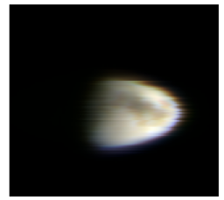
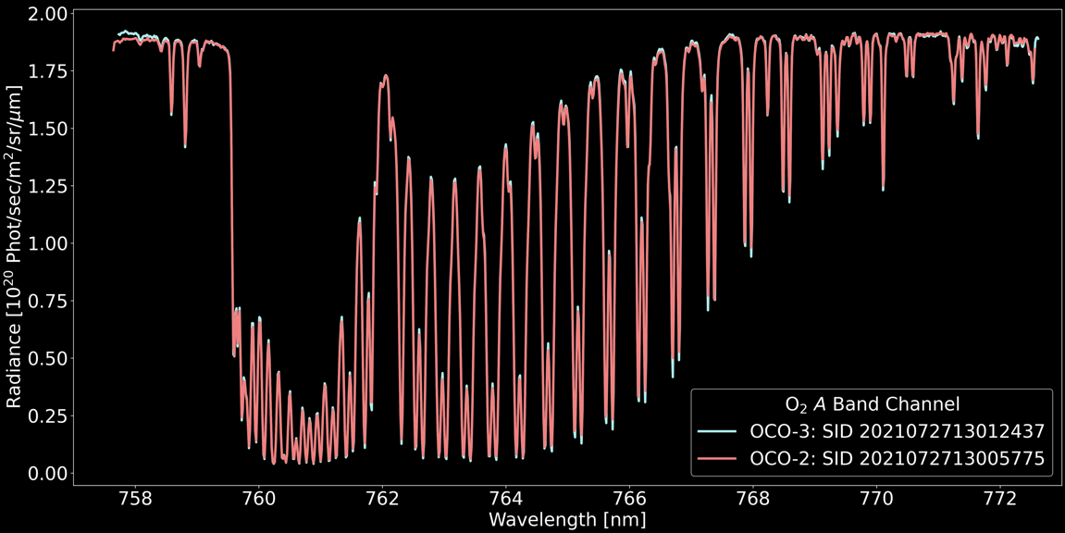
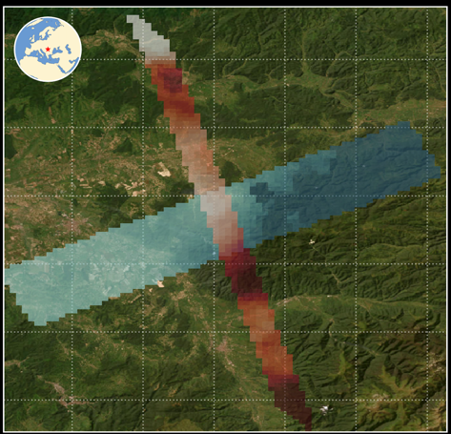
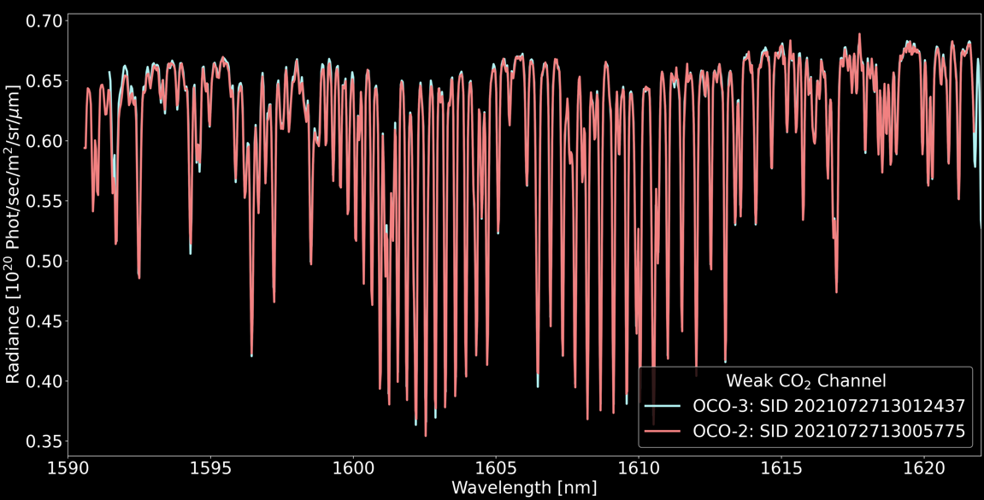
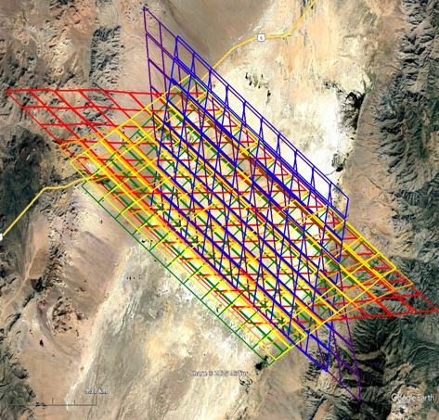
Combining Knowledge
6h. The OCO-2 / 3 Radiometric Puzzle, Robert Rosenberg et al.
1. Based on Lunar, estimate a drift in OCO2 from Feb 2022 onward and apply to SNOs
2. SNOs estimate OCO2/OCO3 =
1.033, 1.048, 1.022
(constant in time)
and validate OCO-3 B11 Lamp Aging assumption
Individual OCO-2 and OCO-3 Band 1 & 2 Radiance Spectra
(from a SNO 25 sec apart)
3. RRV estimates match well if OCO3 = 1.0
1.020, 1.057, 1.043
(constant in time)

Slide 18
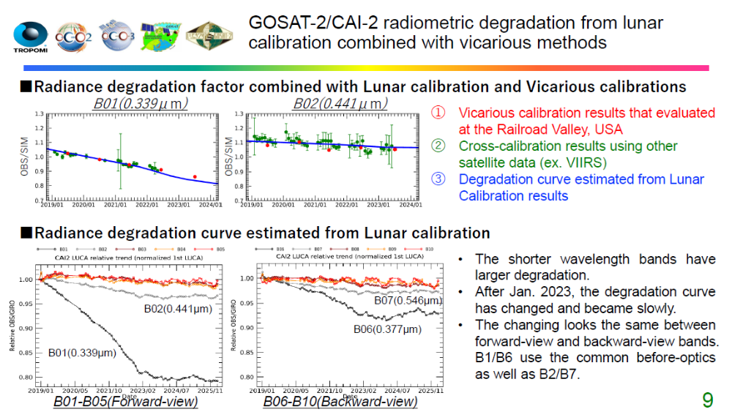
6i. Calibration status of GOSATandGOSAT-2, Kei SHIOMI and GOSAT Team

Slide 19

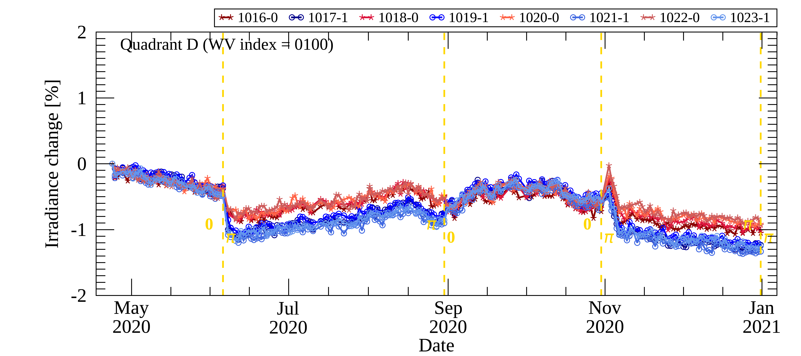
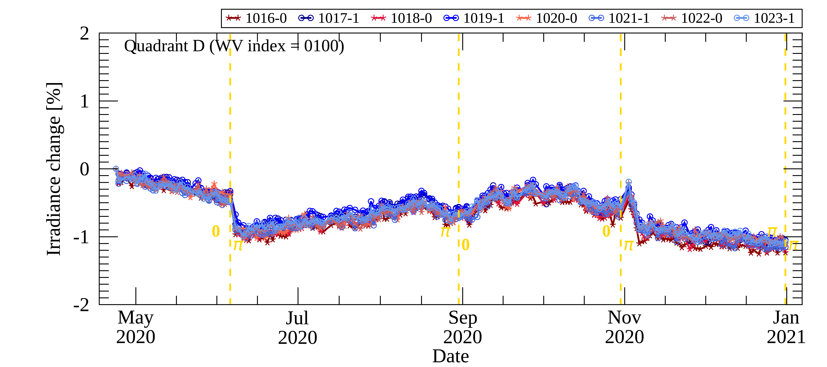
6j. GEMS Status and Calibration Update, Changsuk Lee
2
Analysis of Radiometric correction
Unusual stripe pattern(N-S direction) on CCD
Correction is performed using the error ratio by gain of the radiometric correction
Abnormal differences between adjacent pixels during time series analysis are reduced after correction.
→ Earth and solar observation each need to be applied
Quadrant D (WV index = 100)
before
After Gain & Radiometric calibration coeff.
19

Slide 20
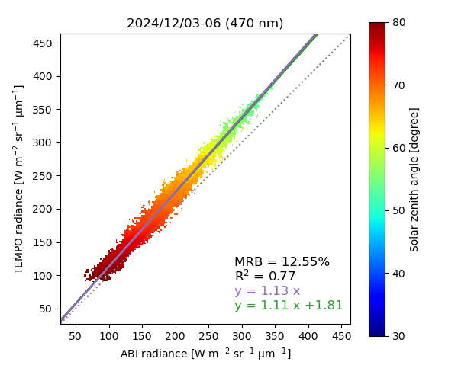
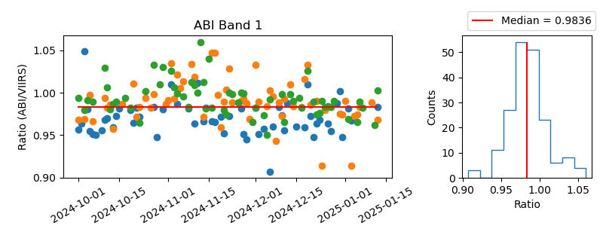





6n. TEMPO Level 1 Status, Heesung Choi et al.
Absolute calibration after solar calibration correction
Earth radiance intercomparison (TEMPO V03 vs. ABI vs. VIIRS)
Example: 470 nm (UV), GOES-19
$$\frac{TEMPO}{ABI}=1.1255$$
$$×$$
$$\frac{ABI}{VIIRS}=0.9836$$
$$→$$
$$\frac{TEMPO}{VIIRS}=1.1070$$
In Version 4, the UV and visible calibration coefficients have been reduced by 11% and 7%, respectively.

Slide 21
Backup

Slide 22
Future Plans for UVN Spectrometer Subgroup
Discussion

Slide 23
Topics
Solar Trending and Comparisons
  Absolute Calibration (TSIS HSRS validated at 1% level)
    https://lasp.colorado.edu/lisird/data/tsis1_hsrs_p1nm
  Modelling – solar activity, wavelength shifts, diffuser degradation, throughput degradation
    Time dependent components can be attributed/explained/estimated at the 0.1% level.
  Intercomparisons
Radiance Trending and Comparisons
  Deep Convective Clouds (DCC)
  Simultaneous Nadir Overpass (SNO)
  Ice, Deserts, tropical forests
  Equatorial Pacific Ocean
  Radiative Transfer over dedicated sites (PICS, RadCalNet)
Level 2 products (Effective Reflectivity, Aerosol Indices, O3, Other trace gases)
  Deep Convective Clouds (DCC) (effective reflectivity & its wavelength dependence)
  Simultaneous Nadir Overpass (SNO)
  Ice, Deserts
  Equatorial Pacific Ocean
Notes:
Wang, W.; Flynn, L.; Zhang, X.; Wang, Y.; Wang, Y.; Jiang, F.; Zhang, Y.; Huang, F.; Li, X.; Liu, R.; Zheng, Z.; Yu, W.; Liu, G.; , "Cross-Calibration of the Total Ozone Unit (TOU) With the Ozone Monitoring Instrument (OMI) and SBUV/2 for Environmental Applications," Geoscience and Remote Sensing, IEEE Transactions on , vol.PP, no.99, pp.1-13, doi: 10.1109/TGRS.2012.2210902.

Slide 24
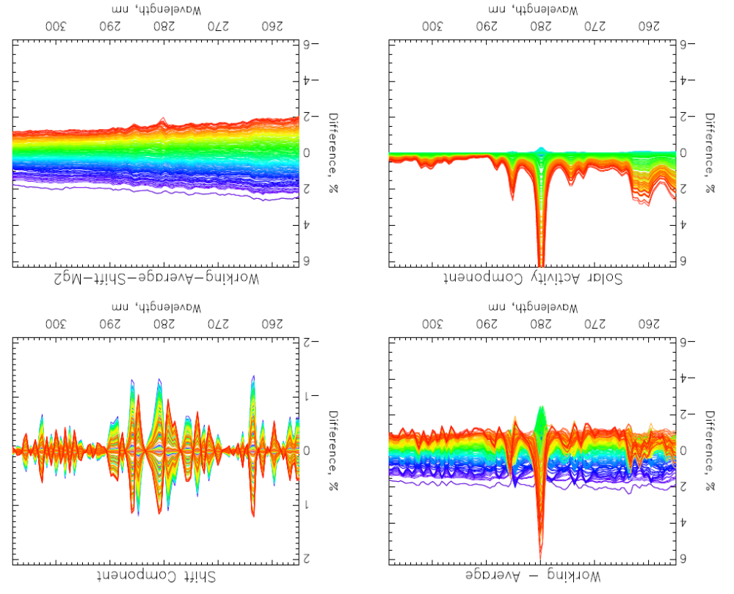
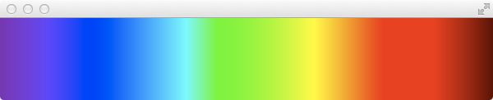
Six years of NOAA-20
OMPS NP bi-weekly Working Diffuser Soar measurements compared to their average.
(b) Wavelength Shift Patterns. Wavelength shifts track optical bench annual thermal variations.
(c) Solar Activity Patterns. Patterns are Mg II scale factors and track Solar activity.
(d) Differences after subtracting the shift and activity patterns. This shows the combined degradation of the reference diffuser and the instrument’s optical throughput.
Note: The working diffuser’s exposure is deployed every two weeks.
    Time dependent components can be attributed/explained/estimated at the 0.1% level.
(a)
(b)
Newest
(c)
(d)
4%
Oldest

Slide 25
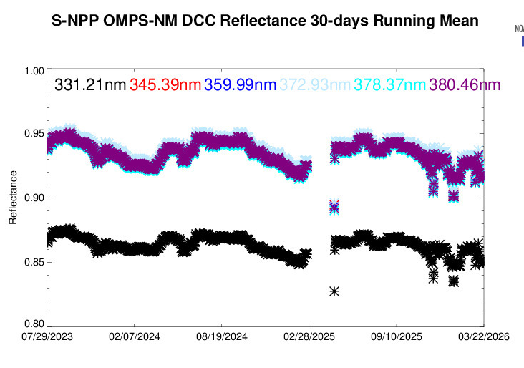
Deep Convective Cloud (DCC) Monitoring at NOAA Integrated Cal/Val System (ICVS) https://www.star.nesdis.noaa.gov/icvs/status_N21_OMPS_NM.php

Slide 26
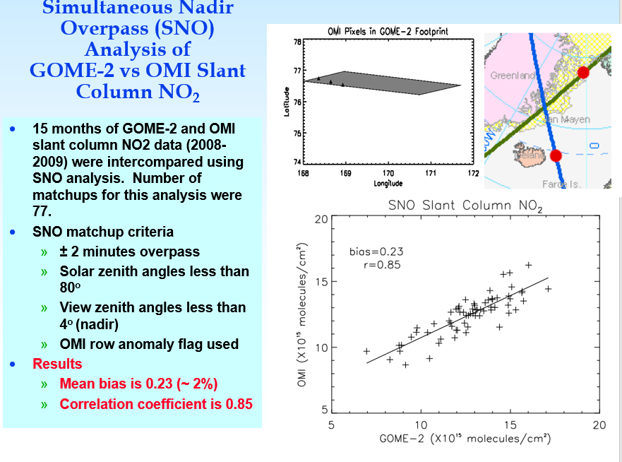
Before doing science applications with the data, we ran the same algorithm on both OMI and GOME-2 and compared the two NO₂ products
Slide from talk by S. Kondragunta (NOAA)

Slide 27
Agenda for Topical Meeting on Solar Analysis and Comparisons on June 2, 2024
OMI and TropoMI Solar Activity Time Series by Matt Deland et al.
TEMPO Solar Measurements by Heesung Chong et al.
TropoMI Solar Measurements by Erwin Loots et al.
Bremen Composite Mg II Index by Mark Weber et al.
Analysis of OMPS Solar Measurements by Larry Flynn et al.

