Slide 1
GSICS website way-forward
Mounir Lekouara (EUMTESAT)

Slide 2
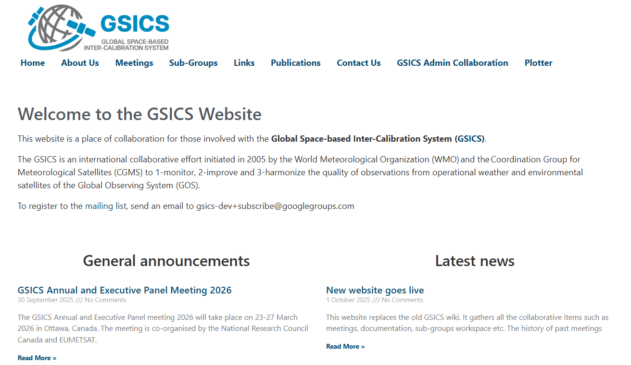
new website replacing the wiki
Developed the new gsicsweb.eumetsat.int website in replacement of the GSICS wiki decommissioned mid-2025.
On-going:
  Consolidation of the three websites (WMO, GCC and the new website)
  Definition of new cooperative tools (forums, mailing lists, gitlab)
  Import of the relevant old content of the wiki
  Assignment of the contributors for the various sections
https://gsicsweb.eumetsat.int

Slide 3
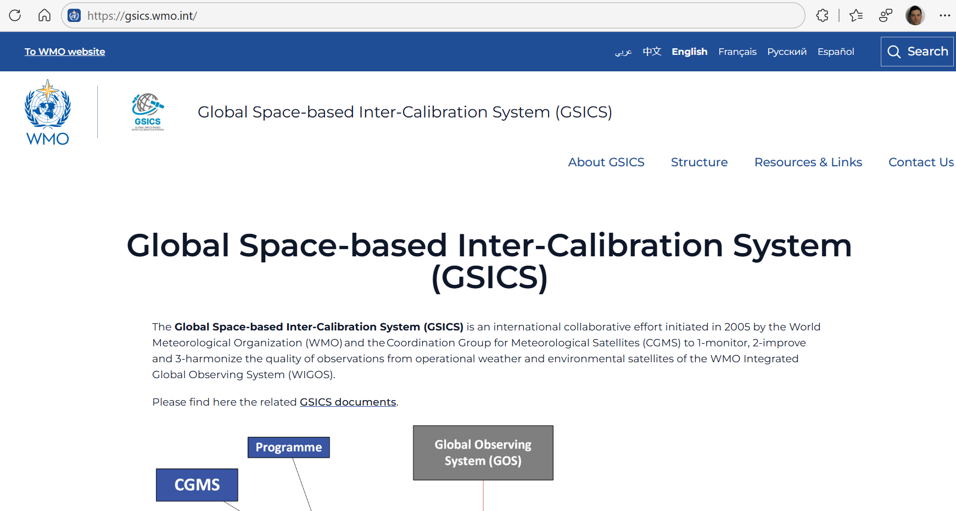
WMO GSICS Website

Slide 4
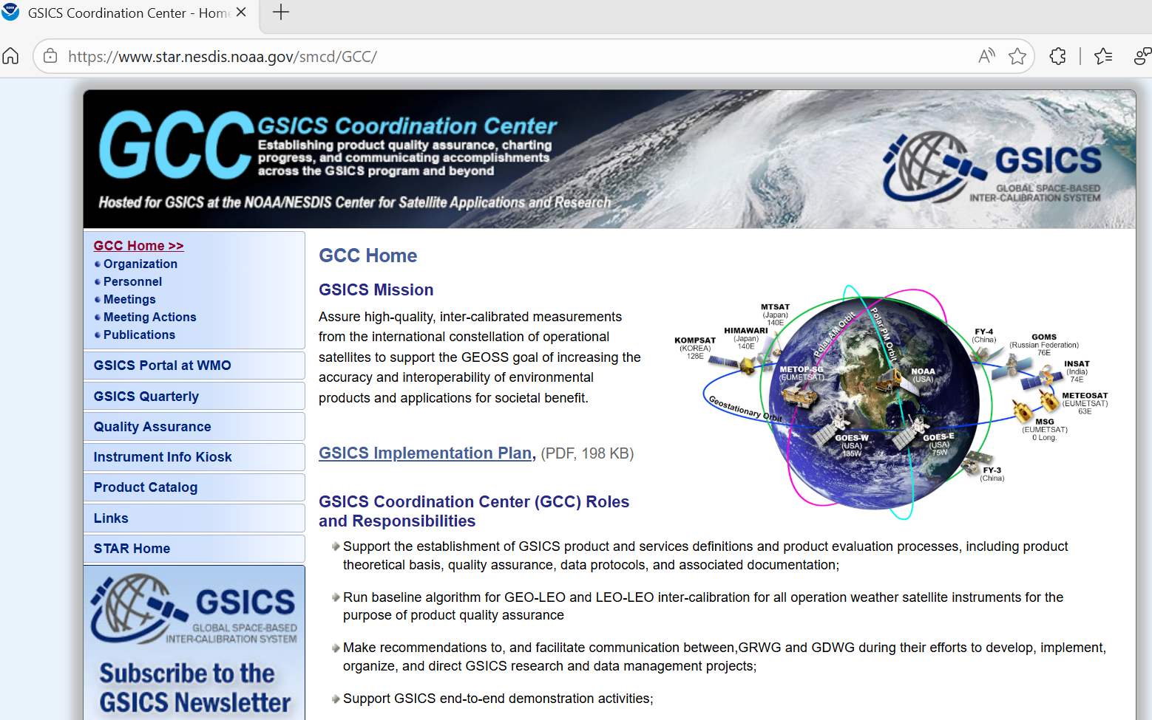
GCC website

Slide 5
Outcomes of sub-groups and GDWG discussions
Priorities for the website evolutions
  Old meetings
  Conventions
  Good practices
Separate the developers area (collaborative, restricted) from the users area (consolidated/approved content, public)
Provide cooperative tools (forums, sharepoint documents, mailing lists)
Mounir to organize a review to decide what content/document from the wiki needs to be migrated to the new website
Consider the merging of the 3 websites under https://cgms-info.org/gsics/

