Slide 1
Polarimeters – Specific Needs in Calibration & In-orbit Activities
Bertrand Fougnie
Clouds & Aerosols (CLA)
for the Remote Sensing & Products division (RSP)
EUMETSAT
27/03/2026

Slide 2
Summary
Introduction - Why polarimeters
Specificity of the polarimeters & needs for the performance
Polarisation model
Measurement of the polarisation
In-flight calibration
  Vicarious Calibration
Summary and Way forward
  Interoperability, many polarimeters, standardisation, methodology
  Within VISNIR subgroup, Workshop…

Slide 3
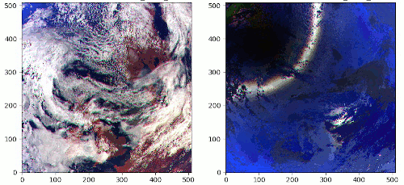
Why Polarisation and Polarimeters
The incoming Solar irradiance, randomly oriented light, becomes polarised after interaction with the particles and surface in the Earth-Atmosphere system
  Asset for aerosol and cloud characterisation
Natural light
Polarized light
TOA reflectance
RGB
3MI simulated observation
R=865nm
G=670nm
B=443nm
Qualitatively:
  where MM is the Mueller Matrix = the instrumental sensitivity to the polarisation
    MM to be maximised/optimised for a polarimeter
Measure = Natural-Light + MM * Polarized-Light

Slide 4
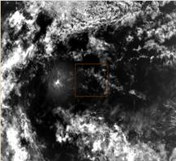
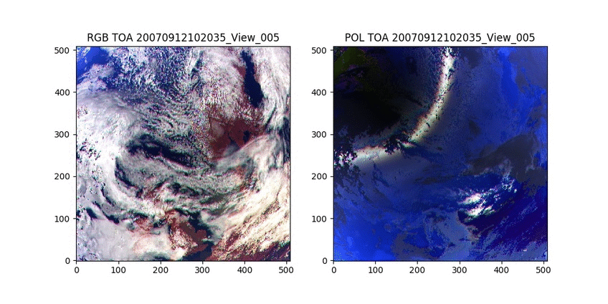
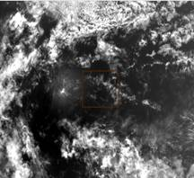
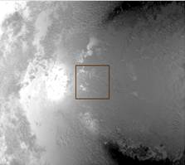
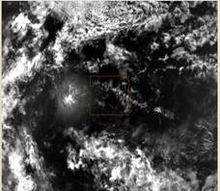
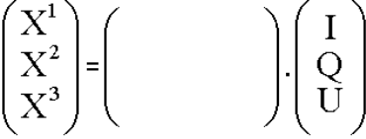
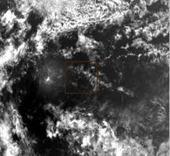
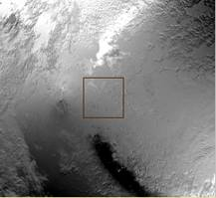
Specificity of Polarimeters
General concept = N measurements through N polarisers (N=3) → I/Q/U Stokes vector
The Mueller matrix describes the instrumental response to polarisation
I
X1
from [IQU] to [X₁X₂X₃]
I
In general, differences between X1, X2, and X3 are small
It implies a higher need in performance
X2
MM
Q
X3
Ip = √(Q²+U²)
DoLP = Ip/I
U
from [X₁X₂X₃] to [IQU]

Slide 5
Performance – Specific Needs for Polarisers
Qualitatively (perfect system -60°/0°/60°):
  I = (X₁ + X₂ + X₃)/3 → average
  Ip ~ √( (X₁-X₂)² + (X₁-X₃)² + (X₃-X₂)² ) → quadratic sum of differences
The 3 cardinal needs = System Performance
Cardinal Needs | Motivation | Associated effort
Absolute | Measure the spectral radiance I | Absolute performance - Usual effort: characterization: on-ground/in-flight radiometric corrections absolute calibration
Inter-polarizer consistency | Derive Ipol/Q/U from the difference of 3 measures no difference = no polarisation fake difference = wrong polarisation | Harmonisation of the 3 measures: all radiometric artefact corrections calibration in polarisation (Mueller Matrix) refined geometrical co-registration
Inter-view consistency | Provide multi-view acquisitions for I and Ipol | Harmonisation of the views: all radiometric artefact corrections multi-view inter-calibration refined geometrical co-registration (LoS)

Slide 6
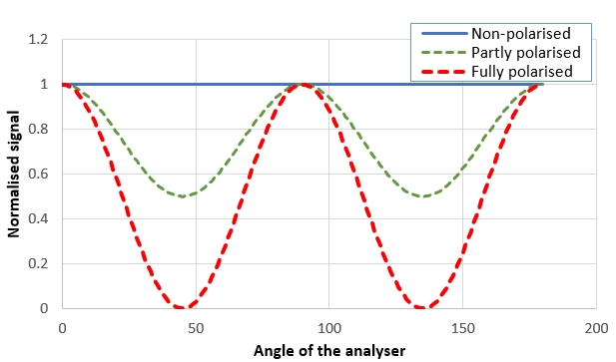
Measure the polarisation sensitivity – Ground or In-Orbit
On-ground or In-flight, the principle remains:
  Put a reference in front of instrument (pixel) – called “analyser”
  Analyse the behaviour of the signal
    Amplitude of polarisation sensitivity
    Angle of polarisation sensitivity
  On-ground: a polarised source serves as analyser
  In-flight: observed targets are polarised sources and can serve as analyser
  ➔ done ideally for all pixels, views, polarisers and bands (practically not always the case)
1
1/ Amplitude of
polarisation
2/ Angle of
polarisation
2

Slide 7
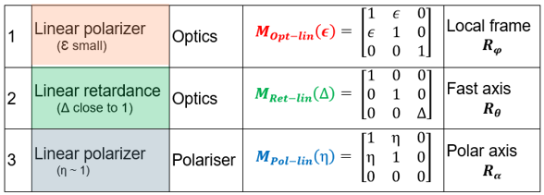
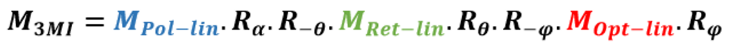
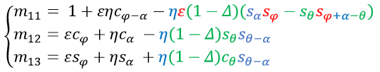
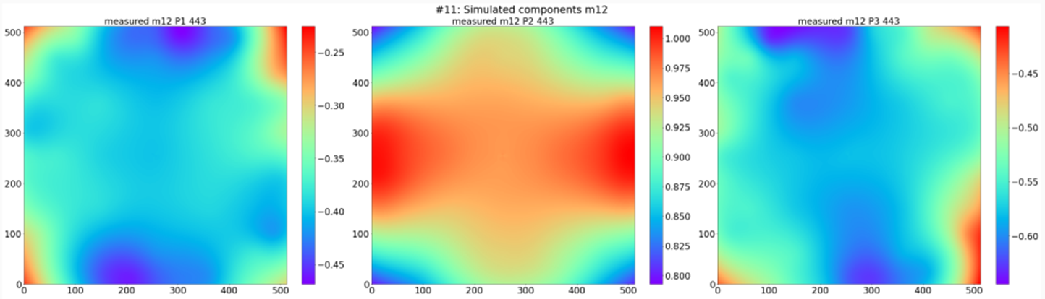
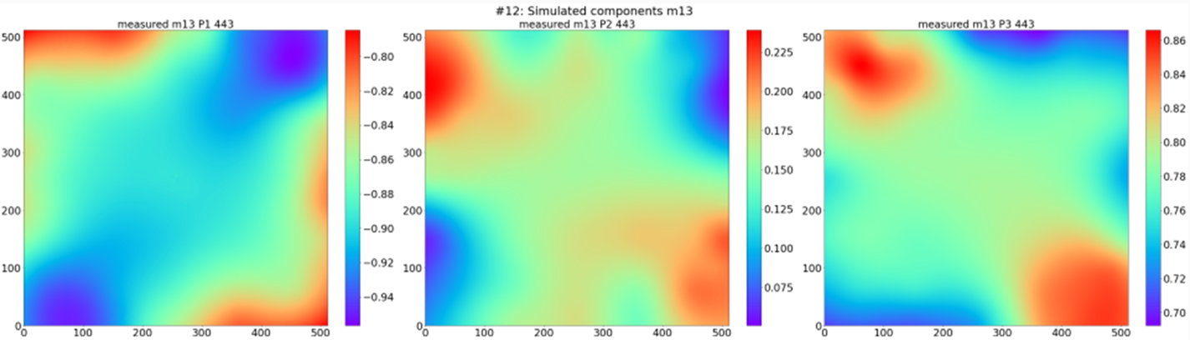



Need for a Physical Polarisation Model
Why a physical model?
  Model based on our knowledge of the instrumental behaviour and its sub-systems
  Provide an understanding of the features observed in MM (ground characterisation + in-flight)
  Small deviation from the model MM and the measured MM
Example: 3MI
$${ m}_{12}$$
P1
P2
P3
4/ combination retardance, optics & polariser
2/ optics
1/ polariser
3/ combination retardance
& polariser
$${ m}_{13}$$
P1
P2
P3
$$X\sim { m}_{11}.I+ m_{12}.Q+ m_{13}.U$$

Slide 8
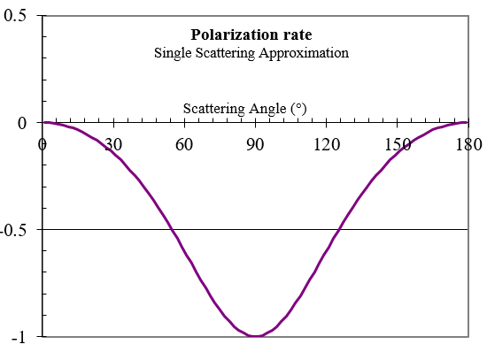
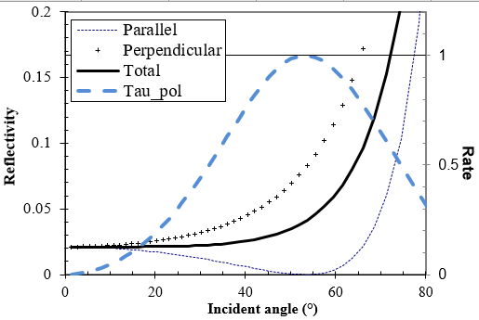
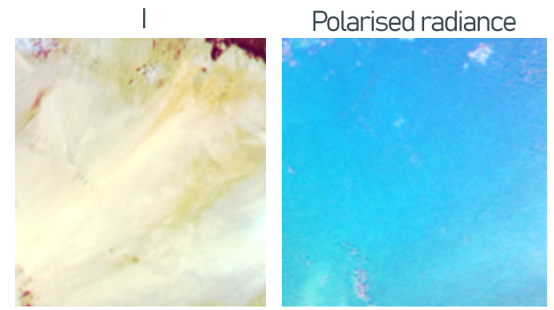
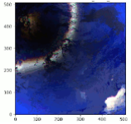
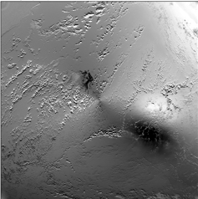
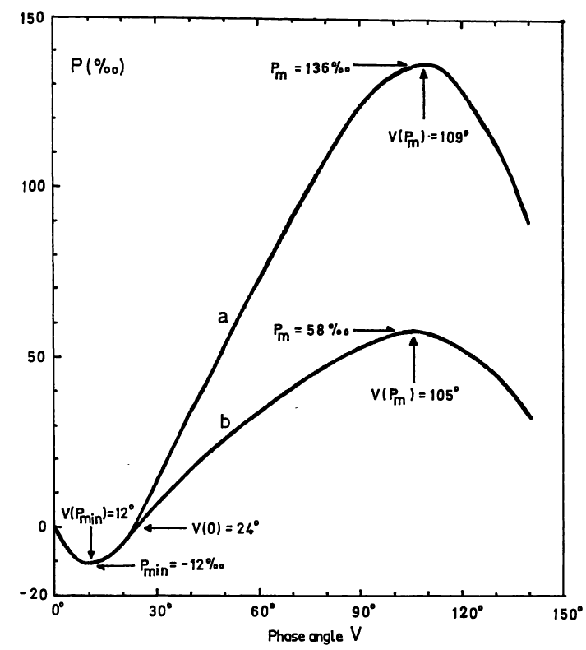
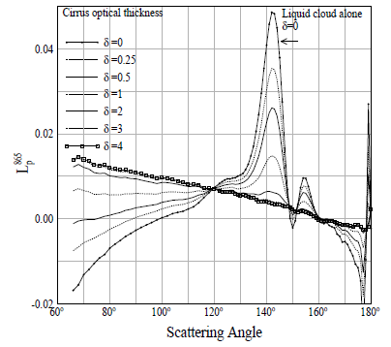
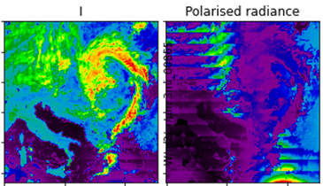
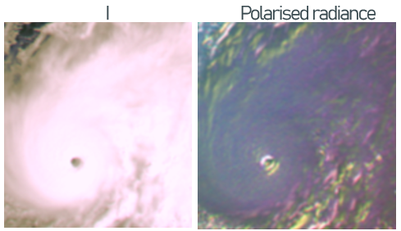
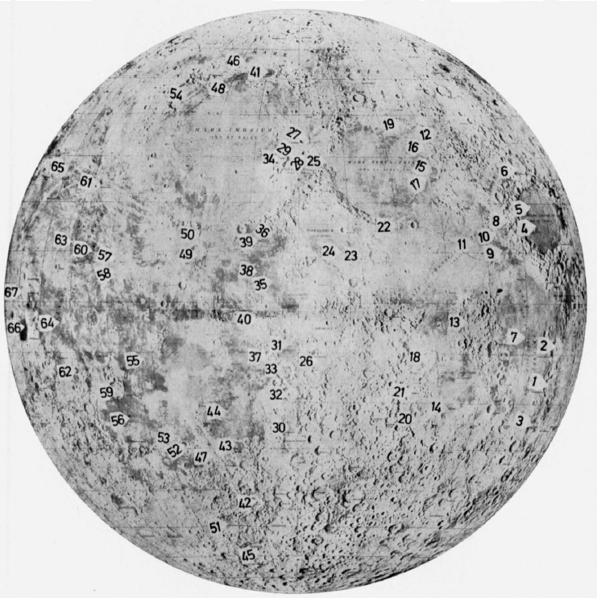
In-flight Calibration of Polarisation - Overview
PICS-Desert
  Moderate polarisation
  Extension of the PICS method
  A TOA-BPDF model/reference needed
  Sciamachy,
  PARASOL, 3MI
Rayleigh Scattering
  High polarisation
  Extension of the Abs-Cal method
  Reference RTM calculation
  GOME-2, MODIS,
  3MI
Sunglint
  Strong polarisation
  Extension of the Cal method
  Reference RTM calculation
  POLDER-1,
  PARASOL, 3MI
DCC - Clouds
  Small polarisation
  Derived from the Abs Cal method
  PARASOL, 3MI
Moon
  Small-Moderate polarisation
  Extension of the Abs-Cal method
  S-GLI, PARASOL,
  3MI
Simultaneous Observations
  All polarisations
  Matching method
  MODIS / PARASOL
  VII / 3MI
+ On-board calibration devices

Slide 9
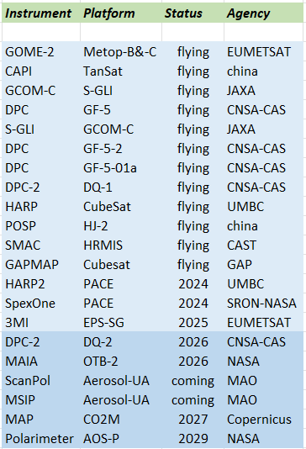
Polarimeters Fleet
Increasing suite of flying instruments
  Many agencies
  Commercial coming
Long-term provision of polarimetric measurements coming
In this context, need for evaluation and monitoring of the performance
Consistency, maybe also harmonisation
Polarimetry = performance differs from more classical imagers
  Specific needs & methodologies
Non-exhaustive list (Dubovik et al, 2019; WMO-OSCAR database)

Slide 10
Summary and way forward - 1
EUMETSAT activities for Level-1
  Currently Cal/Val of 3MI – on-going assessment (already many feedbacks)
  Preparation of CO2M/MAP
  Implementation in operational systems: e.g. MICMICS (EUM), PAT and MUSCLE support from CNES for 3MI…
    Mosly on-going for all approaches
  Interoperability (many polarimeters): standardisation, methodology (3MI, CO2M/MAP)
  Workshop with targeted experts
    Exhaustive brainstorming on in-flight approaches & their performances
    3 needs:
      Evaluation of performance (commissioning)
      Monitoring
      Inter-calibration assessment
    Outcomes: recommendation for implementation and developments

Slide 11
Summary and way forward - 2
GSICS:
High demand for many agencies involved in GSICS
Many polarimeters: Interoperability, standardisation/harmonisation
Need for improvement in methodology, calibration approach, performance assessment
Implementation in operational systems: e.g. MICMICS (EUM), MUSCLE (CNES)…
How to structure the interaction within GSICS
  Discuss a set of common references or methodologies
  RTM, PICS reference BPDF, lunar polarisation model….
  Moving toward inter-calibration of the polarisation
    Special role for polariser equipped with on-board polarisation calibration systems
  Identify priorities & if some approaches can be implemented as GSICS references (operational missions)
Not necessarily a VISNIR subgroup?
Target a Workshop at/around next GSICS Annual Meeting
  Kick Off mid/Q3 2026 ?

Slide 12
GRWG is invited to comment

Slide 13
References
Djellali, M. S., J. Riedi, S. Marcq, B. Fougnie, S. Hioki, and J.M. Nicolas, “Development of calibration methods using specular reflection over the ocean for the Multiviewing, Multichannel, Multipolarization Imager (3MI) of the EUMETSAT Polar System - Second Generation (EPS-SG),” SPIE Optical Engineering, January, 2019.
Toubbé, B., T. Bailleul, J. L. Deuzé, P. Goloub, O. Hagolle, and M. Herman, “In-flight calibration of the POLDER polarized channels using the sun’s glitter,” IEEE Trans. Geosci. Remote Sens. 37, 513–525, 1999.
Fougnie, B., G. Bracco, B. Lafrance, C. Ruffel, O. Hagolle, and C. Tinel, “PARASOL In-flight Calibration and Performance”, Applied Optics, vol. 46, n° 22, pp. 5435-5451, 2007.
Jafariserajehlou, S., B. Fougnie, “EPS/GOME-2 PMD Radiometric Adjustment over Rayleigh Scattering”, GSICS Annual Meeting, Virtual, 2021.
Tilstra, L. G., R. Lang, R. Munro, I. Aben, P. Stammes, “Contiguous polarisation spectra of the Earth from 300 to 850 nm measured by GOME-2 on-board MetOp-A”, Atmos. Meas. Tech., 7, 2047–2059, 2014.
Dolphus, A., E; Bowell, “Polarimetric Properties of the Lunar Surface and its Interpretation”, Astron. & Astrophys., 10, 29-53, 1971.
Phillips, P., and B. Fougnie, “In-orbit monitoring of the EUMETSAT Polar System - Second Generation (EPS-SG) Visible/Infrared Imager (METimage) Polarisation Sensitivity using the Multi-View, Multi-Channel, Multi-Polarisation Imager (3MI)”, SPIE Europe, Edinburg, 2024.
Schutgens, N. A. J., L. G. Tilstra, P. Stamnes, and F. M. Bréon, “On the relationship between Stokes parameters Q and U of atmospheric ultravioletvisiblenear-infrared radiation,” J. Geophys. Res. 109, 2004.
Meister, G., R. E. Eplee and B. A. Franz, "Corrections to MODIS Terra calibration and polarization trending derived from ocean color products", Proc. Earth Observing Syst. XIX, vol. 9218, Oct. 2014.
Goldin, D., B. Rajendra, S. Yolanda, “Evaluation of systematic errors on polarization parameters from POLDER instrument data for use in CLARREO Pathfinder-VIIRS intercalibration”, J. Applied Remote Sensing, Vol. 17, 2023.
Riedi, J., B. Marchant, S. Platnick, B. A. Baum, F. Thieuleux, C. Oudard, F. Parol, J.-M. Nicolas, and P. Dubuisson, “Cloud thermodynamic phase inferred from merged POLDER and MODIS data”, Atmos. Chem. Phys., vol. 10, 11851–11865, 2010
Tilstra, L., J. Acarreta, J.M. Krijger, P. Stammes, “Verification of SCIAMACHY‘s Polarisation Correction Over the Sahara Desert”, ENVISAT Validation Workshop (ESA SP-531). 9-13 December, Frascati, Italy, 2003
McBride, B. A., X. Xiong, A. Wu, “Assessment of polarization sensitivity of Aqua MODIS using co-incident POLDER-3 polarized measurements over marine stratocumulus clouds”, Earth Observing Systems XXVII, vol. 12232, 2022

Slide 14
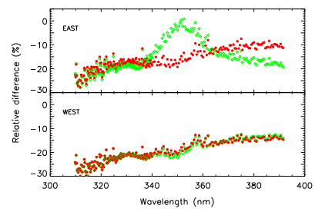
Vicarious Technics - PICS
PICS-Desert: well known but PICS have their own polarisation properties
  Type: moderated (depending on bands)
  A TOA-BPDF model or reference is needed
    Mostly coming from atmosphere
  Don’t need a high spatial resolution – coarse is needed (would be needed for more heterogeneous sites)
  Don’t need a high angular resolution – smooth, avoiding specific features
  Spectral coverage – TBD but no obvious need for super-spectral
    Some bands are needed to anchor
    The interband approach can be used to extend to the whole spectrum
  3MI (and similar sensors) = good candidate to provide such references
    To be tested
    Early morning orbit, but the fitted model could allow extrapolation
    Could be combined with other polarimeters
Sciamachy
Tilstra et al. 2003

Slide 15
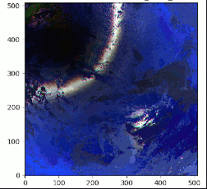
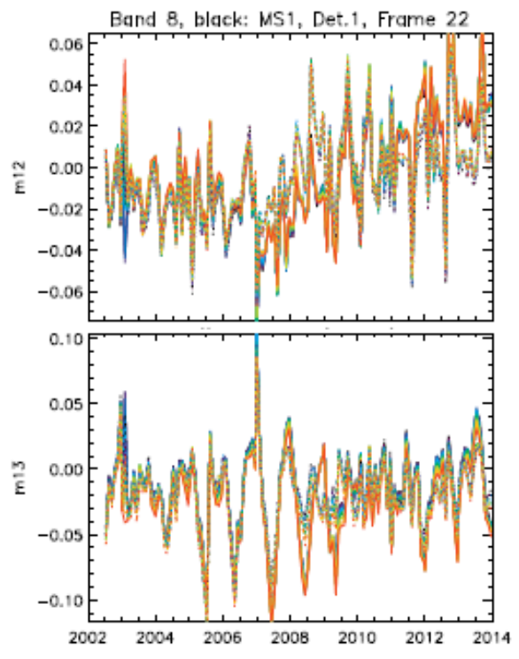
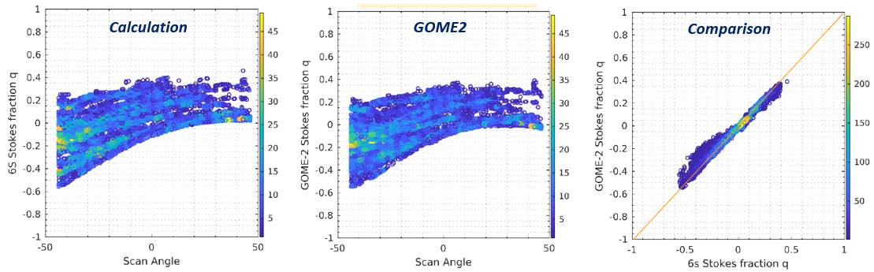
Vicarious Technics – Rayleigh Scattering
Rayleigh Scattering
  Obvious potential – can be mostly fully polarised
  Type: strongly polarised (>60%)
  Accurate RTM calculation needed
    Effects of secondary terms are reduced (oceanic surface, aerosol)
  Examples :
    Adjustment of the MODIS correction
    GOME-2
Jafariserajehlou et al., 2020
see also Tilstra et al., 2014
MODIS
GOME-2
Meister et al. 2014

Slide 16
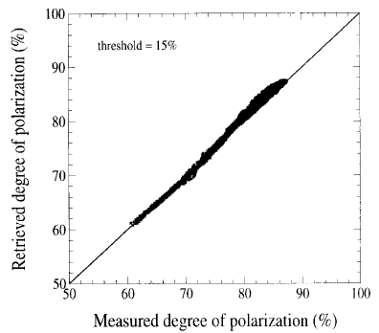
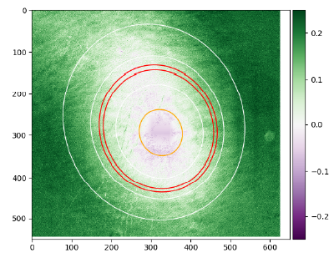
Vicarious Technics - Sunglint
Sunglint
  Obvious potential – can be mostly fully polarised
  Type: strongly polarised (> 60%)
  Accurate RTM calculation needed
    Effects of secondary terms are reduced (oceanic surface, aerosol)
    Reduced sensitivity to the knowledge of the wind speed
  Interband in polarisation for the reflective domain
  Absolute polarisation also accessible
  Examples :
    POLDER-1
    PARASOL
Toubbé et al., 1999
Djellali et al., 2021
POLDER-1
PARASOL

Slide 17
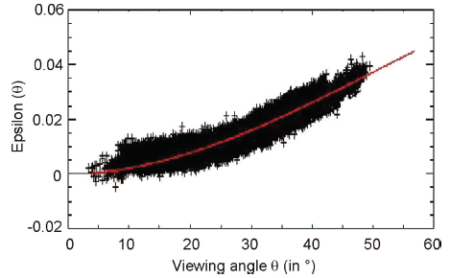
Vicarious Technics - Clouds
Ice Clouds
  Obvious potential – can be mostly fully polarised
  Type: very low (< 5%) in backscattering
  Selection of Ice clouds in backscattering domain
    Modelling can be used to extend the geometrical domain
  Checking the polarisation
  Examples :
    PARASOL
Riedi et al. 2010
PARASOL
Fougnie et al., 2007

Slide 18
Vicarious Technics – Lunar calibration
Moon and Lunar surface
  Well known calibration target
  Type: Moderated (0-15%)
  Integrated disk or ROIs
    Historical measurements
    Potential for polarisation with the advantage of lunar
  Moon acquisitions are already a baseline
    Extension to polarisation would be a minimum cost
    The interband approach can be used to extend to the whole spectrum
  Example:
    S-GLI acquisitions
Dolphus, 1971

Slide 19
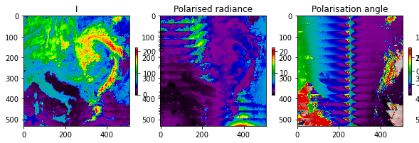
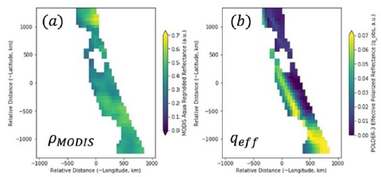
Vicarious Technics – Simultaneous Observations
Simultaneous acquisitions (including SNO, but not only)
  Type: Various / All
  Example of polarisation sensitivity in-flight assessment:
    MODIS-Aqua (imager) using PARASOL (polarimeter) over marine stratocumulus clouds
      Limitation (and needed modelling) because of the difference in acquisition time and so geometry
    EPS-SG/VII (imager) using 3MI (polarimeter)
      Quasi-similar geometry with massive bins of matchups (same platform)
      multiple type of source, level of polarisation and orientation of polarisation (characterised by 3MI)
      Similar to a Lab measurements
    VIIRS/CLARREO
VII
Phillips & Fougnie, 2024
MODIS
McBride et al., 2023

Slide 20
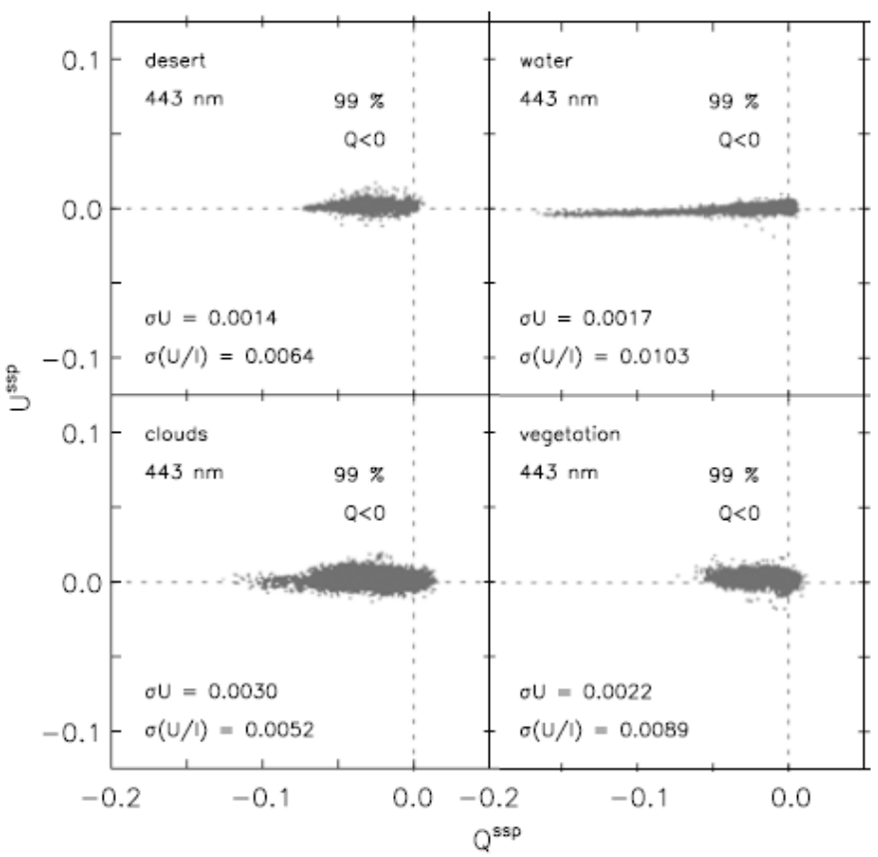
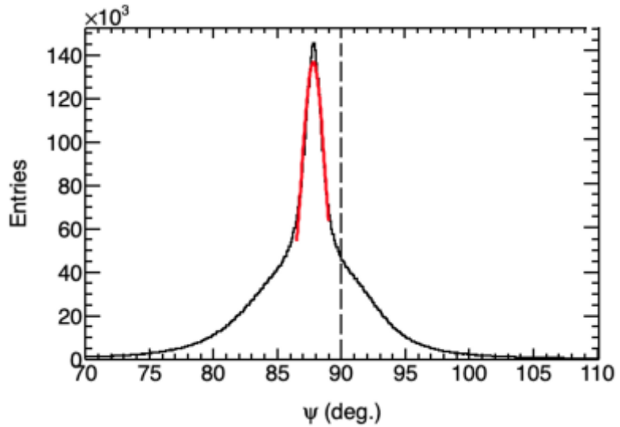
Vicarious Technics – Statistical
Behaviour of the polarisation: identify bias and quantify performance
  Type: Various / All
  Distribution of the polarisation angle
    Expected to be distributed around 90°
  Distribution of the polarisation around scattering plane
    Expected to be U distributed around 0
U component
Polarisation Angle
Goldin et al., 2023
PARASOL
POLDER-1
Schutgens et al., 2004

