Slide 1



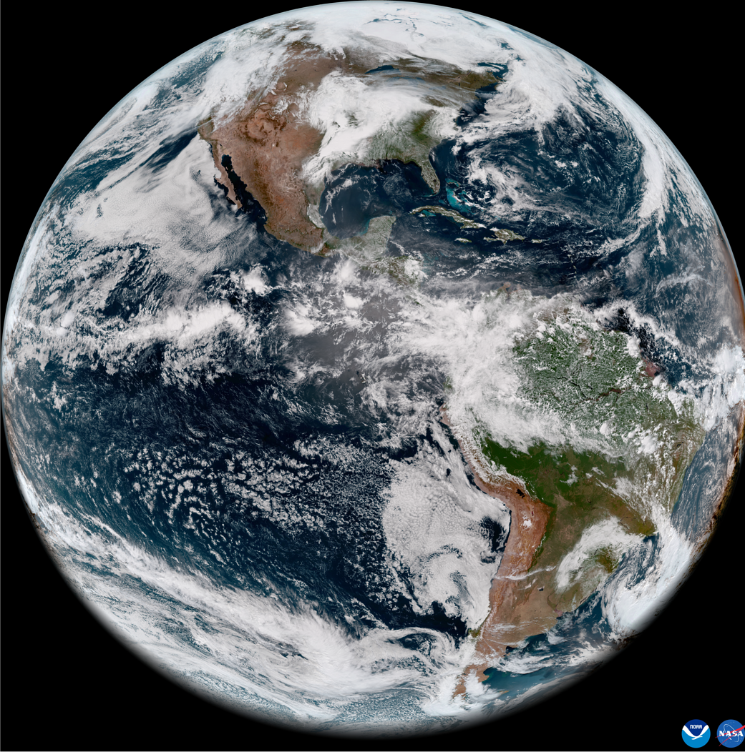
Geo-Ring Radiance FCDR
Viju John¹, Carlos Horn¹, Jessica Matthews², Ken Knapp, Tasuku Tabata³, Arata Okuyama³, Masaya Takahashi³, Shibin Balakrishnan⁴, Andrew Heidinger², Joerg Schulz¹
¹EUMETSAT, ²NOAA, ³JMA, ⁴IMD
GSICS Annual Meeting, 27/03/2026, Online

Slide 2
Outline
Geo-Ring Radiance project
Data rescue
Quality Control
Recalibration
Remapping
Status and plans

Slide 3
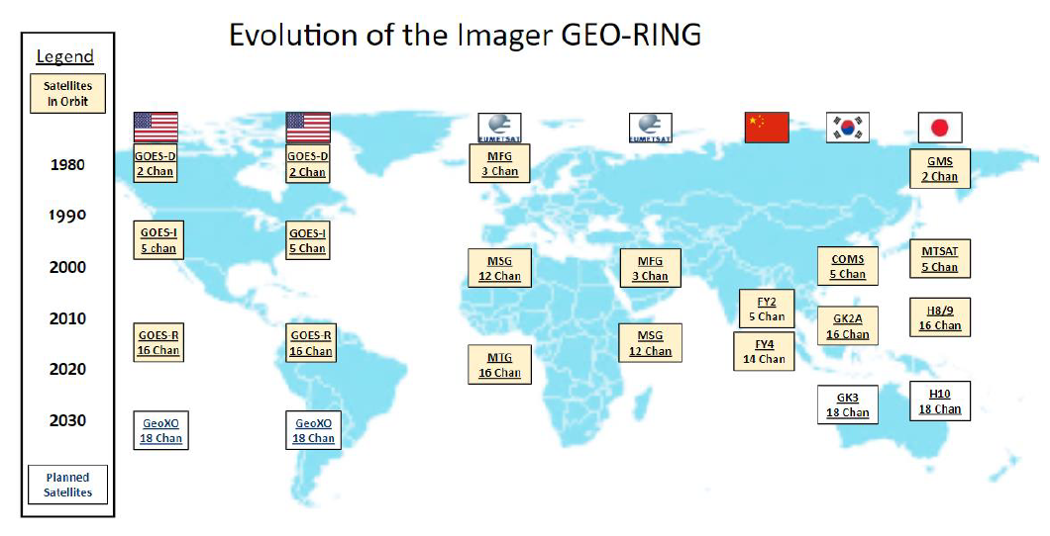
Evolution of the imager GEO-Ring
Heidinger, A., G. Stephens, J. Schulz, V. O. John et al., 2026: A GEO-Ring of spectral radiances: toward a Next Generation of the International Satellite Cloud Climatology Project (ISCCP-NG). Bull. Amer. Meteor. Soc., , BAMS-D-24-0161.1, https://doi.org/10.1175/BAMS-D-24-0161.1.
Notes:
Project runs 2023-2027 and aims at best and longest radiance climatology ever by addressing:
data rescue activities
radiometric anomaly detection
improved navigation
metadata analysis
uncertainty characterisation (EUMETSAT only)
channel re-calibration
channel cross-calibration
spectral band adjustment
validation
mapping on standard grid with fixed temporal sampling
combination of individual mapped satellites into quasi-global product
EUMETSAT and NOAA co-develop and use their cloud infrastructures to enable the most efficient data processing
EUMETSAT and NOAA will both distribute from and into cloud infrastructure

Slide 4
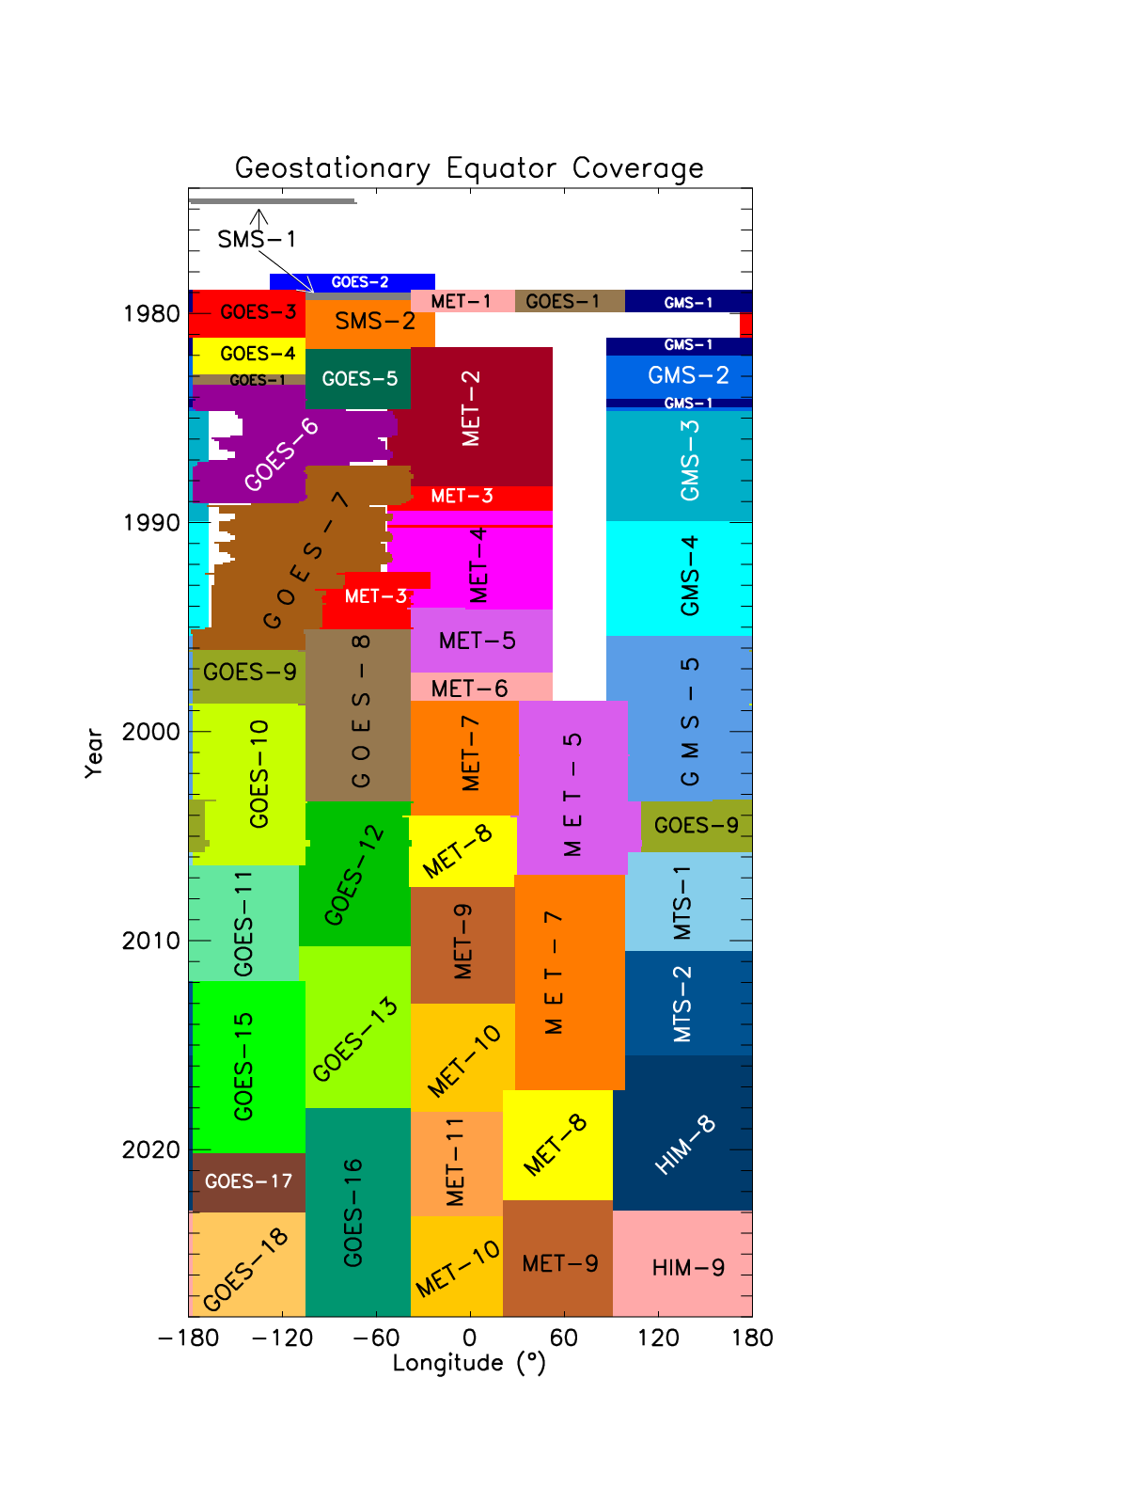
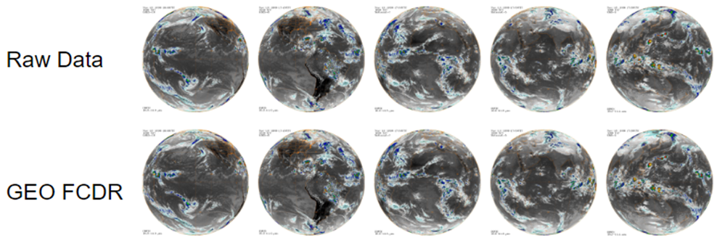
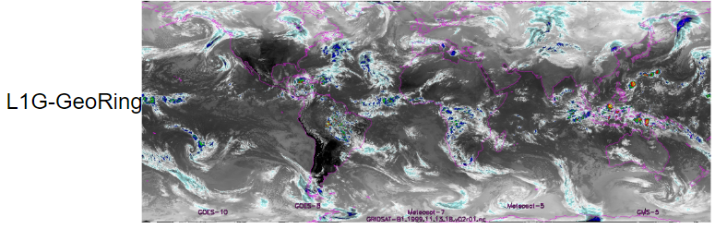
Joint project to realise GEO-Ring radiance record
Consistent: Quality control, recalibration, remapping
~1980-2026 and beyond, 30 minutes, 5 km² resolution
will amend with polar orbiting data towards the poles
Notes:
Project runs 2023-2027 and aims at best and longest radiance climatology ever by addressing:
data rescue activities
radiometric anomaly detection
improved navigation
metadata analysis
uncertainty characterisation (EUMETSAT only)
channel re-calibration
channel cross-calibration
spectral band adjustment
validation
mapping on standard grid with fixed temporal sampling
combination of individual mapped satellites into quasi-global product
EUMETSAT and NOAA will co-develop and use their cloud infrastructures to enable the most efficient data processing
EUMETSAT and NOAA will both distribute from and into cloud infrastructure

Slide 5
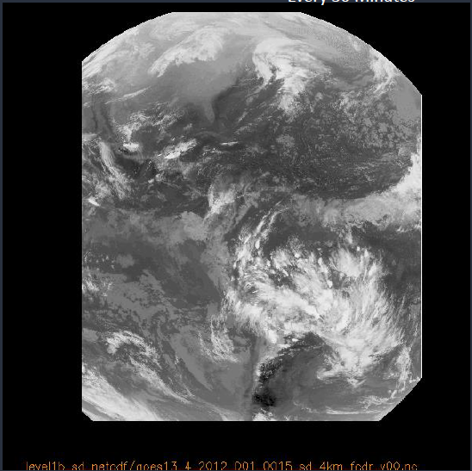
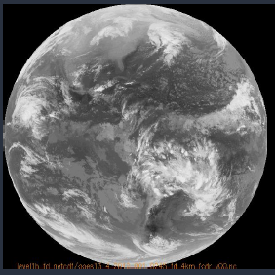
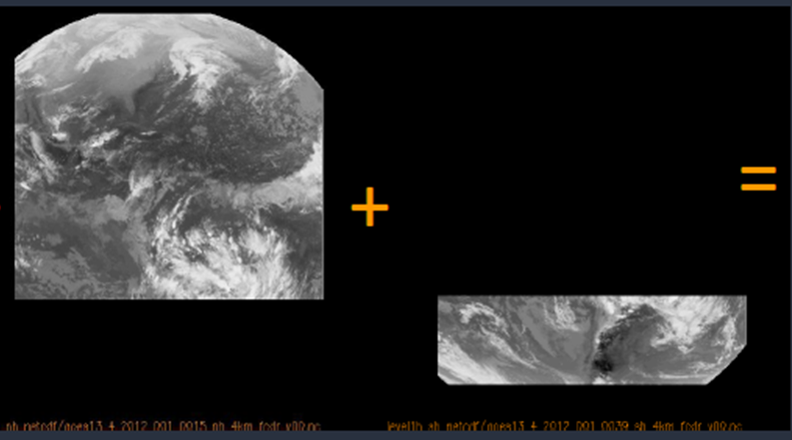
GOES 8-15 - Data Stitching
Stitching together GOES domains for consistent 30 min “Full” Disk FCDR
Unlike some of the other geostationary satellites, GOES 8-15 made observations in several domains to optimize temporal coverage over the USA
CONUS domains every 15 Minutes are ignored
Use 4km fixed grid from L3Harris 4km GOES R products
Stitched full disk every 30 min
Full disk
Every 3h
Northern Hemisphere
Every 30 min
Southern Hemisphere
Every 30 min

Slide 6
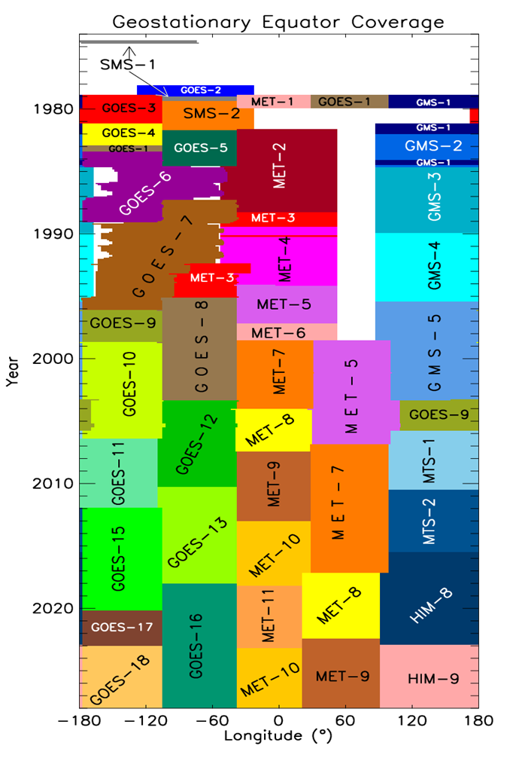
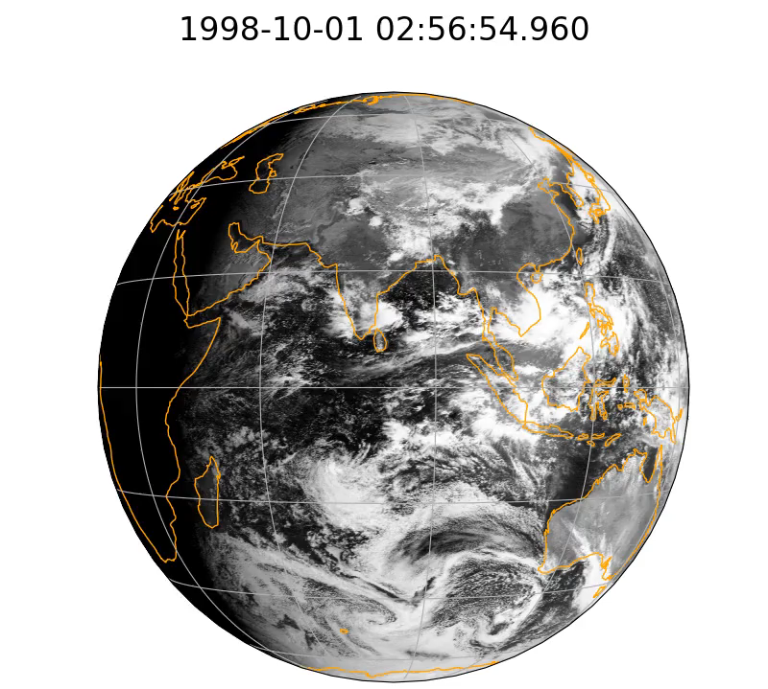
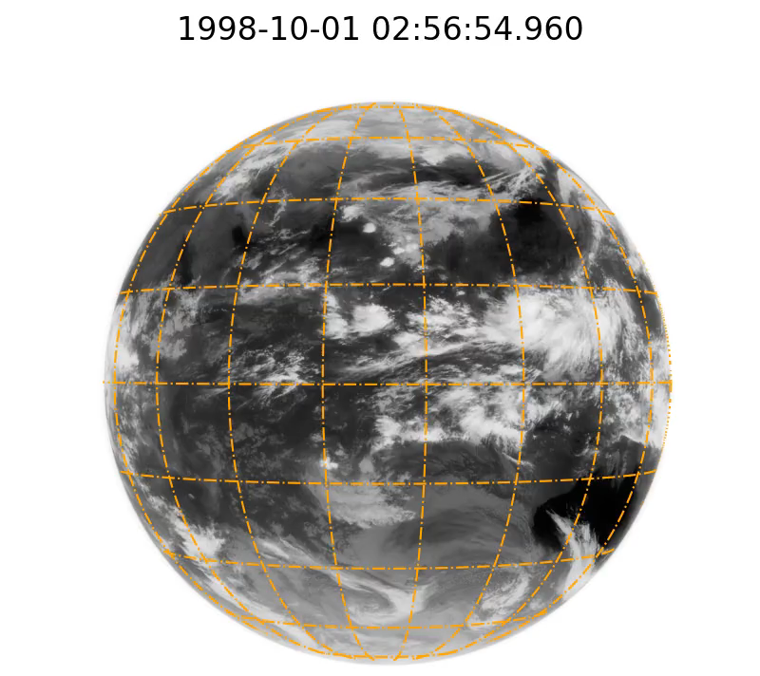
Filling gaps with INSAT
Received a first set of 3 month of INSAT-1D data from IMD, India for the end of 1998 (just the time when Meteosat-5 data IODC started
Started quality analysis aiming at integration into the GEO-Ring in the end if feasible
VIS channel
IR channel
Fill the gap
Thanks to India Meteorological Department for sharing a subset of data – a cooperation agreement is being prepared

Slide 7
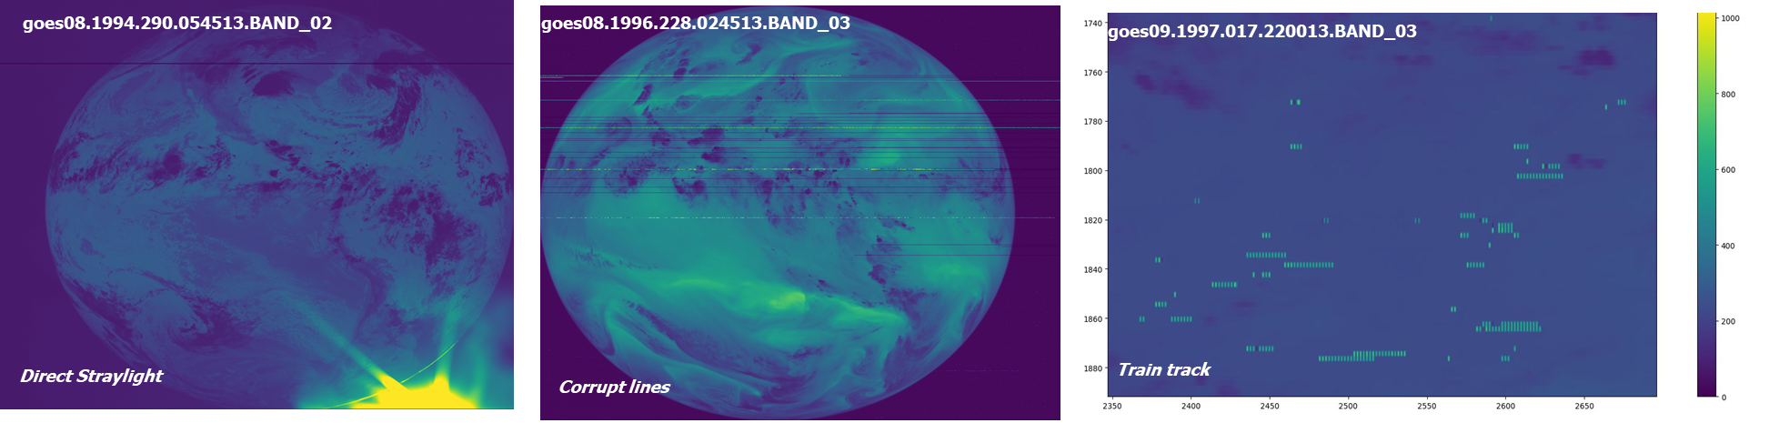
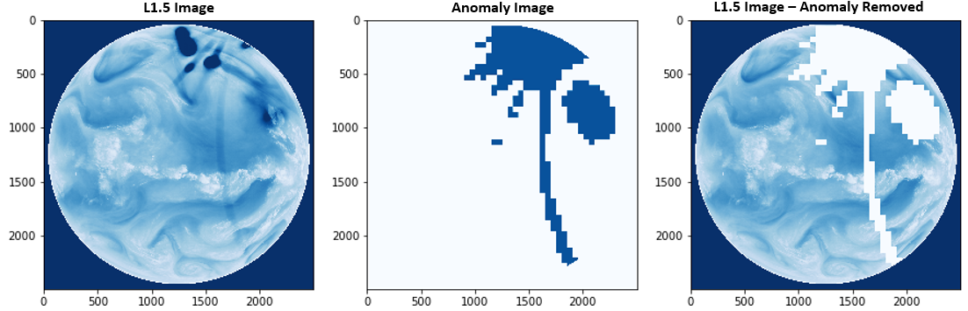
Quality Control
EUMETSAT developed QC tool to identify radiometric image anomalies in satellite images that are collated into a database
Complete for all Meteosat, Himawari, and GOES data
Anomaly images are already available in MVIRI FCDR R2: https://doi.org/10.15770/EUM_SEC_CLM_0057
Similar images will be provided for the full GEO-Ring
Liefhebber, F., S. Lammens, P. Brussee, A. Bos, V. O. John, F. Rüthrich, J. Onderwaater, M. G. Grant, and J. Schulz (2020)
Automatic Quality Control of the Meteosat First Generation Measurements, Atmos. Meas. Tech., 13, 1167–1179. https://doi.org/10.5194/amt-13-1167-2020

Slide 8
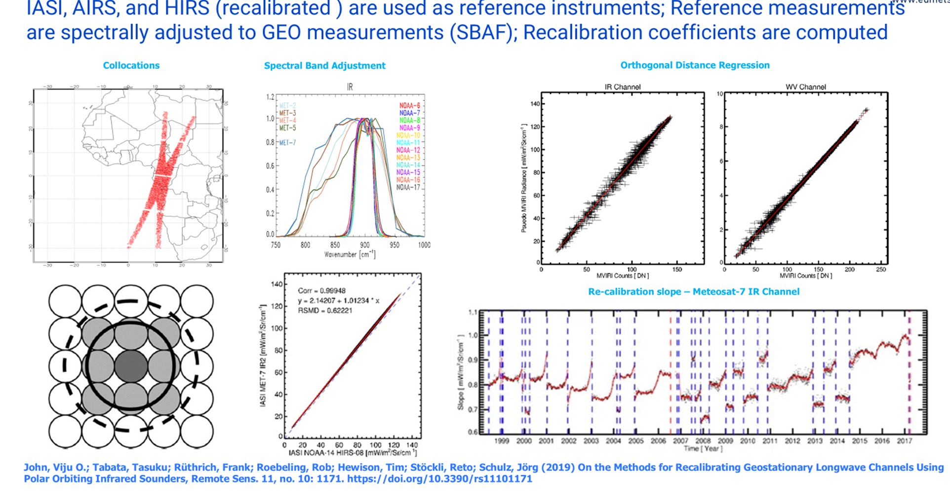
Recalibration – Infrared Channels

Slide 9
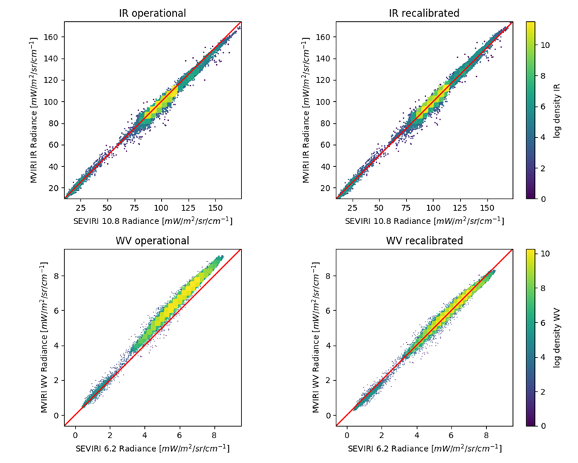
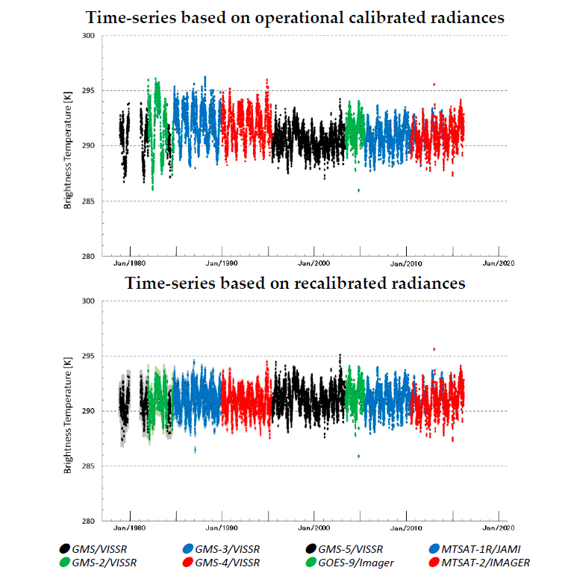
Recalibration – Meteosat and JMA GEO Satellites
John, Viju O.; Tabata, Tasuku; Rüthrich, Frank; Roebeling, Rob; Hewison, Tim; Stöckli, Reto; Schulz, Jörg, 2019. "On the Methods for Recalibrating Geostationary Longwave Channels Using Polar Orbiting Infrared Sounders" Remote Sens. 11, no. 10: 1171. https://doi.org/10.3390/rs11101171
Tabata, T.; John, V.O.; Roebeling, R.A.; Hewison, T.; Schulz, J., 2019: Recalibration of over 35 Years of Infrared and Water Vapor Channel Radiances of the JMA Geostationary Satellites. Remote Sens., 11, 1189. https://doi.org/10.3390/rs11101189

Slide 10
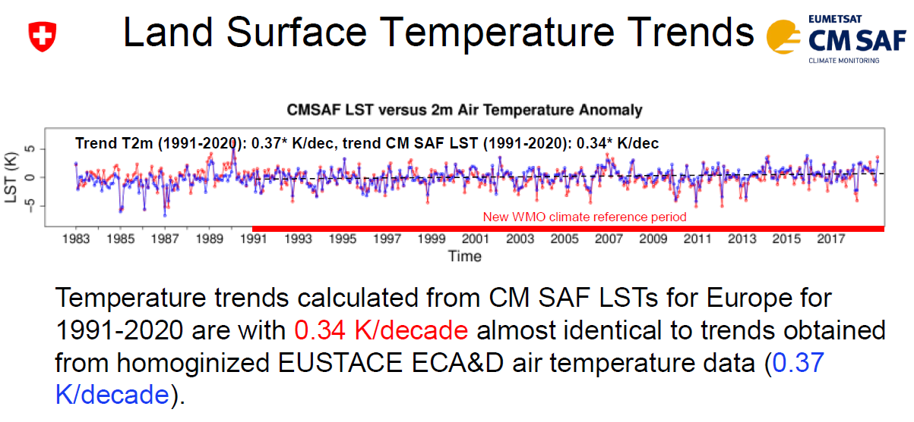
Quality Evaluation – via Level 2 data
Figure from Anke Duguay-Tetzlaff@meteoswiss
Cheda A, Tetzlaff A, Blannin J, Good E, Sharma V, Trigo I, Schwaab J, Riihelä A, Grams CM, Schröder M. Heat Indices for Europe Derived from Satellite Data: A Proof of Concept. Remote Sensing. 2026; 18(4):589. https://doi.org/10.3390/rs18040589

Slide 11
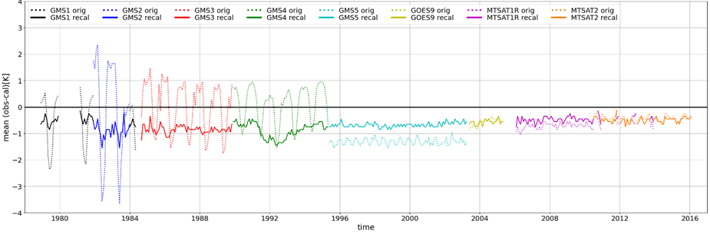
Quality Evaluation – via Simulations
One way to validate the FCDRs is through validation of retrieved variables – the usual way
Another way is to compare against simulated radiances
Observation – simulations using ERA5 (11 µm)
Poli, P., R Roebeling, VO John, et al. (2023) Radiance Simulations in Support of Climate Services, Earth and Space Science, 10, e2023EA002868. https://doi.org/10.1029/2023EA002868

Slide 12
Recalibration – plans
IR channel calibration is consistently applied to all instruments which are currently under consideration
Colleagues (RSP division at EUMETSAT) have developed improved calibration of Meteosat VIS channels (MICMICS) – Can we transfer this to other GEOs via polar orbiting instruments (e.g., VIIRS, MODIS, AVHRR)?

Slide 13
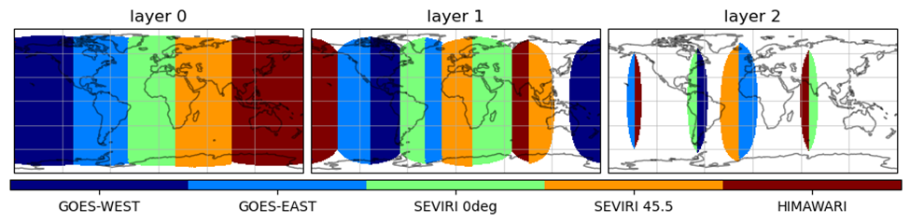
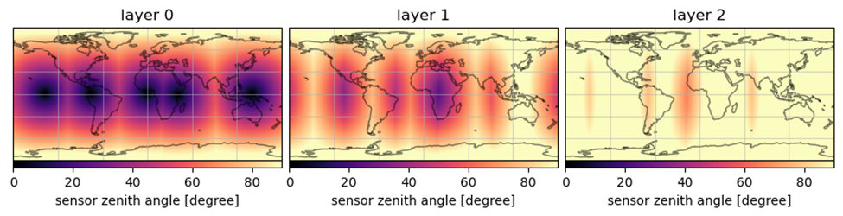
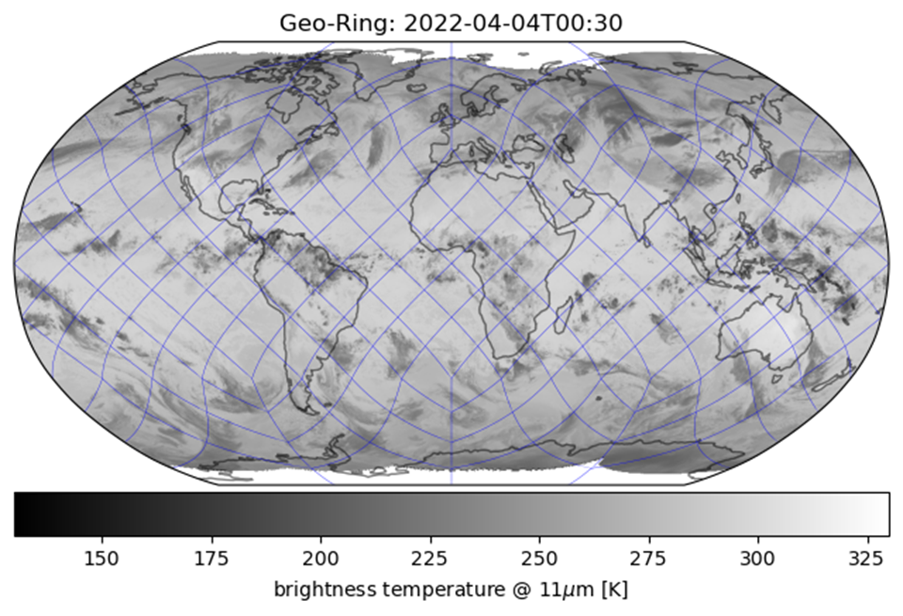
Remapping
Temporal sampling: 30 minutes
Grid: HEALPix – Equal Area – 5 km²
Three layers – based on view angle
All available channels are remapped
The three layers can be used to reconstruct full disk of a satellite
Metadata: Pixel time, satellite and solar angles, sensor flag

Slide 14
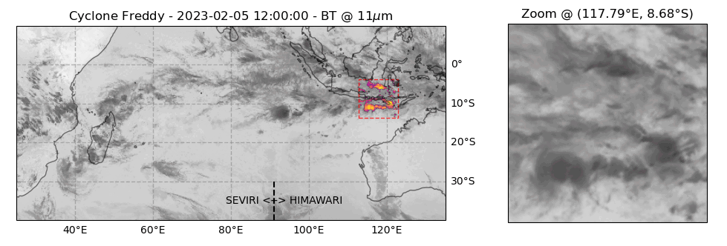
GEO-Ring: Seamless satellite data like model output
Cyclone Freddy from GEO-Ring data set on an equal area HEALPix grid with 5 km² spatial sampling and 30-minute temporal sampling
Test data set covering 2019-2024 is ready to use in EWC will also go to https://data.eumetsat.int
Feedback workshop at EUM, 23 – 25 June 2026, announcement comes next week
Full record starting in the mid-1970s planned for 2027
Continued production with low latency is being discussed

Slide 15
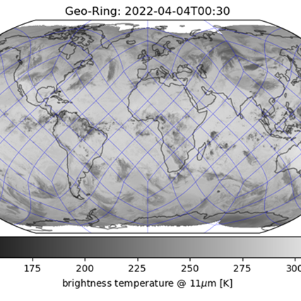
THANK YOU

Slide 16
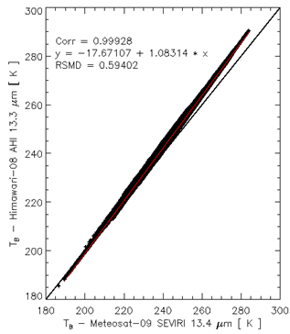
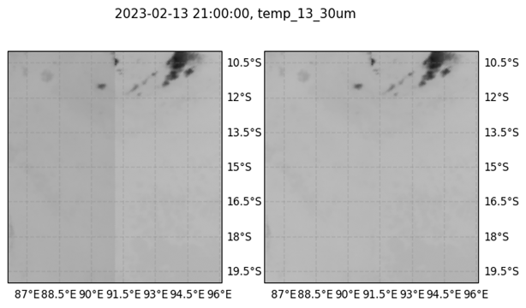
Spectral band adjustment
IASI Spectra are used to derive spectral band adjustment factors (SBAF) for IR channels
Will be added as metadata

