Slide 1
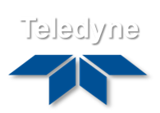
The hyperspectral
EnMAP and DESIS missions: status, processors, calibration and quality control
EnMAP & DESIS Ground Segments,
Processor and Calibration Segment
M. Bachmann ⁽¹⁾, M. Pato ⁽¹⁾, U. Heiden ⁽¹⁾, E. Carmona ⁽¹⁾ on behalf of the DESIS & EnMAP PCV Ground Segments
B. Murphy ⁽²⁾
(1) DLR German Aerospace Center
(2) Teledyne Brown Engineering, Huntsville, USA
GSICS Annual Meeting 2026

Slide 2
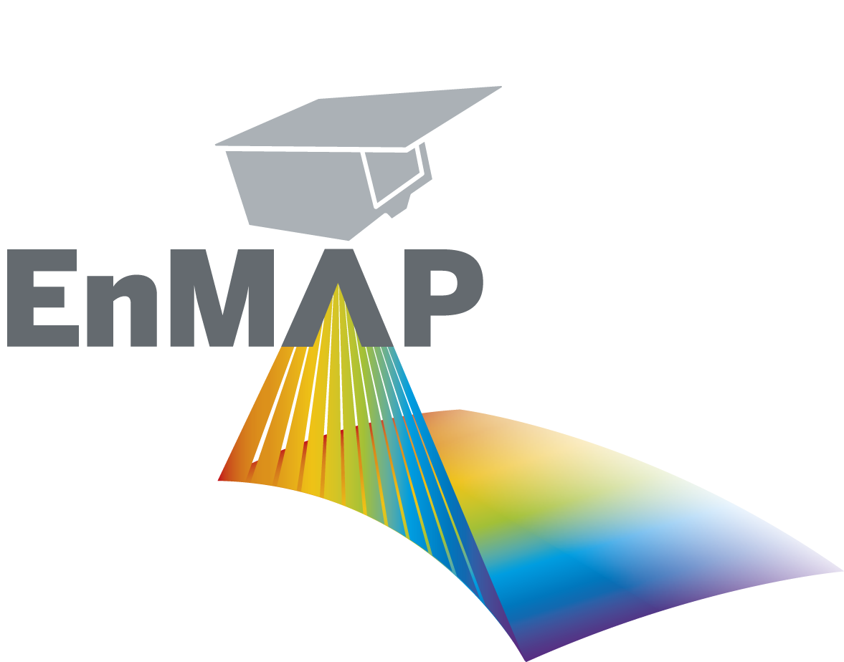






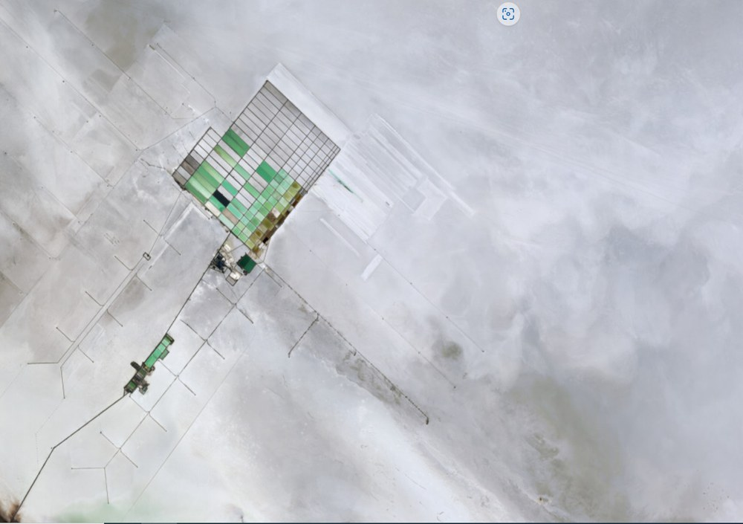
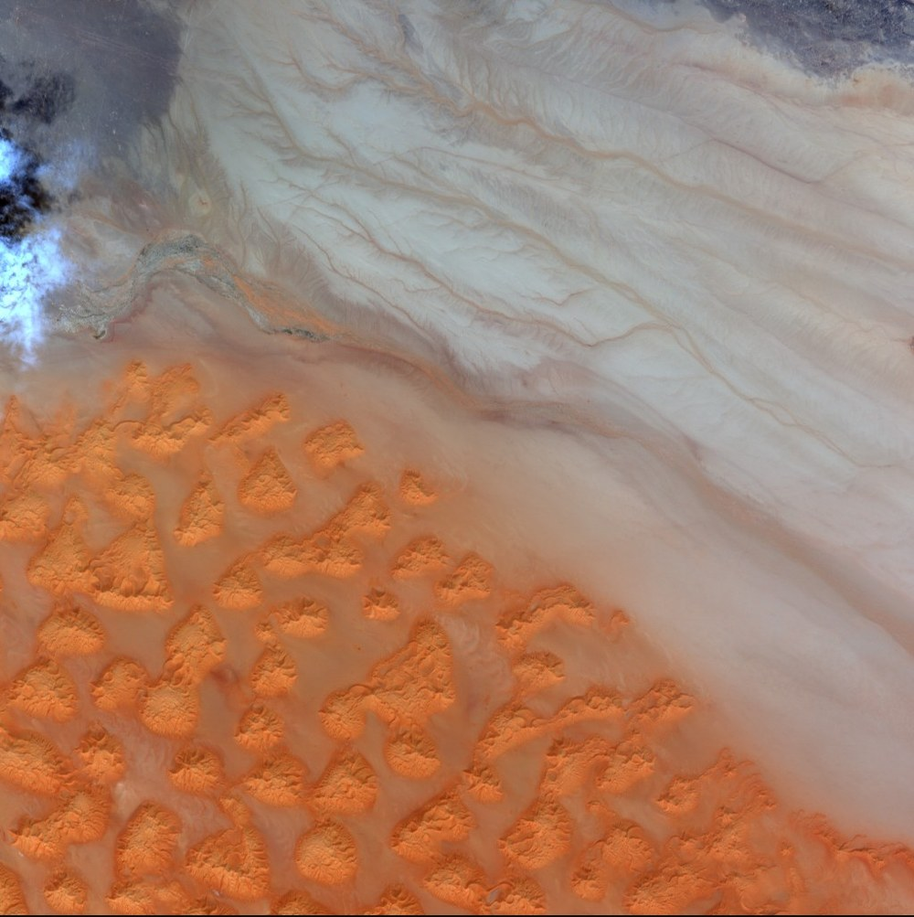
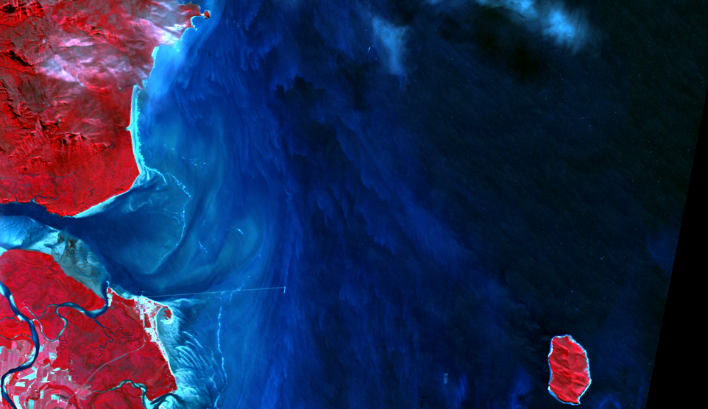
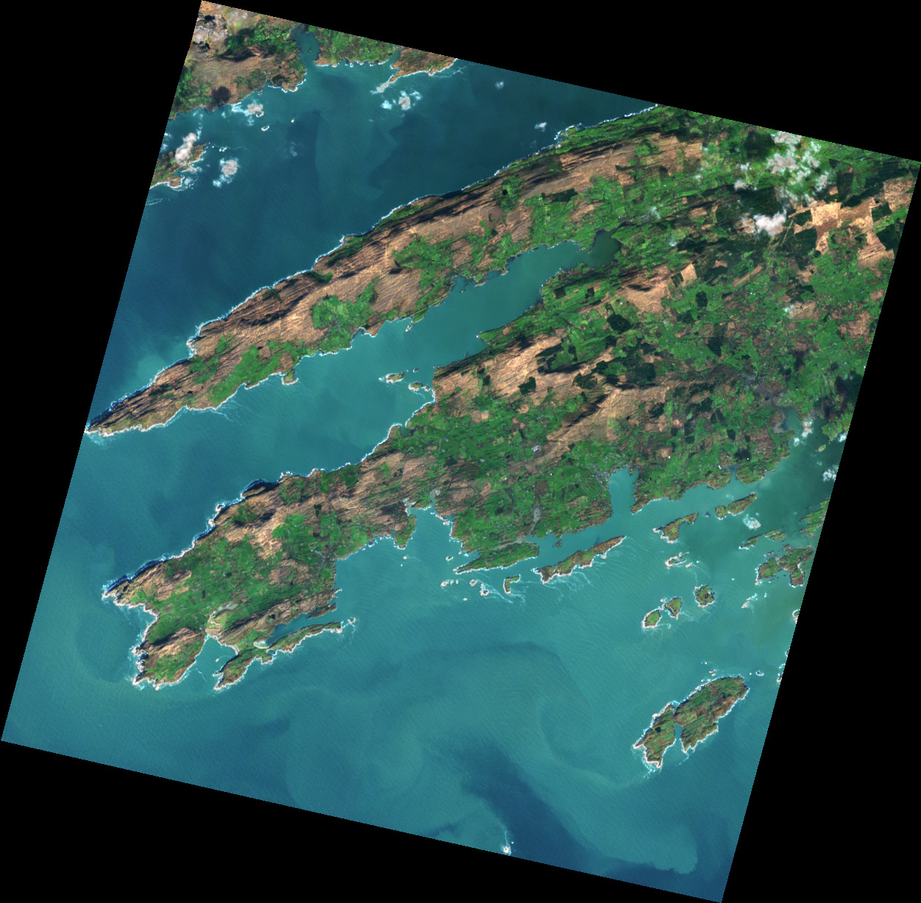
Overview – Teaming
DESIS
Launched to ISS: June 2018
Teaming:
  Teledyne Brown Engineering:
  - MUSES platform
  - Commercial distribution
  DLR:
  - Instrument, calibration
  - Scientific access
EnMAP
Launched: April 2022
Teaming:
Mission Management
Science PI
Platform | Instrument
MOS | PGS | PCV

Slide 3
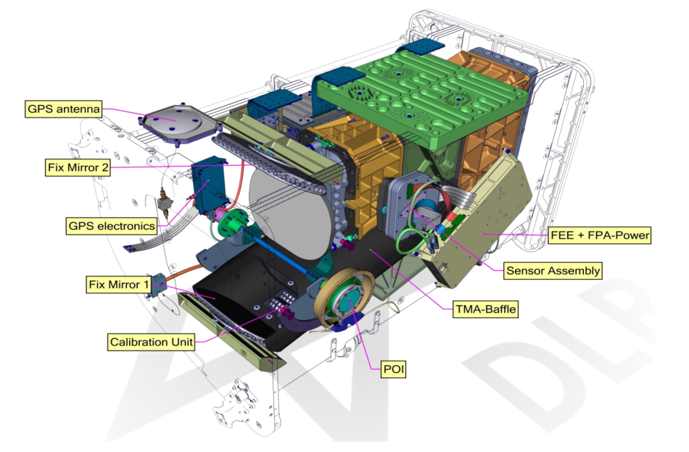
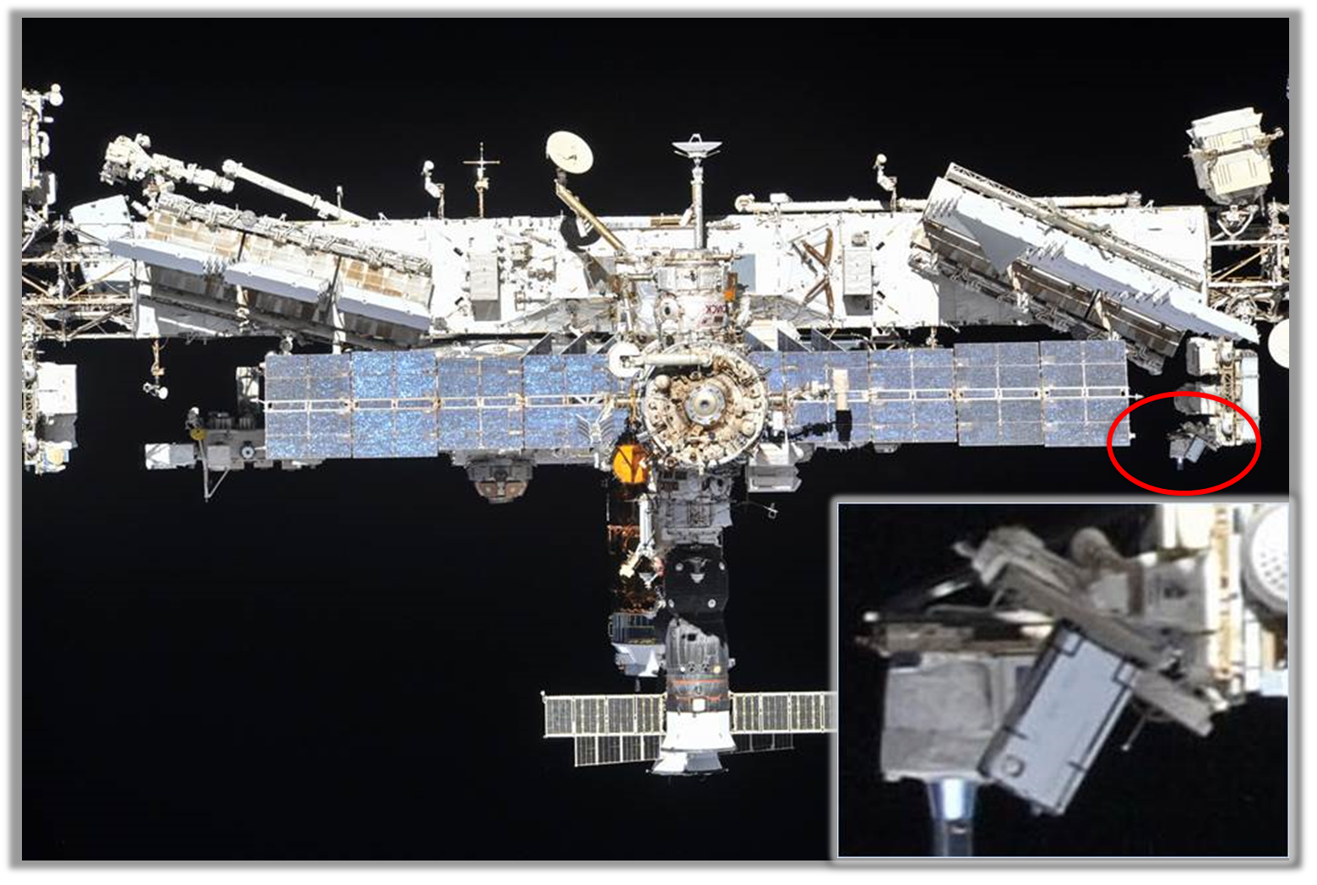
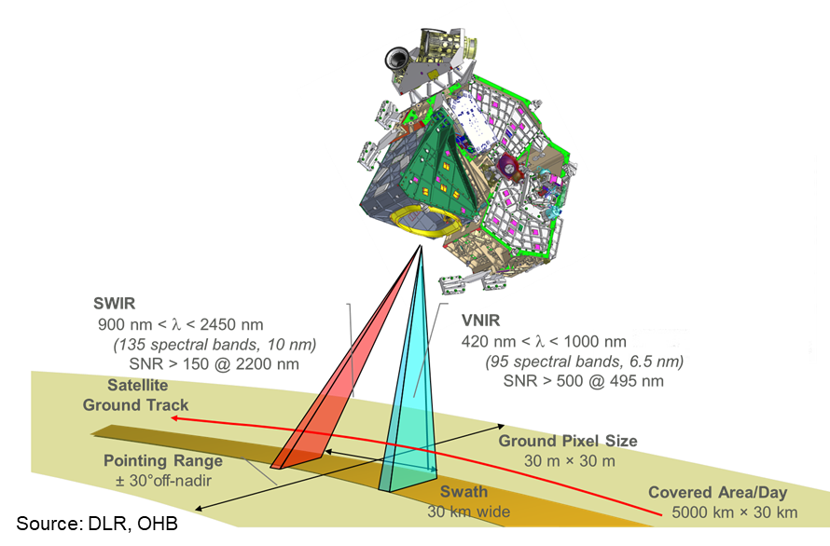
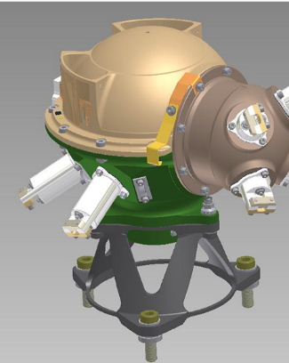
Overview – Instrument and Missions
Mission Instrument | ISS/MUSES DESIS | EnMAP HSI (2 instruments)
Off-nadir tilting (across-track, along-track) | -45° (backboard) to +5° (starboard), -40° to +40° (by MUSES and DESIS) | -30° to +30°, 0° (by EnMAP)
Spectral range | 400 nm to 1000 nm | 420 nm to 2450 nm
Spectral (res., acc.) | 2.55 nm, (*) | 6.5 nm, 0.5 nm (VNIR), 10.0 nm, 1.0 nm (SWIR)
Radiometry (res., acc.) | 13 bits, (*) | 14 bits, 5%
Spatial (res., swath) | 30 m, 30 km (@ 400 km) | 30 m, 30 km
SNR (signal-to-noise) | 205 (no bin.)/406 (4 bin.) @ 550 nm | 500 @ 495 nm, 150 @ 2200 nm
Instrument (mass) | 93 kg | 350 kg
Capacity (km, storage) | 2360 km per day, 225 GBit | 5000 km per day, 512 GBit

Slide 4
Overview – Instrument and Missions
Mission Instrument | ISS/MUSES DESIS | EnMAP HSI (2 instruments)
Off-nadir tilting (across-track, along-track) | -45° (backboard) to +5° (starboard), -40° to +40° (by MUSES and DESIS) | -30° to +30°, 0° (by EnMAP)
Spectral range | 400 nm to 1000 nm | 420 nm to 2450 nm
Spectral (res., acc.) | 2.55 nm, (*) | 6.5 nm, 0.5 nm (VNIR), 10.0 nm, 1.0 nm (SWIR)
Radiometry (res., acc.) | 13 bits, (*) | 14 bits, 5%
Spatial (res., swath) | 30 m, 30 km (@ 400 km) | 30 m, 30 km
SNR (signal-to-noise) | 205 (no bin.)/406 (4 bin.) @ 550 nm | 500 @ 495 nm, 150 @ 2200 nm
Instrument (mass) | 93 kg | 350 kg
Capacity (km, storage) | 2360 km per day, 225 GBit | 5000 km per day, 512 GBit

Slide 5
Overview – Instrument and Missions
Mission Instrument | ISS/MUSES DESIS | EnMAP HSI (2 instruments)
Off-nadir tilting (across-track, along-track) | -45° (backboard) to +5° (starboard), -40° to +40° (by MUSES and DESIS) | -30° to +30°, 0° (by EnMAP)
Spectral range | 400 nm to 1000 nm | 420 nm to 2450 nm
Spectral (res., acc.) | 2.55 nm, (*) | 6.5 nm, 0.5 nm (VNIR), 10.0 nm, 1.0 nm (SWIR)
Radiometry (res., acc.) | 13 bits, (*) | 14 bits, 5%
Spatial (res., swath) | 30 m, 30 km (@ 400 km) | 30 m, 30 km
SNR (signal-to-noise) | 205 (no bin.)/406 (4 bin.) @ 550 nm | 500 @ 495 nm, 150 @ 2200 nm
Instrument (mass) | 93 kg | 350 kg
Capacity (km, storage) | 2360 km per day, 225 GBit | 5000 km per day, 512 GBit

Slide 6
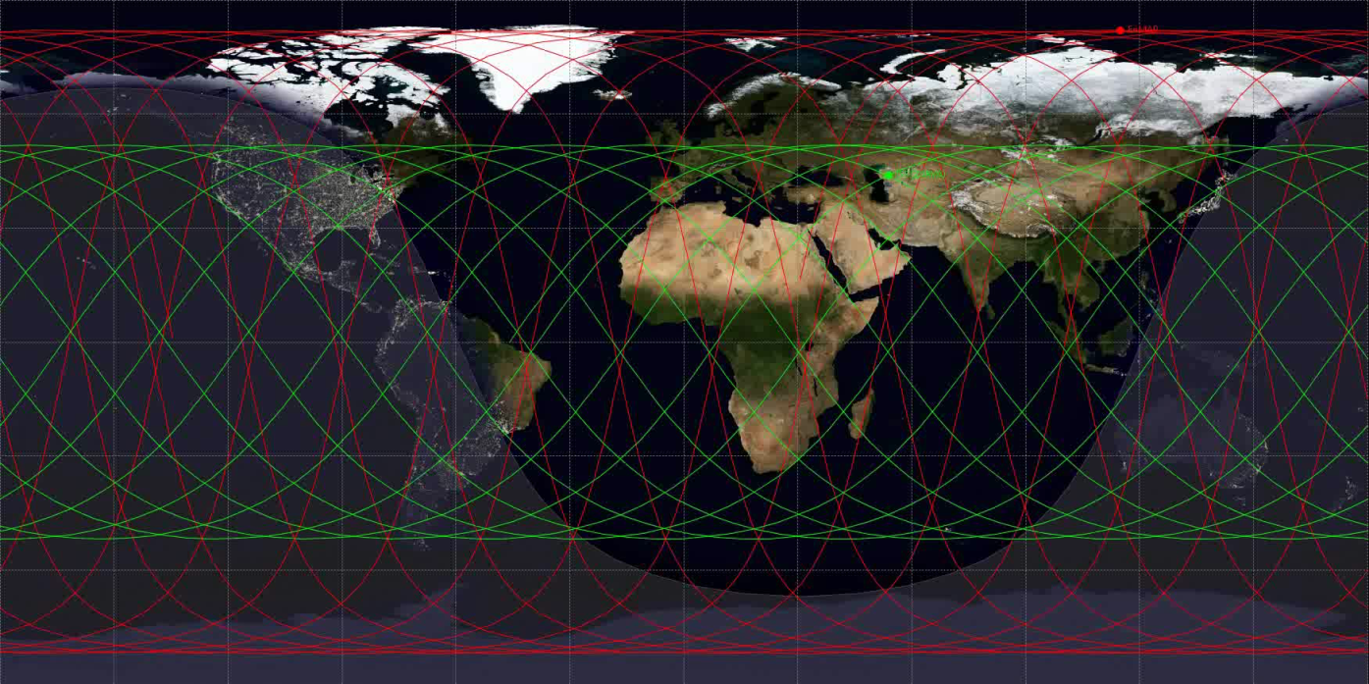
DESIS – Orbit Details
> Lecture > Author • Document > Date
Mission Instrument | ISS/MUSES DESIS
Target lifetime | 2018-2023 (nominal), 2026 in operation*
Orbit type, altitude and inclination | not Sun-synchronous, 51.6°, 400-420 km no repeat cycle
Orbit period and repeat cycle | ~93 minutes, no repeat cycle
Revisit time | 3 – 5 days but depends on latitude and can be 10-12 days
Coverage | 55° N to 52° S

Slide 7
EnMAP – Orbit Details
> Lecture > Author • Document > Date
Mission Instrument | EnMAP
Target lifetime | 04.2022-09.2027 (nominal), extension under consideration
Orbit type, altitude and inclination | Sun-synchronous, 653 km, 97.96°
Orbit period and repeat cycle | 1.6 h, 398 revolutions in 27 days
Local time descending node | 11:00 h ± 18 min
Revisit time | 4 days (±30° off-nadir tilt) 21 days (±5° off-nadir tilt)
Coverage | 84° N to 84° S

Slide 8
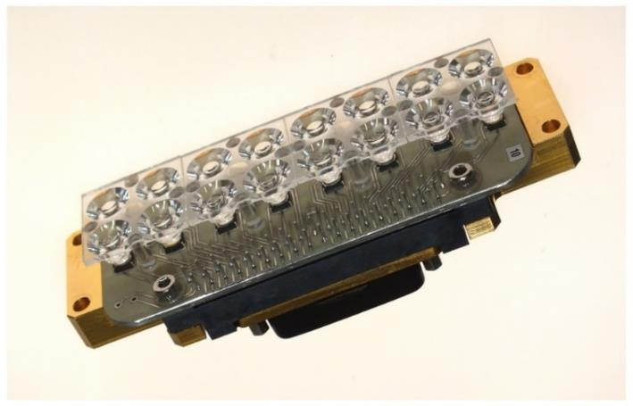
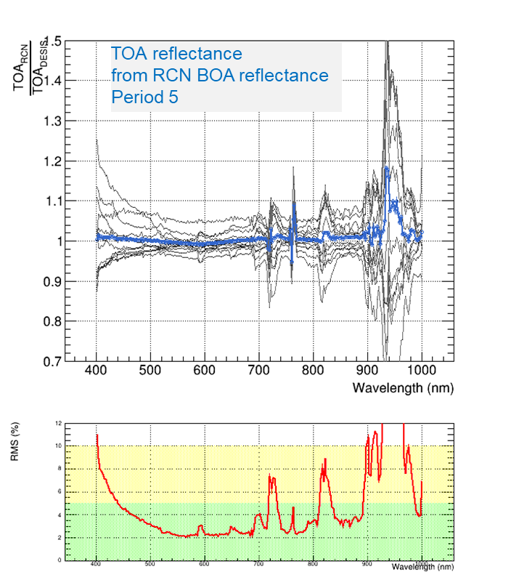
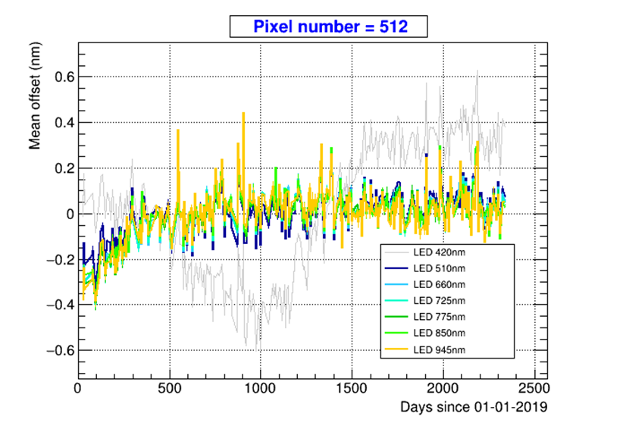
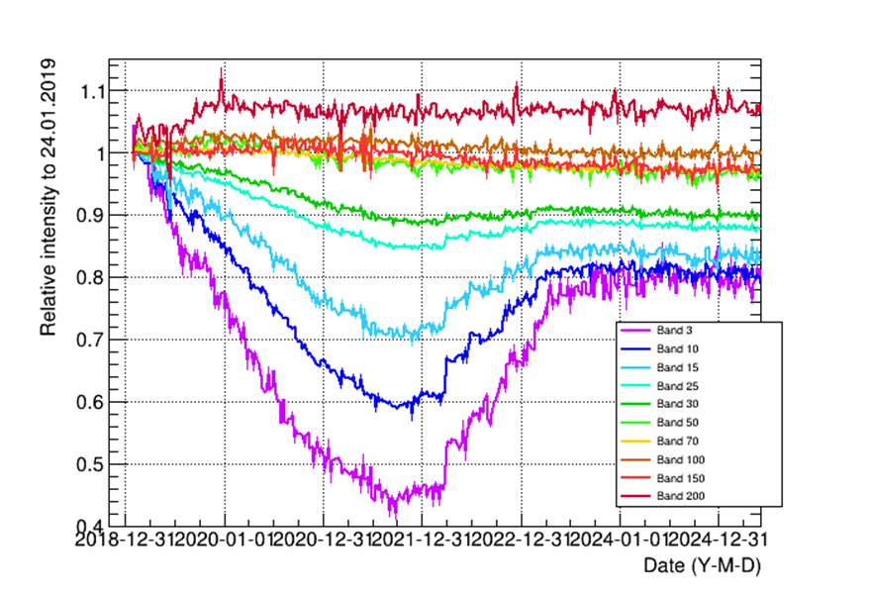
DESIS – Calibration
Calibration unit equipped with 9 different LEDs.
Weekly measurements. Used for spectral calibration.
Spectral calibration after corrections better than ~0.5 nm.
RMS ~0.1 nm
Vicarious radiometric calibration with RadCalNet sites
used as reference. High variability for wavelengths below
480 nm. More stable above 500 nm
Vicarious calibration
On-board calibration

Slide 9
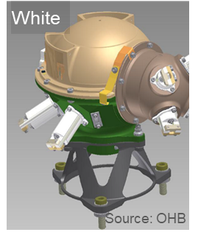
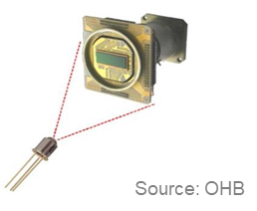
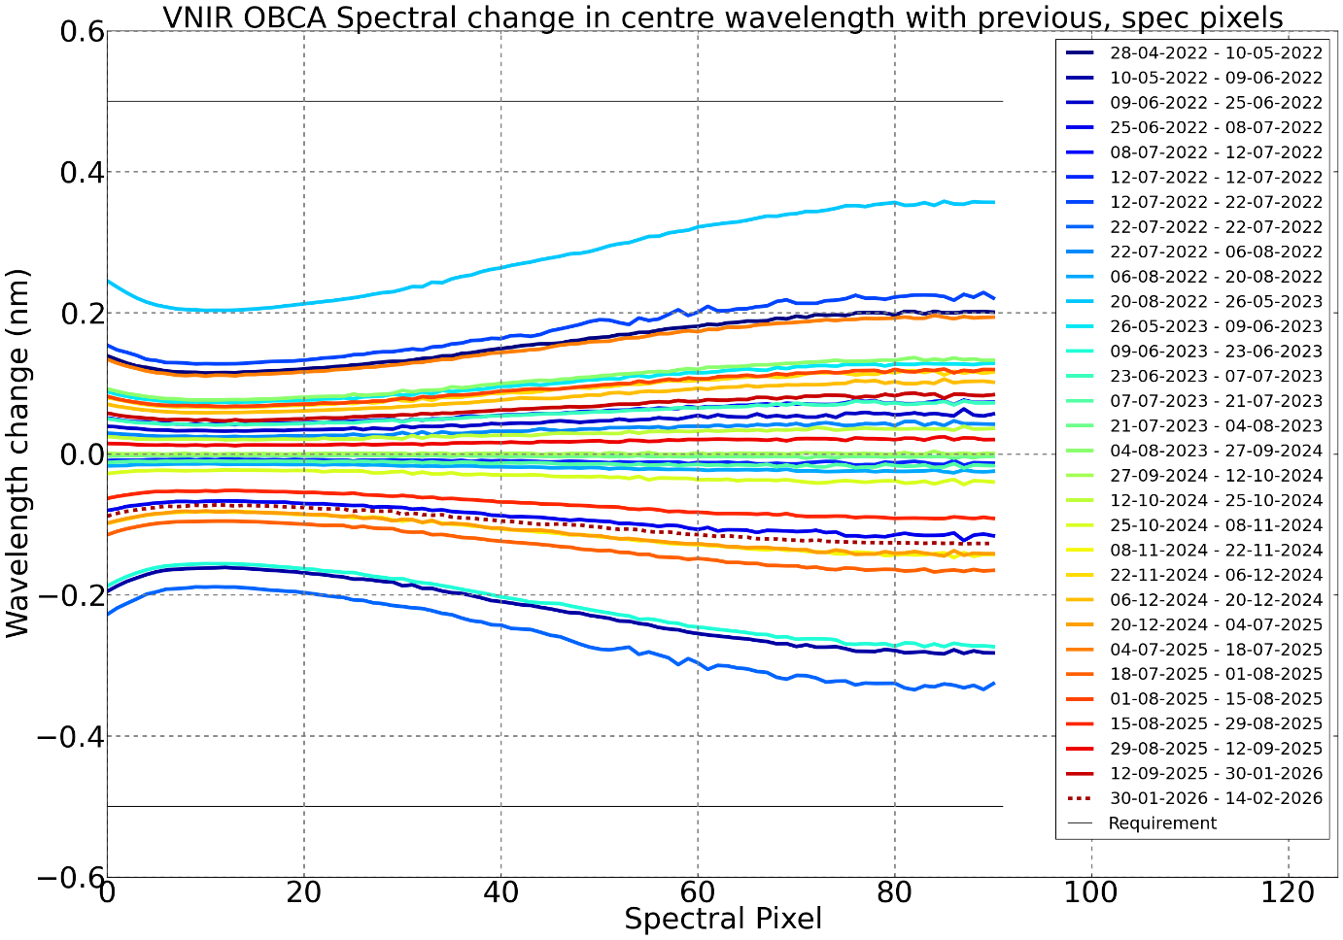
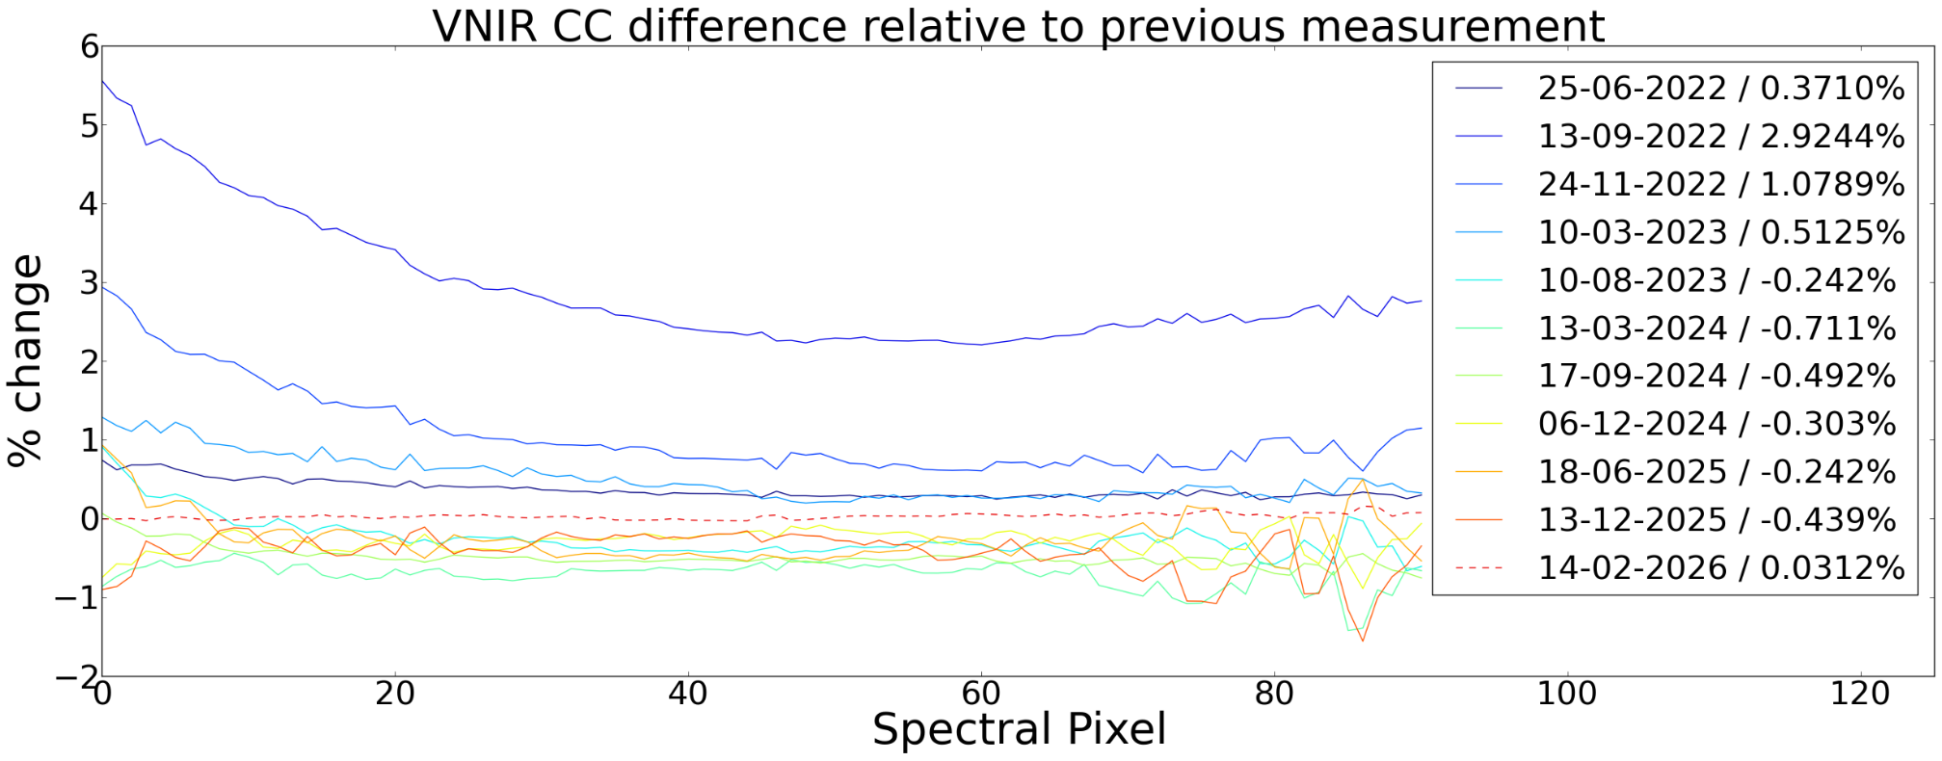
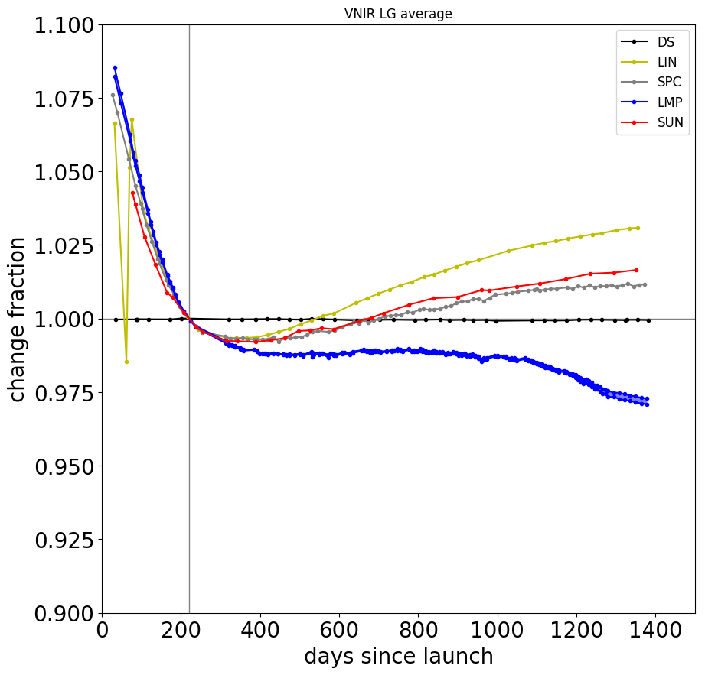
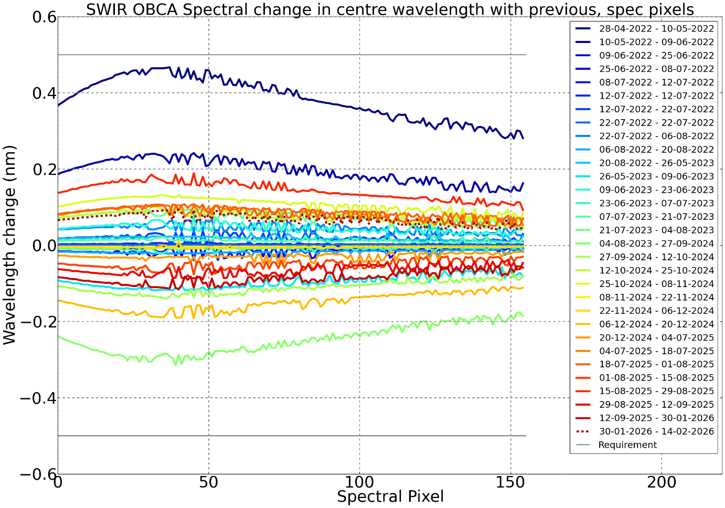
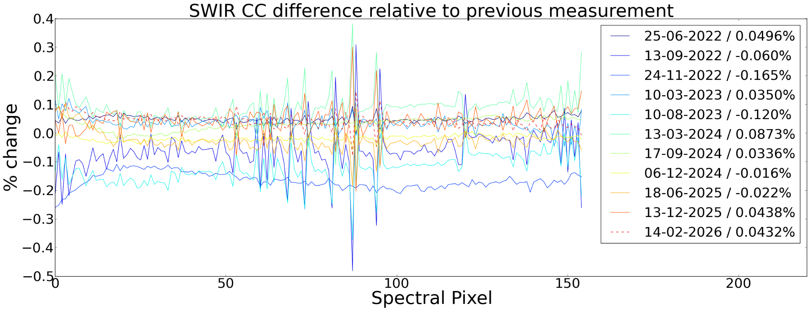
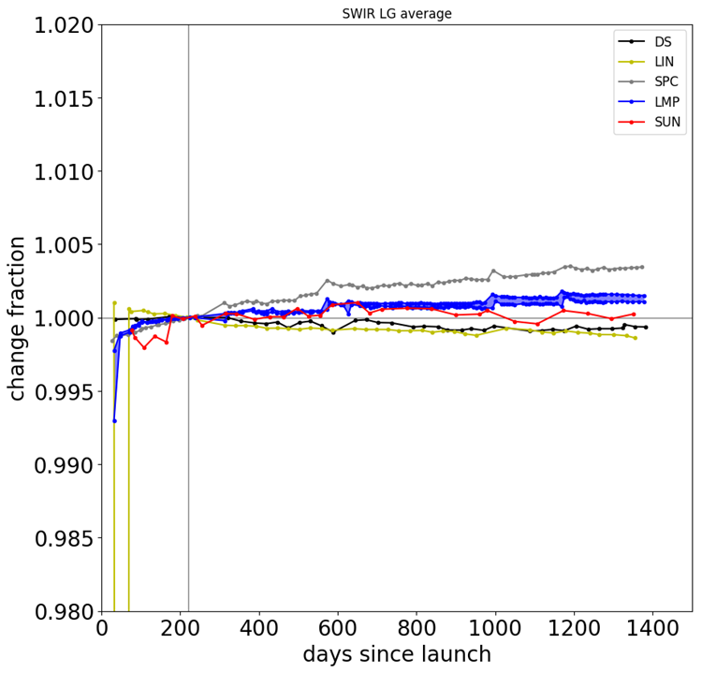
EnMAP – Calibration
EnMAP equipped with 5 on-board calibration/monitoring methods
(spectral, radiometric, lamp, linearity, deep-space calibrations)
Absolute radiometric cal.: solar diffuser
Spectral calibration
Radiometric calibration
Instument monitoring
VNIR
SWIR
For updates, see mission quarterly reports at: https://www.enmap.org/mission/

Slide 10
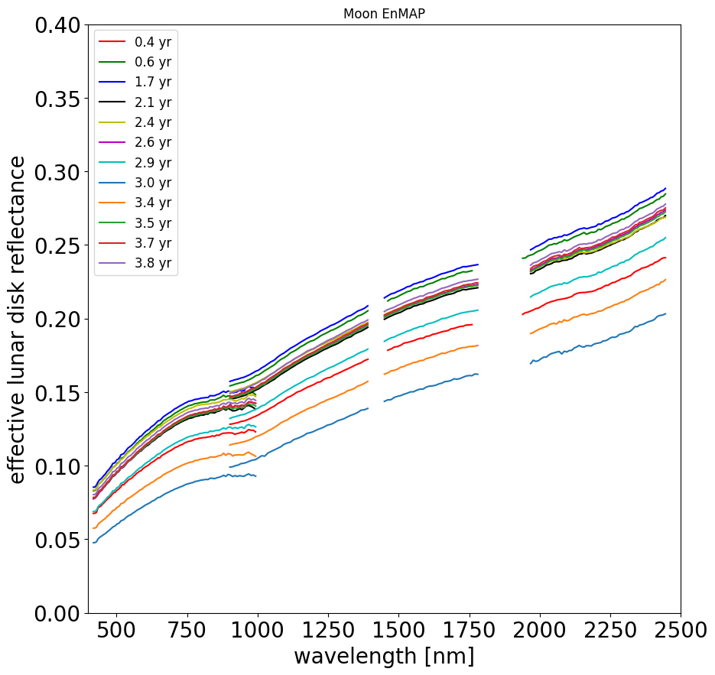
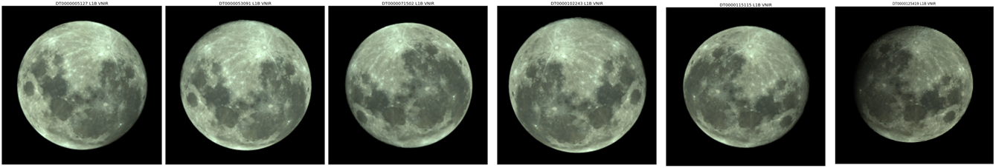
EnMAP – Moon observations
Moon observations are not part of EnMAP routine operations,
but useful for calibration and dedicated Cal/Val studies.
12 Moon observations acquired since 2022 and commitment to observe every two months. Next: early Apr 2026.
Imaging strategy: along-track scan of Moon with 10x oversampling, Earth observation mode used (not all SWIR bands transmitted).
Spectral data:
  418–2445 nm, 91+133 VNIR+SWIR spectral bands
  SSD 5–12 nm, FWHM 6–11 nm
  spectral gaps: 1391–1461 nm, 1760–1939 nm (<05.07.2023)
  1391–1449 nm, 1780–1968 nm (>=05.07.2023)
See also dedicated
presentation @ GSICS Lunar WG
by M. Pato, Nov. 13, 2025

Slide 11
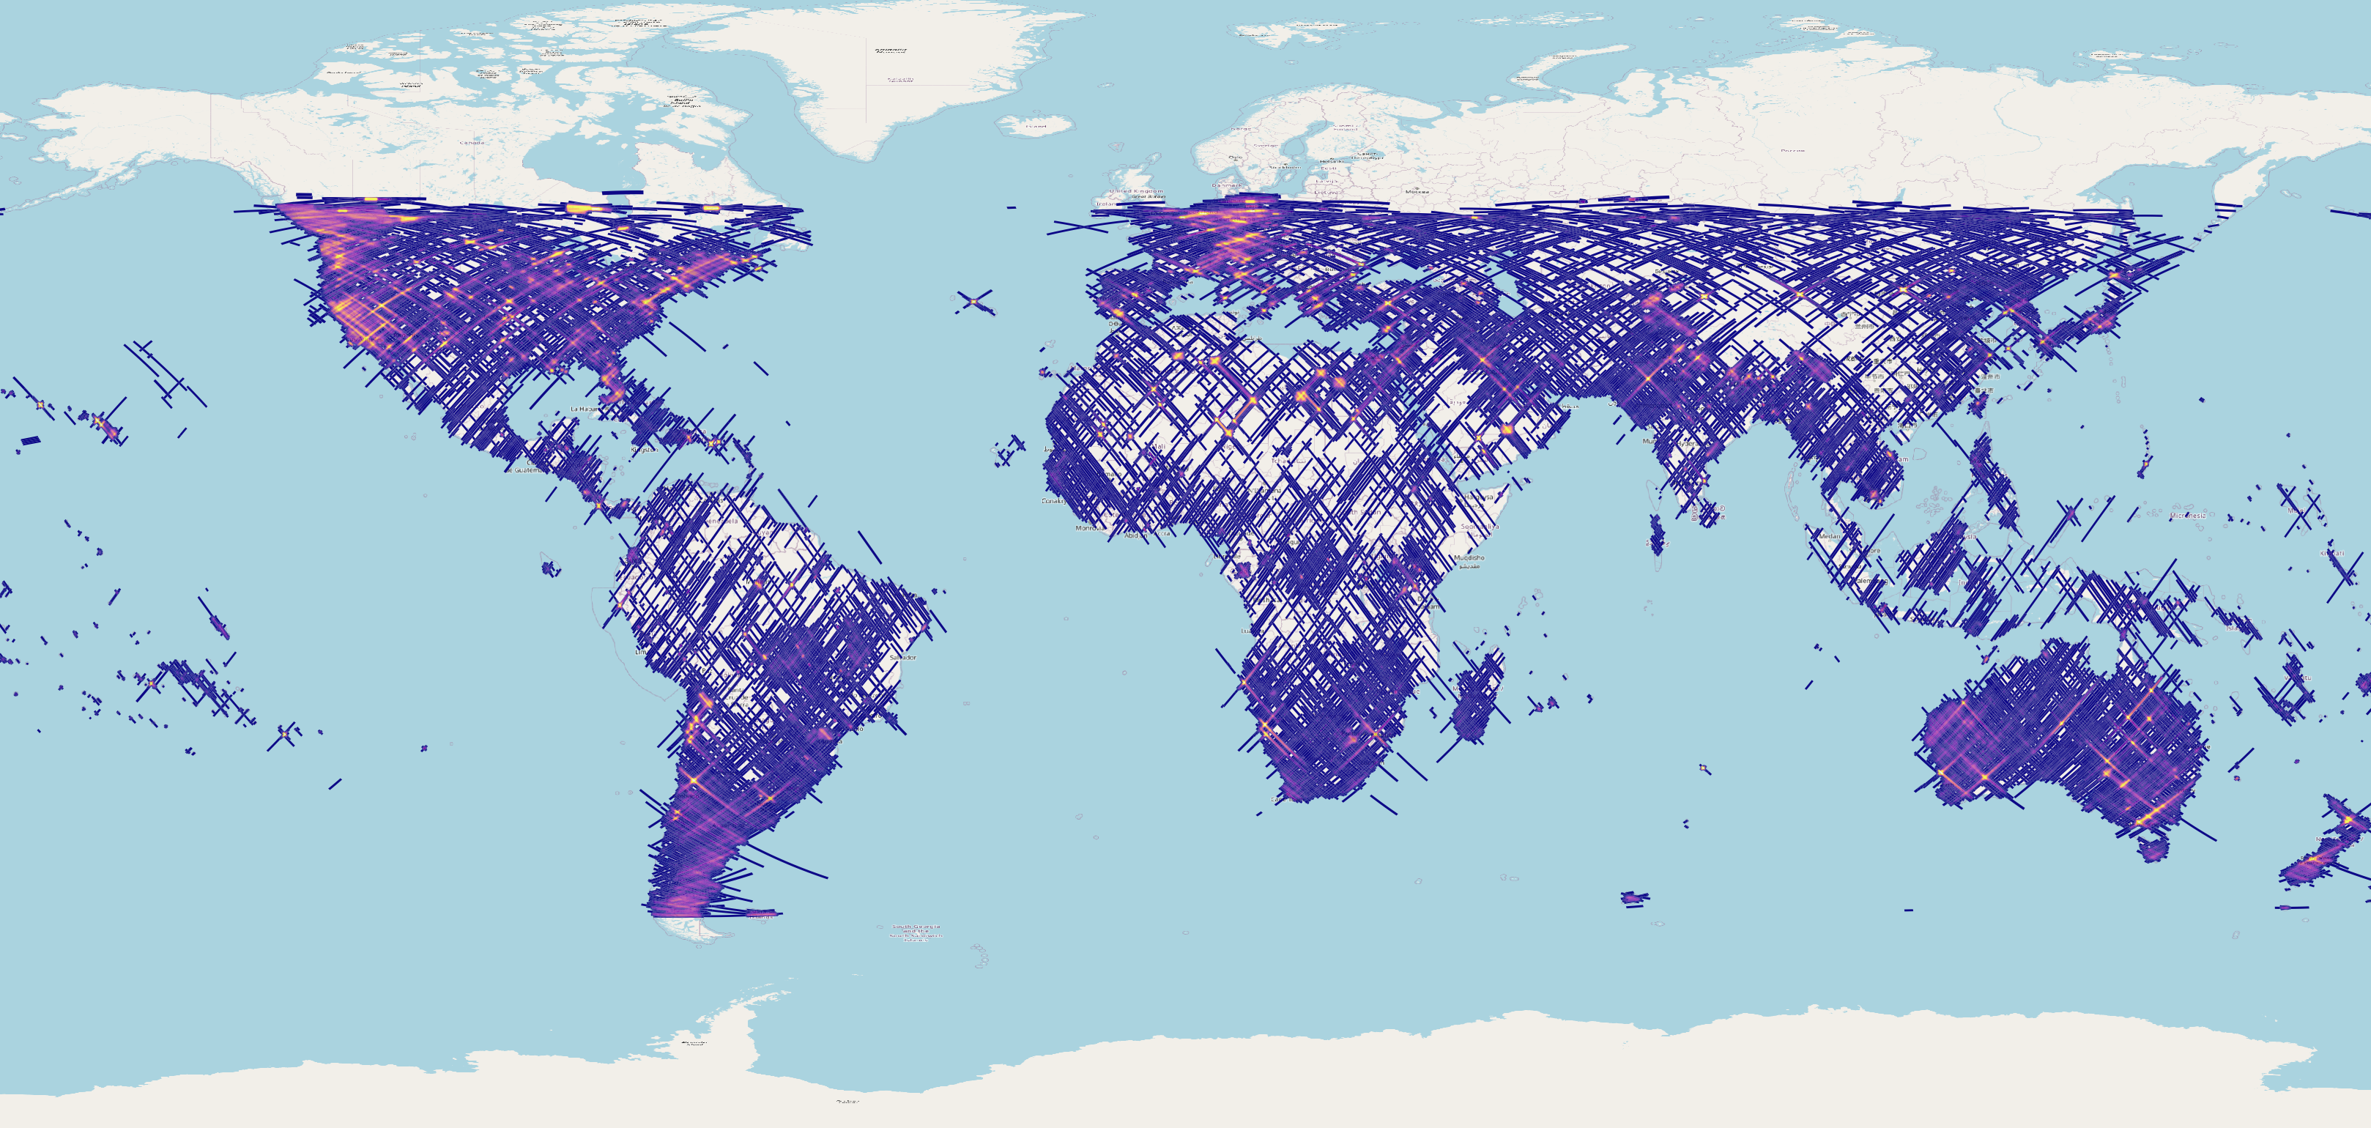

DESIS – 6 years of acquisitions
N° of available scenes
Data since 2018. Certain areas imaged as much as 120 times
>240.000 products until 2024

Slide 12
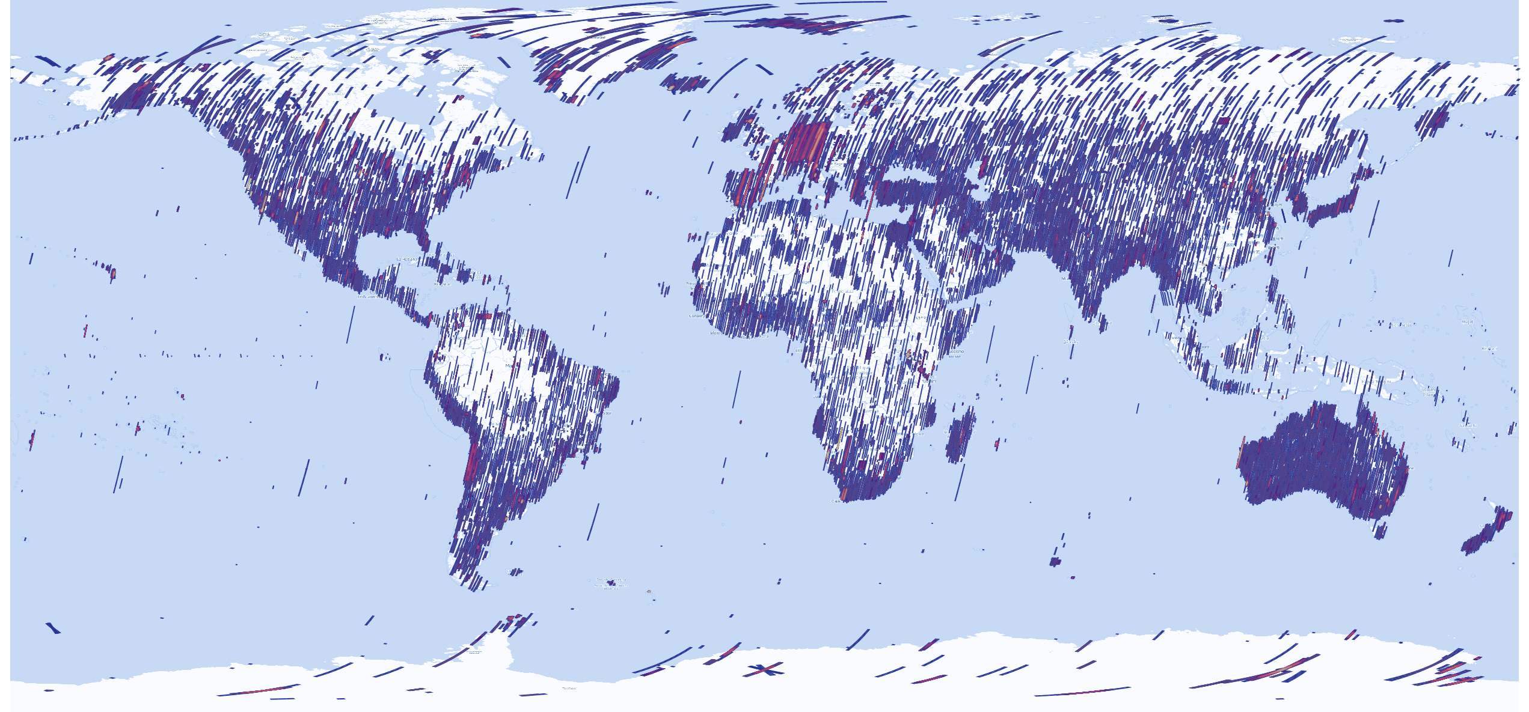
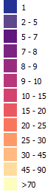
EnMAP – 4 years of acquisitions
N° of available scenes
Source: DLR
More than 22.200 Earth datatakes (DTs) since April 2022
More than 202.500 Earth products archived and available for ordering. Some areas imaged > 70 times

Slide 13

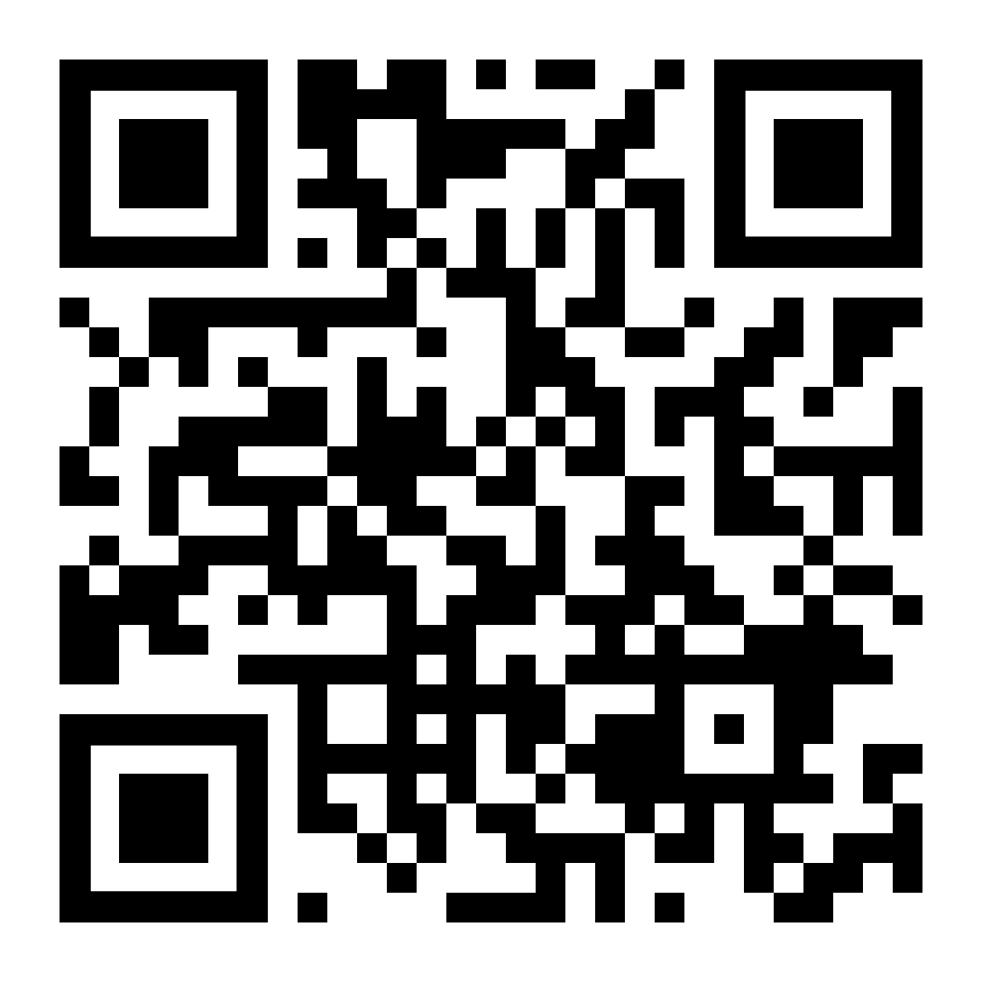
DESIS – Data products
Archive
Absolute radiometric calibration is well
within ~5% at the Top-of-Atmosphere (TOA)
radiance and TOA reflectance level
when validated against RadCalNet
L1A Raw Data
(prepared for selection & ordering & processing)
Geometric accuracy with respect to
Landsat-8 reference is ~20 m (~0.7 pixel)
linear RMSE
Analysis Ready Data
L1B Top-Of-Atmosphere (TOA) Radiance
L1C Geocoded & Orthorectified (TOA) Radiance
L2A Bottom-of-Atmosphere (BOA) Reflectance
Agreement of Bottom-Of-Atmosphere (BOA) reflectance within ~ 5% to RadCalNet sites, significant agreement within uncertainties with other sensors processed with DESIS L2A processor (PACO)
Alonso et al., Data Products, Quality and Validation of the DLR Earth Sensing Imaging Spectrometer (DESIS). Sensors, 2019
  L2A data is CEOS-ARD
  at threshold specification

Slide 14

EnMAP – Data products
Archive
Absolute radiometric calibration is well
within <5% at the Top-of-Atmosphere (TOA, validated)
Radiance requirement. Additionally <<2% difference between consecutive calibrations (~1 or ~2 months)
L0 Raw Data
(prepared for selection & ordering & processing)
Geometric accuracy with respect to Sentinel 2 reference
<0.5 pixel RMSE
VNIR-SWIR Co-registration <0.1 pixel (mean)
Analysis Ready Data
L1B Top-Of-Atmosphere (TOA) Radiance
L1C Geocoded & Orthorectified (TOA) Radiance
L2A Bottom-of-Atmosphere (BOA) Reflectance
(dedicated Land and water processors)
Agreement of Bottom-Of-Atmosphere (BOA) reflectance within Mission requirements:
Land ρ Uncertainty
< 0.01 for ρ < 0.1 and
< 0.02 for 0.1 ≤ ρ < 0.3 and
< 0.05 for 0.3 ≤ ρ ≤ 0.6
Water Rrs Uncertainty
< 0.01 for ρ < 0.1 and
< 0.02 for 0.1 ≤ ρ < 0.3 and
< 0.05 for 0.3 ≤ ρ ≤ 0.6
Storch et al., The EnMAP imaging spectroscopy mission towards operations. Remote Sensing of Environment, 294, 113632.
  L2A data is CEOS-ARD
  at threshold specification

Slide 15
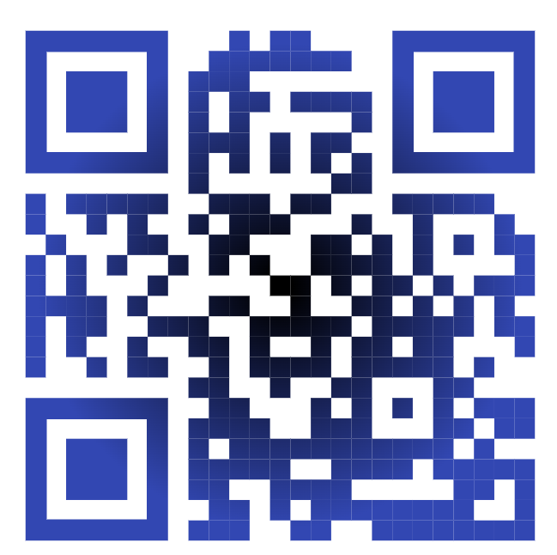



EnMAP & DESIS – Access to Data
On-demand processing (L1B, L1C, L2A): DLR EOWEB
L2A access via web services (WCS, WMS etc.)
incl. STAC metadata catalogue: DLR GEOSERVICE
EnMAP: registration, proposal submission, FAQ,
ATBDs, CalVal reports, and tasking of EnMAP: WWW.ENMAP.ORG
DESIS: contact via desis-scientific@dlr.de
and ATBDs etc. at DESIS webpage:

Slide 16
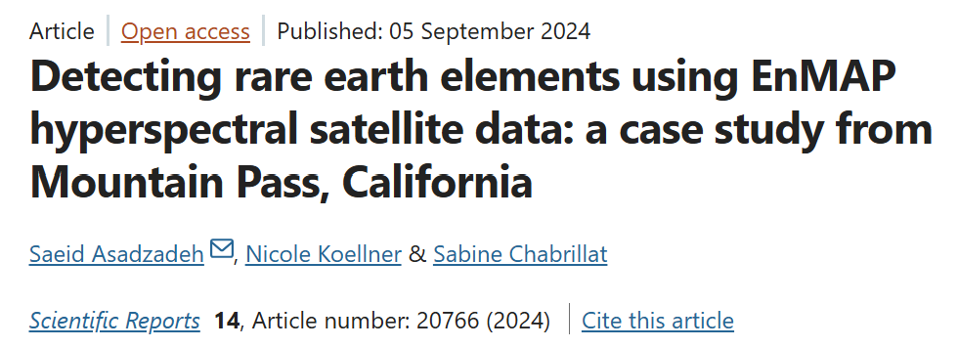
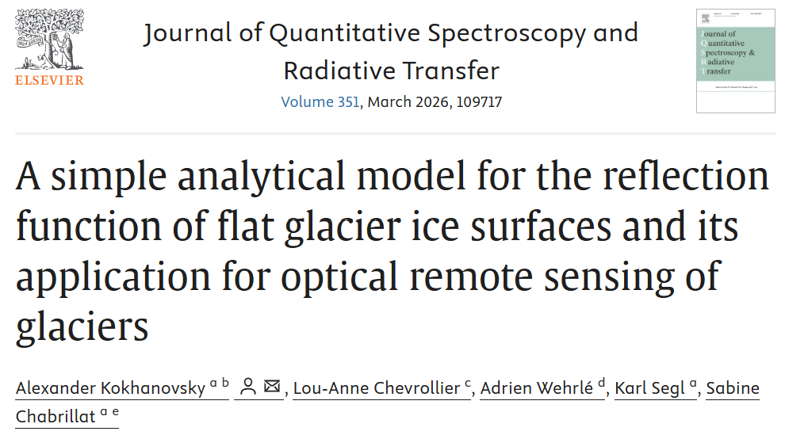
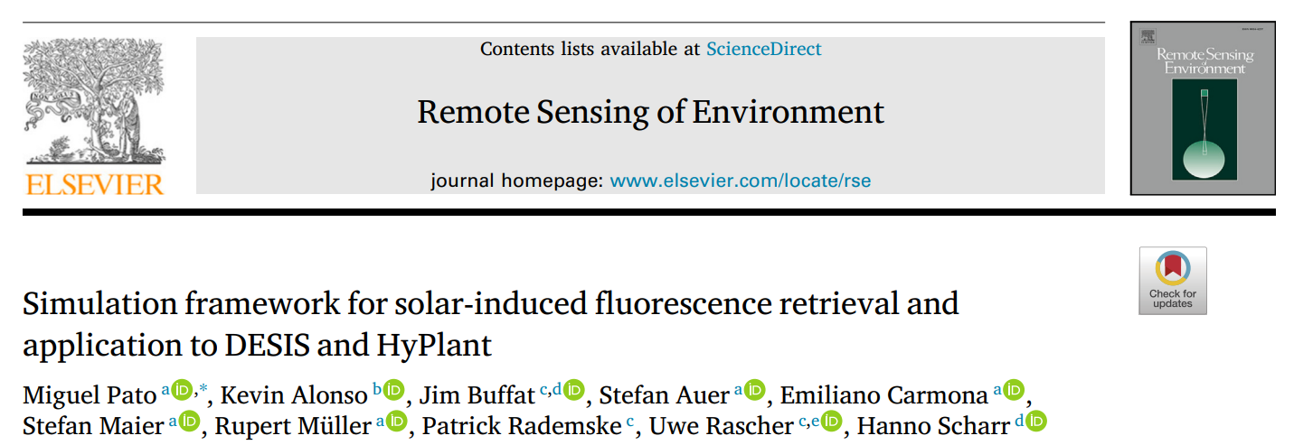
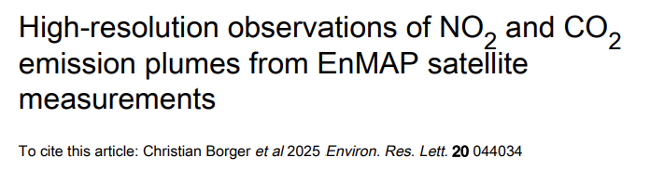
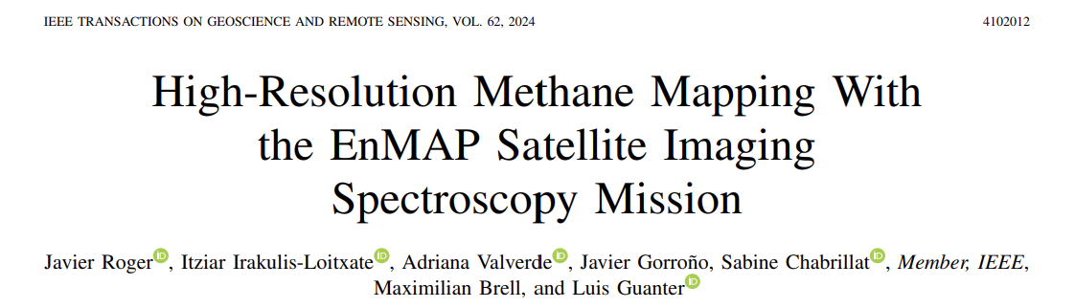
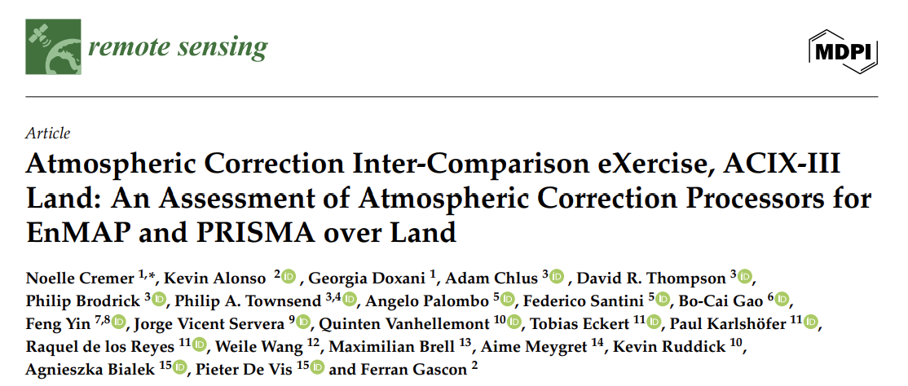
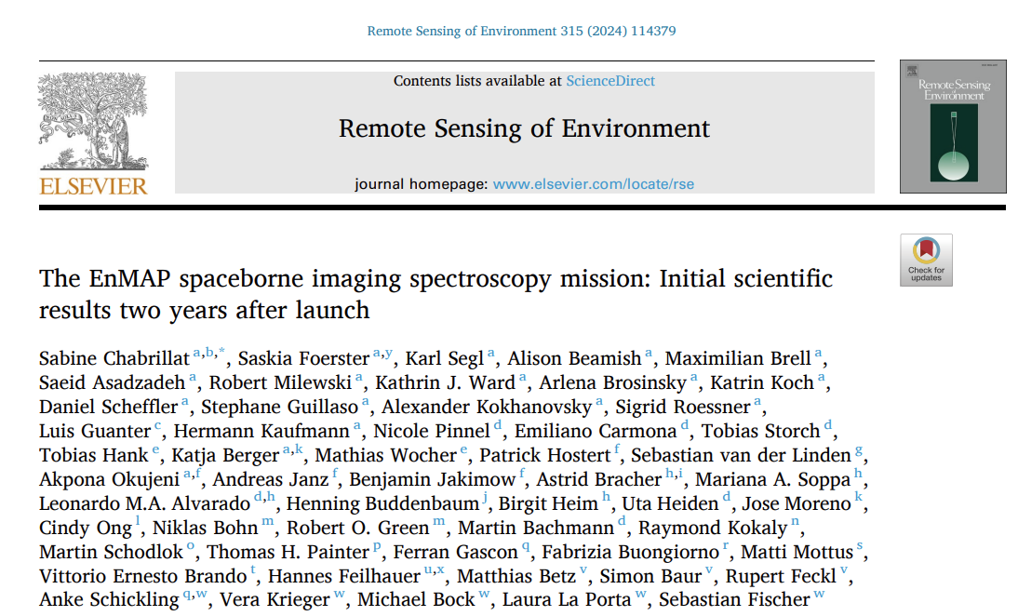
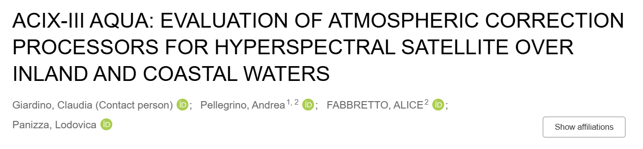
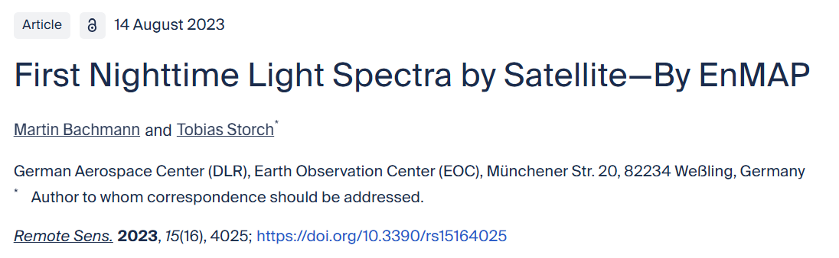
Applications – Examples

Slide 17
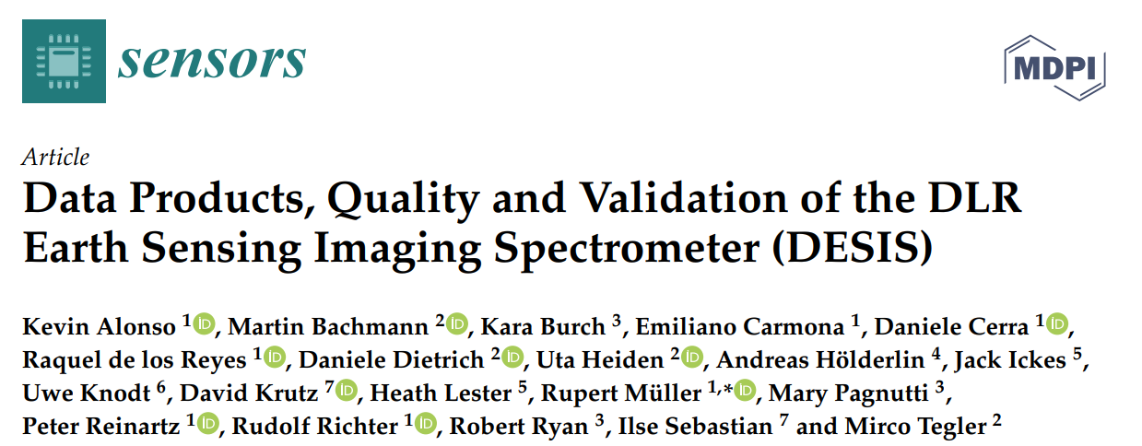
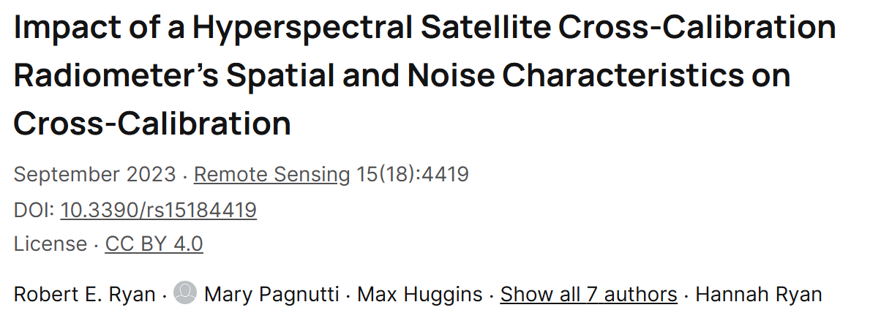
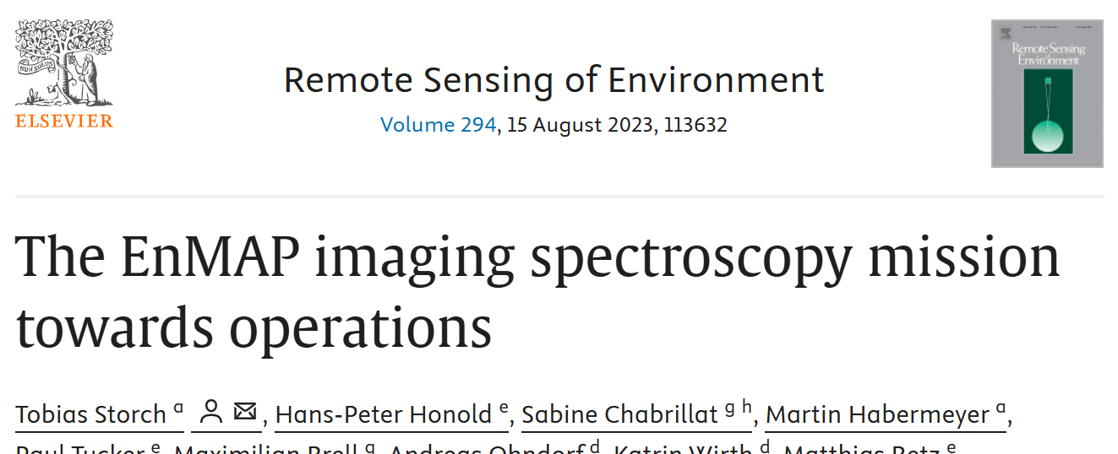
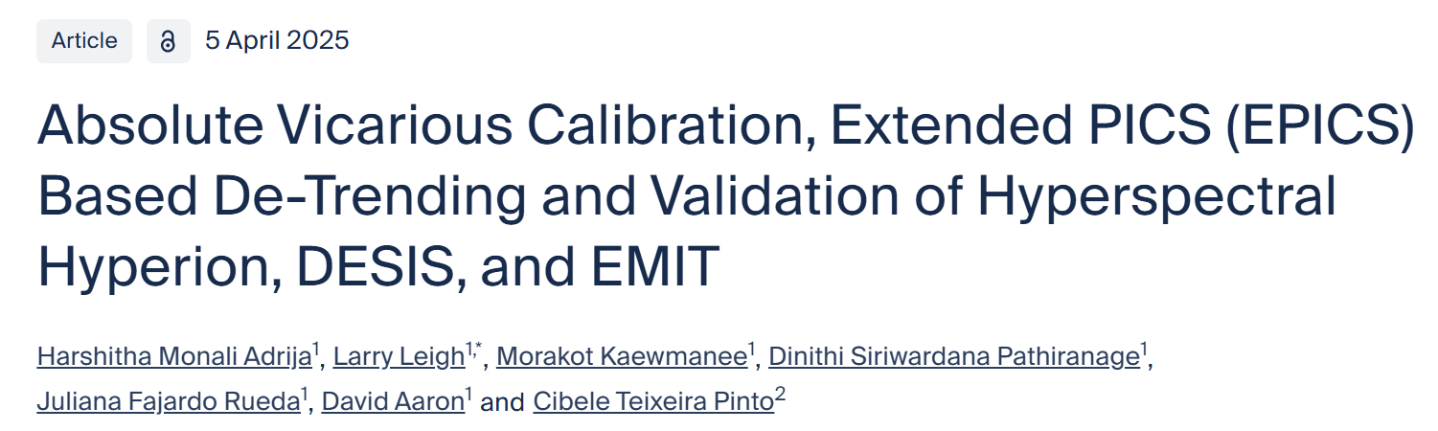
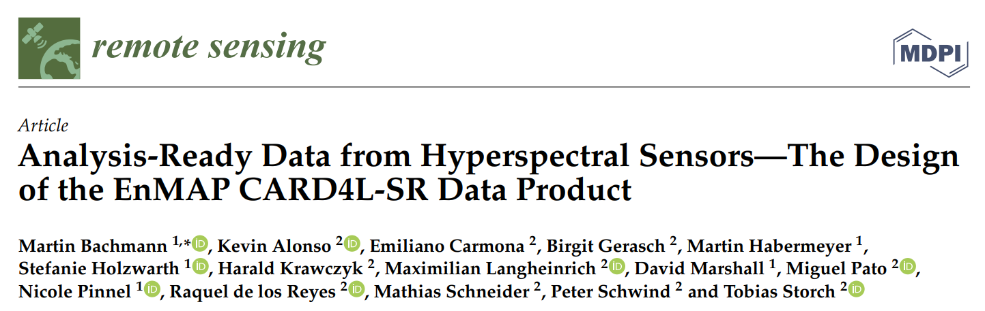
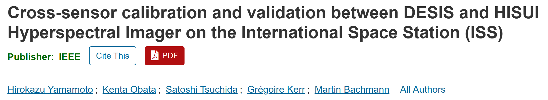
… also some Cal/Val focused publications:

Slide 18

Summary
DESIS and EnMAP offer common characteristics:
  Possibility of matchups or close-in-time observations with other missions
  Large volume of hyperspectral historic data (from 2018 DESIS, from 2022 EnMAP)
  Very similar processing chains (in particular L2A)
  Free access (scientific use) through DLR’s multi-mission platforms (EOWEB, EOC-Geoservice)
But also complementary characteristics:
  EnMAP: high SNR, very stable, SWIR range
  DESIS: high spectral sampling distance
  Passage local time fix (EnMAP) and variable (DESIS)
This research was supported by the DLR Space Agency with funds of the German Federal Ministry of Economic Affairs and Climate Action
on the basis of a decision by the German Bundestag (50 EE 0850, 50 EE 1923 and 50 EE 2108).

