Slide 1
Lunar Acquisitions
Inter-band & Inter-polariser Calibration of 3MI
Margarita Vazquez Navarro¹, Bertrand Fougnie¹
Henda Guermazi¹, Christopher Gin-Lee¹, Lucas Landier²
¹ EUMETSAT
² CNES

Slide 2
Agenda
3MI in a Nutshell
Motivation for Lunar Acquisitions
Approach
Moon Acquisitions
Inter-band Assessment
Exploring Moon in Polarisation
Conclusion

Slide 3
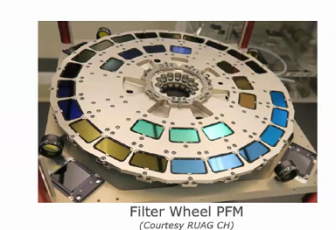
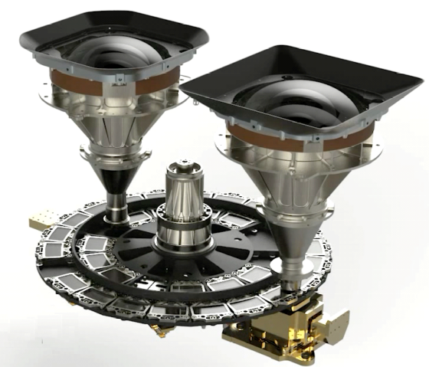
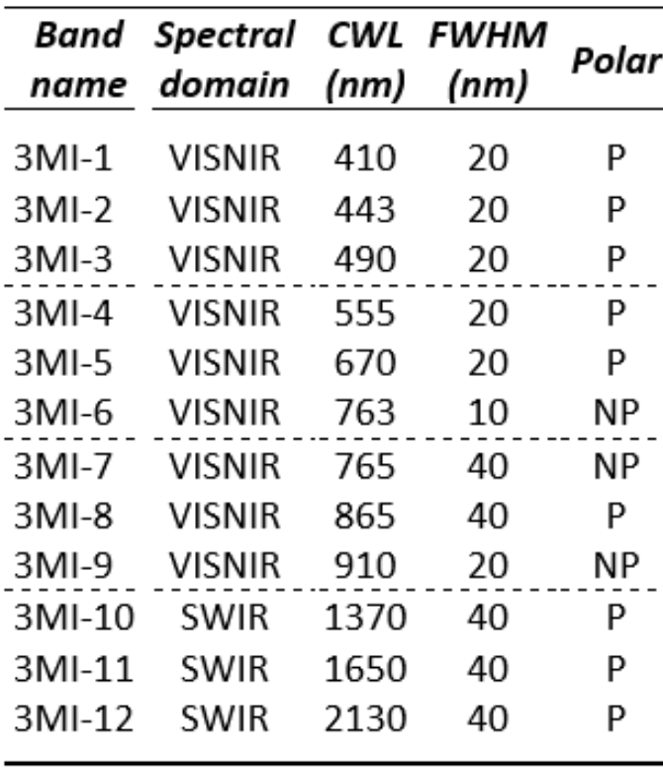
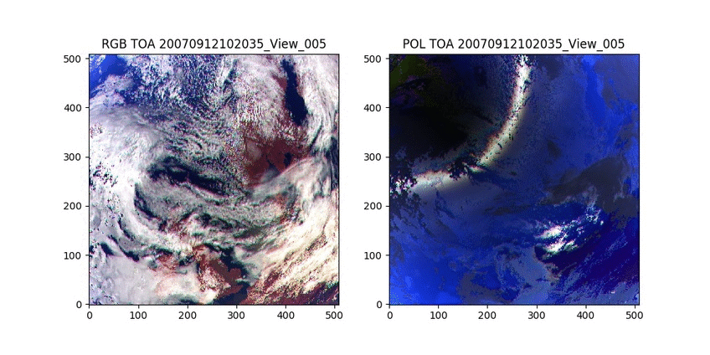
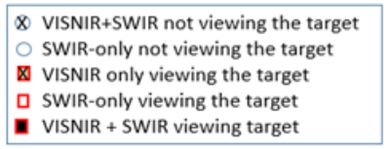
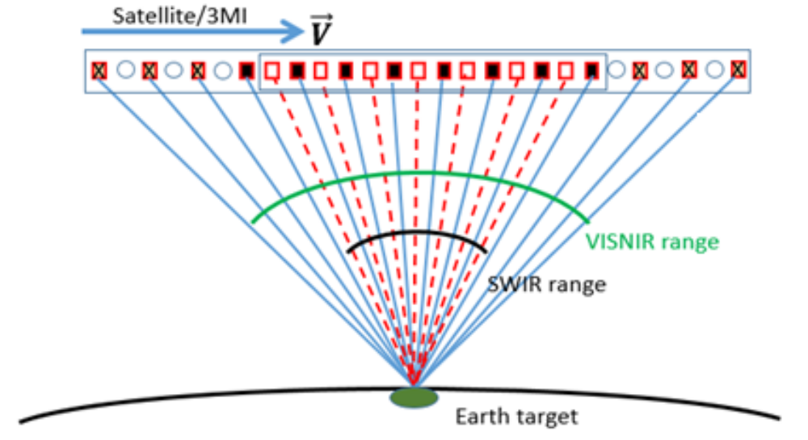
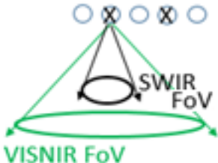
3MI in a nutshell
Multi-viewing Multi-channel Multi-polarisation Imager
Filter wheel = spectral
and polarization
EPS-SG : Polar orbit at 09:30 – 12th August 2025
3 redundant instrument/platforms → 25 y. operation
3MI is a new instrument
12 bands from 410 to 2130nm, inc. 9 with I/Q/U
4km nadir – 2200x2200km² swath (for VISNIR)
Wide field-of-view =
Multi-viewing
Natural light (RGB) Polarized light (RGB)

Slide 4
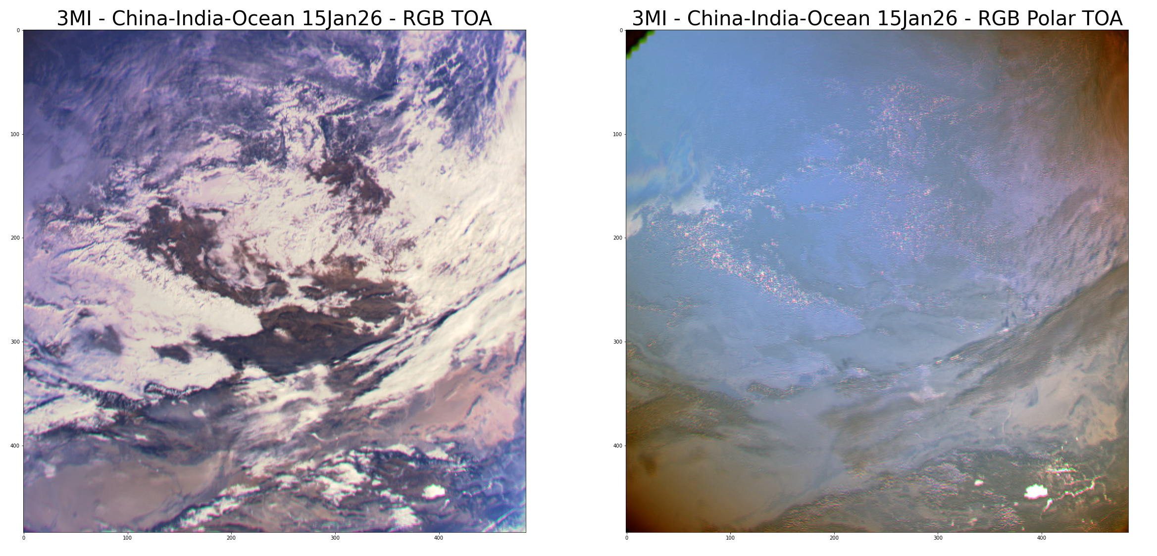
3MI Acquisitions
Overpass China / India – 15th January 2026 (Level-1B)
RGB – TOA Reflectance
RGB – TOA Polarised Reflectance

Slide 5
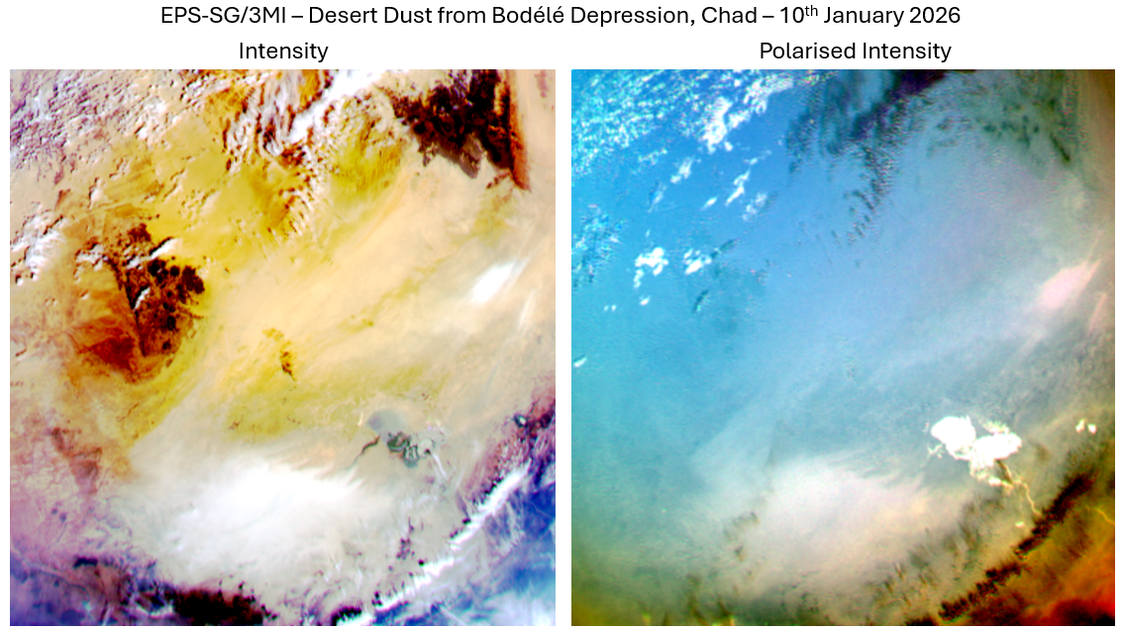
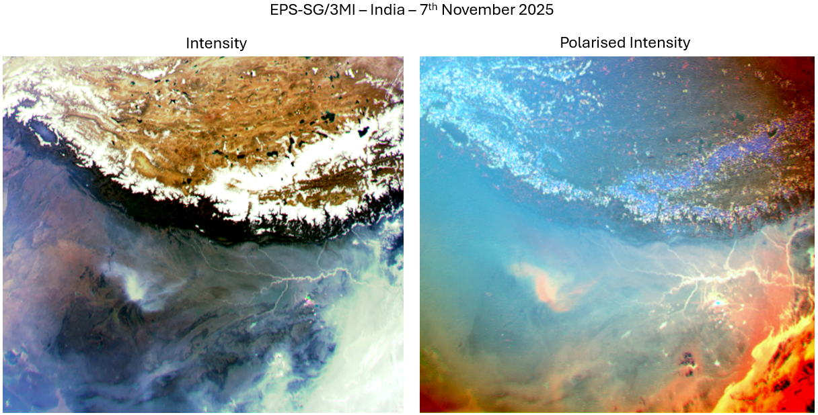
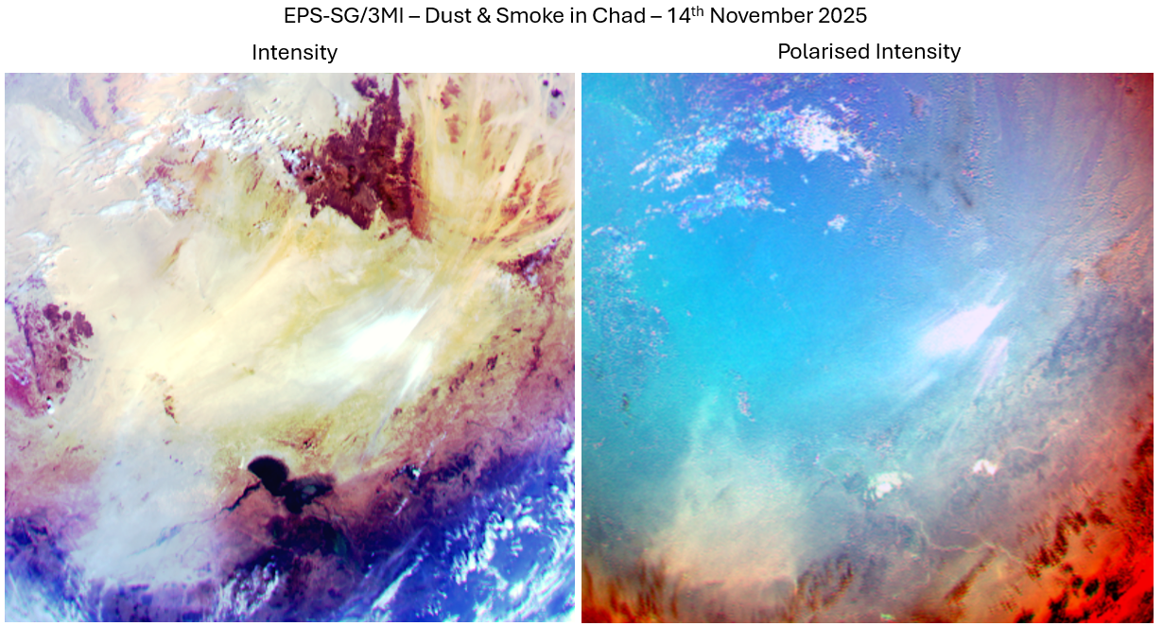
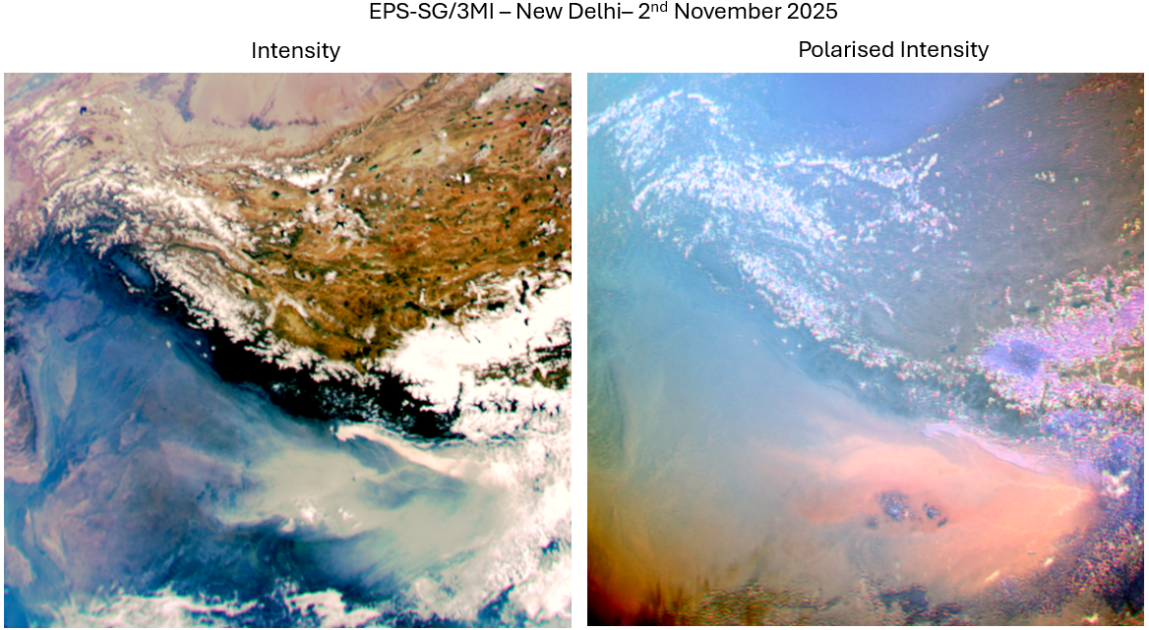
Aerosol events captured by 3MI
10th Jan 2026
Desert dusts emitted from Bodélé depression (Chad)
7th Nov 2025
Pollution & Smoke - New Delhi & Calcutta (India)
14th Nov 2025
Desert dust & Biomass burning (Chad)
2nd Nov 2025
Pollution & Smoke New Delhi (India)

Slide 6
Motivation
One-shot acquisition during commissioning (no routine foreseen)
Check the instrument for a perfect bright/dark target
Check the level-1 processing for radiometric artefact corrections
Check/adjust the inter-band calibration
  especially for the absorption bands (763, 765, 910, 1370) more difficult to calibrate using vicarious calibration
Check/adjust the inter-polariser calibration
Absolute with Moon is nice to have
  Will be relatively well tuned with vicarious calibration over natural targets
Monitoring not planned
➔ Previous experience with PARASOL (reported to GSICS in 2016)

Slide 7

Approach
The lunar disk is captured by a very limited number of pixel
  Makes the calculation of the absolute irradiance very demanding in term of knowledge of the pixels IFOV (varying along the field of view), steering of the line of sight during the acquisition, and proper identification of the lunar disk on the focal plane
All pixels acquired at the same time (2D-detector)
Consider the Moon, and its motion during the acquisition, as the same virtual target for all bands & polarisers
Compare the radiometry
3MI
865nm
4th March 2026

Slide 8
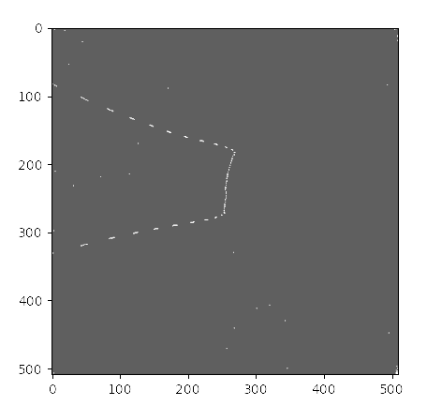
Moon acquisitions
First acquisition 4th March 2026
  Roll manoeuvre 120°
  Lunar phase 11°
  Moon excursion in the center of the field-of-view (~20 images)
Second opportunity coming 1st April 2026
  Lunar phase 9°
  Moon excursion off axis (about 20° ACT)

Slide 9
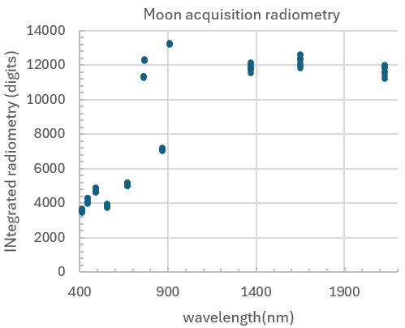
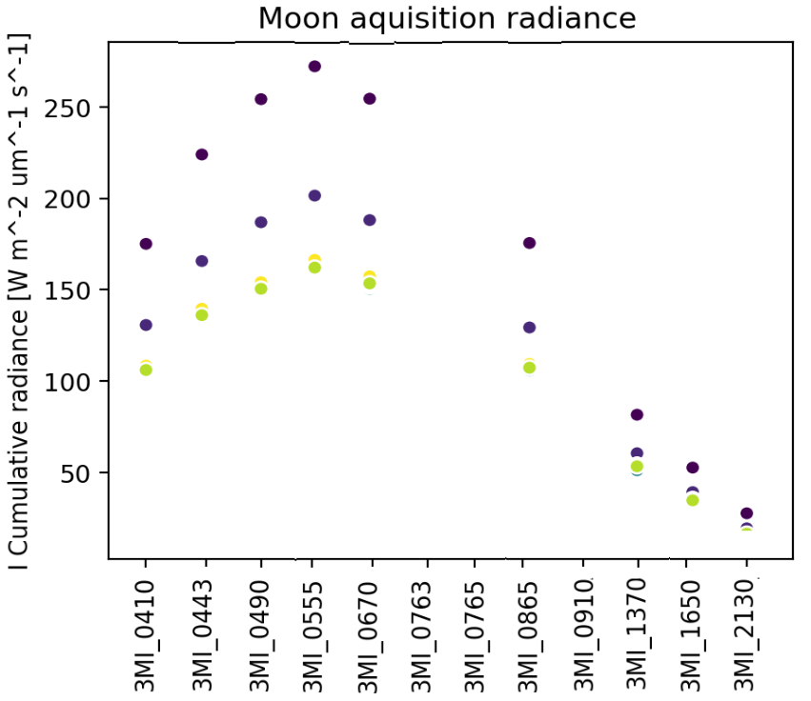
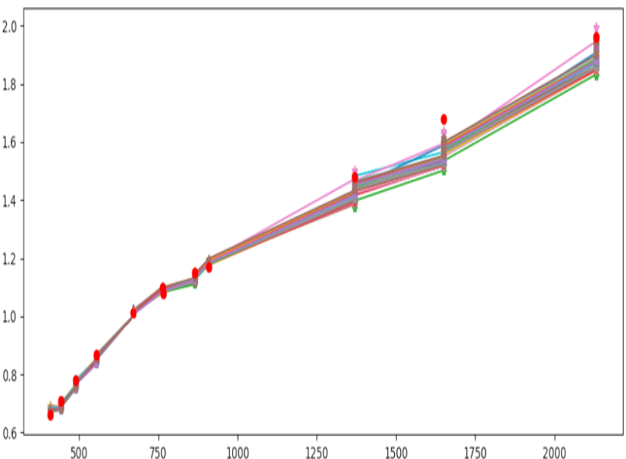
Inter-band Assessment
From measured digits to Moon reflectance
  Correction of radiometric artefacts (DC, NL, SL, FF…)
  Integrated radiometry, absolute calibration, normalisation to solar irradiance
  Dispersion due to polarisers and viewing directions
Moon reflectance
2.0
0.8
1.6
1.4
1.2
1.0
0.8
0.6
VNIR
SWIR
● CNES model
500 750 1000 1250 1500 1750 2000
Preliminary results (but already very good !)

Slide 10
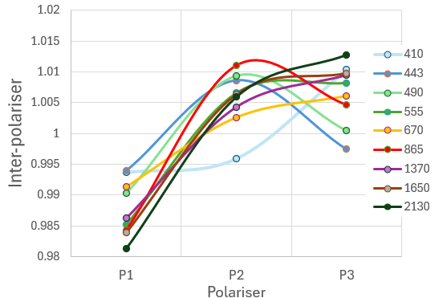
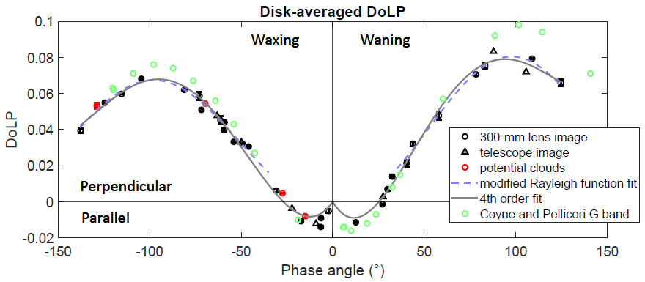
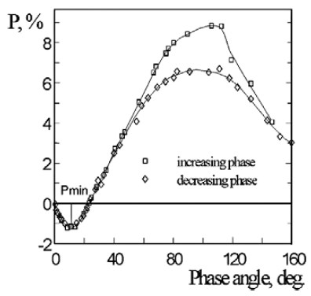
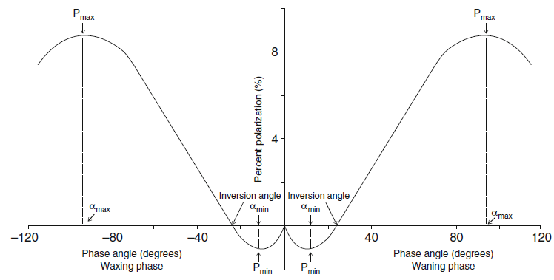
Exploring Moon in Polarisation
Inter-polariser analysis
  P1 always -2%
  Anomaly in 410nm?
Colour of the lunar polarisation?
  Slow blue to SWIR evolution
Polarisation coming from the Moon
  here 1.2% DoLP in average
Orientation of the polarisation
  here looks perpendicular to polariser P1 - TBC
Comparison to the expected polarisation (Dolphus 1971: Pmin=12‰ for phase 12°)
Lyot 1929
Schmude 2019
Venkatesulu and Shaw, 2024

Slide 11
Conclusion and On-going Activity
Moon acquisitions are very useful
  should be able to validate the interband calibration for all bands, especially for absorption bands
The analysis is extended to polarisation
Refine the various corrections (results shown here are preliminary)
Process all images
Second moon acquisition to come
Analyse the variation within the field-of-view
Inject the data in CNES & EUM lunar models --> toward absolute

Slide 12
Thank you!
Questions are welcome.

