Slide 1
Overview of Sentinel-3 vicarious and lunar calibration results
GSICS Annual and Executive Panel meeting
23-27 March 2026
Steffen Dransfeld*, Silvia Scifoni**
*ESA/ESRIN
**Serco for ESA

Slide 2
Summary
Sentinel-3 OLCI/SLSTR L1 main news
Vicarious calibration on Sentinel-3 OLCI and SLSTR
  DIMITRI tool: Rayleigh, Sun Glint, PICS methods (analysis performed at ACRI-ST as ESA/OPT-MPC)
  Lunar Calibration (analysis performed at VITO as ESA/OPT-MPC)
Conclusive remarks

Slide 3
Sentinel-3 OLCI L1 main news
OLCI L1
  OLCI-A and B L1 full mission re-processing performed at EUMETSAT based on ESA processing baseline:
      TSIS-1 solar irradiance spectrum to replace Thuillier as recommended by GSICS/CEOS
      Consistent radiometric calibration for each OLCI-A and OLCI-B mission
      Geometric calibration improvement for early mission of OLCI-A and OLCI-B
      Radiometric uncertainties provided in L1 B products for entire mission
      New Spectral temporal model based on in-flight spectral calibrations and accounts for OLCI spectral evolution over time

Slide 4
Sentinel-3 SLSTR L1 main news
SLSTR L1
  New processing baseline will be deployed soon
    Transition from the Thuillier solar spectral model to the TSIS as recommended by GSICS/CEOS
    Application of vicarious adjustment factors on Visible and SWIR radiances
    Removal of the obsolete parameters associated with the Bayesian cloud mask – now only performed at Level 2 module

Slide 5


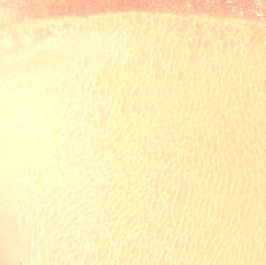
DIMITRI Tool for Vicarious calibration
https://dimitri.argans.co.uk
Rayleigh scattering calibration | Sun-Glint inter-band calibration | Desert (PICS) calibration
Measurement of the Rayleigh atmospheric backscattering over open ocean sites in clear sky off-glint conditions with low aerosol load to provide absolute calibration in the blue-to-red spectral domain. | Using the specular reflection of the sun on the open ocean surface and its known spectral dependency to assess inter-band calibration in the red-to-NIR spectral range. | Measurement over well characterized, temporally stable desert areas to provide absolute calibration over the whole spectral domain.
Absolute calibration coefficient: as ρ^{obs}/ρ^{sim} | Absolute Inter-band calibration coefficient: as ρ^{B(i)}/ρ^{B(ref)} Reference band for SLSTR: S02 (659 nm) Reference band for OLCI: Oa08 (665 nm) | Relative calibration coefficient: as ρ^{obs}/ρ^{sim} (MERIS 3rdR as REF)
Over VIS bands Uncertainty <5% | Over VNIR bands Uncertainty <2% | Over VNIR bands Uncertainty <5% Uses surface BRDF

Slide 6
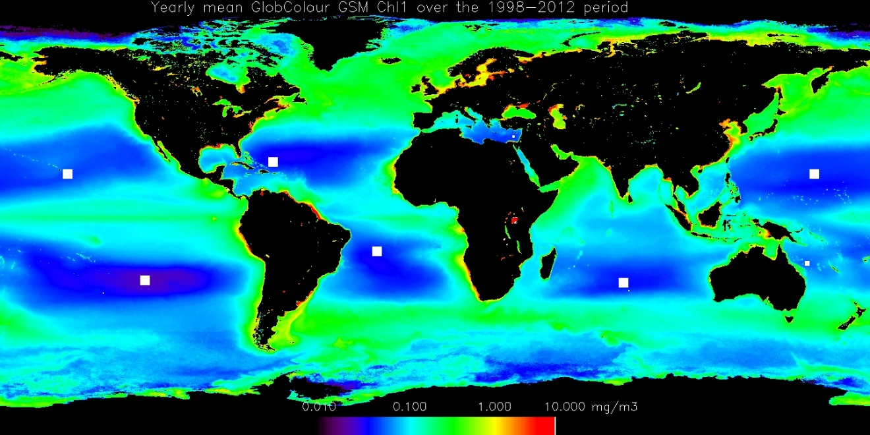
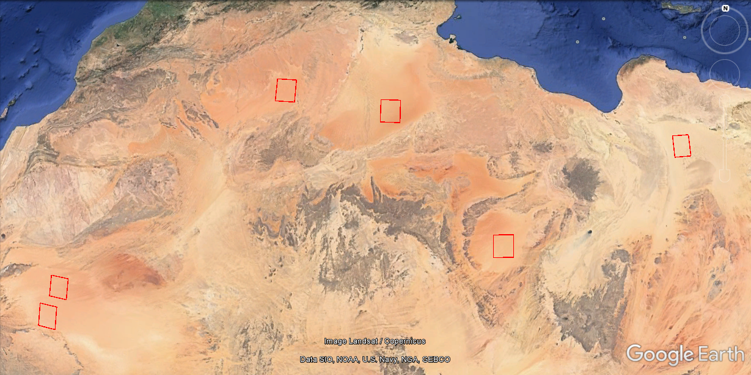
Selected sites
Rayleigh/Sun-Glint calibration sites
CEOS-Desert PICS calibration sites
Algeria-5
Algeria-3
Libya-4
Mauritania-2
Libya-1
Mauritania-1
The yearly Chl-a climatology derived from the full period 1998-2012 from GlobColour-GSM and the optimum regions of interest
(Bouvet, 2013)

Slide 7
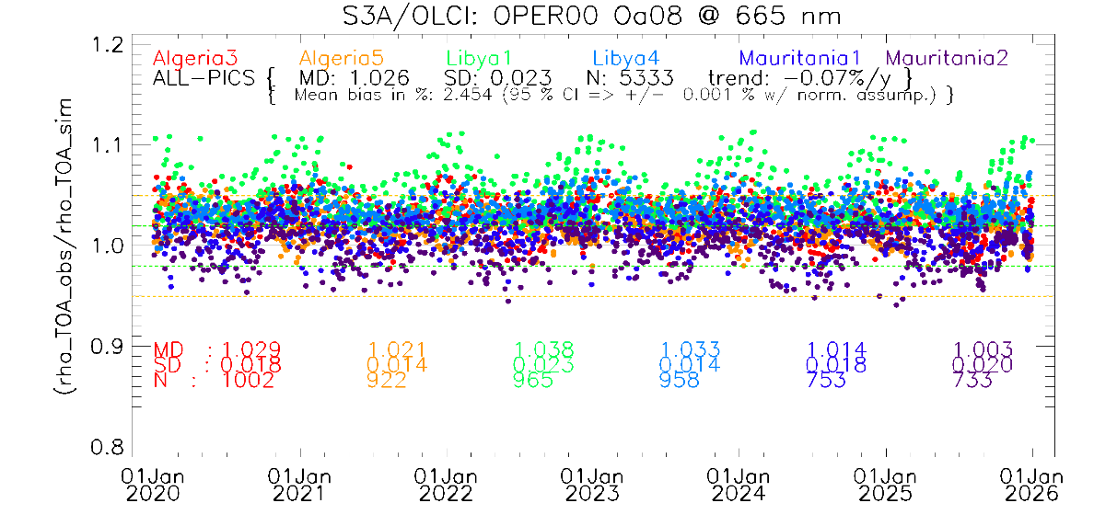
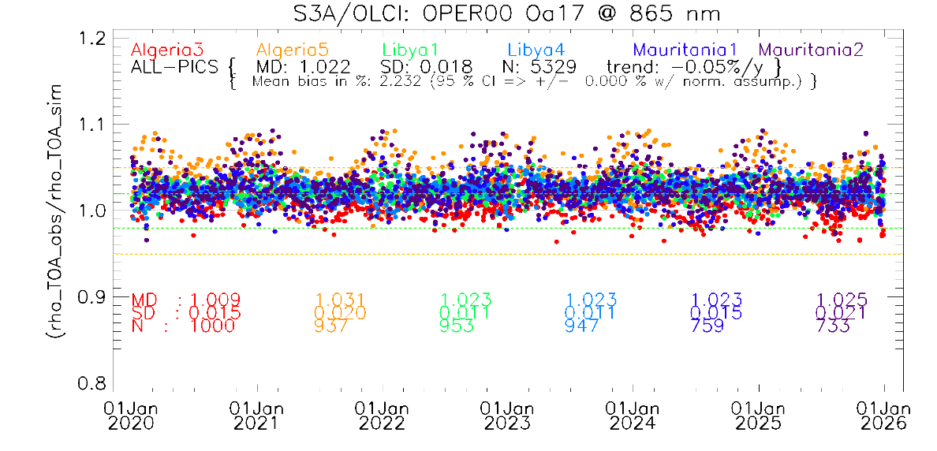
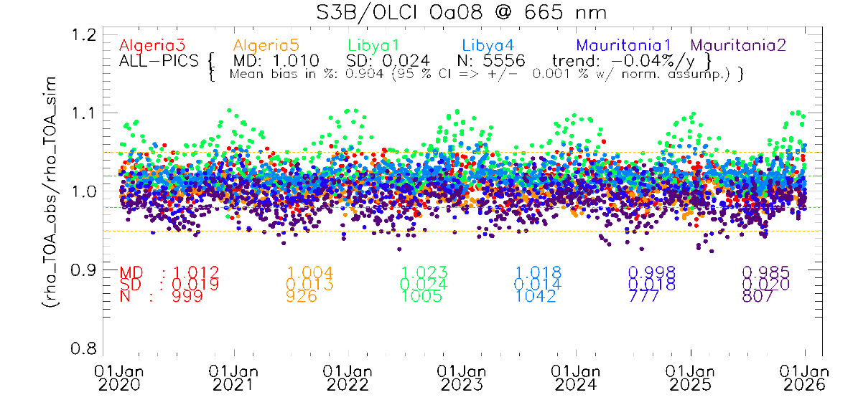

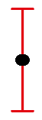
OLCI - PICS results
Performed over 6 CalVal-Sites from Jan. 2020 – Jan. 2026
Results are consistent over all the six used PICS sites
Both sensors show a good stability
Total Uncert. 5%

Slide 8
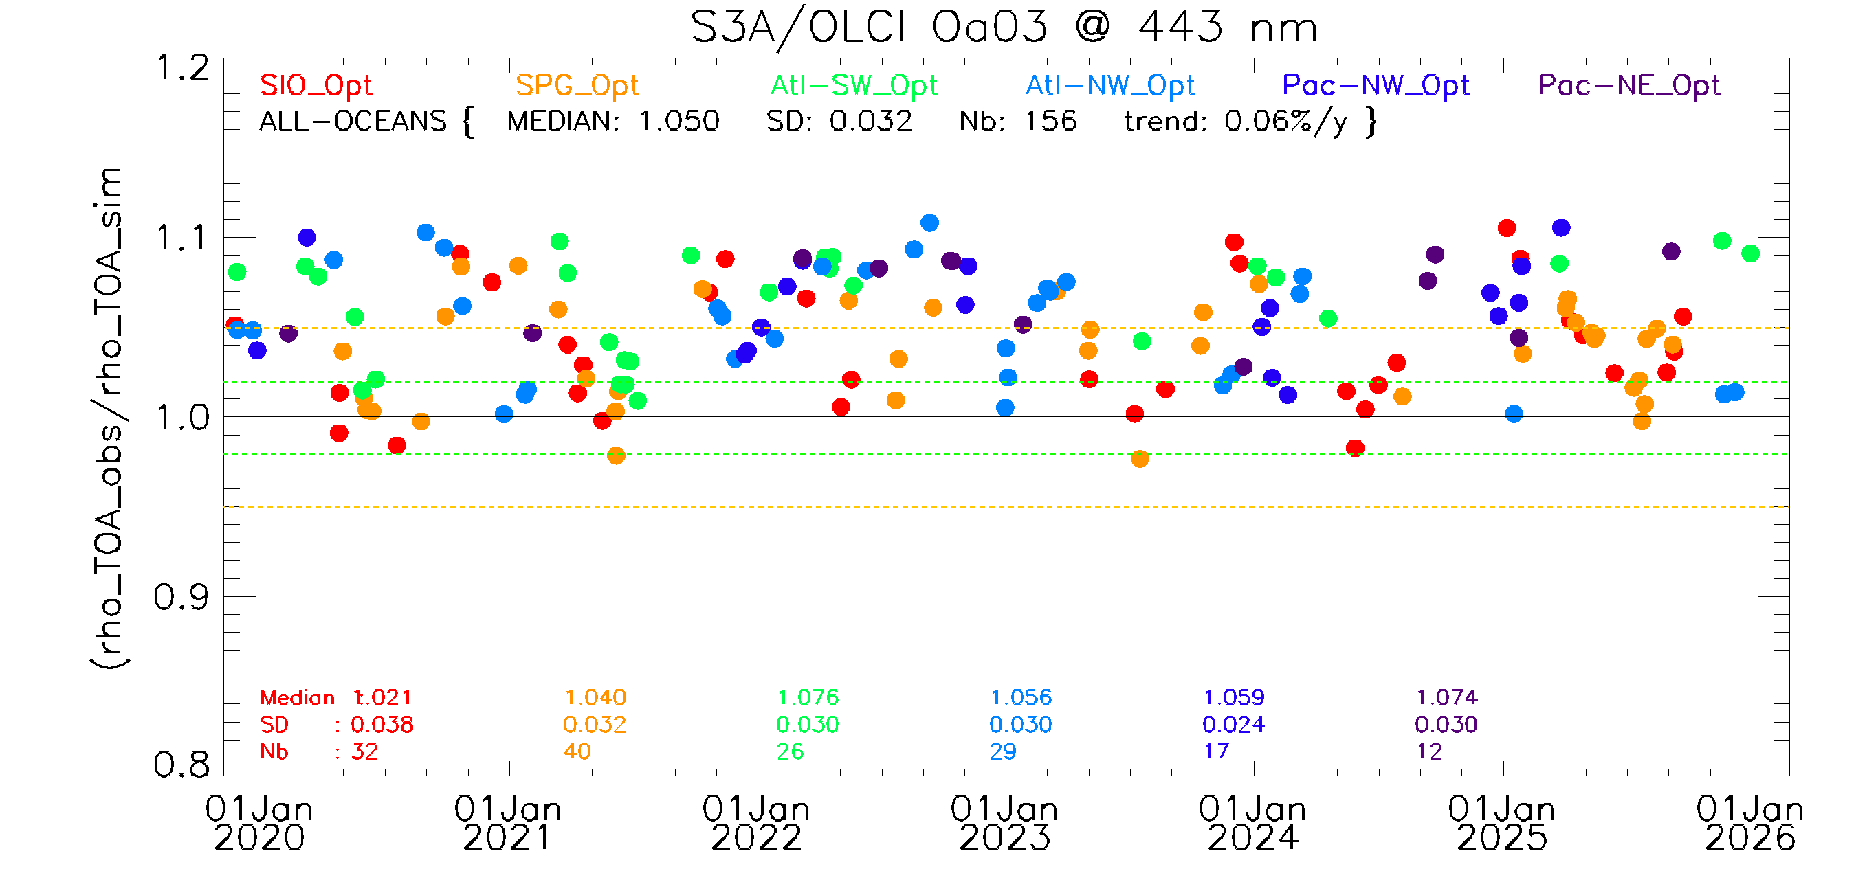
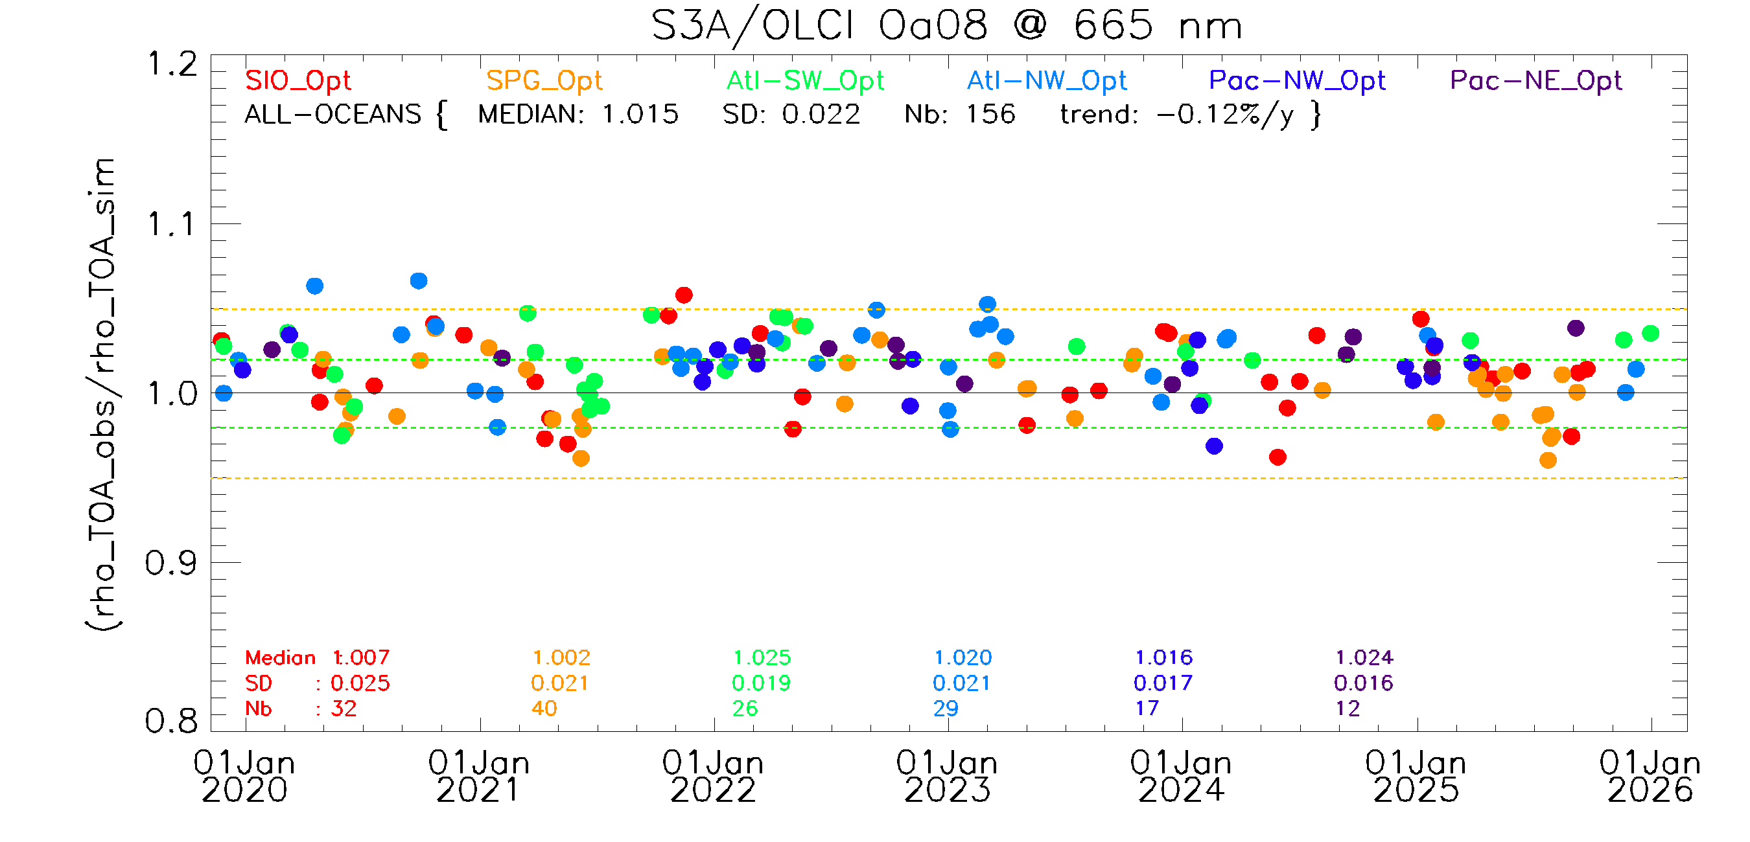
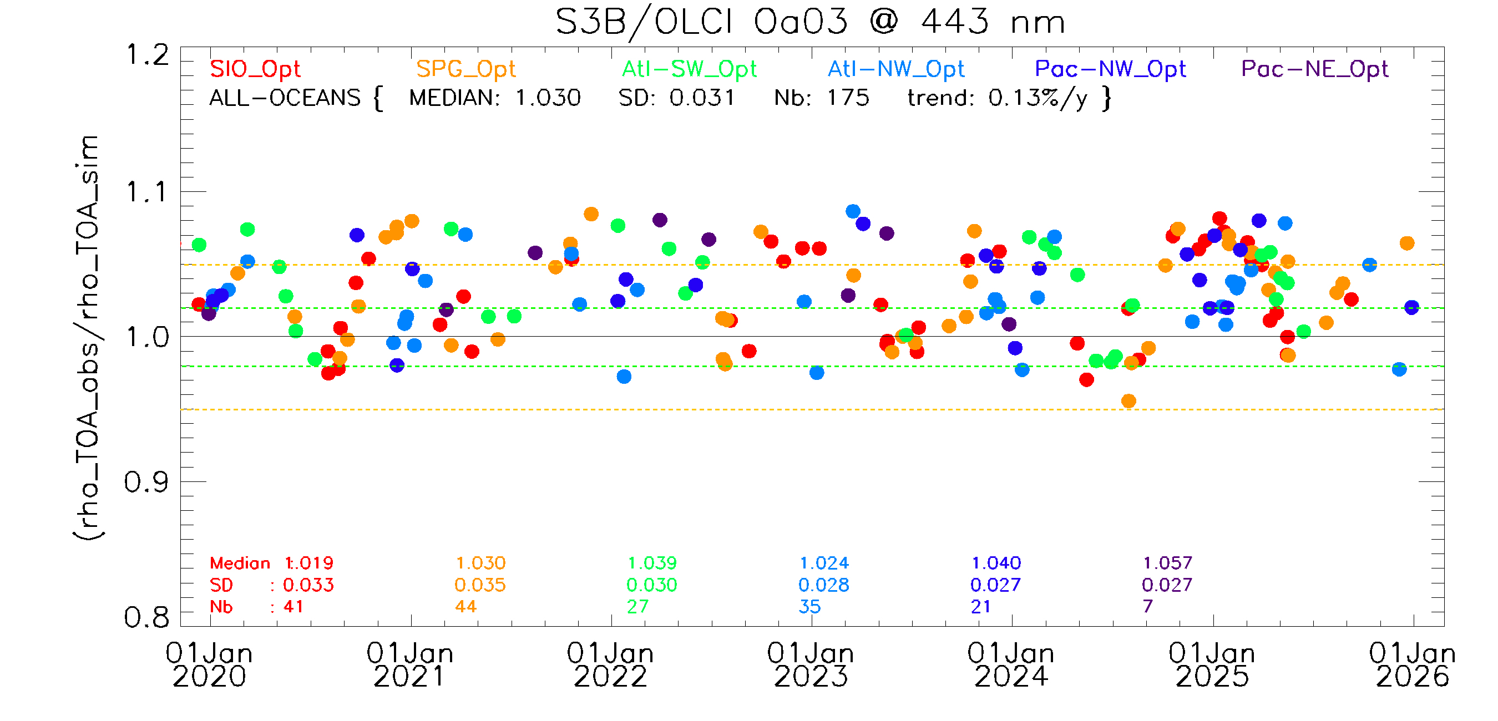
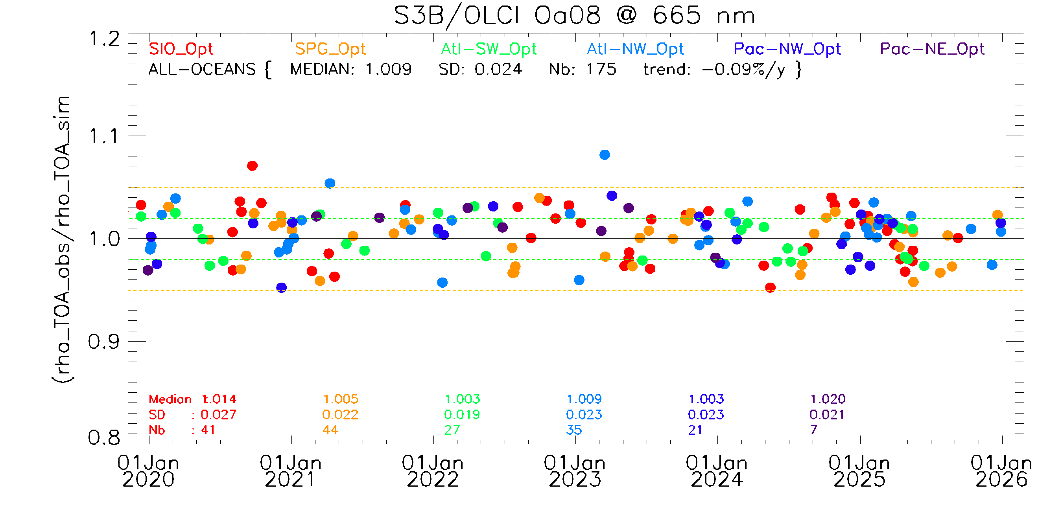
OLCI - Rayleigh results
Performed over 6 CalVal-Sites from Jan. 2020 – Jan. 2026
Total Uncert.4%

Slide 9
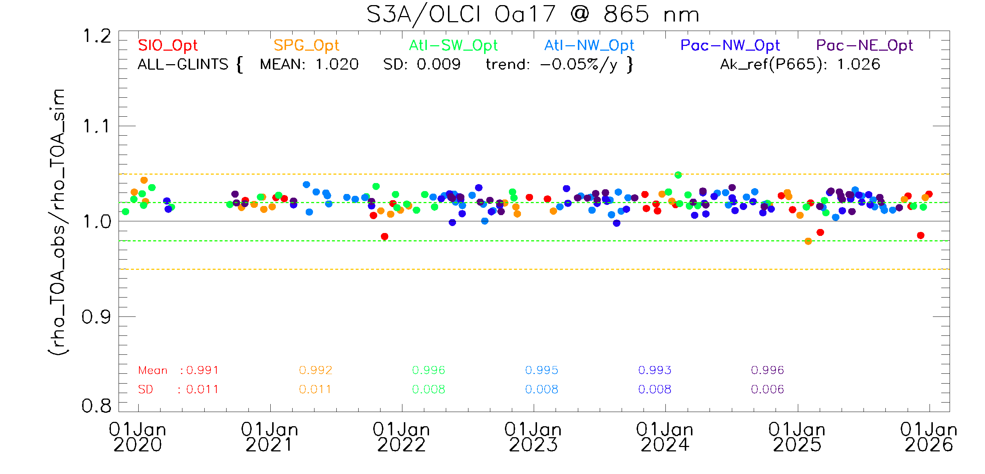
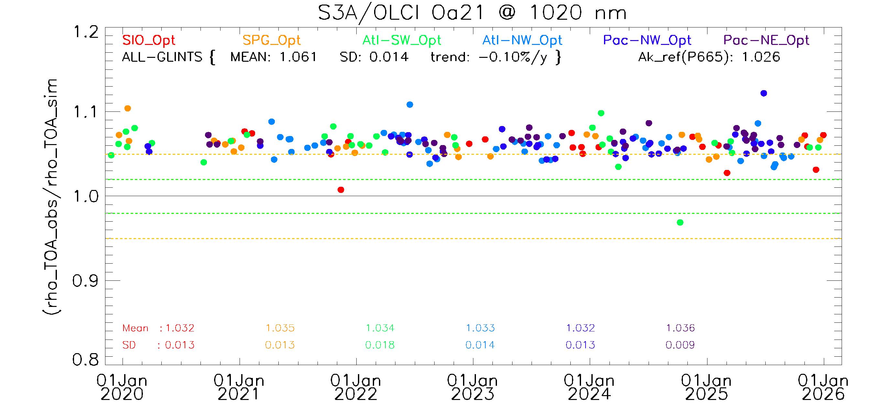
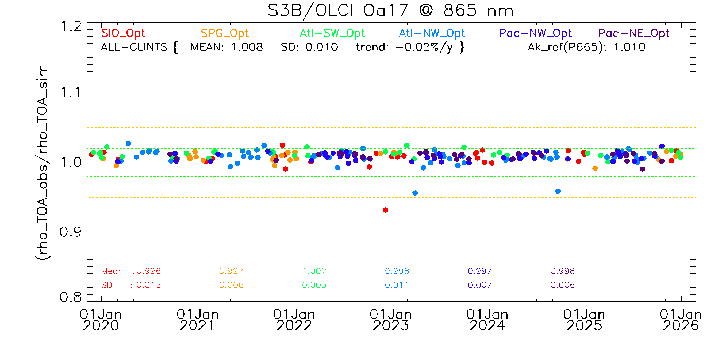
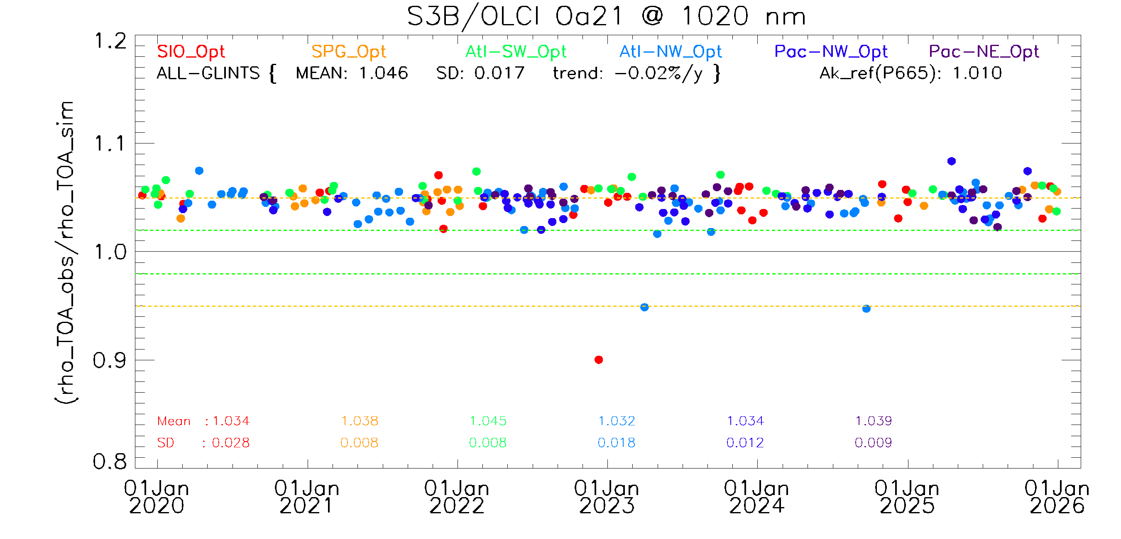
OLCI - SunGlint results
Performed over 6 CalVal-Sites from Jan. 2020 – Jan. 2026
Total Uncert. 5%

Slide 10
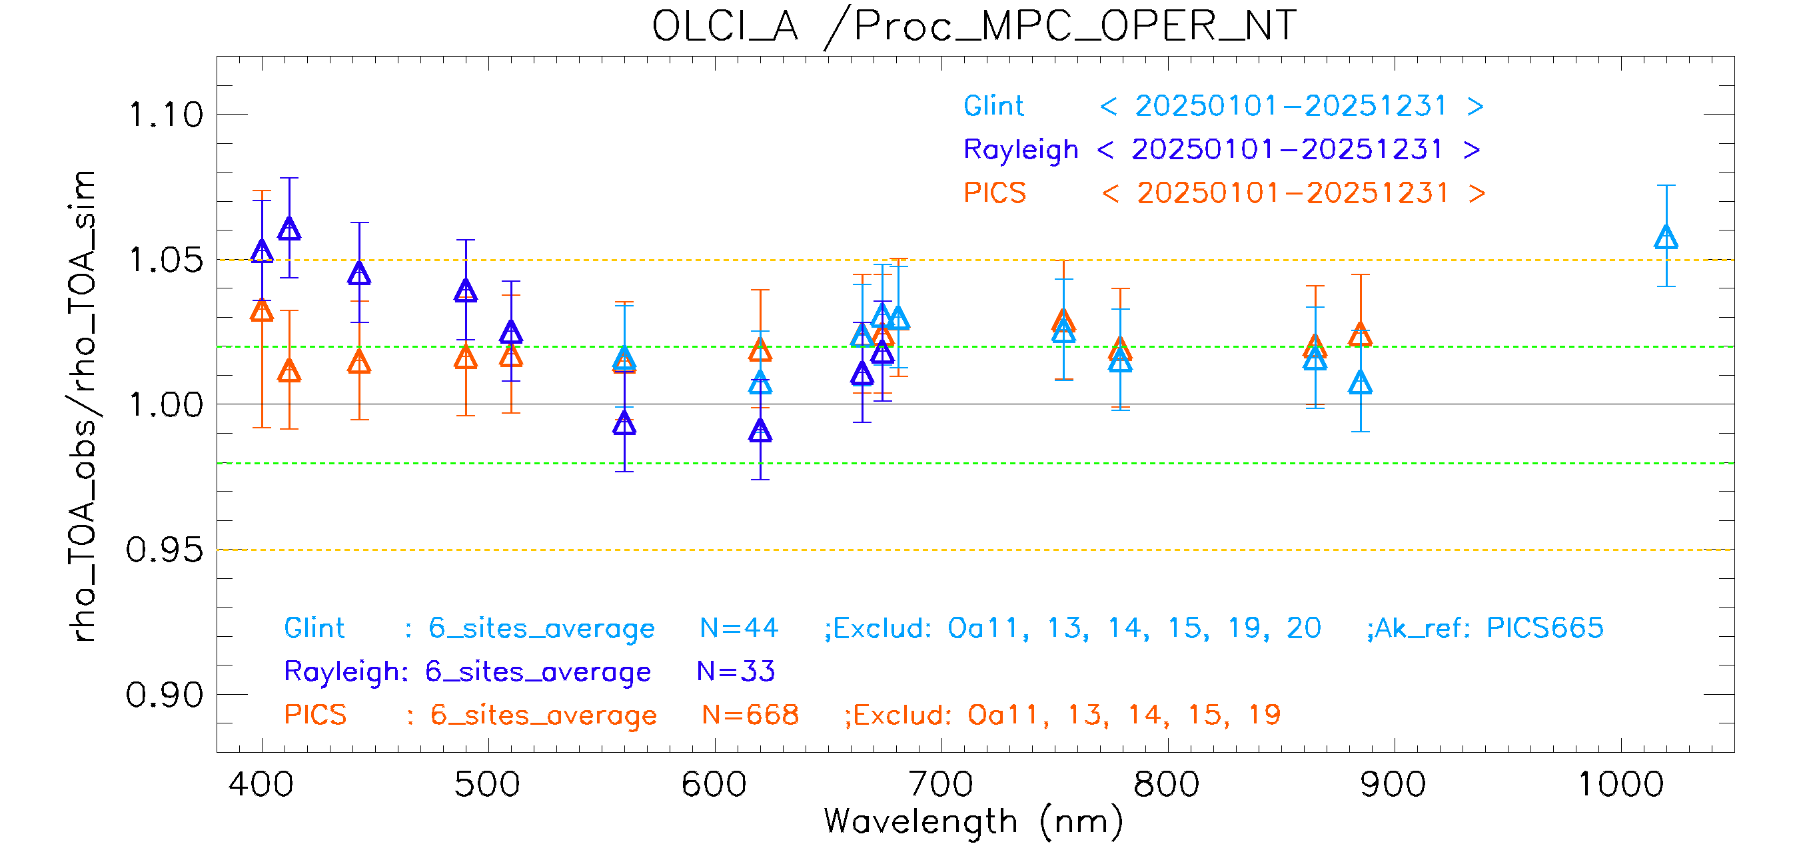
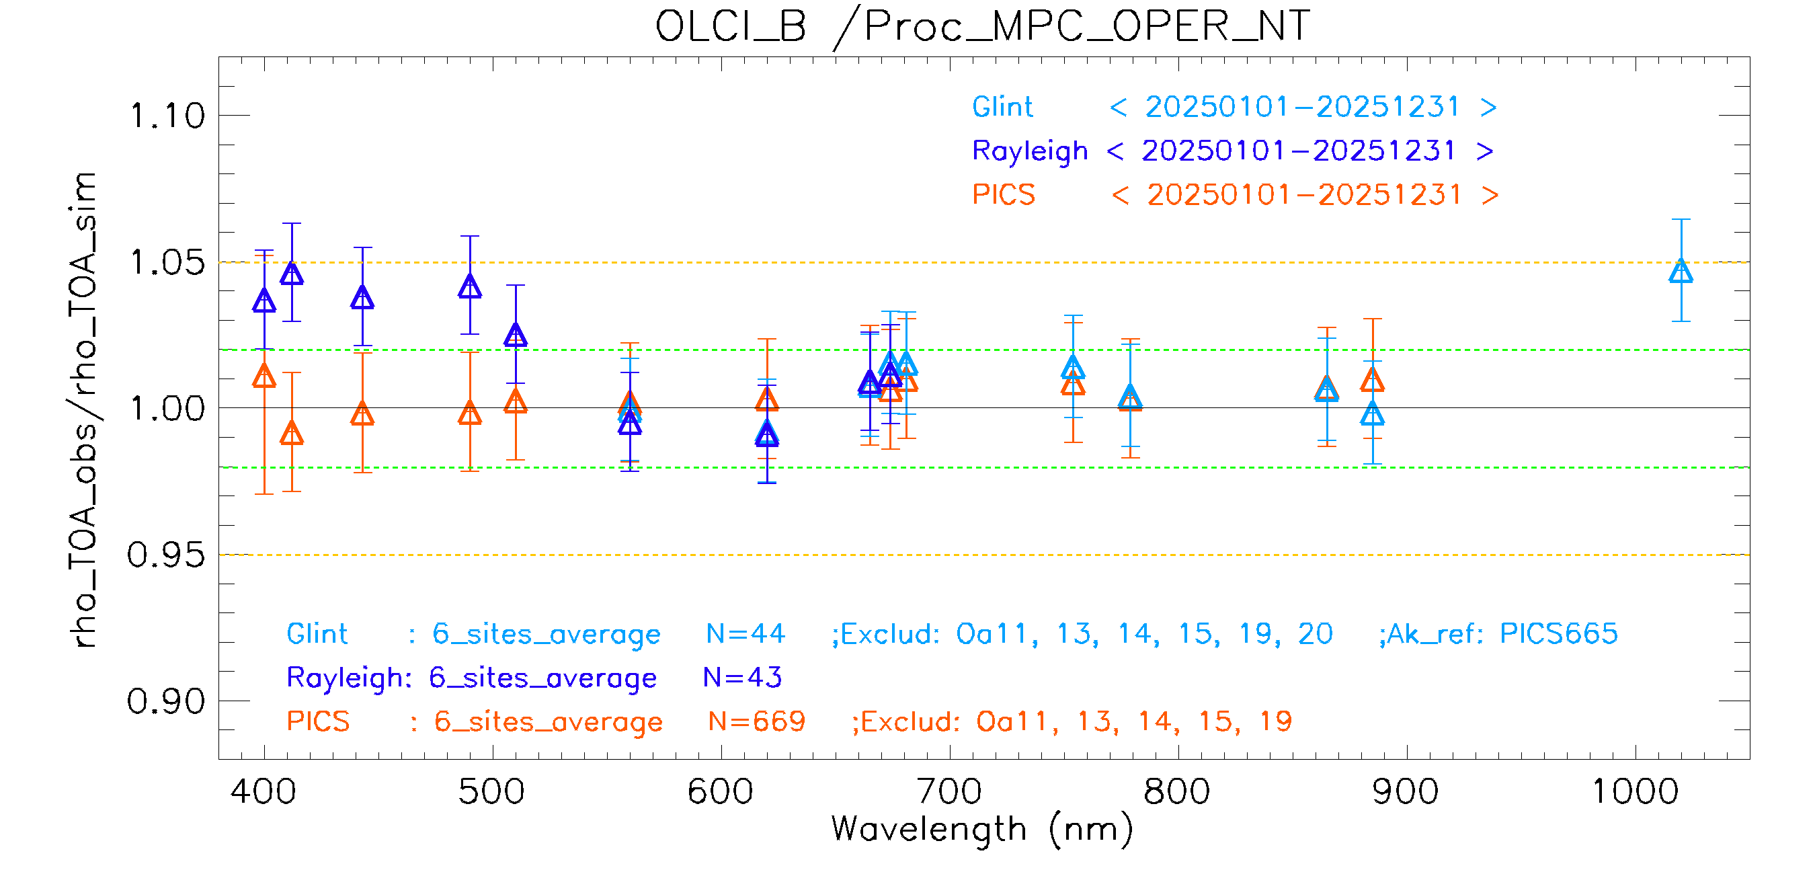
OLCI - Summary
All methods point out an excess of brightness for OLCI-A radiances.
Results are in pretty close agreement around 1-3% between 560 and 900 nm (Oa06 to Oa19). Rayleigh gives higher biases in the blue-green (up to 6 % while PICS remains around 2%) but this method is suspected to overestimate the simulated signal at those wavelengths, so PICS are considered more reliable.
Radiometric validation for OLCI-B indicates performance within the 2% requirement for all bands from 560 nm (Oa05) to 940 nm (Oa20). As for OLCI-A, the PICS method shows compliance also in the blue region (Oa1 to Oa4, 400 to 510 nm) while the Rayleigh method shows biases of about 4 to 5%.

Slide 11
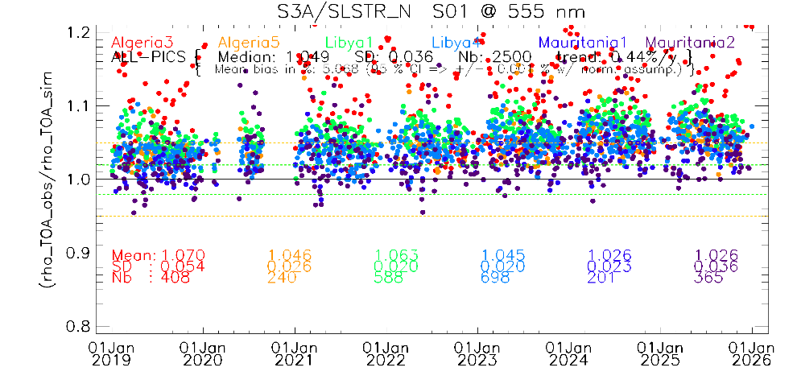
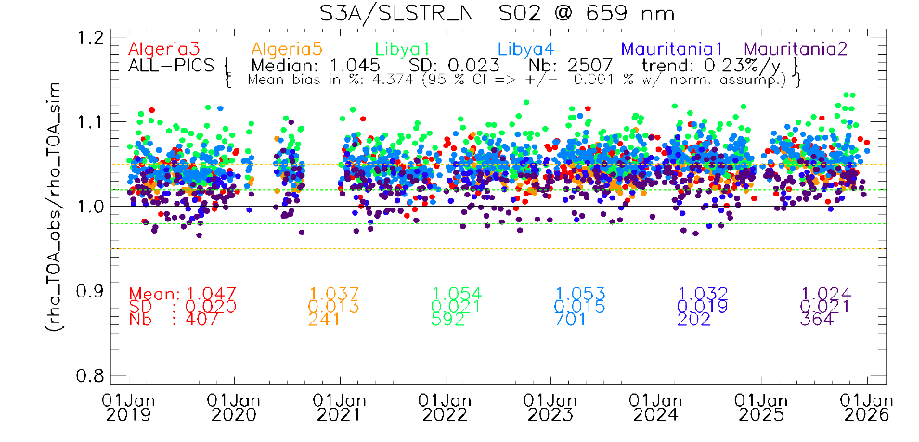
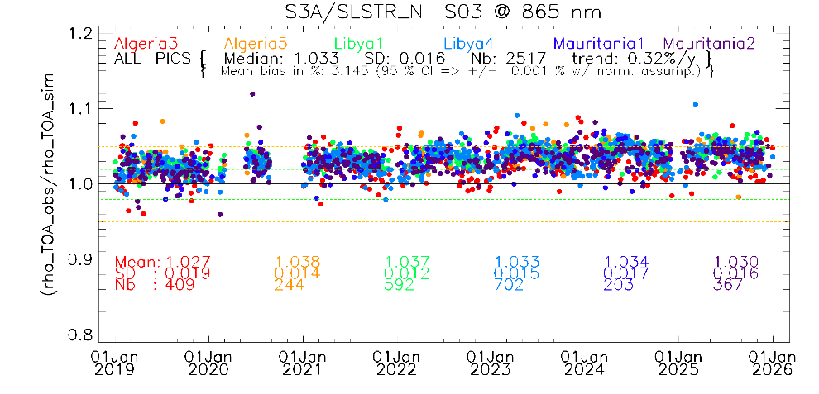
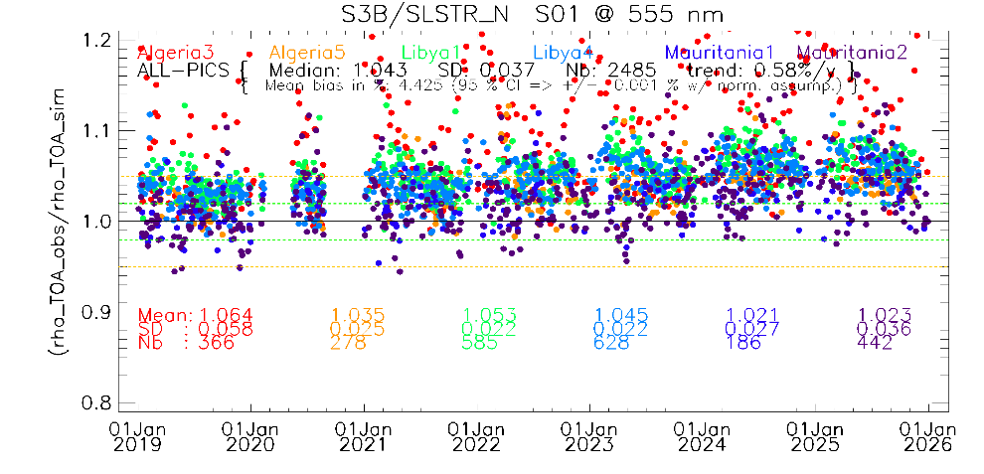
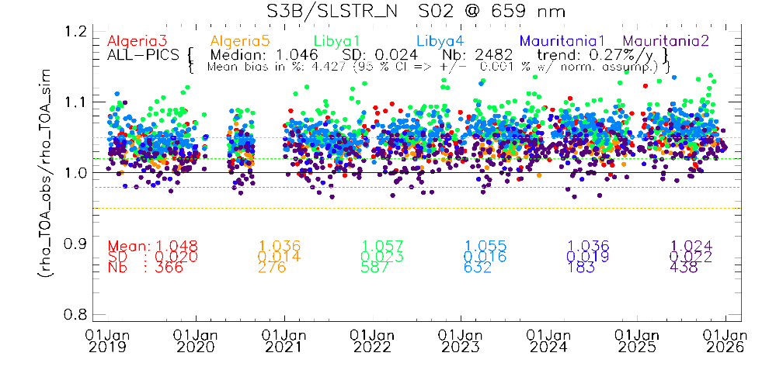
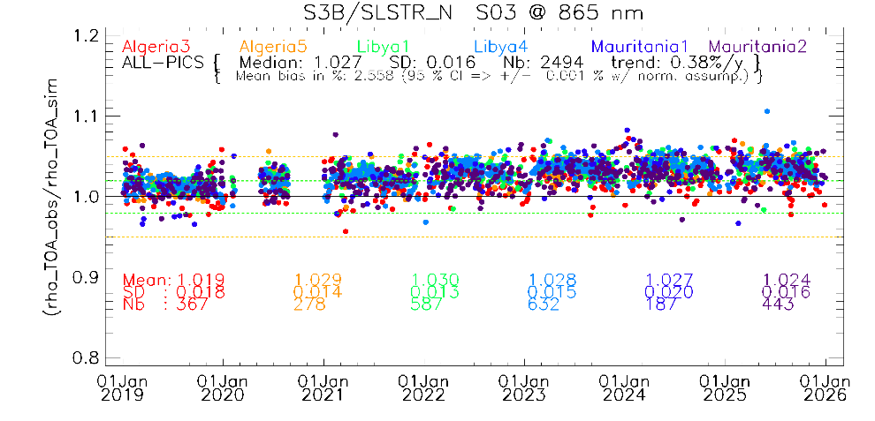
SLSTR (Nadir) - PICS results
Performed over 6 CalVal-Sites from Jan. 2019 – Jan. 2026
      S3A/SLSTR (N); Positive trend
      S3B/SLSTR (N); Positive trend
      VNIR discrepancy of about 3-6%

Slide 12
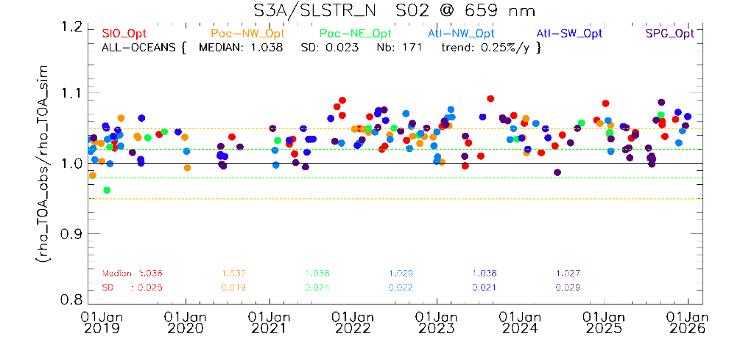
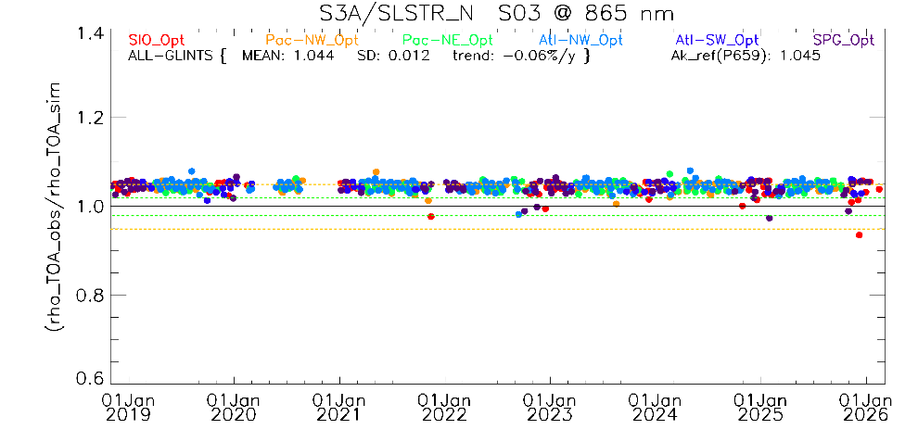
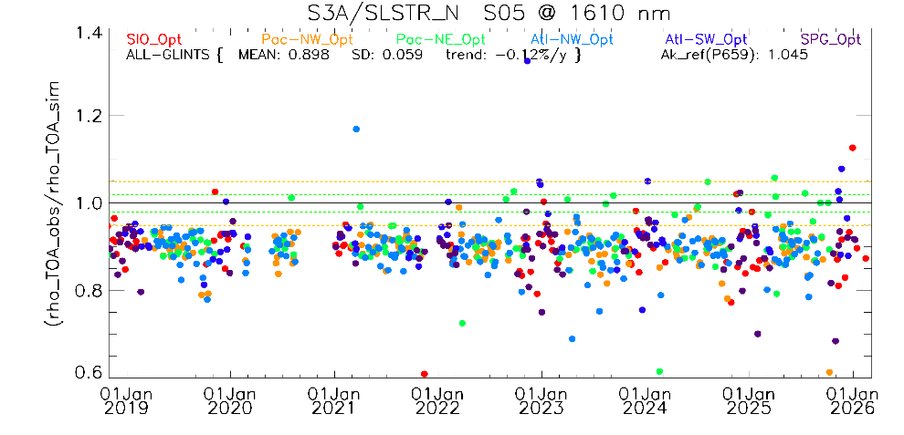
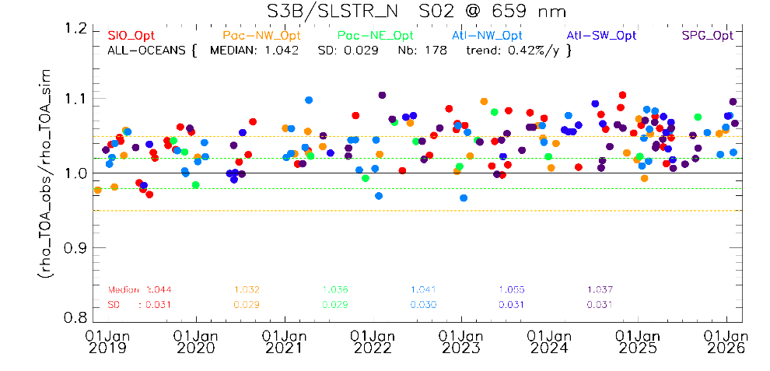
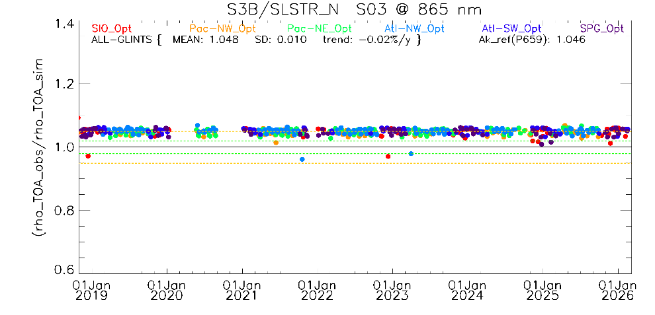
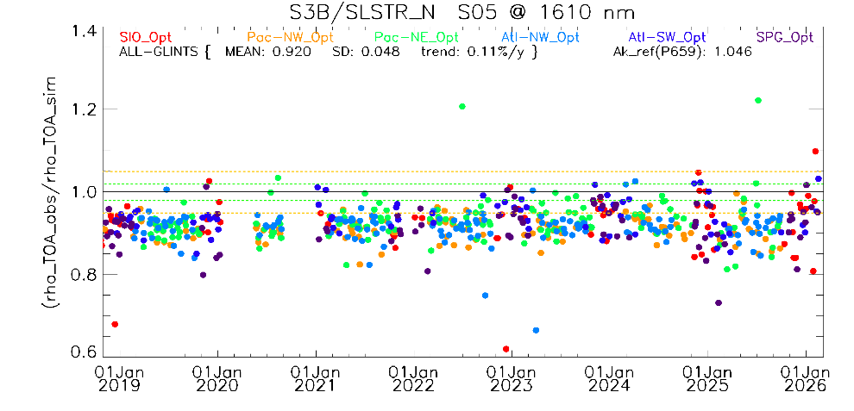
SLSTR (Nadir) – Rayleigh/Glint methods
Performed over 6 CalVal-Sites from Jan. 2019 – Jan. 2026
      S3A/SLSTR (N); Positive trend
      S3B/SLSTR (N); Positive trend
      VNIR discrepancy of about 3-6%

Slide 13
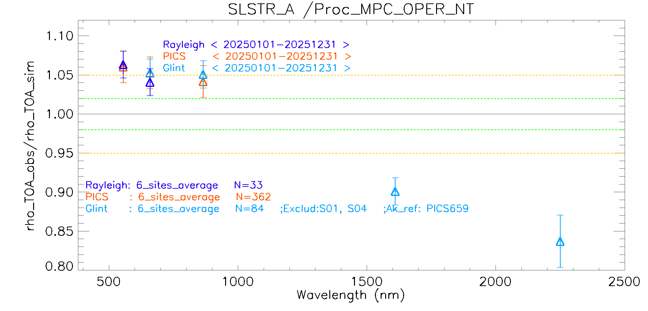
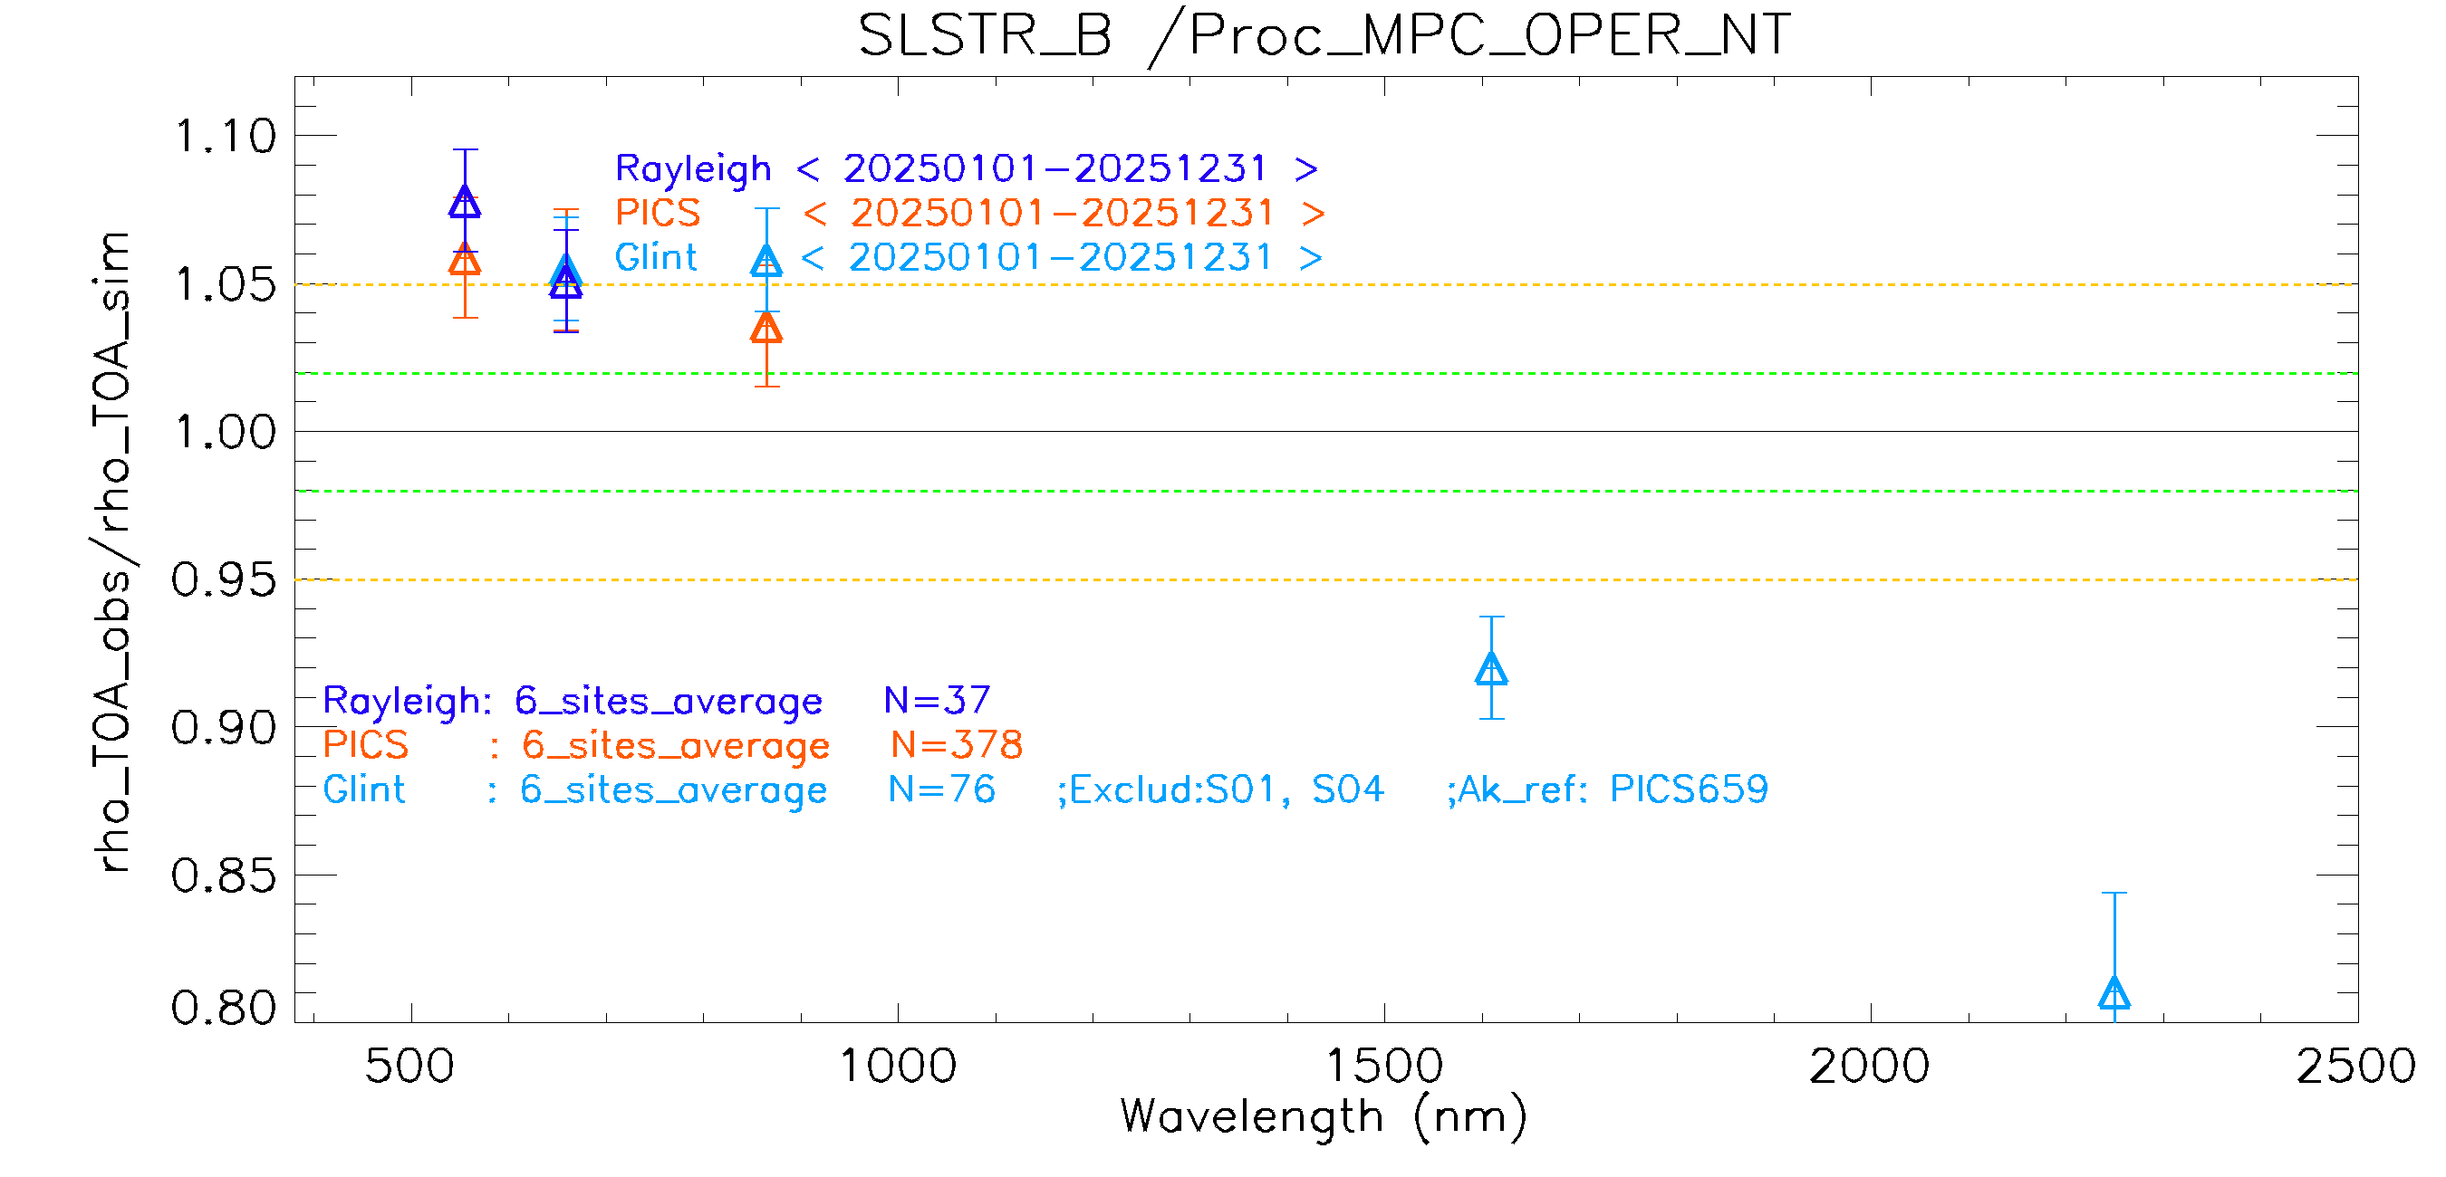
SLSTR - Summary
Good consistency over the three methods Glint, PICS and Rayleigh over VNIR bands.
VNIR bands discrepancy is within 6% (NADIR) up to 8% (OBLIQUE, results not presented)
Positive trend detectable (PICS & Rayleigh)
Good agreement between SLSTR-A & B to better 1% over the analysed period.

Slide 14
The “Lunar” method
Sentinel-3 started to systematically acquire Lunar observation since September 2022
Using regular observations of the Moon at almost constant phase angle and at the same place in the OLCI field of view (centre of camera 4)
The ‘lunar dataset’ was re-processed with the TSIS solar irradiance model
Comparison between OLCI-A & B and the Lunar Irradiance Model of ESA (LIME)

Slide 15
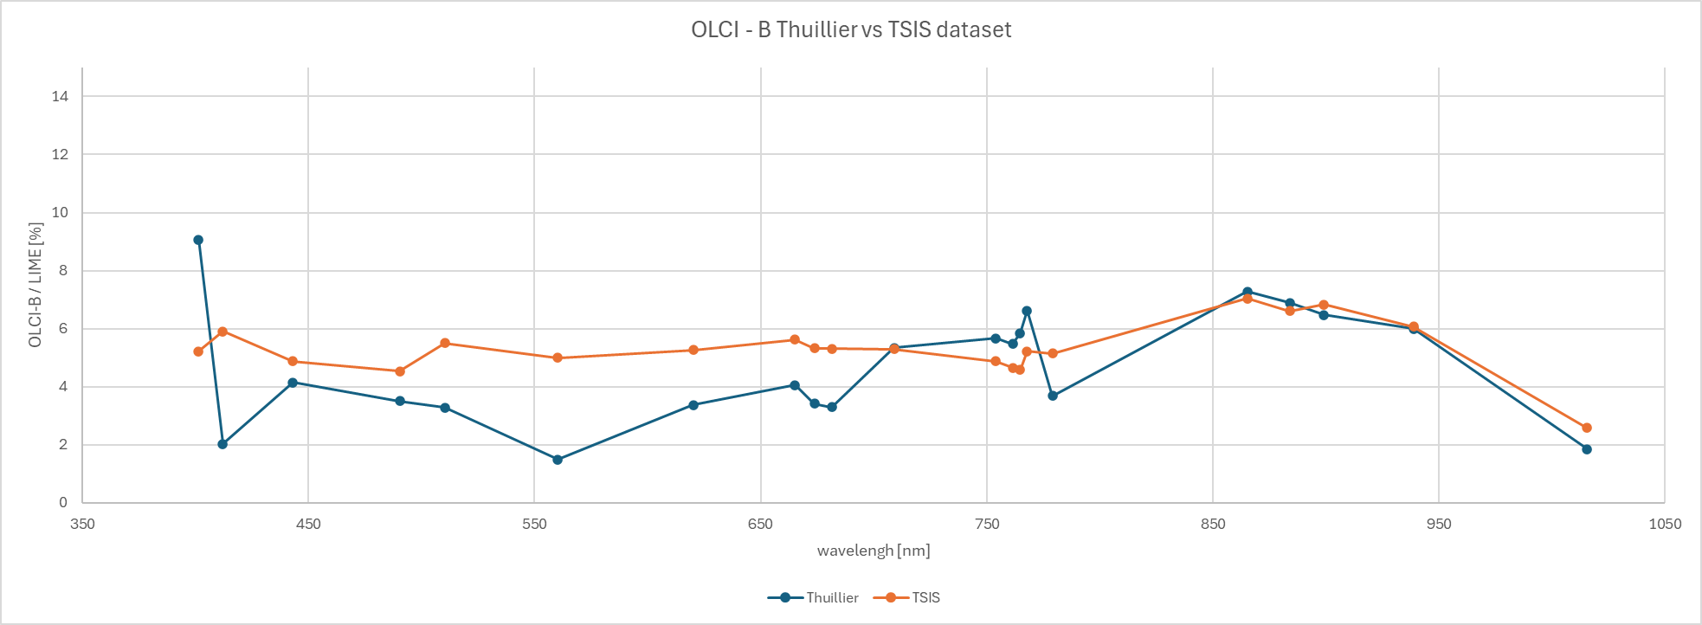
Comparison between datasets TSIS and Thuillier
Comparison between Lunar dataset processed using Thuillier and TSIS. Calibration processing was done identically on both datasets, revealing an important improvement in the obtained result, compared to the (same) LIME output.
Clear improvement in spectral inter-band variation.

Slide 16
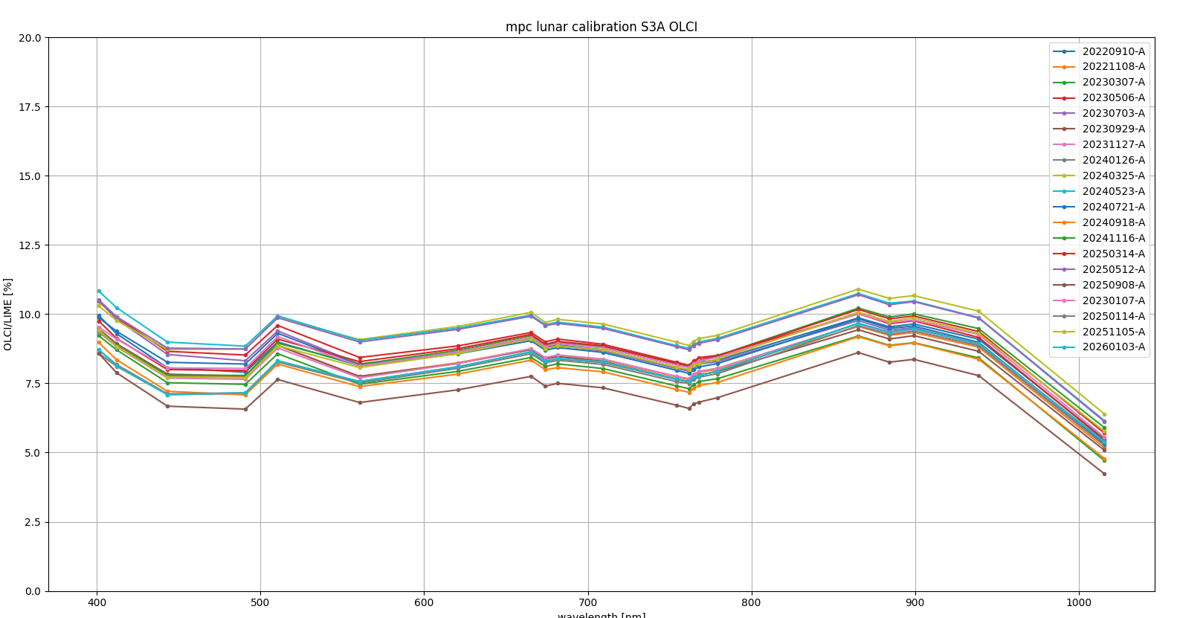
OLCI-A vs LIME
The profile of the results over the wavelengths shows a very good agreement. The average absolute level for all bands varies around 8% for OLCI-A.

Slide 17
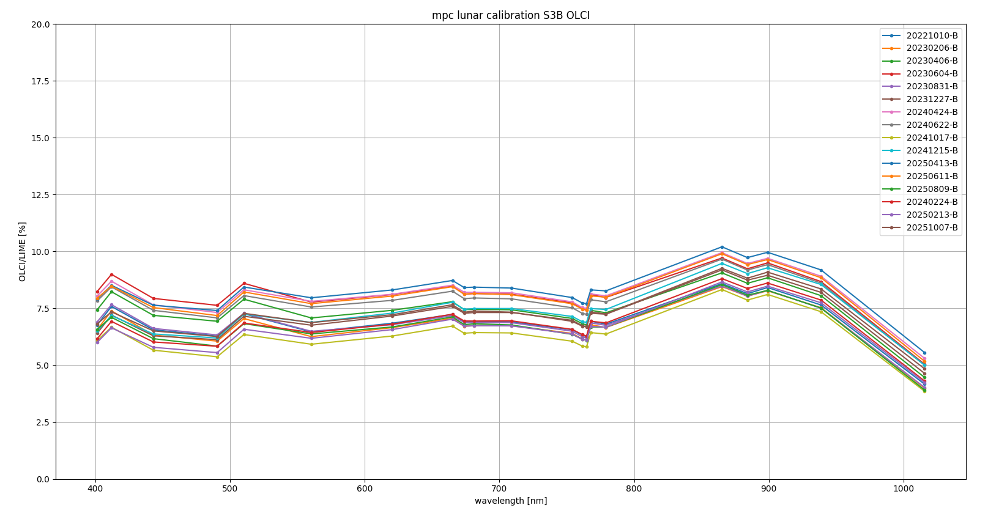
OLCI-B vs LIME
The average absolute level for all bands varies around 7%

Slide 18
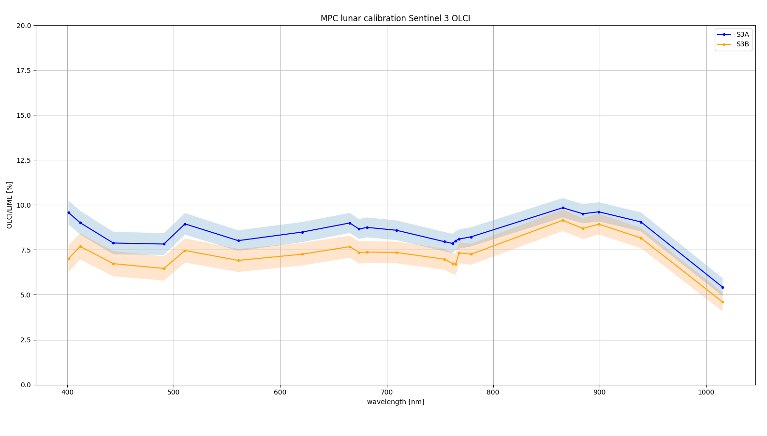
Mean and standard deviation for both OLCI-A&B
The bias between OLCI-A and OLCI-B is also confirmed by lunar observation

Slide 19
Conclusive remarks
In general results from PICS, Rayleigh and SunGlint methods are in pretty close agreement for both OLCI and SLSTR.
S3 SLSTR the VIS/SWIR channels have shown a consistent bias, with regard to reference sites, particularly in the SWIR channels. A first recommendation has been issued by SLSTR experts to apply correction factors before any L2 process. From the next processing baseline bias and drift corrections will be directly applied in the L1 processing.
All methods confirm 1–2% discrepancy between the two units OLCI-A and OLCI-B. Study is ongoing to provide recommendation to users to correct the OLCI-A/OLCI-B bias.
Contrary to the other methods lunar calibration for OLCI band Oa21 shows absolute levels that are lower than overall average band levels. The reason is unknown but could possibly be attributed to the LIME interpolation for the SWIR bands. Currently an update to the model is being established to mitigate the model levels in the SWIR due to the interpolation and coefficient regression. Upon release of the update, the data will be re-processed, and results adjusted in the report if needed.
More results are available in the Annual Performance Report: https://sentiwiki.copernicus.eu/web/document-library#DocumentLibrary-OpticalAnnualPerformanceReports(APRs)Library-S3-Performance-DQR-Optical-APR

