Slide 1
Monitoring Solar Channel Calibration Using Lunar Radiance
Xiangqian Wuª, Fangfang Yu^{b}, Bikash Basnet^{b}, Xi Shao^{c}, Nick Brenner^{d}, and Linfred Kingston^{c}
ª: NOAA/NESDIS/STAR ^{b}: ERT ^{c}: University of Maryland ^{d}: Cornell University
Declaimer: The scientific results and conclusions, as well as any views or opinions expressed herein, are those of the authors and do not necessarily reflect those of NOAA or the Department of Commerce.
Acknowledgements: We thank Dr. Toru Kouyama of the National Institute of Advanced Industrial Science and Technology (AIST) of Japan for lunar reflectance by the Spectral Profiler (SP) data onboard the SELENE, Arata Okuyama and Masaya Takahashi of Japan Meteorological Agency for lunar data by AHI.

Slide 2
Introduction
Radiometric calibration of satellite instruments must be carefully monitored throughout the mission life with external references.
Among the many references, the Moon has several unique advantages:
  Unparalleled stability.
  Independence of Earth events.
    Limit to detect change on Earth with instruments whose calibration depends on objects on Earth.
  Availability to most satellite instruments in the past and future.
    Geostationary satellites cannot see Dome C or Greenland.
    Deserts in GOES Field Of Regard (FOR) are not comparable to those in North Africa.
    GOES-WEST is further limited by the number of Deep Convective Clouds (DCC) in its FOR.
NOAA has collaborated with USGS and other partners for more than two decades to monitor radiometric calibration of satellite instruments with lunar irradiance (Wu et al. 2006).
We have also been exploring the feasibility of monitoring radiometric calibration using lunar radiance (2016 Tsukuba Meeting).

Slide 3
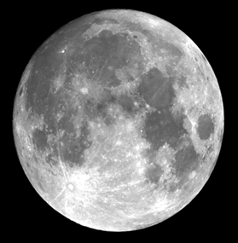
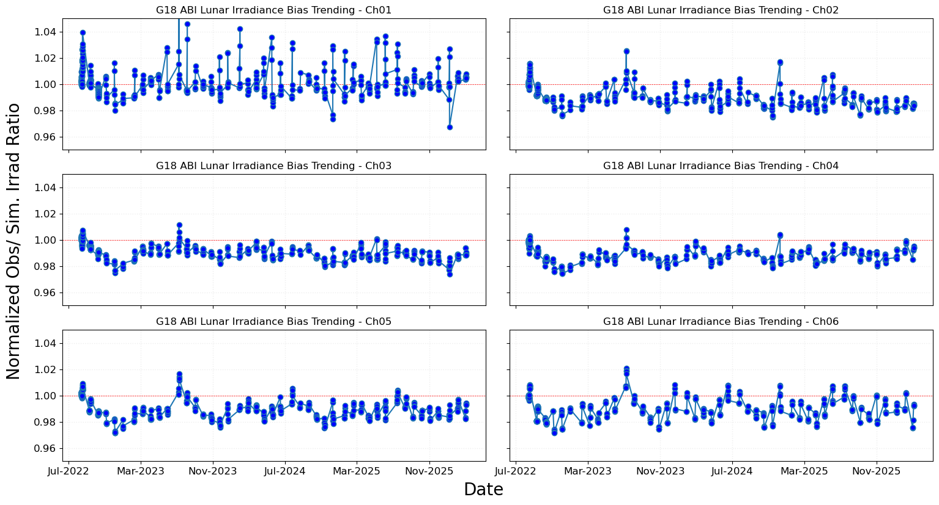
Lunar Irradiance
From the entire lunar disk.
Measured by an instrument and estimated by a model.
  Make the two equal to vicariously calibrate the satellite instrument (Imager).
  Track the ratio of the two to monitor calibration stability over time (ABI).
Example: Normalized ratio for GOES-18.

Slide 4
Lunar Radiance
From a Region Of Interest (ROI) on the Moon.
  ROI location varies with libration.
Lunar radiance depends on:
  The incoming solar irradiance, which is considered known; and
  The ROI reflectance, which in turn depends on the illuminating and viewing geometry (Bidirectional Reflectance Distribution Function or BRDF).
Finding the ROI in a lunar image and its BRDF are the two critical components.

Slide 5
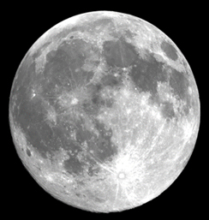
Step 1: Registration
We have tried several ways in the past …
  Selenographic Coordinates Transformation (Shao et al. 2015).
  Scale-Invariant Feature Transform (SIFT), widely used for object recognition and other applications (Yu et al. 2015).
  VGG-16/CNN model (Kingston et al. 2024)
  Graph Neural Network (GNN) (Kingston and Yu 2024, internal).
  Super Glue (Brenner et al. 2024, internal)
… and found LightGlue + Sub-sample Registration.
  LightGlue was used to register image pairs by matching local features, followed by RANSAC to reject outliers and estimate a robust geometric transform.
  Phase correlation was used to estimate sub-pixel shifts in ROI relative to the reference image, enabling consistent alignment of the target region before radiance extraction.
  Gaussian smoothing and Laplacian edge enhancement were applied during preprocessing to suppress noise and emphasize structural features for more reliable shift estimation.

Slide 6
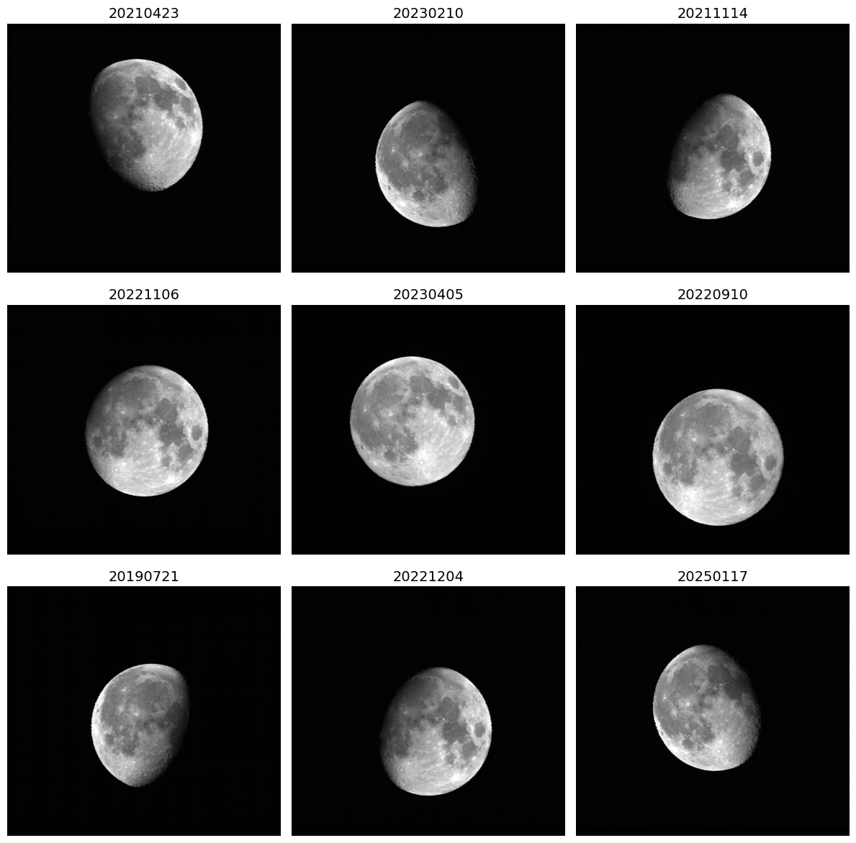
Observed Lunar Images

Slide 7
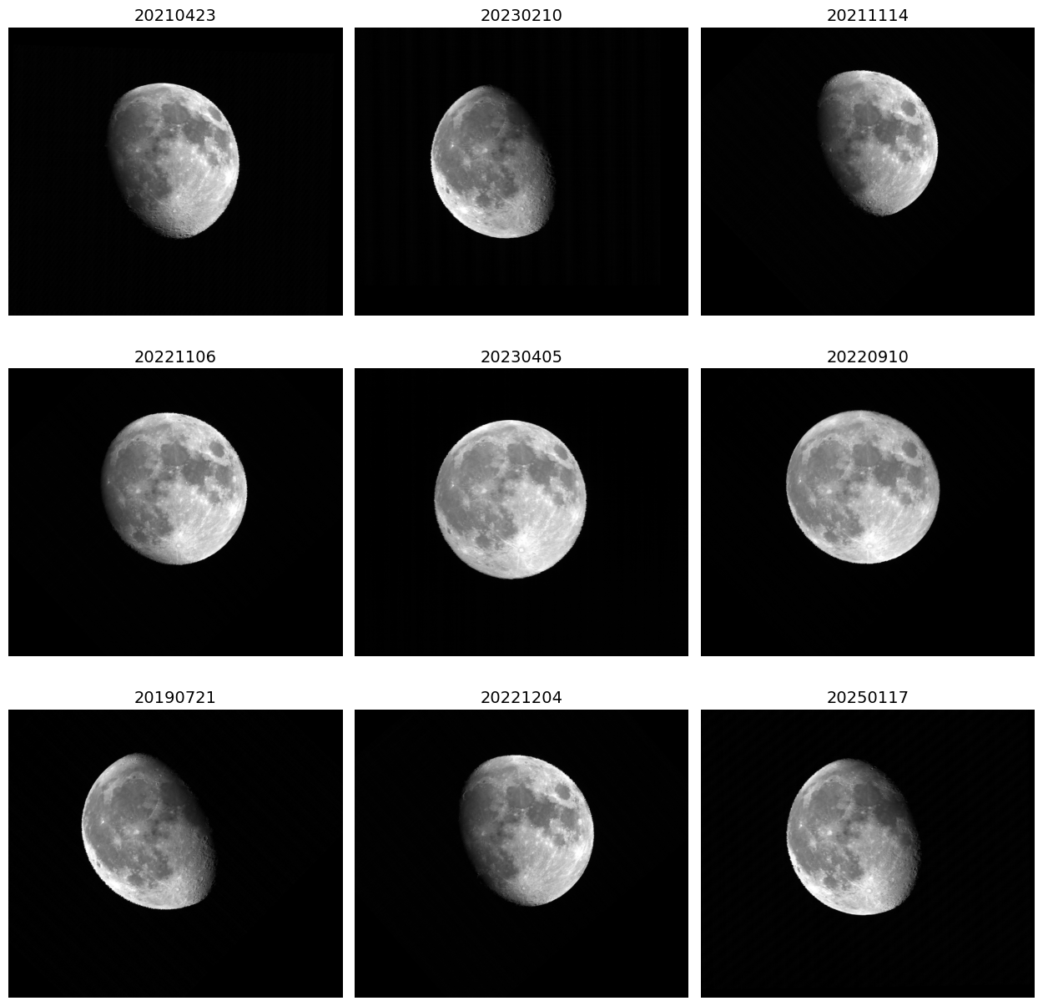
Registered with Light Glue
Rotation
Compression & stretching
Translation

Slide 8
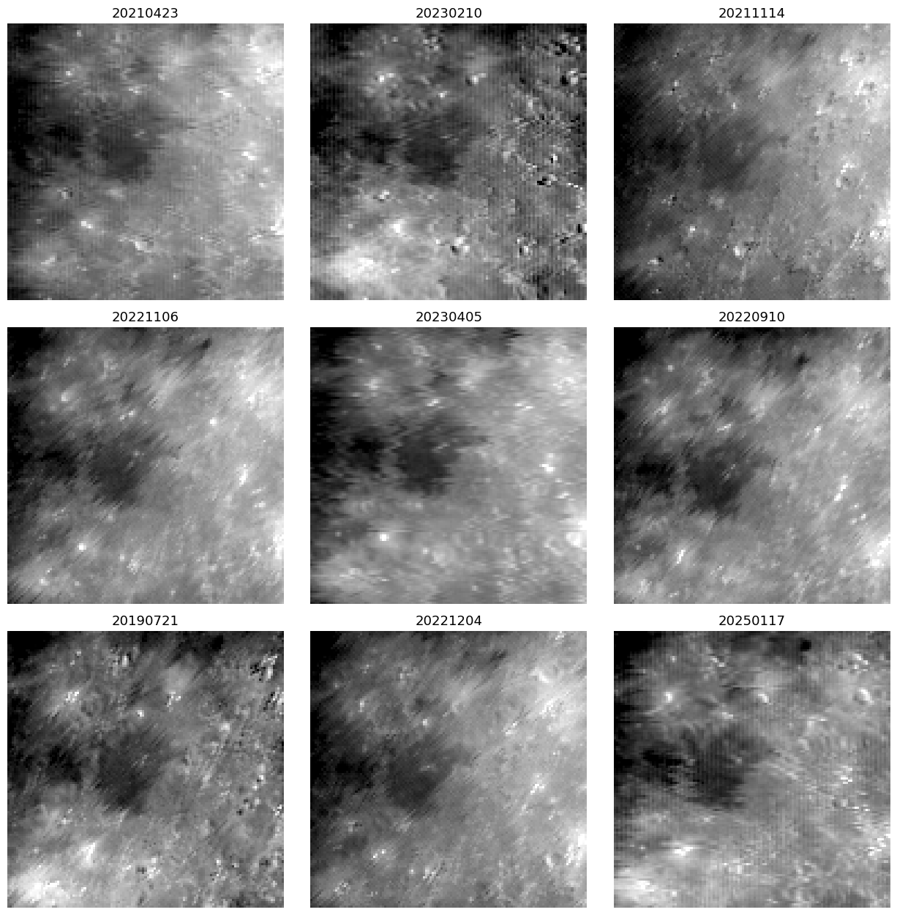
Before Sub-Sample Registration

Slide 9
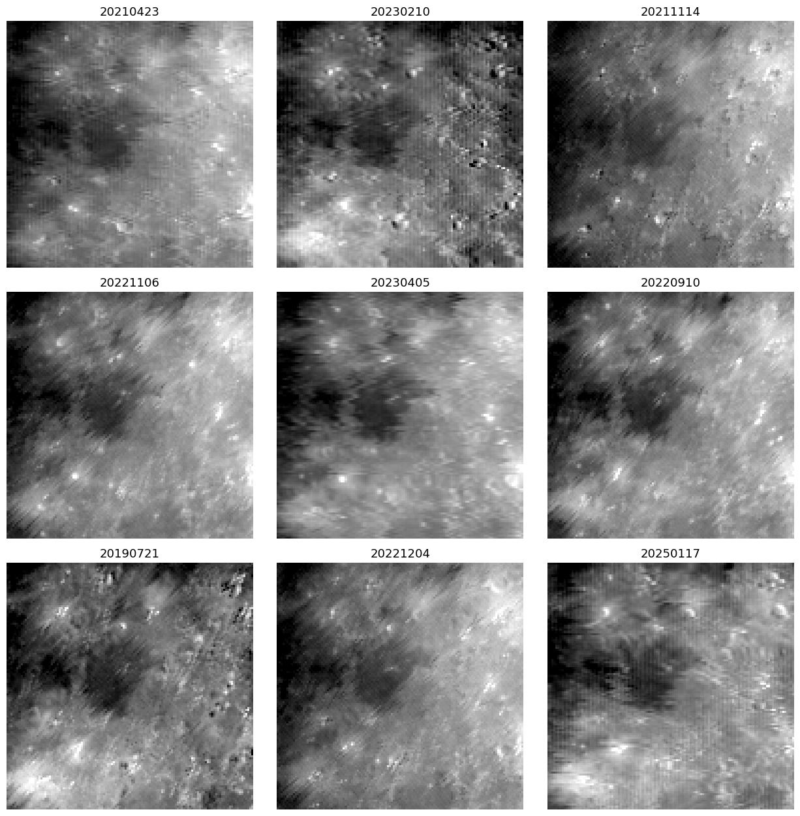
After Sub-Sample Registration

Slide 10
Step 2: ROI Location
Ideal ROI should be:
  Uniform, to minimize the registration error.
  Bright, to enhance the signal to noise ratio.
  Near the center, to maximize the chance that it is well lit.
No ROI has all these features.
Being near the center seems to be the most important.
Current ROI is centered at [0, 0].

Slide 11
Step 3: ROI Size
Channel | EW (µrad) | NS (µrad) | # Samples | Size (µrad) | Size (km)
2 | 11 | 10.5 | 123 | 1353 | 581
1, 3, 5 | 22 | 22.9 | 59 | 1298 | 557
4, 6 | 44 | 42 | 31 | 1364 | 586
Compromise between competing preference for ROI size:
  Large enough for sub-sample registration, and to be less sensitive to registration errors.
  Not too large such that, for example, part of its edge is not be illuminated.
Current ROI sizes for various ABI solar channels are listed in the table above.
  Optimal ROI size is still a subject of investigation.
  For example, register to a larger ROI but extract radiance in a smaller area.
The size in km is based on the mean GEO-Moon distance of 429,411 km and is at the nadir of the Moon.
This is approximately 1/6 of the Moon’s diameter, or the size of a “1 km pixel” (1200 µrad) of a LEO instrument.

Slide 12
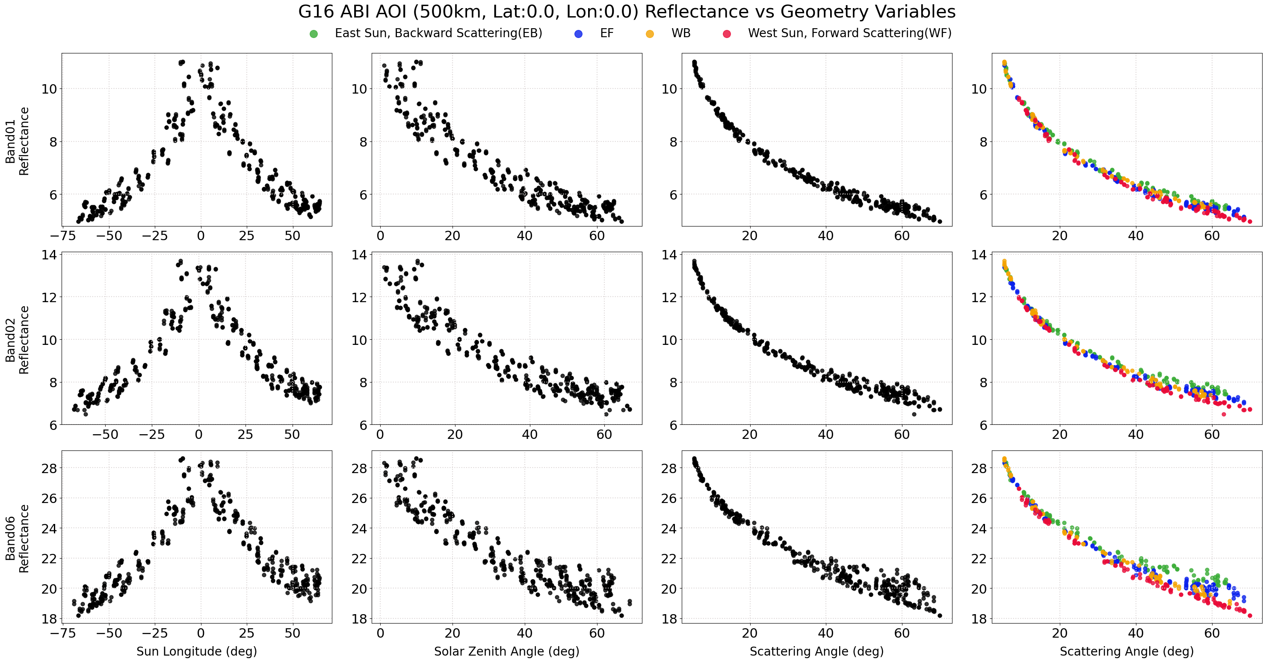
Step 4: ROI BRDF Predictor

Slide 13
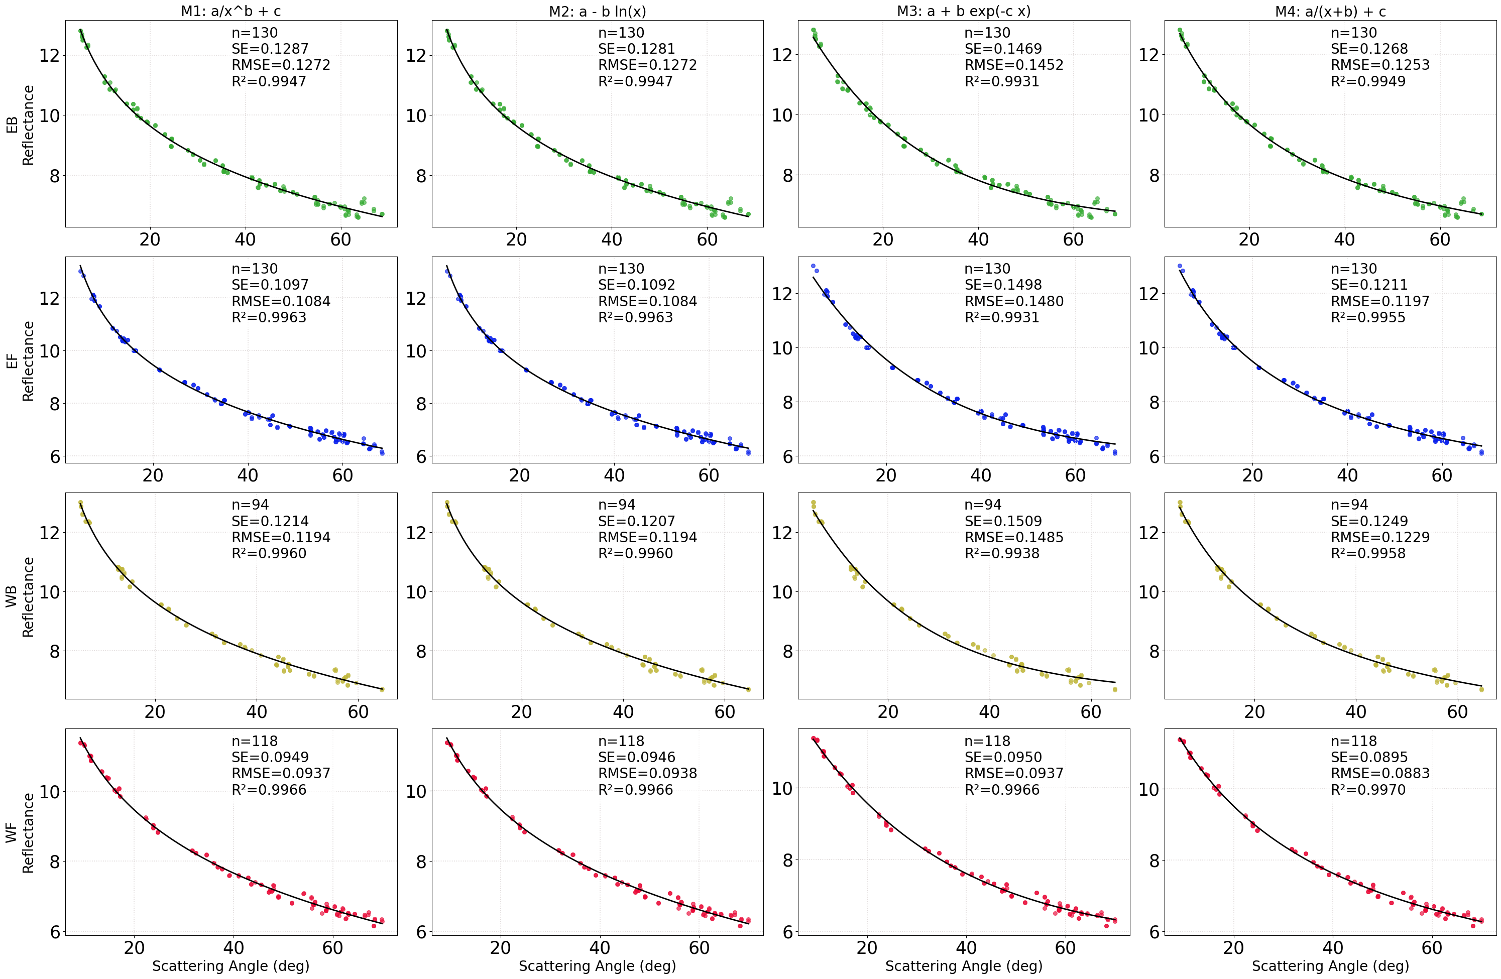
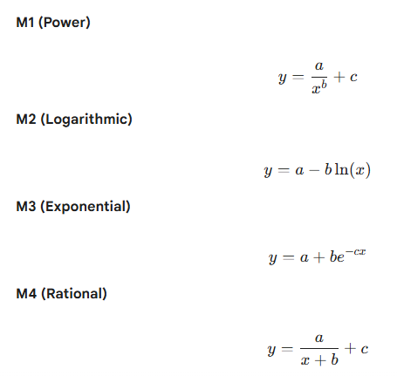
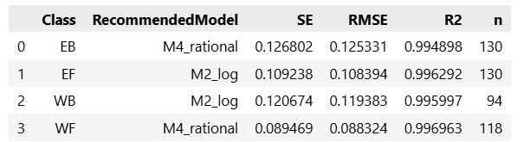
Step 5: Regression Formula
Evaluated by the SE of regression.

Slide 14
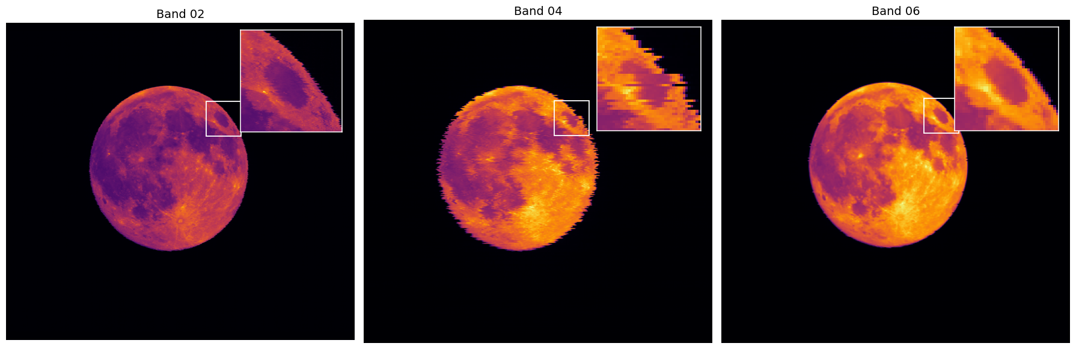
Must Shift per BDS for Band 4
46 µrad for B1 – B3
264 µrad for B4 & B6
For most channels, BDS are predominately on the same column. B04 is an exception.

Slide 15
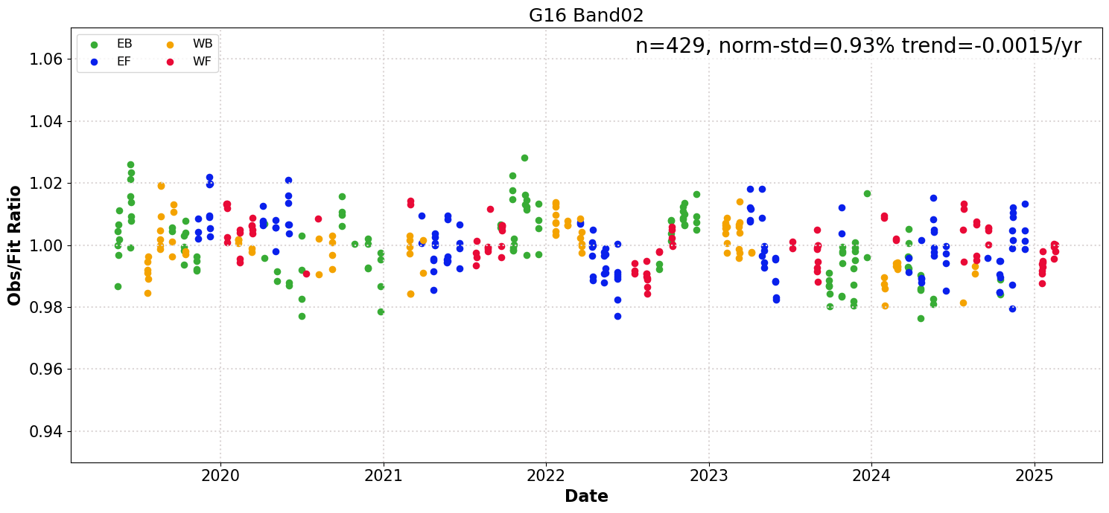
GOES-16 BRDF Applied to GOES-16

Slide 16
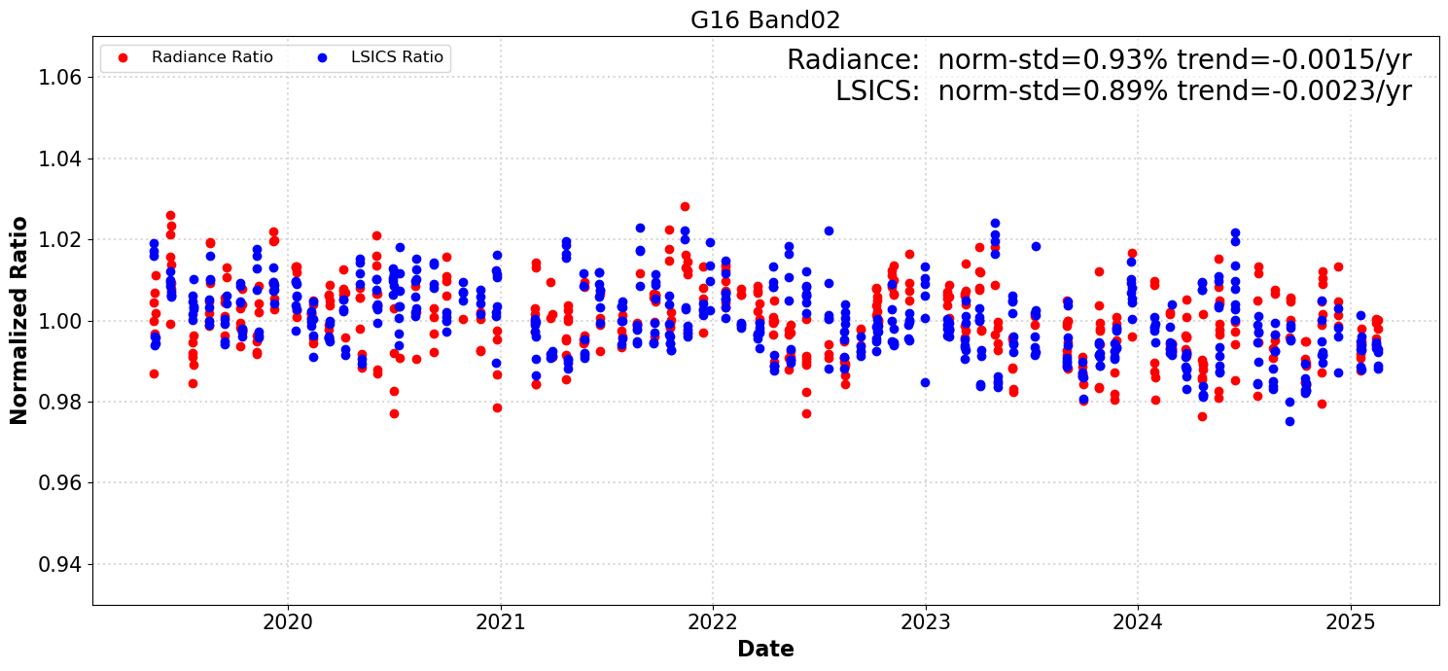
Comparison with LSICS (Irradiance)

Slide 17
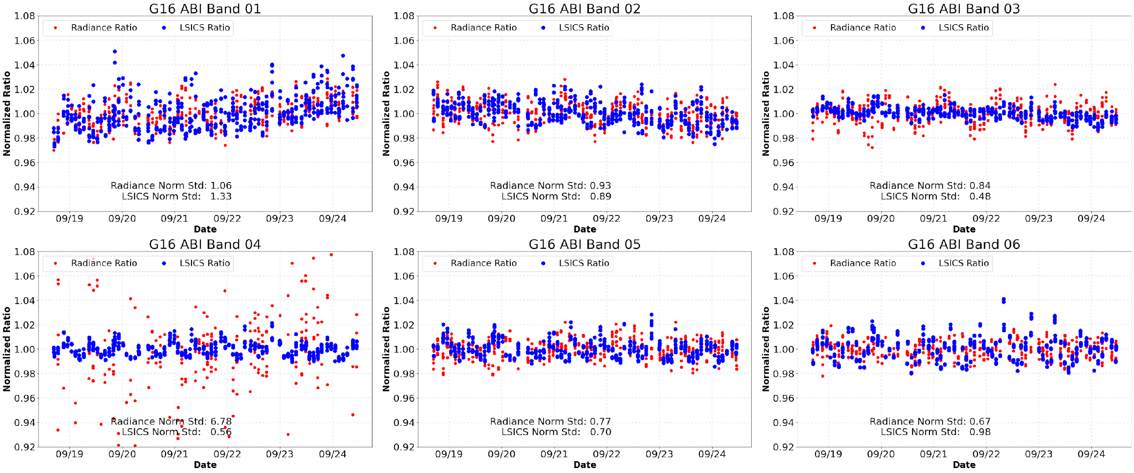
GOES-16 BRDF Applied to GOES-16

Slide 18
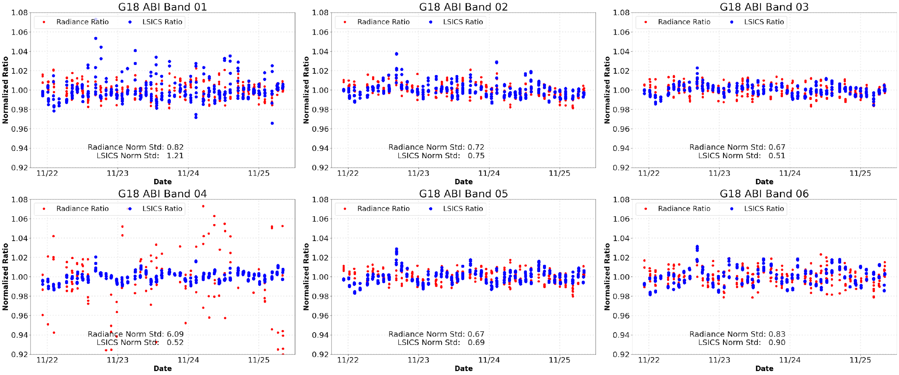
GOES-18 BRDF Applied to GOES-18

Slide 19
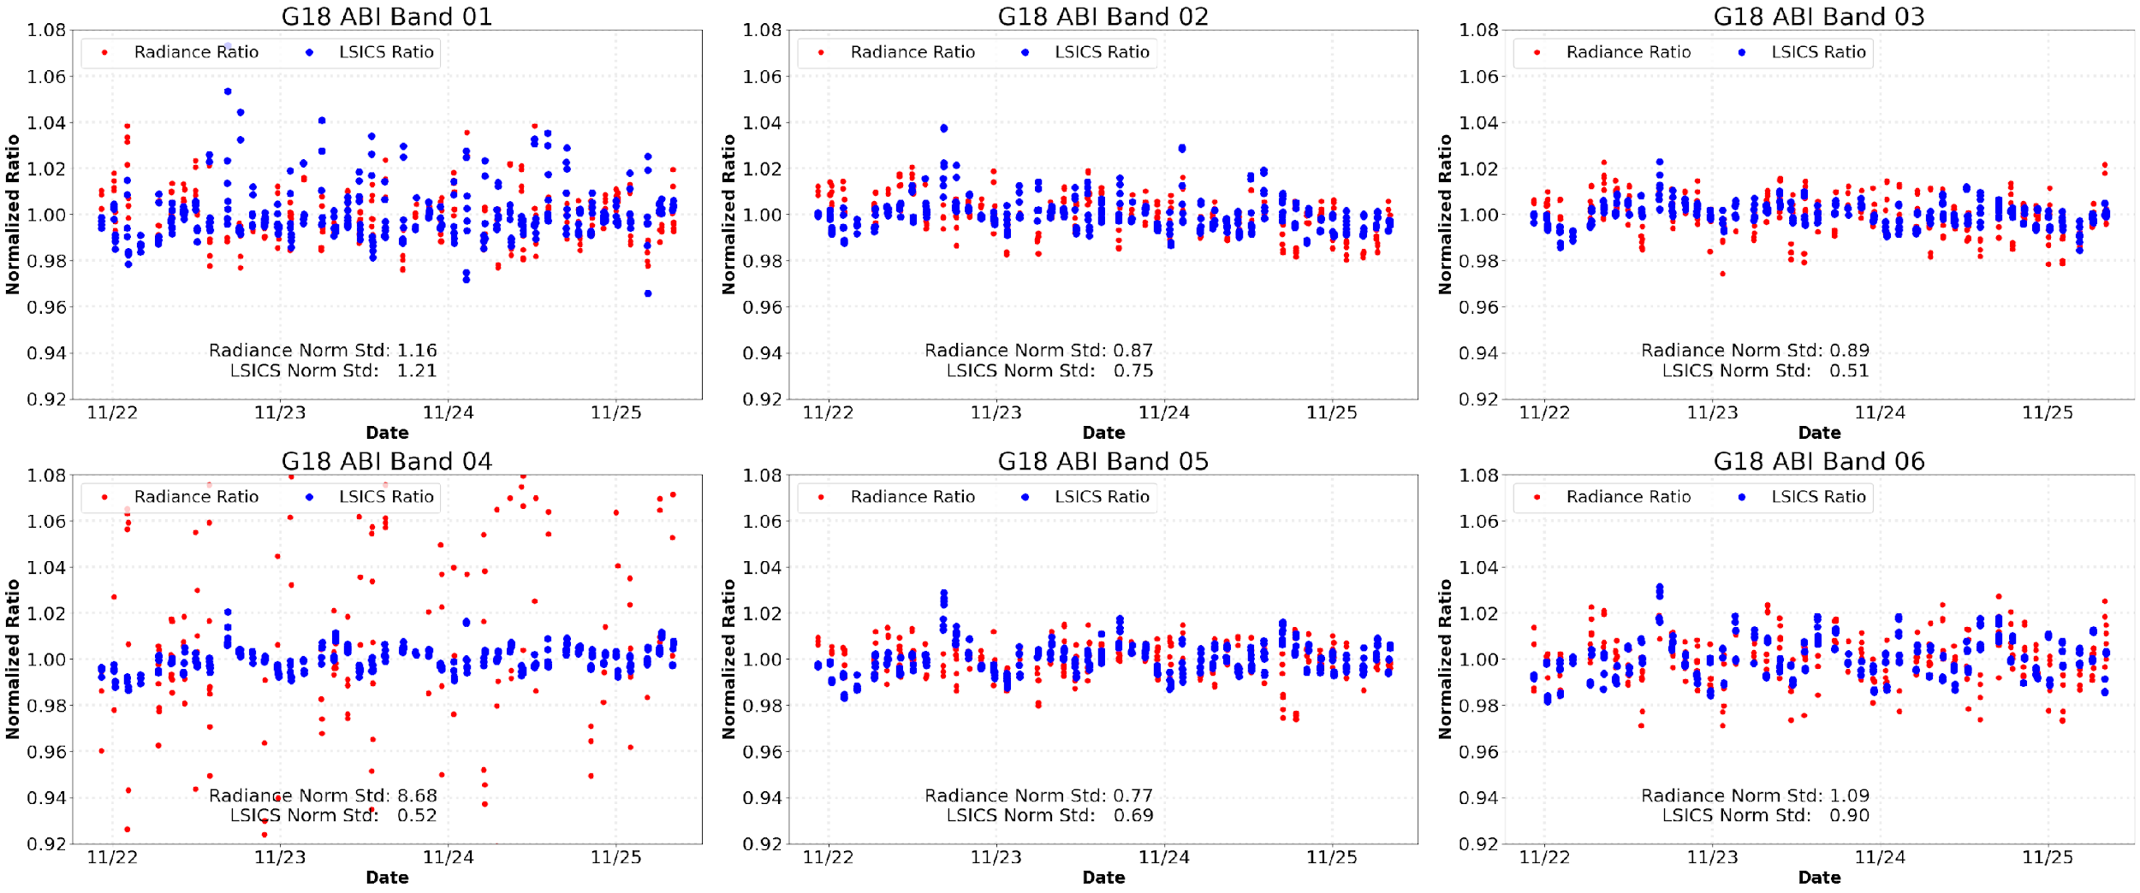
GOES-16 BRDF Applied to GOES-18
Is the BRDF derived from GOES-16 data universal (ABI-independent)?

Slide 20
Summary of the Results
Compared to LSICS, radiance-based monitoring performed better for B01 & B06, worse for B03, and similar for B02 & B05.
When G16 BRDF was applied to G18, performance was worse, but not by too much.
  We don’t have the universal BRDF yet, but it seems to be within reach.

Slide 21
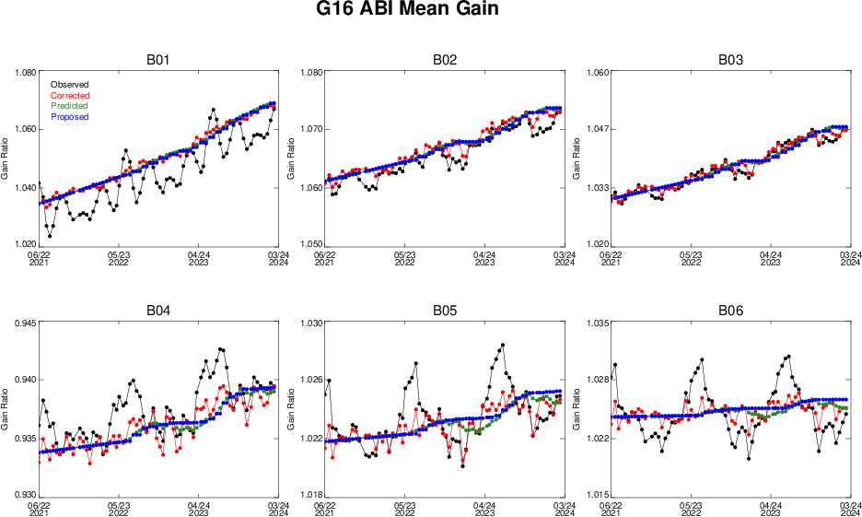
Path to a Community Lunar BRDF
One of the premises of radiance-based lunar calibration is the availability of lunar BRDF.
In deriving the BRDF, an implicit assumption is that GOES-16 ABI calibration is stable such that one can derive the lunar BRDF from ABI data.
But ABI Solar Diffuser (SD) reflectance error imposes an artificial seasonal variation in the lunar reflectance.
  This may compromise the derived BRDF.
  Should use the recalibrated ABI data.
No reason to be limited to one ABI.
  Expand to other ABIs (with recalibration).
  And AHI, AMI, or any stable instruments.
  In particular, solar calibration of AHI is not subject to the SD reflectance error – easier recalibration.
  NOAA would like to collaborate with JMA and other agencies to improve lunar BRDF.

Slide 22
Conclusions
The Moon is unique to monitor radiometric calibration of satellite instruments.
Lunar data can be used as a source of irradiance and radiance.
Both are available to instruments of high spatial resolution.
  All GEOs and many LEOs.
  Emerging commercial remote sensing without onboard calibration.
  Multiple options are often better.
LSICS is irreplaceable for some applications.
  Nighttime visible remote sensing.
  Early instruments with low spatial resolution.

