Slide 1
Lunar Calibration Activities at EUMETSAT
Sebastien Wagner
EUMETSAT - Radiometric Calibration Team
With the support from:
V. Debaecker, R. Degoul – Telespazio Toulouse
O. Henriquez, CS
GSICS annual meeting – Ottawa, 23-27 March 2026

Slide 2
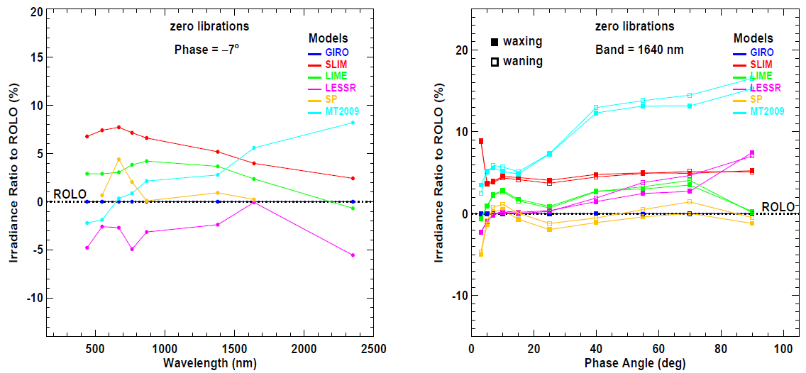
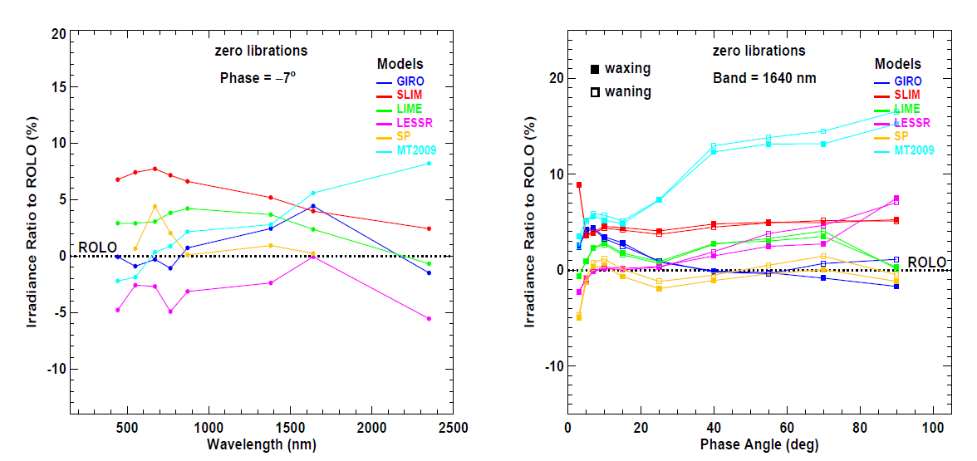
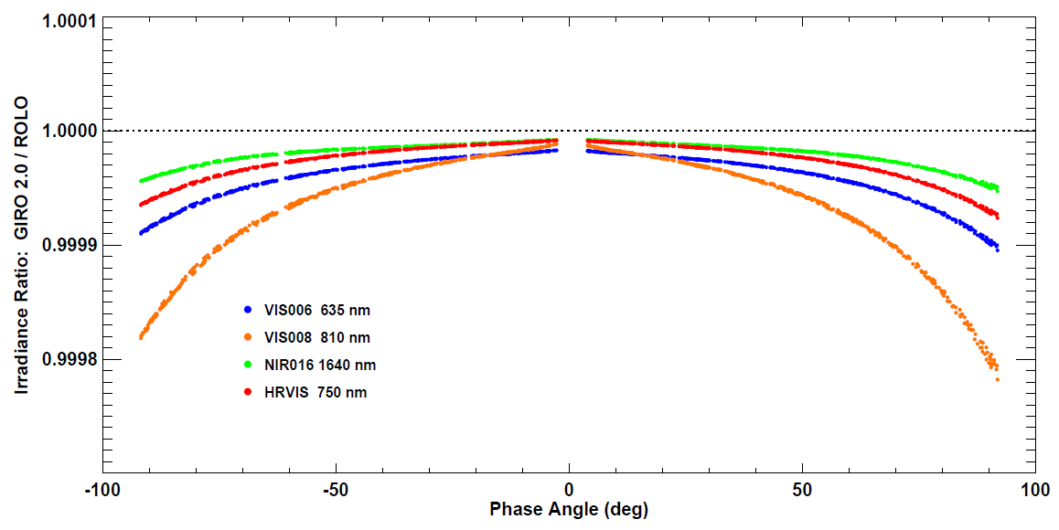
Activities on model development
GIRO v1.1.0 ➔ GIRO v2.0 = Re-alignment with ROLO
  Revised version of the ROLO reference lunar reflectance spectrum
  Revised algorithm for fitting that spectrum (including new C/C++ library)
  Increased precision of the ROLO model coefficients (GIRO implemented initially the 2005 publication coefficients ➔ truncation rounding errors)
Contribution to LSICS development (see LSICS pres.)
New version to be checked for IPR before distribution to licensees.
Residual using MSG1/SEVIRI as a benchmark (1669 obs.) < 10e-5

Slide 3
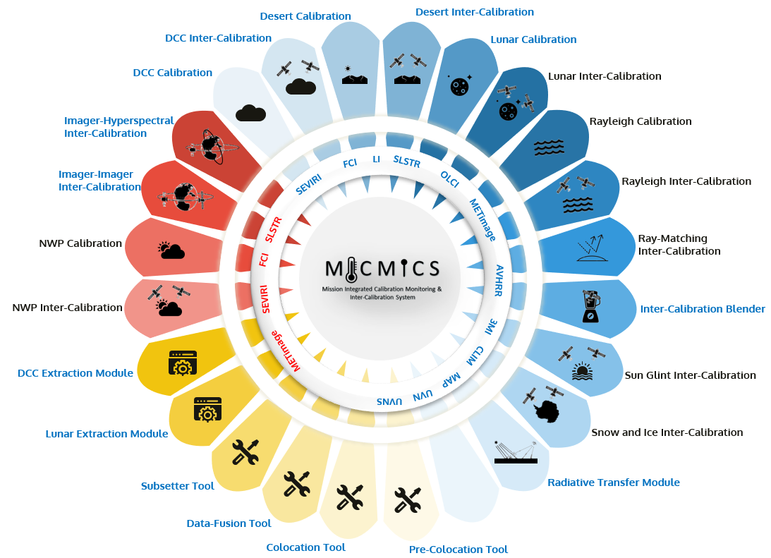
MICMICS Lunar Calibration
MICMICS LXTRM:
Extraction of the lunar data
Preparation of the GIRO input files (single records)
MICMICS LCS ➔ LSICS
LSICS = Lunar Spectral Irradiance Calibration System
LSICS = framework to operate consistently lunar reflectance models
EUMETSAT implementation ➔ 3 lunar models:
  GIRO v2.0 (version = realign. with ROLO)
  SLIMM (H. Kieffer)
  LESSR v2.0 (EUMETSAT / ESS)
TSIS solar spectrum
LIME integration in prep. (GSICS Lunar sub-group)

Slide 4
Missions with lunar acquisitions
MFG
MVIRI
MSG
SEVIRI
MTG
FCI
MTG
LI
S3
OLCI
S3
SLSTR
EPS-SG
METimage
EPS-SG
3MI
EPS-SG
MW inst.
EPS
GOME-2
S4
UVN
S5
UVNS
CO2M
MAP + CLIM
MTG
IRS
GEOs versus LEOs
Ops activities
+
CAL/VAL plans
Activities foreseen
Activities TBC

Slide 5
Missions with lunar acquisitions… past…present…
Past missions ➔ MFG MVIRI + MSG1 SEVIRI + Metop-A GOME2
  Meteosat-1 to 6 not processed yet
  Meteosat-7 and 8 fully processed
  Work still on-going on Metop-A GOME2 ➔ needed to allow inter-calibration against SCIAMACHY + model inference in the future
Routine operations, with regular lunar acquisitions
  MSG2 to MSG4 SEVIRI
  MTI1 FCI + LI
  Metop-B and C GOME2
  Sentinel-3A and Sentinel-3B OLCI + SLSTR ➔ radiometry monitoring incl. inter-band + inter-mission
In commissioning
  EPS-SG A1 METimage + 3MI
  Sentinel-4 UVN
  Sentinel-5 UVNS
➔ EUMETSAT Climate Team
➔ needed to allow inter-calibration against SCIAMACHY + model inference in the future
➔ radiometric monitoring
➔ radiometric monitoring incl. inter-band + inter-camera
  ➔ inter-calibration against SCIAMACHY + model inference
➔ radiometry monitoring incl. inter-band + inter-mission
➔ 2 roll manoeuvres + intrusions Deep Space View (METimage)
➔ Specific acquisitions
➔ No acquisition foreseen

Slide 6
Missions with lunar acquisitions…future…and some others…
In preparation
  July 2026 : MTI2 FCI + LI ➔ radiometric monitoring incl. inter-band + inter-camera
  September 2026: Sentinel-3C OLCI + SLSTR ➔ radiometric monitoring incl. inter-band + inter-camera
    Tandem acquisitions with Sentinel-3B in 2026 and with Sentinel-3A in 2027
    Routine manoeuvres after commissioning
  CO2M MAP + CLIM ➔ radiometric monitoring
  Lunar observations in the IR
  Metop-C IASI ➔ continuation of the lunar acquisitions with one of the reference views
  Opportunities with MTS1 IRS (lunar intrusion) ➔ data usability still to be assessed
  EPS-SG A1 IASI-NG ➔ lunar intrusions foreseen (similar to IASI)
  Lunar observations in MW
  EPS-SG A1 MWS ➔ lunar intrusions but data still to be analysed
  EPS-SG B1 ICI + MWI ➔ lunar observations foreseen, also covering new frequencies

Slide 7
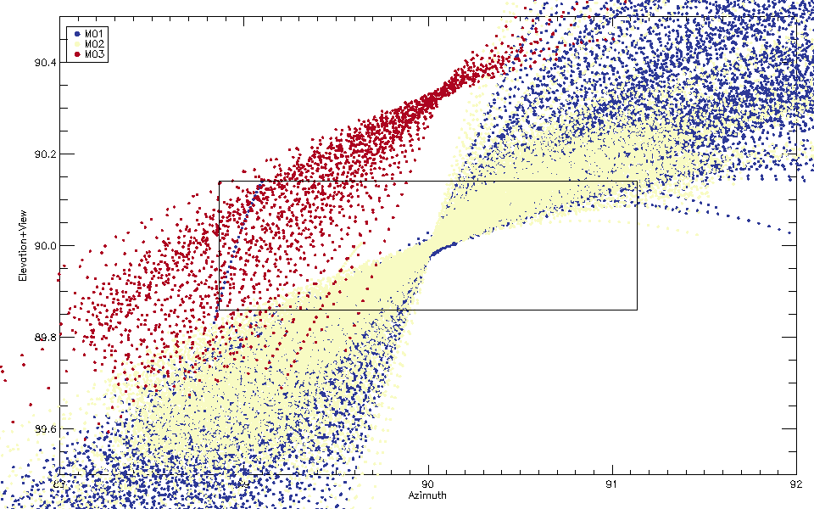
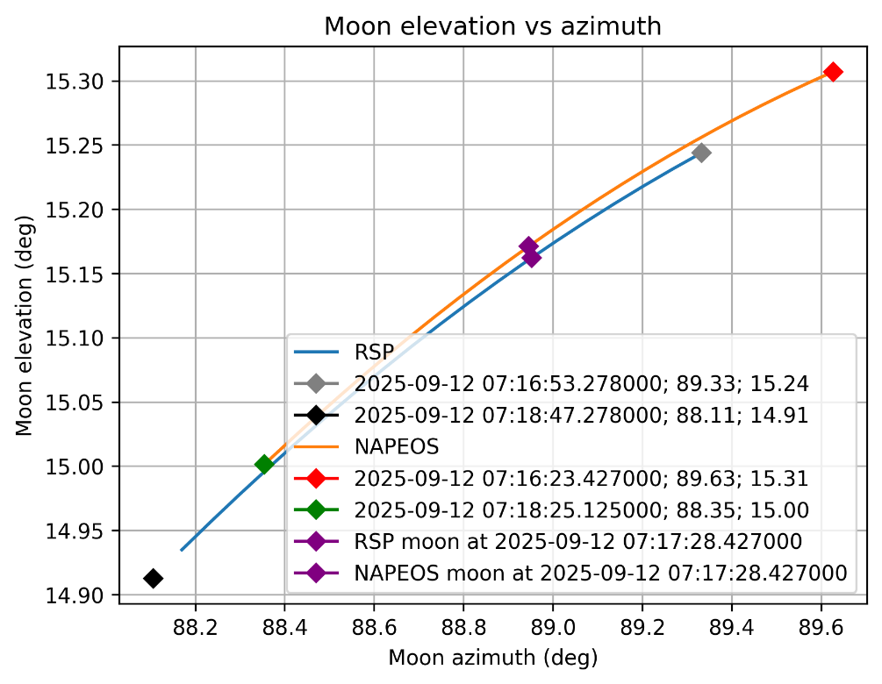
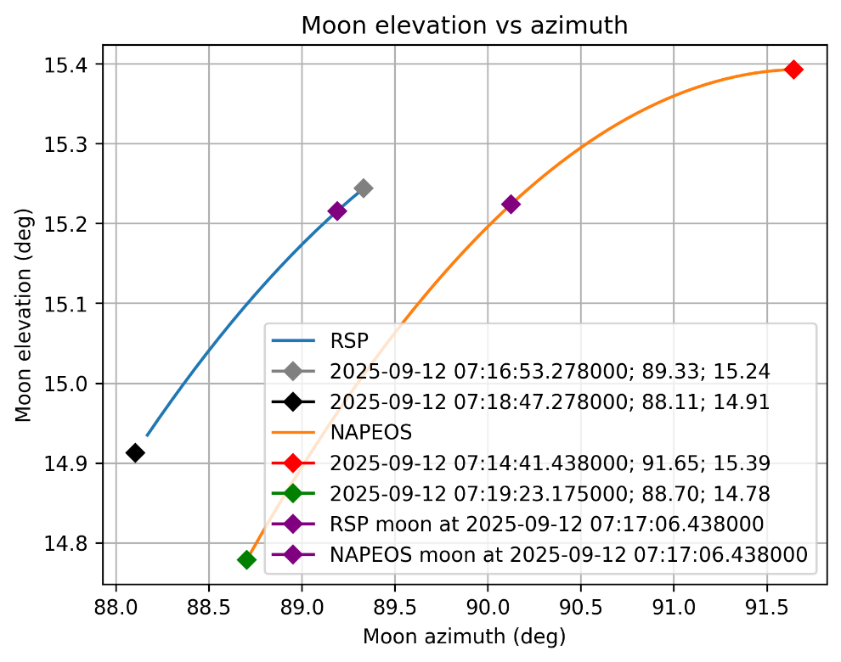
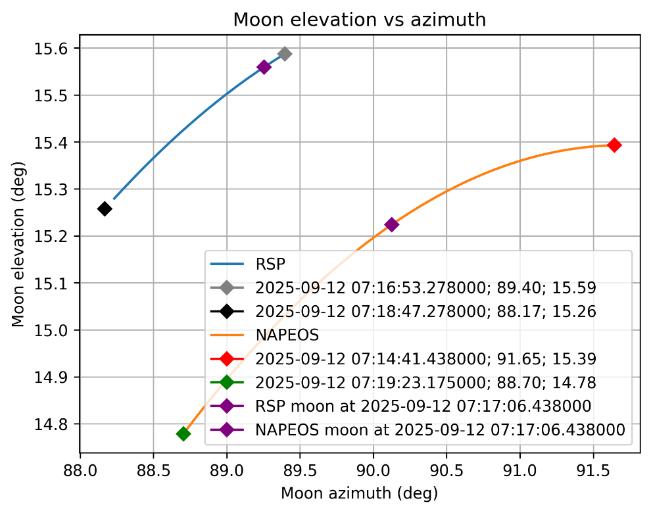
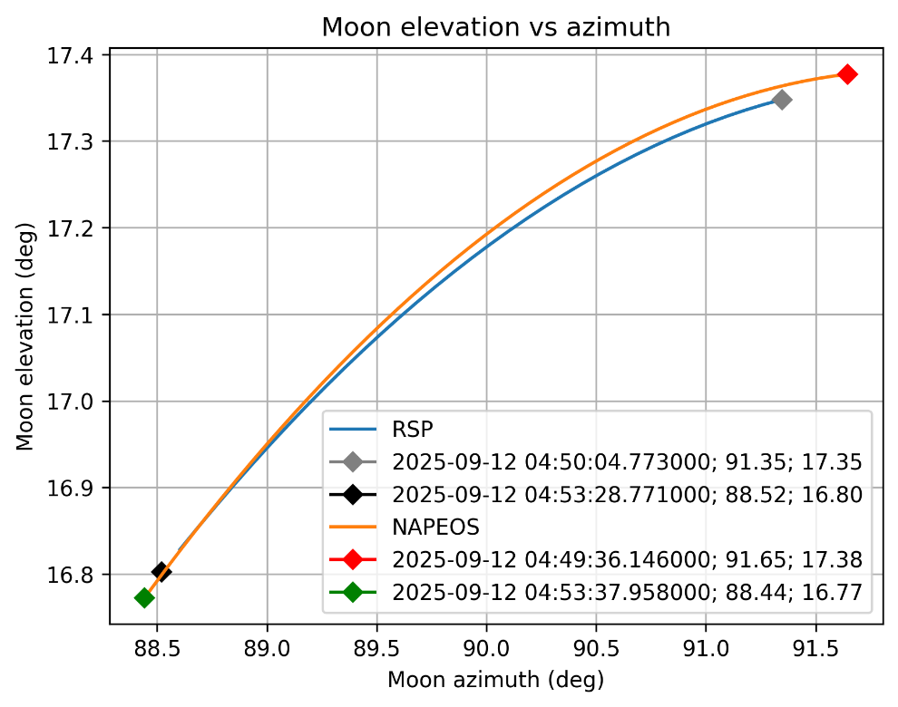
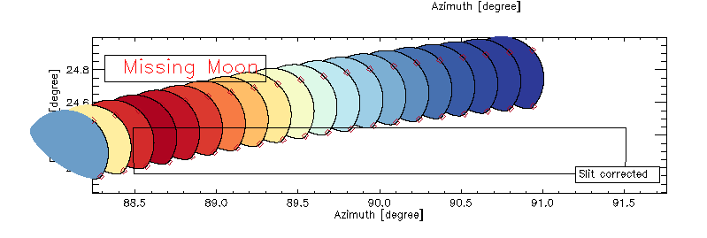
Metop-C GOME2 pointing issue
M01 = GOME2-B
M02 = GOME2-A
M03 = GOME2-C
Many Moon measurements not usable for GOME2-C
GOME2 to complement SCIAMACHY lunar data (complementary lunar phases) ➔ lunar model derivation (LESSR)
Moon used to inter-calibration GOME2 with SCIAMACHY ➔ ESA FDR4ATMOS project
Collaboration with NASA PACE/OCI team + DLR EnMAP team to attempt contemporaneous lunar acquisitions with GOME2
Next opportunities for GOME2 B and C ➔ August 3rd – 4th 2026
After improving the geometrical parameters for the instrument orientation + FOV axis biases
Sanity check on Metop-B GOME2
After removal of Level 1 Earth view corrections
Current situation
An example…
M. Krijger - Earth Space Solutions

Slide 8
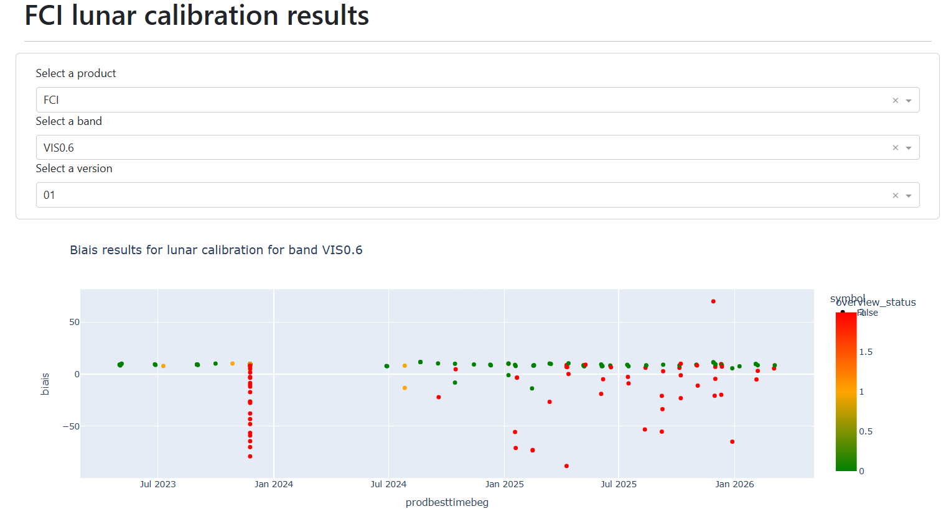
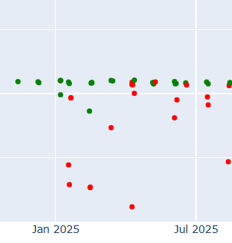
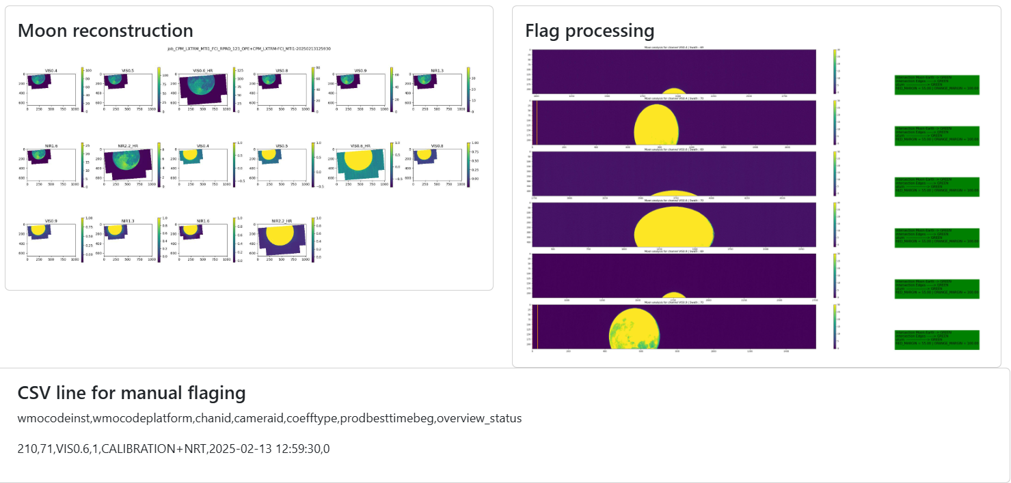
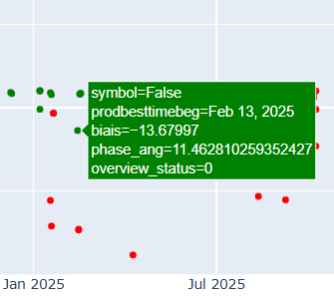
Tools for mission monitoring – MTI1 FCI + LI

Slide 9
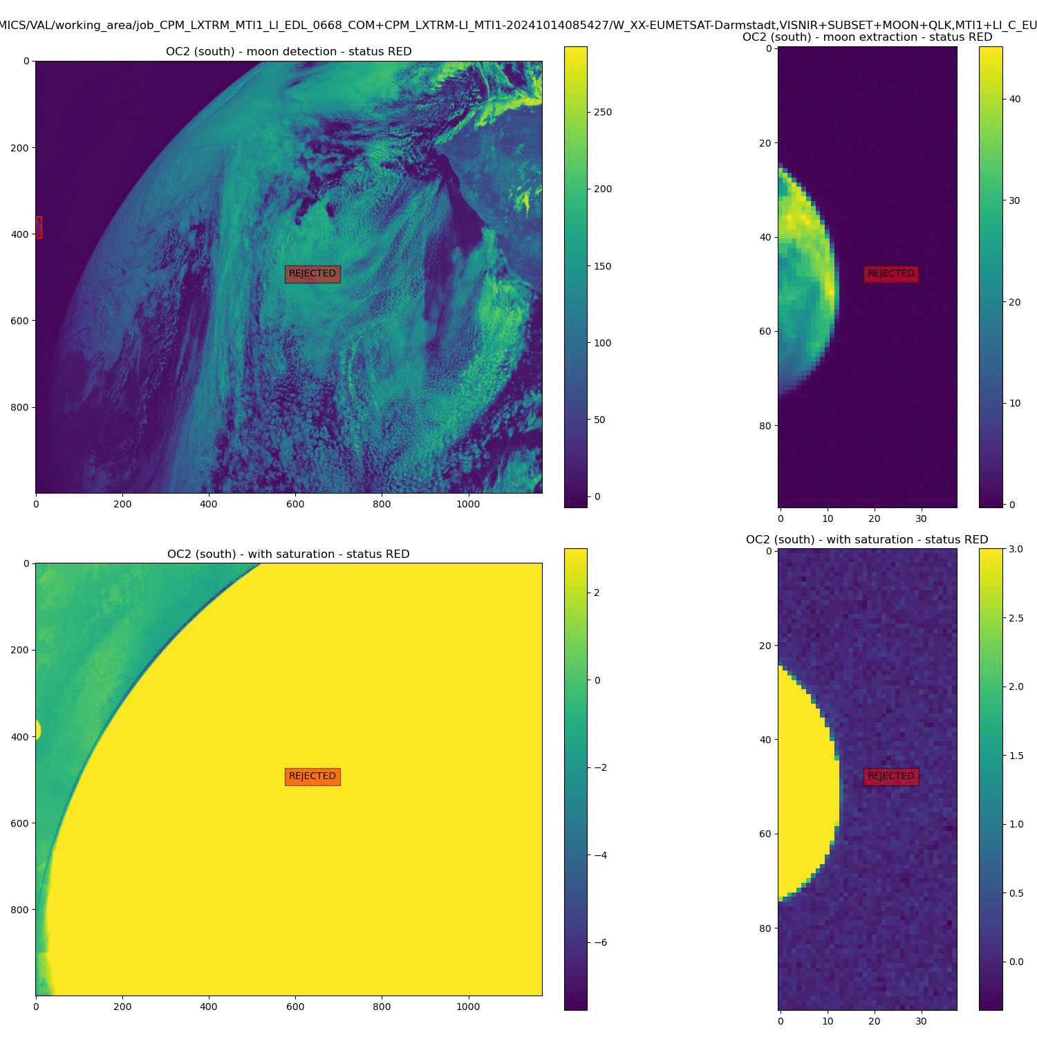
Mission monitoring – MTI1 FCI + LI
Overview status quality flag created when extracting
Propagated through the Lunar Calibration System
  LSICS
  Or GIRO end-to-end version
Allows a posteriori check on the outliers
Example of Moon transit in MTI1 LI OC2
Winter configuration – OC2 over Southern hemisphere

Slide 10
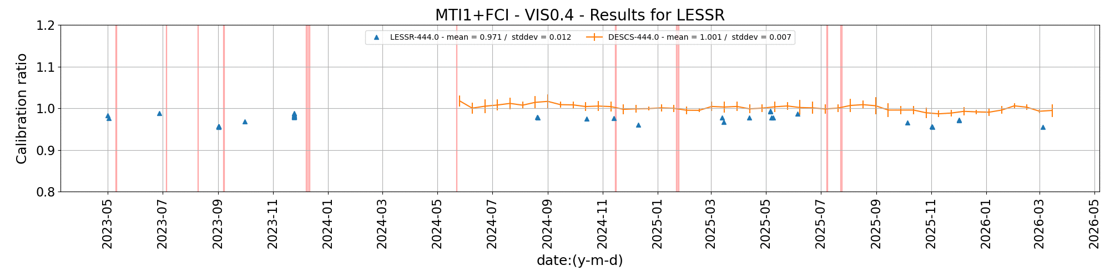
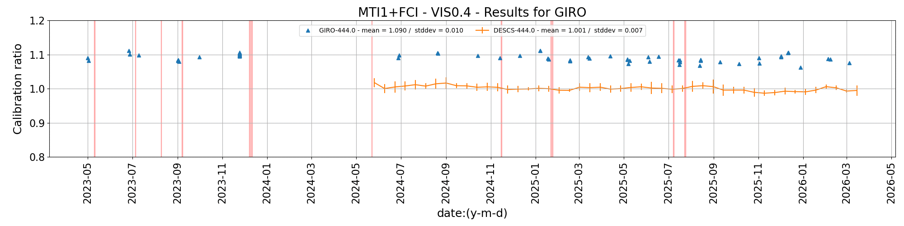
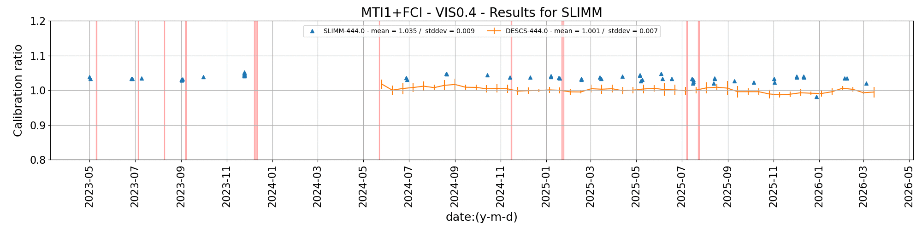
Mission monitoring – MTI1 FCI
Visual inspection of the results needed
NIR1.3 only monitored by lunar calibration
Uncertainties increase with the phase angle
But overall, lunar calibration shows the stability in time of the VIS channels (like deserts and other methods)
SWIR still require further work (e.g. impact of the straylight correction)
Advantage of using several models
More lunar phases covered
For FCI, number of usable lunar observations is critical
Check consistency of the results

Slide 11
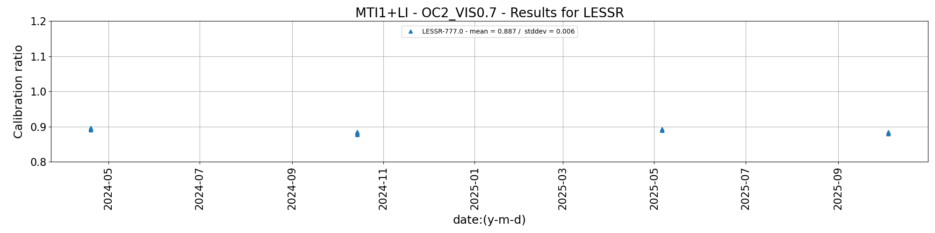
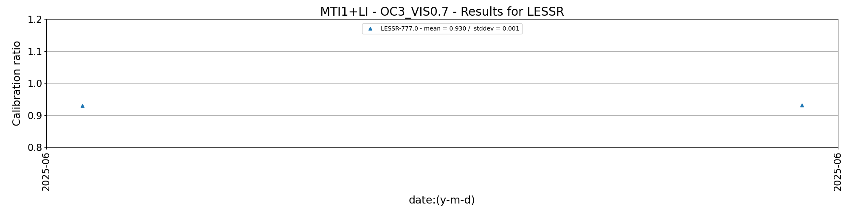
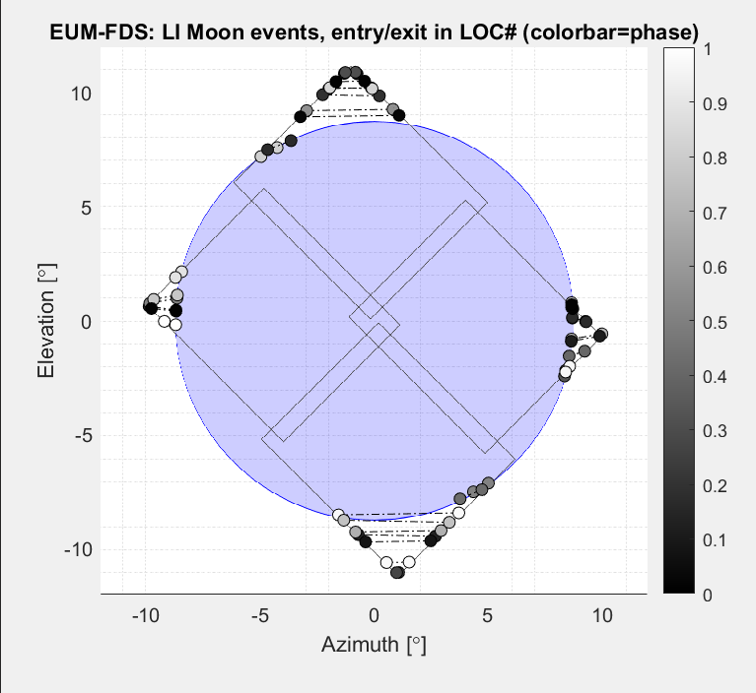
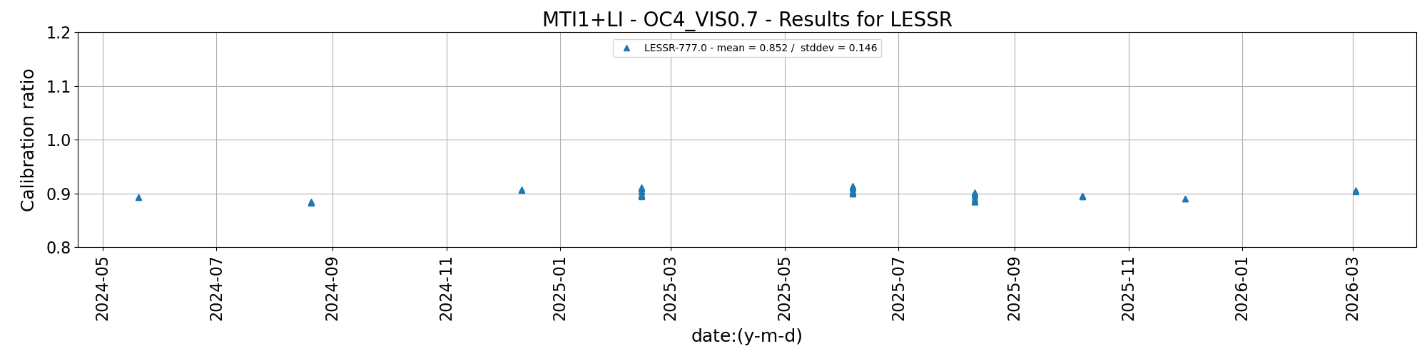
Mission monitoring – MTI1 LI
Platform yaw flip every 6 months
Only part of cameras sees the Moon
Biases confirmed by desert vicarious
No opportunity for OC1
OC-2 / 4
OC-1 / 3
OC-3 / 1
OC-4 / 2

Slide 12

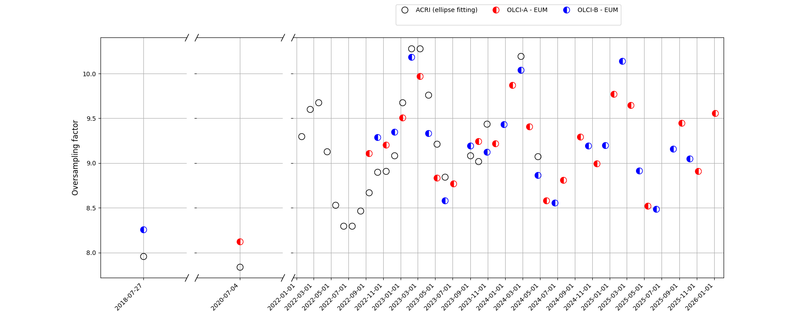
Mission monitoring – S3A + S3B OLCI
Large variability of the oversampling
OLCI-A : 8.52 < Oversampling < 9.77
OLCI-B : 8.49 < Oversampling < 10.14
ACT
ALT

Slide 13
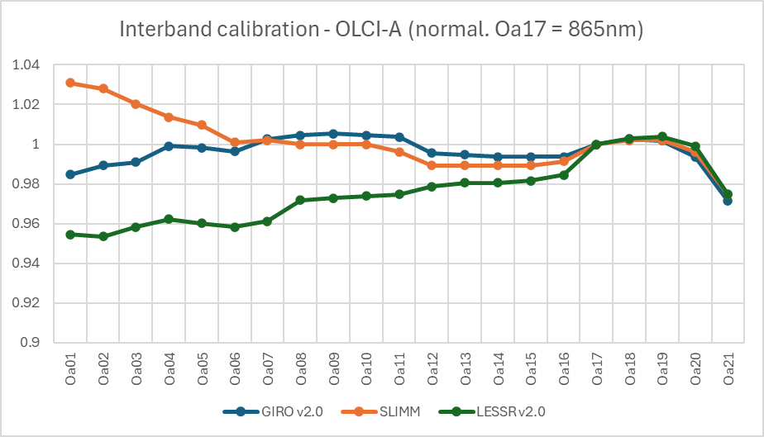
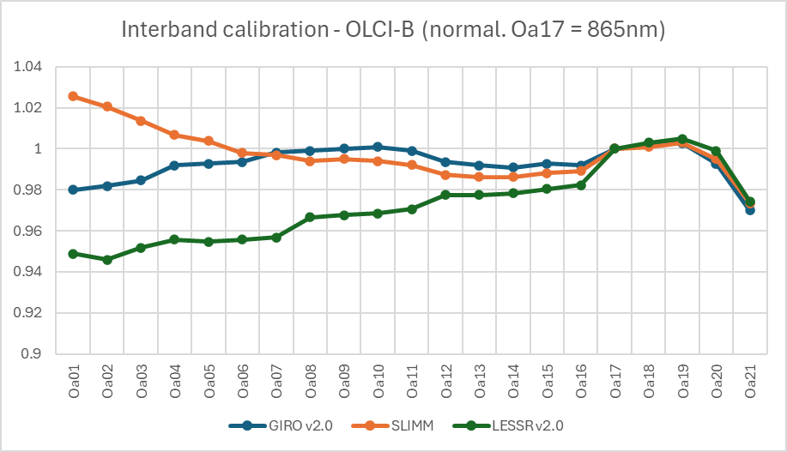
OLCI - Interband calibration – Normalised to the 865nm band
OLCI-A
 | GIRO v2.0 | SLIMM | LESSR v2.0
min | 0.971 | 0.975 | 0.953
max | 1.005 | 1.031 | 1.004
OLCI-B
 | GIRO v2.0 | SLIMM | LESSR v2.0
min | 0.970 | 0.974 | 0.946
max | 1.003 | 1.026 | 1.005

Slide 14
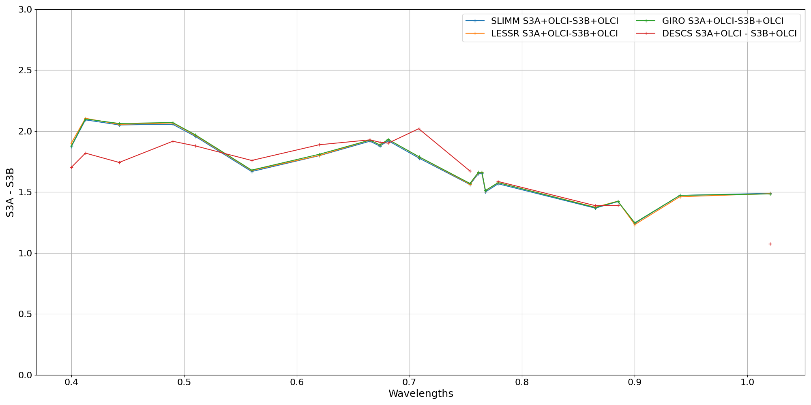
Mean bias between OLCI-A and OLCI-B

Slide 15
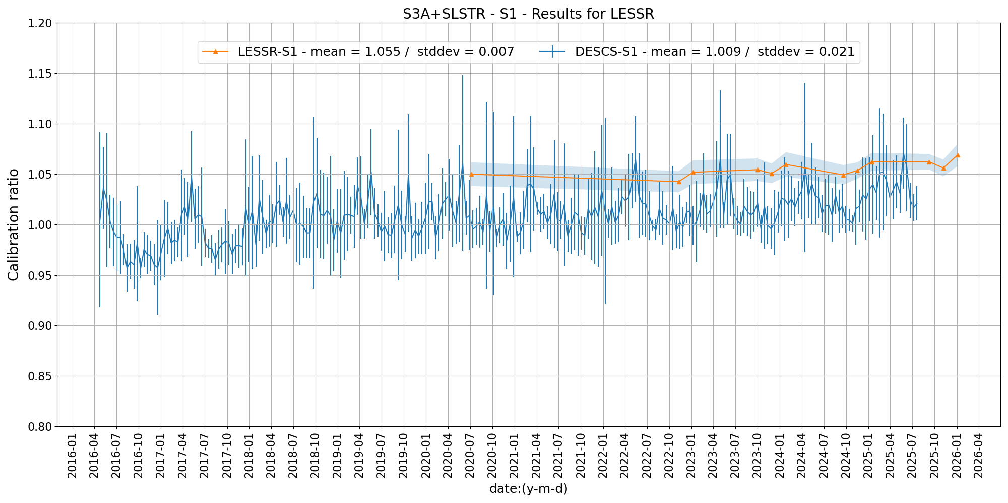
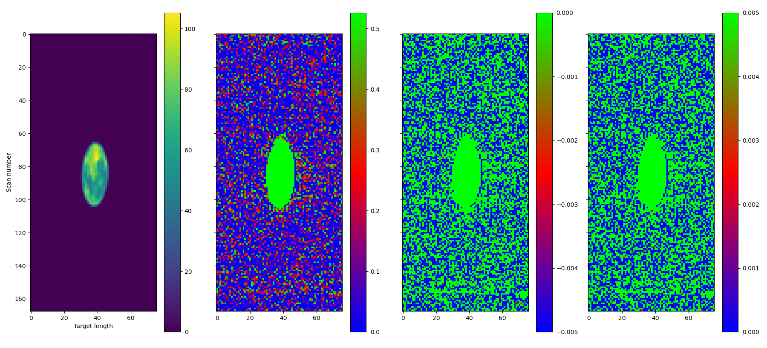
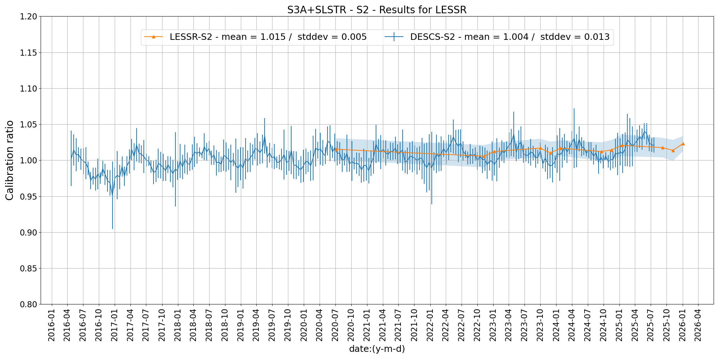
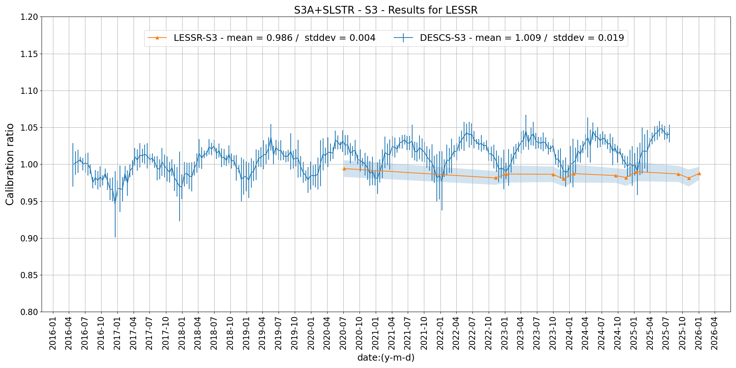
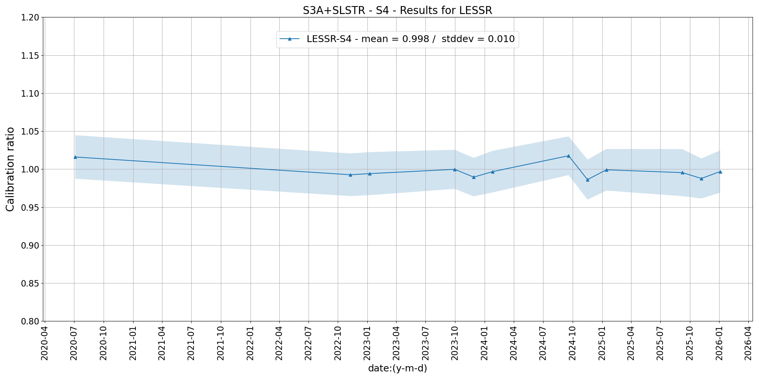
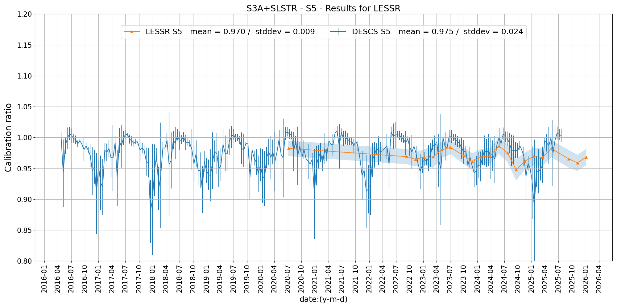
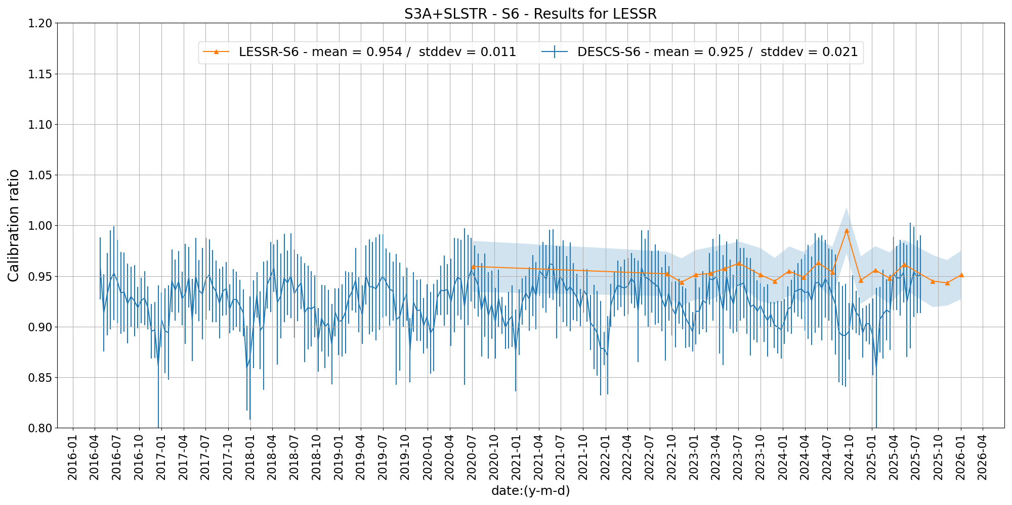
Mission monitoring – S3A + S3B SLSTR
S1
S2
S3
S4
SLSTR-A – Estimated yearly drift
DRIFT for S1 = 0.286% per year +/- 0.106%
DRIFT for S2 = 0.127% per year +/- 0.084%
DRIFT for S3 = -0.103% per year +/- 0.076%
DRIFT for S4 = -0.269% per year +/- 0.18%
DRIFT for S5 = -0.238% per year +/- 0.158%
DRIFT for S6 = -0.057% per year +/- 0.205%
SLSTR-B – Estimated yearly drift
DRIFT for S1 = 0.308% per year +/- 0.175%
DRIFT for S2 = -0.068% per year +/- 0.144%
DRIFT for S3 = -0.107% per year +/- 0.088%
DRIFT for S4 = 0.094% per year +/- 0.126%
DRIFT for S5 = 0.144% per year +/- 0.128%
DRIFT for S6 = 0.146% per year +/- 0.119%
S5
S6
Requires further work but in general, results are in line with results from S3 MPC’s assessment + MICMICS results (except for S3) and accounting for uncertainties

Slide 16
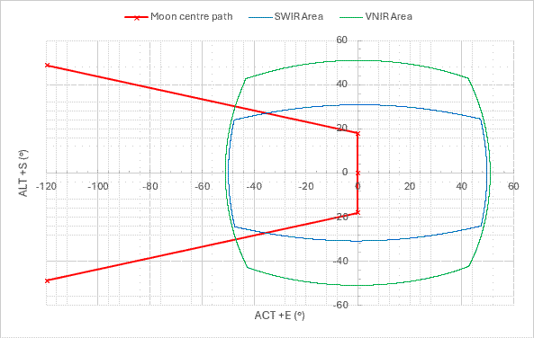
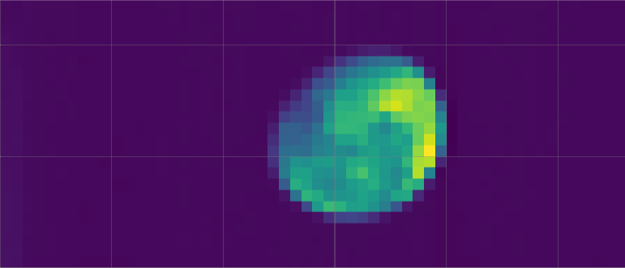
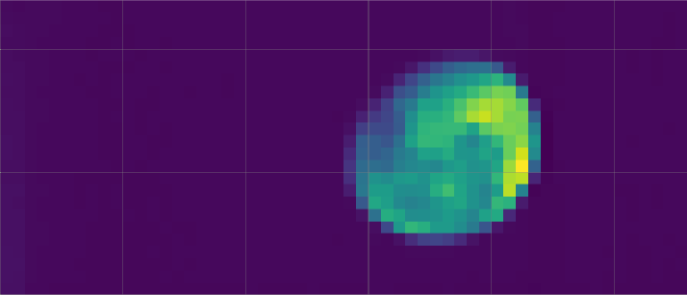
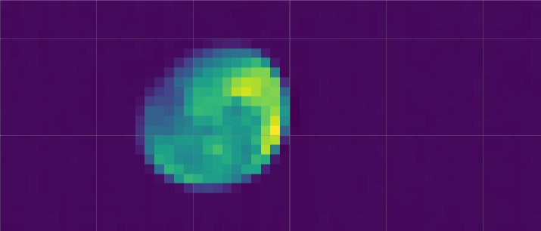
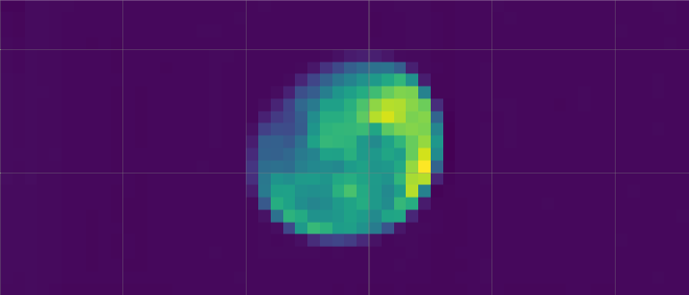
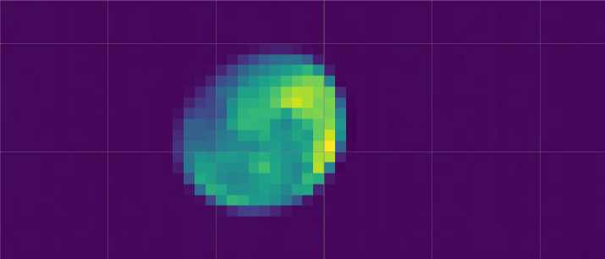
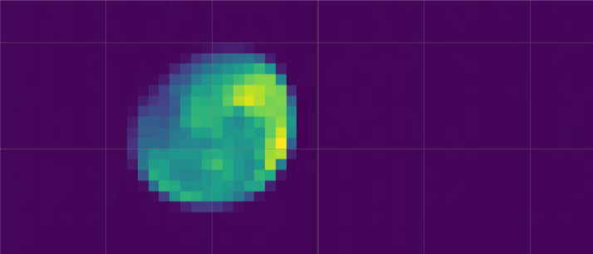
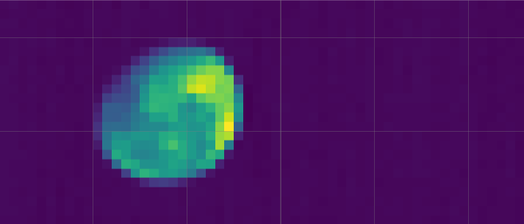
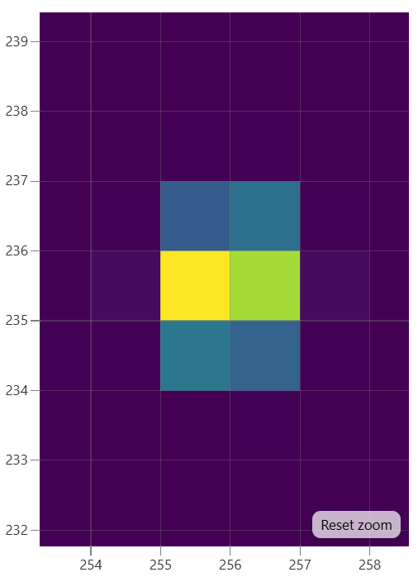
EPS-SG A1
METimage:
  Regular lunar intrusion in the Deep Space View
    Require some specific processing
    Initial processing looks good in VIS/NIR
    Processing of the SWIR still on-going
  Roll manoeuvre to look at the Moon with the Earth view ➔ new acquisition on April 1st
VII-763
VII-443
VII-752
VII-555
VII-668
VII-865
VII-914
3MI:
  Roll manoeuvre to look at the Moon with the Earth view ➔ March 4th + April 1st
  Anchor points for the radiometry (absolute TBC + inter-band)
  2 different locations on the CCD + CMOS detectors (nadir on March 4th and -20 degrees on April 1st)
  Many observations acquired during the manoeuvre, including polarisation
  Data under processing + analysis

Slide 17
Conclusions
MICMICS Lunar Calibration component (LXTRM + LCS) handles a growing number of instruments
Benefits of using lunar calibration for channels that cannot be monitored by other means
Benefits of using multiple models (till we have an absolute reference over the full range of observation conditions)
Importance to have visualisation tools to facilitate visual inspections (e.g. FCI)
Extraction of the observables and associated uncertainties to be revisited as required ➔ oversampling determination + solid angle calculation + irradiance integration (e.g. SLSTR)

Slide 18
Thanks to all colleagues, contractors and externals for their help, the great discussions and their enthusiasm:
V. Debaecker, R. Degoul, O. Henriquez, M. Neneman, P. Valks, G. Poli, J. Onderwaater, L. Andres Moya, J.M. de Juana Gamo, F. Ruethrich, Nan Hao, S. Gimeno Garcia, G. Corlett, E. Kwiatkowska, , M. Vazquez Navarro, F. Lucas Carbo, R. Houdroge, F. Rasool, E. Trollope, P. Arriazu, A. Johnstone, H. Kraemer, M. Krijger, T. Stone, B. Basnet, H. Kieffer, M. Takahashi, S. Adriaensen, X. Wu, F. Yu and many more...
Thank you!
Questions are welcome.

