Slide 1

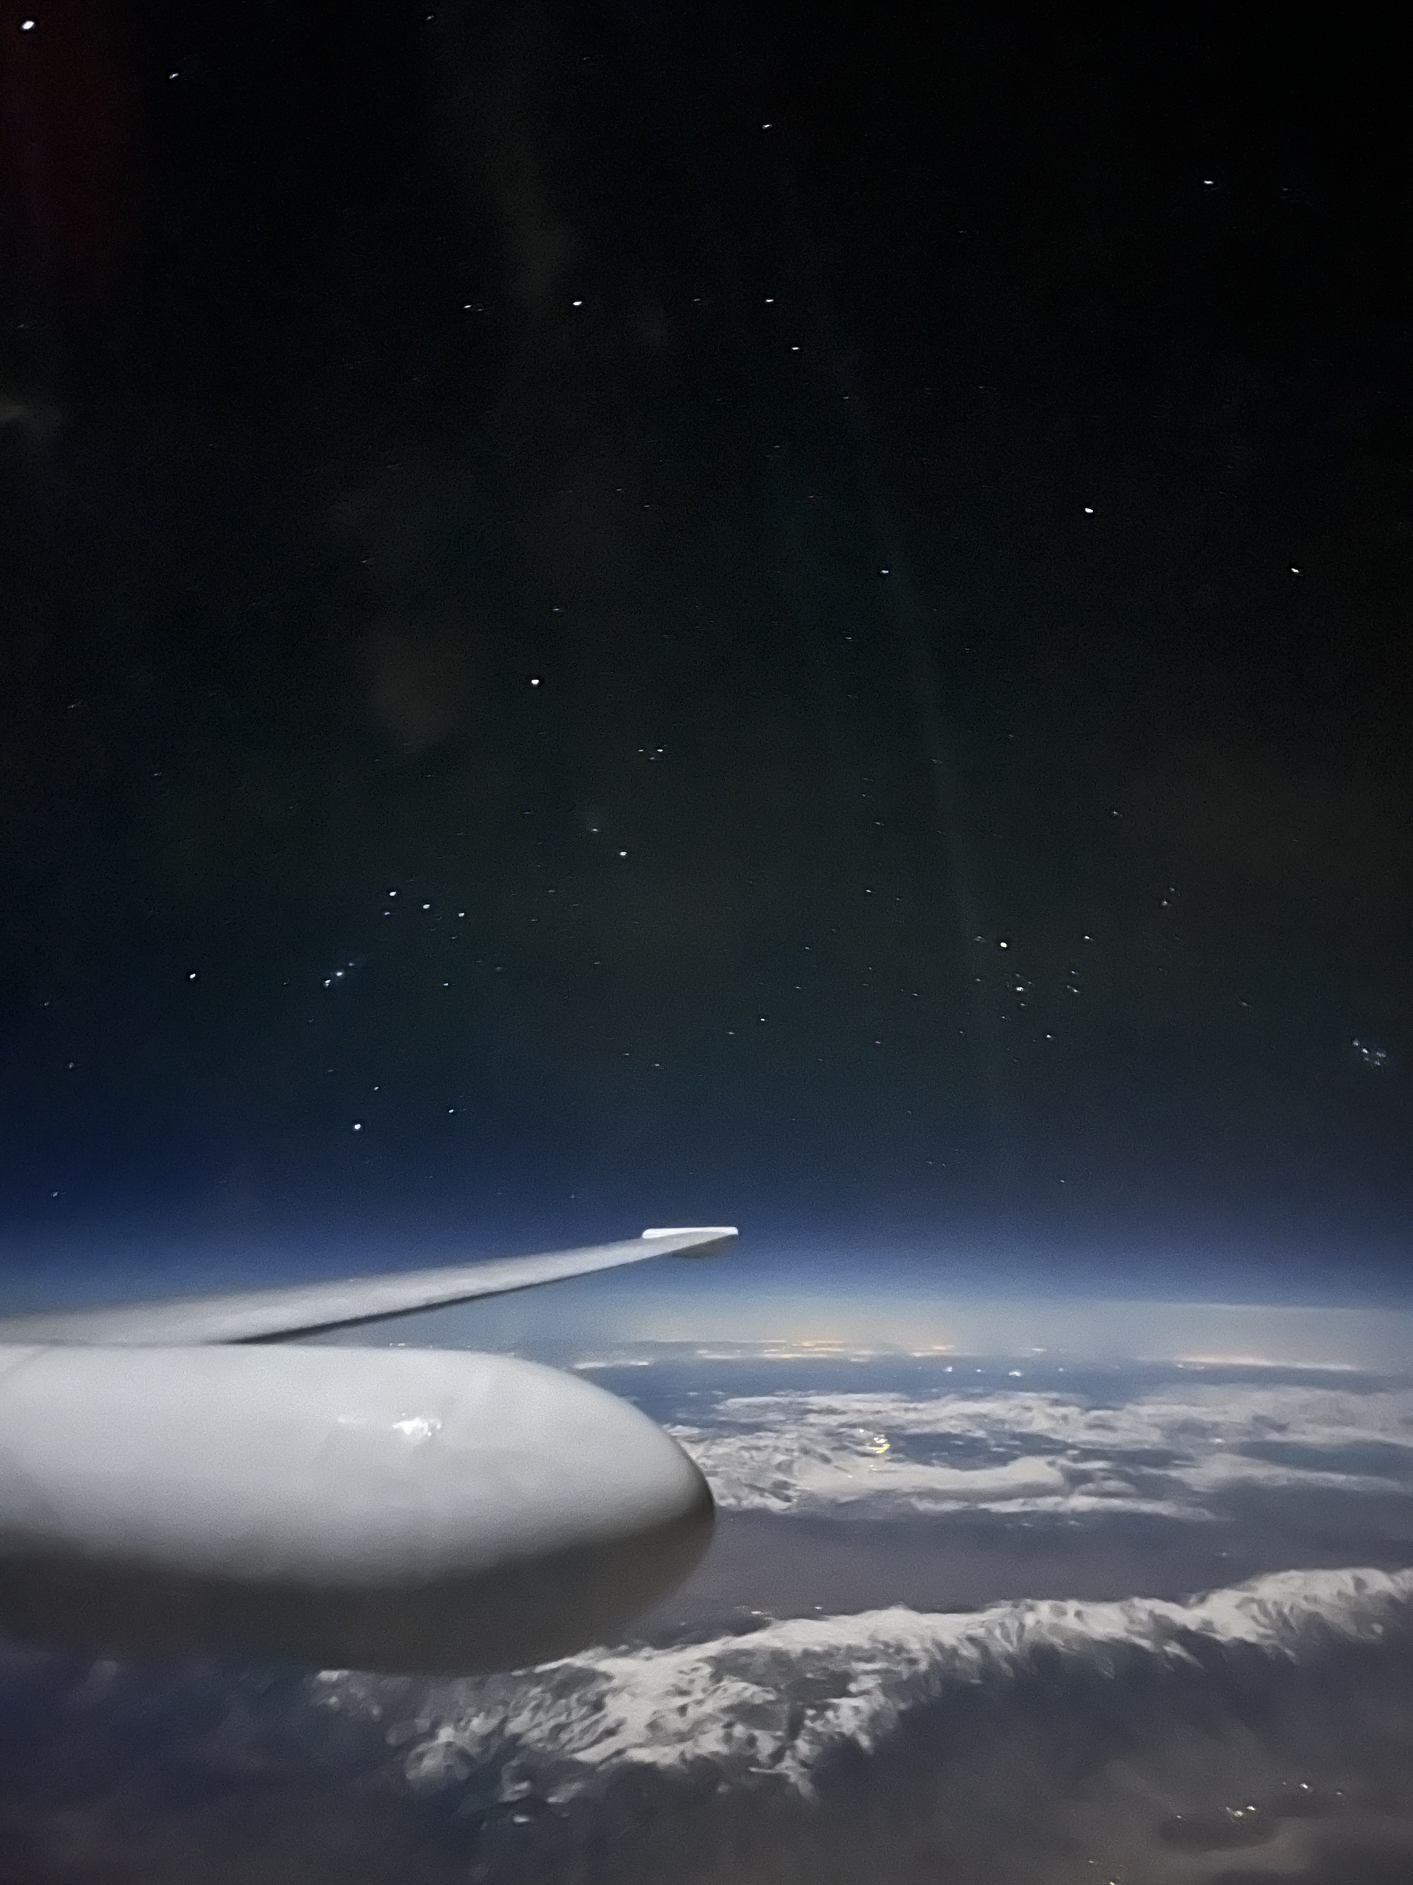
air-LUSI Operational Campaign 3 and Lunar Reference Measurements
K. Turpie (UMBC, NASA/GSFC)
GSICS Annual Meeting
Lunar Calibration Session Day 2
Ottawa, Ontario CA
24 March 2026

Slide 2



air-LUSI Team
Kevin Turpie, PI
Kathleen Scanlon
John Woodward, Co-I
Tom Stone, Co-I
Andrew Klingberg
Barry Lefer
Laura Lorenzoni
Kelsey Bisson
Jack Kaye
Amber Emory
Paula Bontempi
Andrew Gadsden, Co-I
Alex McCafferty-Leroux
Andrew Newton
2

Slide 3
In Memoriam
Keith Lykke
Bob Barnes
Dennis McCarthy
Mary Cleave
3

Slide 4
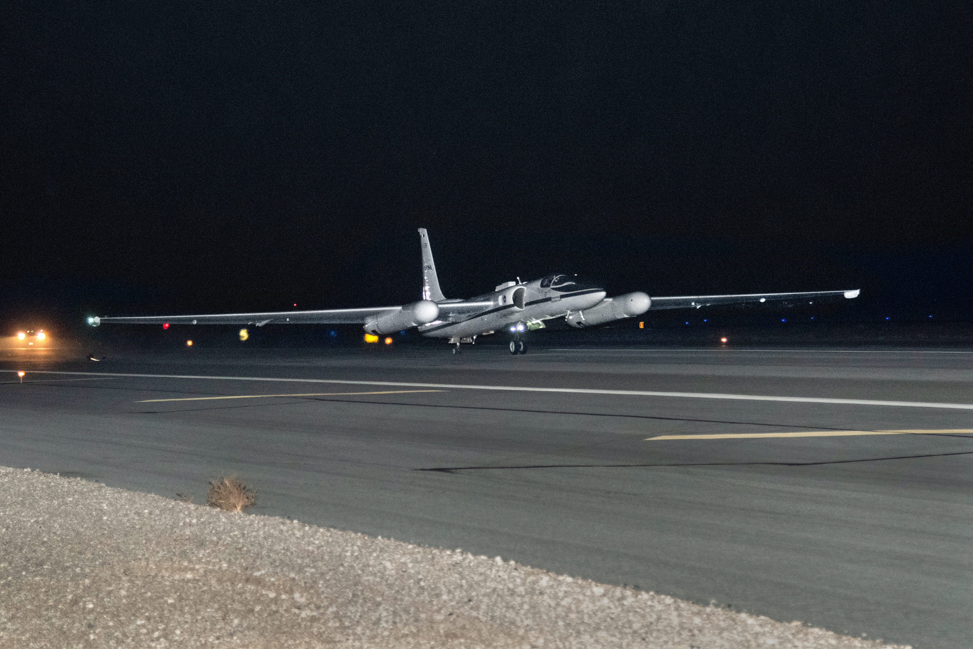
Why the Airborne Lunar Spectral Irradiance (air-LUSI) Mission?
  air-LUSI makes fiducial reference measurements (FRM) of LUSI with sub-percent accuracy.
  air-LUSI flies on NASA’s ER-2 aircraft, measuring moonlight from above 95% of atmosphere (near space).
  Unlike measurements from orbit, air-LUSI lands after each measurement and thus evaluated to assure quality.
  Model improvement with air-LUSI data could revolutionize how we calibrate passive, solar reflectance bands in orbit.
4

Slide 5
air-LUSI Data - Early Applications
Model | PI / POC | Affiliation | Application
ROLO | Tom Stone | USGS | Diagnostics, Adjustment
GIRO | Seb Wagner | EUMETSAT | ← ROLO
LIME | Marc Bouvet | ESA | Diagnostics, Validation
LESSR | Thijs Krijger | ESS / EUMETSAT | Adjustment, Validation
SLIMM | Hugh Kieffer | GSICS | Diagnostics, Adjustment
PACE OCI | Gerhard Meister | NASA GSFC | OCI Calibration Validation
OCO-2 | Rob Rosenberg | NASA JPL | OCO-2 Calibration Validation
Model Development
Sat Cal
5

Slide 6
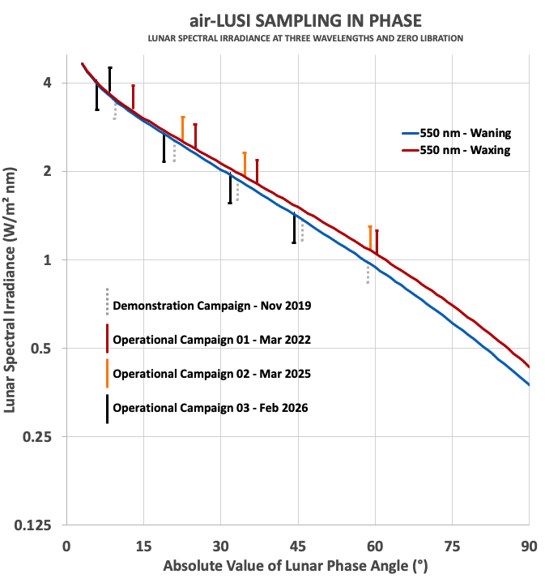
air-LUSI SAMPLING STRATEGY
Objective: make fiducial reference measurements to address biases in LUSI models (e.g., ROLO).
Practical sampling strategy:
  Plan flights to sample nightly between -90° to 90° lunar phase angles → ~13° steps.
  Give priority to phase angles routinely measured by US satellite missions
  (e.g., -55°, -51°, -7°, 7°, 55°).
  Ideally make 3 sweeps of the full range:
    Calibration ( 5 flights + ; 5 flights - )
    Validation ( 5 flights + ; 5 flights - )
    Gap Filling
air-LUSI has acquired LUSI at 8 negative and 4 positive phase angles
6

Slide 7
air-LUSI FLIGHT HISTORY
Year | Milestone | Notes
2017 | Design and development
2018 | Engineering test flights | 2 nights, no data
2019 | Demonstration Campaign | 5 nights, unc ~1.2%
2020 |  | COVID19
2021 | Operational Campaign 01 | Maintenance delay
2022 | Operational Campaign 01 | 4 nights, unc <1%
2023 |  | Robotics overhaul
2024 | Operational Campaign 02 | Cancelled: a/c repair
2025 | Operational Campaign 02 Operational Campaign 03 | 3 nights, unc TBD US Govt Shutdown
2026 | Operational Campaign 03 | 5 nights, unc <1%
7

Slide 8
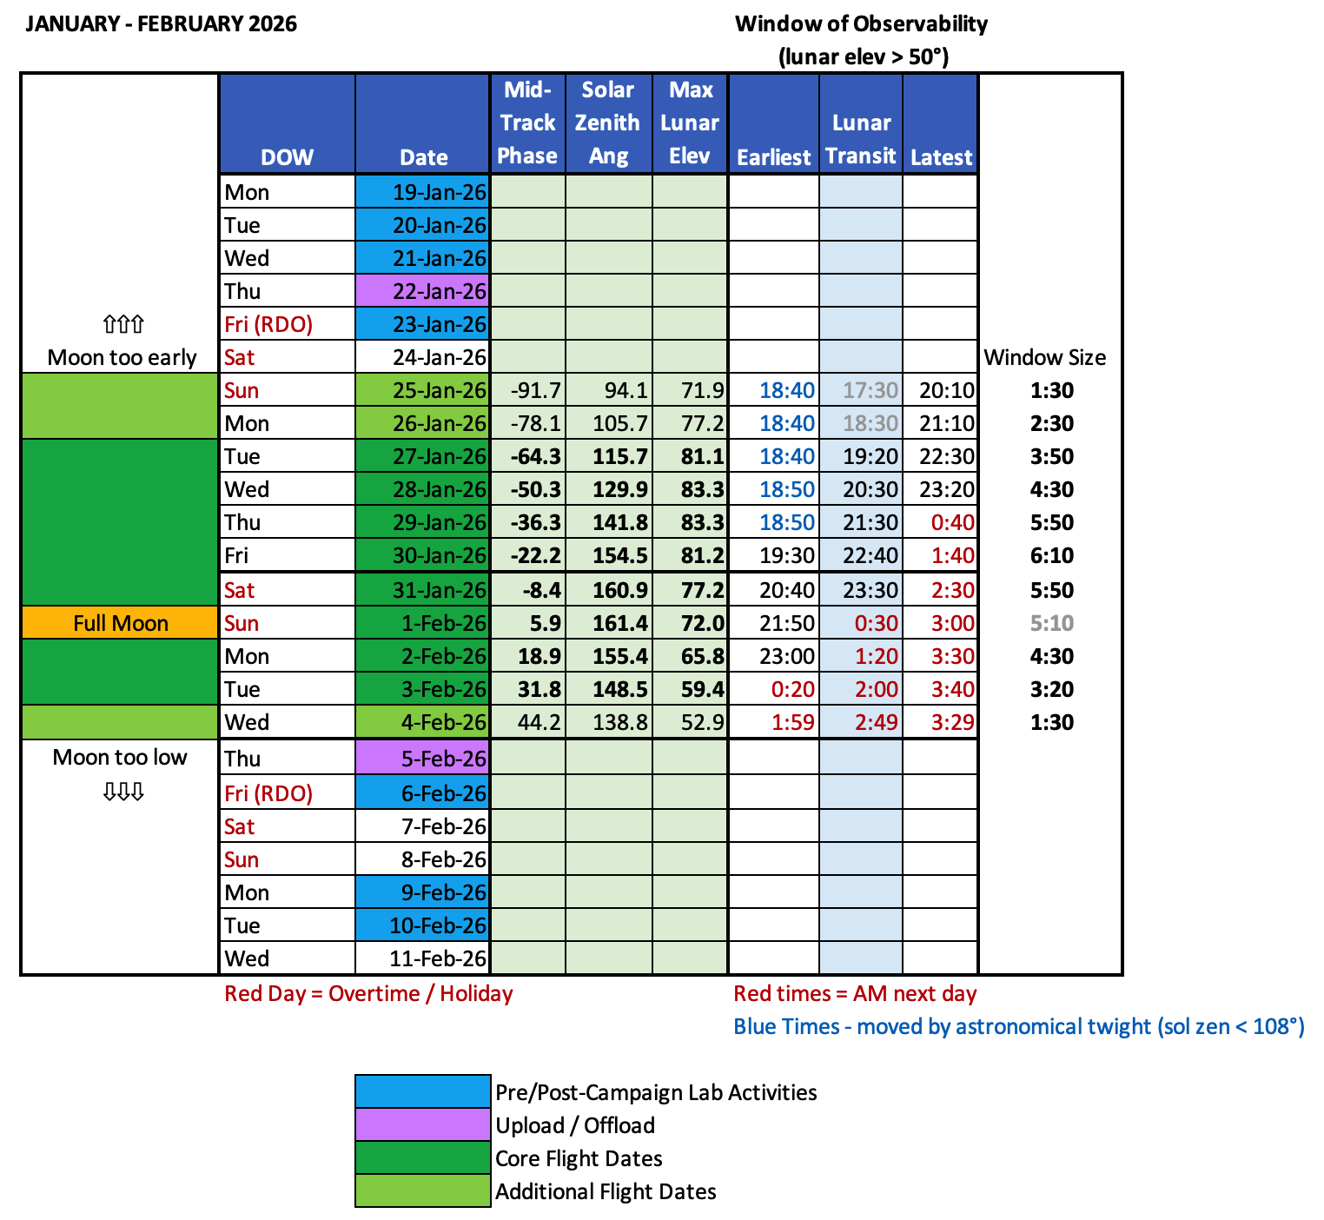
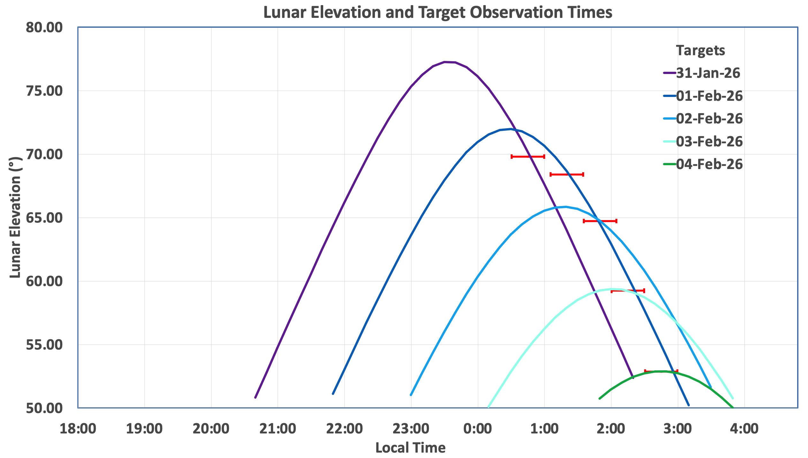
Operational Campaign 03
Moved from Nov 2025 to Feb 2026.
4 nights after the Full Moon (i.e., positive phases) and 7 nights before.
Funding could cover 5 nights.
Chose phases -8°, 6°, 19°, 32°, 44°.
Flight times target high lunar elevation, while reducing time shift from night to night.
8

Slide 9
air-LUSI Data Availability
2022 Data released to earlier adopters in April 2024.
2022 Data made available through NIST data portal via GitHub, mirrored through NASA ORNL-DAAC later in 2024 (DOI assigned).
2025 Data under investigation for stability issue.
2026 Data available to earlier adopters 13 April 2026.
Data moving to be distributed through NASA ORNL-DAAC in mid 2026.
air-LUSI Pending Publications
air-LUSI Summation Paper
Measurement Paper(s) (Operational Campaigns 01-03)
Stability Monitor Paper
air-LUSI Application Paper
9

Slide 10
Summary
air-LUSI is proven well suited to support the lunar calibration community in developing the Moon as an absolute calibration reference and can also be used to validate satellite calibration.
air-LUSI data used for model adjustment, debugging, validation and satellite calibration validation (PACE OCI).
air-LUSI collected eight LUSI FRMs at negative phases and four at positive phases.
2026 data will be available to early adopters after 13 Apr 2026. All data will be published through NASA ORNL-DAAC in mid 2026.
Would like to see:
  Validation of ARCSTONE against air-LUSI.
  Updating of ROLO using air-LUSI data.
  Processing & Distribution Demo Campaign data.
10

Slide 11
Thank You

Slide 12
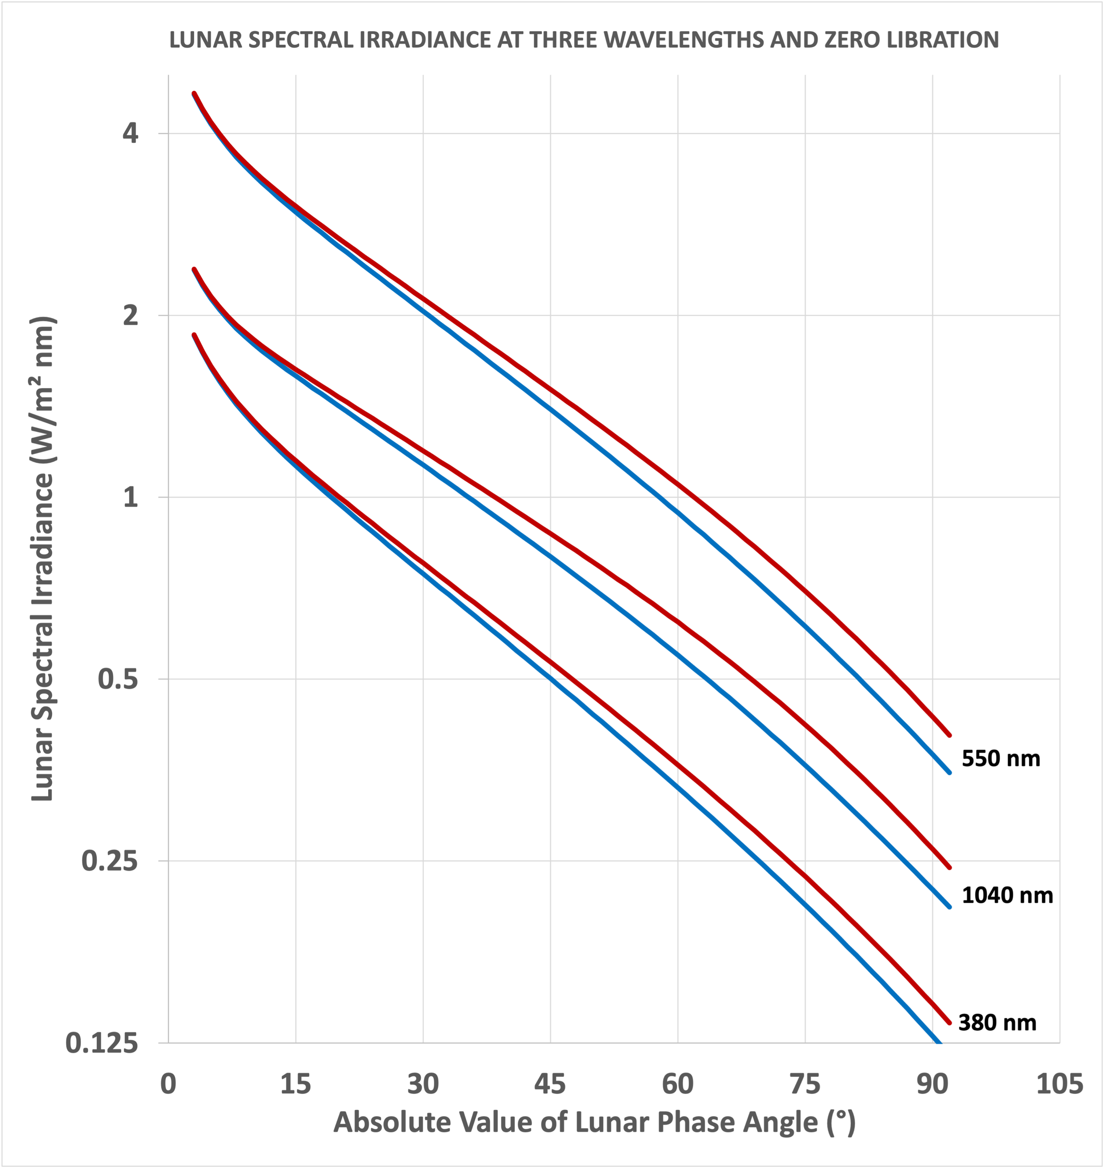
MEASURING LUNAR SPECTRAL IRRADIANCE
Lunar Spectral Irradiance (LUSI) varies spectrally with viewing and illumination geometry.
Of all geometric parameters, LUSI changes most with lunar phase angle (i.e., phase of the Moon).
Because lunar surface features have a nonuniform distribution, the function is asymmetrical around 0° phase (Full Moon).
An air-LUSI campaign can sample at increments of ~13° a night during a campaign.
We do not sample too close to the Full Moon because the change in LUSI is too rapid.
The range of phases that can be collected during a campaign is determined by the time of year and latitude*. @AFRC: Dec-Jan is optimal.
* - We fly only out of AFRC to keep cost low.
ROLO Model
12

Slide 13
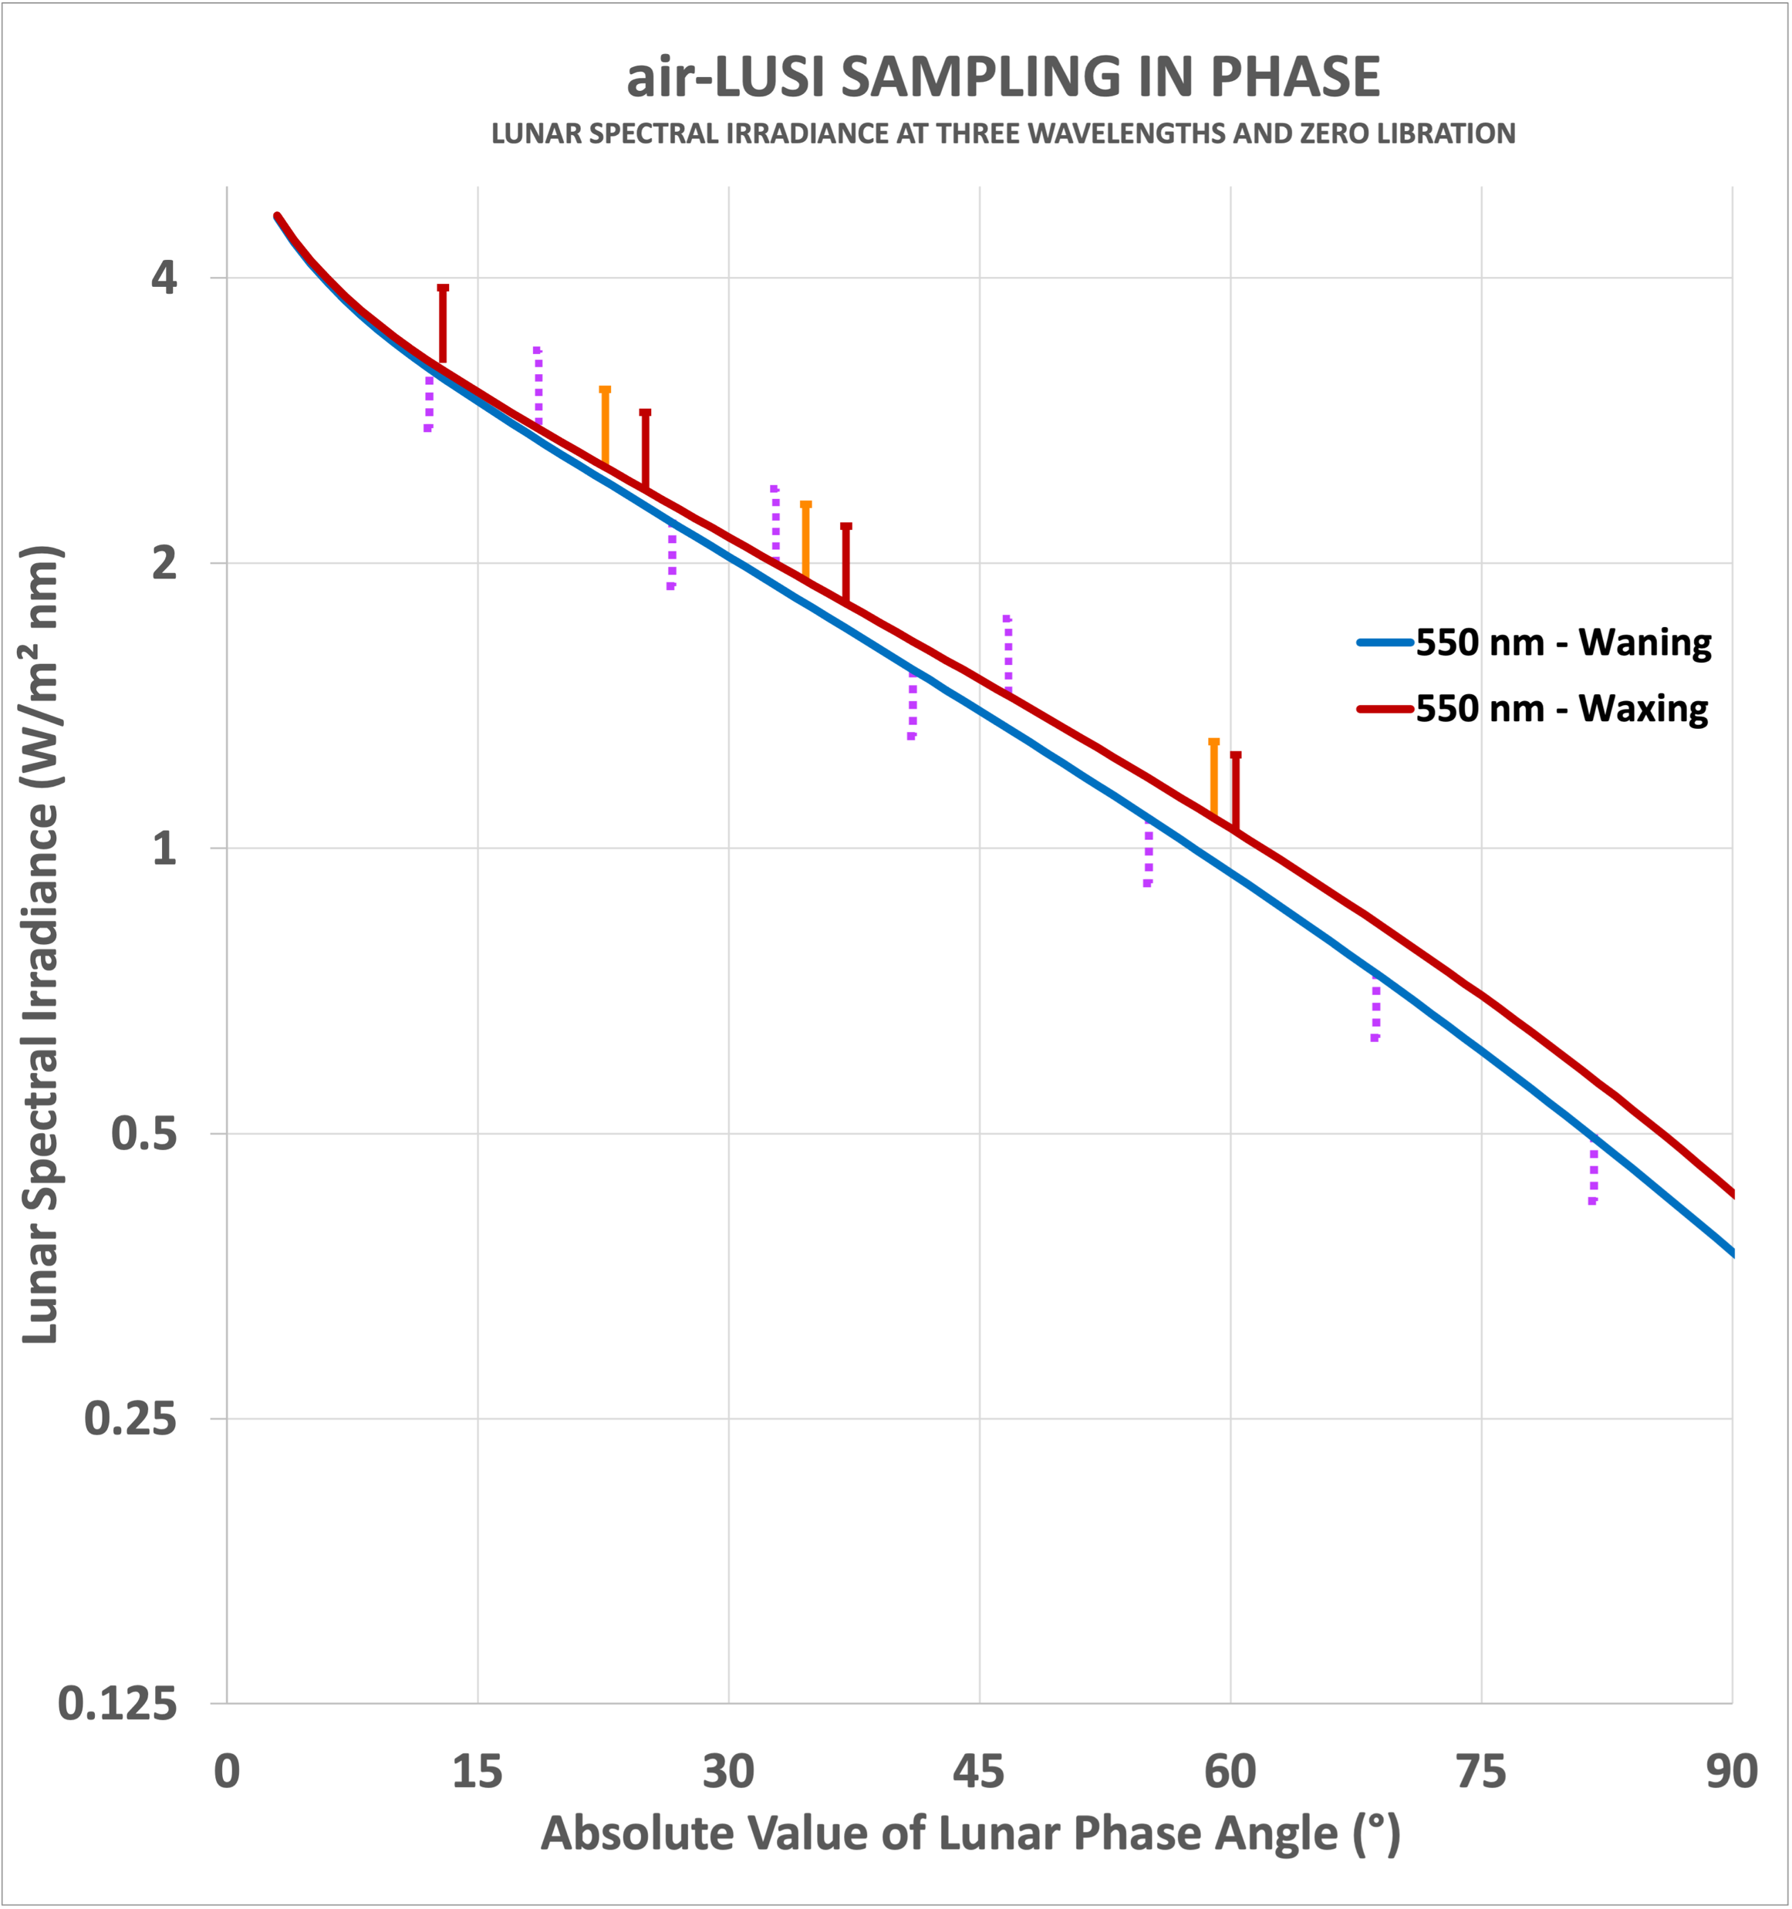
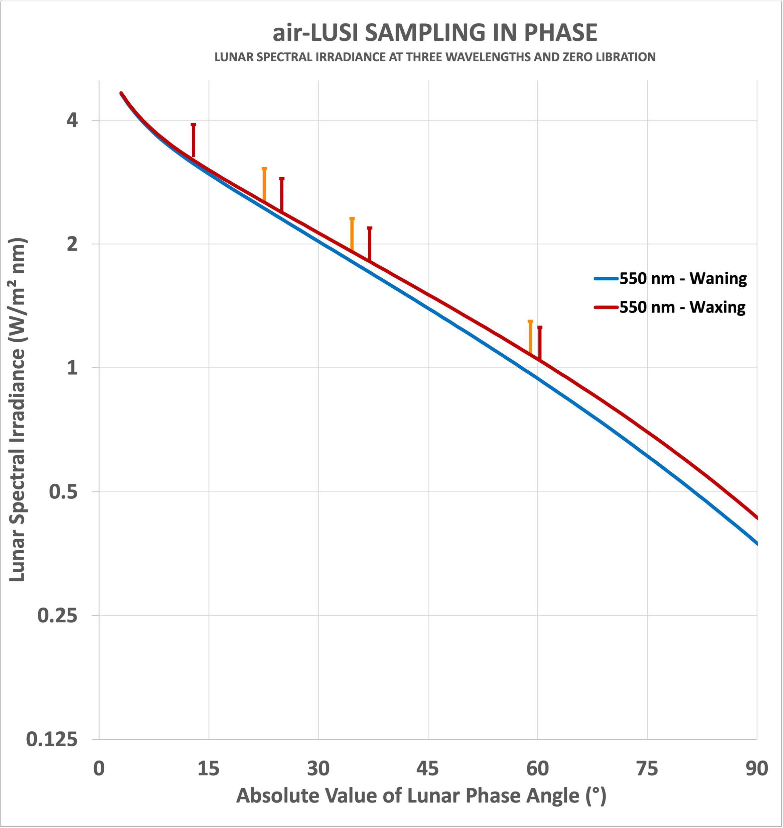
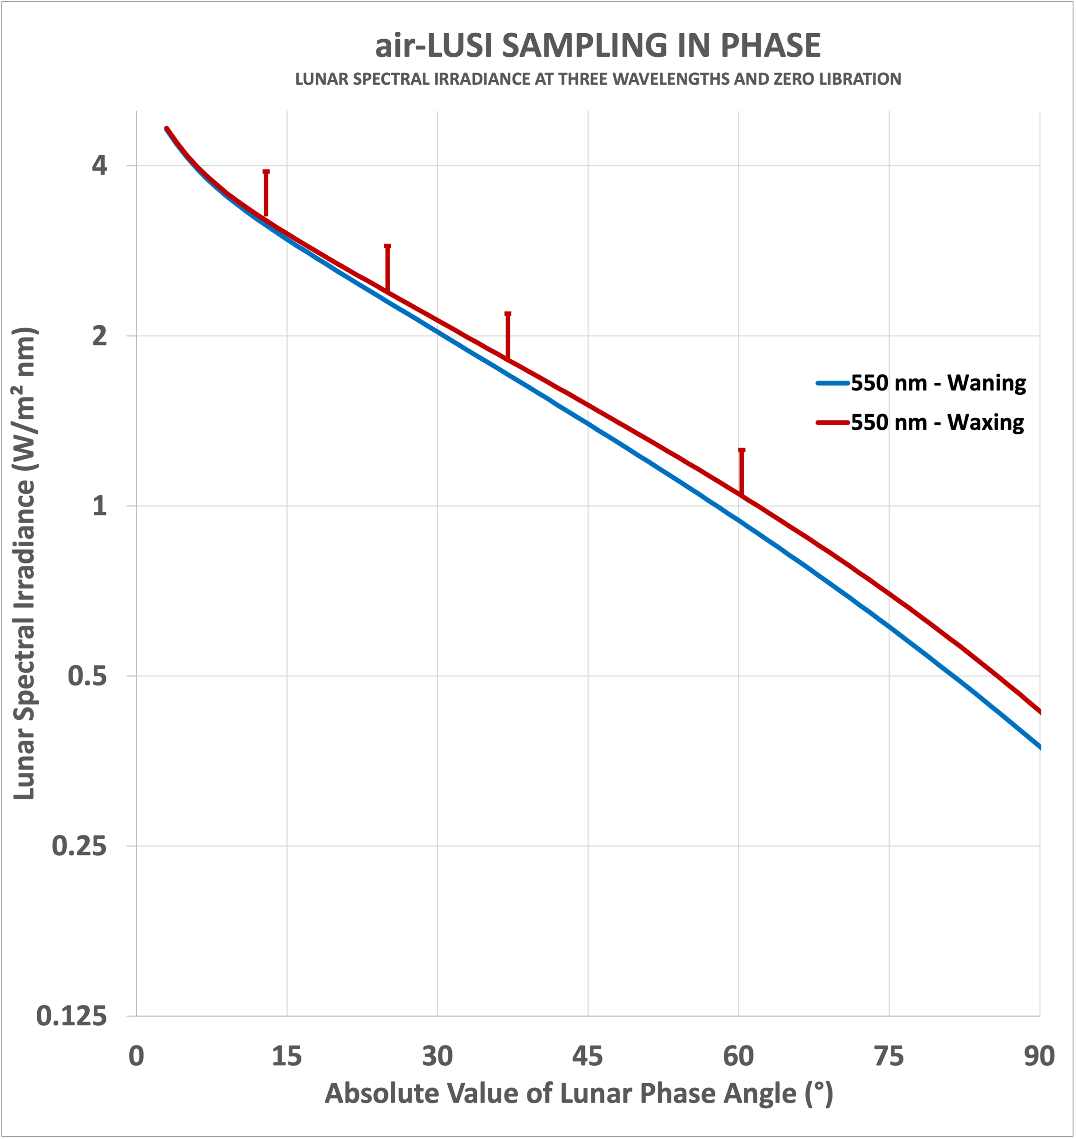
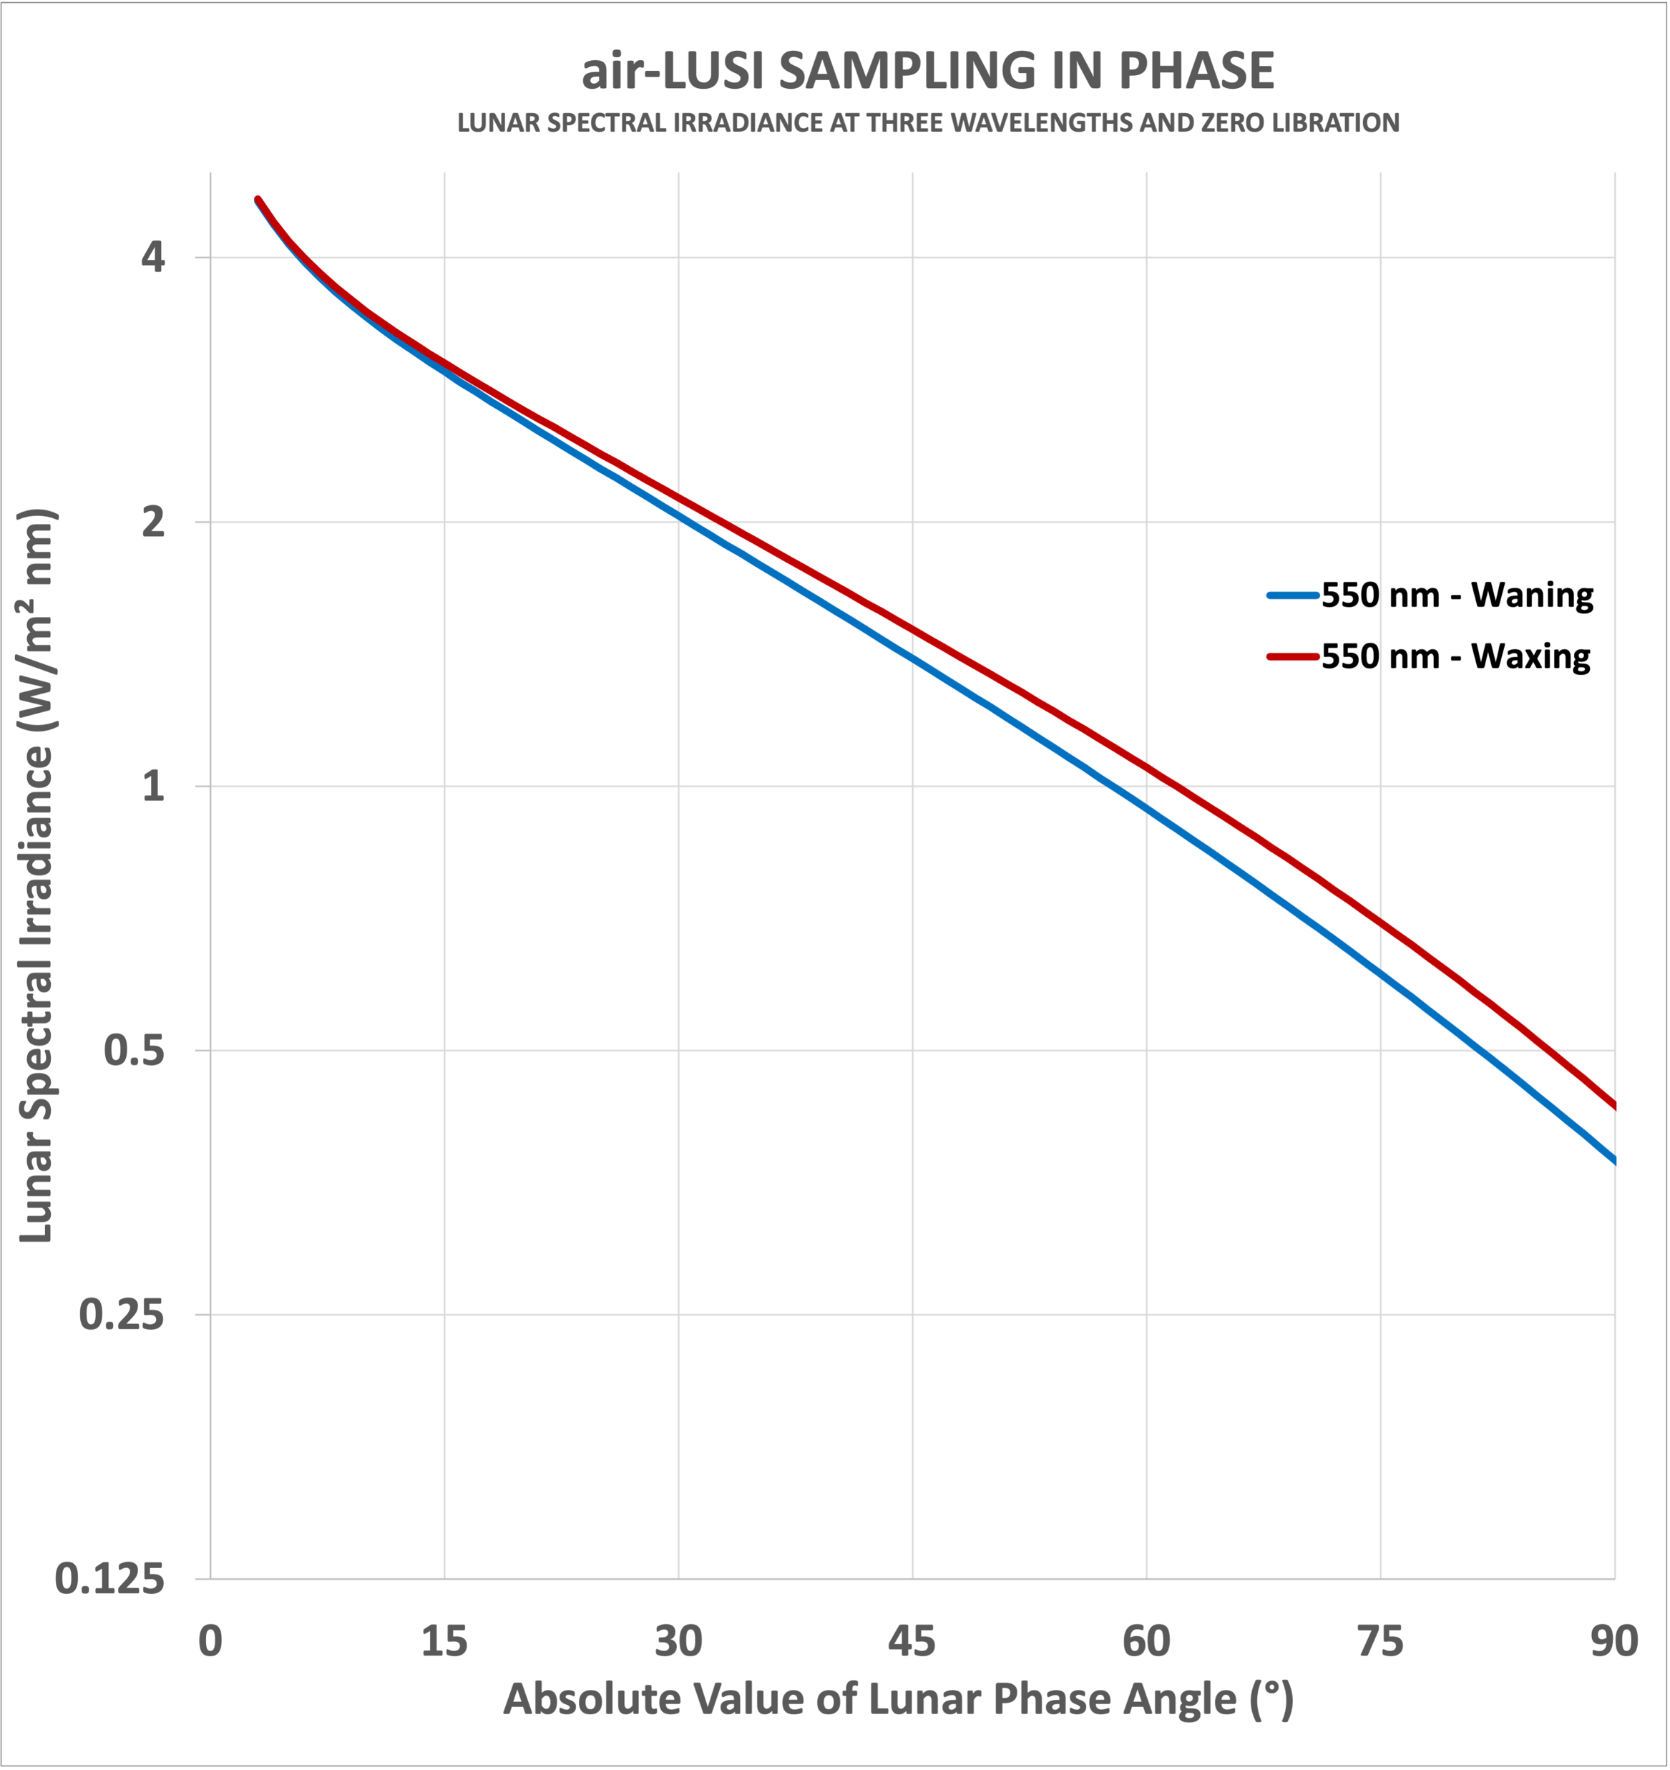
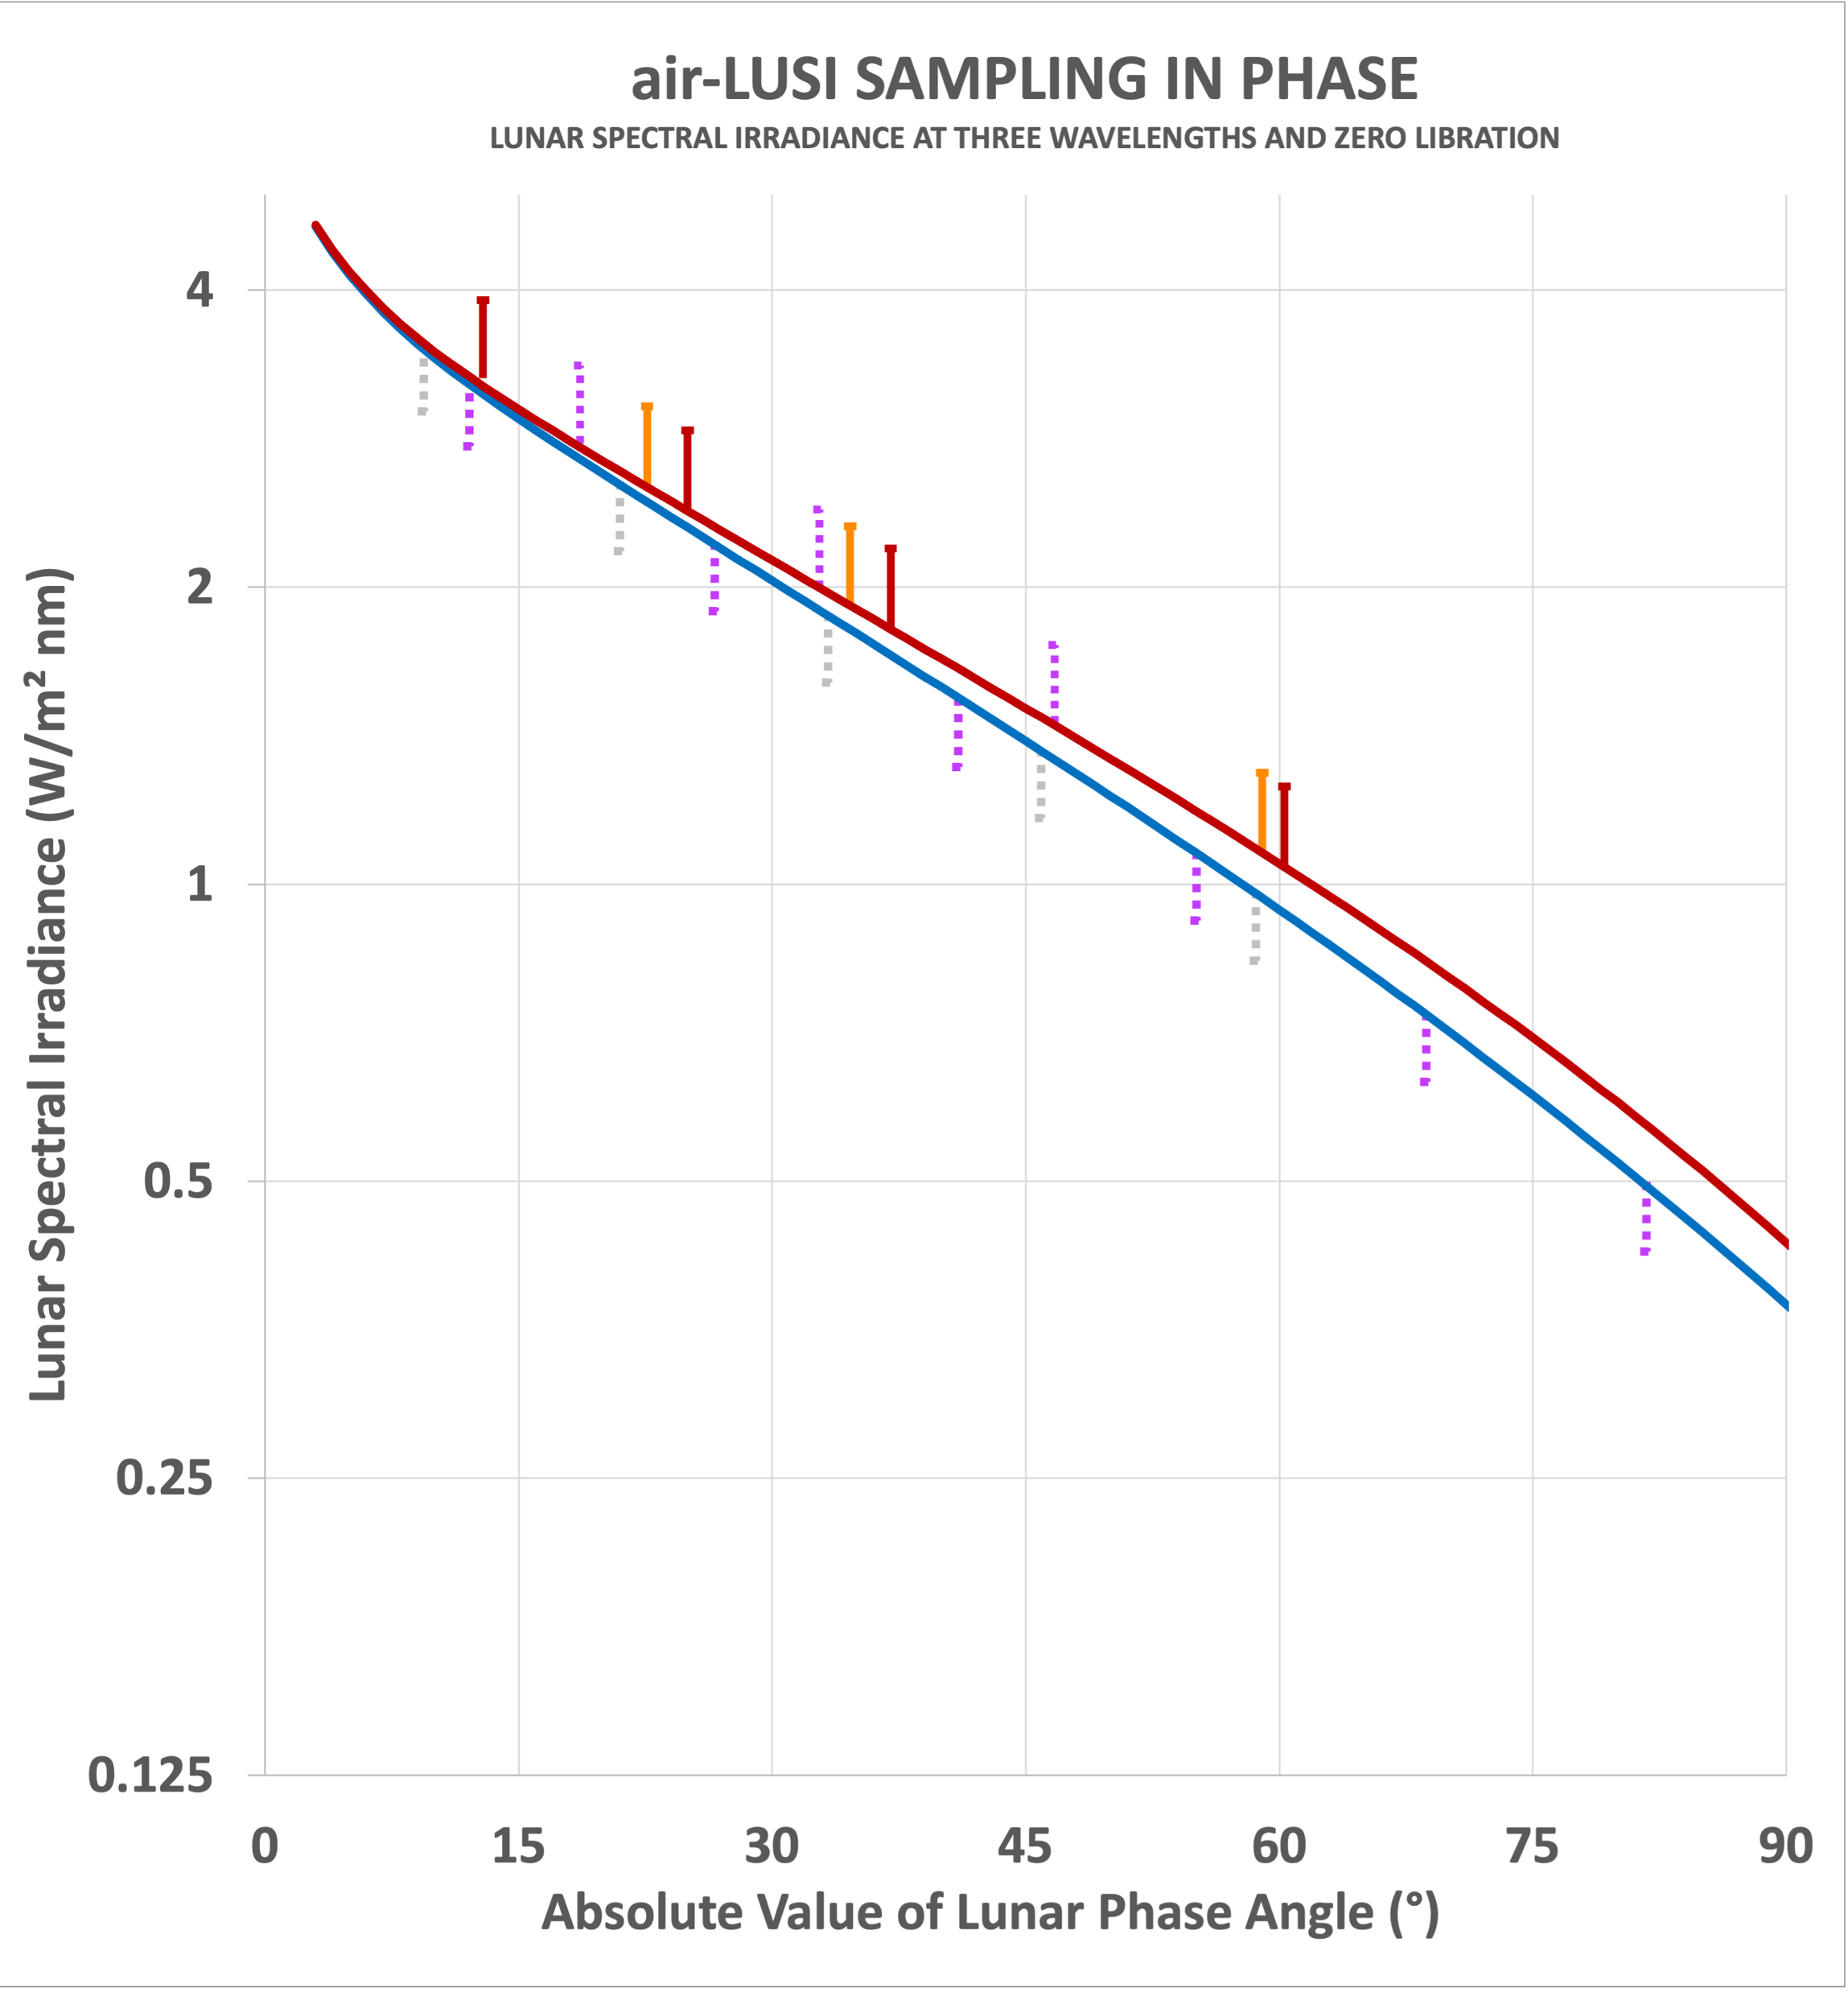
Sampling if Operational Campaign 03
happened in Nov 2025 and all nine
viable nights were acquired.
If only five nights were acquired, then
positive phases up to just above 70 degs
would have been chosen.
However, US Govt Shutdown cancelled
this opportunity.
Subsequent opportunities in December
and January conflicted with holidays, so
February 2026 was the next viable option.
It was also the last opportunity to acquire
positive phases until next Fall 2026.
Operational Campaign 01 – Mar 2022
Operational Campaign 01 – Mar 2022
Operational Campaign 01 – Mar 2022
Operational Campaign 01 – Mar 2022
Operational Campaign 02 – Mar 2025
Operational Campaign 02 – Mar 2025
Operational Campaign 02 – Mar 2025
Operational Campaign 03 – Nov 2025
Operational Campaign 03 – Nov 2025
Demonstration Campaign – Nov 2019
13

Slide 14
Lunar Data Resources for Model Development
Data Source | PI / POC | Affiliation | Status
ROLO Dataset | Tom Stone | USGS | At USGS (Order of 10⁴ spectra).
Mount Hopkins LUSI | Claire Cramer | NIST | At NIST (2 nights), proof of concept.
LIME Dataset | Marc Bouvet | ESA | At ESA (Order of 10⁴ spectra), Cimel based.
air-LUSI | Kevin Turpie | NASA GSFC, NIST, USGS | In Progress - Data Available (NIST, ORNL DAAC).
MLO-LUSI | Stephen Maxwell | NIST | Mauna Loa eruption halted operations.
ARCSTONE* | Cindy Young | NASA LaRC | Cubesat Launch 2025
CPF* | Yolanda Shea | NASA LaRC | Launch 2026
TRUTHS | Nigel Fox | UKSA / ESA | Launch 2030
* - Other Satellites with lunar observations and reliable calibration might be applied to model development.
Notes
Apollo lunar soil spectra has also been applied in model development (e.g., ROLO/GIRO)
Balloon-based instrument was used by LASP, but measurements were never released.
Lunar Measurement Datasets
Lunar Irradiance Model
Geometric Model
14

Slide 15
Lunar Model Developments
Model | PI / POC | Affiliation | air-LUSI | Measurement Basis
ROLO* | Tom Stone | USGS | ✓ | ROLO Dataset
GIRO | Seb Wagner | EUMETSAT |  | ROLO Dataset
LIME | Marc Bouvet | ESA | ✓ | Tenerife / Izaña Atmospheric Observatory Cimel Data
LESSR | Thijs Krijger | ESS / EUMETSAT | ✓ | SCIAMACHY Lunar Observations
SLIMM | Hugh Kieffer | GSICS | ✓ | SeaWiFS, Hyperion, Terra-MODIS, Aqua-MODIS, Suomi-VIIRS, NOAA20-VIIRS, Landsat-8 OLI, PLEIADES-A, PLEIADES-B, ROLO, NIST Mt. Hopkins, AERONET Mauna Loa
SELENE/SP | Toru Kouyama | AIST |  | SELENE/Kaguya lunar satellite
* USGS has been the chief innovator of lunar calibration techniques
  original ROLO model development ca. 1995-2005, funded by NASA EOS program
  service to spacecraft instrument teams, e.g. VCST, MCST, OBPG
  Moon image analysis and lunar irradiance evaluation
Objectives:
  high accuracy: <1% absolute uncertainty, traceable to NIST standards and SI
  improved predictive capability for all phase angles and wavelengths (in reflected solar range)
15

Slide 16
Input from Early Adopters
ROLO – Achieving the target accuracy for model refinements depends critically on air-LUSI measurements! (Tom Stone, USGS)
LIME – We (LIME team) believe the air-LUSI has been and will remain an essential and key dataset for the development of accurate hyperspectral lunar irradiance models for the radiometric performance assessment of space sensors. (Marc Bouvet, ESA)
LESSR – We hope that more measurements are taken in the future that will allow the next generation of lunar models. High accuracy and precision is vital. We've been waiting 5 years for measurements of this quality. (Thijs Krijger, ESS)
SLIMM – Highly desirable to get air-LUSI observations after full-Moon. (Hugh Kieffer)
PACE OCI – The air-LUSI data is currently the best data set available to evaluate OCI absolute calibration, especially its consistency across spectral bands. air-LUSI data at positive phase angles would allow OCI to confirm these encouraging results. (Shihyan Lee and Gerhard Meister, PACE OCI).
16

